Slide 1
The progress of beam-beam simulation and related researches of STCF
Sangya Li
University of Science and Technology of China
2024/09/02

Slide 2

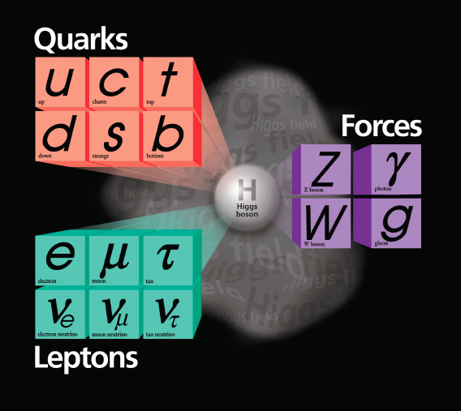
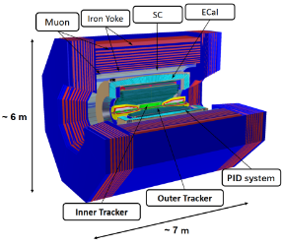
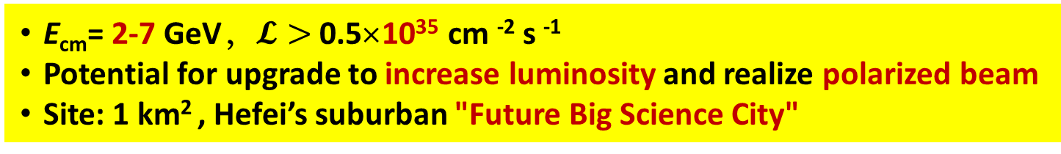
Super Tau Charm Facility (STCF)
Haiping Peng , FTCF, USTC, 2024
STCF: A natural and feasible extension project of BEPCII/ BESIII in the near future, China’s preferred medium-term strategy in particle physics
Linear Accelerator
400 m
Damp ring
100 m
Collider Ring
800m
Detector
Deliver a massive amount of taus and hadrons composed of charm quark, allow for the studies of particle composition, the deep structure of matter, as well as the fundamental interaction forces
E_{cm}= 2-7 GeV，$𝓛>$ 0.5×10³⁵ cm ⁻² s ⁻¹
Potential for upgrade to increase luminosity and realize polarized beam
Site: 1 km² , Hefei’s suburban "Future Big Science City"
14th five-years plan (2021-2025): Conceptual design and R&D of Key technology, 5 years, 0.42 B CNY
15th five-years plan (2026-2030): Construction 6 years, 4.5 B CNY
Operating for 10 years, upgrade for 3 years, operating again for another 8 years
Notes:
Therefore, we proposal a Super Tau-charm facility, which have central mass energy covering from 2-7 GeV, luminisity great than 5 x1034, it also leave the potential for upgrade to increase luminosity and realize polarized beam.
The machine will deliver a massive amount of taus and hadrons composed of charm quarks, allow for the studies of particle composition, the deep structure of matter, as well as the fundamental interaction forces.
The temporary plan for the STCF project is to finish the R&D key technology before the end of 2025, the apply for the construction project during the 2026-2030 if approved by the central government.
STCF is a natural and feasible extension project of the BEPCII/BESIII in the near future, is also China’s preferred medium-tem strategy in particle physics.

Slide 3
Introduction to the research work on beam-beam interaction

Slide 4
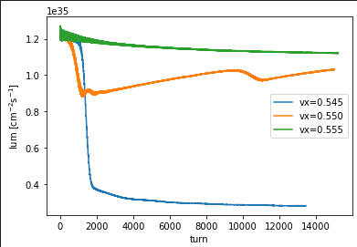
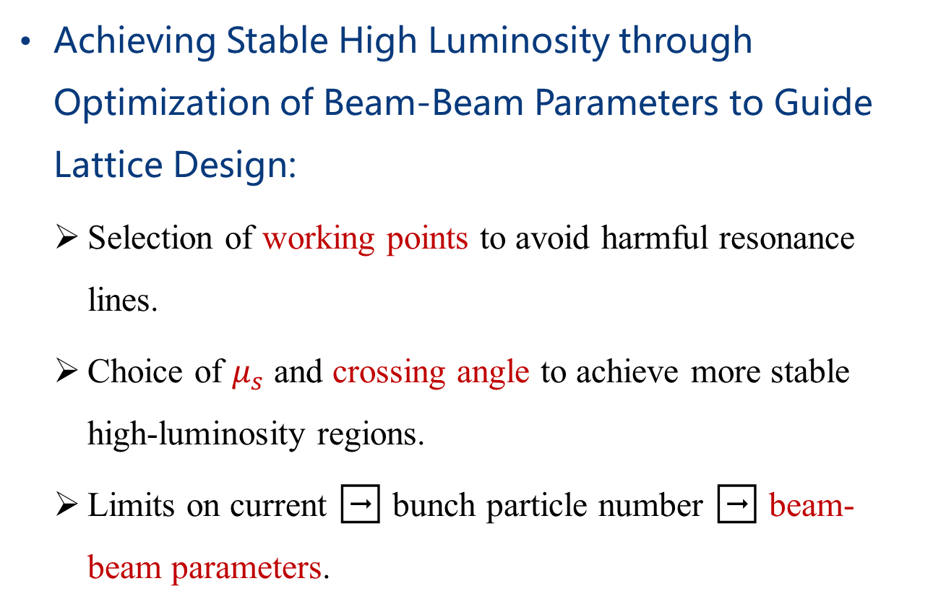
Research emphasis of Beam-Beam Interaction:
Achieving Stable High Luminosity through Optimization of Beam-Beam Parameters to Guide Lattice Design:
  Selection of working points to avoid harmful resonance lines.
  Choice of $μ_{s}$ and crossing angle to achieve more stable high-luminosity regions.
  Limits on current ➡ bunch particle number ➡ beam-beam parameters.
Luminosity simulation results for different working points in the 800m lattice.
4

Slide 5
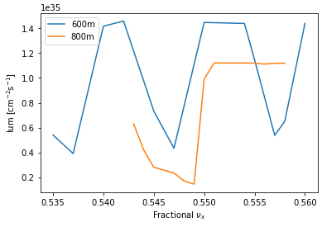
Research emphasis of Beam-Beam Interaction:
Exploring the Impact of Beam-Beam Interaction and Beam Instability under Extreme Luminosity Conditions:
  One of our key research areas is investigating new instabilities caused by the increase in the beam-beam parameter ξy when using the crab waist scheme under large Piwinski angles. Due to the coupling between the longitudinal and transverse planes, the beam-beam interaction is essentially three-dimensional. We will focus on effects such as coherent X-Z instability and 3D triggers to fully understand their impact on collider performance.
  Another focus is the coupling between beam-beam interaction and lattice nonlinearity and impedance. This includes considering the vertical beam-beam interaction and ring impedance, as well as strong coherent positive tail instability related to the transverse mode coupling instability threshold. Special attention will be given to the relationship between nonlinear factors introduced by the crab sextupole and beam-beam interaction.
The impact of X-Z instability is relatively small in the 800m lattice.
5

Slide 6
Beam-beam simulation code
Weak-strong model：Multi-macro particle model and single-macro particle model.
  Strong Beam: Fixed Gaussian distribution, unaffected by the weak beam.
  Weak Beam: The transverse field effect of the strong beam is calculated using the Bassetti-Erskine formula; the crossing angle is handled by introducing a Lorentz transformation; the finite bunch length allows for longitudinal slicing of the strong beam.
  Advantages: Low computational cost (equivalent to introducing only one additional nonlinear element).
  Disadvantages: Not self-consistent, unable to simulate complex instabilities such as coupling impedance.
  Current Usage: BBWS.
Strong-Strong Model: Both bunches are fully modeled using macroparticles.
  The beam-beam interaction is calculated using the Particle-In-Cell (PIC) method, or by first fitting a Gaussian distribution and then applying the Bassetti-Erskine formula.
  Compared to the weak-strong model, it includes:
  (1) Beam-beam interaction at the IP can account for beamstrahlung.
  (2) The linear mapping during arc transport includes synchrotron radiation effects (damping + fluctuation).
  (3) The influence of the full-ring longitudinal wakefield is included at the IP before the collision.
  Disadvantages: High computational cost.
  Advantages: Self-consistent and more accurate.
  Current Usage: IBB, BBSS.
  • Particle In Cell (PIC)
  • Gaussian approximation.
• Lattice transformation compatible with SAD (by Li Zhiyuan, APES-T).
  • Developed by cuda (nvcc) on NVIDIA GPU
IBB, Y.Zhang , IHEP
BBWS, BBSS K. Ohmi ,KEK
6
Notes:
Weak beam: multi-macro particle model.
strong beam: single-macro particle model.

Slide 7
2
Simulation of beam- beam interaction at 600m

Slide 8
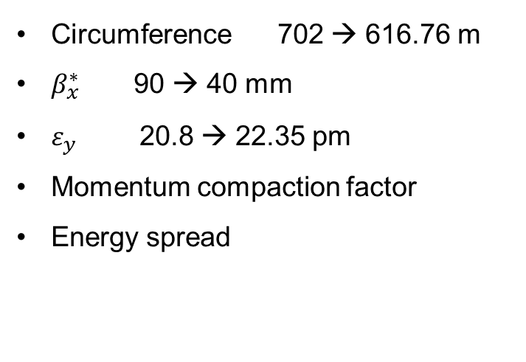

600m lattice
Parameters | Units | STCF
Optimal beam energy, E | GeV | 2
Circumference, C | m | 616.76
Crossing angle, 2θ | mrad | 60
Relative gamma |  | 3913.9
Revolution period, T₀ | μs | 2.057
Revolution frequency, f₀ | kHz | 486.08
Horizontal emittance, ε_{x} | nm | 4.47
Coupling, k |  | 0.50%
Vertical emittance, ε_{y} | pm | 22.35
Hor. beta function at IP, β_{x} | mm | 40
Ver. beta function at IP, β_{y} | mm | 0.6
Hor. beam size at IP, σ_{x} | μm | 13.37
Ver. beam size at IP, σ_{y} | μm | 0.116
Betatron tune, ν_{x}/ν_{y} |  | 31.552/24.572
Momentum compaction factor, α_{p} | 10⁻⁴ | 10.27
Energy spread, σ_{ε} | 10⁻⁴ | 8.77
Beam current, I | A | 2
Number of bunches, n_{b} |  | 512
Single-bunch current, I_{b} | mA | 3.91
Particles per bunch, N_{b} | 10¹⁰ | 5.02
Single-bunch charge | nC | 8.04
Energy loss per turn, U₀ | keV | 273
Hor. damping time, τ_{x} | ms | 30.14
Ver. damping time, τ_{y} | ms | 30.14
Long. damping time, τ_{z} | ms | 15.07
RF frequency, f_{RF} | MHz | 497.5
Harmonic number, h |  | 1024
RF voltage, V_{RF} | MV | 1.2
Synchronous phase, φ_{s} | deg | 167
Synchrotron tune, ν_{z} |  | 0.0099
Bunch length, σ_{z} | mm | 8.94
Natural bunch length, σ_{z} | mm | 8.94
RF bucket height, (ΔE/E)_{max} | % | 1.56
Piwinski angle, φ_{Piw} | rad | 20.06
Hor. beam-beam parameter, ξ_{x} |  | 0.0032
Ver. beam-beam parameter, ξ_{y} |  | 0.111
Equivalent bunch length, σ_{z_e} | mm | 0.45
Hour-glass factor, F_{h} |  | 0.9066
Luminosity, L | cm⁻²s⁻¹ | 1.45E+35
The important changes
Circumference 702 → 616.76 m
$β_{x}^{∗}$ 90 → 40 mm
$ε_{y}$ 20.8 → 22.35 pm
Momentum compaction factor
Energy spread
Natural bunch length
$ξ_{y}$ 0.0855 → 0.111
Input parameters parameters from lattice design also input parameters output parameters (use formula)
8
Notes:
the distance from the collision point and couples the transverse bunch size to the longitudinal position [16]. The hourglass eﬀect
arises when the transverse bunch size becomes comparable to the length of the bunch
With the same number of particles, the smaller the emittance, the higher the beam quality
Geometrically equal to the area of the elliptical phase diagram occupied by the beam in the phase space

Slide 9
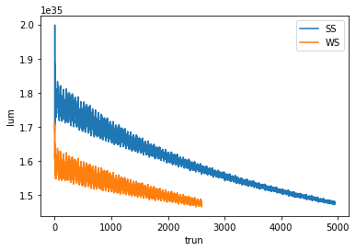
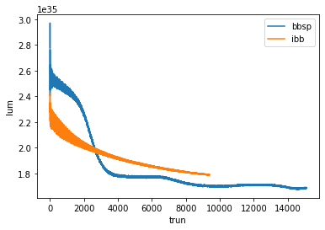
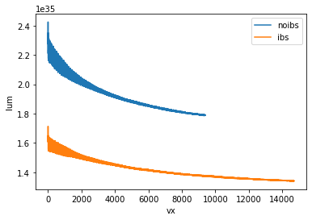
Verification of luminosity at 600m operating point:
comparison of parameters | STCF (v3)
L (m) | 616.76
βy* | 0.6mm
peak luminosity | 1.4e35𝑐𝑚−2 𝑠 −1
ξx/ξy | 0.0038/0.106
νz | 0.0096
design bunch population | 5.02e10
σx /σy (μm) | 15.19/0.132
σz （mm） | 8.21(vs natural bunch length8.2)
9

Slide 10
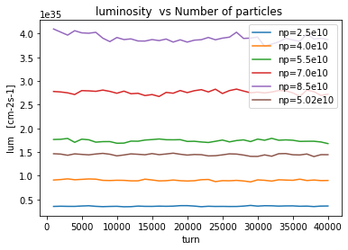
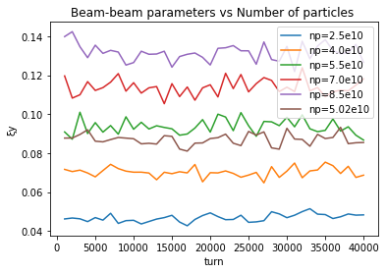
The influence of current intensity on the luminosity of 600m:
change with different number of particles
Dependence on convective strength at design operating point (552,572)
10

Slide 11
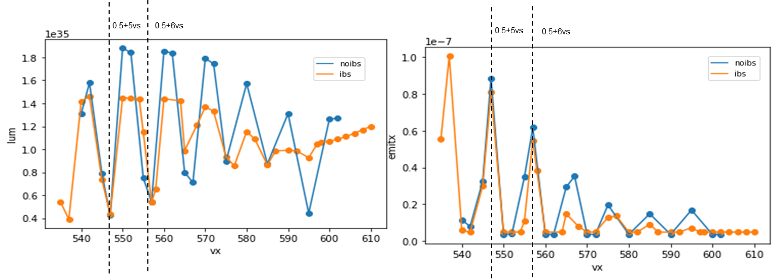
The impact of X-Z instability on 600m luminosity:
Beam-beam simulation results from IBB
There is strong X-Z instability near the designed operating point.
11
Notes:
The coupling of transverse and longitudinal motion caused by large crossing angles reduces the region of stable operating points

Slide 12

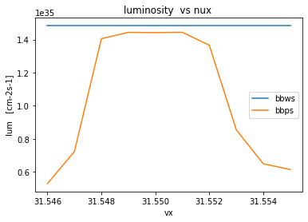
SS result
0.004
Close to xix
In the X-Z resonance, the stable high-luminosity region is relatively narrow.
Adjustment direction:
  1. Adjust the μｓ；
  2. Turn down θ；
  3. Reduce beta βｘ，σｘ
2θ =0.06 nvy = .572
12

Slide 13
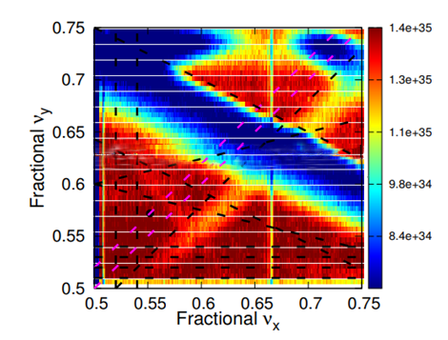
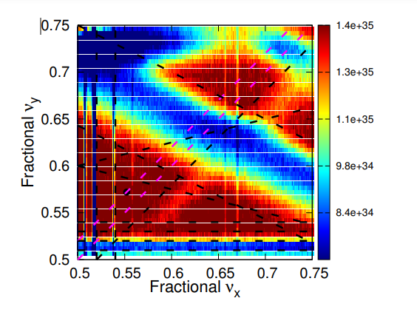
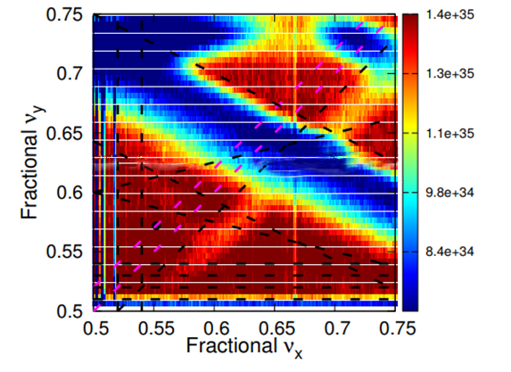
The impact of 𝜈𝑠 on the luminosity of 600m:
Adjustment of nus
Smaller nus narrow the resonance, more disturbance
Bigger nus widens the distance between vertical resonances
nus =0.005
nus=0.0099(design)
nus =0.02
Beam-beam simulation results from BBWS
13
Notes:
tiny resonance

Slide 14
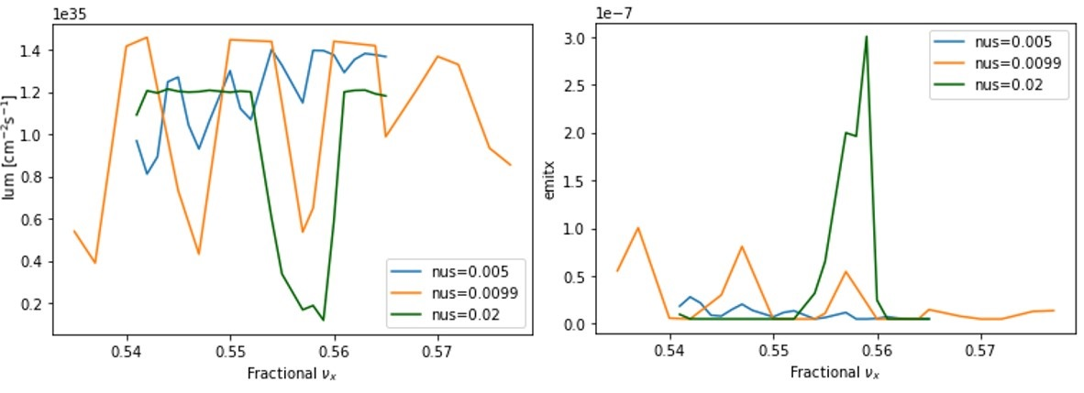
The impact of 𝜈𝑠 on X-Z instability：
Beam-beam simulation results from IBB
The X-Z instability can be adjusted by changing 𝜈𝑠 .
Increasing 𝜈𝑠​ from 0.0099 to 0.02 significantly broadens the stable high-luminosity region, but slightly decreases the peak luminosity.
The luminosity degradation caused by X-Z instability weakens as 𝜈𝑠 decreases, but it becomes more concentrated.
14
Notes:
The coupling of transverse and longitudinal motion caused by large crossing angles reduces the region of stable operating points

Slide 15

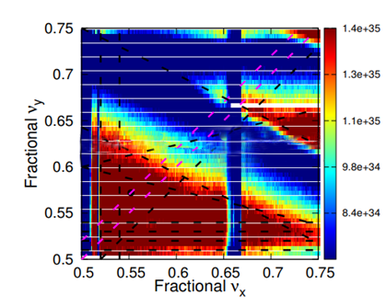
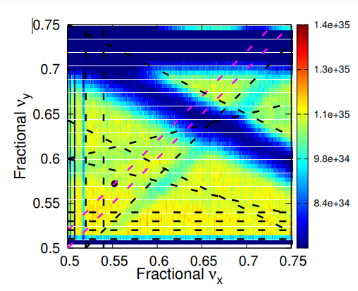
The impact of the crossing angle on 600m luminosity：
Smaller crossing angle higher luminosity.
2θ =0.04
2θ=0.06(design)
2θ =0.08
The luminosity does not significantly increase when the crossing angle is decreased.
15
Notes:
The strong-strong simulation with two kinds of code simulation is cross-verified, which far exceeds the target luminosity under the design parameters without considering the stability.

Slide 16
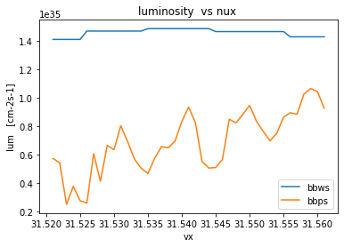
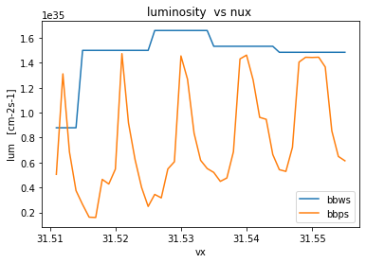
XZ Instability at Different Crossing Angles：
2θ =0.04 nvy = .545
2θ =0.06 nvy = .572
16

Slide 17
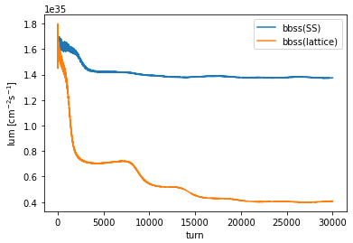
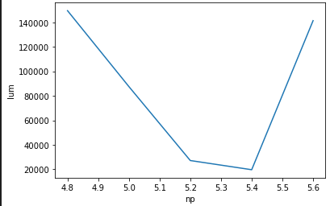
Beam-Beam Simulation Results for 600m with Lattice:
The instability caused by the lattice further narrows the range of stable working points, making the originally designed working point unstable.
The luminosity at the designed working point drops significantly, failing to meet the design target.
17

Slide 18
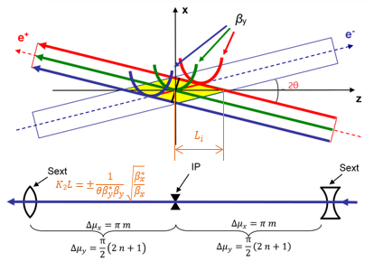
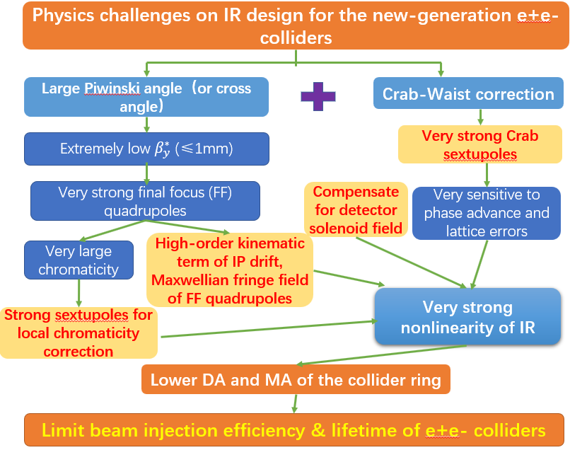
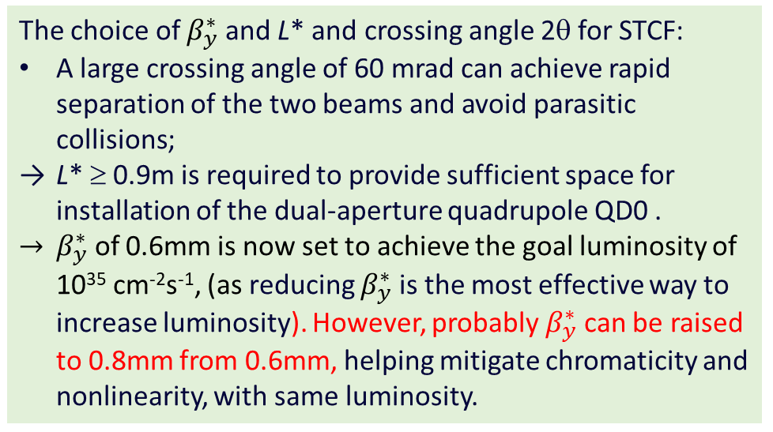
Challenges on IR design for new-generation e⁺e⁻ colliders
The choice of $β_{y}^{∗}$ and L* and crossing angle 2θ for STCF:
A large crossing angle of 60 mrad can achieve rapid separation of the two beams and avoid parasitic collisions;
L* ≥ 0.9m is required to provide sufficient space for installation of the dual-aperture quadrupole QD0 .
$β_{y}^{∗}$ of 0.6mm is now set to achieve the goal luminosity of 10³⁵ cm⁻²s⁻¹, (as reducing $β_{y}^{∗}$ is the most effective way to increase luminosity). However, probably $β_{y}^{∗}$ can be raised to 0.8mm from 0.6mm, helping mitigate chromaticity and nonlinearity, with same luminosity.
D. Zhou, USTC seminar, 2023
Linhao Zhang USTC, 2024
18

Slide 19
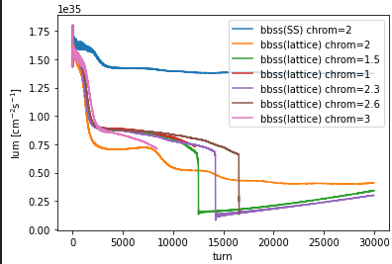
Change the chromaticity
With the working point unchanged, adjust CCY and CCX sextupoles to control chromaticity.
The results do not directly indicate whether chromaticity is the cause of beam instability introduced by the lattice.
19

Slide 20
3
Beam-Beam Interaction Simulation Study for 800m

Slide 21
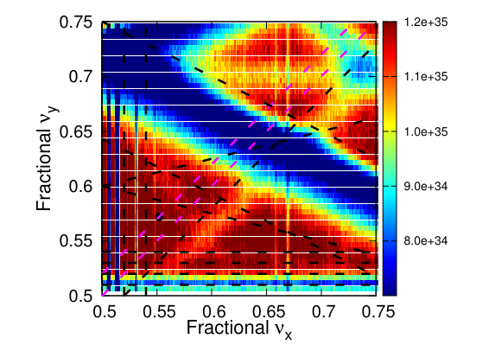
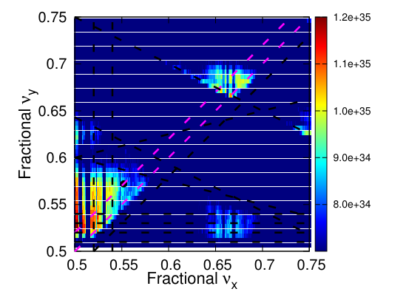
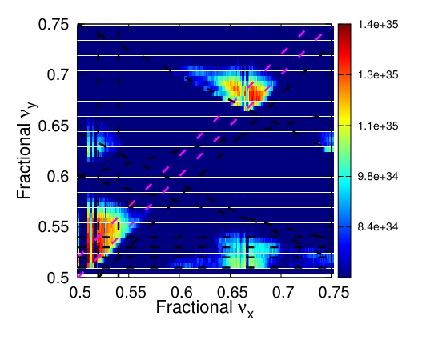
800m VS 600m:
800m
600m
CW ON
CW OFF
CW has a more significant effect in increasing the area of the high-luminosity region for 800m.
21

Slide 22
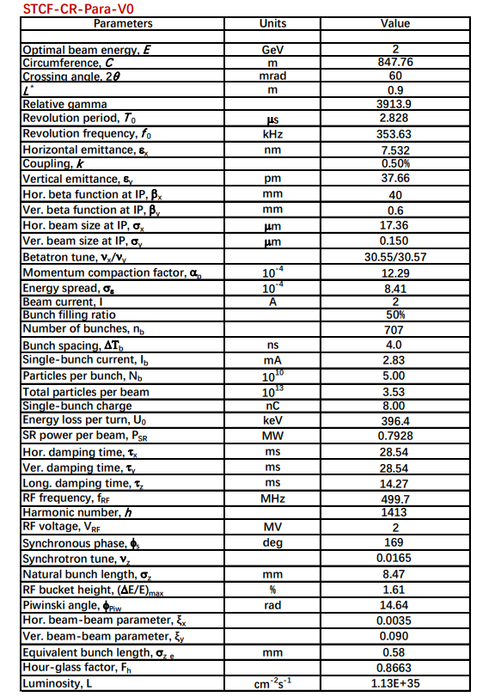
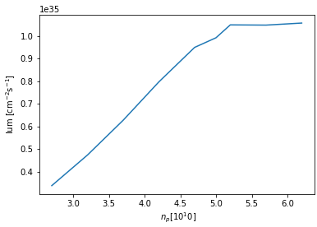
Simulation result at the 800m working point：
The luminosity reaches the engineering design target.
Slightly lower than the design luminosity.
22

Slide 23
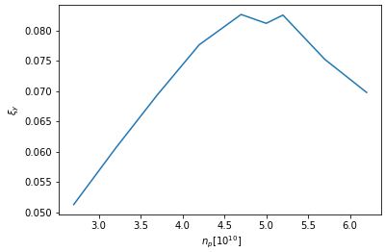
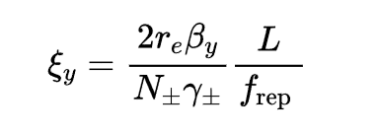
The results of the 800m luminosity scan with varying current intensity：
The current threshold and beam-beam limit occur around np=4.5e10.
Since 550 is not a stable working point, 𝜉𝑦 does not remain constant but instead drops.
23

Slide 24
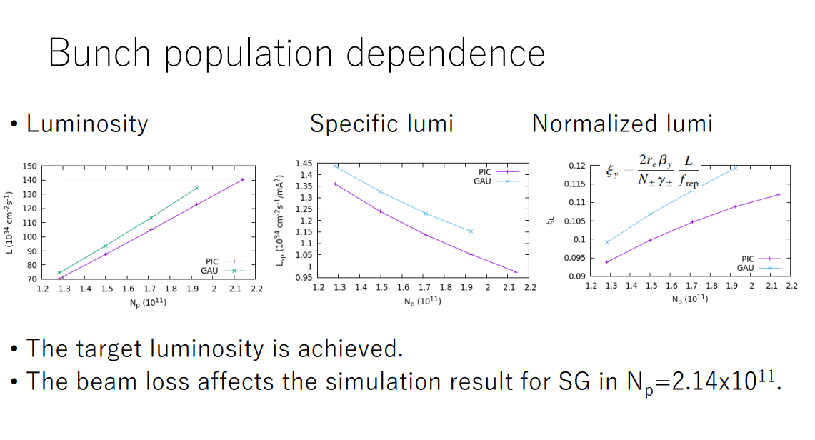
The results of FCCee：
K. Ohmi , FCCee optics meeting, Apr. 4, 2024
24

Slide 25
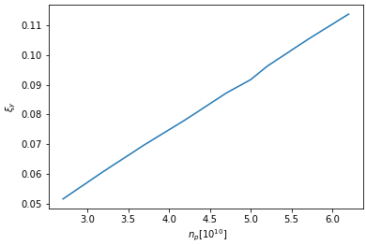
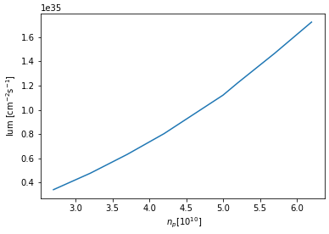
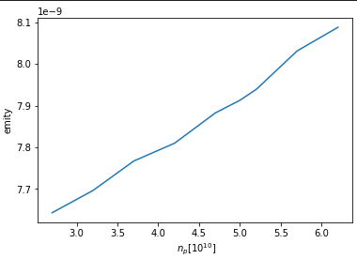
The results of the 800m luminosity scan with varying current intensity：
After shifting the working point to 552, the 𝜉𝑦 decay disappears.
The beam-beam limit has not been reached when 𝑛𝑝≤6.2.
25

Slide 26
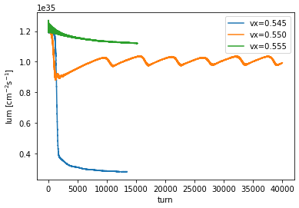
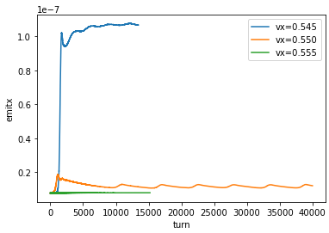
High-Luminosity Region Scan Near the 800m Working Point:
There is unstable luminosity oscillation around 0.550.
At 0.54x, in an unstable region, luminosity drops significantly.
Luminosity at 0.55x remains mostly stable above the design luminosity of 1e35.
26

Slide 27
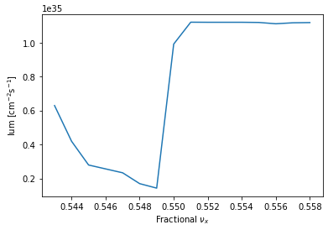
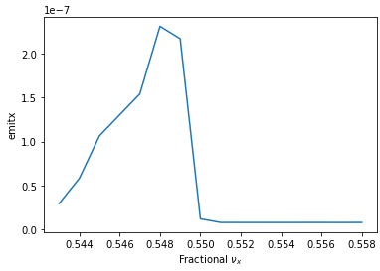
High-Luminosity Region Scan Near the 800m Working Point:
The luminosity remains stable at around 1.12e35 in the range of 0.551–0.558.
Luminosity near the 0.55 point is unstable.
The current X-Z oscillation period is relatively large, nus=0.0165>5*ξ_x (0.0035).
27

Slide 28
Summary:
The adjusted 800m structure is less susceptible to X-Z instability than the 600m structure and has a more stable luminosity region.
The horizontal design working point for 800m requires a slight adjustment.
Ongoing Work:
Conducting GPU-based beam-beam simulations with lattice for 800m.
Simulating the coupling with impedance wakefields.
Attempt to use methods such as Frequency Map Analysis (FMA) to further investigate the reasons behind the luminosity reduction caused by the beam-beam interaction when the lattice is introduced.
28

Slide 29
Acknowledgments
Grateful thanks to Y. Zhang (IHEP), K. Ohmi (KEK), and D. Zhou (KEK) for their guidance and support, and to the teachers and colleagues for their help throughout this project.
29

Slide 30
Thank you!
Looking forward to your feedback and suggestions.

Slide 31
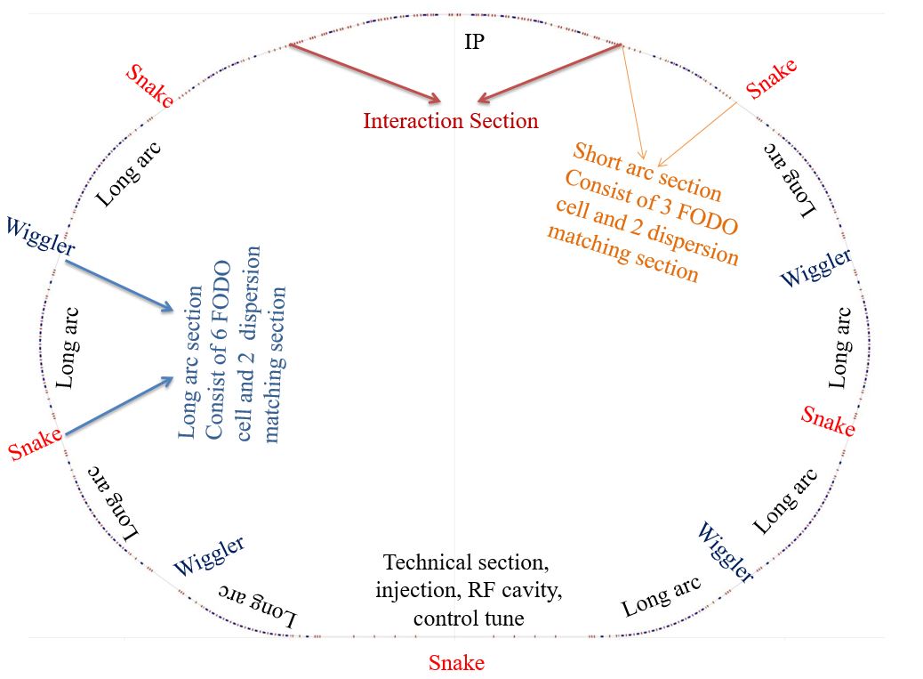
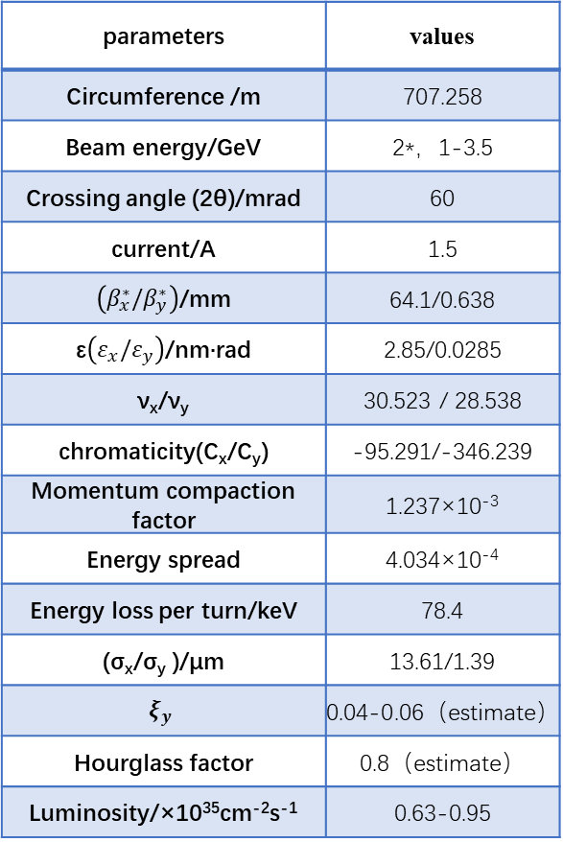
First edition lattice
parameters | values
Circumference /m | 707.258
Beam energy/GeV | 2*，1-3.5
Crossing angle (2θ)/mrad | 60
current/A | 1.5
$\left({β_{x}^{∗}/β}_{y}^{∗}\right)$/mm | 64.1/0.638
ε$\left(ε_{x}/ε_{y}\right)$/nm·rad | 2.85/0.0285
ν_{x}/ν_{y} | 30.523 / 28.538
chromaticity(C_{x}/C_{y}) | -95.291/-346.239
Momentum compaction factor | 1.237×10⁻³
Energy spread | 4.034×10⁻⁴
Energy loss per turn/keV | 78.4
(σ_{x}/σ_{y} )/μm | 13.61/1.39
$$ξ_{y}$$ | 0.04-0.06（estimate）
Hourglass factor | 0.8（estimate）
Luminosity/×10³⁵cm⁻²s⁻¹ | 0.63-0.95
Preliminary lattice design results (no nolinear)
From Q. Luo “STCF-ACC Accelerator concept introduction and summary”,2020.
31

Slide 32
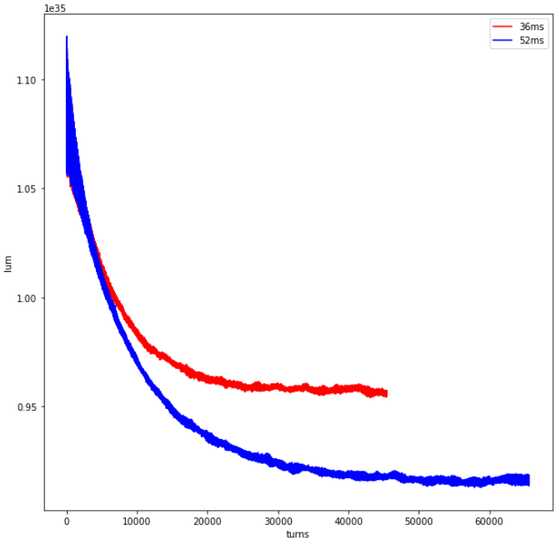
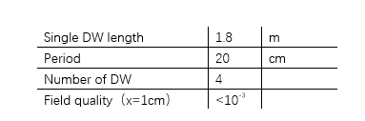
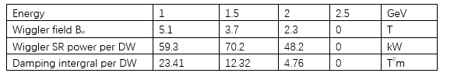
Design of wiggler
Add damping wiggler
(0.536,0.575,0.016)
damping time :
52ms → 36ms
 | damping time/ms | lum at 1dt | lum at 2dt | lum at 3dt
12000 | 24.68 | 10.1225 | 10.025 | 10.015
16000 | 32.91 | 9.895 | 9.81 | 9.7975
17500 | 35.99 | 9.8225 | 9.7225 | 9.725
18180 | 37.39 | 9.79 | 9.685 | 9.6925
20000 | 41.13 | 9.7 | 9.62 | 9.5925
25000 | 51.42 | 9.4925 | 9.3725 | /
design parameter of damping wiggler ：
The luminosity of different damping time
32

Slide 33
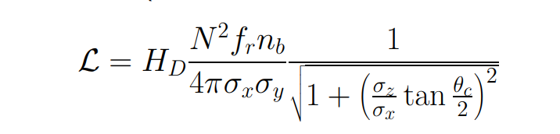
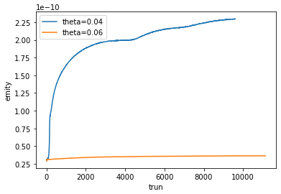




Analysis of luminosity under different cross angles：
The y-direction increases by about eight times
Both at（572，552）
The longitudinal size is much larger than the transverse size.
the X-direction increases by about twice
xangle (half) = 30.00 (mrad)
Luminosity_0_0.04/ Luminosity_0_0.06
= 4.476E+32/ 3.137E +32
≈1.427
xangle (half) = 20.00 (mrad)
The initial luminosity satisfies the formula relation, but the luminosity decreases due to blow-up in the vertical direction.
33

Slide 34


WS result vs SS result
xangle (half) = 30.00 (mrad)
（572，552）
xangle (half) = 20.00 (mrad)
（545，550）
Unstable for 0.04 when SS simulation.
34

Slide 35
XZ Instability at Different Crossing Angles：
2θ =0.04 nvy = .545
2θ =0.06 nvy = .572
35

Slide 36

The results of the 800m luminosity scan with varying current intensity：
After np>5.2, the luminosity no longer increases with the number of particles.
The increase in emittance occurs earlier.
36

Slide 37

The results of the 800m luminosity scan with varying current intensity：
The horizontal emittance growth precedes the vertical emittance growth.
The horizontal emittance begins its first rapid increase at 𝑛𝑝>4.2.
The rapid increase in vertical emittance starts at 𝑛𝑝>4.7, coinciding with the second rapid increase in horizontal emittance.
37

Slide 38


The results of the 800m luminosity scan with varying current intensity：
The growth is mainly related to 𝜎𝑥​ and has little to do with 𝜎𝑥′.
The second rapid vertical growth and the third rapid horizontal growth occur together at 𝑛𝑝>5.2.
38

Slide 39


WS scan
2θ =0.04
2θ=0.06(design)
The luminosity does not significantly increase when the crossing angle is decreased.
39

Slide 40



Longitudinal dynamics design considerations
Coherent X-Z instability
  A newly discovered coherent beam-beam interaction under a large Piwinski angle using strong-strong beam-beam simulations
  primarily leads to an increase in the horizontal emittance 𝜀_{x}
  Considering the coupling between horizontal and vertical emittances, it eventually results in an increase in the vertical emittance 𝜀_{y} and a collapse of the luminosity
  This instability cannot be suppressed through beam feedback systems, but can only be avoided through appropriate parameter optimization
  Typically, a stringent requirement of 𝜉_{x} ≪ 𝜈_{z} is imposed to have wide region for the selection of working point without beam blow-up
  In the case of STCF, 𝜈_{z}/𝜉_{x} ≥ 3 is expected.
SCTF case
CEPC case
Linhao Zhang USTC, 2024

Slide 41




Longitudinal dynamics design considerations
Lattice Design and Damping Wigglers
  Lattice design is crucial for achieving high luminosity by achieving the required optical parameters at IP and by optimizing nonlinear dynamics aperture
  Additionally, it defines the momentum compaction factor 𝛼_{p} and natural energy spread 𝜎_{δ} in the electron storage ring through synchrotron radiation integrals.
  Damping wigglers are essential for STCF to control the damping time (30 ms) and to maintain beam emittance almost constant (~5 nm) throughout the entire energy range 1—3.5 GeV.
    This inevitably increases the synchrotron radiation energy loss per turn
      raising the demand for RF power
    This also increases the natural energy spread
      resulting in a proportional growth in bunch length
  The lattice including damping wigglers has been designed for STCF at 2 GeV
  These parameters (𝛼_{p} and 𝜎_{δ} ) are of importance in the longitudinal dynamics
Linhao Zhang USTC, 2024

Slide 42


Longitudinal dynamics design considerations
Non-impedance-induced collective effects
  Intrabeam scattering (IBS): multiple small-angle Coulomb scattering processes
  not immediately cause particle loss in the bunch
  but increase the equilibrium energy spread, bunch length, and transverse emittances
  Touschek effect: single large-angle scattering processes
  A large momentum deviation (beyond RF momentum acceptance or physical aperture)
  thus limit the lifetime of the stored beam (i.e., the Touschek lifetime)
  These two effects are directly related to the 6D phase-space size and thus associated with longitudinal parameters such as the bunch length
  elegant and SAD codes can be used to calculate IBS and the Touschek lifetime
IBS
Touschek scattering
Impedance-induced single-bunch collective effects
  bunch lengthening due to potential well distortion (PWD)
  longitudinal microwave instability (LMWI)
  transverse mode coupling instability (TMCI)
$${\left(\frac{σ_{z}}{σ_{z0}}\right)}^{3}−\frac{σ_{z}}{σ_{z0}}=\frac{I_{b}α_{p}}{4\sqrt{π}ν_{z}^{2}E/e}{\left(\frac{R}{σ_{z0}}\right)}^{3}Im{\left(\frac{Z_{∥}}{n}\right)}_{eff}$$
$$I_{b}^{mwi}=\frac{σ_{z}}{R}\frac{\sqrt{2π}α_{p}E/e}{{\left|Z_{∥}/n\right|}_{eff}}σ_{δ}^{2}$$
$$I_{b}^{tmci}=\frac{σ_{z}}{R}\frac{4\sqrt{π}ν_{z}E/e}{\left\langle β\right\rangle ⋅ImZ_{⊥}^{eff}}$$
Linhao Zhang USTC, 2024
Notes:
collective effects can be induced by beam itself and beam interaction with surroundings.

