Slide 1

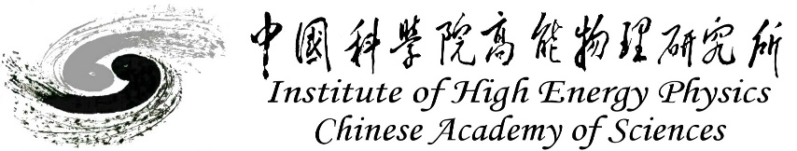
Beam-Beam Effects at CEPC
Yuan Zhang
Contributors:
Na Wang, Zhiyuan Li (IHEP), Kazuhito Ohmi(KEK), Chuntao Lin (IASF), Demin Zhou(KEK), M. Zobov(INFN/LNF)
Thanks:
D. Shatilov, K. Oide, M. Migliorati
2-5. September. 2024, EPFL, ICFA mini-Workshop BB24

Slide 2
Outline
Introduction
Instability & Mitigation
Optics distortion and lattice
Summary

Slide 3
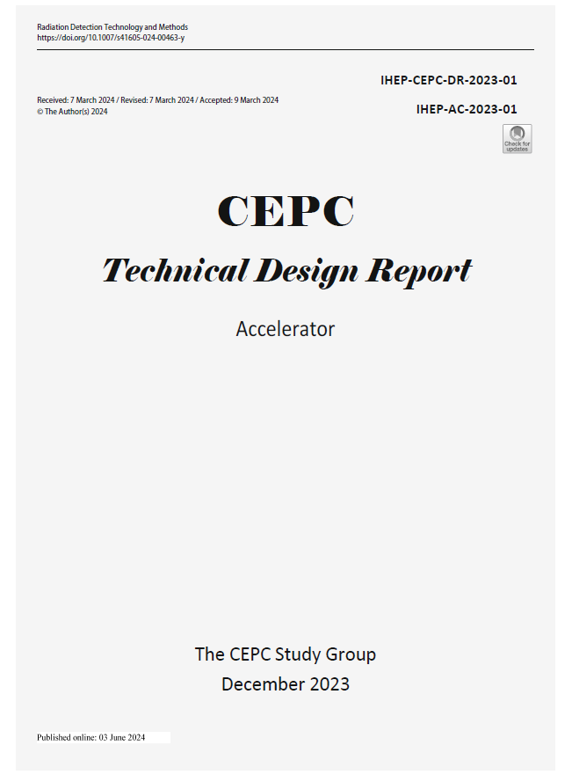
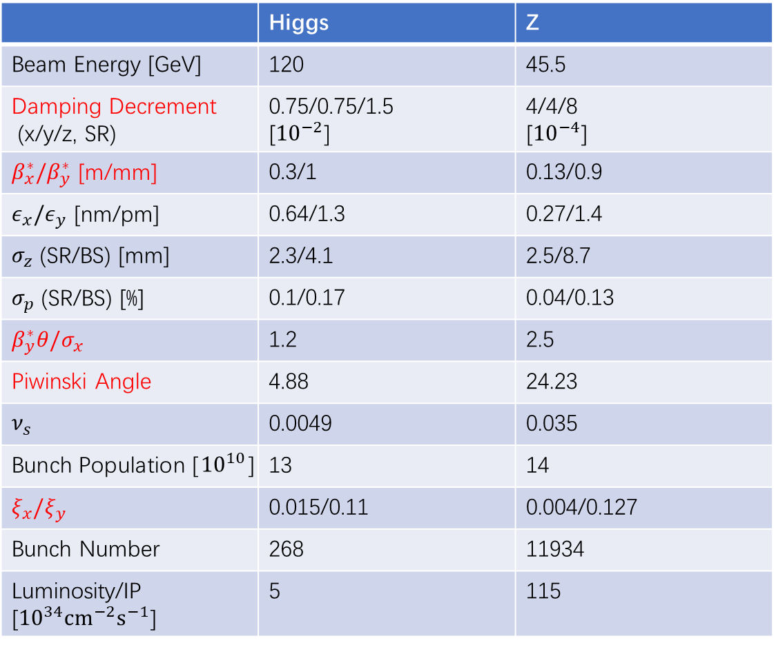
Design Parameters
2 IPs, 2x16.5 mrad
100 km
 | Higgs | Z
Beam Energy [GeV] | 120 | 45.5
Damping Decrement (x/y/z, SR) | 0.75/0.75/1.5 [${10}^{−2}$] | 4/4/8 [${10}^{−4}$]
$β_{x}^{∗}/β_{y}^{∗}$ [m/mm] | 0.3/1 | 0.13/0.9
$ε_{x}/ε_{y}$ [nm/pm] | 0.64/1.3 | 0.27/1.4
$σ_{z}$ (SR/BS) [mm] | 2.3/4.1 | 2.5/8.7
$σ_{p}$ (SR/BS) [%] | 0.1/0.17 | 0.04/0.13
$β_{y}^{∗}θ/σ_{x}$ | 1.2 | 2.5
Piwinski Angle | 4.88 | 24.23
$ν_{s}$ | 0.0049 | 0.035
Bunch Population [${10}^{10}$] | 13 | 14
$ξ_{x}/ξ_{y}$ | 0.015/0.11 | 0.004/0.127
Bunch Number | 268 | 11934
Luminosity/IP [${10}^{34}cm^{−2}s^{−1}$] | 5 | 115
DOI:10.1007/s41605-024-00463-y

Slide 4
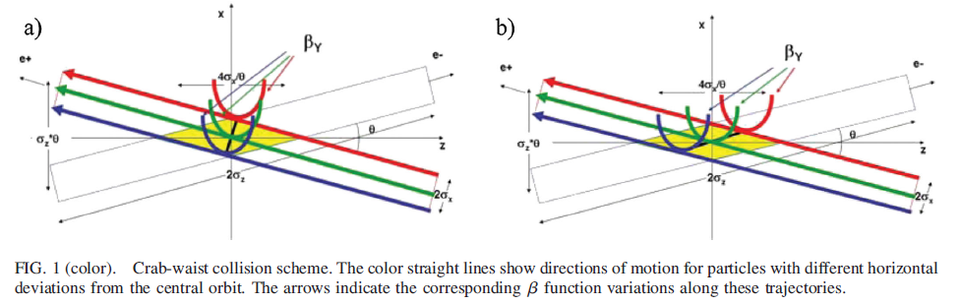

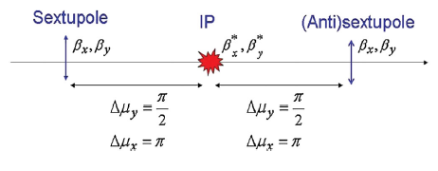


Crab-waist collision
P. Raimondi , 2nd SuperB Workshop, March 2006
M. Zobov et al., PRL 104, 174801 (2010)

Slide 5
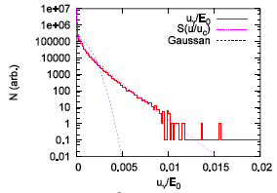
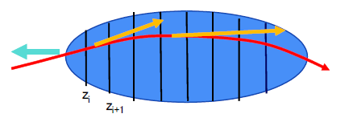
Beamstrahlung Effect & 3D flip-flop
V. I. Telnov, PRL 110, 114801 (2013)
A. Bogomyagkov et al., Phys. Rev. ST Accel. Beams 17, 041004 (2014)
D. Shatilov, ICFA Beam Dyn. Newslett. 72, 30 (2017).
Synchrotron radiation during beam-beam interaction
High energy photon -> Momentum acceptance -> Lifetime
Longer bunch length and Higher energy spread
Asymmetrical beam blowup: 3D flip-flop

Slide 6
Simulation Tool
IBB
K. Hirata et al., PA 40, 205-228 (1993)
K. Hirata, PRL, 74, 2228 (1995)
Y. Zhang et al., PRST-AB, 8, 074402 (2005)
Y. Seimiya et al., PTP 127, 1099 (2012)
K. Ohmi, IPAC16
Y. Zhang et al., PRAB 23, 104402, (2020)
Linear Arc Map with SR radiation
One turn map including general chromaticity
Horizontal crossing angle: Lorentz boost map
Bunch slice number is about 10 times Piwinski angle
Slice-Slice collision: Synchro-beam mapping method (or PIC)
Synchrotron radiation during collision
Longitudinal wakefield
Transverse wakefield
Space charge

Slide 7
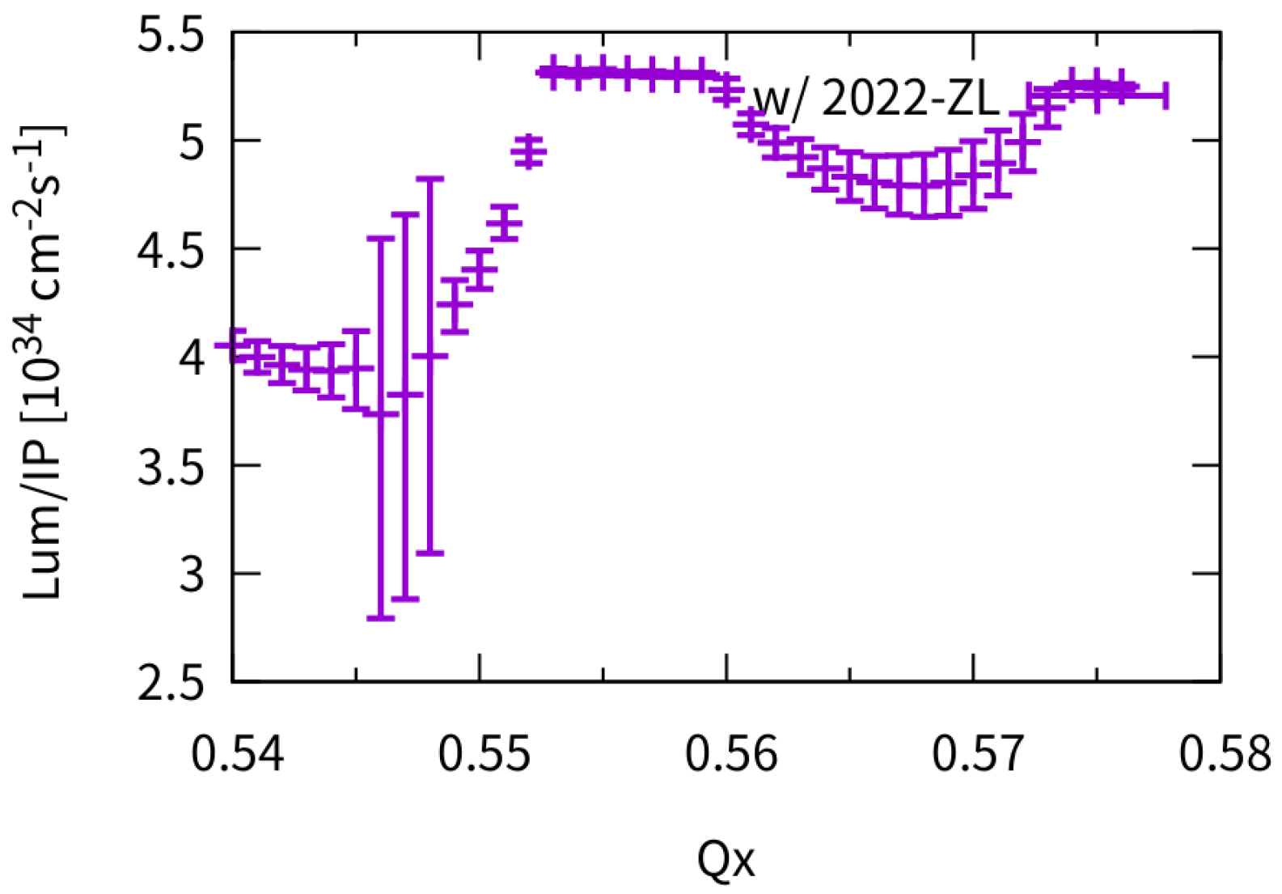
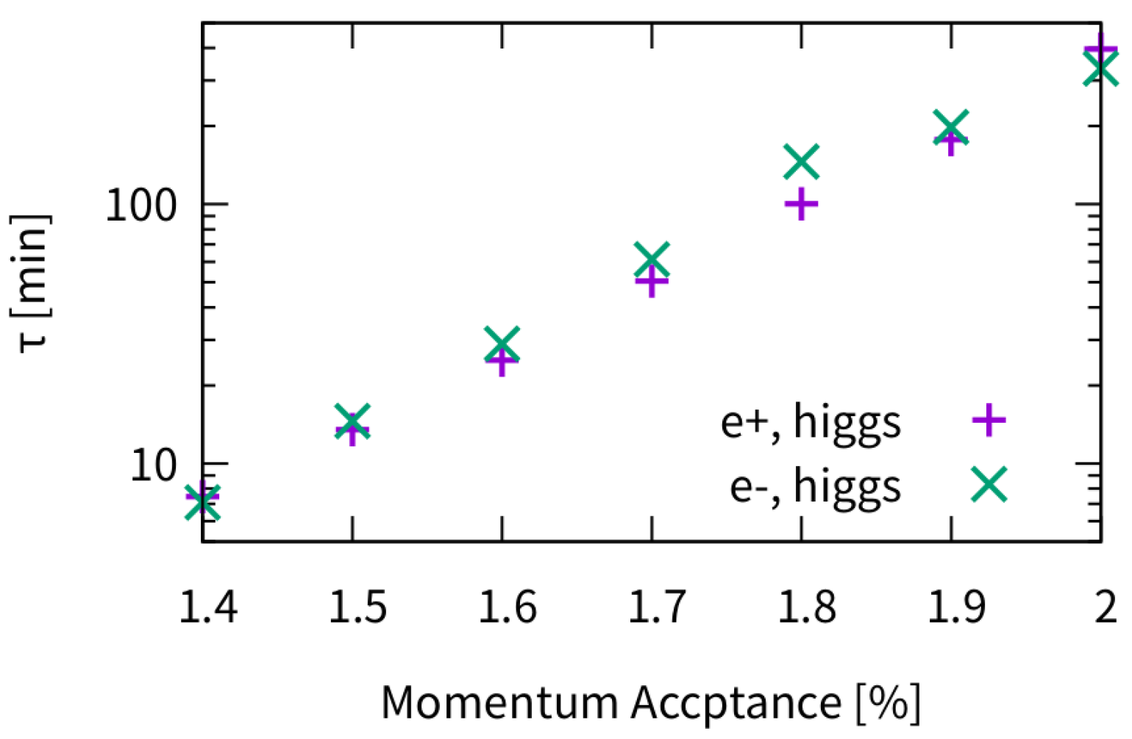
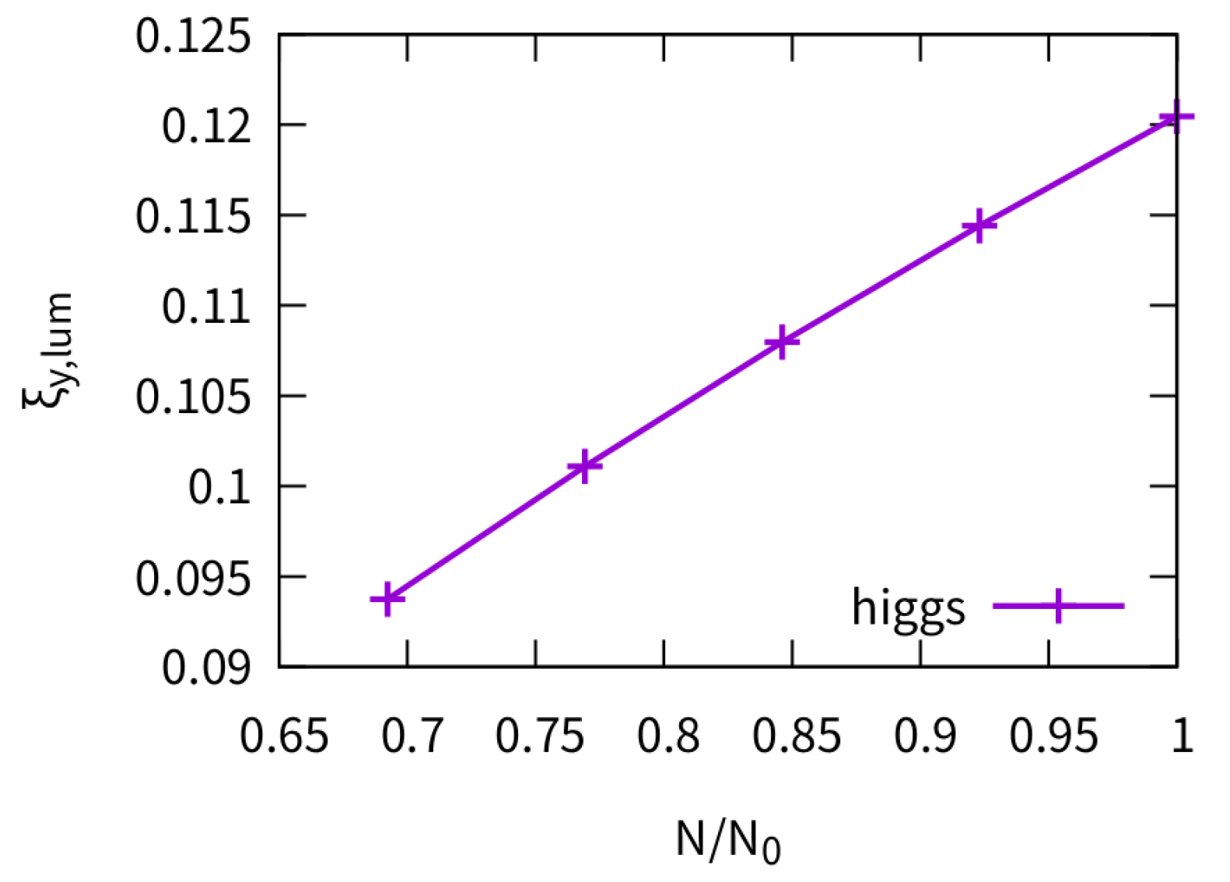
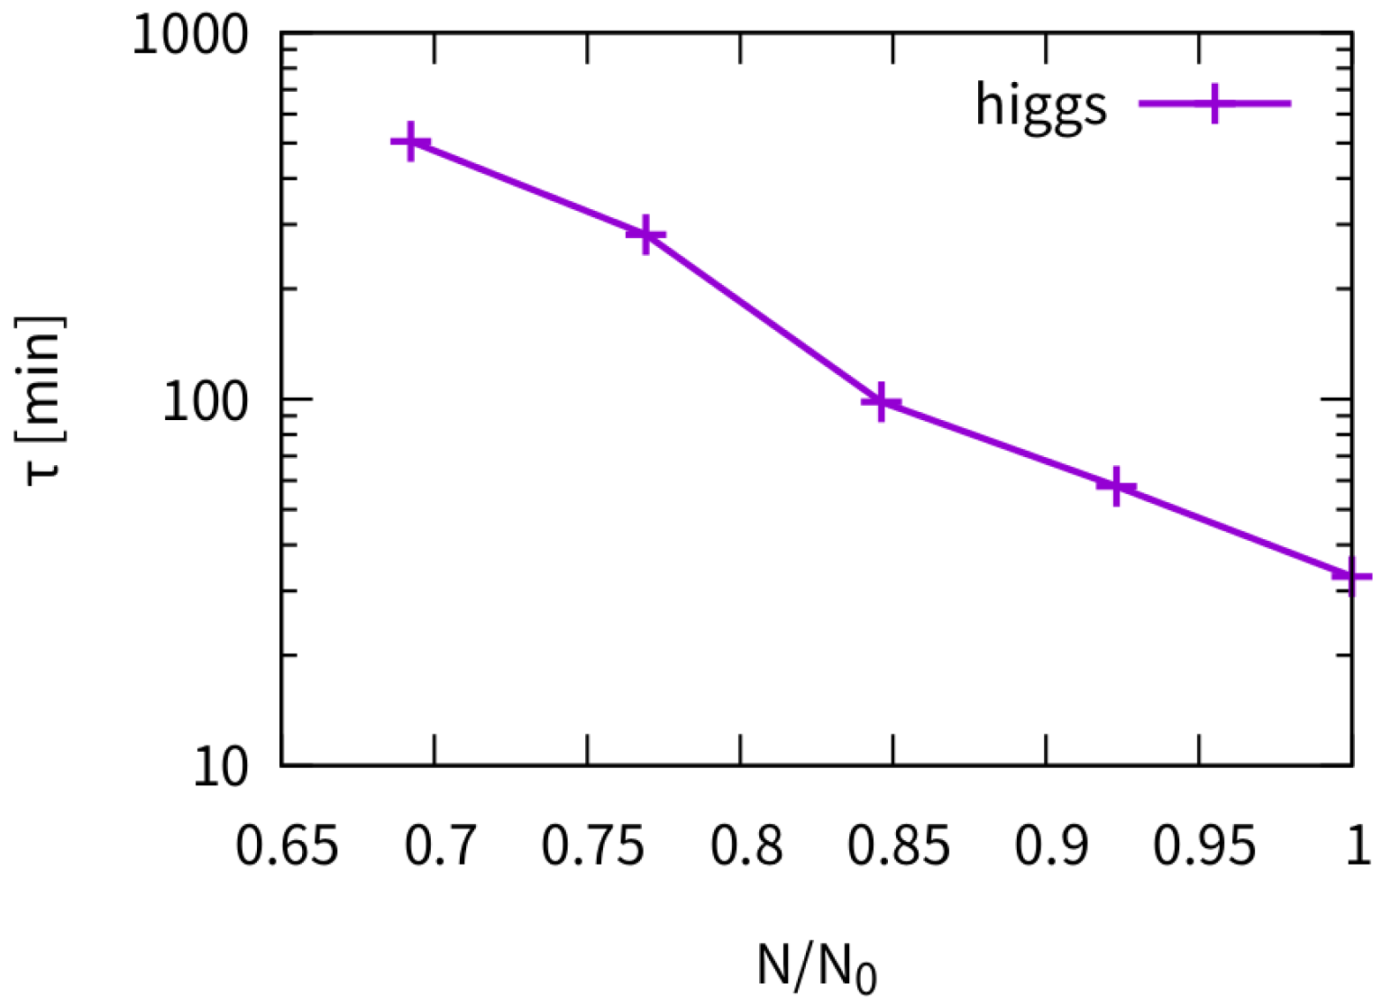
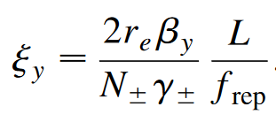
Higgs (TDR)
The beamstrahlung lifetime is very sensitive to the bunch population
Luminosity versus horizontal tune
Beamstrahlung Lifetime vs Momentum Acceptance

Slide 8
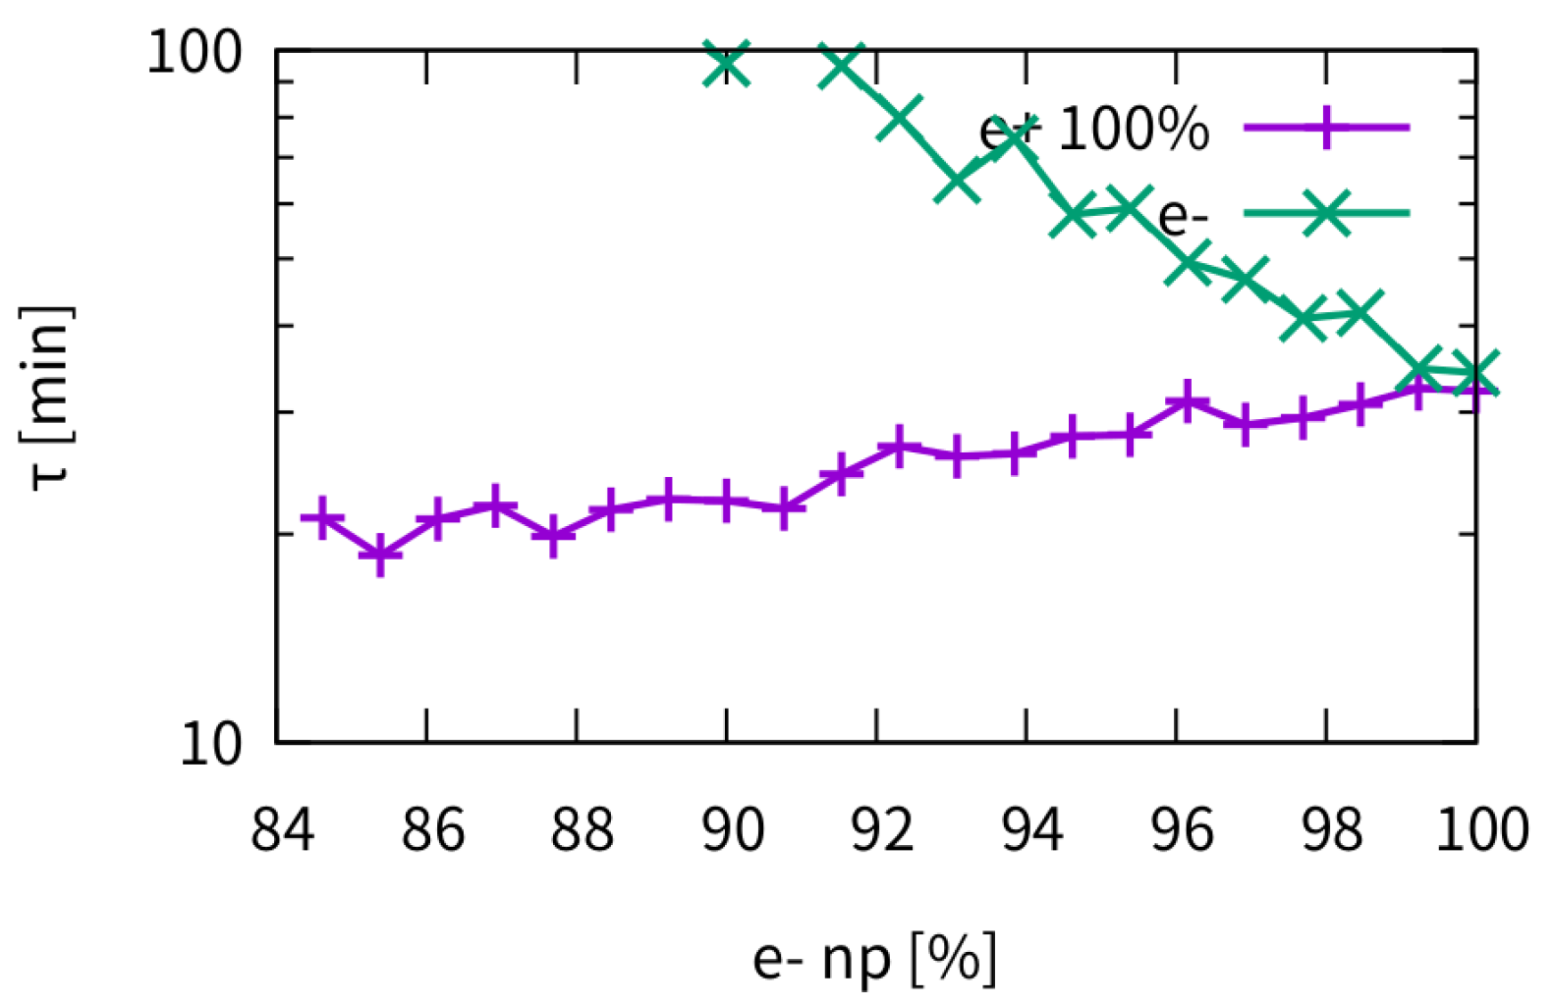
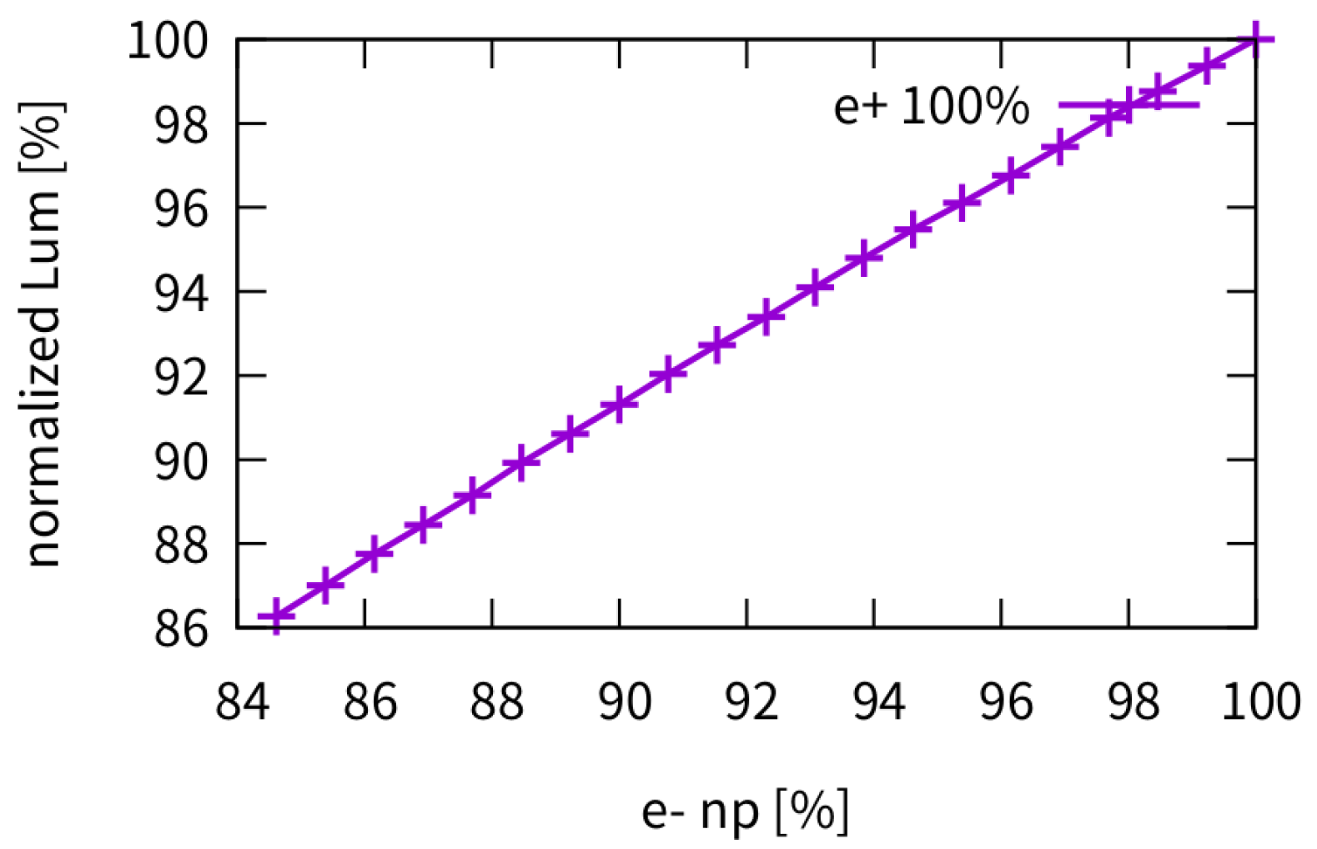
Higgs (TDR) – asymmetric bunch population
Lifetime
Luminosity
The weak beam’s lifetime would be about only half with collision between 100% vs 90% bunch population. (100% vs 97%: ~20% lifetime reduction)
The luminosity scale linearly with the weak beam’s bunch population

Slide 9
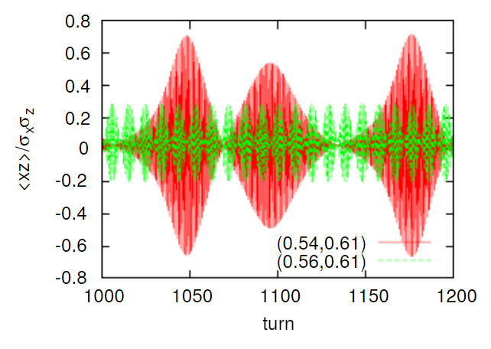
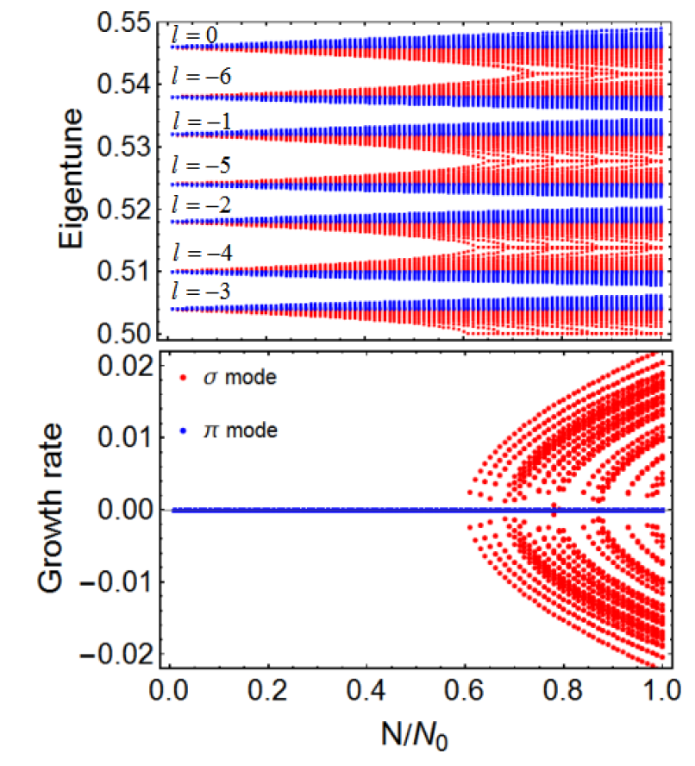
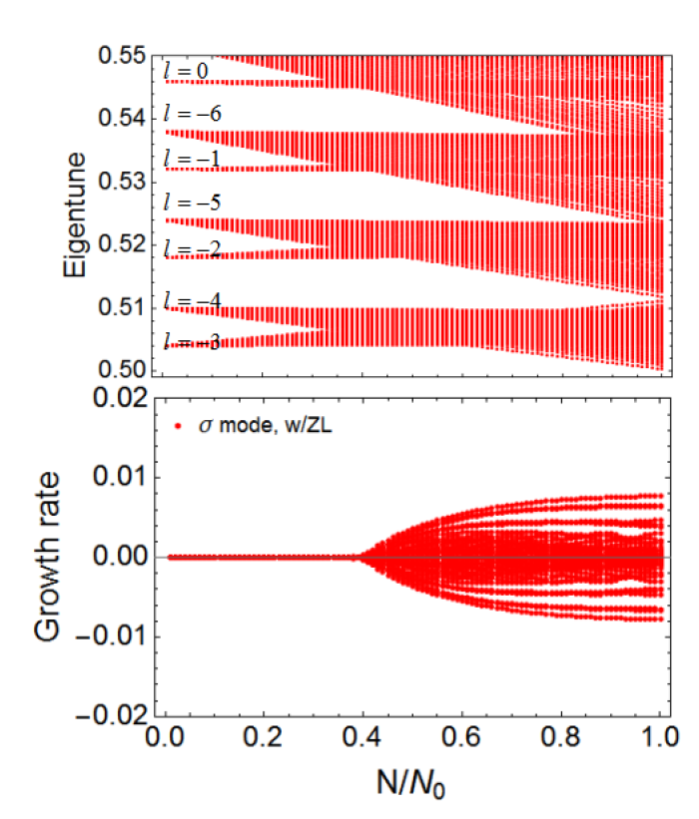
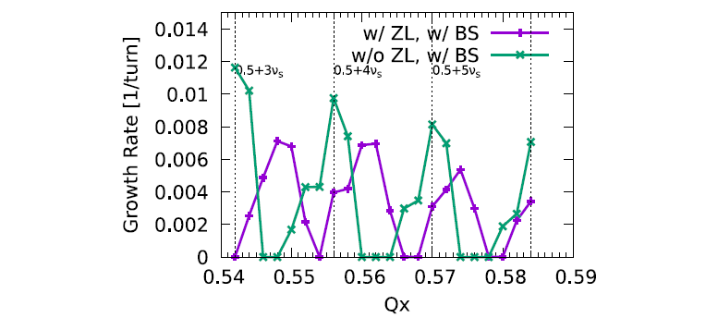
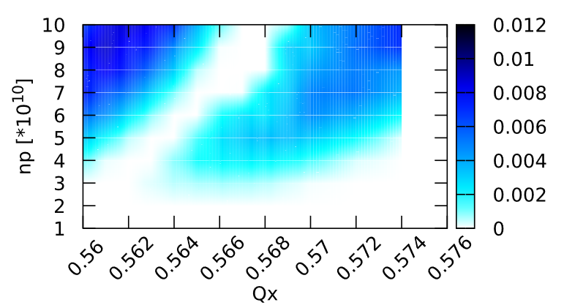


Horizontal Beam-Beam Instability (X-Z)
Larger $ν_{s}/ξ_{x}$ is preferred
K. Ohmi, Int. J. Mod. Phys. A, 31, 1644014 (2016).
K. Ohmi and et al., PRL 119, 134801 (2017)
N. Kuroo et al, PHYS. REV. ACCEL. BEAMS 21, 031002 (2018)
Y. Zhang etal., PRAB 23, 104402, (2020)
C. Lin etal.,, PRAB 25, 011001 (2022)
w/o ZL
By including the impedance stable areas become narrower and are shifted
w/ ZL, $σ$ mode
(CEPC-CDR-Z)
Growth rate versus horizontal tune,
w/ and w/o ZL
Growth rate versus bunch population,
w/ ZL

Slide 10
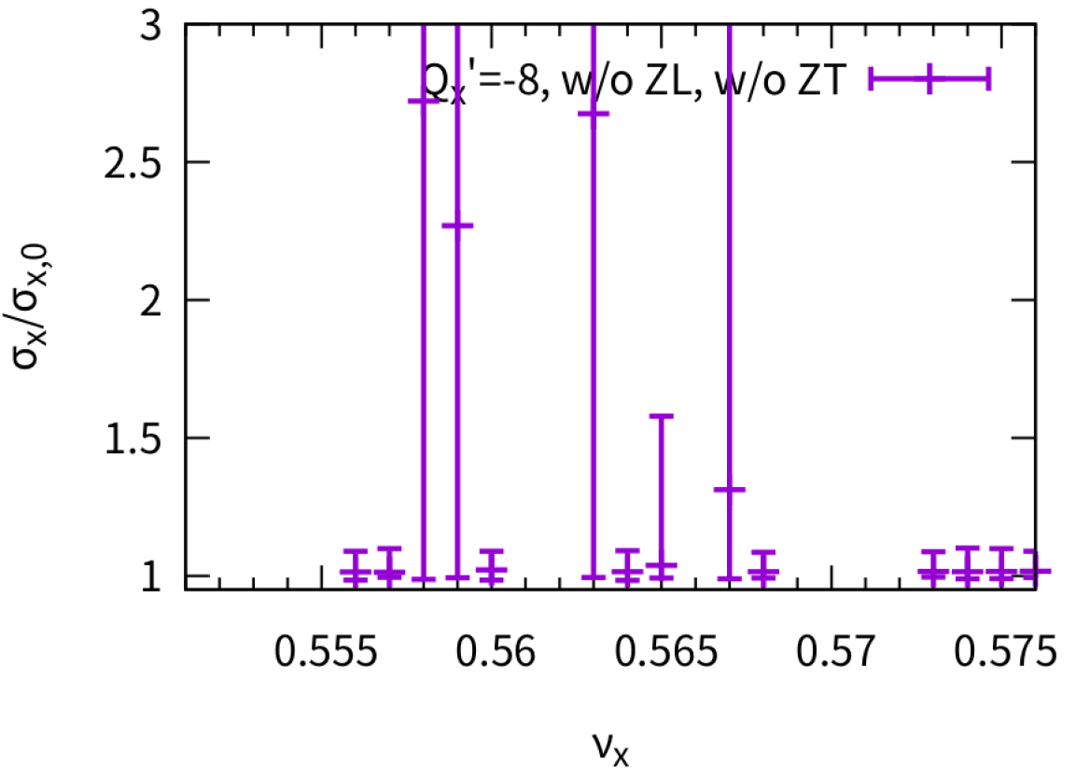
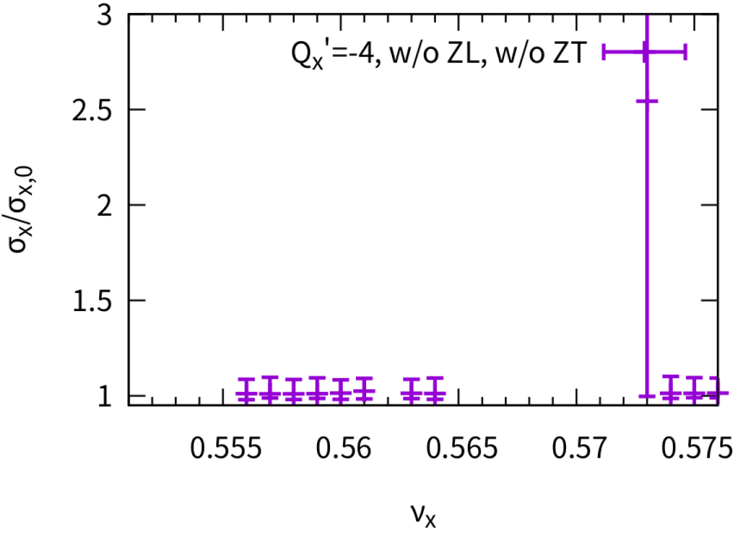
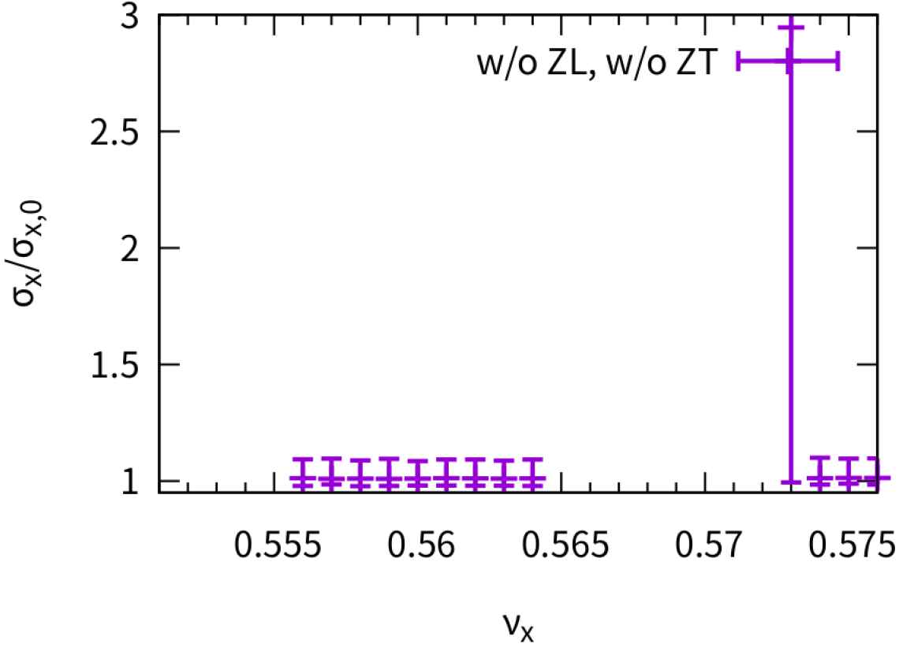
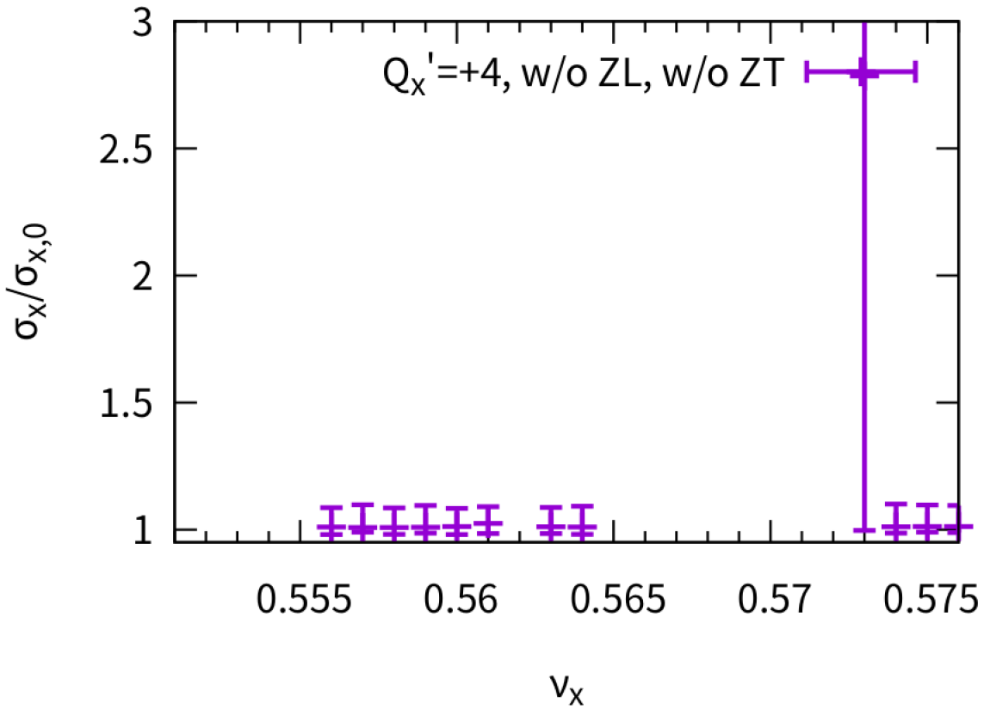
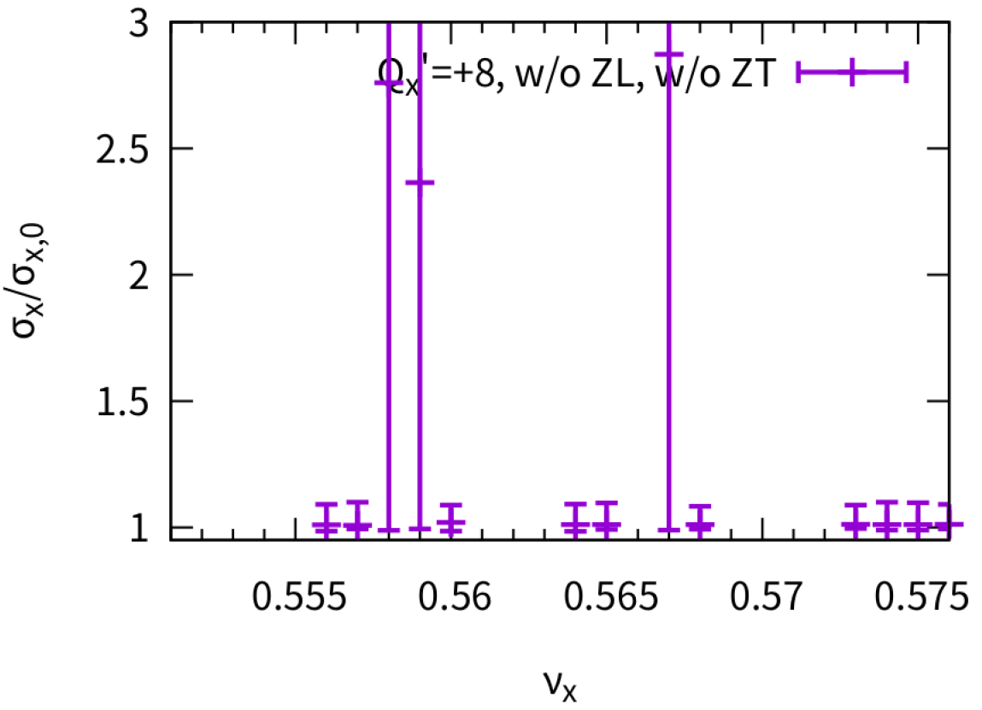
Effect of Chromaticity on X-Z instability w/o ZL, w/o ZT, simulation
Qx’=-8/-4/0/4/8 is scanned at different horizontal tune
Sign of chromaticity make no difference
New unstable working point appear with finite chromaticity
Stable working point is more uncertain with large chromaticity
Chromaticity is detrimental (w/o ZL)

Slide 11
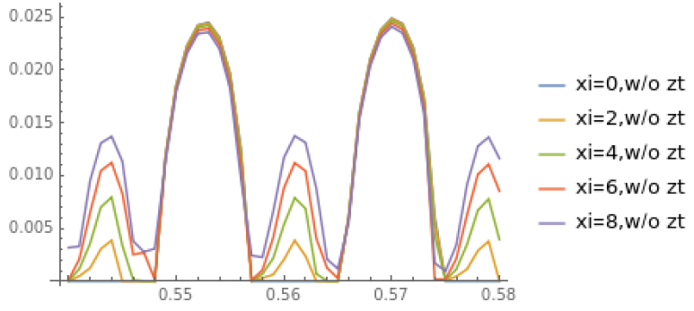
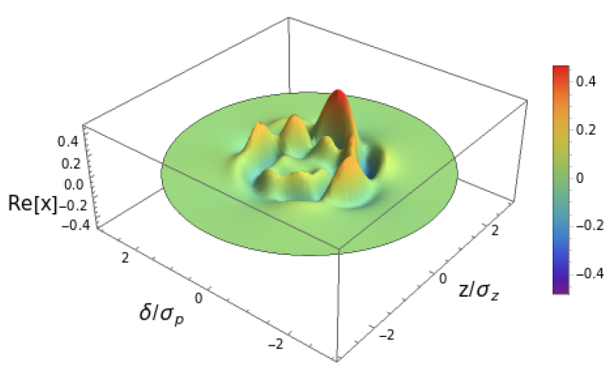
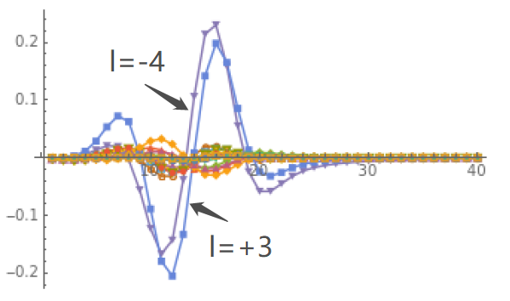
Effect of Chromaticity on X-Z instability w/o ZL, w/o ZT, analysis
Tune scan at design bunch population
The growth rate nearly keep unchanged with chromaticity in unstable tune region of zero chromaticity
New unstable region appear with increase of chromaticity
@Qx=0.559
It is suspected that the most unstable mode would not appear in the simulation,
Some unstable mode may be induced referring to the simulation (remains to be done)
More detailed intra-bunch information in the simulation need to be inspected, as well as the unstable mode in the analysis.

Slide 12
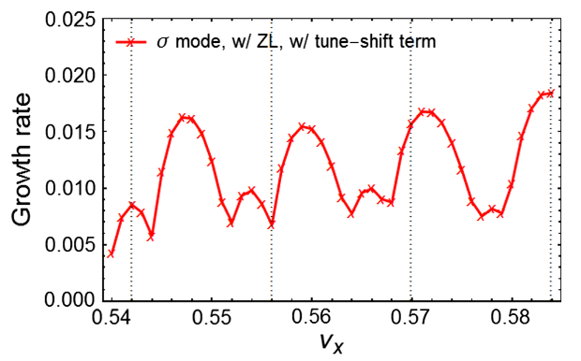
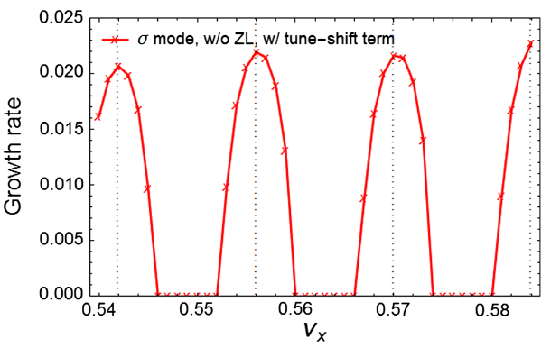
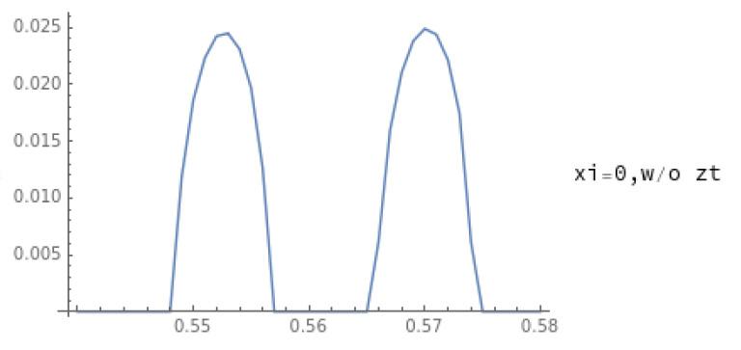
Chromaticity: X-Z instability (w/o ZL)
C. Lin etal,PRAB 25, 011001 (2022)
Similar?
ZL
Chromaticity

Slide 13
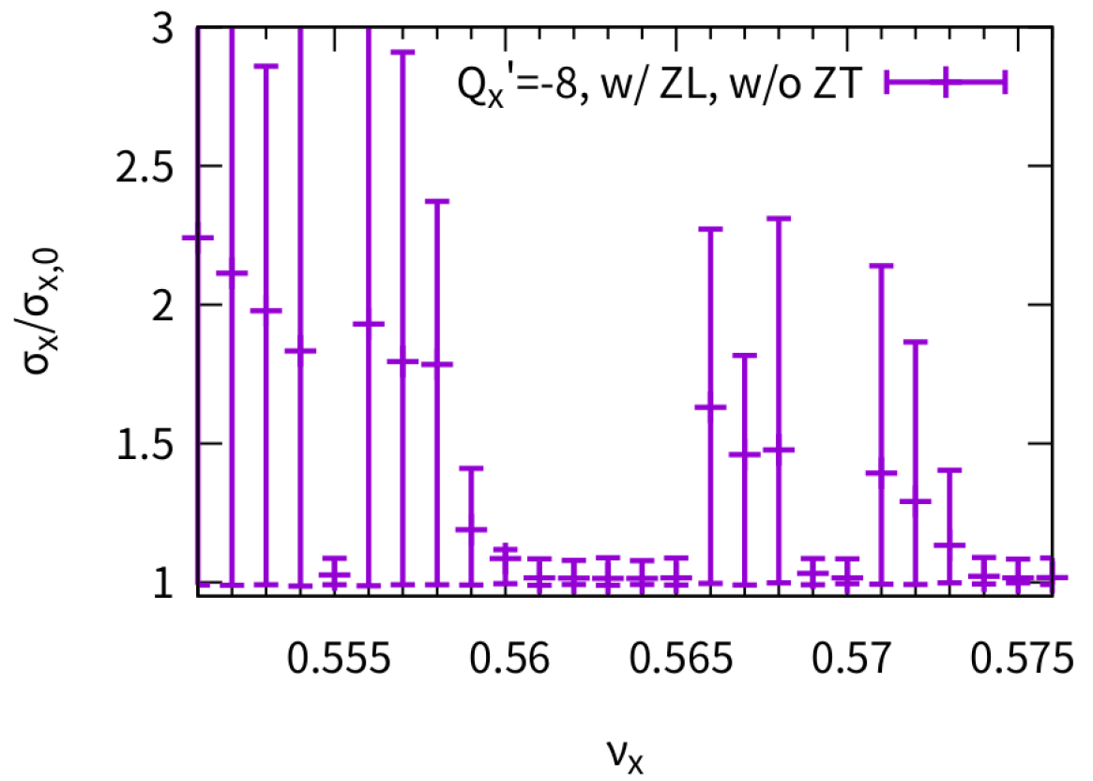
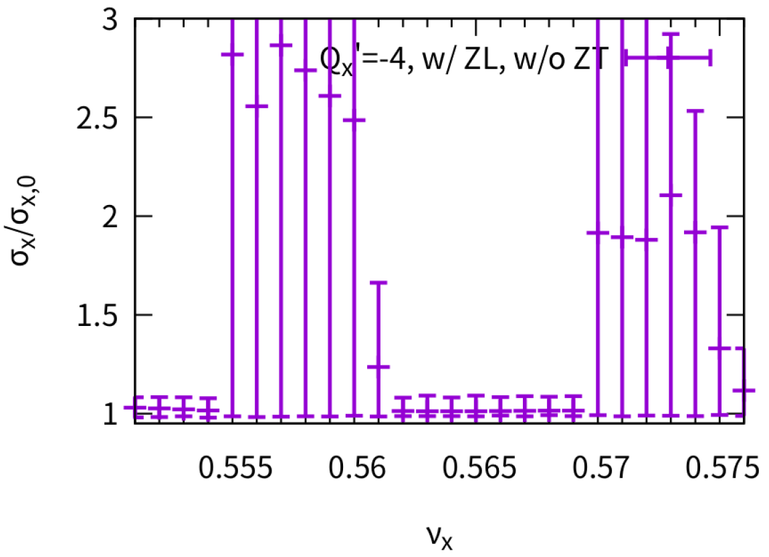
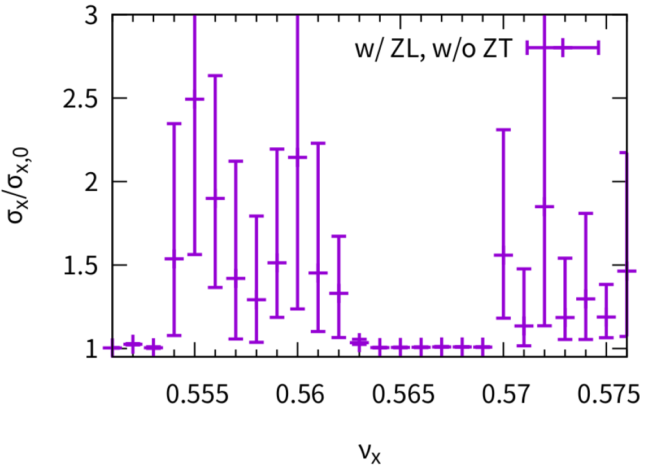
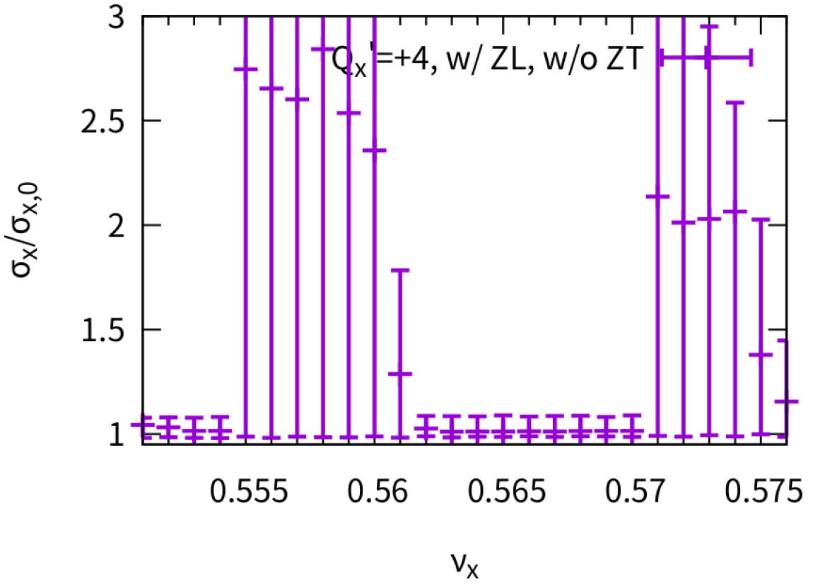
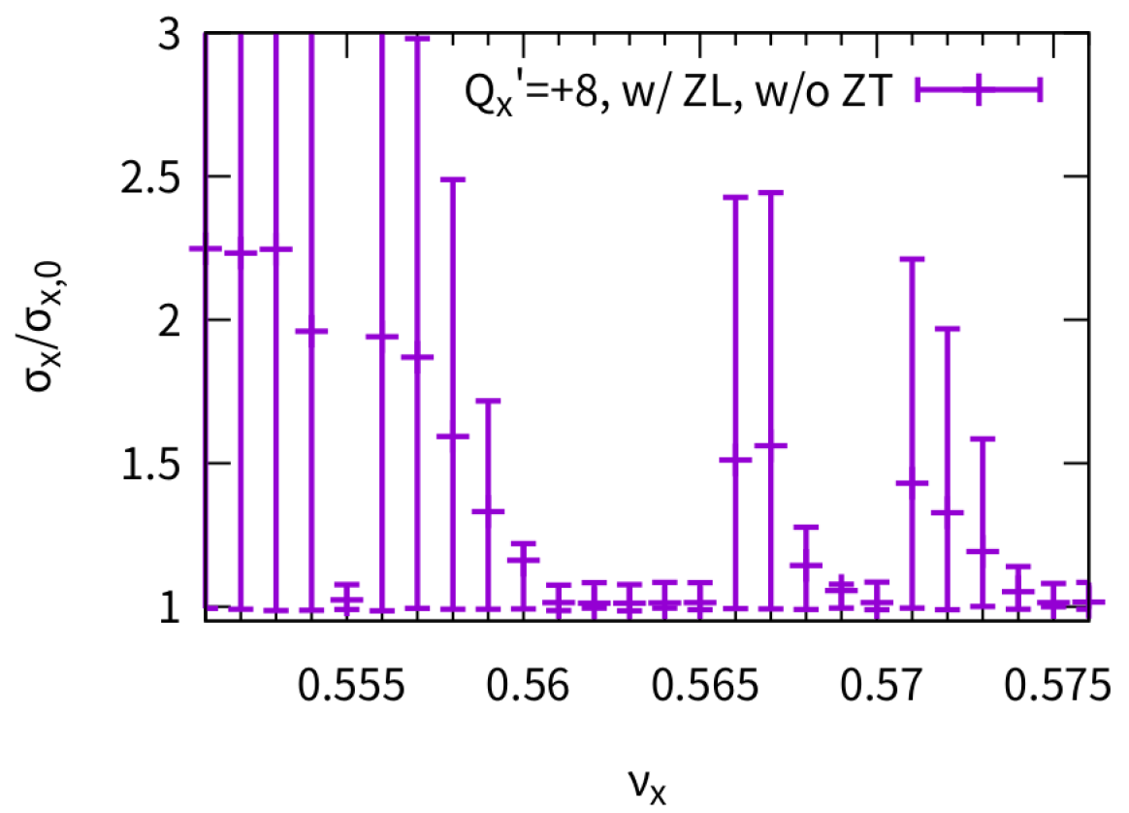
Effect of Chromaticity on X-Z instability w/ ZL, w/o ZT, simulation
Qx’=-8/-4/0/4/8 is scanned at different horizontal tune
Sign of chromaticity make no difference
Stable tune area increase with proper chromaticity (Qx’=+-4)
Stable tune area may reduce with large chromaticity
Chromaticity could be helpful (w/ ZL), since Chromaticity and PWD both induce coupling between different parity mode.
-8
-4
0
+4
+8

Slide 14
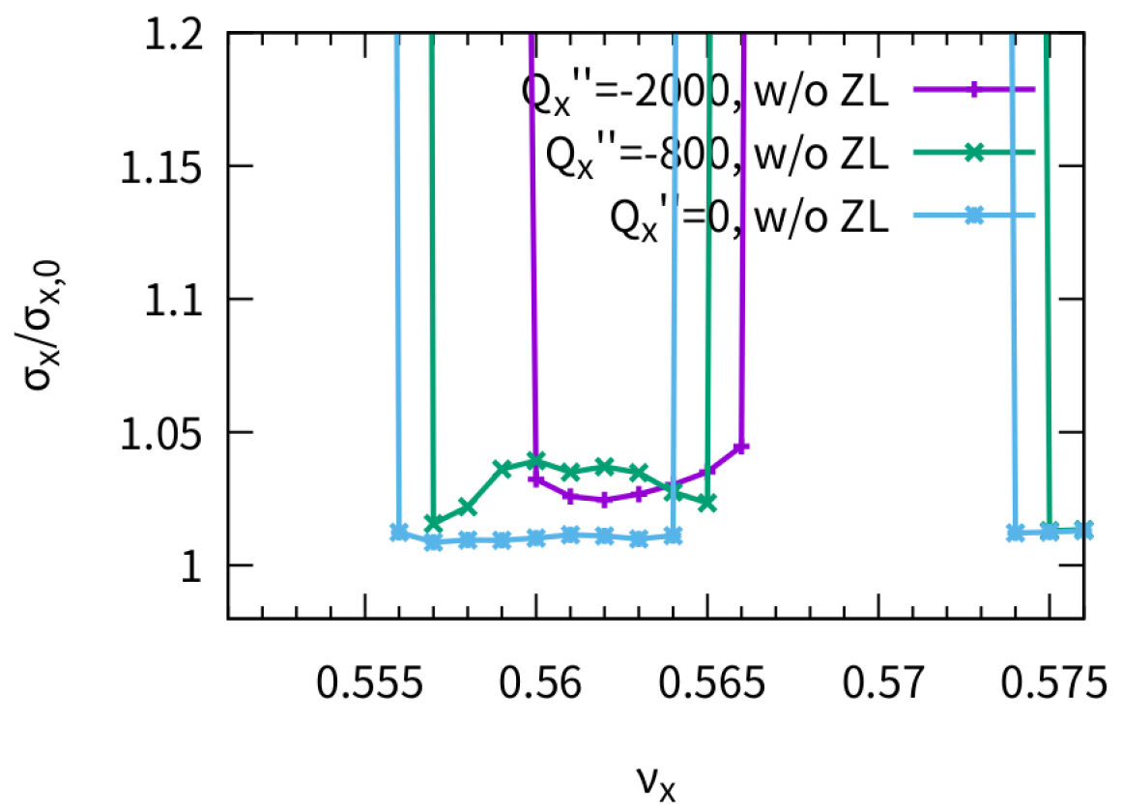
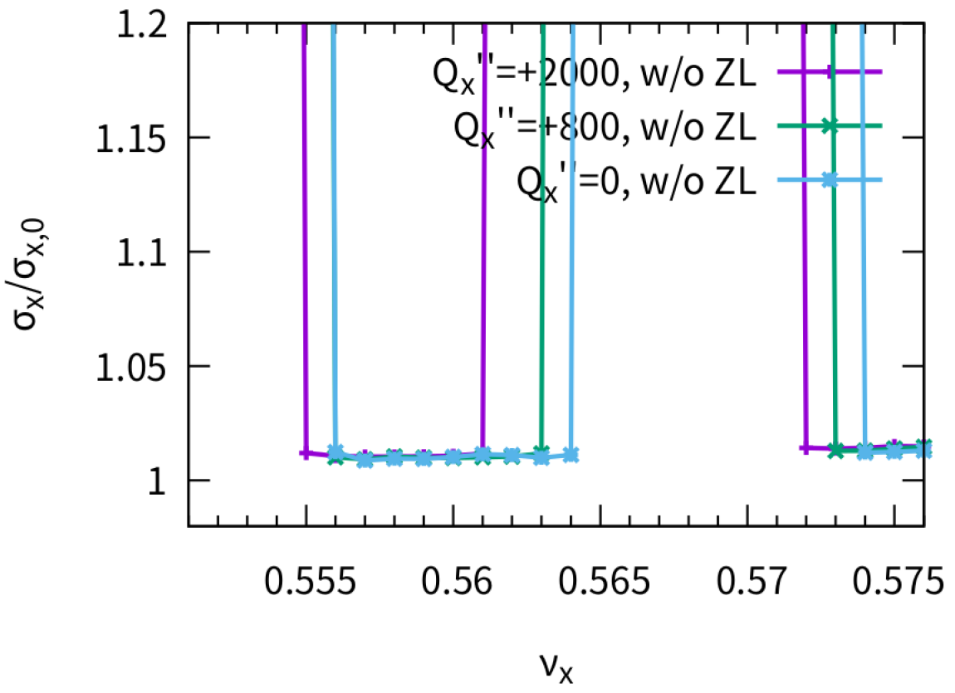


2nd order chromaticity on X-Z instability w/o ZL, w/o ZT, simulation
$$ν\left(δ\right)=ν_{0}+ν_{1}δ+ν_{2}δ^{2}$$
$ν_{2}$=-2000/-800/0/+800/+2000 is scanned in simulation
Finite $ν_{2}$ is detrimental for instability
  The left(right) side of stable tune region ($ν_{2}$=0) may become unstable for minus(positive) 2nd order chromaticity

Slide 15
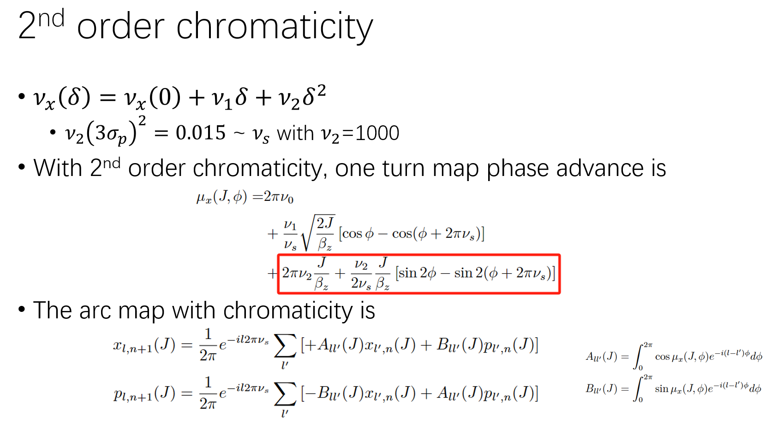
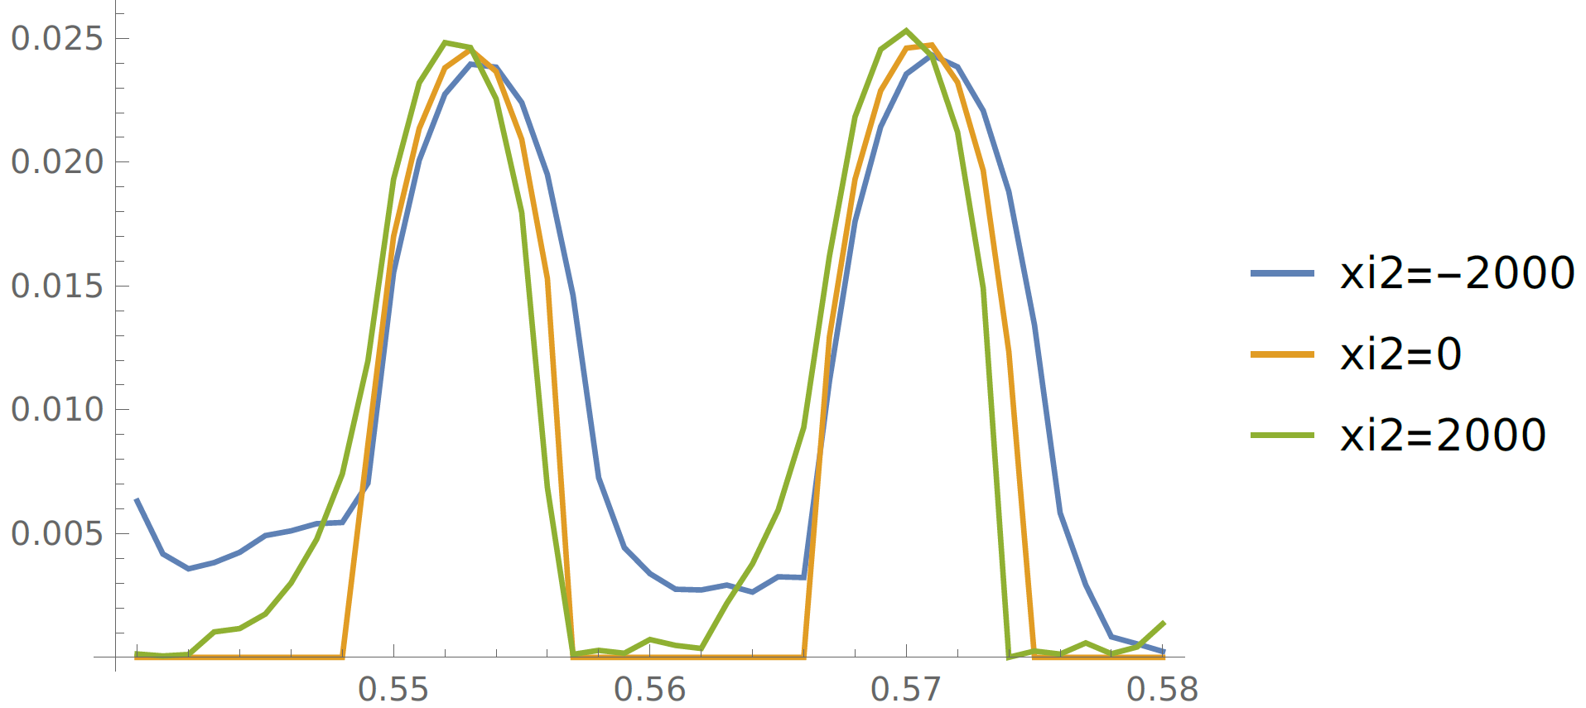
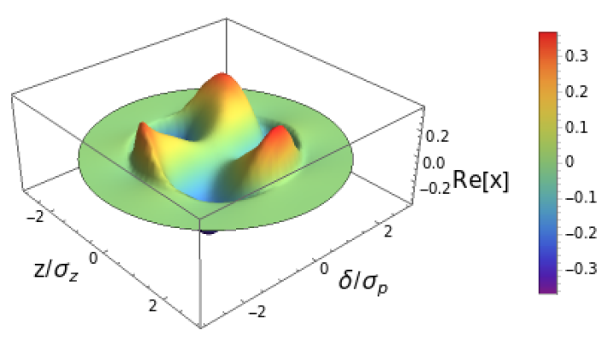

2nd order chromaticity on X-Z instability w/o ZL, w/o ZT, Analysis
Analysis results agrees with simulation basically
The eigen mode distribution induced by finite chromaticity is not singular, and is expected to appear in simulation
Eigen-mode distribution: Qx=0.558, $ν_{2}$=-2000

Slide 16
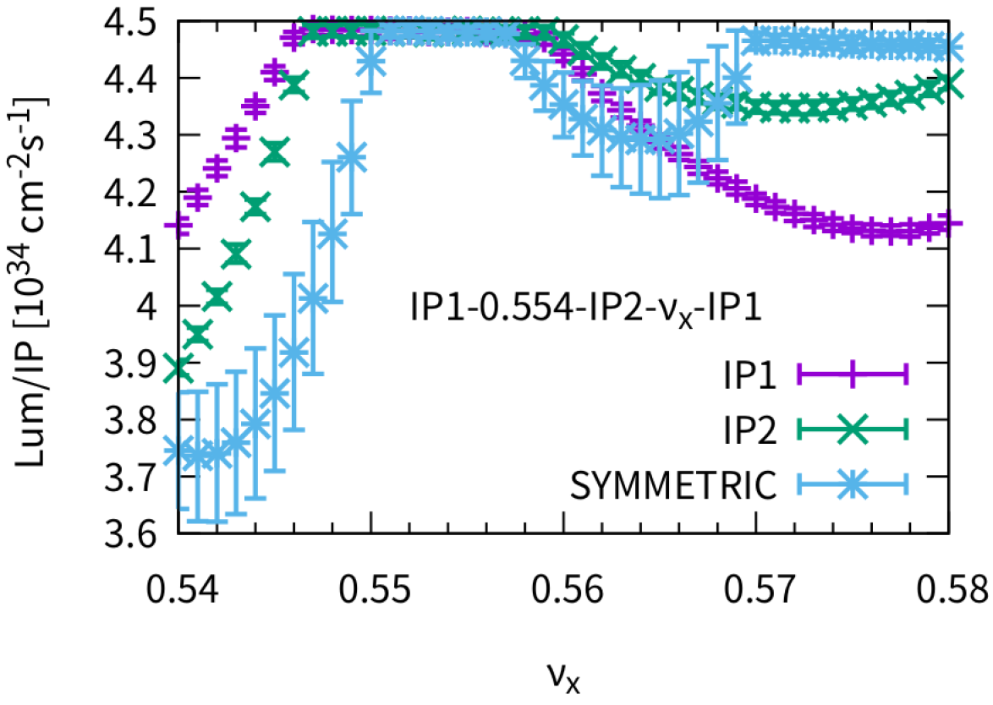
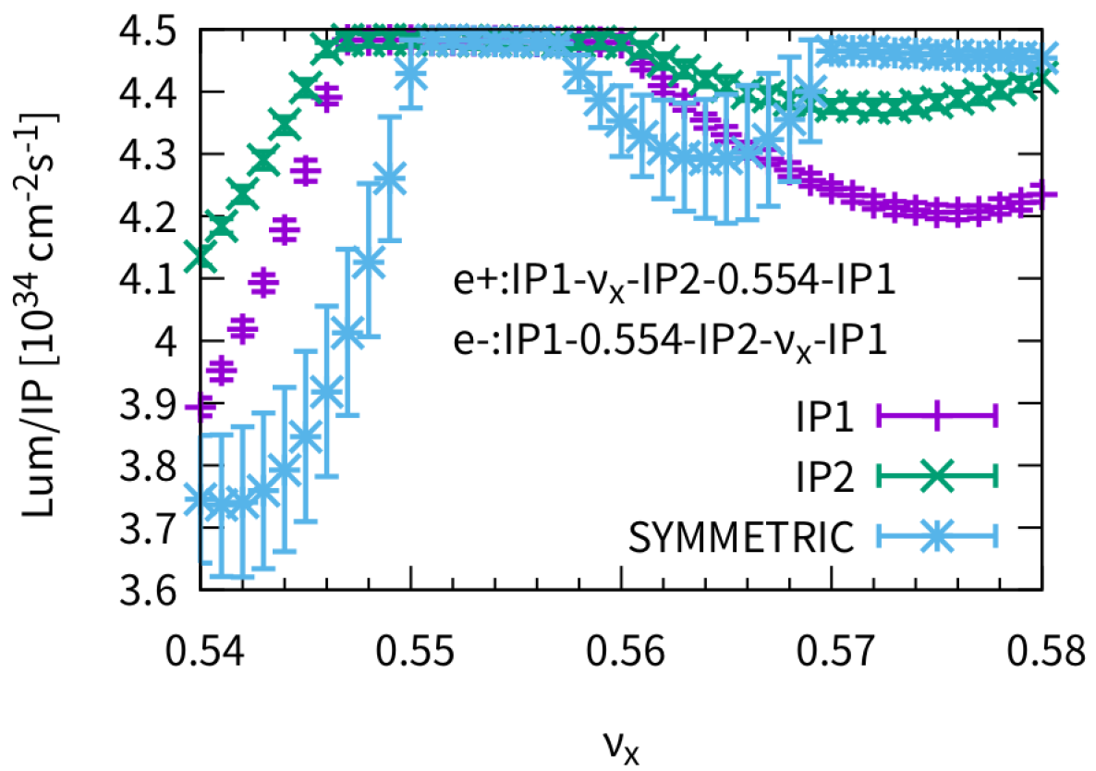
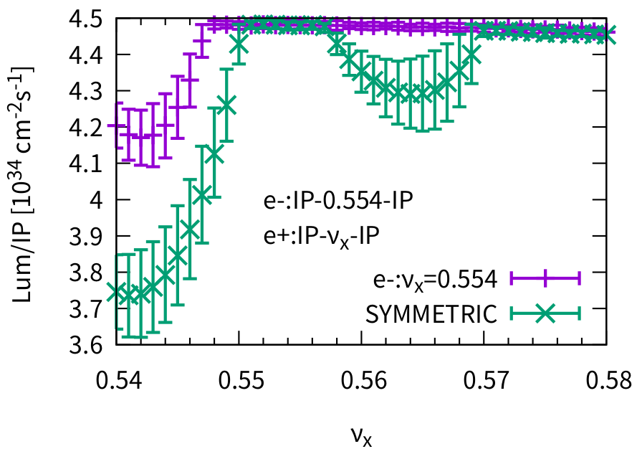






X-Z instability: Asymmetric two half rings
It is best for same phase advance between two half rings in one ring.
IP1
IP1
IP1
e+
e-
e+
e-
e+
e-
0.554
$$ν_{x}$$
$$ν_{x}$$
0.554
$$ν_{x}$$
$$ν_{x}$$
0.554
0.554
$$ν_{x}$$
0.554
$$ν_{x}$$
0.554
IP2
IP2
IP2

Slide 17
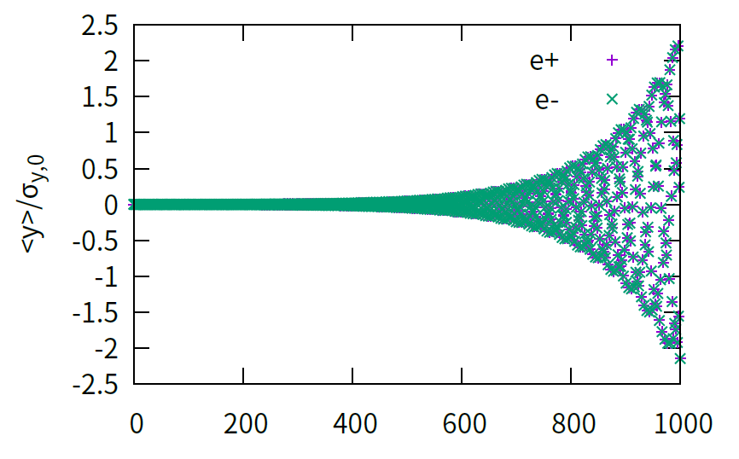
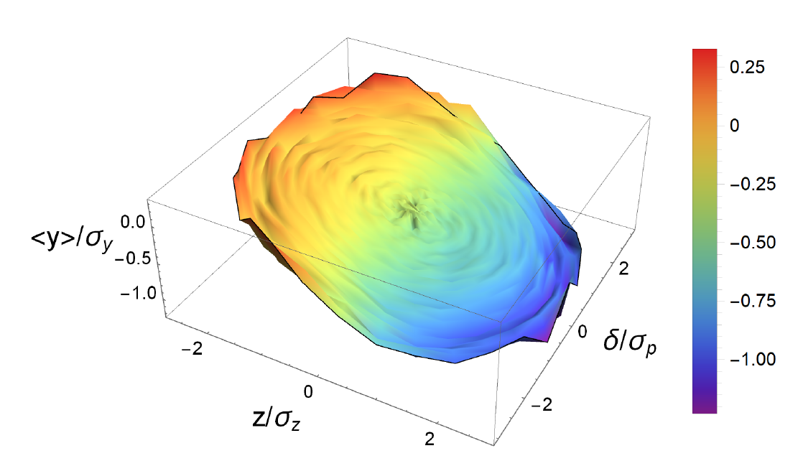
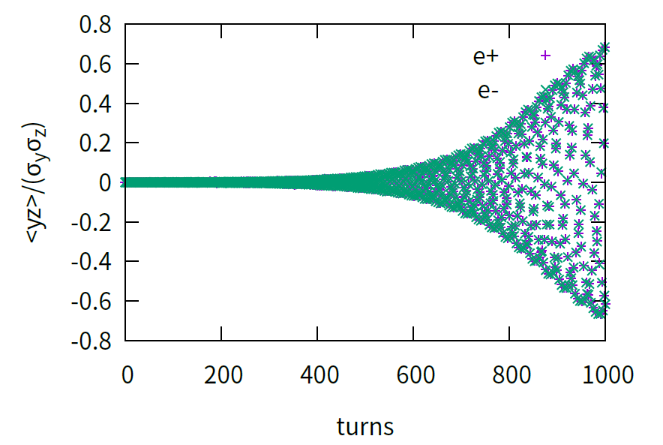
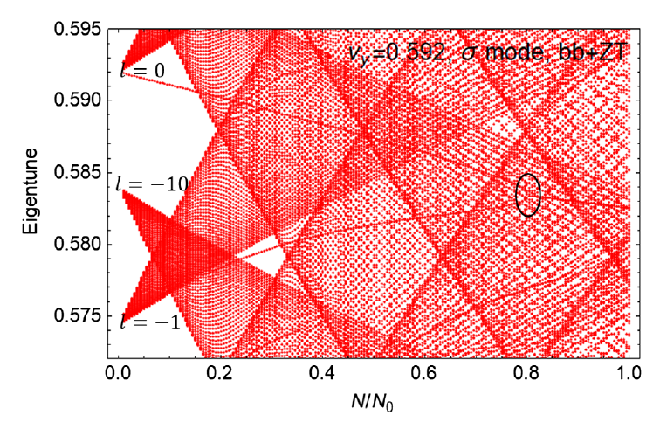
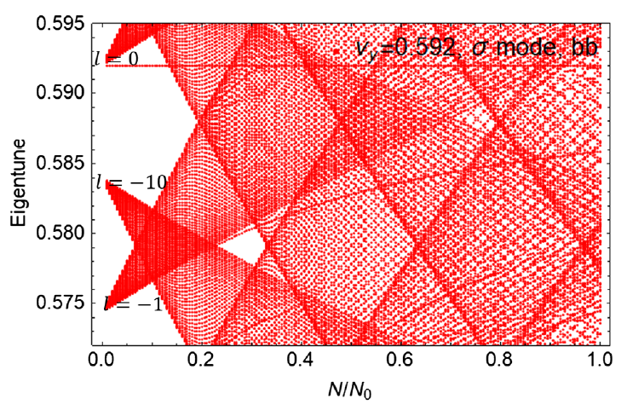
Vertical mode coupling with ZT($σ$-mode)
Y. Zhang et al., PRAB 26, 064401 (2023)
K. Ohmi et al., PRAB 26, 111001 (2023)
TMCI threshold is reduced from about 21e10 to 11e10
(2022 impedance)

Slide 18
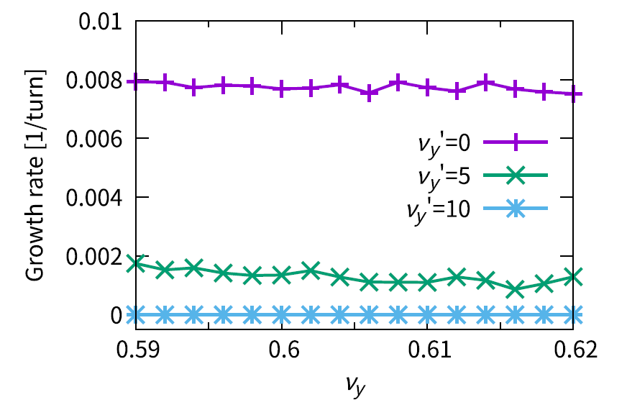

Mitigation of Vertical TMCI (BB+ZT)
Y. Zhang et al, PRAB 26, 064401 (2023)
Thanks: K. Oide
Asymmetrical Tunes + Chromaticity
(2022 impedance)
Chromaticity
Growth rate of vertical centroid versus tune with different vertical chromaticity. Both transverse and longitudinal
impedance are considered.
vertical beam size versus asymmetric vertical tunes with different vertical chromaticity. Both transverse and longitudinal impedance are considered. One beam’s vertical working point is fixed at 0.610.

Slide 19


Hourglass effect on vertical TMCI
Thanks: K. Ohmi
Hourglass effect may help mitigate vertical TMCI when $\frac{β_{y}}{σ_{z}/θ_{p}}<1.6$.
Scan emitx, w/ ZY, w/ ZL
Off beamstrahlung, but similar bunch length and energy spread

Slide 20




Effect of feedback on single bunch instability (w/o and w/ chromaticity)
Thanks: M. Zobov, M. Migliorati
Fig. 3, E. Metral, PRAB, 24, 041003 (2021)
A simplified resistive damper is used: $Δp_{i}=−2d_{p}p_{i}$
Strong feedback reduce the TMCI threshold.
Growth rate is lower with feedback above threshold
w/ chromaticity, strong feedback could be helpful
w/o chromaticity
w/ chromaticity

Slide 21



Resistive feedback on X-Z instability
D. Shatilov,
ICFA Beam Dyn.Newslett. 72 (2017) 30-41
w/ ZT, no stable working point at design bunch population due to TMCI (not shown)
Strong resistive feedback (with finite chromaticity) could help mitigate TMCI, similar to single bunch
The stable tune region (w/ ZT+feedback) is same as that (w/o ZT and w/o feedback)
Not helpful to mitigate X-Z instability
X-Z instability could not be suppressed by feedback, since no dipole oscillations
No difference
w/ ZL
d_{p}=0.05, w/ ZL
d_{p}=0.05, w/ ZL+ZT

Slide 22


Resistive feedback on vertical TMCI (Qy’=5)
np=7e10
With finite tune chromaticity, resistive feedback is helpful to mitigate the instability
Damp rate from chromaticity would increase with bunch population, which induces that the growth rate near 20e10 is even slower than that at low bunch population.

Slide 23


Space charge (Z)
$Δν_{y,sc}=−\frac{Nr_{e}}{{\left(2π\right)}^{3/2}σ_{z}β^{2}γ^{3}}\oint{ds\frac{β_{y}}{\left(σ_{x}+σ_{y}\right)σ_{y}}}\sim −0.02$ (full ring)
Mitigation effect coming from space charge is found, while limited
Beamstrahlung effect is included, initial bunch length is that of the designed bunch population

Slide 24



Optics distortion:
Vertical COD and Vertical Dispersion
Error only exit in one beam(ring)
$Δy<0.3σ_{y}$ is required to keep luminosity loss < 10%
$η_{y}σ_{p,0}<0.2σ_{y}$ is required to keep luminosity loss < 10% (beamstrahlung + vertical emittance increase) (asymmetric effect)

Slide 25






Optics distortion: local coupling at IP
Error only exit in one beam(ring)
The scaled R1/R2/R3/R4 have similar effects, where the scaled parameters should $<1$ to keep luminosity loss < 10%.
$$σ_{y}^{2}\left(0\right) \sim σ_{y,0}^{2}+σ_{x}^{2}\left[R_{1}^{2}+\frac{R_{2}^{2}}{β_{x}^{2}}\right]$$
$$σ_{y}^{2}\left(s\right)∼ε_{x}\left[β_{x}{\left(−R_{1}+R_{3}s\right)}^{2}+\frac{1}{β_{x}}{\left(R_{2}+R_{4}s\right)}^{2}\right]+ε_{y}\left[β_{y}+\frac{s^{2}}{β_{y}}\right]$$

Slide 26




Strong-strong Beam-beam + Lattice (APES-T)
Zhiyuan Li etal., NIMA 1064 (2024) 169386
In collaboration with KEK team
SAD lattice is fully supported
Dynamic aperture benchmark with SAD
Parallel: MPI+GPU
First-time strong-strong simulation in ee machines with element-by-element tracking in arc
CEPC
SuperKEKB
CEPC

Slide 27
Summary
With the publish of CEPC TDR, some performance evaluation / optimization work has been done
Horizontal/vertical beam-beam instability and their mitigation methods (chromaticity, asymmetric tunes, feedback)
Initial optics error effects
New code has been developed to support strong-strong bb + lattice tracking

