Slide 1
beam-beam effects at the FCC-ee
Peter Kicsiny, X. Buffat, V. Gawas, G. Iadarola, K. Oide, T. Pieloni, J. Salvesen, L. van Riesen-Haupt
for the beam-beam working group, with special thanks to:
H. Burkhardt, C. Carli, F. Carlier, M. Hofer, D. Schulte, M. Seidel, D. Shatilov, D. Zhou
ICFA mini workshop: Beam-Beam Effects in Circular Colliders BB24
02 September 2024
This work was performed under the auspices and with support from the Swiss Accelerator Research and Technology (CHART) program.
Notes:
overview on the beambeam studies at the fcc-ee

Slide 2
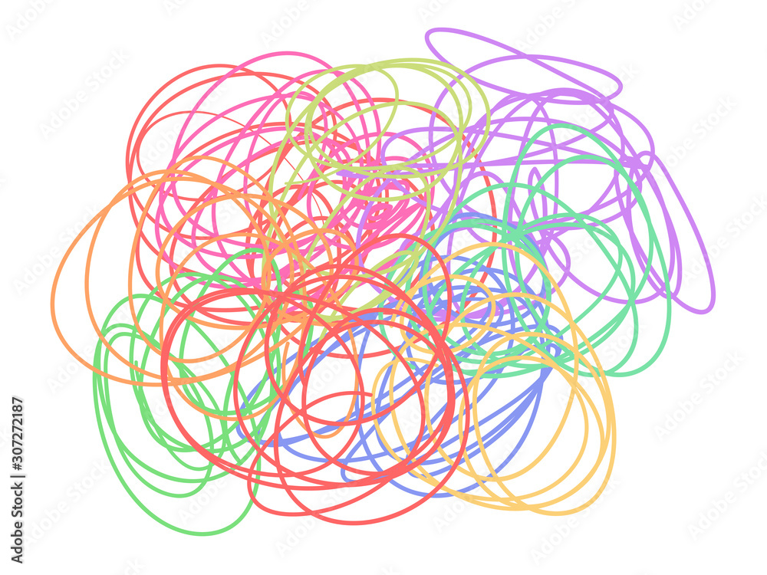
Overview
errors &
misalignments
  FCC-ee will be a highly complex machine
  Interplay of various effects
electron cloud
impedances
collimation
radiation
lattice nonlinearities
Notes:
The fcc ee will be a highly complex machine with many effects will interplay with each other, such as machine impedances, radiation, collimation, lattice resonances, misalignments and so on.

Slide 3

Overview
errors &
misalignments
  FCC-ee will be a highly complex machine
  Interplay of various effects
  Presence of beam-beam collisions
  further complicates beam dynamics
  Self-consistent simulations are challenging
electron cloud
impedances
beam-beam
collimation
radiation
lattice nonlinearities
Notes:
the presence of beambeam collisions makes the dynamics even more complicated as they interplay with all these other components of the machine. Because of this complex dynamics the self consistent simulation of the machine is very challenging but crucial for the success of the design study.

Slide 4
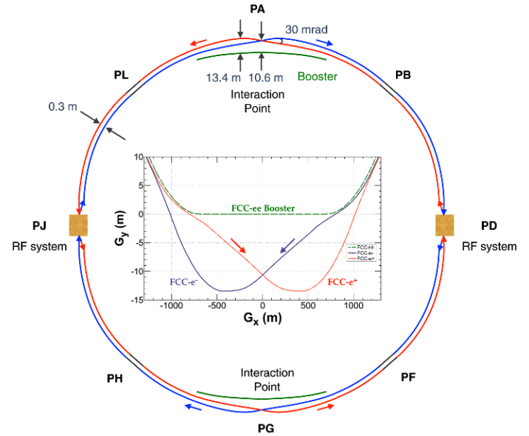
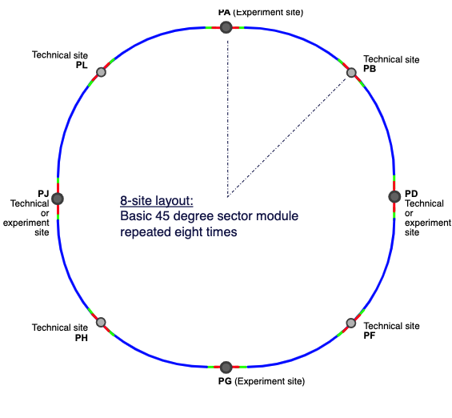
FCC-ee design
Interaction point (IP)
Synchrotron radiation
Beamstrahlung + radiative Bhabha scattering
2 IP
4 IP
5 working points
Z: 45.6 GeV
W±: 80 GeV
ZH: 120 GeV
ttbar 1: 175 GeV
ttbar 2: 182.5 GeV
4 working points
Z: 45.6 GeV
W±: 80 GeV
ZH: 120 GeV
ttbar: 182.5 GeV
Notes:
1 min
On this im showing the baseline layout of the FCC-ee. There are 2 competing designs, one with 2 and one with 4 experiments. In the arc the electrons and positrons undergo synchrotron radiation and at the Ips the beams undergo radiation in the form of beamstrahlung and radiative bhabha scattering which i will discuss later in this presentation.

Slide 5
Design studies so far
  Design strategy: balancing several effects
    Past studies on parameter optimization [1,2]
  Constraint on beam current: 50 MW synrad power
    Constrains beam parameters at IP
    Different challenges at each energy
  In general: high energy & charge density
  Goal: increase lumi by keeping lifetime long enough & avoid instabilities
  This talk: overview of ongoing studies
beamstrahlung
non-Gaussian tails
reduced beam lifetime
Notes:
The overall design strategy has been to try to reach a balance of several interplaying effects. The main constraint in the choice of beam parameters is the synrad power which is kept fixed at all energies at 50 MW. However the challenges are different at each of the 4 operation modes. In general the FCC-ee will feature high energy collisions with high charge density, which makes beamstrahlung dominant for the first time among e+e- colliders. This beamstrahlung causes nongaussian bunch tails and reduces beam lifetime. The overall goal of the machine design is to reach a high luminostiy while keeping the lifetime long enough and avoiding instabilities. The work that im going to show here is a contiuation of studies started in the past and they use the 4 IP design.

Slide 6
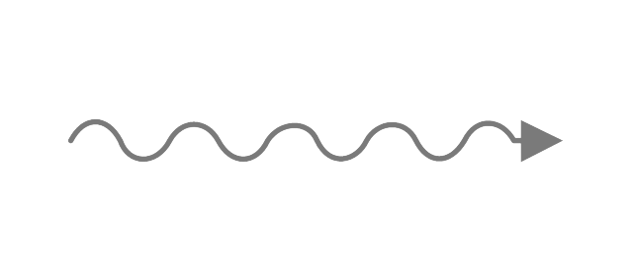
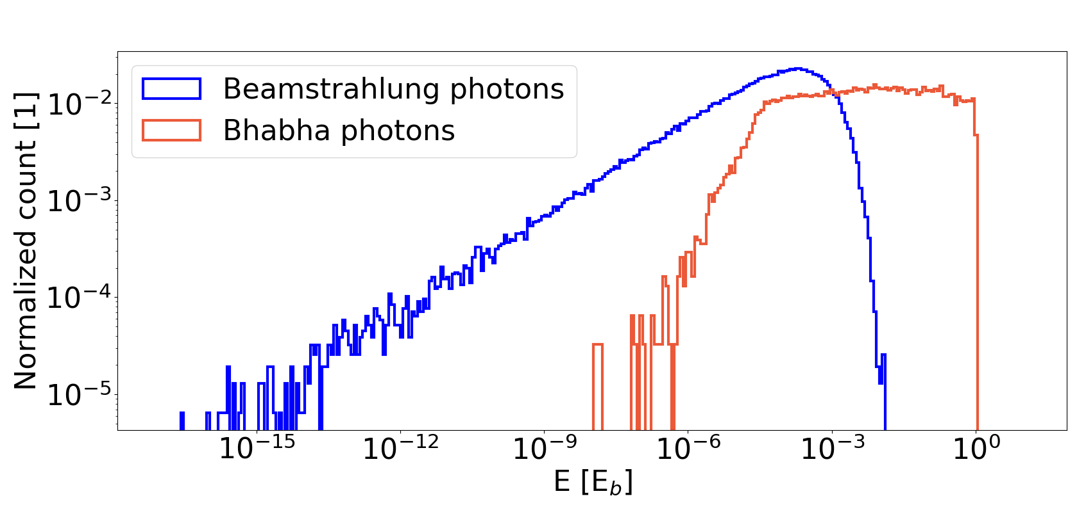




Radiation at FCC-ee collisions
Incoherent
Radiative Bhabha
scattering
Deflection in field of
single particle of opposite bunch
Collective
Beamstrahlung
Deflection in collective
field of opposite bunch
Radiation particle losses
lifetimes:
BS ~100 min
BH ~30 min
Notes:
1 min
During beambeam collisions at the FCC-ee, the particles can undergo radiation. Bhabha scattering is an incoherent effect and it is when a beam particle deflects due to the Coulomb field of another beam particle of the opposite bunch. Beamstrahlung is a collective effect, in this case the beam particle is deflected due to the collective EM field of the opposite bunch.
Both mechanisms can result in the emission of photons. On the plot you see an energy spectrum for these. Photons from Bhabha scattering are more rare than from beamstrahlung but they have typically a larger energy. The energy loss carried away by these photons leads to particle losses and therefore they also result in the decrease of luminosity. In the FCC-ee these mainly two types of radiation determine the beam lifetime.

Slide 7
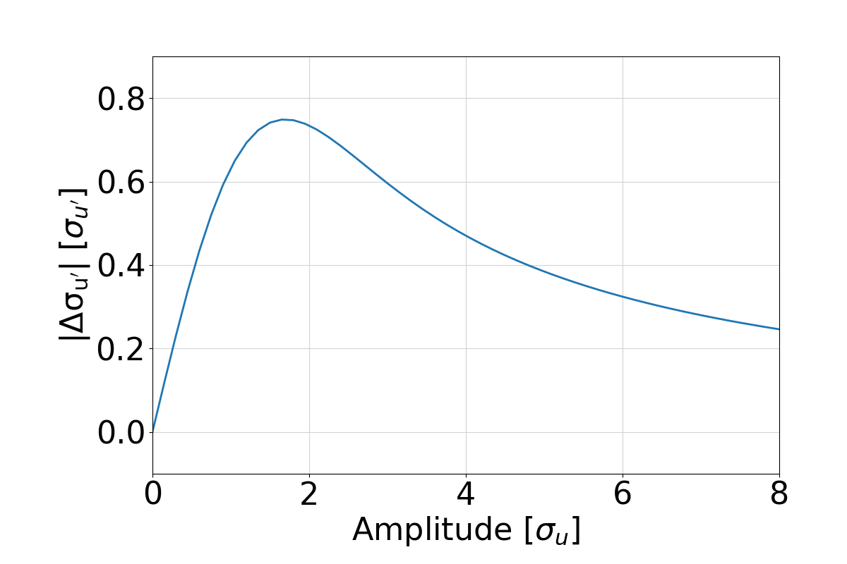

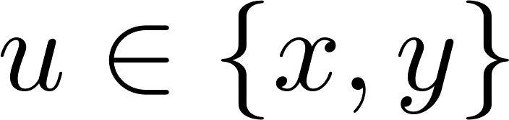
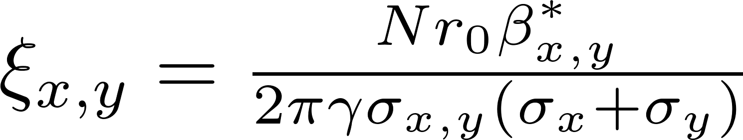
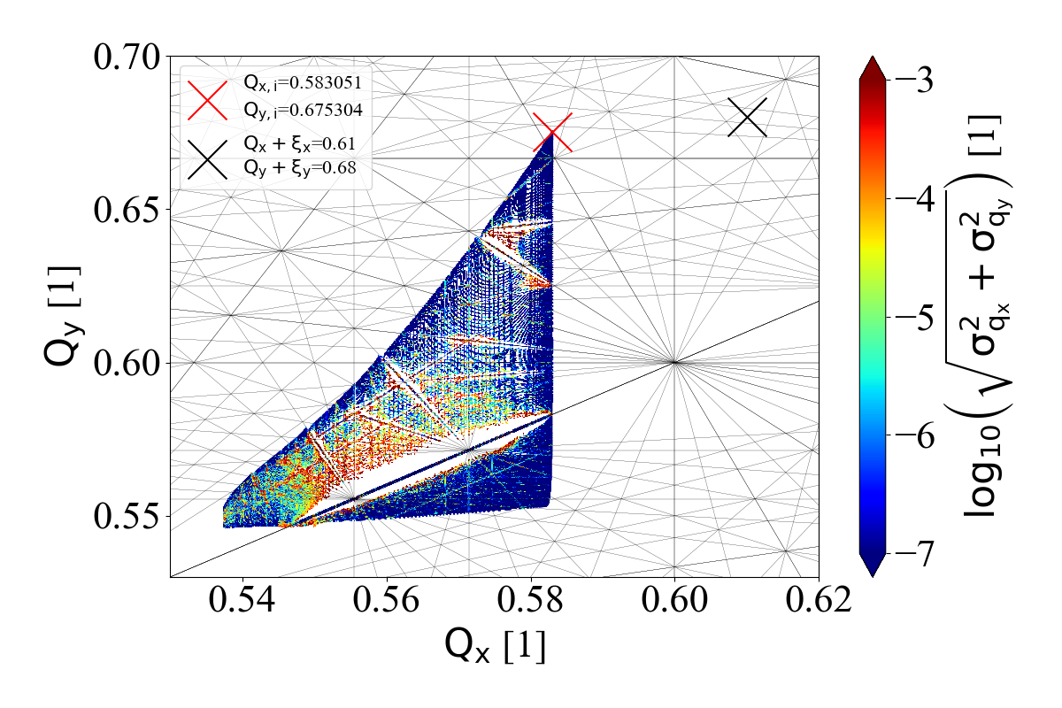
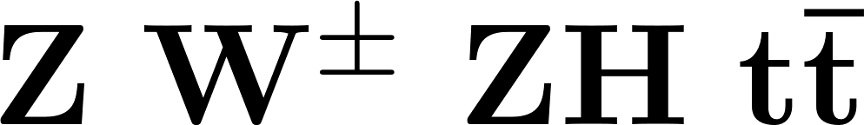
Beam-beam force
High lumi strong beam-beam force
Consolidation...
Radiation (synchrotron radiation, beamstrahlung, Bhabha)
IP tuning & feedback
Beam asymmetries
Top-up injection
linear model
w/o radiation
Notes:
Optmizations of the machine for high luminosity have already done for the 4 IP baseline design. High lumi implies a strong bb force which can be characterized by the xi. We want to consolidate these previous estimates on lumi and lifetimes with more detailed models using simulatons of radiation, IP tuning, topup and, beam asymmetries, so these are the studies that i will highlight in this preso.
Beambeam collisions at the FCC-ee cause an amplitude dependent tune shift. The consequnece of this is that the beam will have a lartge tune footprint which potentially crosses many resonance lines which can be dangeorus for the beam stability.

Slide 8
8
Tools
 | Weak-strong 6D | Quasi-strong-strong 6D | Strong-strong 6D |  | Beamstrahlung | Bhabha-scattering | Transverse wakefields | Longitudinal wakefields | Linear tracking | Nonlinear tracking | Open source
GUINEA-PIG [3]
COMBI [4]
BBWS [5]
BBSS [6]
SCTR [7]
IBB [8]
LIFETRAC [9]
BeamBeam3D [10]
Xsuite [11]
Strong-strong 6D SG
Strong-strong 6D PIC
Quasi-strong-strong 6D
Longitudinal wakefields
Runs on GPU
Beamstrahlung
Transverse wakefields
Lattice tracking
Weak-strong 6D
Bhabha-scattering
Linear tracking
Open source
Different beam-beam codes exist, with different features
FCC-ee: self-consistent & fast modeling needed including many effects
Xsuite: development driven by needs for FCC-ee
G. Iadarola, talk @ this workshop
Available
Not available
Notes:
There exist several numerical tools to model the fccee beam-beam effects that are collected in this table. The columns show the various features that are important for the FCC-ee. You can see that each of them has different features but none is able to tick all the boxes. Therefore for many of these studies we are using xsuite, a general purpose beam dynamics simulation tool, developed at CERN by taking into account the simulation needs of the FCC-ee. There will be a dedicated talk on the xsuite beam-beam code development by gianni in this workshop.

Slide 9
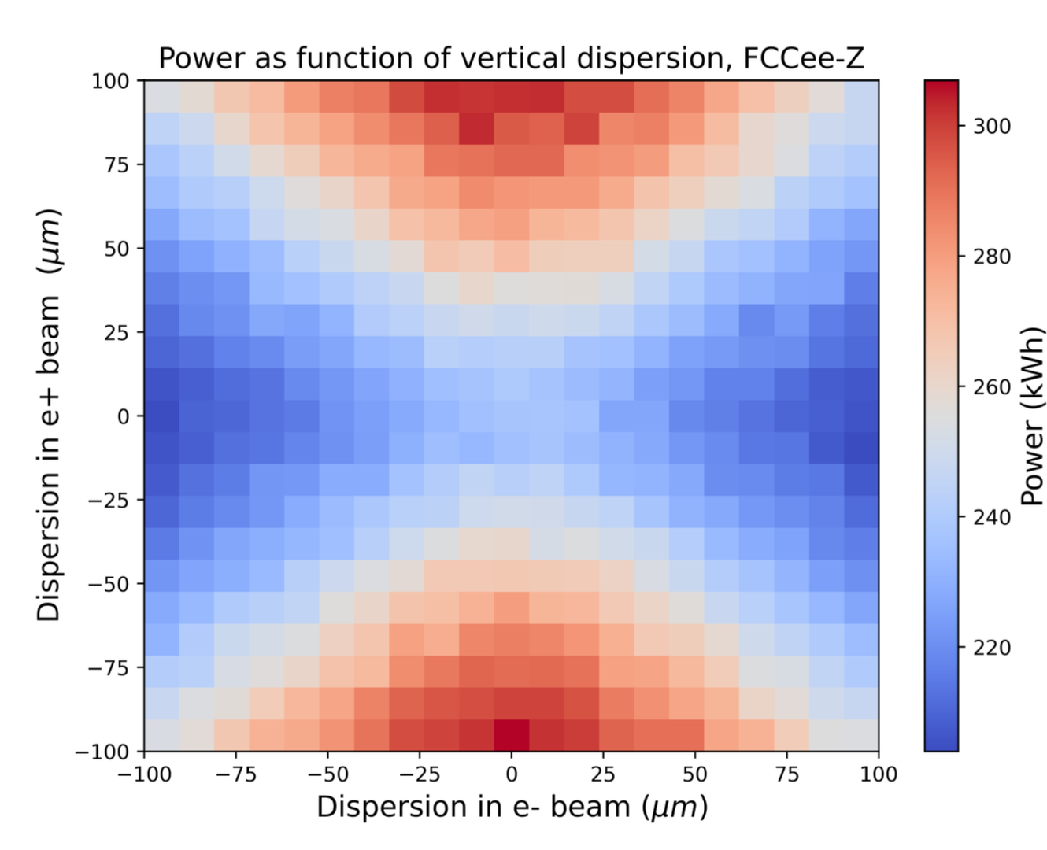
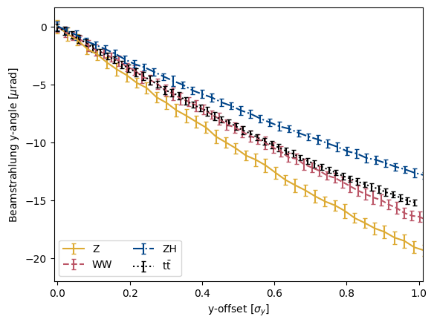
IP tuning & optimization
Design schemes to infer and correct for imperfections based on different signals (radiation, orbit measurements, ...)
Waist & dispersion shifts, beam offsets (fast IP feedback)
Using GUINEA-PIG (single passage), multiturn effects with Xsuite need to be considered
V. Gawas, talk @ this workshop
Notes:
In the following slides i want to show some highlights from ongoing beam-beam studies by our group. One important aspect is IP tuning and optimization. The motivation here is that we want the two beams of the fcc-ee to actually collide at the IP. We will have BMSs just before and after the IP but their precision for correcting the beam position at the IP is limited because of the small size of the beams. Therefore if the beam profile changes at the IP, we need a way to infer these changes directly at the IP for accurate correction. For this different approaches are being explored, for example to infer changes of luminosity from different radiation signals. For this various scans in the beam waist, and offset are performed using simulation tools like guineapig. guineapig is a single passage tool, but also we need information from multuturn tracking so for this xsuite simulations are being considered.

Slide 10
IP tuning & optimization
Xsuite, FCC ttbar
relaxed optics [12]
300 turns
1e5 macroparticles
Development of tuning knobs to vary beam configuration at the IP (waist)
  Determine whether optics can be relaxed for better performance (e.g. easier startup)
  Design experimental methods for waist correction based on luminosity
Larger sensitivity in luminosity for vertical but smaller in horizontal waist
Tests with machine errors in progress
Notes:
In xsuite, there is the possibility to do multiturn simulations with the full lattice model. There is an ongoing effort to add tuning knobs to the lattice model which can give us the desired beam distribution with a given offset or waist shift which allows us to perform these parameter scans mentioned on the previous slide. There are also tests going on which include machine errors and misalignments.
On this plot im showing the luminosity as a function of the horizontal or vertical waist shift.

Slide 11
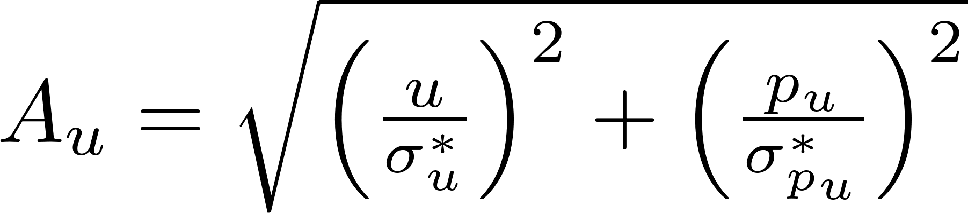
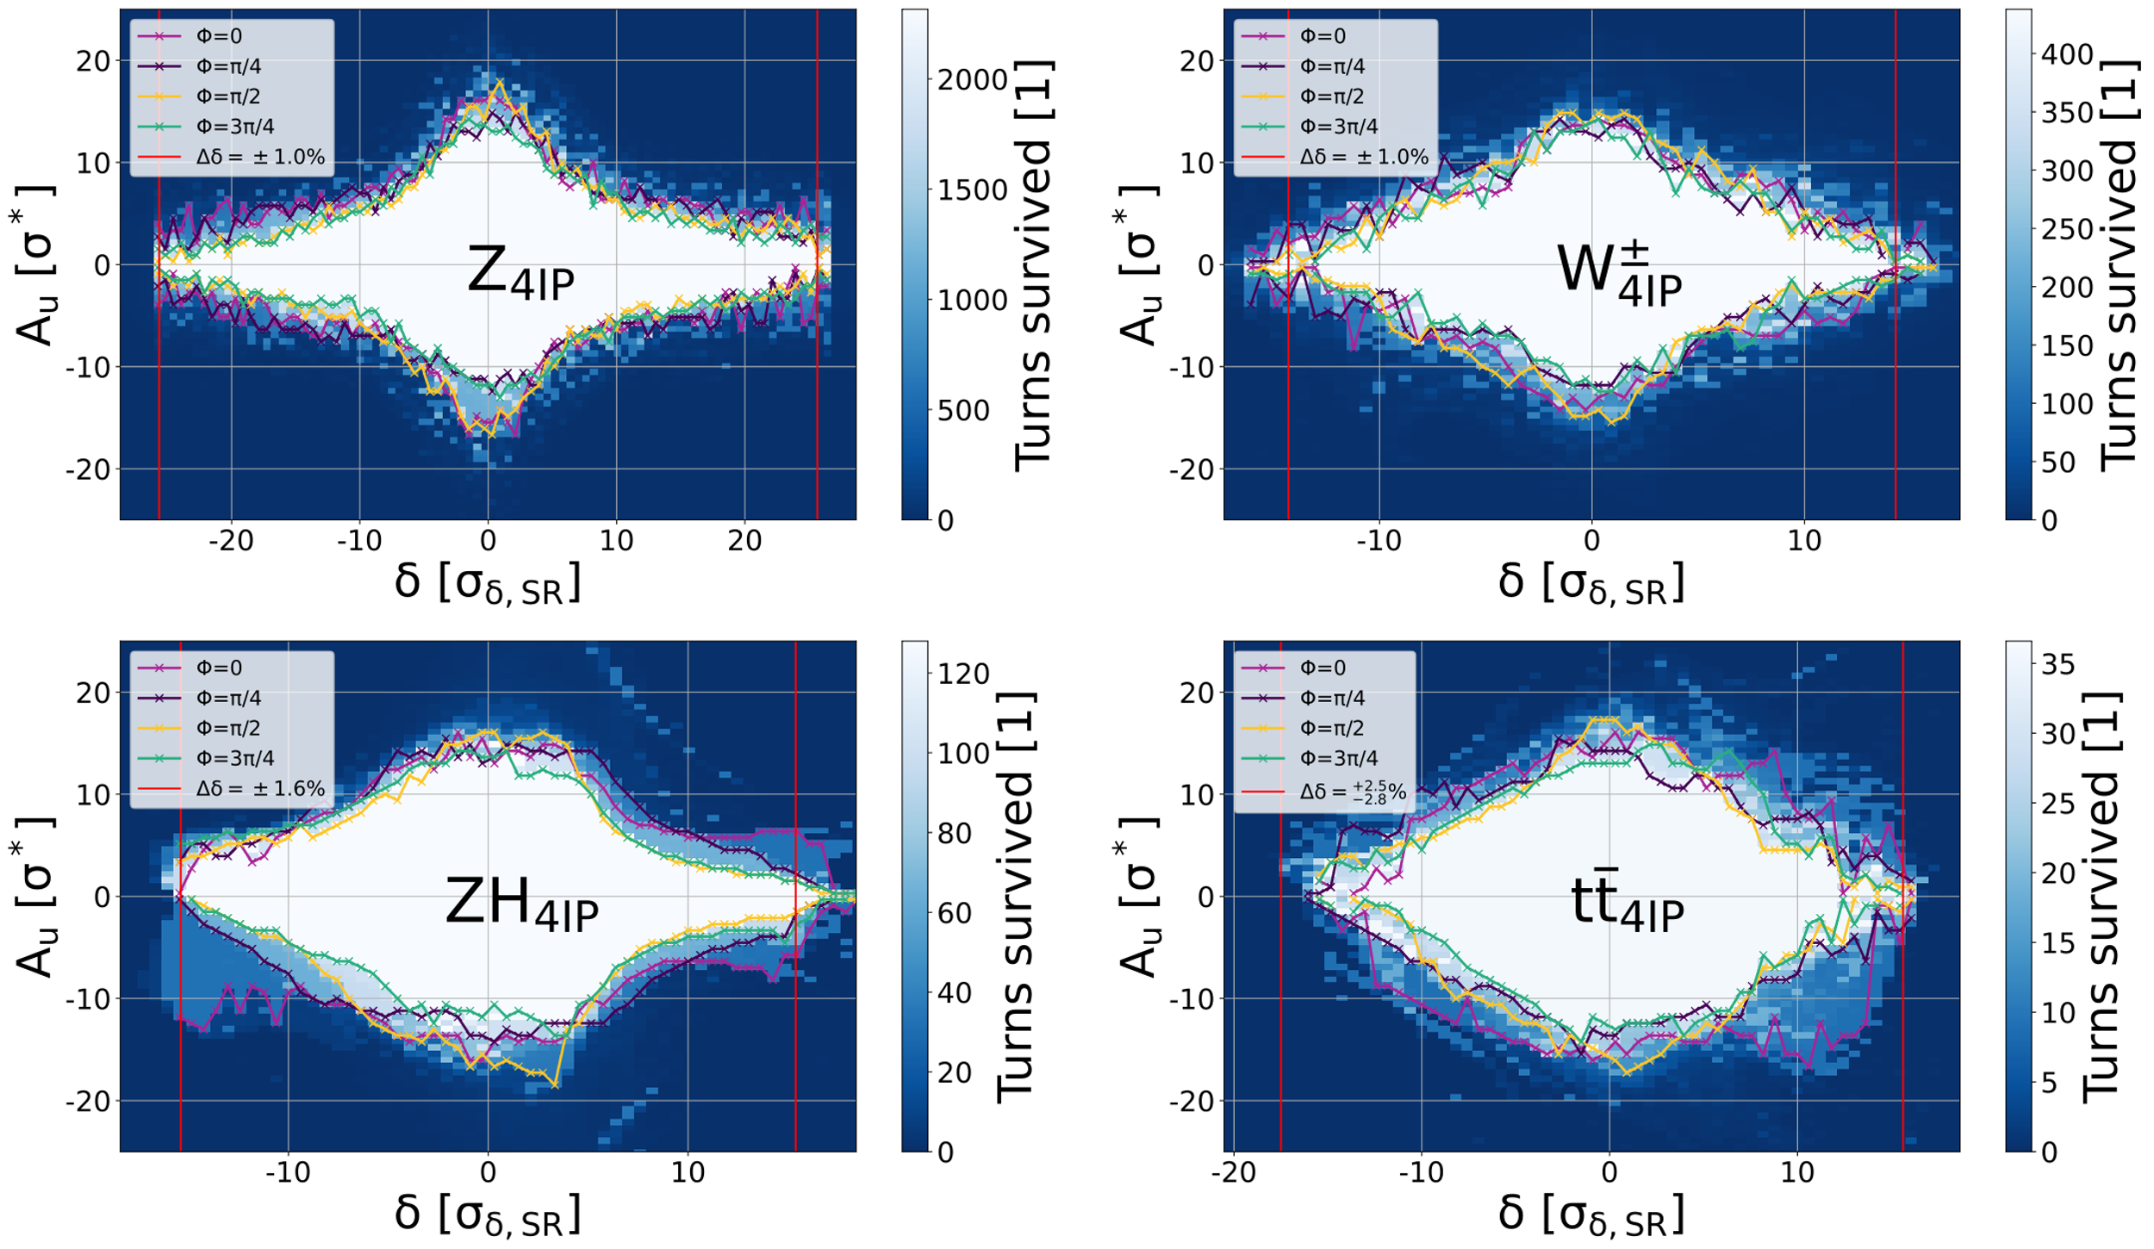
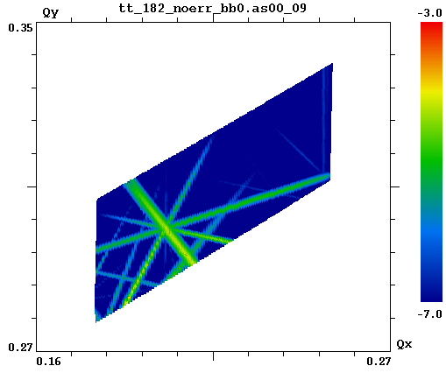
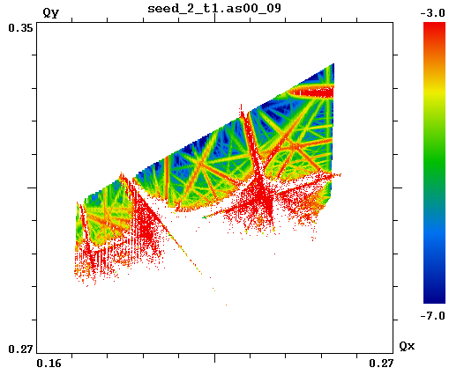
Dynamic aperture
w/o errors
Negligible reduction from beam-beam
Compares well with SAD results from K. Oide [13]
w/ errors & corrections
More lattice induced resonances are seen with beam-beam due to large amplitude detuning
Full lattice needs to be optimized with beam-beam included
Tools are ready, requires work with tuning working group to establish correction strategies
D. Shatilov [2]
L. van Riesen-Haupt, talk @ this workshop
Notes:
prefer to code slide xsuite all features
before it was not possible
The dynamic aperture of the fcc-ee has been simulated with SAD and Xsuite, including beambeam and it was found that without machine errors, beambeam has a negligible impact on the dynamic aperture.
Because of the beambeam kick, there will be a detuning of the beam at large amplitudes which results in a tune footprint that spans over many resonance lines in the tune space. When adding machine errors, these resonances enhance and potentially kill the beam, so it is crucial to do the machine optimizations with the beambeam included, because the tune footprint without beambeam is much smaller so optimizing the lattice without beambeam is not indicative of the final performance.

Slide 12
Top-up injection & asymmetry scans
Longitudinal top-up simulated with Xsuite
Perturbed bunch init. with 95% intensity
Track till equilibrium & top-up
Luminosity lower than in symmetric case (L₀) due to vertical blowup
  Should be avoided (e.g. working point optimization)
topup
0.95N₀
lower due to asymmetric setup
N₀
Evaluate asymmetries in emittance/beta leading to 50% vertical blowup
Derived coarse tolerances for machine tuning
  Some seem hard to reach e.g. for W
  Working point needs to be optimized
Notes:
relative change in emittance (relative to nominal zeta=1)
The currently preferred injection scheme for the fccee is longiduitnal topup where low intensity bunches are injected with high frequency with an offset in energy to merge with the stored beam. In such a setup there will always be an asymmetry in the bunch intensity of the 2 beams which can potentially trigger a blowup for one of the beams. For this Xsuite is a particularly useful tool because the injection process and the beam-beam can be simulated with the same tool. Here we simulated the longitudinal topup which is currently the preferred injection option. In this example we initialized the first beam at nominal parameters and the second with a bunch intensity 5% lower than nominal. Then we performed tracking with xsuite using a linear transfer map for the arc and the beam-beam and track till equilibrium, then topup the weak beam and track again till convergence. The plots on the right show the rms and luminosity evolution over the turns. The luminosity is normalized to the nominal value and here it is about 10% smaller because of the asymmetric setup. This should be taken into account in the machine design by appropriate working point optimization.
On the bottom i showing another highlight where we evaluated tolerances for machine tuning based on 50% vertical blowup of one of the beams. Some of these tolerances seem hard to reach in practice, such as for the W mode, which indicates that this mode needs to be further optimized.

Slide 13
Case study at the SuperKEKB
Beam-beam excites synchro-betatron resonances (collective [14], here single particle)
Interplay with longitudinal wakefield enhances amplitude dependent incoherent x-z resonance
  Impact on FCC-ee W [15]? (high Q_{s})
Successful Xsuite benchmarks against BBWS, BBSS, PyHEADTAIL
Crab-waist imperfections
Transverse impedance + beam-beam @ FCC-ee
SuperKEKB LER
linear tracking +
beam-beam
SuperKEKB LER
linear tracking +
beam-beam + longitudinal wake
D. Zhou, talk @ this workshop
R. Soos, talk @ this workshop
Notes:
The superkekb in japan is an ep collider therefore it serves as a good demonstrator for the fcc ee. We have performed studies in this context, using Xsuite. We looked at in particular a synchrobetatron resonance driven by the interplay of beambeam and longitudinal wakefields in the machine. We performed a tune scan that you can see on the right. The top plot shows the equilibrium horizontal rms as a function of the longitudinal amplitude and tune, in a linear tracking model with bemabeam. The bottom plot is when we add longitudinal wakefeields to the model. You can see that the peak becomes broader and there is an amplitude dependence of the tune shift. This study is a successsful benchmark of the xsuite software against other tools. There will be a talk from Roxana in this conference on impedance + beambeam at the FCC-ee.
potential impact at W, sb res close to working point from oides plot, migh hve to change wp

Slide 14
Summary
Work so far
Xsuite beam-beam model developed:
  Benchmarked against other codes GUINEA-PIG, BBWS, BBSS, PyHEADTAIL, COMBI, BBBREM, SAD, MAD-X
  Tools are ready to combine beam-beam + lattice / IP + errors & tuning
  Consolidated tolerances for asymmetries (bunch intensity, emittance, beta)
Lots of work still ahead...
Errors & misalignments + beam-beam: needed for realistic estimates
Parameter optimization of FCC-ee W
IP tuning with multiturn tracking
Beam-beam + transverse impedances
Thank you!
Notes:
With this i have come to my summary. We have developed the Xsuite beambeam model and benchmarked it against several other codes. We have already performed many physics studies but there is still much work to do.
For example we want to add errors and misalignments for realistic luminosity estimates. We need to optimize the W working pojnt. There are ongoing studies for ip tuning with multiturn tracking, beambeam + impedances

Slide 15
References
  [1] D. Shatilov, https://cds.cern.ch/record/2816655/files/9999999_30-41.pdf
  [2] D. Shatilov, FCC Week 2022 https://indico.cern.ch/event/1064327/contributions/4893272/
  [3] D. Schulte https://cds.cern.ch/record/331845/files/shulte.pdf
  [4] T. Pieloni, W. Herr https://accelconf.web.cern.ch/p05/PAPERS/TPAT078.PDF
  [5] K. Ohmi https://indico.cern.ch/event/438918/contributions/1085290/attachments/1147002/ 1644777/BenchBBcodes.pdf
  [6] K. Ohmi https://oraweb.cern.ch/pls/hhh/code_website.disp_code?code_name=BBSS
  [7] K. Ohmi https://indico.cern.ch/event/1398060/contributions/5876155/attachments/2831376/4947208/Beam-beamFCCee_ohmi.pdf
  [8] Y. Zhang https://journals.aps.org/prab/pdf/10.1103/PhysRevAccelBeams.23.104402
  [9] D. Shatilov http://cds.cern.ch/record/1120233/files/p65.pdf
  [10] J. Qiang https://amac.lbl.gov/~jiqiang/BeamBeam3D/
  [11] Xsuite 10.18429/JACoW-HB2023-TUA2I1
  [12] L. van Riesen-Haupt https://www.jacow.org/ipac2024/pdf/WEPR04.pdf
  [13] K. Oide, FCC-ee Collider Optics
  https://indico.cern.ch/event/1202105/contributions/5408583/attachments/2659051/4608141/FCCWeek_Optics_Oide_230606.pdf
  [14] K. Ohmi https://journals.aps.org/prl/pdf/10.1103/PhysRevLett.119.134801
  [15] K. Oide, FCC Week 2024, https://indico.cern.ch/event/1298458/contributions/5977859/attachments/2873388/5034194/Optics_Oide_240611.pdf

Slide 16
backup

Slide 17
Simulation parameters
Slide # | 11 | 12/upper | 12/lower | 13
Machine setup | FCC 4 IP baseline | FCC 4 IP baseline, W | FCC 4 IP baseline | SuperKEKB LER
Lattice model | nonlinear | linear | linear | linear
Beam-beam model | weak-strong | 1st part: quasi-strong-strong (f_{update}=100), 2nd part: strong-strong | quasi-strong-strong (f_{update}=100) | strong-strong
# slices in beam-beam | 100 (200 for Z) | 100 | 100 (200 for Z) | 100
# macroparticles | 4e4 | 1e5 | 1e5 (1e6 for Z) | 1e5
# turns | 2x SR damping time | 2e4 | 1e4 (Z, W), 5e3 (H, T) | 2e4

Slide 18
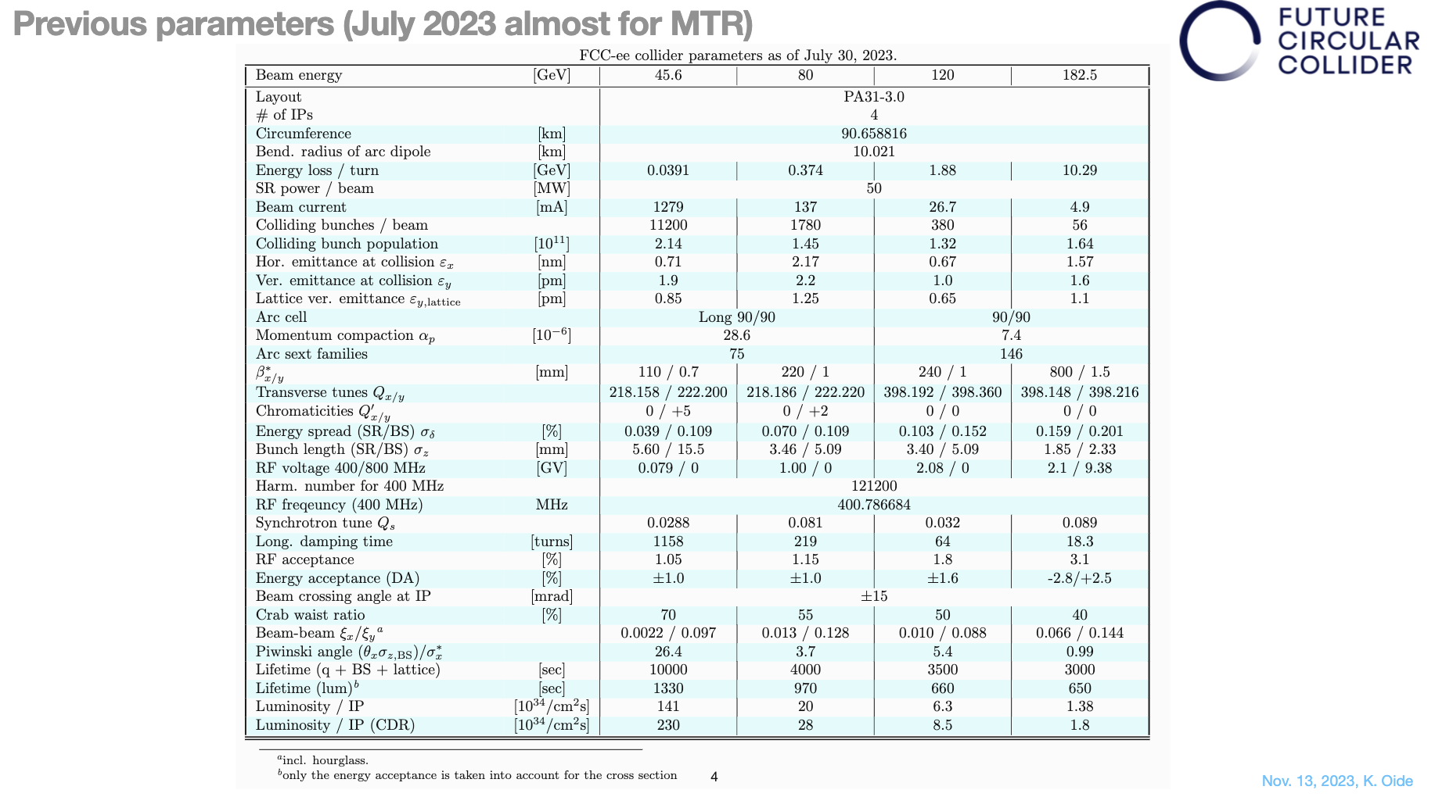

Slide 19
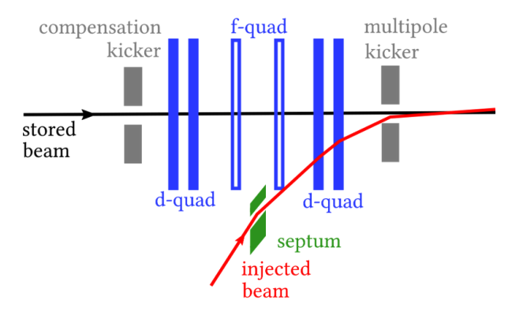
Top-up injection
  Maintains luminosity levels & compensates for decreased beam lifetime
  Single booster feeds both beams
Longitudinal top-up simulated with Xsuite
Perturbed bunch init. with 95% intensity
Track till equilibrium & top-up
Luminosity lower than in symmetric case (L₀)
  This reduction cannot be avoided
  but currently not taken into account in design
0.95N₀
lower due to
asymmetric setup
N₀

Slide 20
Simplified tracking simulations with Xsuite
  First studies with 2 IP baseline from CDR
  Recent studies with 4 IP design
  Xsuite tracking setup:
    1 IP + tracking over arc superperiod
    with linear transfer matrix
    Arc split into 3 segments
    2 crab sextupoles between arc segments (β_{x}=3 m, β_{y}=500 m)
    Each iteration begins in front of the right sextupole
      Observation point for coordinates
    Synchrotron radiation (damping+noise) in arc, beamstrahlung+bhabha scattering in beam-beam element
IP + BS | lin. arc | sext. | lin. arc + SR | sext. | lin. arc
START
repeat
Notes:
1 min
Next I will explain our tracking setup in xsuite. In our first studies we used the baseline FCC setup which has 2 Ips, but in our newer studies we switched to the more recent 4IP design. In any case the tracking setup contains one 1 ip followed by a linear transfer map representing a half or a quarter ring, depending on the setup.
The arc is split into 3 segments and 2 sextupoles are inserted between the segments to implement the crab waist scheme.
Then each tracking iteration begins in front of the right sextupole and this point is chosen of observation of the beam coordinates.
The synchrotron radiation is implemented by an effective model of the damping and gaussian noise for quanctum excitation in the middle arc element and at the ip in the beambeam element we have the option to simulate beamstrahlung or bhabha scattering.

Slide 21
Dynamic aperture with beam-beam

Slide 22
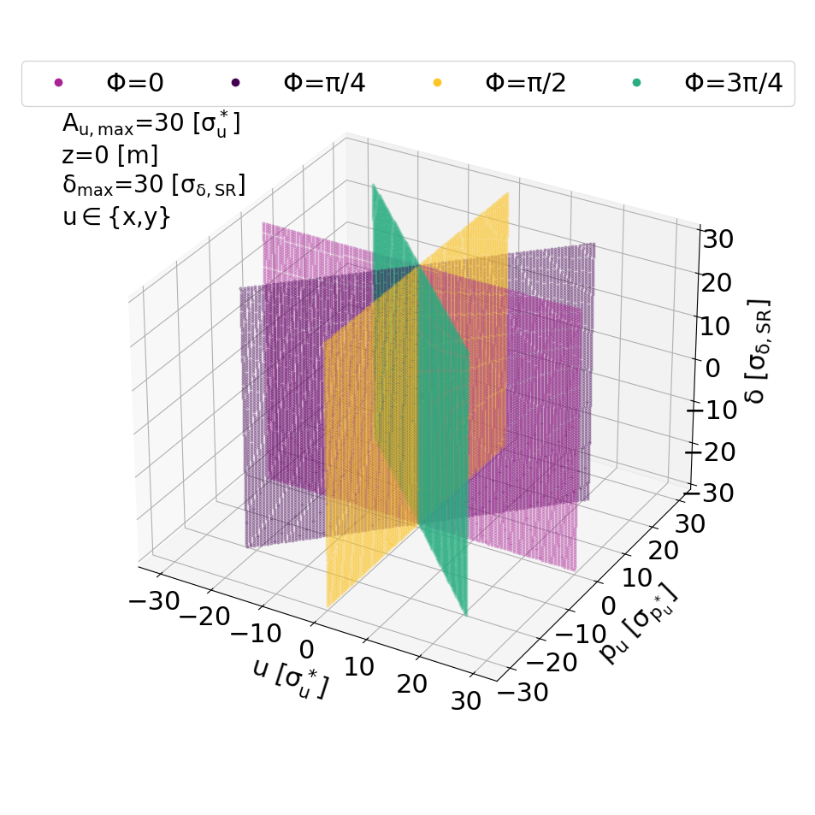
Dynamic aperture test grid

Slide 23
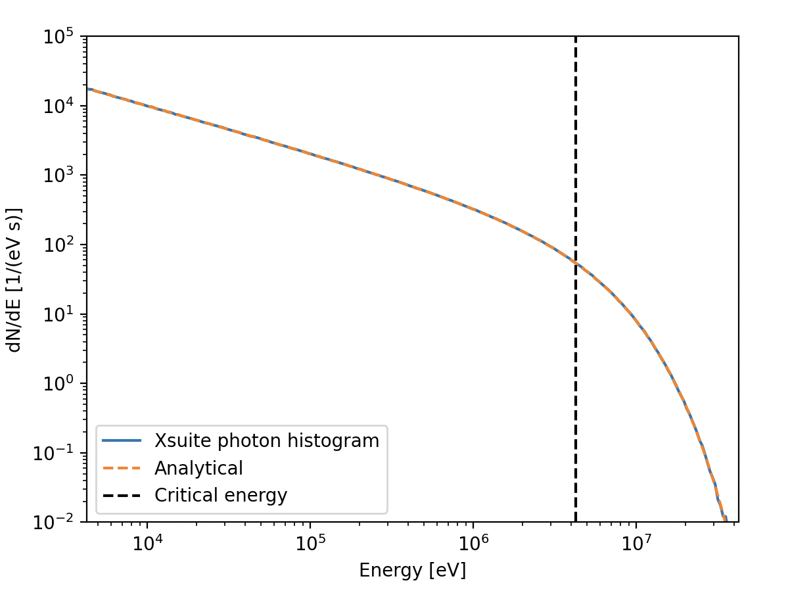
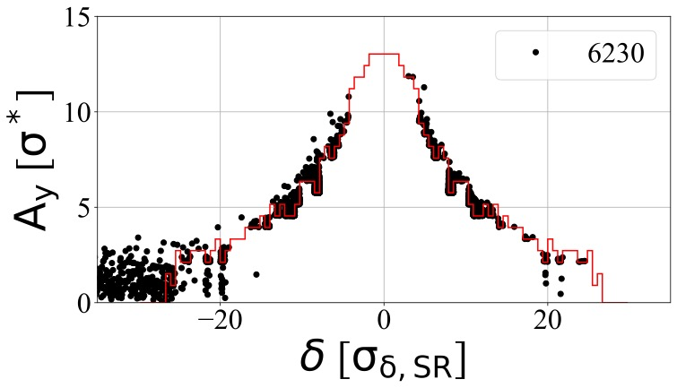
Benchmarking radiation in Xsuite
Several benchmarks
  Synchrotron radiation with MAD-X and SAD
  Optics, orbit, energy with and without errors
  Quantum excitation and damping
  Equilibrium emittance w/ vertical wiggler
  Tracking and matrix methods
  Bhabha + beamstrahlung lifetimes
  Issue with synchrotron radiation loss rate resolved
?
Bhabha
Notes:
Another branch of ongoing effotrs is the benchmarking of the radiation models in Xsuite in the context of the fcc-ee. Several studies have been performed, for exmaple of the synchrotron radiation model of Xsuite with comparisons to mad and sad, or the benchmarking of the vertical emittances by the insertion of speical wigglers, or the benchmarking of beam lifetimes which are dominated by beamstrahlung and radiative bhabha scattering. In the overall lifetime a there is a discrepancy between results obtained with SAD and Xsuite which is currently under invesitagion.

Slide 24
Beam lifetime
Bhabha lifetimes simulated & compare well to reference estimates (GUINEA-PIG + BBBREM)

Slide 25
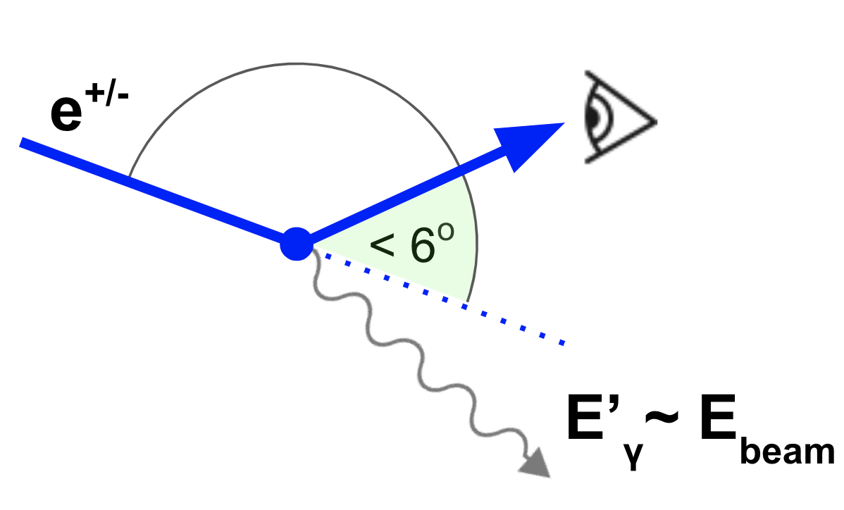
Small angle Bhabha scattering
Dominated by t-channel (scattering) process
luminosity in lepton colliders
primary particles lost within a turn
Main limitation of FCC-ee beam lifetime (alongside beamstrahlung)

Slide 26
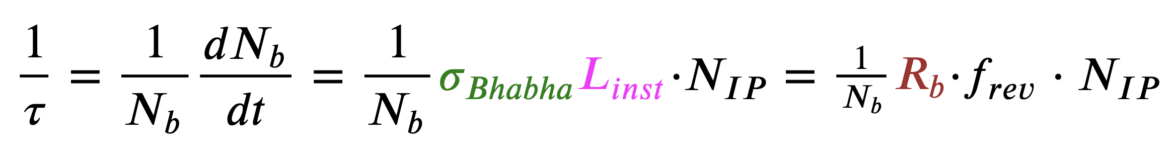
Bhabha lifetimes
τ: Bhabha lifetime [s]
N_{b}: bunch intensity [1]
σ_{Bhabha}: Bhabha cross section [m^2]
N_{IP}: number of Ips [1]
L_{inst}=L*f_{rev}: instantaneous lumi of 1 bunch crossing [m^-2 s^-1]
L: integrated lumi of a single collision (luminosity per bunch crossing) [m^-2]
f_{rev}: revolution frequency [s^-1]
R_{b}= σ_{Bhabha}*L: number of emitted Bhabha photons with E above mom. acceptance [1]

Slide 27
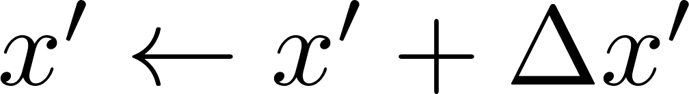
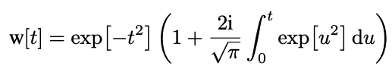

Beam-beam in Xsuite
  Lorentz transform into head-on frame
  Longitudinal slicing
  Beam-beam kick in soft-Gaussian approximation [4]
Notes:
1 min
In Xsuite we model the collision of two bunches at a time. We have a collision with a crossing angle and first we perform a lorentz boost and a rotation to move to a head-on frame where the description of the EM potential is easier.
Then we slice the bunches longitudinally and slide them across each other in discrete steps. At each step there will be a number of slices from bunch 1 overlapping with bunch 2. For these overlapping slices we compute the statistical moments and apply the beambeam kick on the particles of the opposite slice.
This beambeam kick is computed using the so called soft Gaussian approximation, which assumes a Gaussian transverse beam profile. This is a fast and accurate way of getting the force but it is valid only for Gaussian bunches. You can see the formula for the soft-gaussian kick. In red you see that it uses the statistical moments of the opposite slice. In blue I denoted the coordinates of a single particle that interacts with hte slice. The w is the complex error function.

Slide 28
Beam-beam in Xsuite
Multiturn tracking
t
IP | arc | IP | arc | IP ...
Faster & less accurate
...
Weak-Strong
(WS)
Quasi-Strong-Strong (QSS)
...
FCC-ee
Strong-Strong
(SS)
(e.g. f_{update}= 2)
...
Slower & more accurate
: untracked bunch
with fixed moments
: bunch slice with
macroparticles
: soft-Gaussian kick
: compute statistical
moments of slice
Notes:
2 min
Next i will try to demonstrate in graphically how a single collision is simulated in xsuite. Lets take for example a simple setup wherre each bunch is sliced into 2 longitudinal slices. Then we have 3 steps in time, as the bunches pass through each other. In the code we can perform the beambeam interaction in 3 ways.
In the weak-strong approximation we track only one beam and the other beam is frozen. For this frozen bunch we input the statistical moments of the slices manually and they stay hardcoded for the whole simulation. The particles of the other beam are just passed through these slices and at every step the soft-Gaussian kick is applied. For multiturn tracking it would look like this on this simplified drawing.
The second model is the quasi strong strong. In this one we track both beams and at he beginning of the collision we compute the statistical moments of each slice of both beams. Then we use these moments in the soft-gaussian kick. In multiturn tracking this will look something like this. The frequency of recomputing the moments can be varied depending on the simulation.
The third model is the strong-strong where we recompute the moments before each timestep to model the variation of the beambeam force within a single collision.
In general there is a speed versus accuracy tradeoff between the models. The weakstrong model is the fastest but the least accurate, and the strongsterong is the most realistic but slowest. The best choice to use depends on the instability and the beam configuration we want to study. In general for the FCC-ee the quasi strong strong model is an optimal choice.

Slide 29
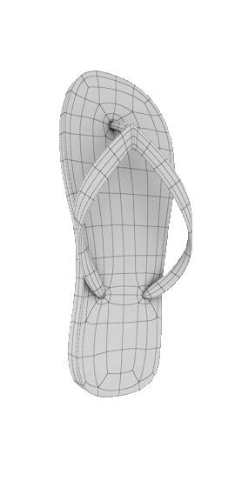
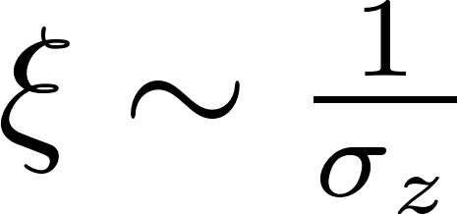
Flip-flop
Flip-flop instability (1D) observed in other colliders (VEPP-2000)
For FCC-ee: 3D flip-flop - direct consequence of beamstrahlung, triggered by an initial asymmetry in bunch intensity
Inflation of one bunch beam loss
Above a threshold ξ₀ longitudinal blowup drives transverse diffusion 3D flip-flop
Relevant for FCC-ee top-up injection
Slightly less populated bunch: N_{b}-ΔN
Undergoes more intense beamstrahlung
Bunch length increases
Undergoes even more Beamstrahlung
Bunch length increases even more
ξ < ξ
Slightly more populated bunch: N_{b}+ΔN
Undergoes less intense beamstrahlung
Bunch length decreases
Undergoes even less Beamstrahlung
Bunch length decreases even more
“weak bunch”
N_{b}-ΔN
ξ < ξ
“strong bunch”
N_{b}+ΔN
Notes:
2 min
The flipflop instability it the blowup of one bunch and the while the other bunch shrinks or remains unchanged. It has been observed in previous machines like veep where this effect is 1D caused by the nonlinear dynamics.
In the fcce flip flop has been observed in simulations and here it is a direct consequence of BS. It is triggered by an initial small asymmetry in the bunch intensities and this initial perturbation determines which of the bunches will blow up. The bunch intensity is directly related to the intensity of beamstrahlung.
So when we have a collision with a slight asymmetry in the charge. The bunch which experiences a stronger beambeam force from the other beam will undergo more beamstrahlung so its bunch length will increase while the bunch which undergoes a slightly less beamstrahlung than the equilibrium will experience a reduction of the bunch length.
Since we collide with a crossing angle, the beambeam force will depend on the bunch length. Therefore the now shorter bunch will exert an even stronger beambeam force on the other bunch so that will undergo an even stronger BS and the cycle repeats. This process eventually leads to the inflation of one bunch which will lose particles. It is called 3D flipflop because above a certain threshold in the strnegth of the beambeam force, the change of the bunch length is coupled to the change of the transverse beam sizes. So the beam which blows up longitudinally will also experience a transverse blowup.
This effect hasnt been studied before FCC but with the fcc it is open question whether this dynamics is triggered during the topup injection of the machine, where a small intensity bunch is injected and merged with the higher intensity stored bunch. So now that we have the tools it is very important to study this mechanism in this context.

Slide 30
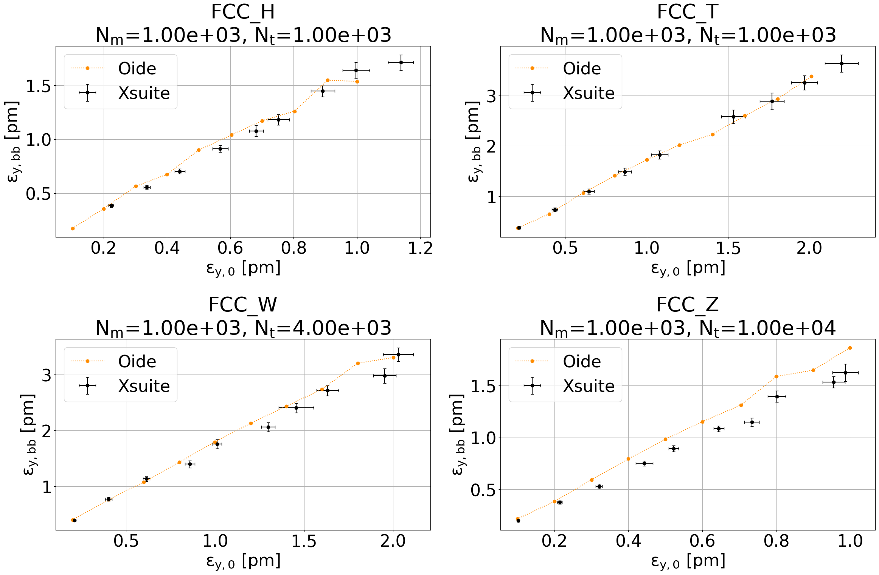
Vertical emittance
w/ beam-beam
+beamstrahlung
Xsuite tracking
error bars:
stat. of last 2500 turns
Reference data
by K. Oide
full lattice
Independent benchmarks with SAD & Xsuite
Good agreement

Slide 31
Workflow for emittance scan – everything in Xsuite
Prepare Xtrack line once:
Loop over a range of ε_{y} values:
load MAD-X sequence
load Xtrack line
...
add observation point @ RF
add beam-beam element (optional)
add wigglers
convert to Xtrack line
build + twiss 4D
build
twiss 6D mean synrad + tapering
set quantum synrad
build + twiss 4D
match ε_{y}
track
slice sequence
twiss 6D mean synrad + tapering
repeat with next ε_{y}
build + twiss 4D
save Xtrack line
...

