Slide 1

Challenges and Research Status of Beam-Beam Effects in the EicC in China
Jie Liu, on behalf of the EicC Design Group
Institute of Modern Physics, Chinese Academy of Sciences
ICFA mini workshop: Beam-Beam Effects in CircularColliders BB24
EPFL, Lausanne, Switzerland, 2/9/2024~5/9/2024

Slide 2
Contents
Overview of EicC Facility
Ion and Electron Accelerators
Challenges & Status of BB Research
Summary

Slide 3
1. Overview of EicC Facility – Goals
Accelerator Facility Goals Raised by Scientific Goals
Center-of-Mass (CM) Energy
The most optimized CM energy is 16.76 GeV, and several specific points in the range of 12 ~ 23 GeV in e-p collisions
Luminosity
In e-p collisions, peak luminosity > 4.0×10³³ cm⁻²s⁻¹ @ 16.76 GeV，while integral luminosity > 100 fb⁻¹/y @ 80%
Polarization
Average polarization of e > 80%, while average polarization of p > 70%, and polarized D & ³He²⁺ should be provided
Collision Regions
In e-A collisions, the possible CM energy is limited by the maximum $Bρ$
In e-A collisions, the possible CM energy is limited by the maximum 𝑩𝝆
In e-A collisions, peak lumi. ~ 1.0×10³³ cm⁻²s⁻¹，while integral lumi. ~ 20 fb⁻¹/y @ 80%
At interaction point, e ~ longitudinal p ~ arbitrary
High-luminosity mode and quasi-full-acceptance mode by only one set of magnets
Two interaction points (IPs) ~ one is employed while the other is reserved for upgrading
Spin flip

Slide 4

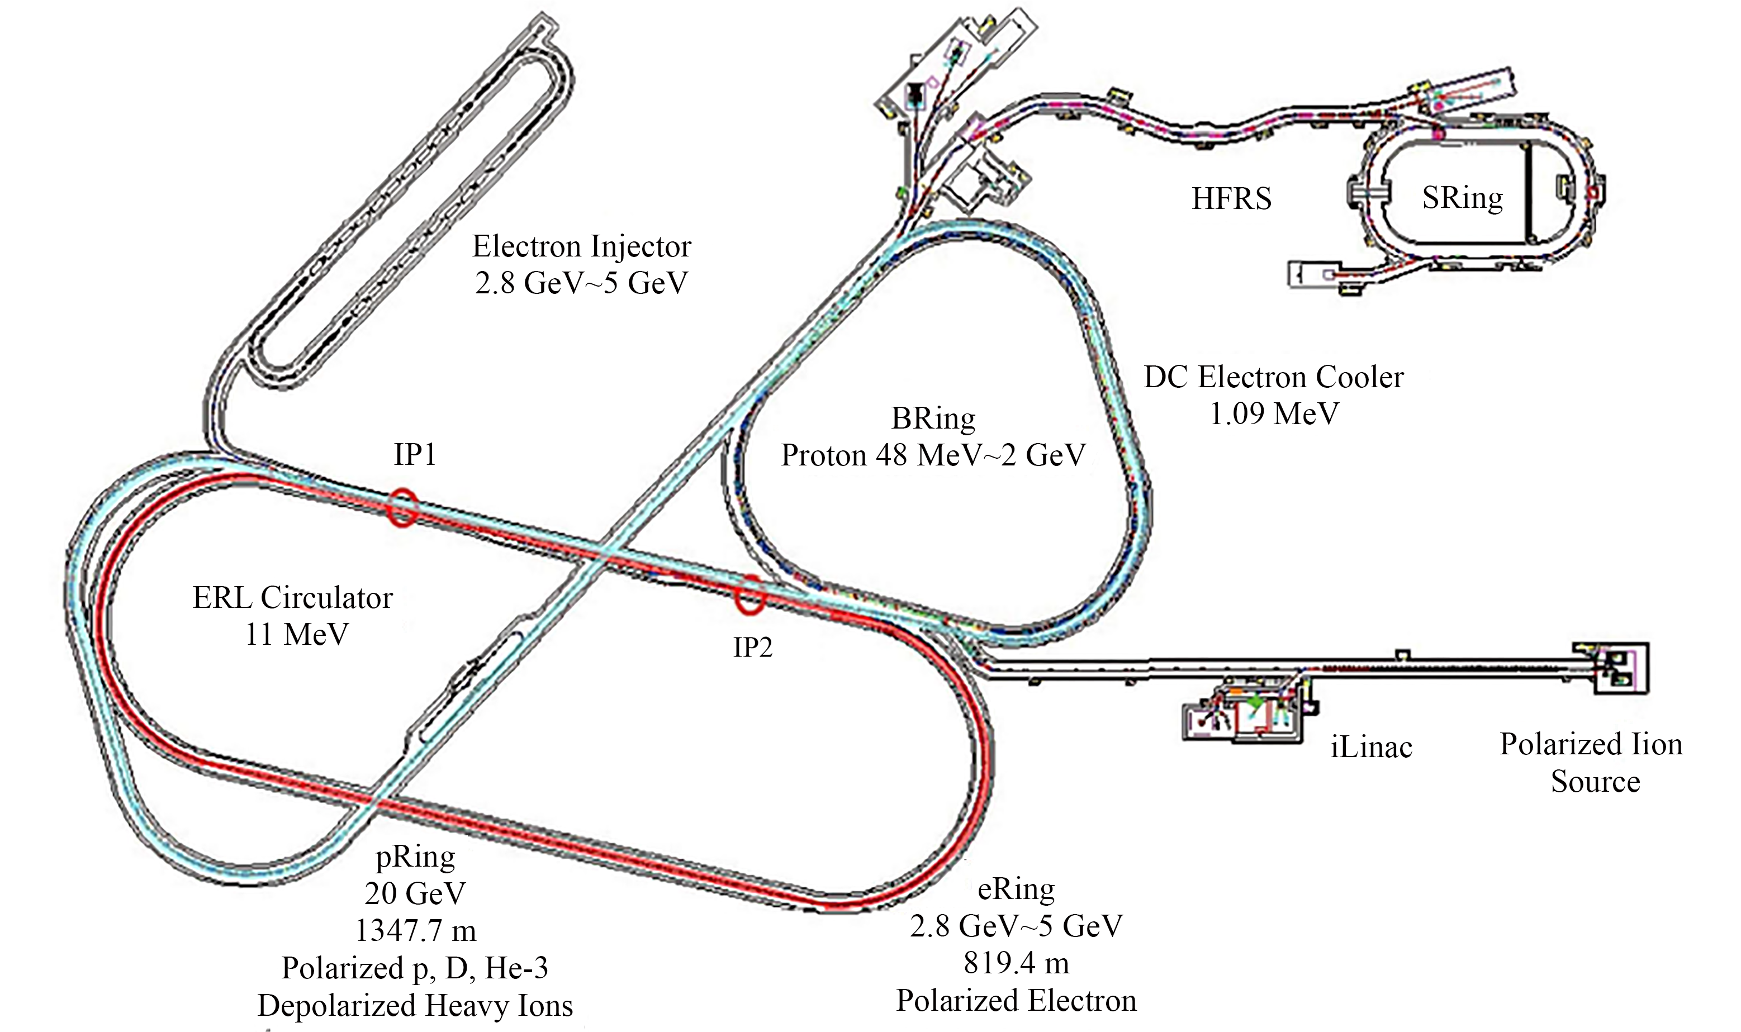
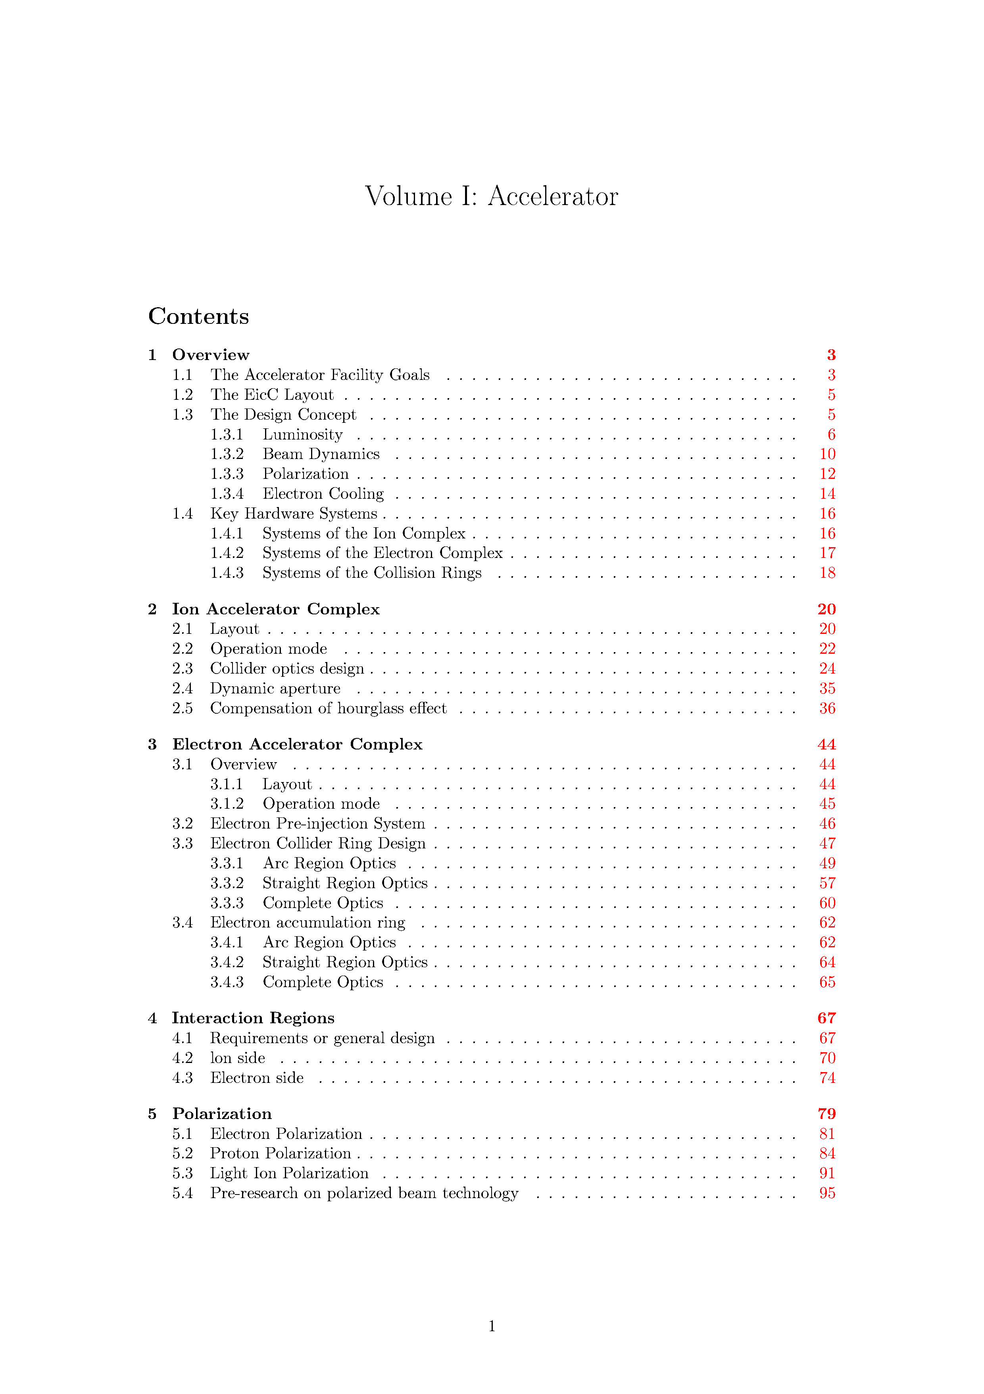
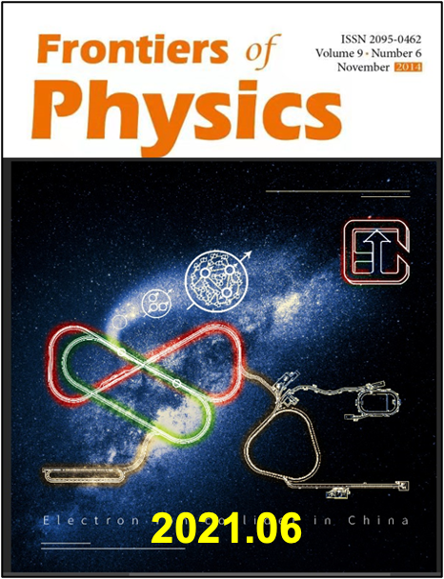
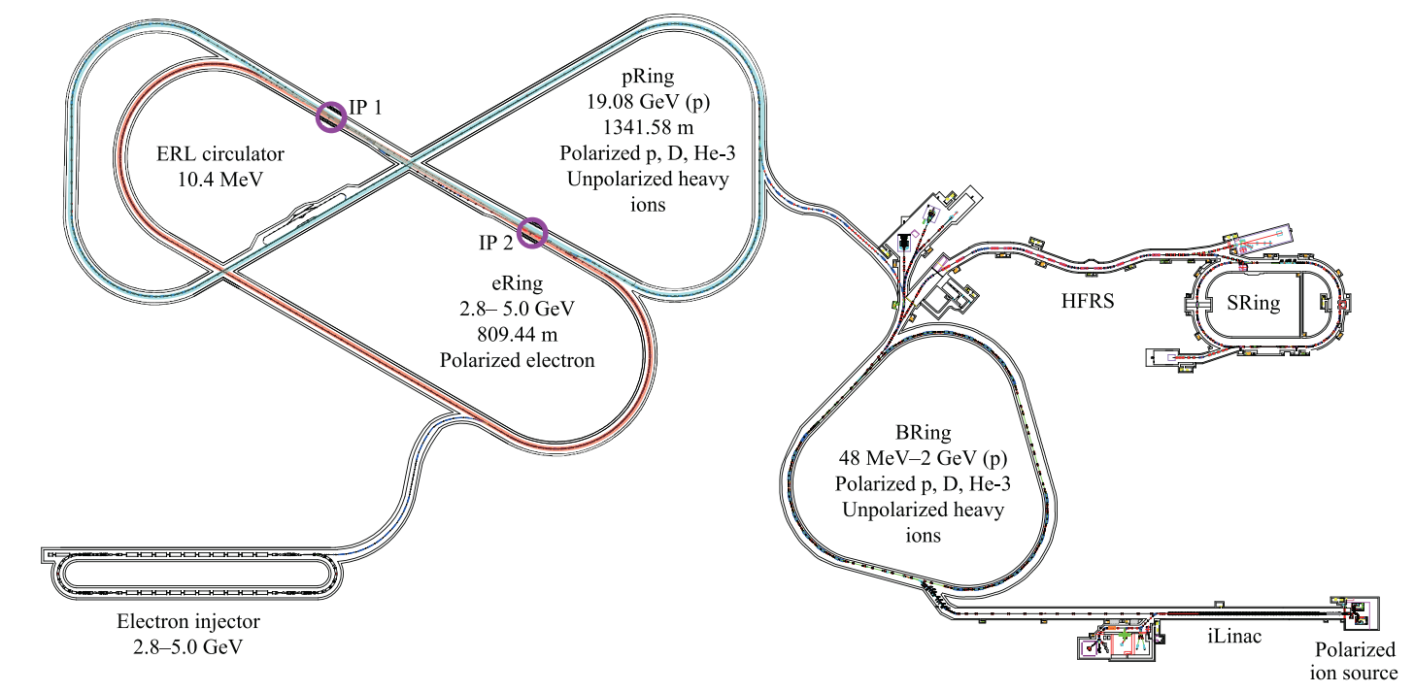
1. Overview of EicC Facility – Designs
To meet beam dynamics challenges and fully utilize HIAF & HIAF-U, a new EicC design is proposed
EicC CDR
Based on HIAF
~ End of 2024

Slide 5
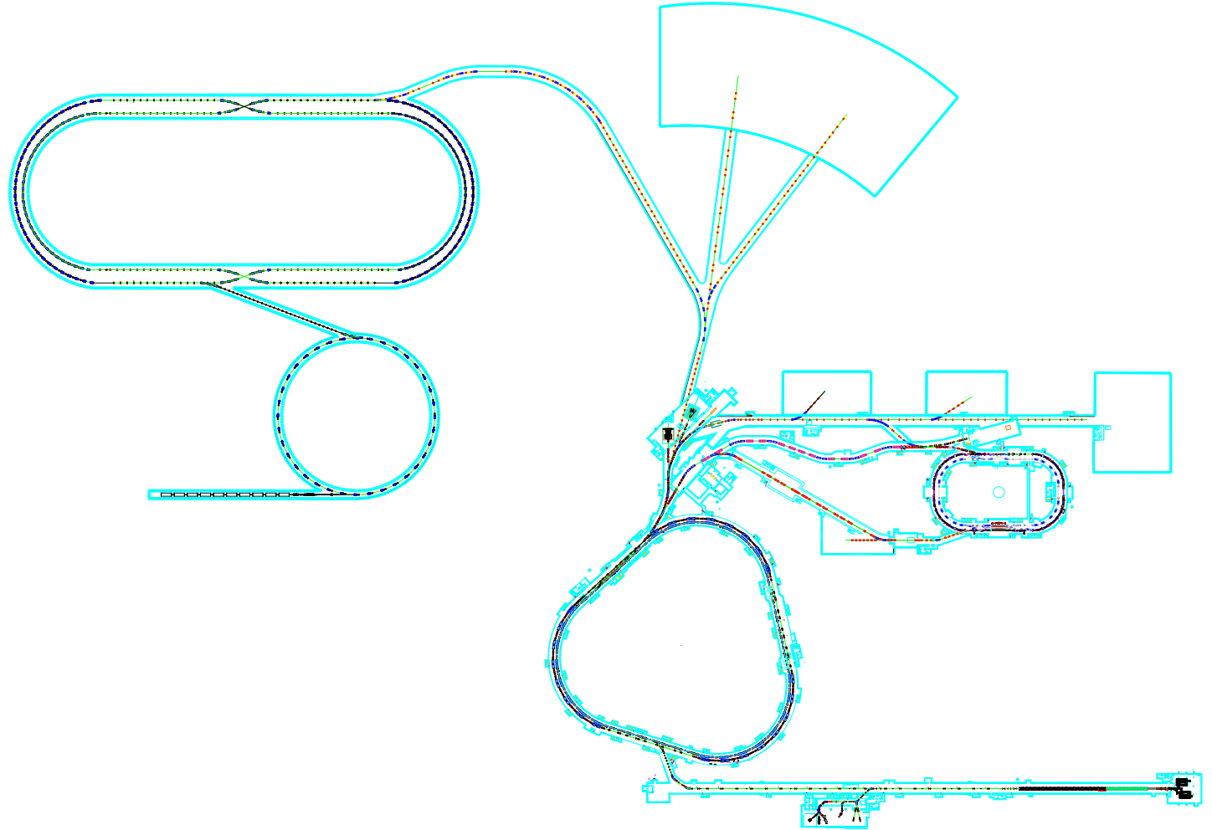
1. Overview of EicC Facility – Layout
• Same collision bunch numbers • Two IPs • Swap-out injection
EicC
HIAF & HIAF-U
Electron Collision Ring (eRing) ~ 1151.20 m
Proton & ion Collision Ring (pRing) ~ 1149.81 m
Based on the upgraded HIAF – HIAF-U
From proton to uranium with collision energy
Electron Accumulation & Acceleration Ring (AR) ~ 287.80 m ～ 2.8 GeV – 5 GeV
Electron Source (eSource)
Electron Linac (eLinac) ～ 300 – 500MeV
Normal Booster Ring (BRing-N) ~ 569.10 m ~ p 9.3 GeV
Superconducting Booster Ring (BRing-S) ~ 574.54 m ~ p 24.85 GeV
To fully utilize the powerful HIAF & HIAF-U facility to achieve high performance and largely reduce cost
Ion Source (iSource)
Ion Linac (iLinac) ~ p 200 MeV

Slide 6
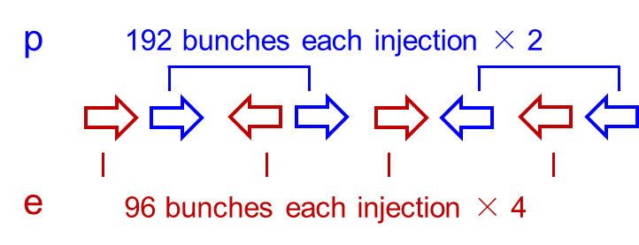
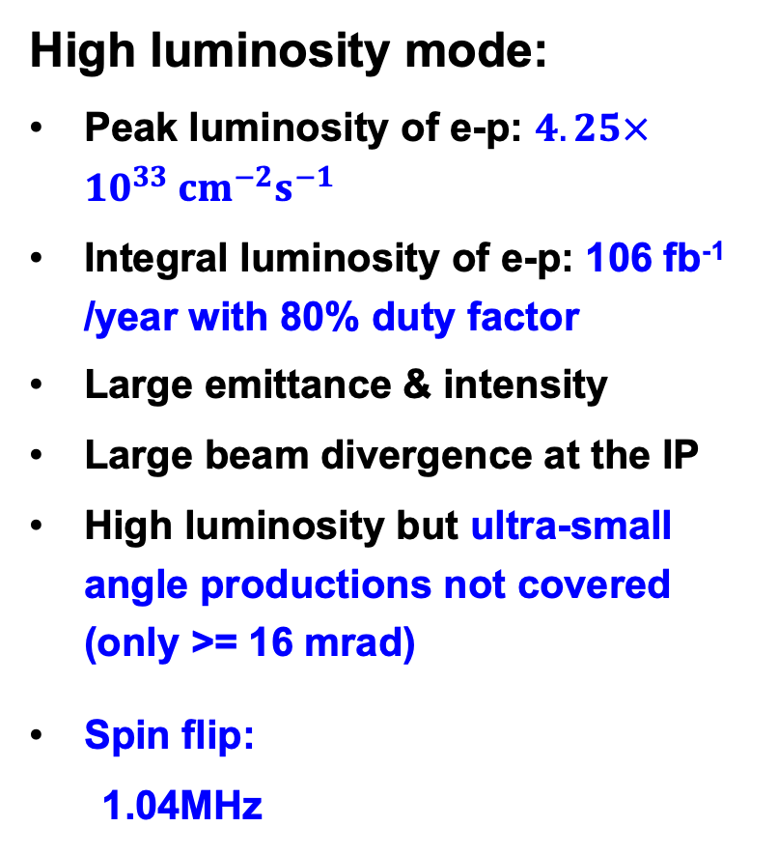
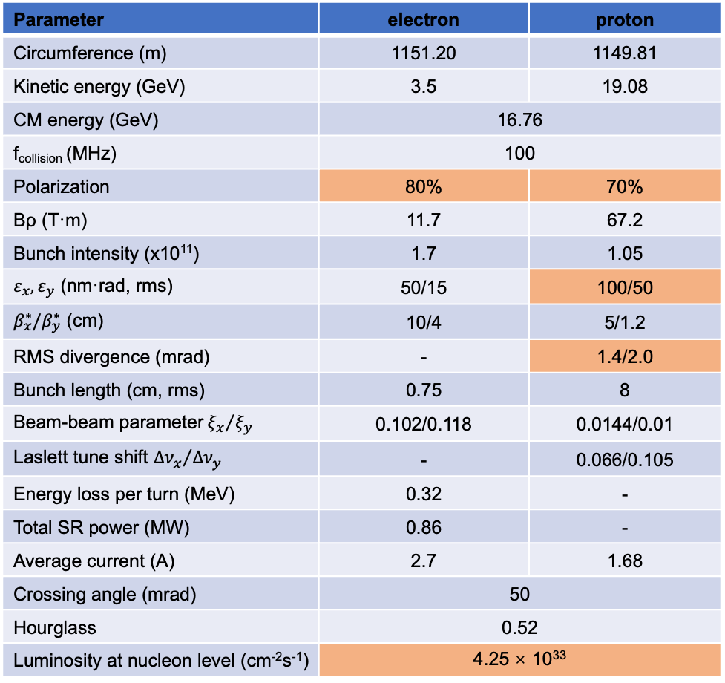
1. Overview of EicC Facility – Main Parameters
Parameter | electron | proton
Circumference (m) | 1151.20 | 1149.81
Kinetic energy (GeV) | 3.5 | 19.08
CM energy (GeV) | 16.76
f_{collision} (MHz) | 100
Polarization | 80% | 70%
Bρ (T·m) | 11.7 | 67.2
Bunch intensity (x10¹¹) | 1.7 | 1.05
$ε_{x},ε_{y}$ (nm·rad, rms) | 50/15 | 100/50
$β_{x}^{∗}/β_{y}^{∗}$ (cm) | 10/4 | 5/1.2
RMS divergence (mrad) | - | 1.4/2.0
Bunch length (cm, rms) | 0.75 | 8
Beam-beam parameter${ξ_{x}}/{ξ_{y}}$ | 0.102/0.118 | 0.0144/0.01
Laslett tune shift ${Δν_{x}}/{Δν_{y}}$ | - | 0.066/0.105
Energy loss per turn (MeV) | 0.32 | -
Total SR power (MW) | 0.86 | -
Average current (A) | 2.7 | 1.68
Crossing angle (mrad) | 50
Hourglass | 0.52
Luminosity at nucleon level (cm⁻²s⁻¹) | 4.25 × 10³³
High luminosity mode:
Peak luminosity of e-p: $4.25×10^{33} cm^{−2}s^{−1}$
Integral luminosity of e-p: 106 fb⁻¹ /year with 80% duty factor
Large emittance & intensity
Large beam divergence at the IP
High luminosity but ultra-small angle productions not covered (only >= 16 mrad)
Spin flip:
  1.04MHz

Slide 7
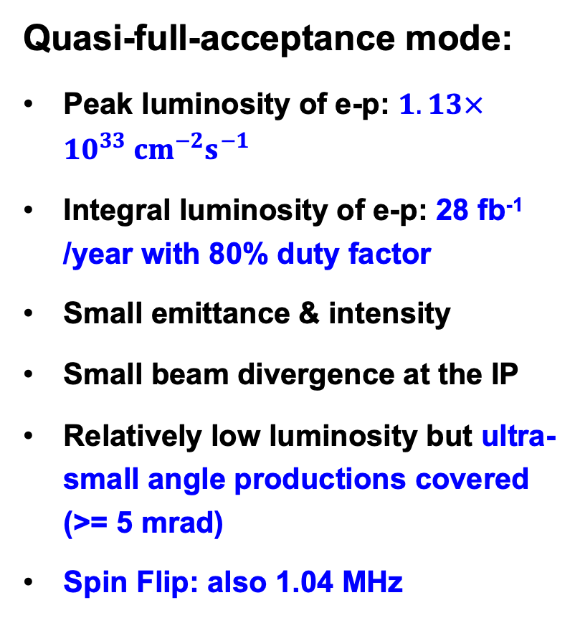
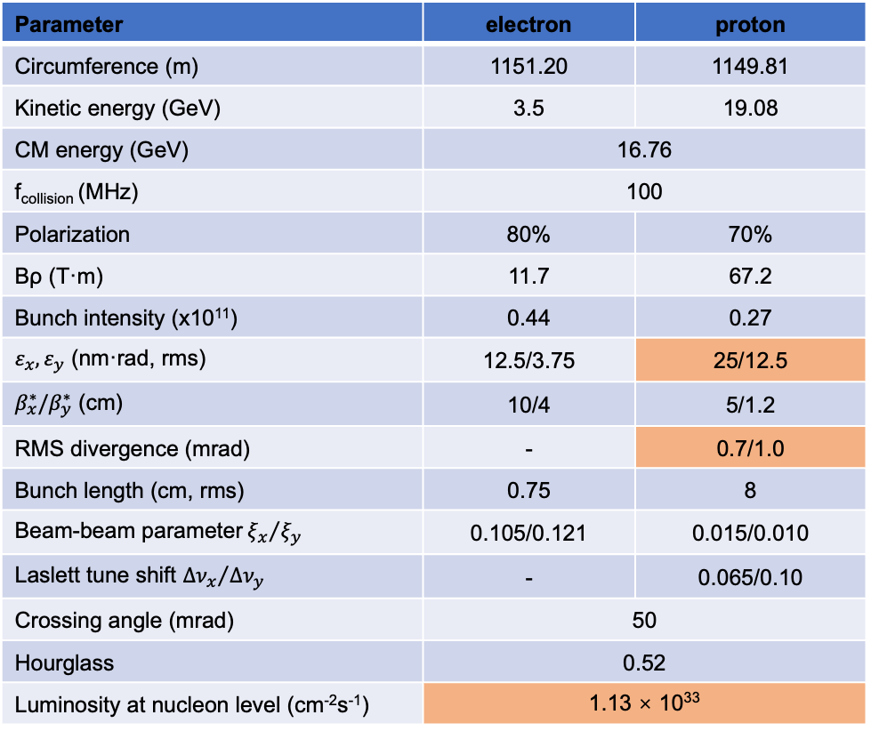
1. Overview of EicC Facility – Main Parameters
Parameter | electron | proton
Circumference (m) | 1151.20 | 1149.81
Kinetic energy (GeV) | 3.5 | 19.08
CM energy (GeV) | 16.76
f_{collision} (MHz) | 100
Polarization | 80% | 70%
Bρ (T·m) | 11.7 | 67.2
Bunch intensity (x10¹¹) | 0.44 | 0.27
$ε_{x},ε_{y}$ (nm·rad, rms) | 12.5/3.75 | 25/12.5
$β_{x}^{∗}/β_{y}^{∗}$ (cm) | 10/4 | 5/1.2
RMS divergence (mrad) | - | 0.7/1.0
Bunch length (cm, rms) | 0.75 | 8
Beam-beam parameter${ξ_{x}}/{ξ_{y}}$ | 0.105/0.121 | 0.015/0.010
Laslett tune shift ${Δν_{x}}/{Δν_{y}}$ | - | 0.065/0.10
Crossing angle (mrad) | 50
Hourglass | 0.52
Luminosity at nucleon level (cm⁻²s⁻¹) | 1.13 × 10³³
Quasi-full-acceptance mode:
Peak luminosity of e-p: $1.13×10^{33} cm^{−2}s^{−1}$
Integral luminosity of e-p: 28 fb⁻¹ /year with 80% duty factor
Small emittance & intensity
Small beam divergence at the IP
Relatively low luminosity but ultra-small angle productions covered (>= 5 mrad)
Spin Flip: also 1.04 MHz

Slide 8
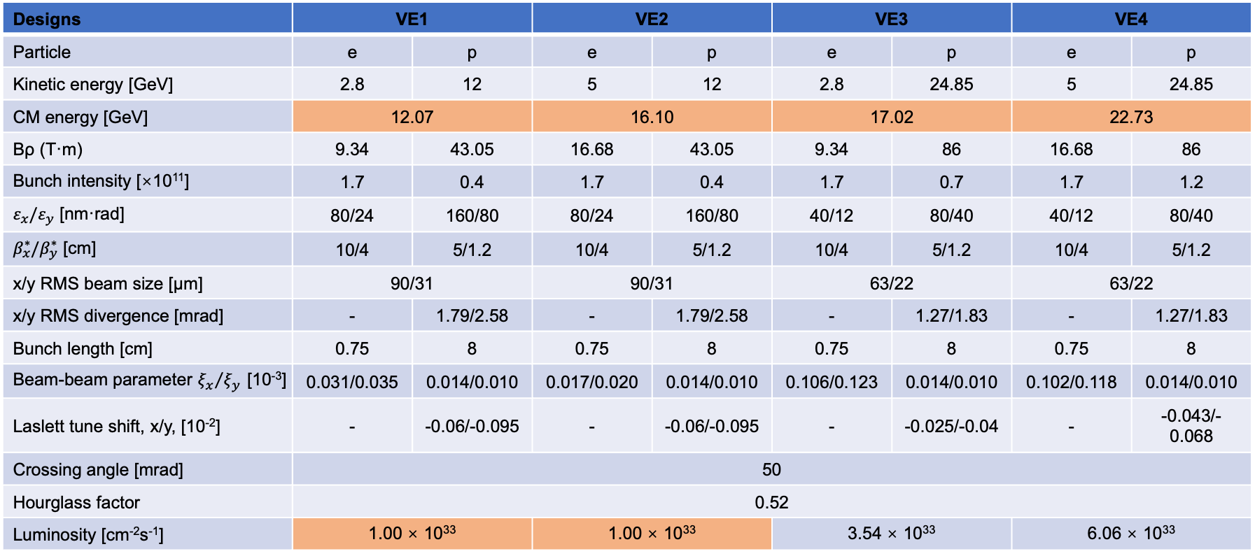
1. Overview of EicC Facility – Main Parameters
4 e-p energy points in 12 ~ 23 GeV, peak luminosity >= $1×10^{33} cm^{−2}s^{−1}$
Designs | VE1 |  | VE2 |  | VE3 |  | VE4
Particle | e | p | e | p | e | p | e | p
Kinetic energy [GeV] | 2.8 | 12 | 5 | 12 | 2.8 | 24.85 | 5 | 24.85
CM energy [GeV] | 12.07 |  | 16.10 |  | 17.02 |  | 22.73
Bρ (T·m) | 9.34 | 43.05 | 16.68 | 43.05 | 9.34 | 86 | 16.68 | 86
Bunch intensity [×10¹¹] | 1.7 | 0.4 | 1.7 | 0.4 | 1.7 | 0.7 | 1.7 | 1.2
$ε_{x}/ε_{y}$ [nm·rad] | 80/24 | 160/80 | 80/24 | 160/80 | 40/12 | 80/40 | 40/12 | 80/40
$β_{x}^{∗}/β_{y}^{∗}$ [cm] | 10/4 | 5/1.2 | 10/4 | 5/1.2 | 10/4 | 5/1.2 | 10/4 | 5/1.2
x/y RMS beam size [μm] | 90/31 |  | 90/31 |  | 63/22 |  | 63/22
x/y RMS divergence [mrad] | - | 1.79/2.58 | - | 1.79/2.58 | - | 1.27/1.83 | - | 1.27/1.83
Bunch length [cm] | 0.75 | 8 | 0.75 | 8 | 0.75 | 8 | 0.75 | 8
Beam-beam parameter${ξ_{x}}/{ξ_{y}}$ [10⁻³] | 0.031/0.035 | 0.014/0.010 | 0.017/0.020 | 0.014/0.010 | 0.106/0.123 | 0.014/0.010 | 0.102/0.118 | 0.014/0.010
Laslett tune shift, x/y, [10⁻²] | - | -0.06/-0.095 | - | -0.06/-0.095 | - | -0.025/-0.04 | - | -0.043/-0.068
Crossing angle [mrad] | 50
Hourglass factor | 0.52
Luminosity [cm⁻²s⁻¹] | 1.00 × 10³³ |  | 1.00 × 10³³ |  | 3.54 × 10³³ |  | 6.06 × 10³³

Slide 9
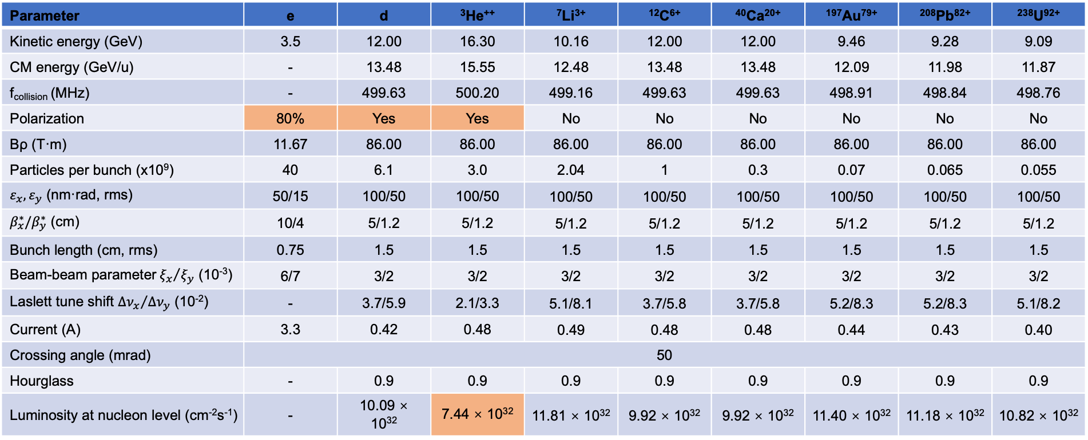
1. Overview of EicC Facility – Main Parameters
e-A collisions up to e-U, and D & ³He²⁺ beams are polarized, integral luminosity >= 18.6 fb⁻¹/year
Parameter | e | d | ³He⁺⁺ | ⁷Li³⁺ | ¹²C⁶⁺ | ⁴⁰Ca²⁰⁺ | ¹⁹⁷Au⁷⁹⁺ | ²⁰⁸Pb⁸²⁺ | ²³⁸U⁹²⁺
Kinetic energy (GeV) | 3.5 | 12.00 | 16.30 | 10.16 | 12.00 | 12.00 | 9.46 | 9.28 | 9.09
CM energy (GeV/u) | - | 13.48 | 15.55 | 12.48 | 13.48 | 13.48 | 12.09 | 11.98 | 11.87
f_{collision} (MHz) | - | 499.63 | 500.20 | 499.16 | 499.63 | 499.63 | 498.91 | 498.84 | 498.76
Polarization | 80% | Yes | Yes | No | No | No | No | No | No
Bρ (T·m) | 11.67 | 86.00 | 86.00 | 86.00 | 86.00 | 86.00 | 86.00 | 86.00 | 86.00
Particles per bunch (x10⁹) | 40 | 6.1 | 3.0 | 2.04 | 1 | 0.3 | 0.07 | 0.065 | 0.055
$ε_{x},ε_{y}$ (nm·rad, rms) | 50/15 | 100/50 | 100/50 | 100/50 | 100/50 | 100/50 | 100/50 | 100/50 | 100/50
$β_{x}^{∗}/β_{y}^{∗}$ (cm) | 10/4 | 5/1.2 | 5/1.2 | 5/1.2 | 5/1.2 | 5/1.2 | 5/1.2 | 5/1.2 | 5/1.2
Bunch length (cm, rms) | 0.75 | 1.5 | 1.5 | 1.5 | 1.5 | 1.5 | 1.5 | 1.5 | 1.5
Beam-beam parameter${ξ_{x}}/{ξ_{y}}$ (10⁻³) | 6/7 | 3/2 | 3/2 | 3/2 | 3/2 | 3/2 | 3/2 | 3/2 | 3/2
Laslett tune shift ${Δν_{x}}/{Δν_{y}}$ (10⁻²) | - | 3.7/5.9 | 2.1/3.3 | 5.1/8.1 | 3.7/5.8 | 3.7/5.8 | 5.2/8.3 | 5.2/8.3 | 5.1/8.2
Current (A) | 3.3 | 0.42 | 0.48 | 0.49 | 0.48 | 0.48 | 0.44 | 0.43 | 0.40
Crossing angle (mrad) | 50
Hourglass | - | 0.9 | 0.9 | 0.9 | 0.9 | 0.9 | 0.9 | 0.9 | 0.9
Luminosity at nucleon level (cm⁻²s⁻¹) | - | 10.09 × 10³² | 7.44 × 10³² | 11.81 × 10³² | 9.92 × 10³² | 9.92 × 10³² | 11.40 × 10³² | 11.18 × 10³² | 10.82 × 10³²
Spin flip is also feasible

Slide 10
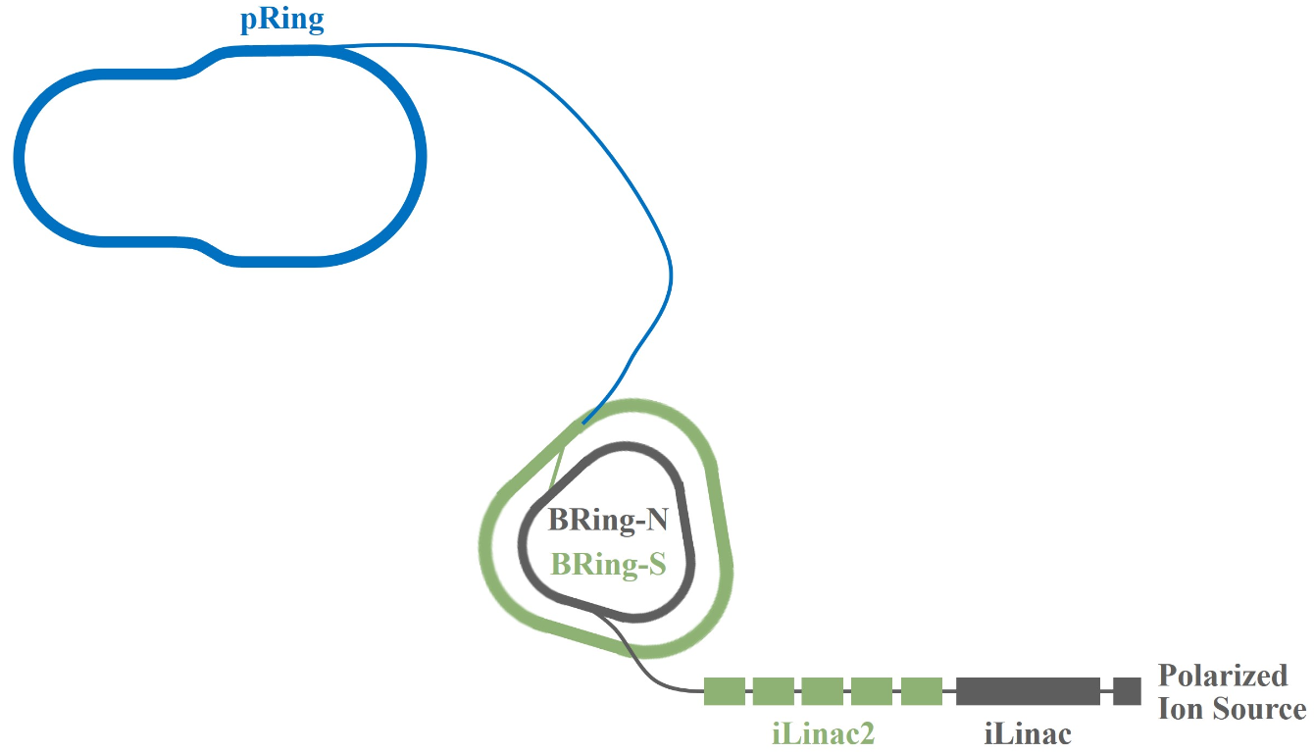
2. Ion and Electron Accelerators – Ion Complex
Ion complex consists of
iSource
  Generate polarized proton, D and ³He²⁺ beams, and other unpolarized ion beams
Op. mode 1: Multi-plane painting injection + Multi-stage electron cooling ~ 12 mins to replace all
iLinac
  Accelerate all kinds of ion beams, including H⁻ beams for stripping injection in the future
  Maximum energy (like proton) is 200 MeV
BRing-N & BRing-S
  The maximum momentum rigidity ~ 34 T m & 86 T m
  Intensity of p ~ 6.8×10¹² ppp & 2.03×10¹² ppp
  The required emittance is achieved in the BRing-N
Op. mode 2: Stripping injection + Single-stage electron cooling ~ 9 s to replace all
pRing
  Swap-out inj. to replace 384 bunches online (p), collision freq. is 100 MHz (e-p) or 500 MHz (e-A)

Slide 11
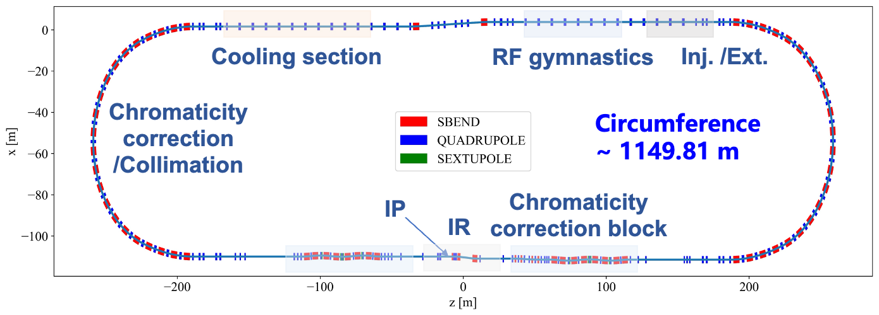
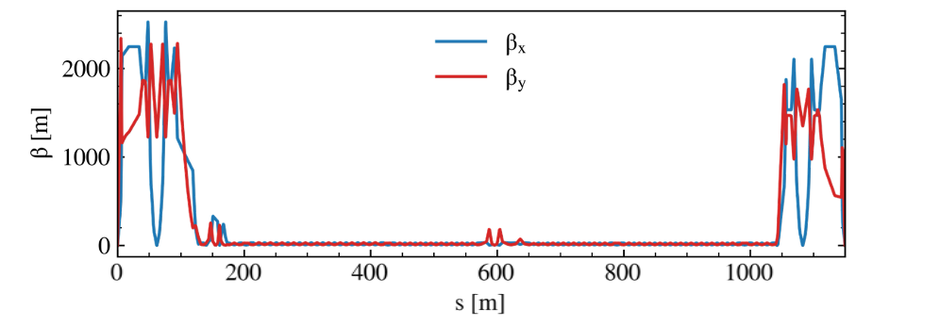
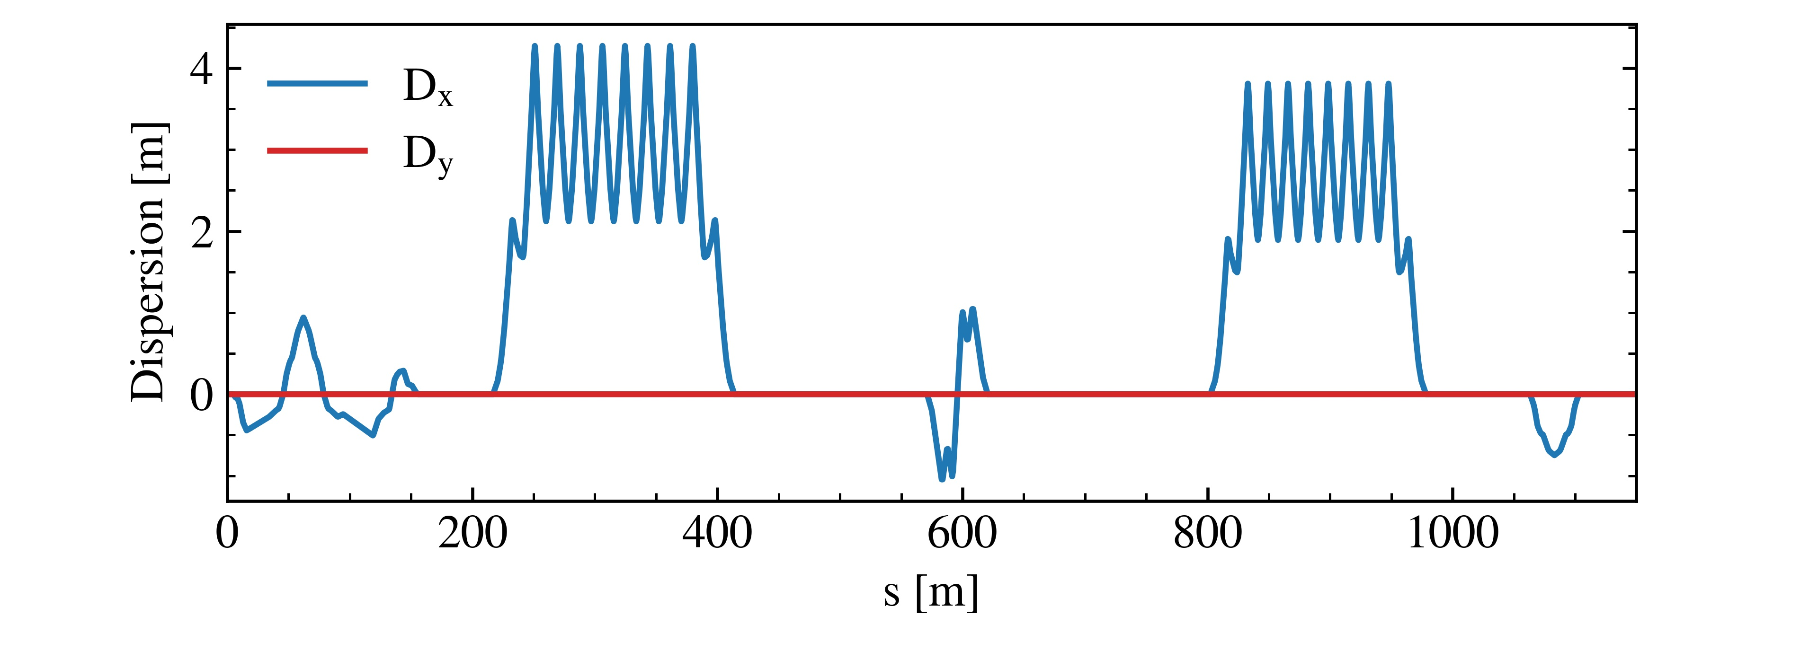
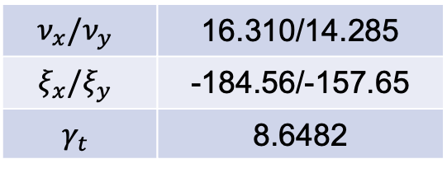
2. Ion and Electron Accelerators – pRing Lattice
The lattice of pRing is preliminarily designed as the base of BB research
$$ν_{x}/ν_{y}$$ | 16.310/14.285
$$ξ_{x}/ξ_{y}$$ | -184.56/-157.65
$$γ_{t}$$ | 8.6482
Chromaticity correction is challenging as large dynamic aperture should be guaranteed
CCB + ARC SEXT scheme

Slide 12
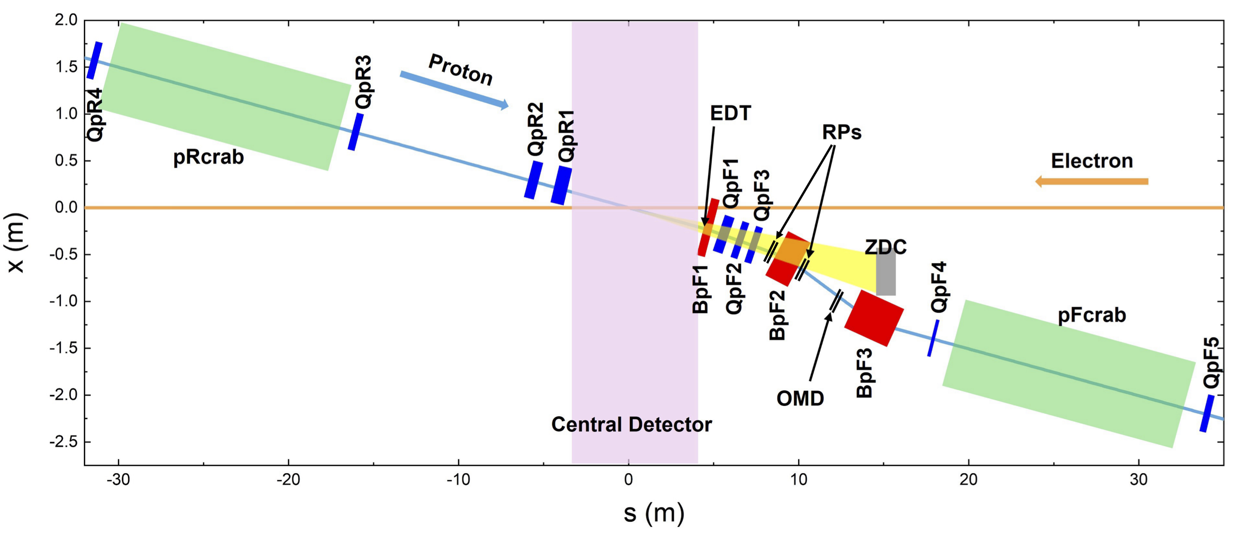
2. Ion and Electron Accelerators – Interaction Region (Ion)
Further studies should be performed with detector group …
50 mrad
40% ~ 80% off-momentum
Maximum gradient ~ 52.9 T/m @ 19.08 GeV
Space for crab cavities ~ 16 m * 2
Space for central detector ~ +4.4 m/-3.6 m
Endcap dipole tracker (EDT) is in the BpF1 with acceptance +/-16~60 mrad
Roman pot detectors are placed before and after BpF2 to cover ultra-small angle productions in +/-5~16 mrad
Zero-degree calorimeter (ZDC) for the neutral particles should cover +/- 25 mrad

Slide 13
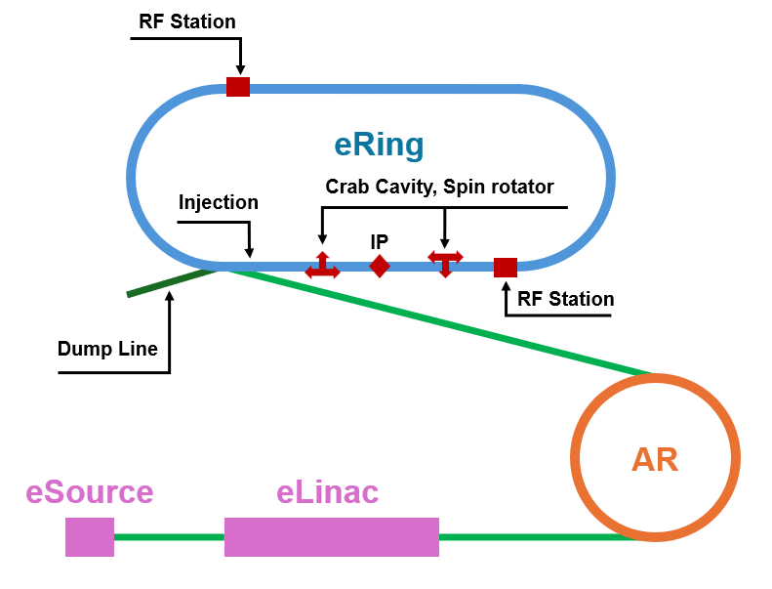
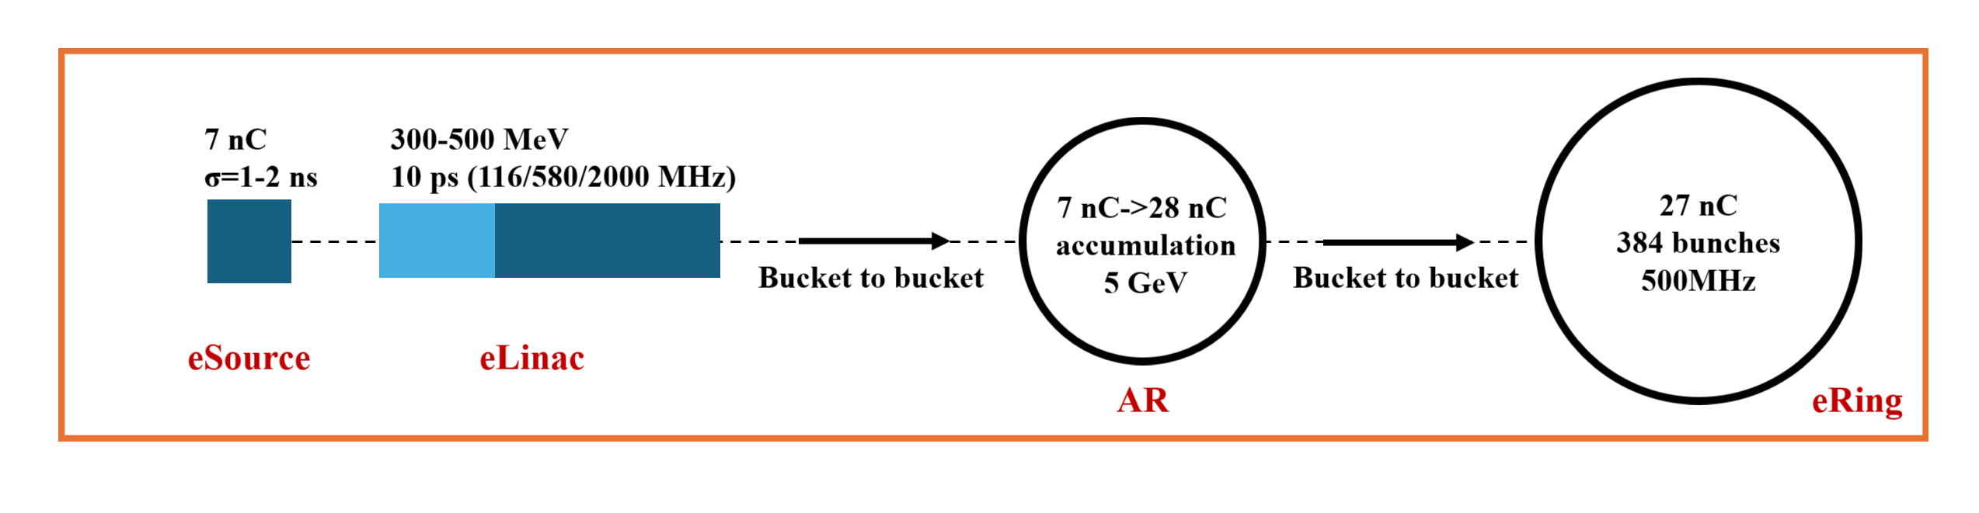
2. Ion and Electron Accelerators – Electron Complex
Electron complex consists of
eSource
  Polarized electron beams, and intensity of 5 ~ 10 nC per pulse
eLinac
  Accelerate to 300 ~ 500 MeV
AR
  Circumference ~ 287.8 m
  Accumulate 4 times to reach the intensity of 27 nC per bunch
  Accelerate to 2.8 ~ 5.0 GeV
eRing
  Circumference ~ 1151.2 m
  384 bunches (100 MHz in e-p)
  Swap-out injection scheme

Slide 14
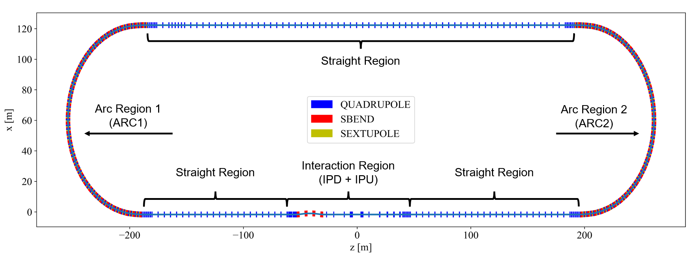
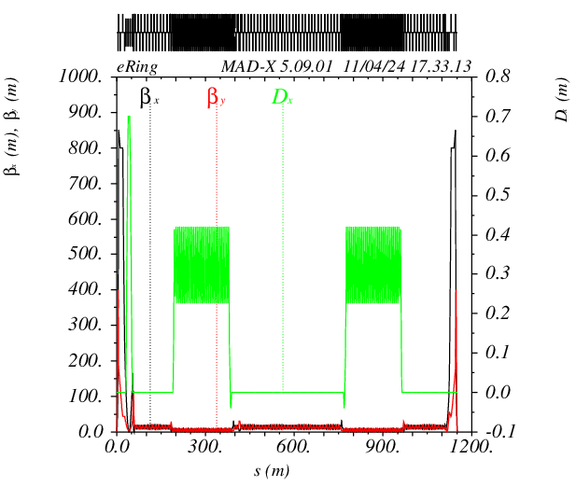
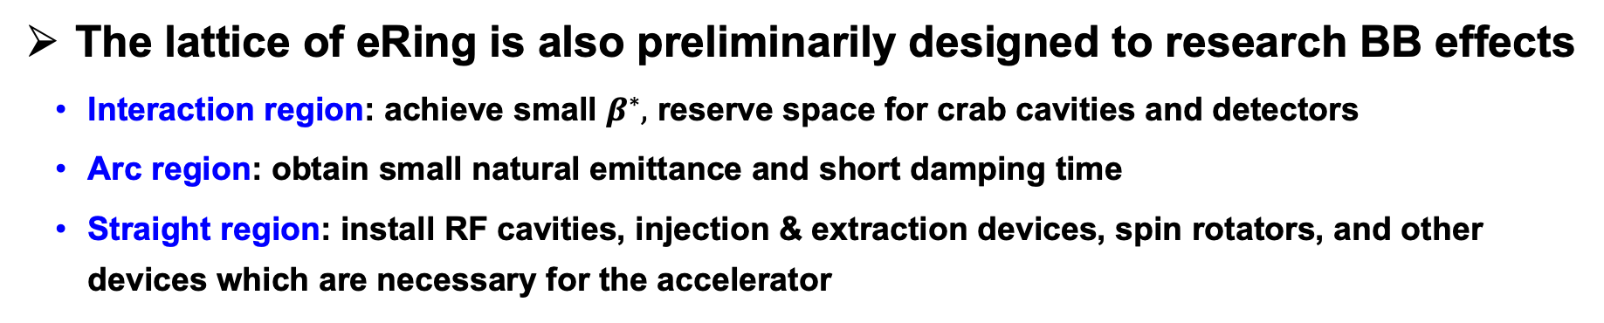
2. Ion and Electron Accelerators – eRing Lattice
The lattice of eRing is also preliminarily designed to research BB effects
  Interaction region: achieve small $β^{∗},$ reserve space for crab cavities and detectors
  Arc region: obtain small natural emittance and short damping time
  Straight region: install RF cavities, injection & extraction devices, spin rotators, and other devices which are necessary for the accelerator

Slide 15
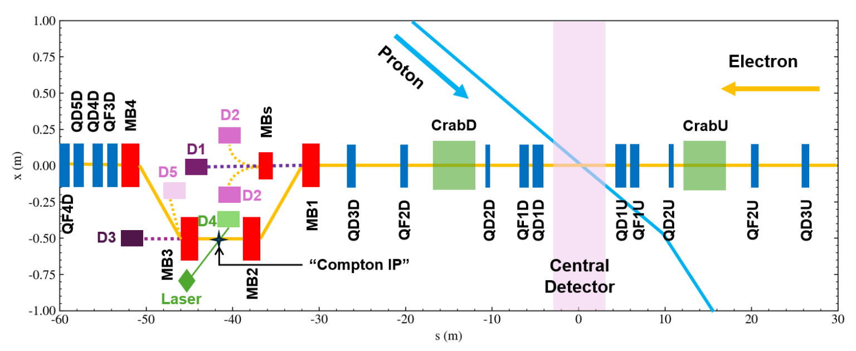
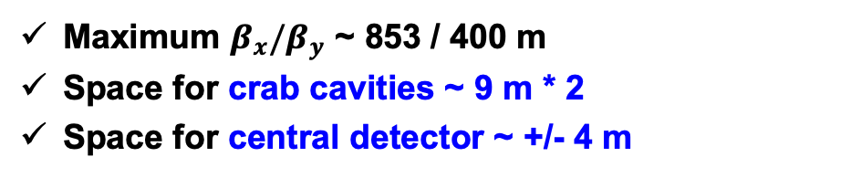
2. Ion and Electron Accelerators – Interaction Region (e)
50 mrad
Maximum $β_{x}/β_{y}$ ~ 853 / 400 m
Space for crab cavities ~ 9 m * 2
Space for central detector ~ +/- 4 m
A Chicane section formed by four dipoles is employed to measure lumi. and polarization, which has severe impact on emittance (20%)

Slide 16
3. Challenges & Status of BB Research
Nonlinear effects
Simulation platforms for coupling eff.
Relatively
low energy
More extreme beam parameters
Space charge effects
Collective instabilities
Rapid-cycling operation mode
High aiming luminosity
e or ion cloud effects
Stronger asymmetric focusing at the IP
Float waist collision scheme
Beam-Beam effects
Electron
Hadron
Strong hourglass eff.
…
Crab Cavities

Slide 17
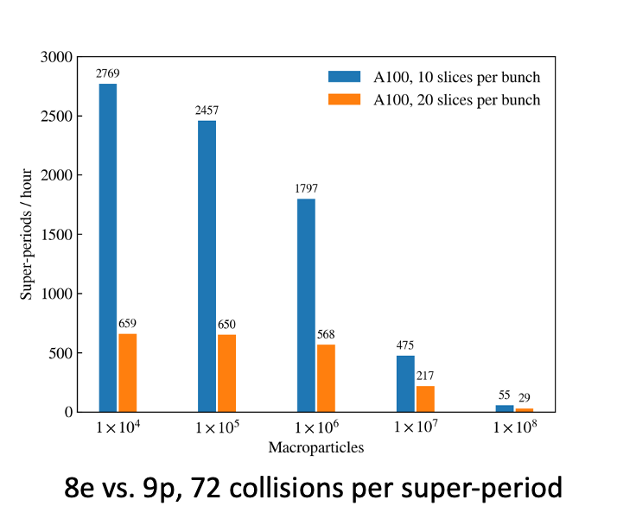
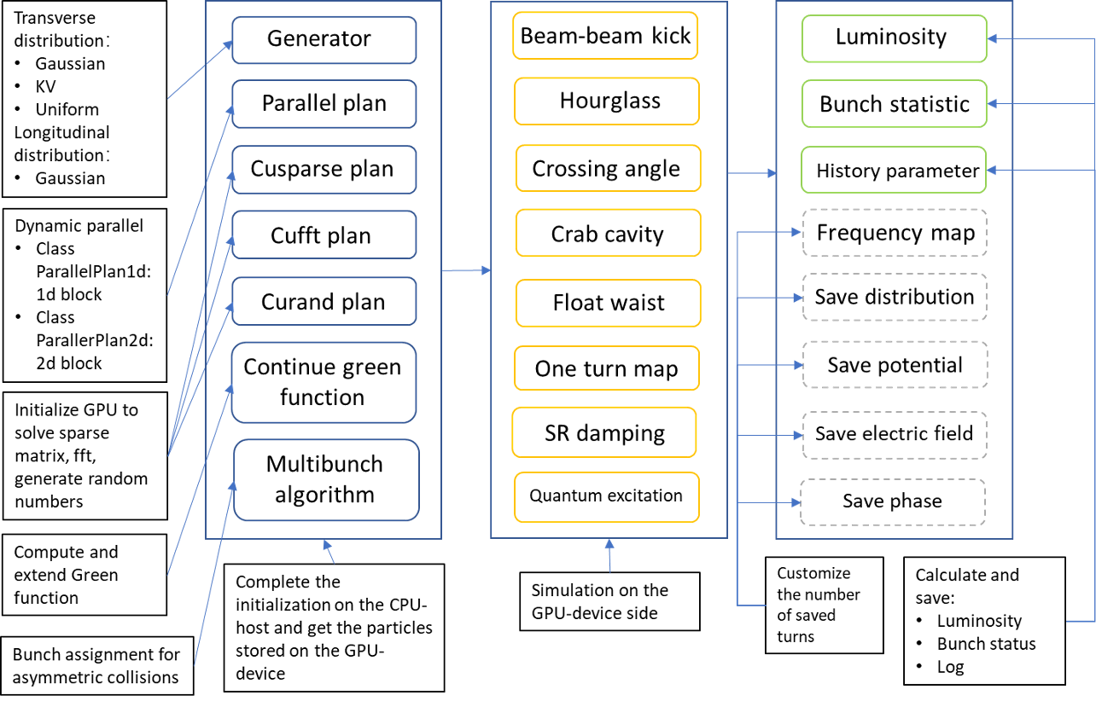
3. Challenges & Status of BB Research – Simulation Platforms
In the old designs, EicC employed asymmetric collisions, so finding the best n:m is important!
turn1
turn2
turn3
turn4
2
4
Basic (fast) beam
1
2
3
1
2
3
1
2
3
3
1
2
3
1
1
3
Non-basic (slow) beam
1
2
3
4
1
2
3
4
1
2
3
4
turn1
turn2
turn3
3
2
12 collisions in 1 super period
Much more computing time (super periods) vs. 1e : 1p (turns)
A gpu-based high-performance self-consistent multi-bunch beam-beam simulation program: Athena

Slide 18
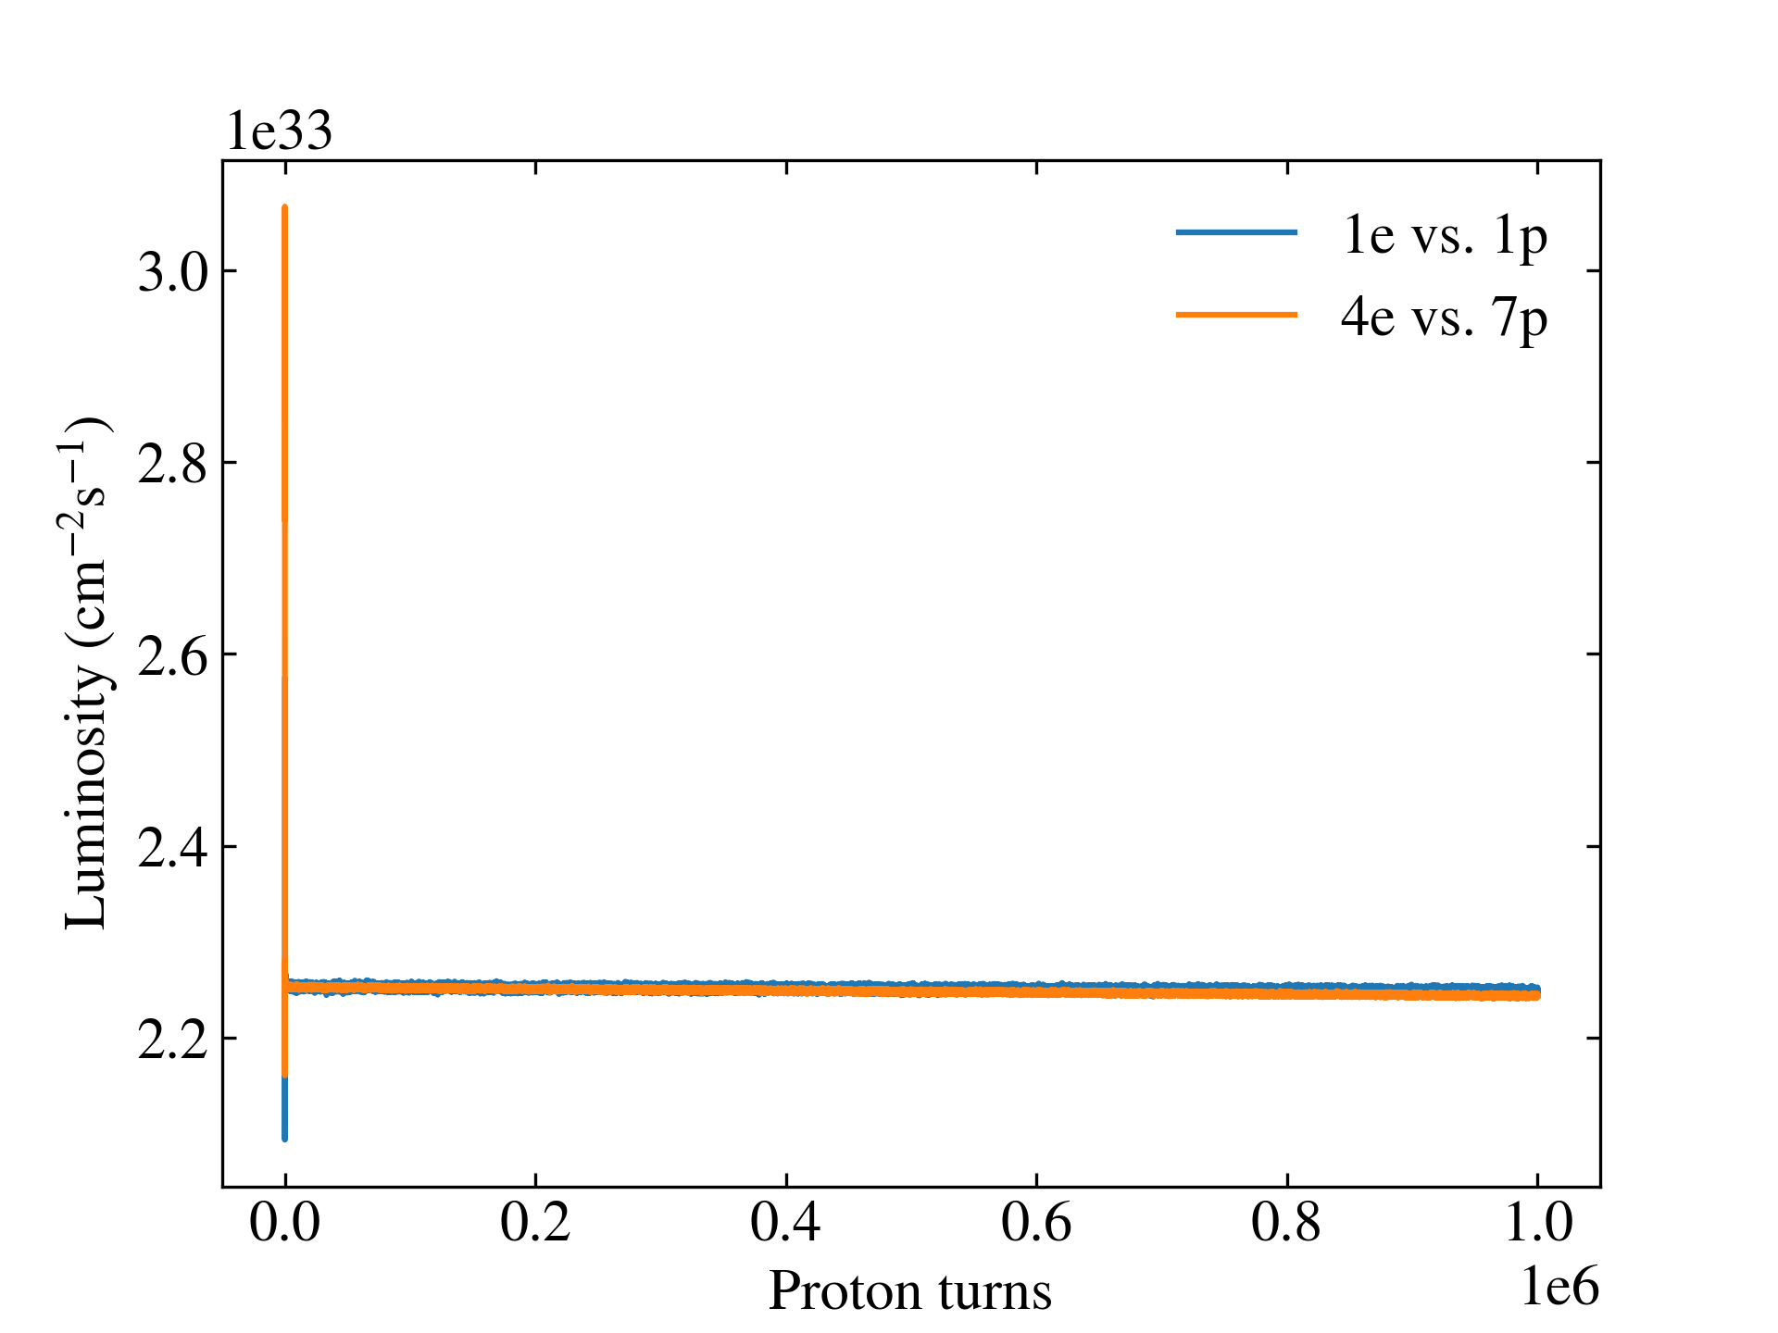
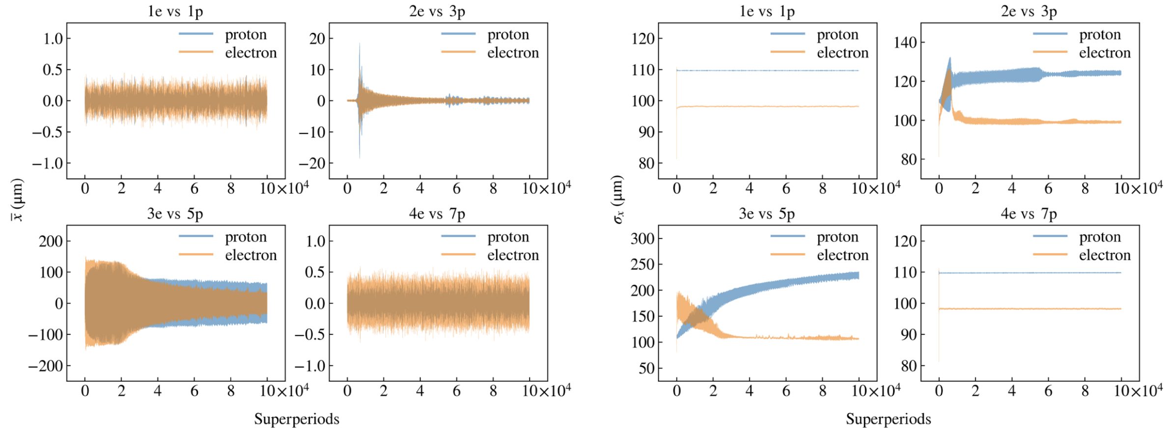
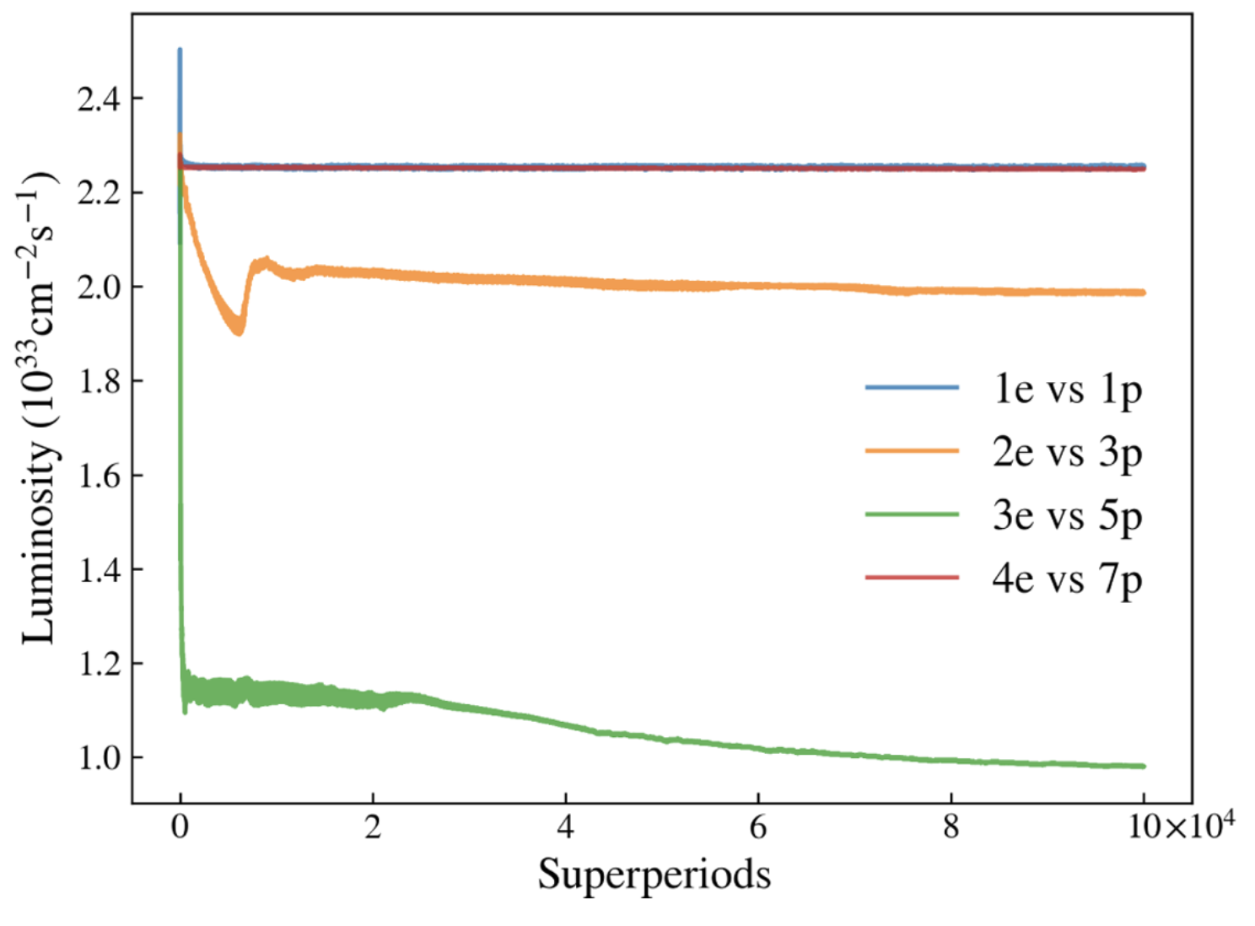
3. Challenges & Status of BB Research – Simulation Platforms
1e vs. 1p, 2e vs. 3p, 3e vs. 5p, and 4e vs. 7p are simulated
  Similar luminosity and bunch parameter evolutions in 1e vs. 1p and 4e vs. 7p collision modes (stable)
  Luminosity loss in 2e vs. 3p and 3e vs. 5p due to dipole instability which can be avoided by choosing appropriate nominal tunes
New EicC design uses 1e vs. 1p to make dynamics easier

Slide 19
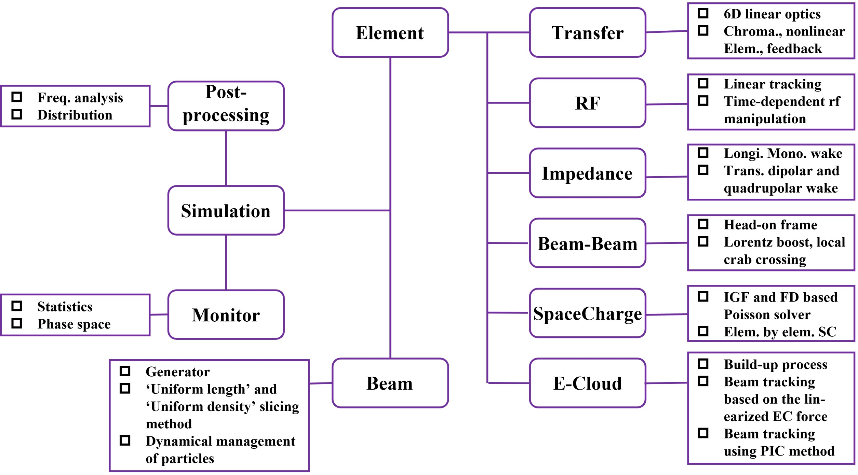
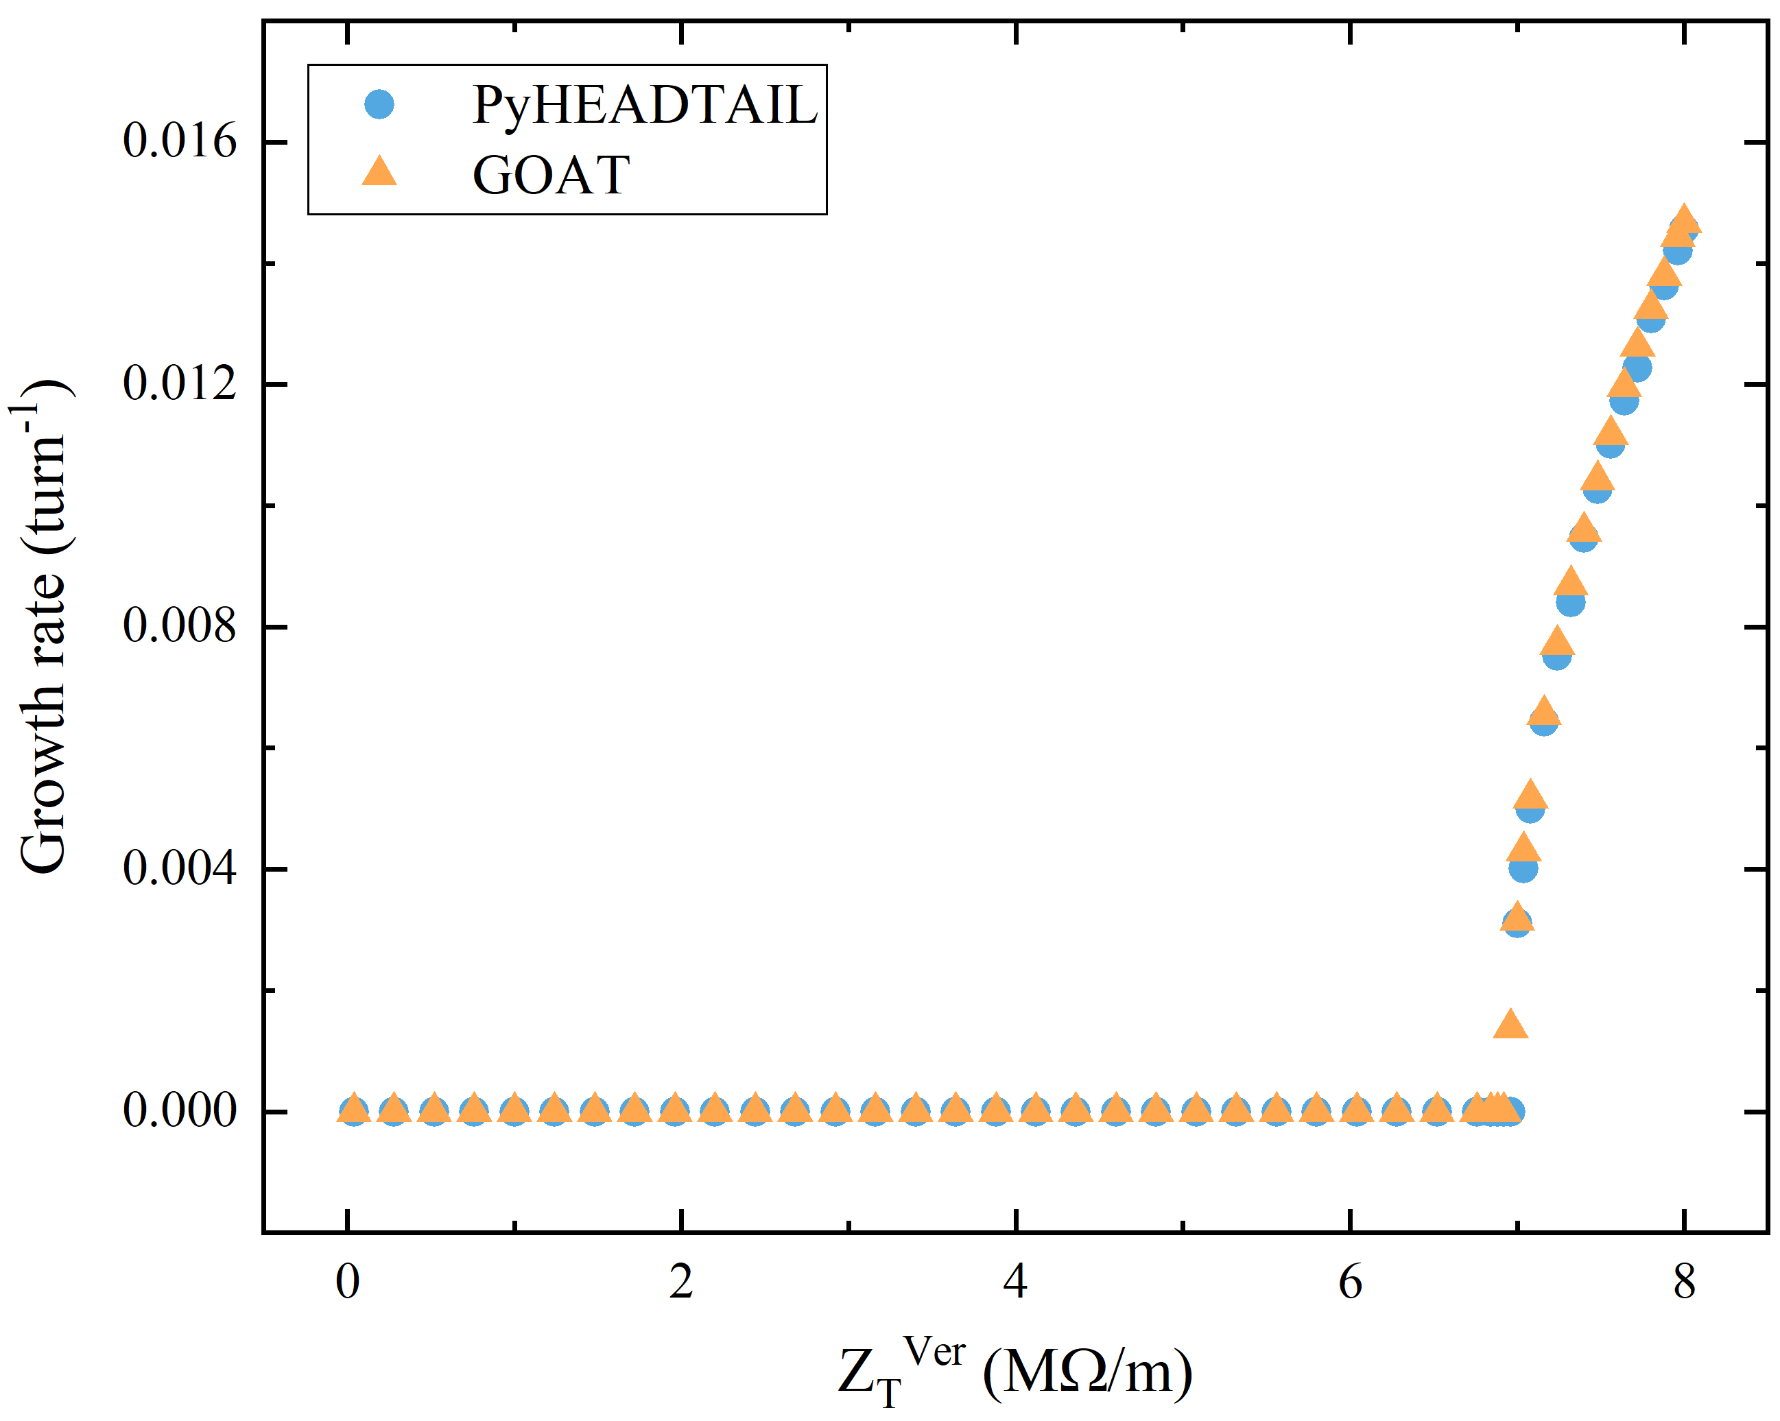
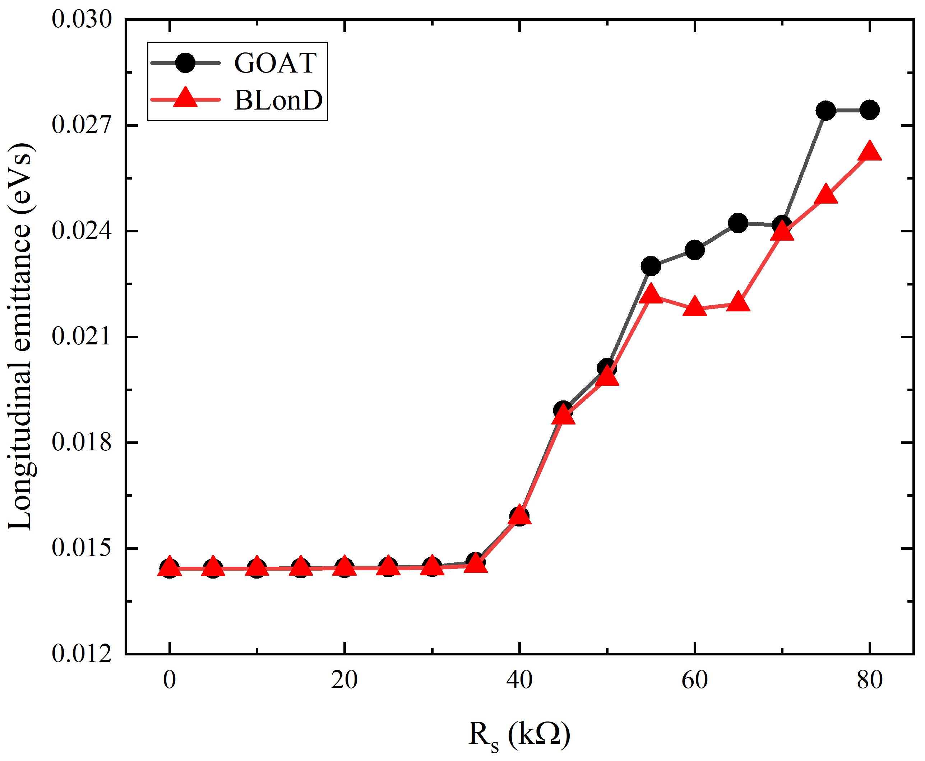
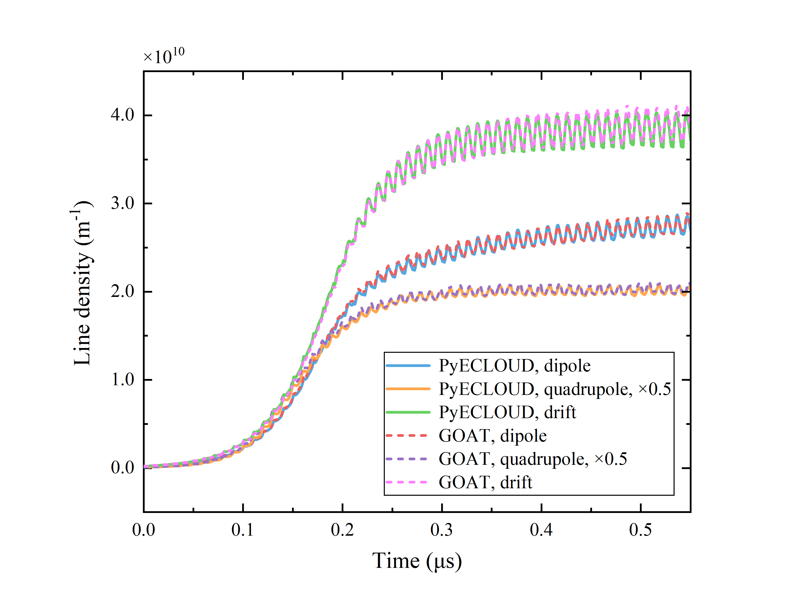
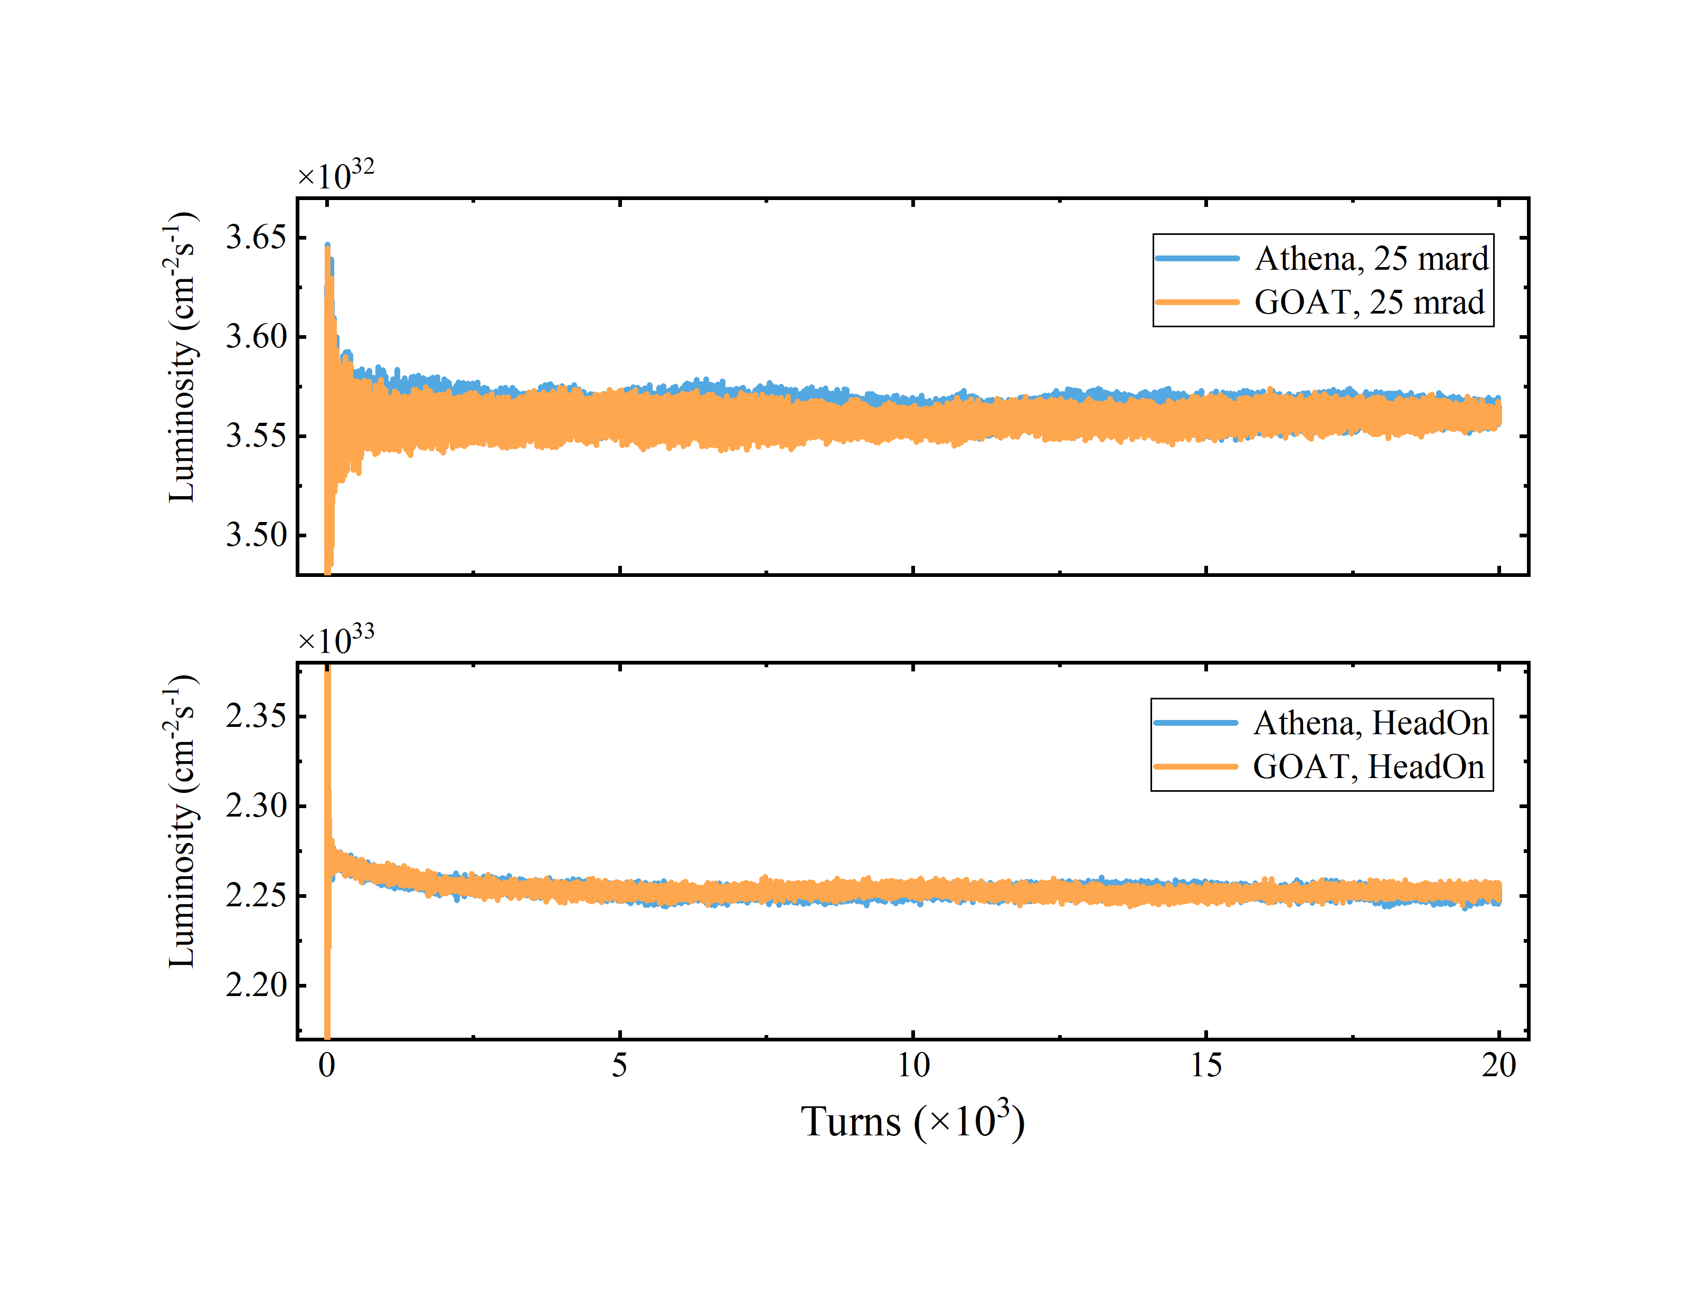
3. Challenges & Status of BB Research – Simulation Platforms
After 1e vs. 1p chosen as the collision mode, whether beams are stable with all effects and their coupling effects becomes a new problem. GOAT is developed to verify diverse coupling effects.
Benchmark with PyHEADTAIL
Benchmark with Blond
Benchmark with PyECLOUD
Benchmark with Athena
In the future, a new simulation platform, PASS (Particle Accelerator Simulation Studio), combining
Athena & GOAT, will be developed in IMP, CAS to support complicated beam dynamics studies.

Slide 20
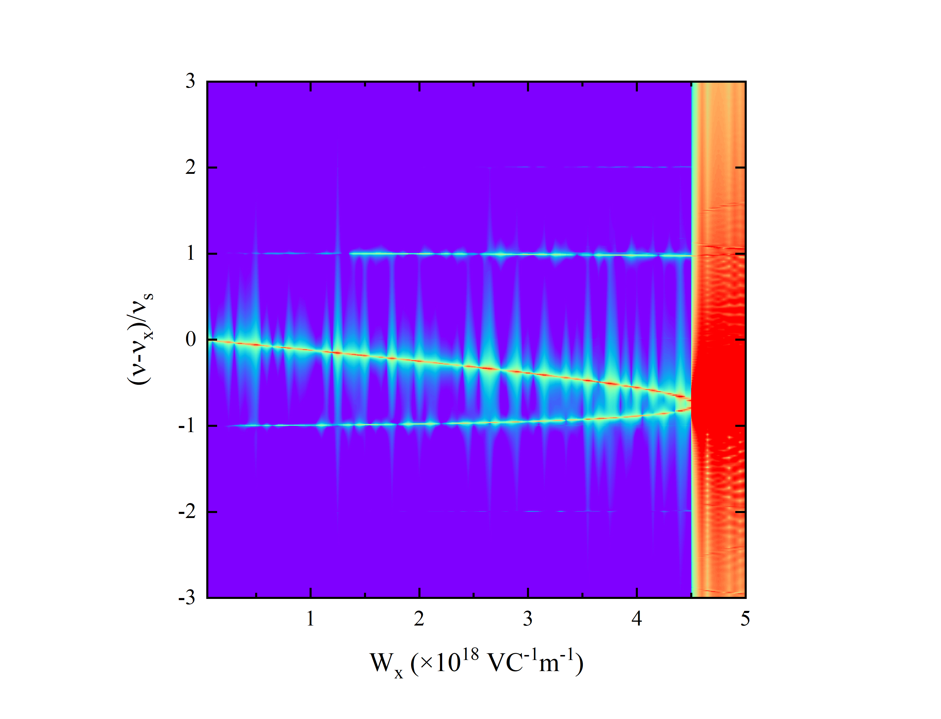
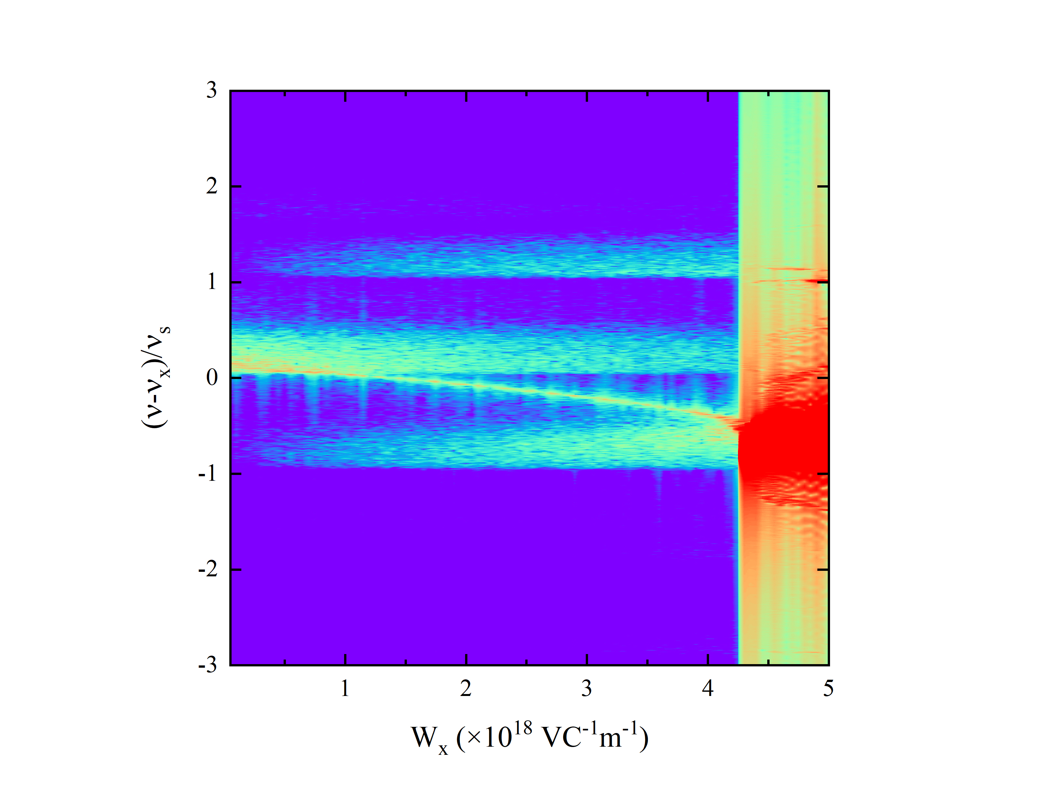
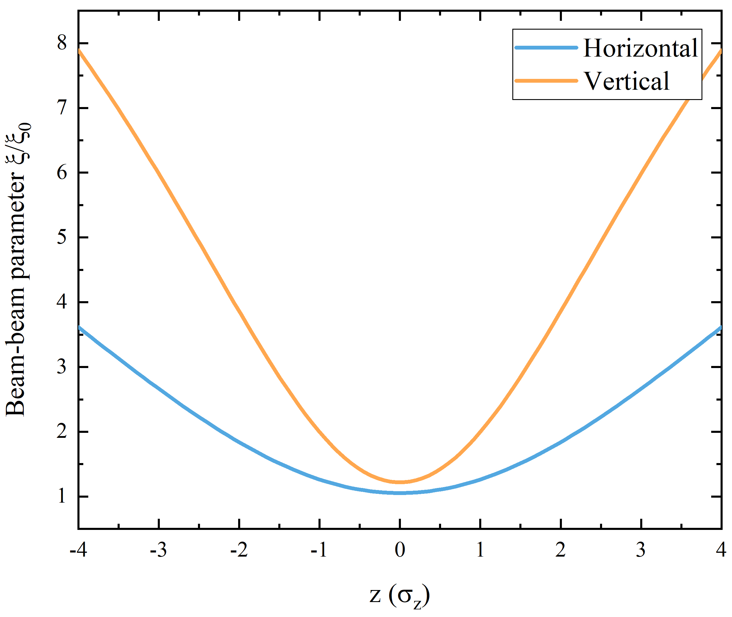
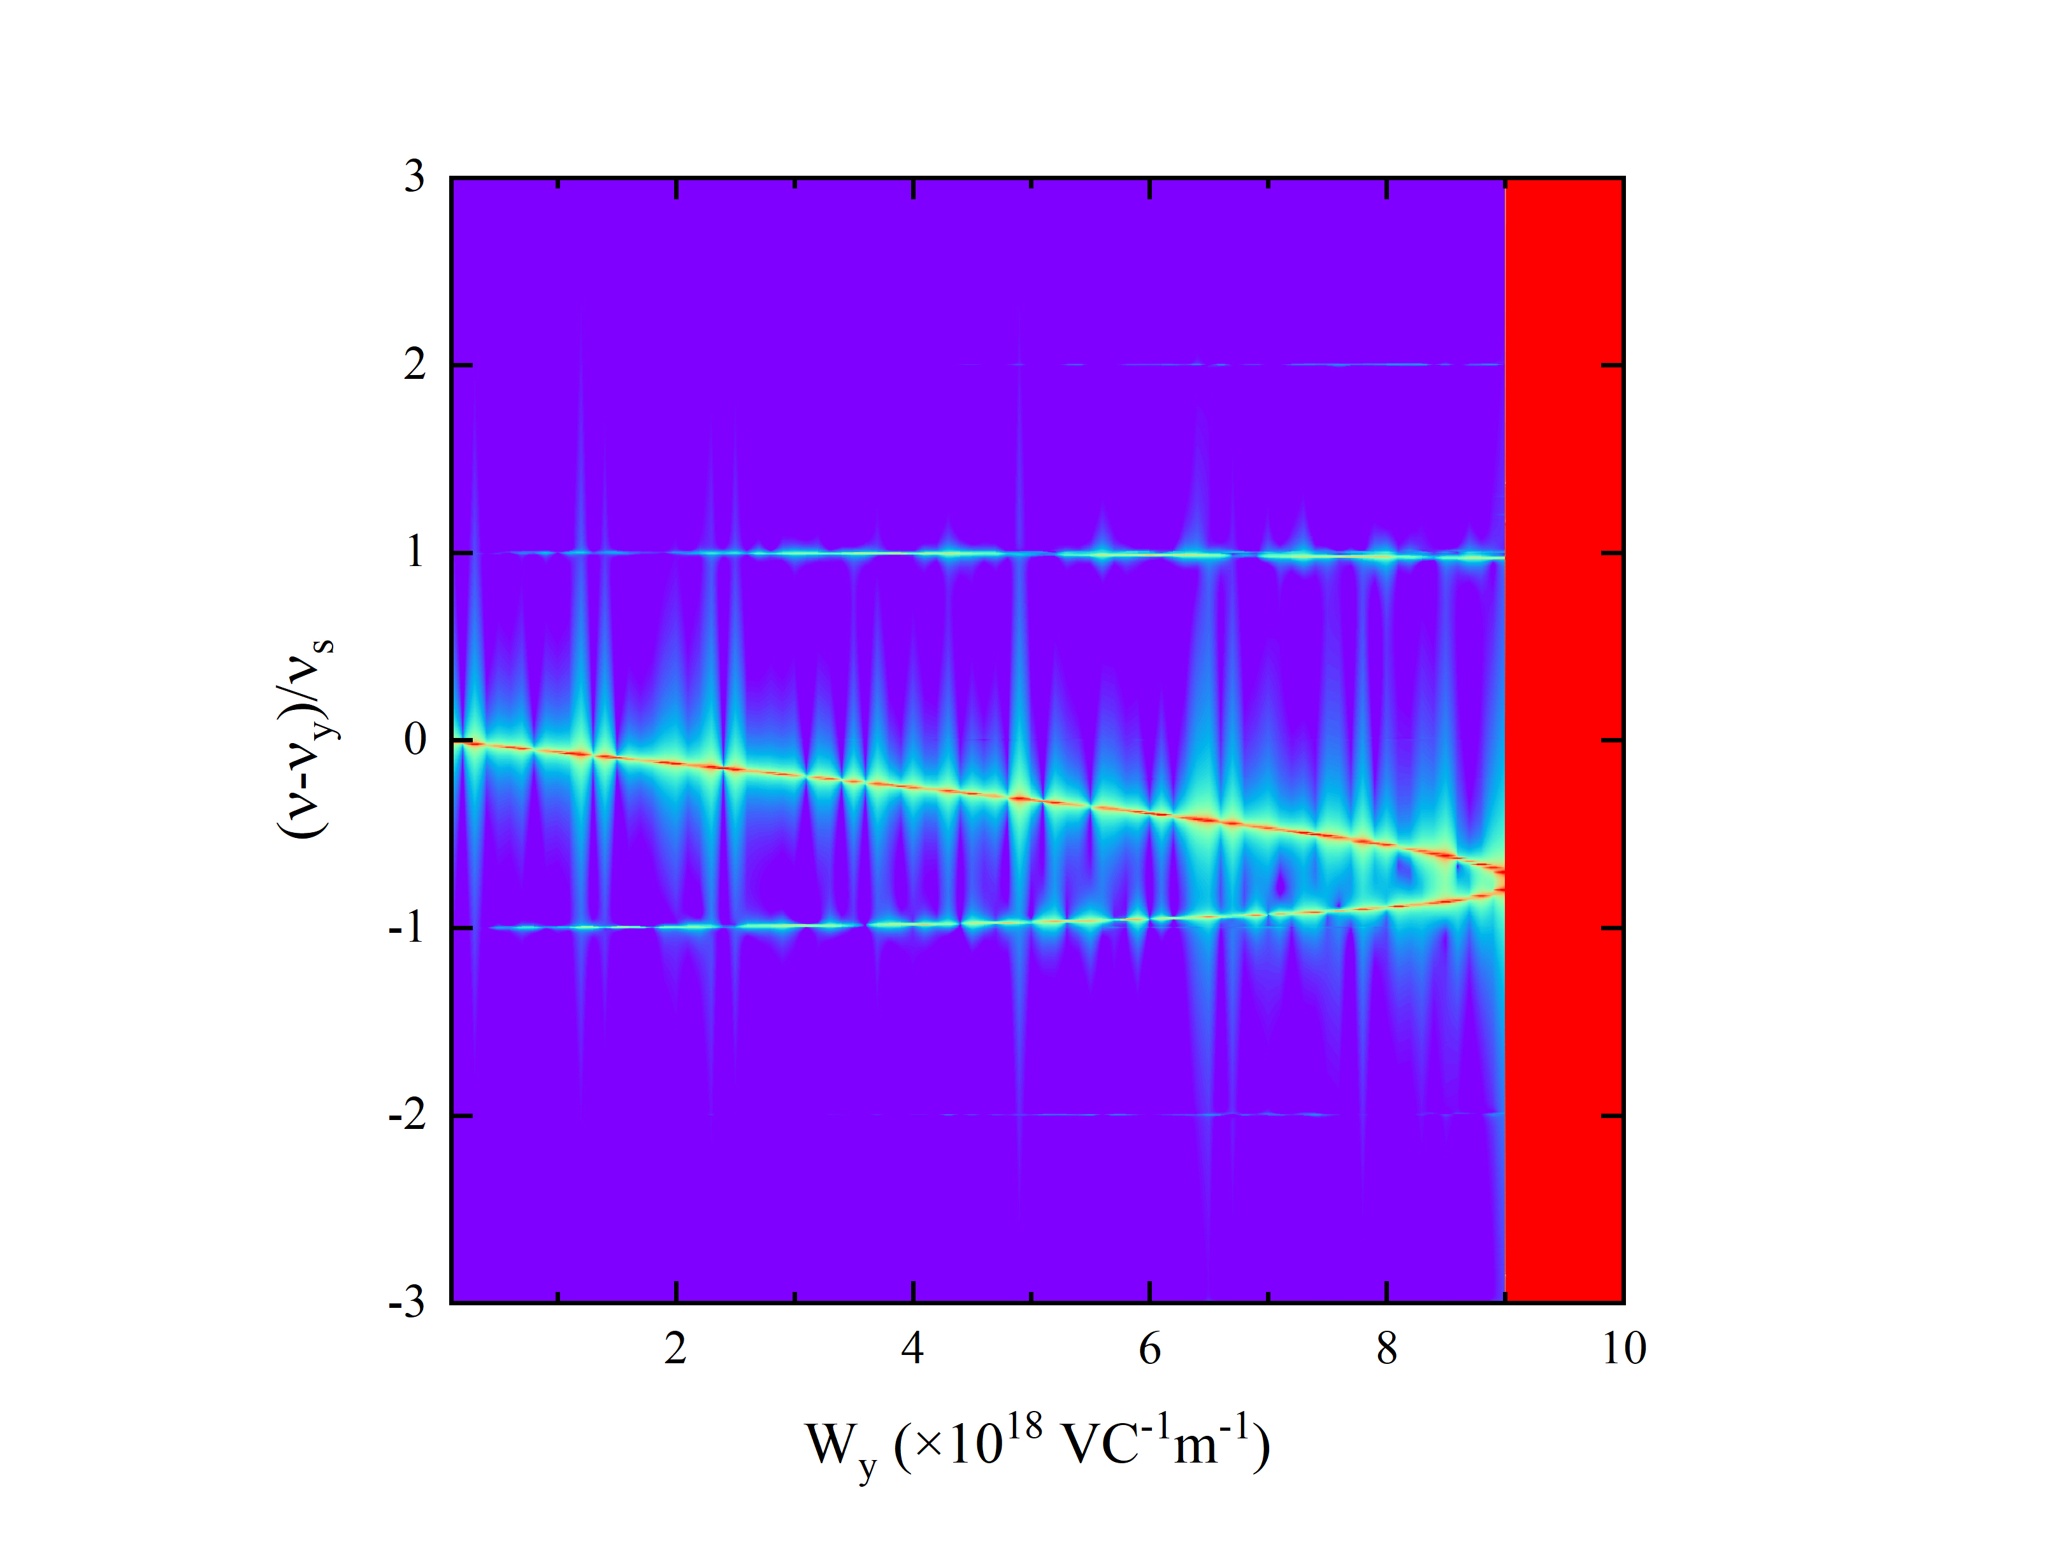
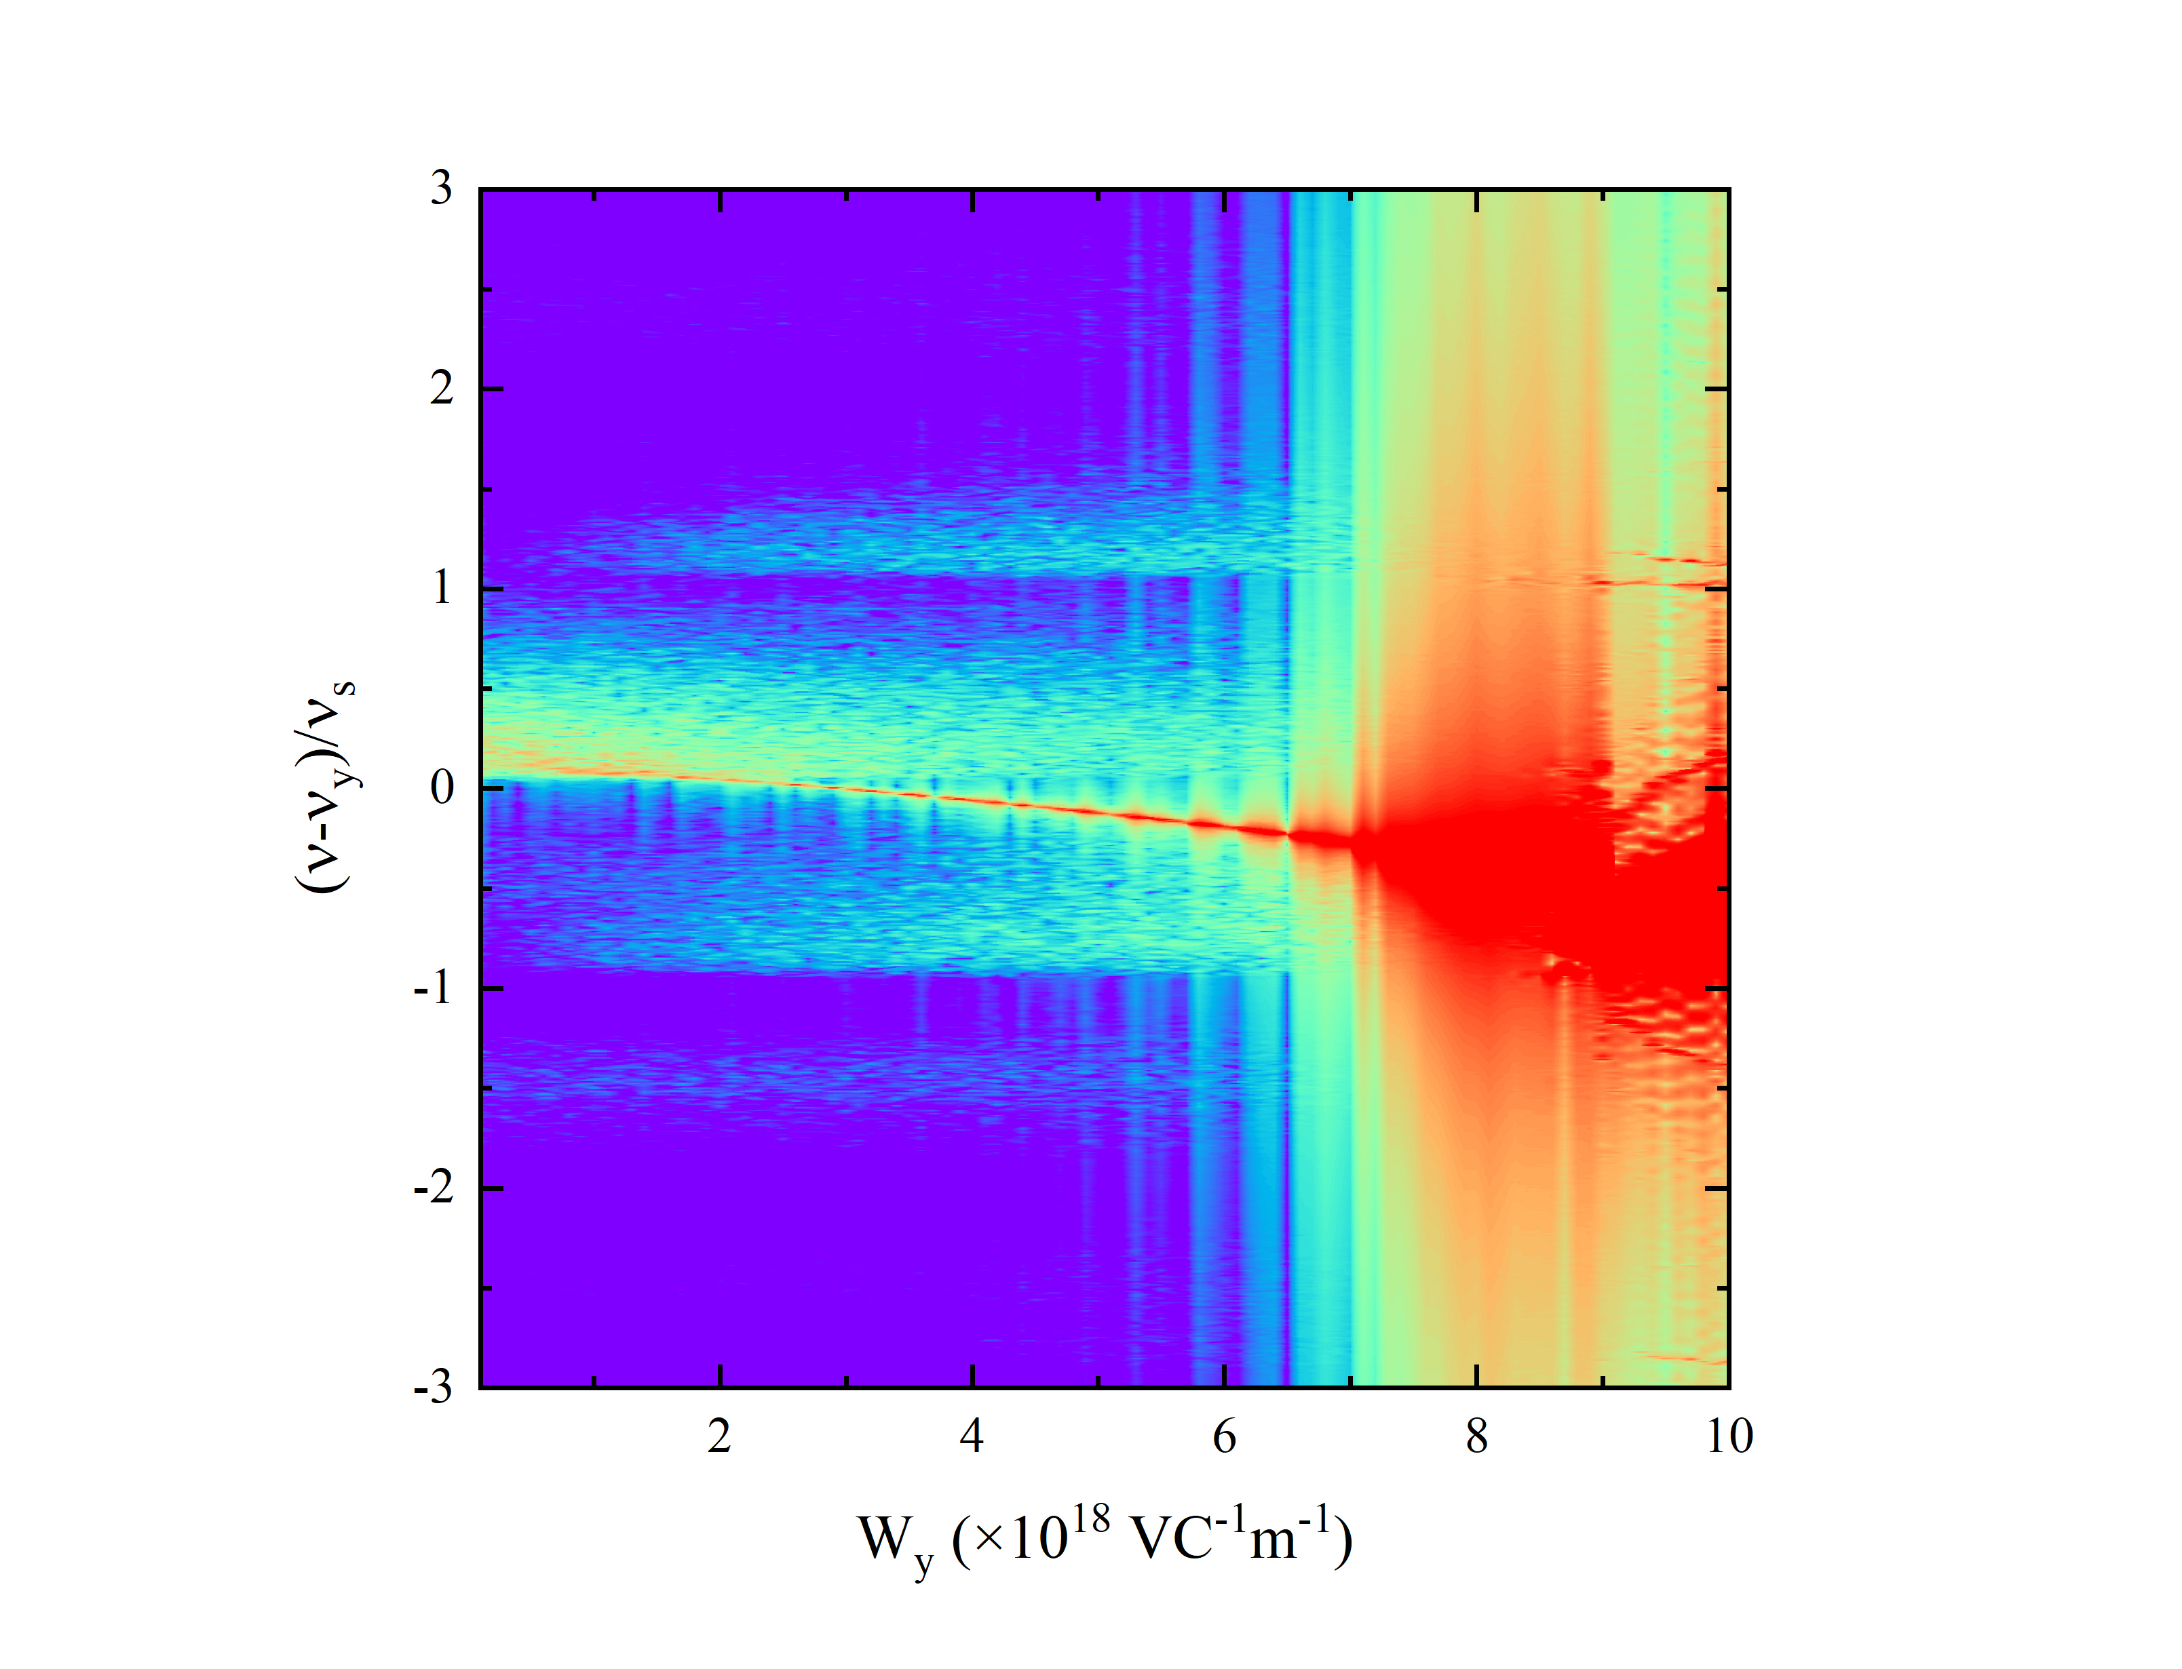
3. Challenges & Status of BB Research – Simulation Platforms
Coupling effect of constant wakes and beam-beam interactions by GOAT
Local beam-beam parameters are changing along the bunch
Horizontal
GOAT sim.s show the coupling effect of wakes and BB effects makes beams much more unstable
Other coupling effects of space charge, impedance, beam-beam and so on should be studied in the future to ensure beam stability
Vertical
Threshold decreases significantly

Slide 21
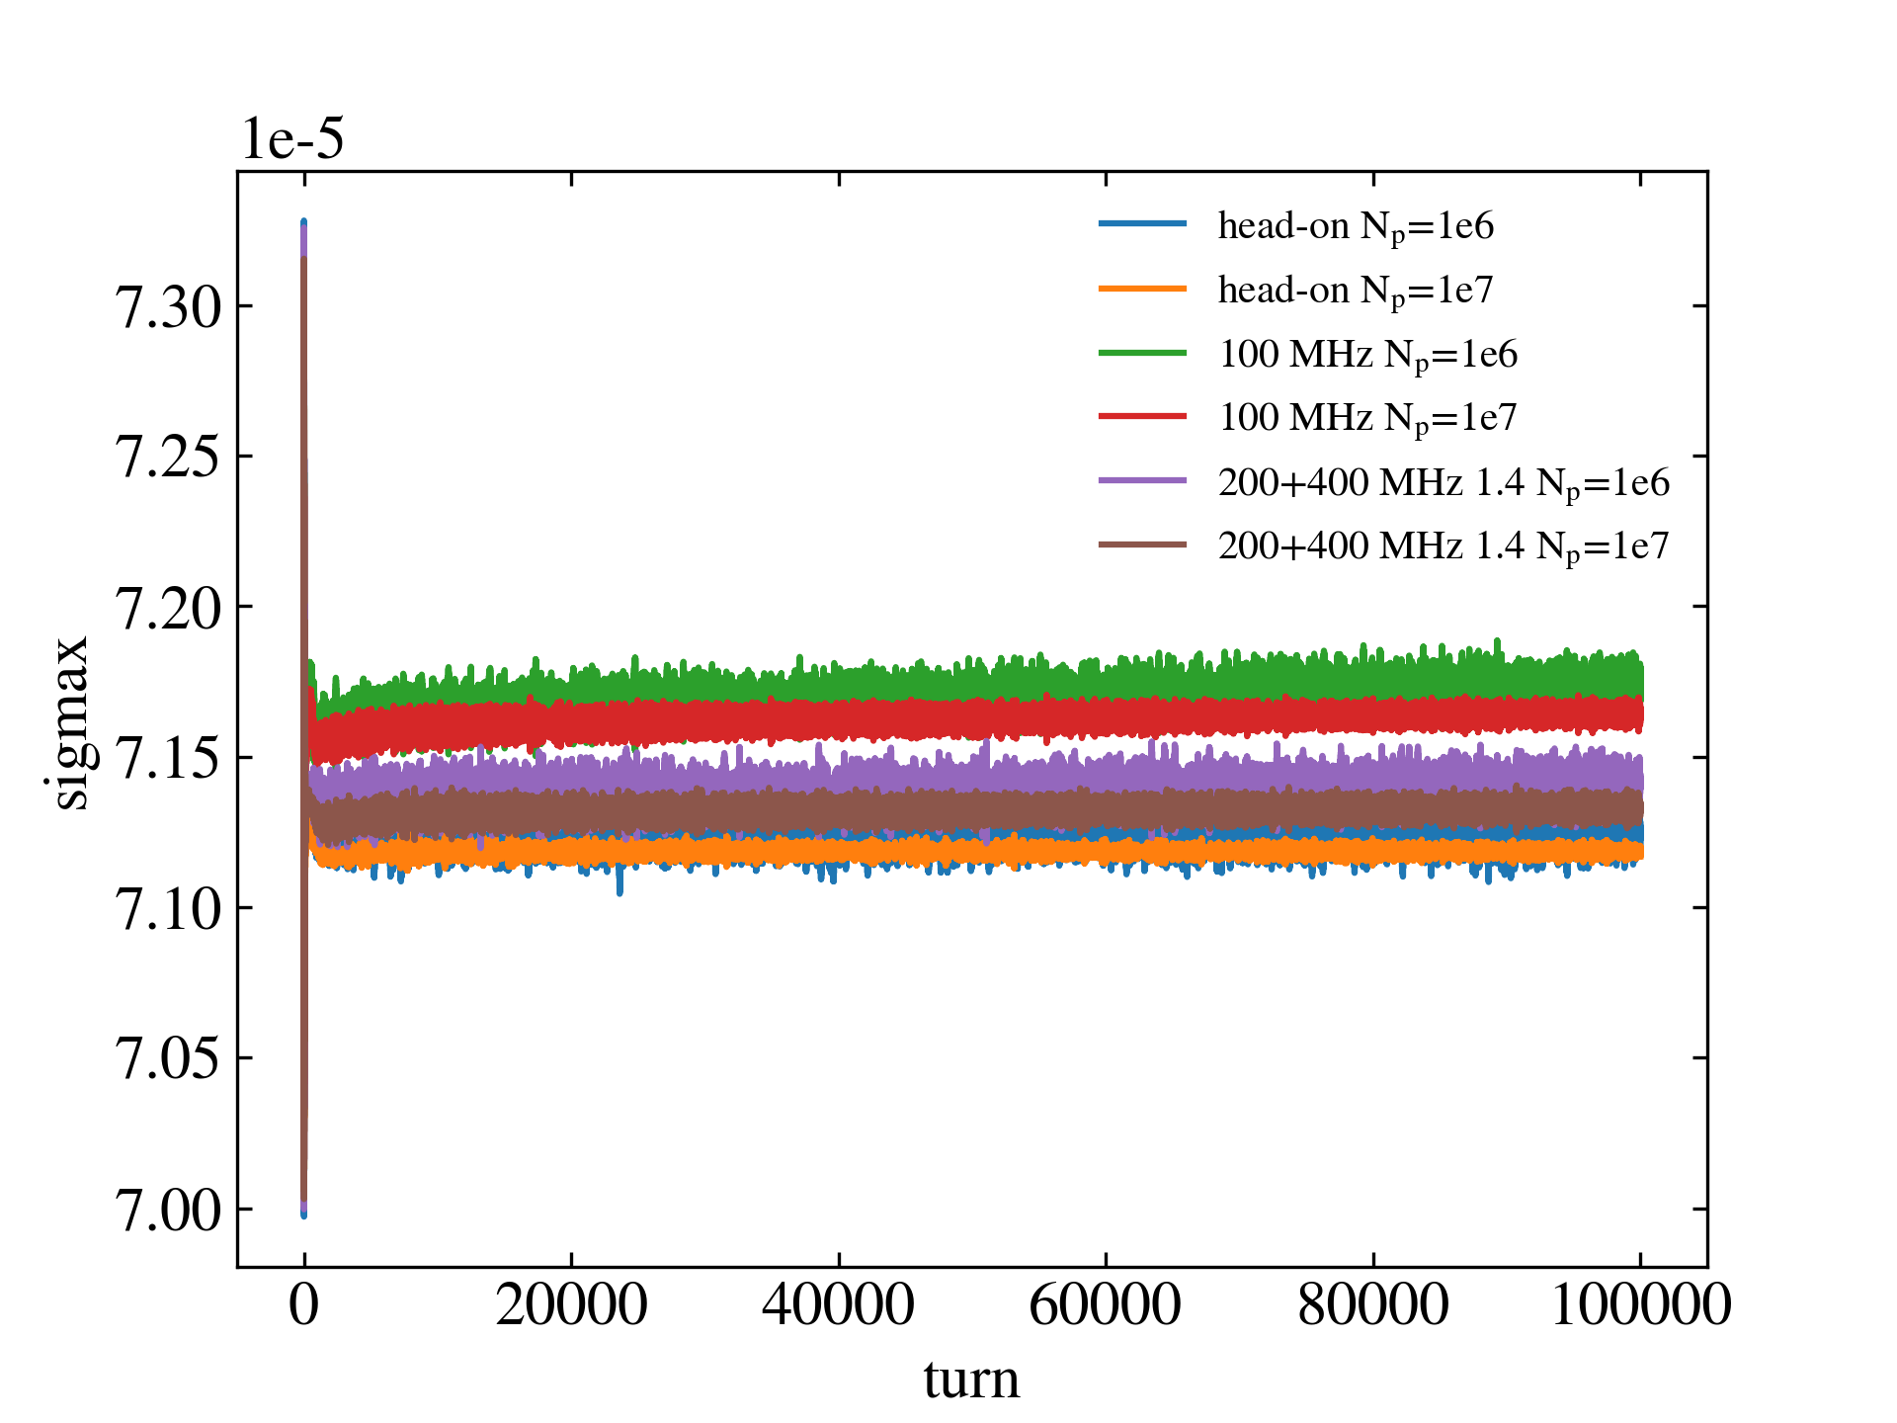
3. Challenges & Status of BB Research – Rapid-Cycling Mode
Athena sim.s show the vertical emittance of proton beams increases quickly, while emittances in both directions increase with crab cavities
Linear fit of bunch size growth
Head-on σx | 0.05%/min
Head-on σy | 4.02%/min
100 MHz σx | 7.69%/min
100 MHz σy | 7.73%/min
200+400 MHz (1.4) σx | 3.51%/min
200+400 MHz (1.4) σy | 6.46%/min
Although peak luminosity increases with crab cavities, luminosity life is so short that
integral luminosity can be quite little. How can we achieve higher integral luminosity?

Slide 22
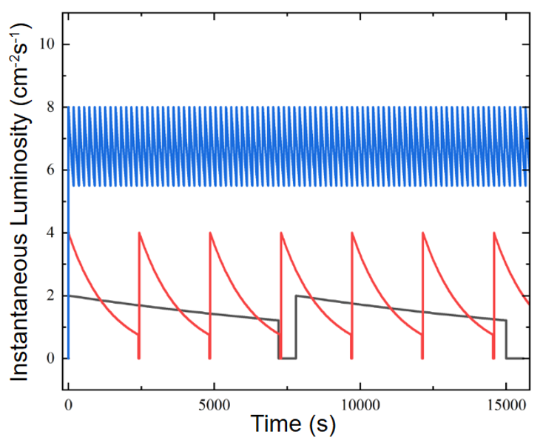
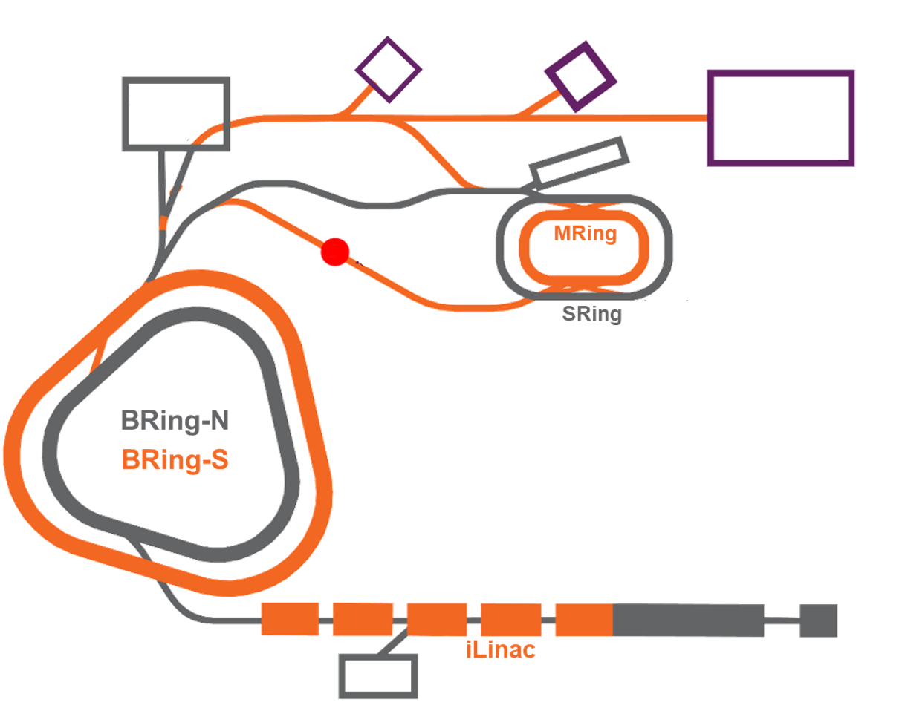
3. Challenges & Status of BB Research – Rapid-Cycling Mode
Rapid-cycling booster
9 s or 12 min (multi-EC)
Higher integral luminosity
Injection line
Beam dump line
DUMP
If the collision bunches are replaced online and quickly enough, much higher peak and integral luminosity is feasible without worrying its life.
Kicker
Collision ring
Swap-out injection scheme
Replace all in minutes or seconds

Slide 23
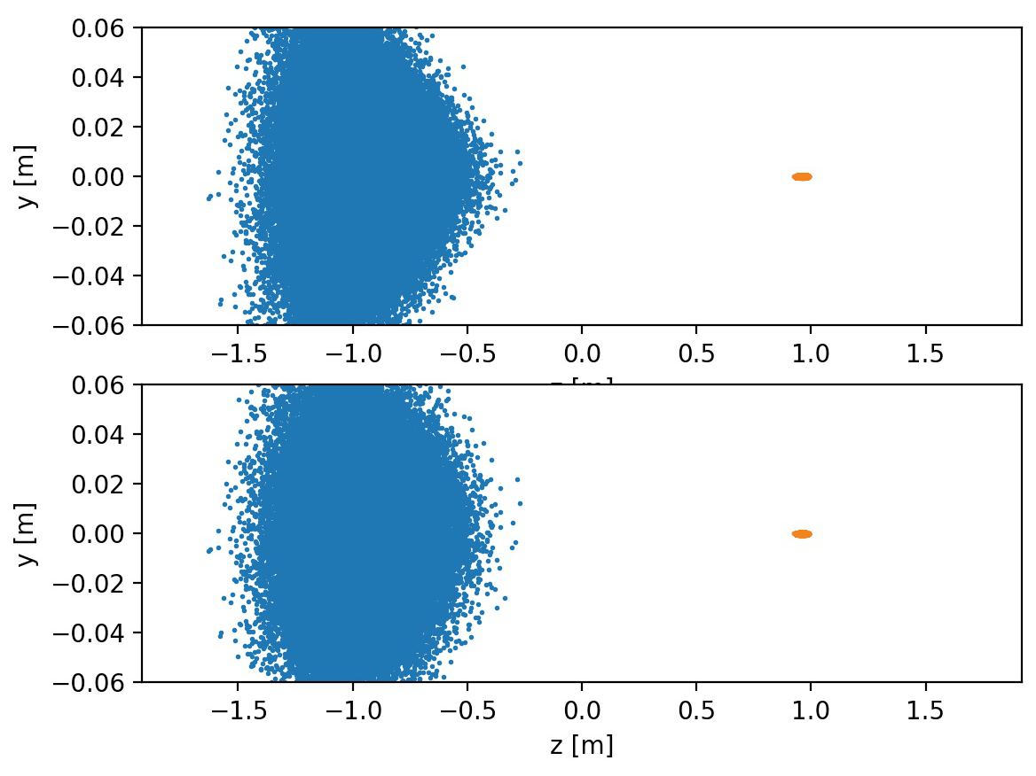
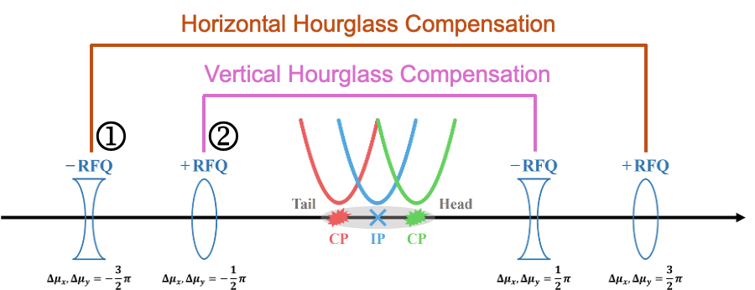
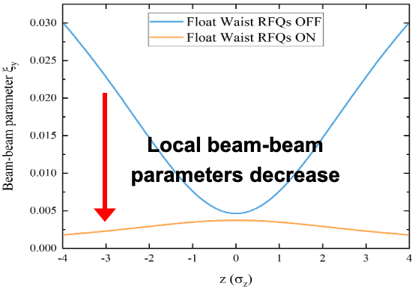
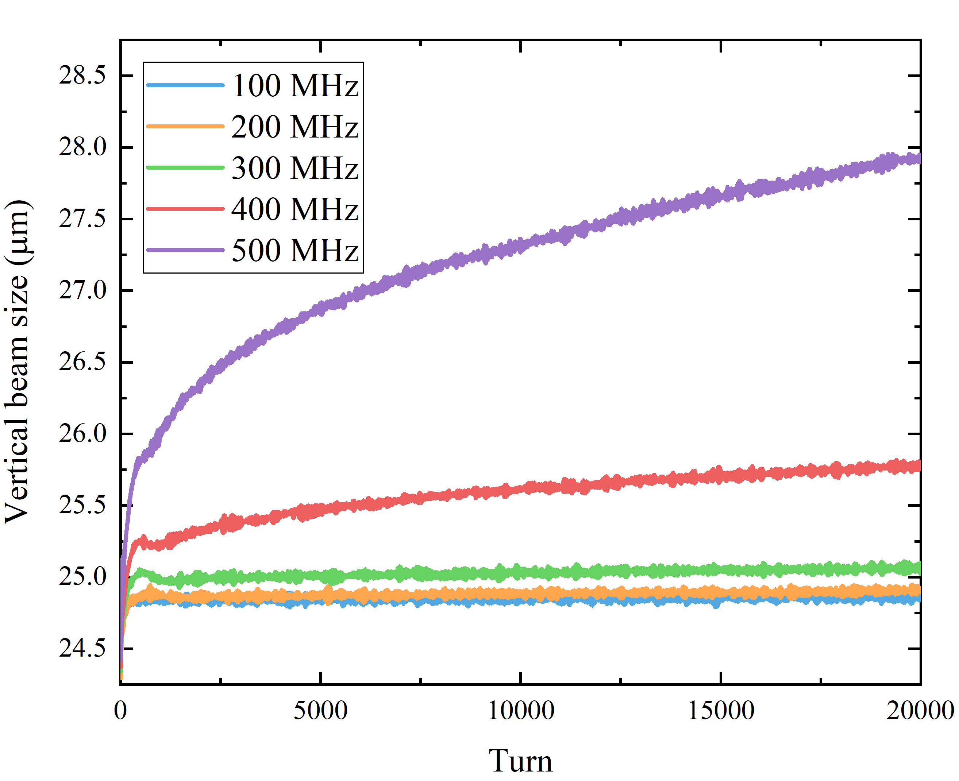
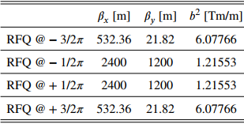
3. Challenges & Status of BB Research – Float Waist
Normal
p
e
Float waist
Hourglass factor 0.52 → 0.80, higher luminosity and more feasible designs
Suppress strong hourglass effects
RFQ frequencies < 300MHz
RFQ can provide enough focusing strength

Slide 24
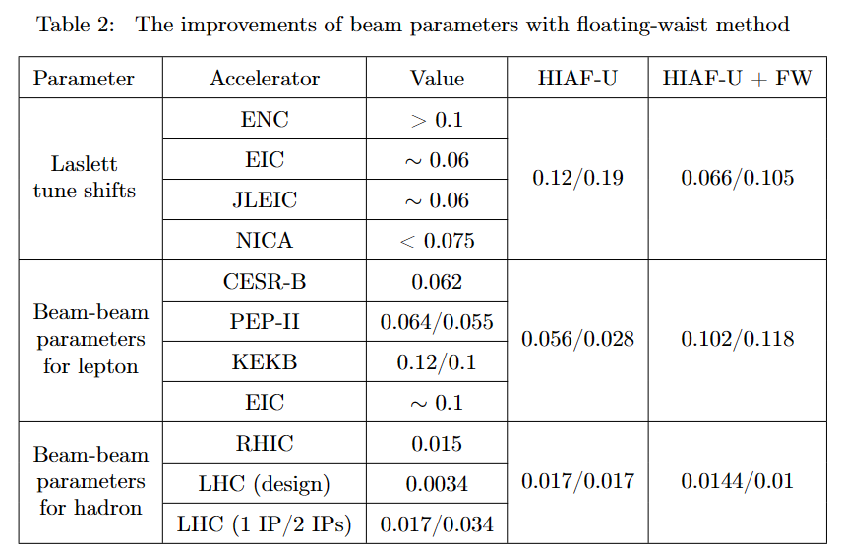
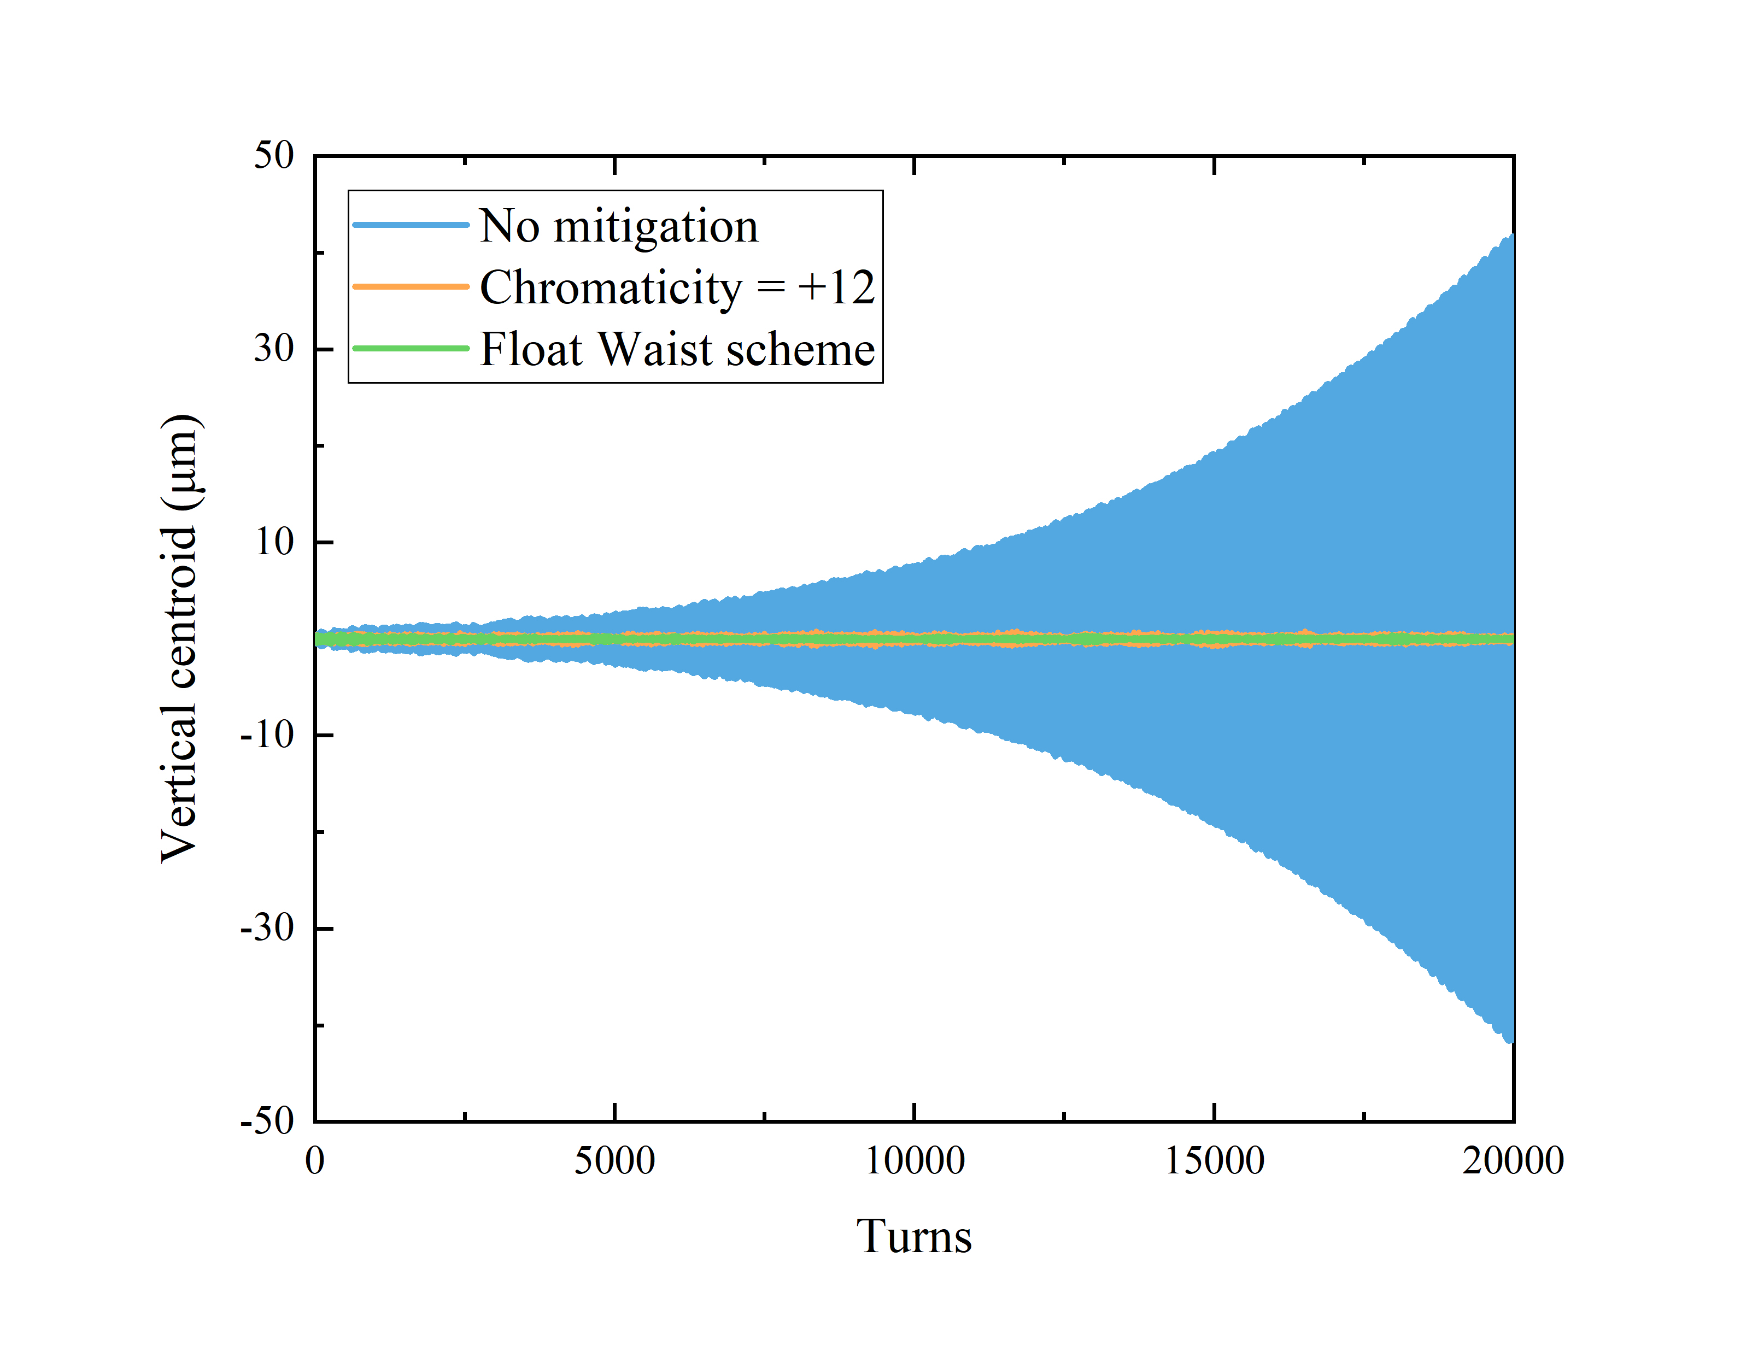


3. Challenges & Status of BB Research – Float Waist
When parameters are limited to more feasible ones, luminosity is much higher
The previous instability is stabilized by float waist naturally
Float waist is better than chromaticity
Luminosity can increase to 6.85×10³³ cm⁻²s⁻¹ (1.6 times the one in normal collisions), and its life is better

Slide 25




3. Challenges & Status of BB Research – Crab Cavities
It is necessary to employ local crab cavities to perform head-on collision as the luminosity is severely limited by large cross angle ~ 50 mrad
However, the nonlinear effects and imperfection effects of crab cavities will have detrimental impacts on beams

Slide 26





3. Challenges & Status of BB Research – Crab Cavities
Proton crab cavity
Proton
Proton
Proton: voltage noise < 1×10⁻⁵, phase noise < 1 μrad, phase control is quite difficult. More work is necessary …
Electron: voltage noise < 1×10⁻³, phase noise < 10 μrad (feasible)
D_{x} @ CC < 0.5 m
Proton: D_{px} @ CC ~ 0
Electron: D_{px} @ CC < 0.1
The frequency should be set based on bunch length, cross angle, …

Slide 27
4. Summary
The preliminary designs of EicC project in the CDR make it possible to investigate diverse single-particle and collective effects including beam-beam effects.
Simulation platforms Athena & GOAT are developed to study coupling effects, and an unstable situation is identified with wakes & beam-beam interactions.
Rapid-cycling operation mode that employs swap-out injection scheme to replace collision bunches online will increase both the peak and integral luminosity.
Float waist is a quite promising technology to suppress the strong hourglass effects from strong asymmetric focusing and increase the luminosity & the stability.
Crab cavities are necessary in EicC to compensate large cross angle, but they may have severe impact on the beams. Further studies and careful designs are needed.
Still a lot of work on the to-do list!

Slide 28
Thank you
Any comments or questions

Slide 29



Backups
Mode 1: Multi-plane painting injection + Multi-stage electron cooling
CW
1 bunch
3 injections
2.03×10¹³ ppp
RMS $ε_{x}/ε_{y}$ ~ 200/100 π nm·rad
192 bunches
2 injections, 384 bunches
1.05×10¹¹ ppb
4.05×10¹³ ppp
RMS $ε_{x}/ε_{y}$ ~ 100/50 π nm·rad
6.8×10¹² ppp
RMS $ε_{x}/ε_{y}$ ~
12/6 π mm·mrad
Proton beams as an example!
2 GeV
9.3 GeV
Acc. ~ 0.1 s
E.C. ~ 120 s
To replace all collision bunches ~ 12 mins
Acc. ~ 4 s

Slide 30


Backups
Mode 2: Stripping injection + Single-stage electron cooling
CW
1 bunch
3 injections
2.03×10¹³ ppp
RMS $ε_{x}/ε_{y}$ ~ 200/100 π nm·rad
192 bunches
2 injections, 384 bunches
1.05×10¹¹ ppb
4.05×10¹³ ppp
RMS $ε_{x}/ε_{y}$ ~ 100/50 π nm·rad
6.8×10¹² ppp
RMS $ε_{x}/ε_{y}$ ~ 3.2/1.6 π mm·mrad
Only for proton beams now!
9.3 GeV
To replace all collision bunches ~ 9 s
Acc. ~ 0.1 s
Acc. ~ 4 s

Slide 31

Backups
Ion Complex
The proton beams with opposite spin directions are injected and accelerated
Fixed field Siberian snakes will be employed in rapid-cycling boosters
pRing will be spin-transparent, and required spin directions are achieved at the injection line
Electron Complex
Electron beams matched with self-polarization direction are inj. & acc.
Opposite spin directions are achieved at the injection line
2 Spin rotators around the IP
Swap-out injection is necessary to maintain high polarization in eRing
Lose polarization much quicker

