Slide 1



Beam-Beam and related effects at the
Large Hadron Collider and FCC-hh
T. Pieloni EPFL
Acknowledgements: M. Hostettler, S. Kostoglou, G. Sterbini, X. Buffat, R. Tomas, W. Herr, S. Redaelli
Beam-Beam Workshop 2-5th September 2024
EPFL, Lausanne

Slide 2
Outlook
The Large Hadron Collider Beam-beam effects
  Strong BB effects in 2012
  Luminosity levelling
  LHC 2012→2024 controlled BB
  HL-LHC what is still missing?
  Coherent effects and stability
  Interplay, optics, collimation and modelling
Far future FCC-hh
Conclusions

Slide 3
Outlook
The Large Hadron Collider Beam-beam effects
  Strong BB effects in 2012
  Luminosity levelling
  LHC 2012→2024 controlled BB
  HL-LHC what is still missing?
  Coherent effects and stability
  Interplay, optics, collimation and modelling
Far future FCC-hh
Conclusions

Slide 4






The Large Hadron Collider (LHC)
8 arcs (~3 km)
8 straight sections (~700 m).
Two-in-one magnet design
4 interaction points (IPs): IP1, IP2, IP5, IP8
IP2 / IP8: beam injection
IP6: beam dump region
IP4: RF (acceleration)
IP3 / IP7: beam cleaning systems
27km underground tunnel
Synchrotron: proton beams accelerate from 450 GeV and collide at 4-6.8 TeV

Slide 5
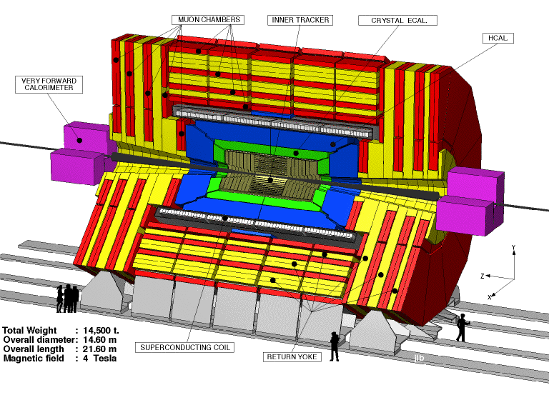
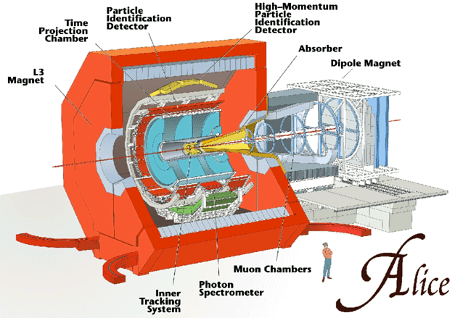
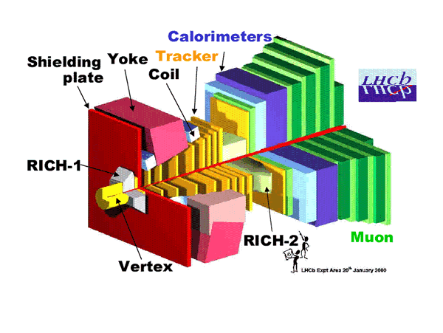
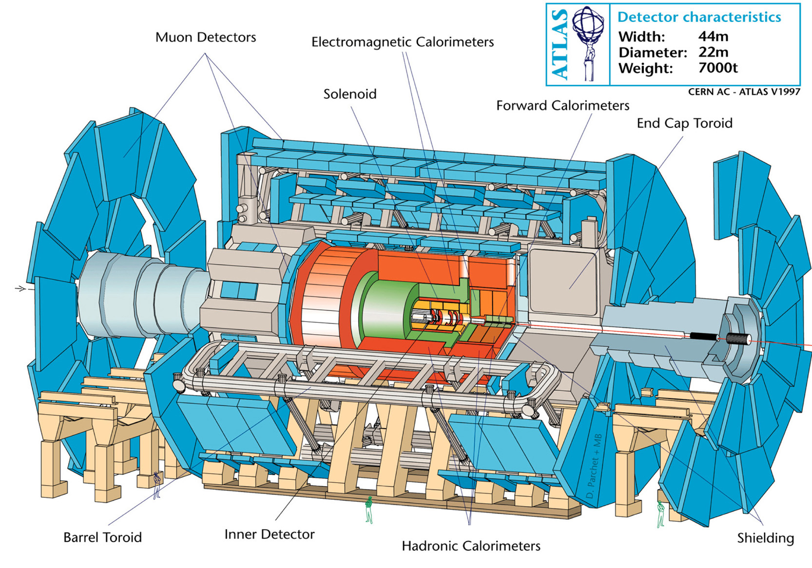
Beam-Beam effects
Multi-bunches in train structure spaced by 50-25 ns
Crossing angle operation needed to avoid multiple collisions
IP5
IP8
IP2
Head-On
Long Range
IP1
d

Slide 6
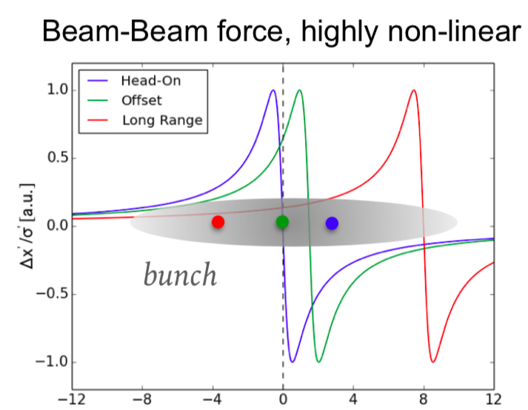
Beam-Beam effects
Many interactions ( ~124 per turn for 25 ns spacing)
Different types: Head-on, Offset and Long-Range collisions
IP5
HEAD-ON beam-beam interaction (core particles mostly affected)
IP8
LONG-RANGE beam-beam interaction (tail particles affected)
IP2
Head-On
Long Range
OFFSET beam-beam interaction (mixed state)
IP1
d
Changes:
the OPTICS (tune shifts, spread, Q’, beating, resonance excitation or enhancement, particle diffusion, distribution modification, reduced dynamic aperture)
Interplays with the other collective effects (Impedance, electron cloud)

Slide 7
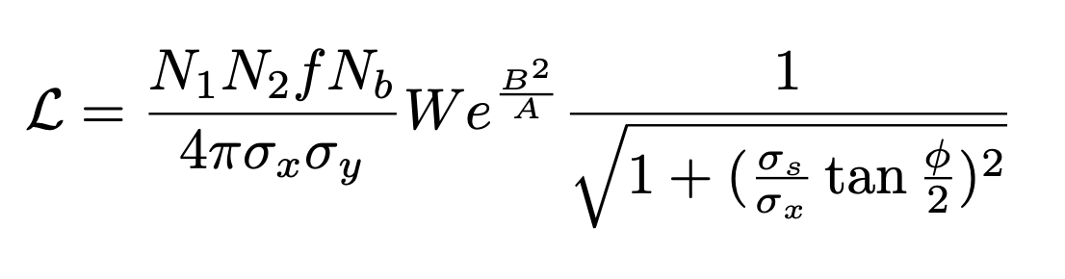
Beam-Beam effects
IP5
Complex problem with many parameters!
IP8
Luminosity key parameter for collider performance like the beam-beam force it depends on:
- β*
- φ
- beam intensities Ν_{1,2}
- emittances ε
- optics and non-linearities
IP2
Head-On
Long Range
IP1
d
Luminosity
Beam-Beam effects
Best Performances is a trade off of the different parameters involved…plus the experiment requests!

Slide 8
LHC parameters 2012 versus design
 | 2012 | Design
Intensities protons per bunch | 1.6-1.8 10¹¹ | 1.1
Normalized Emittances | 2.5 μm | 3.75 μm
ξ_{bb} | 0.008/IP | 0.0034/IP
Bunch spacing/ maximum # LR | 50 ns / 60 | 25 ns/120
IP1/IP5 LR sep | 9.5 σ | 9.8 σ
IP2 LR sep | > 12 σ | …
IP8 LR sep | > 10 σ | …
Energy | 4 TeV | 7 TeV
Peak Luminosity | 6.6 10³³ | 10³⁴
Octupole magnets | 550 A | …
Chromaticity | >20 units | 2 units
2012 Beam-Beam effects were strong!
2 HO 0.016 total tune shift (almost HL-LHC type)
IP2 and IP8 with relevant efefcts
Transverse Feedback at maximum gain
Electron cloud signatures on train tails
Strong Octupoles for Landau damping
Notes:
Add RUN2 pushed cases and RUN3.

Slide 9
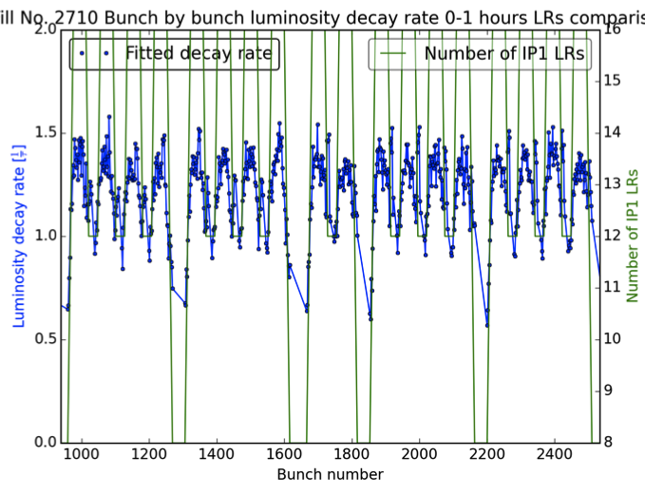
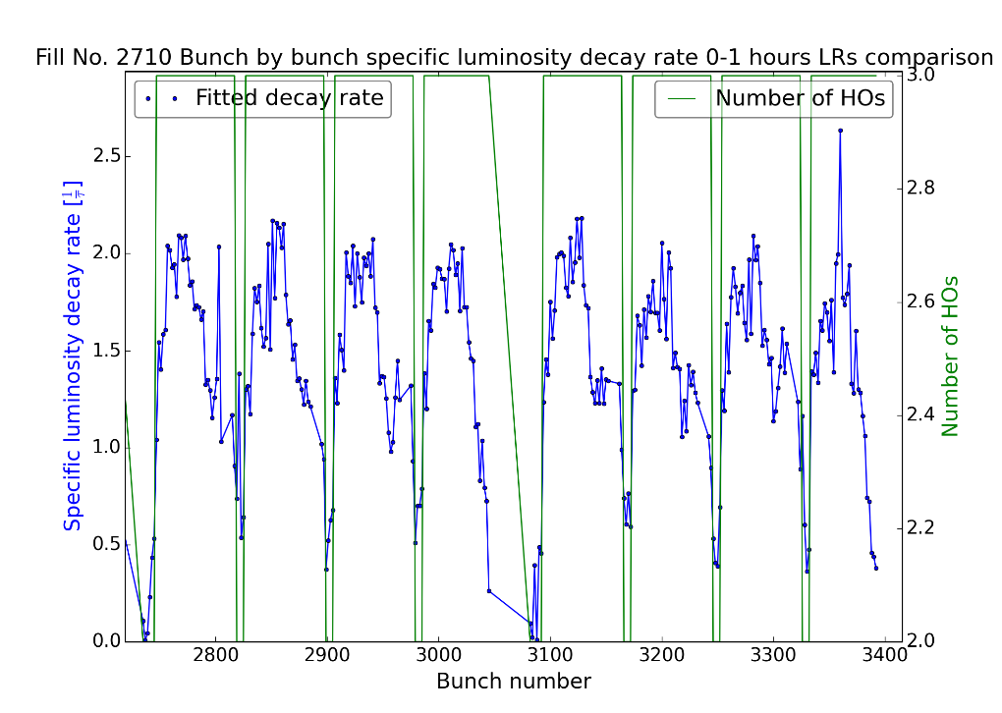
Strong Beam-beam Observations 2012
Regular Physics Fill of 2012 LHC RUN
Intensity lifetimes reduction → losses in first 2 hours
Emittance blow-up → 20% in 1h
Luminosity lifetime reduction
Increased beam brightness → no gain in Int Luminosity
New regime: experiments require levelled luminosity lumi constant at a fixed pile-up !
Game changer → allows to relax beam-beam effects!

Slide 10
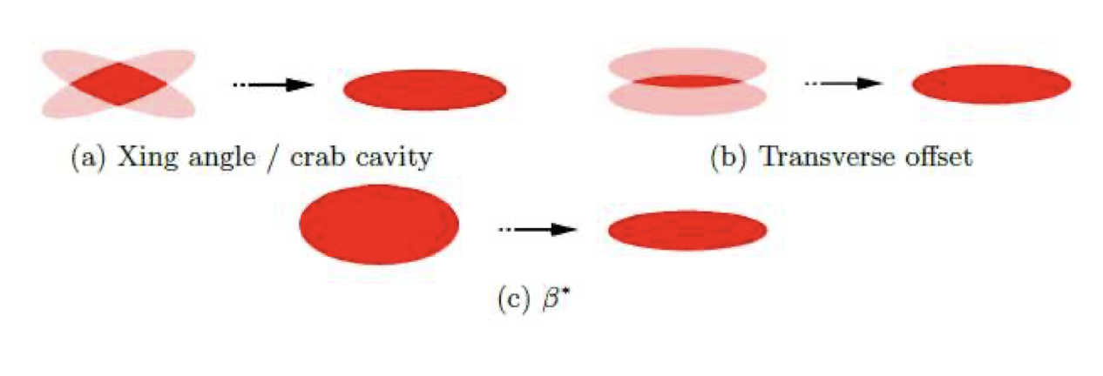
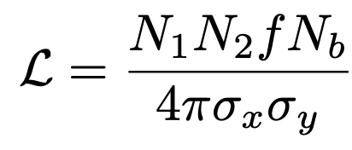
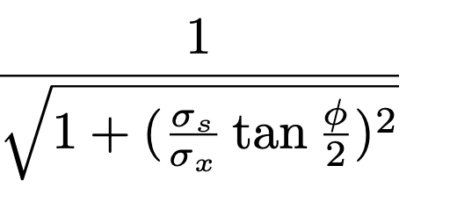
Luminosity levelling : useful knobs to reduce limits
Separation factor
Control luminosity using reduction factors (separation, beta*, angles) at a constant value while the beams intensity decays
Crossing Angle factor

Slide 11
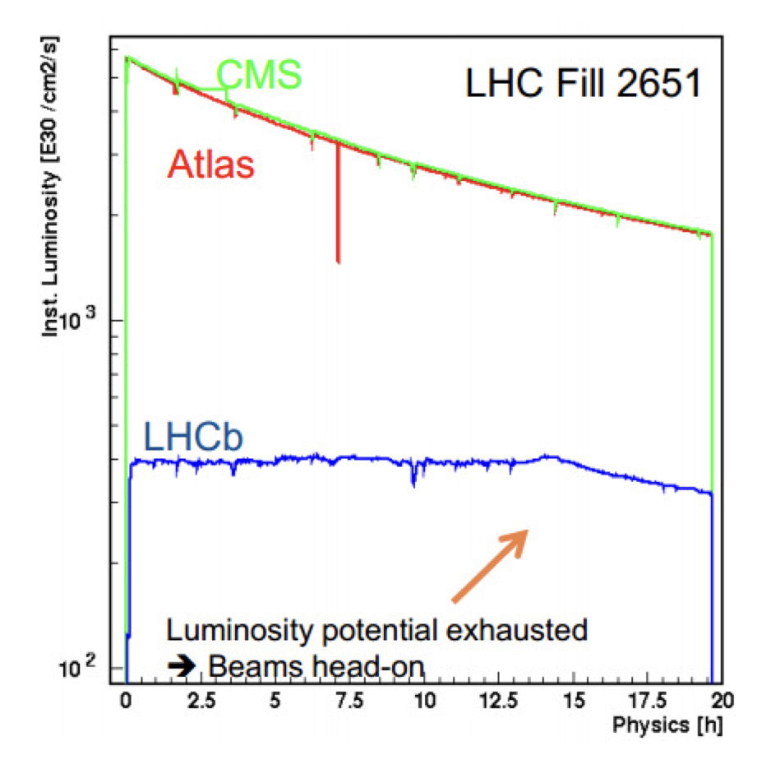
Luminosity levelling : useful knobs to reduce limits
Separation factor
Separation Levelling: LHCb and Alice
Keep luminosity constant at a fixed value while reducing the beams separation (W factor) 2012

Slide 12
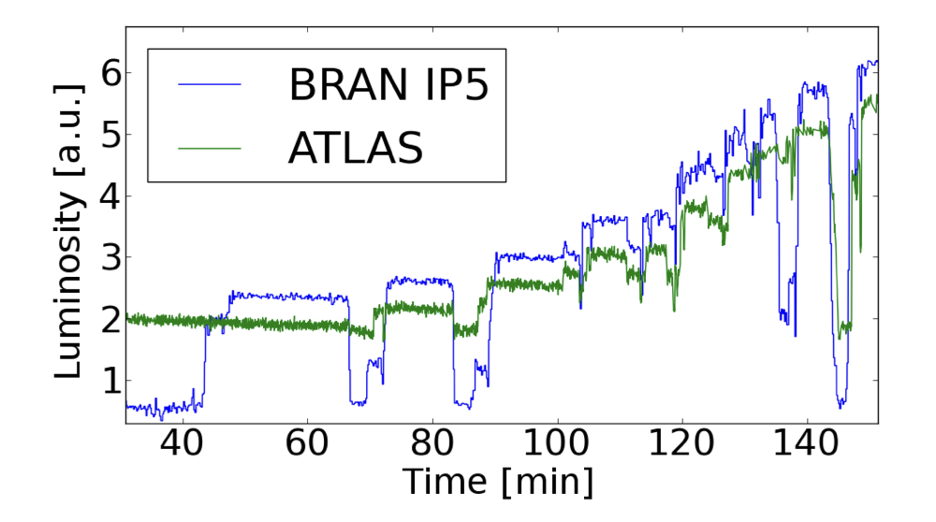
Luminosity levelling : useful knobs to reduce limits
1st b* leveling
Redution of luminosity increasing the beta* and angles
Reduce beta* while intensity decays → larger Long Range BB separations !
Crossing Angle factor

Slide 13
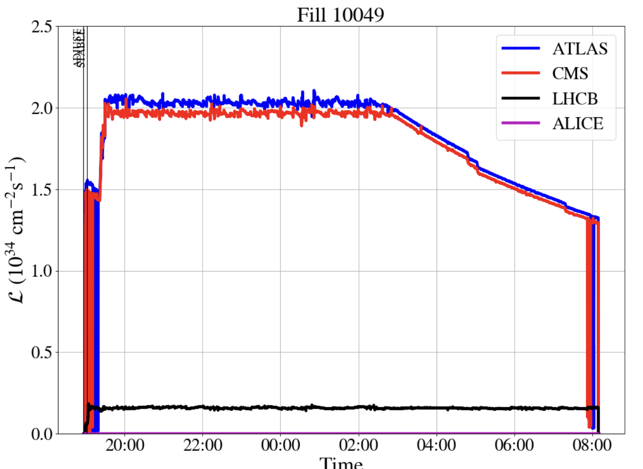
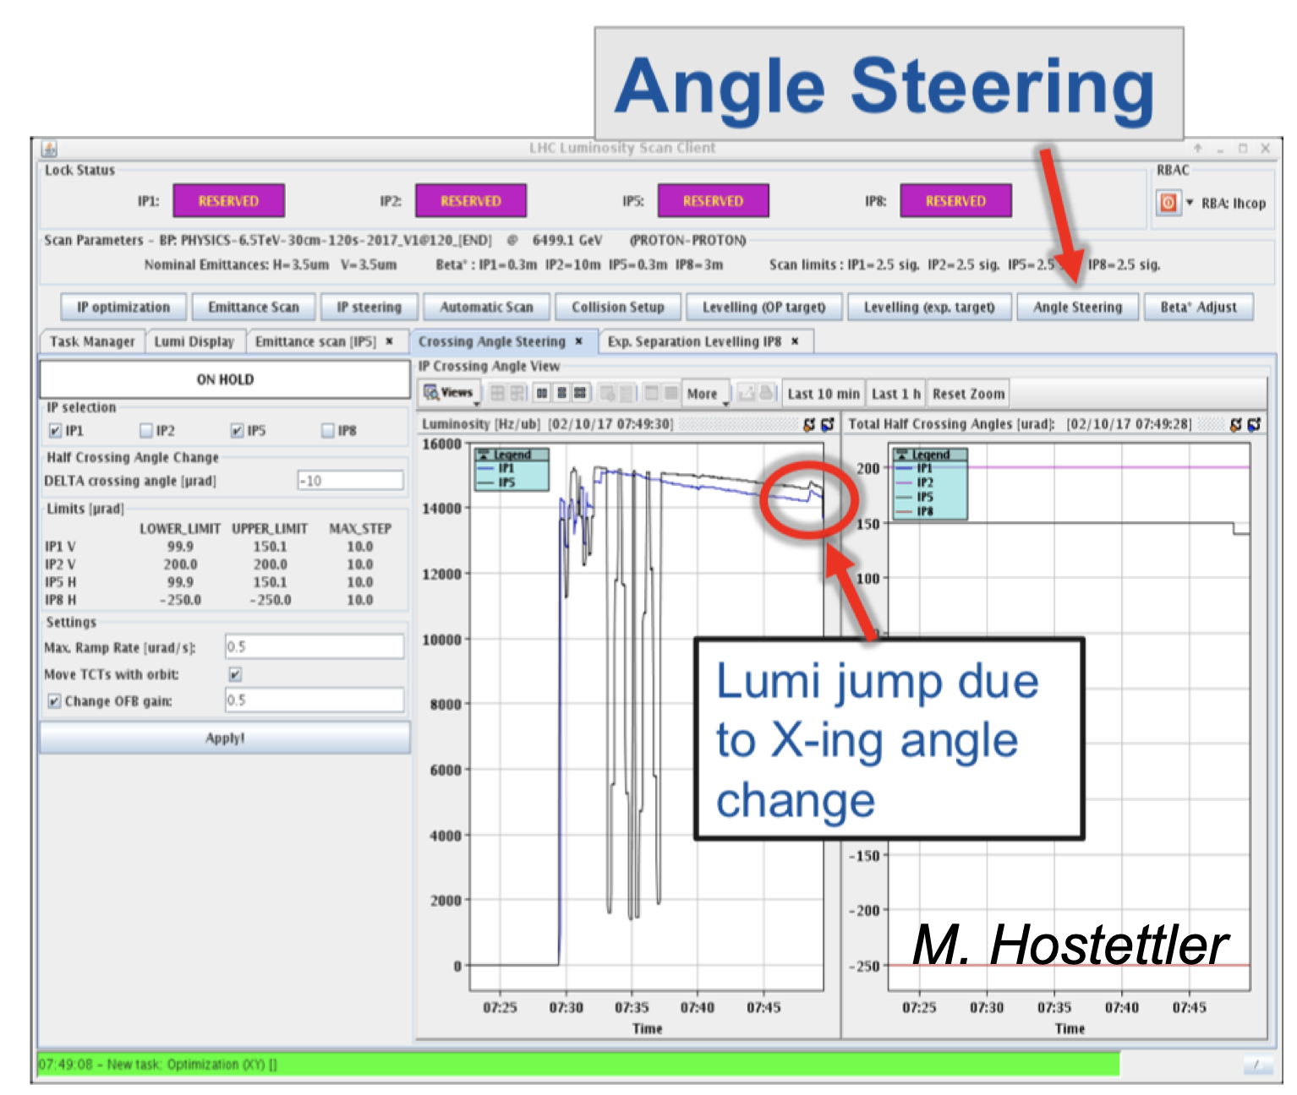
Luminosity levelling : useful knobs to reduce limits
Luminosity constant at a fixed target value (optimal for detectors efficiancy)
Knobs used: beta*, separation and angles in a combined way.
Optimizing integrated lumi → optimizing reducing BB effects!

Slide 14
Outlook
The Large Hadron Collider Beam-beam effects
  Strong BB effects in 2012
  Luminosity levelling
  LHC 2012→2024 controlled BB
  HL-LHC what is still missing?
  Coherent effects and stability
  Interplay, optics, collimation and modelling
Far future FCC-hh
Conclusions

Slide 15
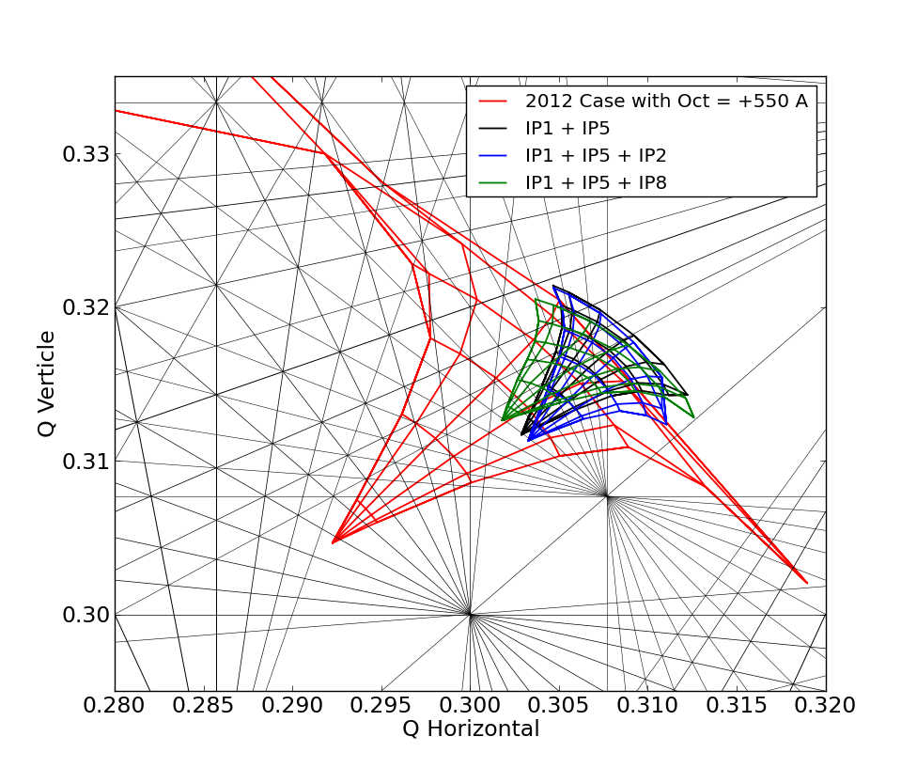
Footprint 2012 versus 2016
RUNI push for highest Lumi for higgs discovery pushed everything at the limit
- full squeeze to smallest beta*
- highest intensities 1.8-10¹¹ ppb
- smallest crossing angles
RUN2 levelled luminosity: integrated versus peak → relax versus pushed. All methods developed and made operational as valuable knobs to relax limits!
IP8 and IP2 in shadow of high lumi experiments→ tune shifts and spread below 10⁻⁴ level
IP1 and IP5 beta* levelling at larger beta relaxes BB LR separations → reduce separations when intensity drops
The LHC had a bright future toward 2*10³⁴ and beyond at peak for beta* of 30cm and injectors smaller emittances!
Footprints picture well the situation
A first try of a “global” optimization.
LHC simpler to optimize, keep margins for higher luminosity and to operate with high octupoles and chromaticity to stabilize beams

Slide 16
LHC parameters and RUN II strategy
 | 2012 | 2015 | 2016
Intensities protons per bunch | 1.6-1.7 10¹¹ | 1.2 10¹¹ | 1.1-1.25 10¹¹
Normalized Emittances | 2.5 μm | 3.5 μm | 3.5-2.5 μm
ξ_{bb} | 0.007/IP | 0.0035/IP | 0.003-0.004/IP
Bunch spacing/ maximum # LR | 50 ns / 60 | 25 ns / 120 | 25 ns / 120
IP1/IP5 LR sep | 9.5 σ | 11.5 σ | 10.5-12.3 σ
IP2 LR sep | > 12 σ | > 26 σ | > 26 σ
IP8 LR sep | > 10 σ | > 26 σ | > 26 σ
Energy | 4 TeV | 6.5 TeV | 6.5 TeV
Peak Luminosity | 6.6 10³³ | 0.7 10³⁴ | 1.1-1.4 10³⁴
Octupole magnets | 550 A | 470 A | 470 A
Chromaticity | 20 units | 15 units | 15/22 units
Potential to go to ~ 2 10³⁴ at reduced BB separations after tests
Notes:
Add RUN2 pushed cases and RUN3.

Slide 17
Long Range experiments 2016: LR limits
Beam 1
Beam 2
1.2-1.35 10¹¹ ppb intensity
[370-250] μrad no long-range pattern lifetimes as in regular physics fills 20-30 h
[250-230] μrad moderate long-range effects → impact on beam lifetimes 15-10 h
Below 230 μrad long-range effects and intensity lifetimes below few hours for fast losses
Two beam differences to be understood! 1 beam no effects observed!
IP2 and IP8 no effect
Q’ an Oct at low values help.

Slide 18
Long Range experiments 2016: LR limits
Beam 1
Beam 2
7.6 σ
φ
310
280
270
260
250
240
230
210
190
7.6 σ
8.0 σ
8.3 σ
Intensities 1.2-1.35 10¹¹ppb:
Fast losses at first time window of 5 min increases
Slow losses increase and do not improve after 15 minutes
Transient effect + strong deterioration of intensity lifetimes
Beam-beam effects visible with impact on losses 24%/hour
Two beam differences should be investigated

Slide 19
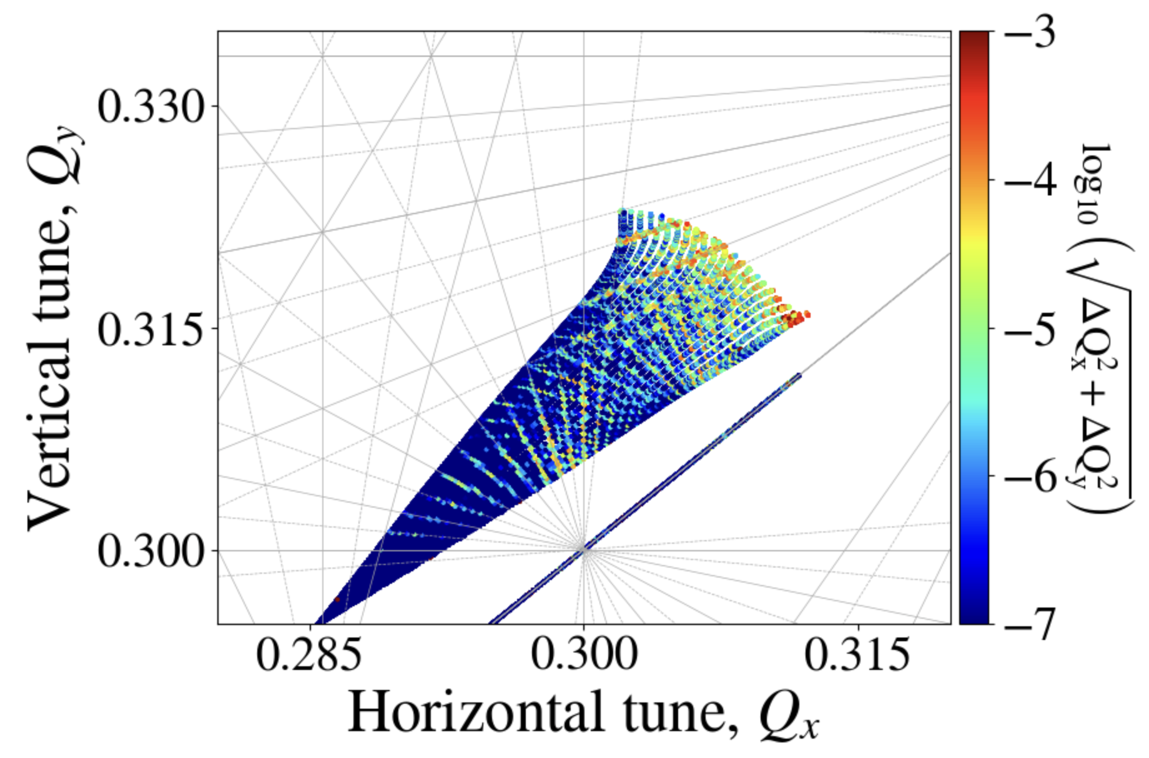
Footprint in 2024: past versus Present
S. Kostoglou
BB effects for LHCB and ALICE experiments are not negligible
LHCb at 1.5 σ separation HO!
β* levelling reduces long range effects of IP1 and IP5
Multiple knobs→ complex optimization!

Slide 20
Footprint RUN1 → RUN2 →RUN3
Footprint dominated by head-on collisions, maximum tune shift ~0.025

Slide 21
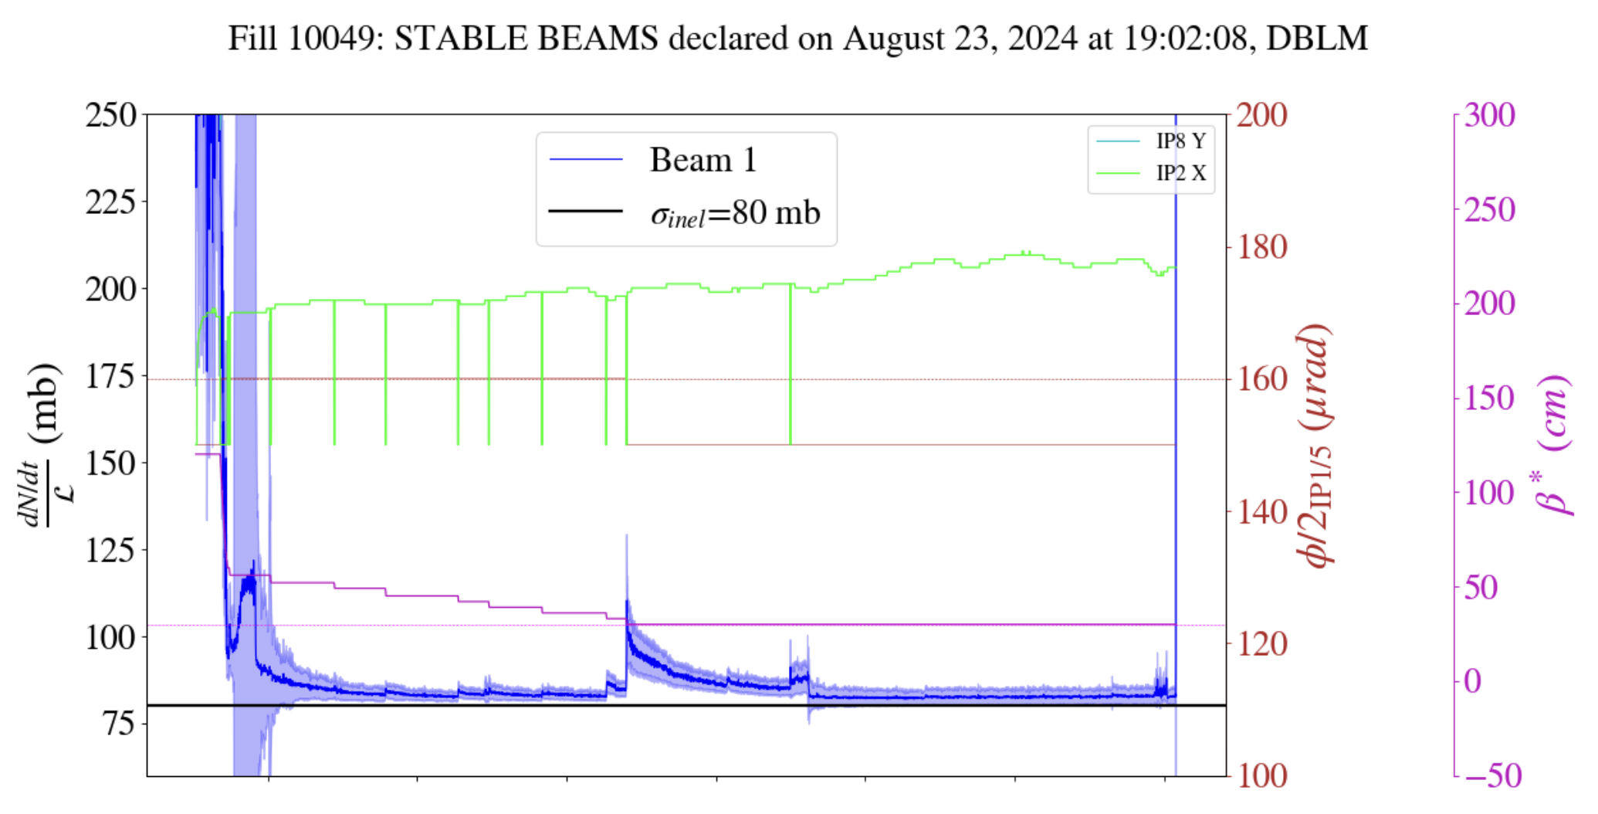
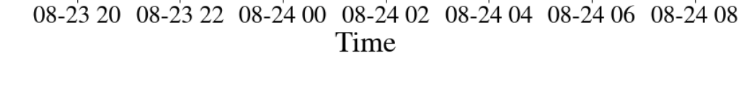
2024 observations: losses and levelling
Losses during 1st hour of collisions, no signature of long range
Beam lifetimes 20-10 h all along the fills
Minor emittance blow-up, losses under control
10σ separation
Tune trim
talks S. Kostoglou

Slide 22
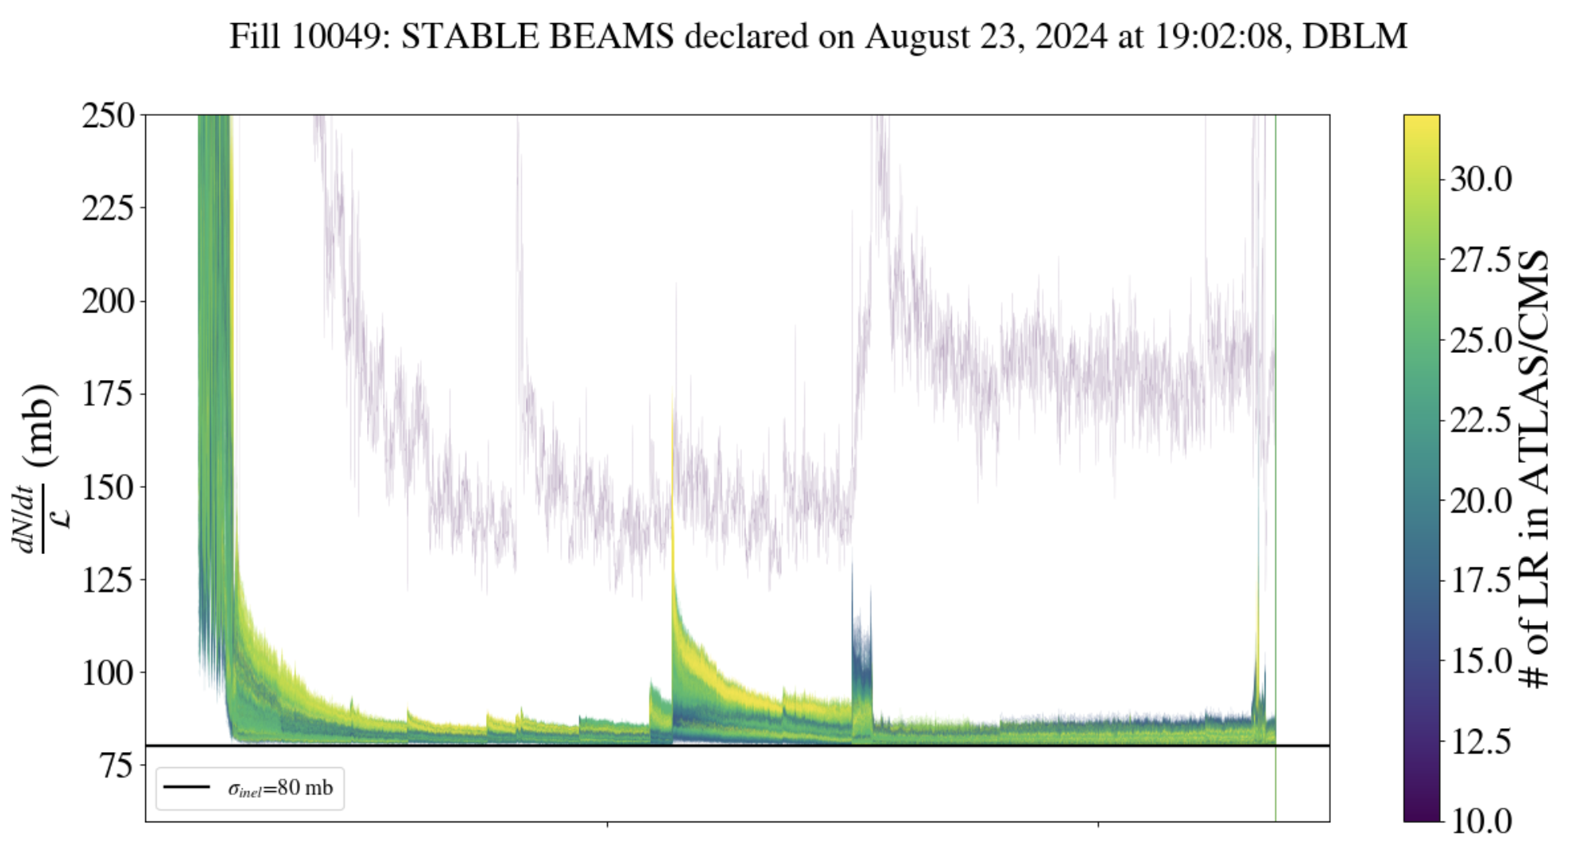
2024 observations: Bunch by bunch signatures?
At smaller separations (reduction of crossing angles IP1 and IP5) signature of LR
Lifetimes still above 10 h (tune trim seems even mitigating the effects)
Development of Wire compensation scheme in the LHC (talks G. Sterbini and P. Belanger)
LR act as scrapers but lifetime is good
10σ separation
Tune trim

Slide 23
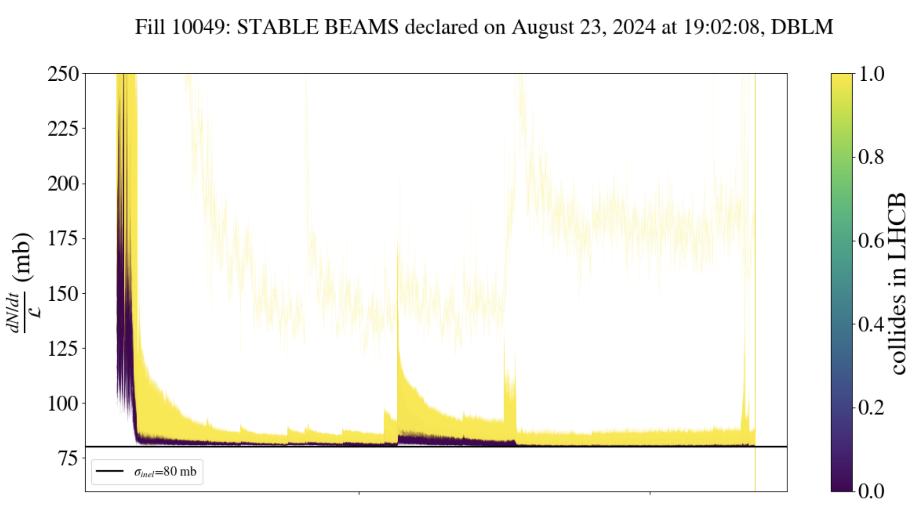
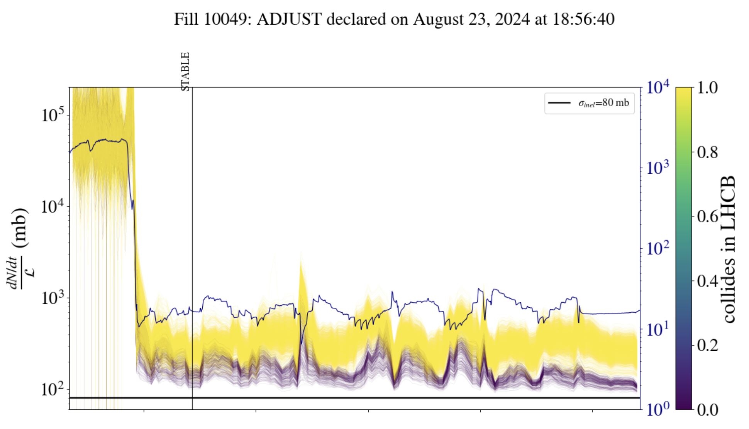
2024 observations: IP8
Bunches colliding in IP8 have larger losses
  Contribution to HO not negligible at 1.5 σ sep
  Offset collision shifts particles tunes
HO collision at 1.5 σ shows its effect
What is causing the effect? Need to improve understanding!
Separation levelling in IP and IP5 visible in lifetimes
S. Kostoglou, G. Sterbini

Slide 24
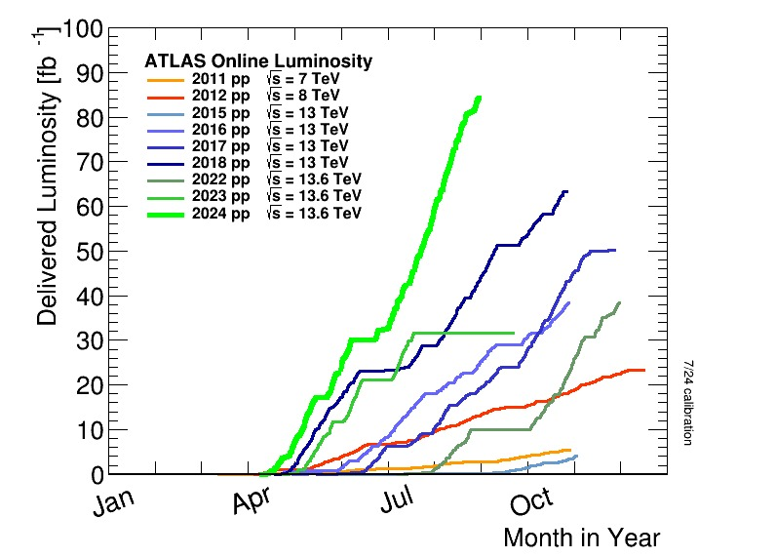
Where are the limits?
Over the last years several knobs developed to improvement and optimize the physics cycle reducing beam-beam effects all along
Good optimization of integrated lumi!
Beam-beam effects seem to be undercontrol and with margins!No real limits

Slide 25
Where are the limits?
Very little exploration of the limits in terms of HO and LR
  Understand the margins (reproducibility, optimization, B1 and B2 differences)
  Models benchmark to get confidency on observations and simulation results
  Prepare the future if HO or LR limited one needs different mitigations
HL-LHC is coming!

Slide 26
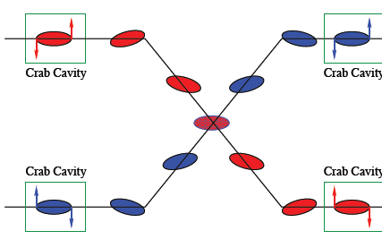
The High-Luminosity LHC
The main objective of the HL-LHC is to determine and build a hardware configuration and a set of beam parameters that will allow the LHC to reach the following targets:
Prepare machine for operation beyond 2025 and up to the early 2040s
Devise beam parameters and operational scenarios for:
    Enabling at total integrated luminosity of 3000 fb⁻¹
    Implying an integrated luminosity of 250 fb⁻¹ per year,
    Design for pile-up ≤ 140 (➔ peak luminosity 5 x 10³⁴cm⁻²s⁻¹)
Crab Cavities to compensate for geom loss reduction (LHC24 down to 0.6)

Slide 27
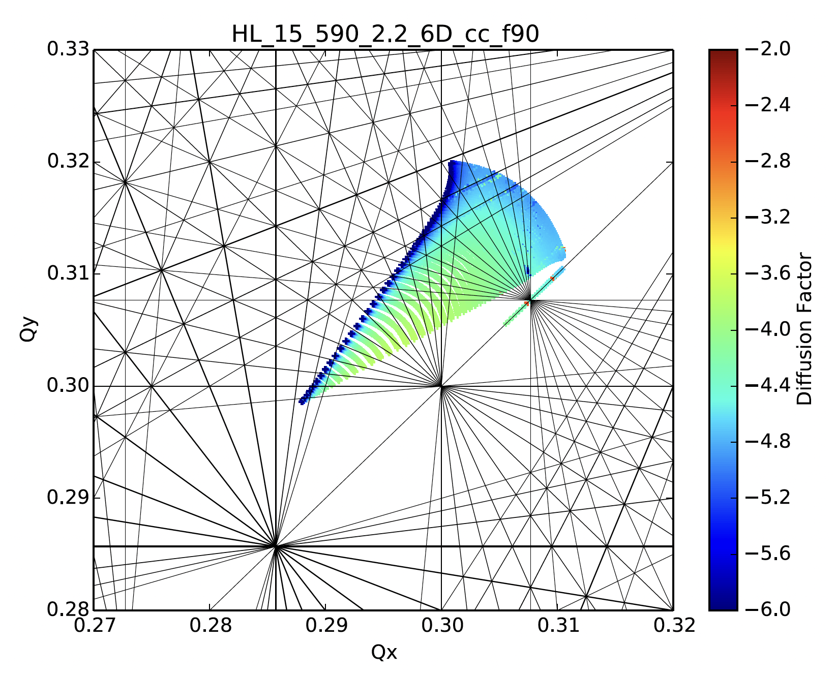
Footprint RUN1 → RUN2 →RUN3→HL-LHC
IP1 and IP5
HL-LHC larger beam charges 2.2 10¹¹
IP8 will become a high luminosity exp
Experiments will explore higher pile-ups
Relys on Beta* levelling and Crab crossing scheme
Need to be ready!
CERN-ACC-NOTE-2018-035

Slide 28
Footprint RUN1 → RUN2 →RUN3→HL-LHC
IP1, P5 AND IP8
IP1,5 and 8 in HO collision
Separation levelling for IP1 and 5 might be reconsidered to help reducing HO limit?!
Stability needs to be mantained
CERN-ACC-NOTE-2018-035

Slide 29
Footprint RUN1 → RUN2 →RUN3→HL-LHC
IP1, P5 AND IP8
IP1,5 and 8 in HO collision
Tunes might need adjustment in collision
LR contribution very small
Separation levelling for IP1 and 5 might be reconsidered to help reducing HO
Stability needs to be mantained
We have to explore the limits of HO and LR to be ready for HL-LHC!
Pushed tests and extensive benchmark of models versus observations
Need observations ahead of time to understand and improve models!
CERN-ACC-NOTE-2018-035

Slide 30
Outlook
The Large Hadron Collider Beam-beam effects
  Strong BB effects in 2012
  Luminosity levelling
  LHC 2012→2024 controlled BB
  HL-LHC what is still missing?
  Coherent effects and stability
  Interplay, optics, collimation and modelling
Far future FCC-hh
Conclusions

Slide 31
Beam-beam coherent effects
Talk X. Buffat
Coherent modes
Landau damping of impedance driven modes
High feedback operation → Noise + beam-beam
Beam-beam + Impedance mode coupling
Orbit effects
Optics and collimation
Any effect visible is an opportunity to benchmark models!

Slide 32
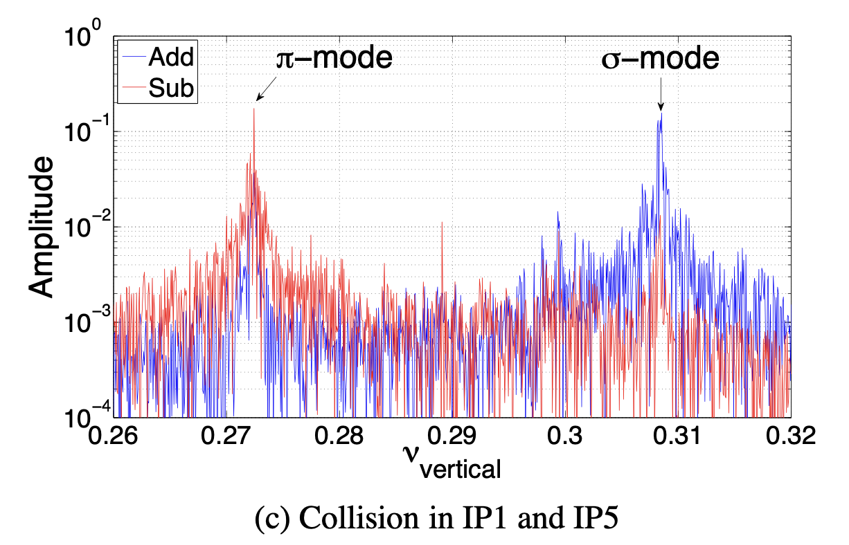
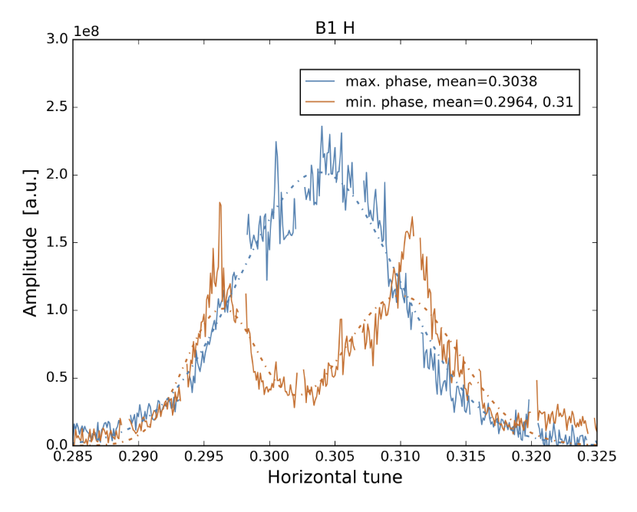
Beam-beam coherent modes
Measured several times in the LHC, well reproduced
No bad impact to performances
No instabilities due to only coherent BB modes
Most of the time due to strong non-linearities, many long-ranges and strong transverse feedback → they are suppressed
Proved very large beam-beam tune shift not impossible but limits are in incoherent effects→ lifetimes, losses, emittance blow-up.
Recently experimentally proved one can suppress them with optics corrections → possible improvement of spectra, disentagling coherent from incoherent effects. (test to be prepared)
LHC test 2011
W. Herr and Co.
ΔQ~-0.04
J. Wacsky EPFL Thesis

Slide 33
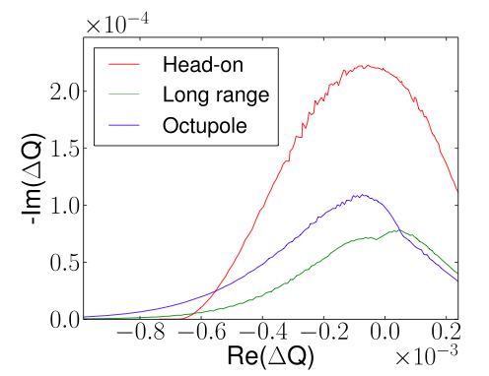
Beam-beam and Landau damping
HO beam-beam spread very effective in stabilizing coherent instabilities (impedance driven)→ Landau damping contribution
Larger frequency spread → Stronger Landau damping
A way to quantify the Landau damping is by use of the Stability Diagram
Several references Prof. Vaccaro, Berg-Ruggiero
Beam-beam effects do contribute to stability!
Quote by A. Chao from BB2013 “Colliding beams will never become unstable”
X. Buffat EPFL PhD Thesis

Slide 34
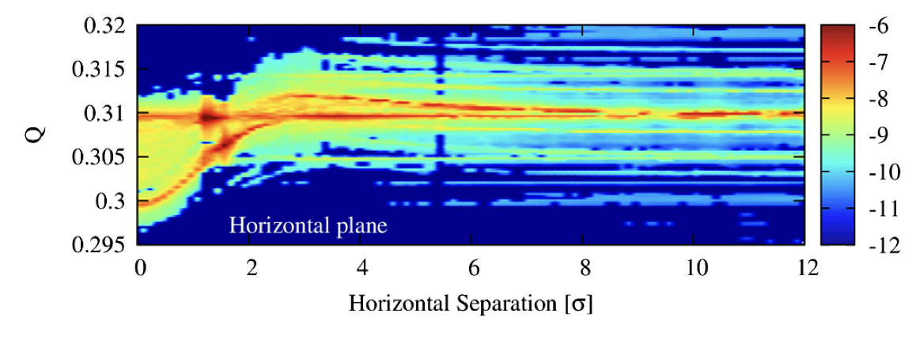
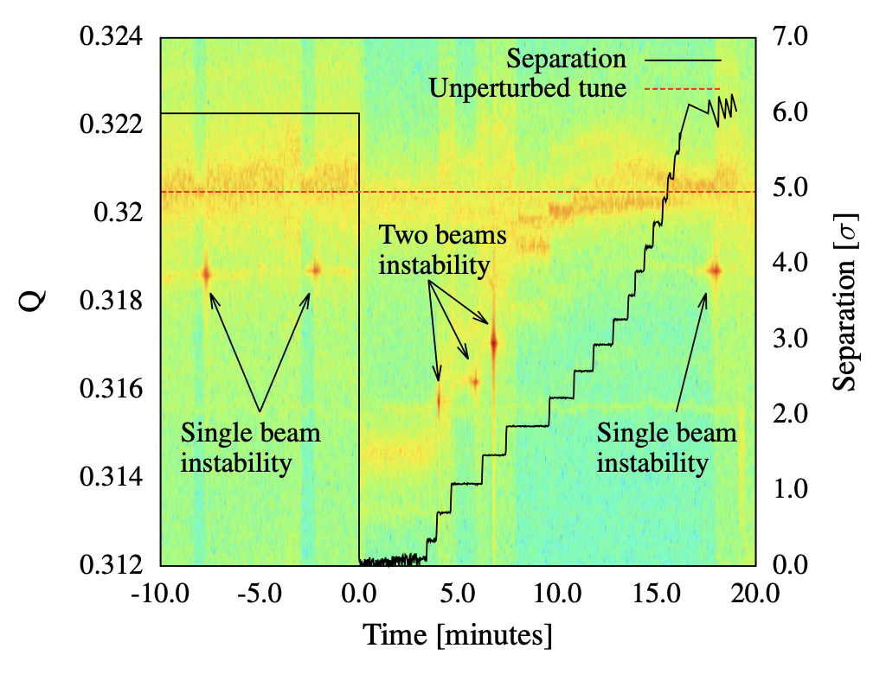
Coherent instabilities and noise
Transverse Mode Coupling BB and impedance has been proved experimentally and in simulations but fully cured by transverse feedback
Transverse feedback intrinsic Noise and high gain operation
Extensive use of feedback to damp coherent instabilities → drive emittance blow-up due to intrisic noise
Larger Beam-beam parameter → larger emittance growth
LHC 2024 emittance growth minor thanks to optimized transverse feedback noise level and gain
2017 CERN-ACC-NOTE-2017-0044 CERN-ACC-NOTE-2017-0030

Slide 35
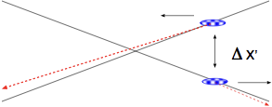
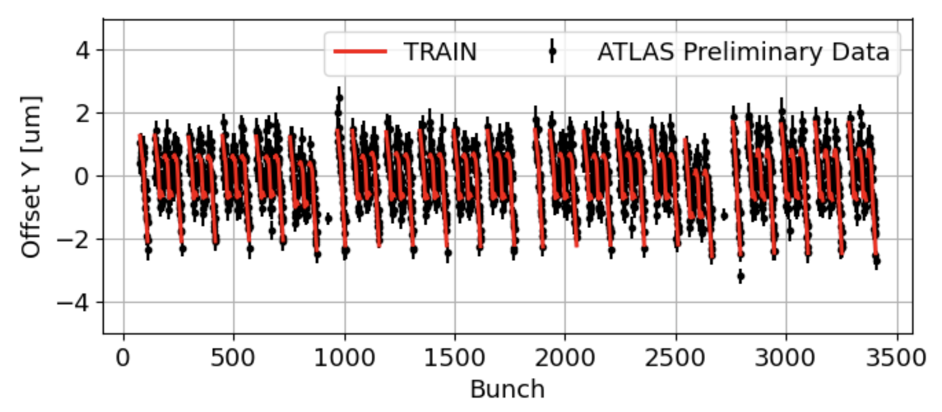
Beam-beam orbit effects
Long range beam-beam interactions will modify the closed orbit → offsets at the collision points
Self consistent calculations are used to compute the orbit changes (PyTRAIN)
Benchmark of model to detectors measurements show excellent agreement between orbit model and reality
Minor impact to luminosity
New observable luminous regions from detectors
Talk by M. Hostettler

Slide 36
Beam-beam effects: modelling, collimation, optics
Even if LHC seems not to be BB limited “yet”
→ Beam-Beam still defines the dynamics of colliding beams
  Collimation hierarchy breakage and observations on protection system (C.E. Montanari, F. van der Veken) → Models with BB and collimation tracking
  Non-linear dynamics: BB and Optics (T. Carlier, E. Maclean)
  Beam-beam and electron cloud interferences (Pop-corn instabilities at end of fill)
  → Modeling → XSUITE (Ji’s talk)
  Fundamental to model all effects together and benchmark to reality ! (talk G. Iadarola)

Slide 37
Outlook
The Large Hadron Collider Beam-beam effects
  Strong BB effects in 2012
  Luminosity levelling
  LHC 2012→2024 controlled BB
  HL-LHC what is still missing?
  Coherent effects and stability
  Interplay, optics, collimation and modelling
Far future FCC-hh
Conclusions

Slide 38
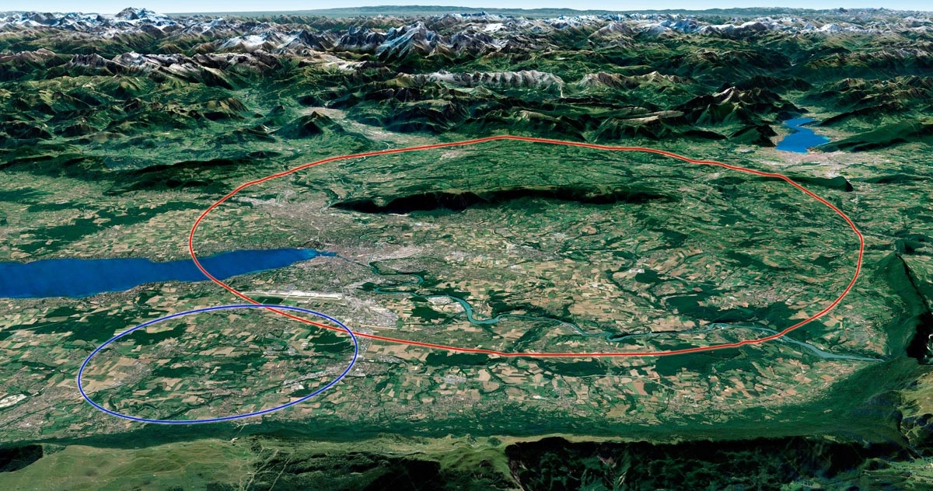
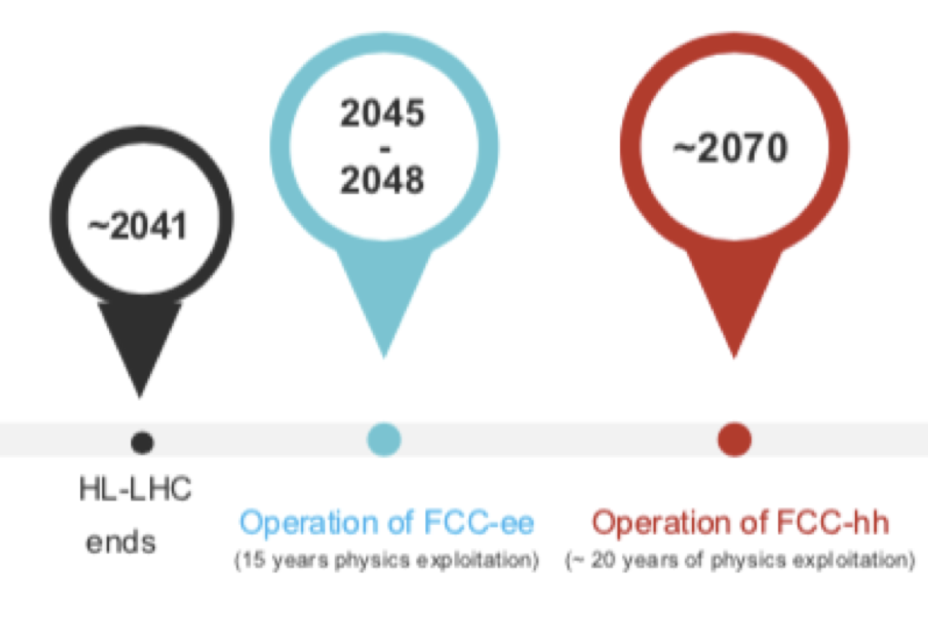
FCC ee/hh
LHC / HL-LHC

Slide 39
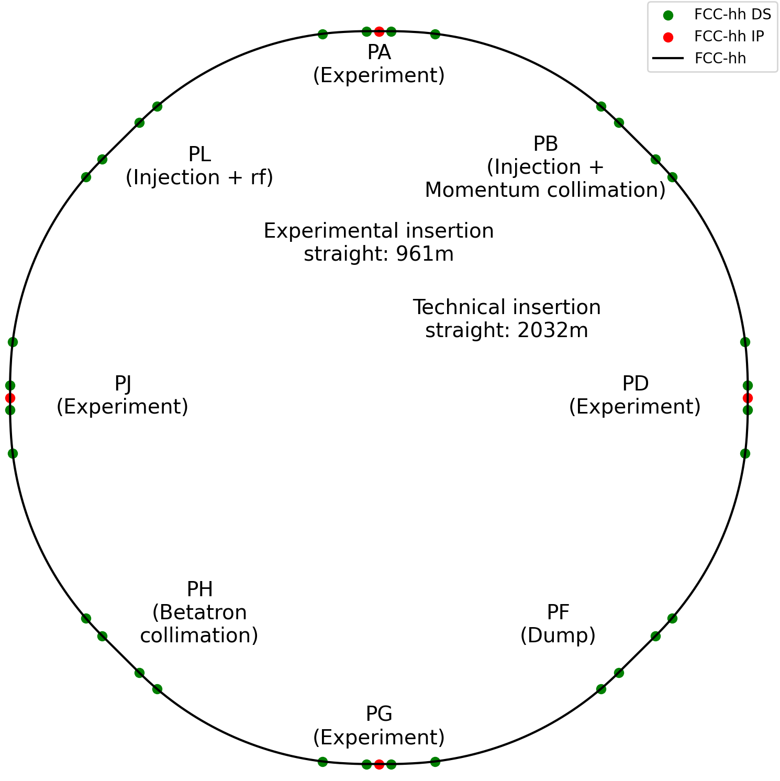
FCC-hh
  4-fold symmetry with 4 experimental interaction points
  Target for centre of mass energy is 90 TeV @ 14T
Main area of R&D for FCC-hh is high field superconducting magnets
Low temperature, high temperature or hybrid
G. P. Segurana and M. Giovannozzi

Slide 40
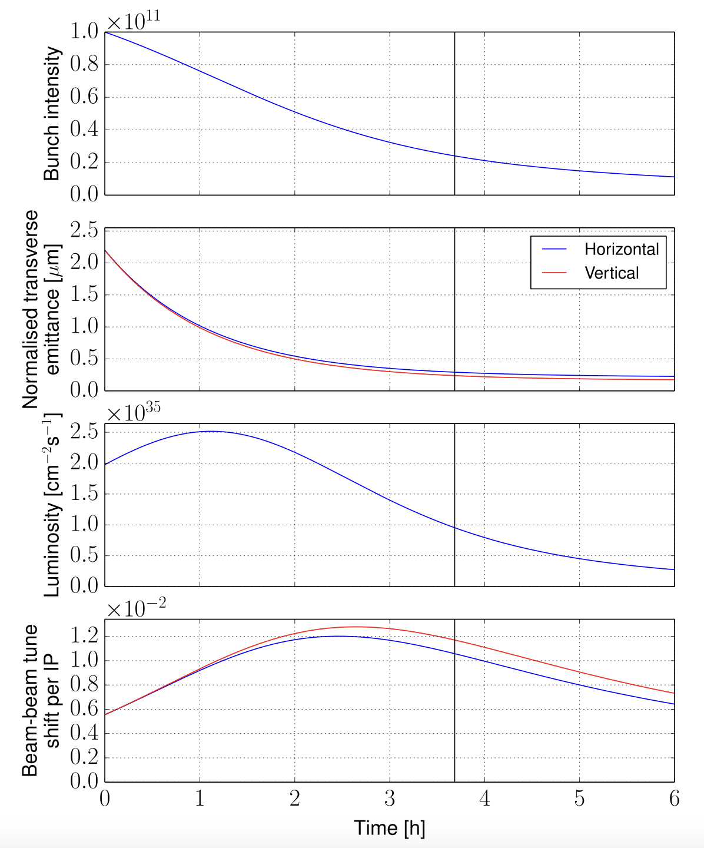
FCC-hh
Beam-beam effects will be even different:
HO dominated maximum tune shift of 0.024 (LHC today) 2IPs
2 secondaries at separation levelling
Relevant damping large BB tune shift middle fill
Long range effects negligible (beta* levelling)
LHC has to explore all the effect to make future colliders designed on solid foundations!
Need to explore experimentally where possible, develop more realistic models and benchmark extensively present machines!

Slide 41
Outlook
The Large Hadron Collider Beam-beam effects
  Strong BB effects in 2012
  Luminosity levelling
  LHC 2012→2024 controlled BB
  HL-LHC what is still missing?
  Coherent effects and stability
  Interplay, optics, collimation and modelling
Far future FCC-hh
Conclusions

Slide 42
Conclusions (I)
Several Beam-beam effects have been observed in the LHC and mitigated resulting in a collider with excellent performances and not limited by BB
    This was possible thanks to luminosity levelling requests by the experiments → knobs exsist to reduce lumi and consequently the BB effects (relaxed beta, separations, angles)
    Losses observed seem to show the head-on effects to be more dominant today
    No long-range limitations seem to be present
  Very little experimental tests have been made in the last 8 years: head-on and long range limits have not be explored and studied sistematically
    Fundamental to understand the limits and where the margins are
    Prepare possible mitigation strategies and compensation schemes for the future: HO? LR?
    Benchmark models as much as possible in systematic manner→ bridge simulations/observables

Slide 43
Conclusions (II)
  HL-LHC will have 2.2*10¹¹ppb and crab cavities → will reserve some observations we need to be ready
    LHC today is alredy showing what HL-LHC with 2 collisions will be, exploring will prepare us for the RUN4
  FCC-hh will have beam-beam effects very similar to HL-LHC but with relevant radiation damping (~1h damping time).
    LHC will be the last hadron collider ever built till FCC-hh.
    Everything learned at the LHC will represent an unvaluable source of knowledge for who will have to design such collider
    We need to explore limits in MDs pushing the limits and learning beyond the operational needs

Slide 44
Thank you!

Slide 45
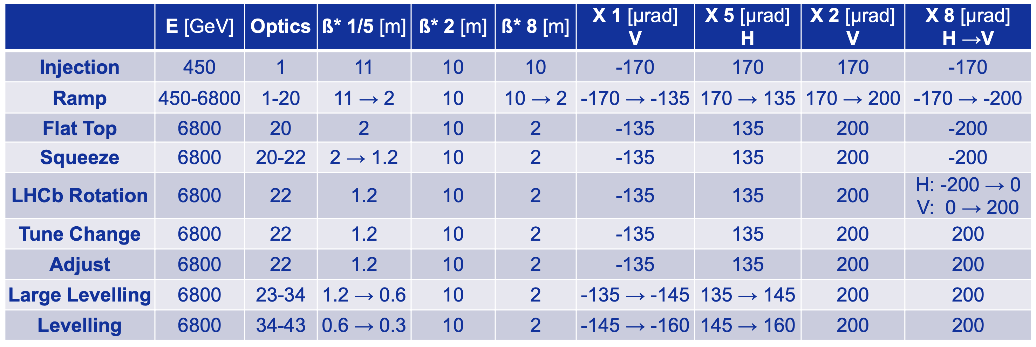
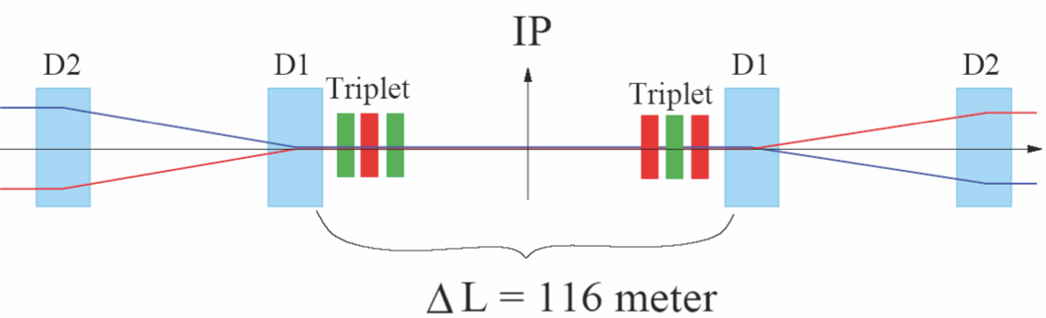
Operational configurations 2023 — challenging!
Deployed already some key features required for the HL-LHC operation!
Smoothly put in operation in 2023 and 2024 despite the complexity!

Slide 46
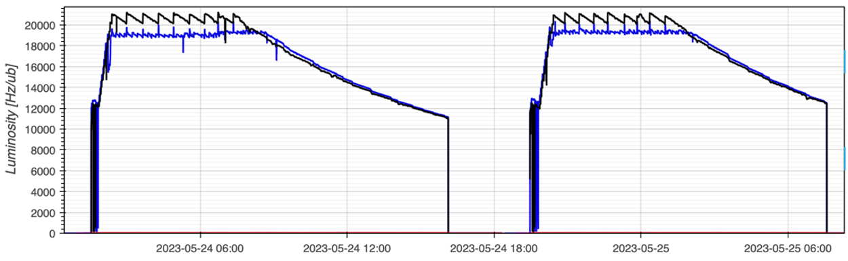
Luminosity levelling at the LHC
β* levelling
Collisions head-on
Fast β* change to target luminosity
“Emittance scans”
Levelling range 120cm-30cm initially optimised for bunch intensities up to 1.8x10¹¹p
Most complex operations were deployed starting in 2023 with changes at the same time of the β* functions, the separation bumps and crossing angle.
IR’s tertiary and physics-debris collimators changing gaps and positions!
Target lumi step size ~5% — can do much better by combining separation and β*!
Separation levelling in LHCb and ALICE

Slide 47
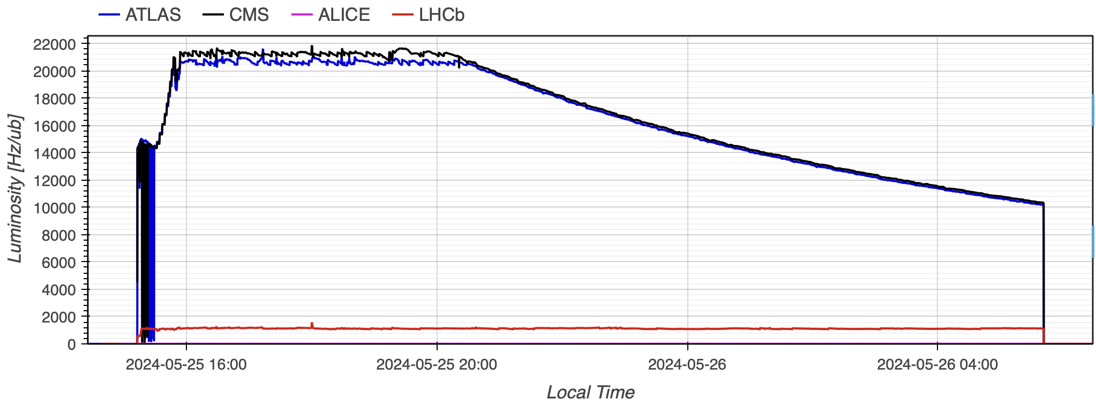
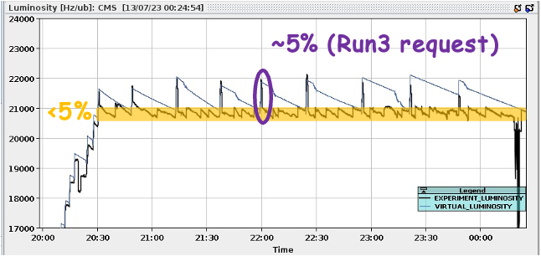
Further improvements in 2024
Fast levelling to peak luminosity, reached at around 60cm
Branch 120cm-60cm kept in case of
larger bunch currents are accessible
later in the year
Finer tuning of pile-up, independently for ATLAS and CMS: new tools to combine separation and β* levelling
Larger-than-needed “virtual” luminosity
done with a step in β*, then fine tuning
with separation

Slide 48
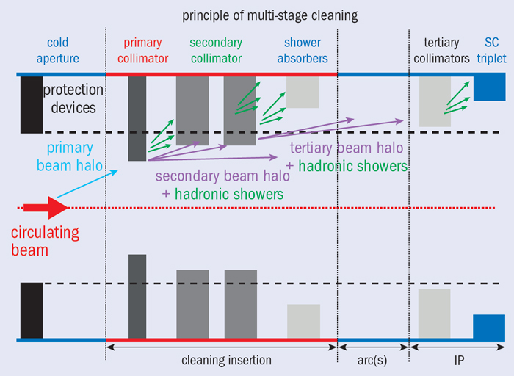
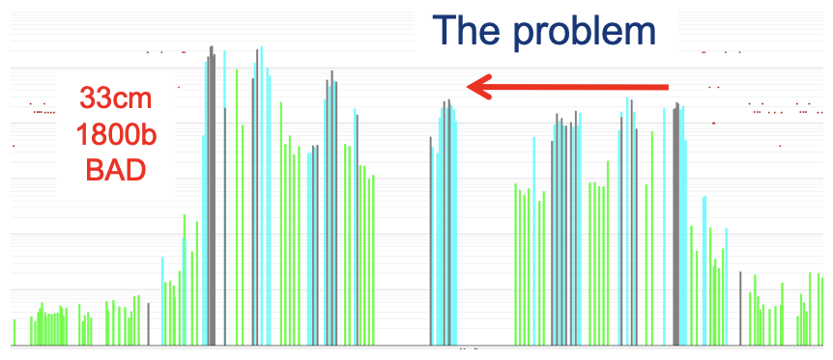
Collimator Hierarchy
On 17 April a first breakage in the collimator hierarchy was observed:
With 1800 bunches per beam
Losses on the secondary collimators increased more than the losses on the primary collimators during the 𝛽* squeeze from 36 to 30 cm
The squeeze halted at 36 cm for machine protection reasons → ~ 2% loss in luminosity
Studies and tests indicate that off-momentum halo particle with a large vertical betatron amplitude are responsible for the breakage

Slide 49
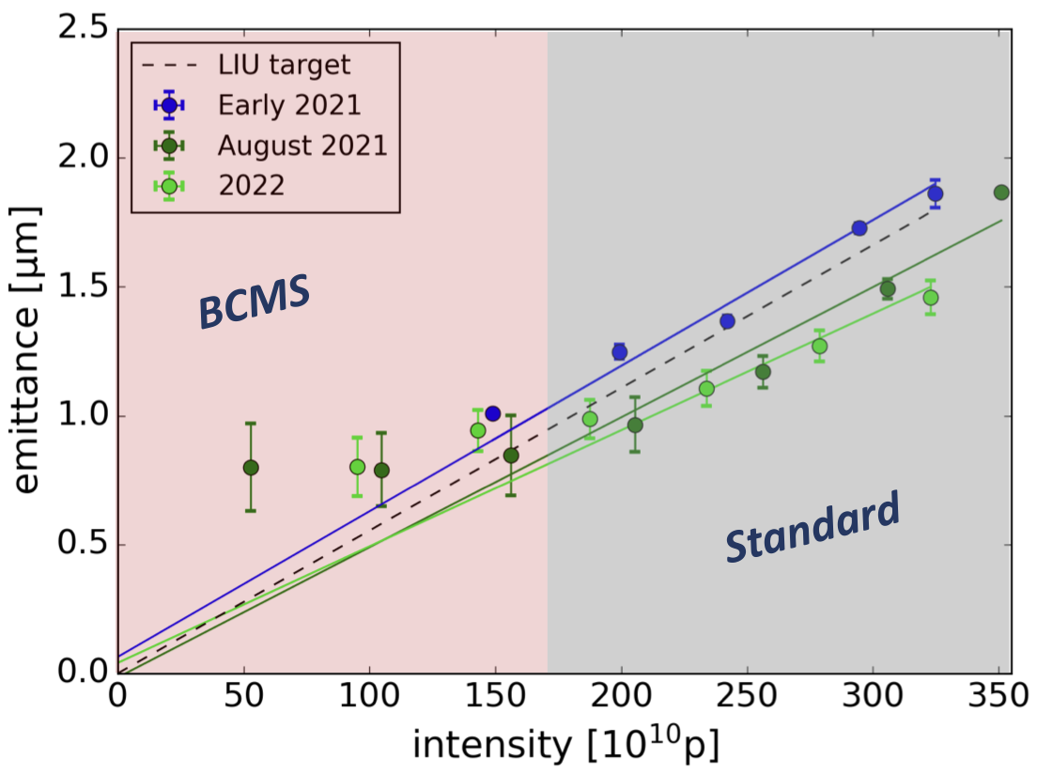
Standard vs BCMS in the Injectors
Splitting factor Standard beam = 12
Splitting factor BCMS beam = 6
BCMS beam requires less protons per bunch injected in the PSB
Transverse emittance is preserved during longitudinal bunch splitting
Therefore, BCMS beam has higher brightness

Slide 50
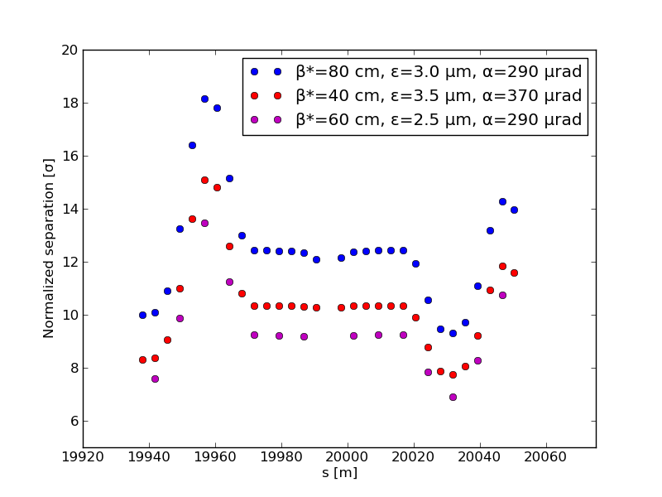
LHC configuration RUN I→RUN II
Move from 50 to 25 ns spacing → double long-range numbers
Electron cloud effects → big uncertainty on final emittances in collision
Instabilities during squeeze → allow for safe High chromaticity and high octupoles operation
β* → to probe potential luminosity reach commissioning the final optics
2015
IP1
IP5
2016
2012
IP1 and IP5 at 10 σ beam-beam separation for emittance of 3.75 μm → relaxed configuration Dynamic Aperture from 4 to 5-6 σ
When emittances stable and at the smallest values → room for reducing crossing angles!

Slide 51
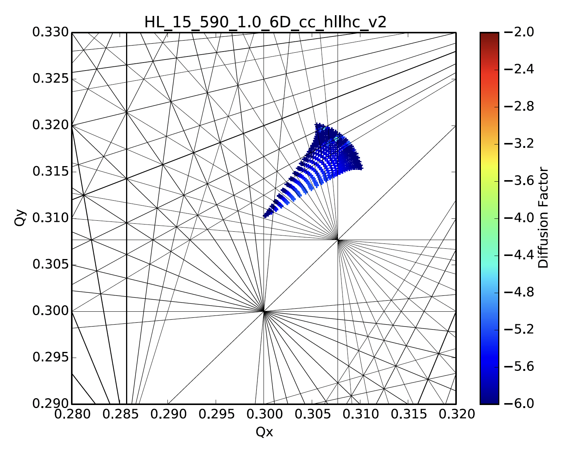
Footprint RUN1 → RUN2 →RUN3→HL-LHC
IP1 and IP5
IP1 and IP5
2 IPS end of Fill 10¹¹ppb
CERN-ACC-NOTE-2018-035

