Slide 1






Beam-beam effects overview and their impact on collider design and performance
Xavier Buffat, Tatiana Pieloni, Lenny Rivkin
EPFL, Lausanne, 2 September 2024

Slide 2
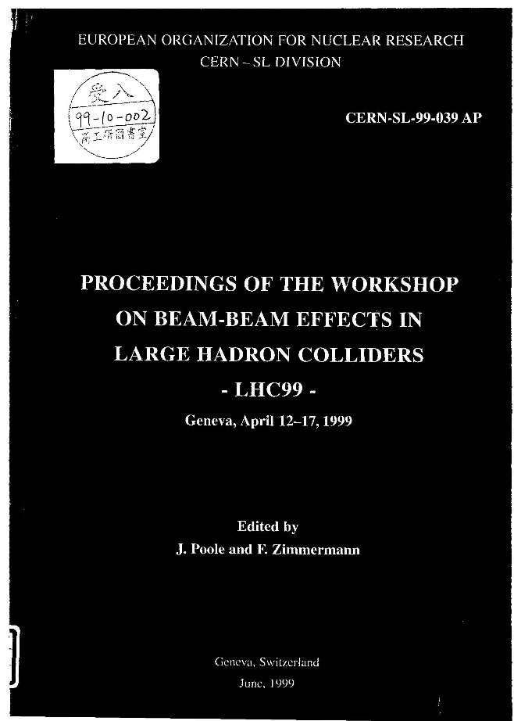



Workshops on beam-beam effects in circular colliders
1999 (CERN)
2001 (Fermilab)
2013 (CERN)
2018 (LBNL)
2024 (EPFL)

Slide 3
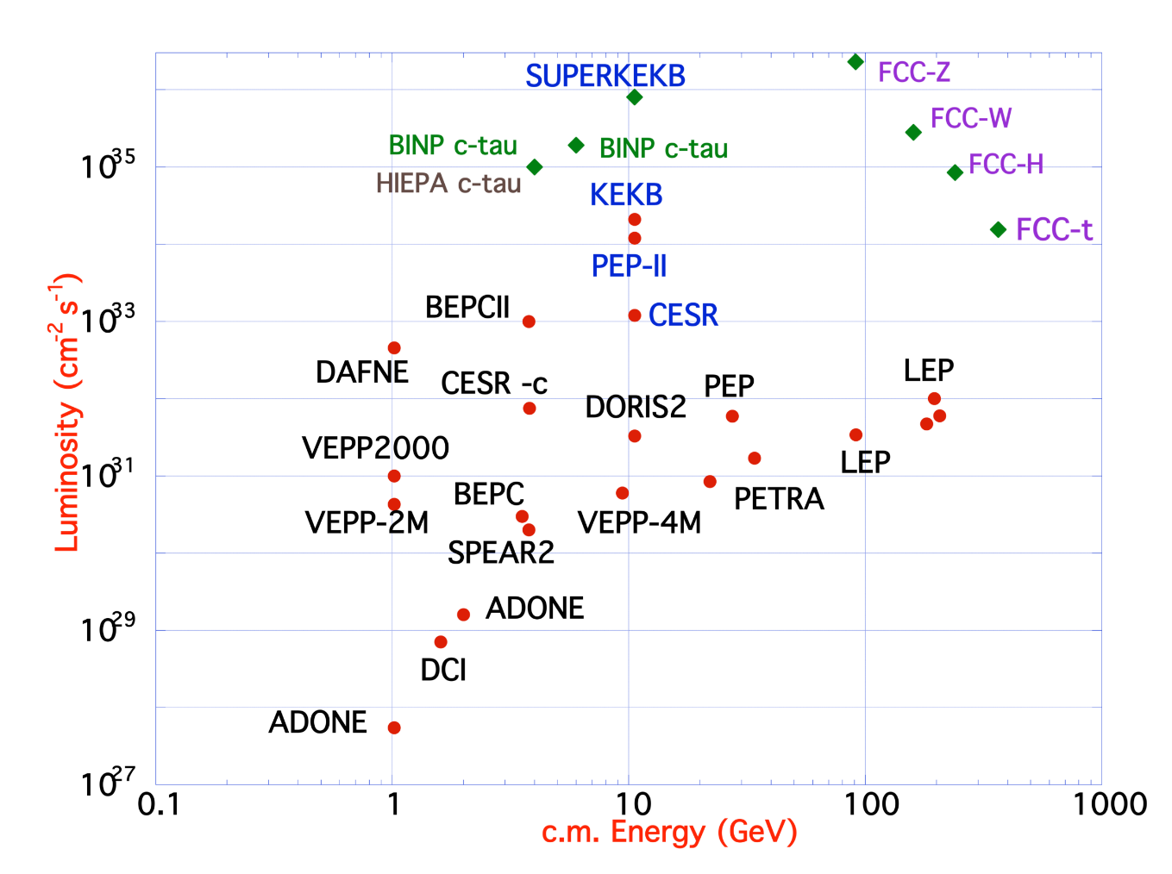
Electron-positron collider evolution
Two separate beam pipes “Factories”
  Allows for many bunches (reaching total currents of few A) without parasitic encounters
  Imposes a large crossing angle
  Single bunch current remains limited by the beam-beam tune shift
Crab cavities (KEKB) [Funakoshi13]
Crab waist
(DAPHNE, SuperKEKB)
[Raimondi06, Zobov10]
Single beam pipe
  Number of bunches limited by parasitic encounters
  Single bunch current limited by the beam-beam tune shift (‘beam-beam limit’)
24m
240m
2.3km
27km
4-beam compensation (DCI) [Derbenev73]
Round beams (VEPP-2000) [Danilov96, Shwartz16]
Bigger rings
3

Slide 4
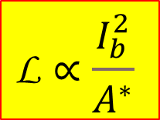
Beam - beam limit
$$\text{L}∝\frac{I_{b}^{2}}{A^{∗}}$$
L_{max}
L
I_{b}
ξ
ξ_{max}
start of
blow-up
aperture
limit
I_{b}
4

Slide 5
Beam – beam effects in linear and circular colliders
Near the axis the other bunch is equivalent to a focusing lens
Disruption is defined as:
and it can be viewed as:
to connect it to the storage ring jargon
Dy
z
Dy’
s_{z}

Slide 6
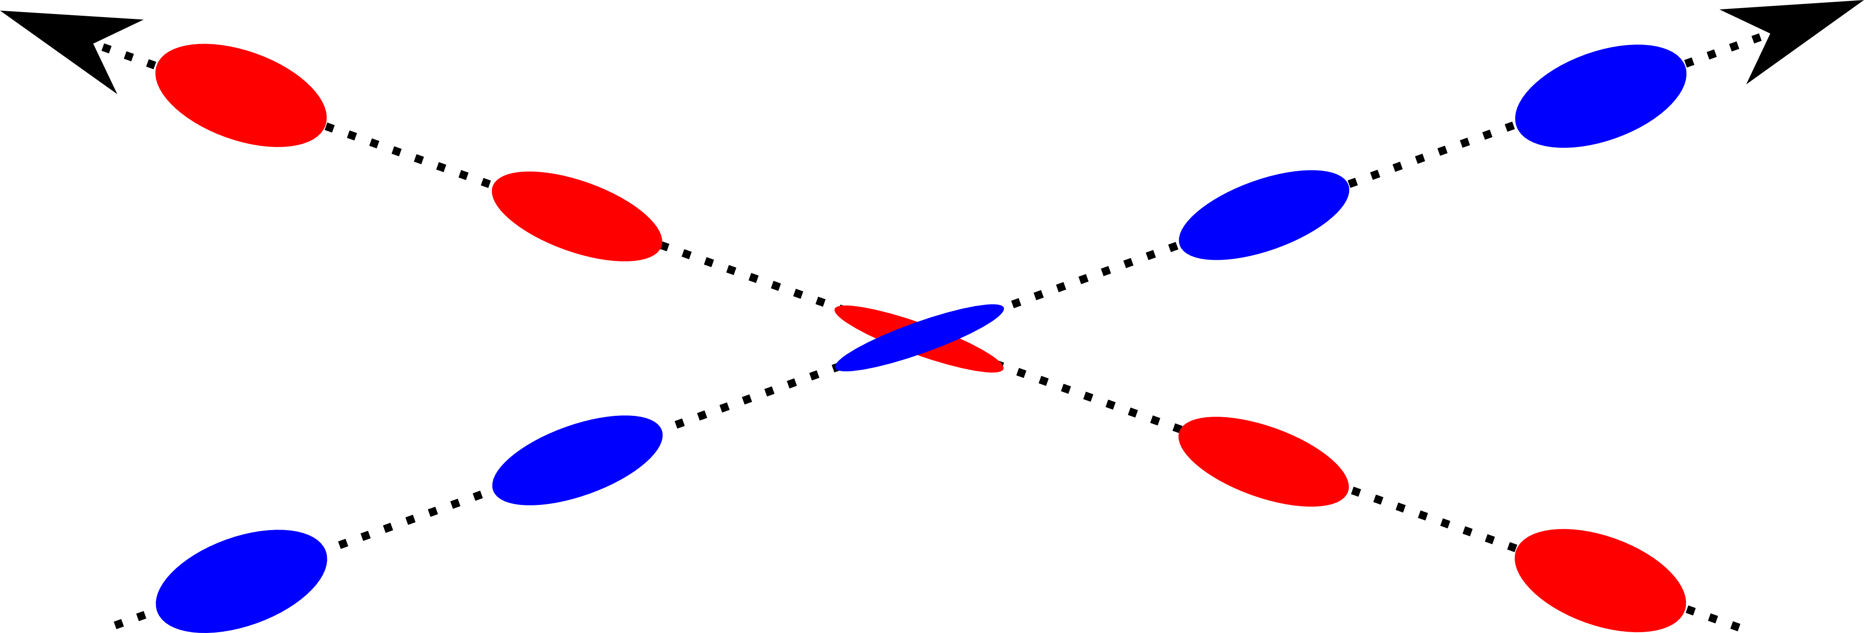
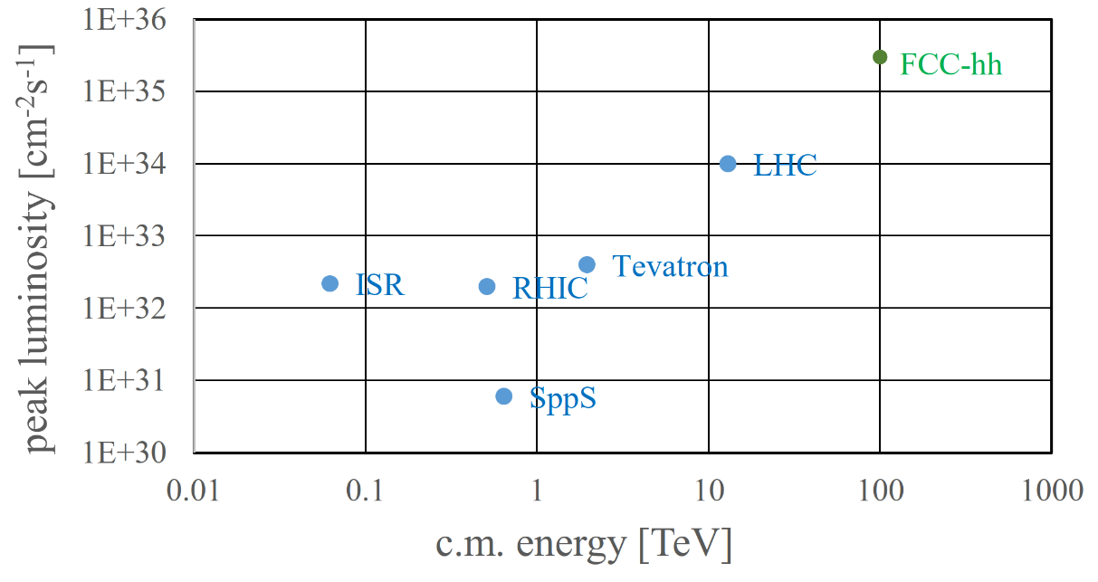
Hadron collider evolution
Limited by beam-beam tune shift
Electron lens ‘non-linear’ compensation [Fischer17]
Number!
Not
same
for
each
bunch!
“Pacman”
Not limited by beam-beam [Huebner74]
Limited by parasitic encounters
Current carrying wire
[Sterbini24]
Crab cavity
[HL-LHC]
Single pipe p-pbar colliders
  Number of bunches limited by parasitic encounters
  Challenging p-bar production
Electron lens ‘tune shift’ compensation [Shiltsev07]
Bigger rings + stronger magnets
6

Slide 7
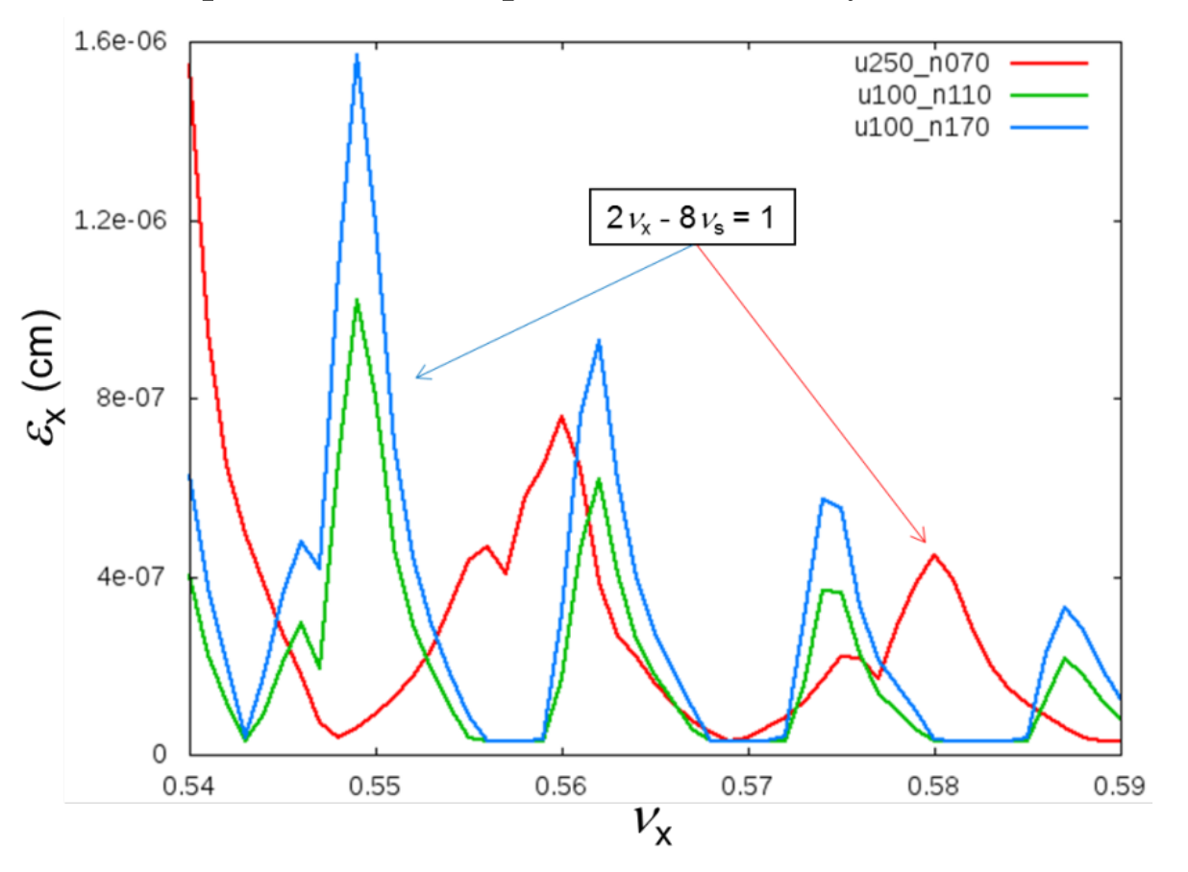
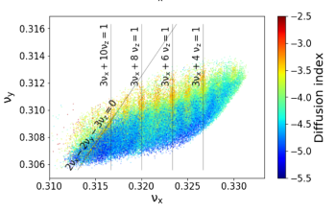
Finite bunch length effect
Important development for the understanding of parasitic encounters for both e⁺e⁻ and pp (self-consistent orbit / optics, non-linear dynamics)
  → The current trend for either designs (and also e-p) is to increase the number of bunches and minimize number of parasitic encounters by having two separate beam pipes
  → Finite bunch length effect (crossing angle, hourglass)
Large efforts to understand and increase the maximum beam-beam tune shift including synchrobetatron effects [Piwinski87, …, Hirata92, …, Xu21]
  → Constraints on transverse/longitudinal tunes, Piwinski angle, hourglass parameter, lattice driven resonances
  → (Partial) mitigation: crab waist tuning, Crab cavity frequency
EIC with crab cavity, including RF curvature [Xu21]
FCC-ee Z horizontal tune scan including crab waist [Shatilov17]
7

Slide 8
Classic “Mini – β” schemes
Luminosity
Tune shift
Required large emittance: “fill the aperture”
With the advent of small emittance collider rings
We want large current,
fill large collision area!
Luminosity per unit power!
Fill dynamic aperture
to the limit of transverse density

Slide 9
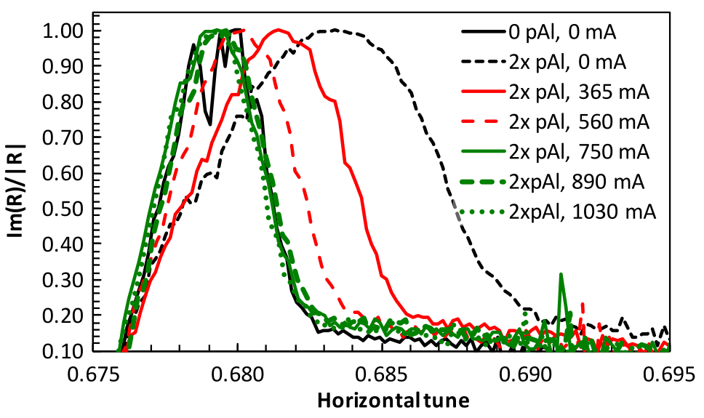
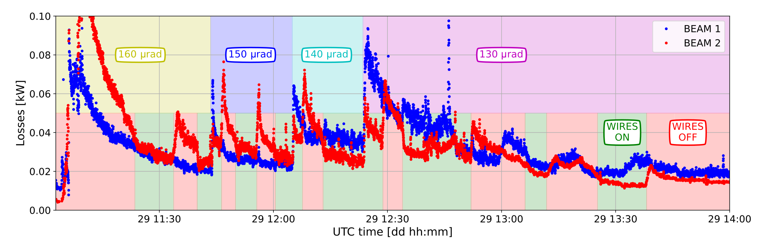
Rise of beam-beam compensation
In the last 20 years, we observe a rise in successful compensation scheme, based on detailed understanding of side effects such as noise (e-lens), feed-down and non-linear optics control (wire, crab waist, resonance compensation)
Tune spread reduction measured by beam transfer function with and without electron lens [Fischer17]
Compensation of half the tune shift in order to maintain Landau damping
→ Two fold increase of luminosity
Loss reduction with wires at the LHC (partial system deployed in operation, cf. Guido’s talk)
9

Slide 10
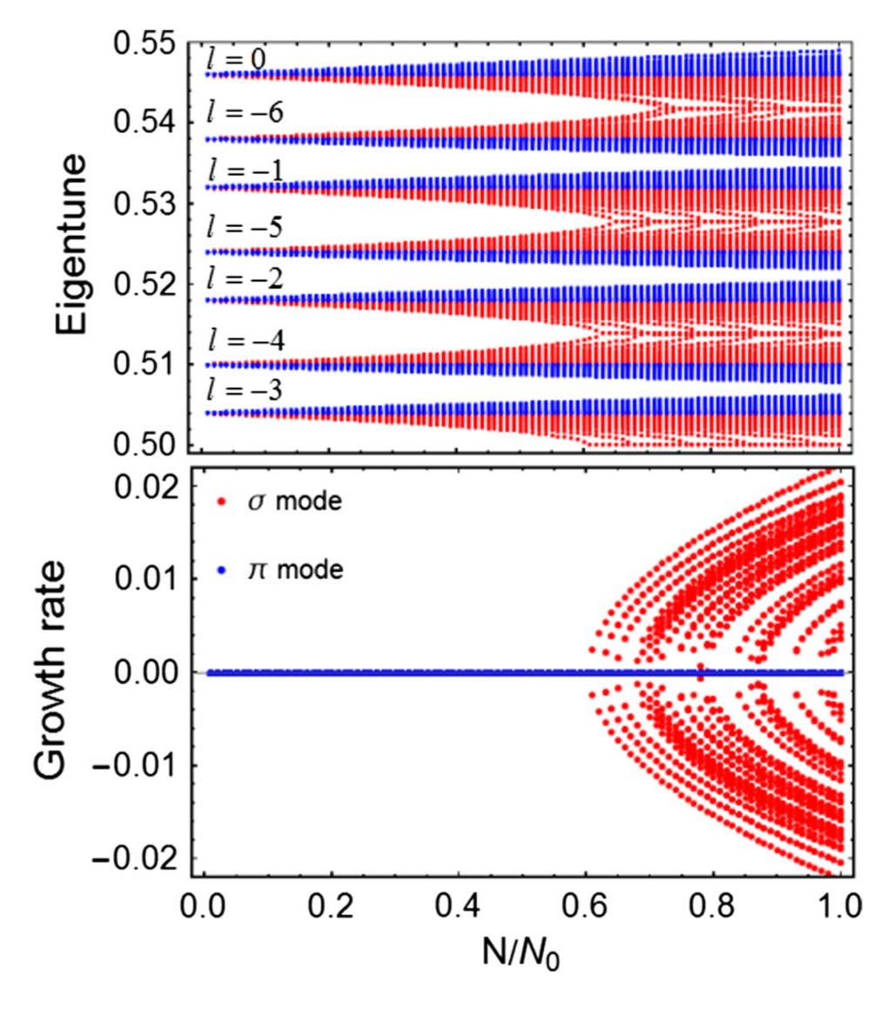
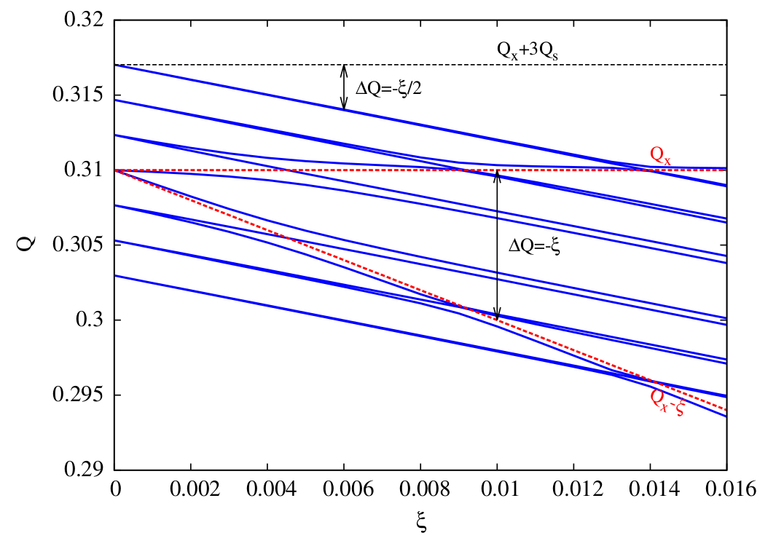
High intensity regime
The failure of the 4-beam compensation scheme highlights the importance of understanding collective instabilities [Derbenev73]
  Important work to understand stability (Landau damping) of beam-beam modes [Yokoya90, Perevdentsev01, Chao05, Alexahin02] → Several measurements of the σ/π modes + flip-flop effect
The high intensity regime pushes the beam stability
  The need for tight collimation and a large number of cavities leads to strong wake fields
  Feedback (noise) for the coupled bunch instability
Coupling instability of beam-beam modes caused by transverse impedance [White14, Zhang23]
Loss of Landau damping for weak head-tail modes [Buffat14]
Coupling instability of beam-beam modes caused by longitudinal impedance [Lin22]
10

Slide 11
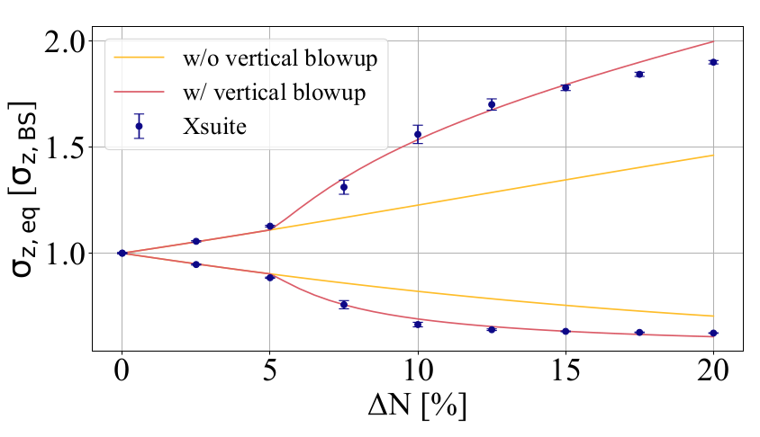
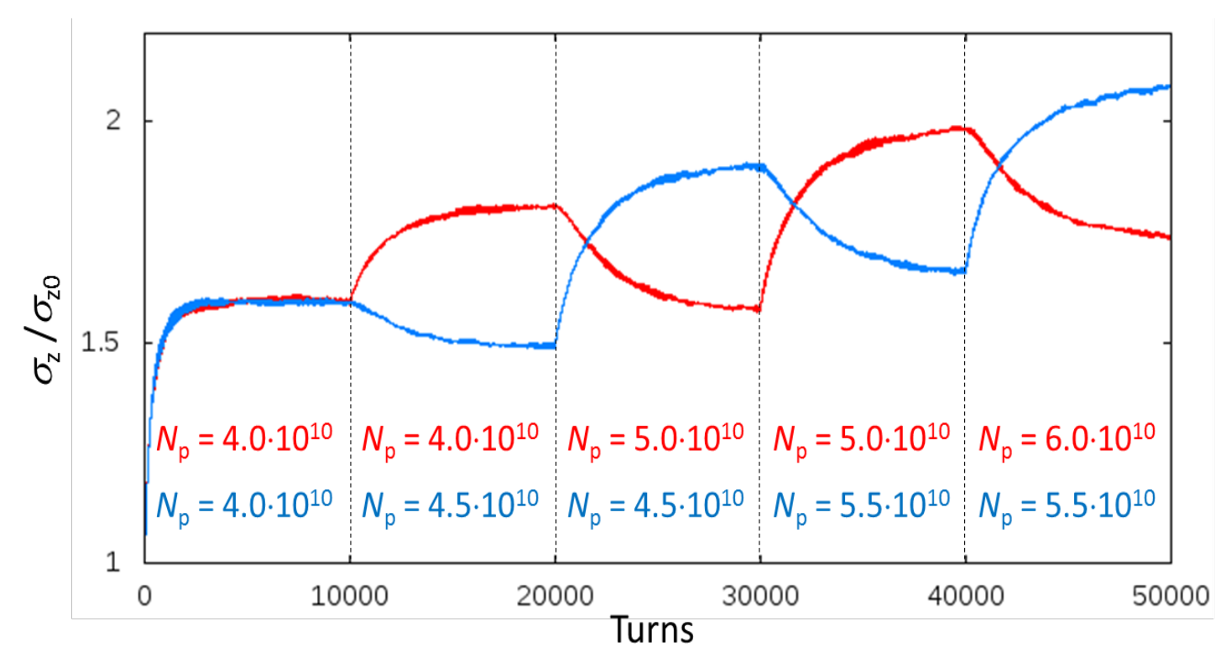
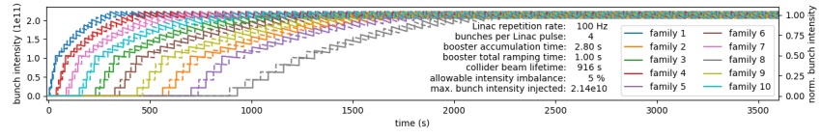
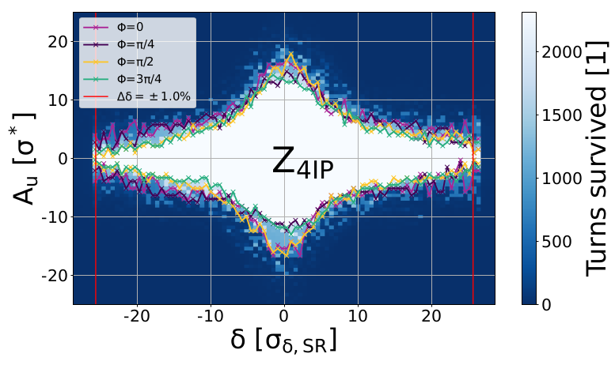
Beamstrahlung
Beamstrahlung is no longer exclusive to linear colliders
→ The energy spread is no longer defined by the lattice but rather the result from an equilibrium between the two beams (blow-up of bunch length decreases beamstrahlung)
[Kicsiny24]
Bootstrap injection to gradually reach the equilibrium bunch length and maintain good enough symmetry between the beams [Shatilov17]
Onset of 3D flip-flop
Bootstrap injection that also mitigate e-cloud instabilities [Bartosik24]
→ The strength of the beam-beam interaction becomes limited by the lattice momentum acceptance (beamstrahlung lifetime)
11

Slide 12
Muon colliders
Multibunch operation is disfavored (The luminosity goes linearly with the number of bunches but quadratically with the bunch population)
With a 'single pipe' acceleration chain, there will be beam-beam interactions in the re-circulating LINACs and rapid cycling synchrotrons, not only in the collider ring.
Due to the short lifetime, the beam-beam force is strong only for few turns (~100), much larger beam-beam tune shift might be tolerable.
To be studied...
12

Slide 13
Beam beam limit at LHC: why so much higher?
X 2-3?

Slide 14
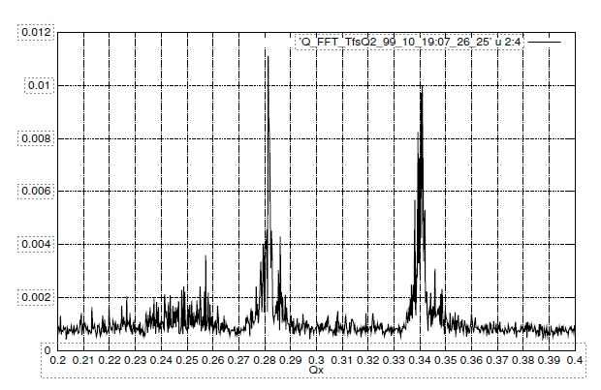
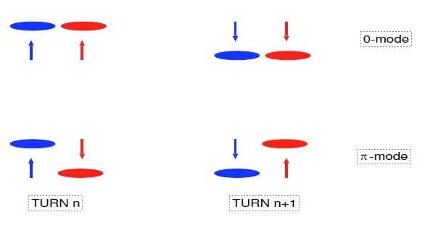
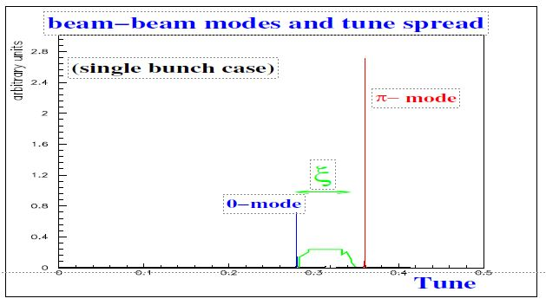
Diagnostics and observables
Beam-beam tune shift: is it a good measure of beam-beam interaction?
    But! Close to integer resonances dynamic beta inflation!
    Why is it larger than expected in the new/higher energy machines???
Coherent modes (σ and π modes): beautiful observations at LEP
Need tools to measure the nonlinear aspects! Usable and be used!

Slide 15
Rise of interplays
  “Although beam-beam simulations have advanced in the past 25 years or so, more ingredients need to be incorporated to make them more realistic, such as non-linear lattice maps, field calculations with bunch length effects, current-dependent effects […] and errors such as jitter and off-center collisions.”
  (after M.A. Furman @ eeFACT97)
Most of these aspects will be discussed this week !
15

Slide 16
Challenges to design better colliders
Maximum Integrated vs. peak luminosity
  Hadrons: leveling schemes, radiation damping
  Leptons: top-up injection
Machine Detector Interface (MDI)
  Hadrons: pile-up: 10⁹ – 10¹¹ interactions/s, x100 particles/s
  Hadrons & Leptons: Backgrounds in the detectors!
Improved simulation tools and
… their benchmarking (LHC, SUPERKEKB, etc.)
Relevant observables!

Slide 17
References
[Derbenev73] Y. S. Derbenev, SLAC TRANS-151, 1973
[Danilov96] V.V.Danilov, et. al, "The Concept of Round Colliding Beams", EPAC'96,. Barcelona (1996)
[Shwartz16] D. Shwartz, et al., “Implementation of round colliding beams concept at VEPP-2000”, eeFACT2016, Daresbury, UK
[Funakoshi13] Y. Funakoshi, et al., “Operational experience with crab cavities at KEKB”, BB13, Geneva, 2013 (CERN–2014–004)
[Raimondi06] P. Raimondi, 2nd SuperB Workshop, 2006.
[Zobov10] M.Zobov, et al., Phys. Rev. Lett. 104:174801, 2010.
[Huebner74] K. Hübner and E. Keil, “A Search for a Beam-Beam Effect in the ISR”, HEACC74, CERN-ISR-TH-74-29
[Shiltsev07] V. Shiltsev, et al., Phys. Rev. Lett. 99, 244801 (2007)
[Fischer17] W. Fischer, et al., Phys. Rev. Accel. Beams 20, 091001 (2017)
[Poyet24] A. Poyet, et al., First experimental evidence of a beam-beam long-range compensation using wires in the Large Hadron Collider, Phys. Rev. Accel. Beams 27, 071003 (2024)
[HL-LHC] High-Luminosity Large Hadron Collider (HL-LHC): Technical design report, CERN-2020-010
[Piwinski87] A. Piwinski, CERN 87-03, 187 (1987)
[Hirata92] K. Hirata, et al, A symplectic beam-beam interaction with energy change, Part. Accel. 40, 1993
[Ohmi17] K. Ohmi, et al., Phys. Rev. Lett. 119, 134801 (2017)
[Xu21] D. Xu, et al., Synchrobetatron resonance of crab crossing scheme with large crossing angle and finite bunch length, Phys. Rev. Accel. Beams 24, 041002 (2021)
[Shatilov17] D. Shatilov, FCC-ee Parameter Optimization, ICFA Beam Dyn. Newsl. 72 (2017)
[Perevdentsev01] E.A. Perevedenstsev and A.A. Valishev, Phys. Rev. ST Accel. Beams 4, 024403 (2001)
[Chao05] A.W. Chao, “Coherent beam-beam effects”, Particle Beams: Intensity Limitations. Lecture Notes in Physics, vol 400. Springer, Berlin, Heidelberg.
[Yokoya90] K. Yokoya and H. Koiso, Part. Acc. 27, 181 (1990)
[Alexahin02] Y. Alexahin, NIM-A 480 2-3 (2002)
[White14] S. White, et al., Phys. Rev. ST Accel. Beams 17 04002 (2014)
[Zhang23] Y. Zhang, et al., Phys. Rev. Accel. Beams 26, 064401 (2023)
[Buffat14] X. Buffat, et al., Phys. Rev. ST Accel. Beams 17, 111002 (2014)
[Lin22] C. Lin, et al., Coupling effects of beam-beam interaction and longitudinal impedance, Phys. Rev. Accel. Beams 25, 011001 (2022)
[Kicsiny24] P. Kisciny, PhD Thesis, EPFL (2024)
[Hannes24] H. Bartosik, et al., FCCee filling scheme, FCC Week 2024, San Francisco, USA
17

Slide 18
Thank You
Wishing you a good workshop
and
lots of new ideas
18

