Slide 1
Update on the Electron Cloud Studies for FCC-ee
Sabato Luca
12th September 2023

Slide 2
Outline
Possible Filling Schemes
Dispersion
Bunch Length
Stability
FCC Mid-term report
Update on the Electron Cloud Studies for FCC-ee 12/09/2023

Slide 3
Outline
Possible Filling Schemes
  E-cloud Density
  Heat Loads
Dispersion
Bunch Length
Stability
FCC Mid-term report
Update on the Electron Cloud Studies for FCC-ee 12/09/2023

Slide 4
Filling Schemes
From Tor Raubenheimer
Filling schemes (with constant total number of particles per beam)
Filling Scheme Number | Bunch Intensity [x10¹¹ ppb] | Bunch Spacing [ns] | Number bunches / Train | Number Trains | Gap Length [ns] (gap/bunch spacing)
1 | 1.51 | 15 | 320 | 50 | 1275 (85)
2 | 2.15 | 20 | 280 | 40 | 1980 (99)
3 | 2.15 | 25 | 560 | 20 | 1175 (47)
4 | 2.43 | 25 | 255 | 40 | 1225 (49)
Good to understand the impact of lower bunch intensity (we will need to fill the ring)
Update on the Electron Cloud Studies for FCC-ee 12/09/2023

Slide 5
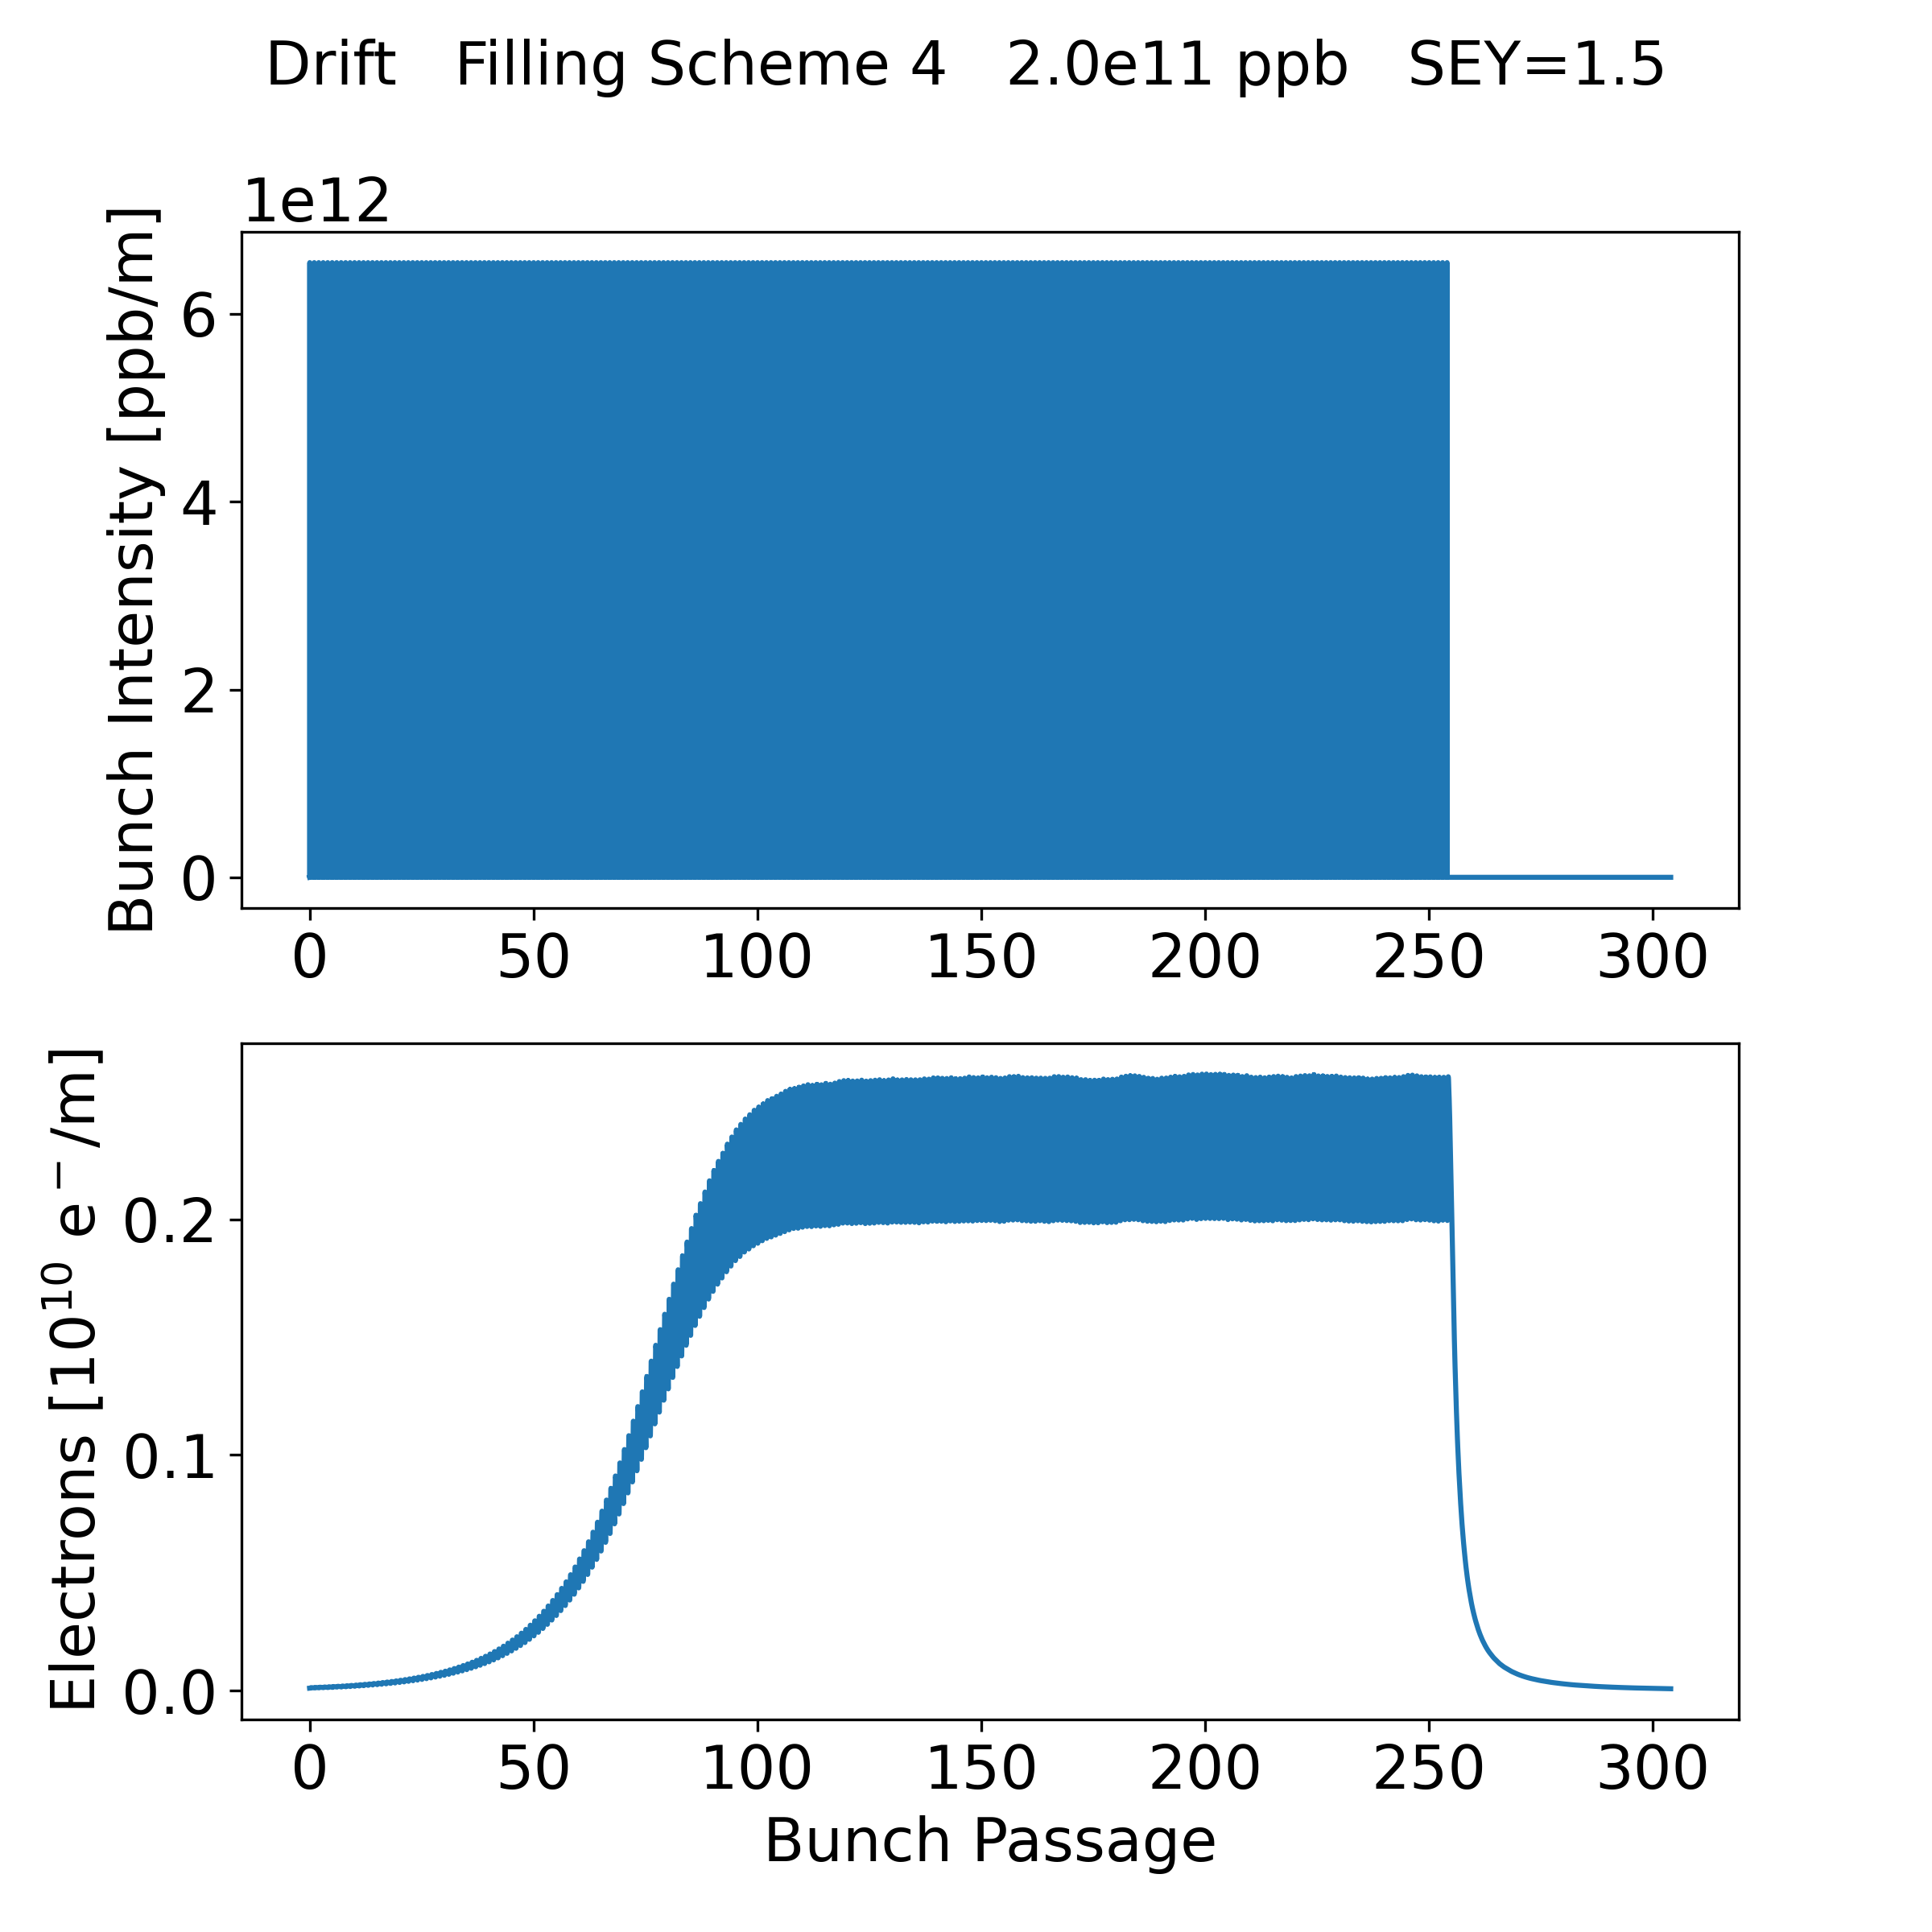
Strategy
To simulate the 4 filling schemes
  In the different element: drift spaces, dipoles, quadrupoles;
  For the different bunch intensity;
  For the different values of the SEY;
To keep simulation time reasonable
  I simulated the passage of one train + the gap
Train
Gap
Update on the Electron Cloud Studies for FCC-ee 12/09/2023

Slide 6
Simulation Result Example
Train
Gap
23/06/2023

Slide 7
Strategy
Case 1: Multipacting occurs and the saturation is reached after 1 train
Case 2: Multipacting occurs and the saturation is not reached after 1 train
Case 3: No multipacting
Update on the Electron Cloud Studies for FCC-ee 12/09/2023

Slide 8
Strategy
Case 1: Multipacting occurs and the saturation is reached after 1 train
Average of the e-cloud density after saturation
Train
Gap
Parameter
Update on the Electron Cloud Studies for FCC-ee 12/09/2023

Slide 9
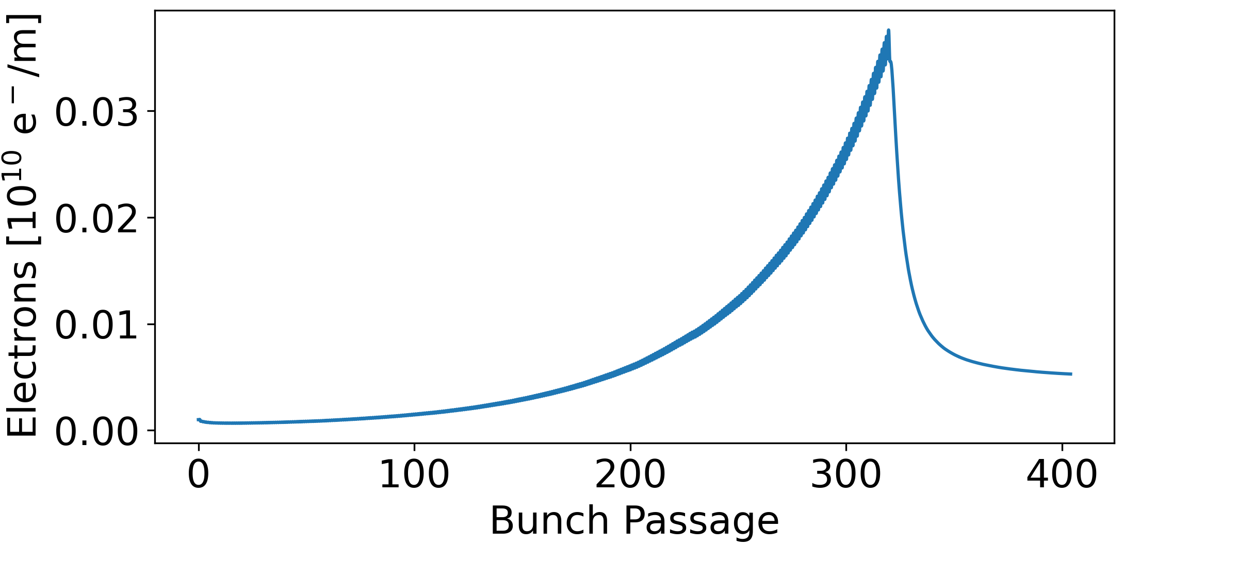
Strategy
Case 2: Multipacting occurs and the saturation is not reached after 1 train
Case 2.1: e-cloud after the gap is smaller than at the start of the simulation ->
  the length of the gap is sufficient to clean the e-cloud -> e-cloud value at the end of the train
Case 2.2: e-cloud after the gap is larger than at the start of the simulation ->
  the length of the gap is not sufficient to suppress the e-cloud -> the saturation value can be reached with the following trains -> e-cloud larger than the value at the end of the train
Train
Gap
Parameter
Update on the Electron Cloud Studies for FCC-ee 12/09/2023

Slide 10
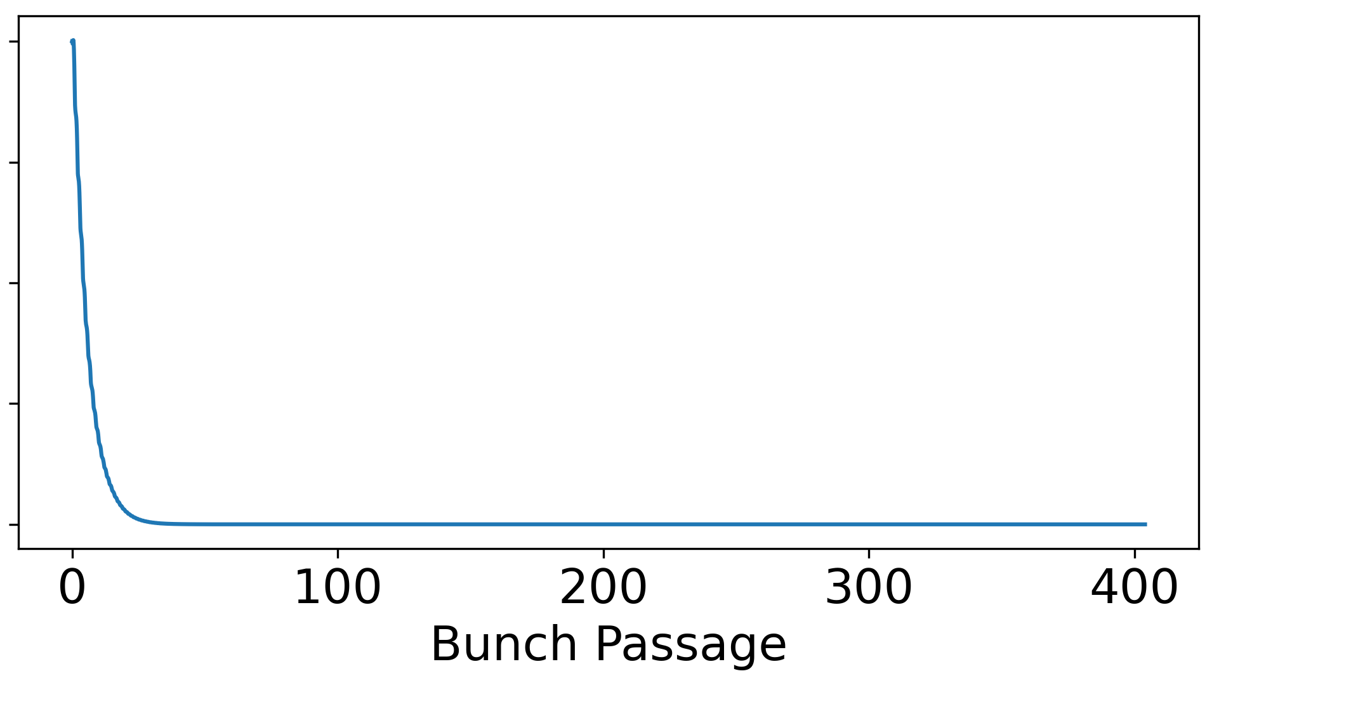
Strategy
Case 3: No multipacting
Train
Gap
Update on the Electron Cloud Studies for FCC-ee 12/09/2023

Slide 11
Simulation Results
Element:
  Drift Space
  Dipole (14.15 mT)
  Quadrupole (5.65 T/m)
Update on the Electron Cloud Studies for FCC-ee 12/09/2023

Slide 12
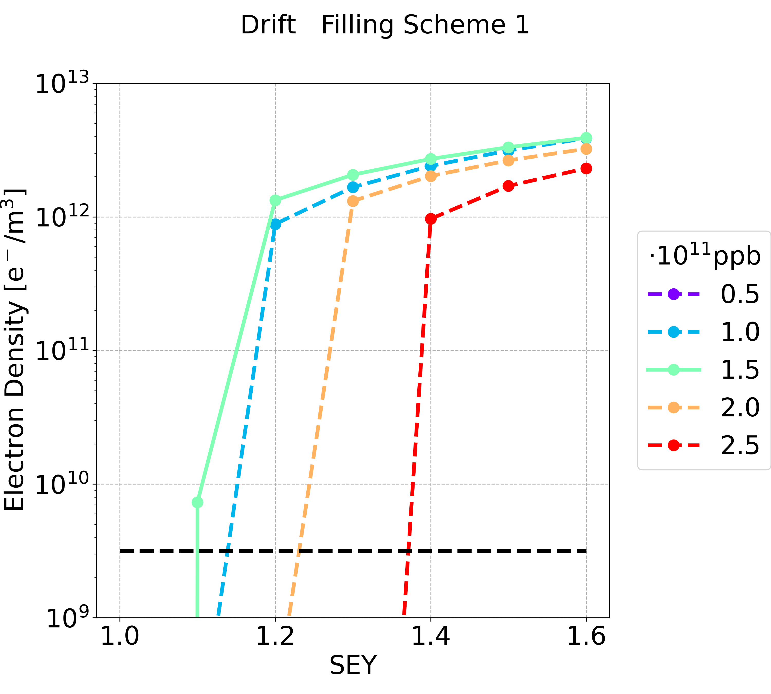
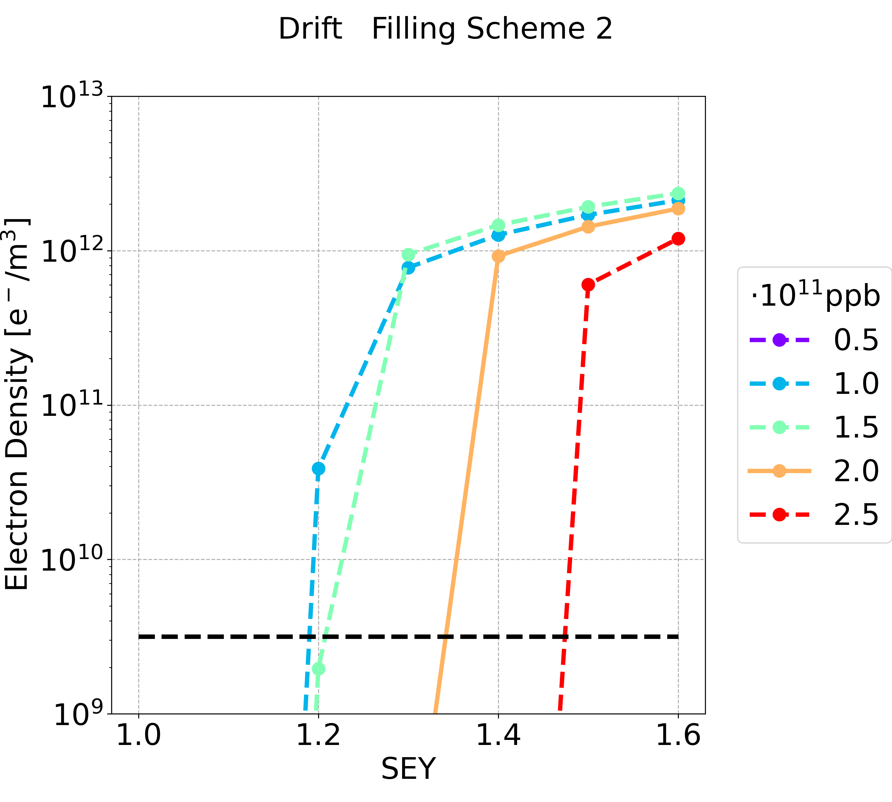
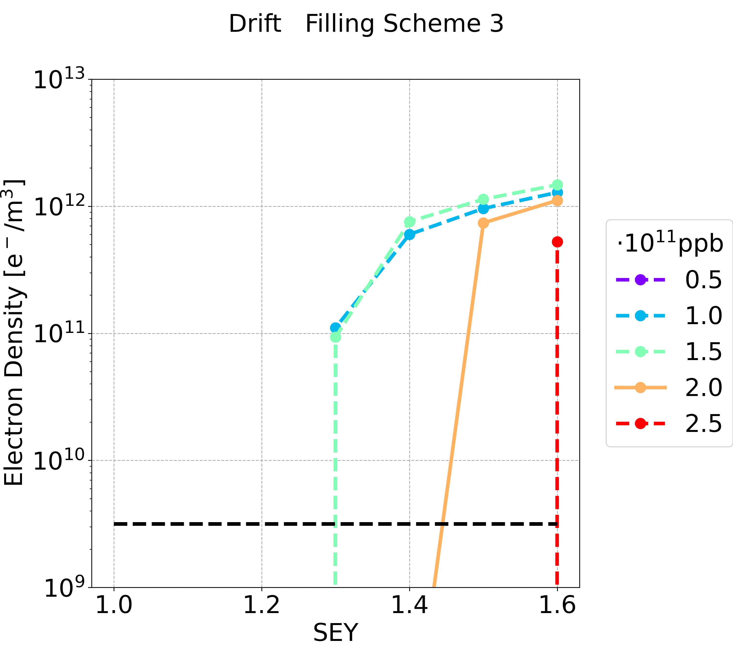
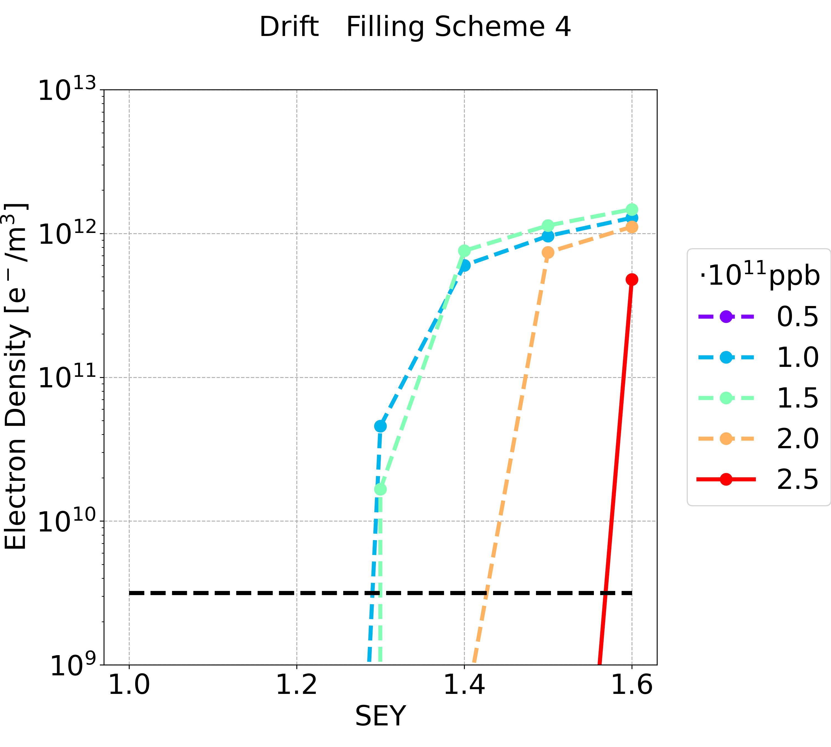
Simulation Results: Drift Space
 | Filling Scheme 1 | Filling Scheme 2 | Filling Scheme 3 | Filling Scheme 4
SEY threshold (nominal intensity) | 1.0 | 1.3 | 1.4 | 1.5
SEY threshold (all intensity below nominal one) | 1.0 | 1.1 | 1.2 | 1.2
Filling scheme 3 and 4 (with longer bunch spacing) are better: multipacting threshold higher
Considering the nominal bunch intensity the filling scheme 4 is preferable

Slide 13
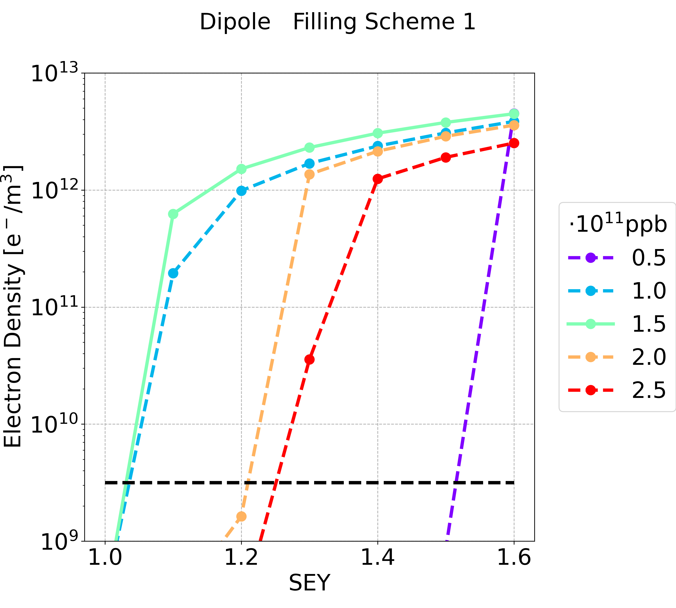
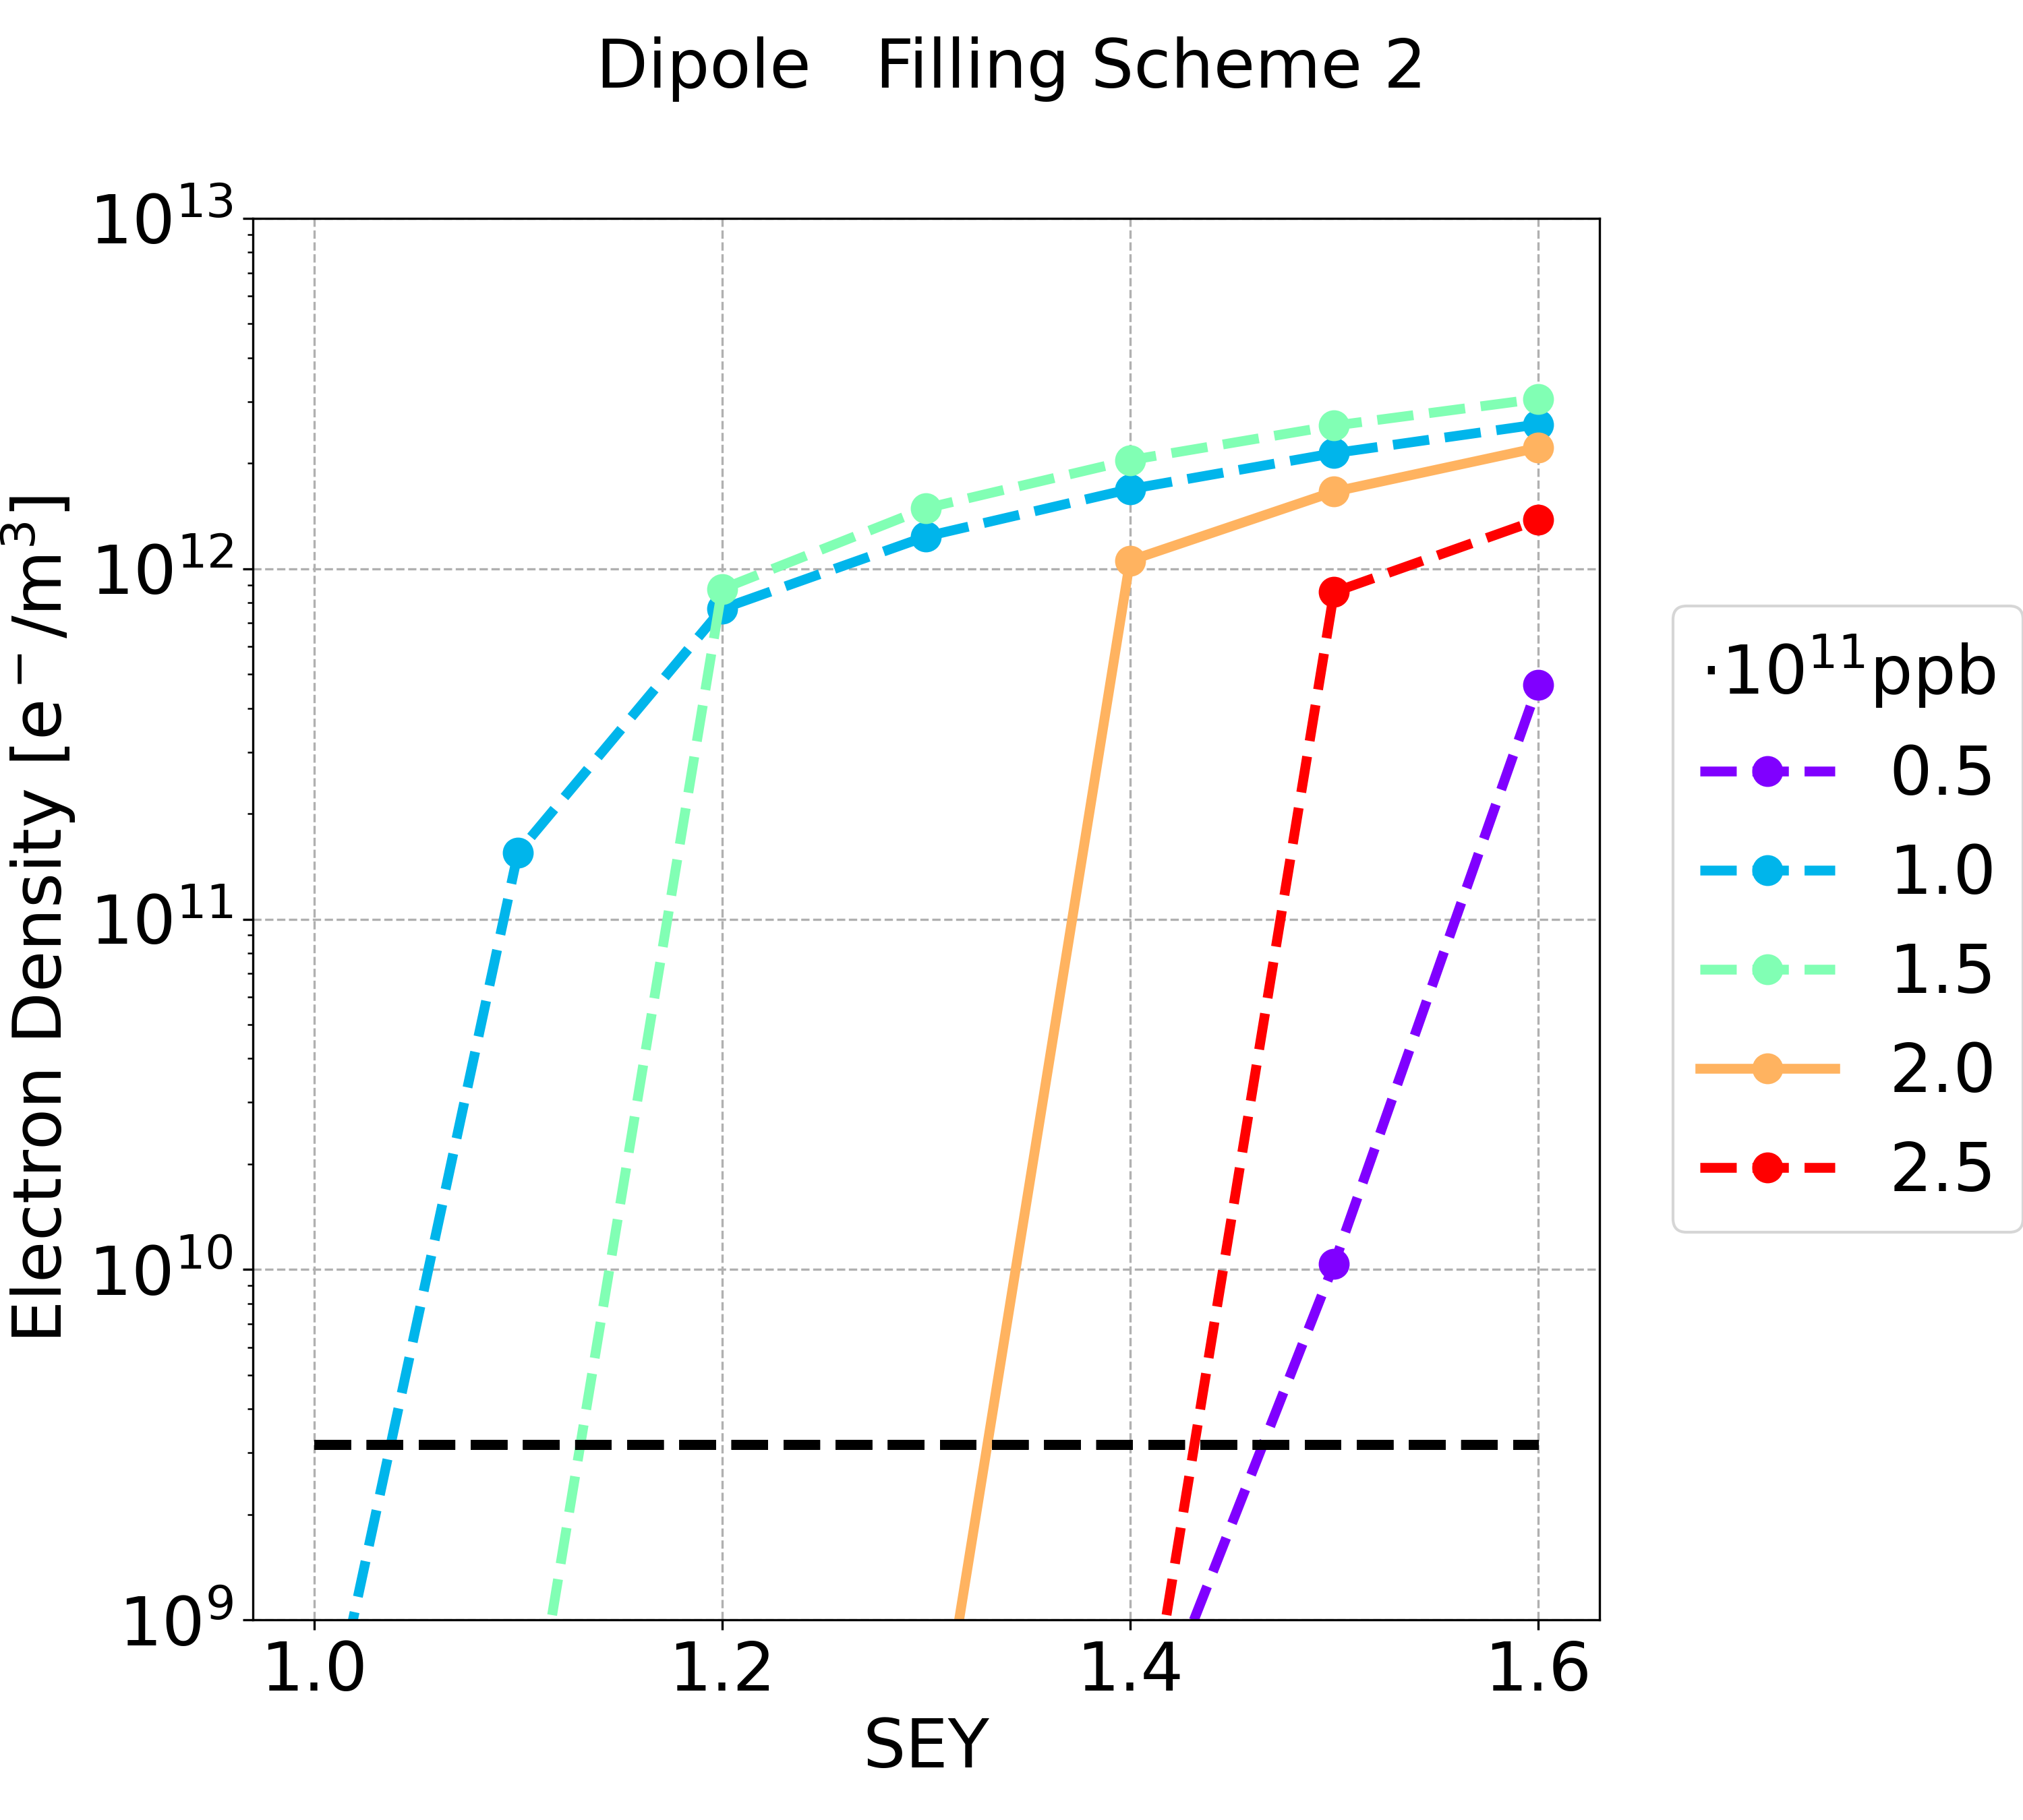
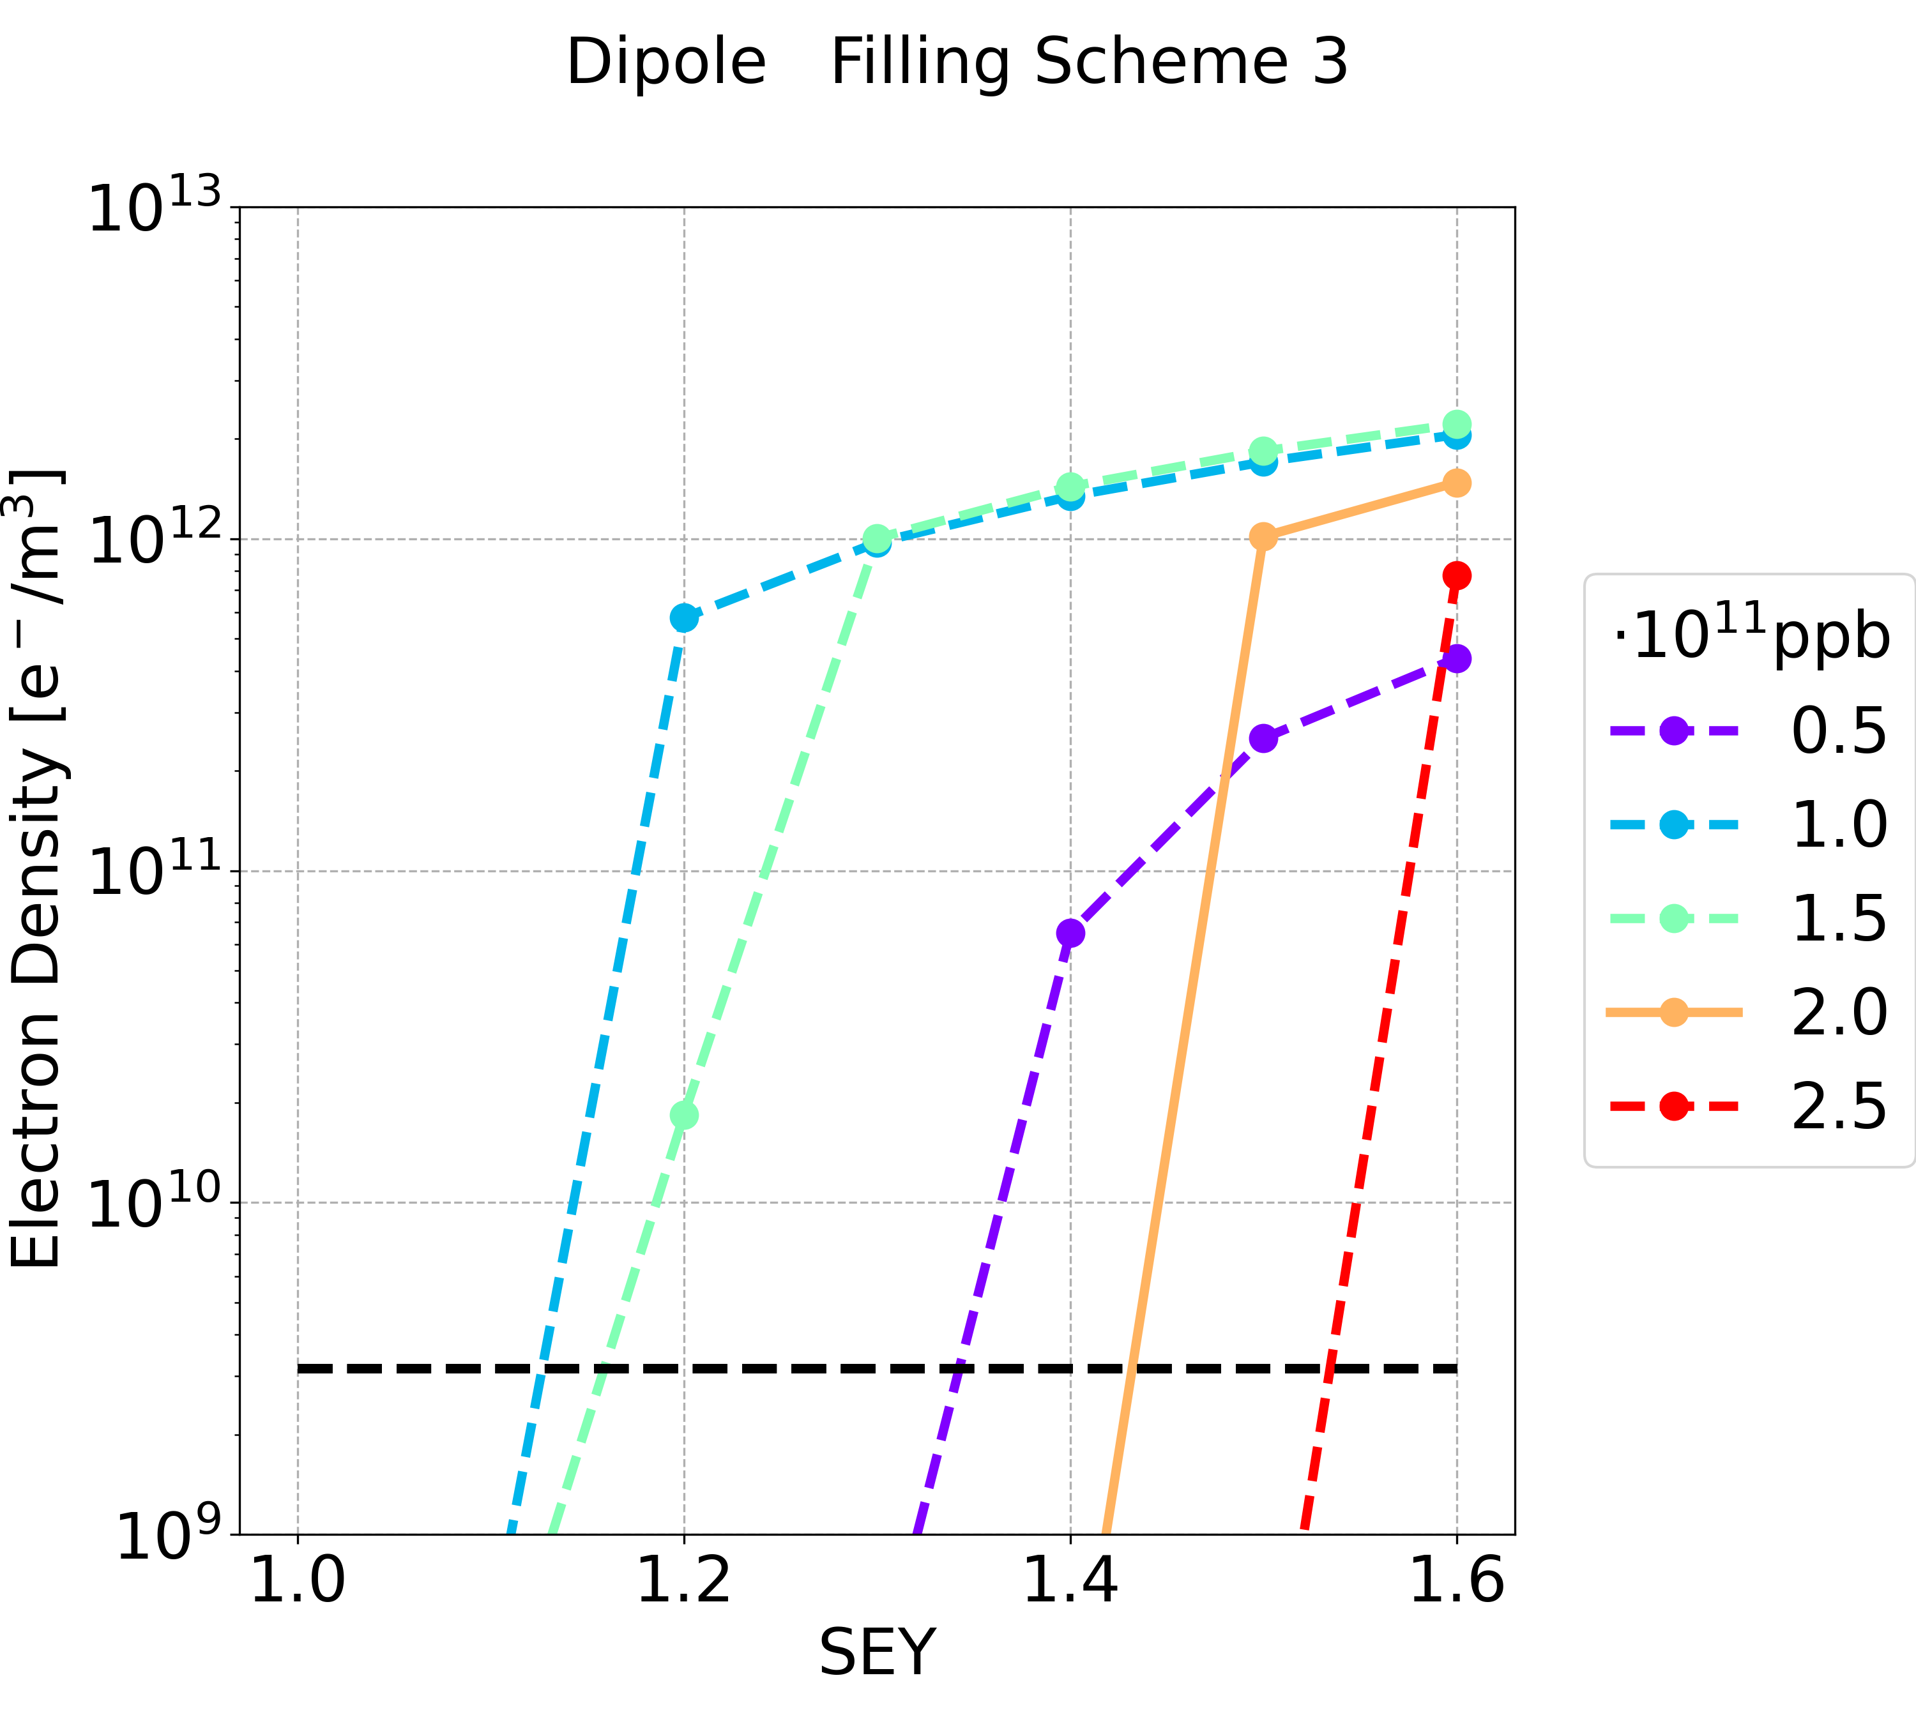
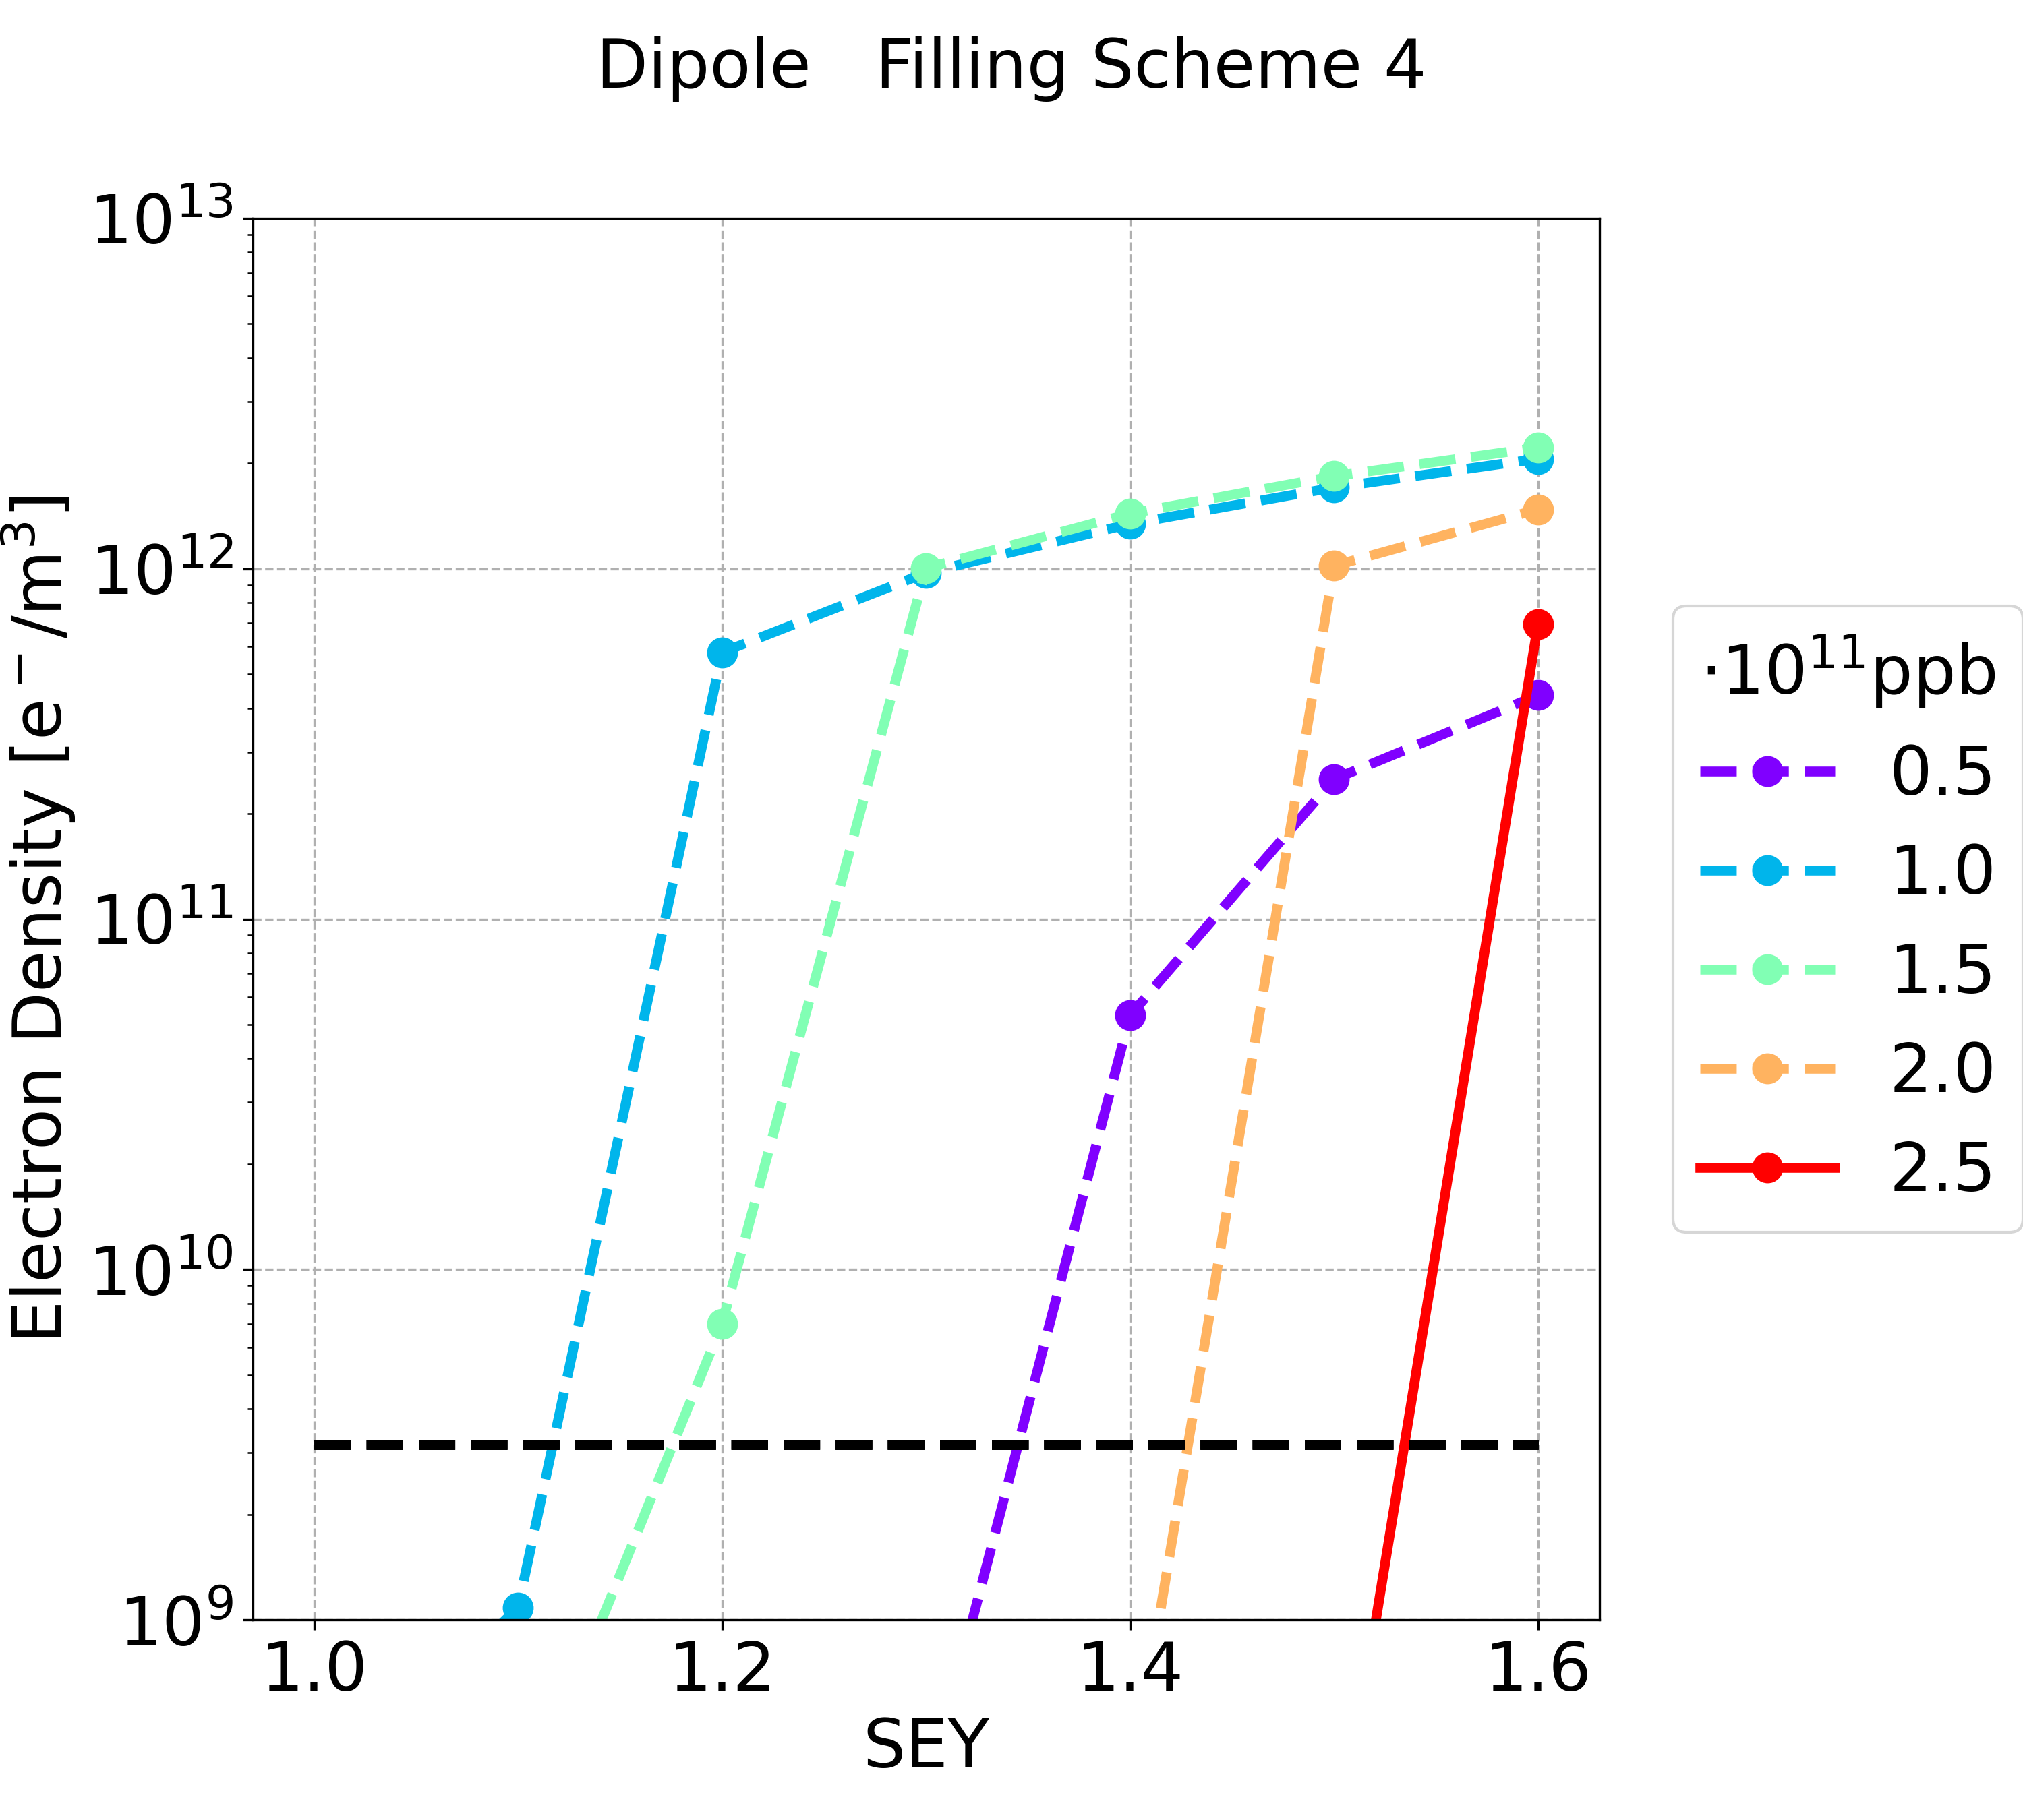
Simulation Results: Dipole
 | Filling Scheme 1 | Filling Scheme 2 | Filling Scheme 3 | Filling Scheme 4
SEY threshold (nominal intensity) | 1.0 | 1.3 | 1.4 | 1.5
SEY threshold (all intensity below nominal one) | 1.0 | 1.0 | 1.1 | 1.1
Filling scheme 3 and 4 (with longer bunch spacing) are better: multipacting threshold higher
Considering the nominal bunch intensity the filling scheme 4 is preferable

Slide 14
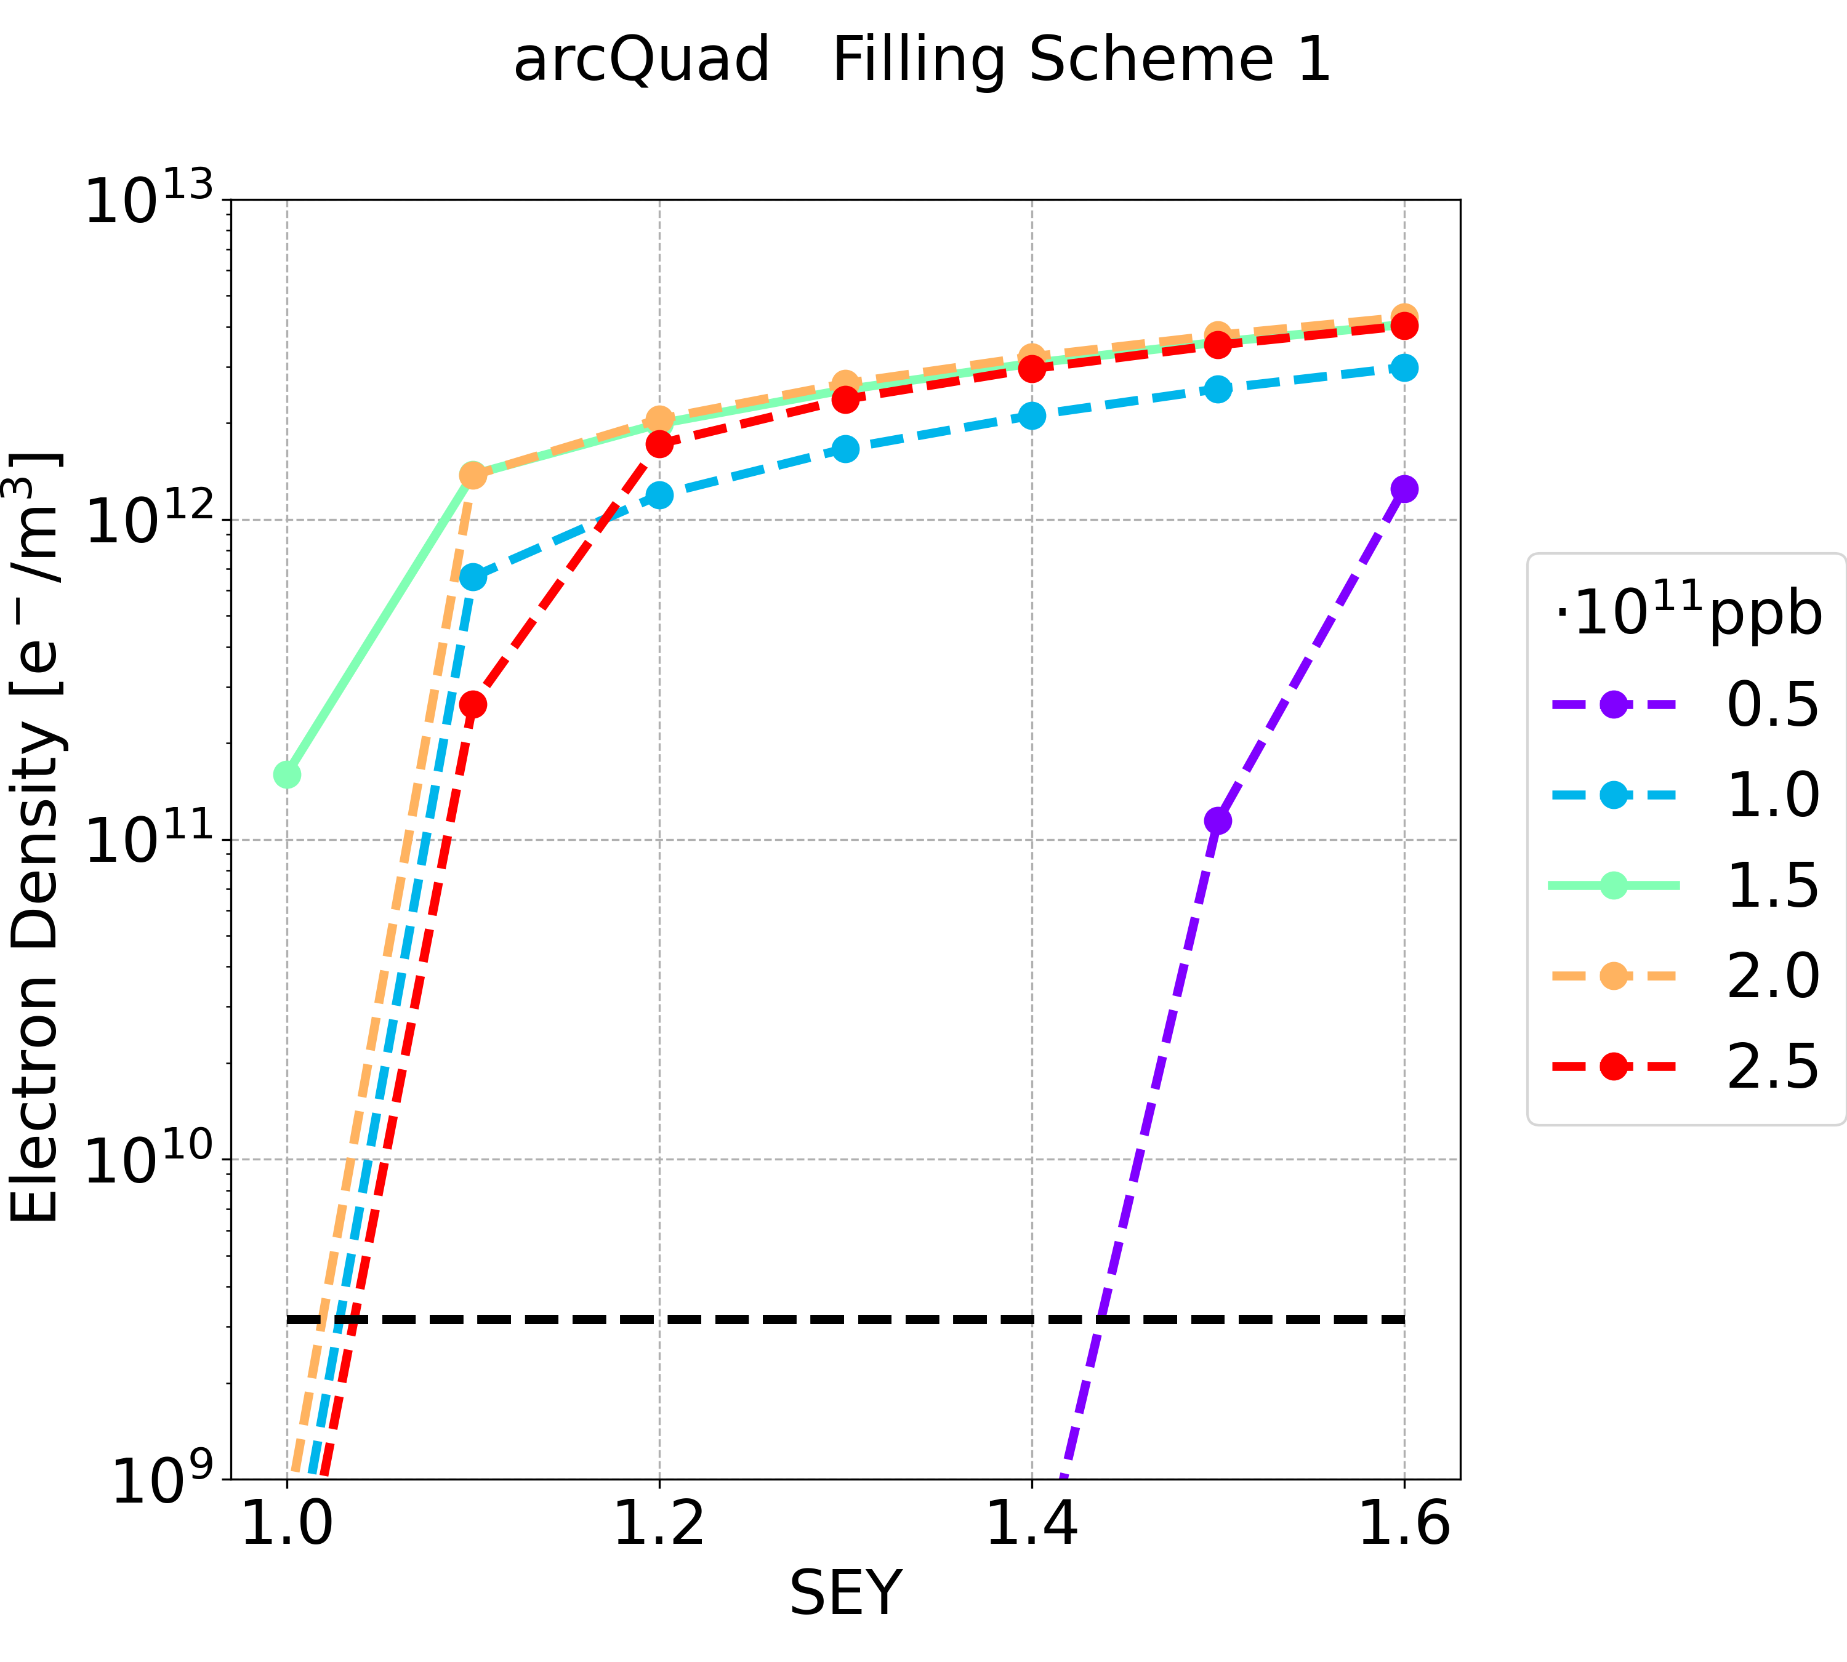
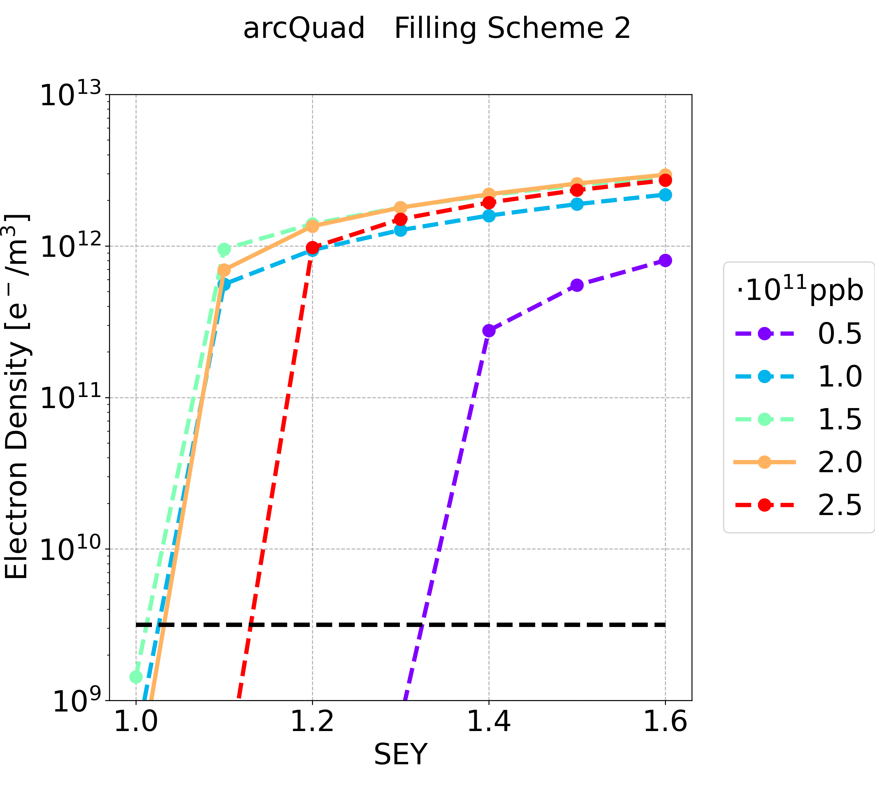
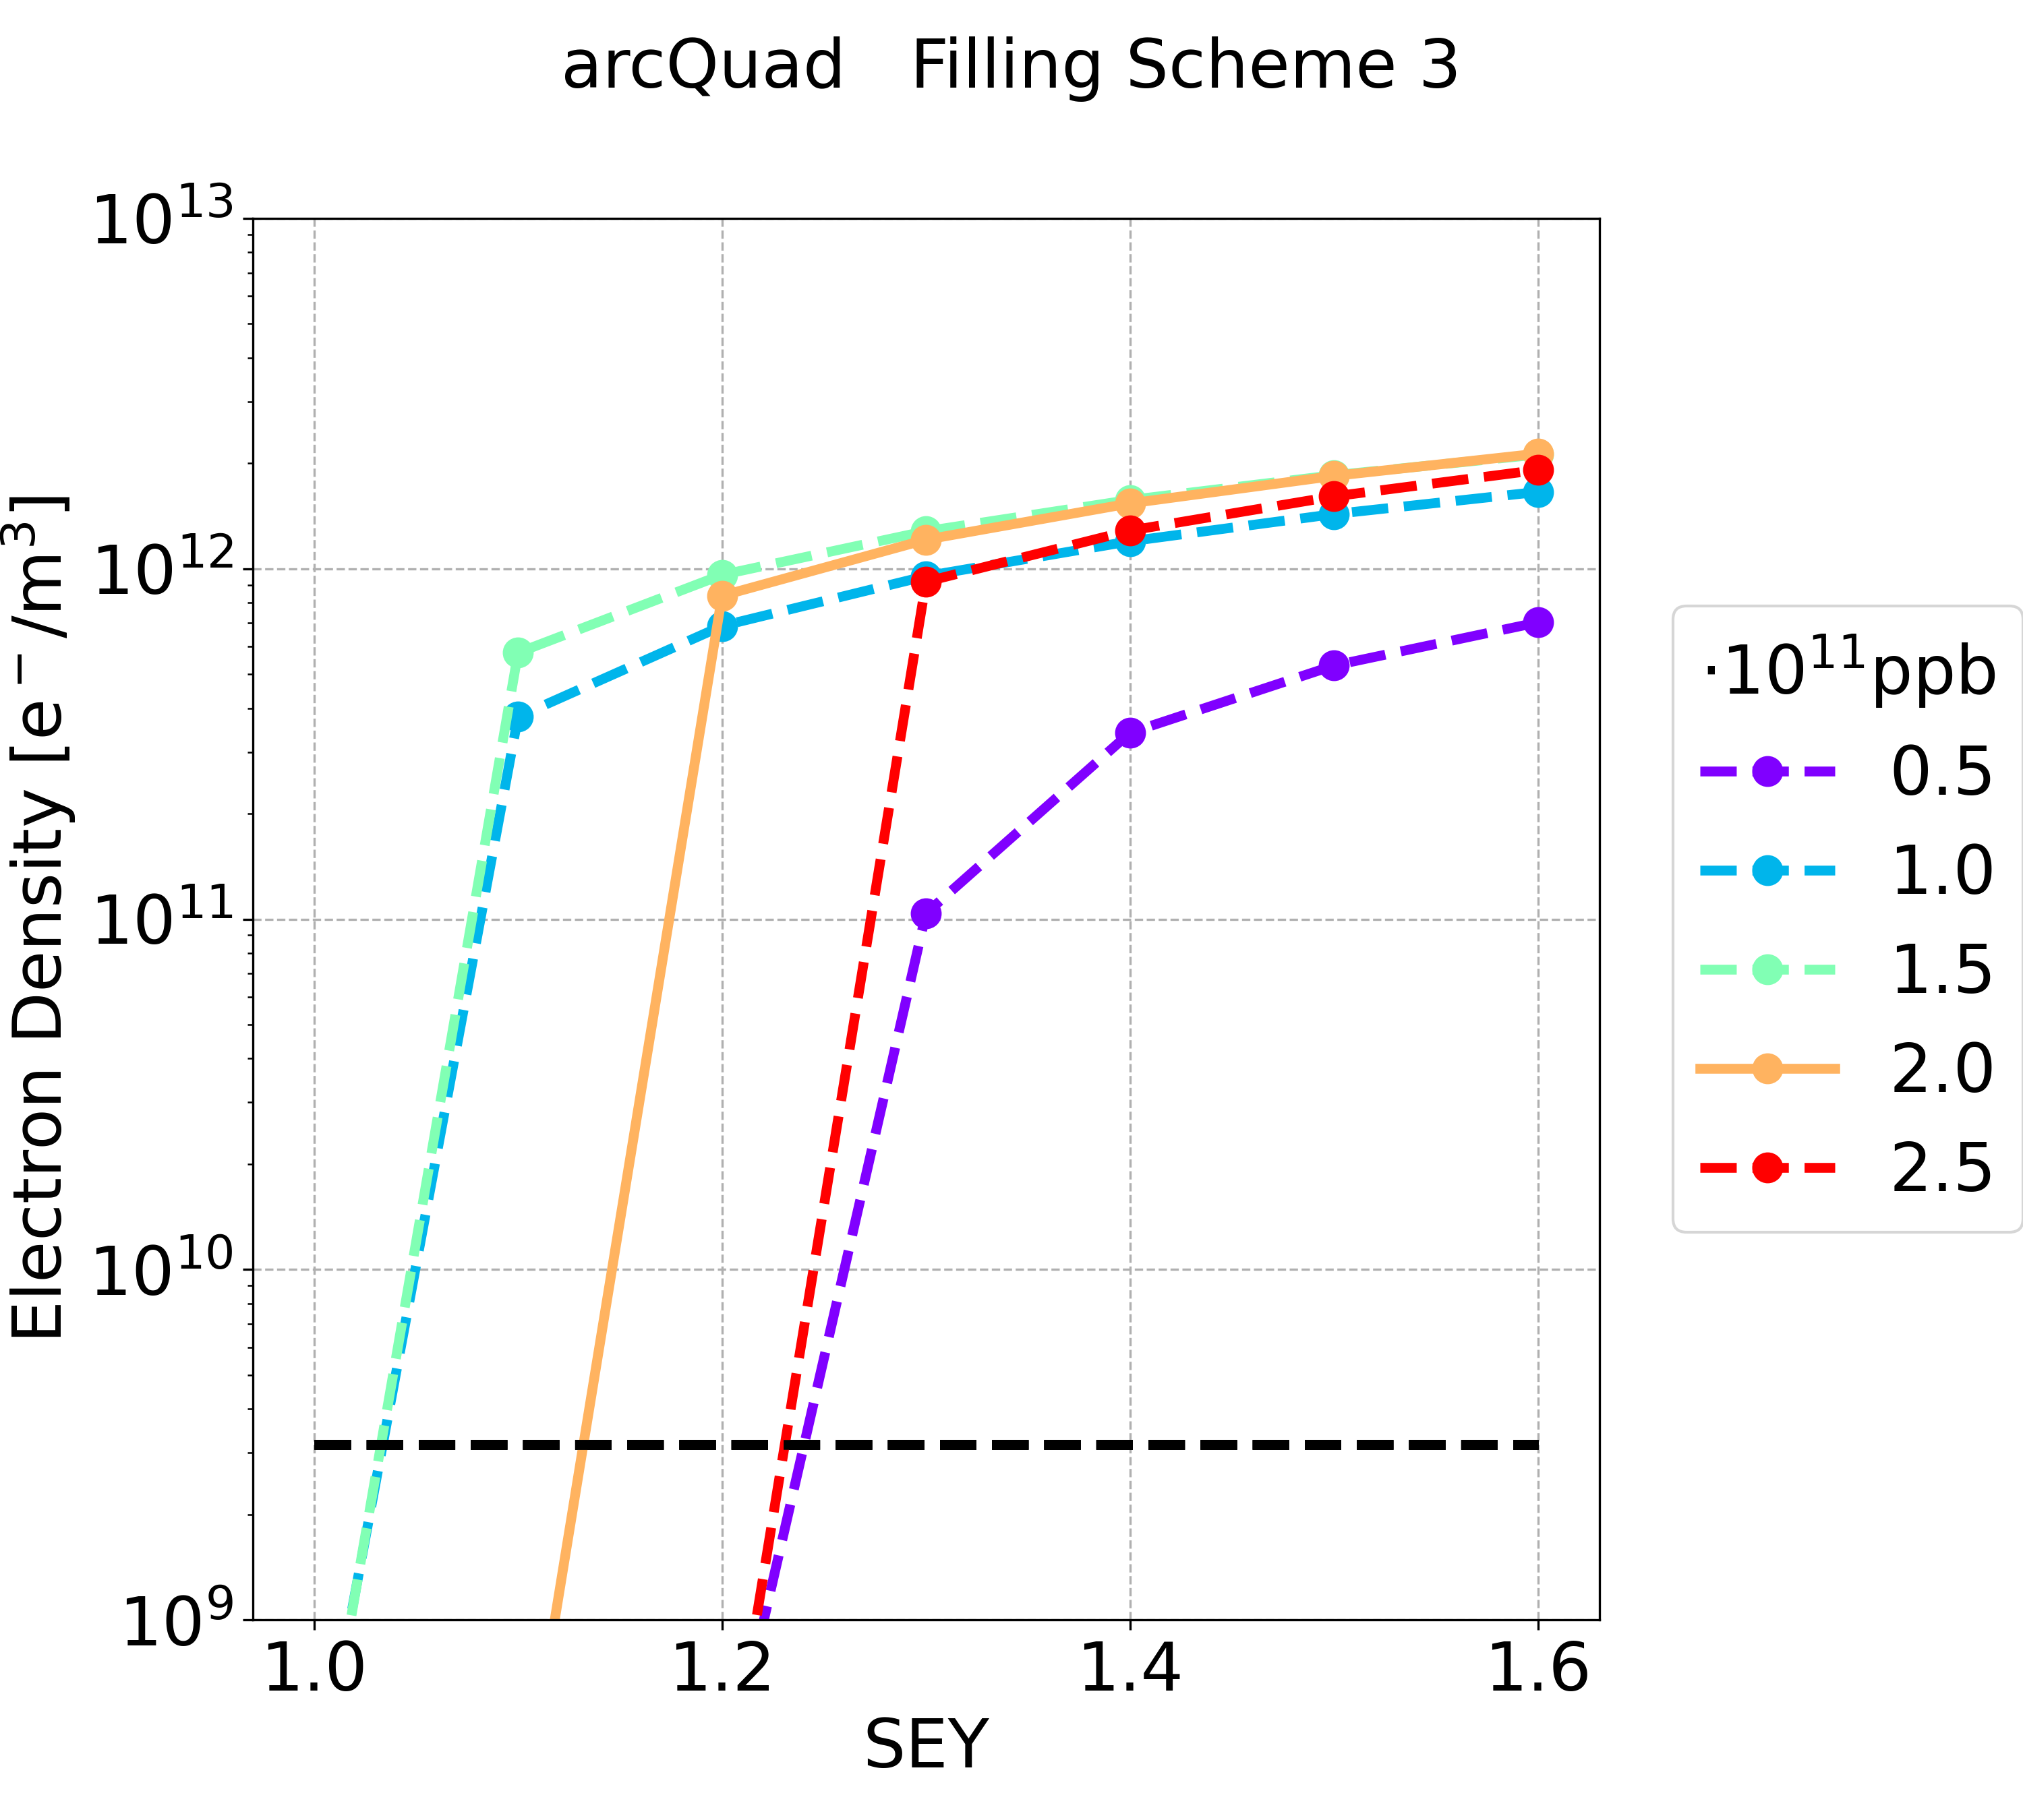
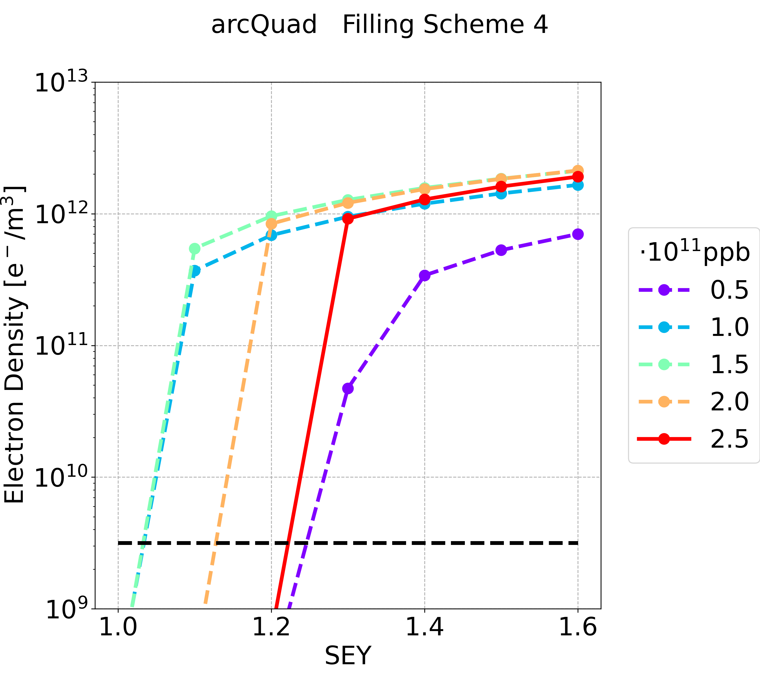
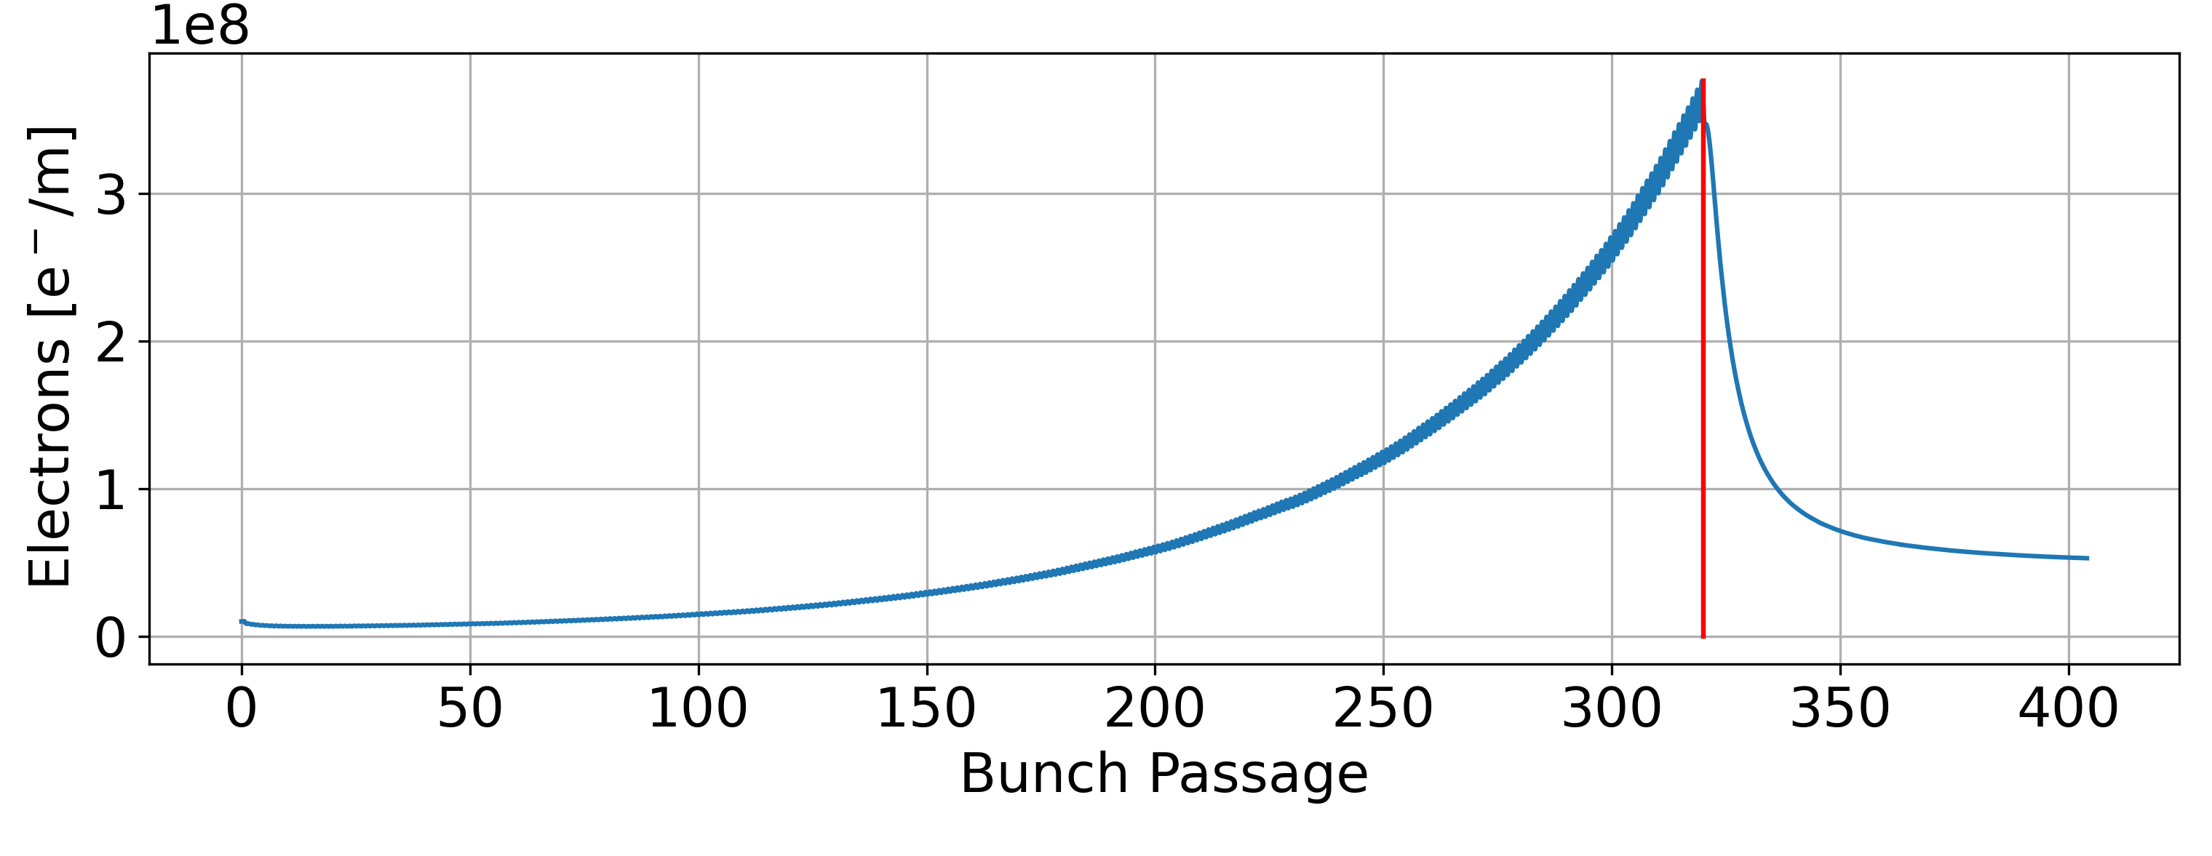
Simulation Results: Quadrupole
Gap does not suppress the e-cloud
23/06/2023
Update on the Electron Cloud Studies for FCC-ee 12/09/2023

Slide 15
Simulation Results: Quadrupole
 | Filling Scheme 1 | Filling Scheme 2 | Filling Scheme 3 | Filling Scheme 4
SEY threshold (nominal intensity) | <1.0 | 1.0 | 1.1 | 1.2
SEY threshold (all intensity below nominal one) | <1.0 | 1.0 | 1.0 | 1.0
The SEY threshold is the smallest for the filling scheme 1
Considering the nominal bunch intensity the filling scheme 4 is preferable

Slide 16
Summary
Filling scheme 4 is preferable
  With larger bunch spacing the required SEY threshold (to suppress the e-cloud build-up) is higher
Quadrupoles have the lowest thresholds
Element | SEY Threshold | Filling Scheme 1 | Filling Scheme 2 | Filling Scheme 3 | Filling Scheme 4
Drift Space | nominal intensity | 1.0 | 1.3 | 1.4 | 1.5
 | all intensity below nominal one | 1.0 | 1.1 | 1.2 | 1.2
Dipole | nominal intensity | 1.0 | 1.3 | 1.4 | 1.5
 | all intensity below nominal one | 1.0 | 1.0 | 1.1 | 1.1
Quadrupole | nominal intensity | <1.0 | 1.0 | 1.1 | 1.2
 | all intensity below nominal one | <1.0 | 1.0 | 1.0 | 1.0
Update on the Electron Cloud Studies for FCC-ee 12/09/2023

Slide 17
Outline
Possible Filling Schemes
  E-cloud Density
  Heat Loads
Update on the Electron Cloud Studies for FCC-ee 12/09/2023

Slide 18
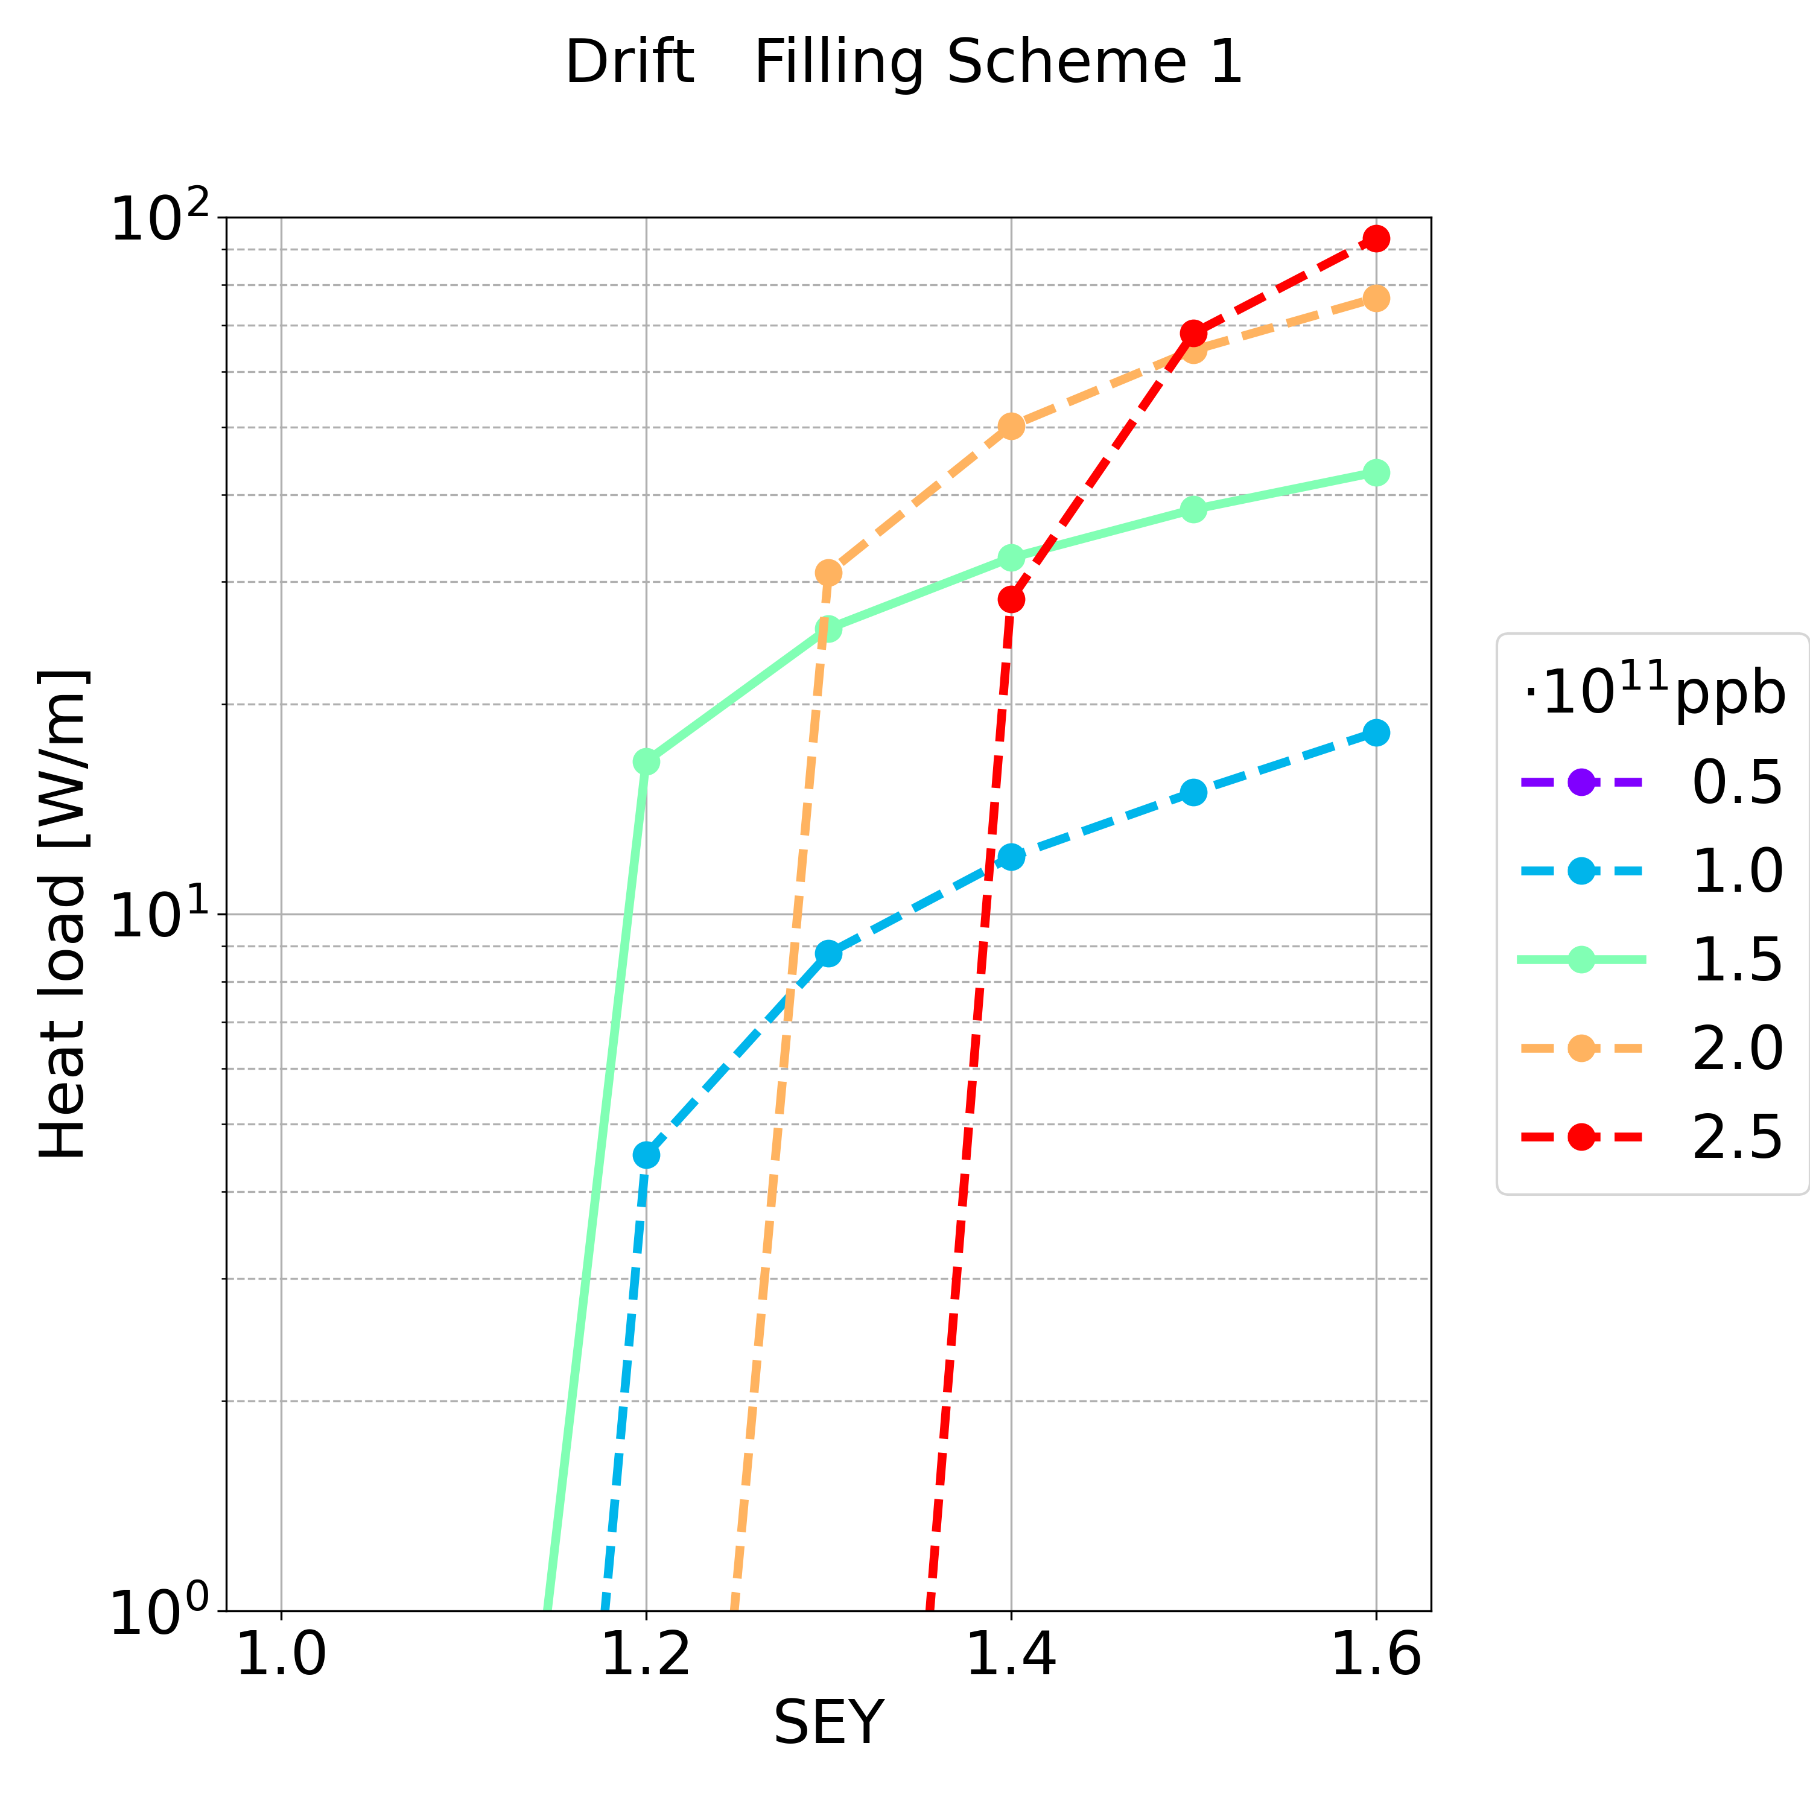
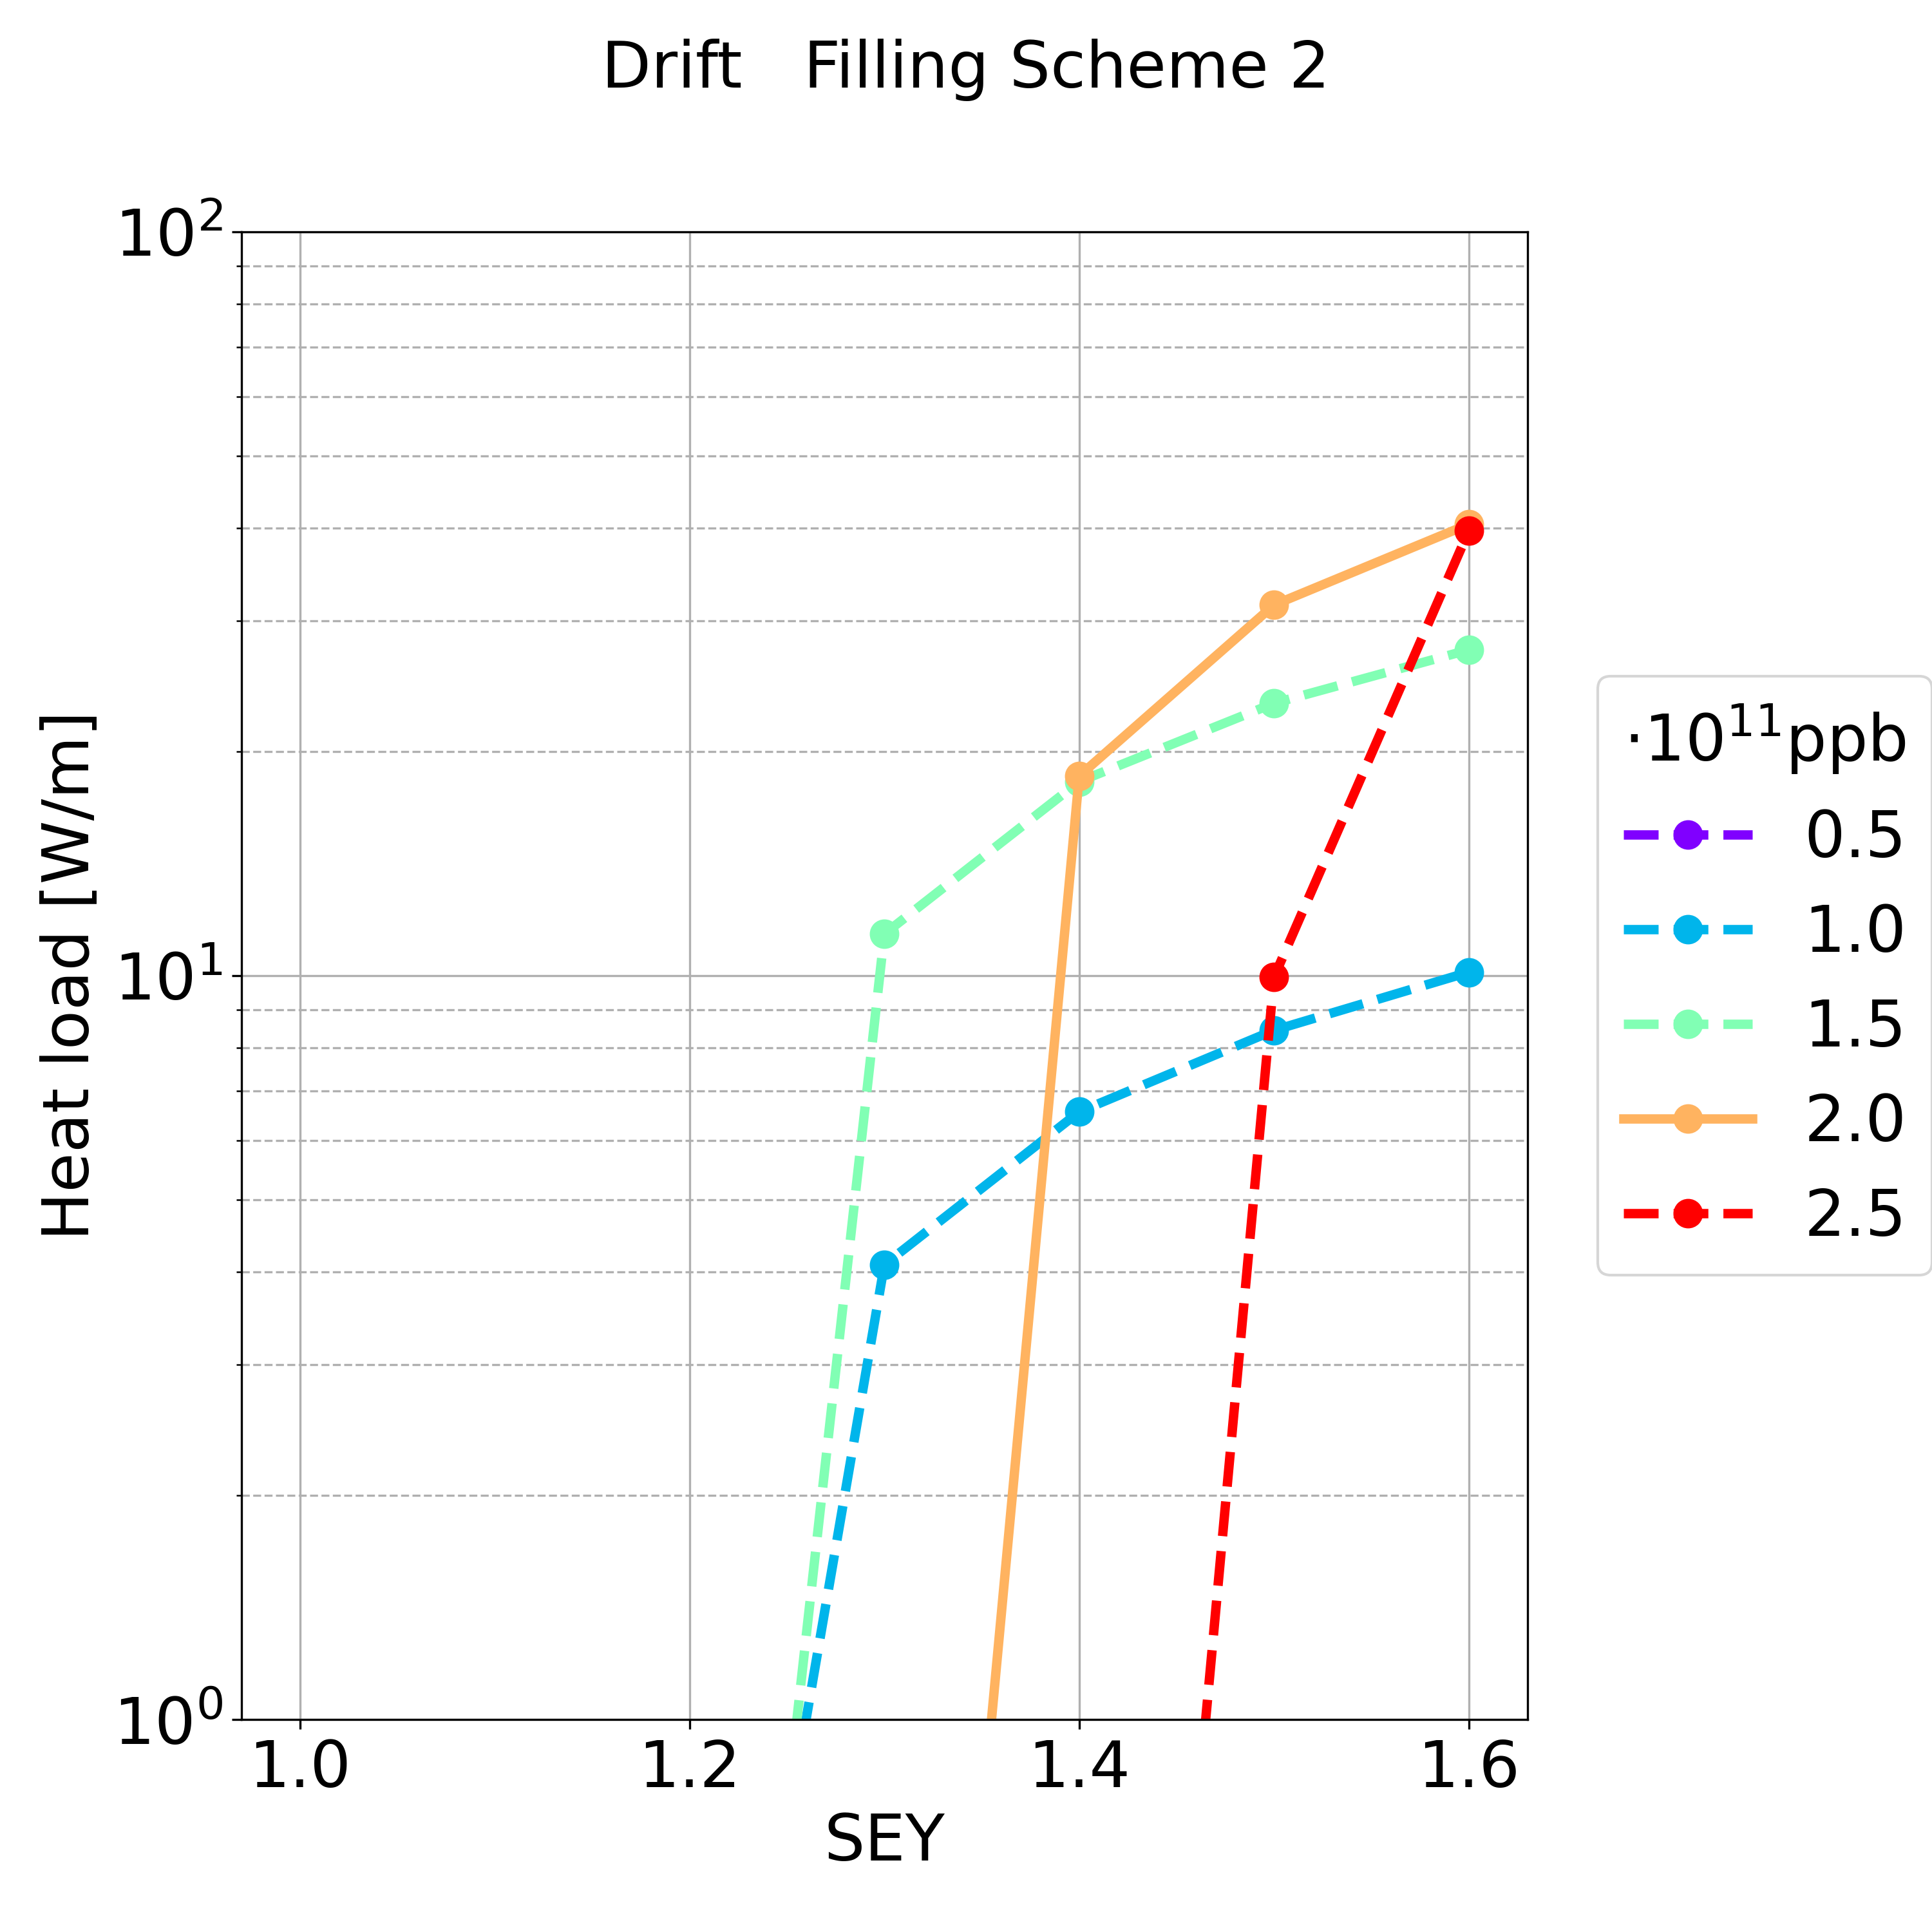
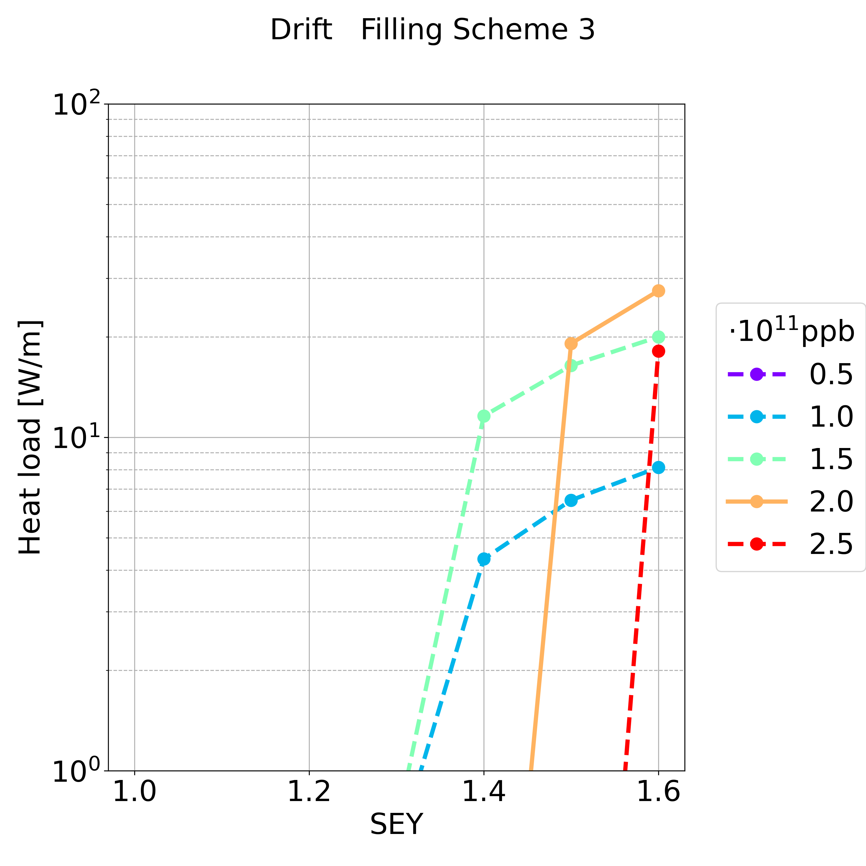
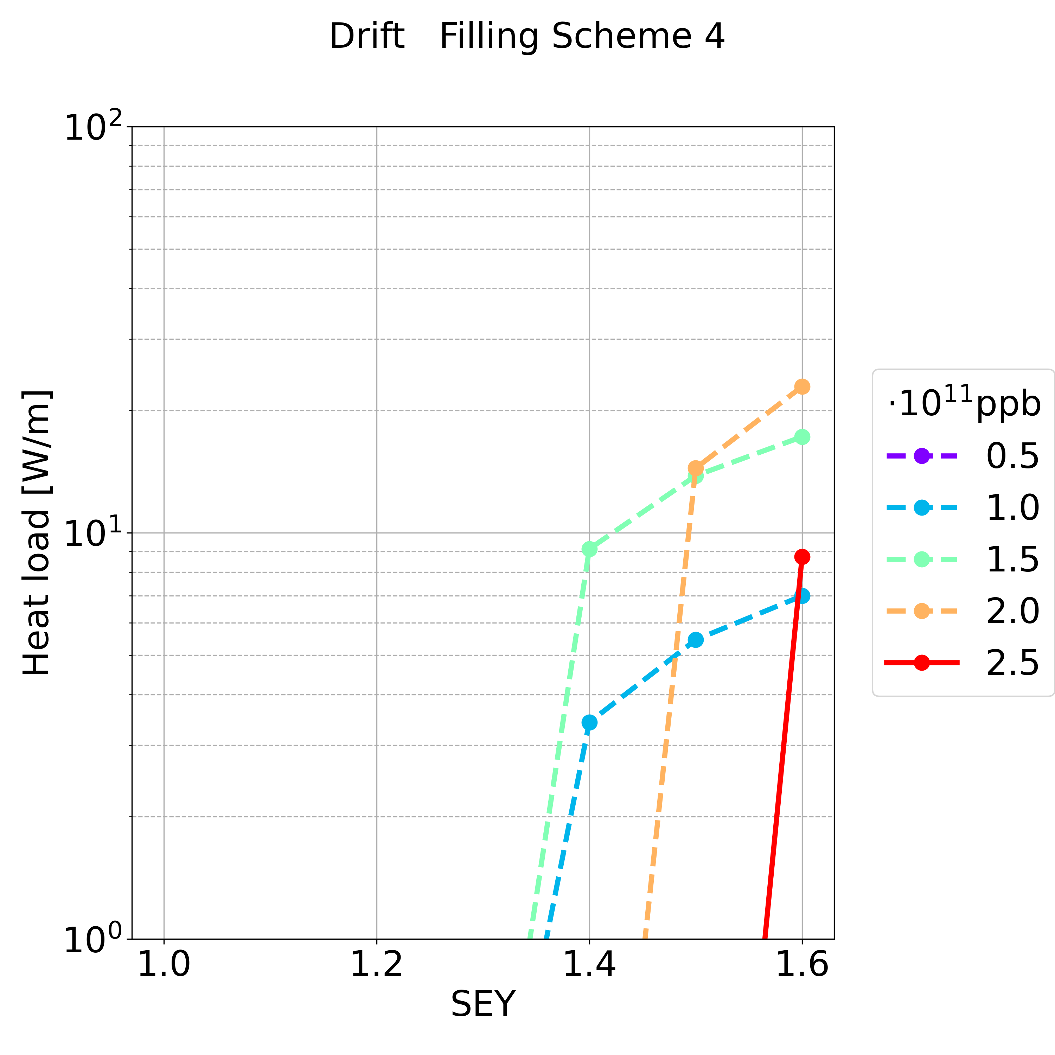
Simulation Results: Drift Space
Synchrotron radiation ~50 MW per beam
  L_{drift} = 17.4 km in the arcs (L_{drift} /L = 19.2%)
For the max simulated SEY and for the nominal bunch intensity (in most of the cases there is multipacting), the heat load is in the order of:
  Filling scheme 1: ~ 0.7 MW
  Filling scheme 2: ~ 0.7 MW
  Filling scheme 3: ~ 0.5 MW
  Filling scheme 4: ~ 0.2 MW

Slide 19
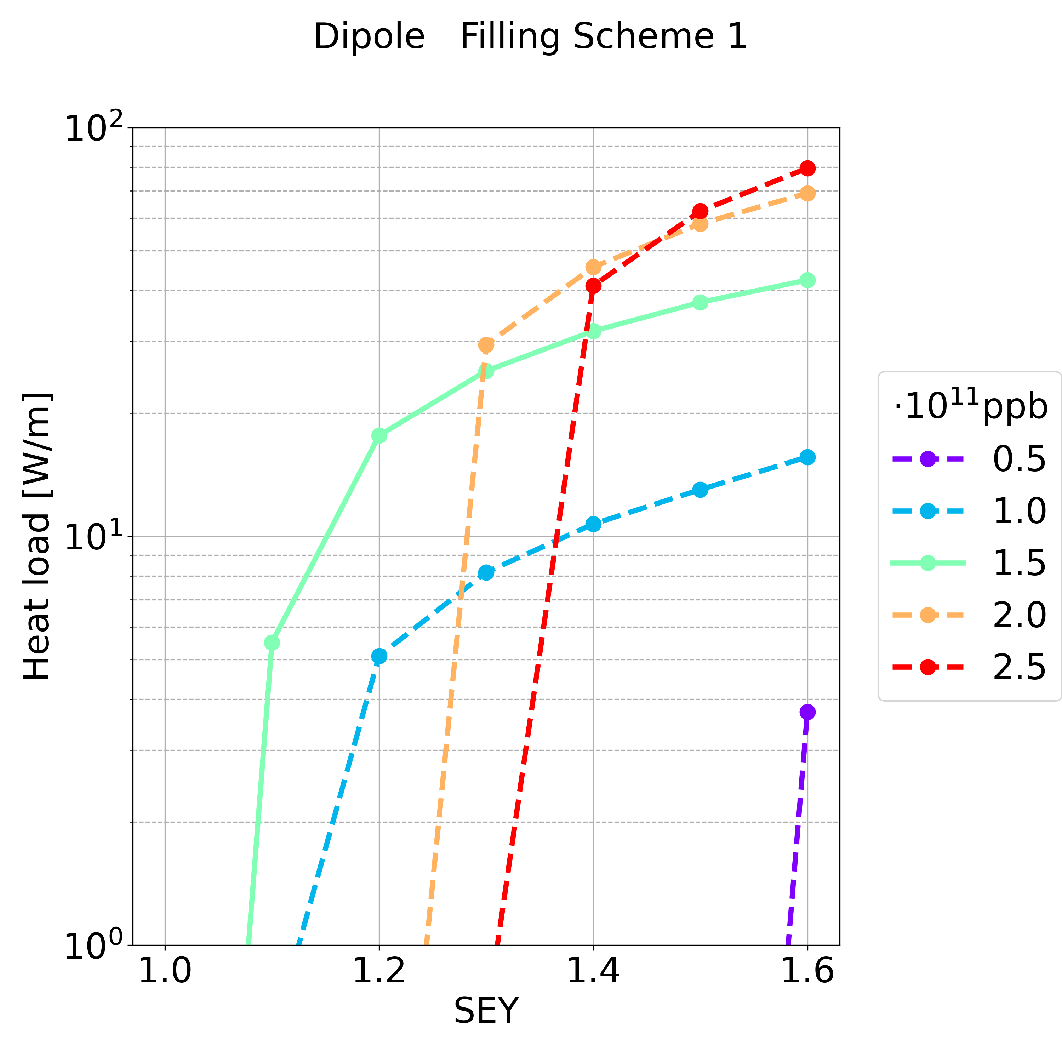
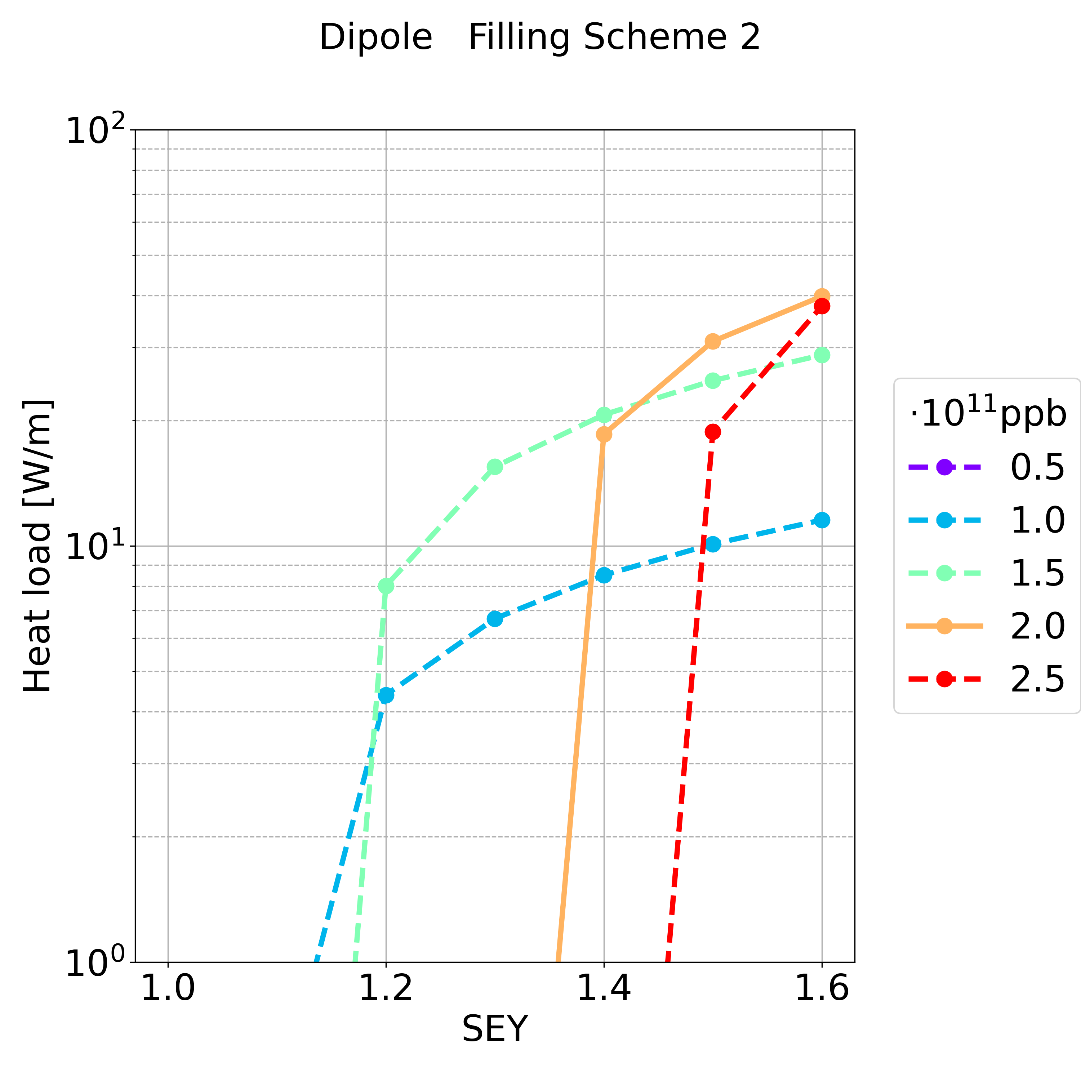
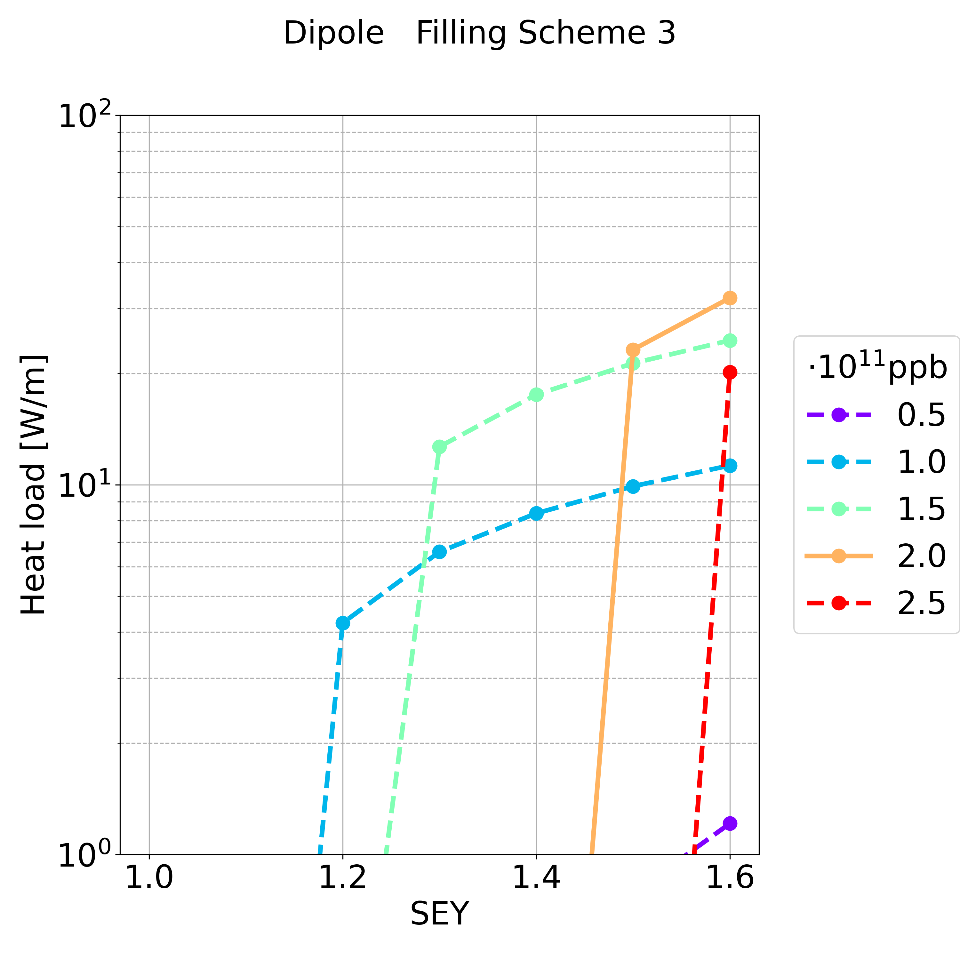
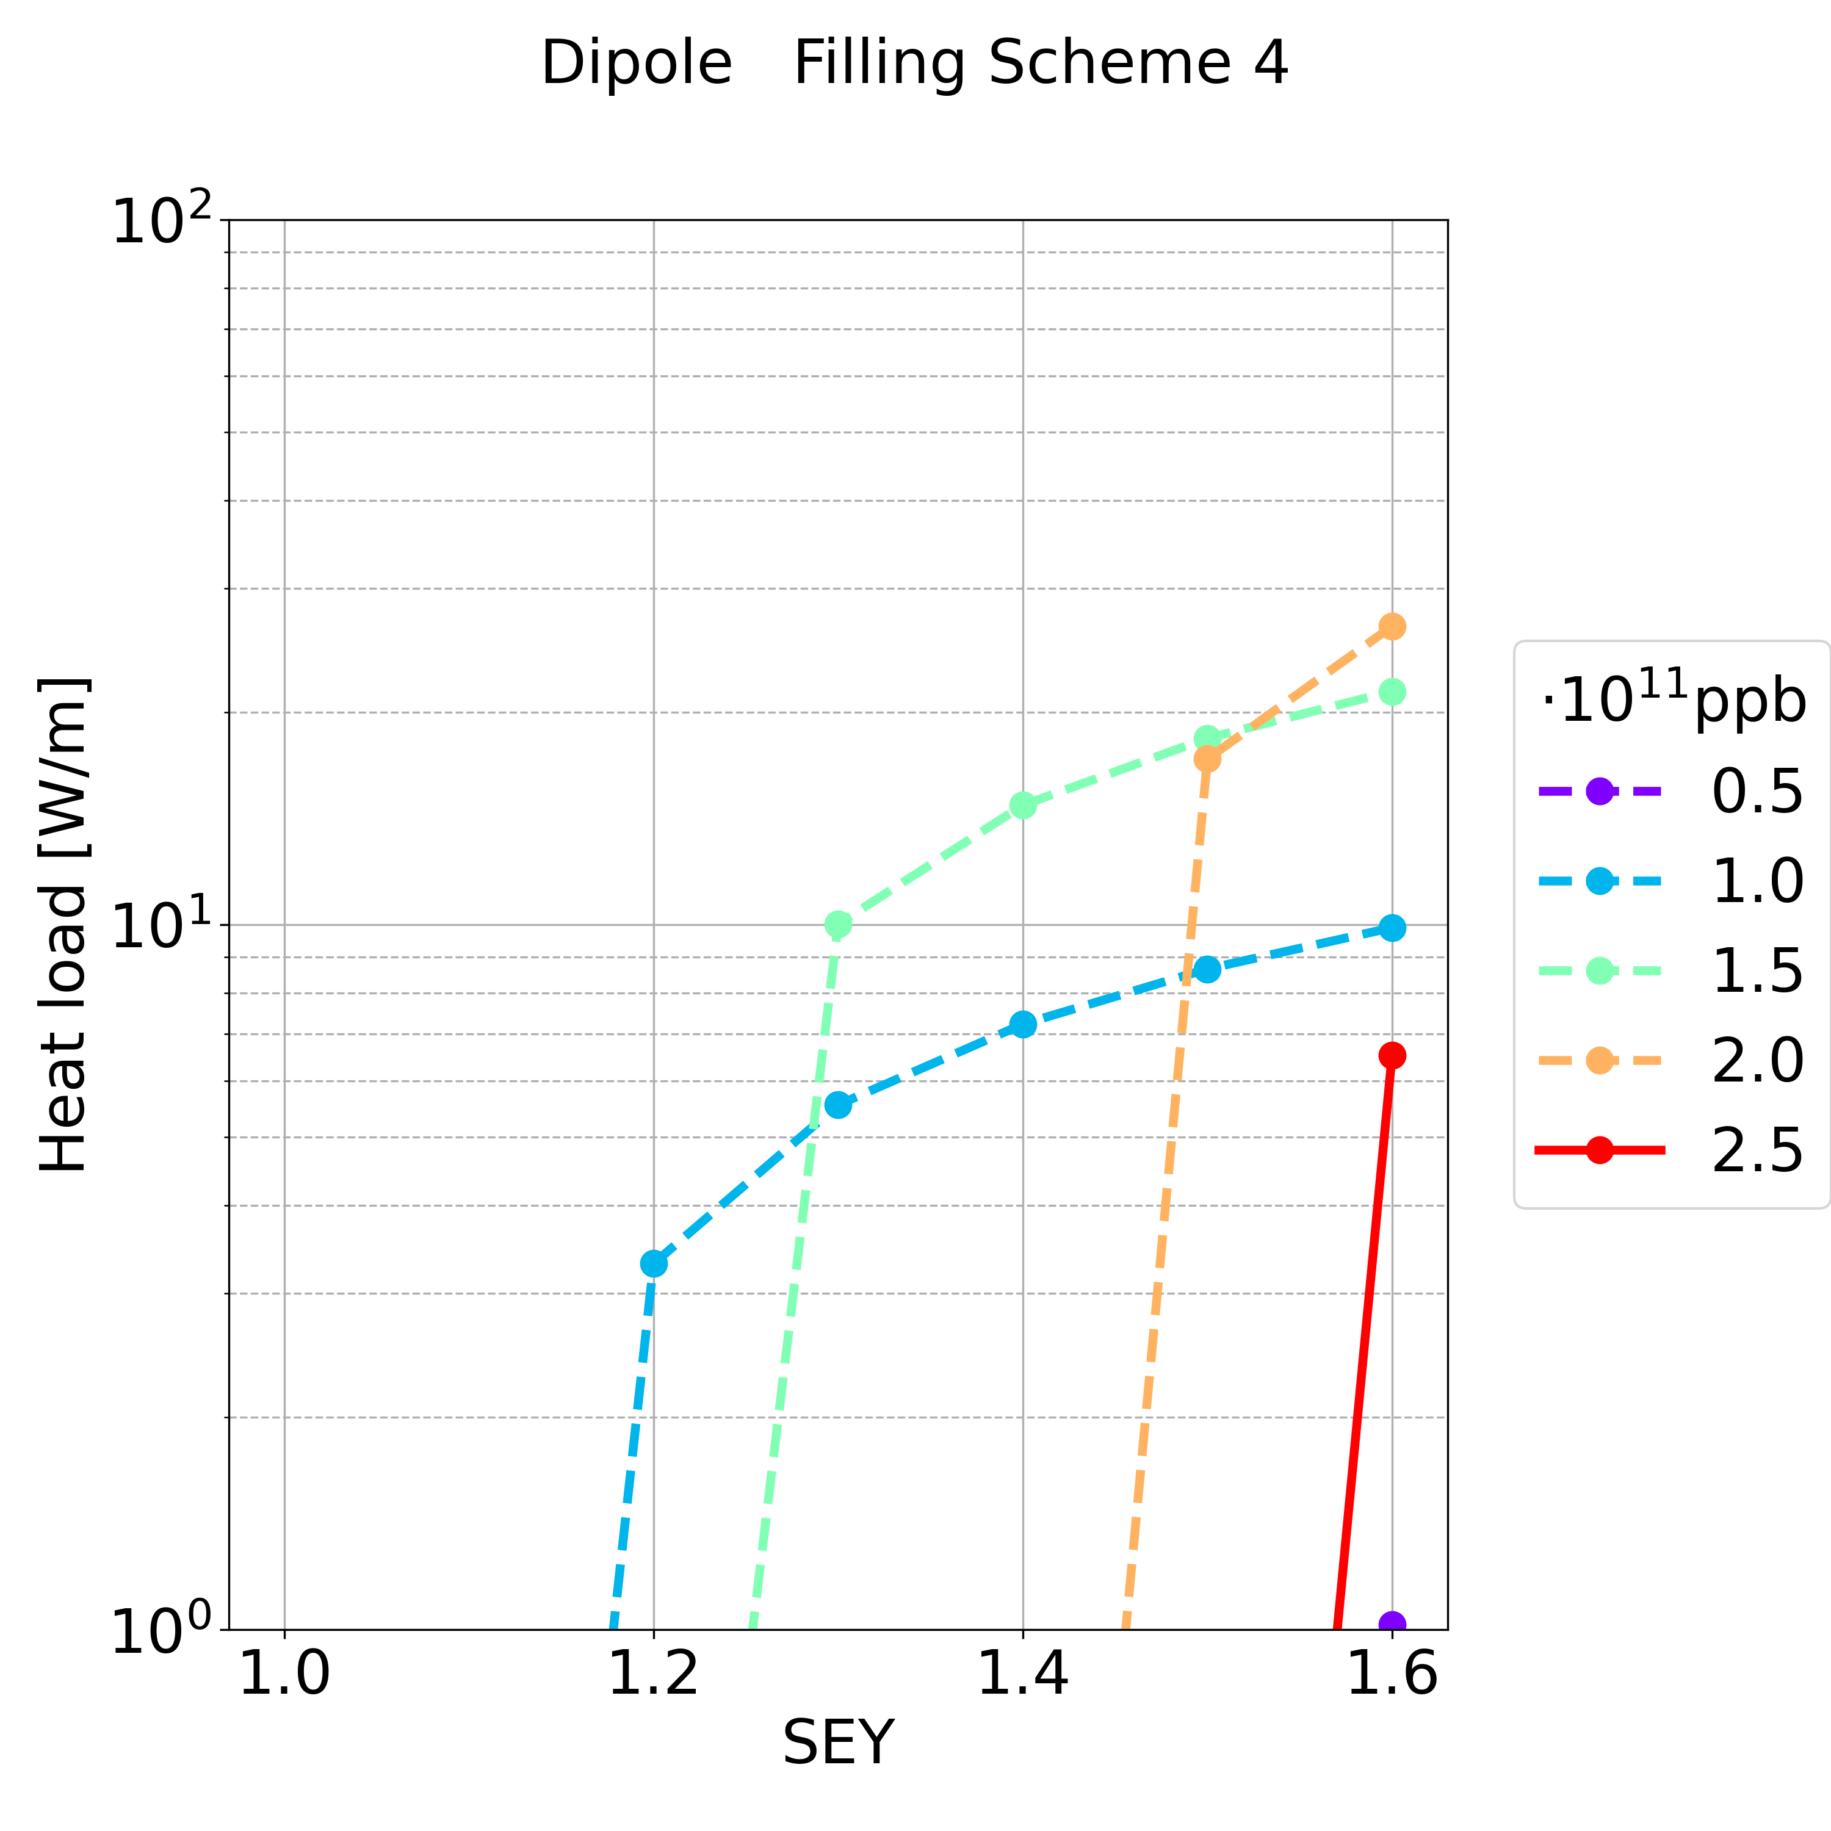
Simulation Results: Dipole
Synchrotron radiation ~50 MW per beam
L_{dipole} = 62.8 km in the arcs (L_{dipole} /L = 69.2%)
For the max simulated SEY and for the nominal bunch intensity (in most of the cases there is multipacting), the heat load is in the order of:
  Filling scheme 1: ~ 2.5 MW
  Filling scheme 2: ~ 2.5 MW
  Filling scheme 3: ~ 1.9 MW
  Filling scheme 4: ~ 0.4 MW

Slide 20
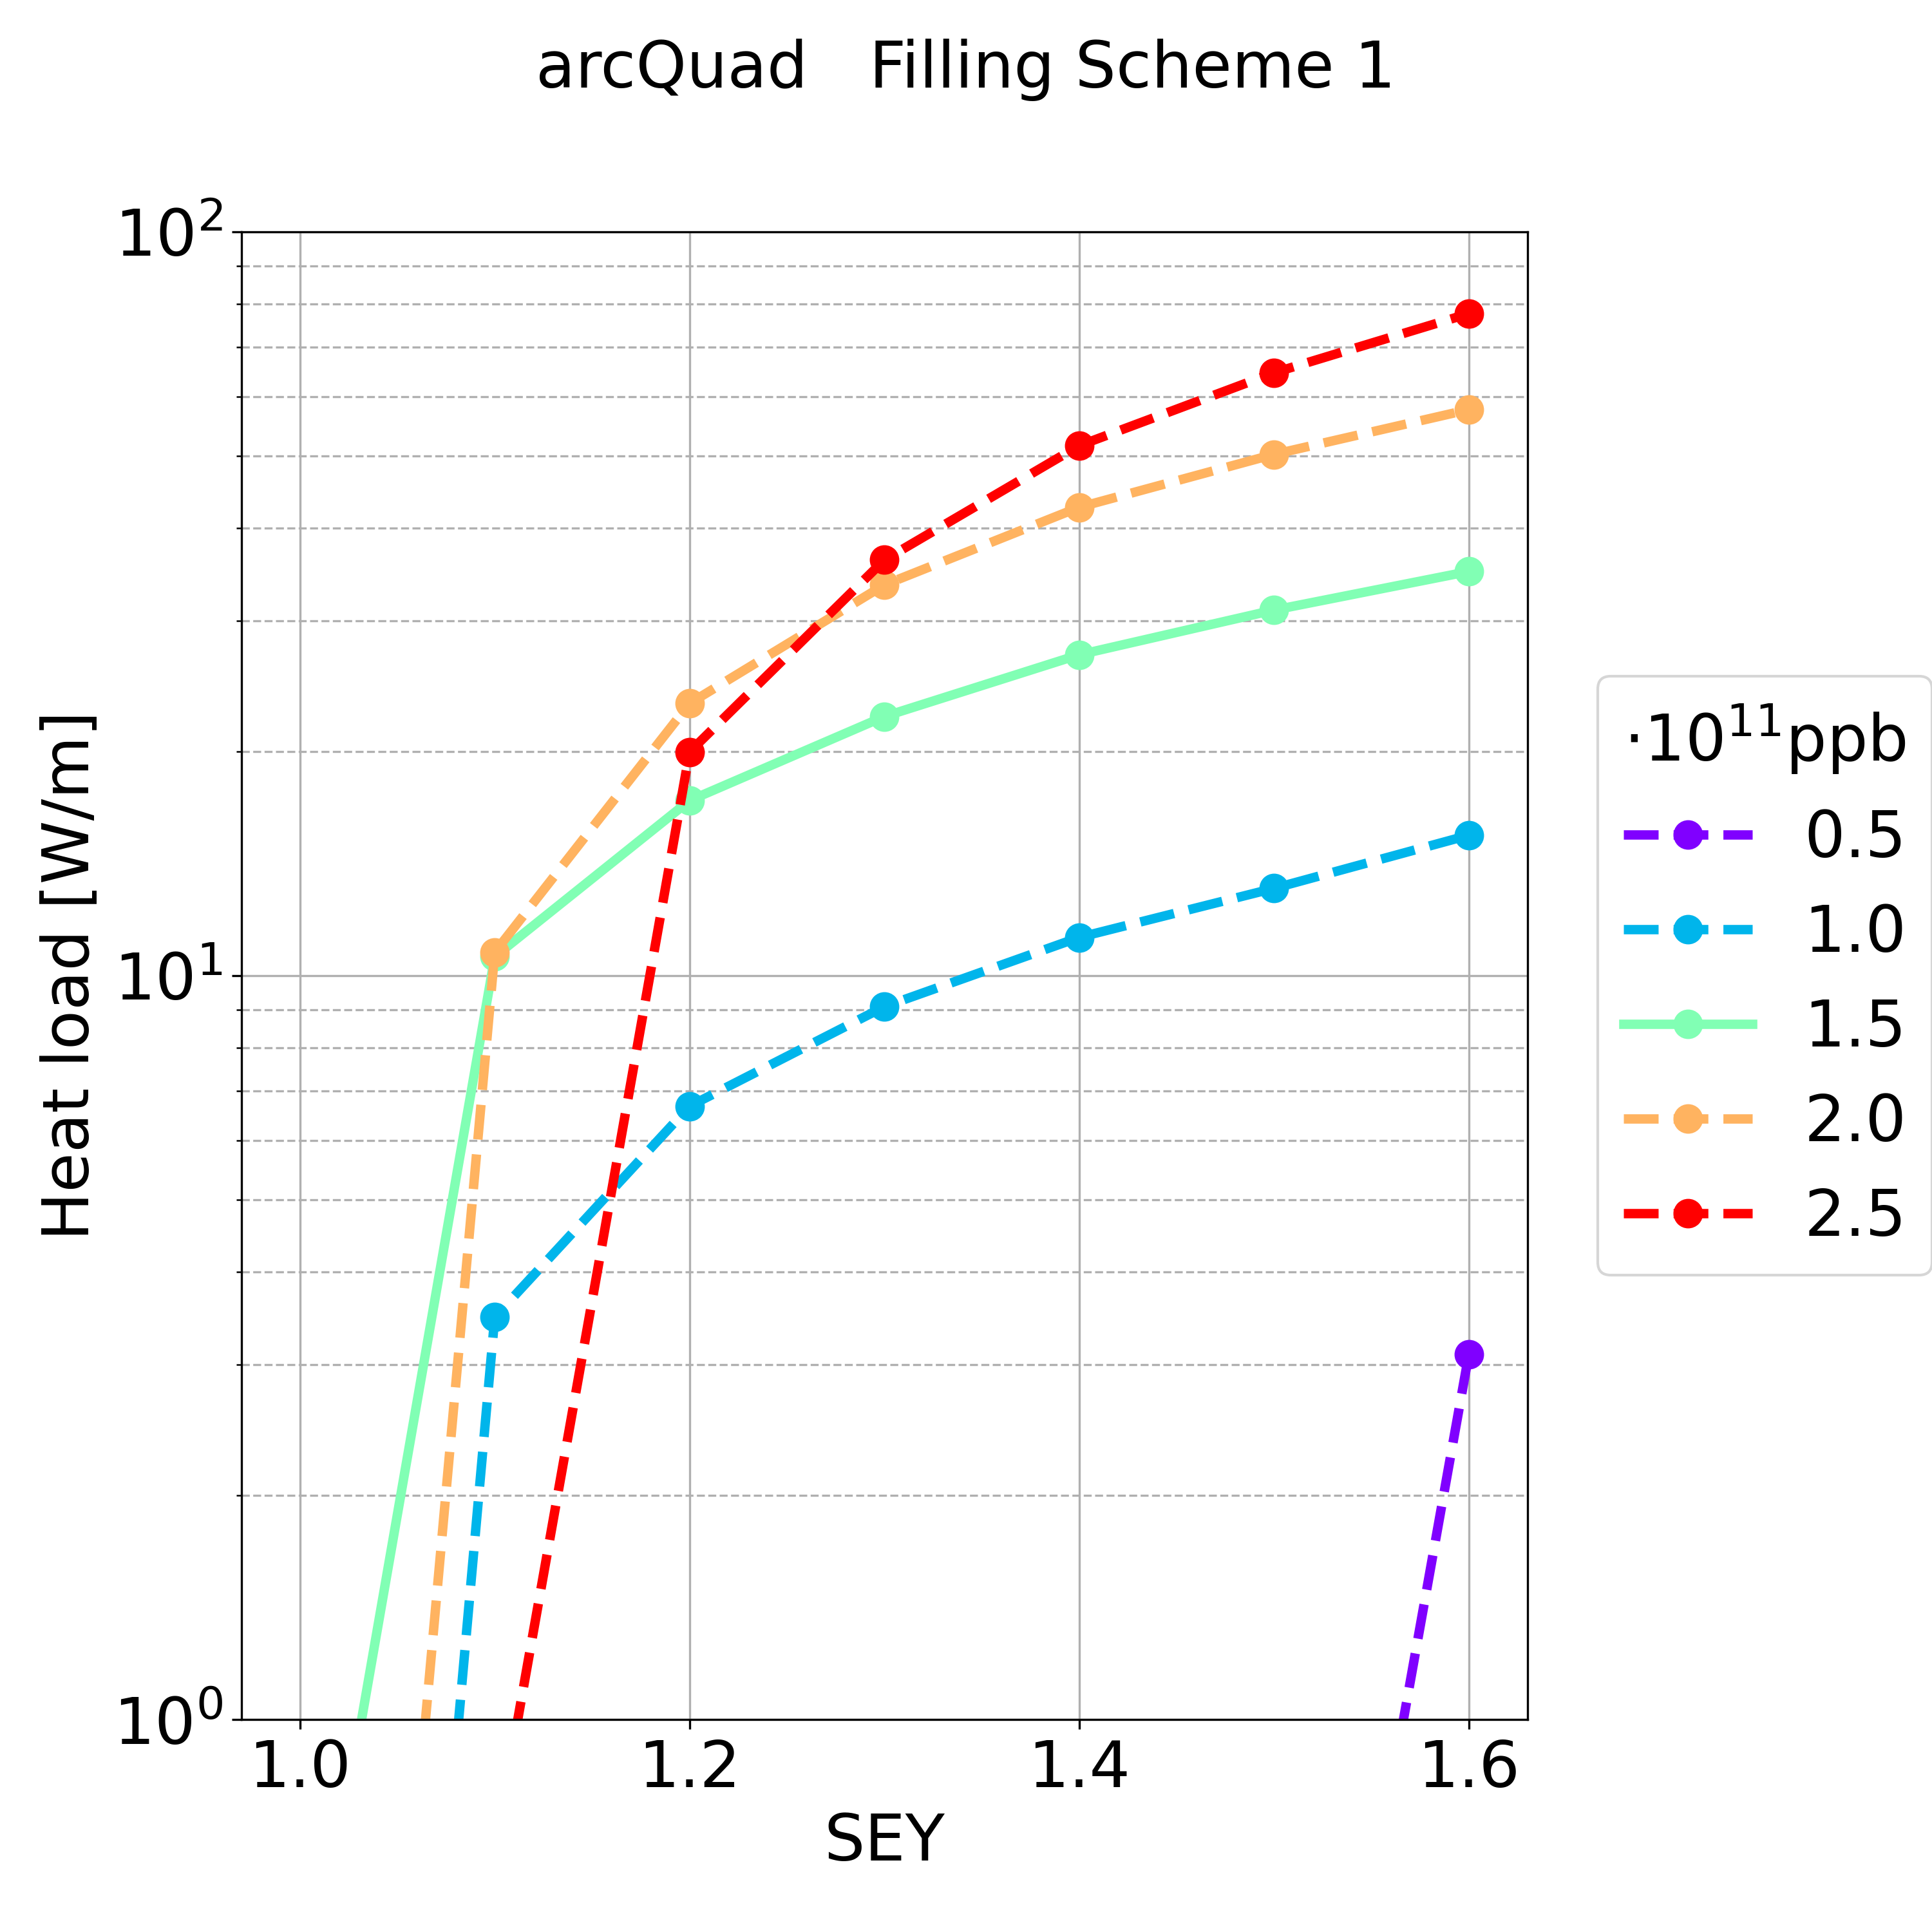
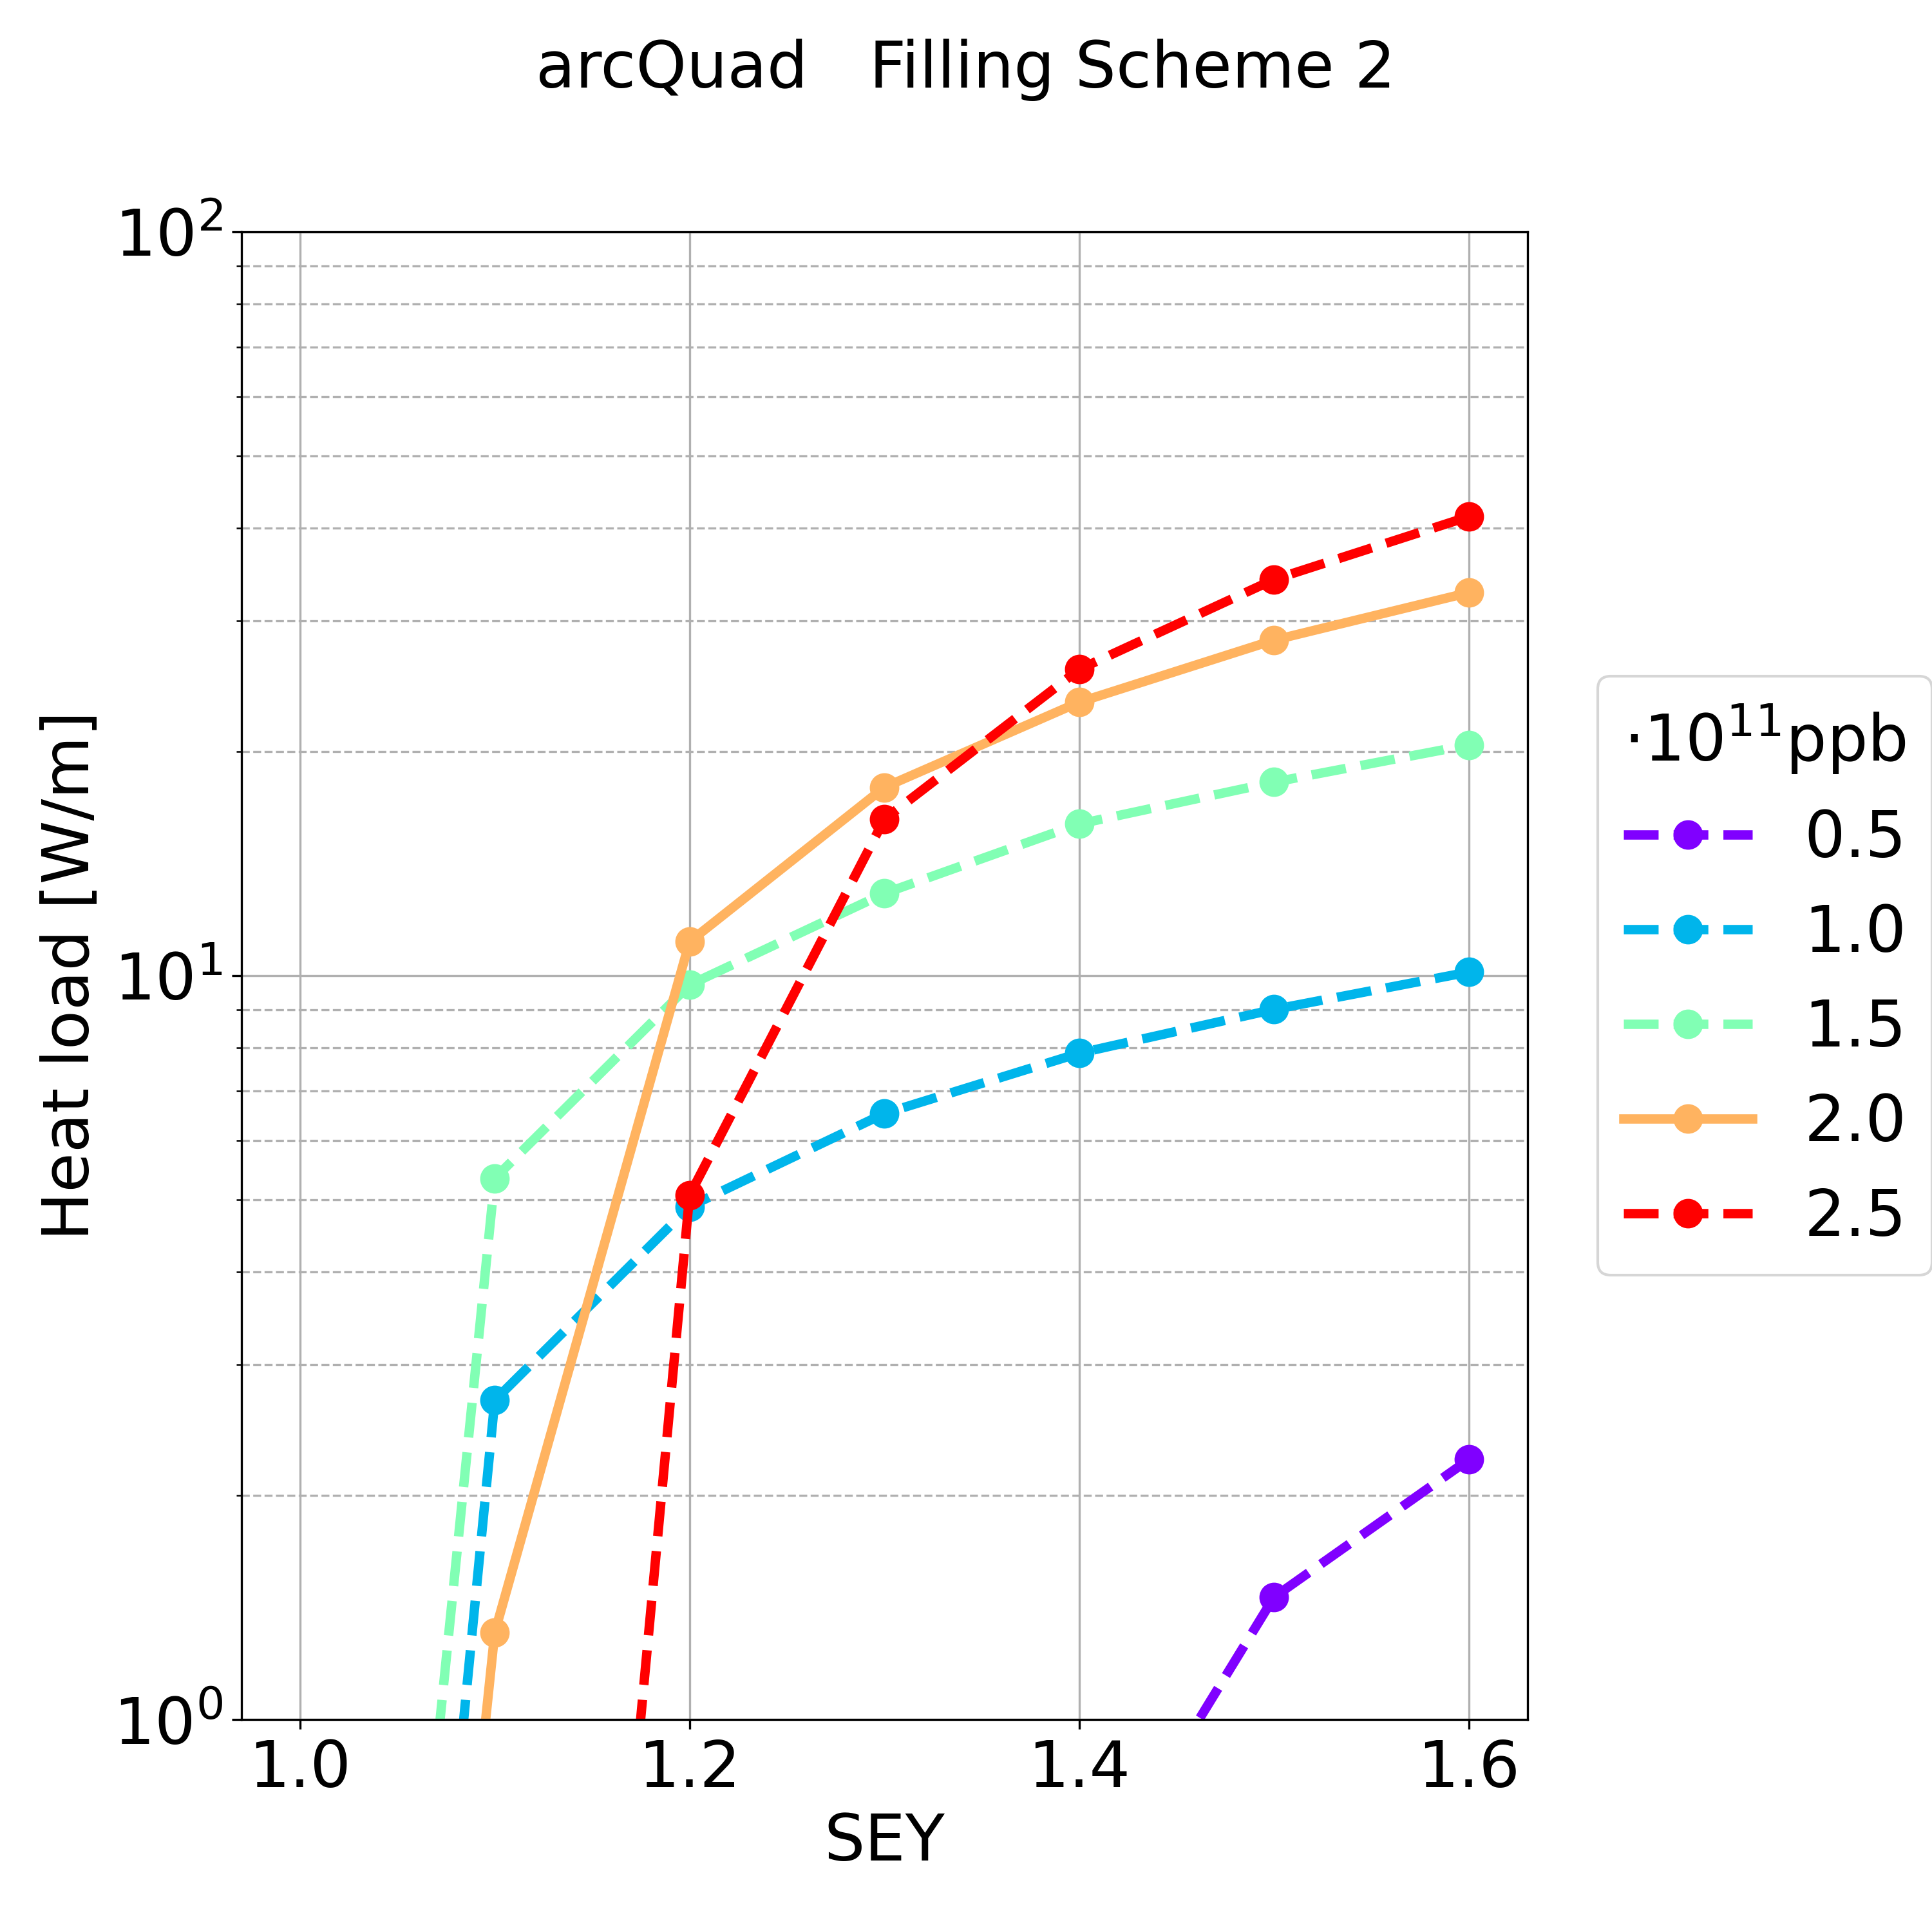
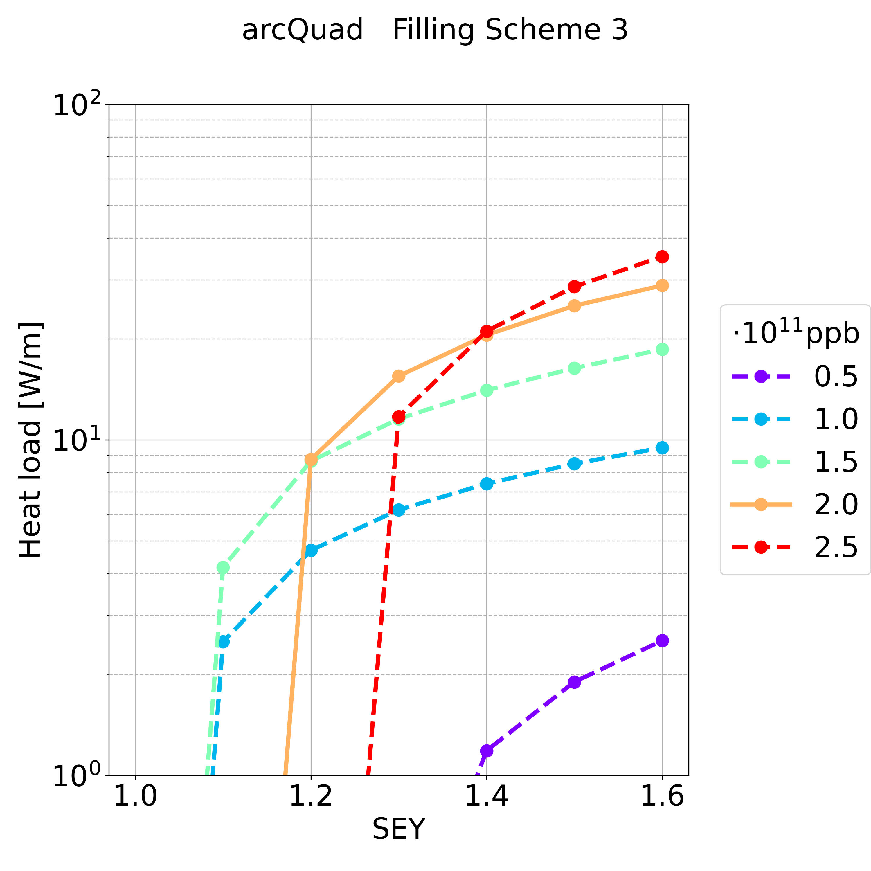
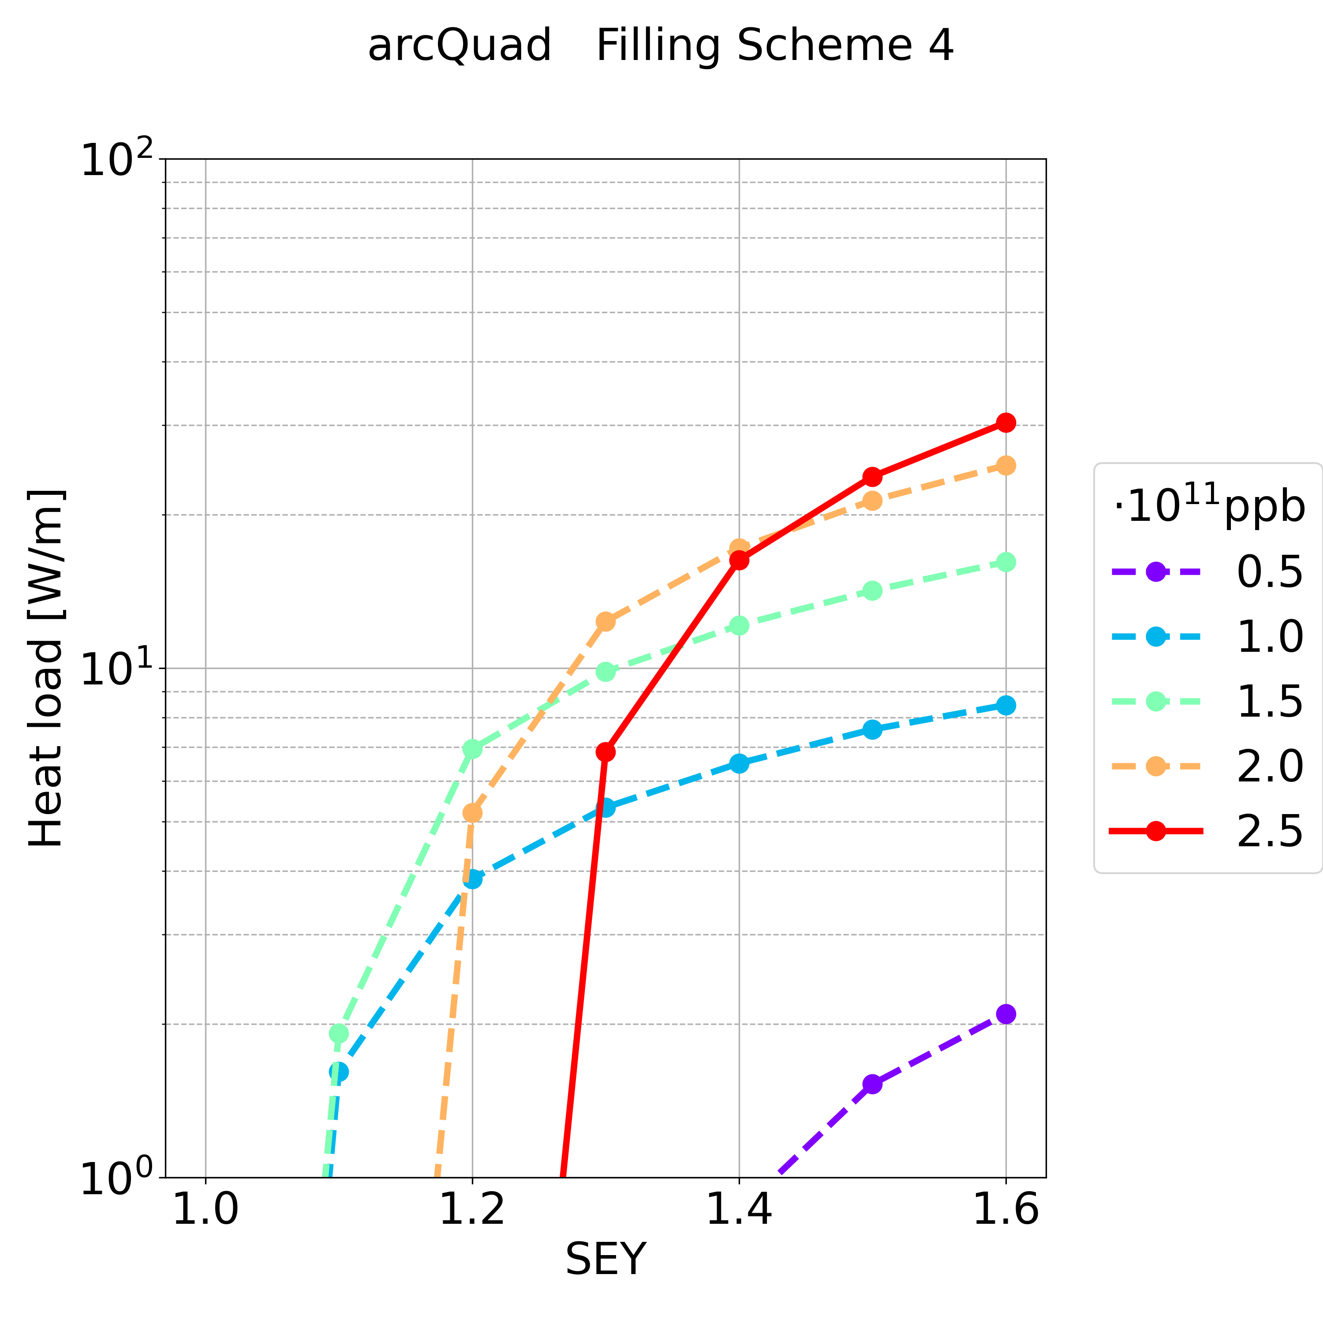
Simulation Results: Quadrupole
Synchrotron radiation ~50 MW per beam
L_{quad} = 4.77 km in the arcs (L_{quad} /L = 5.26%)
For the max simulated SEY and for the nominal bunch intensity (in most of the cases there is multipacting), the heat load is in the order of:
  Filling scheme 1: ~ 0.1 MW
  Filling scheme 2: ~ 0.1 MW
  Filling scheme 3: ~ 0.1 MW
  Filling scheme 4: ~ 0.1 MW

Slide 21
Outline
Possible Filling Schemes
Dispersion
Bunch Length
Stability
FCC Mid-term report
Update on the Electron Cloud Studies for FCC-ee 12/09/2023

Slide 22
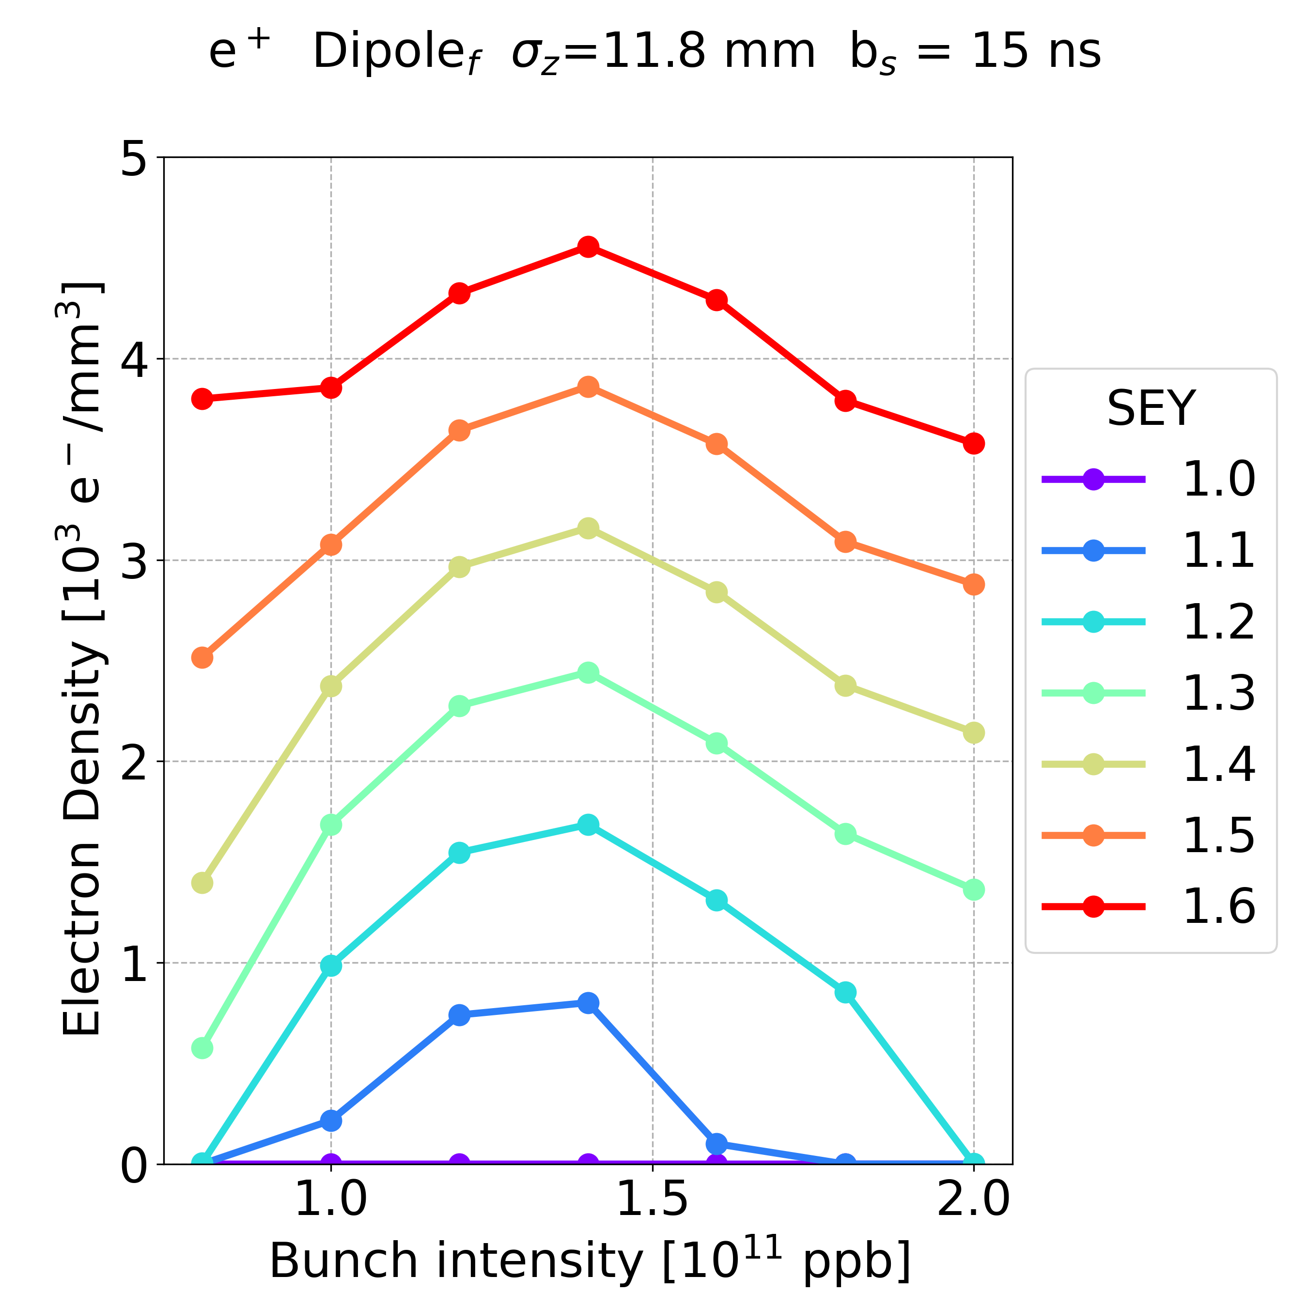
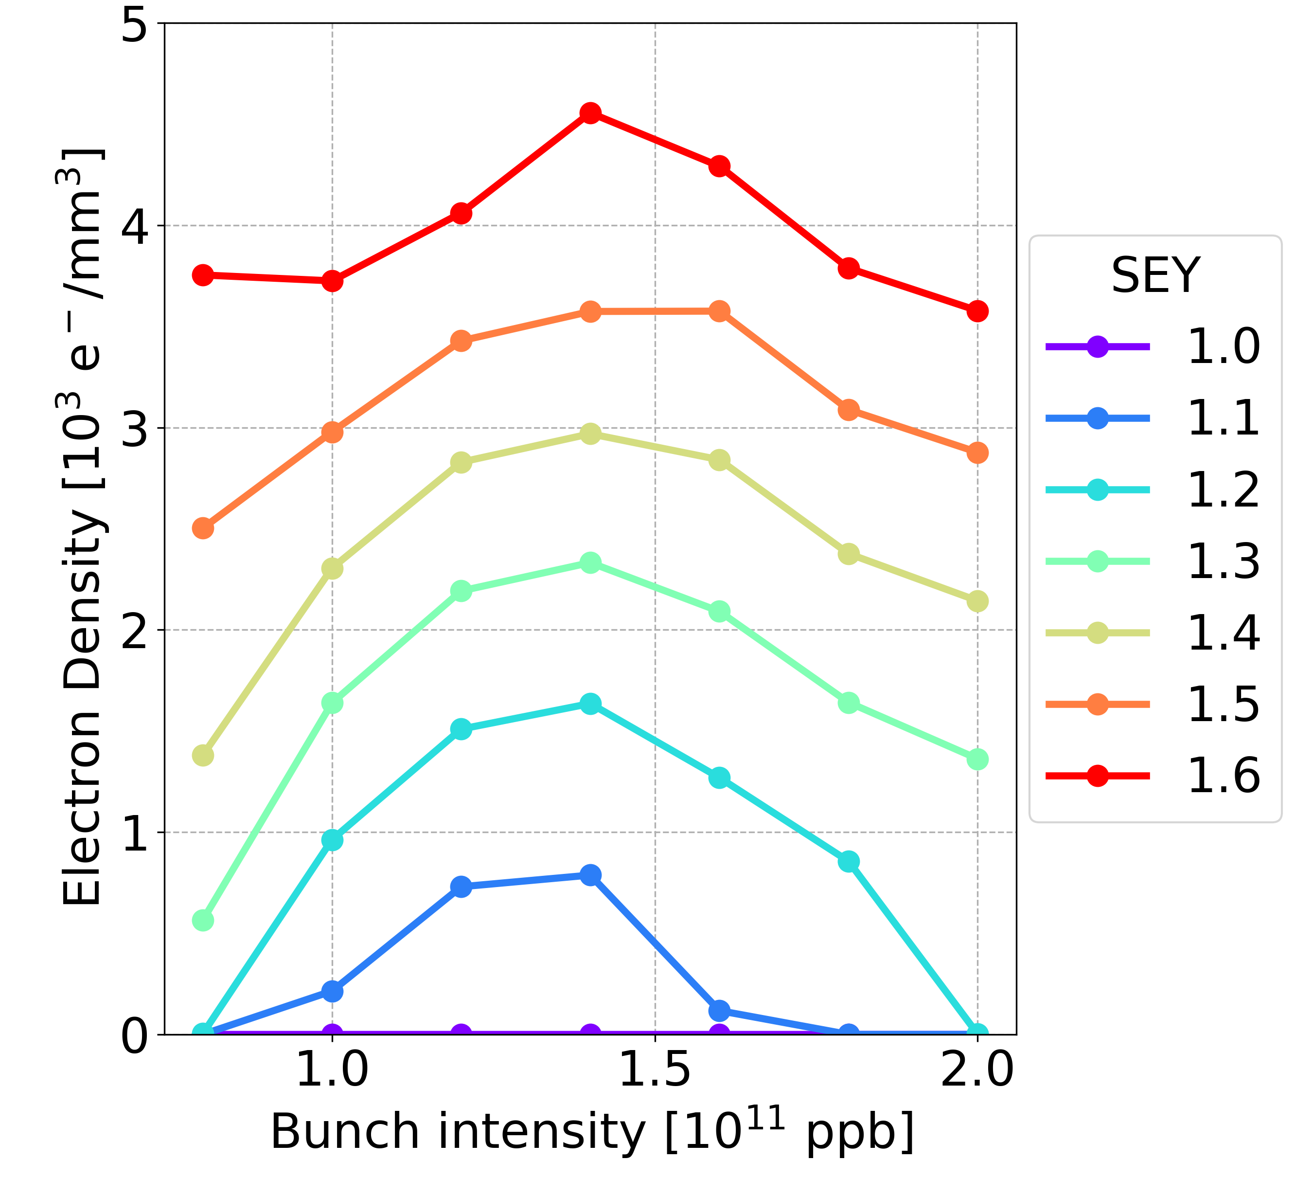
Dispersion
Dipole, bunch spacing 15 ns
Without Dispersion
With Dispersion
Average in the arcs
D_{x} = 0.433 m
Dispersion has a negligible effect on the e-cloud formation process
  the multipacting thresholds are not modified
The same conclusion can be observed for both the drift spaces and the quadrupoles
It was expected:
introducing the dispersion -> the horizontal dimension becomes larger
variation of the beta-functions -> negligible effect on the e-cloud formation process

Slide 23
Outline
Possible Filling Schemes
Dispersion
Bunch Length
Stability
FCC Mid-term report
Update on the Electron Cloud Studies for FCC-ee 12/09/2023

Slide 24
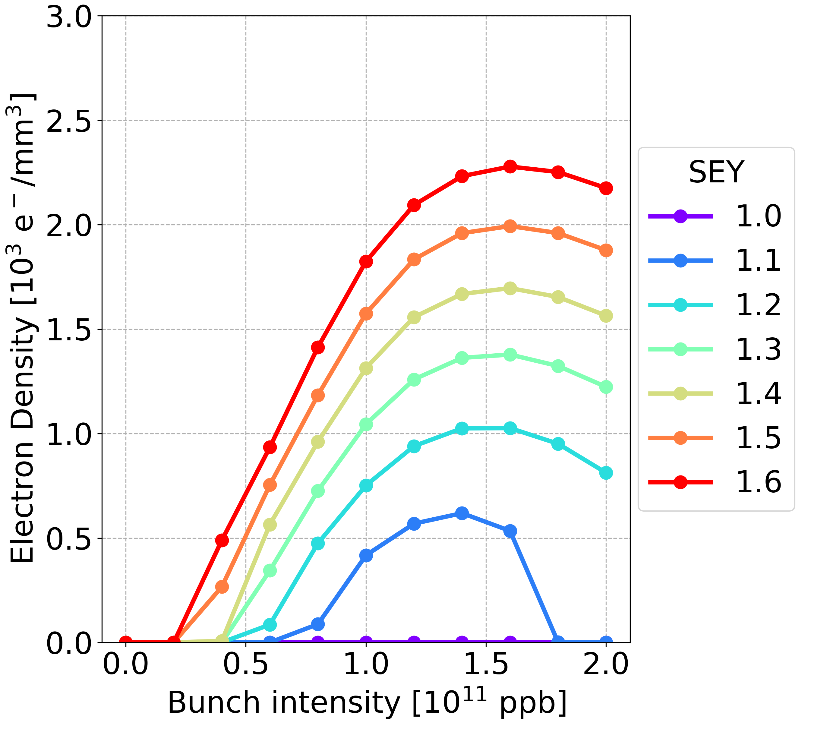
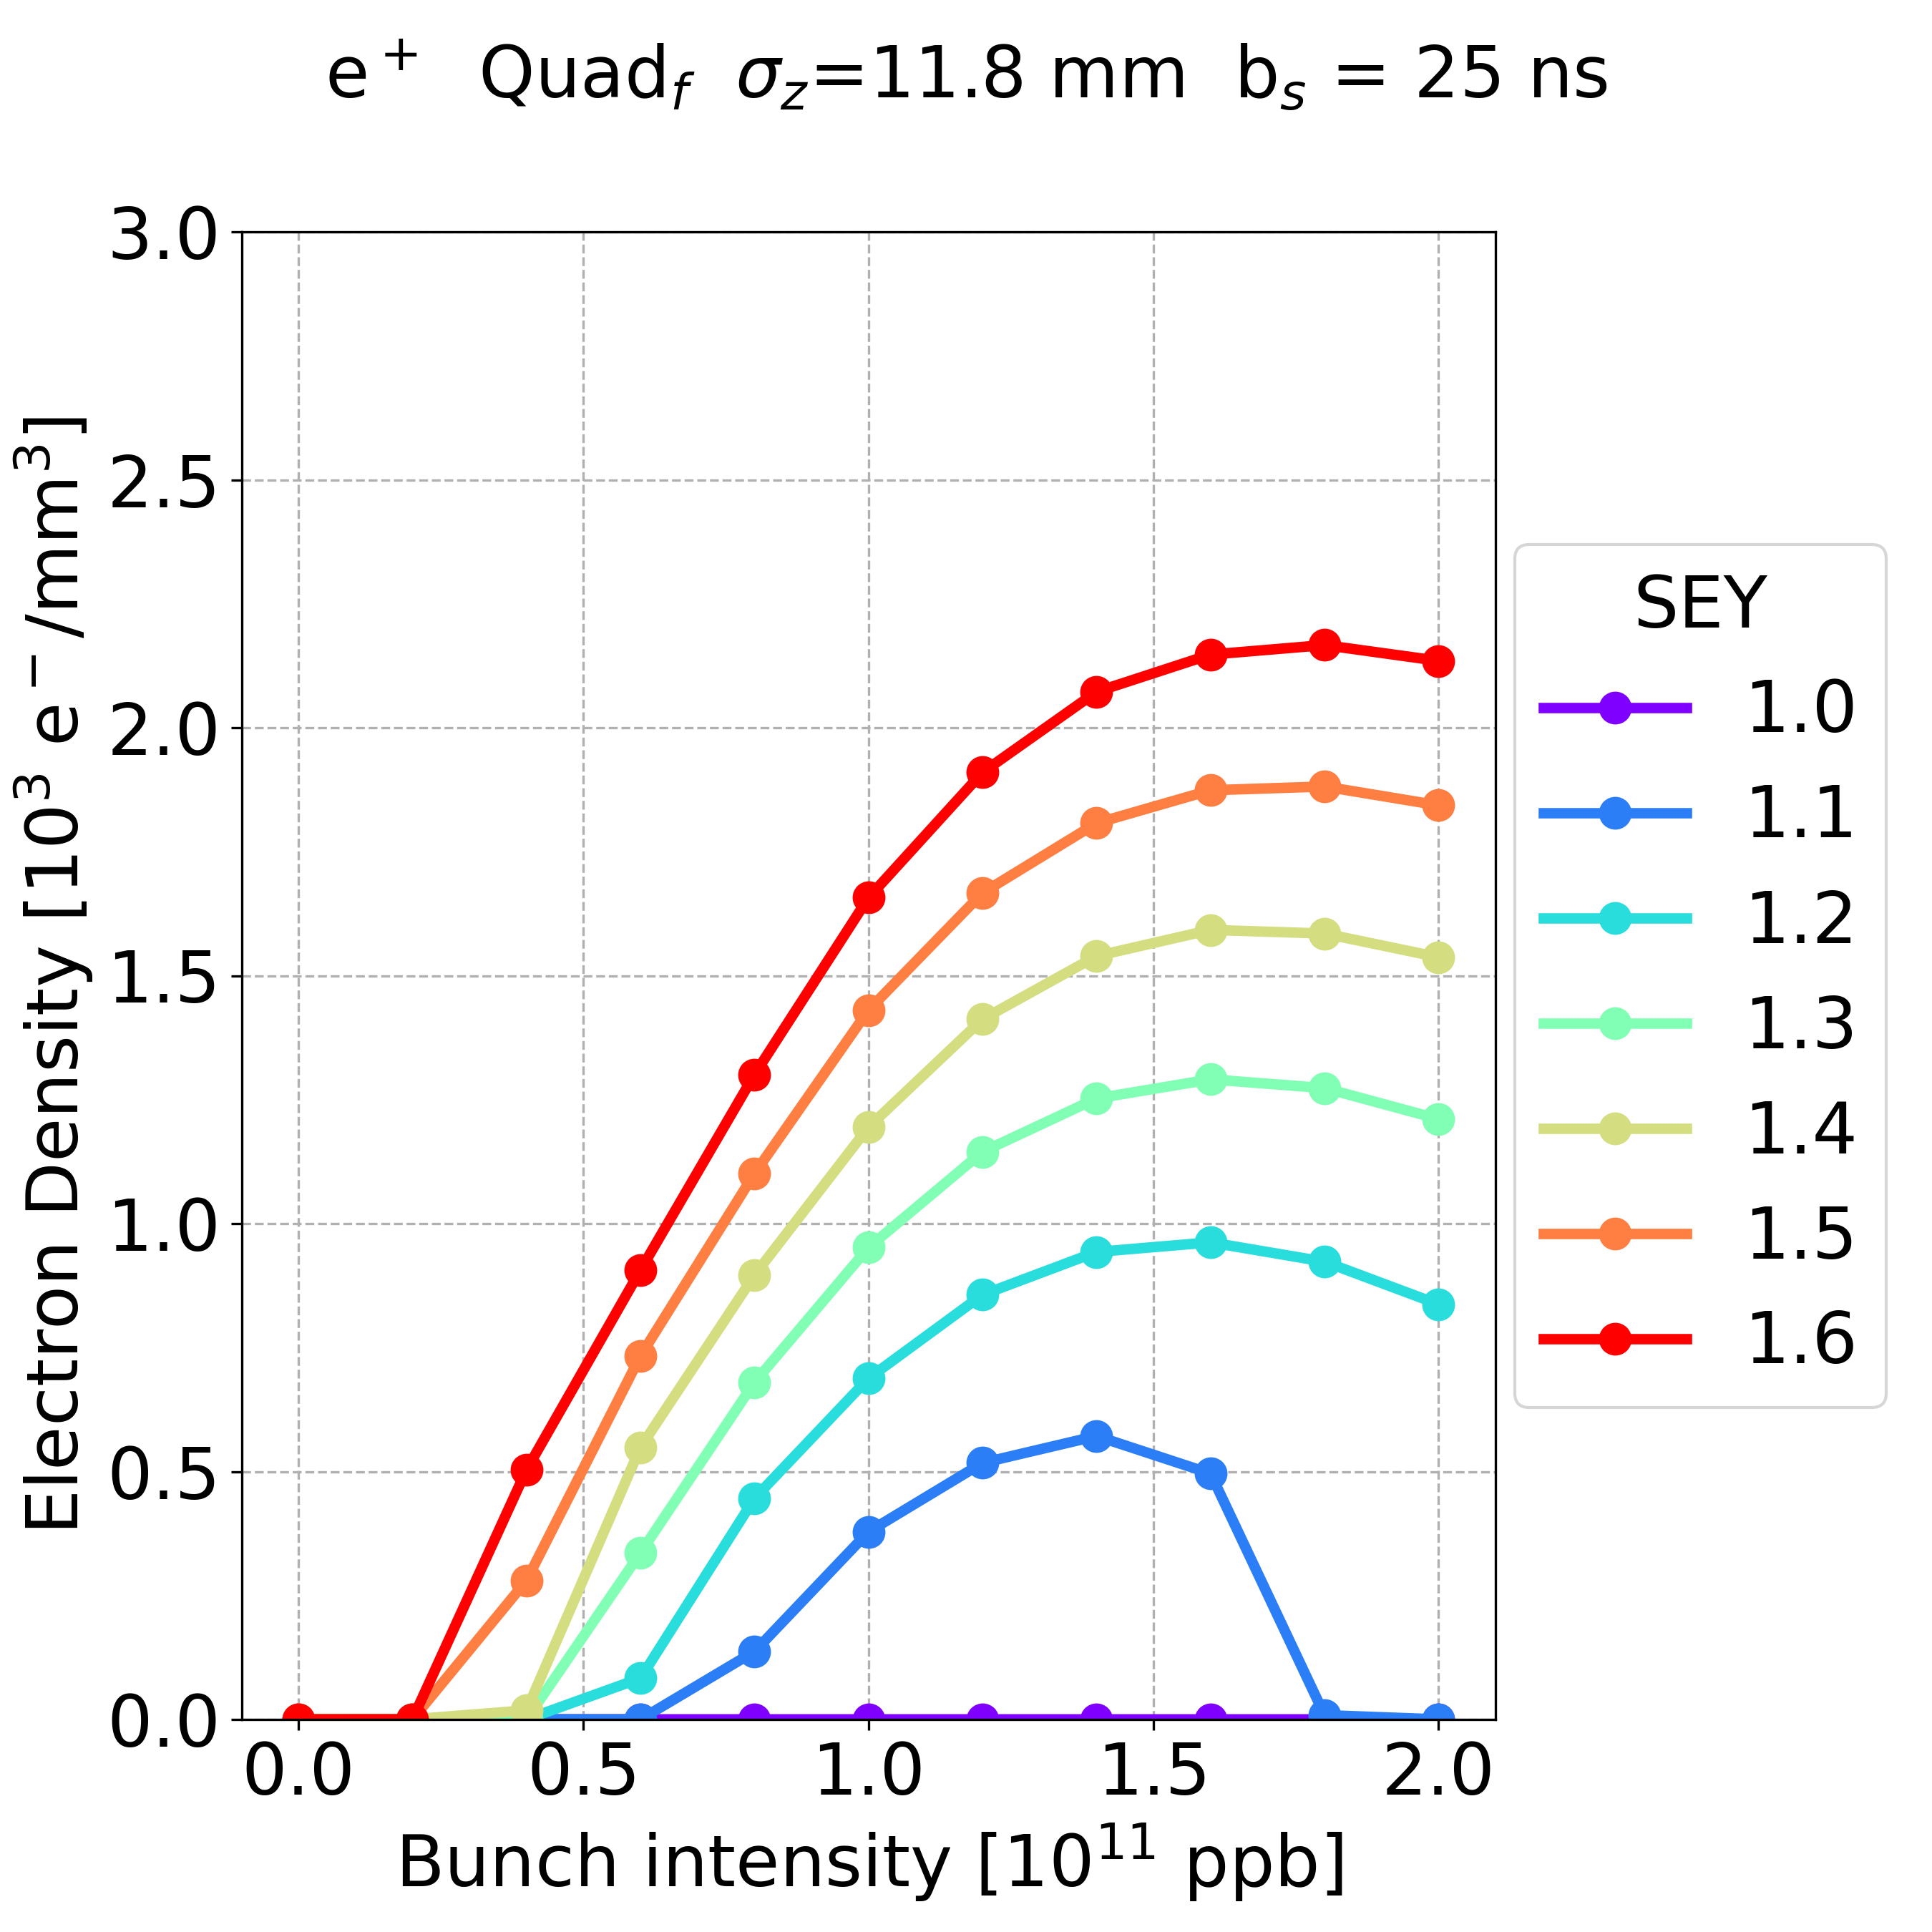
Bunch Length
Quadrupole, bunch spacing 25 ns
5.4 mm
11.8 mm
The largest effect can be observed in the quadrupole magnets
The variation of the bunch length has a small contribution on the e-cloud build-up formation process
  the SEY thresholds are not modified
  with the lowest bunch length, the e-cloud density is larger in most of the cases
  this difference decreases with increasing the bunch intensity
Update on the Electron Cloud Studies for FCC-ee 12/09/2023

Slide 25
Outline
Possible Filling Schemes
Dispersion
Bunch Length
Stability
  Theoretical Threshold
  Simulation Threshold
FCC Mid-term report
Update on the Electron Cloud Studies for FCC-ee 12/09/2023

Slide 26


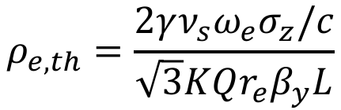

E-Cloud Stability Theoretical Threshold
$$ρ_{e,th}=\frac{2γν_{s}ω_{e}σ_{z}/c}{\sqrt{3}KQr_{e}β_{y}L}$$
$$ω_{e}=\sqrt{\frac{λ_{p}r_{e}c^{2}}{σ_{y}\left(σ_{x}+σ_{y}\right)}}$$
$$λ_{p}=\frac{i_{b}}{{\sqrt{2π}σ}_{z}}$$
$$\begin{matrix}K=ω_{e}σ_{z}/c \\ Q=min⁡\left(K,7\right)\end{matrix}$$
From [1]
𝛾 = E/E₀ , where E is the beam energy, E₀ is the particle rest energy.
𝜈_{s} is the synchrotron tune.
σ_{z} is the bunch length.
c is the light velocity.
r_{e} is the classical electron radius.
σ_{x} and σ_{y} are the bunch horizontal and vertical dimension, respectively.
λ_{p} is the line density of the proton bunch.
ω_{e} is the electron angular oscillation frequency.
K characterizes how many electrons contribute to the instability.
Q is the quality factor of the wake field.
𝛽_{y} is the vertical beta function.
L is the circumference length.
[1] K. Ohmi et al., “Study of Electron Cloud Instabilities in FCC-hh”, Proc. of IPAC2015
Update on the Electron Cloud Studies for FCC-ee 12/09/2023

Slide 27
E-Cloud Stability Theoretical Threshold
$$ρ_{e,th}=\frac{2γν_{s}ω_{e}σ_{z}/c}{\sqrt{3}KQr_{e}β_{y}L}$$
$$ω_{e}=\sqrt{\frac{λ_{p}r_{e}c^{2}}{σ_{y}\left(σ_{x}+σ_{y}\right)}}$$
$$λ_{p}=\frac{i_{b}}{{\sqrt{2π}σ}_{z}}$$
$$\begin{matrix}K=ω_{e}σ_{z}/c \\ Q=min⁡\left(K,7\right)\end{matrix}$$
From [1]
  ⍴_{e,th} = 1.89⋅10¹⁰ e⁻/m³ considering the full circumference L = 90.7 km
[1] K. Ohmi et al., “Study of Electron Cloud Instabilities in FCC-hh”, Proc. of IPAC2015
12/09/2023

Slide 28
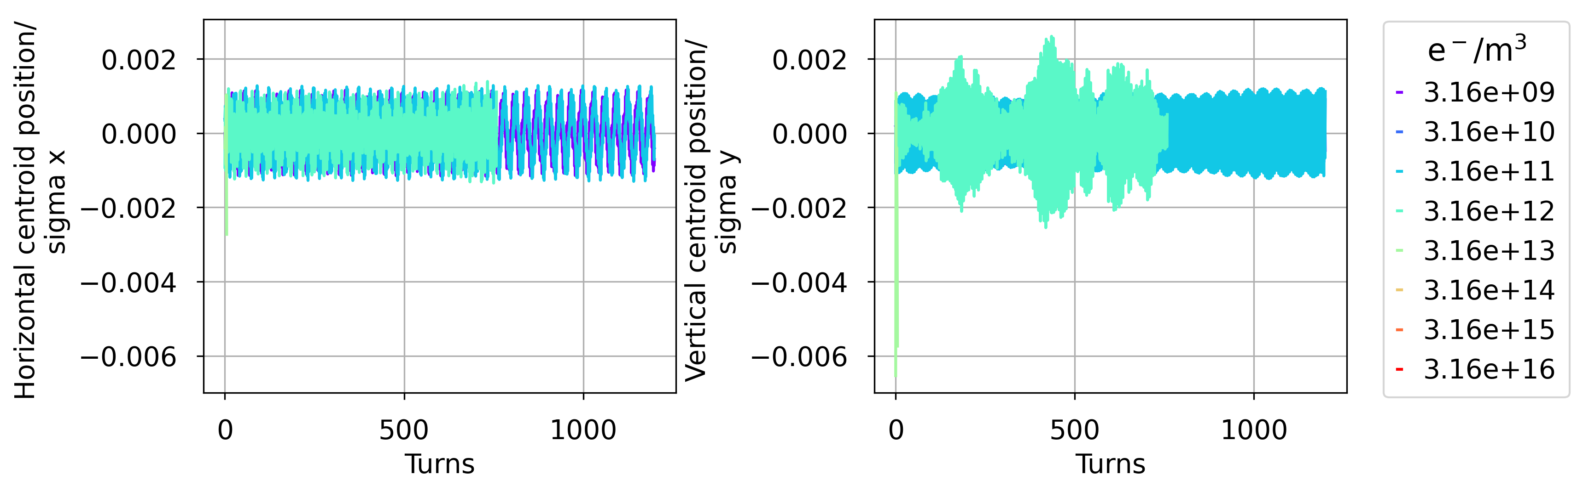
E-Cloud Stability Simulation Threshold
Drift Space
  ⍴_{e,th} = 9.85 ⋅10¹⁰ e⁻/m³ considering only the drift length L_{drift} = 17.4 km (L_{drift} /L = 19.2%)
Horizontal
Vertical
Centroid/
Sigma
Stable
Unstable
Unstable < 6 turns
More simulations between 3.16⋅10¹¹ and 3.16⋅10¹² e⁻/m³
Update on the Electron Cloud Studies for FCC-ee 12/09/2023

Slide 29
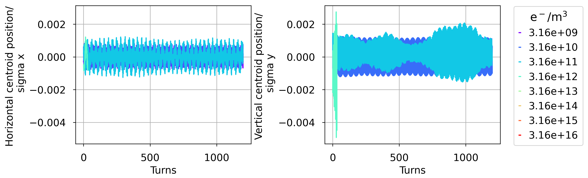
E-Cloud Stability Simulation Threshold
Dipole
  ⍴_{e,th} = 2.73 ⋅10¹⁰ e⁻/m³ considering only the dipole length L_{dipole} = 62.8 km (L_{dipole} /L = 69.2%)
Horizontal
Vertical
Stable
Centroid/
Sigma
Unstable
Unstable < 32 turns
More simulations between 3.16⋅10¹⁰ and 3.16⋅10¹² e⁻/m³
Update on the Electron Cloud Studies for FCC-ee 12/09/2023

Slide 30
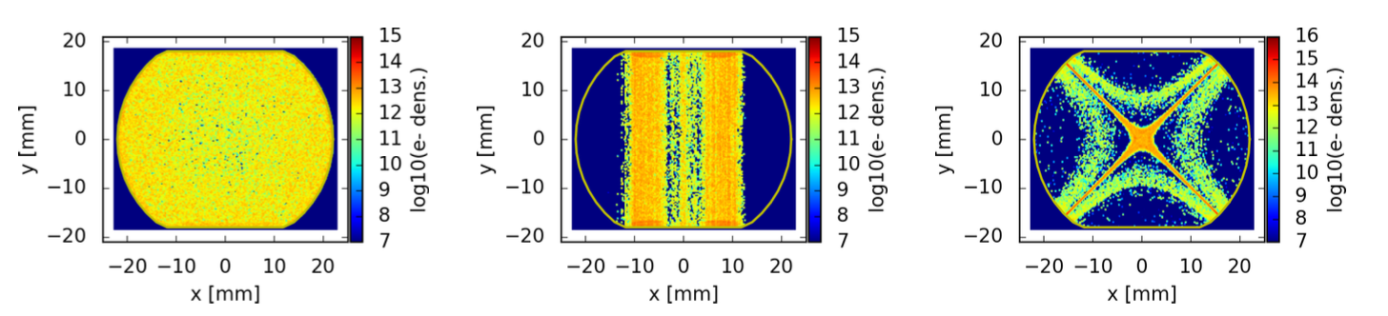
E-Cloud Stability vs Build-up Simulation
E-cloud distribution in the LHC arc magnets
Courtesy of
P. Dijkstal
In drift space, all the electrons are free to move
In magnetic elements, electron trajectories are strongly influenced by externally applied magnetic fields (electrons spin around the field lines)
  Dipole:
    the electrons are trapped in two vertical strips
    only the electrons in the area between the two strips are close to the bunch and free to move
  Quadrupole:
    the electrons are trapped in an area with a shape of a cross passing through the vacuum chamber centre
    the real e-cloud map has to be simulated
Update on the Electron Cloud Studies for FCC-ee 12/09/2023

Slide 31
Outline
Possible Filling Schemes
Dispersion
Bunch Length
Stability
FCC Mid-term report
Update on the Electron Cloud Studies for FCC-ee 12/09/2023

Slide 32
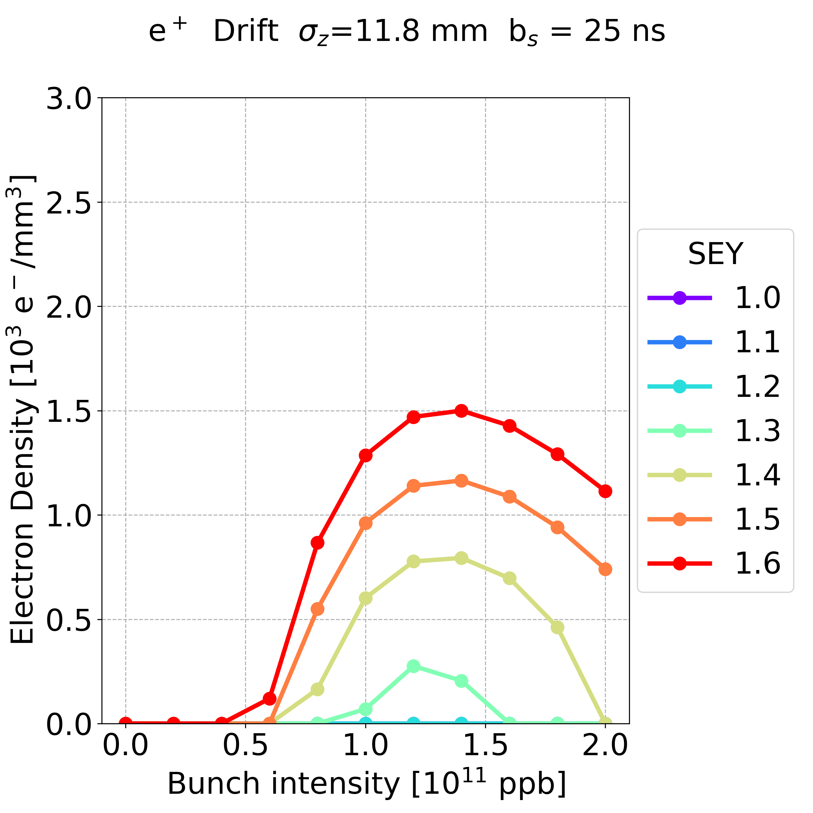
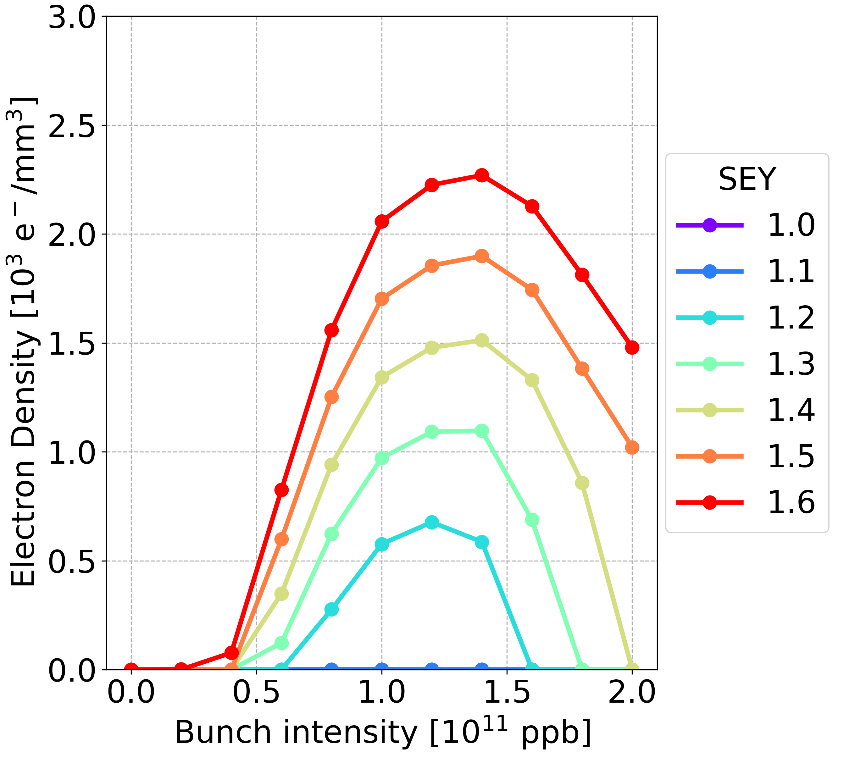
FCC Mid-term Report
Drift space
Dipole
Quadrupole
Updated plots with also lower bunch intensities
Update on the Electron Cloud Studies for FCC-ee 12/09/2023

Slide 33
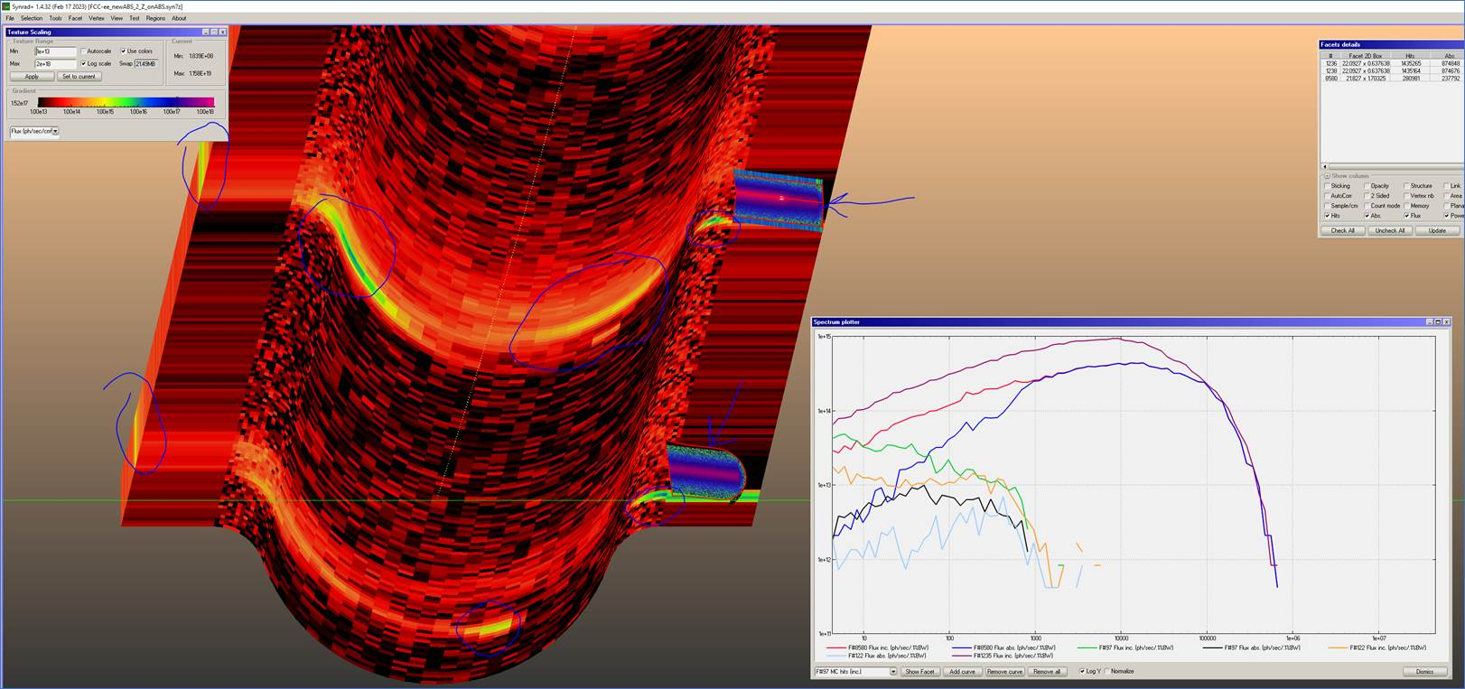
Outline
The impact of photoemission has to be assessed (it can raise the e-cloud density)
The EPFL student Lucas Pyziak will start the TP IV project in the next week
From the previous chamber design parameters
Courtesy of
R. Kersevan
Update on the Electron Cloud Studies for FCC-ee 12/09/2023

Slide 34
Thank you for your attention
Update on the Electron Cloud Studies for FCC-ee 12/09/2023

