Slide 1
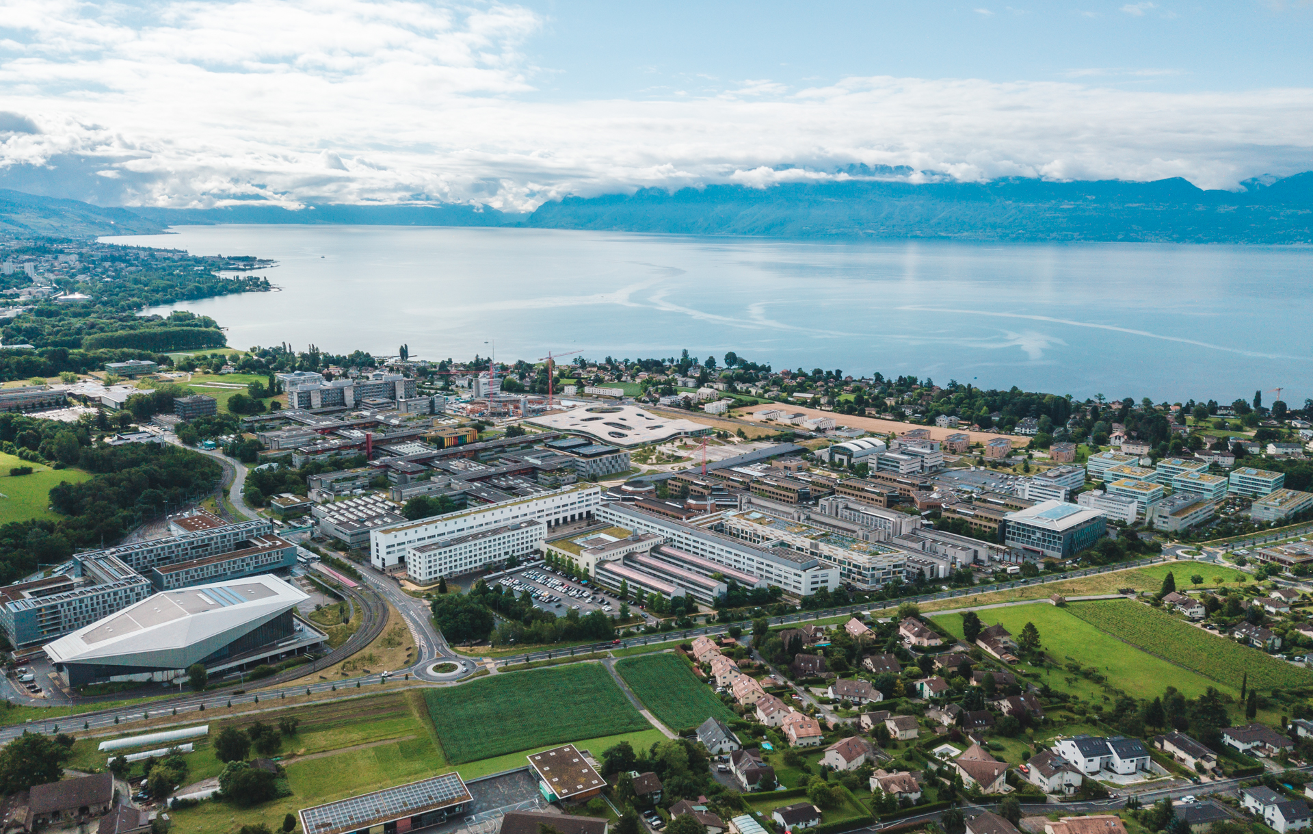
FCCee-Beam Dynamics Simulations
Leon van Riesen-Haupt
October 2023

Slide 2
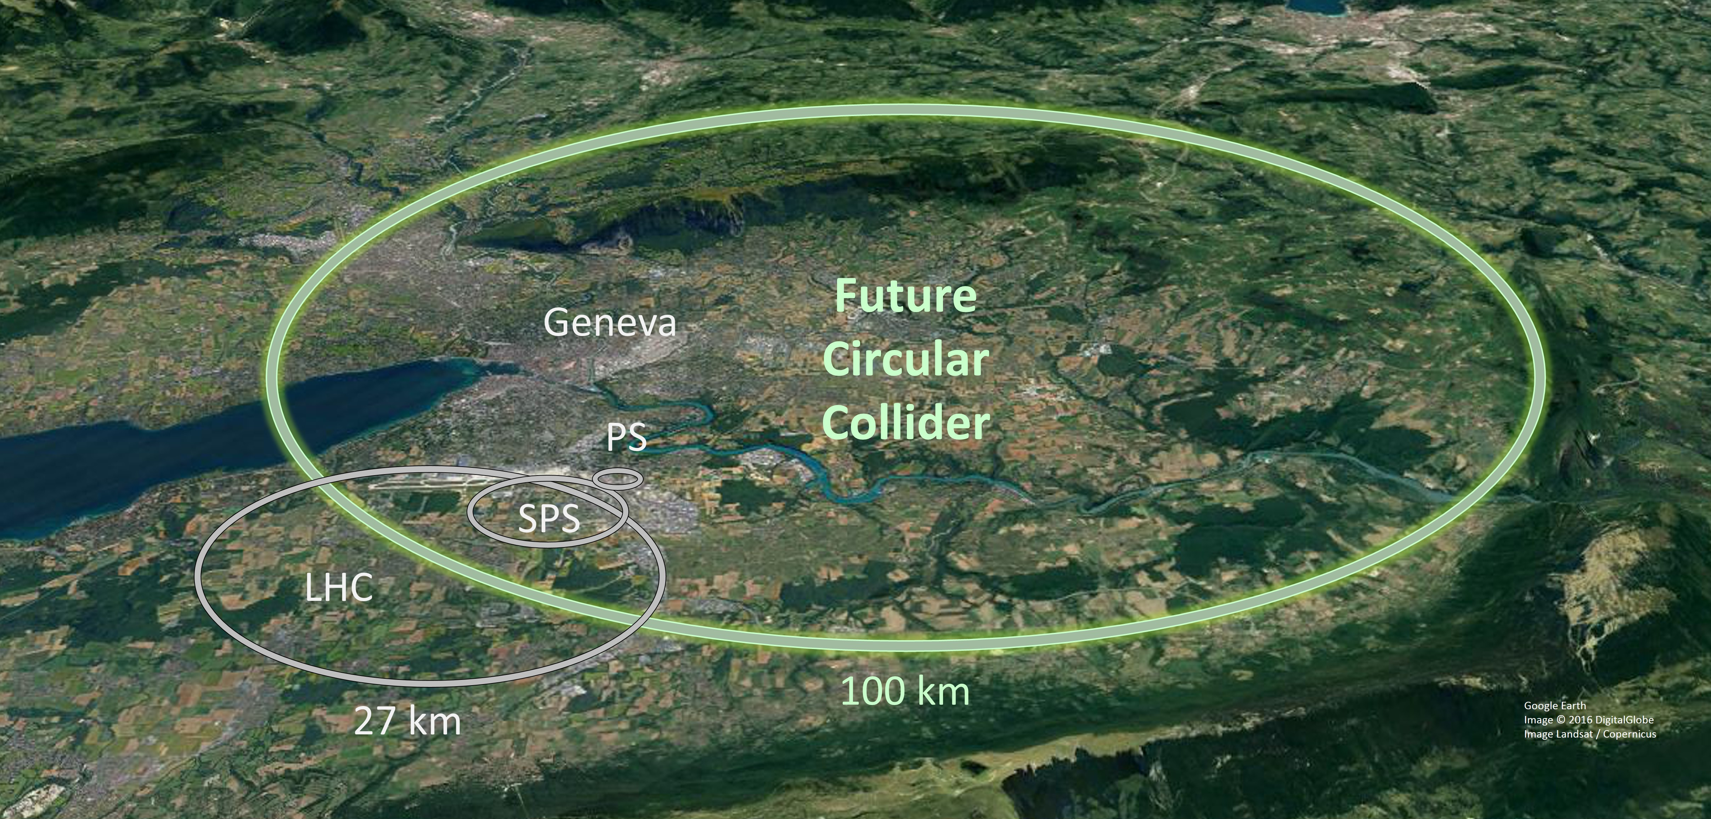
Motivation
Challenges set out by Future Circular electron-positron Collider (FCC-ee)
  Large and complex machine with many components
  Challenging collision parameters and insertion region design
  Tight alignment, manufacturing and correction tolerances
Challenges unique to lepton colliders
  E.g. synchrotron radiation effects
  Recent focus in CERN on hadron machines
Work with experts in the community to create tools for the broader community

Slide 3
Introduction
Large number of tools used in FCC study
  Often specialised to one purpose/aspect of beam physics
  Sometimes tools with overlapping purpose used, depending on the user’s expertise
Vast and very active community in the CERN ABP Computing Working Group
  Maintenance, improvement, complement existing codes
  Development of modern, robust and broad tools for the entire accelerator community
Large community outside of FCC and CERN with overlapping interests
  Potential for synergies and cooperation

Slide 4
FCC Software Framework Project
Understand requirements for the development and simulation of FCC
  Which effects need to simulated and which tools exist or need to be developed/optimised for these purposes
  Identify which simulations need to interplay/overlap and understand how they fit together in the “bigger picture”
Ensure that the needs of the FCC study are met by
  Maintaining, benchmarking and improving current simulation tools
  Actively contributing to the development of new simulations tools
  Create tools to allow for interfacing between different simulation tools
Work closely with the ABP Computing WG and identify synergies and come up with a common strategy
Offer a first point of contact for external collaborators that see synergies
Perform simulations to realistically model FCC using advanced techniques

Slide 5
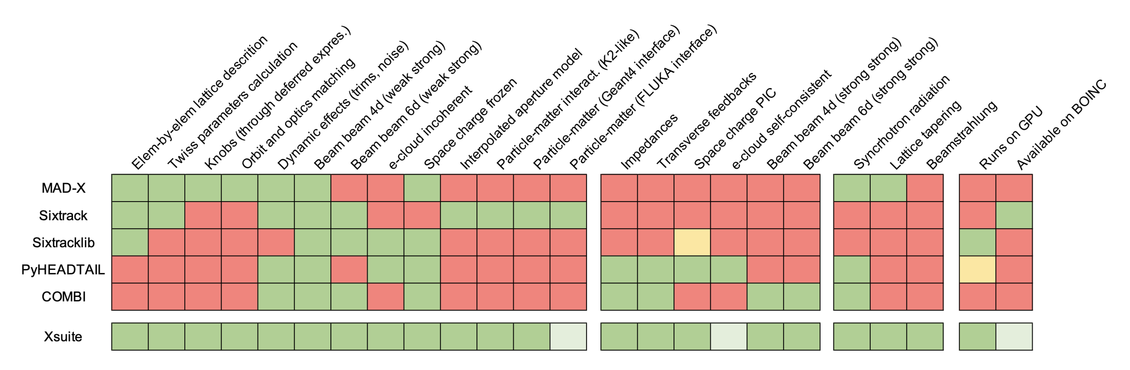



Synergies and New Developments
Polarization and SPIN tracking
ML for DA optimization
Xsequence,
Xconverter
(F. Carlier)
SITROS
SAD
Y. Wu,
F. Carlier,
T. Pieloni
EPOL team
BMAD
PyAT
D. Di Croce,
G. Iadarola,
F. Vanderveken,
T. Pieloni,
SDSC
MADX
P. Kicsiny,
X. Buffat,
D. Schulte
P. Kicsiny, X. Buffat
X. Buffat, G Iadarola
P. Kicsiny, X. Buffat
G. Simon, R. De Maria,
F. Schmidt, A. Faus-Golfe
L. Sabato, L. Mether
Tapering
F. Carlier, L. van Riesen-Haupt, G. Simon, S. White

Slide 6
Beam-Beam, Beamstralung, bhabha scattering Code
Xsequence,
Xconverter
(F. Carlier)
P. Kicsiny, X. Buffat
P. Kicsiny,
X. Buffat,
D. Schulte
P. Kicsiny, X. Buffat

Slide 7
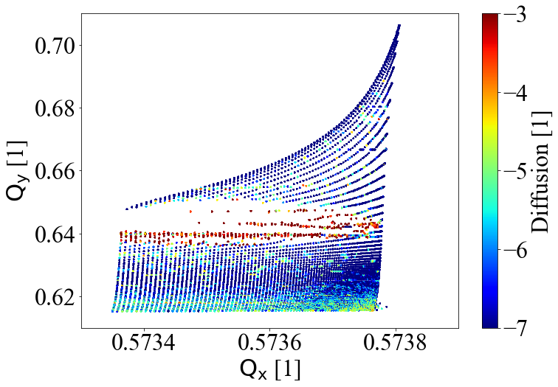
Beam-Beam Code
Efforts led by P. Kicsiny, X. Buffat, D. Schulte
Aim to simulate beam-beam, beamstrahlung, bhabha scattering
Implement different beam-beam models in (WS, QSS, SS)
  Benchmarking against other codes (lifetrac)
  Make use of modern technologies such as GPUs, open MP
Xsuite implementation can be combined with other effects
  E.g. errors, radiation in the arcs, impedance …

Slide 8
Relevant Publications
P. Kicsiny, “6D Beam-beam Modelling in Xsuite”, FCCIS WP2 Workshop 2021, 1. Dec. 2021. (Oral Presentation)
P. Kicsiny “Beam-beam effects in future circular lepton colliders, EPFL-LPAP Activity Meeting, EPFL, 11/02/2022. (Oral Presentation)
P. Kicsiny “6D beam-beam modeling in Xsuite “, BE-ABP-CEI section meeting, CERN,17/01/2022. (Oral Presentation)
P. Kicsiny “6D beam-beam modeling in Xsuite”, EPFL-LPAP FCC-ee Software Framework Meeting, EPFL, 11/11/2021. (Oral Presentation)
P. Kicsiny “Beam-beam studies with MadX and first steps with PyHEADTAIL and xsuite “, EPFL-LPAP FCC-ee Software Framework Meeting, EPFL, 08/07/2021. (Oral Presentation)
P. Kicsiny, “Modelling of beam-beam effects in future lepton colliders”, Swiss Physical Society Meeting 2022, Fribourg, CH. (Oral presentation)
P. Kicsiny et al., “Simulations of FCC-ee beam-beam effects with xsuite”, FCC week 2022, 30 May-3 June, Paris, France.
P. Kicsiny, “Towards beam-beam simulations for the FCC-ee”, presentation & publication at the ICFA Advanced Beam Dynamics Workshop on High Luminosity Circular e+e- Colliders (eeFACT2022), 12-16 Sept. 2022 INFN Frascati
P. Kicsiny, “Towards beam-beam simulations for FCC-ee”, FCCIS 2022 Workshop, 06 Dec 2022. (Oral Presentation)
P. Kicsiny, “Benchmark and performance of beam-beam interaction models for XSUITE”, IPAC’23, Venice, Italy, May 2023.
P. Kicsiny, “Bhabha scattering model for multiturn tracking simulations at the FCC-ee”, IPAC’23, Venice, Italy, May 2023.
P. Kicsiny, “Beam-beam code progress”, FCC week 2023, London, United Kingdom, June, 2023. (Oral Presentation)
P. Kicsiny, “Simulation of beam-beam effects at the FCC-ee using Xsuite”, ABP Group Information Meeting, CERN, August 2023

Slide 9
MAD-X for FCC-ee
SAD
BMAD
PyAT
MADX
G. Simon, R. De Maria,
F. Schmidt, A. Faus-Golfe
Tapering
F. Carlier, L. van Riesen-Haupt, G. Simon, S. White

Slide 10
MAD-X for FCC-ee
Efforts led by G. Simon, R. De Maria, A. Faus-Golfe and F. Schmidt
Ongoing review of MAD-X for FCC-ee simulations
  Investigation of Twiss, Emit and Track modules
  Improved modeling in presence of energy deviations (tapering)
  Implement more accurate twiss computation considering energy offset
  Review of radiation damping modelling
TWISS | No tapering | Tapering
5.07.00 | 0.2240 0.3600 | 0.2240 0.3593
5.08.01 | 0.2240 0.3600 | 0.2153 0.3509
5.09.00 | 0.2240 0.3600 | 0.2153 0.3509
TRACK | No tapering | Tapering
5.07.00 | 0.2240 0.3600 0.101 | 0.1797 0.3942 0.0833
5.08.01 | 0.2240 0.3600 0.101 | 0.2236 0.3588 0.0815
5.09.00 | 0.2240 0.3600 0.101 | 0.2236 0.3588 0.0815

Slide 11
Relevant Publications
G. Simon, “Realistic Optics & Simulation Modelling in the FCC-ee Era : update”, BIMP meeting at Université Paris-Saclay, 8th March 2022:.
G. Simon, “Comparisons of radiation and damping”, EPFL-LPAP FCC-ee Software Framework Meeting, 24th March 2022.
G. Simon, “SR radiation issues in FCC-ee “, FCC week 2022, 2nd June 2022.
G. Simon, “Synchrotron radiation improvements in MAD-X for FCC-eestudies”, EPFL CERN FCC Coffee, 20th June 2022.
G. Simon, “Synchrotron Radiation issues in MADX”, FCC- France & Italy workshop 2022, 22nd November 2022.
G. Simon, “MAD-X modules review for FCC-ee”, LNO section meeting on MADX and Xsuite for FCC-ee, 9th December 2022.

Slide 12
Electron Cloud
L. Sabato, L. Mether

Slide 13
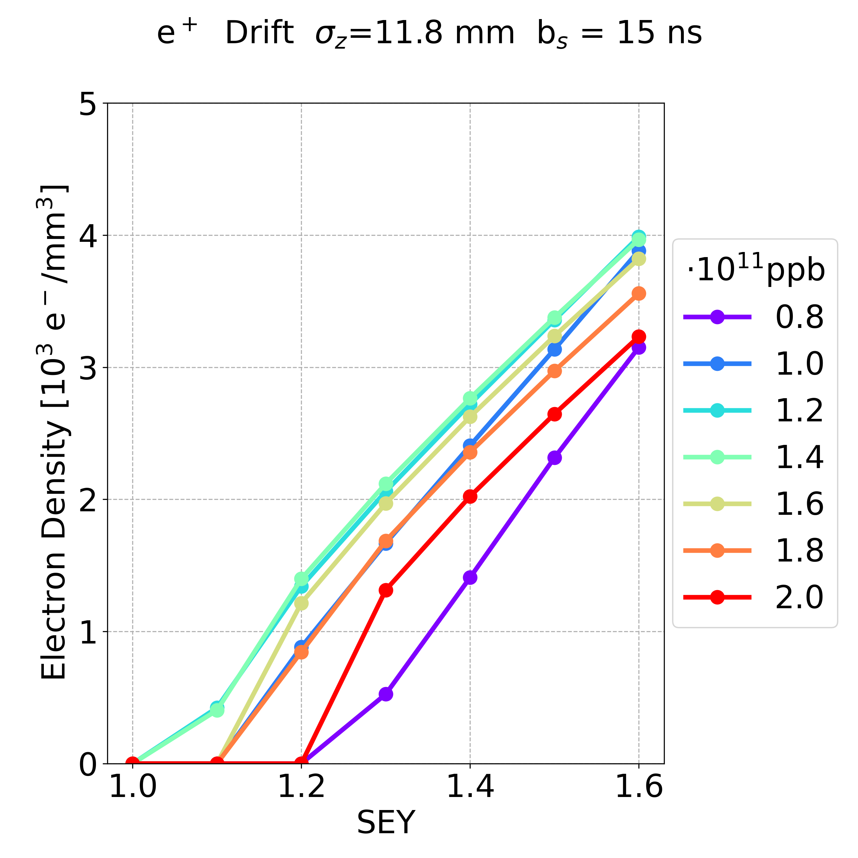
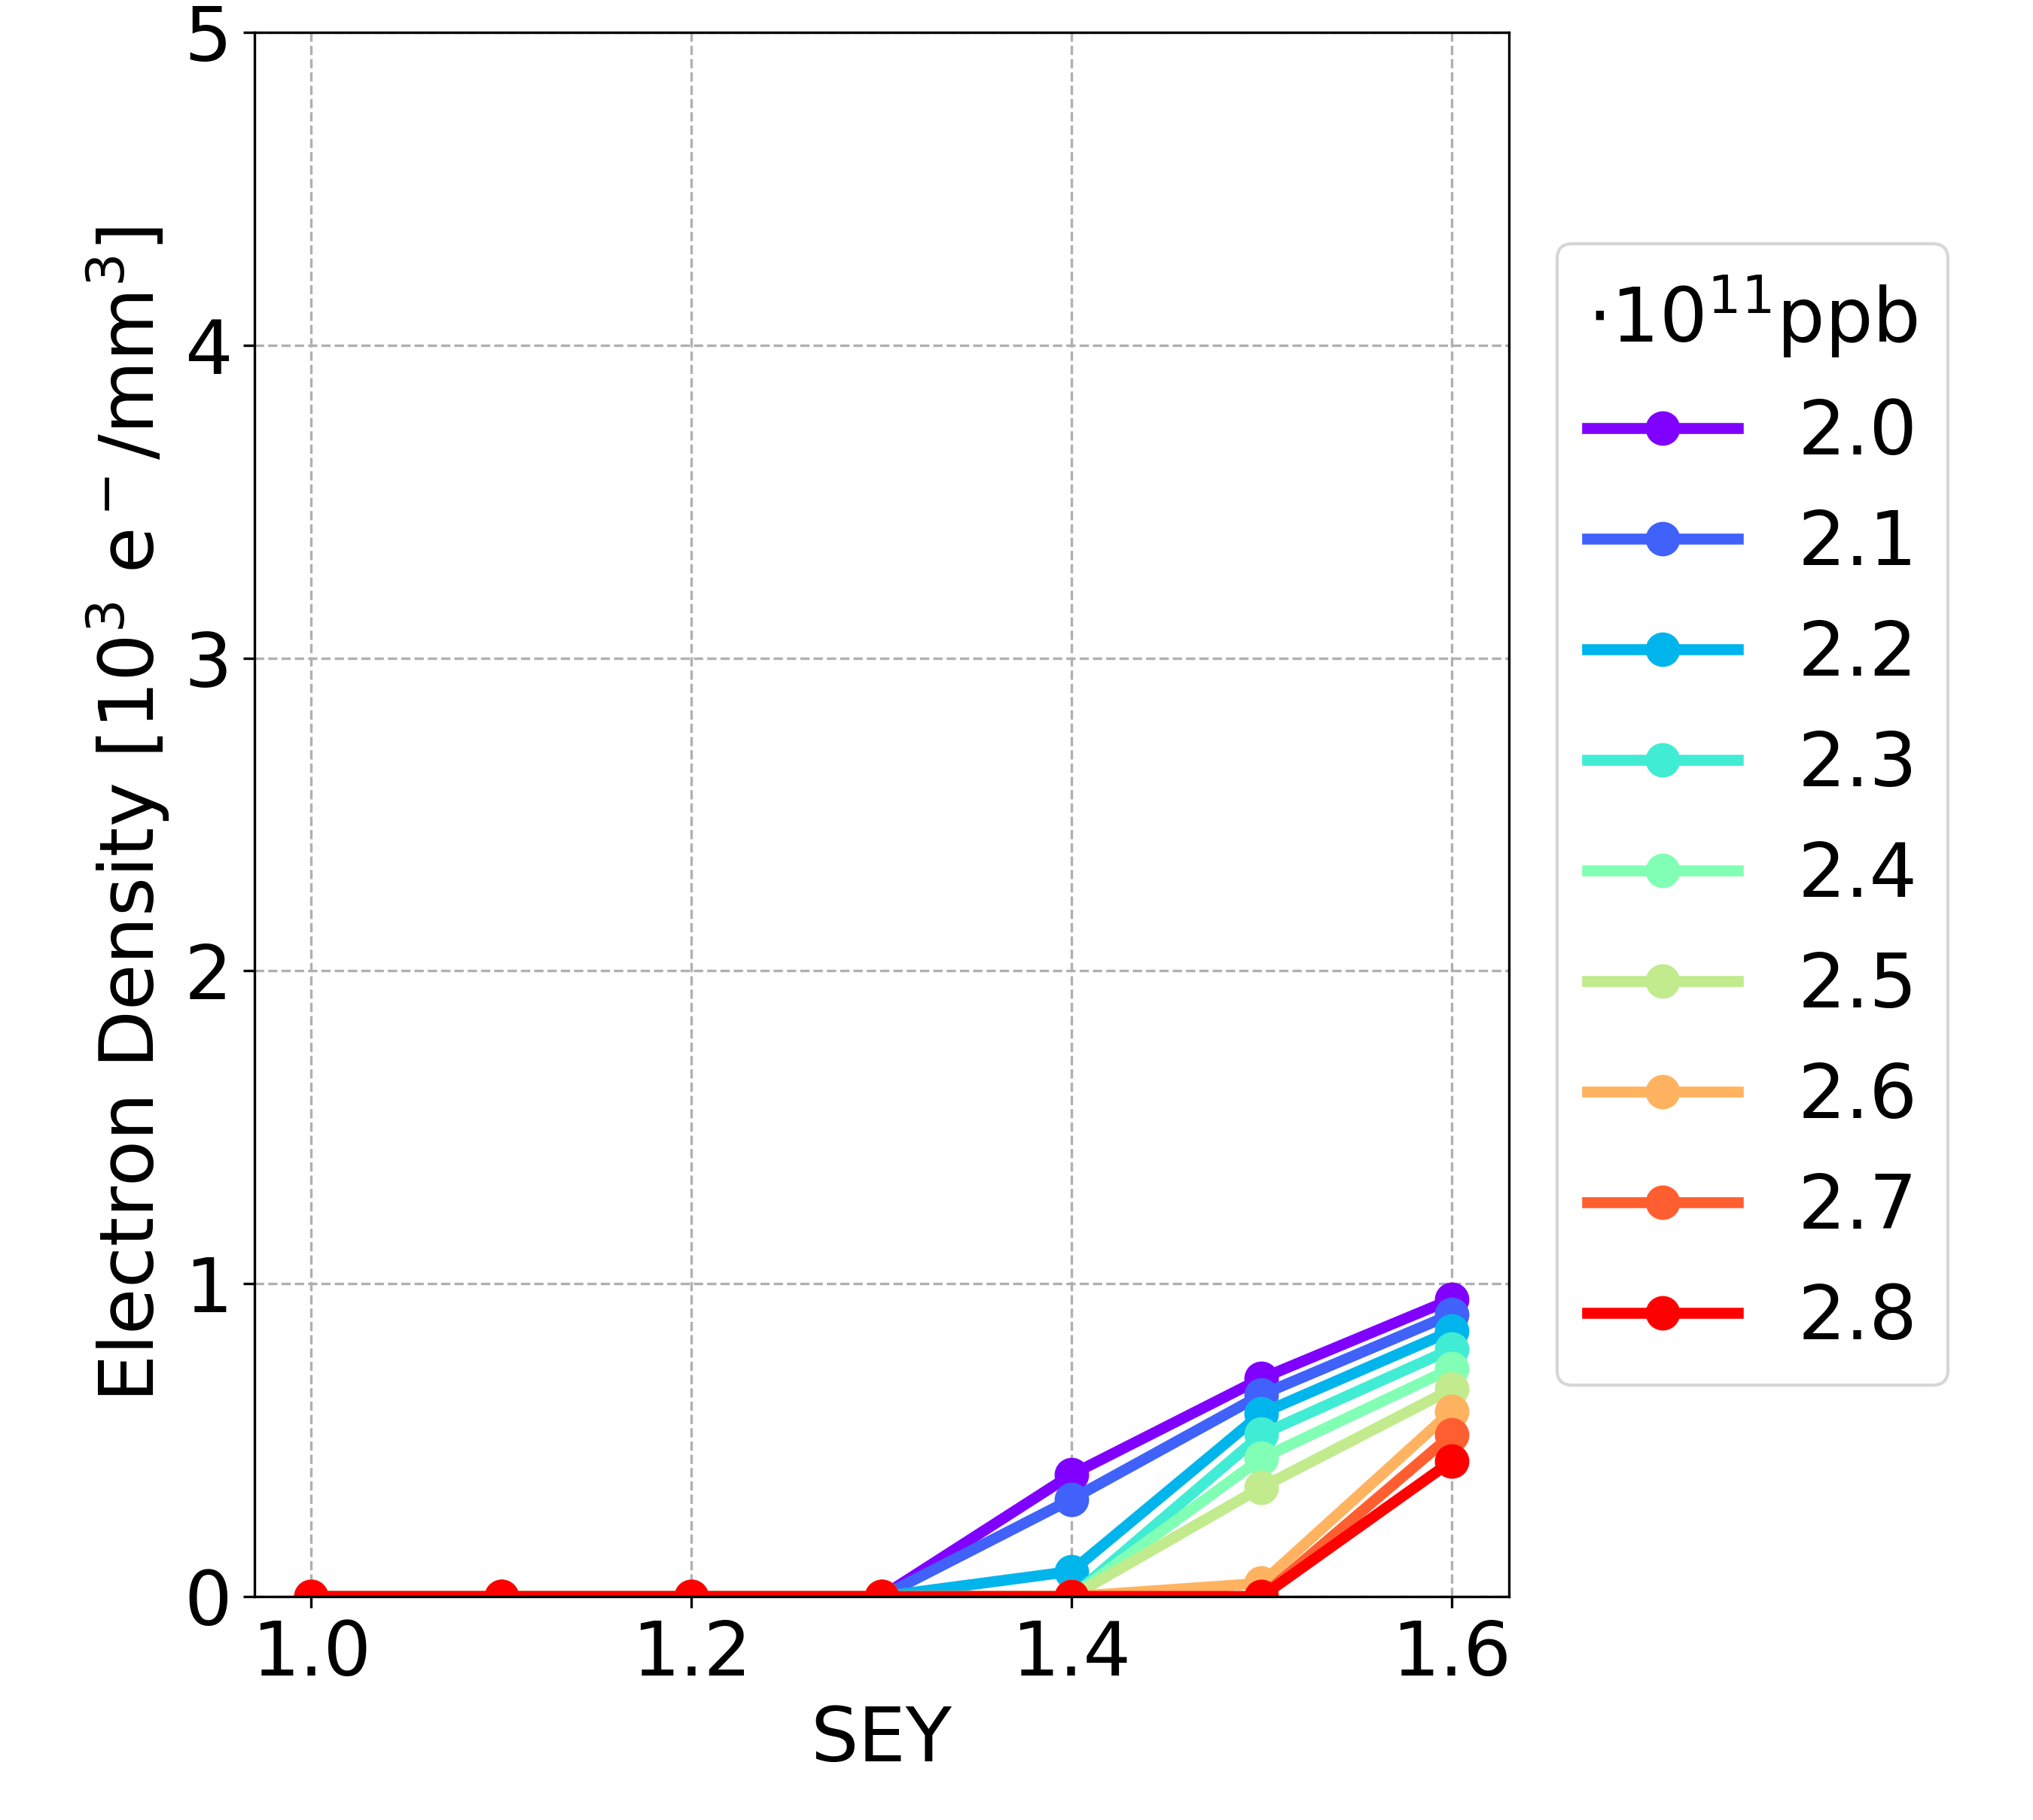
Electron Cloud
Efforts by L. Sabato and L. Mether
Provide feedback for vacuum design
Cloud formation using pyECLOUD
  Improved electron cloud models based on LHC
  Systematically reduce computational load by identifying parameter range
Beam stability simulations with pyHeadTail
  Using distributions from pyECLOUD
Possible aim to integrate with other (python) codes for multiple effects
Electron cloud formation in dipoles for two design iterations with different bunch spacing

Slide 14
Spin Polarisation
Polarization and SPIN tracking
SITROS
Y. Wu,
F. Carlier,
T. Pieloni
EPOL team

Slide 15
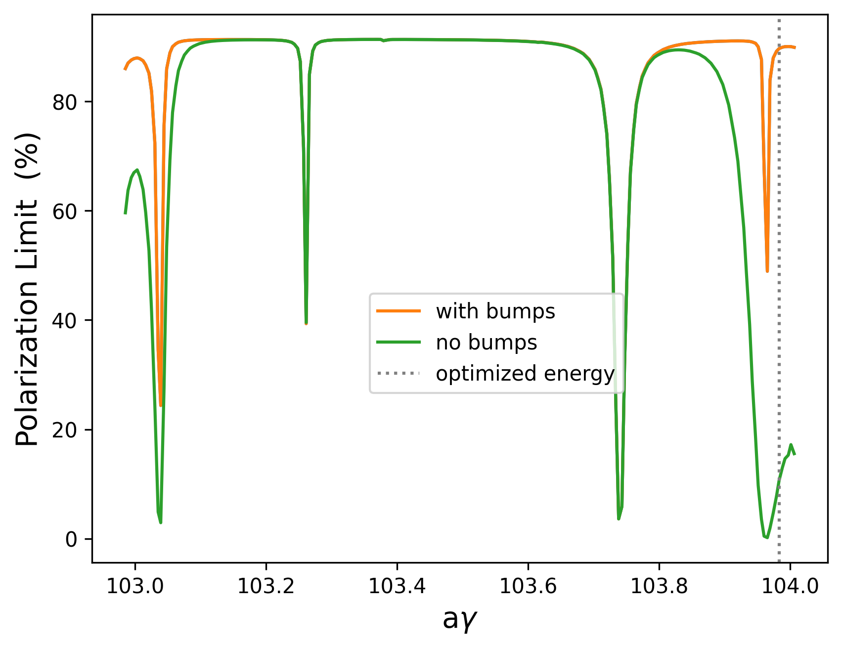
Spin Polarisation
Lead by Y. Wu, D. Barber
Spin polarisation required for energy calibration by spin tune measurement
Polarisation levels and times determined from simulations
  Currently done in Bmad
Software framework requirements:
  Simulate and optimise polarisation with realistic lattice errors and corrections
  Understand how spin optimisation affects other properties
  Accurate representation and propagation of changes between codes
Polarisation levels before and after implementing orbit bumps using harmonic spin matching.

Slide 16
Relevant Publications
Y. Wu, “Spin Polarization Simulations for the Future Circular Collider e+e- using BMAD” 2nd FCC Energy Calibration, Polarization and Mono-chromatisation (EPOL) workshop, CERN, 22 Sep 2022.
Y. Wu, “First trials of harmonic spin matching in the FCC-ee” FCC-FS EPOL group and FCCIS WP2.5 meeting 16, CERN, 15 Dec 2022.
Y. Wu, “Spin Polarization Simulations for the Future Circular Collider e+e- using BMAD” Workshop on Beam Polarization, Hiroshima University, 9 Feb 2023,
Y. Wu, “Updates on the Exploration of Harmonic Spin Matching in the FCC-ee” FCC-FS EPOL group and FCCIS WP2.5 meeting 18 - Joint with FCC-ee tuning meeting, CERN, 16 Feb 2023.
Y. Wu, “Updates on the Exploration of the Possible Spin Matching Methods used in the FCC-ee” FCC-FS EPOL group and FCCIS WP2.5 meeting 21, CERN, 13 Apr 2023,
Y. Wu, “Comparison of Harmonic Spin Matching Schemes using Orbit Bumps in the FCC-ee” FCC Week 2023, London, 5–9 Jun 2023.
Y. Wu, “Comparison of Harmonic Spin Matching Schemes using Orbit Bumps in the FCC-ee” Optics Tuning and Corrections for Future colliders workshop, CERN, 26–28 Jun 2023.
Y. Wu et al., “Spin polarization simulations for the Future Circular Collider e+e- using Bmad”, in Proc. eeFACT'22, Frascati, Italy, September 2022, TUZAS0104, pp. 103-107, 2023.
Y. Wu et al., “Spin-polarization simulations for the Future Circular Collider e+e- using Bmad”, in Proc. IPAC'23, Venice, Italy, May 2023, SUPM010, MOPL055, 2023

Slide 17
XSuite
Polarization and SPIN tracking
ML for DA optimization
Xsequence,
Xconverter
(F. Carlier)
SITROS
SAD
Y. Wu,
F. Carlier,
T. Pieloni
EPOL team
BMAD
PyAT
D. Di Croce,
G. Iadarola,
F. Vanderveken,
T. Pieloni,
SDSC
MADX
X. Buffat, R. Soos
P. Kicsiny,
X. Buffat,
D. Schulte
P. Kicsiny, X. Buffat, T.Pieloni
P. Kicsiny, X. Buffat
G. Simon, R. De Maria, G. Iadarola
L. Sabato, L. Mether,
G. Iadarola
Tapering
F. Carlier, L. van Riesen-Haupt, G. Simon, S. White

Slide 18
Great Progress
Polarization and SPIN tracking
ML for DA optimization
Xsequence,
Xconverter
(F. Carlier)
SITROS
SAD
Y. Wu,
F. Carlier,
T. Pieloni
EPOL team
BMAD
PyAT
D. Di Croce,
G. Iadarola,
F. Vanderveken,
T. Pieloni,
SDSC
MADX
X. Buffat, R. Soos
P. Kicsiny,
X. Buffat,
D. Schulte
P. Kicsiny, X. Buffat, T.Pieloni
P. Kicsiny, X. Buffat
G. Simon, R. De Maria, G. Iadarola
L. Sabato, L. Mether,
G. Iadarola
Tapering
F. Carlier, L. van Riesen-Haupt, G. Simon, S. White

Slide 19
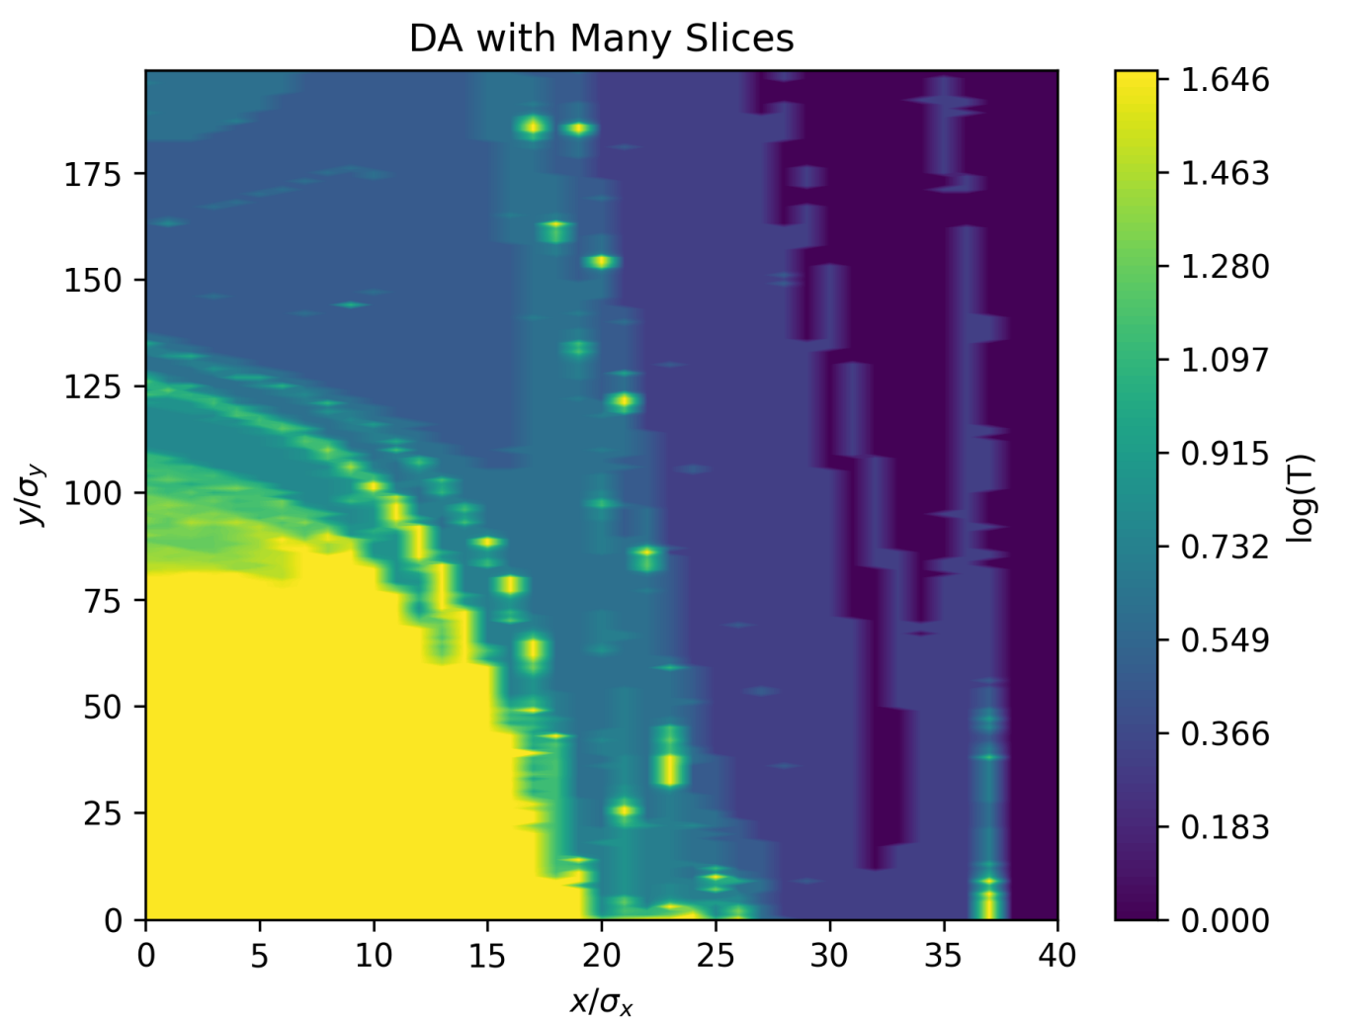
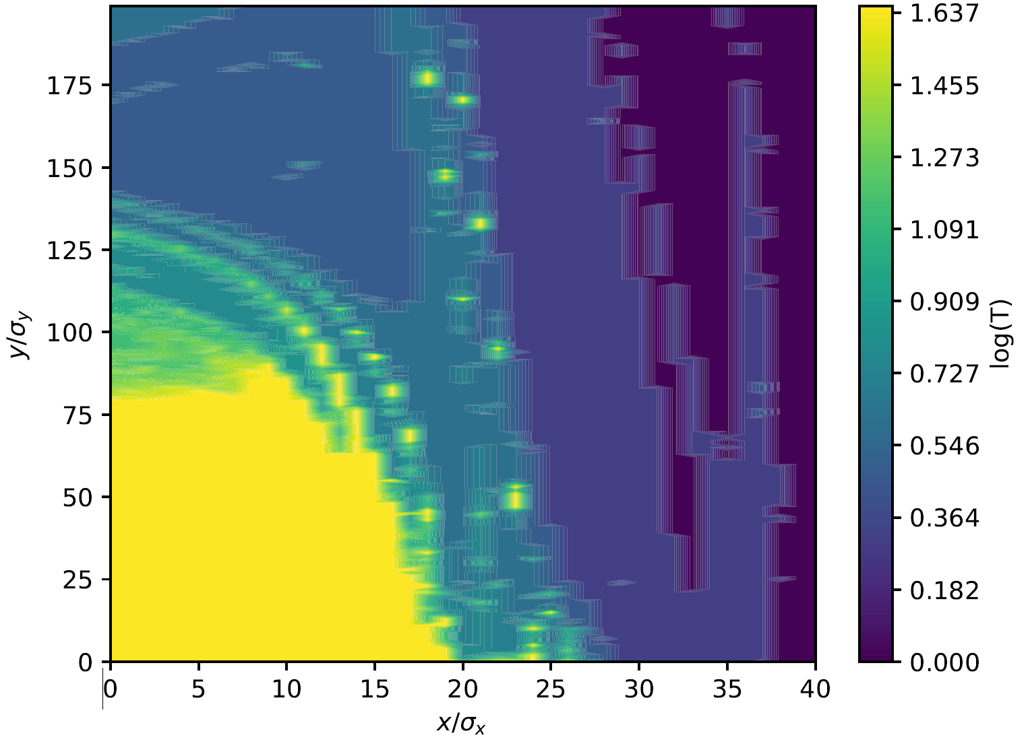
Consistency - Benchmarking
Important to benchmark new tools with existing codes
  Simple examples before multiple effects
  Understand possible inconsistencies
Extensive study benchmarking XSuite since this is a primary tool
  Optics with radiation and tapering compared to optics codes (MADX,SAD)
  Dynamic aperture with and without radiation (MADX, SAD, MADX-PTC)
  Emittance from tracking
    Compared to other tracking codes
    Compared to matrix methods
  Radiated photon spectrum
FCC-ee survival plot with radiation using SAD (top) and Xtrack (bottom)

Slide 20
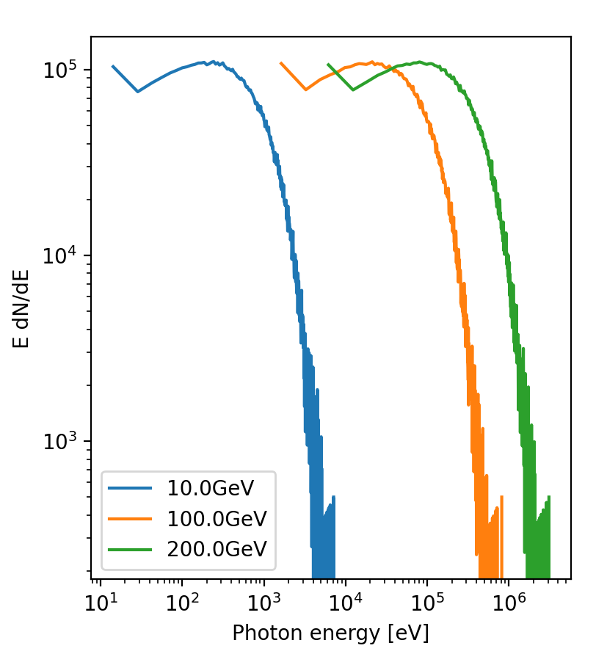
Consistency - Benchmarking
Important to benchmark new tools with existing codes
  Simple examples before multiple effects
  Understand possible inconsistencies
Extensive study benchmarking XSuite since this is a primary tool
  Optics with radiation and tapering compared to optics codes (MADX,SAD)
  Dynamic aperture with and without radiation (MADX, SAD, MADX-PTC)
  Emittance from tracking
    Compared to other tracking codes
    Compared to matrix methods
  Radiated photon spectrum
Power spectrum of photons emitted in 2T dipole at different energies in XSuite

Slide 21
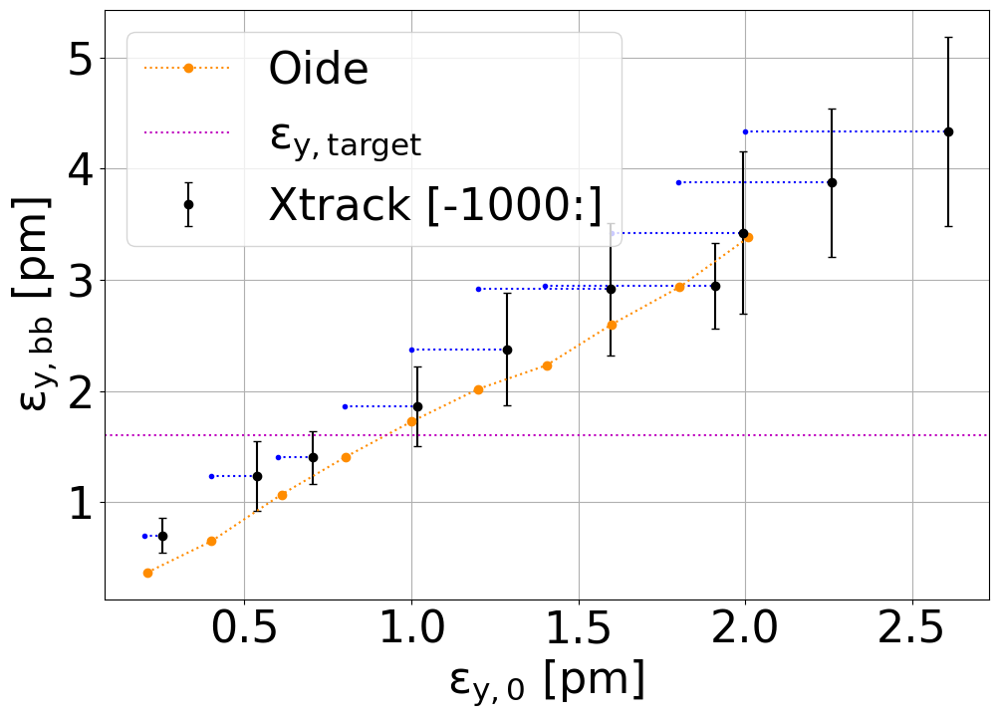
First Results: Optics, Beam-Beam and Emittance
SAD
First example of “bringing it together”
  Optimising optics of the machine
  Including beam-beam effects
  Tracking in lattice for emittance and beam-beam
Full benchmarking with previous studies
Many upcoming studies for FCC-ee
  Tune spread of particles in beam
  Dynamic aperture
  Emittance evolution
Emittance increase due to beam-beam from tracking in XSuite for various lattice emittances compared to SAD results. (Preliminary)

Slide 22
Relevant Publications
F. Carlier,”Code developments”, EPFL-LPAP Activity Meeting, EPFL.
T. Pieloni and F. Carlier, “Overview of the Software framework and developments for the FCC-ee”, FCC week 2022, 30 May-3 June, Paris, France.
L. van Riesen-Haupt, “EPFL-CERN Software Collaboration”, FCC-EIC Joint &MDI Workshop 2022, 19 Oct 2022, CERN.
L. van Riesen-Haupt, “IP Optics Corrections in FCC-ee”, FCC-EIC Joint &MDI Workshop 2022, 21 Oct 2022 , CERN.
L. van Riesen-Haupt, “IP Tuning”, FCCIS 2022 Workshop, 6 Dec 2022 , CERN.
L. van Riesen-Haupt, “Testing the New Exact Solenoid in MAD-X”, LNO Meeting, 16 Nov 2022 , CERN.
L. van Riesen-Haupt, “FCC-ee IR matching and tuning knobs”, FCC-ee Tuning Meeting, 14 July 2022 , CERN.
L. van Riesen-Haupt, “FCC-ee IR matching with errors”, FCC-ee Tuning Meeting, 25 Aug 2022 , CERN.
L. van Riesen-Haupt, “Code Development Status”. FCC Week 2023. London. 08.06.2023
L. van Riesen-Haupt,“Simulations for IR Tuning”. FCC Week 2023. London. 08.06.2023
L. van Riesen-Haupt, “IP Tuning”. FCC-ee Tuning Meeting, 09 June 2022 , CERN.
L. van Riesen-Haupt, “Simulation Tools for Future Colliders” Joint Annual Meeting of SPS and ÖPG, 4 - 8 September 2023, Basel.

Slide 23
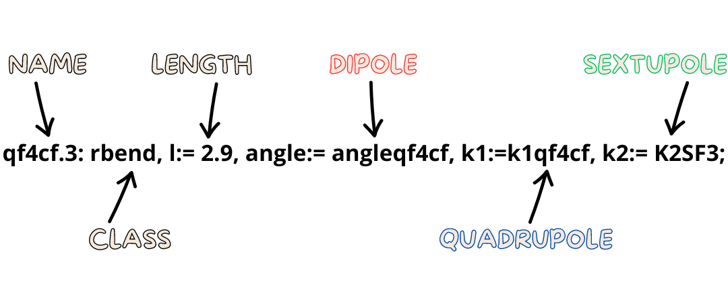
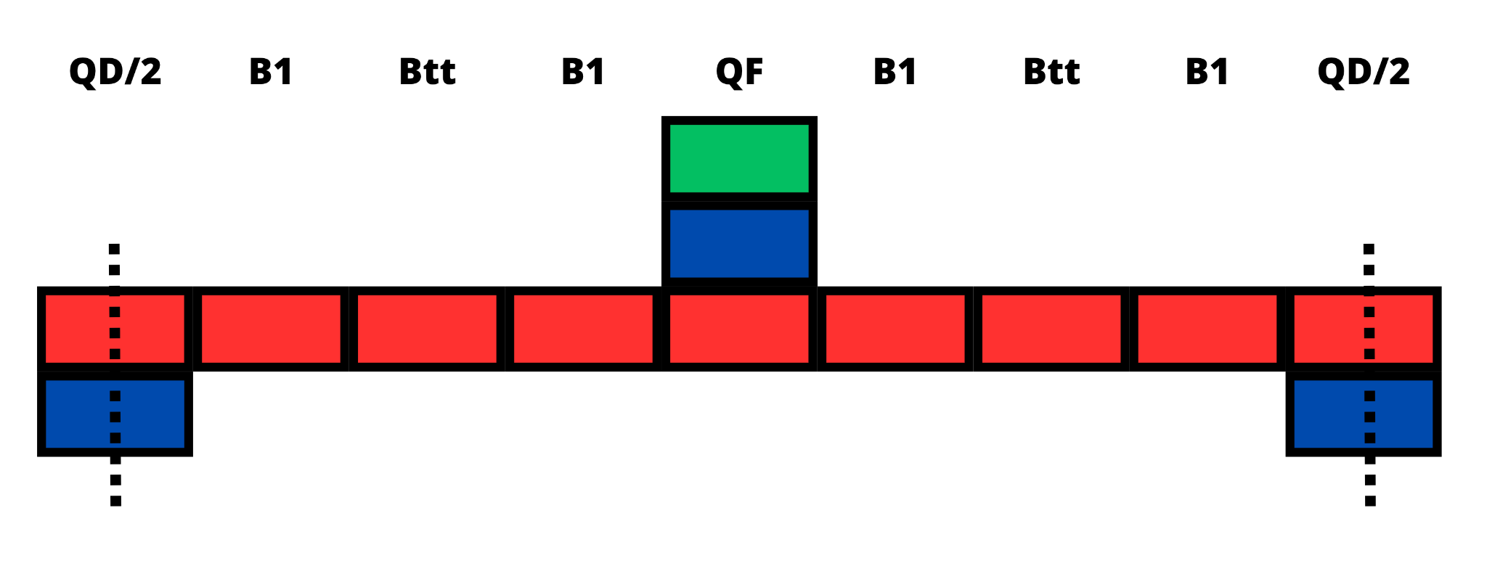
Arc Optimisation Studies
Effort by C. García-Jaimes, T. Pieloni, L. van Riesen-Haupt, R. Tomas
Arc optimisation using combined function magnets
  Allow overlapping dipole, quadrupole and sextupole fields
  17% reduction in synchrotron radiation power
Extensive studies required to investigate properties compared to baseline
  Optics, emittance, dynamic aperture…
  Benefits from software framework

Slide 24
Relevant Publications
C. García-Jaimes, “Impact of dipole b2”, FCC-ee Tuning Meeting, 09 June 2022, CERN.
C. García-Jaimes, “Optics Matching with Arc Errors”, FCC-ee Tuning Meeting, 29 Aug 2022, CERN.
C. García-Jaimes, “PHD Status report”, FCC-ee Tuning Meeting, 30 Sep 2022, CERN.
C. García-Jaimes, “Optics Matching with Arc Errors”, FCCIS 2022 Workshop, 08 Dic 2022 , CERN.
C. García-Jaimes, T. Pieloni, L. van Riesen-Haupt, R. Tomas, “Combined function magnets with constant partition numbers lattice for the Future Circular lepton Collider”, Accelerating News, No. 43, Mar. 2023.
C. García-Jaimes, T. Pieloni, L. van Riesen-Haupt, M. Seidel, R. Tomas, “Impact of dipole quadrupolar errors in FCC-ee”. IPAC’23, Venice, Italy, May 2023.
C. García-Jaimes, T. Pieloni, L. van Riesen-Haupt, M. Seidel, R. Tomas, “Exploring FCC-ee optics designs with combined function magnets”. IPAC’23, Venice, Italy, May 2023.
C. García-Jaimes, “Combined function lattice with constant partition numbers for FCC-ee”. FCC Week 2023. London. 08.06.2023.
C. García-Jaimes, “HTS FCC-ee energy efficient beam optics”. CHIPP/CHART Workshop on Sustainability in Particle Physics and CHIPP 2023 plenary, Sursee. 14.06.2023
C. García-Jaimes, “HTS FCC-ee energy efficient beam optics”. Joint Annual Meeting of SPS and ÖPG, 4 - 8 September 2023, Basel.

Slide 25
Conclusion
Large amount of different software used for FCC-ee and accelerators in general
  Many different unique purposes
  Dependent on specialised development and knowledge of few experts/labs
Improved interoperability by
  Facilitating conversion and model management
  Contribute to the development of modern broader tools
    Steer towards and use for FCC-ee purposes
    Benchmark against established codes
    Many meaningful contributions by CHART colleagues
First studies using new tools underway contributing to the FCC-ee study
Arc optimisation studies using combined function magnets to reduce synchrotron power consumption

Slide 26
Many Thanks

