Slide 1
Beam-beam code progress
P. Kicsiny, X. Buffat, D. Schulte, M. Seidel
Special thanks to:
F. Carlier, M. Hofer, G. Iadarola, K. Oide, D. Shatilov, T. Pieloni, D. Zhou
FCC-week
5-9 June 2023

Slide 2
Outline
Outline
Introduction
First results
        Performance of the Xsuite beam-beam model
      Scan of x-z instability
      3D flip-flop instability
      Bhabha scattering
Summary

Slide 3
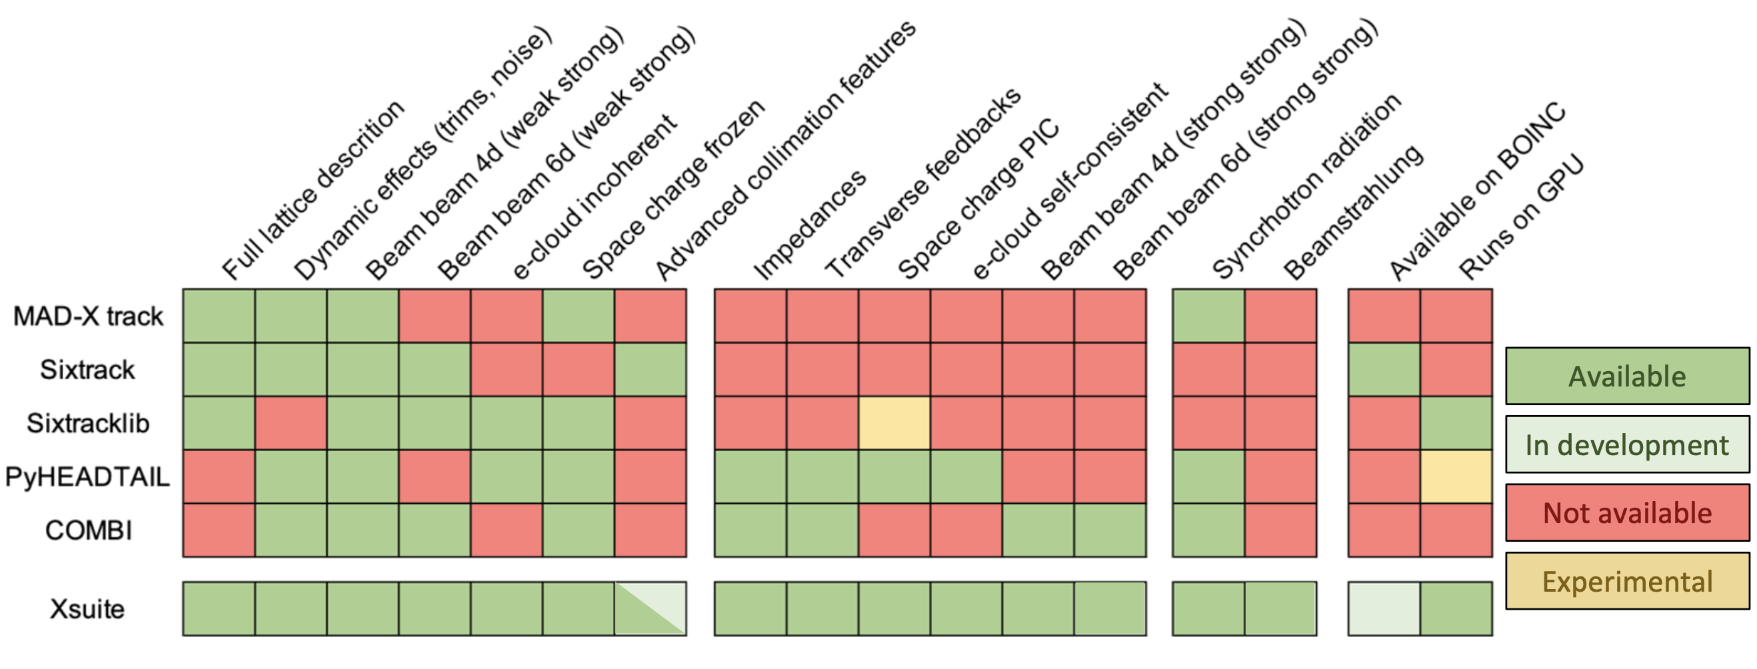
Introduction
Xsuite development status
[1]
Single integrated toolkit for multiparticle simulations

Slide 4
Introduction
Simplified tracking simulations with Xsuite
  Exploit superperiodicity of machine (2 IP case)
  In code:
    1 IP + tracking over half arc
    with linear transfer matrix
    Arc split into 3 segments
    2 crab sextupoles between arc segments (β_{x}=3 m, β_{y}=500 m)
    A «turn» begins in front of the right sextupole:
      Observation point for coordinates
    Effective radiation (damping+noise) in arc, beamstrahlung in beam-beam
      No radiation for FMA
IP + BS | lin. arc | sext. | lin. arc + eff. SR | sext. | lin. arc
START
repeat
Notes:
Then in the next step we have moved to simplified tracking simulations.
We exploited the periodicity of the baseline design with 2 ips so the simulations consist of 1 ip followed by tracking with a linear transfer map over the fcc half arc.
The arc is split into 3 segments and 2 sextupoles are inserted between the segments to implement the crab waist scheme.
Then each tracking turn begins in front of the right sextupole and this point is chosen of observation of the beam emittances.
The synchrotron radiation is implemented by an effective model of the damping and gaussian noise for quanctum excitation in the middle arc element and the beamstrahlung is implemented inside the beambeam element.

Slide 5
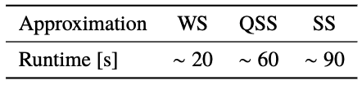
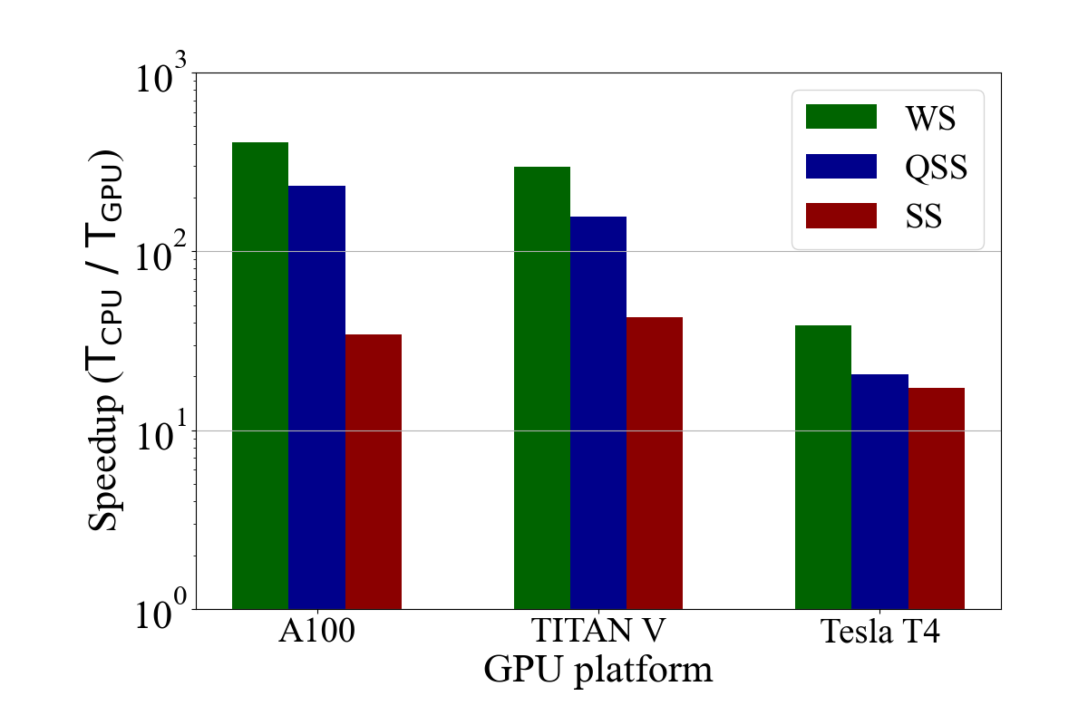
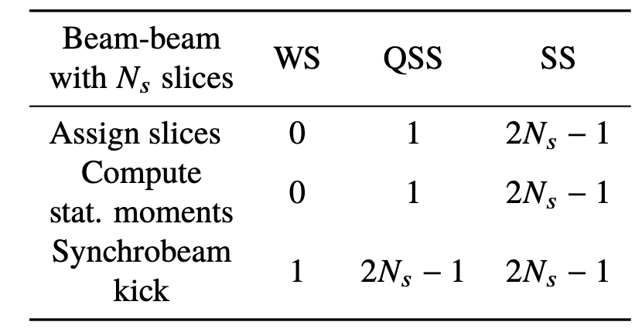
Performance of the Xsuite beam-beam model
First results
Time 1 collision on CPU
FCC-ee Z
N_{particles} = 1e6
N_{slices} = 100
Scaling on GPU
Number of calls to the 3 main operations
over a single collision
Notes:
WS: single loop; best scaling
QSS: reduced performance due to more calls to synchrobeam kick operation
SS: reduced performance due to more calls to all operations & increased communication between bunches

Slide 6
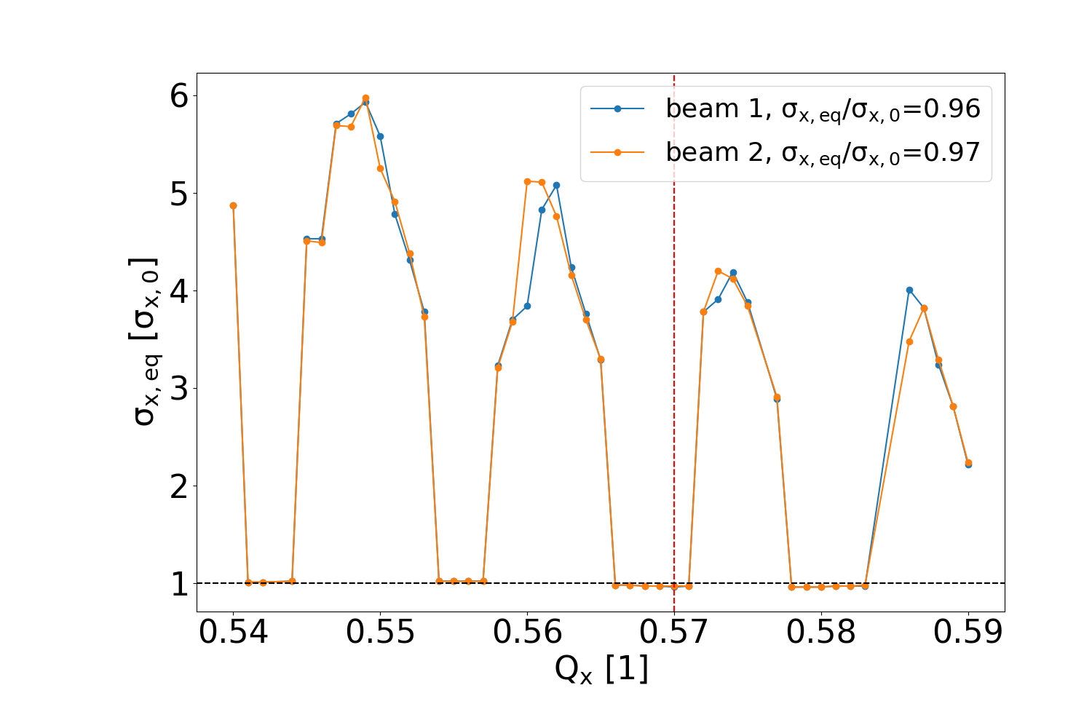
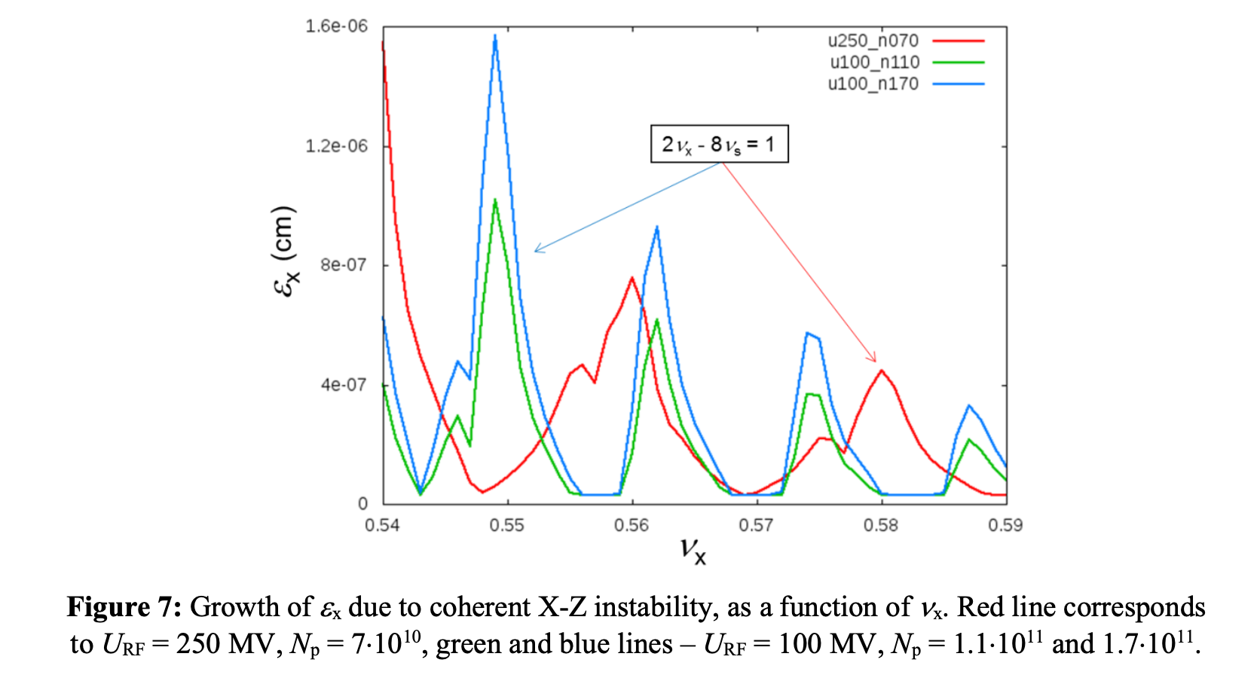
x-z instability
First results
x-z instability regions reproduced in QSS simulation
Stable
Q_{x}=0.57
Unstable
Q_{x}=0.575
nominal
beam size
[2]
FCC-ee Z
Quasi strong-strong (f=1)
N_{turns} = 1e4
N_{particles} = 1e6
N_{slices} = 300
Notes:
link this to next slide better
mark 2 lines i look at what happens when long term tracking

Slide 7
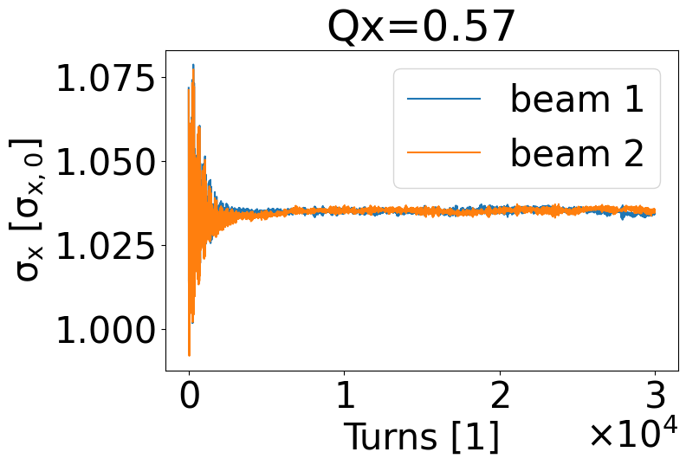
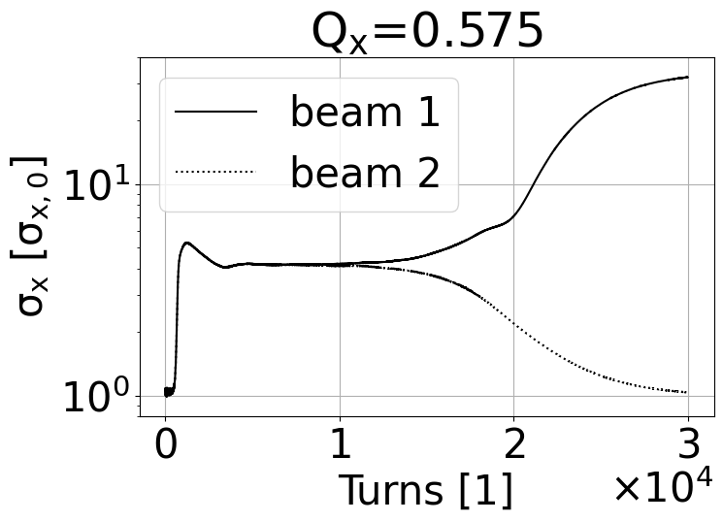
x-z instability
First results
Stable
Unstable
Notes:
plot centroid x wrt turns to see magnitude of noise
flipflop not relevant if happens in unstable config

Slide 8
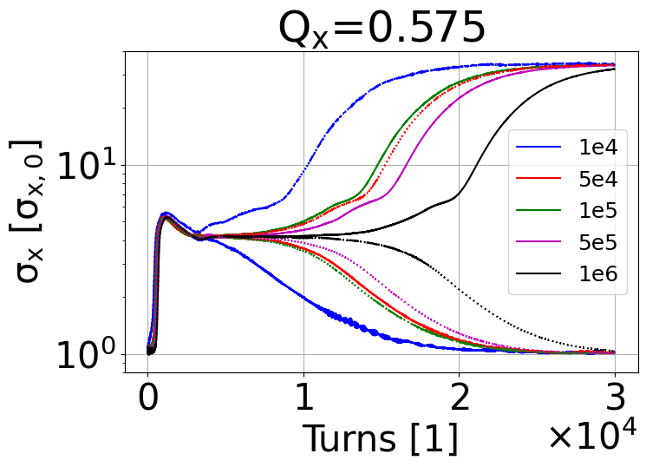
x-z instability
First results
num. macroparticles
Stable
Unstable
Flip-flop driven by numerical noise
  Irrelevant as it happens only in unstable configurations
Notes:
plot centroid x wrt turns to see magnitude of noise
flipflop not relevant if happens in unstable config

Slide 9
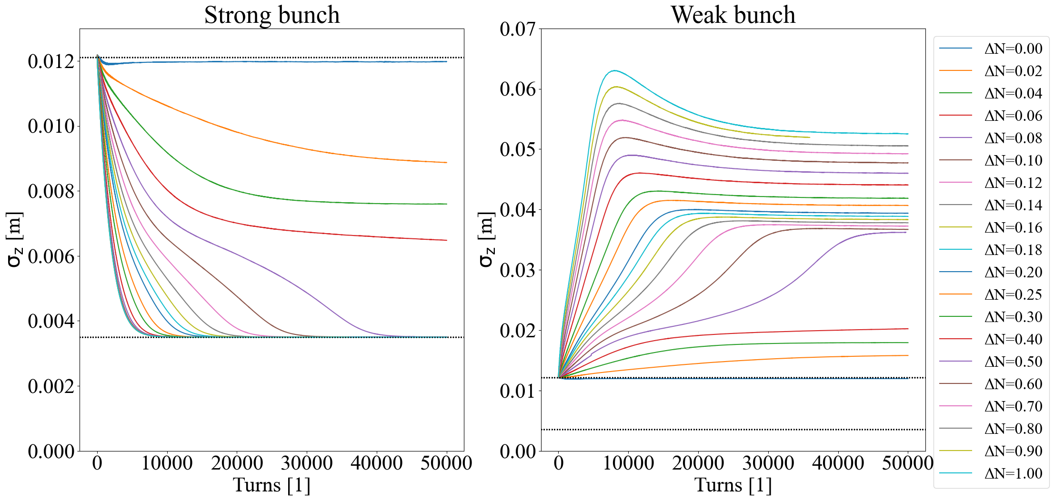
3D flip-flop
First results
FCC-ee Z
Quasi strong-strong (f=100)
N_{turns} = 5e4
N_{particles} = 1e7
N_{slices} = 300
Blowup due to asymmetry in bunch intensity
1D variant previously observed in VEPP-2000 [3]
FCCee: 3D flipflop [4] – interplay of longitudinal and transversal beam sizes
Notes:
one of our main interests is to study the 3D flip flop instability that can play a role during the top up injection. We have derived an analytical approximation for the equilibrium bunch size with a given asymmetry in the bunch intensity. This will be discussed in the next talk. We then compared these predictions to the bunch length obtained from tracking. The plot shows the bunch length as a function of the initial bunch asymmetry. We see that the first results are promising. The symmetric case has a blowup since our working point is unstable, likely due to the low statistics. Here we need more macroparticles but such a simulation will take longer in the order of weeks or even months. For this we are trying to improve the parallelization in xsuite.

Slide 10
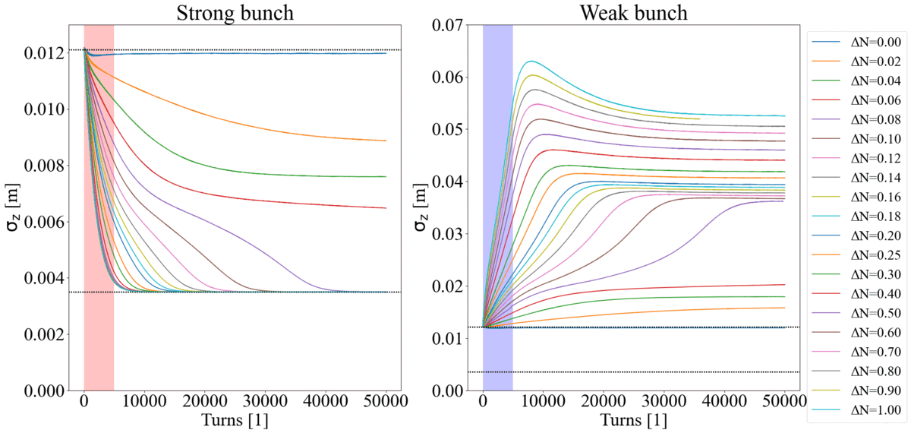
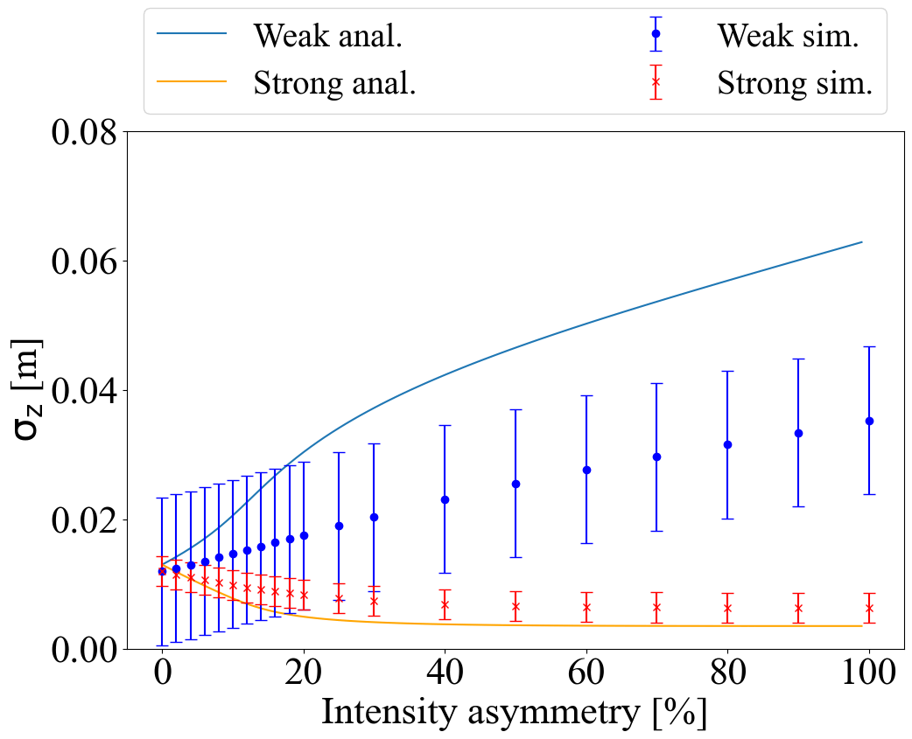

3D flip-flop
First results
FCC-ee Z
Quasi strong-strong (f=100)
N_{turns} = 5e4
N_{particles} = 1e7
N_{slices} = 300
Blowup due to asymmetry in bunch intensity
Details of analytical formalism in [5]
Formulas do not take into account nonlinear
behavior due to resonances at high asymmetries
(=100*ΔN)
Notes:
first order efect modeled maximum
other effects not captured by the formula
cannot rely on formula
at 10% asymm the formula causes a factor 2 discrepancy
in the end tracking is conclusive
put khois plot from supplement including y
explaing linear model 1D 3D switching point
resonance lines not captured in khois linear model

Slide 11
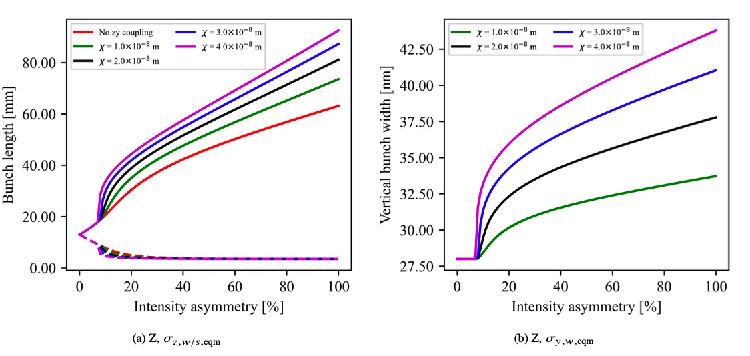
3D flip-flop
First results
FCC-ee Z
Quasi strong-strong (f=100)
N_{turns} = 5e4
N_{particles} = 1e7
N_{slices} = 300
[5]
1D
1D
3D
3D
[5] is a linear model with 2 tuneable
parameters to bedetermined from tracking
  3D flipflop with y-z coupling “turned on” by ξ₀
  Magnitude of blowup determined by χ
(=100*ΔN)
Notes:
first order efect modeled maximum
other effects not captured by the formula
cannot rely on formula
at 10% asymm the formula causes a factor 2 discrepancy
in the end tracking is conclusive
put khois plot from supplement including y
explaing linear model 1D 3D switching point
resonance lines not captured in khois linear model

Slide 12
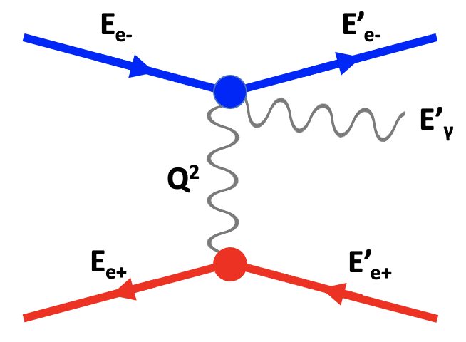
Bhabha scattering
First results
Coulomb scattering of relativistic charges of opposite sign
occasional Bremsstrahlung (radiative Bhabha) photons
virtual photon
Notes:
one of our main interests is to study the 3D flip flop instability that can play a role during the top up injection. We have derived an analytical approximation for the equilibrium bunch size with a given asymmetry in the bunch intensity. This will be discussed in the next talk. We then compared these predictions to the bunch length obtained from tracking. The plot shows the bunch length as a function of the initial bunch asymmetry. We see that the first results are promising. The symmetric case has a blowup since our working point is unstable, likely due to the low statistics. Here we need more macroparticles but such a simulation will take longer in the order of weeks or even months. For this we are trying to improve the parallelization in xsuite.

Slide 13
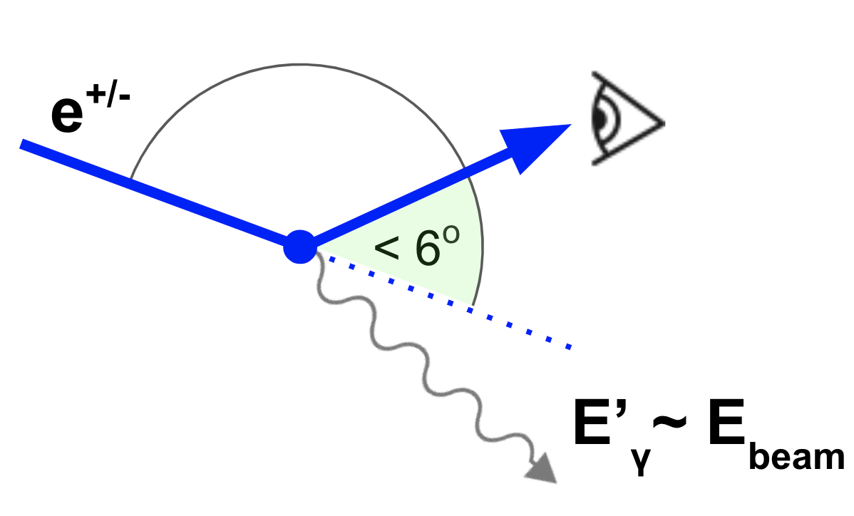
Small angle Bhabha scattering
First results
Dominated by t-channel (scattering) process
luminosity in lepton colliders
primary particles lost within a turn
Main limitation of FCC-ee beam lifetime (alongside beamstrahlung)
Notes:
one of our main interests is to study the 3D flip flop instability that can play a role during the top up injection. We have derived an analytical approximation for the equilibrium bunch size with a given asymmetry in the bunch intensity. This will be discussed in the next talk. We then compared these predictions to the bunch length obtained from tracking. The plot shows the bunch length as a function of the initial bunch asymmetry. We see that the first results are promising. The symmetric case has a blowup since our working point is unstable, likely due to the low statistics. Here we need more macroparticles but such a simulation will take longer in the order of weeks or even months. For this we are trying to improve the parallelization in xsuite.

Slide 14
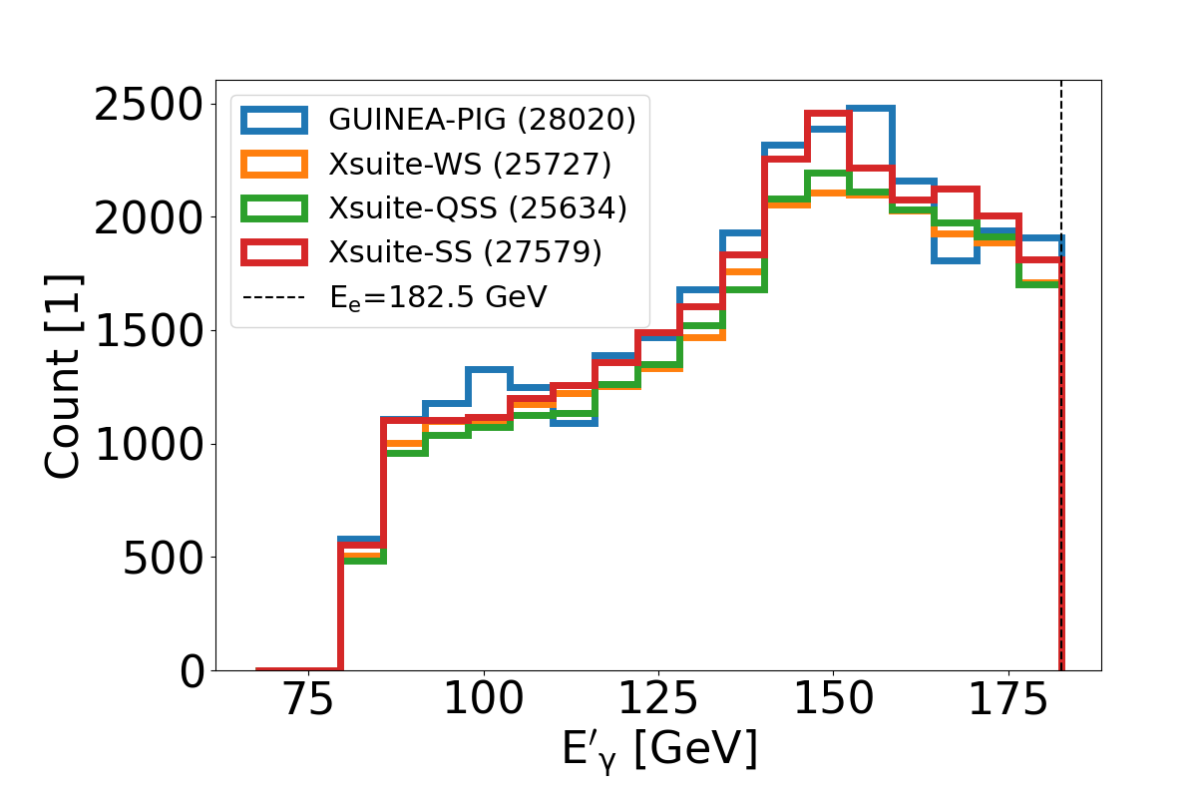
Bhabha scattering event generator in Xsuite
First results
Modeled with the method of equivalent photons [6]
Successful benchmark of event generator against GUINEA-PIG [7]
Ready to simulate beam lifetime
FCC-ee ttbar
N_{collisions} = 10
N_{particles} = 1e4
N_{slices} = 100
Notes:
one of our main interests is to study the 3D flip flop instability that can play a role during the top up injection. We have derived an analytical approximation for the equilibrium bunch size with a given asymmetry in the bunch intensity. This will be discussed in the next talk. We then compared these predictions to the bunch length obtained from tracking. The plot shows the bunch length as a function of the initial bunch asymmetry. We see that the first results are promising. The symmetric case has a blowup since our working point is unstable, likely due to the low statistics. Here we need more macroparticles but such a simulation will take longer in the order of weeks or even months. For this we are trying to improve the parallelization in xsuite.

Slide 15
Summary
Summary
  Xsuite beam beam model https://github.com/xsuite
    Beamstrahlung
    Bhabha scattering
    Luminosity (soft-Gaussian)
  Model extensively benchmarked
  Bhabha scattering lifetime study ongoing
  First results for x-z instability, 3D flip-flop
  Next steps
  Simulations with updated FCC-ee parameters
  Impact of lattice imperfections (misalignment, orbit and optics corrections)
  Top-up injection
  Benchmark at SuperKEKB
Thank you!

Slide 16
Summary
References
  [1] G. Iadarola, Xsuite update
  https://indico.cern.ch/event/1263239/contributions/5314669/attachments/2612972/4515112/000_Xsuite_fcc.pdf
  [2] D. Shatilov, FCC-ee Parameter Optimization
  https://cds.cern.ch/record/2816655
  [3] D. Shwartz et al., Recent Beam-Beam Effects at VEPP-2000 and VEPP-4M
  https://cds.cern.ch/record/1757099
  [4] D. Shatilov, Beam-beam Effects at High Energy e⁺e⁻ Colliders
  https://doi.org/10.18429/JACoW-eeFACT2018-TUYBA02
  [5] K. Le Nguyen Nguyen, Analytical Description of the Impact of Intensity Asymmetry in Colliders with Strong Beamstrahlung https://indico.cern.ch/event/1193165/contributions/5015797
  [6] C. Weizsäcker, E. Williams
  doi:10.1007/BF01333110, http://gymarkiv.sdu.dk/MFM/kdvs/mfm%2010-19/mfm-13-4.pdf
  [7] D. Schulte, GUINEA-PIG
  https://gitlab.cern.ch/clic-software/guinea-pig
  [8] Courtesy of D. Shatilov

Slide 17
backup

Slide 18
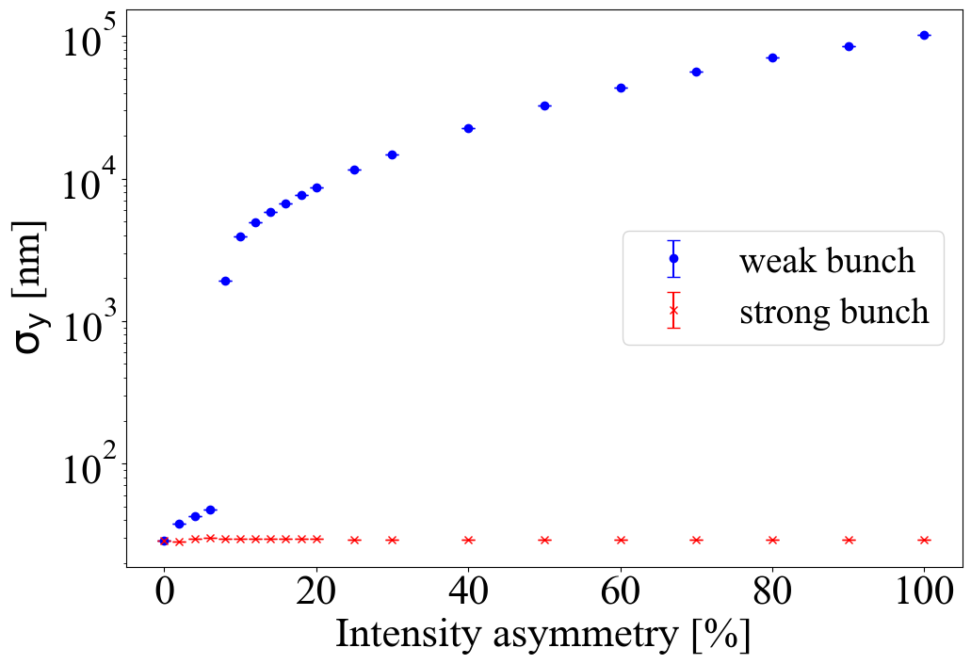
3D flip-flop
First results
FCC-ee Z
Quasi strong-strong (f=100)
N_{turns} = 5e4
N_{particles} = 1e7
N_{slices} = 300
[5]
1D
1D
3D
3D
[5] is a linear model with 2 tuneable
parameters to bedetermined from tracking
  3D flipflop with y-z coupling “turned on” by ξ₀
  Magnitude of blowup determined by χ
(=100*ΔN)
Notes:
first order efect modeled maximum
other effects not captured by the formula
cannot rely on formula
at 10% asymm the formula causes a factor 2 discrepancy
in the end tracking is conclusive
put khois plot from supplement including y
explaing linear model 1D 3D switching point
resonance lines not captured in khois linear model

Slide 19
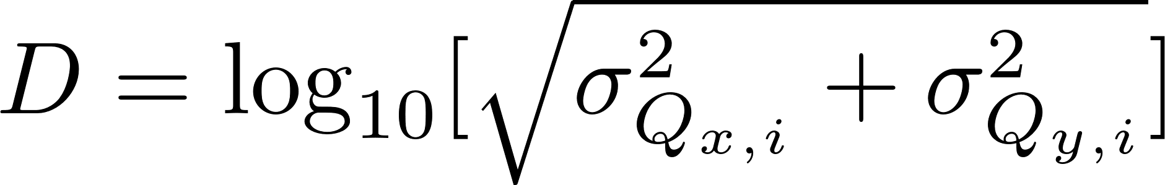
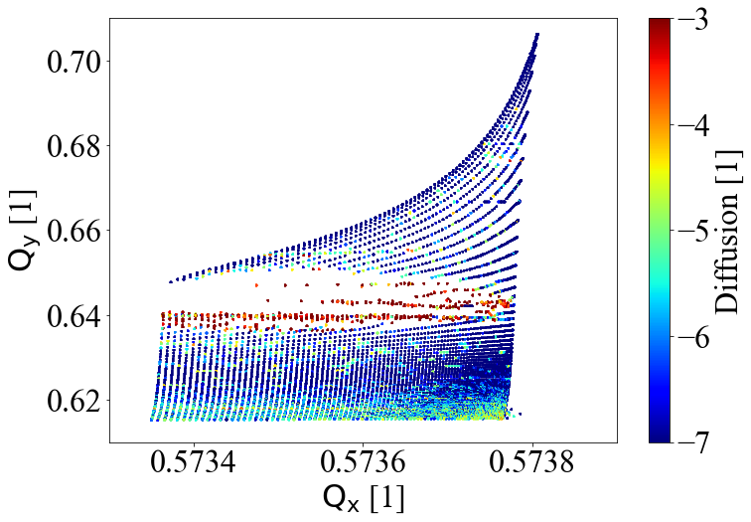
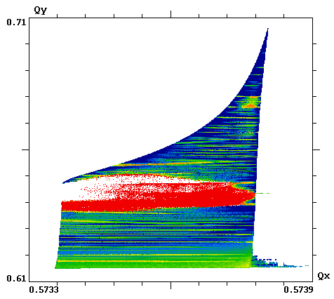
FMA – diffusion
First results
Q_{x} max ~ 0.573806
xsuite
LIFETRAC [8]
Q_{x} min ~ 0.57335
Notes:
Then we can add a colormap to the footprint representing the diffusion that is computed from the standard deviation of a number of tunes using an fft window. Here the left plot shows the footprint of xsuite and the right one shows lifetrac. In conclusion the shape and boundaries of the footprints agree up to an accuracy of 1e-7, so the benchmark can be considered successful.

Slide 20
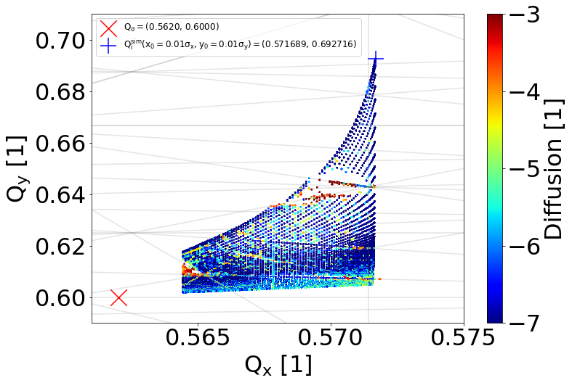
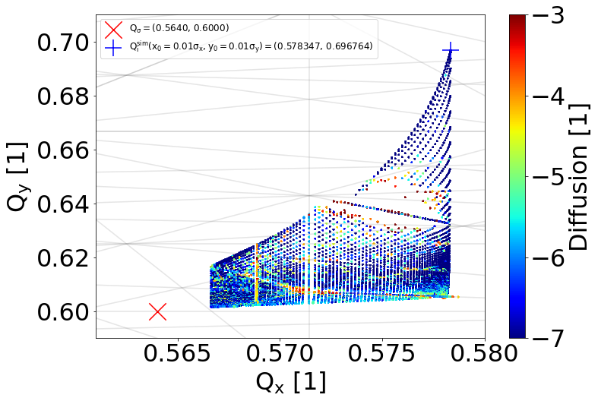
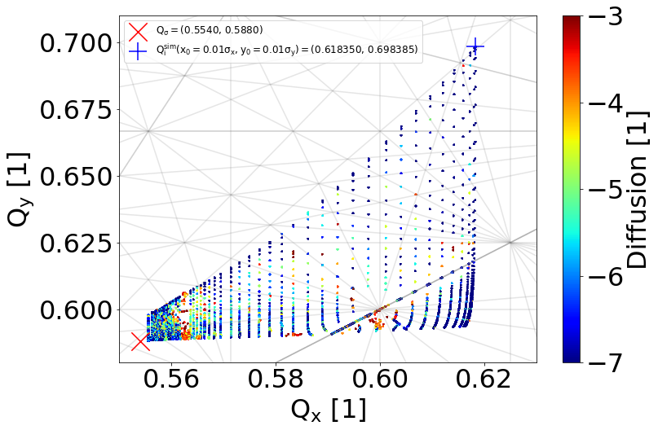
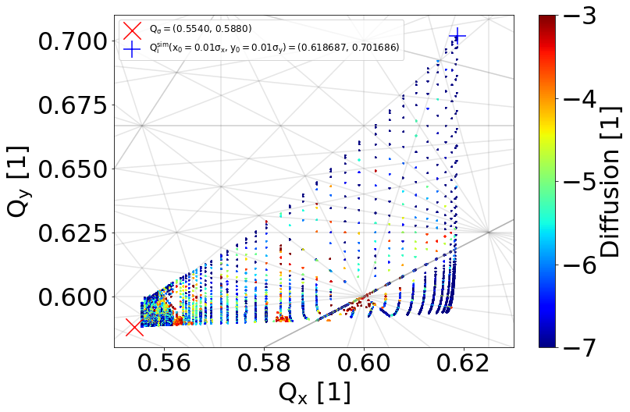
FMA –
Footprint of other
FCCee energies
WW
80 GeV
ZH
120 GeV
TTbar
175 GeV
TTbar
182.5 GeV
Notes:
This plot just shows the tune footprint for the other FCCee energies. The big red cross on the plots indicates the bare tune for half period and the big blue cross indicates the incoherent tune shift of the test particle with 1% sigma initial transverse coordinates.

