Slide 1
Code Development Status

Slide 2
Introduction
Large number of tools used in FCC study
  Often specialised to one purpose/aspect of beam physics
  Sometimes tools with overlapping purpose used, depending on the user’s expertise
Vast and very active community in the CERN ABP Computing Working Group
  Maintenance, improvement, complement existing codes
  Development of modern, robust and broad tools for the entire accelerator community
Large community outside of FCC and CERN with overlapping interests
  Potential for synergies and cooperation

Slide 3
FCC Software Framework Project
Understand requirements for the development and simulation of FCC
  Which effects need to simulated and which tools exist or need to be developed/optimised for these purposes
  Identify which simulations need to interplay/overlap and understand how they fit together in the “bigger picture”
Ensure that the needs of the FCC study are met by
  Maintaining, benchmarking and improving current simulation tools
  Actively contributing to the development of new simulations tools
  Create tools to allow for interfacing between different simulation tools
Work closely with the ABP Computing WG and identify synergies and come up with a common strategy
Offer a first point of contact for external collaborators that see synergies

Slide 4
Simulation Tools

Slide 5
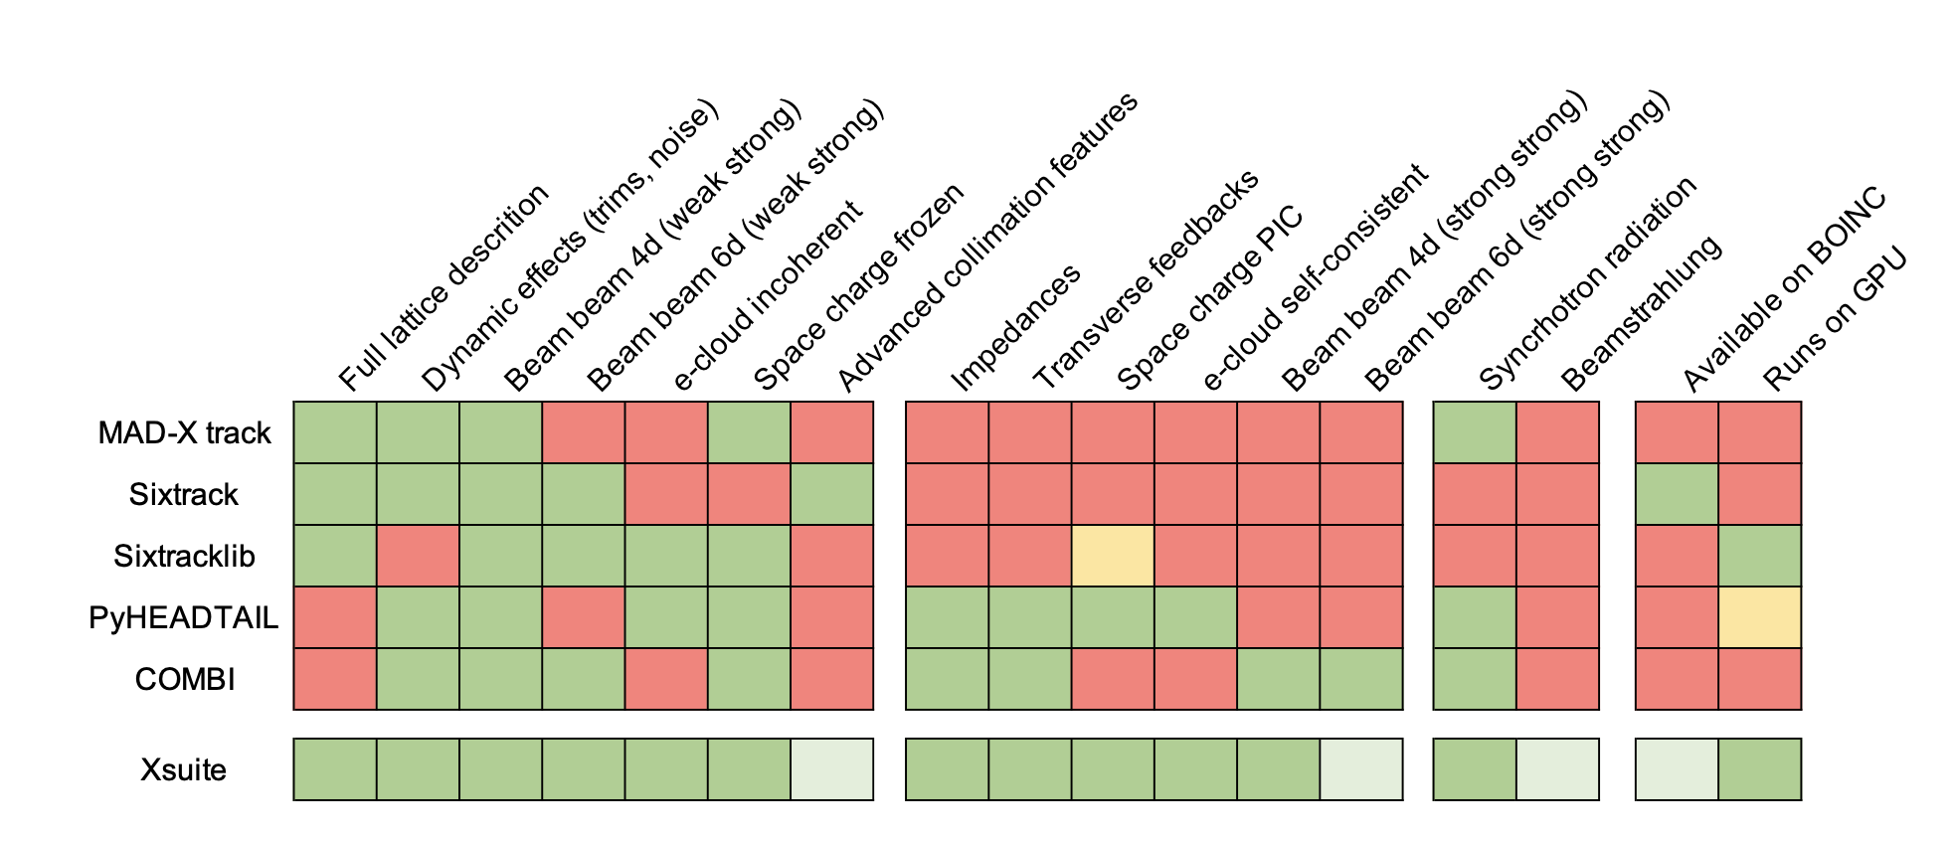


Synergies and New Developments
ML for DA optimization
Polarization and SPIN tracking
Xsequence,
Xconverter
(F. Carlier)
SITROS
SAD
Y. Wu,
F. Carlier,
T. Pieloni
EPOL team
BMAD
PyAT
D. Di Croce,
G. Iadarola,
F. Vanderveken,
T. Pieloni,
SDSC
MADX
P. Kicsiny,
X. Buffat,
D. Schulte
P. Kicsiny, X. Buffat
L. Sabato, L. Mether
G. Simon, R. De Maria,
F. Schmidt, A. Faus-Golfe
P. Kicsiny, X. Buffat
Tapering
F. Carlier, L. van Riesen-Haupt, G. Simon, M. Rakic S. White

Slide 6
Software Framework Talks
Title | Presenter | Description
Beam-beam Code Progress | Peter Kicsiny | Novel beam-beam simulation tools for FCC-ee and integration into Xsuite framework.
Review of MAD-X for FCC-ee studies | Guillaume Simon | Accurate simulation of energy loss compensation in arcs (tapering) for MADX optics, tracking and emittance simulation code.
Electron Cloud Studies | Luca Sabato | Improved electron cloud simulations for FCC-ee using pyECLOUD. Integration with other tools. Stability simulations.
Polarisation Studies | Yi Wu | Spin polarisation studies for energy calibration. Simulation of methods to improve polarisation levels.
XBOINC System for XSUITE and Dynamic Aperture Optimisation | Davide Di Croce | Speed up dynamic aperture studies for FCC-hh using machine learning and parallelisation

Slide 7
Beam-Beam Code
P. Kicsiny,
X. Buffat,
D. Schulte
P. Kicsiny, X. Buffat
P. Kicsiny, X. Buffat

Slide 8
Beam-Beam Code

Slide 9
MAD-X for FCC-ee
ML for DA optimization
Polarization and SPIN tracking
Xsequence,
Xconverter
(F. Carlier)
SITROS
SAD
Y. Wu,
F. Carlier,
T. Pieloni
EPOL team
BMAD
PyAT
D. Di Croce,
G. Iadarola,
F. Vanderveken,
T. Pieloni,
SDSC
MADX
P. Kicsiny,
X. Buffat,
D. Schulte
P. Kicsiny, X. Buffat
L. Sabato, L. Mether
G. Simon, R. De Maria,
F. Schmidt, A. Faus-Golfe
P. Kicsiny, X. Buffat
Tapering
F. Carlier, L. van Riesen-Haupt, G. Simon, M. Rakic S. White

Slide 10
MAD-X for FCC-ee
Guillaume Simon
Efforts led by G. Simon, R. De Maria, A. Faus-Golfe and F. Schmidt
Ongoing review of MAD-X for FCC-ee simulations
  Investigation of Twiss, Emit and Track modules
  Improved corrections due to energy loss (tapering)
  Implement new optics computation considering energy offset
  Optimisation of radiation damping modelling

Slide 11
Electron Cloud
L. Sabato, L. Mether

Slide 12
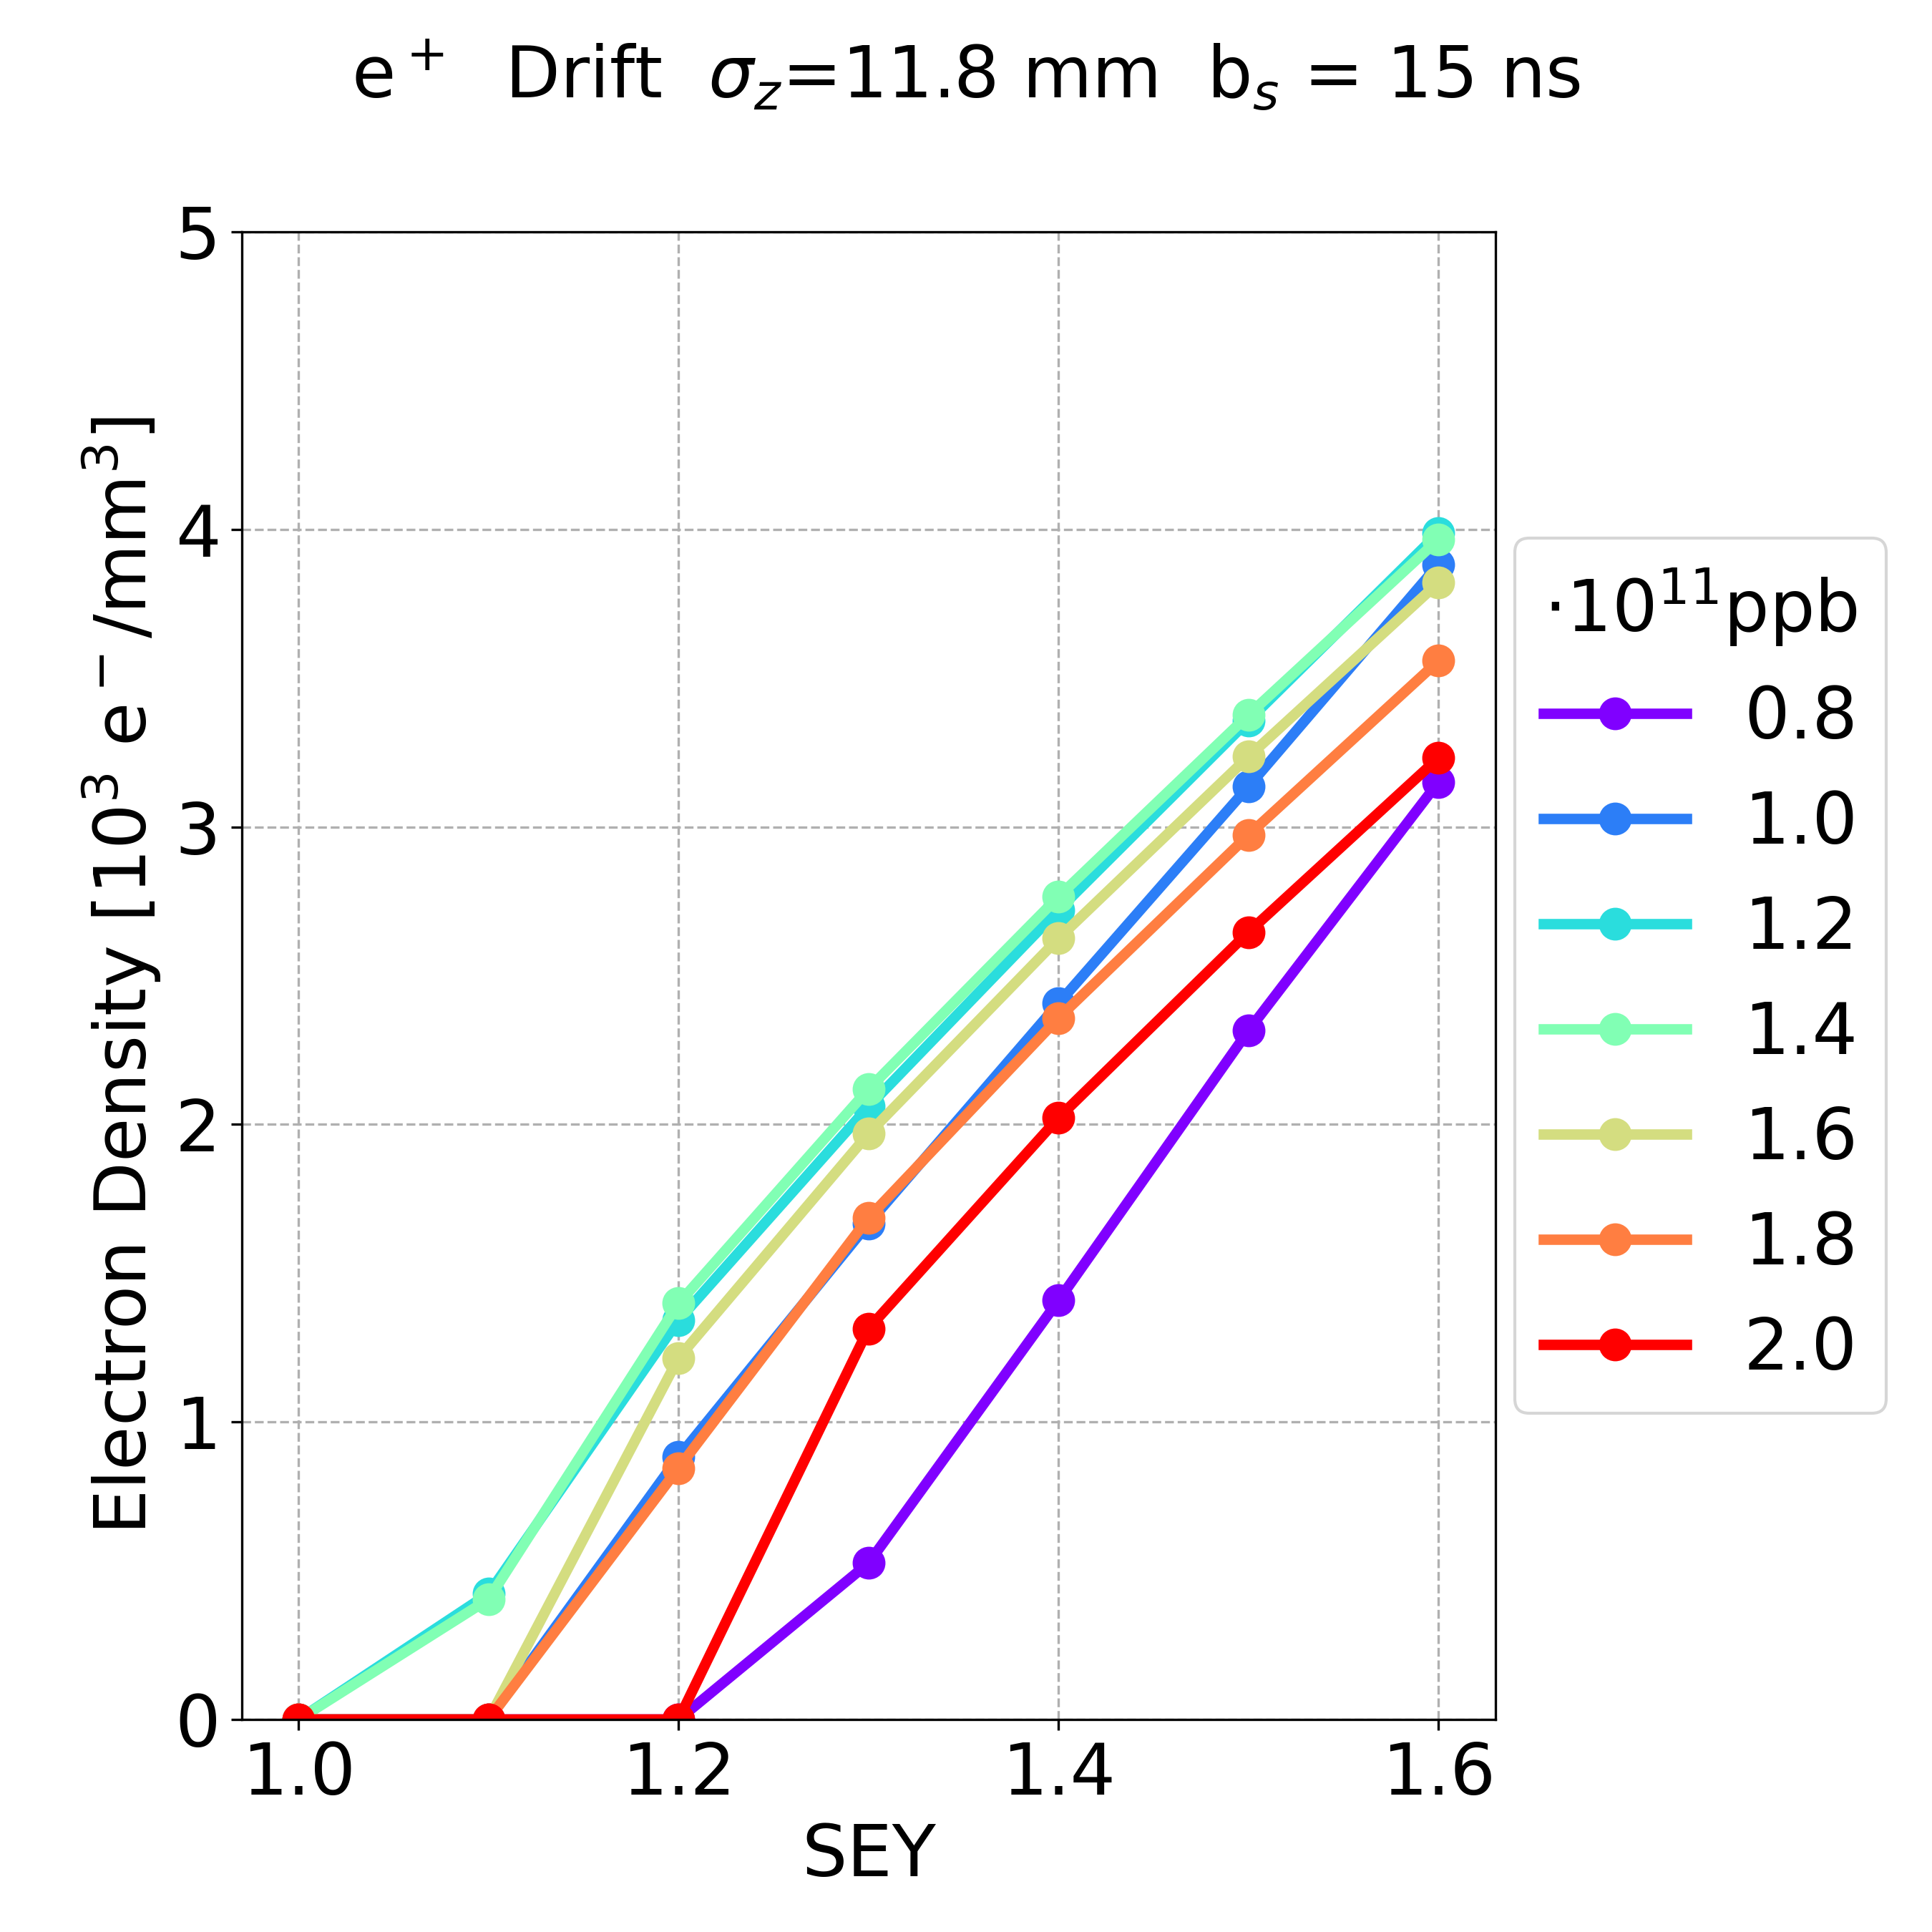
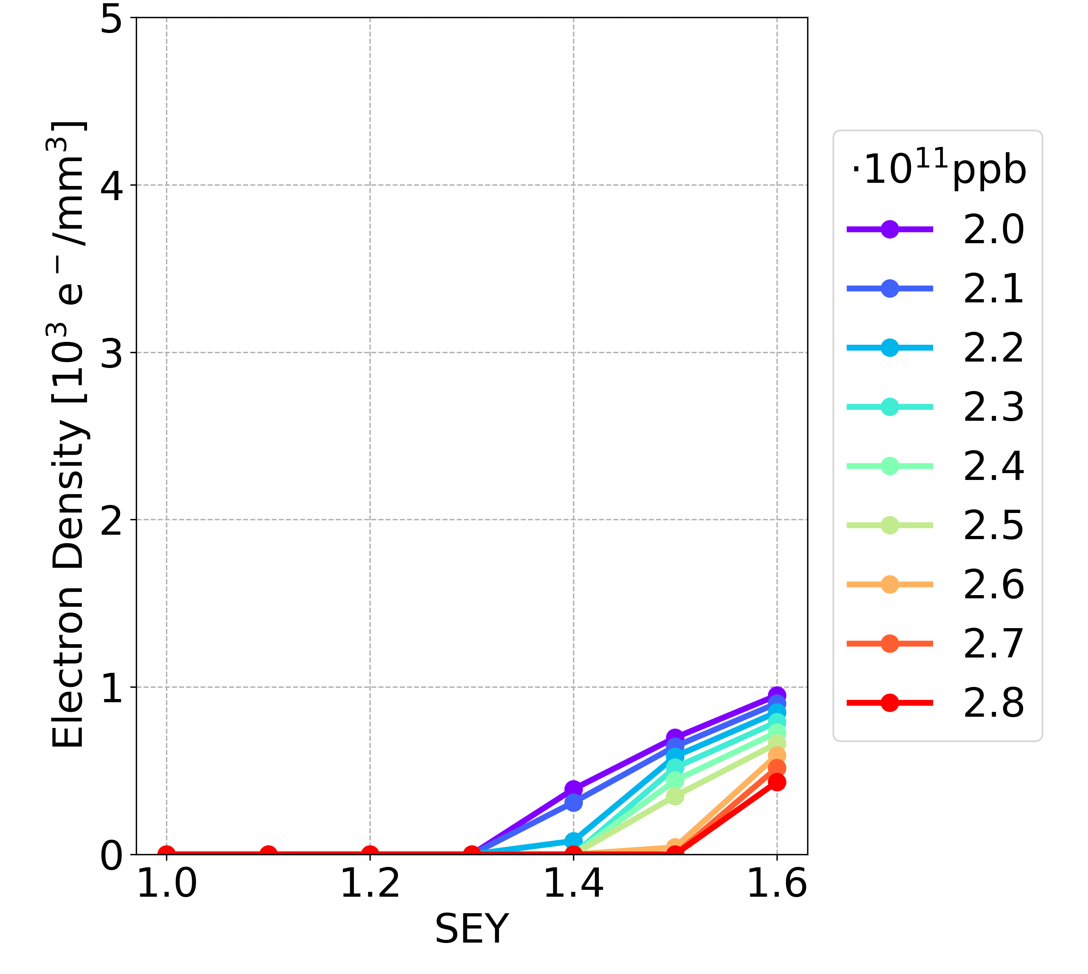
Electron Cloud
Luca Sabato
Efforts by L. Sabato and L. Mether
Simulations performed using pyECLOUD
  Improved electron cloud models based on LHC
  Aim to integrate models in Xsuite
Systematically reduce computational load by identifying parameter range with largest contribution to electron cloud
Beam stability simulations
  Using pre-calculated un-perturbed beam distribution
  Performed on HPC Cluster in INFN-CNAF
Provide feedback for vacuum design
Electron cloud formation for two design iterations with different bunch spacing

Slide 13
Spin Polarisation
Polarization and SPIN tracking
SITROS
Y. Wu,
F. Carlier,
T. Pieloni
EPOL team

Slide 14
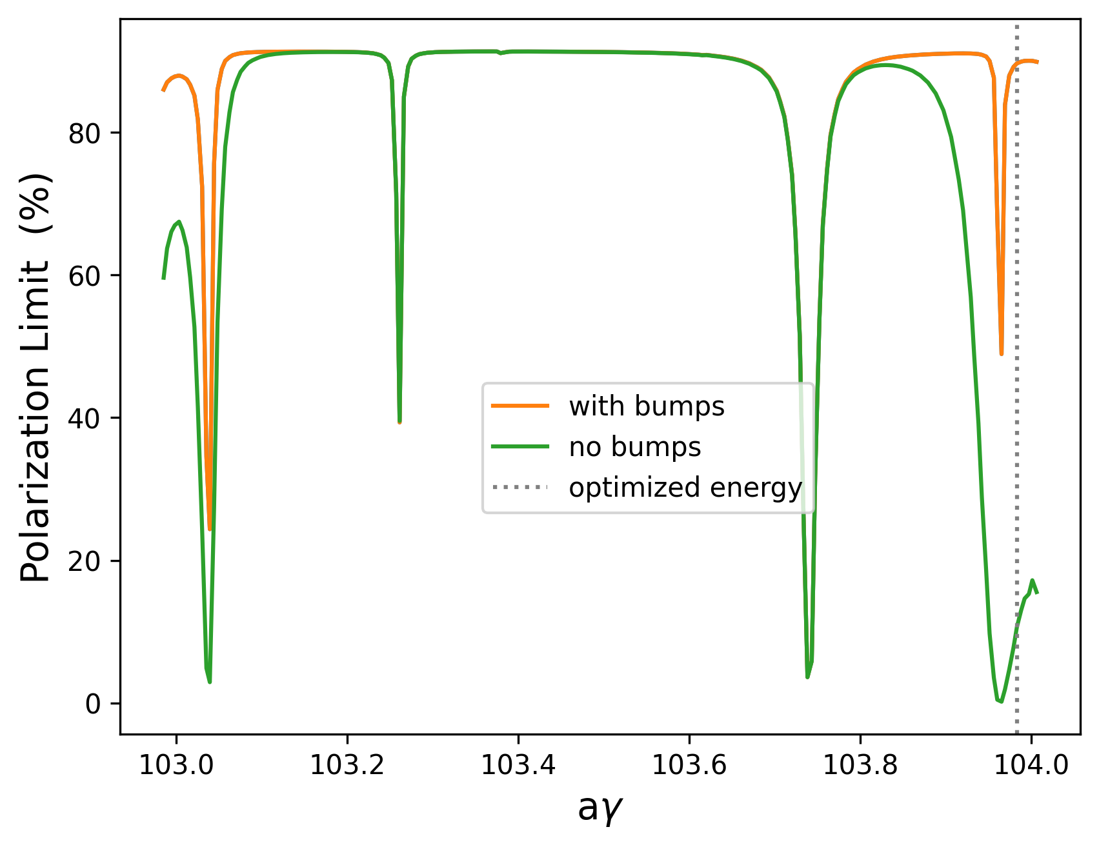
Spin Polarisation
Yi Wu
Spin polarisation required for energy calibration by spin tune measurement
Polarisation levels and times determined from simulations
  Currently done in Bmad
Software framework requirements:
  Simulate and optimise polarisation with realistic lattice errors and corrections
  Understand how spin optimisation affects other properties
  Accurate representation and propagation of changes between codes
Polarisation levels before and after implementing orbit bumps using harmonic spin matching.

Slide 15
Synergies and New Developments
ML for DA optimization
Polarization and SPIN tracking
Xsequence,
Xconverter
(F. Carlier)
SITROS
SAD
Y. Wu,
F. Carlier,
T. Pieloni
EPOL team
BMAD
PyAT
D. Di Croce,
G. Iadarola,
F. Vanderveken,
T. Pieloni,
SDSC
MADX
P. Kicsiny,
X. Buffat,
D. Schulte
P. Kicsiny, X. Buffat
L. Sabato, L. Mether
G. Simon, R. De Maria,
F. Schmidt, A. Faus-Golfe
P. Kicsiny, X. Buffat
Tapering
F. Carlier, L. van Riesen-Haupt, G. Simon, M. Rakic S. White

Slide 16
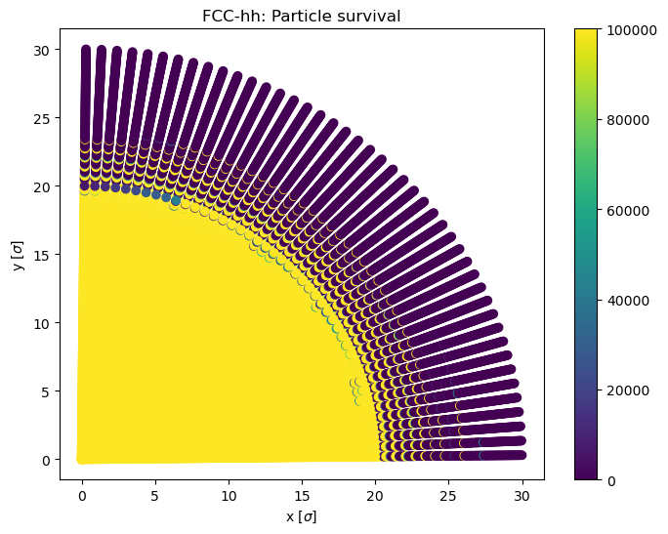
Parallelisation and Machine Learning
Davide di Croce
Efforts led by D. di Croce, F. van der Veken, G. Iadarola
Improve efficiency of dynamic aperture studies for FCC-hh
  Implementing machine learning techniques
  Provide infrastructure for submitting xsuite jobs to LHC@home via xboinc
xboinc module to allow computationally intense FCC-ee studies to be parallised
  Emittance, dynamic aperture and lifetime from tracking
  Studies with beam-beam, errors and other effects
FCC-hh survival plot

Slide 17
Bring it together

Slide 18
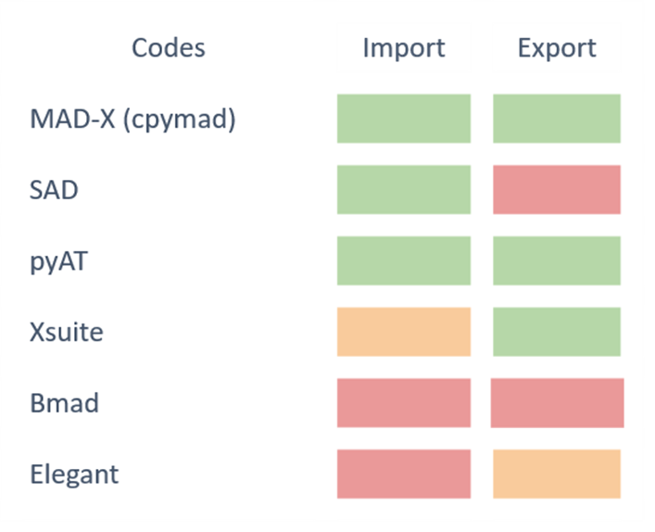
Lattice Conversion and Management
Lattice conversion and management tools written by F. Carlier
  XConverter to convert to and from different codes
  XSequence to manage sequences in python
To be adjusted and augmented based on user requirements
Available on github

Slide 19
Consistency – Matching after Conversion
Matching of lattice after conversion important to recover accurate physics
Matching on multiple levels
  Global parameters (tune, chromaticity…)
  Local linear optics (segment-by-segment)
  Fine tuning in specific areas (e.g. IP) using dedicated knobs
    Knobs creation ongoing
  Non-linear corrects after optics matching
    Under investigation
Synergies with machine tuning studies

Slide 20
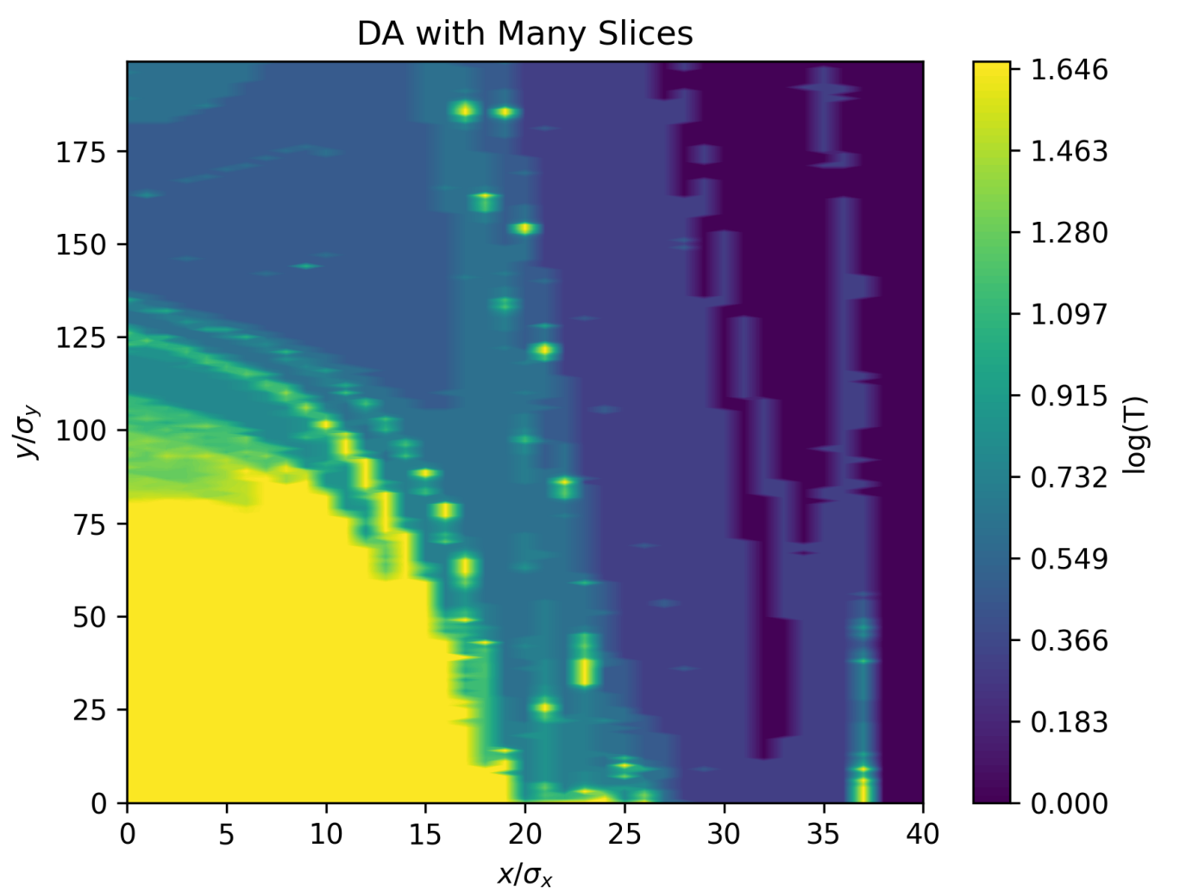
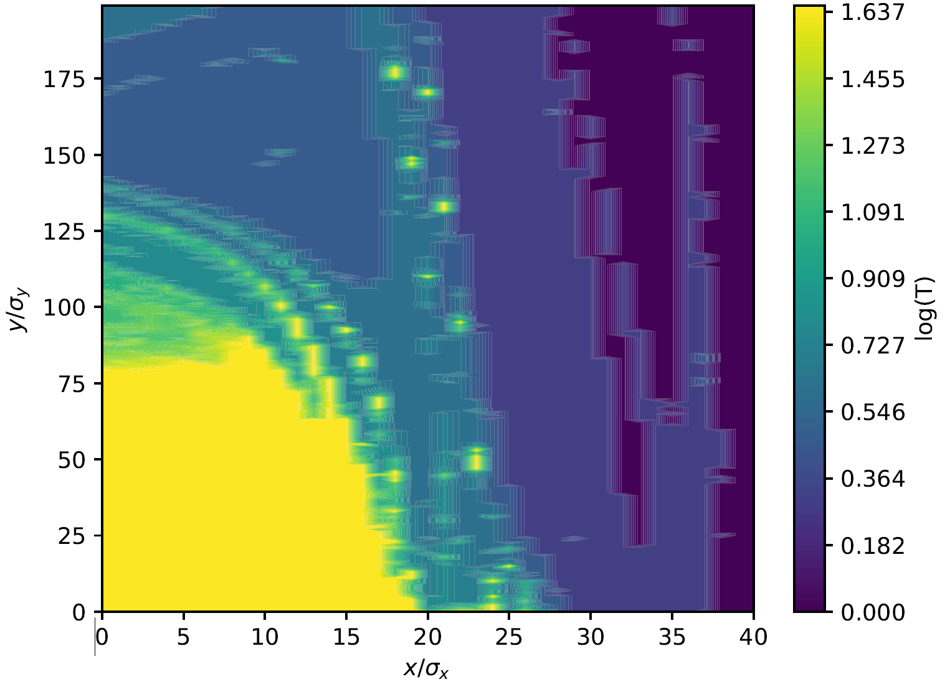
Consistency - Benchmarking
Important to benchmark new tools with existing codes
  Simple examples before studying multiple effects
  Understand sources of possible inconsistencies
Extensive study benchmarking xsuite since this is a primary tool
  Optics with radiation and tapering compared to optics codes (MADX,SAD)
  Dynamic aperture with and without radiation (MADX, SAD, MADX-PTC)
  Emittance from tracking
    Compared to other tracking codes
    Compared to matrix methods
FCC-ee survival plot with radiation using SAD (top) and Xtrack (bottom)

Slide 21
First Results:
Beam-beam and full lattice

Slide 22
Outlook and Conclusion

