Slide 1






XBOINC: A BOINC APPLICATION FOR Xtrack (XSUITE)
R. De Maria¹, D. Di Croce², M. GiOVANNOZZI¹, G. IaDAROLA¹, T. Pieloni², F. F. Van der Veken¹
¹CERN, ²EPFL, ³PSI, ⁴SDSC
JUN 8, 2023 | FCC–$ee$ accelerator: code development

Slide 2

The Berkeley Open Infrastructure for Network Computing
BOINC is an open-source middleware system which supports volunteer computing;
BOINC aims to enable sharing the enormous processing resources of multiple personal computers among the world in order to accelerate scientific computations;
Anyone can collaborate for free to the computation of scientists all around the world with their available CPU time of their own PC;
More info at BOINC website: https://boinc.berkeley.edu

Slide 3

LHC@Home
LHC@Home is the BOINC-based project at CERN for volunteer computing;
Volunteers routinely run applications by LHC experiments (ATLAS and CMS event reconstruction), by the Theory group, ...and SixTrack (Beam Dynamics);
More info: https://lhcathome.web.cern.ch/

Slide 4
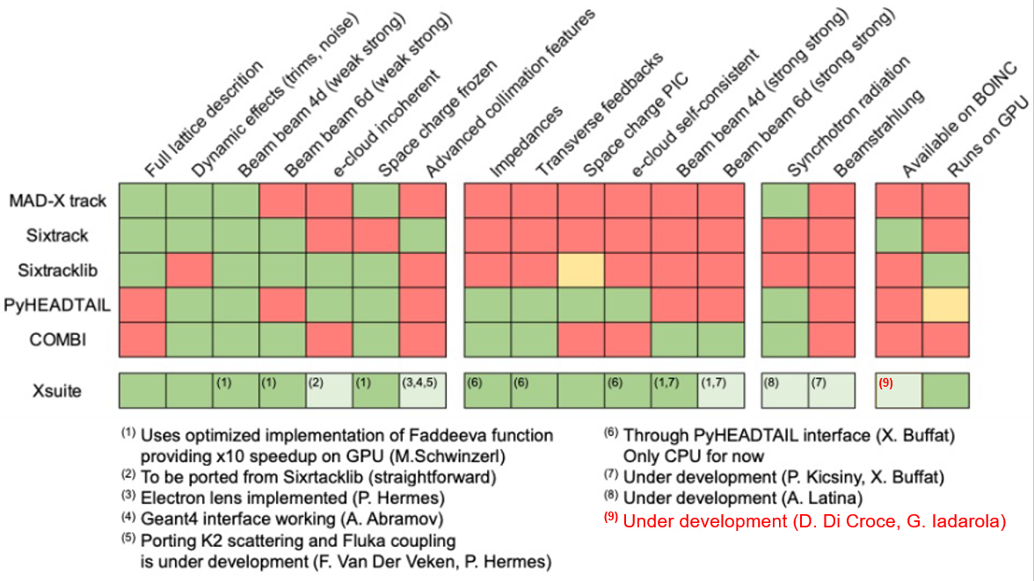
Particle Dynamics Simulation FOR FCC
Legacy tracking simulation tool is SixTrack.
Tracking simulations with +10⁶ turns and many parameters are computationally expensive (few days)
SixTrack was implemented as native BOINC app (LHC@home) to submit up to 350K jobs in parallel
Higher computational complexity for FCC:
Higher number of lattice elements,
Synchrotron radiation,
6D beam-beam interactions…
BOINC system ideal to submit jobs for FCC tracking simulations!
An improved tracking simulation tool has been developed: Xtrack (part of Xsuite framework)
BOINC app for Xtrack simulation is being developed within LHC@home
Possible to develop GPU support for Xtrack BOINC app (xboinc)
Relevant for the ML4FCC project: implementation of an active DL framework to provide an FCC (DA) model and tuning knobs for machine design and optimization

Slide 5
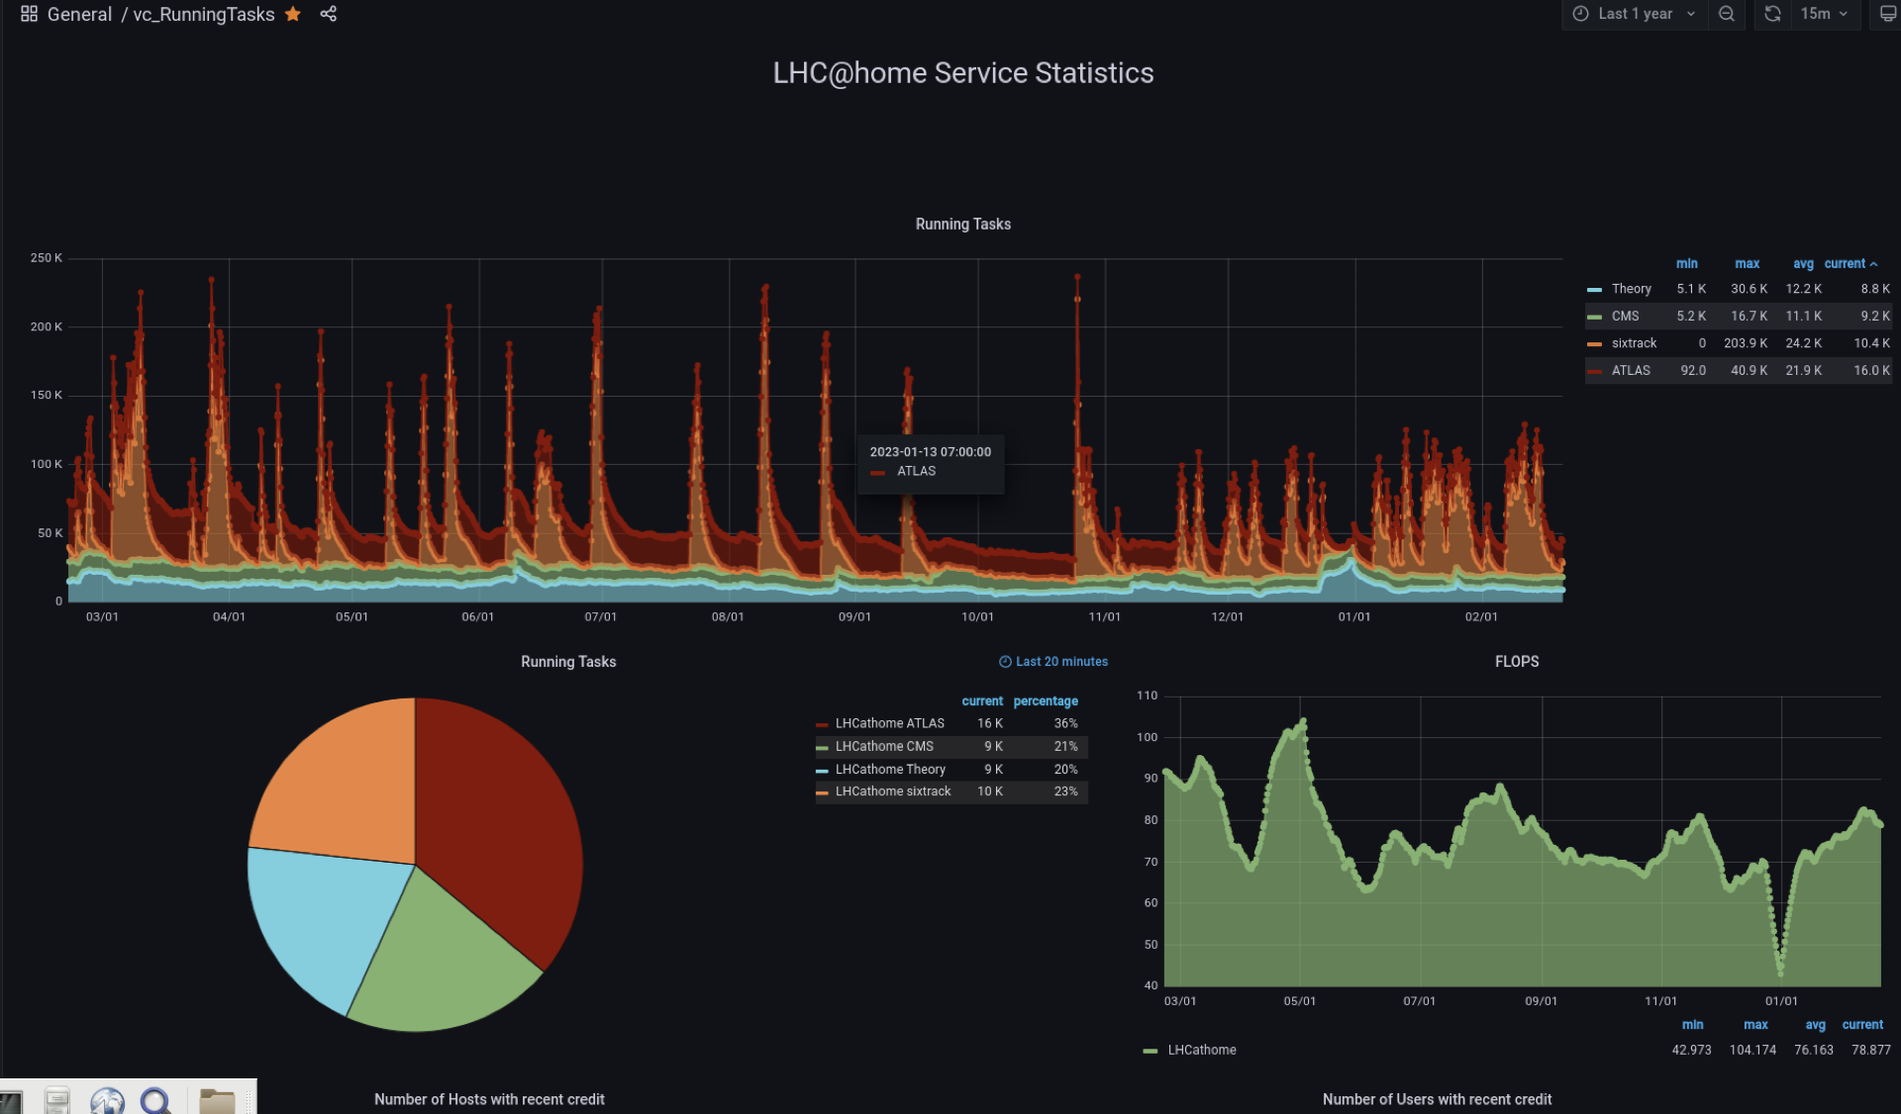
LHC@HOME PERFORMANCE

Slide 6
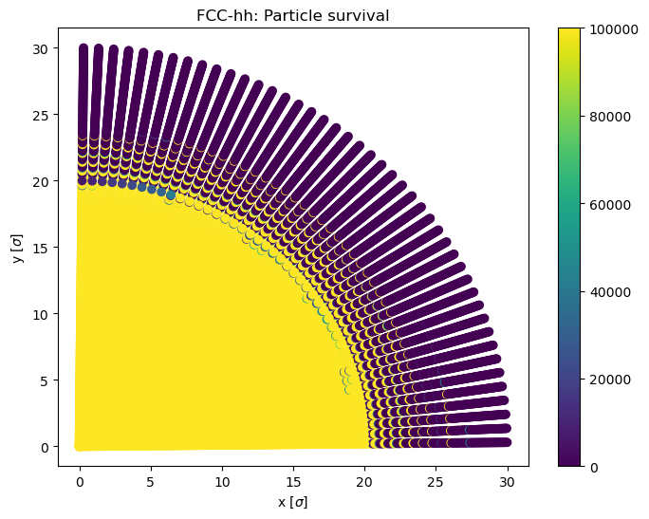
FIRST FCC RESULTS WITH XBOINC on DEV SERVER
First xboinc app deployed in the lhc@home dev server
To test different volunteer architectures before user release
To benchmark the app performance

Slide 7

FCC NEEDS YOU!
JOIN LHC@HOME TODAY! https://lhcathome.web.cern.ch/join-us

Slide 8
XBOINC STATUS
Standalone and static Xtrack binary was developed for Windows and Linux.
Standalone BOINC was developed for Windows and Linux to test BOINC API functions.
BOINC API functions were added into Xtrack.
Xtrack with BOINC API functions tested without the BOINC test server (Linux and Windows).
A test server was setup developed to learn and test BOINC functions.
To develop a Xtrack validator and assimilator.
Test the Xboinc binary (Xtrack with BOINC API and his validator/assimilator) with the BOINC dev server.
Pre-release of Xboinc for FCC study cases.

