Slide 1



Electron Cloud Studies for FCC-ee
Sabato Luca¹, Mether Lotta²
Acknowledgement: Pieloni Tatiana¹, Iadarola Giovanni², Paraschou Konstantinos²
¹ ²
ABP-CEI Section Meeting
1st June 2023
This work was performed under the auspices and with support from the Swiss Accelerator Research and Technology (CHART) program (www.chart.ch).

Slide 2
Outline
Introduction
E-Cloud Formation Process
Build-up Simulation Results
Stability Simulations
Conclusions and Outlook
ABP-CEI Section Meeting 01/06/2023

Slide 3
Outline
Introduction
Scientific Goal
FCC
New Parameters
E-Cloud Formation Process
Build-up Simulation Results
Stability Simulations
Conclusions and Outlook
ABP-CEI Section Meeting 01/06/2023

Slide 4
Introduction: Scientific Goal
The scientific goal of the research activity is to check the stability limits by means of self-consistent beam stability simulations for the different arc elements with realistic electron cloud (e-cloud) distributions obtained from build-up simulations
Comparison between the analytical central electron density threshold for single bunch instability and the simulation results
The beam stability simulations are heavy from the computational point of view
For this reason, a preliminary study to identify the parameters, in the range of the values of FCC-ee case, which play a significant role in the e-cloud formation has been performed
[ ] K. Ohmi et al., “Study of Electron Cloud Instabilities in FCC-hh”, Proc. of IPAC2015
ABP-CEI Section Meeting 01/06/2023

Slide 5
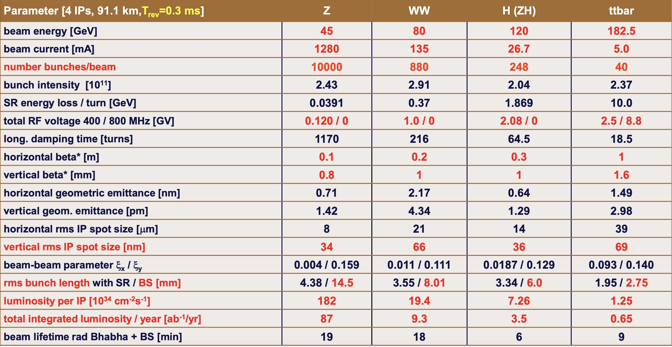
Introduction: FCC-ee
FCC-ee is a circular electron-positron collider, the first stage towards a 100 TeV proton-proton collider FCC-hh
[ ] FCC week 2022, “Accelerator overview”, Frank Zimmermann, Tor Raubenheimer
The Z configuration has been investigated, because the strongest e-cloud effects are foreseen for this configuration due to the highest number of bunches (smallest bunch spacing)
ABP-CEI Section Meeting 01/06/2023

Slide 6
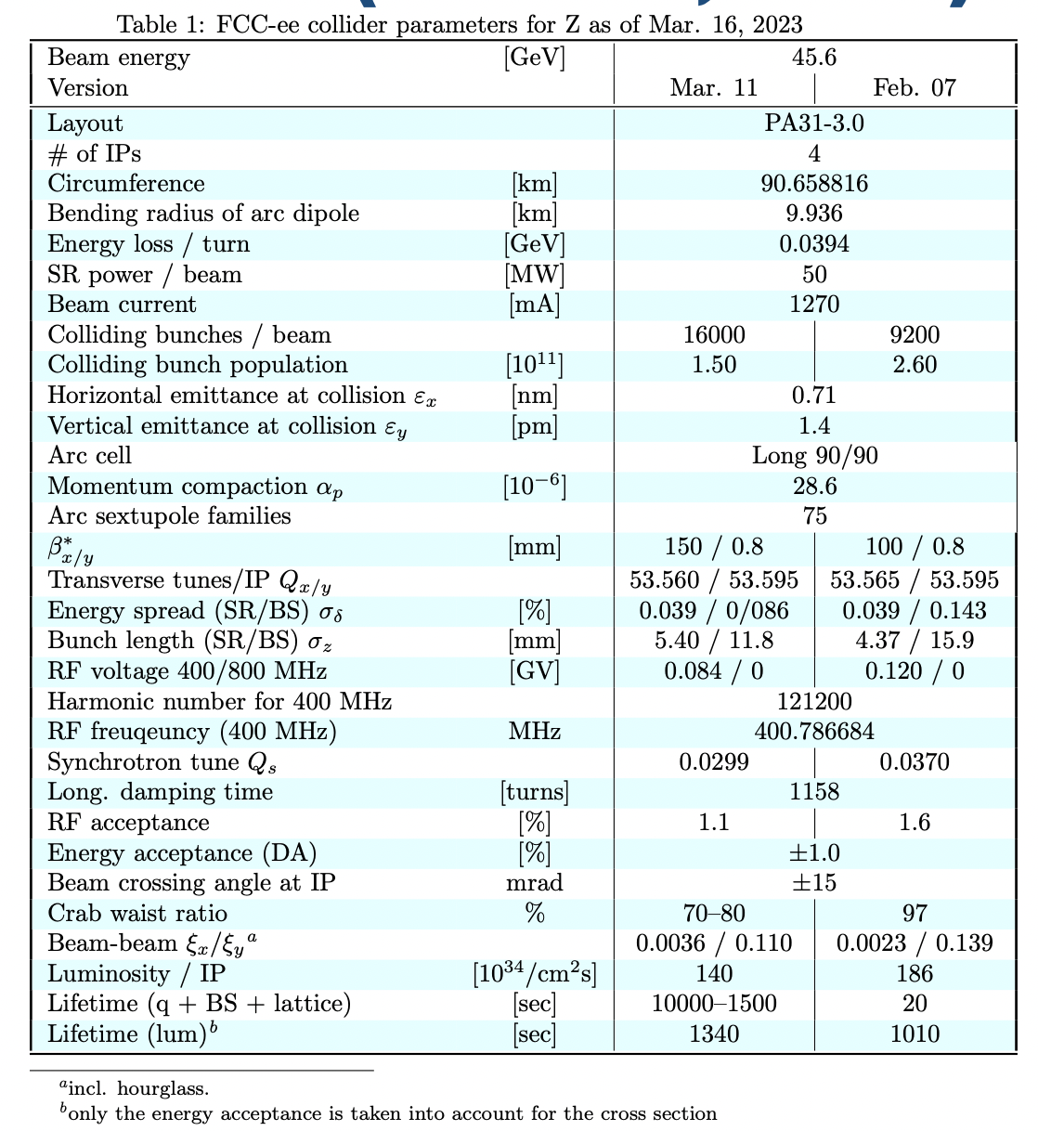
Introduction
New machine and beam parameters
More bunches -> less bunch spacing (max 18.9 ns)
Smaller bunch intensity
Bunch length
[ ] K. Oide 16th March 2023, “Impact of beamstrahlung on crab sextupole compensation”, 163rd FCC-ee Optics Design Meeting & 34th FCCIS WP2.2 Meeting
ABP-CEI Section Meeting 01/06/2023

Slide 7
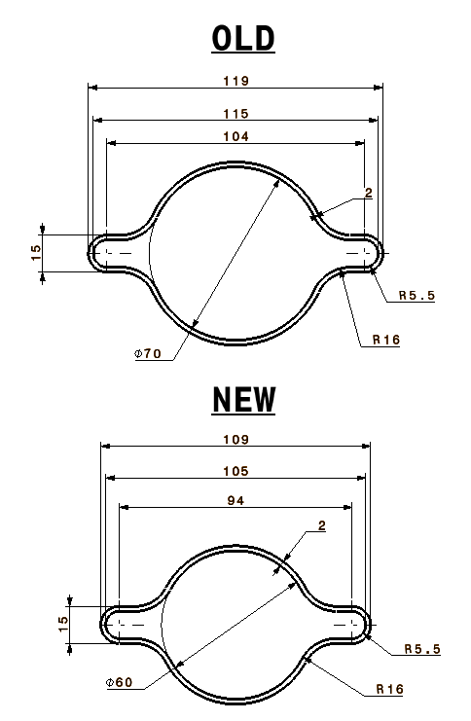
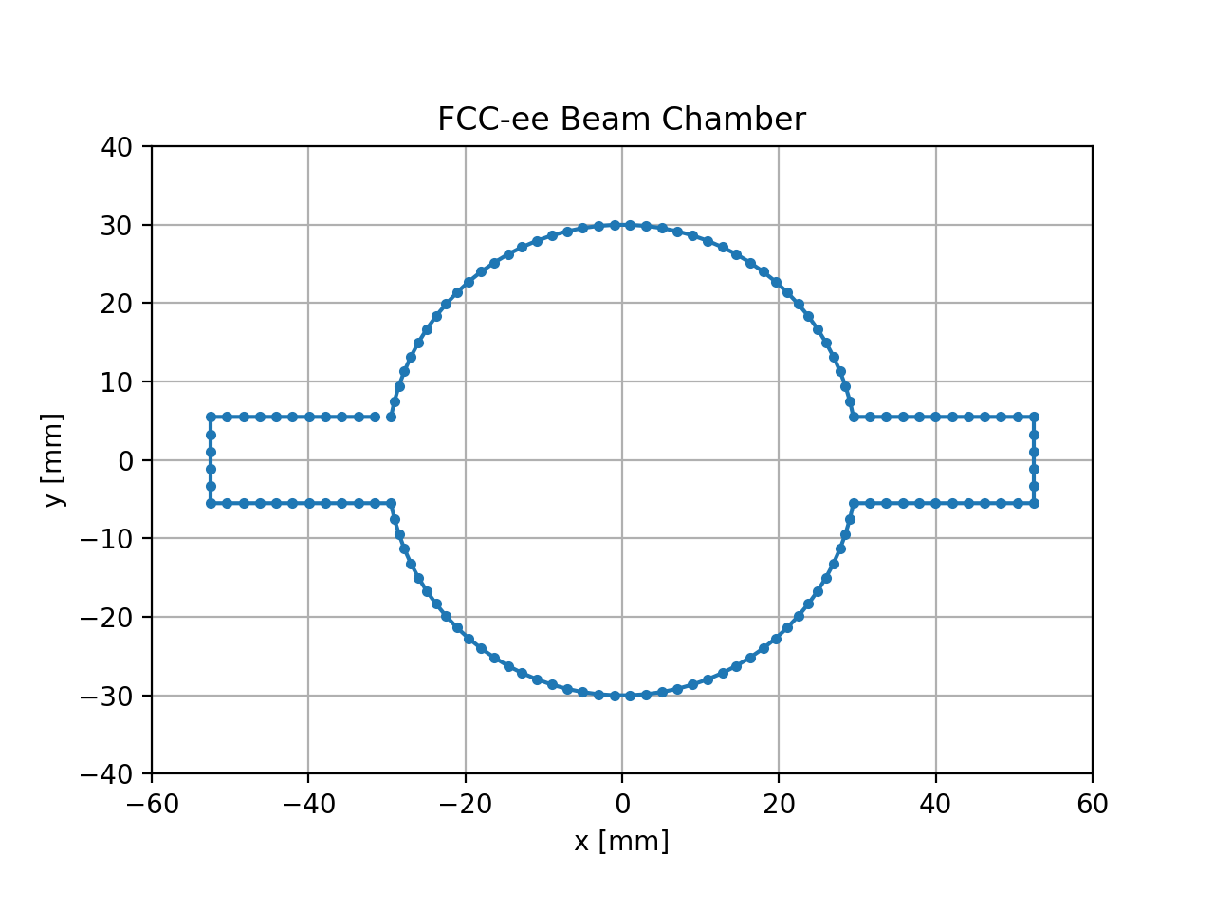
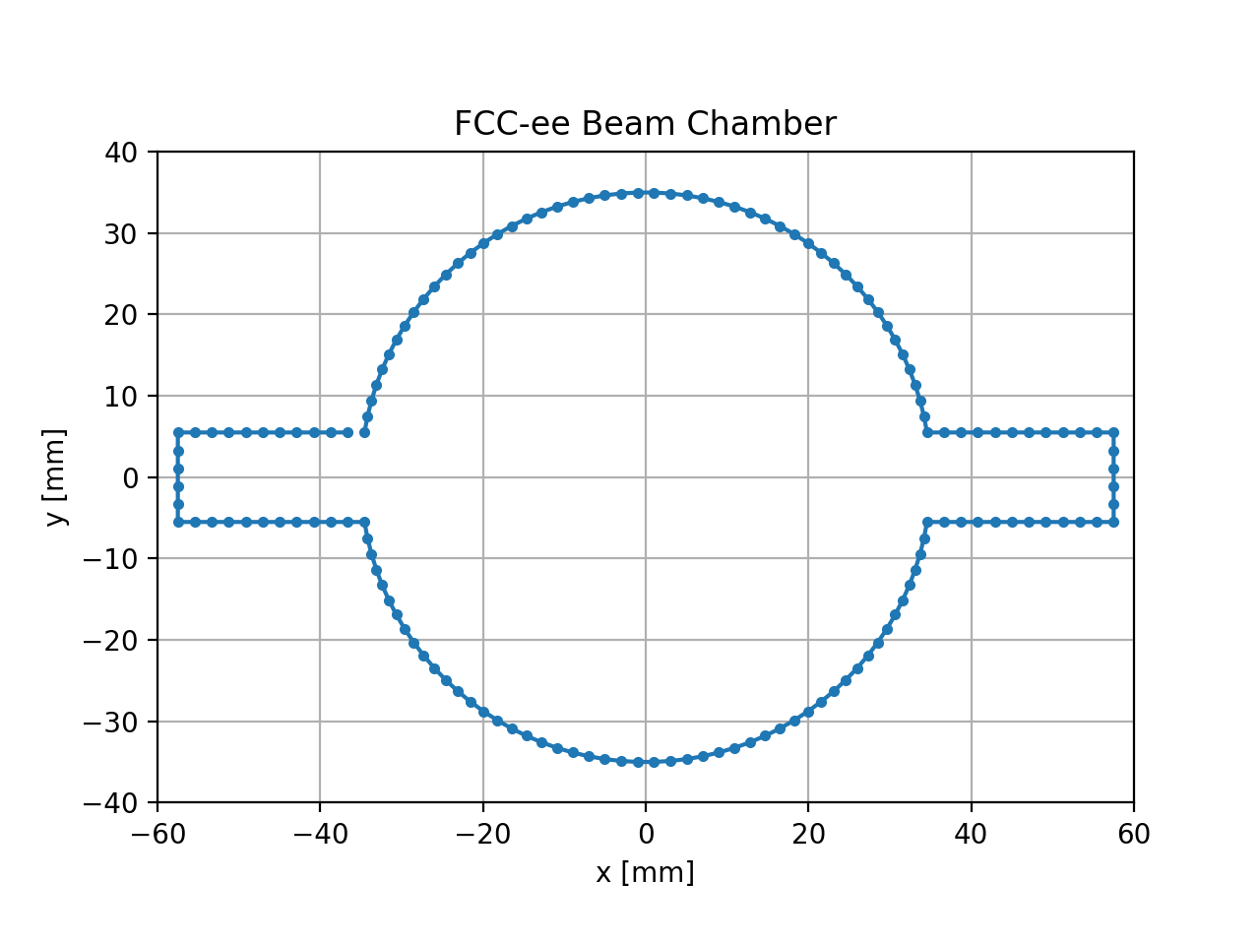
Introduction
New vacuum chamber
Courtesy of R. Kersevan and F. Santangelo
Design in PyECLOUD
Design in PyECLOUD
ABP-CEI Section Meeting 01/06/2023
15/05/2023

Slide 8
Outline
Introduction
E-Cloud Formation Process
Build-up Simulation Results
Stability Simulations
Conclusions and Outlook
ABP-CEI Section Meeting 01/06/2023

Slide 9
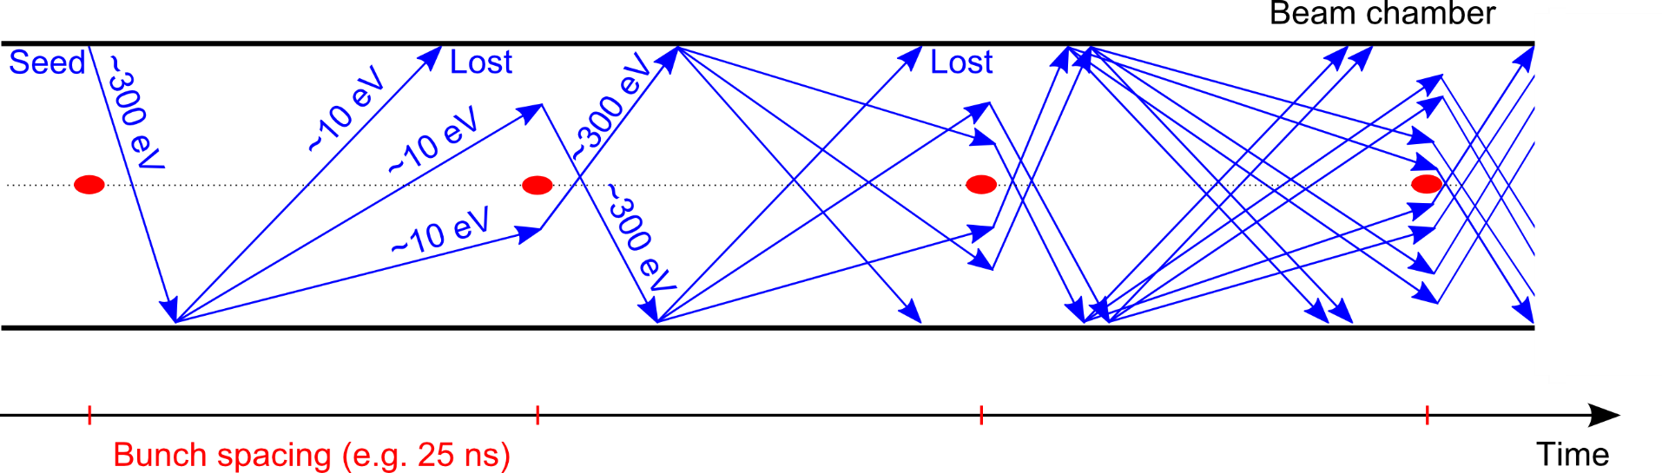
E-Cloud Formation Process
e⁻ is emitted (photoelectric effect)
Secondary Electron Emission can drive an avalanche multiplication effect filling the beam chamber with an electron cloud
Trailing bunches of the train are in a dense electron-cloud
Transverse instabilities
Transverse emittance blow-up
Particle losses
Proton bunch
Secondary Electron Emission
e-cloud induces other unwanted effects like:
Heat load on the beam chambers
Vacuum degradation
Affects mainly machine operating with positively charged particles (p⁺, e⁺, positive ions…)
Courtesy of
G. Iadarola
ABP-CEI Section Meeting 01/06/2023

Slide 10
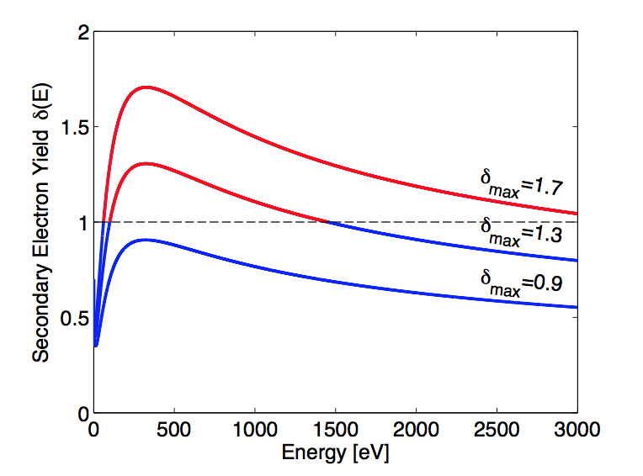
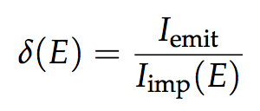
E-Cloud Formation Process
The chamber geometry influences e- acceleration and time of flight
Surface properties have a primary role in the e- multiplication process
The main quantity involved is the Secondary Electron Yield (SEY):
The SEY is the ratio between emitted and impacting electron current as a function of the energy of the impinging electrons
It depends on surface chemical properties
Courtesy of
G. Iadarola
it depends on the history of the surface, in particular on accumulated electron dose -> to a certain extent the e-cloud cures itself (beam induced scrubbing)
ABP-CEI Section Meeting 01/06/2023

Slide 11
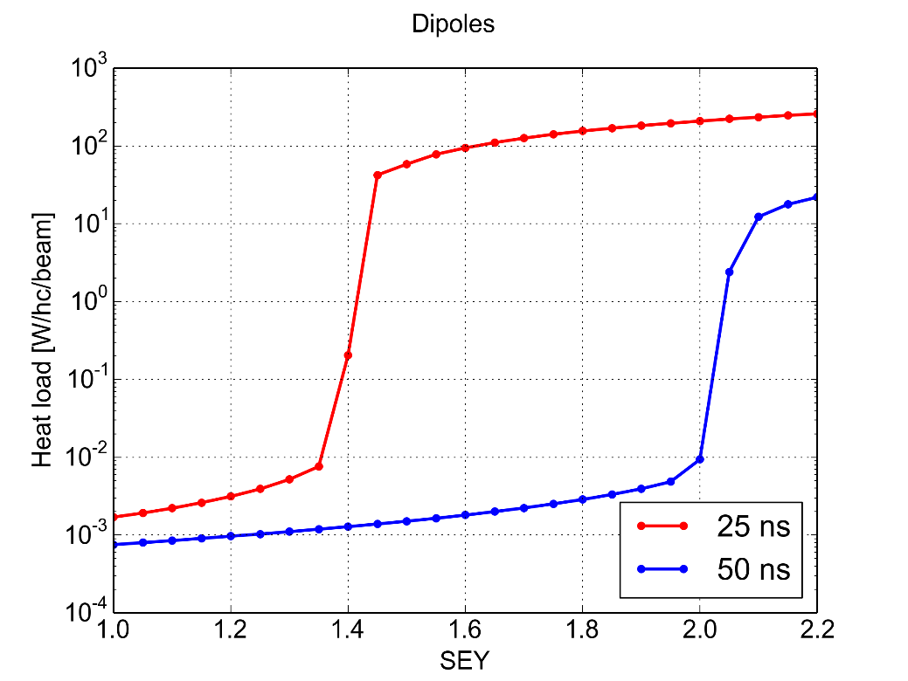
E-Cloud Formation Process
A key ingredient is the bunch spacing:
It determines how many electrons survive between consecutive bunch passages
Significant impact on multipacting threshold, i.e. SEY above which avalanche multiplication (multipacting) is triggered
Bunch intensity and bunch length also have an important effect as they affect the acceleration received by the electrons
PyECLOUD simulations – LHC arc dipole
Courtesy of
G. Iadarola
Multipacting
Multipact.
Accumulation of primary e⁻
Accumulation of primary e⁻
Maximum Secondary Electron Yield (δ_{max})
ABP-CEI Section Meeting 01/06/2023

Slide 12
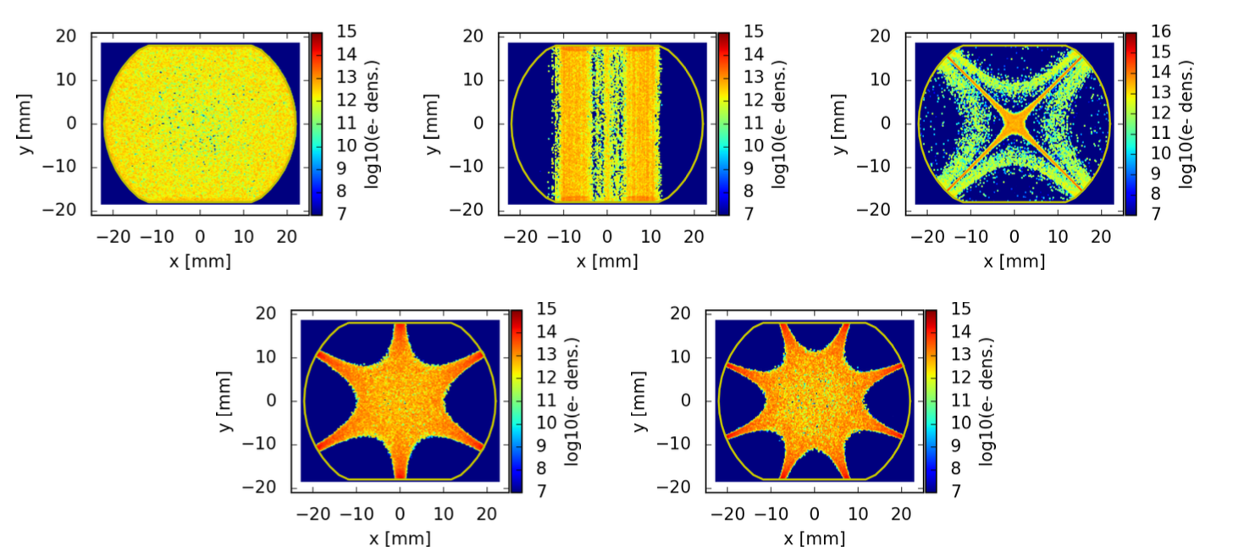
E-Cloud Formation Process
Electron trajectories are strongly influenced by externally applied magnetic fields (Electrons spin around the field lines)
e-cloud distribution in the LHC arc magnets
Courtesy of
P. Dijkstal
ABP-CEI Section Meeting 01/06/2023

Slide 13
Outline
Introduction
E-Cloud Formation Process
Build-up Simulation Results
Parameter Overview
Summary Previous Results
Results for New Parameters
Stability Simulations
Conclusions and Outlook
ABP-CEI Section Meeting 01/06/2023

Slide 14
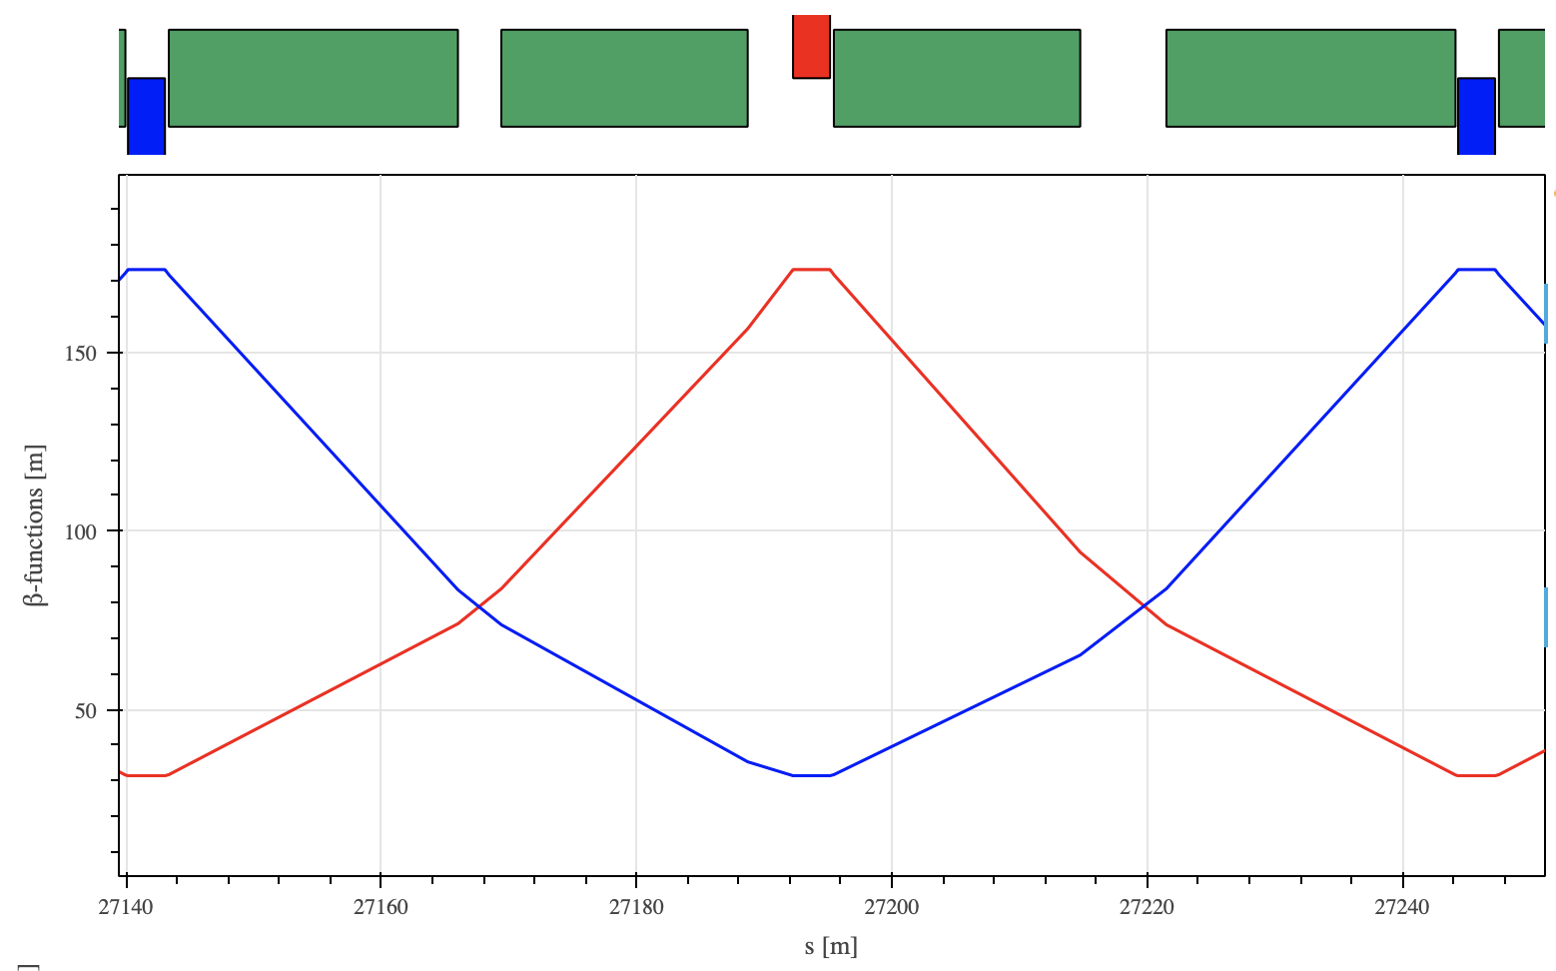
Simulation Results: Parameter Overview
Element:
Drift space
Quadrupole (5.65 T/m)
focusing
defocusing
Dipole (1.415 mT)
close to focusing quadrupole
close to defocusing quadrupole
The version V22.2 has been used
[] https://acc-models.web.cern.ch/acc-models/fcc/fccee/V22.2/z/
Defocusing
quadrupole
Focusing
quadrupole
Defocusing
quadrupole
Drift space
Drift space
Dipole
Dipole
Dipole
Dipole
β_{y}
β_{x}
ABP-CEI Section Meeting 01/06/2023

Slide 15
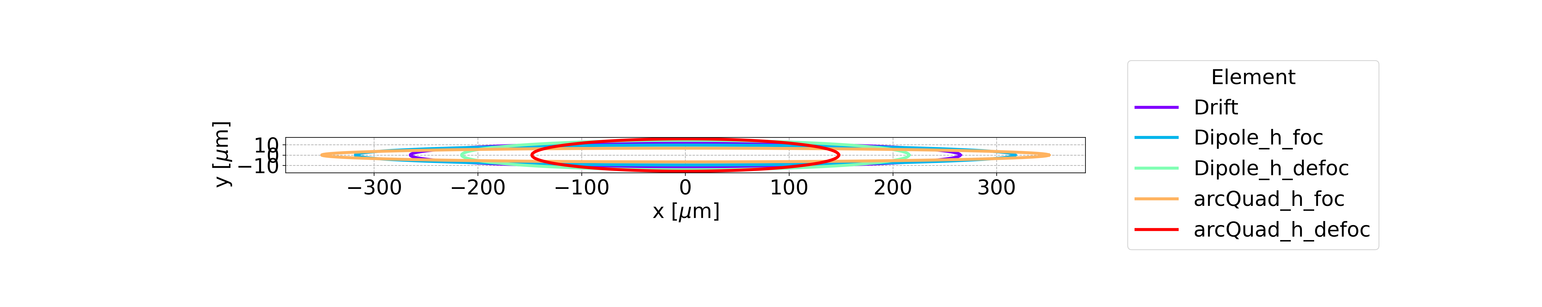
Simulation Results: Parameter Overview
Element:
Drift space
Quadrupole (5.65 T/m)
focusing
defocusing
Dipole (1.415 mT)
close to focusing quadrupole
close to defocusing quadrupole
Drift space
Dipole close to foc quad
Dipole close to defoc quad
Focusing quadrupole
Defocusing quadrupole
ε_{g,x} = 0.71 nm
ε_{g,y} = 1.42 pm
ABP-CEI Section Meeting 01/06/2023

Slide 16
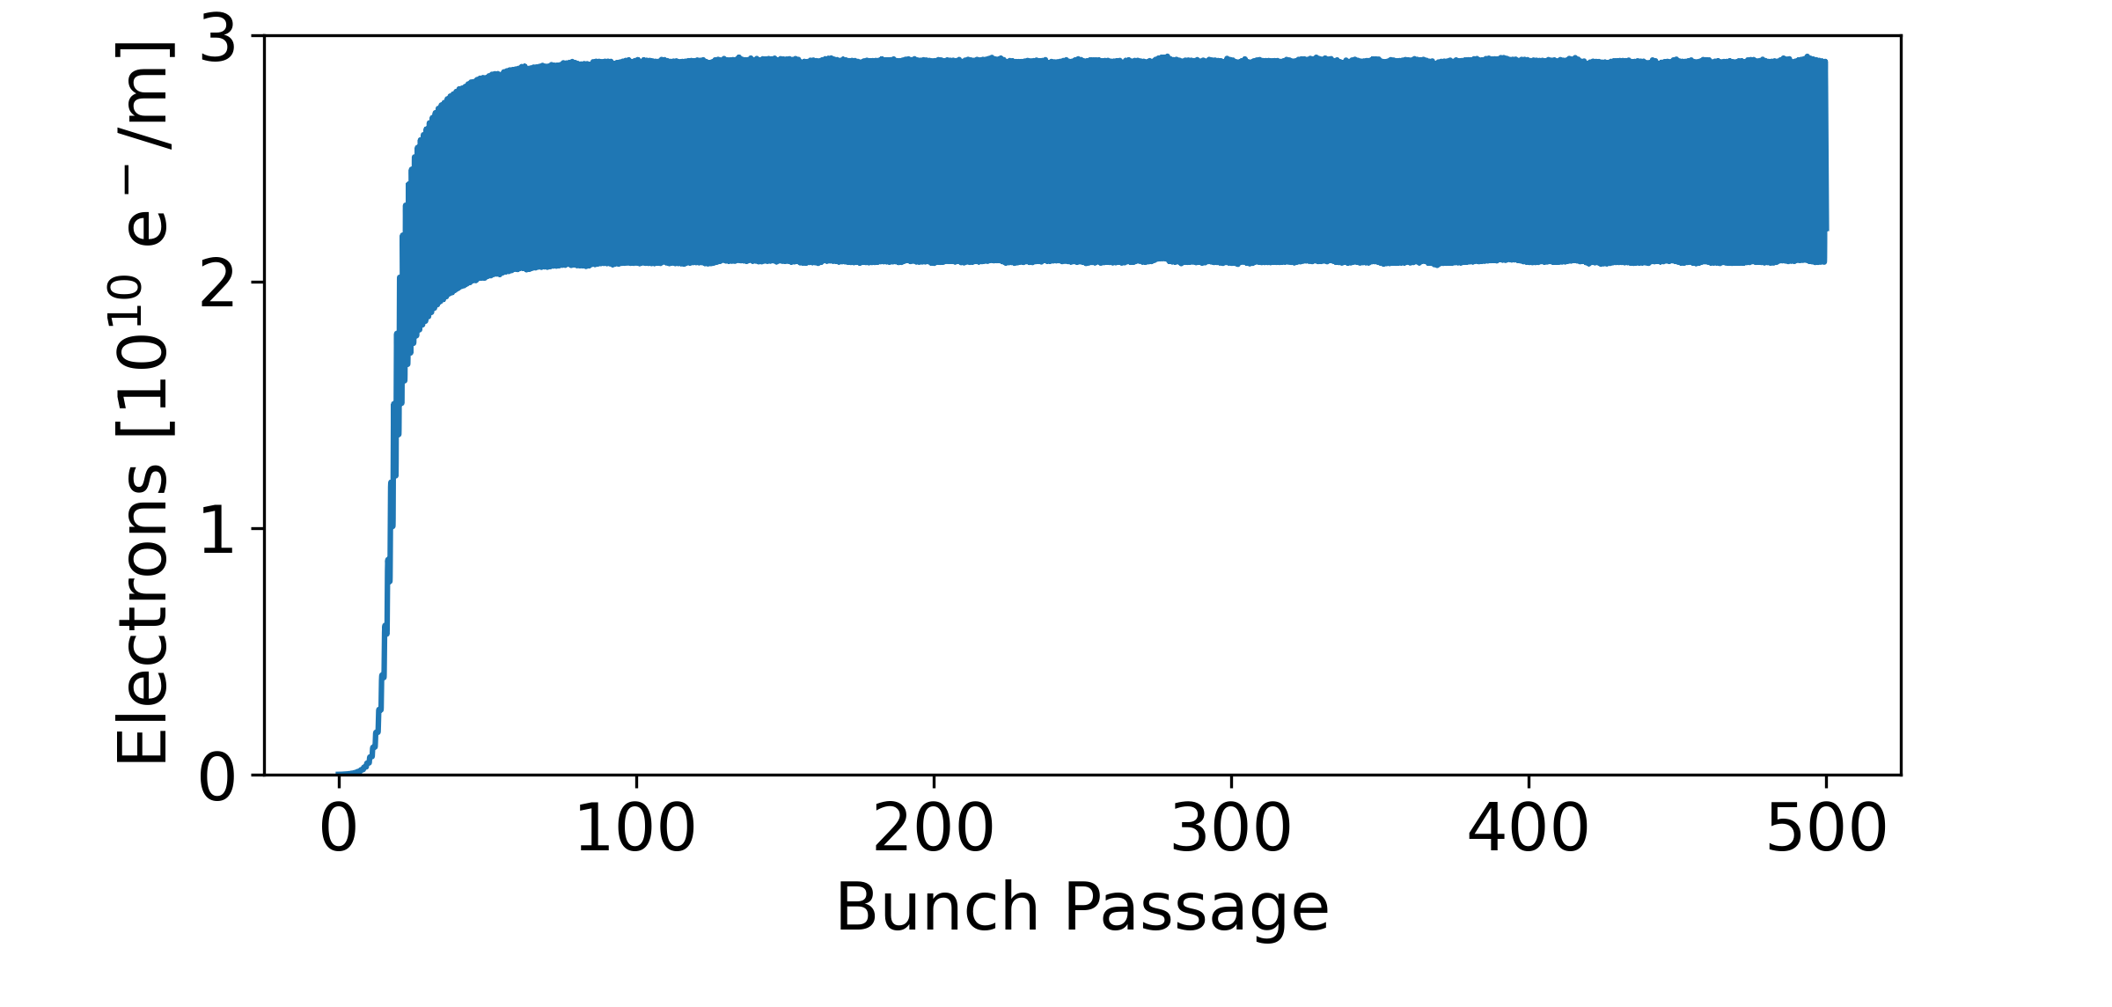
Simulation Results: Parameter Overview
For the summary plots
The parameter is divided by the transverse surface of the vacuum chamber in order to do the comparison with different vacuum chambers
Parameter
ABP-CEI Section Meeting 01/06/2023

Slide 17
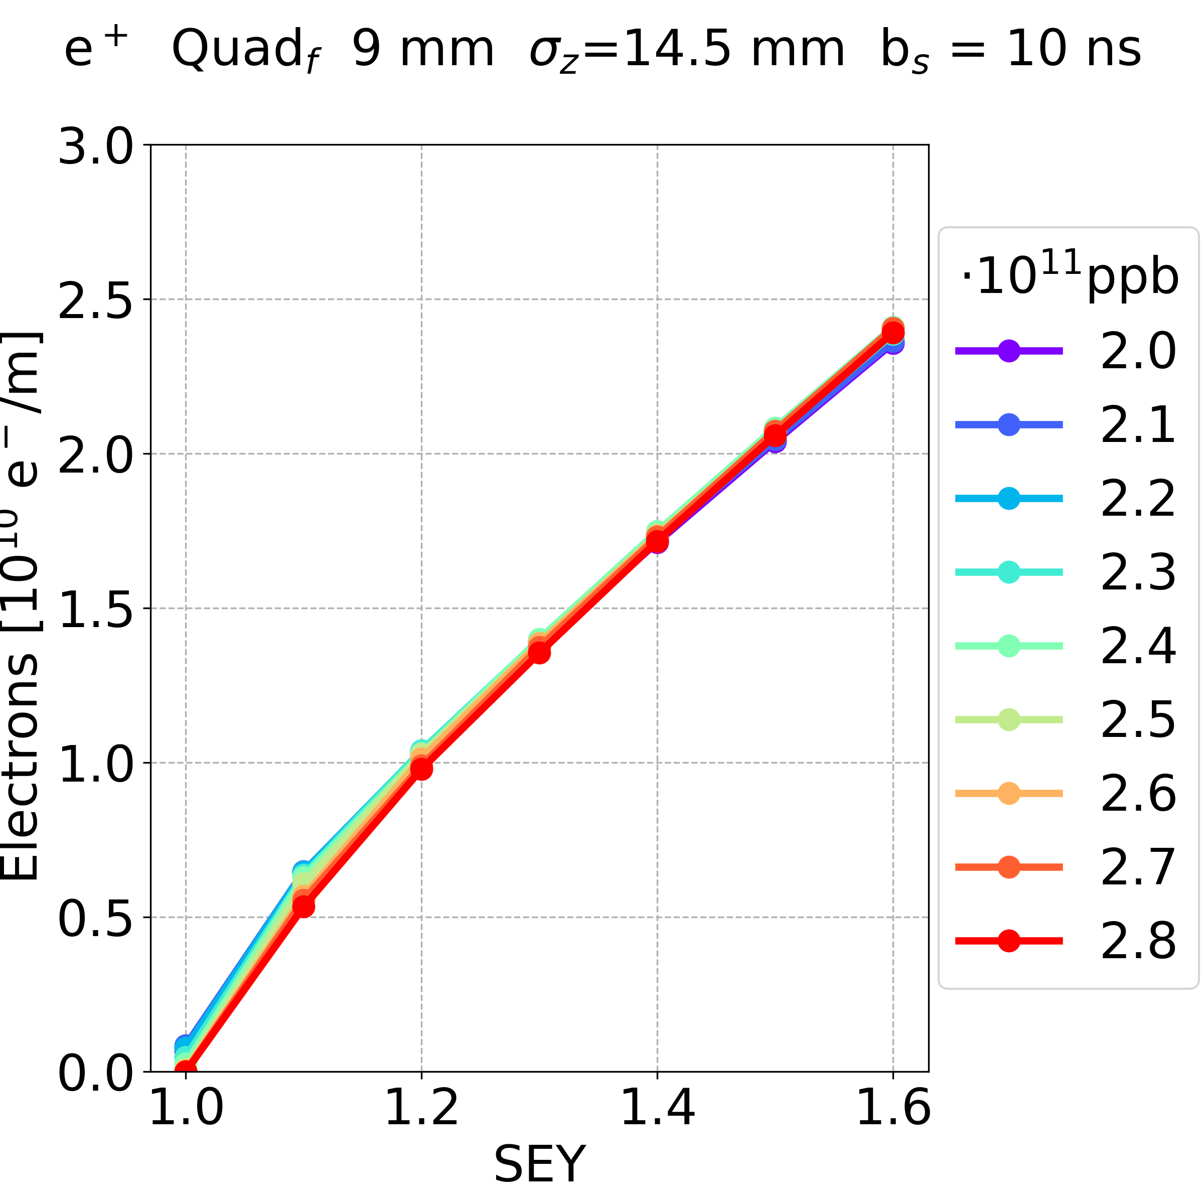

Simulation Results: Summary Previous Results
No dependence on beta functions found in quadrupoles and dipoles
positrons, beam chamber 9 mm, bunch spacing 10 ns
Focusing
Defocusing
For more details: L. Sabato, 20th November 2022, “E-cloud studies in the FCC-ee”, 159th FCC-ee Optics Design Meeting & 30th FCCIS WP2.2 Meeting
ABP-CEI Section Meeting 01/06/2023

Slide 18
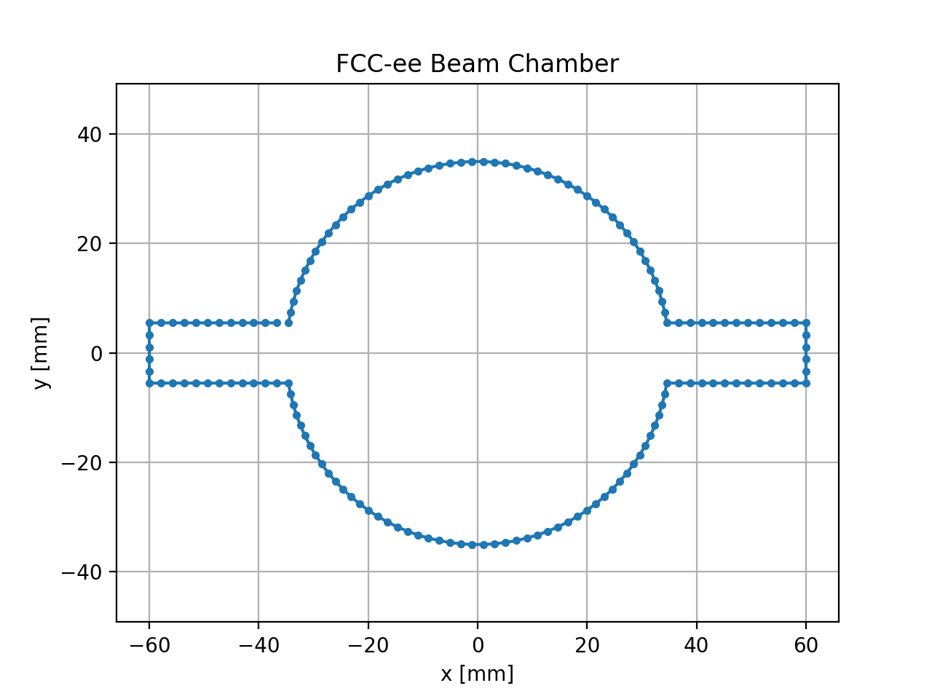
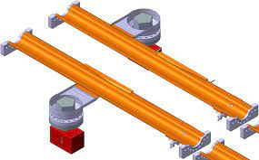
Simulation Results: Summary Previous Results
Beam chamber winglet geometry
a = 9 mm
a = 10 mm
a = 11 mm
Courtesy of
R. Kersevan
Design in PyECLOUD
a
ABP-CEI Section Meeting 01/06/2023

Slide 19
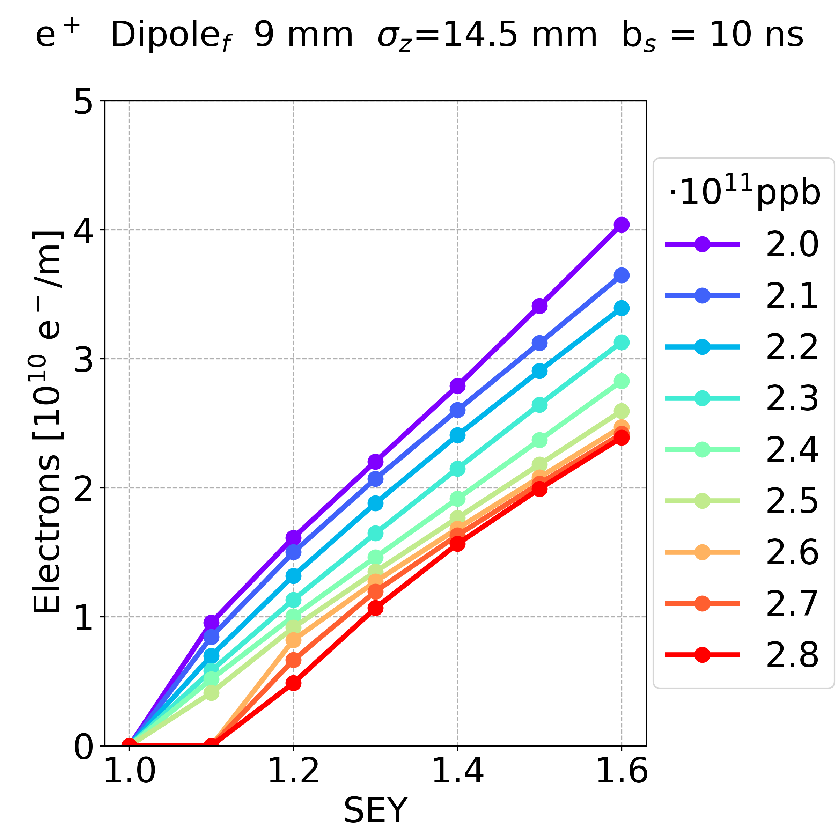

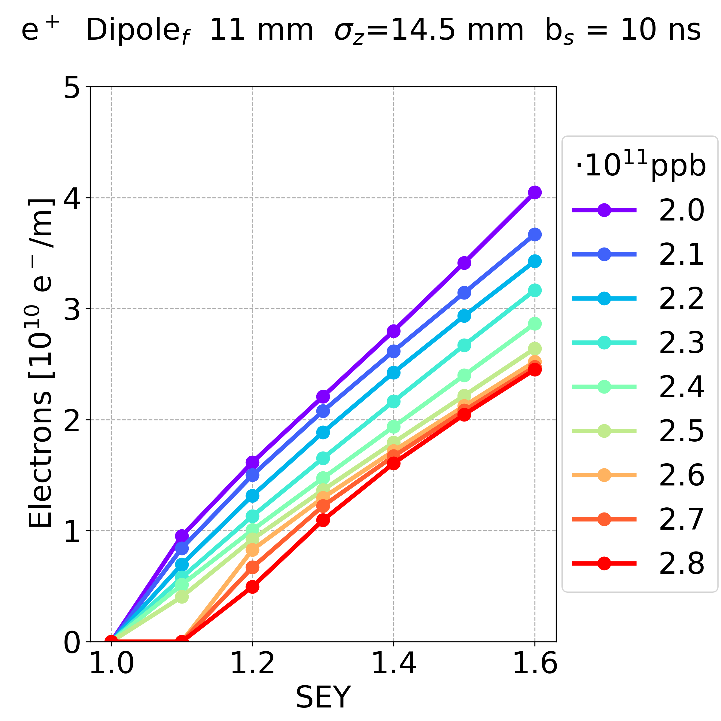
Simulation Results: Summary Previous Results
No dependence on the beam chamber winglet height
positrons, dipole, bunch spacing 10 ns
9 mm
10 mm
11 mm
For more details: L. Sabato, 20th November 2022, “E-cloud studies in the FCC-ee”, 159th FCC-ee Optics Design Meeting & 30th FCCIS WP2.2 Meeting
ABP-CEI Section Meeting 01/06/2023

Slide 20
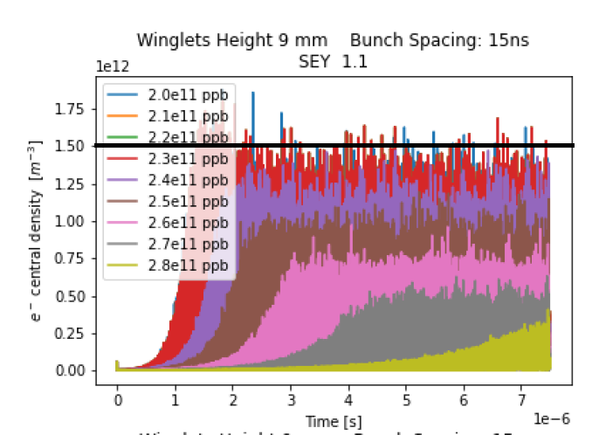
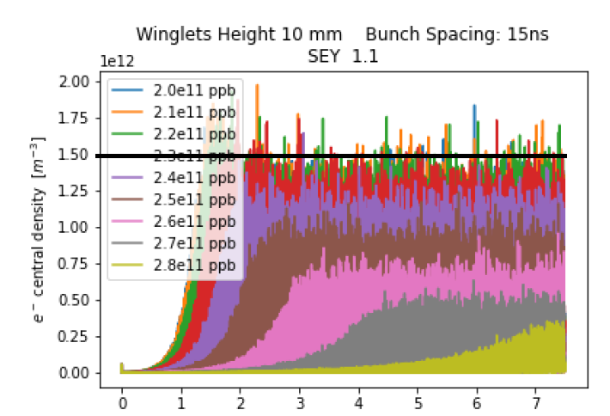
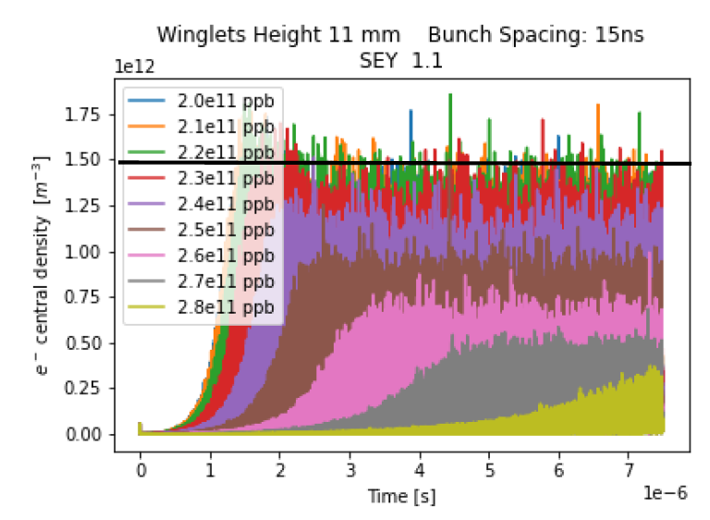
Simulation Results
No dependence on the beam chamber winglet height
Recently confirmed also for the sextupoles (from the studies of H. Maury and K. Cantún, Universidad Autónoma de Yucatán)
9 mm 10 mm 11 mm
Courtesy of H. Maury and K. Cantún
ABP-CEI Section Meeting 01/06/2023

Slide 21
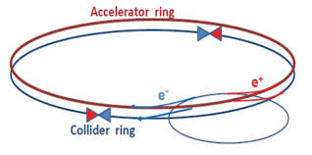
Simulation Results: Summary Previous Results
Particles: positron, electron
ABP-CEI Section Meeting 01/06/2023

Slide 22
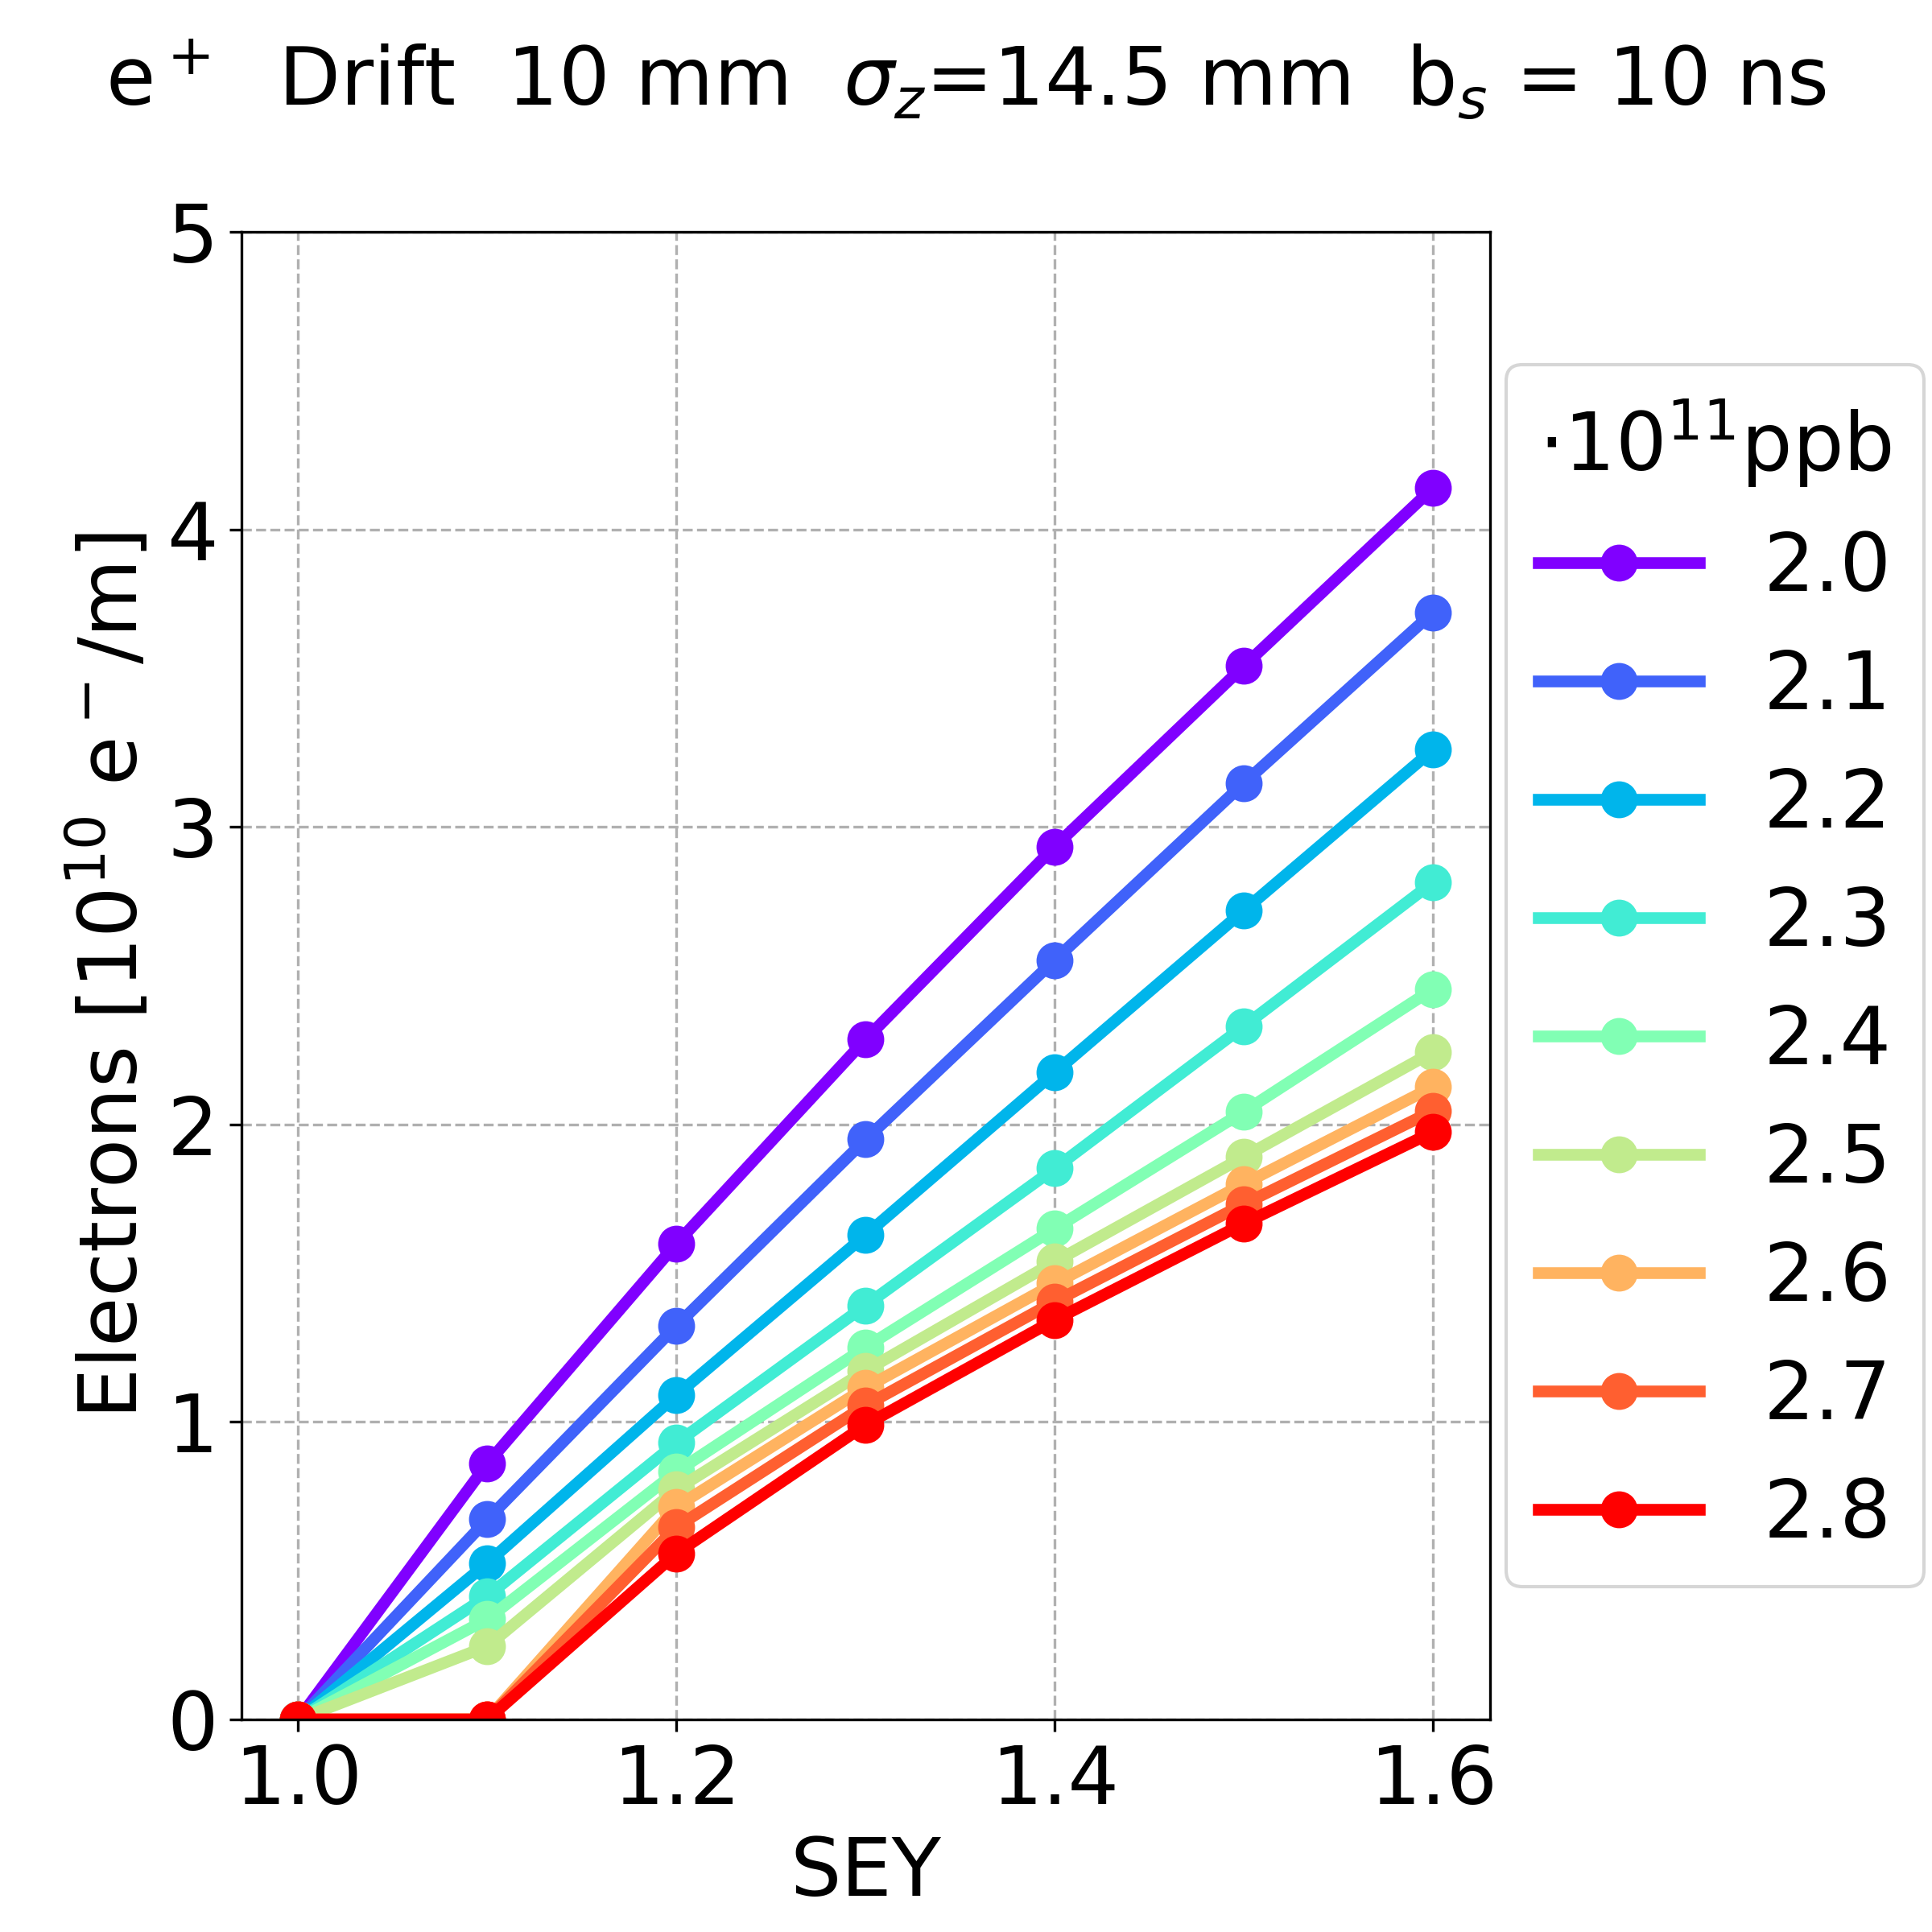
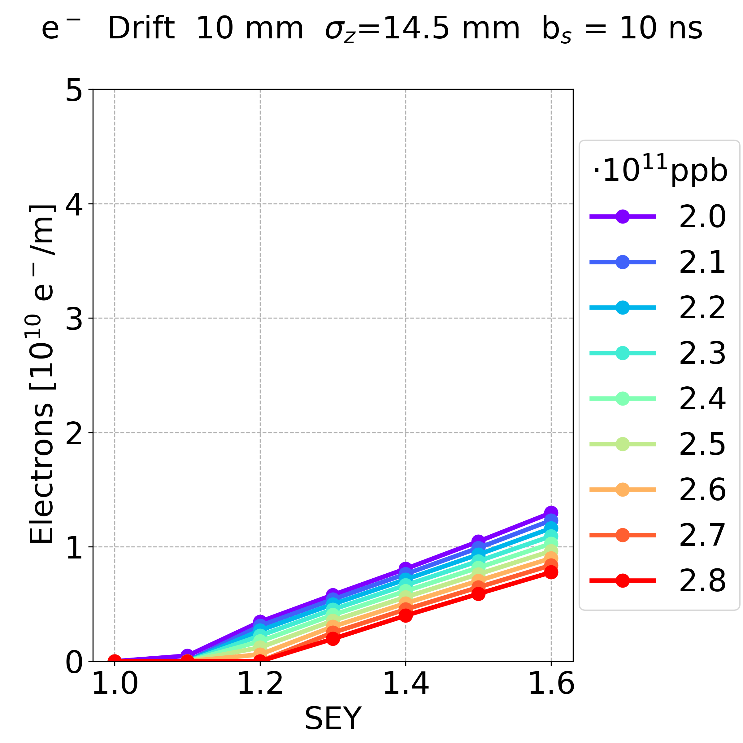
Simulation Results: Summary Previous Results
Dependence on the bunch charge
Drift space, bunch spacing 10 ns
Central density?
Positron Bunches
Electron Bunches
In the case of electron bunches, the e-cloud density is smaller
Multipacting occurs in a few cases
For more details: L. Sabato, 20th November 2022, “E-cloud studies in the FCC-ee”, 159th FCC-ee Optics Design Meeting & 30th FCCIS WP2.2 Meeting
ABP-CEI Section Meeting 01/06/2023

Slide 23
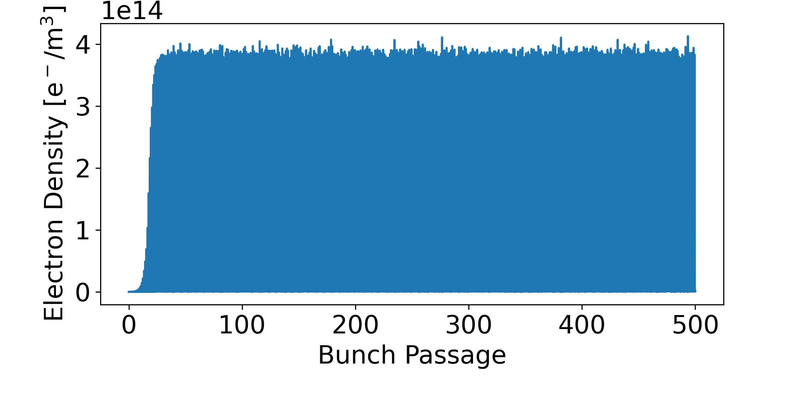
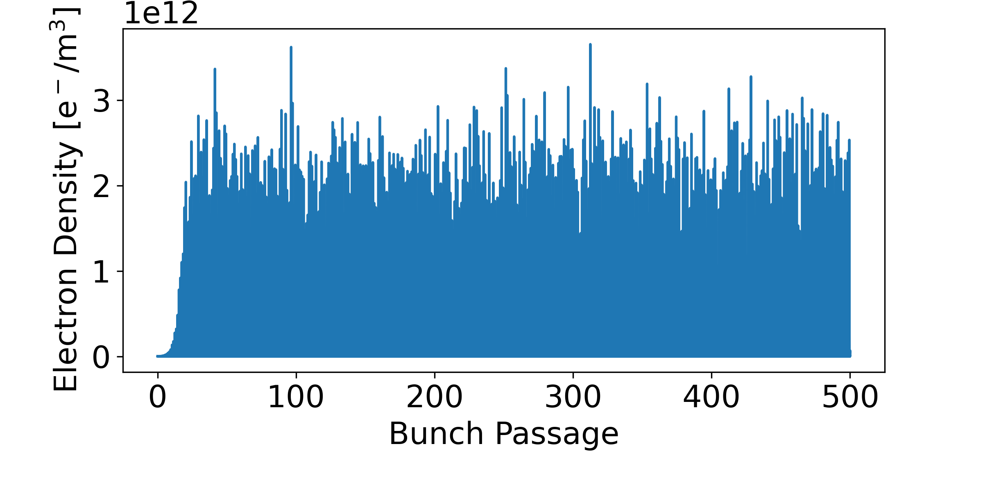
Simulation Results: Summary Previous Results
Dependence on the bunch charge:
(Drift space, bunch spacing 10 ns, bunch intensity 2.0e11 ppb, SEY 1.6)
Positron Bunches Electron Bunches
In the case of electron bunches, the electrons are mainly located far from the beam chamber centre
For more details: L. Sabato, 20th November 2022, “E-cloud studies in the FCC-ee”, 159th FCC-ee Optics Design Meeting & 30th FCCIS WP2.2 Meeting
ABP-CEI Section Meeting 01/06/2023

Slide 24
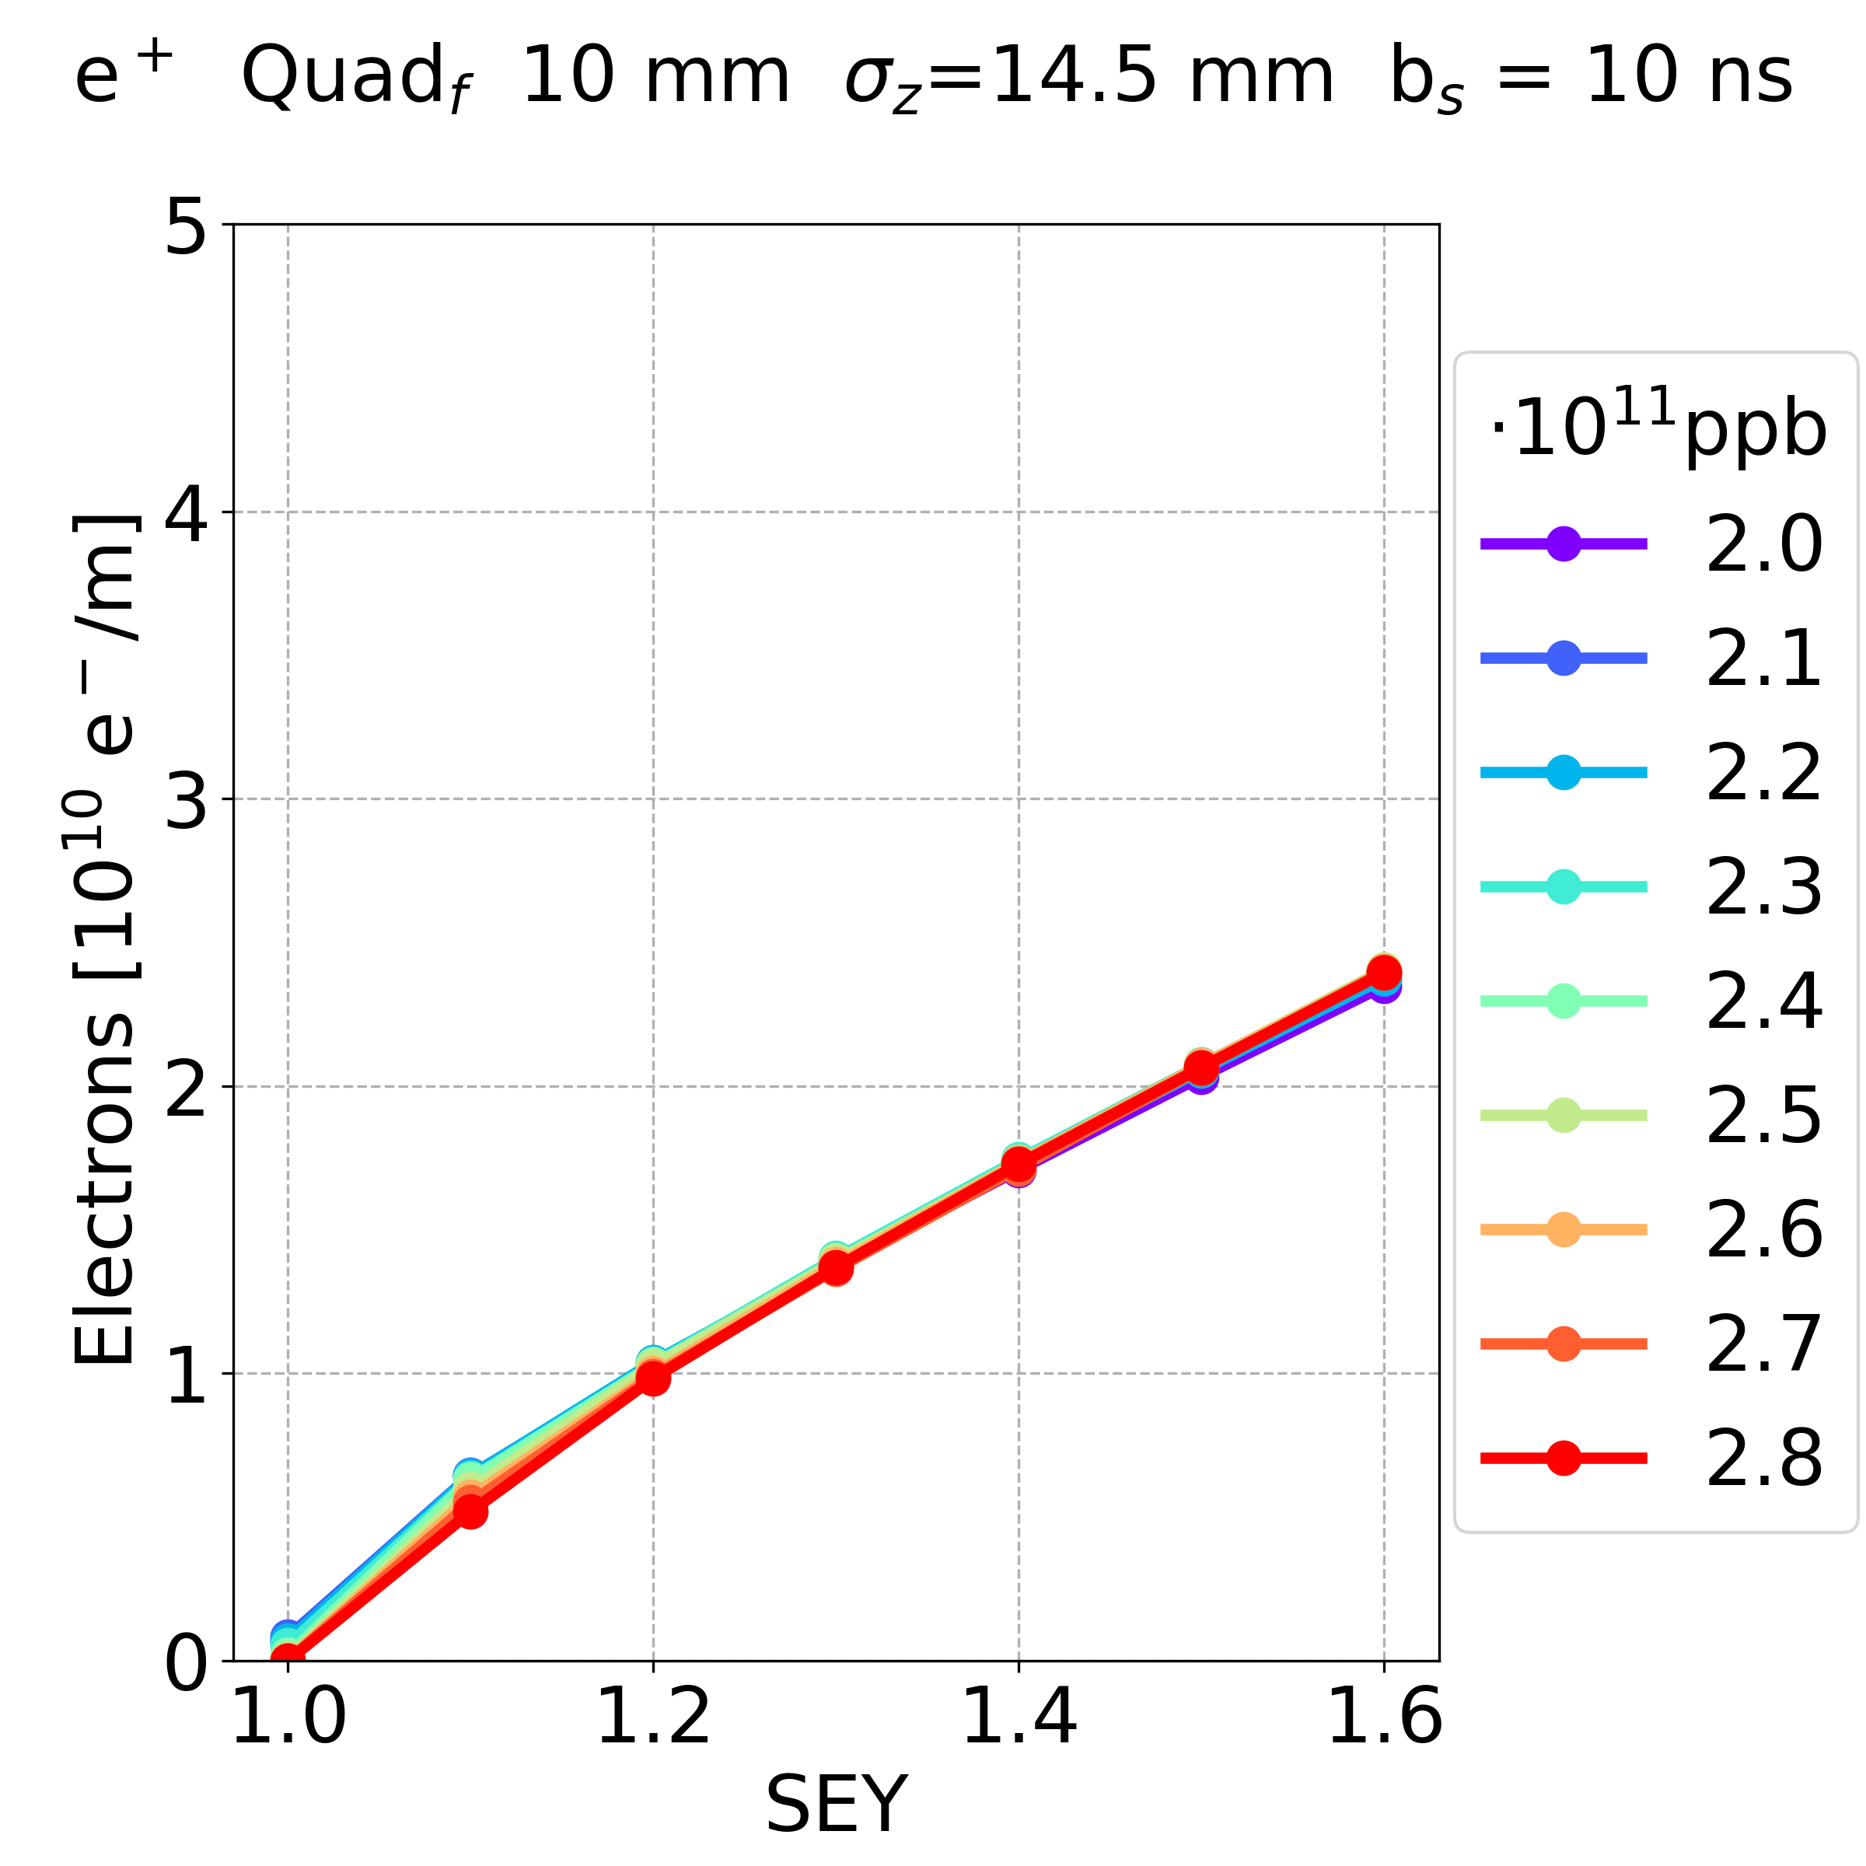
Simulation Results: Summary Previous Results
Dependence on the bunch intensity
positrons, bunch spacing 10 ns
Drift space
Dipole
Quadrupole
In the drift space and dipole, the electron density has a similar behaviour with respect to the bunch intensity
less bunch intensity more electron density
In the quadrupole,
the bunch intensity has a negligible effect on the electron density
For more details: L. Sabato, 20th November 2022, “E-cloud studies in the FCC-ee”, 159th FCC-ee Optics Design Meeting & 30th FCCIS WP2.2 Meeting
ABP-CEI Section Meeting 01/06/2023

Slide 25
Simulation Results: New Parameters
Element: Drift space, Dipole, Quadrupole
Bunch spacing: 15 – 25 ns (step 5 ns)
Bunch intensity: 0.8 – 2.0e11 (step 0.2e11)
SEY: 1.0 – 1.6 (step 0.1)
Bunch Length: 11.8 mm
Total: 441 simulations
ABP-CEI Section Meeting 01/06/2023

Slide 26
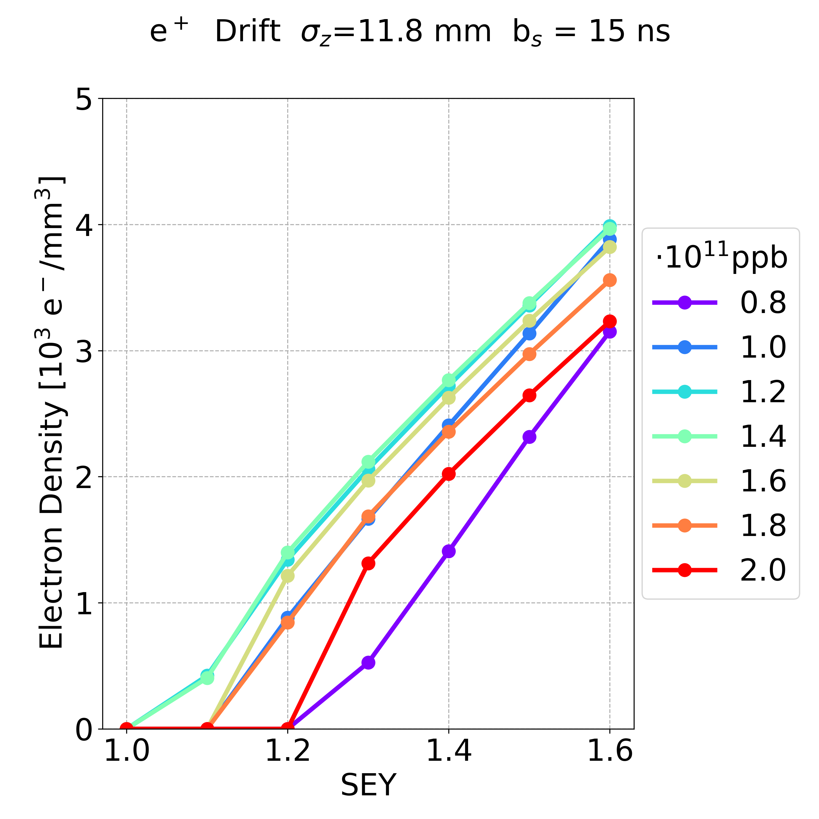
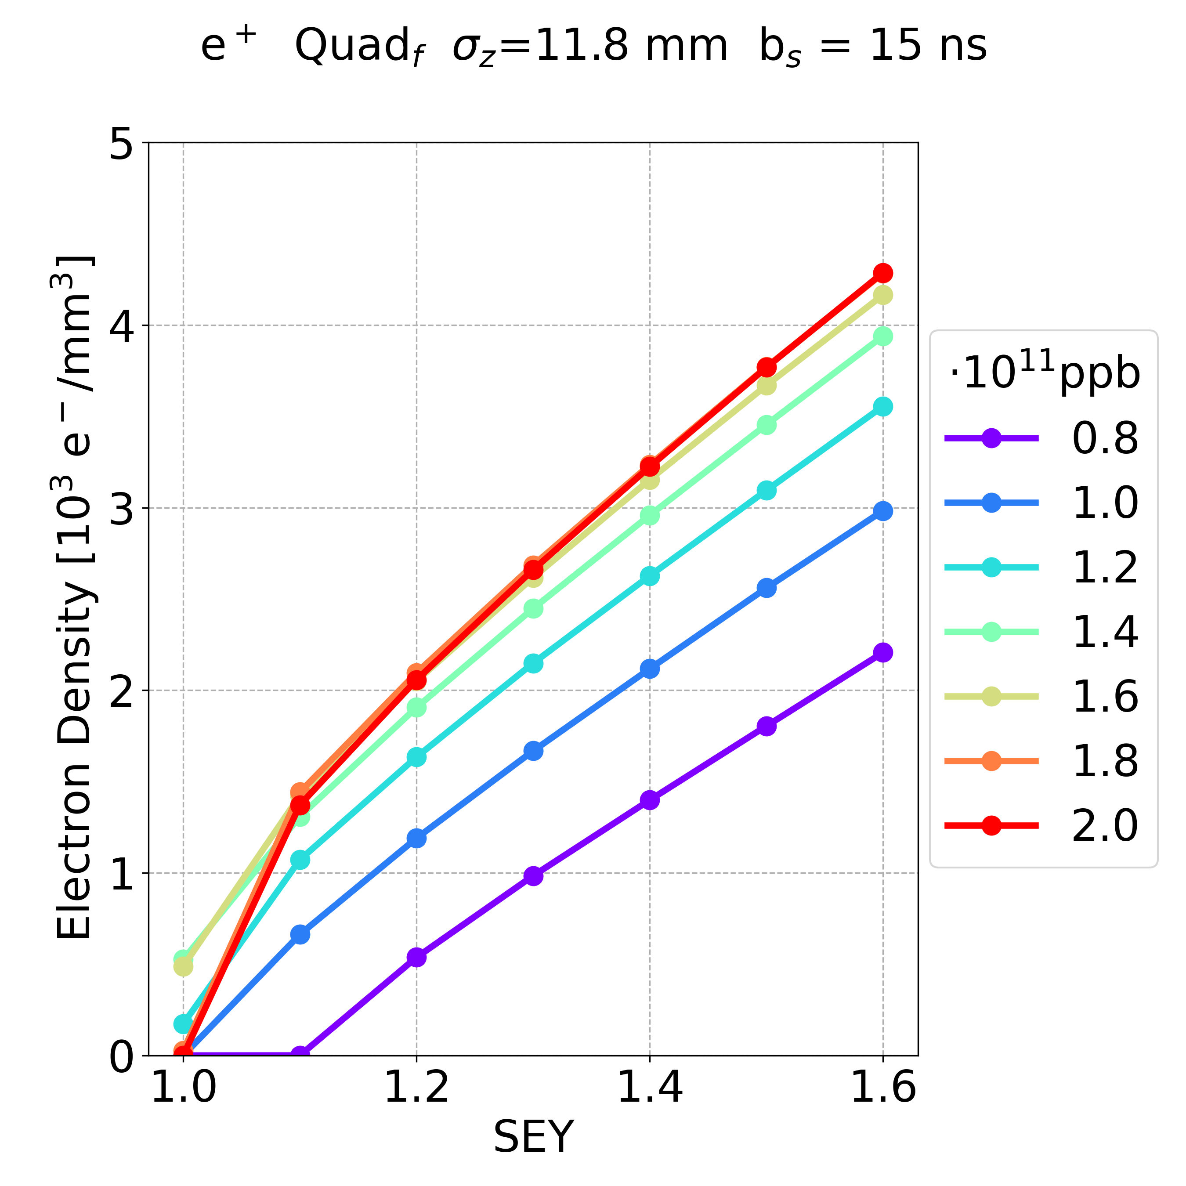
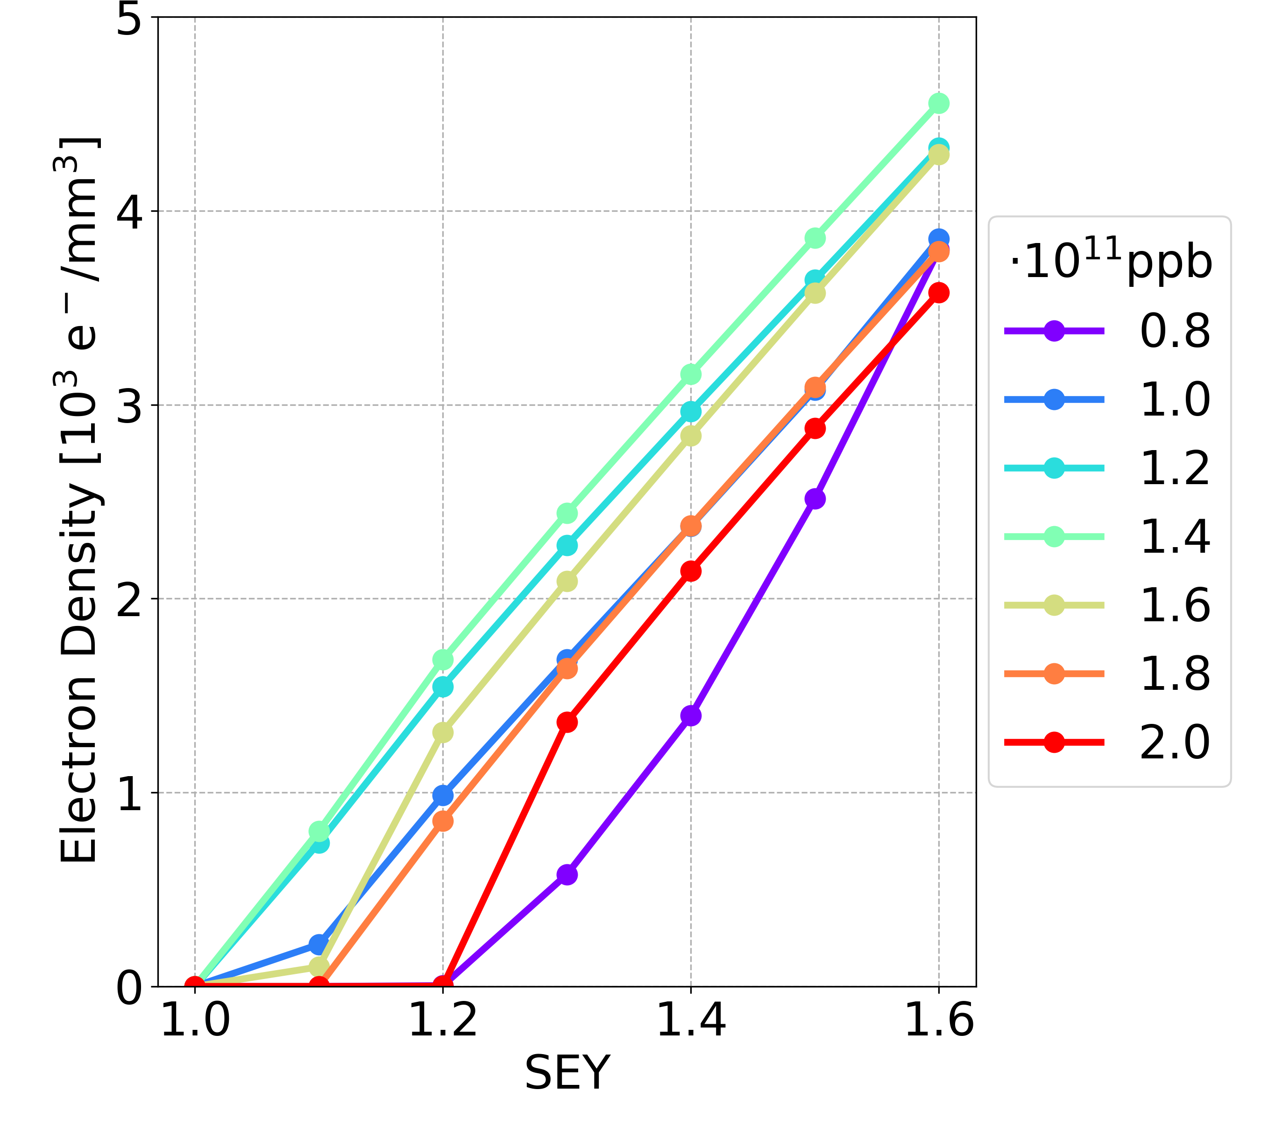
Simulation Results: New Parameters
bunch spacing 15 ns, longer bunch length
Drift space
Dipole
Quadrupole
In the drift space and dipole, the electron density has a similar behaviour with respect to the bunch intensity
the dependence on the bunch is not monotonic
In the quadrupole,
the bunch intensity has a non-negligible effect on the electron density
less bunch intensity less electron density
ABP-CEI Section Meeting 01/06/2023

Slide 27
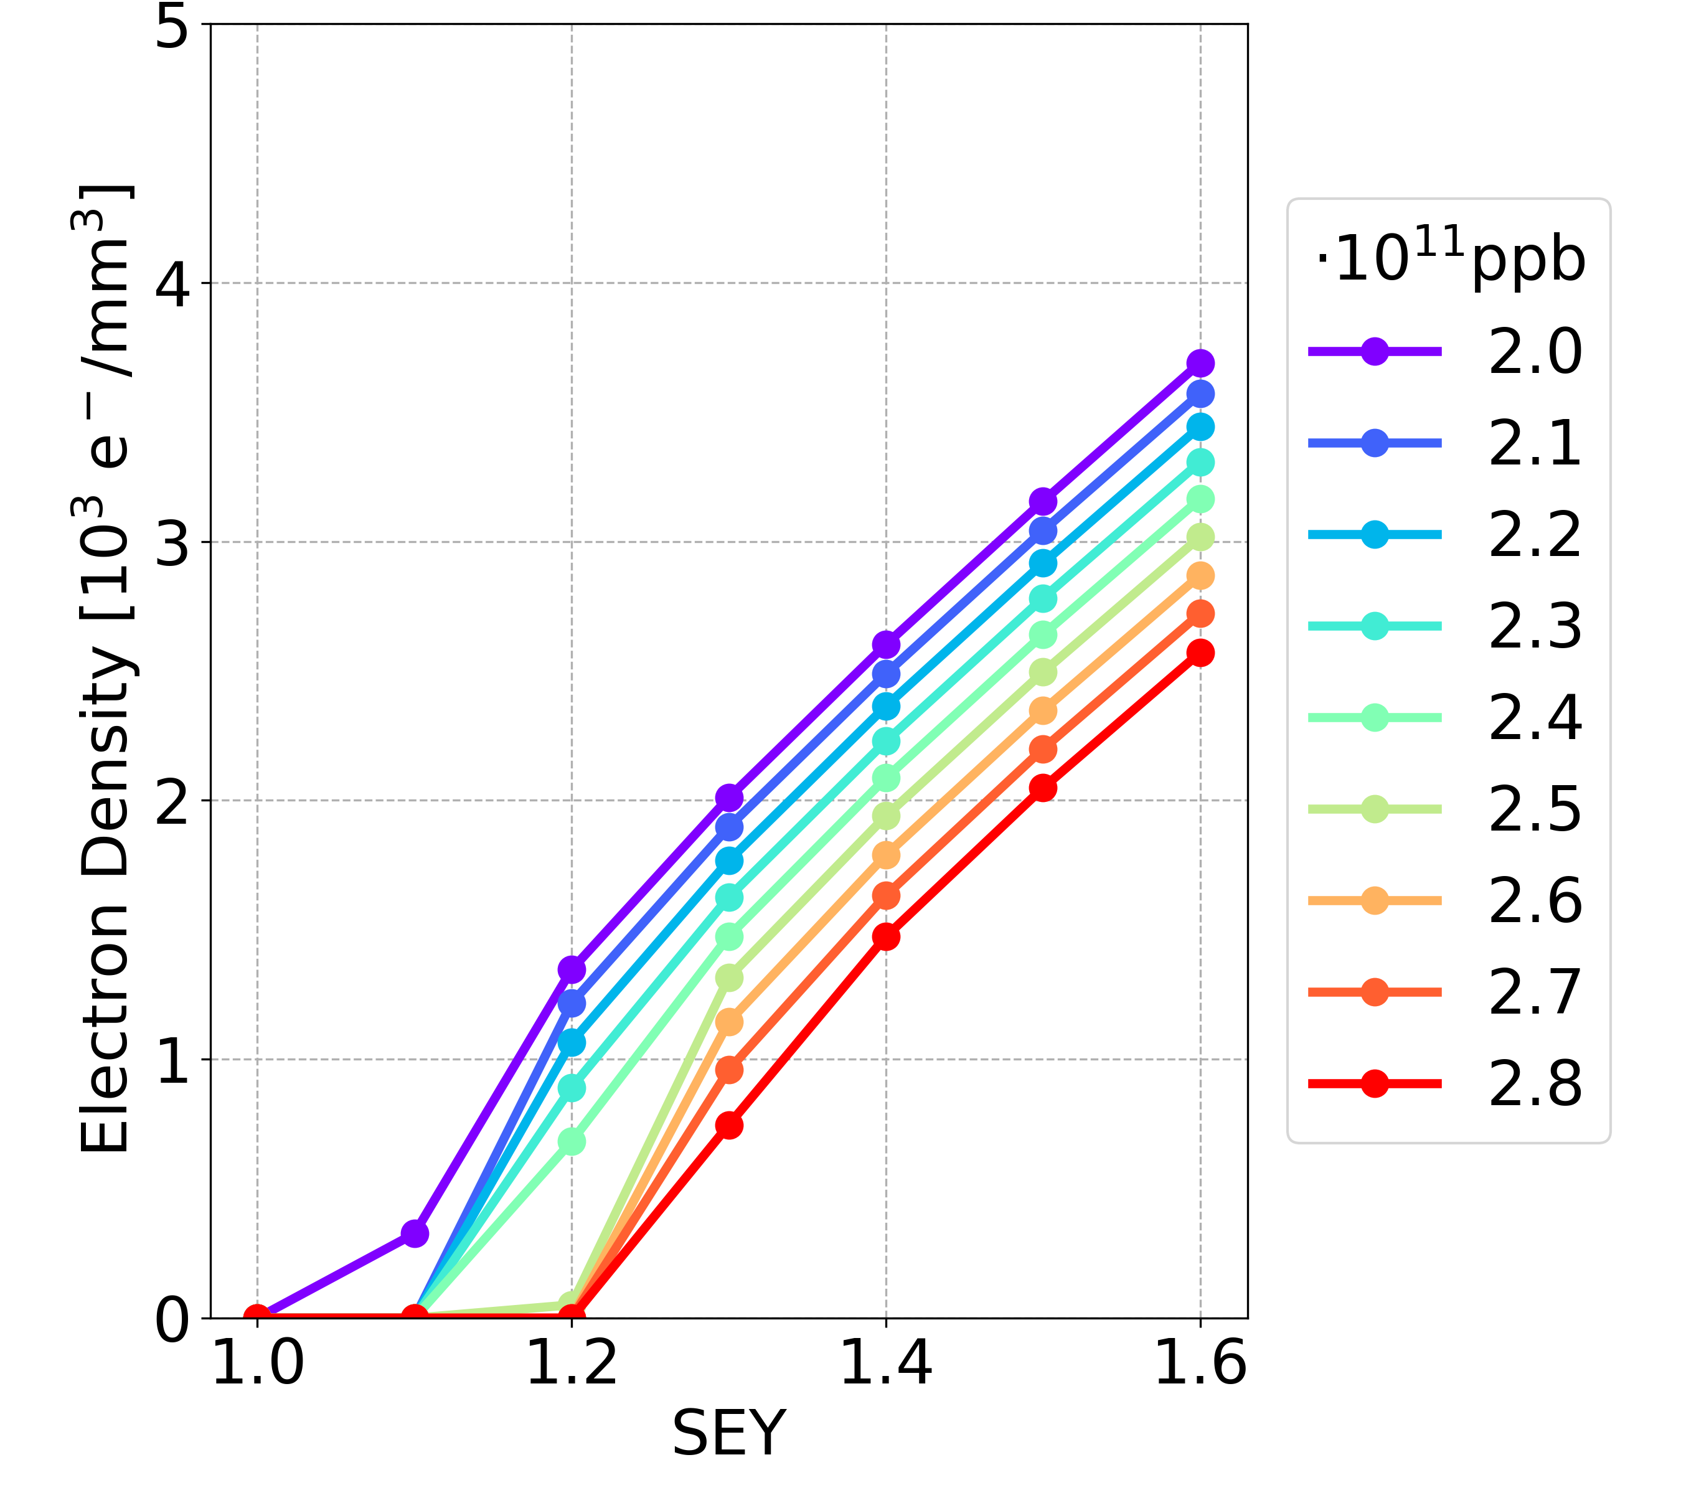
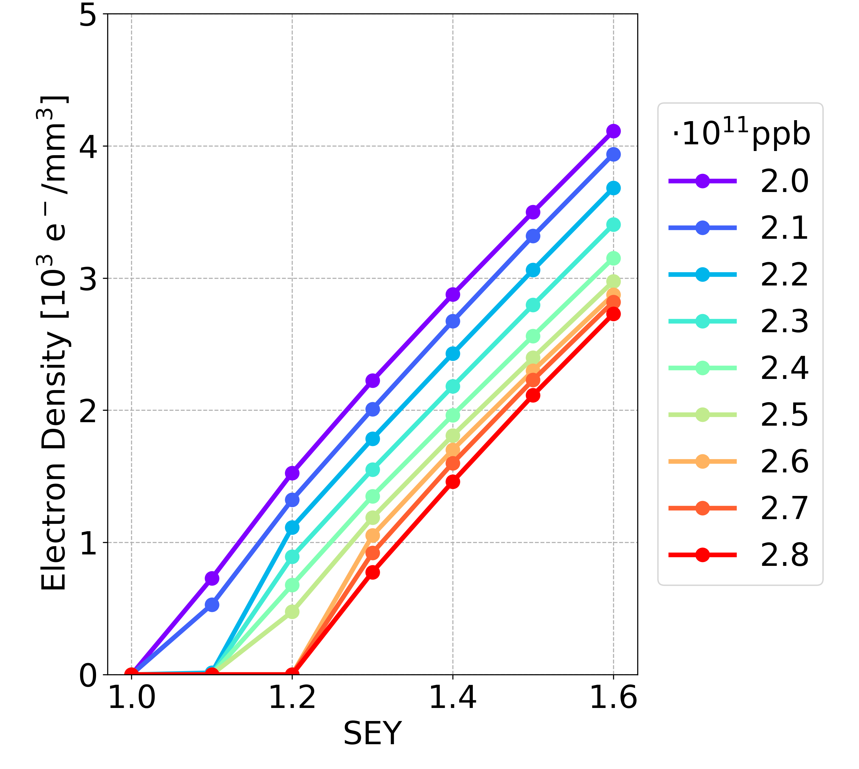
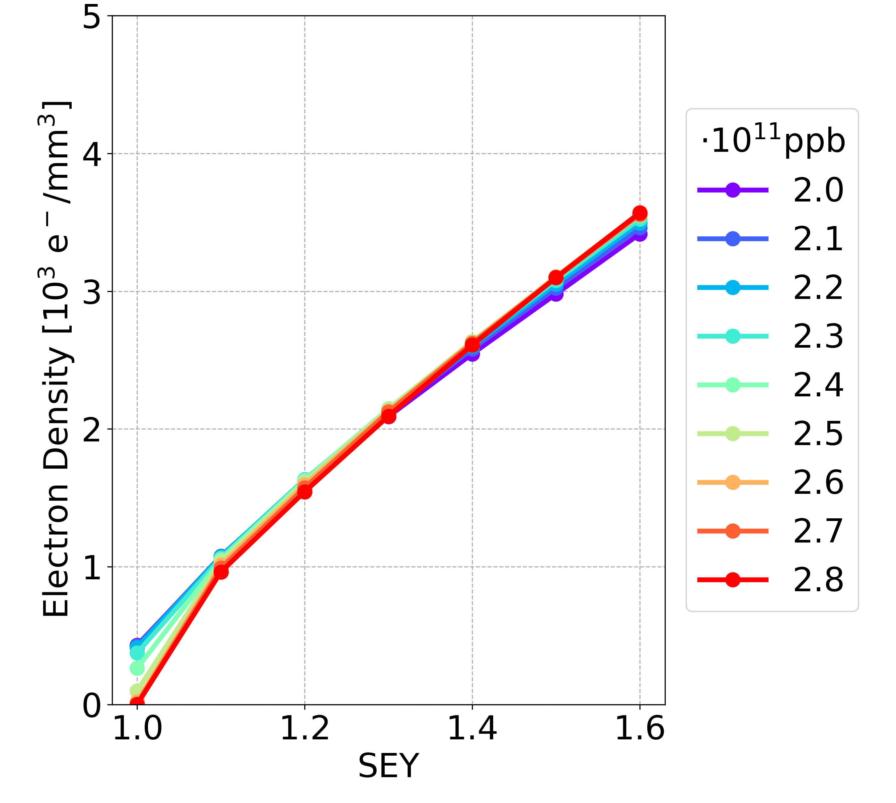
Simulation Results: New Parameters
Bunch spacing 15 ns, longer bunch length
Drift space
Dipole
Quadrupole
NEW
Drift space
Dipole
Quadrupole
OLD

Slide 28
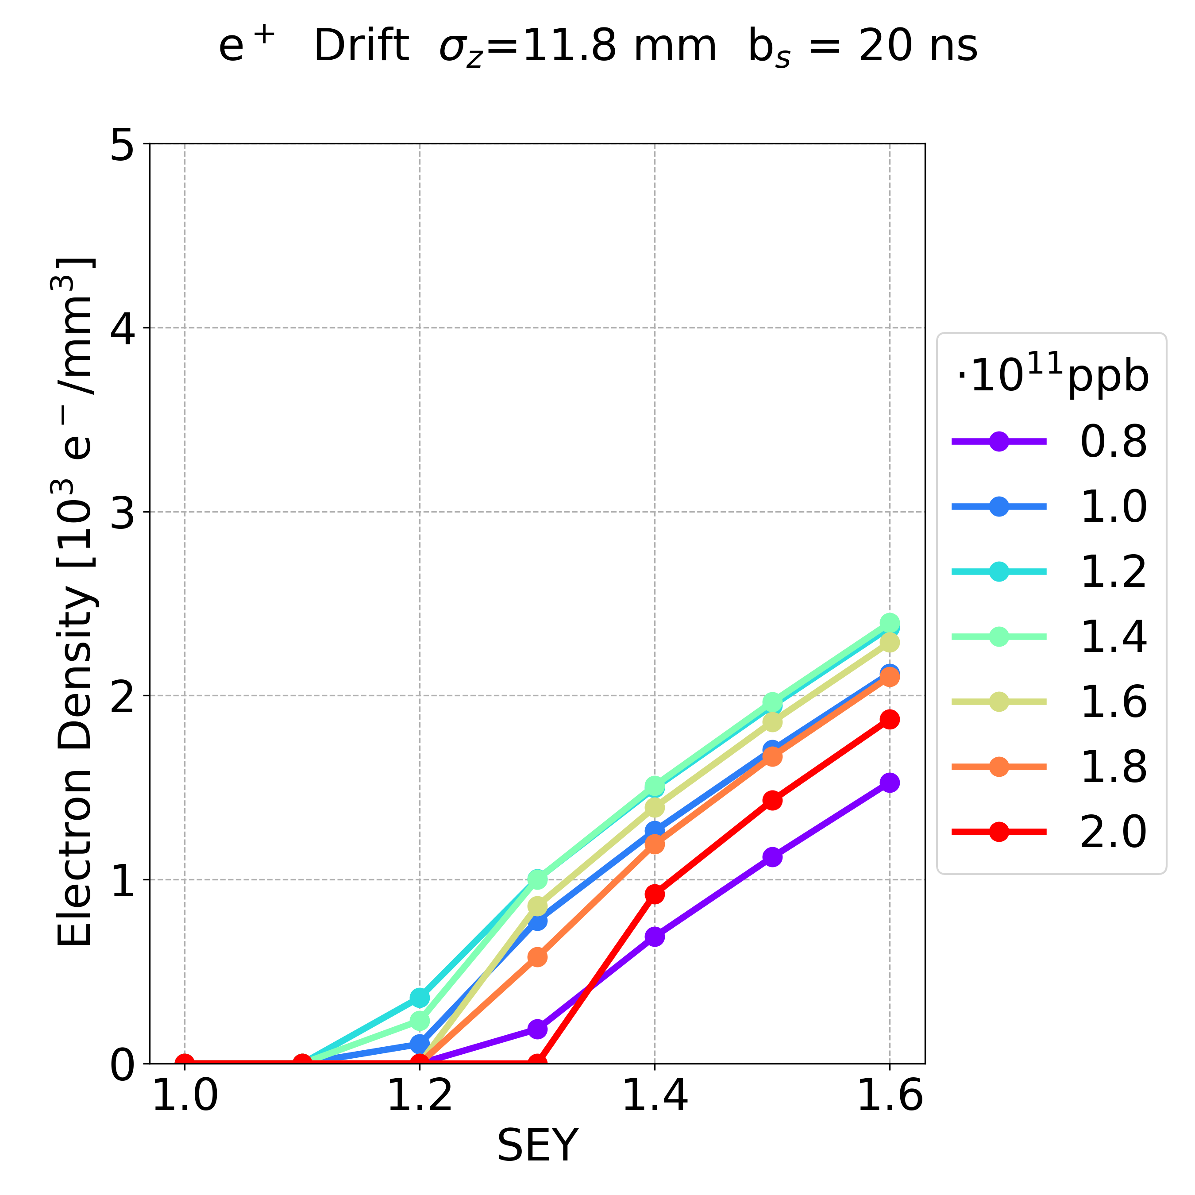
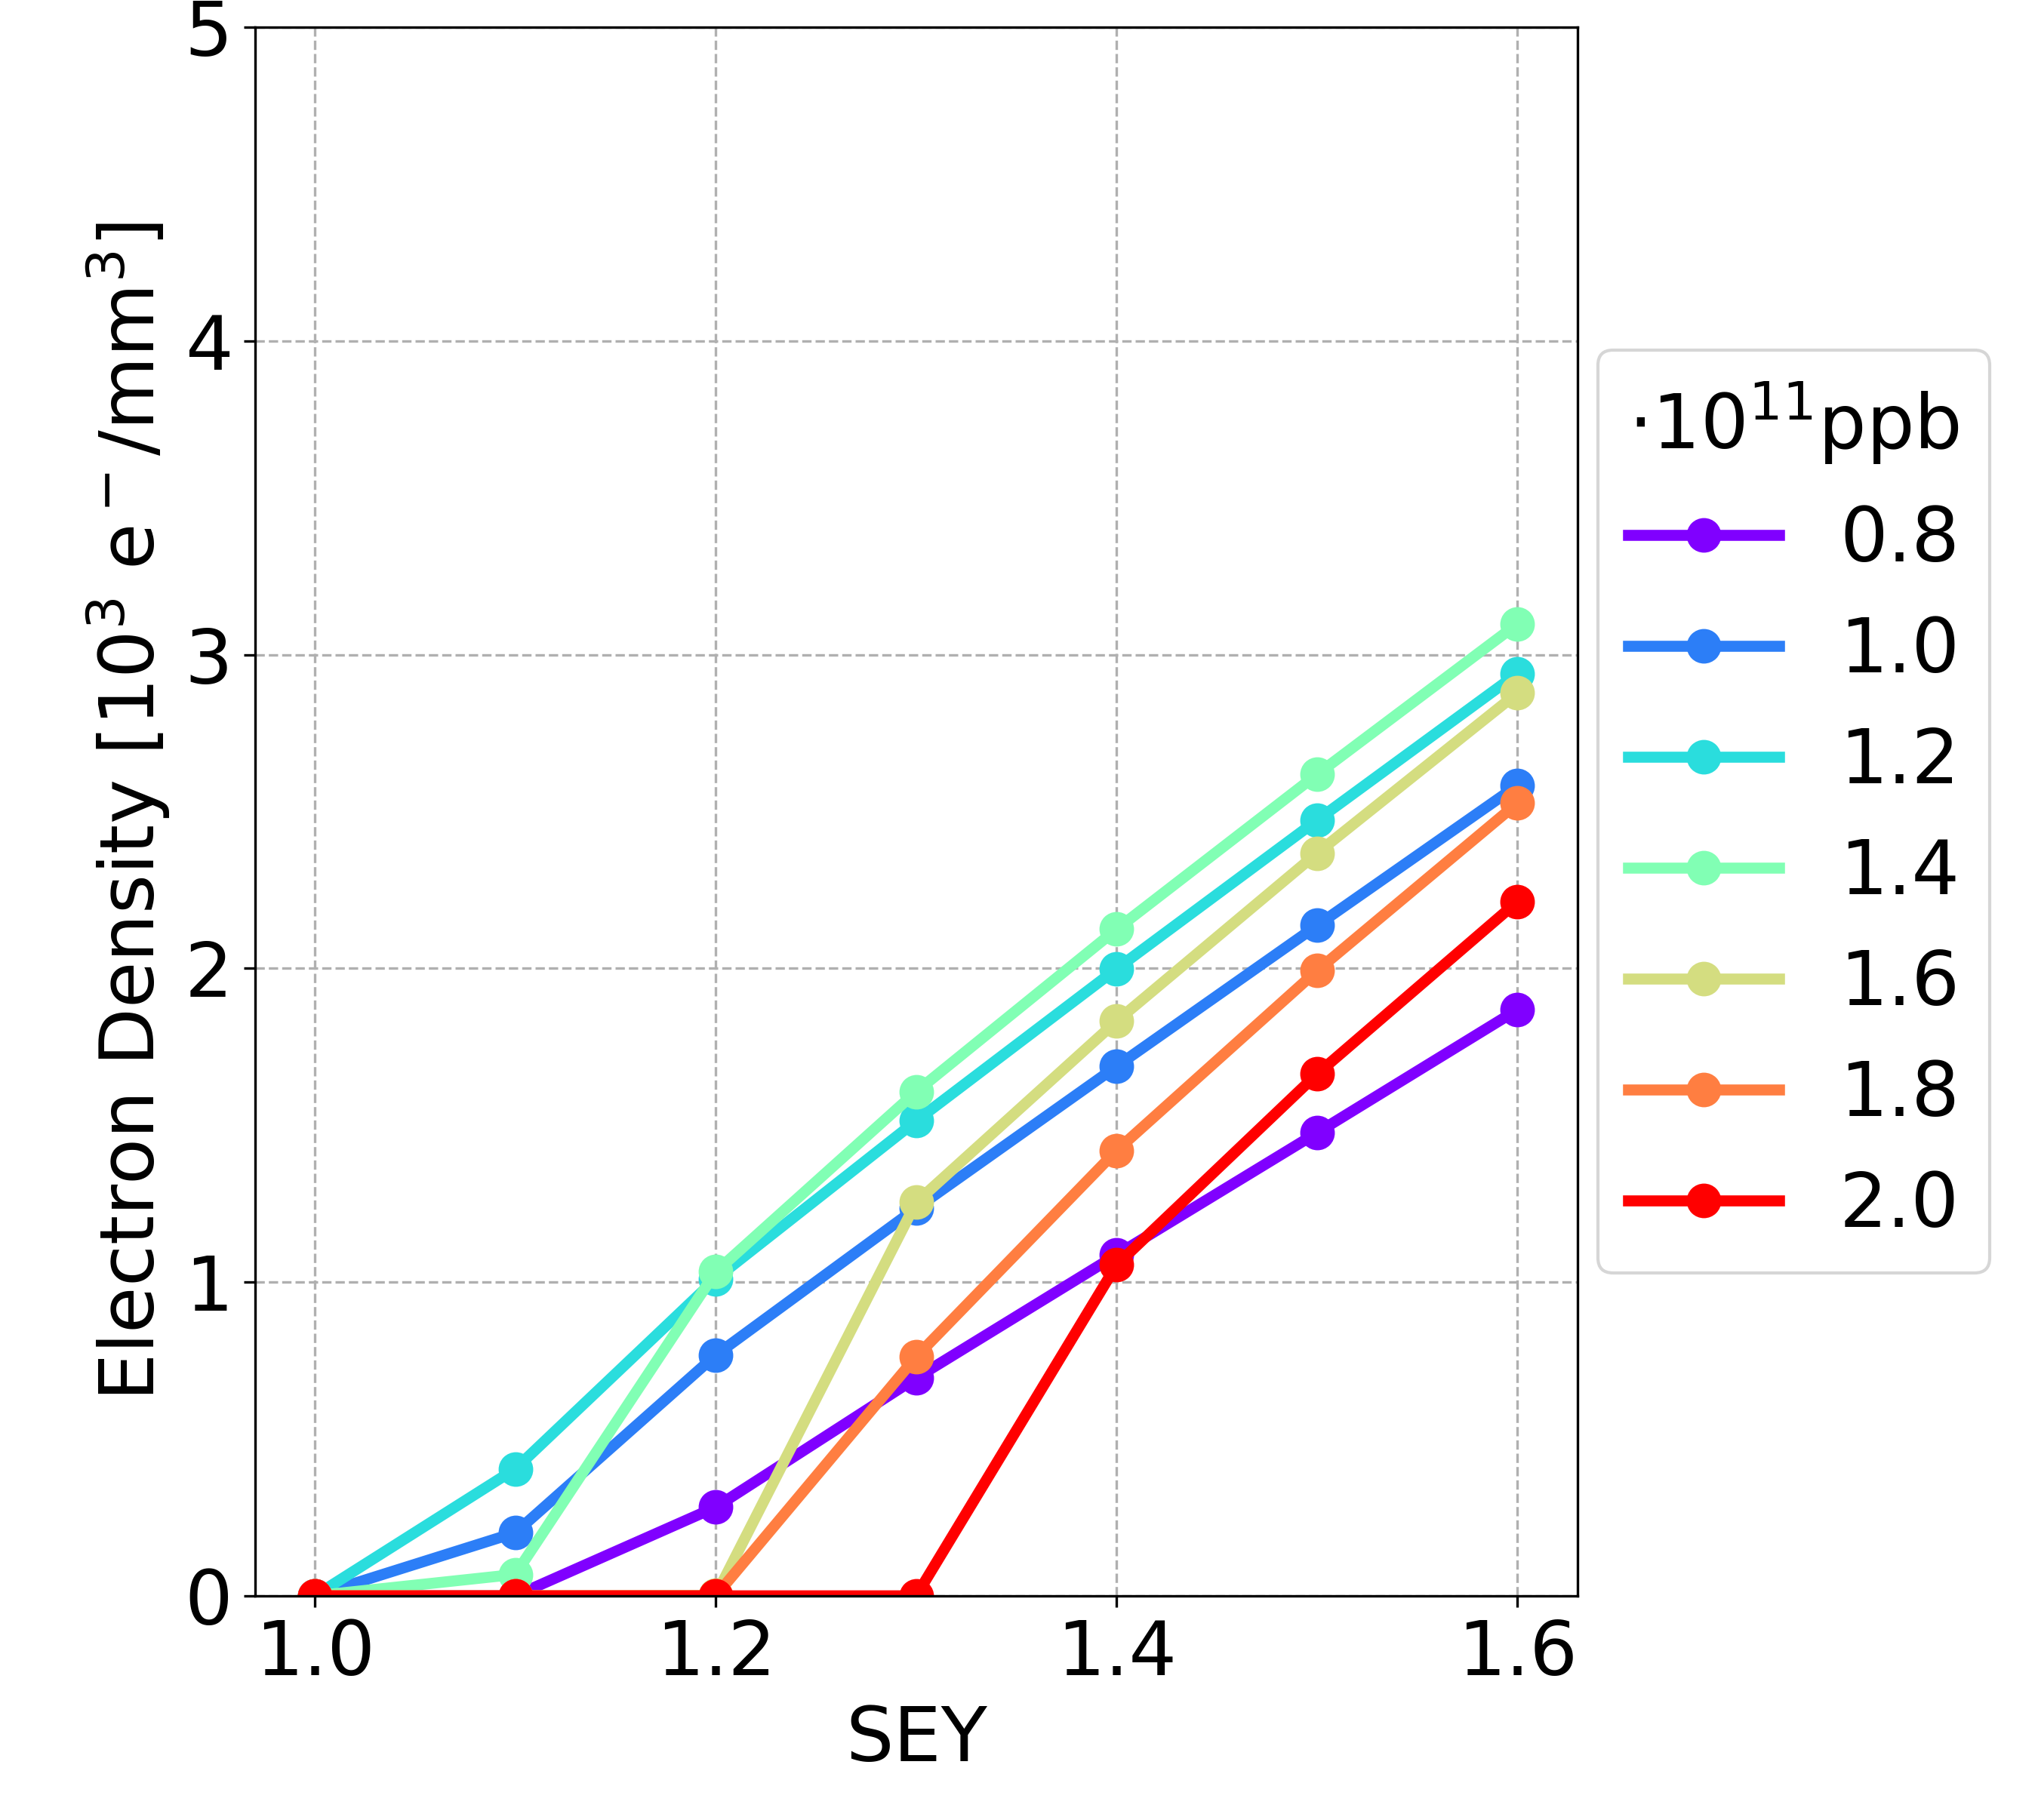
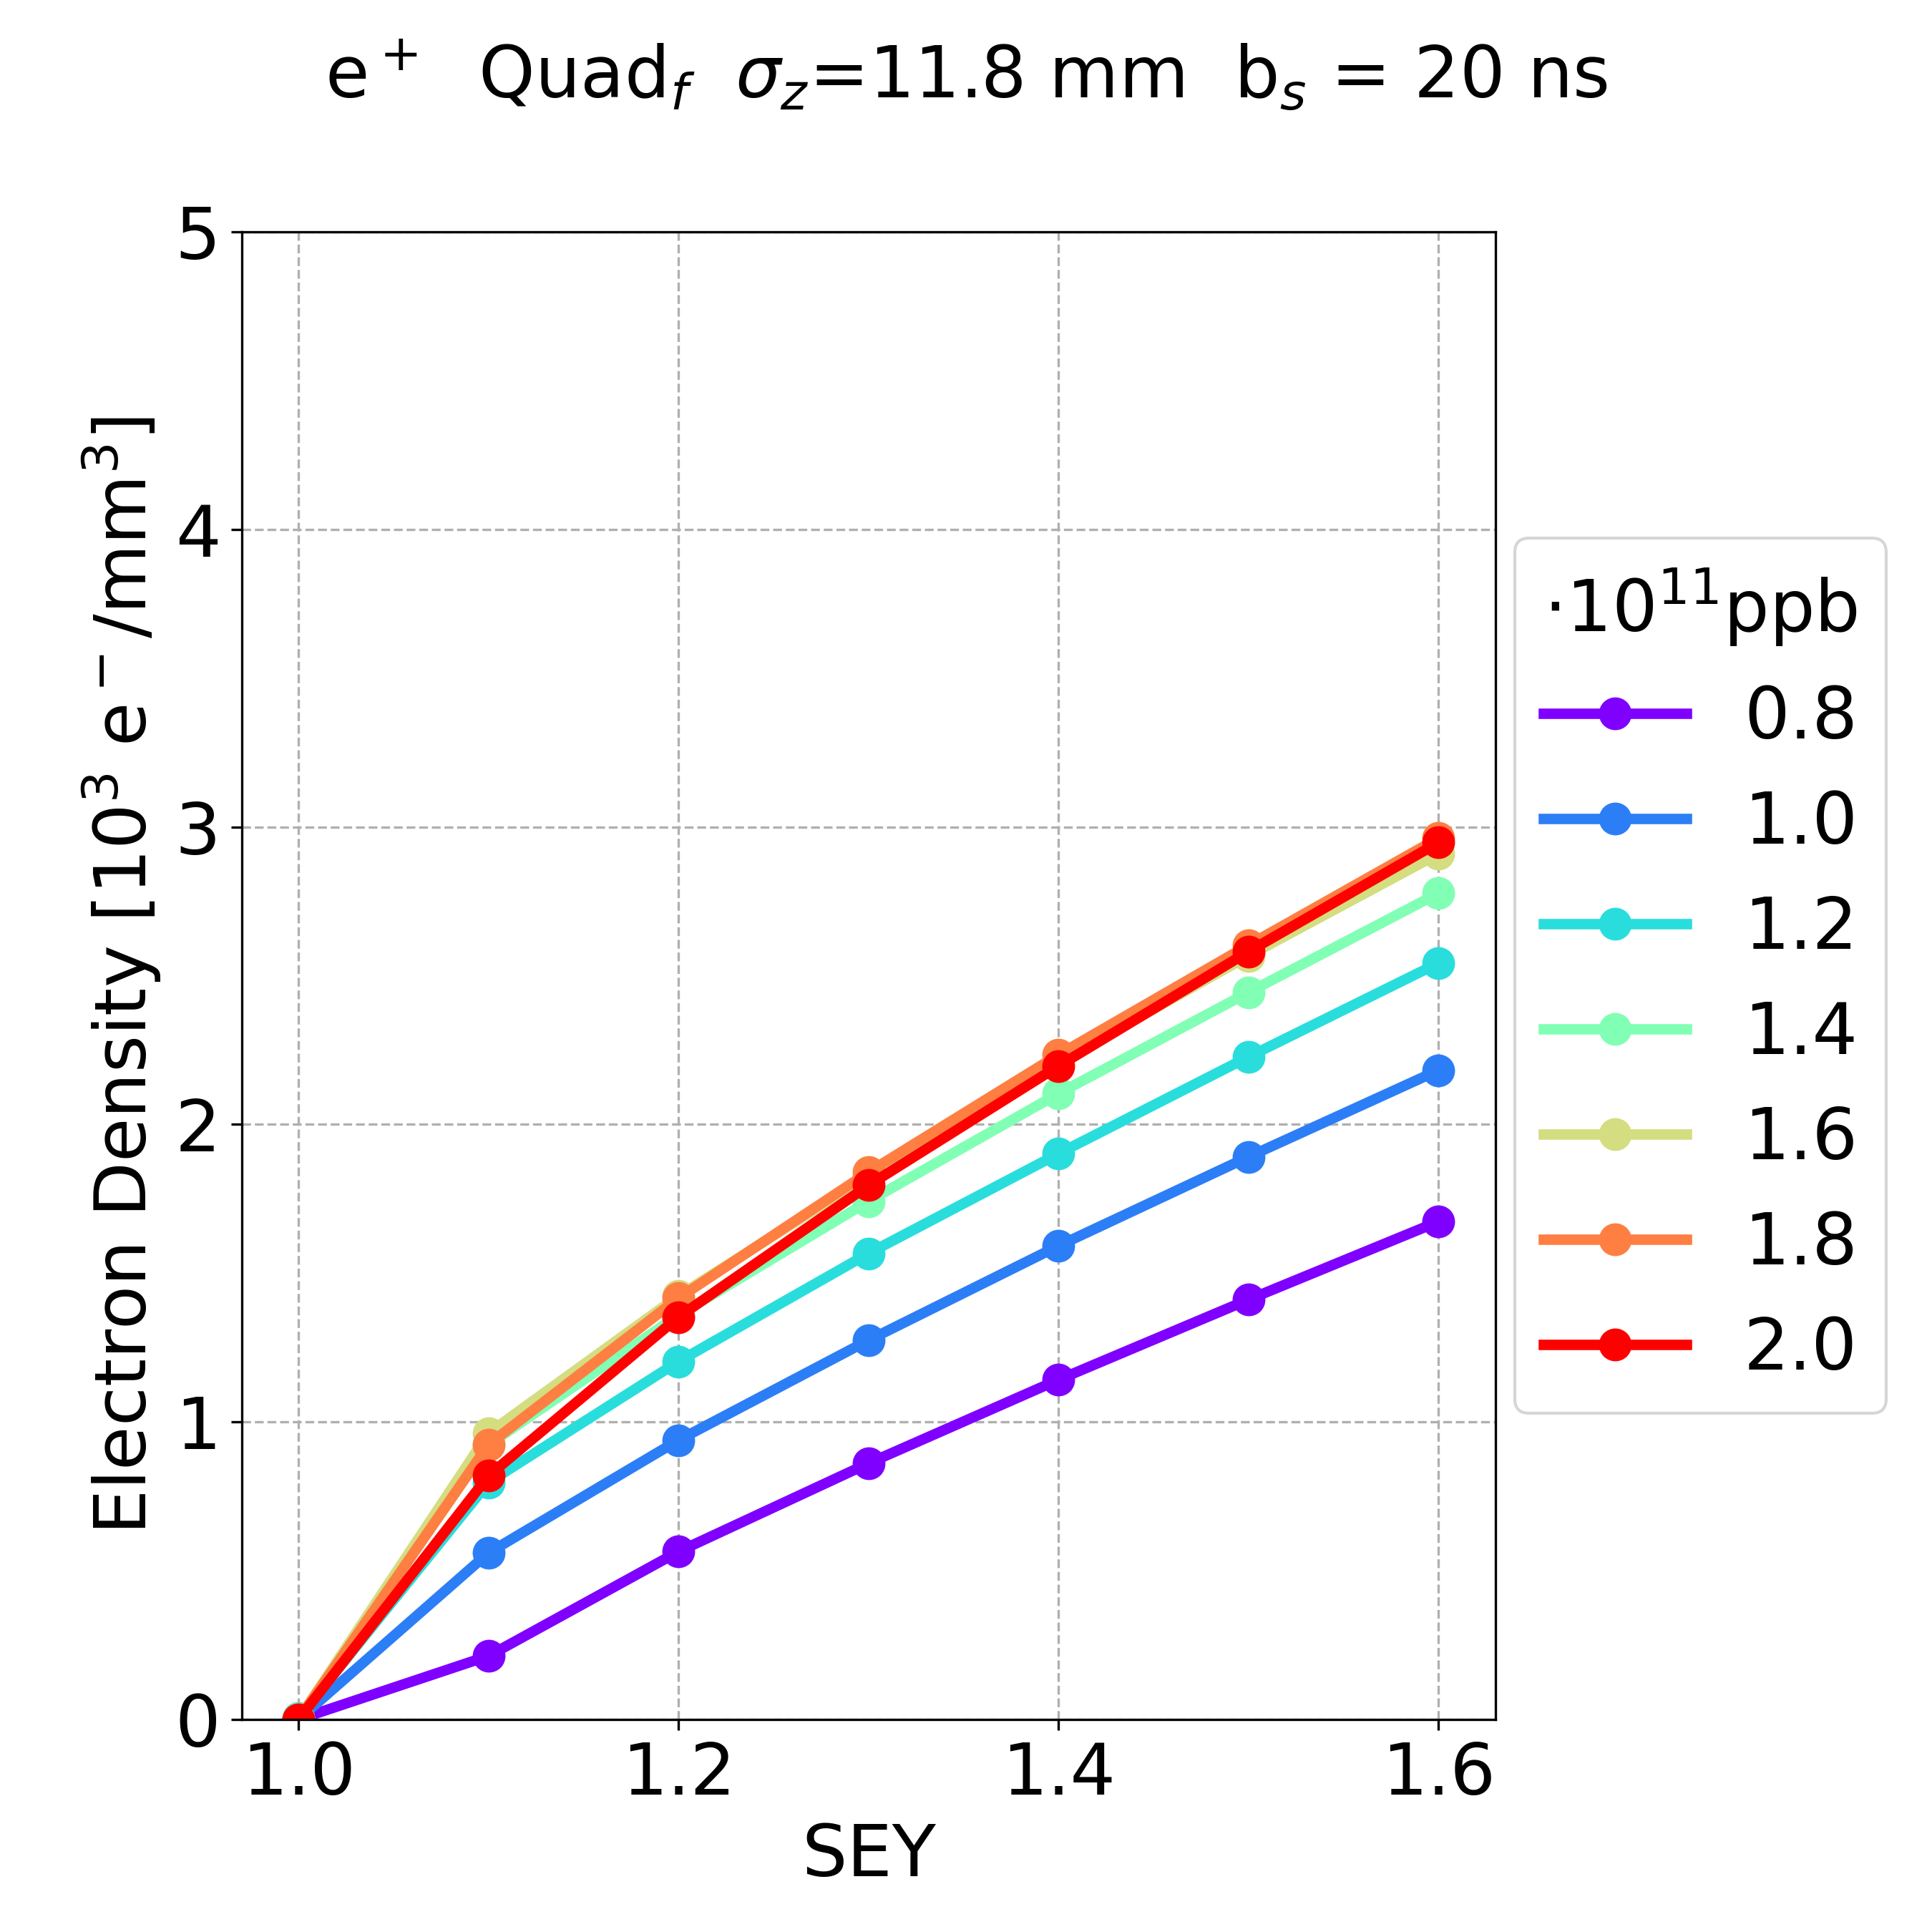
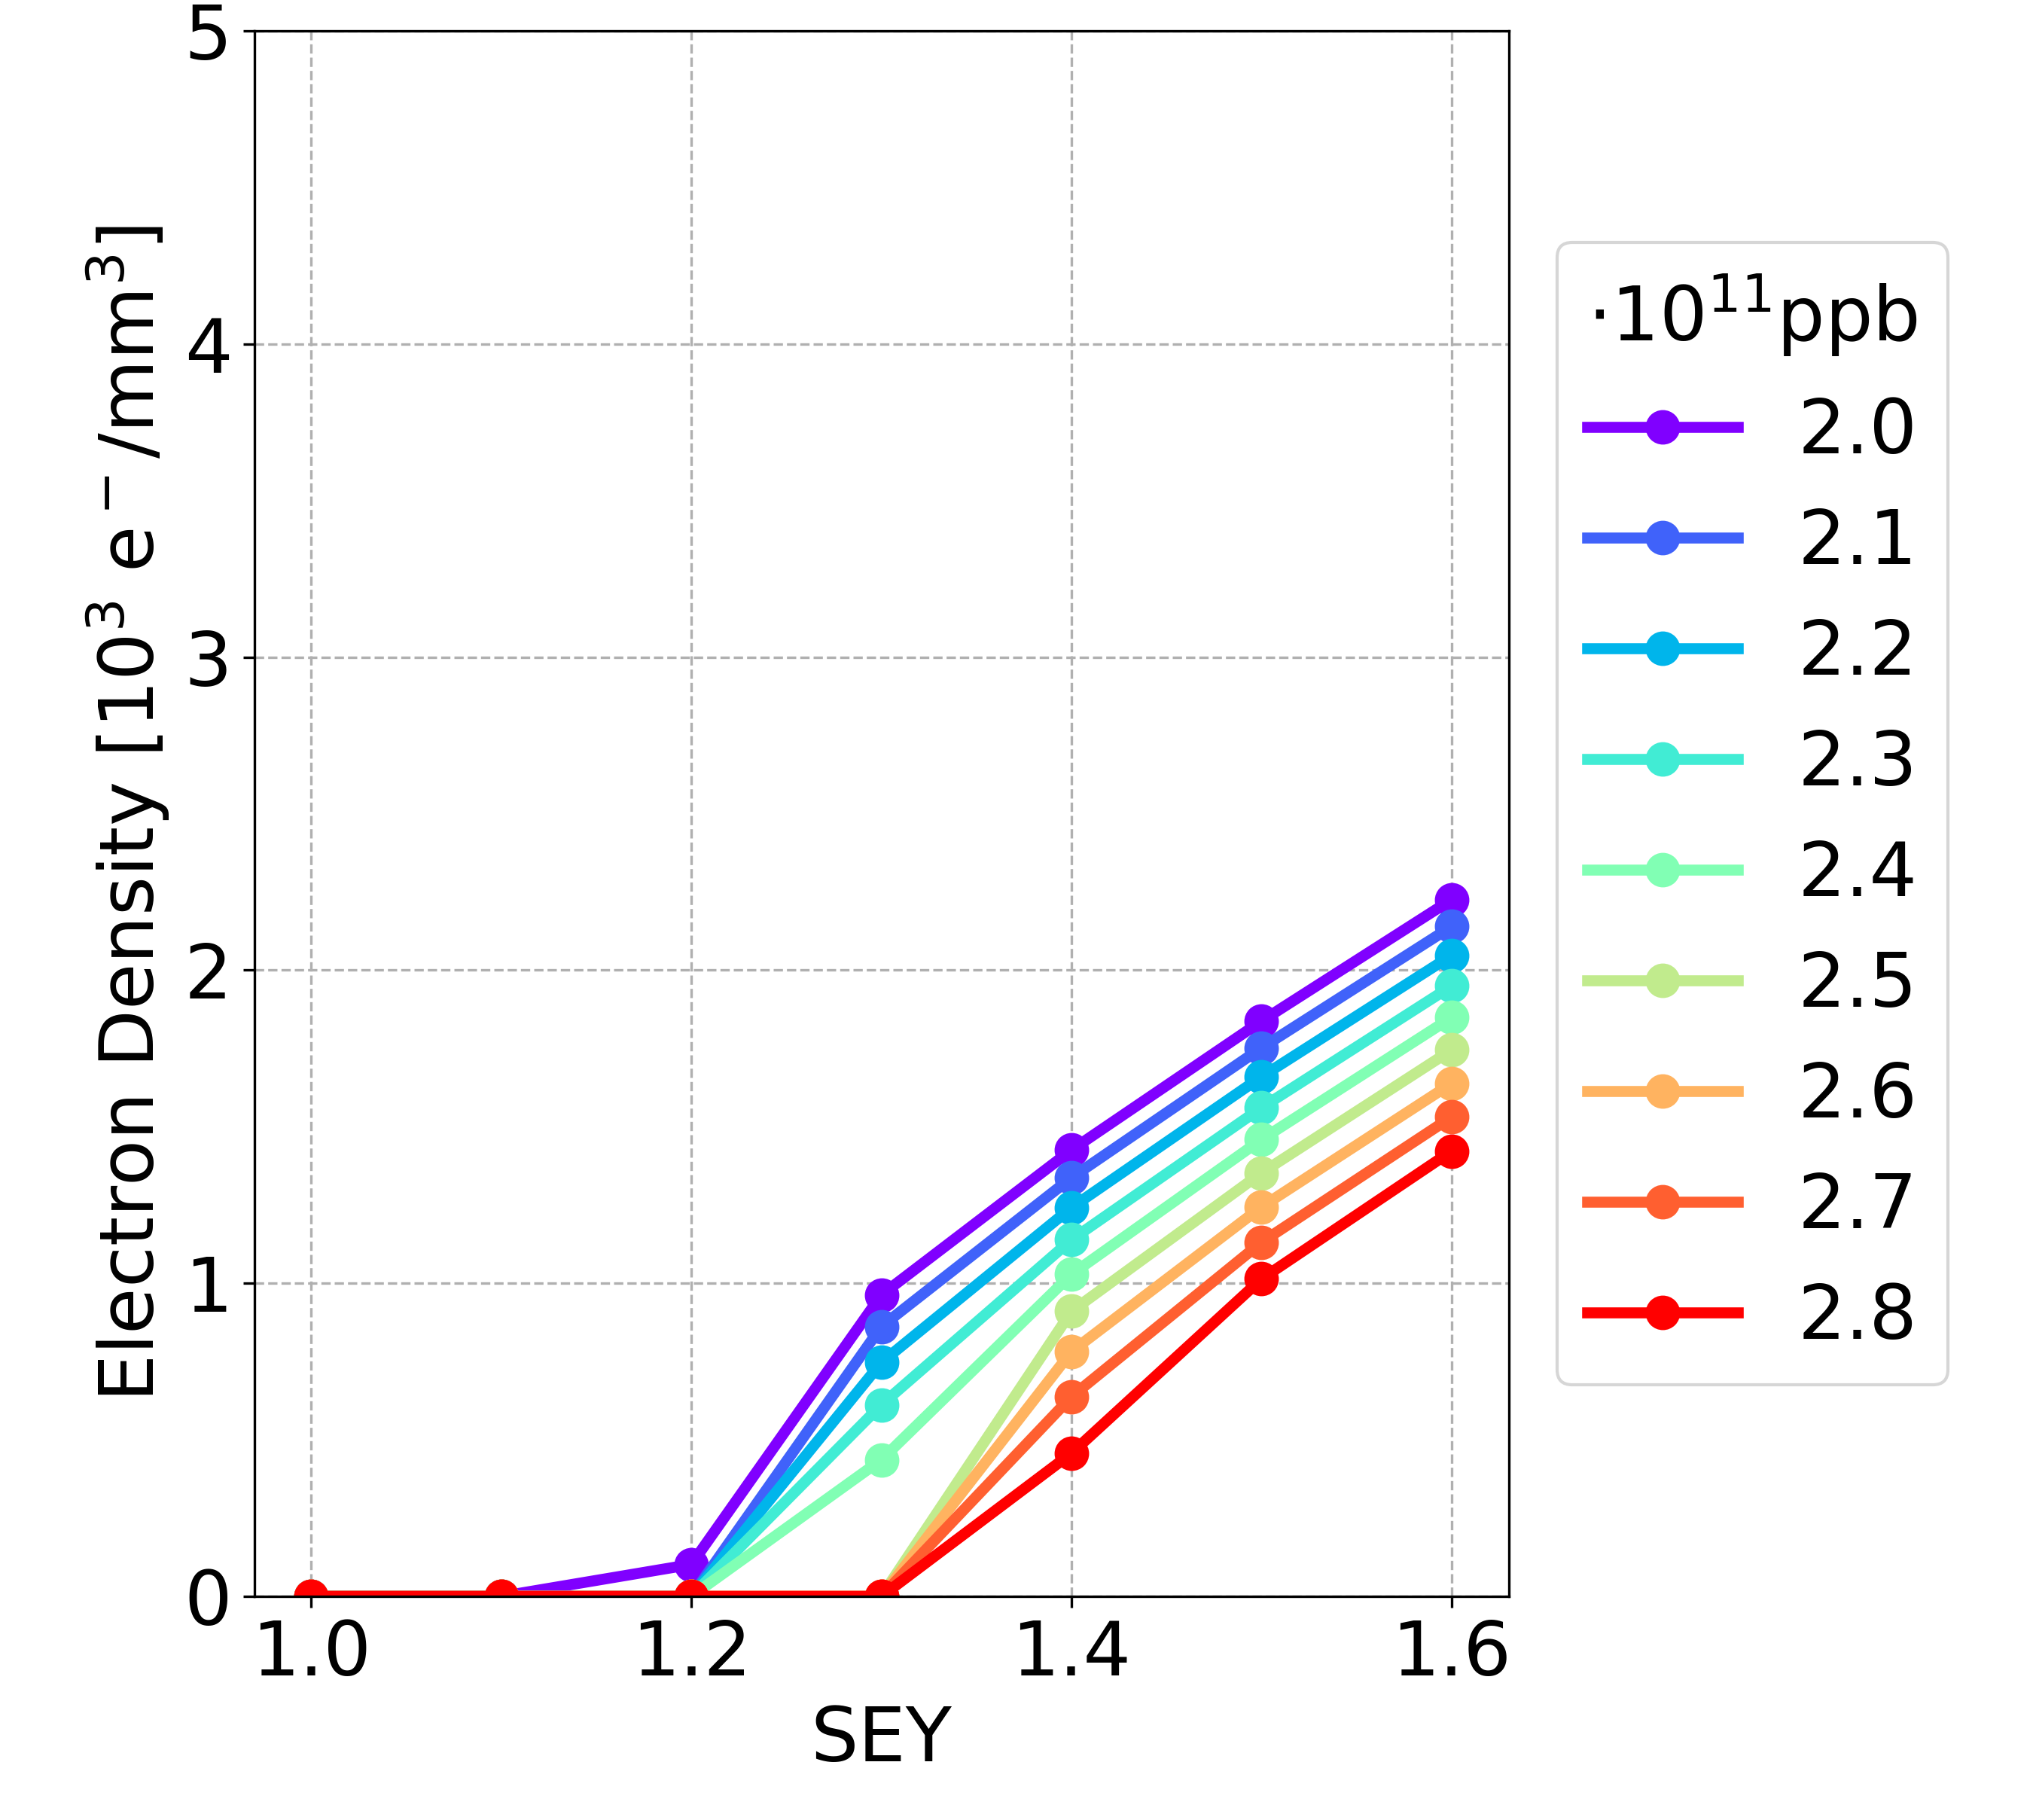
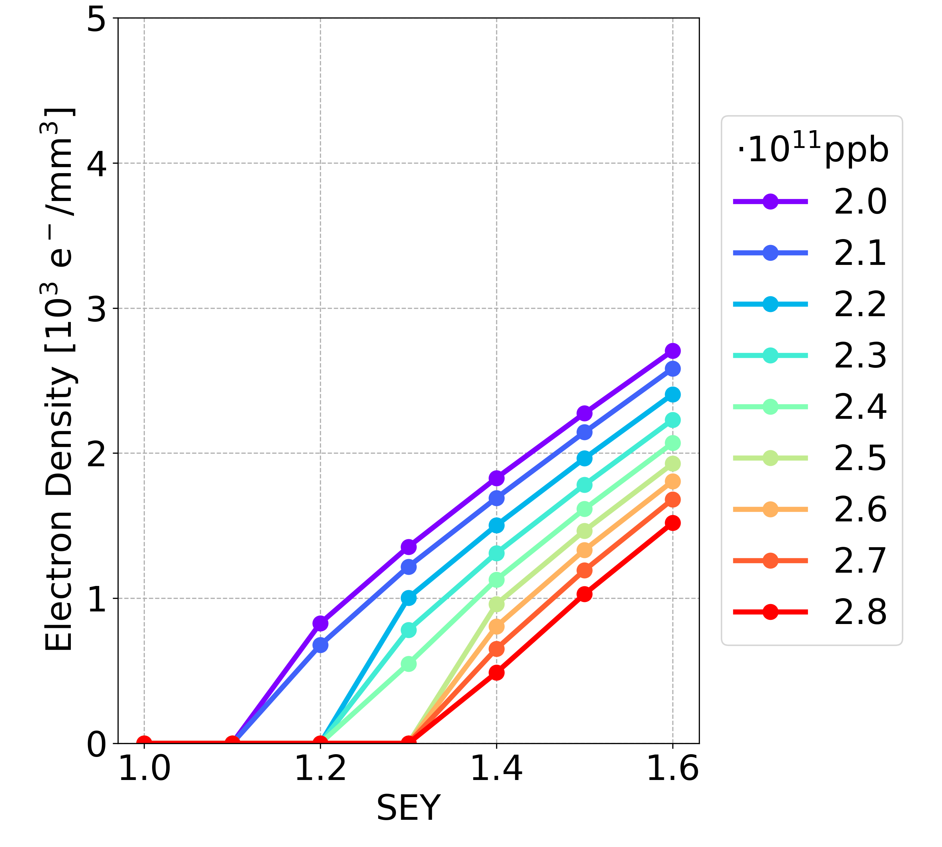
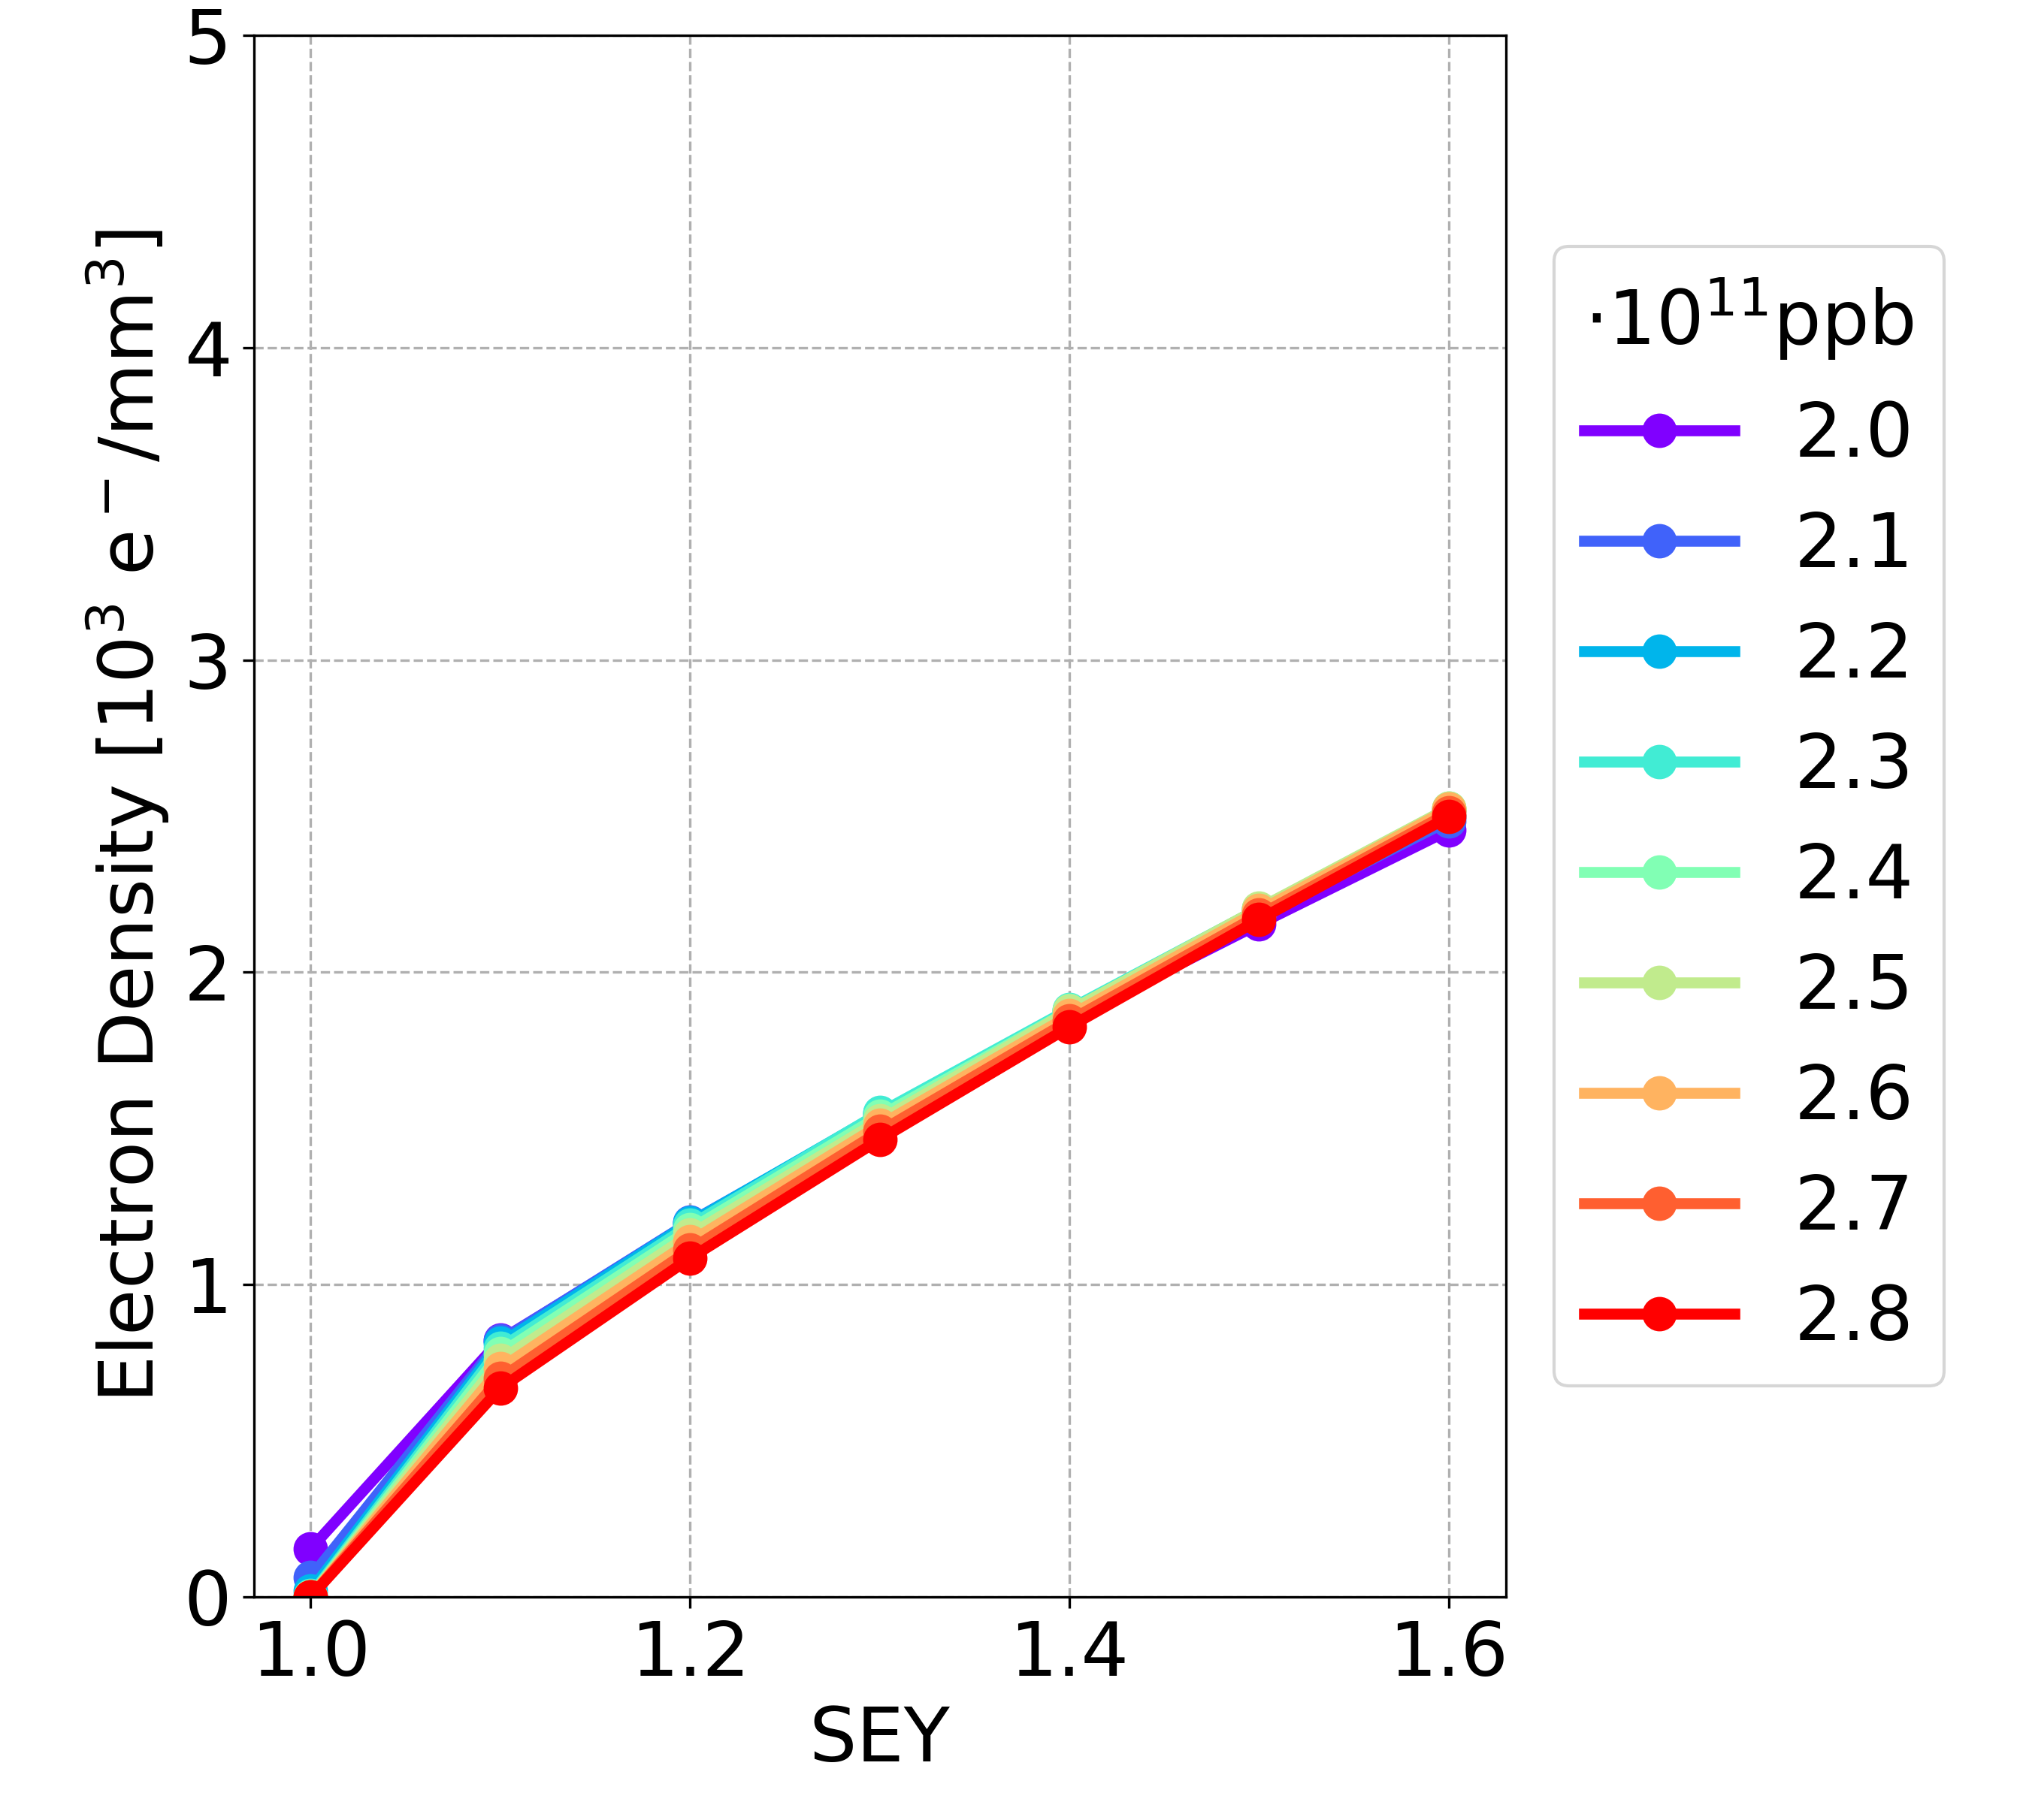
Simulation Results: New Parameters
Bunch spacing 20 ns, longer bunch length
Drift space
Dipole
Quadrupole
NEW
Drift space
Dipole
Quadrupole
OLD

Slide 29
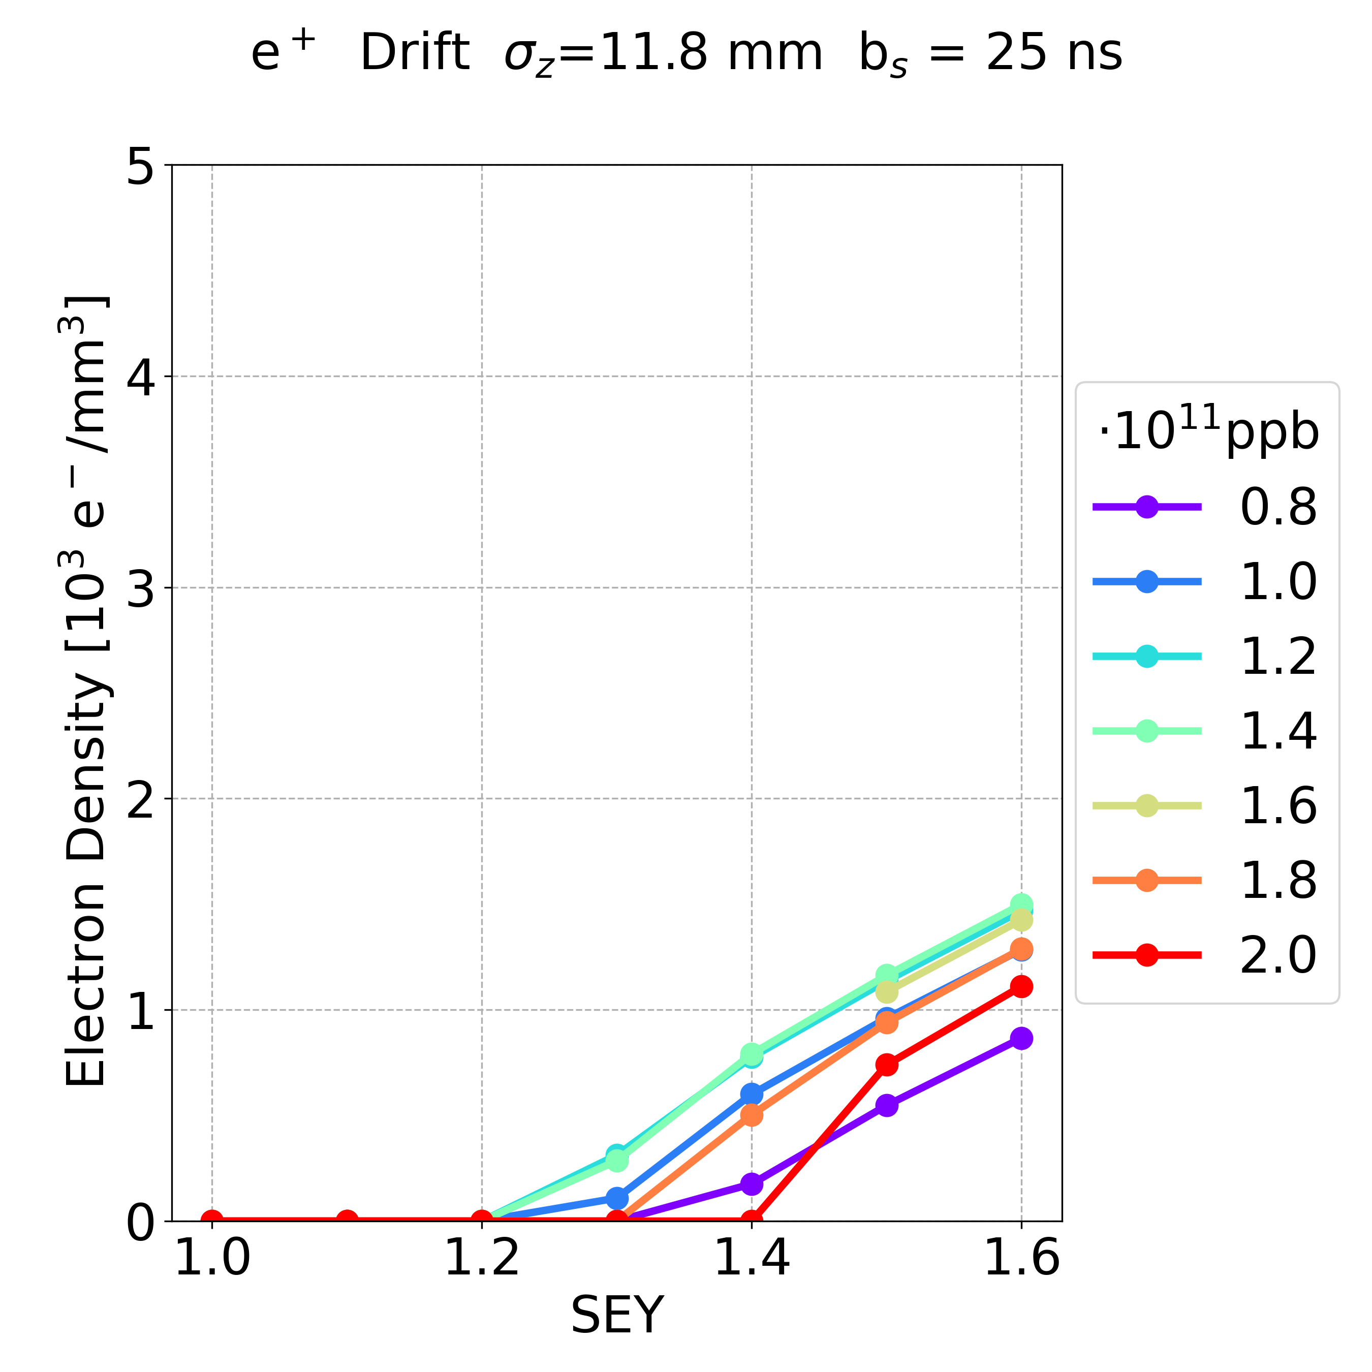
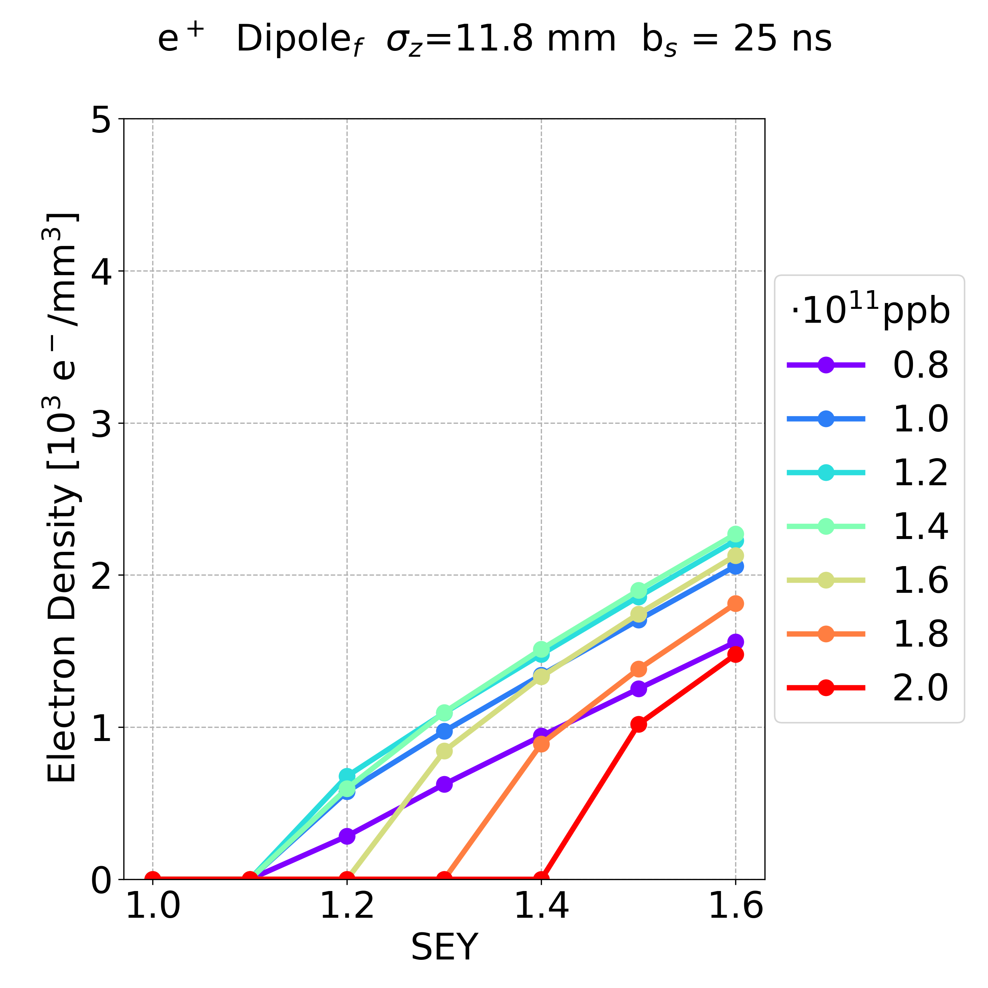
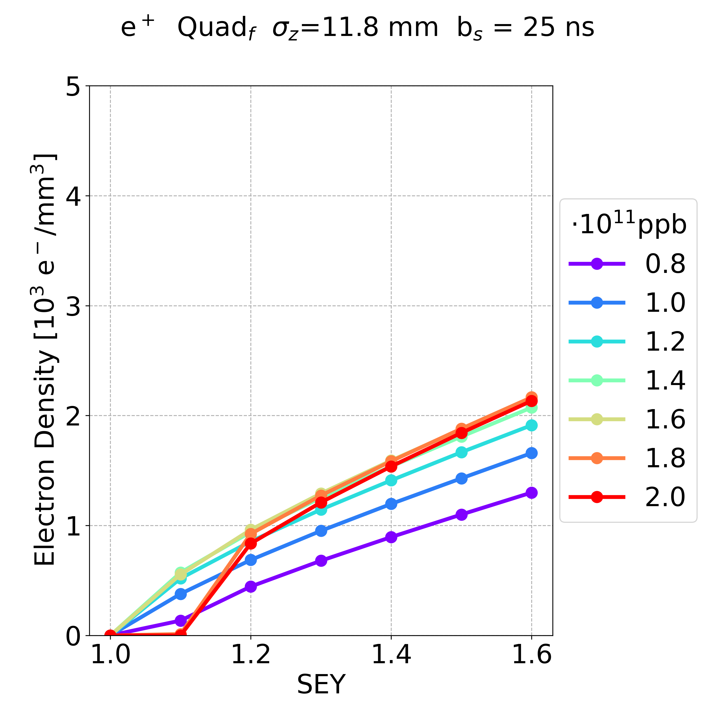
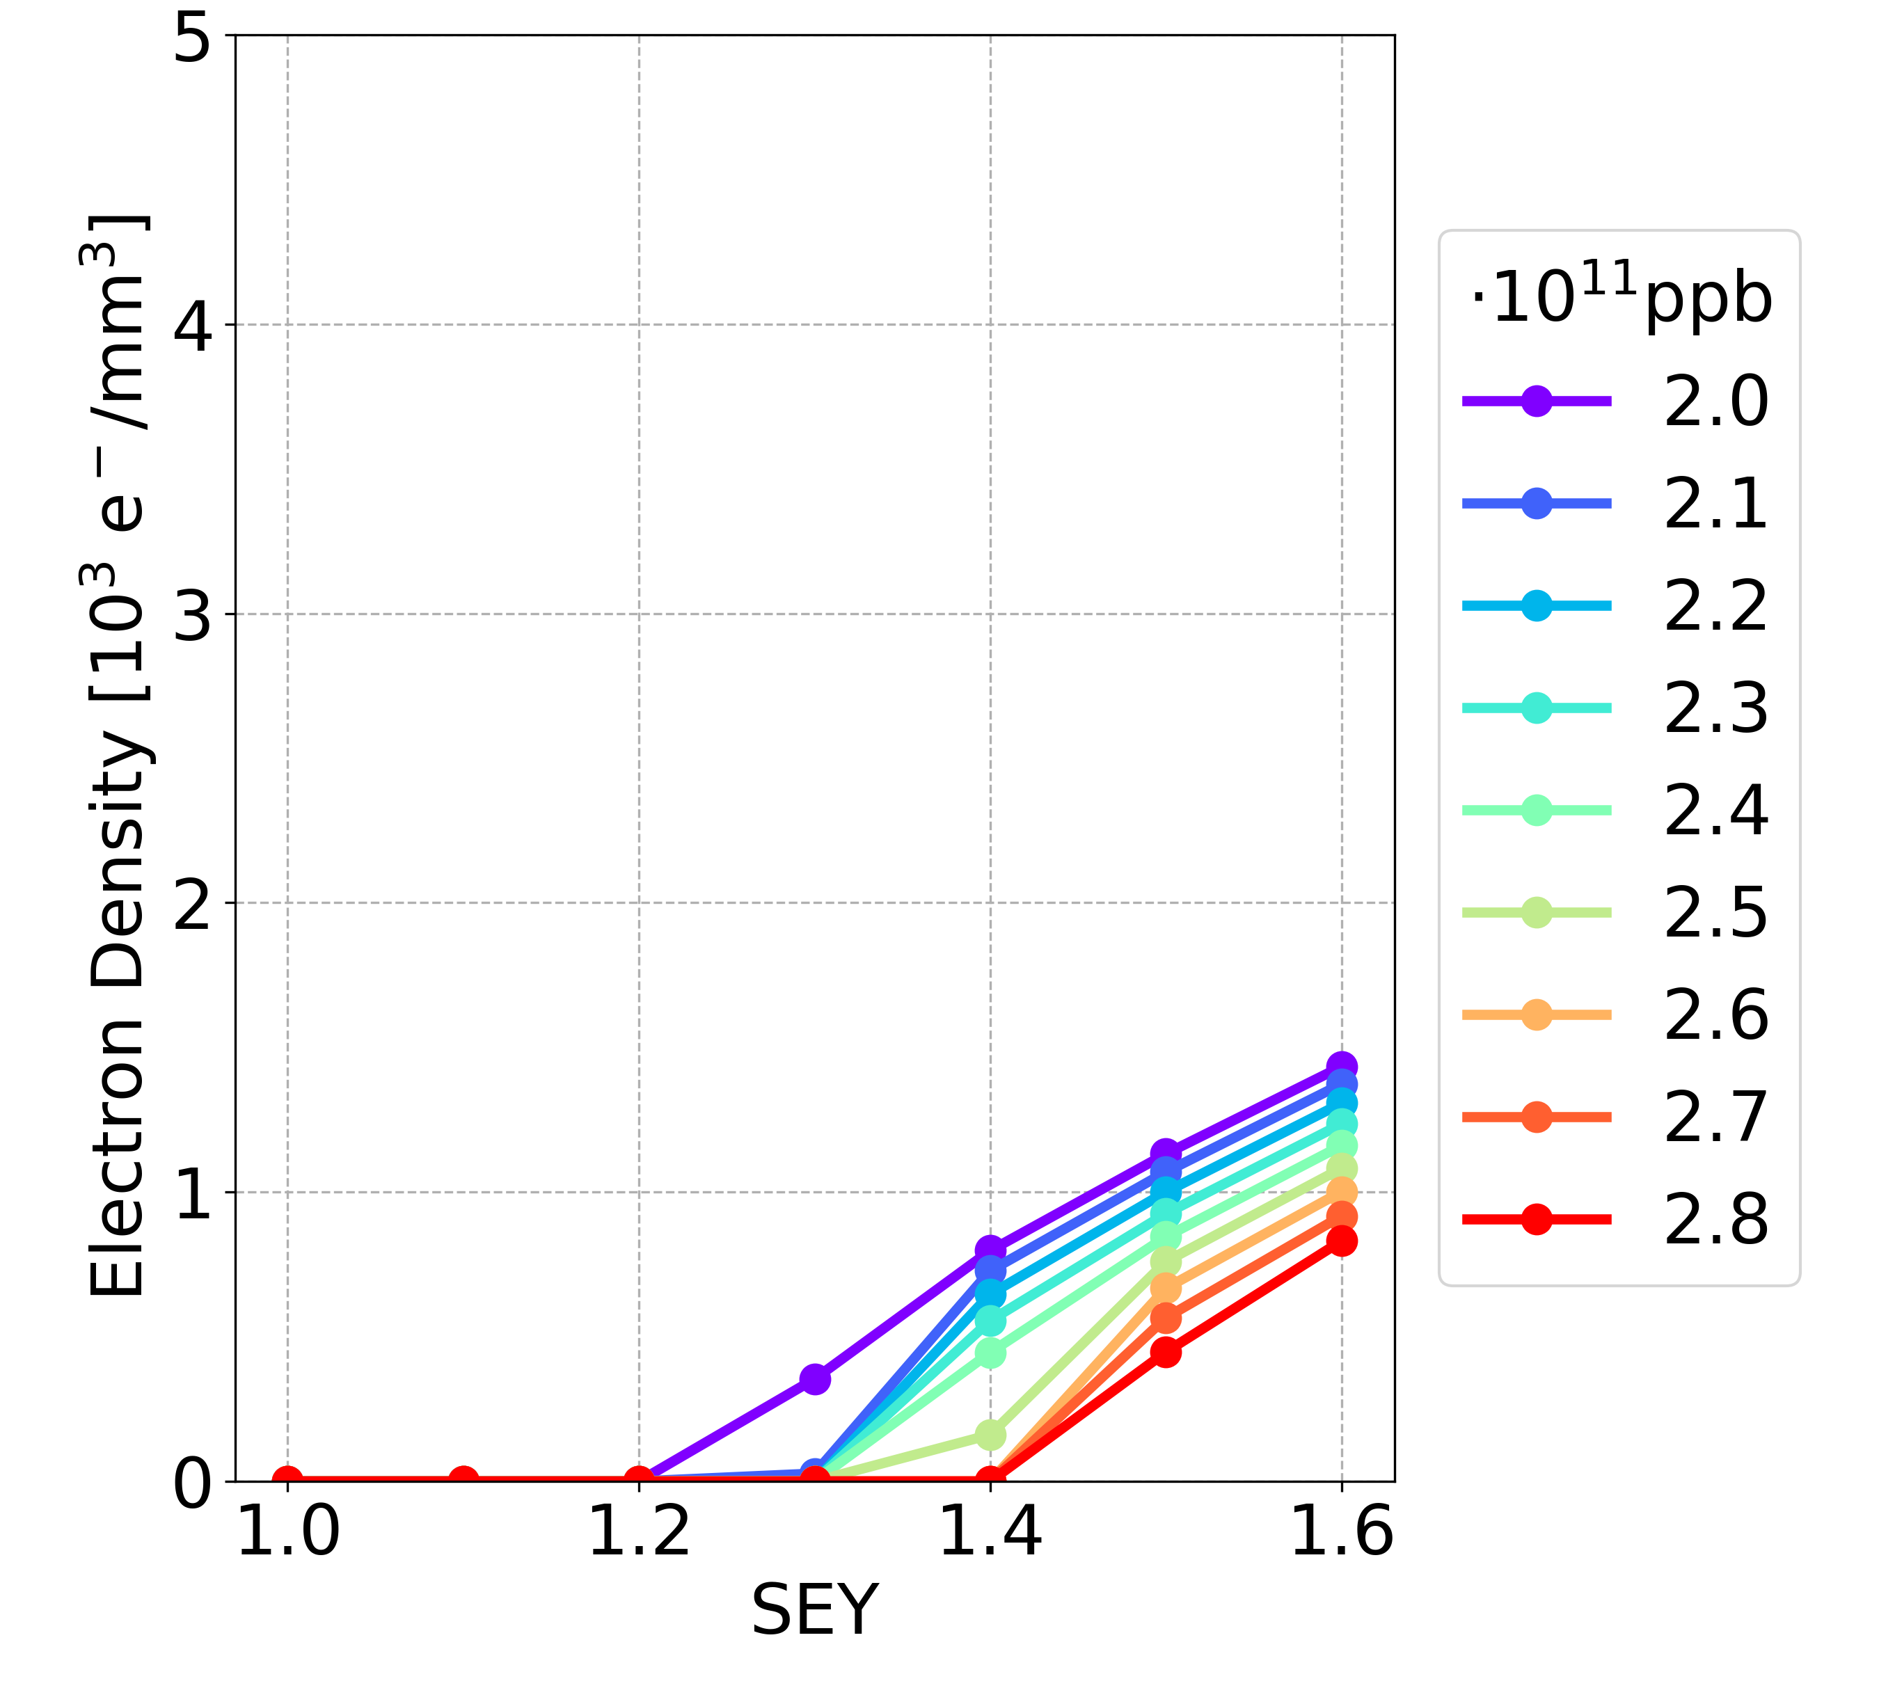
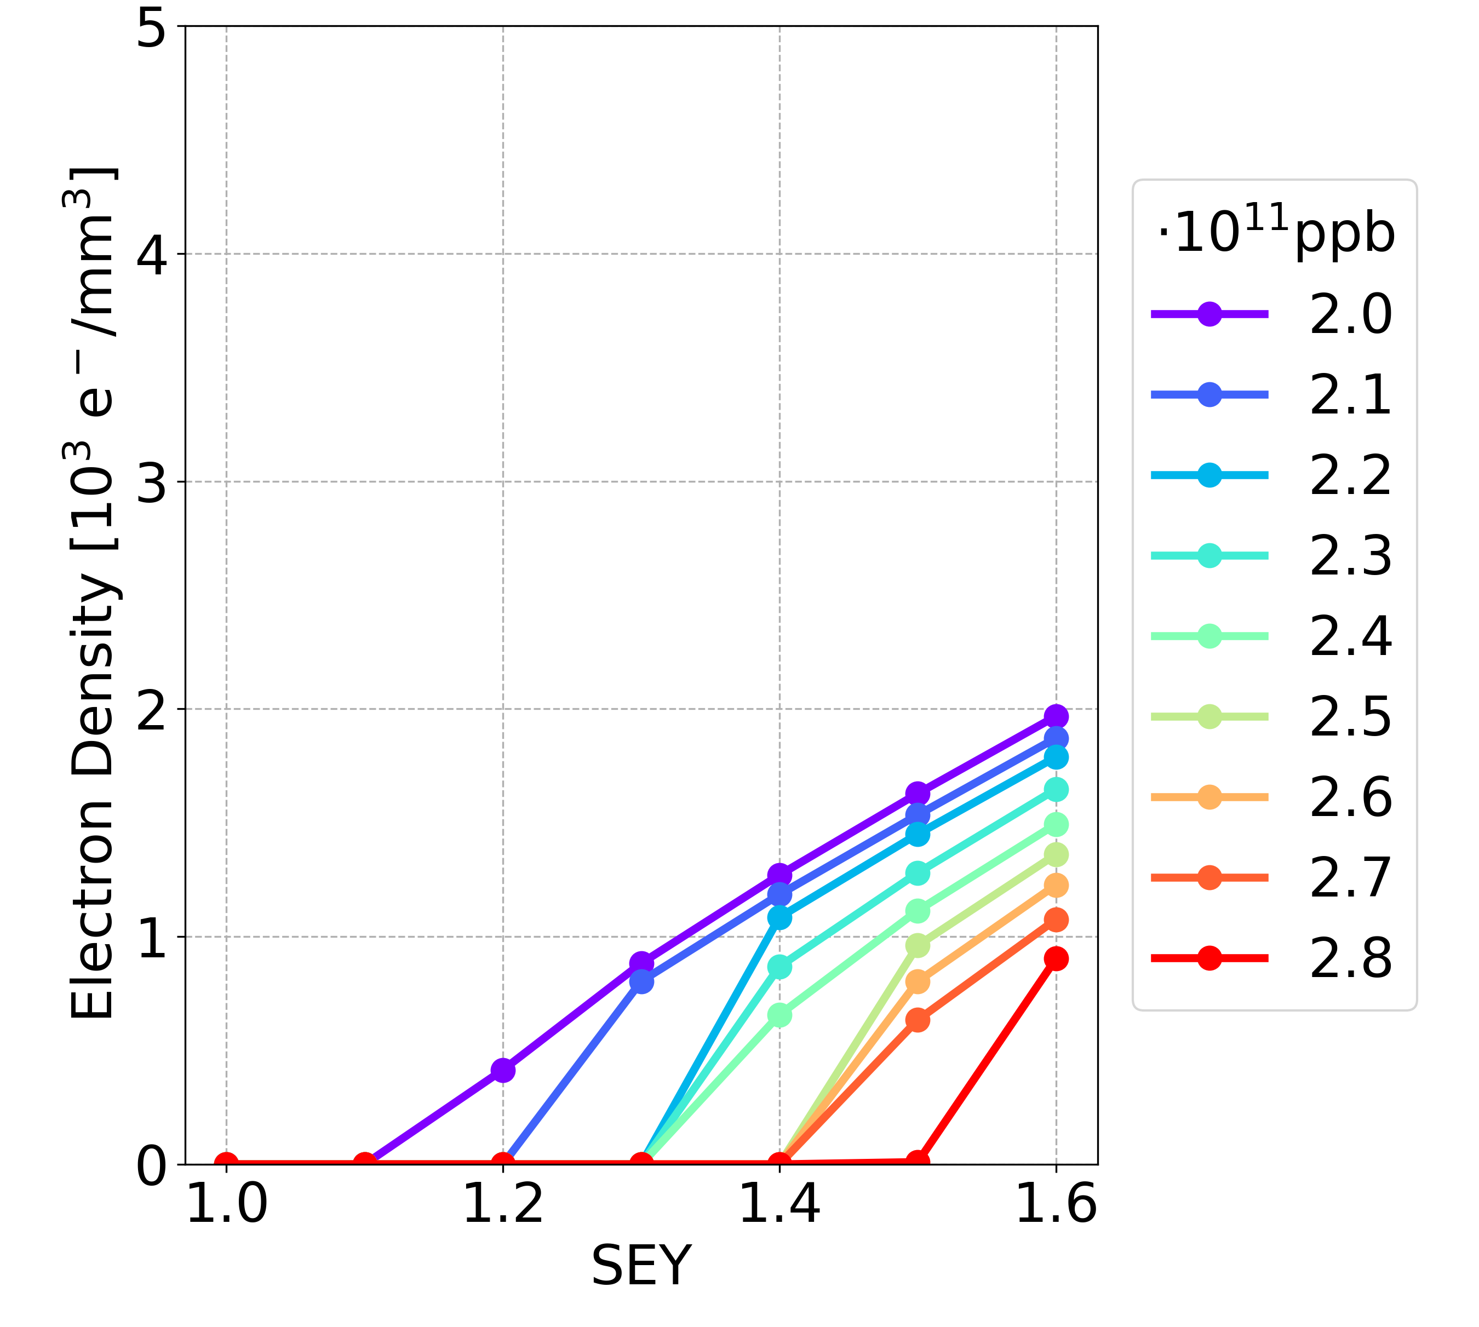
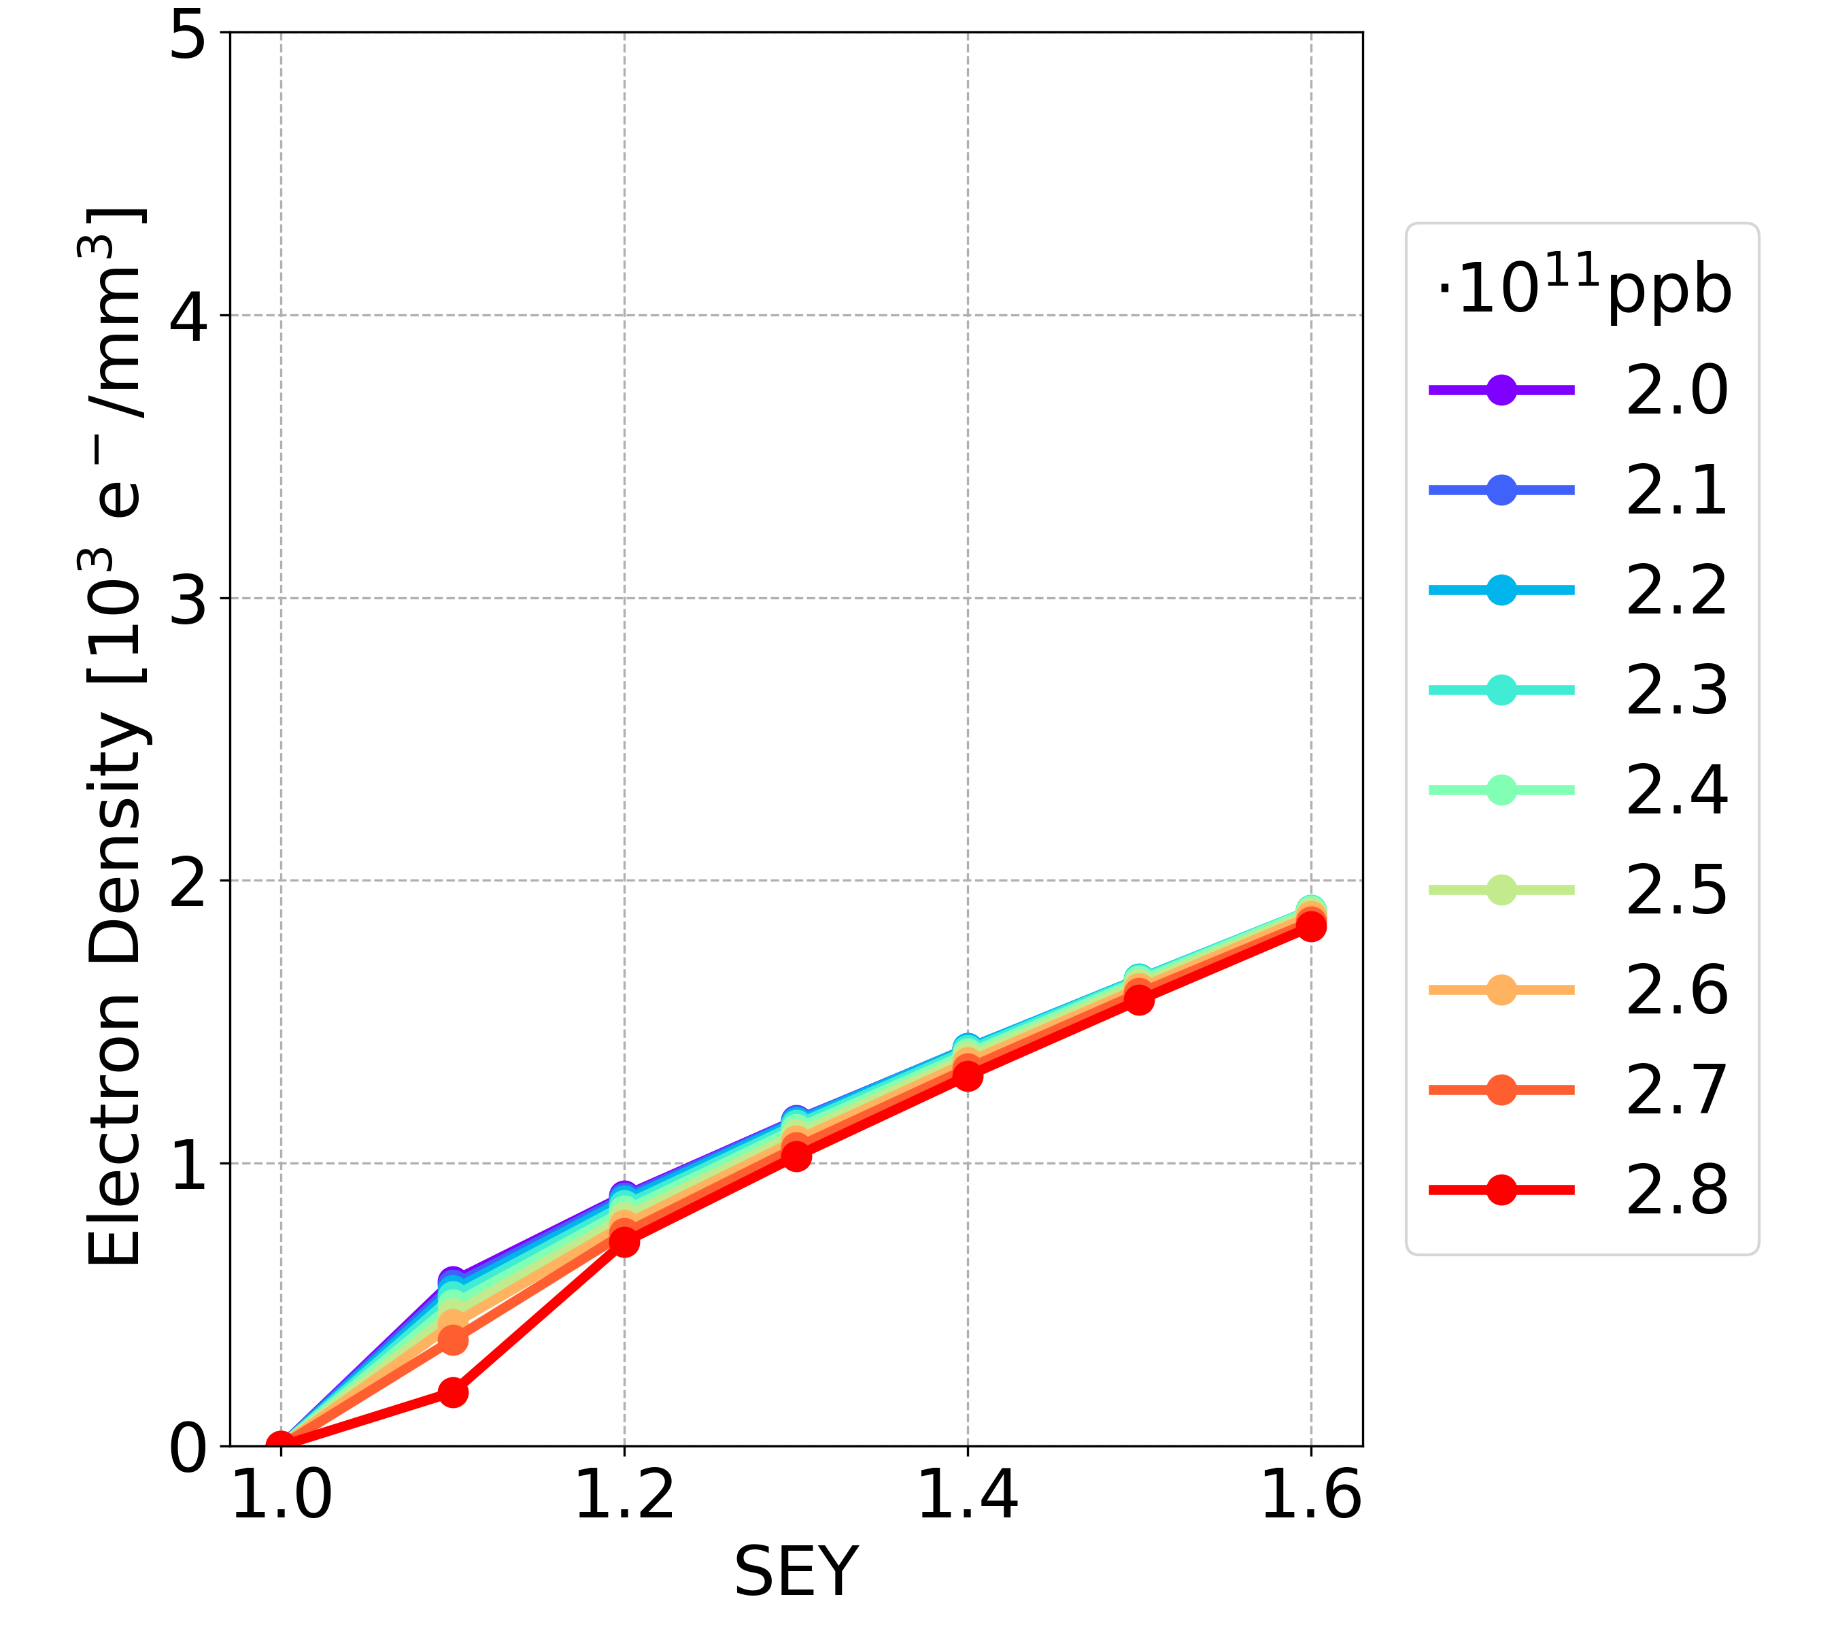
Simulation Results: New Parameters
Bunch spacing 25 ns, longer bunch length
Drift space
Dipole
Quadrupole
NEW
Drift space
Dipole
Quadrupole
OLD

Slide 30
Simulation Results: New Parameters
For a fixed bunch spacing
The e-cloud density has the same order of magnitude for the new parameters and the old ones
The new configuration of beam chamber / bunch length / bunch intensity does not significantly alter the e-cloud density
New parameters, max bunch spacing reachable 18.9 ns (16,000 bunches)
Old parameters, max bunch spacing reachable 32.9 ns (9,200 bunches)
ABP-CEI Section Meeting 01/06/2023

Slide 31
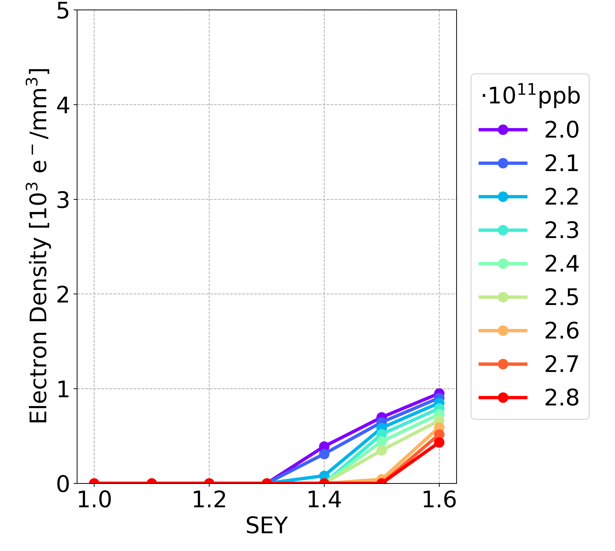
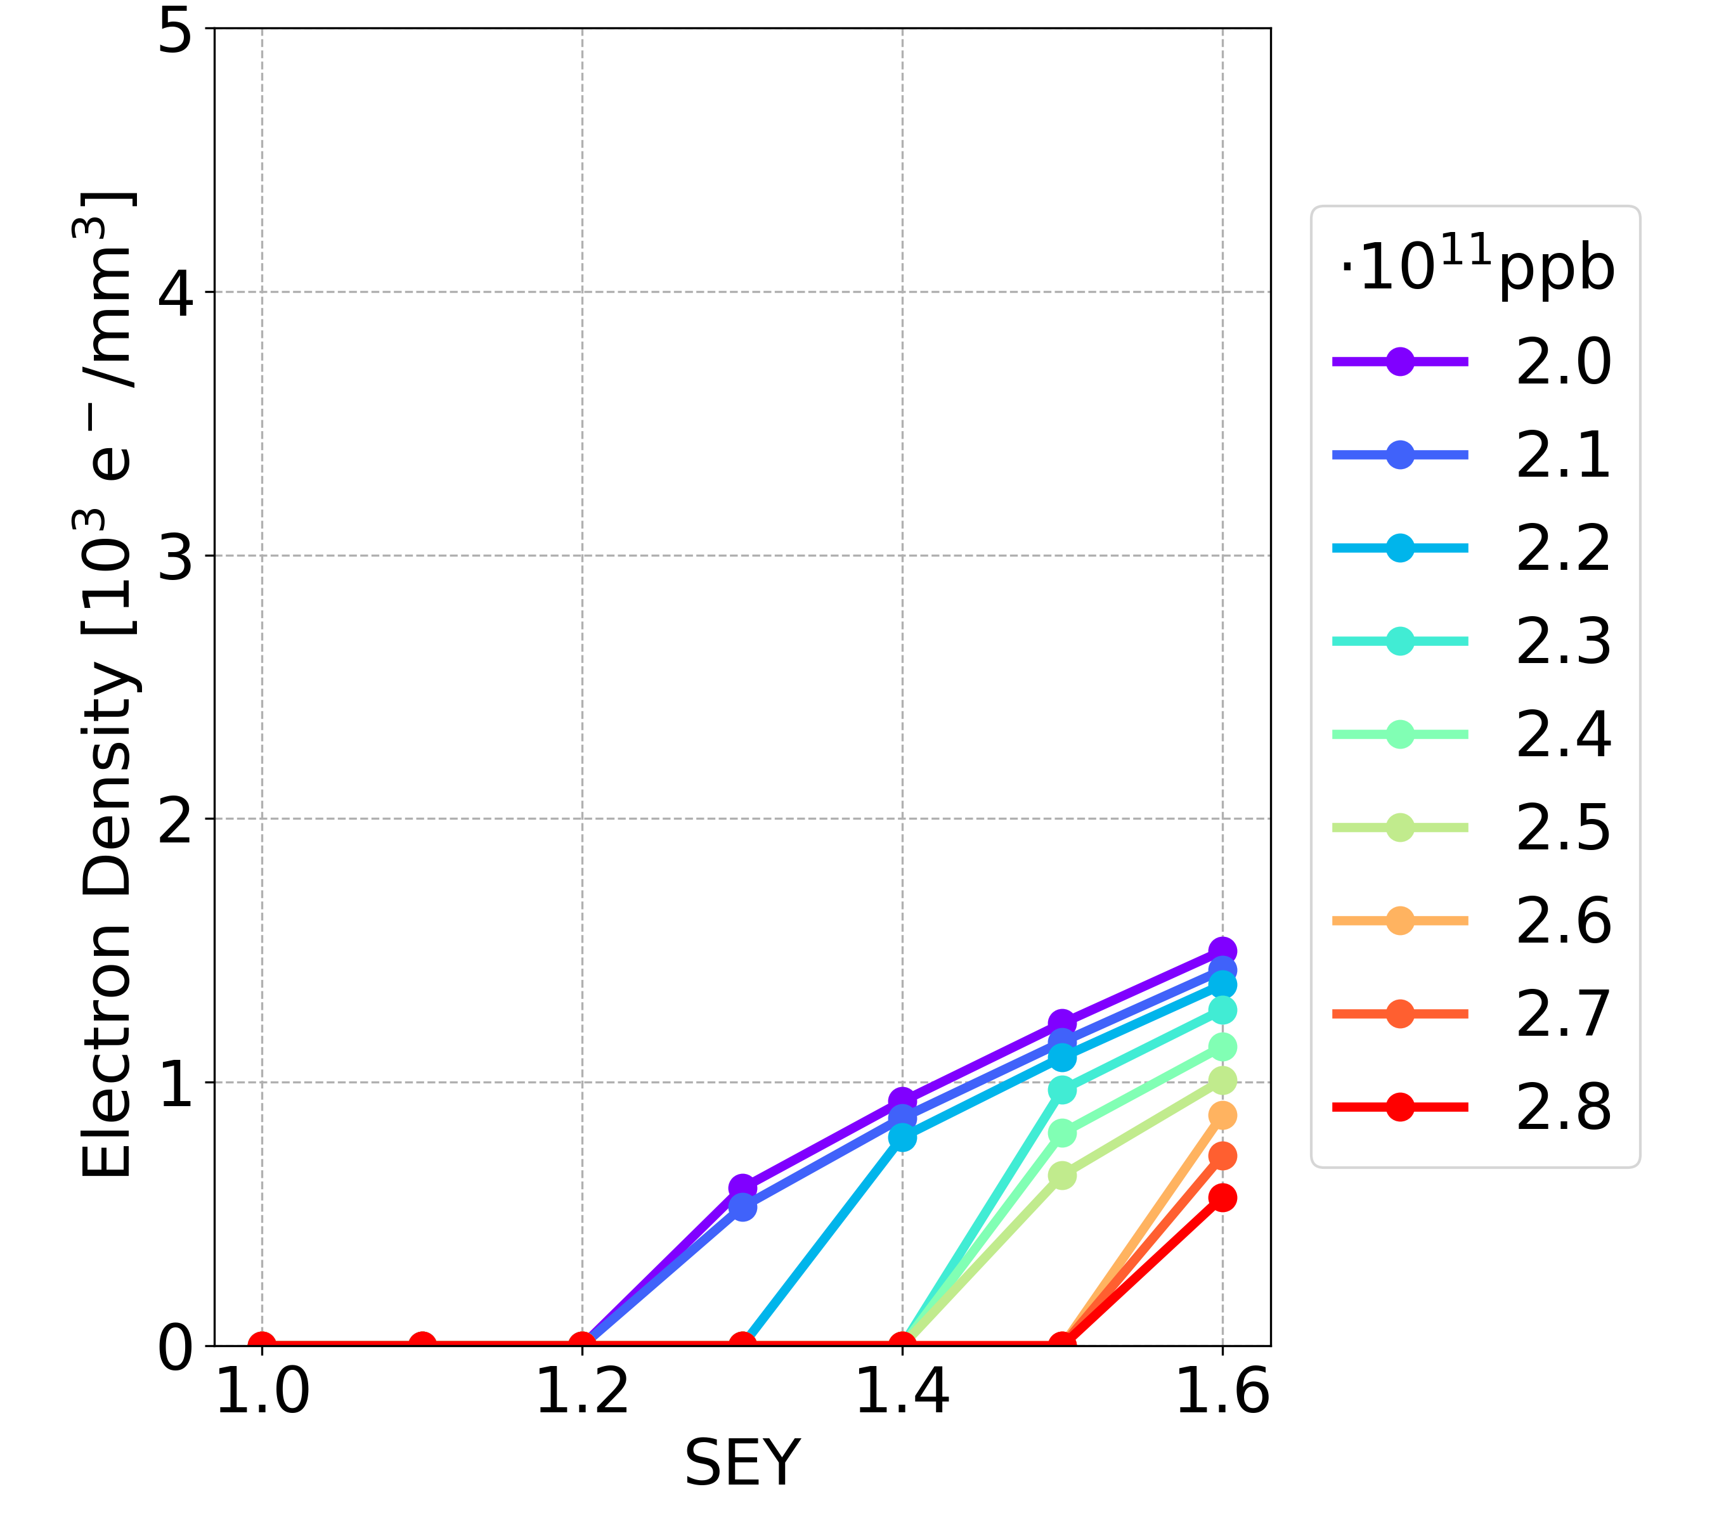
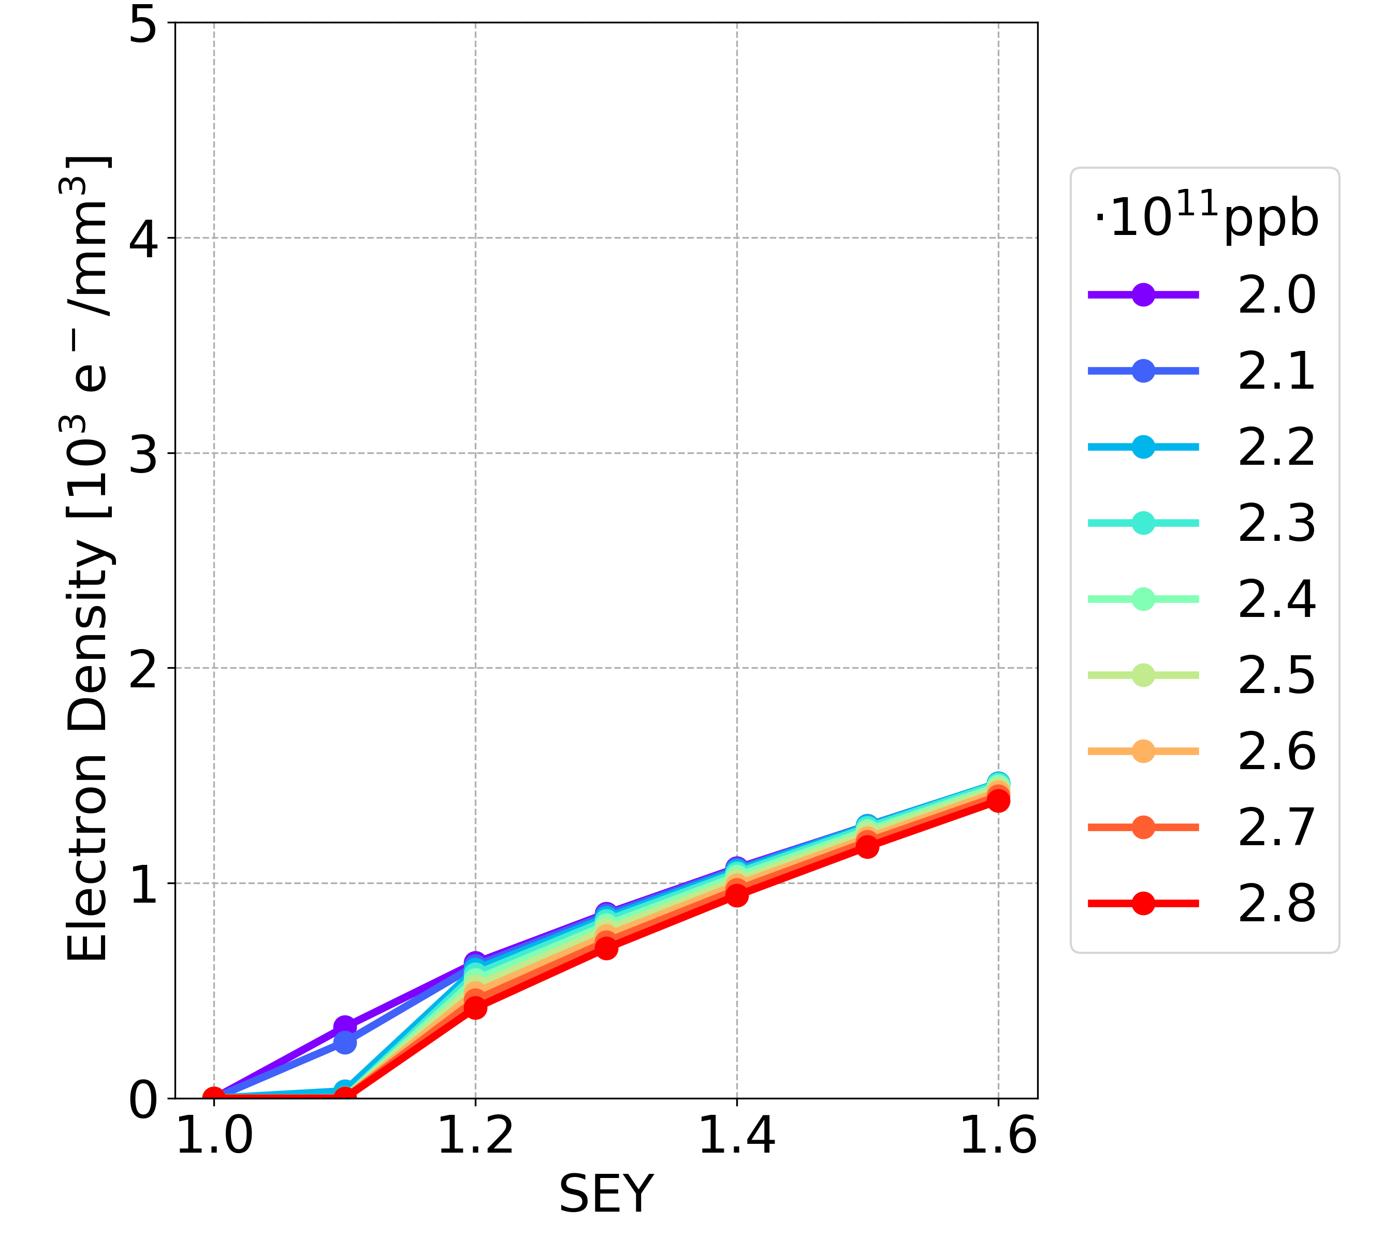
Simulation Results: New vs OLD
Drift space
Dipole
Quadrupole
NEW
15 ns
Drift space
Dipole
Quadrupole
OLD
30 ns

Slide 32
Outline
Introduction
E-Cloud Formation Process
Build-up Simulation Results
Stability Simulations
Conclusions and Outlook
ABP-CEI Section Meeting 01/06/2023

Slide 33
Stability Simulations
A complex problem involving two sets of particles mutually interacting
Vacuum chamber
Electron cloud effects
Courtesy of
G. Rumolo
Shape, PEC boundary conditions
e⁻ production mechanisms
(e.g. secondary emission)
Beam charge distribution
Maxwell’s equations
E.M.
forces
e⁻ equations of motion
Maxwell’s equations
E.M.
forces
External B field
Beam equations of motion
External forces from
Magnets & RF
ABP-CEI Section Meeting 01/06/2023

Slide 34
Stability Simulations
Beam dynamics simulations → Model the interaction of the beam (typically a single bunch) with a given initial electron distribution
Vacuum chamber
Electron cloud effects
Courtesy of
G. Rumolo
Shape, PEC boundary conditions
Pre-calculated initial electron distribution
e⁻ production mechanisms
(e.g. secondary emission)
Beam charge distribution
Maxwell’s equations
E.M.
forces
e⁻ equations of motion
Maxwell’s equations
E.M.
forces
External B field
Beam equations of motion
External forces from
Magnets & RF
ABP-CEI Section Meeting 01/06/2023

Slide 35
Stability Simulations
E-cloud build-up → Solely focuses on electron dynamics with an unperturbed beam distribution to determine how the e-cloud forms and where it saturates
Vacuum chamber
Electron cloud effects
Courtesy of
G. Rumolo
Shape, PEC boundary conditions
e⁻ production mechanisms
(e.g. secondary emission)
External EM fields in RF cavity
Pre-calculated forces from unperturbed beam distribution
Beam charge distribution
Maxwell’s equations
E.M.
forces
e⁻ equations of motion
Maxwell’s equations
E.M.
forces
External B field
Beam equations of motion
External forces from
Magnets & RF
ABP-CEI Section Meeting 01/06/2023

Slide 36
Stability Simulations
The beam stability simulations are heavy from the computational point of view
HPC cluster at INFN-CNAF (Bologna, Italy) allowing for Message Passing Interface (MPI) applications across multiple nodes
The cluster presently features a total of about 800 CPU-cores
ABP-CEI Section Meeting 01/06/2023

Slide 37
Stability Simulations
Convergence studies on the numerical parameters are needed:
the number of longitudinal slices along the bunch
the average number of MPs/slice used to model the proton bunch
the number of e-cloud interactions (kicks) along the ring
the number of MPs used to model the e-cloud at each interaction
the configuration of the transverse grids used to compute the fields generated by the beam and by the electrons through the PIC method [ ] )
10
9
8
7
6
5
4
3
2
1
Bunch length
MP₁
MP₂
MP₃
…
MP_{N}
[ ] E. Belli, “PyPIC: the multigrid solver”, EC Meeting #32 – September 2, 2016
ABP-CEI Section Meeting 01/06/2023

Slide 38
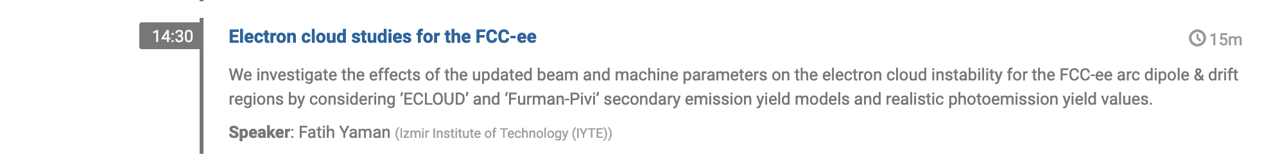
Stability Simulations
For the first results, see the presentation of Fatih Yaman on Thursday 8th June at 14:30
ABP-CEI Section Meeting 01/06/2023

Slide 39
Outline
Introduction
E-Cloud Formation Process
Build-up Simulation Results
Stability Simulations
Conclusions and Outlook
ABP-CEI Section Meeting 01/06/2023

Slide 40
Conclusions and Outlook
The FCC-ee in the Z configuration has been investigated, because the strongest electron cloud effects are foreseen for this configuration, due to the highest number of bunches (smallest bunch spacing)
Some parameters, in the range of considered values, give a negligible contribution to the e-cloud formation
Beta functions (focusing-defocusing) in quadrupoles and dipoles
Beam chamber winglet geometry
In some cases multipacting can occur even with electron bunches
The e-cloud density is smaller compared with the positron bunches
The electrons are mainly located far from the beam chamber centre
The dependence on the bunch intensity is not monotonic:
It is dependent on the considered value range
it is related to the different elements
ABP-CEI Section Meeting 01/06/2023

Slide 41
Conclusions and Outlook
Increasing the bunch spacing, the e-cloud density decreases in all elements (for more cases there is no multipacting)
For a fixed bunch spacing
the e-cloud density has the same order of magnitude for the new parameters and the old ones
the new configuration of beam chamber / bunch length / bunch intensity does not significantly alter the e-cloud density
The max bunch spacing reachable
new parameters, 18.9 ns (16,000 bunches)
old parameters, 32.9 ns (9,200 bunches)
Comparing the new configuration and the old configuration with the max bunch spacing reachable
e-cloud density is higher in all the elements
ABP-CEI Section Meeting 01/06/2023

Slide 42
Conclusions and Outlook
One of the main concerns is the e-cloud effect on the beam stability
Further studies will be performed in order to check the stability limits by means of self-consistent beam stability simulations for the different arc elements with realistic e-cloud distributions obtained from build-up simulations
ABP-CEI Section Meeting 01/06/2023

Slide 43
Thank you for your attention
ABP-CEI Section Meeting 01/06/2023

Slide 46
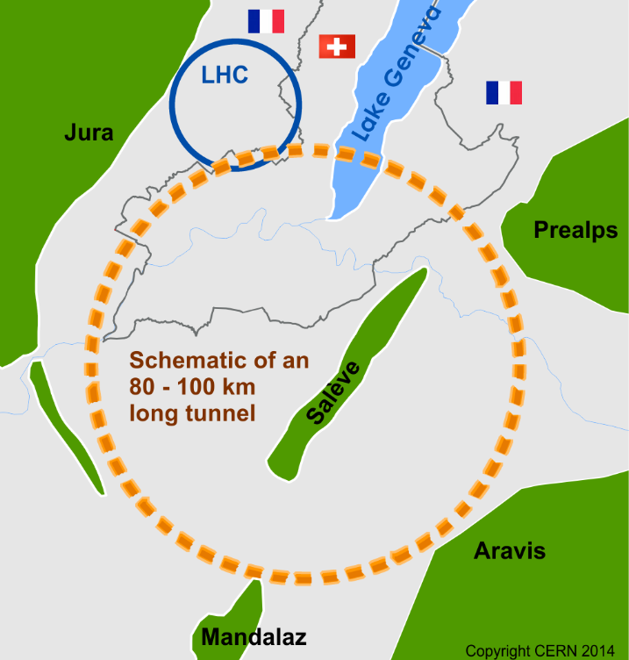
Introduction: FCC
The research project is in the framework of long term coherent stability for the Future Circular Collider (FCC)
FCC study is developing designs for a new research infrastructure to host the next generation of higher performance particle colliders to extend the research currently being conducted at CERN
The goal of the FCC is to push the energy and intensity frontiers of particle colliders, with the aim of reaching collision energies of 100 TeV, in the search for new physics
ABP-CEI Section Meeting 01/06/2023

Slide 47
Simulation Results: Summary Previous Results
Particle
Beam chamber winglet geometry
Element
Bunch spacing: 10 – 30 ns (step 5 ns)
Bunch intensity: 2.0 – 2.8e11 (step 0.1e11)
SEY: 1.0 – 1.6 (step 0.1)
Total: 9,450 simulations
ABP-CEI Section Meeting 01/06/2023

Slide 48


Background: Case Study
$δ\left(E\right)=δ_{elas}\left(E\right)+δ_{true}(E)$ (2)
$δ_{elas}\left(E\right)=R_{0} {\left(\frac{\sqrt{E} −\sqrt{E+E_{0}}}{\sqrt{E}+\sqrt{E+E_{0}}}\right)}^{2}$ (3)
E₀ and R₀: shape parameters.
For the LHC beam chambers:
E₀ = 150 eV
R₀ = 0.7
(2)
(3)
ABP-CEI Section Meeting 01/06/2023

Slide 49


Background: Case Study
$δ\left(E\right)=δ_{elas}\left(E\right)+δ_{true}(E)$ (2)
$δ_{true}\left(E\right)=δ_{max}\frac{s \frac{E}{E_{max}}}{s−1+{\left(\frac{E}{E_{max}}\right)}^{s}}$ (4)
s: shape parameter;
$δ_{max}$: maximum of the SEY curve dependent on the surface material, roughness and history
E_{max}: electron energy, where the SEY reach the maximum 𝛿_{𝑚𝑎x}:
$$δ\left(E_{max}\right) ≅δ_{true}\left(E_{max}\right)=δ_{max}$$
For the LHC beam chambers:
s = 1.35
E_{max} = 332 eV
𝛿_{𝑚𝑎x}
(2)
(4)
(3)
$$E_{max}$$
ABP-CEI Section Meeting 01/06/2023

Slide 50


Background: Case Study
Parameter Overview
Secondary emission model:
LHC beam chambers:
$σ_{true}$ = 1.0828
$μ_{true}$ = 1.6636
$\frac{dn_{true}}{dE}=\frac{1}{Eσ_{true}\sqrt{2π}}e^{−\frac{{\left(ln\left(E\right)−μ_{true}\right)}^{2}}{2{σ_{true}}^{2}}}$
[eV]
[] B. Henrist et al., “Secondary Electron Emission Data for the Simulation of Electron Cloud”, cds 2002.
ABP-CEI Section Meeting 01/06/2023

Slide 51

Project Goals
The goal is to go below the SEY threshold for instabilities driven by e-cloud
Comparison between the analytical central electron density threshold for single bunch instability and the simulation results
Analytical equation
[] K. Ohmi et al., “Study of Electron Cloud Instabilities in FCC-hh”, Proc. of IPAC2015
Single-bunch stability simulations in dipoles
Courtesy of
L. Mether
ABP-CEI Section Meeting 01/06/2023

Slide 52
ABP-CEI Section Meeting 01/06/2023

