Slide 1
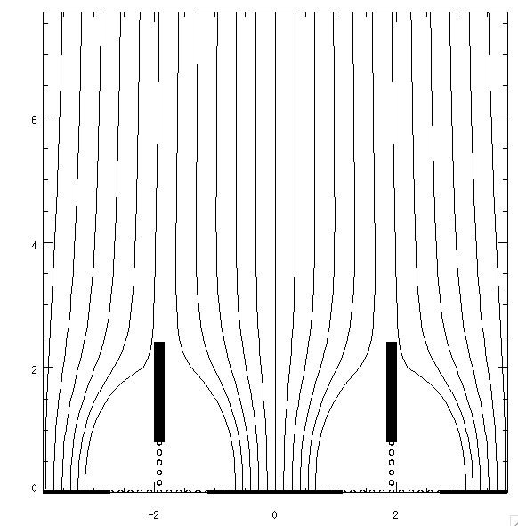
Pixels with shielding electrodes
0.5 KV/cm drift field
Steering electrode (200 V)
3-4 mm
Steering electrode inside Kapton
3-4 mm
Ground
Pixel electrode
Steering and ground electrodes provide mutual shielding to minimize induced signals
How to make it?

