Slide 1
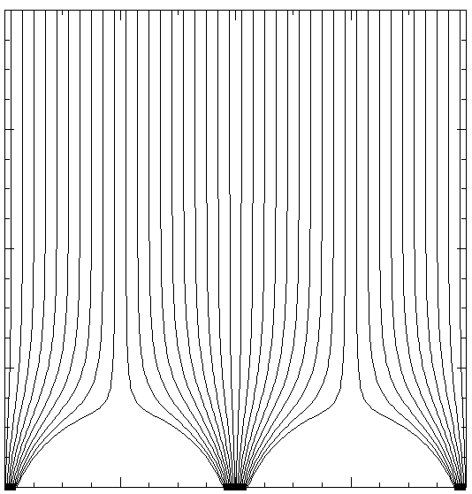
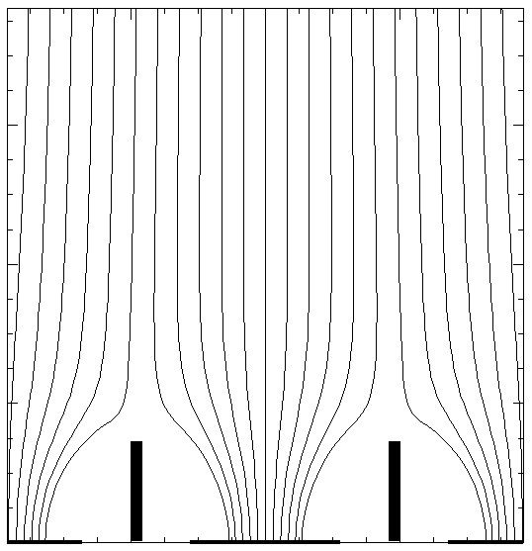
Using shielding electrodes to minimize induced signals
Small collecting electrode
Shielding electrode is a grounded plate at the bottom
Shielding vertical strips (a fence around collecting electrode)
Field lines simulated for 2D case
0.5 KV/cm drift field
4 mm pitch
0.4 mm collecting strips
Assuming that the gaps are fully charged (this is equivalent to 300 V in the middle)
Field lines simulated for 2D case
0.5 KV/cm drift field
200 V on shielding strips
4 mm pitch
Zero potential in the gaps
Z (mm)
0 2 4 6
Z (mm)
0 2 4 6
Shielding strips
-2 0 2
X (mm)
-2 0 2
X (mm)
Shielding plate

