Slide 1
Electron Cloud Build-up Simulation Studies for FCC-ee with new Parameters
Sabato Luca
15/05/2023

Slide 2
Outline
Introduction
Simulation Results
15/05/2023

Slide 3
Outline
Introduction
Simulation Results
15/05/2023

Slide 4
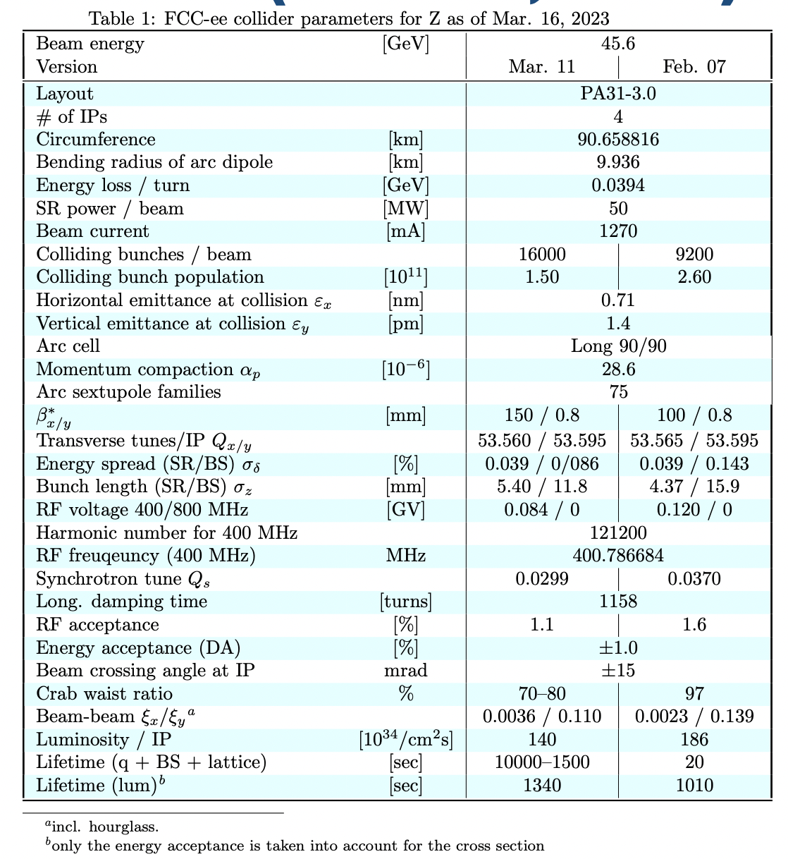
Introduction
New machine and beam parameters
  More bunches -> less bunch spacing (max 18.9 ns)
  Smaller bunch intensity
  Bunch length
K. Oide 16th March 2023, “Impact of beamstrahlung on crab sextupole compensation”, 163rd FCC-ee Optics Design Meeting & 34th FCCIS WP2.2 Meeting
15/05/2023

Slide 5
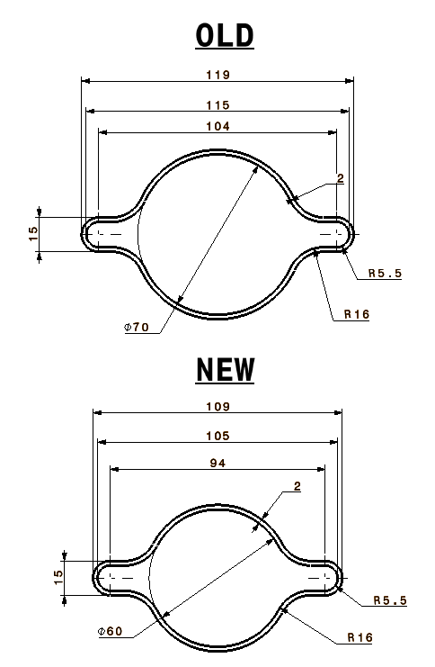
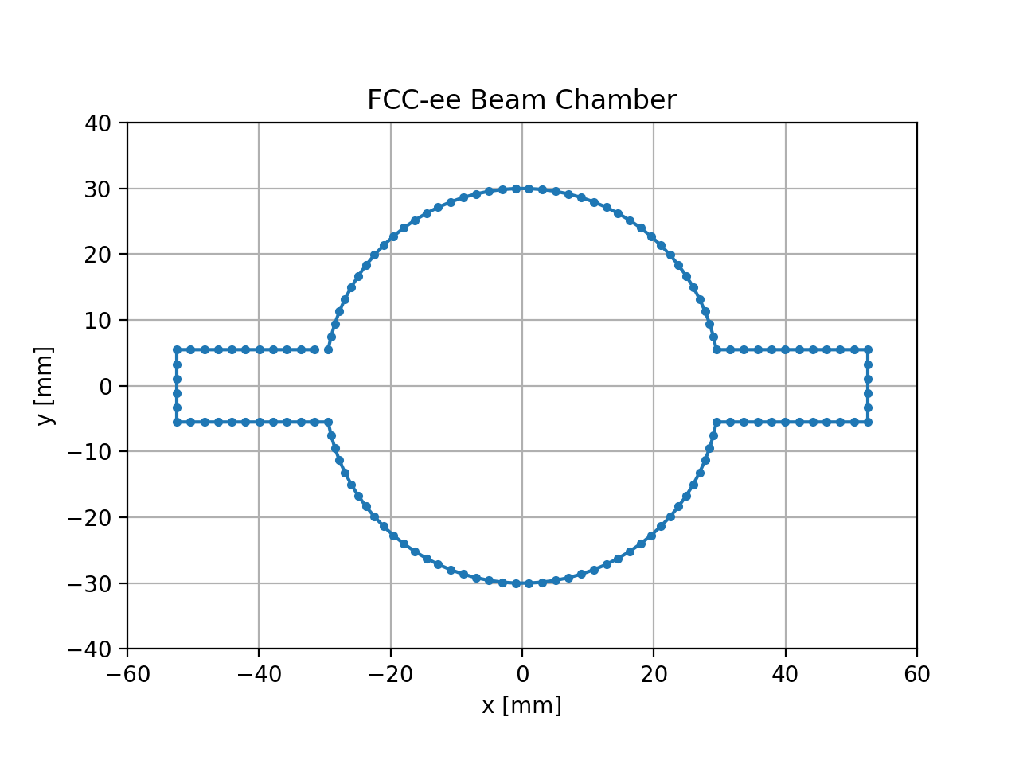
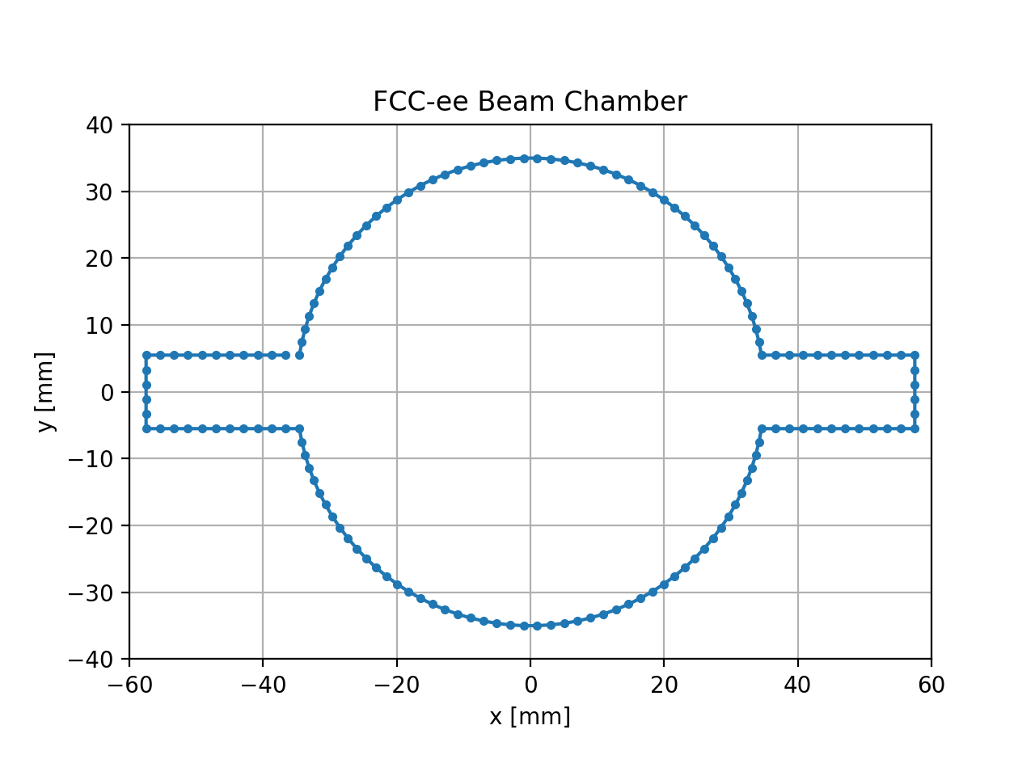
Introduction
New vacuum chamber
Courtesy of R. Kersevan and F. Santangelo
Design in PyECLOUD
Design in PyECLOUD
15/05/2023

Slide 6
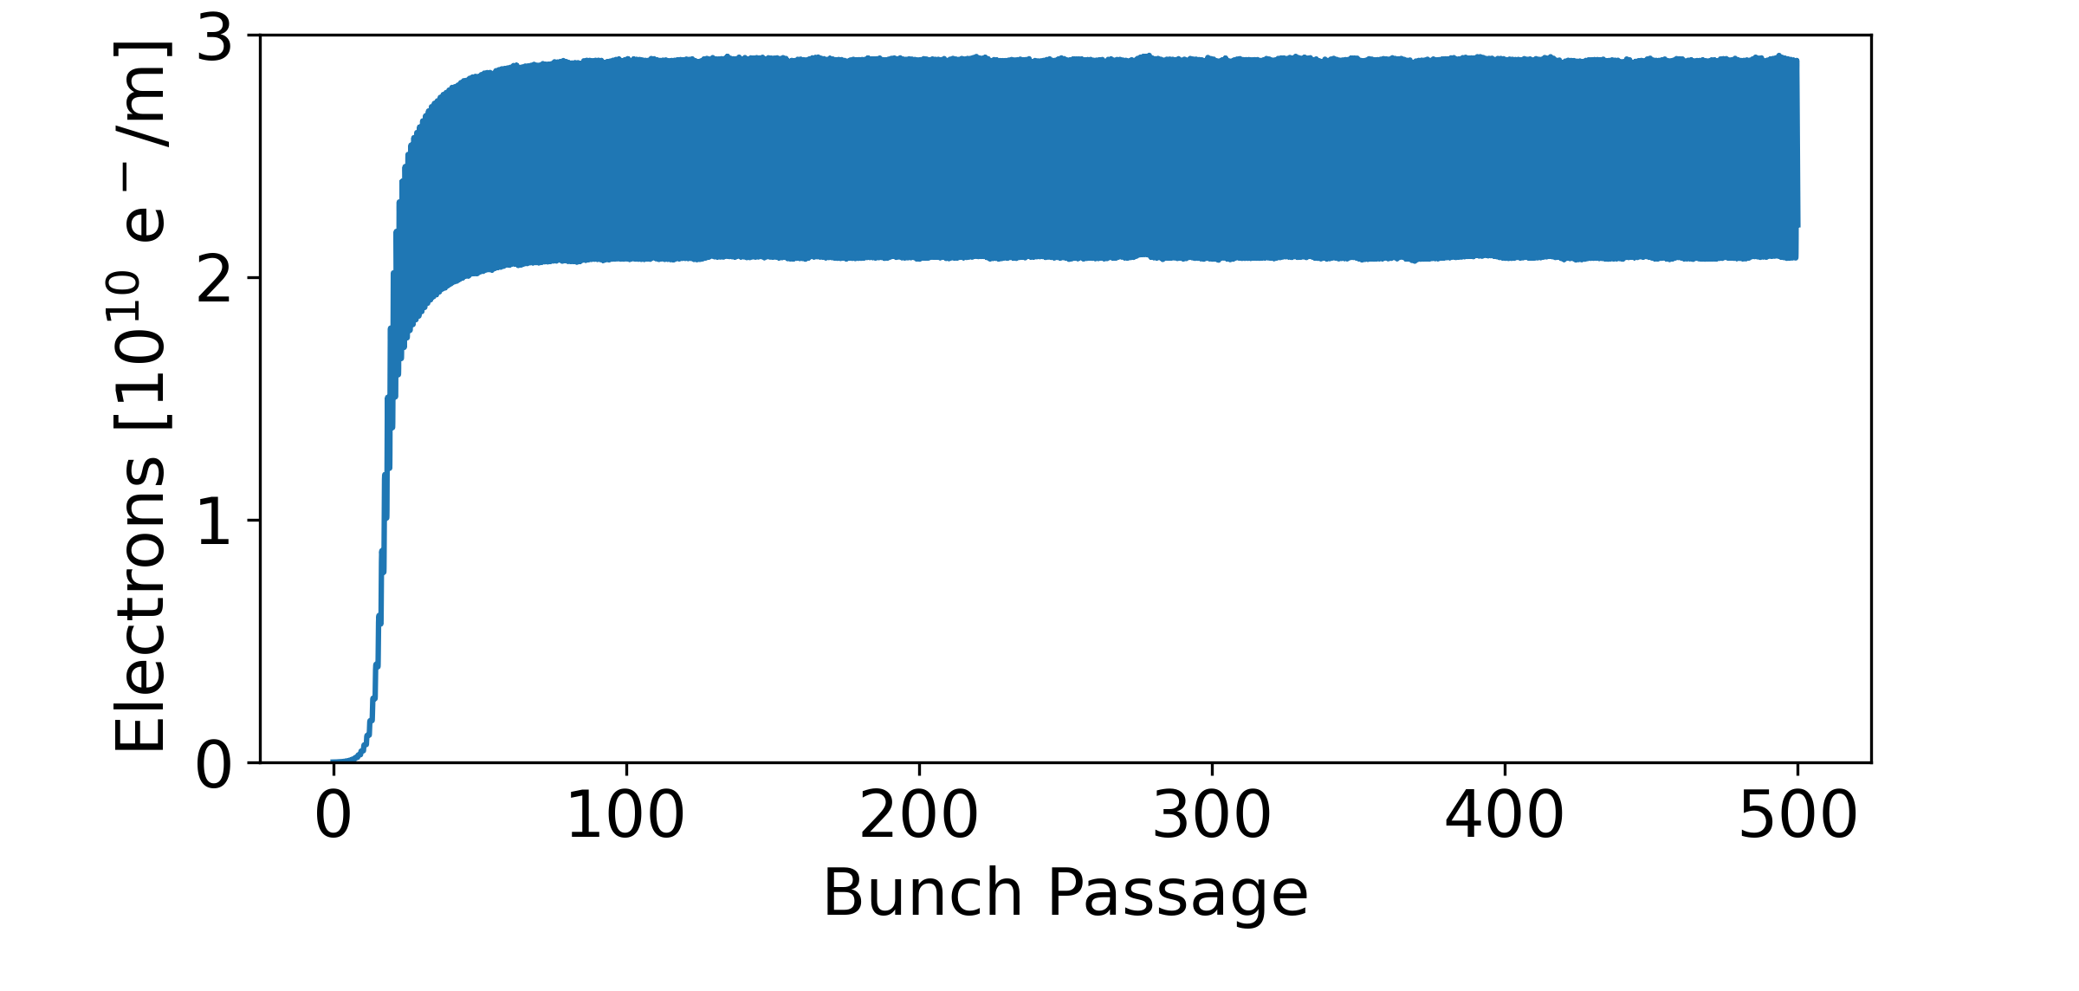
Introduction
Output parameter
  Nel_timep: [m⁻¹] Number of electrons currently in the chamber [1]
  Less noisy of cen_density ([m⁻³] Electron density in a sphere around the centre of the chamber with radius r_center)
For the summary plots
The synthetic parameter is divided by the transverse surface of the vacuum chamber in order to do the comparison with different vacuum chambers
Synthetic parameter
Nel_timep
[1] PyECLOUD manual
https://raw.githubusercontent.com/PyCOMPLETE/PyECLOUD/master/doc/reference/reference.pdf
15/05/2023

Slide 7
Outline
Introduction
Simulation Results
  Bunch Intensity
  New Parameters vs Old Parameters
  Bunch Spacing
15/05/2023

Slide 8
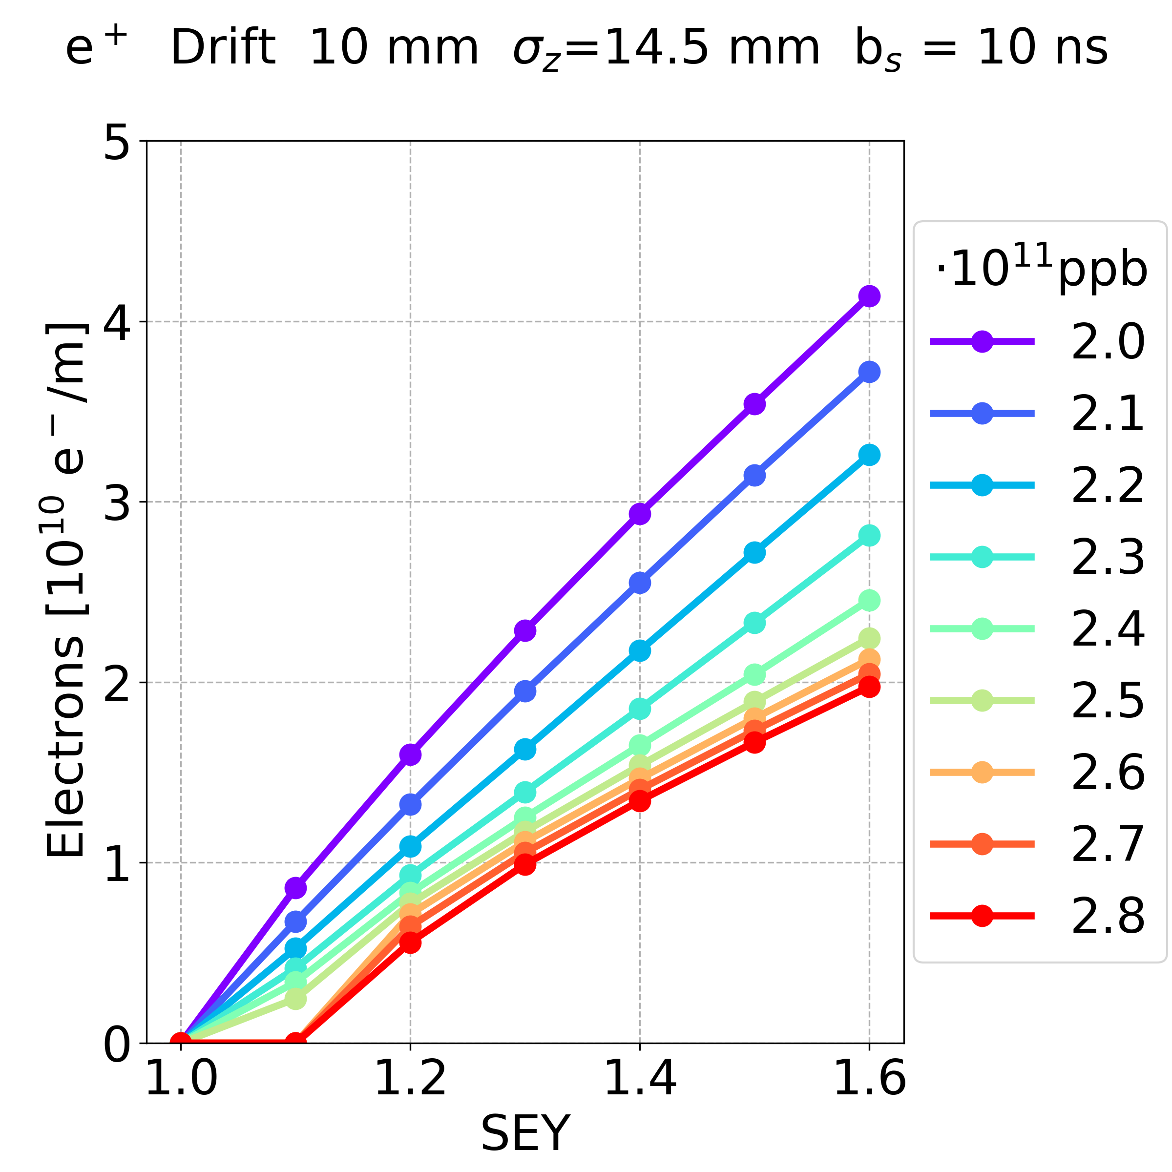
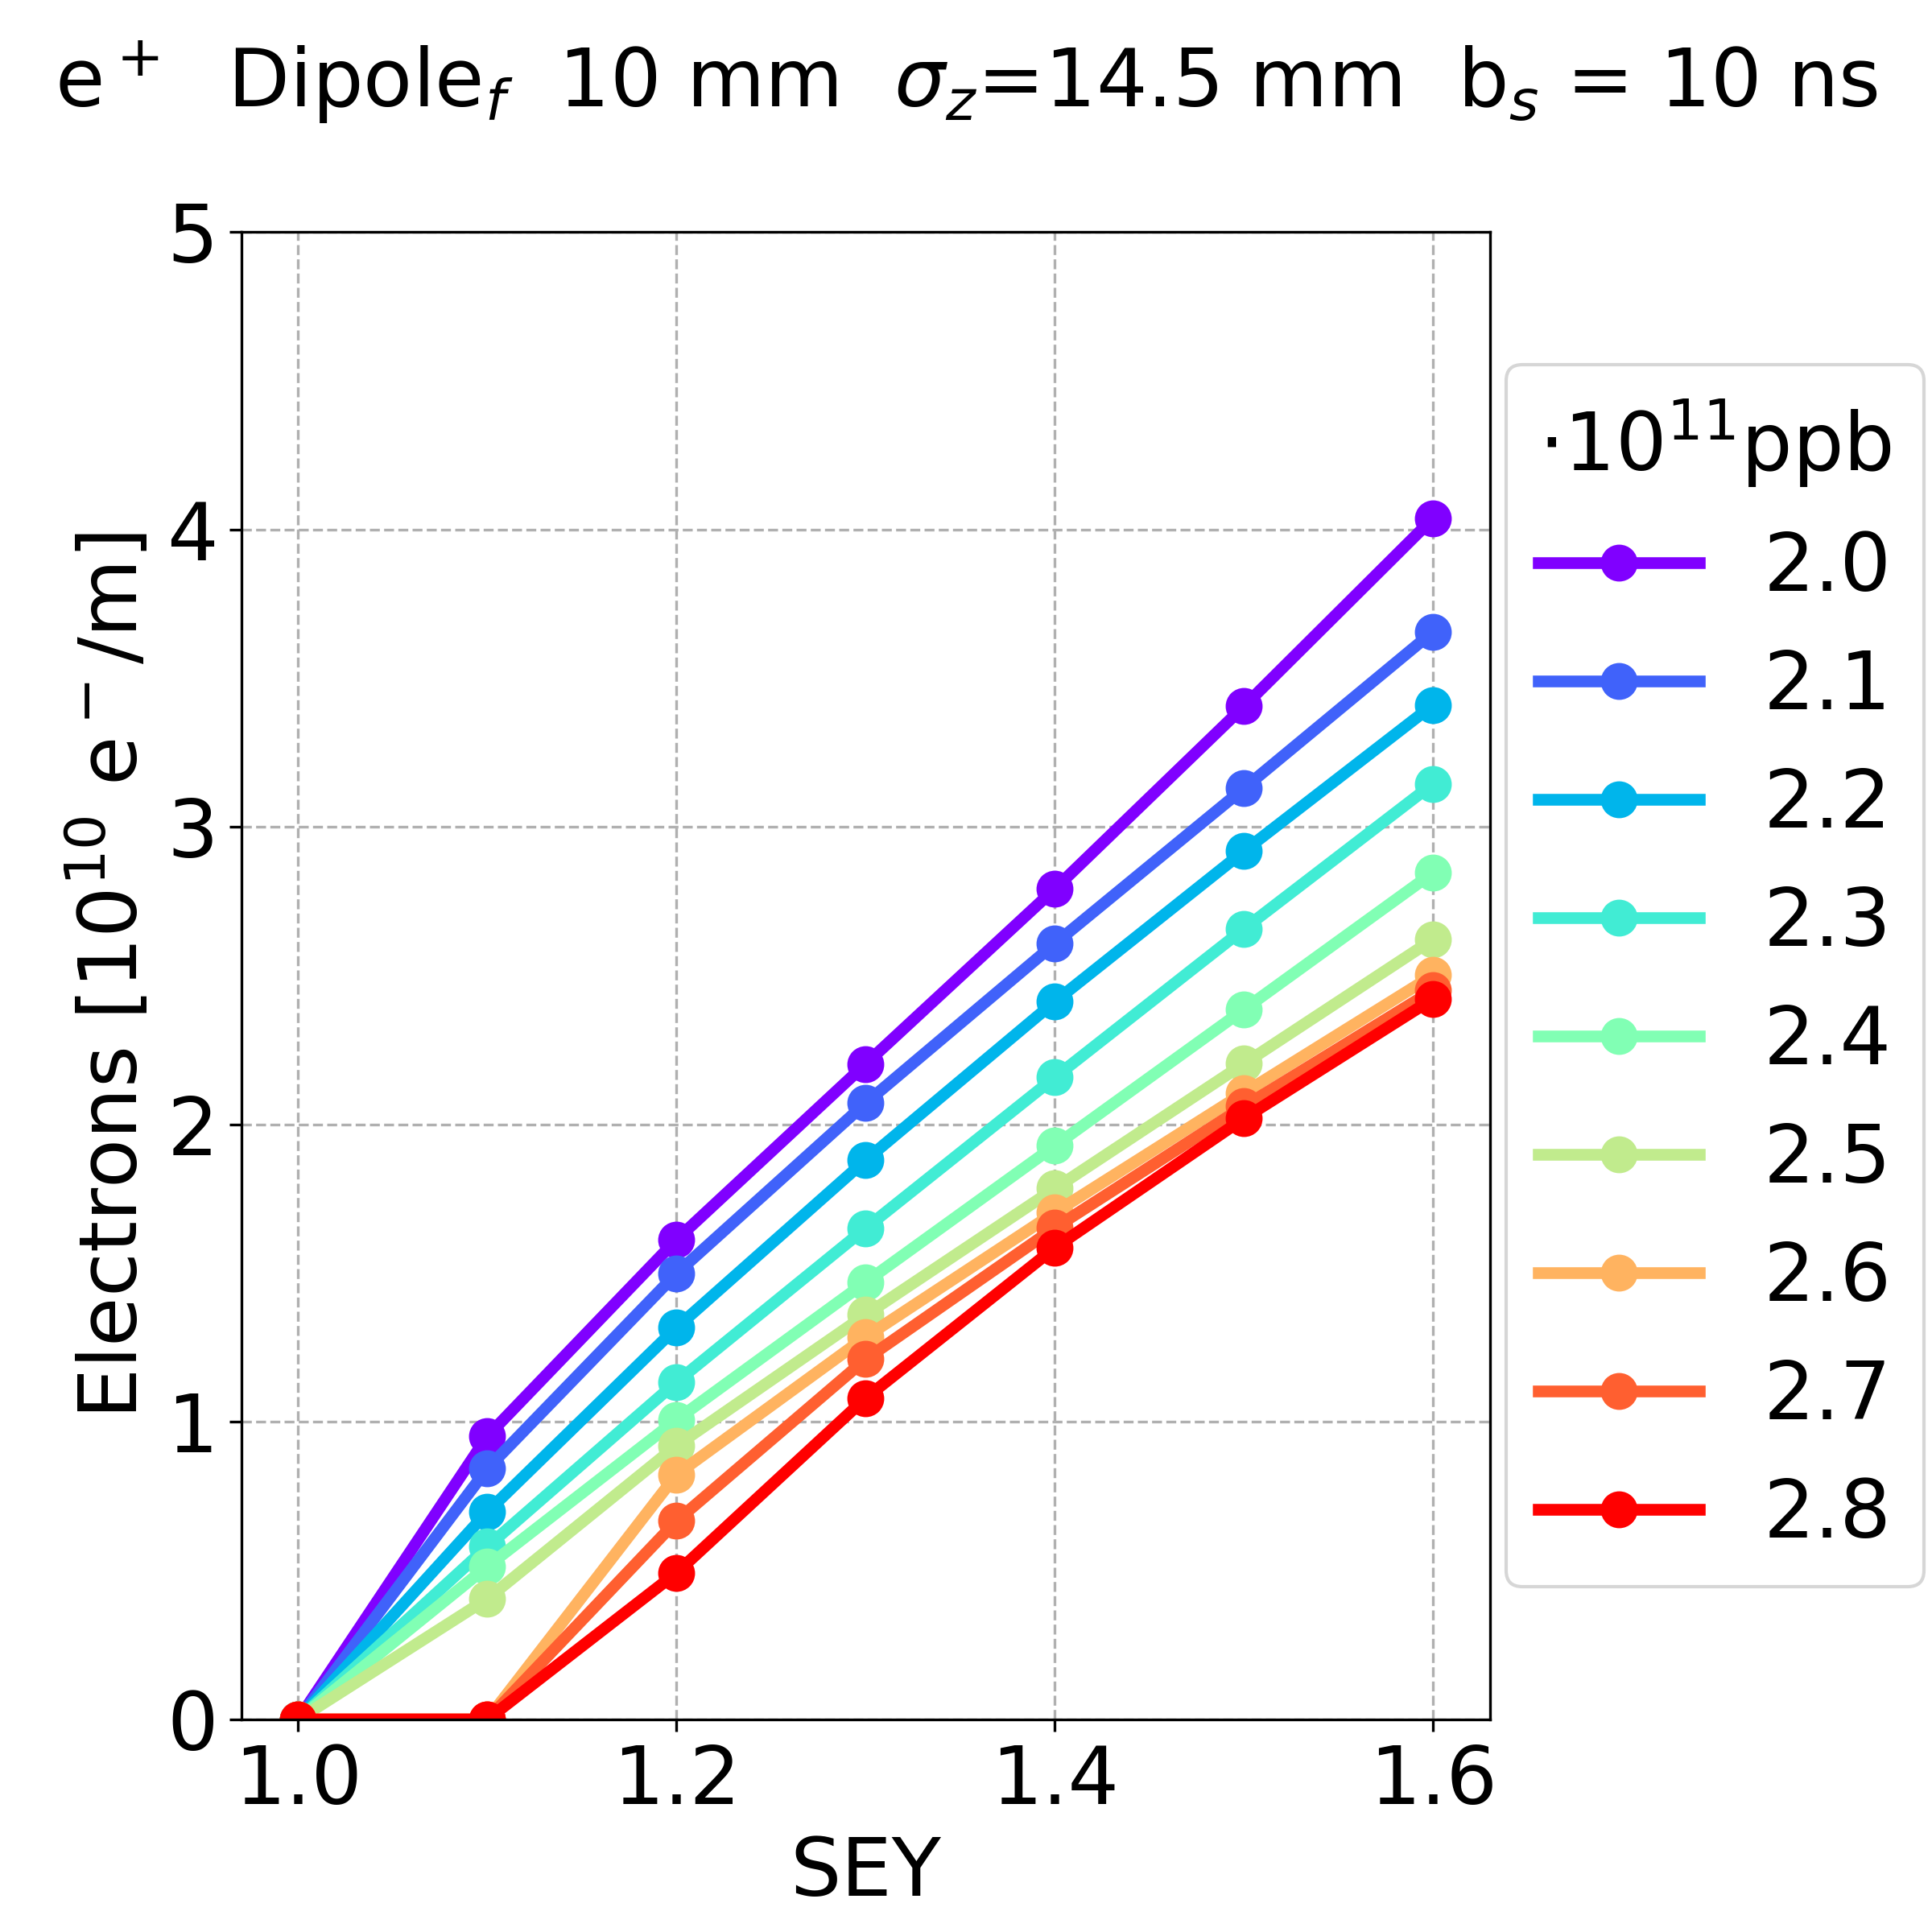
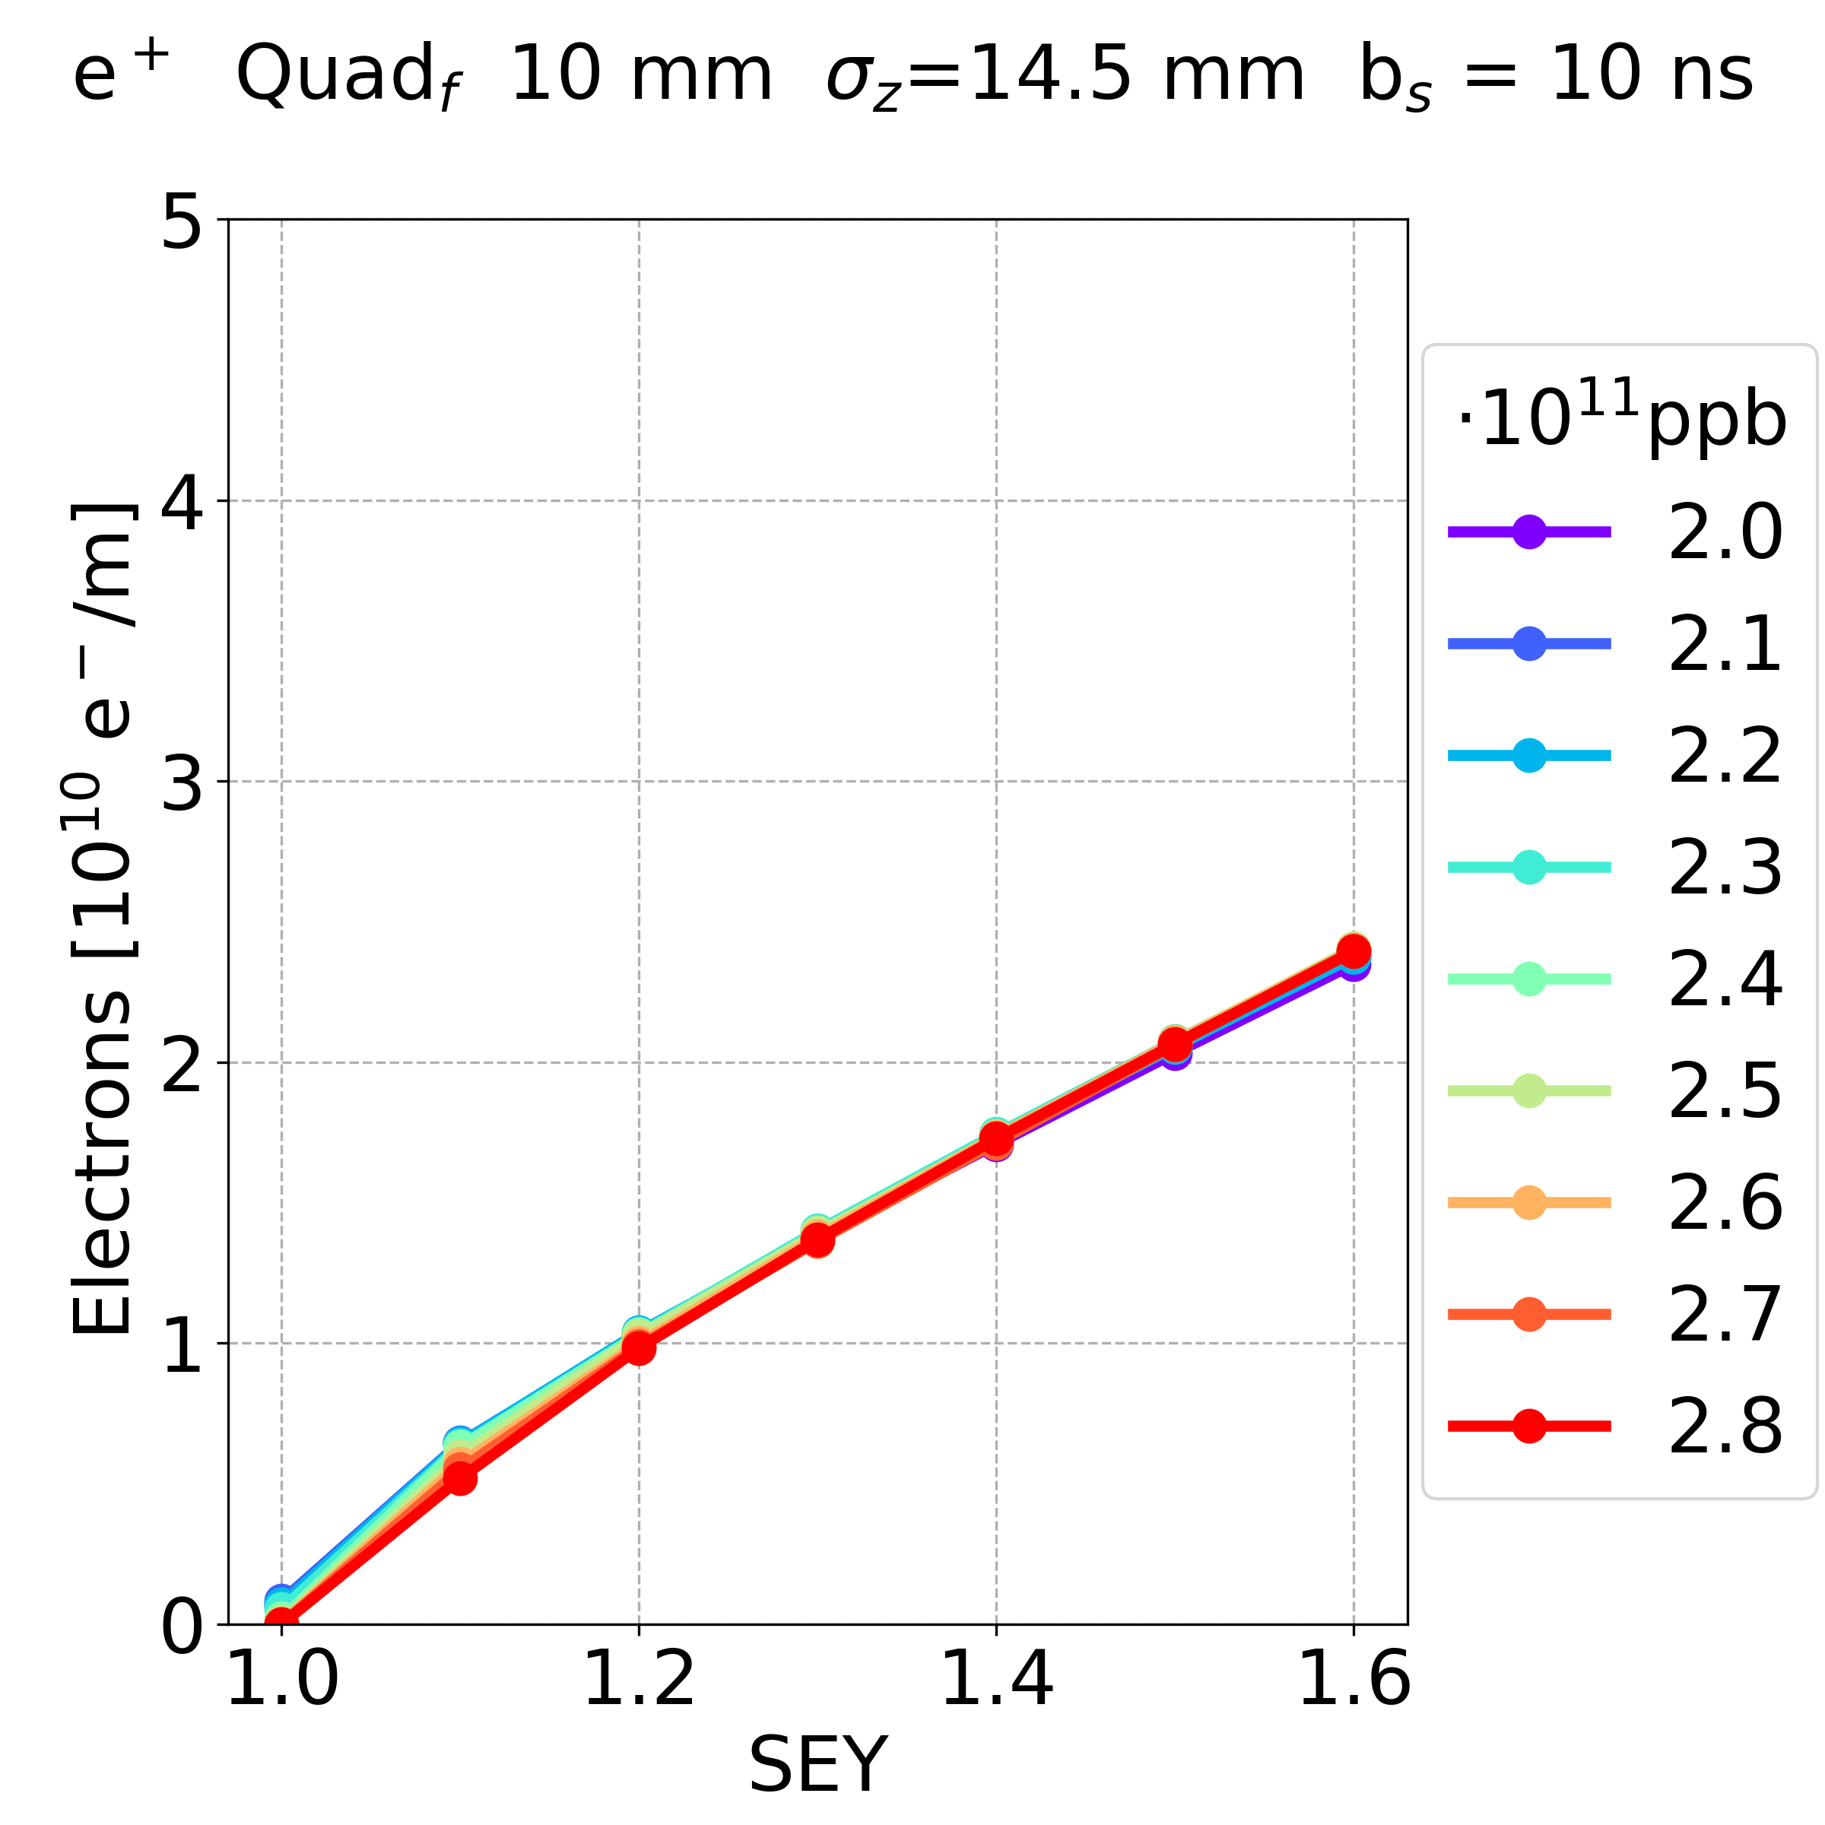
Simulation Results: Bunch Intensity
Old parameters
Drift space
Dipole
Quadrupole
In the drift space and dipole, the electron density has a similar behaviour with respect to the bunch intensity
  less bunch intensity more electron density
In the quadrupole,
  the bunch intensity has a negligible effect on the electron density
L. Sabato, 20th November 2022, “E-cloud studies in the FCC-ee”, 159th FCC-ee Optics Design Meeting & 30th FCCIS WP2.2 Meeting
15/05/2023

Slide 9
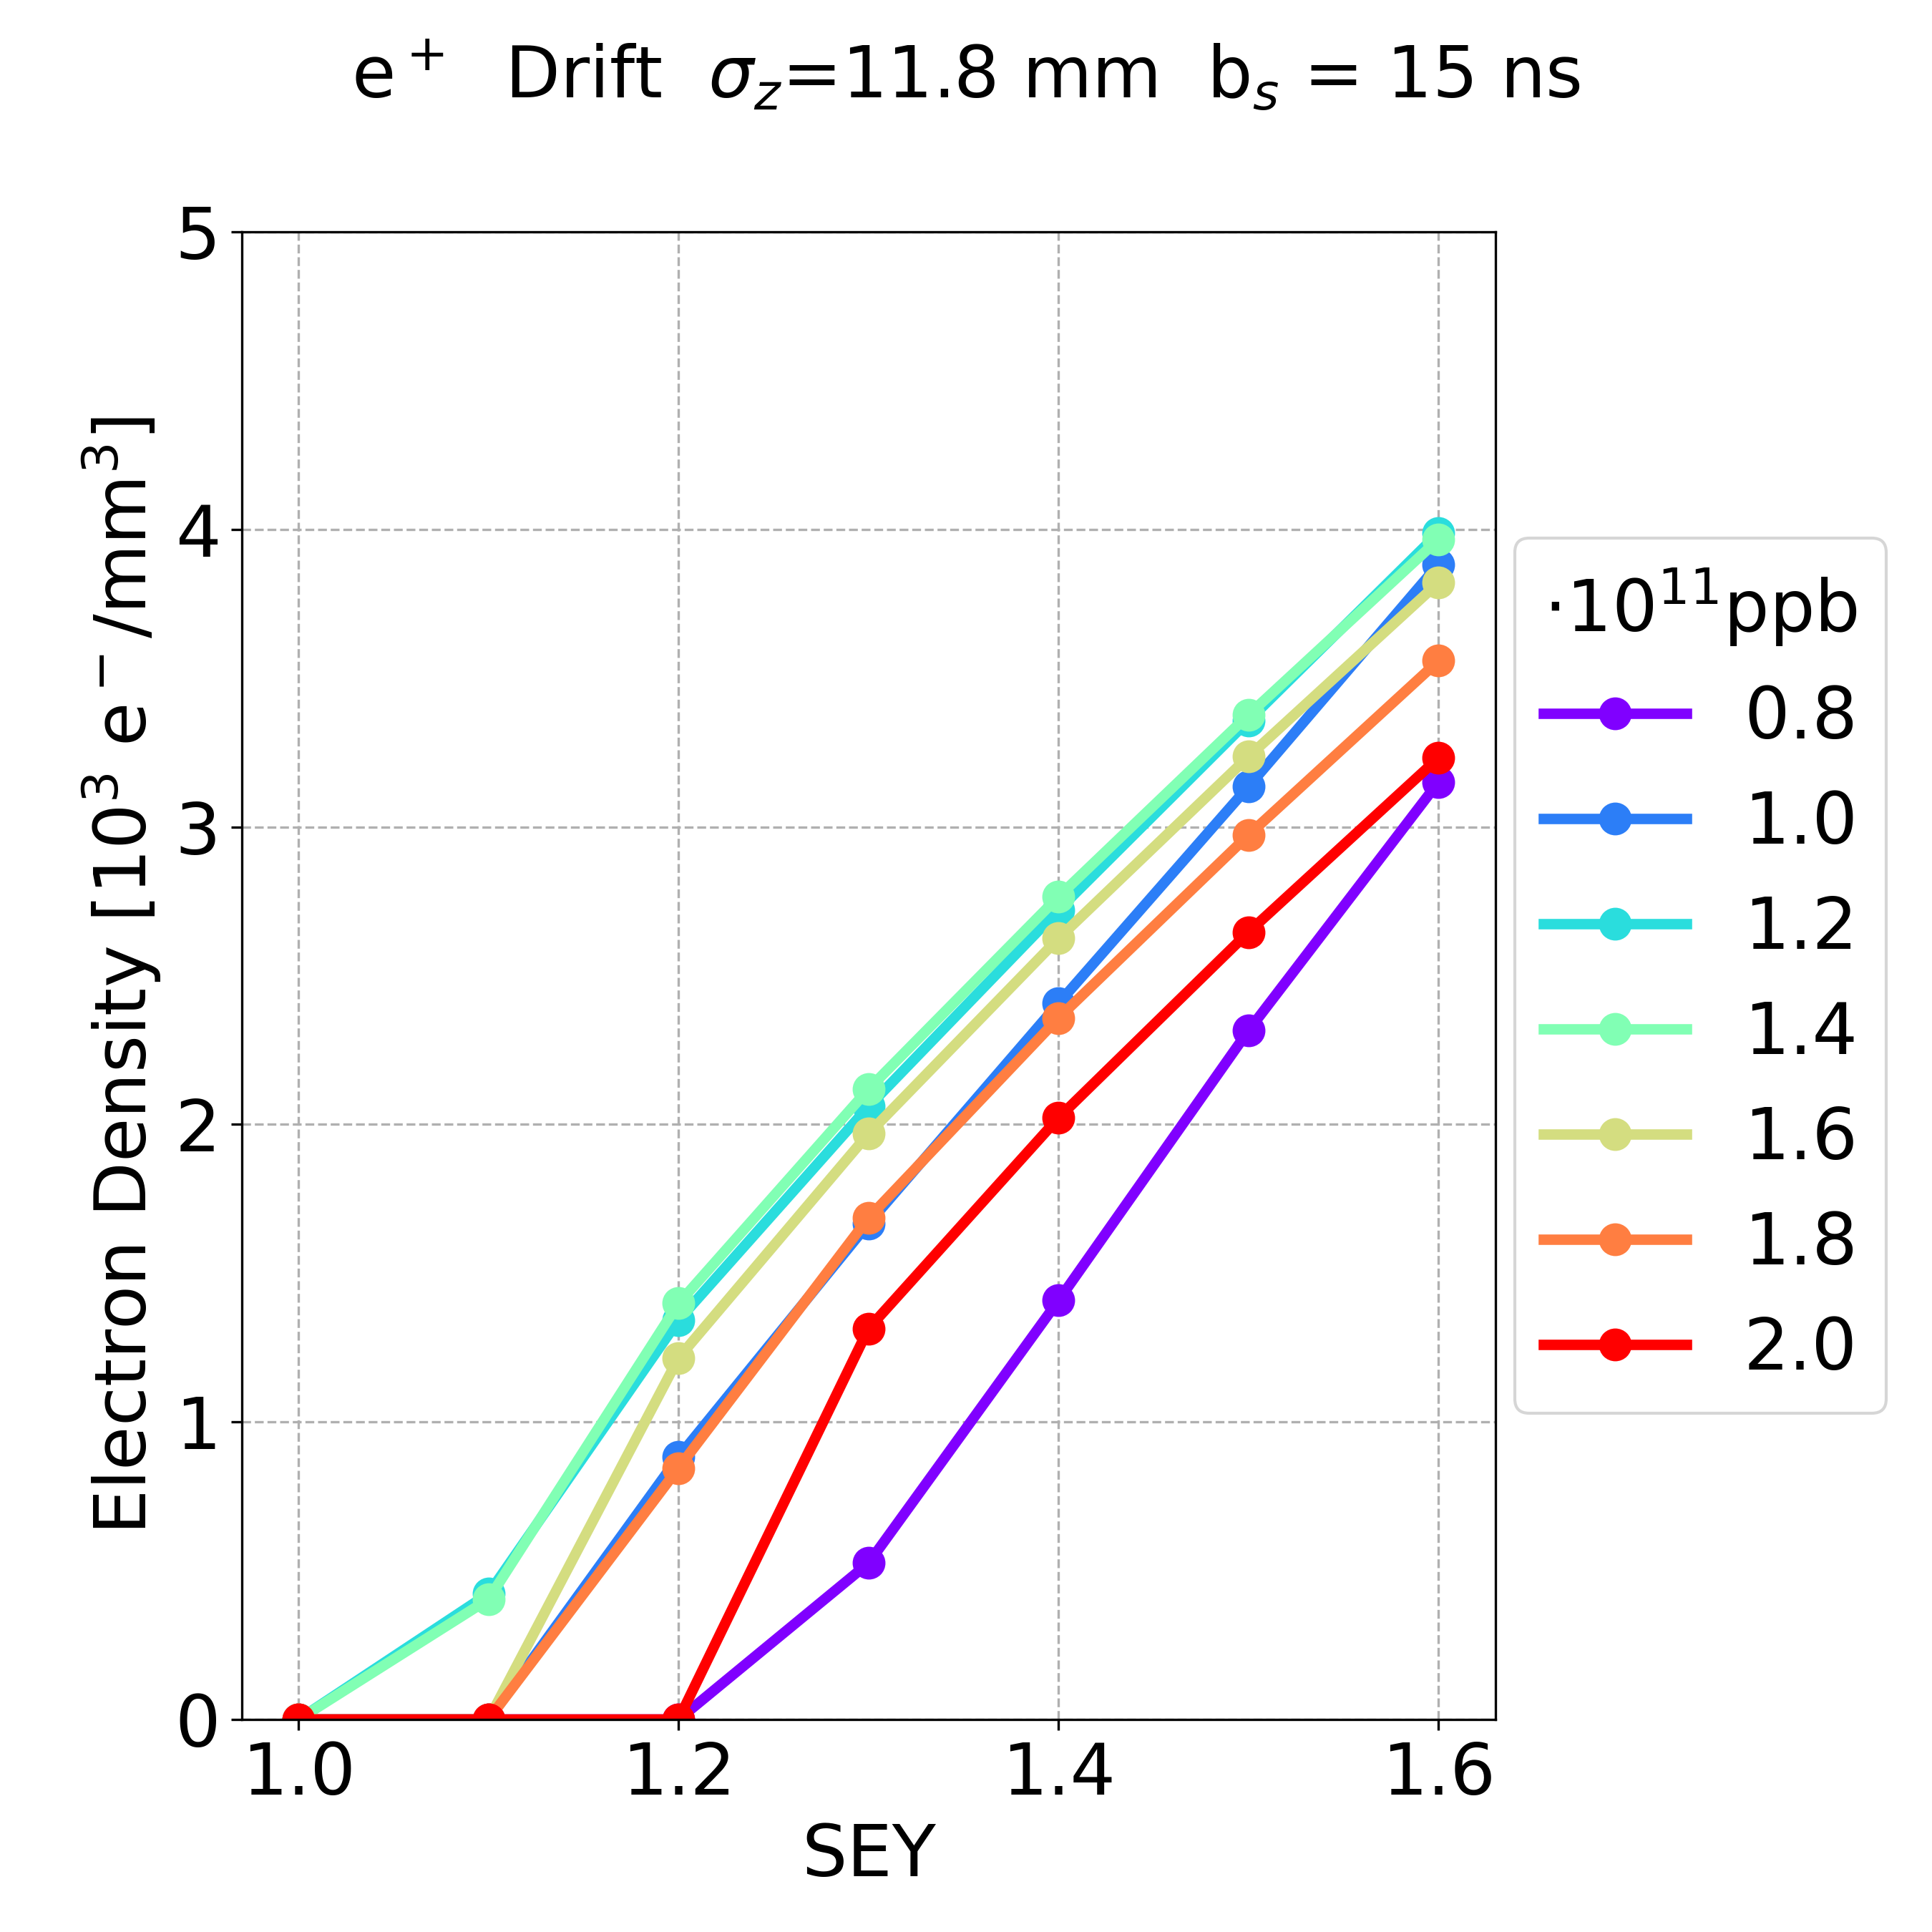
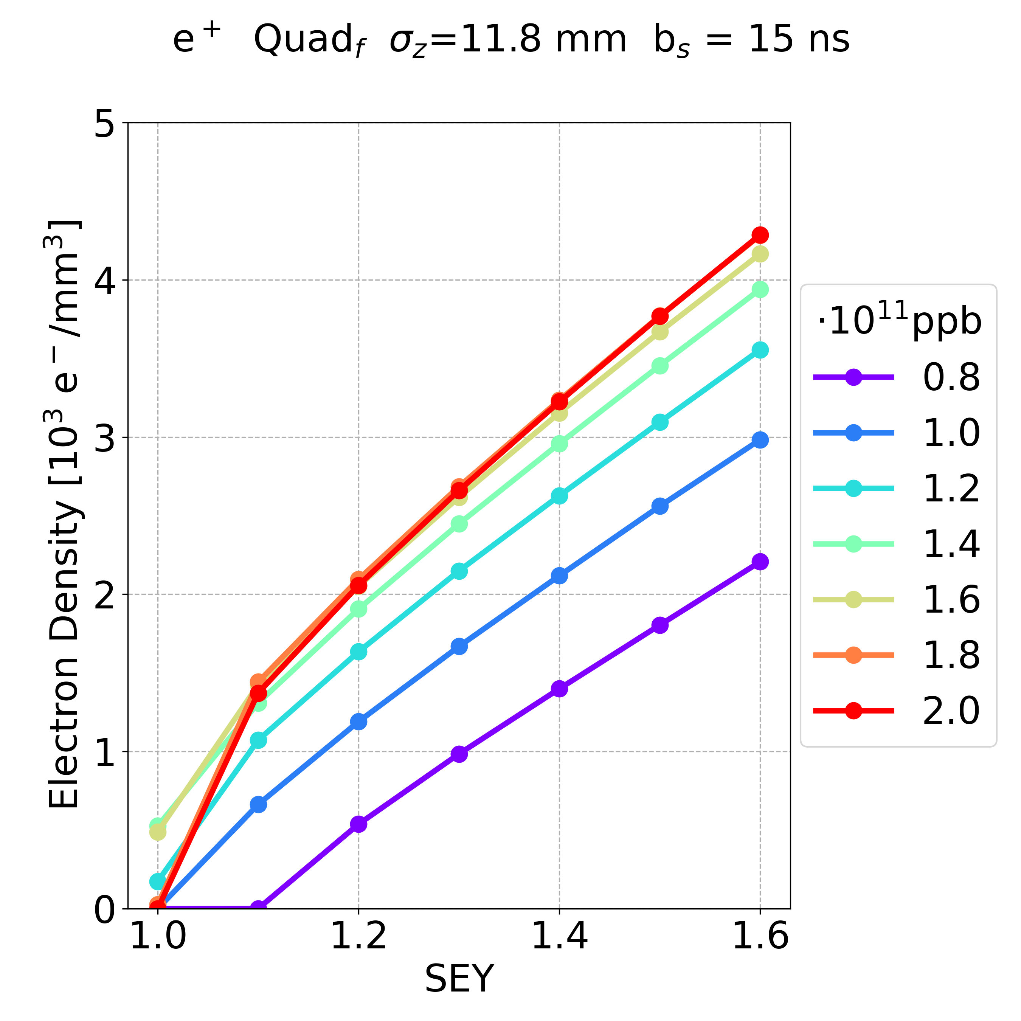
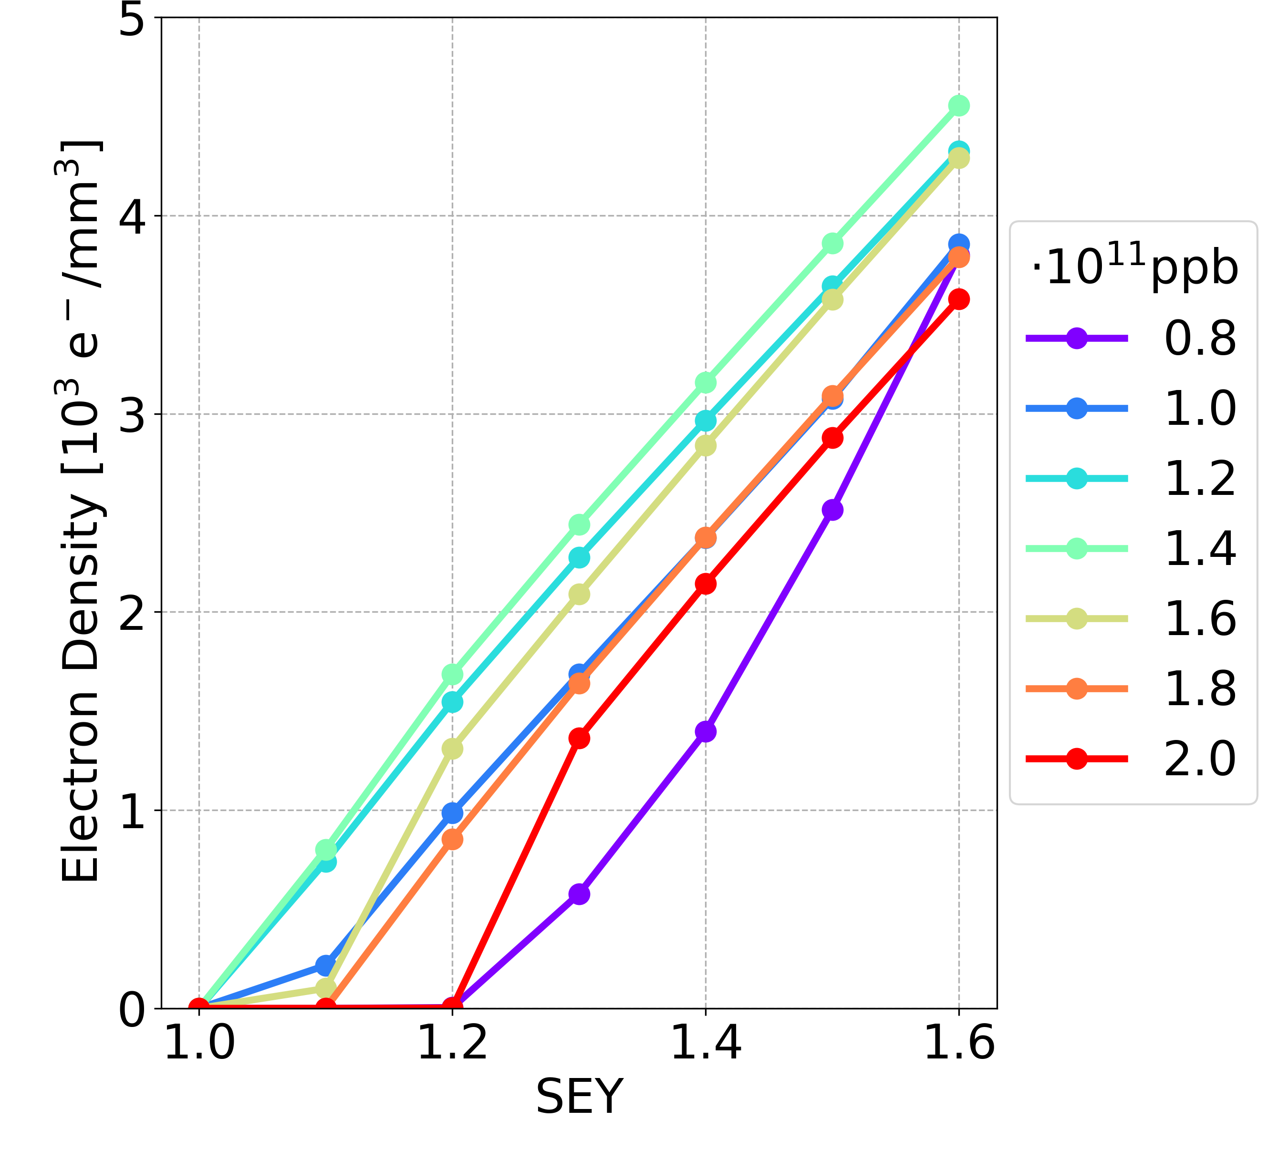
Simulation Results: Bunch Intensity
New parameters (bunch spacing 15 ns, longer bunch length)
Drift space
Dipole
Quadrupole
In the drift space and dipole, the electron density has a similar behaviour with respect to the bunch intensity
  the dependence on the bunch is not monotonic: the worst case is the 1.4⋅10¹¹ ppb
In the quadrupole,
  the bunch intensity has a non-negligible effect on the electron density
  less bunch intensity less electron density
15/05/2023

Slide 10
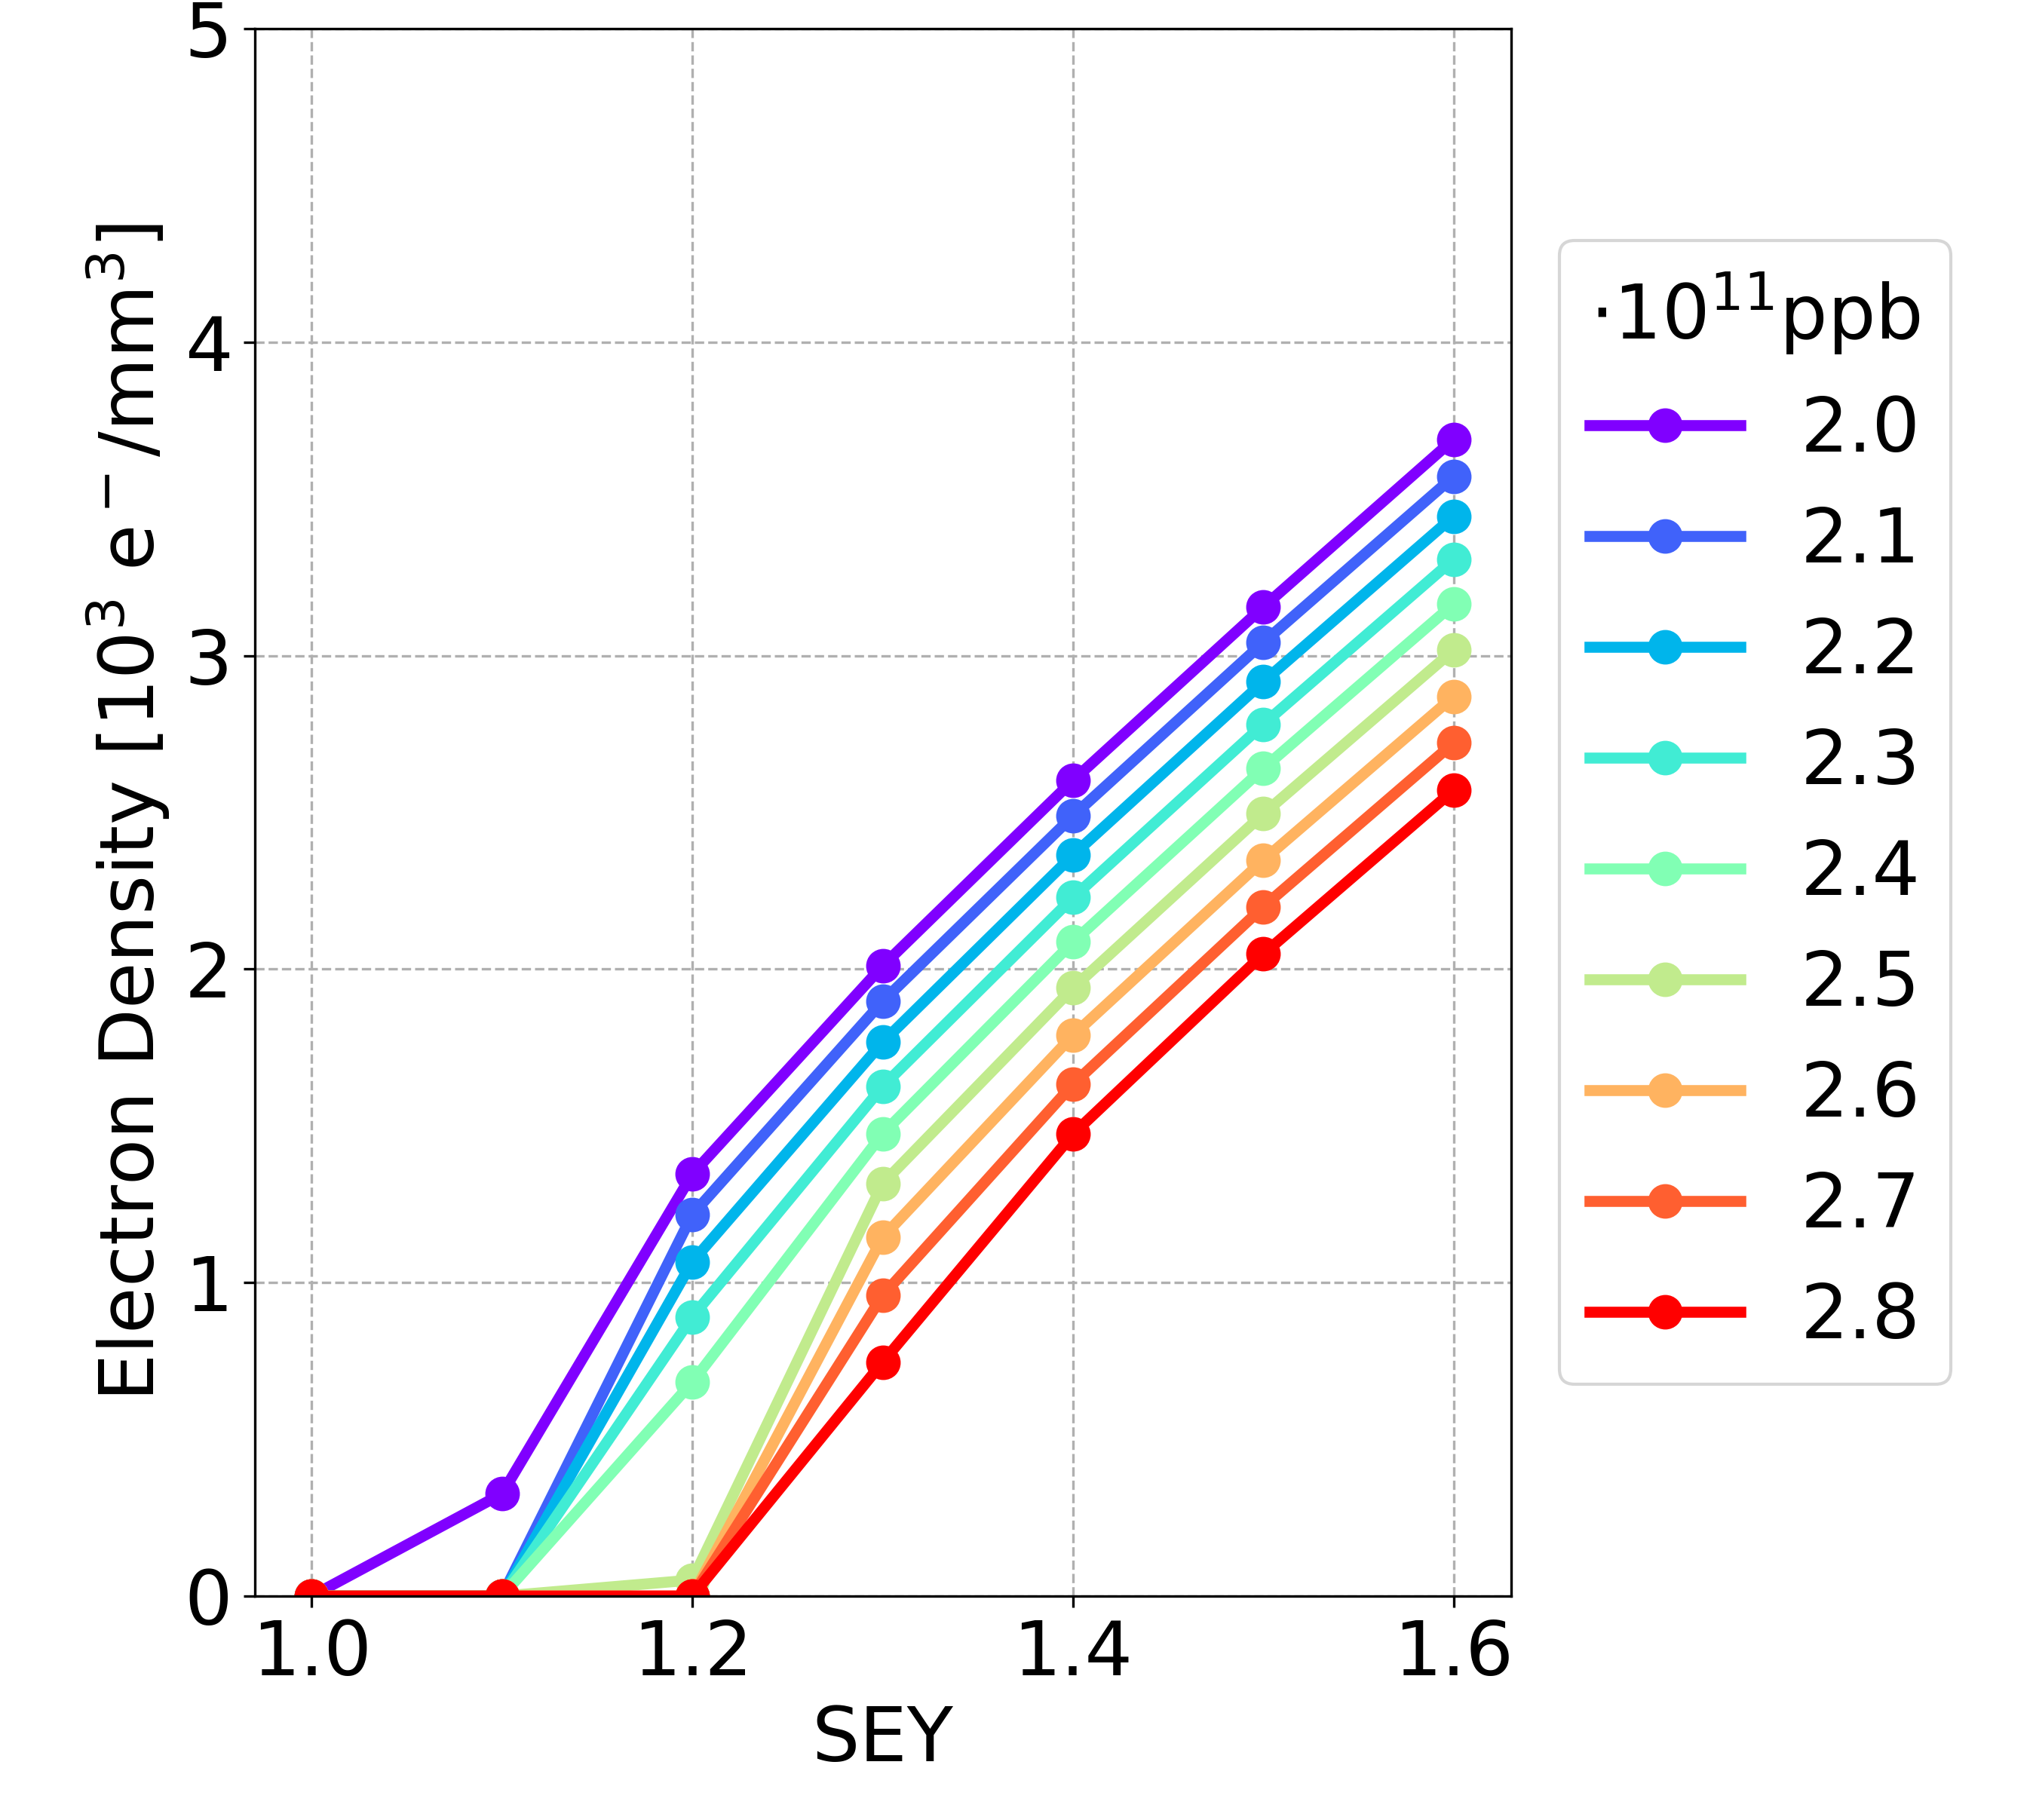
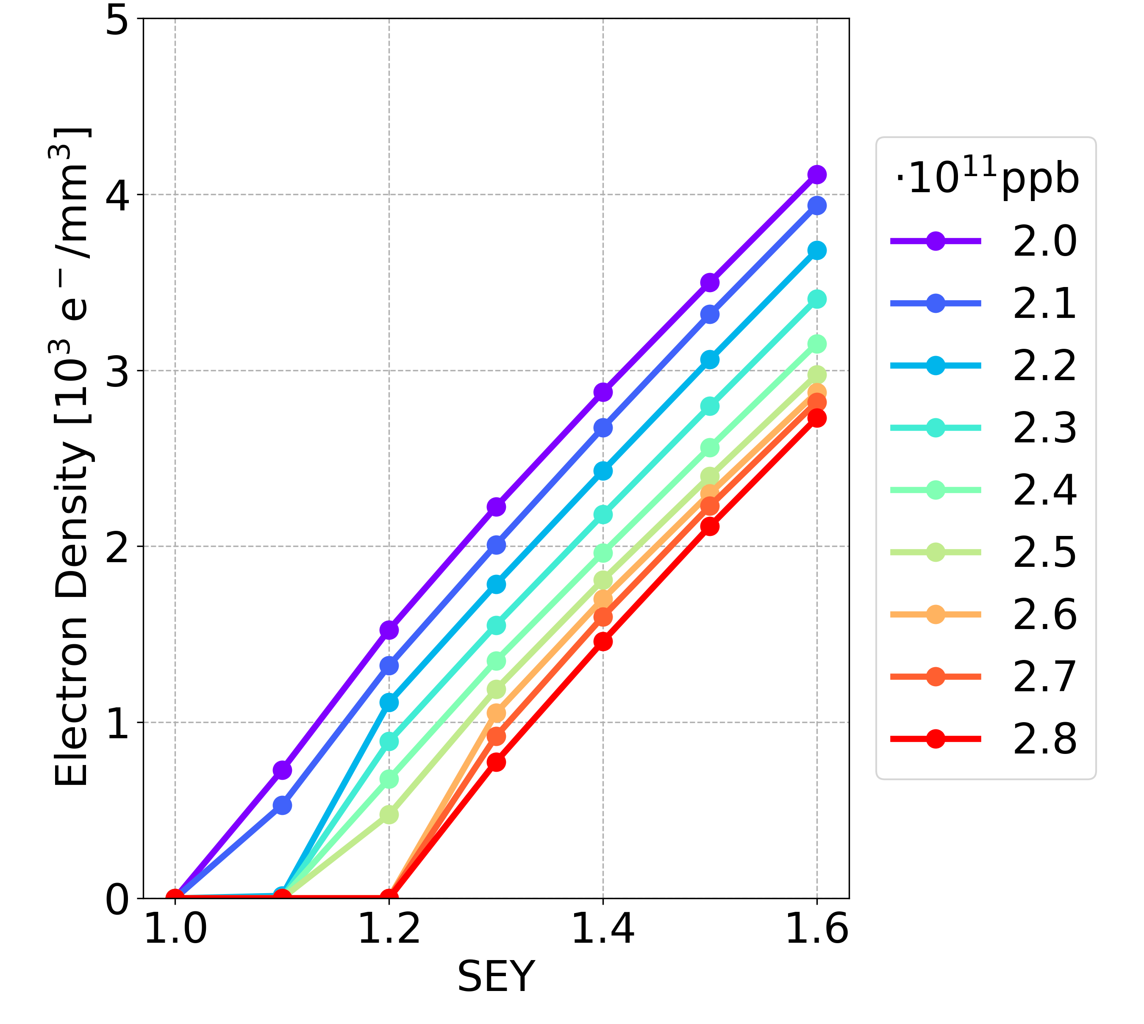
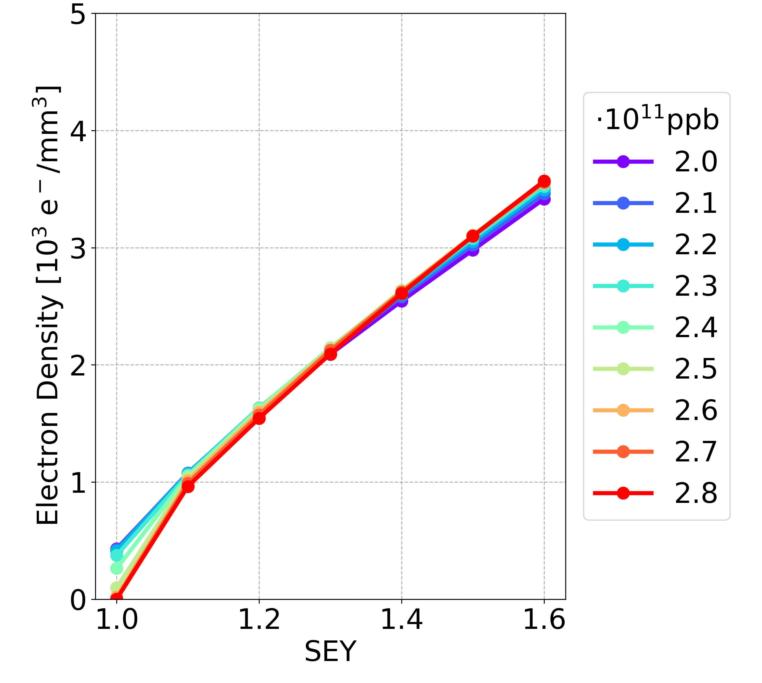
Simulation Results: New vs OLD
Bunch spacing 15 ns, longer bunch length
Drift space
Dipole
Quadrupole
NEW
Drift space
Dipole
Quadrupole
OLD

Slide 11
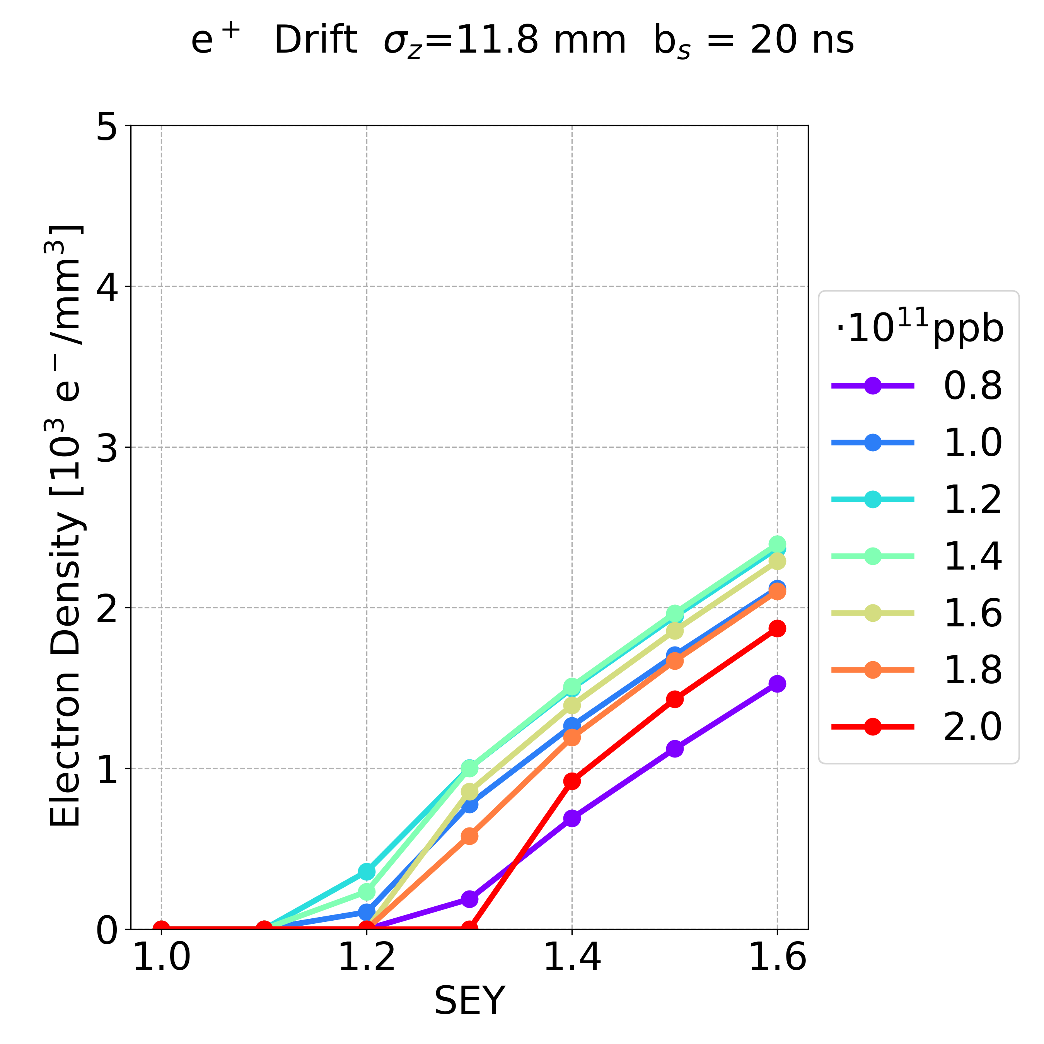
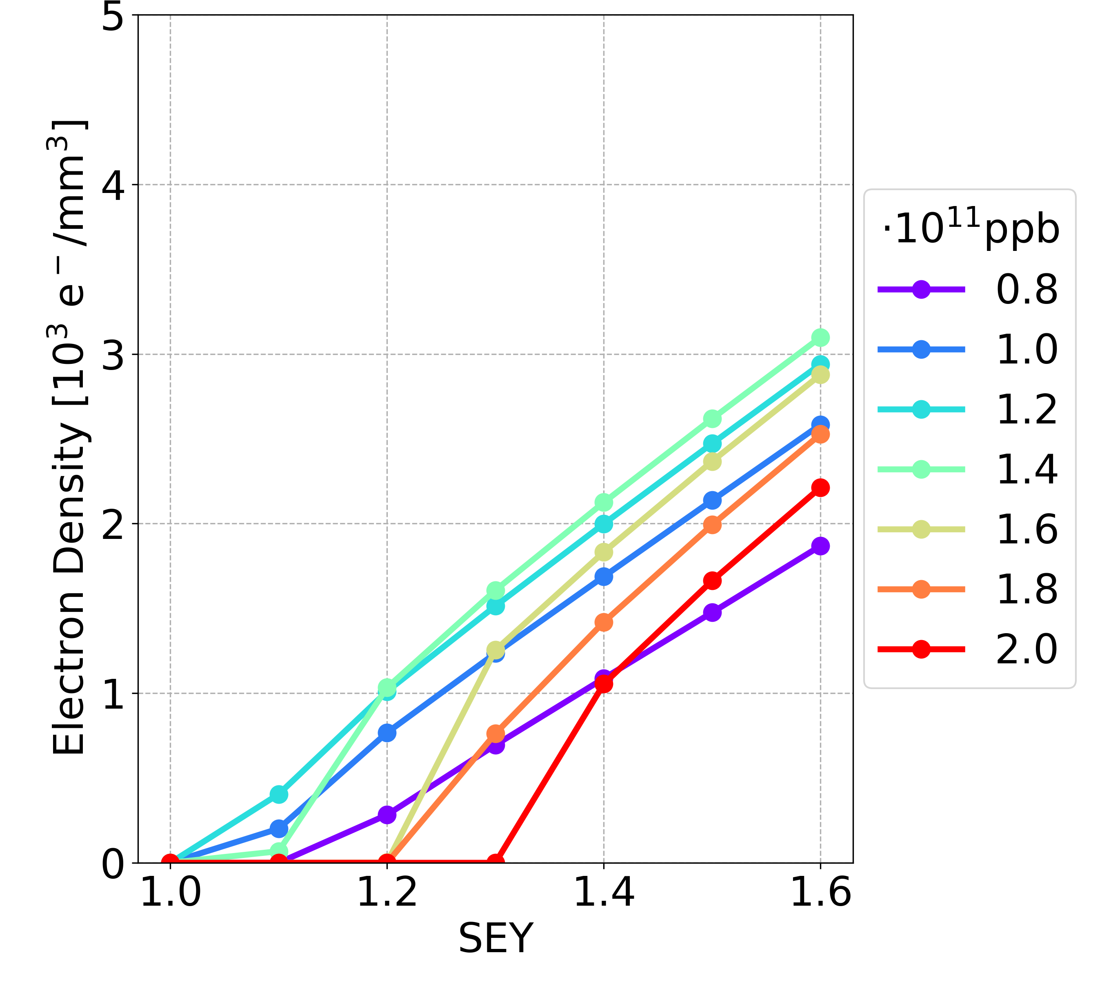
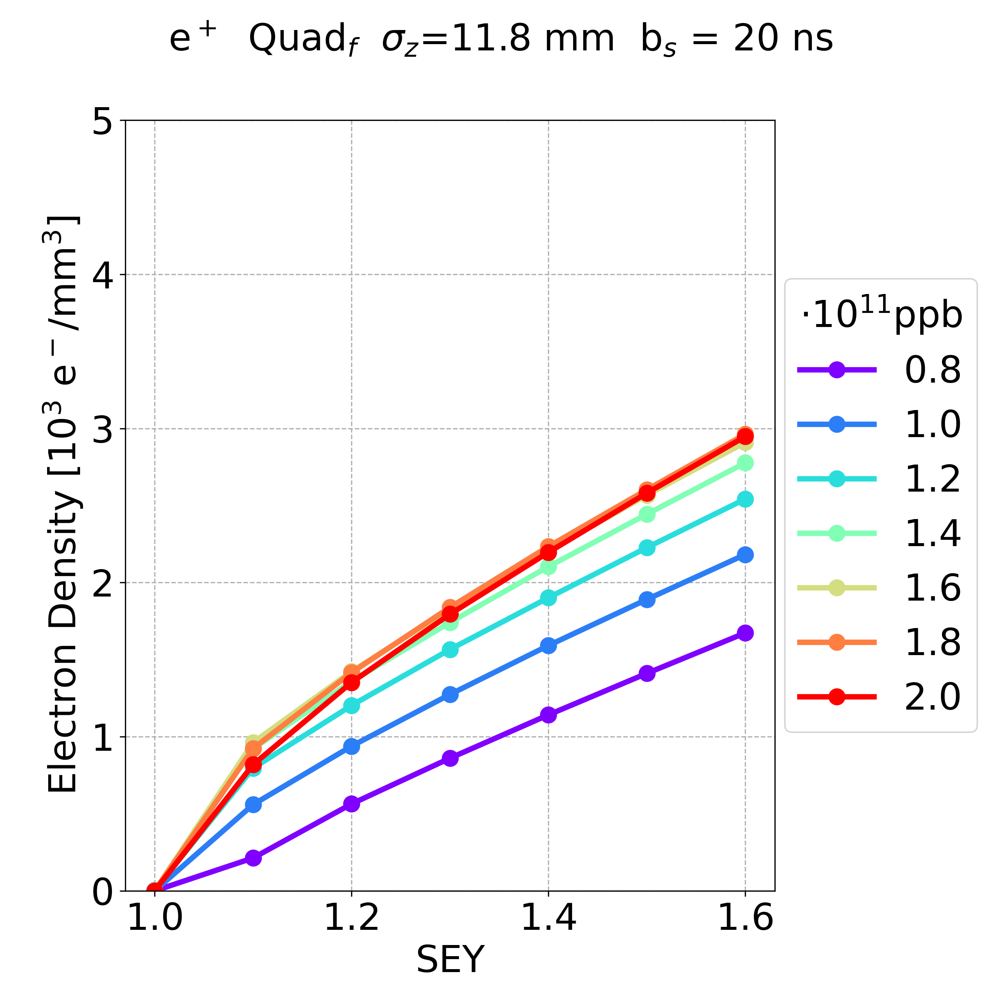
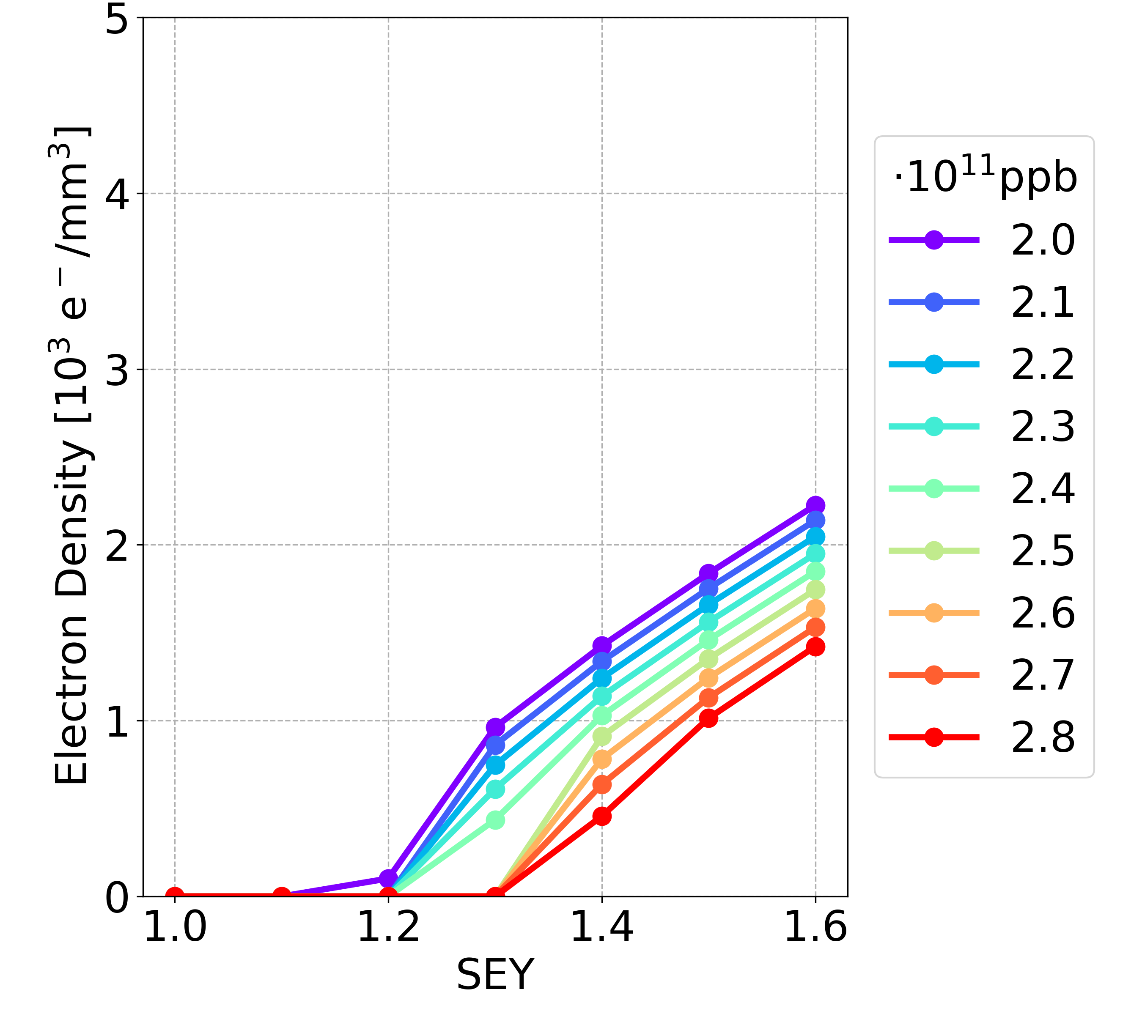
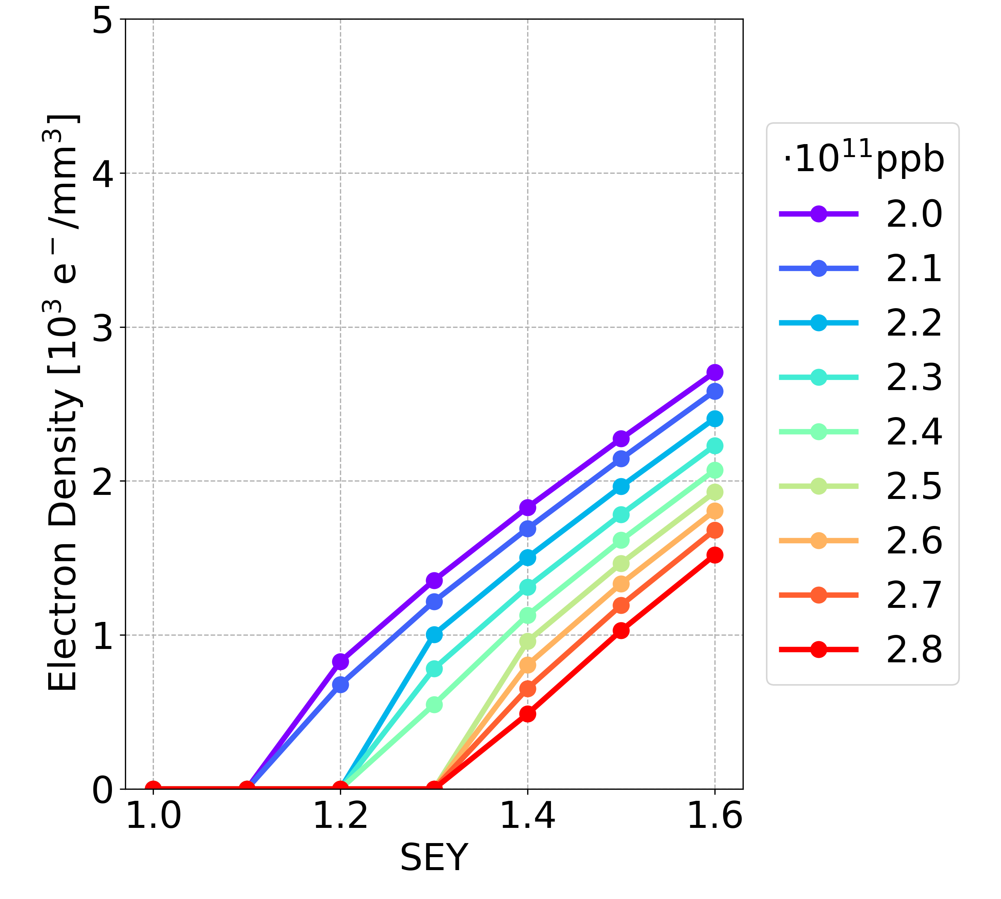
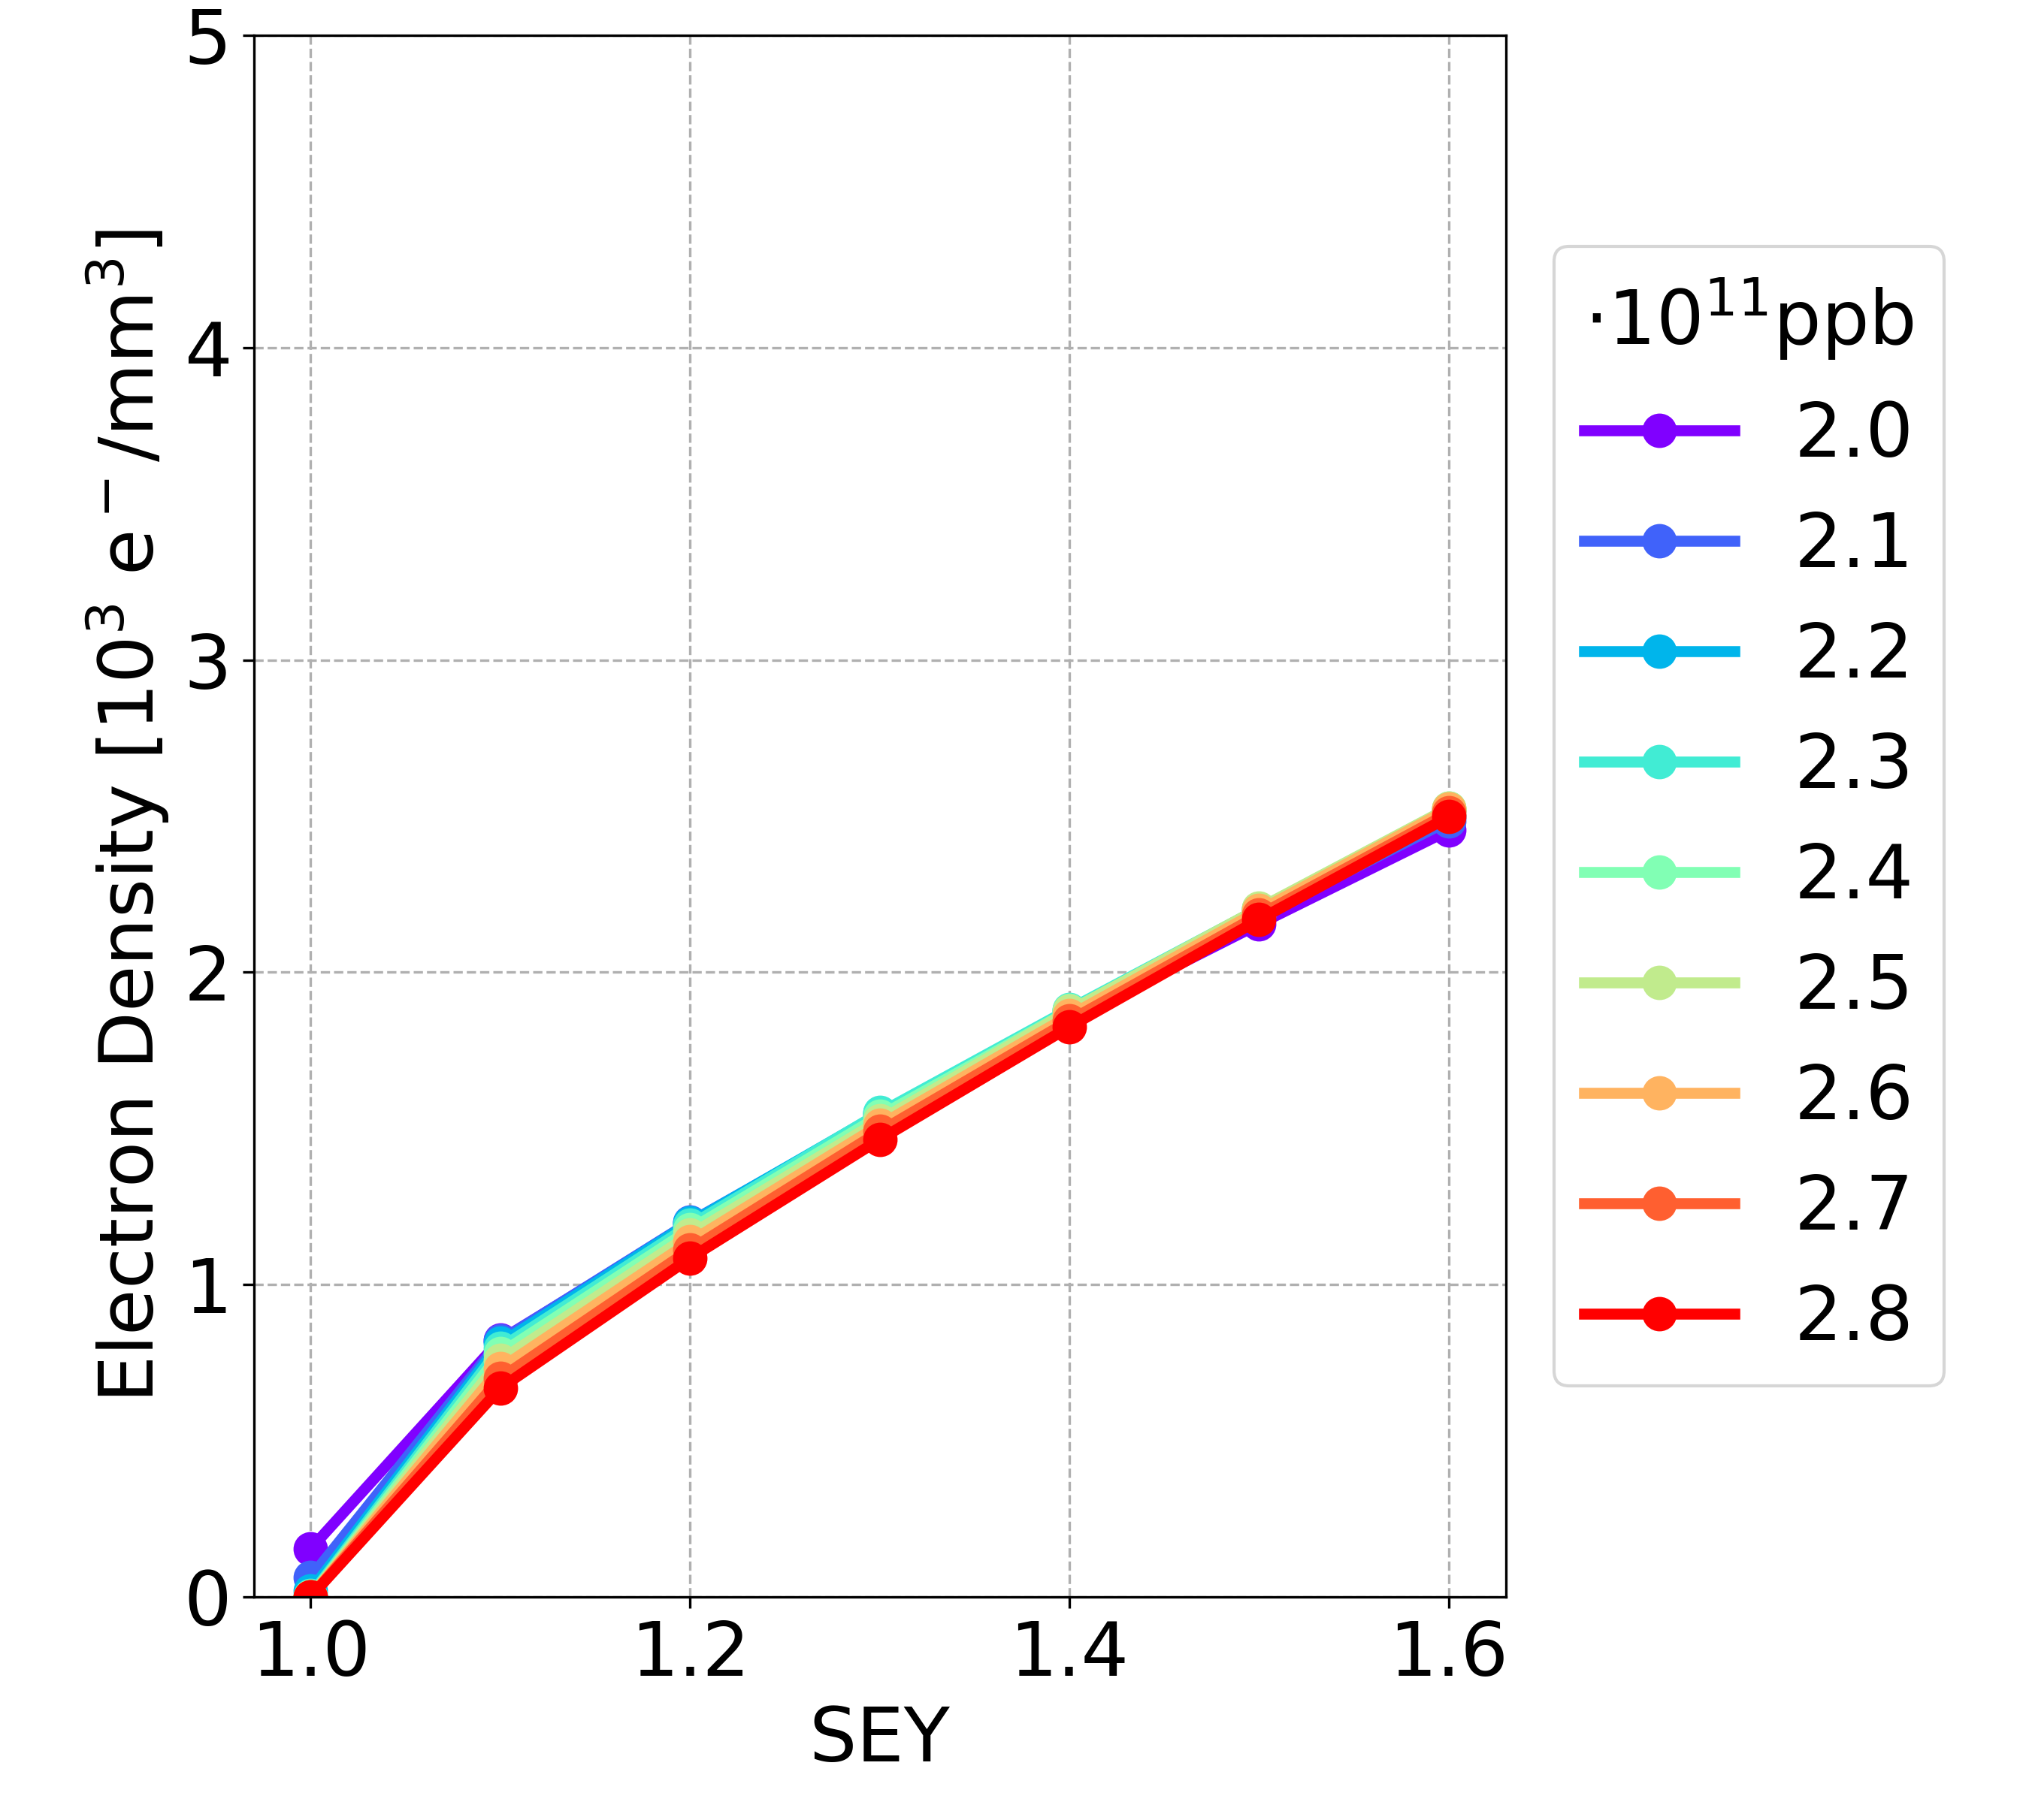
Simulation Results: New vs OLD
Bunch spacing 20 ns, longer bunch length
Drift space
Dipole
Quadrupole
NEW
Drift space
Dipole
Quadrupole
OLD

Slide 12
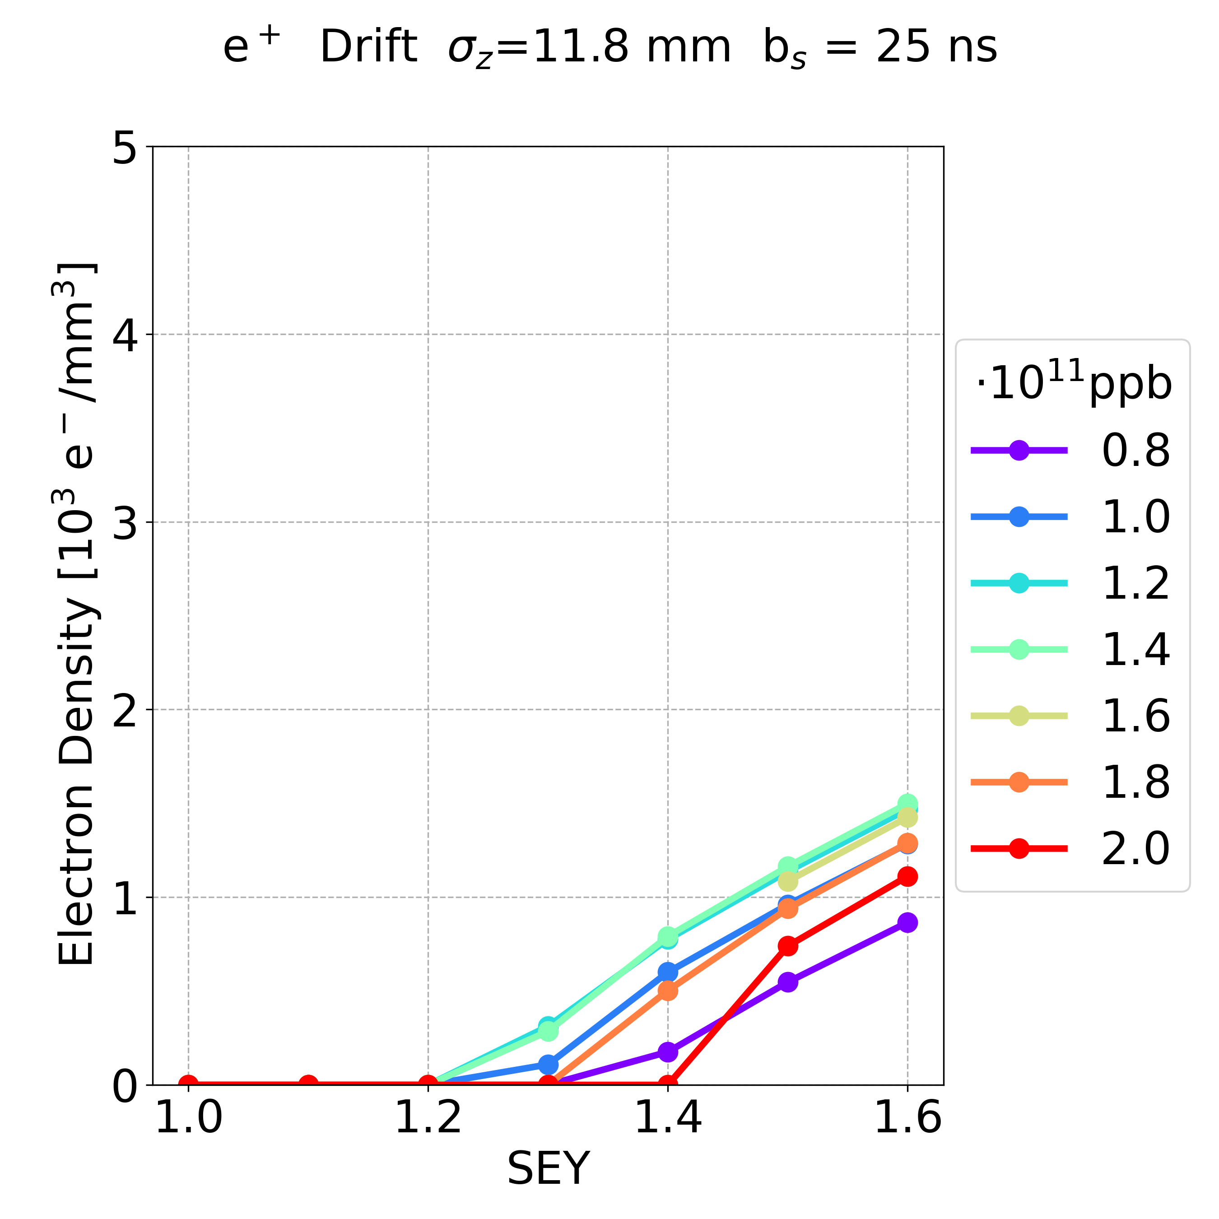
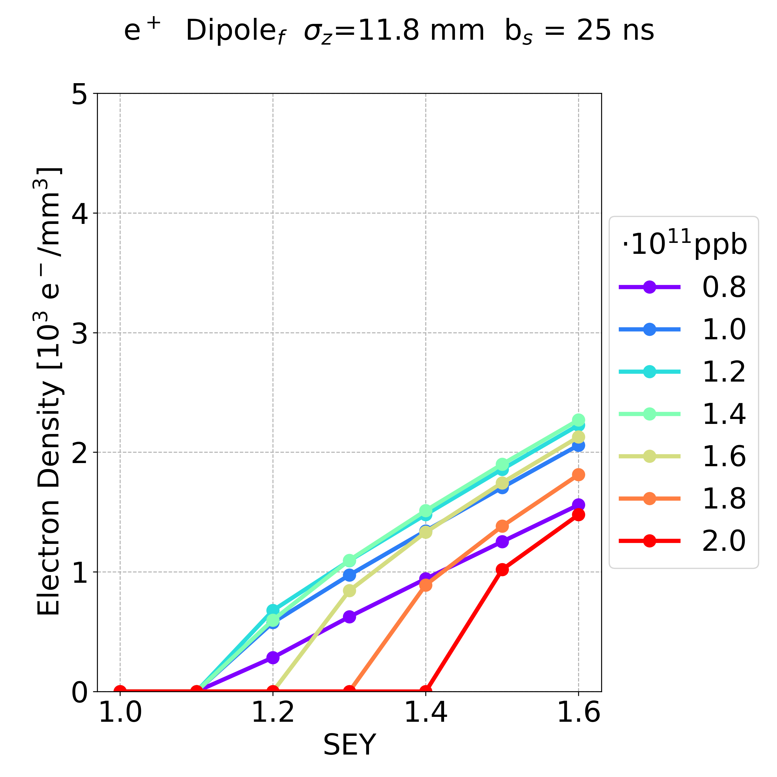
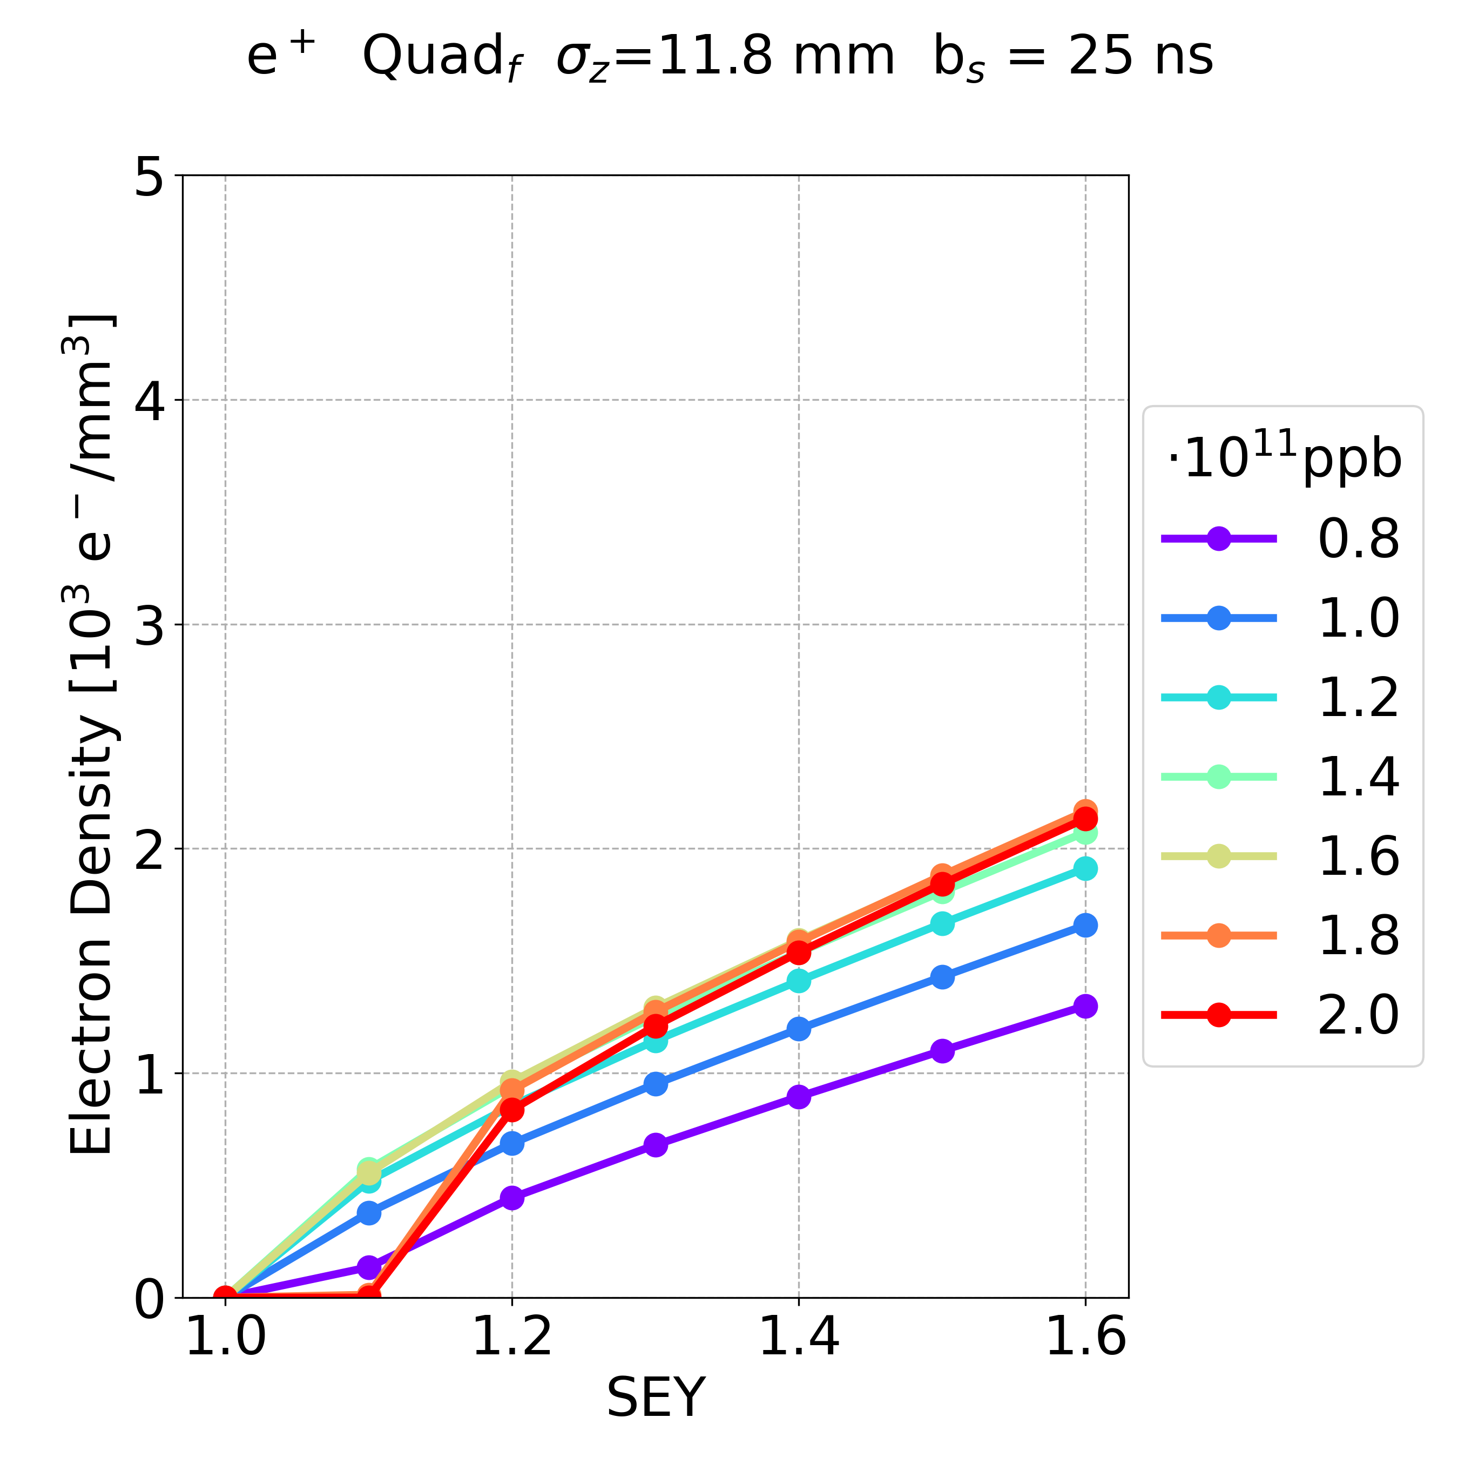
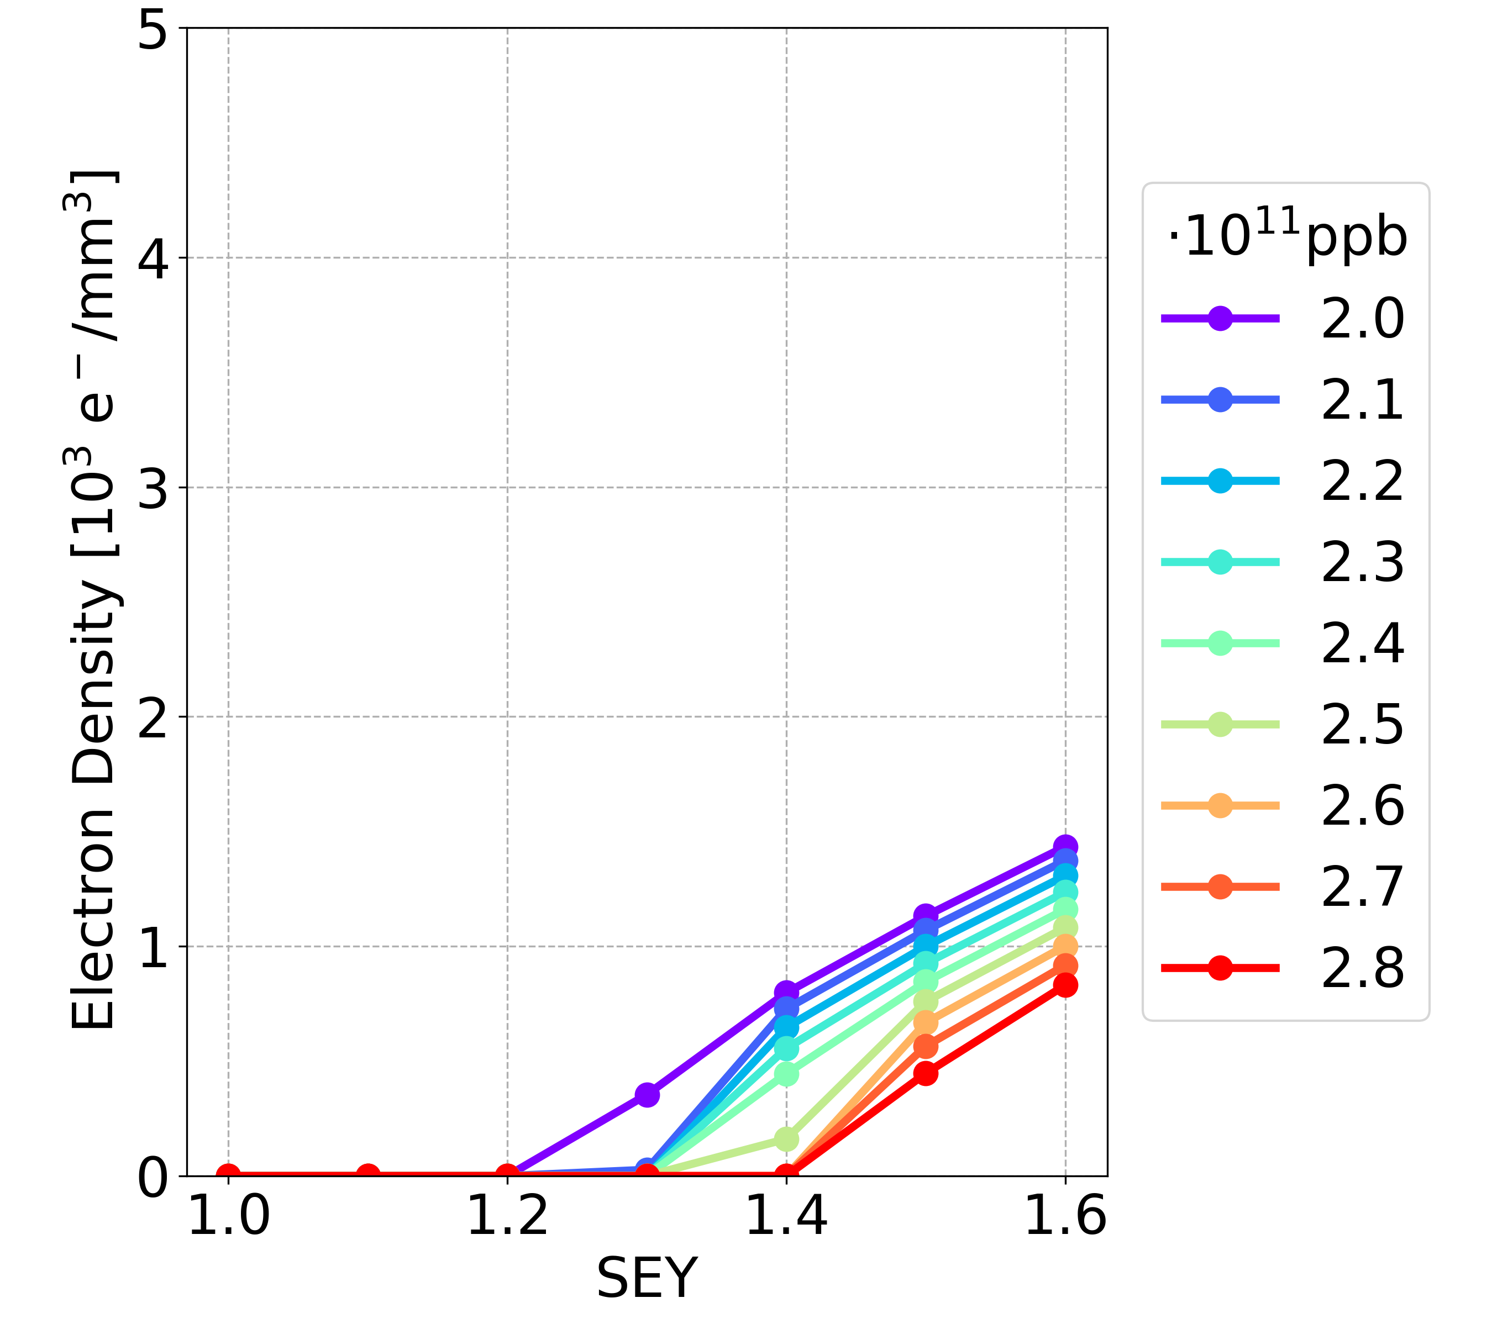
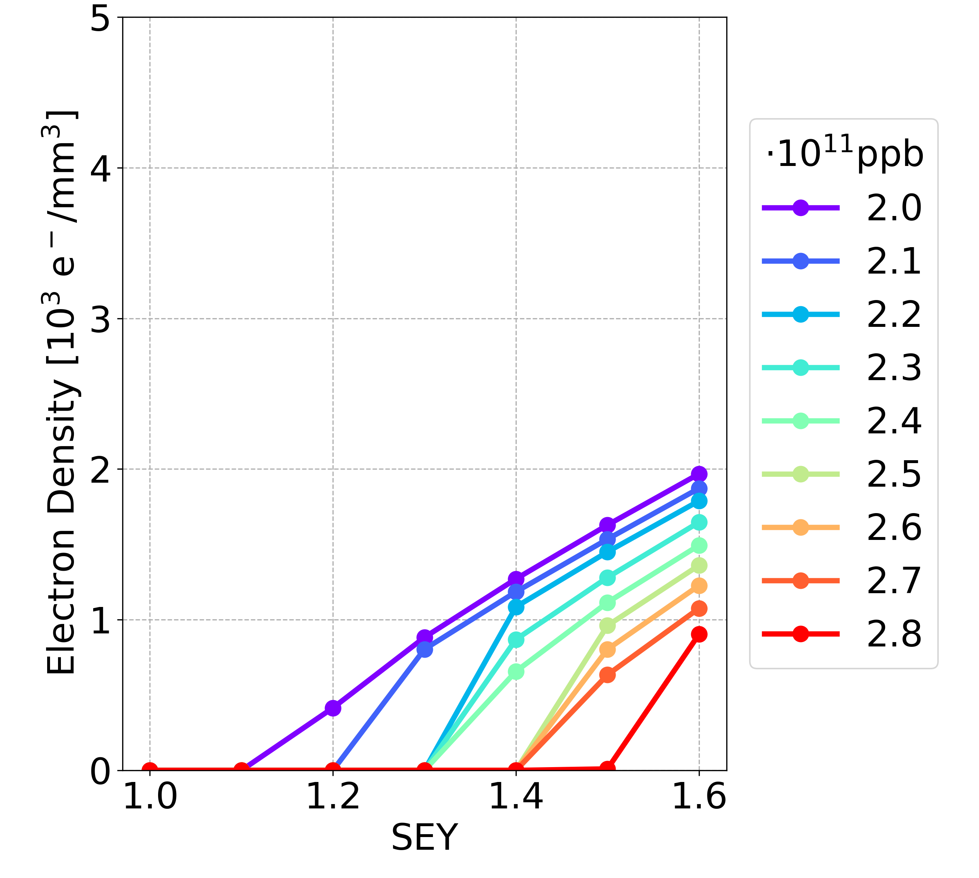
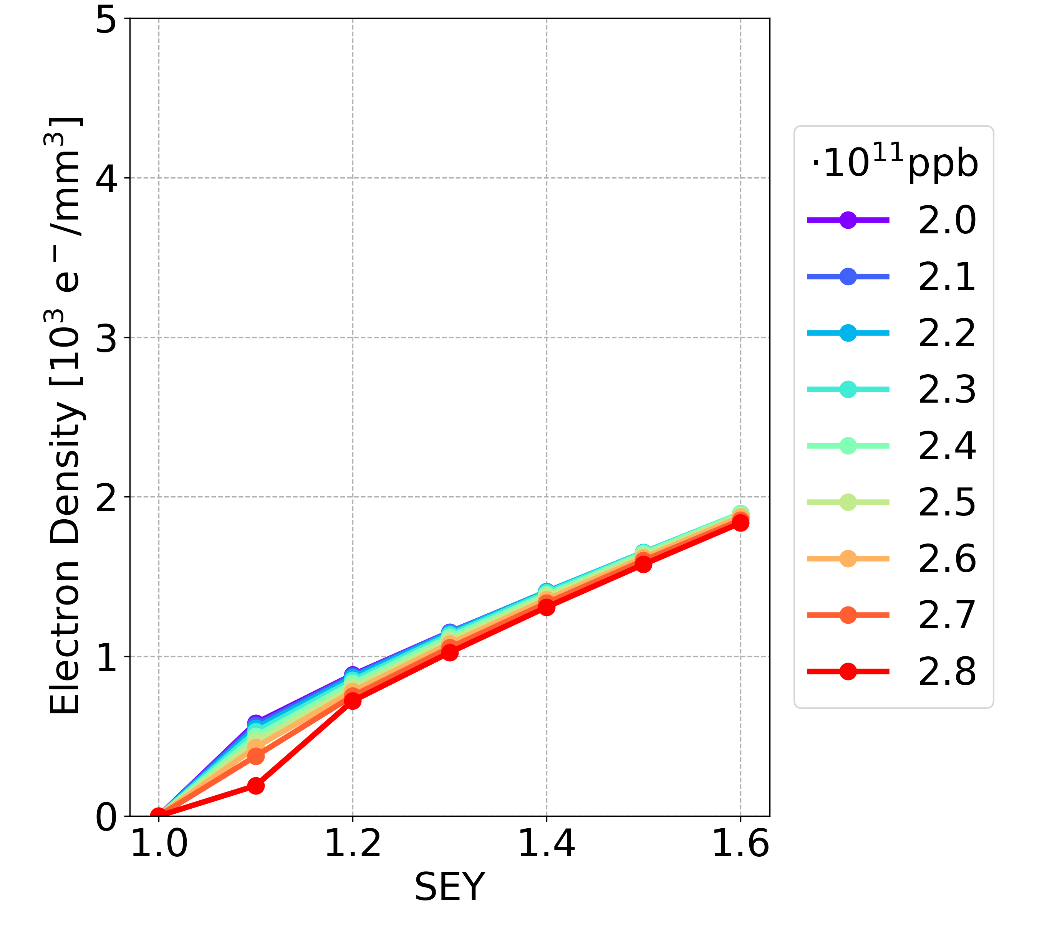
Simulation Results: New vs OLD
Bunch spacing 25 ns, longer bunch length
Drift space
Dipole
Quadrupole
NEW
Drift space
Dipole
Quadrupole
OLD

Slide 13
Simulation Results: New vs OLD
For a fixed bunch spacing
  The e-cloud density has the same order of magnitude for the new parameters and the old ones
  The new configuration of beam chamber / bunch length / bunch intensity does not significantly alter the e-cloud density
15/05/2023

Slide 14
Simulation Results: Bunch Spacing
New parameters, max bunch spacing reachable 18.9 ns (16,000 bunches)
OLD parameters, max bunch spacing reachable 32.9 ns (9,200 bunches)
15/05/2023

Slide 15
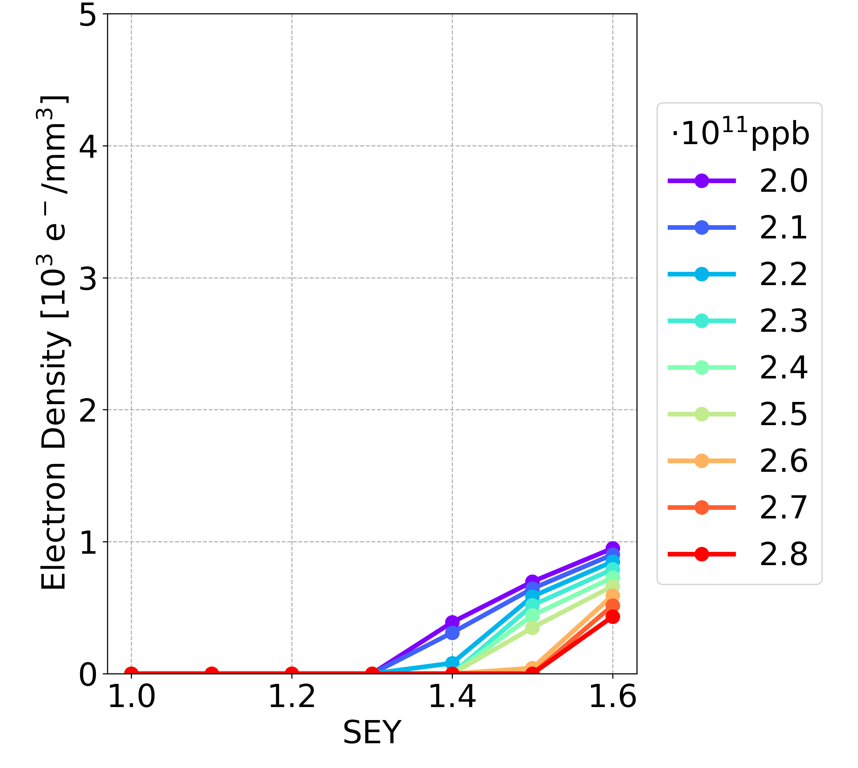
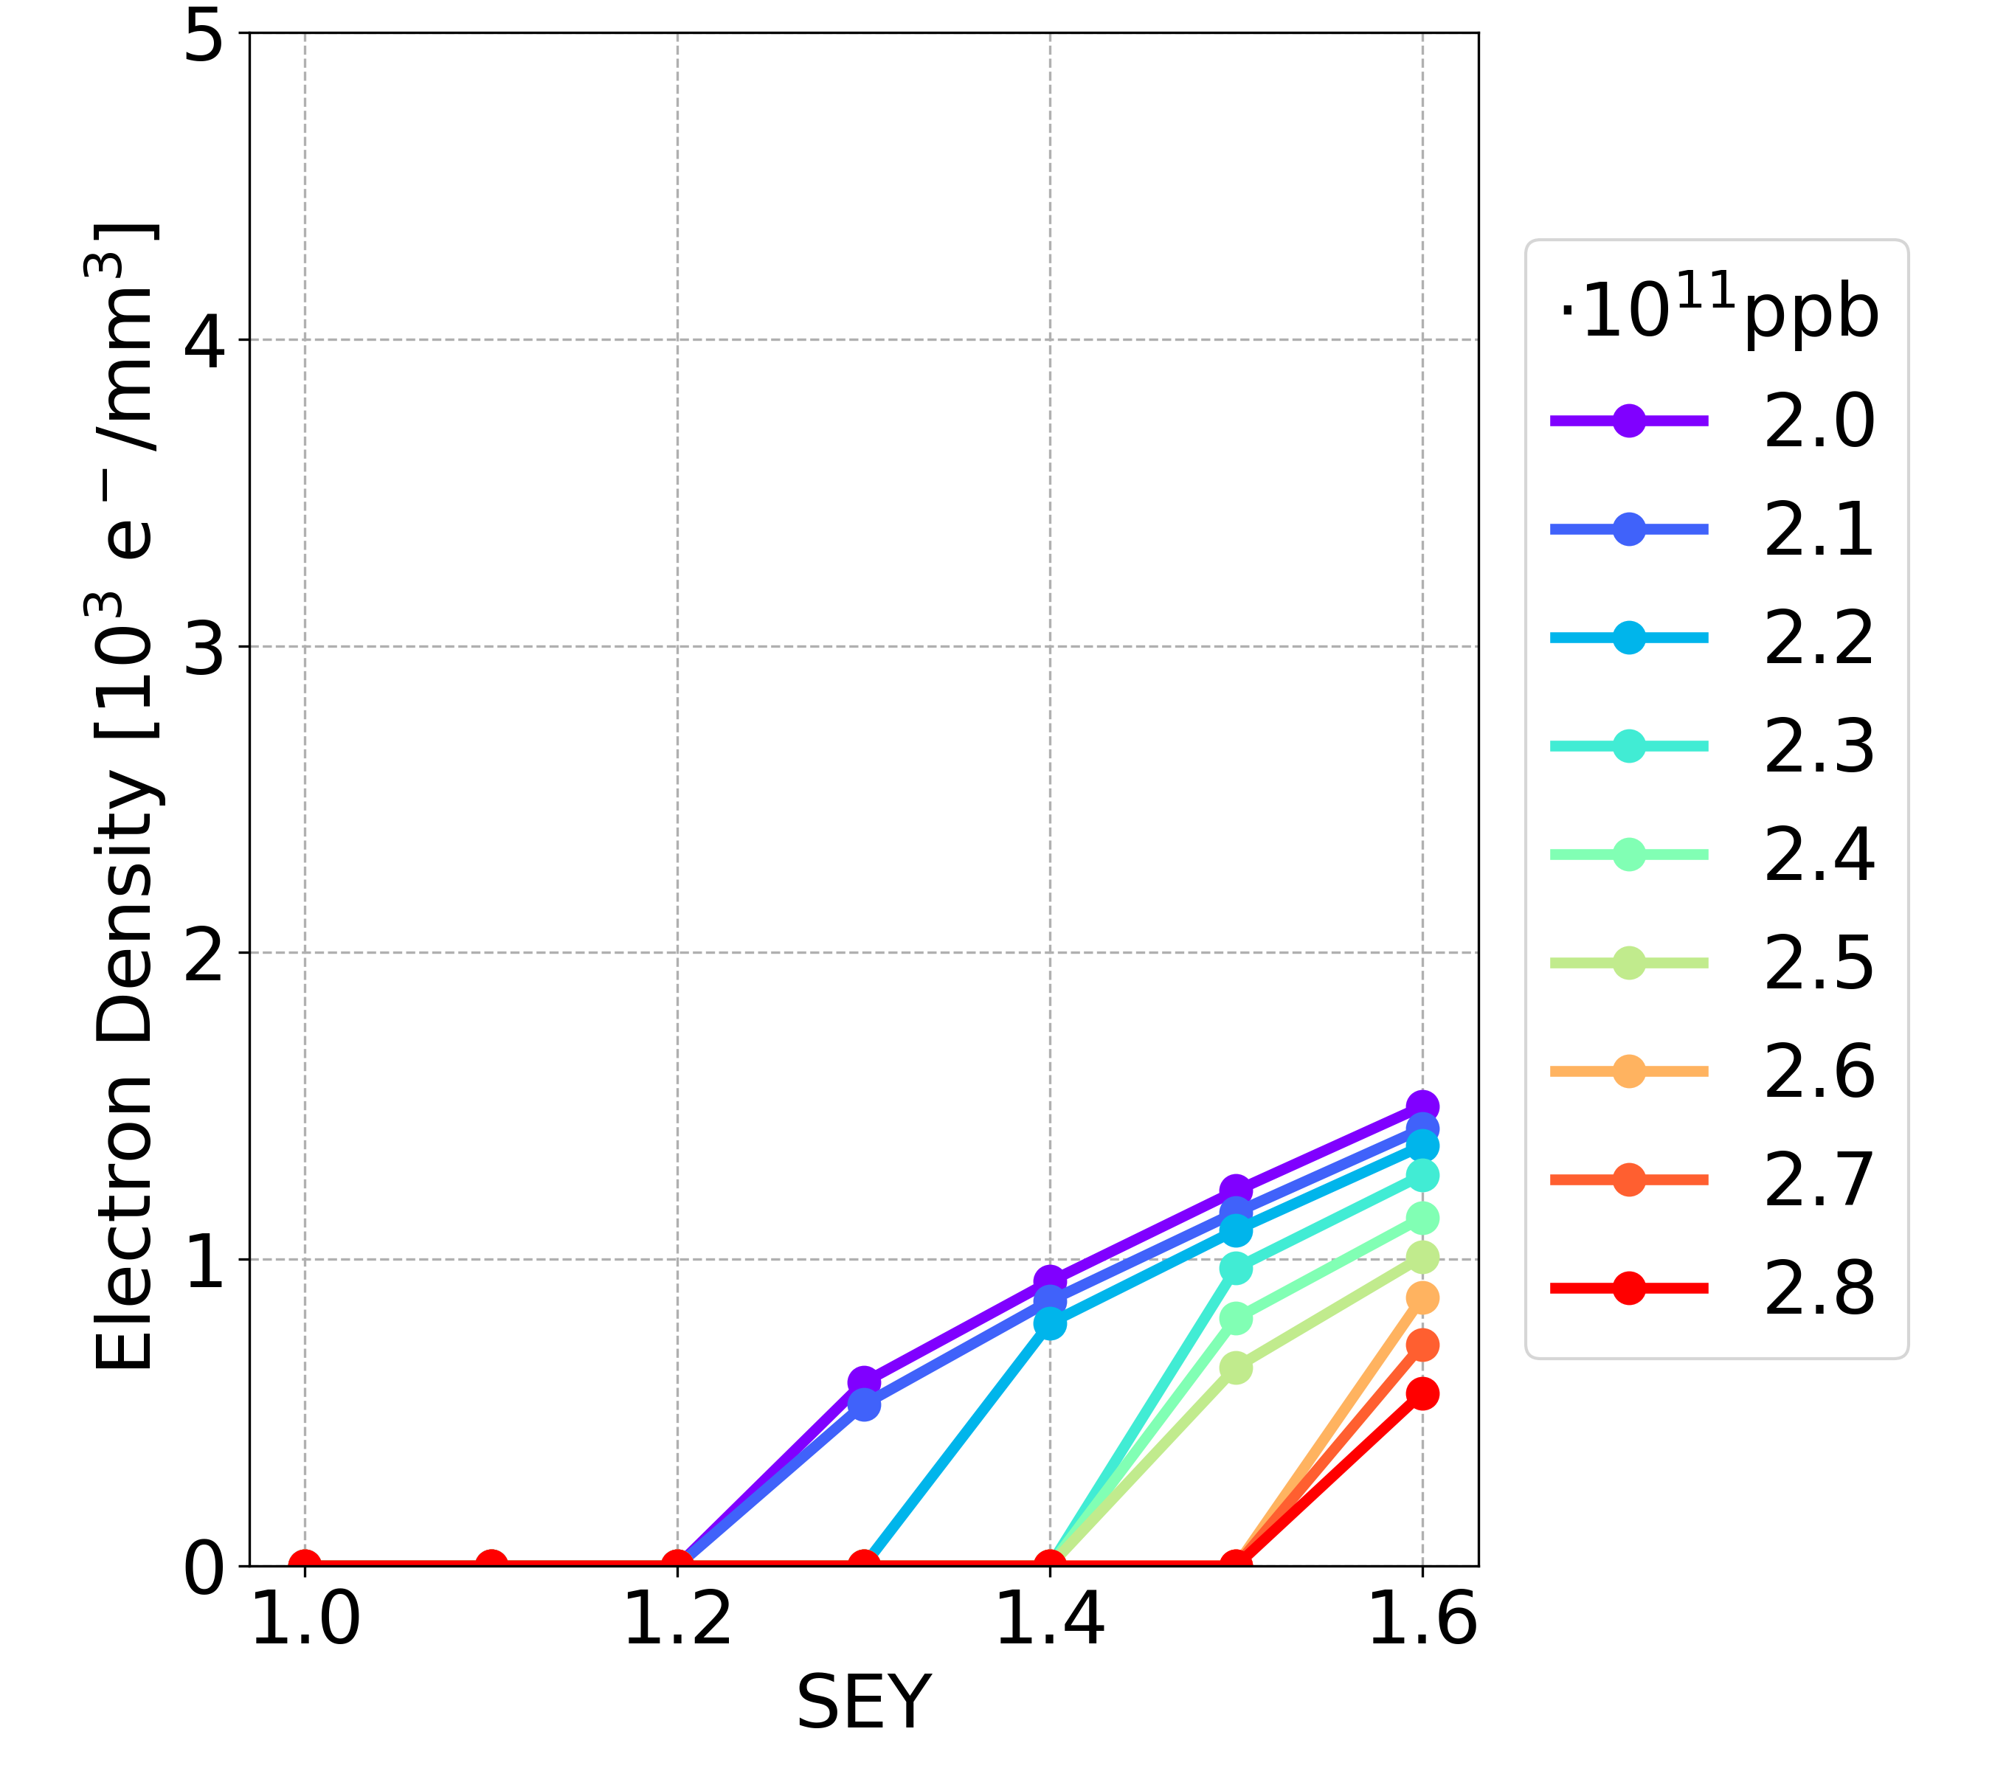
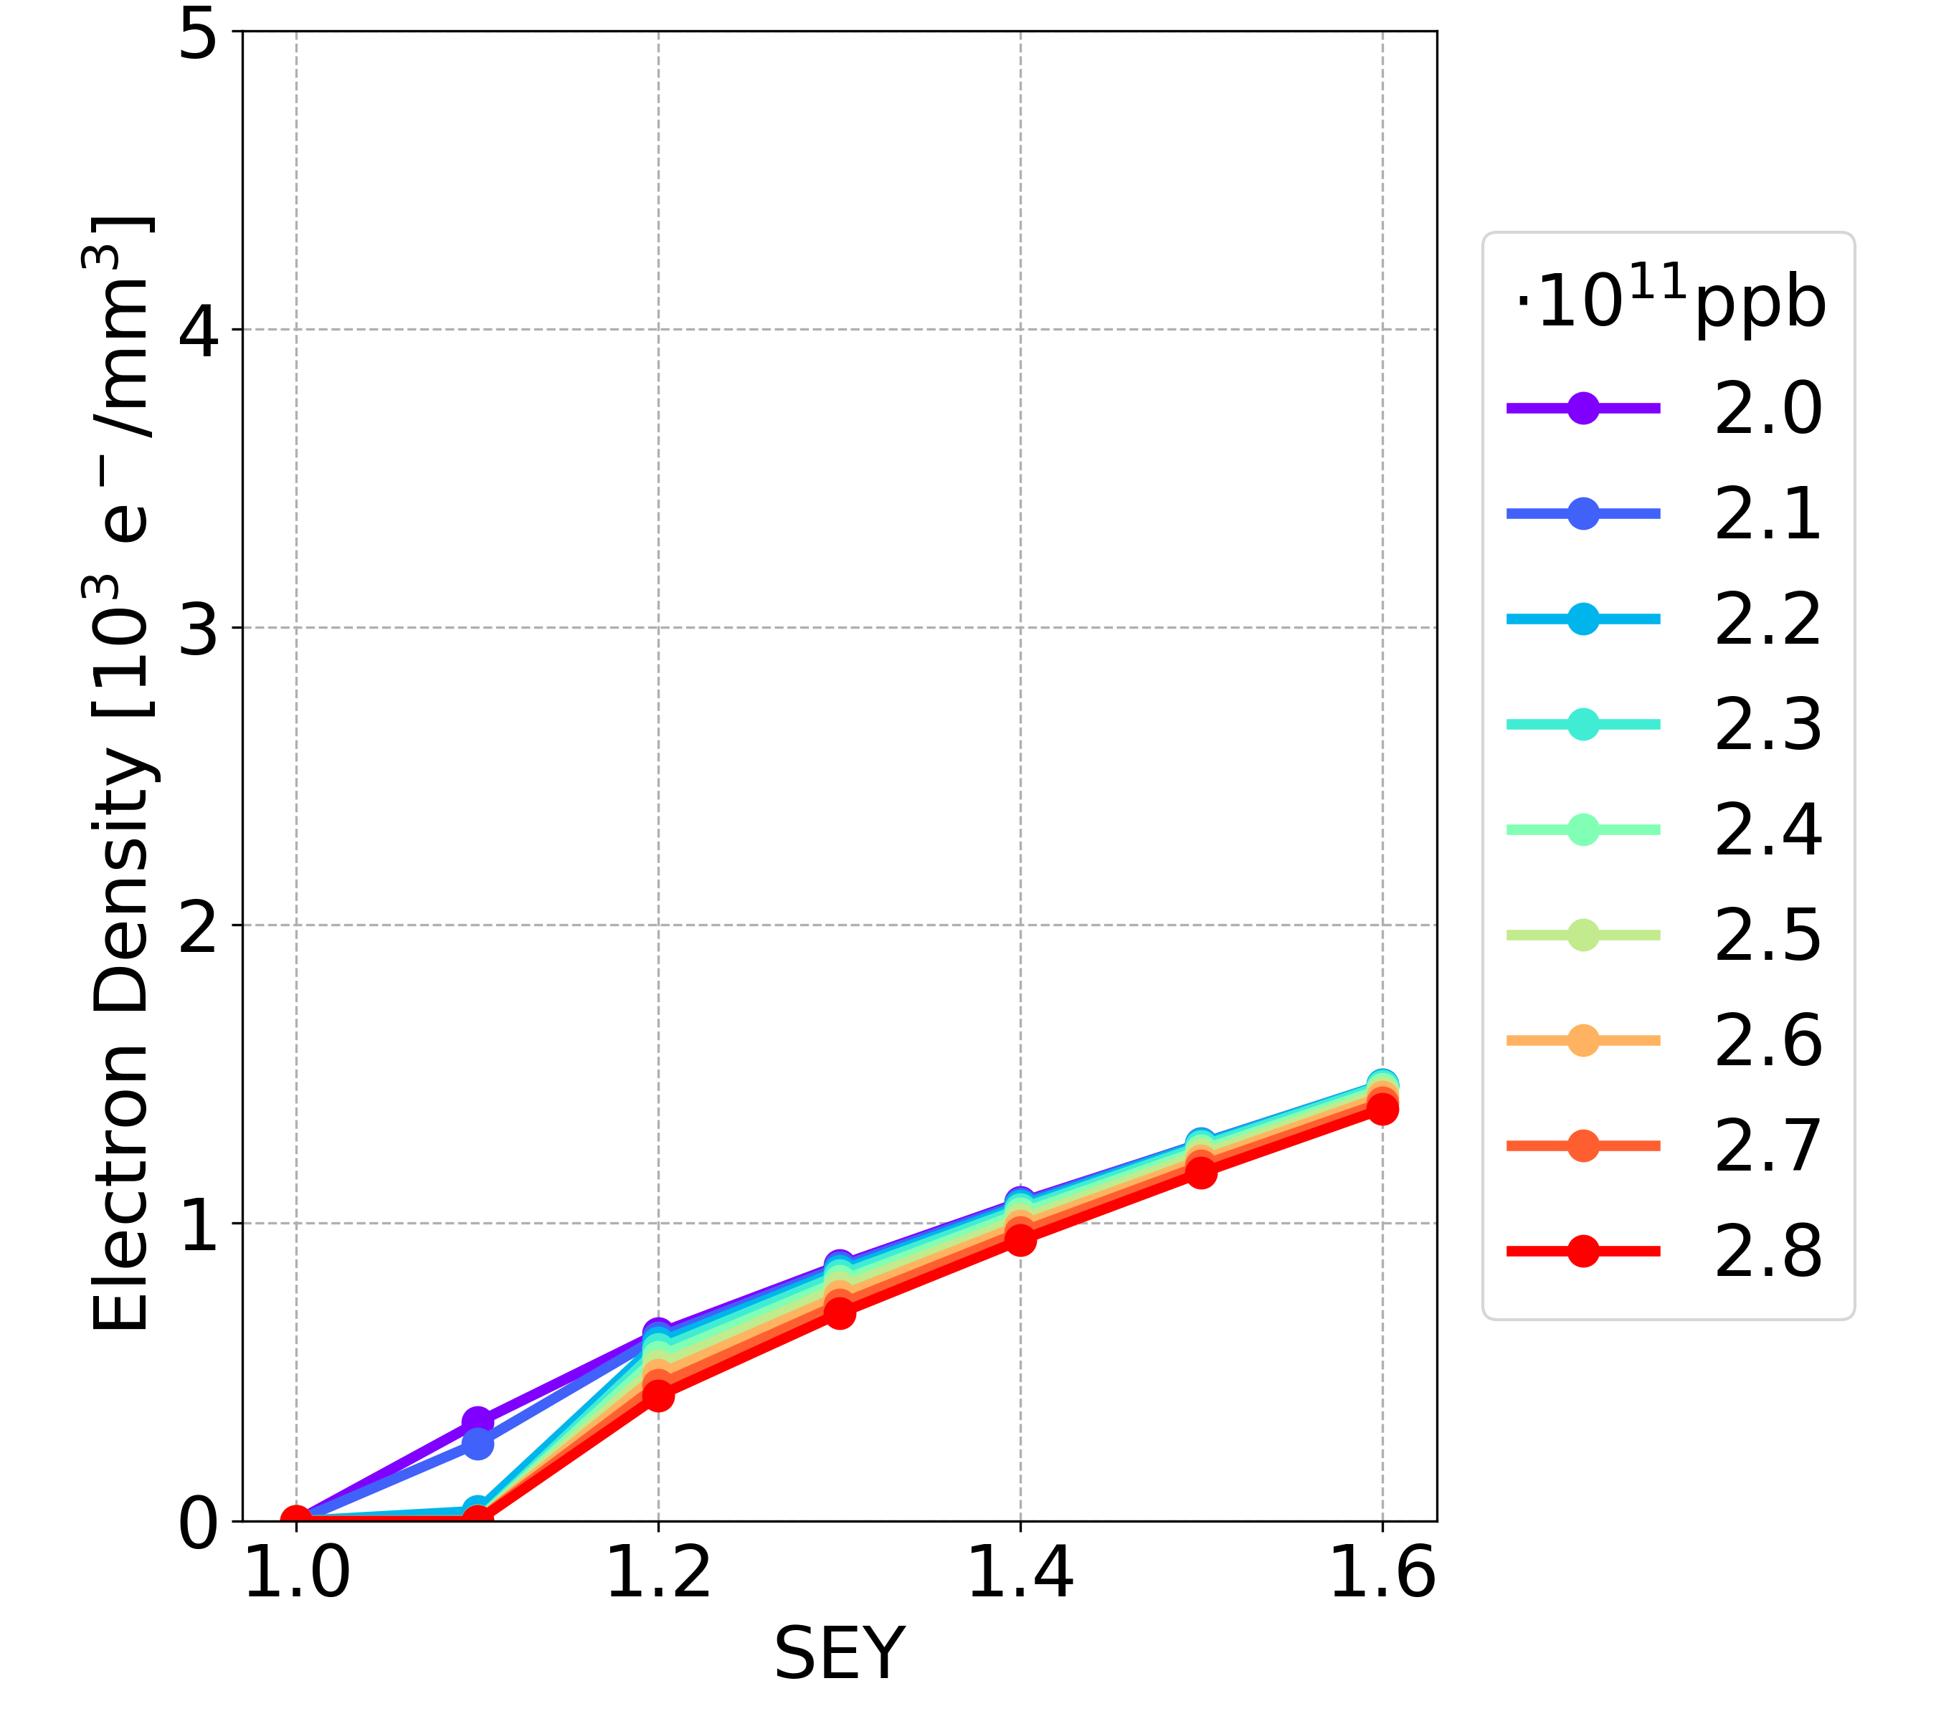
Simulation Results: New vs OLD
Drift space
Dipole
Quadrupole
NEW
15 ns
Drift space
Dipole
Quadrupole
OLD
30 ns

Slide 16
Thank you for your attention
FCCIS 2022 Workshop 07/12/2022

Slide 20
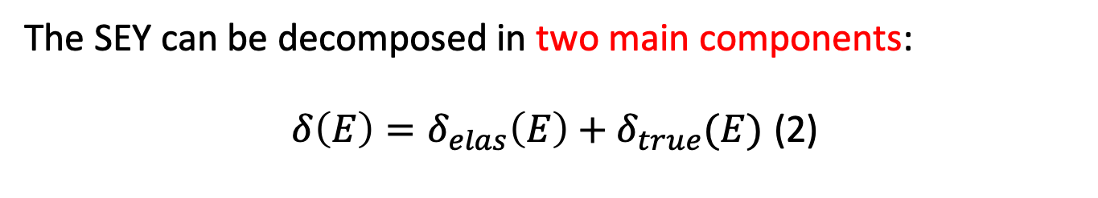
Background: Case Study
The SEY can be decomposed in two main components:
$δ\left(E\right)=δ_{elas}\left(E\right)+δ_{true}(E)$ (2)
Electrons interact elastically by the chamber’s wall
(same energy, no deposition of energy in the surface)
true secondary electrons created by inelastic scattering (photoemission)
with a fraction of the impacting energy
[] R. Cimino, I. R. Collins, M. A. Furman, M. Pivi, F. Ruggiero, G. Rumolo, and F. Zimmermann, “Can Low-Energy Electrons Affect High-Energy Physics Accelerators?,” Phys. Rev. Lett., vol. 93, p. 014801, Jun 2004.
FCCIS 2022 Workshop 07/12/2022

Slide 21
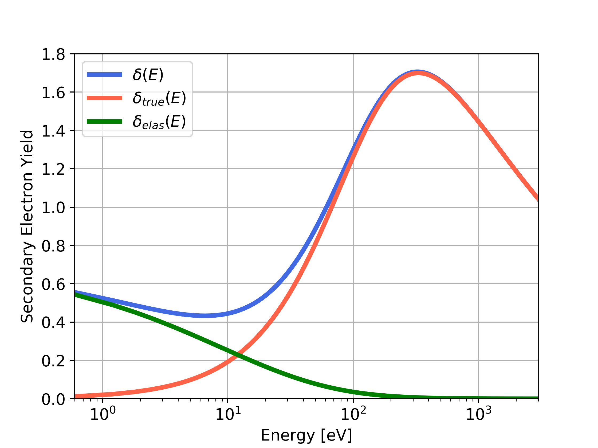

Background: Case Study
$δ\left(E\right)=δ_{elas}\left(E\right)+δ_{true}(E)$ (2)
$δ_{elas}\left(E\right)=R_{0} {\left(\frac{\sqrt{E} −\sqrt{E+E_{0}}}{\sqrt{E}+\sqrt{E+E_{0}}}\right)}^{2}$ (3)
E₀ and R₀: shape parameters.
For the LHC beam chambers:
  E₀ = 150 eV
  R₀ = 0.7
(2)
(3)
FCCIS 2022 Workshop 07/12/2022

Slide 22

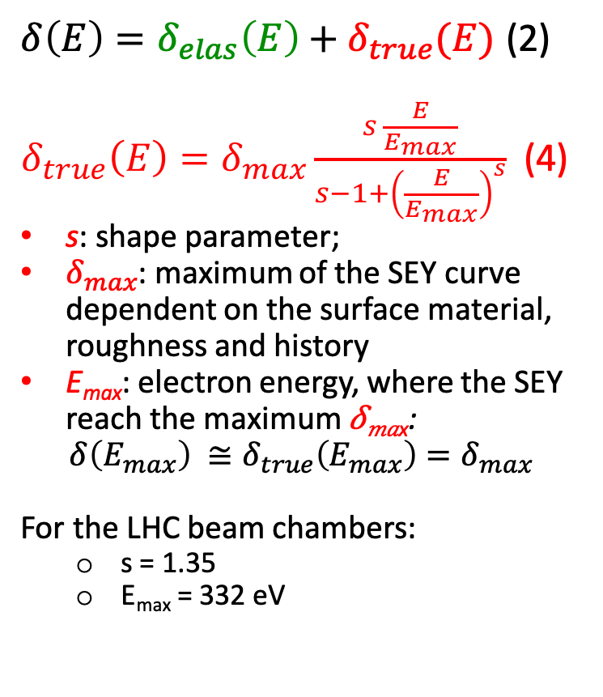
Background: Case Study
$δ\left(E\right)=δ_{elas}\left(E\right)+δ_{true}(E)$ (2)
$δ_{true}\left(E\right)=δ_{max}\frac{s \frac{E}{E_{max}}}{s−1+{\left(\frac{E}{E_{max}}\right)}^{s}}$ (4)
s: shape parameter;
$δ_{max}$: maximum of the SEY curve dependent on the surface material, roughness and history
E_{max}: electron energy, where the SEY reach the maximum 𝛿_{𝑚𝑎x}:
$$δ\left(E_{max}\right) ≅δ_{true}\left(E_{max}\right)=δ_{max}$$
For the LHC beam chambers:
  s = 1.35
  E_{max} = 332 eV
𝛿_{𝑚𝑎x}
(2)
(4)
(3)
$$E_{max}$$
FCCIS 2022 Workshop 07/12/2022

Slide 23
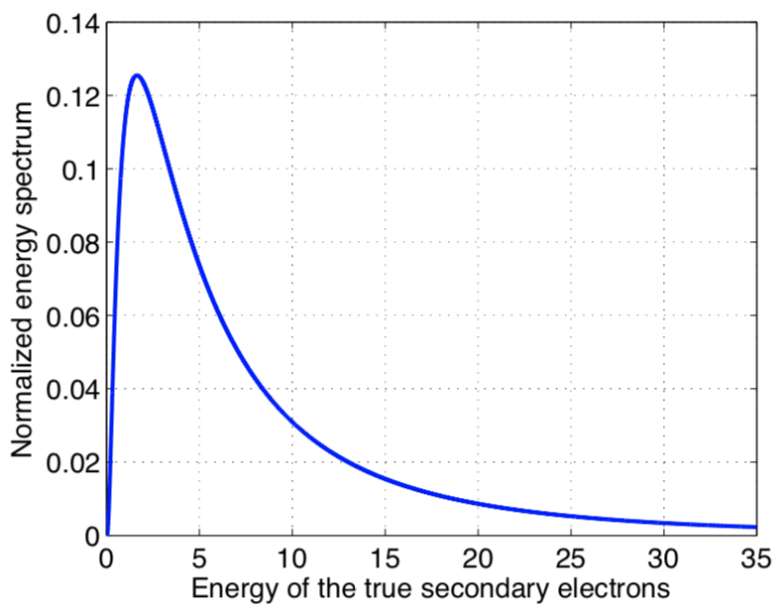
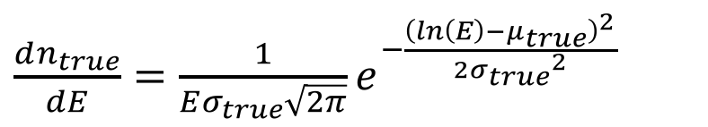
Background: Case Study
Parameter Overview
Secondary emission model:
LHC beam chambers:
  $σ_{true}$ = 1.0828
  $μ_{true}$ = 1.6636
$\frac{dn_{true}}{dE}=\frac{1}{Eσ_{true}\sqrt{2π}}e^{−\frac{{\left(ln\left(E\right)−μ_{true}\right)}^{2}}{2{σ_{true}}^{2}}}$
[eV]
[] B. Henrist et al., “Secondary Electron Emission Data for the Simulation of Electron Cloud”, cds 2002.
FCCIS 2022 Workshop 07/12/2022

Slide 24
Modeling of electron cloud effects
A complex problem involving two sets of particles mutually interacting
Beam dynamics simulations → Model the interaction of the beam (typically a single bunch) with a given initial electron distribution
Vacuum chamber
Electron cloud effects
Courtesy of
G. Rumolo
Shape, PEC boundary conditions
e⁻ production mechanisms
(e.g. secondary emission)
Beam charge distribution
Maxwell’s equations
E.M.
forces
e⁻ equations of motion
Maxwell’s equations
E.M.
forces
External B field
Beam equations of motion
External forces from
Magnets & RF
FCCIS 2022 Workshop 07/12/2022

Slide 25
Modeling of electron cloud effects
Beam dynamics simulations → Model the interaction of the beam (typically a single bunch) with a given initial electron distribution
Vacuum chamber
Electron cloud effects
Courtesy of
G. Rumolo
Shape, PEC boundary conditions
Pre-calculated initial electron distribution
e⁻ production mechanisms
(e.g. secondary emission)
Beam charge distribution
Maxwell’s equations
E.M.
forces
e⁻ equations of motion
Maxwell’s equations
E.M.
forces
External B field
Beam equations of motion
External forces from
Magnets & RF
FCCIS 2022 Workshop 07/12/2022

Slide 26
Modeling of electron cloud effects
E-cloud build-up → Solely focuses on electron dynamics with an unperturbed beam distribution to determine how the e-cloud forms and where it saturates
Vacuum chamber
Electron cloud effects
Courtesy of
G. Rumolo
Shape, PEC boundary conditions
e⁻ production mechanisms
(e.g. secondary emission)
External EM fields
in RF cavity
Pre-calculated forces from unperturbed beam distribution
Beam charge distribution
Maxwell’s equations
E.M.
forces
e⁻ equations of motion
Maxwell’s equations
E.M.
forces
External B field
Beam equations of motion
External forces from
Magnets & RF
FCCIS 2022 Workshop 07/12/2022

Slide 27
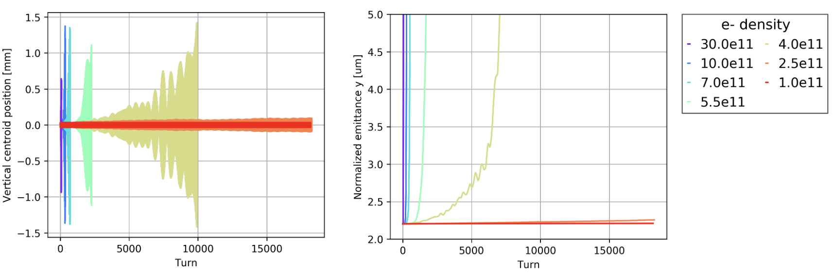
Project Goals
  The goal is to go below the SEY threshold for instabilities driven by e-cloud
Comparison between the analytical central electron density threshold for single bunch instability and the simulation results
Analytical equation
[] K. Ohmi et al., “Study of Electron Cloud Instabilities in FCC-hh”, Proc. of IPAC2015
Single-bunch stability simulations in dipoles
Courtesy of
L. Mether
FCCIS 2022 Workshop 07/12/2022

Slide 28
FCCIS 2022 Workshop 07/12/2022

