Slide 1
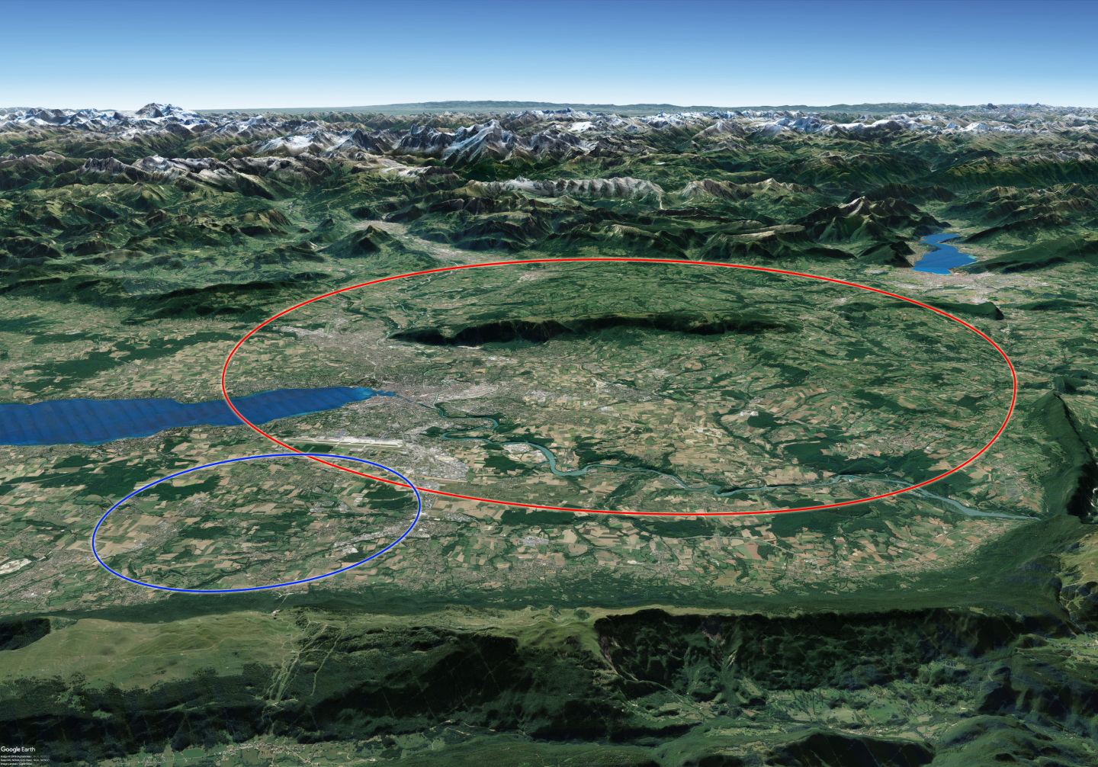
FCC-ee Orbit Correction Methods and Sensitivity Studies for IP Tuning in Python
Guilhem Doat
Supervised by Léon van Riesen-Haupt
LPAP
TPIV presentation

Slide 2
Project Context & Goals
A part of the FCC Feasibility study : importance of orbit & optics corrections in achieving the desired luminosity. The large number of magnets ( > 9000) makes the FCC a challenging machine through which steer the beam.
The current orbit correction tools implemented in Mad-X are efficient but opaque and complicated to modify, for example to add additional constraints.
Both of these issues can be adressed through :
Investigating how sensitive the beam is to magnetic perturbations.
Implementing in a widely used language, such as Python using the cpymad library, orbit correction methods and testing them.

Slide 3
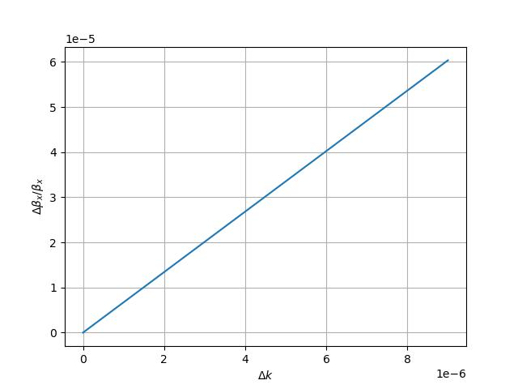
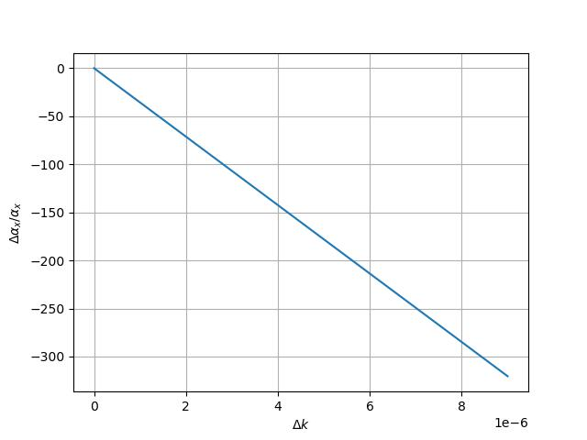
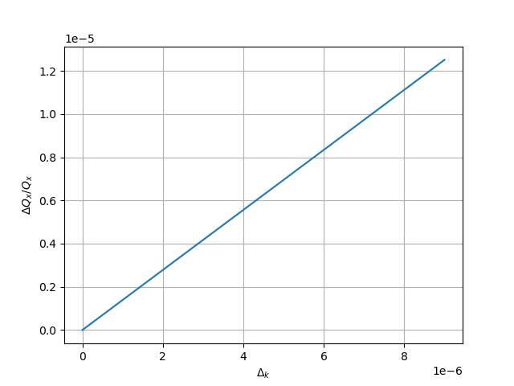
Sensitivity Study
Figure 1 : Response of different parameters as a function of ∆k

Slide 4
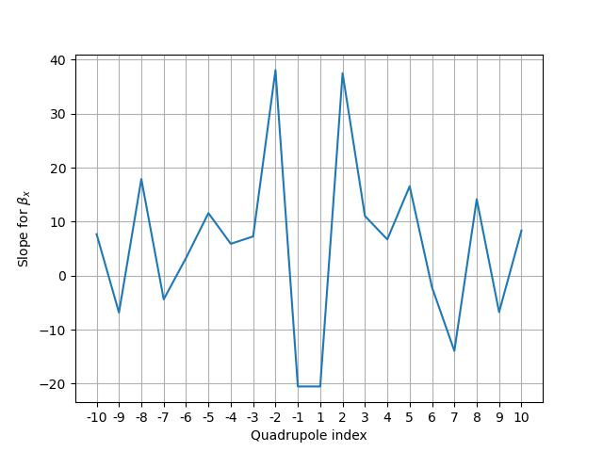
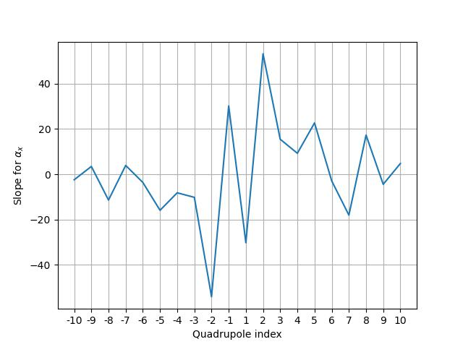
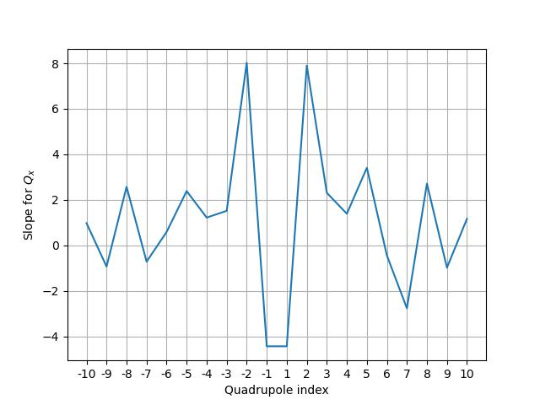
Sensitivity study
Figure 2 : Comparing the response at ∆k = 10^(−6) [m−1] of each couple of (same plane) parameters for each magnet.

Slide 5
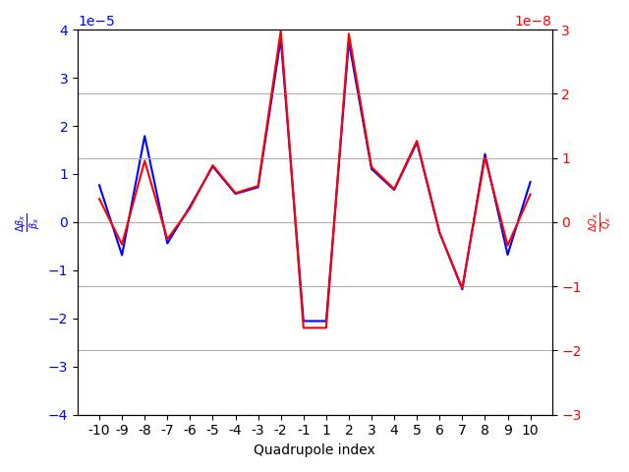
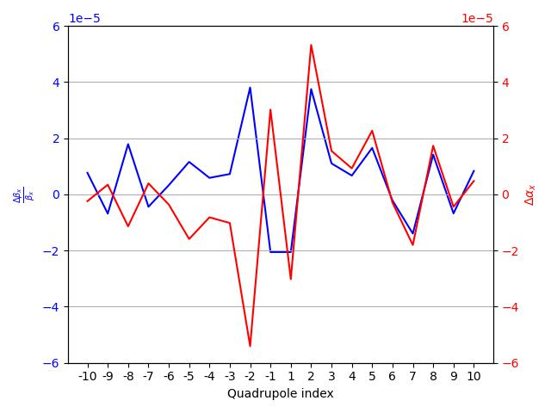
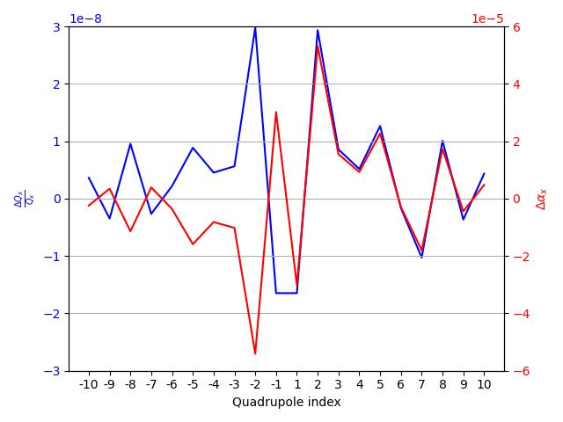
Sensitivity study
Figure 3 : Comparing the response at ∆k = 10^(−6) [m−1] of each couple of (same plane) parameters for each magnet.

Slide 6
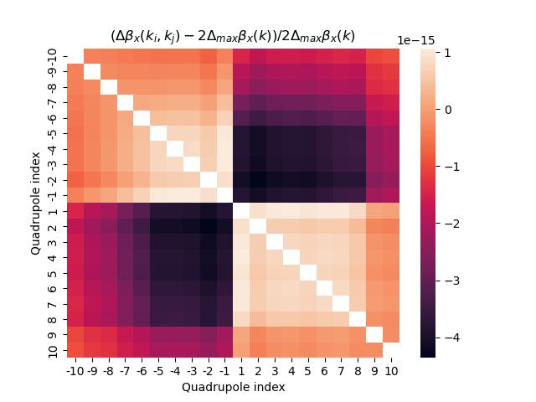
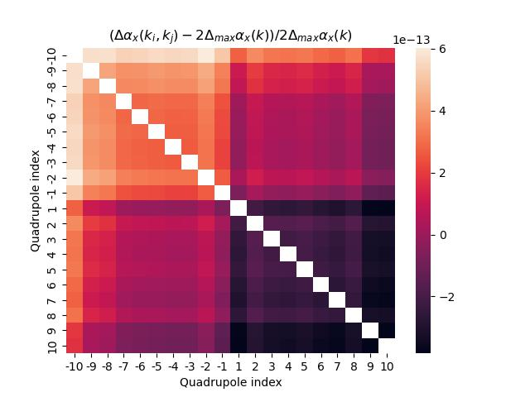
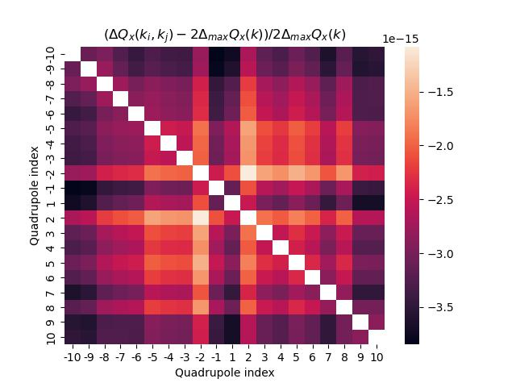
Sensitivity study
Figure 4 : Difference between the combined effect of each pair of kicker and the sum of their individual contributions (∆k = 10^(−6) [m−1])

Slide 7
Orbit correction methods
Knowing the behaviour of the beam, one can try applying corrections : we present and test different orbit correction methods, using the response matrix of the machine :
Least Square Method
Singular Value Decomposition
Orthogonal Matching Pursuit (MICADO)
These methods can be complemented by conditionning methods, used to condition the response matrix before correcting to ensure good results

Slide 8
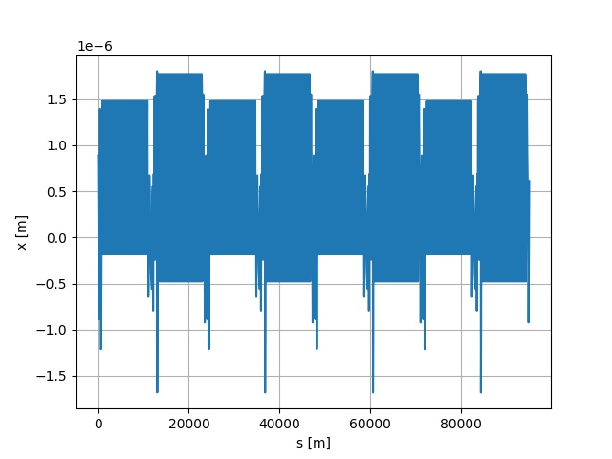
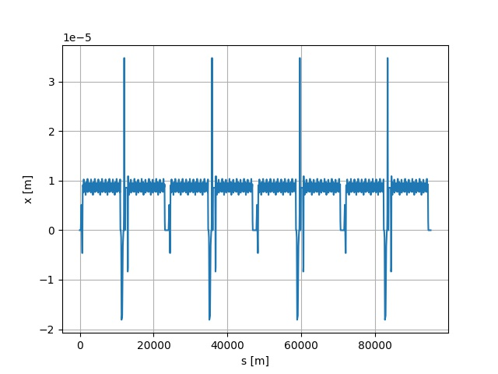
Orbit correction methods : Least Squares
Figure 5 : Perturbed and corrected orbit using the Least Squares method

Slide 9
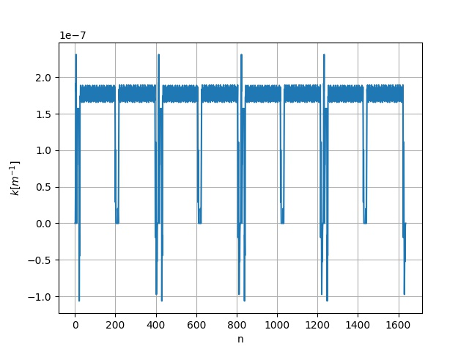
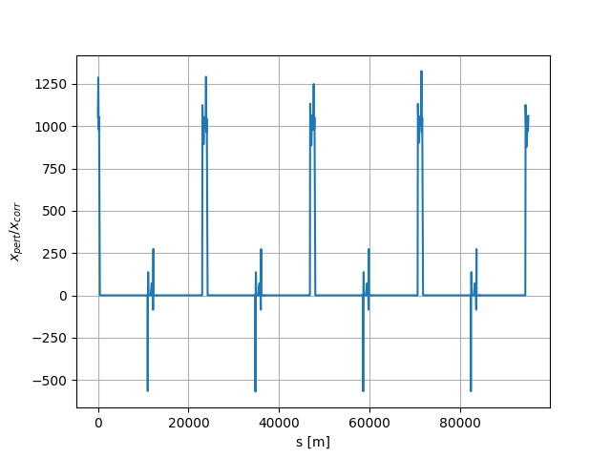
Orbit correction methods : Least Squares
Figure 6 : Corrector strength and orbit ratio using the Least Squares method

Slide 10
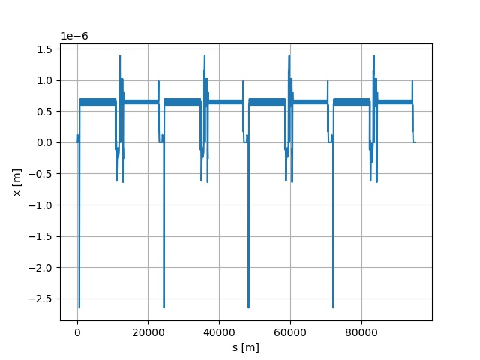
Orbit correction methods : Conditionned Least squares
Figure 7 : Perturbed and corrected orbit using the Least Squares method with prior conditioning using the correlation matrix.

Slide 11
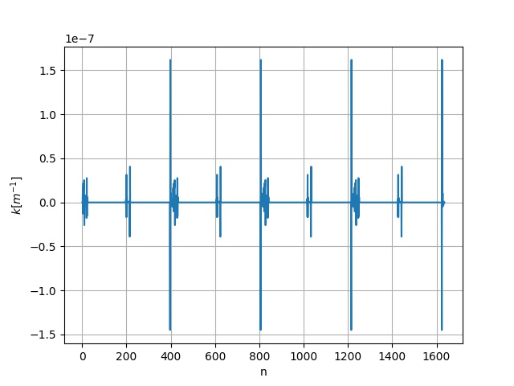
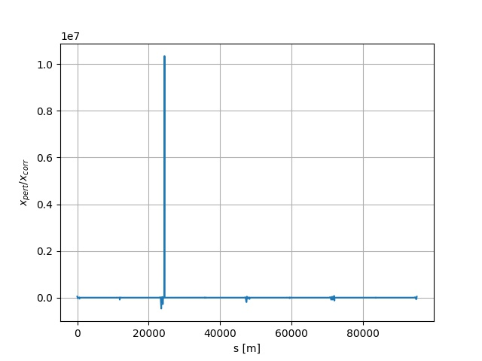
Orbit correction methods : Conditionned Least squares
Figure 8 : Corrector strength and orbit ratio using the Least Squares method with prior conditioning using the correlation matrix.

Slide 12
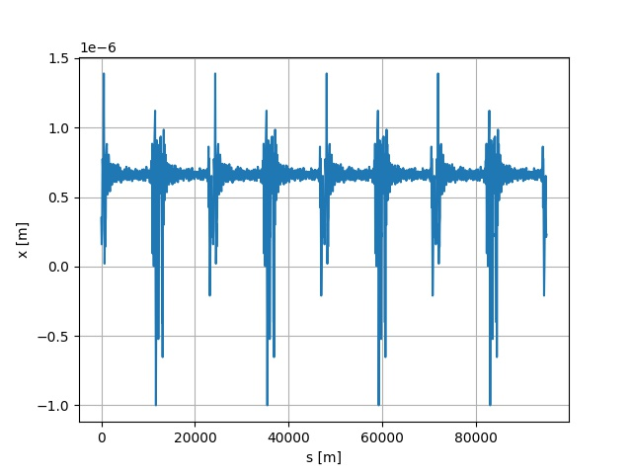
Orbit correction methods : SVD
Figure 9 : Perturbed and corrected orbit using the SVD method.

Slide 13
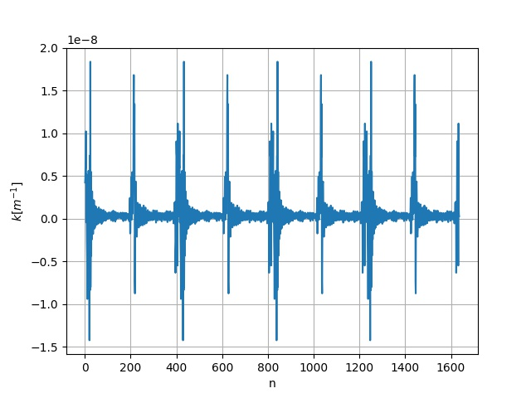
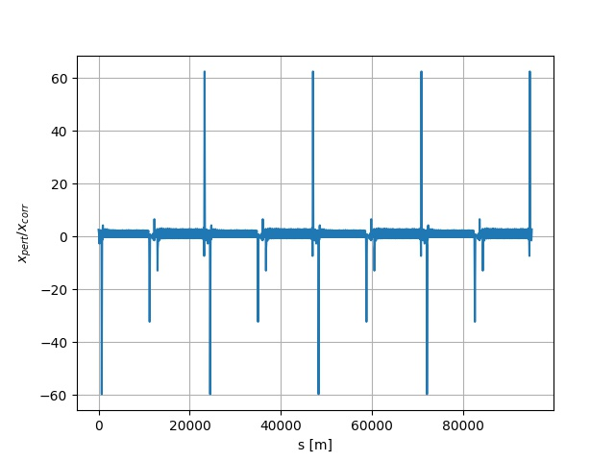
Orbit correction methods : SVD
Figure 10 : Corrector strength and orbit ratio using using the SVD method

Slide 14
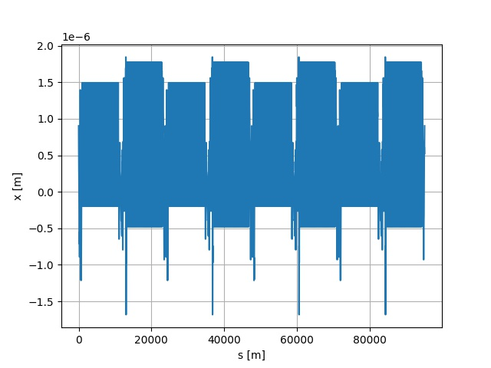
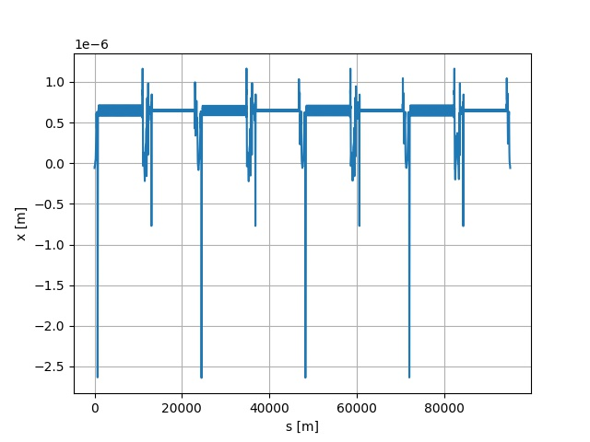
Orbit correction methods : OMP
Figure 11: Perturbed and corrected orbit using the OMP method.

Slide 15
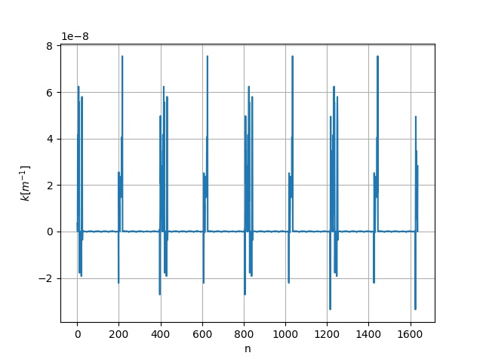
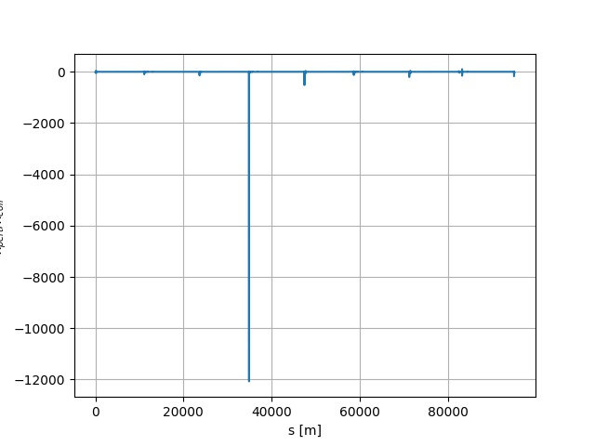
Orbit correction methods : OMP
Figure 12 : Corrector strength and orbit ratio using using the OMP method

Slide 16
Conclusions : What to take away
Studying the beam’s behaviour, we conclude that it is possible to find a combination of perturbations that targets one property of the beam while leaving the others untouched
It is possible to implement simple and efficient orbit correction methods in Python, and to use them to actually correct orbits.
What is next ?
Use this knowledge to find how to accurately target specific characteristics of the beam
Play around with the correction methods to see if they are applicable to other aspects of the beam’s optics

Slide 17
Thank you for your attention ! Questions ?

Slide 18
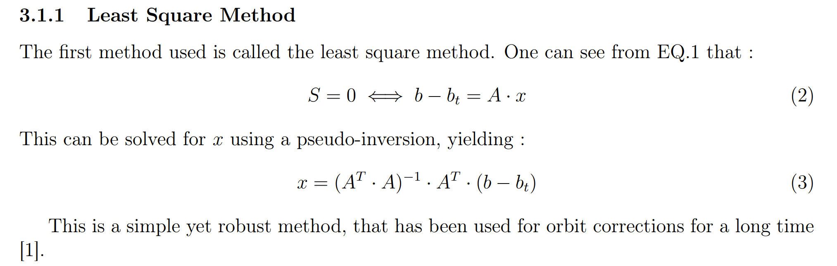
Appendix

Slide 19
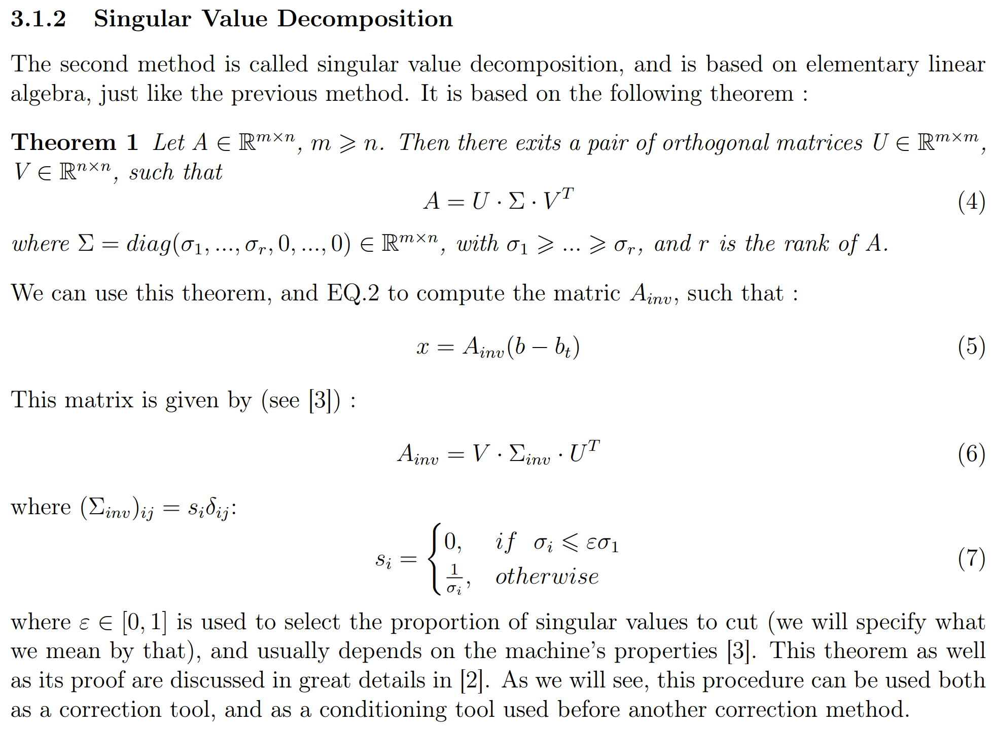

Slide 20
