Slide 1
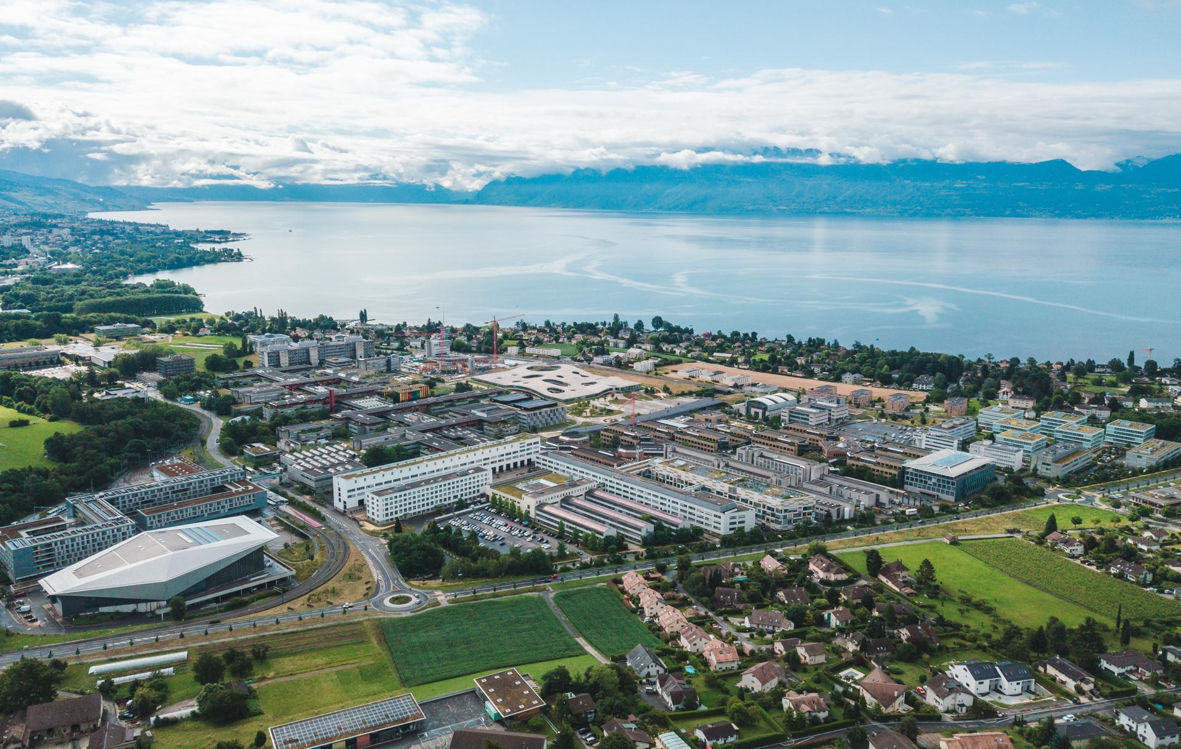
Optics Matching Studies for FCC:
Quadrupolar errors and a first step towards Combined Function magnets
Cristóbal GARCÍA, Rogelio TOMÁS, Tatiana PIELONI, Leon VAN
Special thanks to H. WERNER, Joshua W. Davide C. and FCC-ee team
This work was performed under the auspices and with support from EPFL-GlobalLeaders under the Marie Skłodowska-Curie grant agreement No 945363.
September 2022

Slide 2
Outline
Introduction
Optics Matching with ARC Errors
Structures in the ARCs
Matching the Lattice
Combined function magnets
Summary and Outlook

Slide 3
Outline
Introduction
  Introduction to FCC
  Introduction to FCC-ee Optics
  Distribution of elements in the ring
Optics Matching with ARC Errors
Structures in the ARCs
Matching the Lattice
Combined function magnets
Summary and Outlook

Slide 4
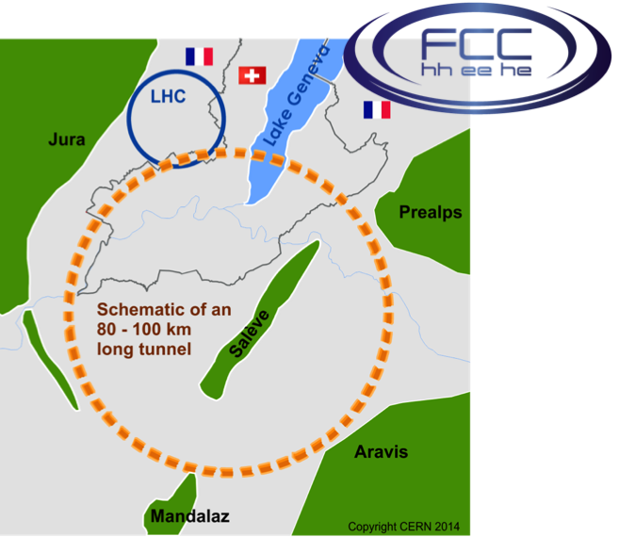
Introduction to FCC
The goal of the Future Circular Collider (FCC) is to push the energy and intensity frontiers of particle colliders, with the aim of reaching collision energies of 100 TeV, in the search for new physics.
FCC-ee will provide unprecedented sensitivity to signs of new physics appearing either in the form of small deviations from the Standard Model or as rare decay processes.
4 Interaction Points (IP) for FCC-ee. [1]

Slide 5
Introduction to FCC-ee Optics
FCC-ee_Z | Parameters from MADX
Length [m] | 91174.117
Horizontal tune | 214.260
Vertical tune | 214.380
Betax_max [m] | 4663.567
Betay_max [m] | 9924.567
Horizontal Chromaticity | -1.165
Vertical Chromaticity | -1.911
Dispersion_{max} [m] | 0.624
FCC-ee is a circular electron-positron collider, the first stage towards a 100 TeV proton-proton collider FCC-hh.
Double ring e+e- collider.
β*_{XY} = (0.1m, 0.8mm) for Z mode due to the Crab Waist collision scheme.
Some parameters from the sequence-file for MAD-X

Slide 6
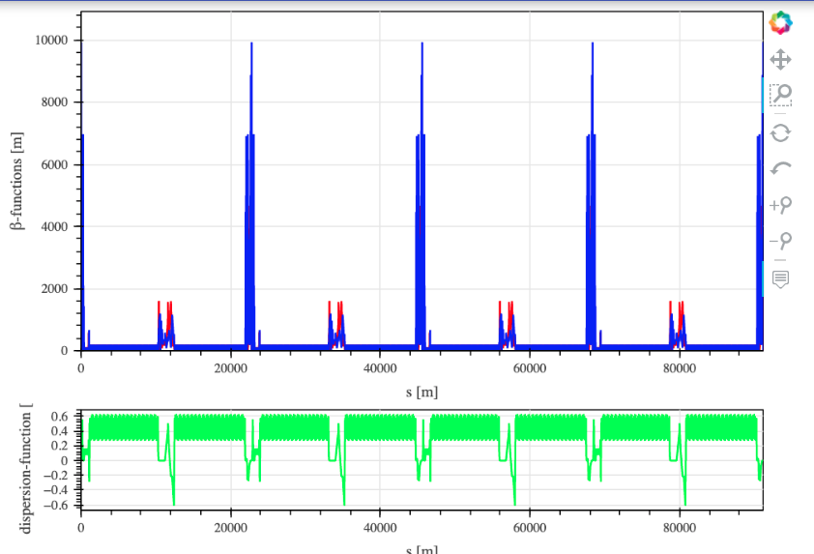
Introduction to FCC-ee Optics
IR 1
IR 3
IR 5
IR 7
Overview of lattice from CERN Optics Repository for Z-mode [2]
IR 2
IR 4
IR 6
IR 8
ARC 1
ARC 2
ARC 3
ARC 4
ARC 5
ARC 6
ARC 7
ARC 8

Slide 7
Distribution of elements in the ring
Element | Length [m]
QF4,QD3,QF2,QD1 | 2.9
QC | 3.5
QY | 3.5
QT | 1.0
QB | 2.9
QL | 1.8
SF, SD | 1.5
B1 | 22.654927
B1S | 19.304929
B1L | 20.954928
BL1 | 29.6201078
The main families of magnets in the accelerator are:
SECTION | IR_1_R | ARC_1 | IR_2_L | IR_2_R | ARC_2 | IR_3_L
QUADS | QC1L1 QC1R QT QC QY QA QS QDG/QFG QG | QF4 QD3 | QH QU QRFR QRDR | QI | QF2 QD1 | QL QB QY QC QT
DIPOLES | BC BS BG | B1 B1S B1L | BDS BWR BRX1 | BRX2 BI | B1 B1S B1L | BL BC BWL
Short description | Doublet, Matching, Dispersion suppressor | FODOs cell | Matching, Focusing-Defocusing between cavities | Matching | FODOs cell | Dispersion suppressor, Matching, Doublet

Slide 8
Outline
Introduction
Optics Matching with ARC Errors
  Matching with MAD-X
  Assignment of errors per ARCs
  Impact of dipole b2
Structures in the ARCs
Matching the Lattice
Combined function magnets
Summary and Outlook

Slide 9
Optics Matching with ARC Errors
The magnet design team predict a systematic quadrupolar error in the ARC dipoles.
This quadrupolar field will cause a change in the beta function (Beta-Beating).
The value of this systematic error depends on the arc number.
The effect can be simulated using MAD-X.
MAD-X matching can be used to recover:
  The correct phase advance in the arcs (and then the tunes).
  The correct twiss parameters in the insertion regions.
Notes:
To get the optical configuration you want → matching

Slide 10

Matching with MAD-X
“MAD-X is a project with a long history, aiming to be at the forefront of computational physics in the field of particle accelerator design and simulation. Its scripting language is de facto the standard to describe particle accelerators, simulate beam dynamics and optimize beam optics at CERN” [3]
Constraints
Matching Methods
LMDIF: Fast Gradient Minimisation
MIGRAD: Gradient Minimisation
SIMPLEX: Simplex Minimisation
JACOBIAN: Newton Minimisation.
Local
Global
Q1, Q2, dQ1, dQ2: enable a correction of tunes and chromaticities in presence of magnetic imperfections or misalignments
ddQ1, ddQ2: enable a correction of nonlinear chromaticities
BETX, BETY,
ALFX, ALFY,
MUX, MUY,
DX, DY,
DPX, DPY
Notes:
Used at CERN since more than 20 years for machine design and simulation (PS, SPS, LEP, LHC, future linacs, beam lines

Slide 11
Assignment of errors per ARCs
Quadrupolar errors of 1.6x10⁻⁴ in all ARCs dipoles are applied, considering a sign to differentiate the tunnel exchange (double ring collider) due to IP and RF.
SELECT, FLAG=ERROR, PATTERN="^B1", range=BGA.2/B1.533; !ARC3
SELECT, FLAG=ERROR, PATTERN="^B1", range=BGA.3/B1.890; !ARC5
SELECT, FLAG=ERROR, PATTERN="^B1", range=BGA.4/B1.1247; !ARC7
SELECT, FLAG=ERROR, PATTERN="^B1", range=BGA.1/B1.176; !ARC1
EFCOMP, ORDER=0, RADIUS=0.01, DKNR={0,16e-5};
SELECT, FLAG=ERROR, CLEAR;
SELECT, FLAG=ERROR, PATTERN="^B1", range=BI4.1/BL4.1; !ARC2
SELECT, FLAG=ERROR, PATTERN="^B1", range=BI4.2/BL4.2; !ARC4
SELECT, FLAG=ERROR, PATTERN="^B1", range=BI4.3/BL4.3; !ARC6
SELECT, FLAG=ERROR, PATTERN="^B1", range=BI4.4/BL4.4; !ARC8
EFCOMP, ORDER=0, RADIUS=0.01, DKNR={0,-16e-5};
The tunes Q1 and Q2 change with the error application as we can see in the next table:
Assigned field errors to 1400 elements:
ARCs 1,3,5,7
Assigned field errors to 1440 elements (there are 40 extra dipoles because the arcs are longer 40):
ARCs 2,4,6,8
 | Ideal | Error
Q1 | 214.2600 | 214.2492
Q2 | 214.3800 | 214.3876

Slide 12
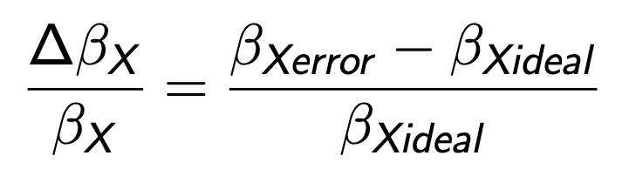
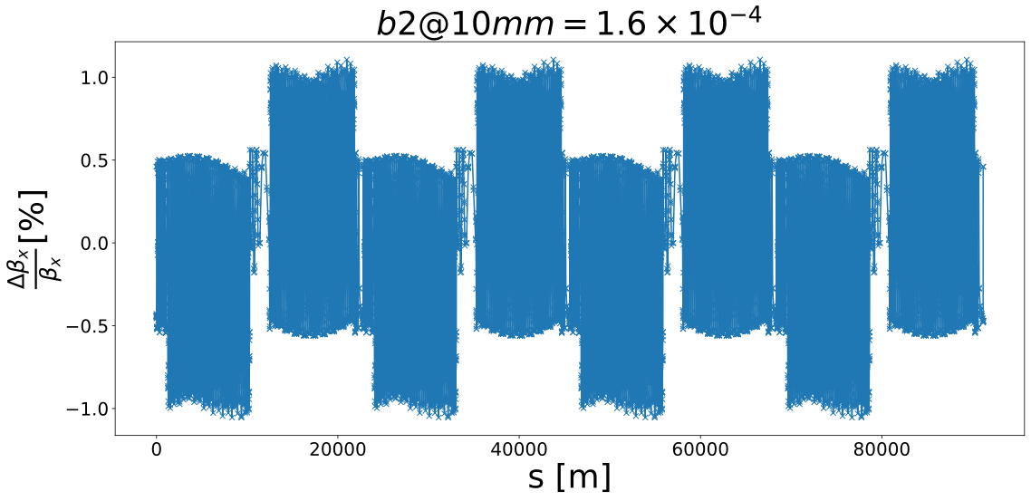
Impact of dipole b2
Apart from the change of tune, we can also look at the change in beta function due to the b2 errors.
The change in beta function can be quantified by computing the beta-beating.
DEFINITION OF BETA-BEATING
The beta beating in this case is shown in the next plot.
The magnitude of the beta-beating is around 1% for an error of 1.6x10⁻⁴ in the dipoles.
https://indico.cern.ch/event/1167740/

Slide 13
Outline
Introduction
Optics Matching with ARC Errors
Structures in the ARCs
  The super-FODOcell
  Layout with the super-FODO cell
  super-FODOs in the odd ARCs
  super-FODOs in the even ARCs
  Points of interest in the ARC 1
  Points of interest in the IR_2
Matching the Lattice
Combined function magnets
Summary and Outlook

Slide 14
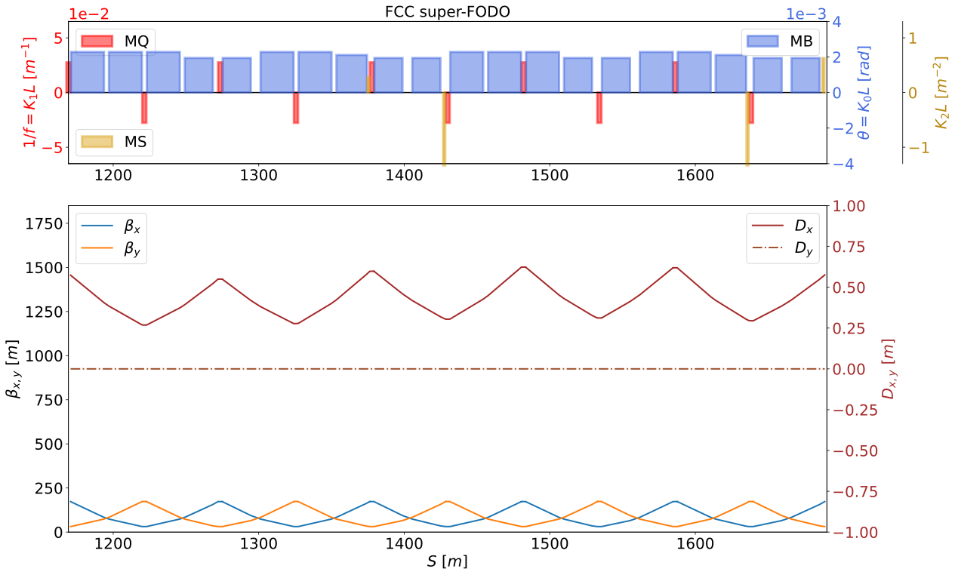
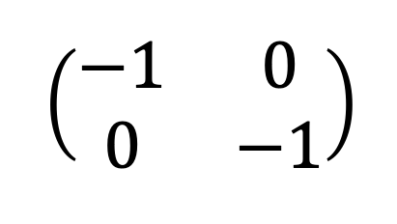
Structures in the ARCs: The super-FODOcell
In the FCCee here is a supercell consisting of 5 90°/90° FODO cells, this scheme has been applied successfully at B-factories for more than 20 years [4].
To achieve sufficient dynamic apertures is necessary a chromaticity correction with non-interleaved pairs of sextupoles [5], this new super-FODO has a phase advance 1.25(2π).
The sextupoles are placed to make pairs in which two identical sextupole magnets were connected by a −I transformer [6].
MS
Structures in the ARCs | ARC 1,3,5,7 | ARC 2,4,6,8
# 5-FODO (super-FODO) | 17 | 17
FODOs Remaining | 2 | 4

Slide 15
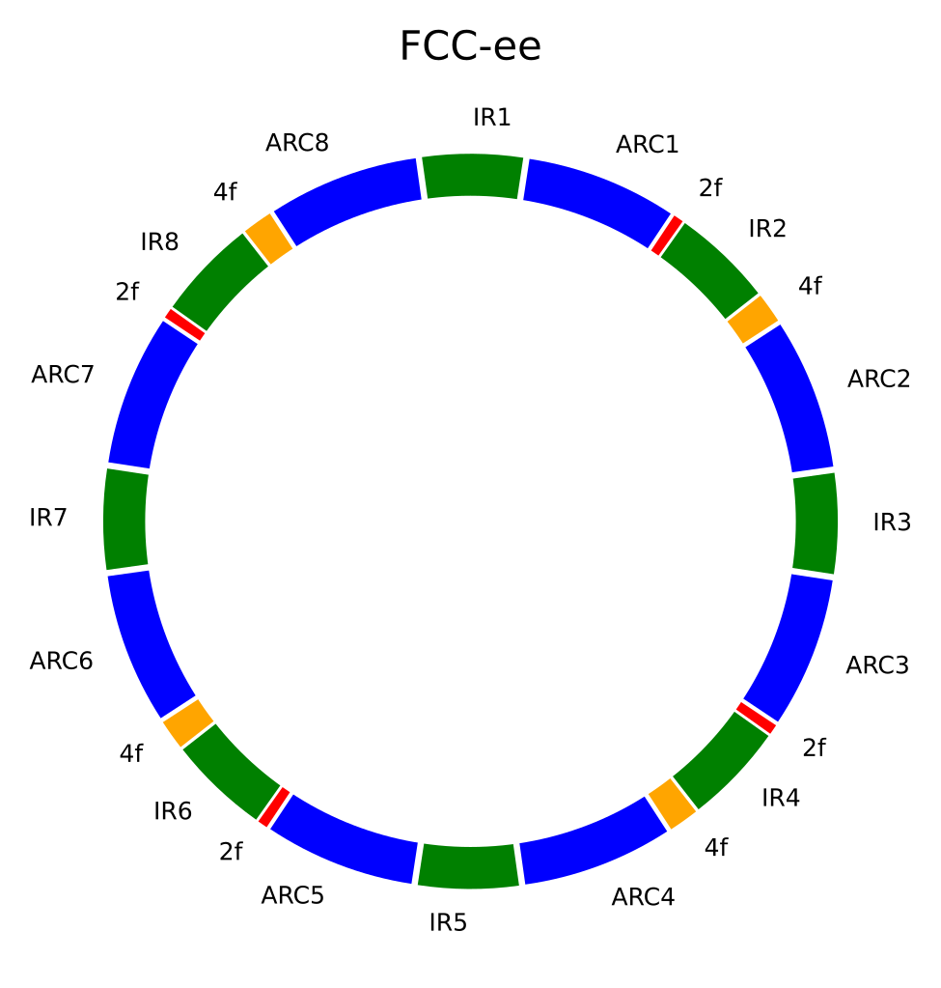
Layout with the super-FODO cell
8 Interaction Region (IR)
4 Interaction Point (IP)
4 Intermediate Straight Section (ISS)
8 ARC
17 super-FODO cells/ARC
24 FODO cells remaining
—----------------------------------------
704 FODO cells in total
Using ¼ of ring due to the symmetry to do Matching

Slide 16
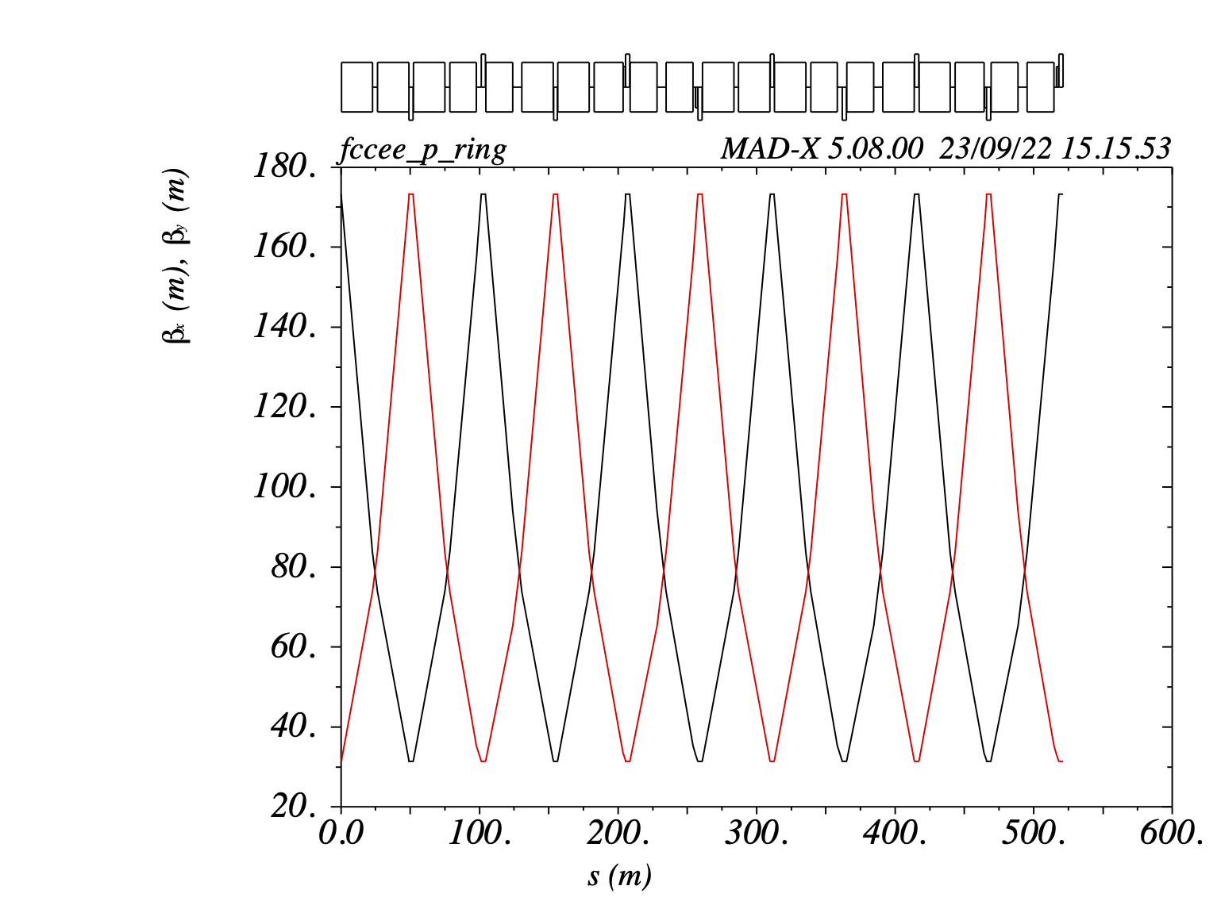
Structures in the ARCs:
super-FODOs in the odd ARCs
This structure has a length of 521.11m and the quads QF4 & QD3.
3 kinds of dipoles: B1, B1S & B1L.
4 sextupoles.
mux=muy= 1.25 (2π).
Structure ARC 1,3,5,7 super-FODO cell
QF4 B1 B1 QD3 B1 B1S | QF4 B1S B1 QD3 B1 B1L SF | QF4 B1S B1S SD QD3 B1 B1 | QF4 B1 B1S QD3 B1S B1 | QF4 B1 B1L SD QD3 B1S B1S SF

Slide 17
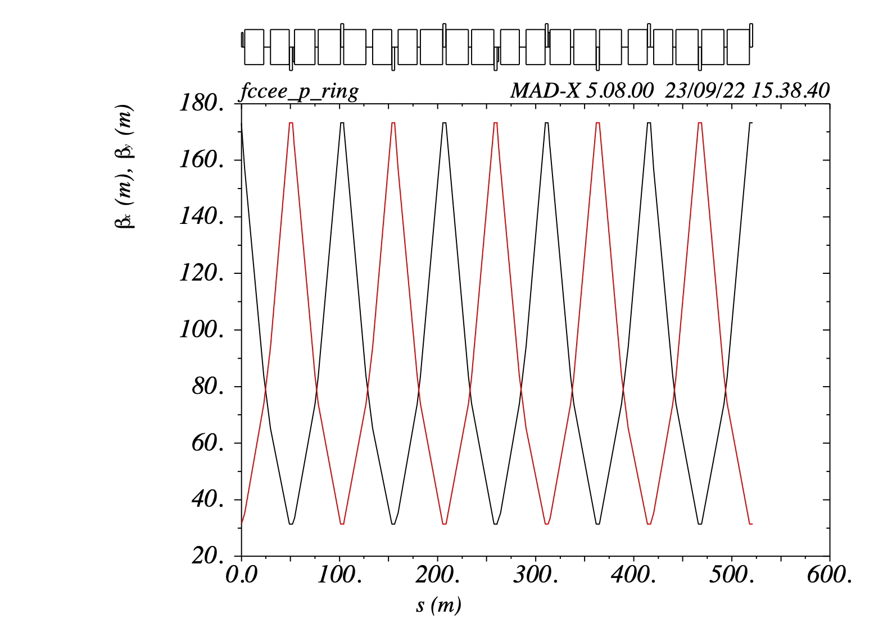
Structures in the ARCs:
super-FODOs in the even ARCs
This structure has a length of 521.09m and the quads QF2 & QD1.
3 kinds of dipoles: B1, B1S & B1L.
4 sextupoles.
mux=muy= 1.25(2π).
Structure ARC2,4,6,8 super-FODO cell
QF2 SF B1S B1S QD1 SD B1L B1 | QF2 B1 B1S QD1 B1S B1 | QF2 B1 B1 QD1 SD B1S B1S | QF2 SF B1L B1 QD1 B1 B1S | QF2 B1S B1 QD1 B1 B1

Slide 18
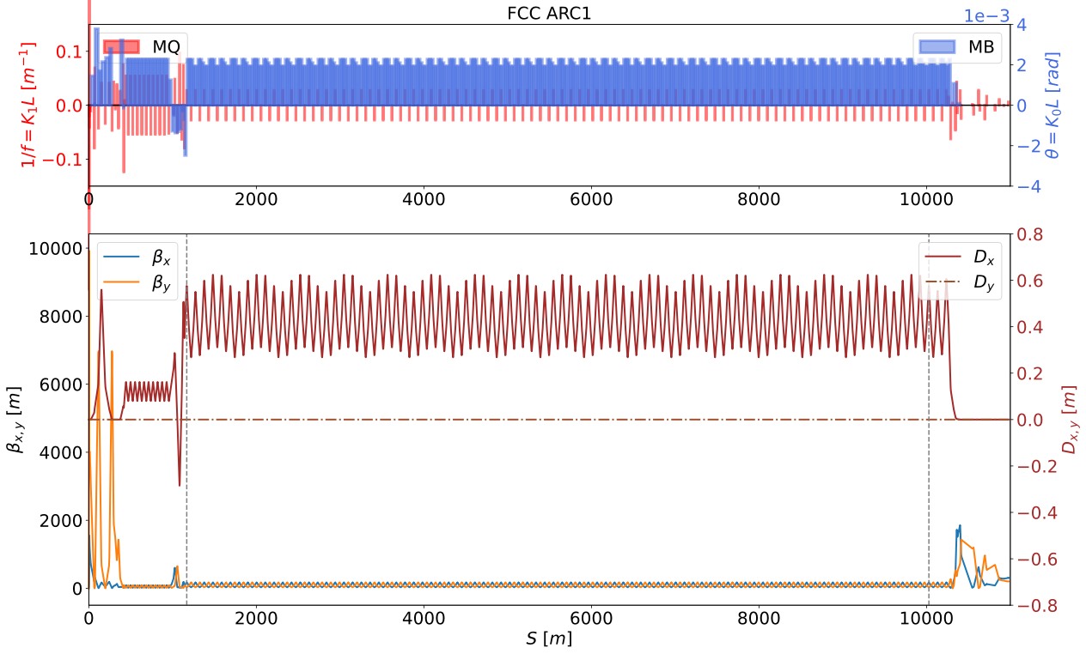
Points of interest in the ARC 1
2 points of interest, in the beginning and the end of the ARC1.
Without considering the structure based on a super-FODO cell, only from the initial point to the final point of the ARC the periodicity is lost (different Dx)
On the other hand, when the superstructure is used, the symmetry is preserved (Dx=0.574197)

Slide 19
Points of interest in the ARC 1
2 points of interest, in the beginning and the end of the ARC1.
Without considering the structure based on a super-FODO cell, only from the initial point to the final point of the ARC the periodicity is lost (different Dx)
On the other hand, when the superstructure is used, the symmetry is preserved (Dx=0.574197)
ARC1
ARC1_START
ARC1_END

Slide 20
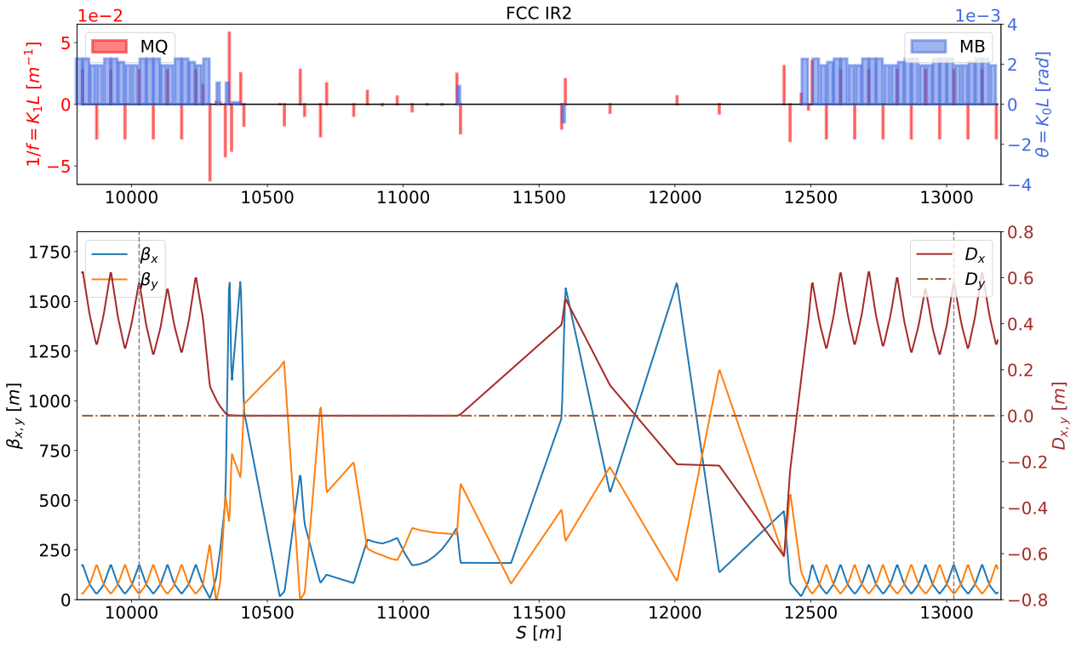
Points of interest in the IR_2
3 points of interest, in the beginning, in the middle and in the end of the Interaction Region.
There is not a BETX & BETY maximun due to the Low Beta IPs are in the Interaction Points (IR 1,3,5,7).
IR_2
ARC1_END
ISS_2
ARC2_START

Slide 21
Outline
Introduction
Optics Matching with ARC Errors
Structures in the ARCs
Matching the Lattice
  Matching the IR1_R
  Matching the IR_2_L
  Matching the IR_2_R
  Matching the IR_3_L
  “Matching” in all the ring
  Beta-Beating in the lattice
Combined function magnets
Summary and Outlook

Slide 22
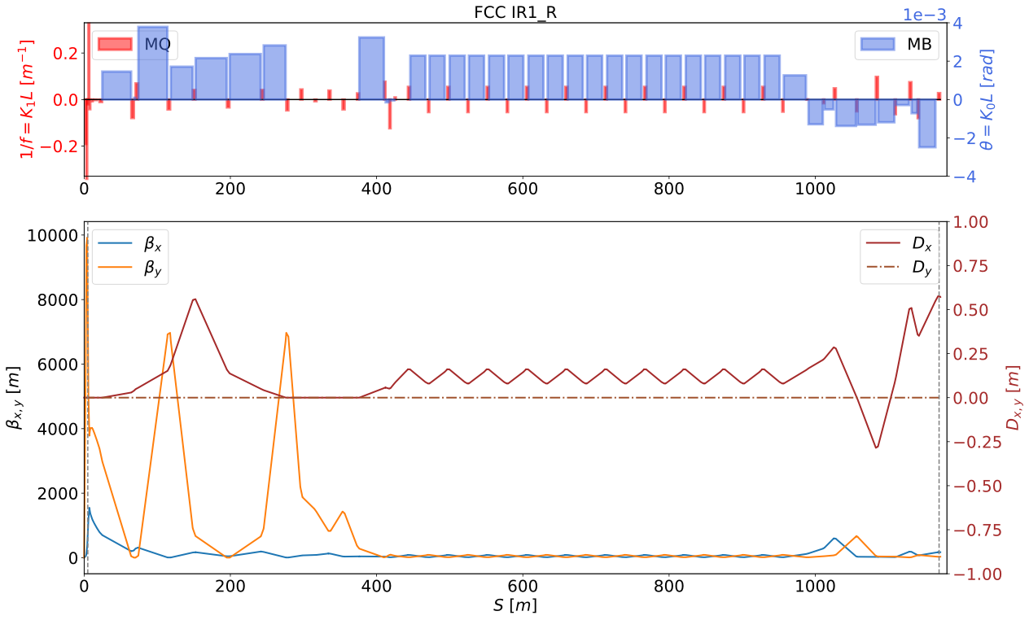
Matching the IR1_R
The ARCs already have Matching and with that the K1 of the QUADs have already been modified.
CONSTRAINT:
MUX
MUY
BETX
BETY
ALFX
ALFY
DX
DPX
IR1_R
Penalty | 2.296x10⁻²⁴ | 1.898x10⁻²⁵ | 6.503x10⁻²³ | 8.324x10⁻⁸
# vary | 10 | 9 | 8 | 7
ARC1_START
IP_1

Slide 23
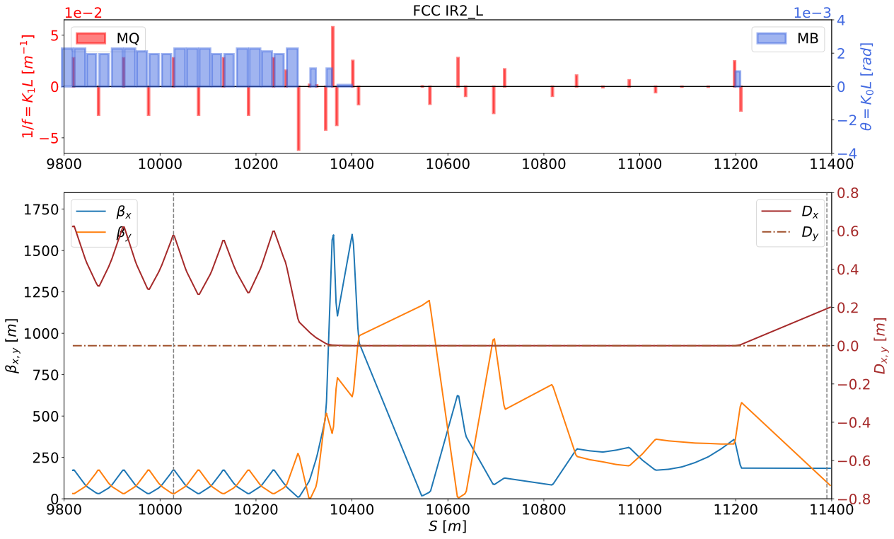
Matching IR_2_L
CONSTRAINT:
MUX
MUY
BETX
BETY
ALFX
ALFY
DX
DPX
In this section ALFX, ALFY & DPX has a negative sign because the matching is going from right to left and the we use the REFLECT function.
IR_2_L
Penalty | 3.325 x10⁻²² | 1.454 x10⁻²² | 2.672 x10⁻²² | 1.639 x10⁻²³ | 3.605 x10⁻²² | 8.733 x10⁻²² | 3.459 x10⁻⁰²
# vary | 15 | 14 | 13 | 12 | 11 | 10 | 9
ARC1_END
IR_2

Slide 24
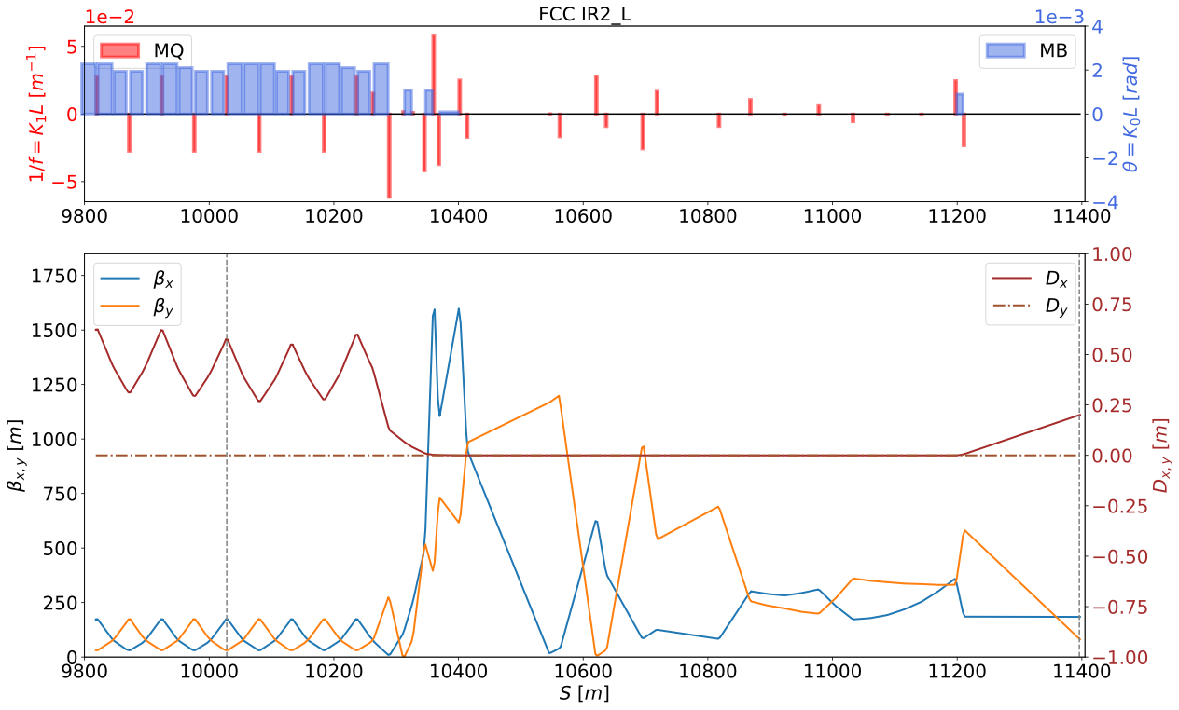

Matching IR_2_L
When the matching is applied to IR2_Left-HALF we have an increment to the peak of the BetX, because to use the Quadrupoles as variables in the matching the strengths are change (K1L).
Ideal Lattice vs Lattice with Matching

Slide 25

Matching IR_2_L
We could do the matching with the another way (more quadrupoles as variables) but that would have increases in the Chromaticity:
matching #2 with 15 variables VS matching #1 with 10 variables
dQ1=-0.677 dQ1=-0.945
dQ2= -3.617 dQ2=-2.796
Ideal Lattice
dQ1= -1.165
dQ2=-1.911

Slide 26
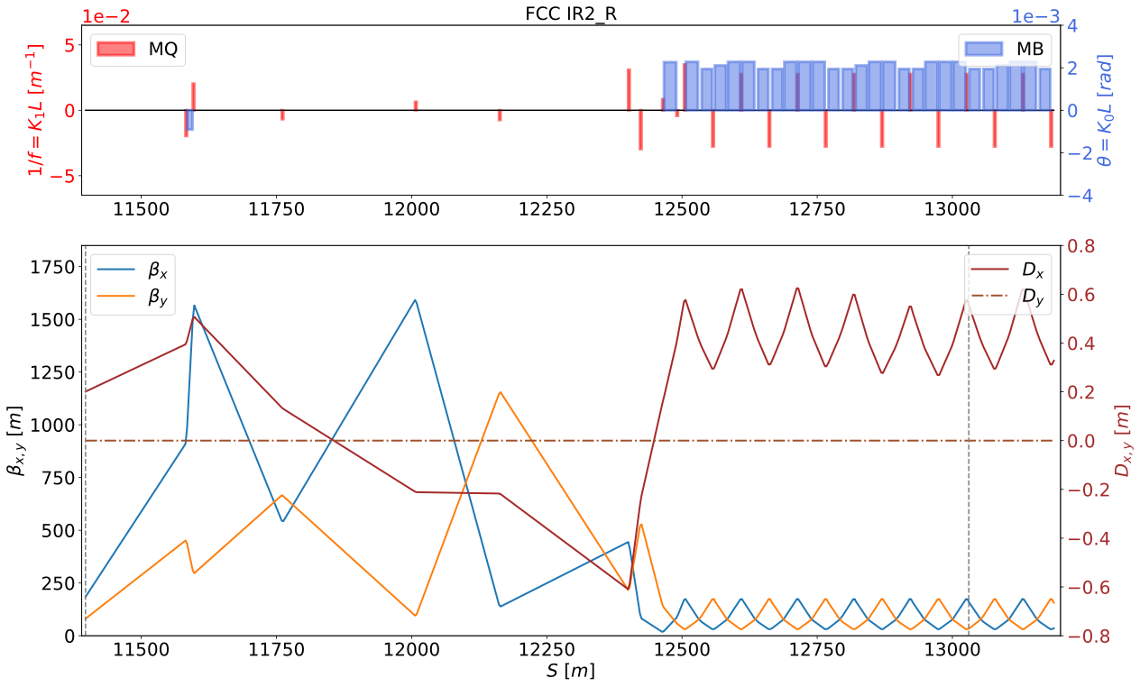
Matching IR_2_R
In this section the matching is with respect to the next arc (ARC2_START)
CONSTRAINT
MUX
MUY
BETX
BETY
ALFX
ALFY
DX
DPX
IR_2_R
Penalty | 4.159 x10⁻⁰¹ | 7.535 x10⁻²⁵ | 5.112 x10⁻²⁴ | 1.829 x10⁻²⁴ | 4.159 x10⁻⁰¹ | 4.159 x10⁻⁰¹
# vary | 9 | 10 | 11 | 12 | 11 | 10
IR_2
ARC2_START

Slide 27
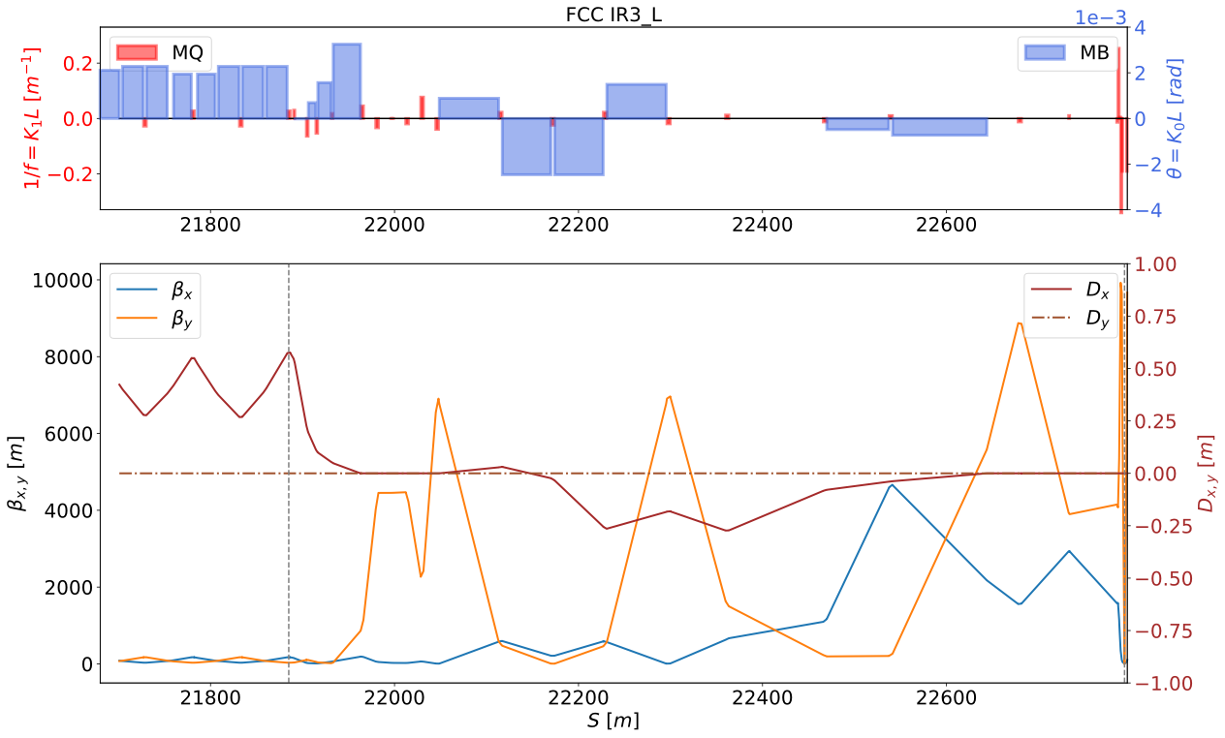
Matching IR_3_L
CONSTRAINT
MUX
MUY
BETX
BETY
ALFX
ALFY
DX
DPX
In this section ALFX, ALFY & DPX has a negative sign too because the matching is going from right to left and the we use the REFLECT function.
IR3_L
Penalty | 1.450 x10⁻²² | 2.032 x10⁻²² | 5.814 x10⁻²⁴ | 3.460 x10⁻⁰²
# vary | 11 | 10 | 9 | 8
ARC2_END
IR_3

Slide 28
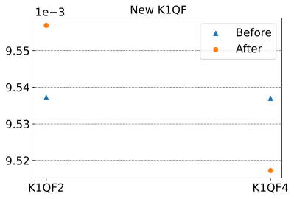
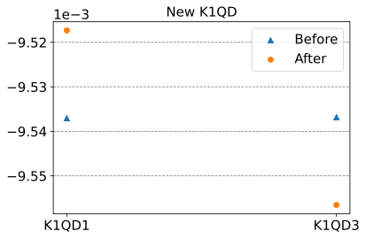
“Matching” in all the ring
Parameter | Before | After
Horizontal tune | 214.260 | 214.260
Vertical tune | 214.380 | 214.380
Horizontal Chromaticity | -1.165 | -0.945
Vertical Chromaticity | -1.911 | -2.796
BETX_{MAX} | 4663.567 | 4663.567
BETY_{MAX} | 9924.567 | 9924.567
Dispersion_{max} [m] | 0.624 | 0.787
Thanks to the symmetry, the last step is just to apply the errors in all the ARCs and then do… TWISS;
The K1 for all the QUADs around the lattice were changed with the previous matching.
Finally we have the tunes as at the beginning.
The Beta_{max} in X & Y are also the same.
The Chromaticity is changing by less than a one unit.
Quads | BEFORE (Ideal Machine) | AFTER (Errors and Matching)
K1QF4 | 9.53695 x10⁻⁰³ | 9.51723 x10⁻⁰³
K1QD3 | -9.53682 x10⁻⁰³ | -9.55653 x10⁻⁰³
K1QF2 | 9.53719 x10⁻⁰³ | 9.55690 x10⁻⁰³
K1QD1 | -9.53706 x10⁻⁰³ | -9.51733 x10⁻⁰³

Slide 29
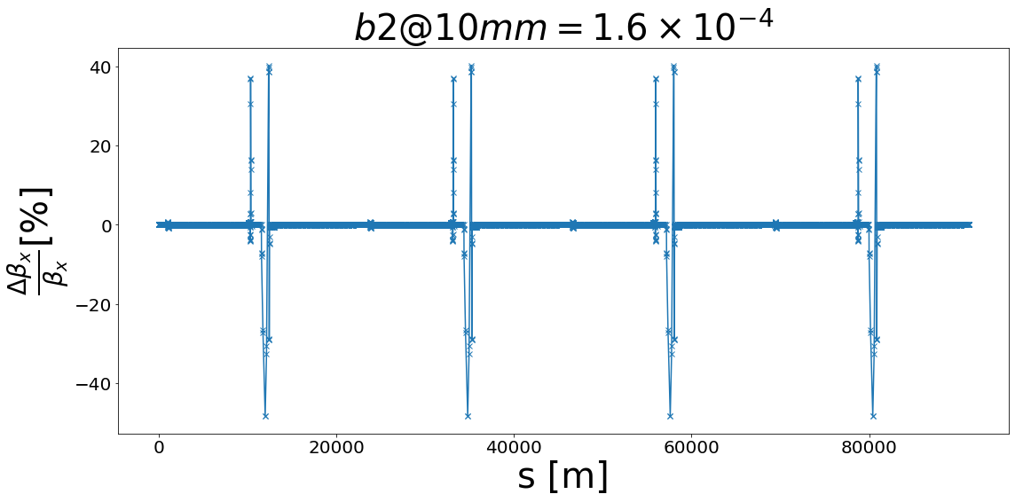
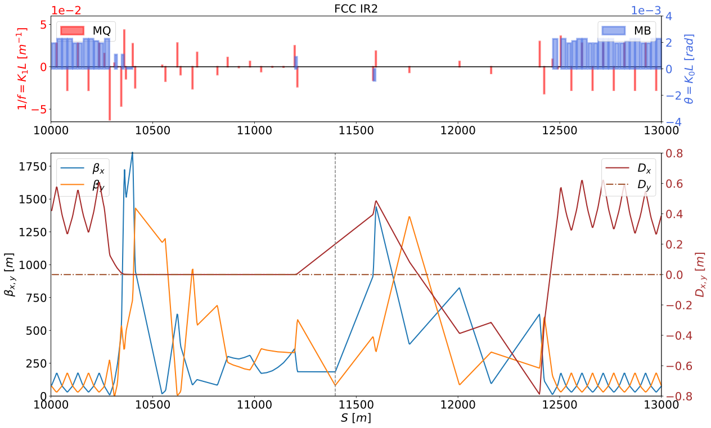
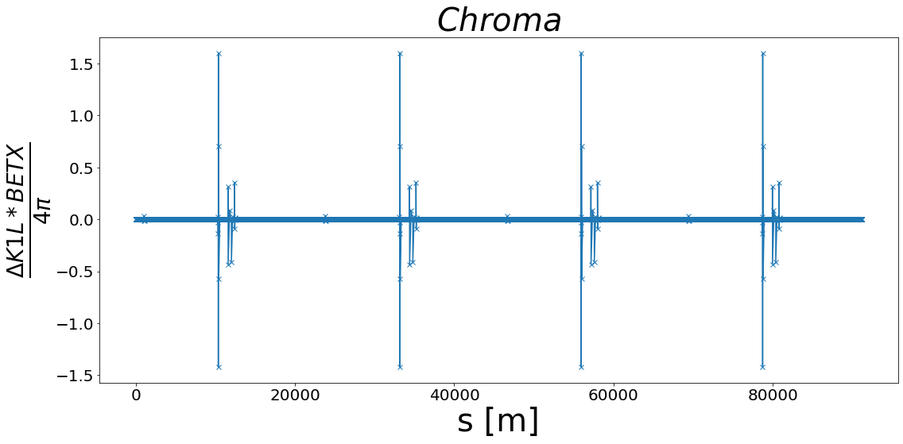
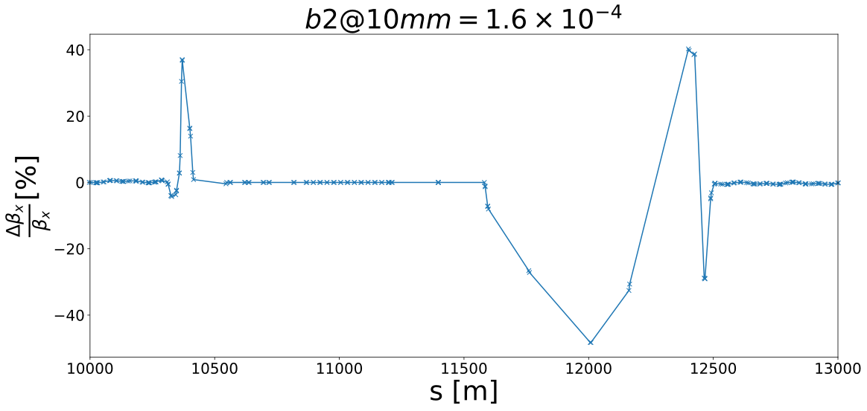
Beta-Beating in the lattice
There is an impact on the Lattice at the end of the matching due to the change in strengths as we can see in the Chromaticity and Beta-Beating plots.
The impact is not so important because in IR 2,4,6,8 we don't have IP and so it is not necessary to avoid these peaks.
+zoom

Slide 30
Outline
Introduction
Optics Matching with ARC Errors
Structures in the ARCs
Matching the Lattice
Combined function magnets
  FODO Cell with combined function magnets
Summary and Outlook

Slide 31
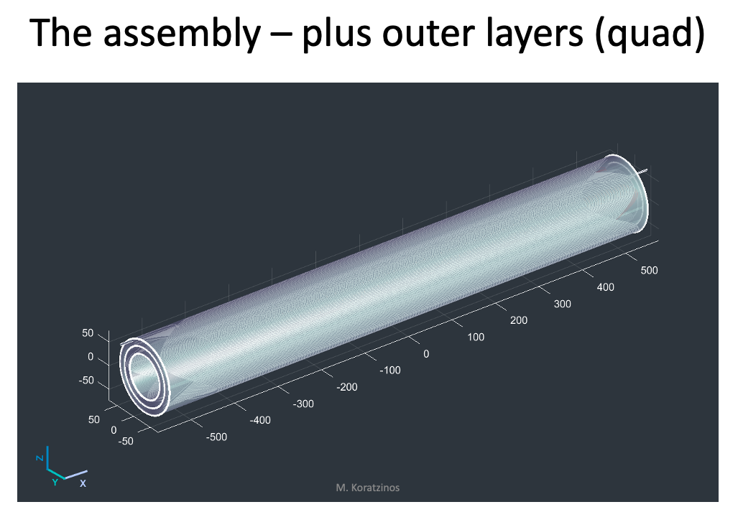
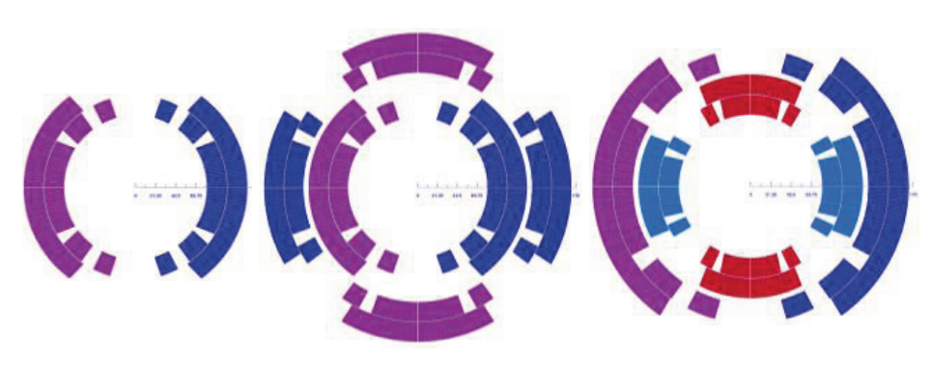
Combined function magnets
By increasing the length occupied by dipoles, the magnetic field decreases in it and the associated adverse effects such as radiation, power.
  According to M. Koratzinos we can explore the combined function magnets for the FCC [7]:
“Bending dipole (left) and combined-function quadrupoles with the dipole coil inside (center) and outside (right) of the main quadrupole coil. The color shades represent the current directions in the coils” [C]
M. Koratzinos. 150th FCC-ee Optics Design Meeting & 21st FCCIS WP2.2 Meeting

Slide 32
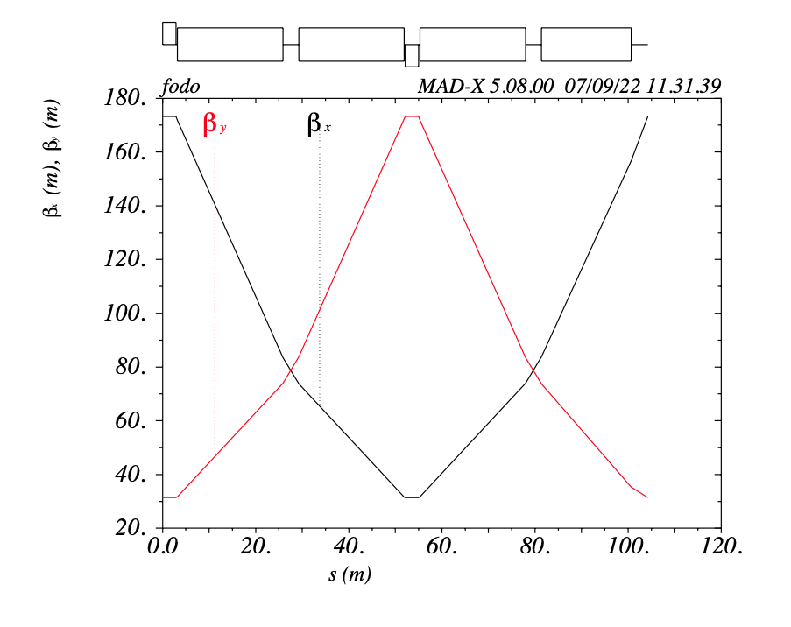
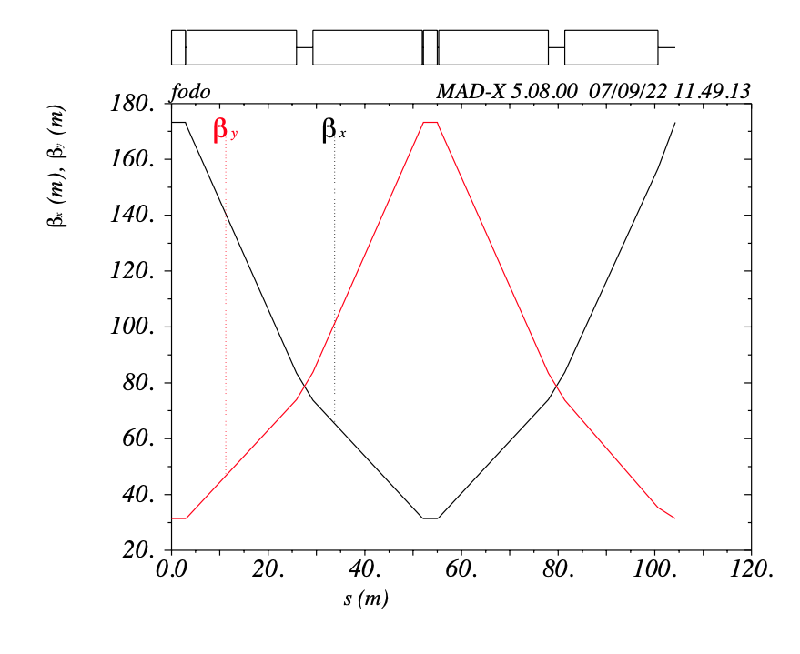
FODO Cell with combined function magnets
  A FODO Cell with combined function is possible.
  The mux & muy is maintained.
  The length of the FODO is the same.
FODO cell | Dipoles+Quass | Only Dipoles
length [m] | 104.22 | 104.22
Mux, Muy | 90º, 90º | 90º, 90º
Betax_max [m] | 173.234 | 173.234
Betay_max [m] | 173.233 | 173.233

Slide 33
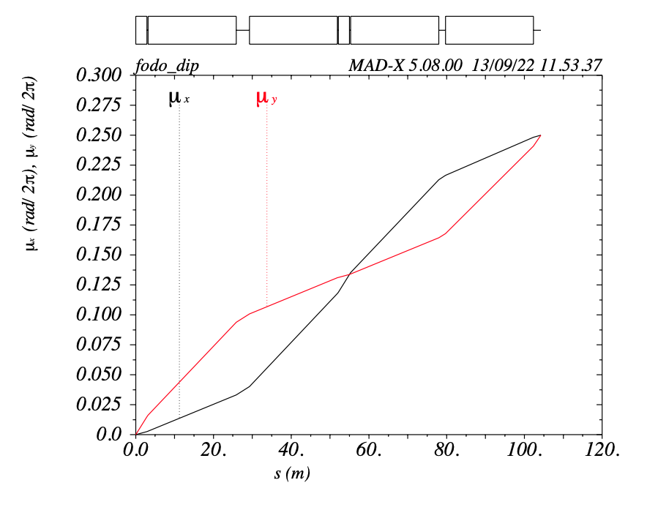
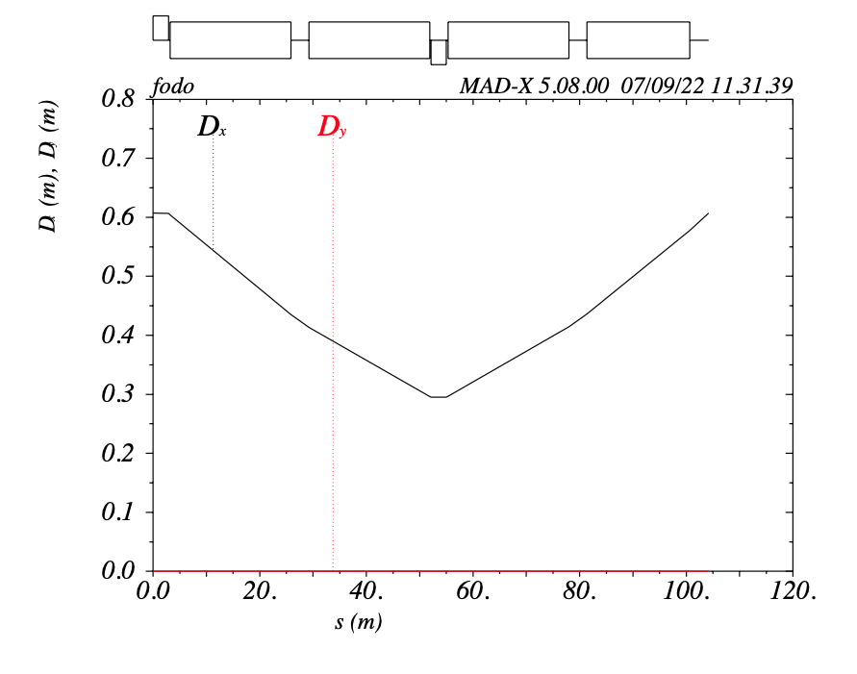
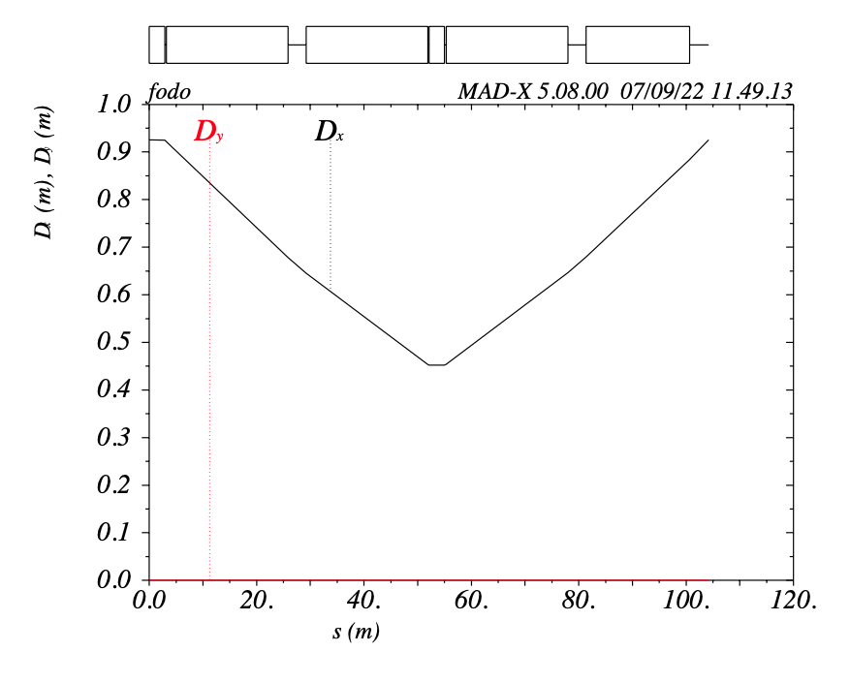
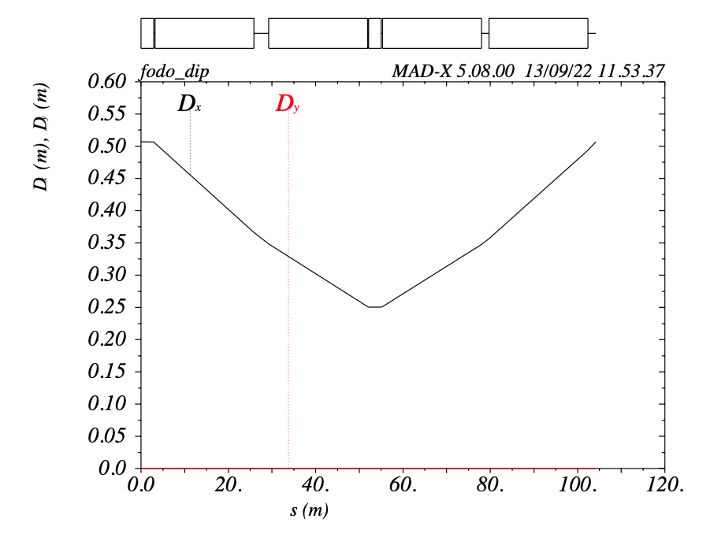
FODO Cell with combined function magnets
We can see the different Dispersion Dx en the FoDO cells.
The Dx is good for a FoDo made with the Dipoles B1S.
MUX, MUY = 90° the same for all the FoDos
Quads+Dipoles Dipoles (B1) Dipoles (B1S)
LQF4=LQF2=LQD3=LQD1=2.9 m. LB1=22.654m LB1S=19.304m

Slide 34
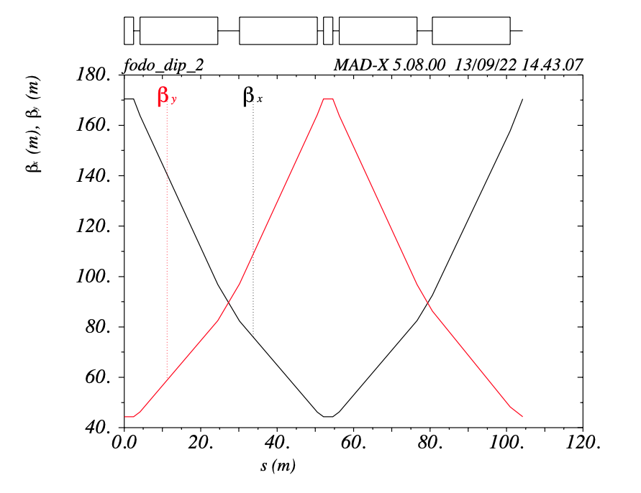


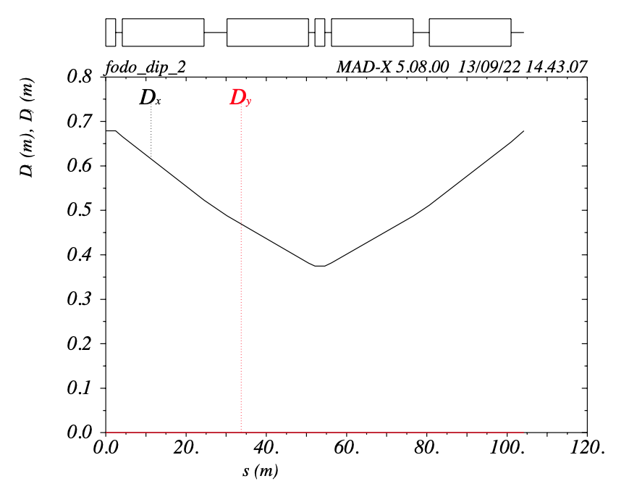
FODO Cell with combined function magnets
Its necessary to divide the Bending Angle between all the dipoles in the new FODO cell:
ANGLEB1 = .0022799261602137414;
ANGLEB1S = .0019427919548032158;
ANGLEB1L = .00210884313060243;
ANGLEB1S = 0.001807062833;
ANGLEB1QF = 0.0001357291;
ANGLEB1QD = -0.0001357291;
FODO cell
length | 104.22 [m]
Mux, Muy | 73.62º, 73.62º
Betax_max | 170.442
Betay_max | 170.441

Slide 35
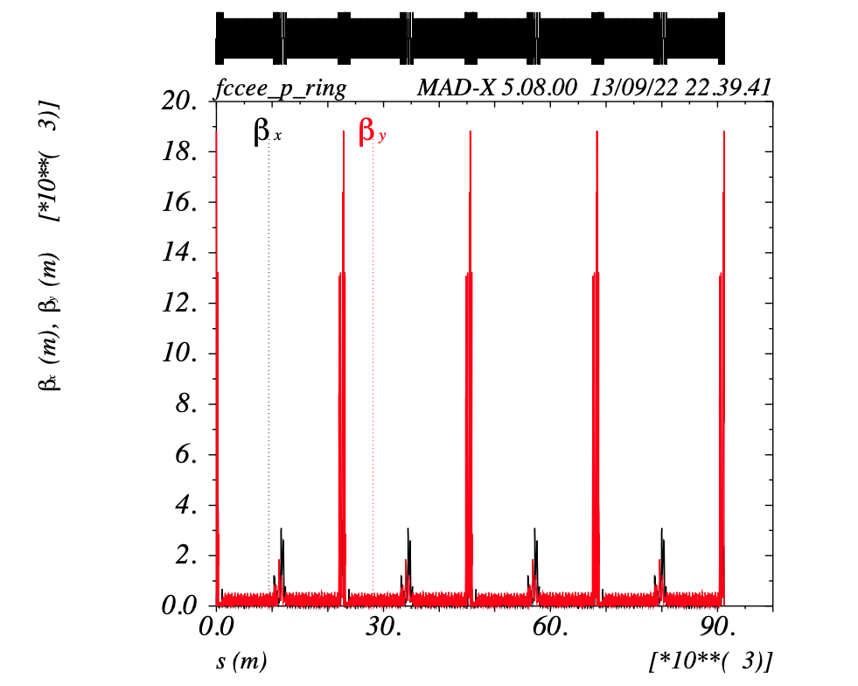
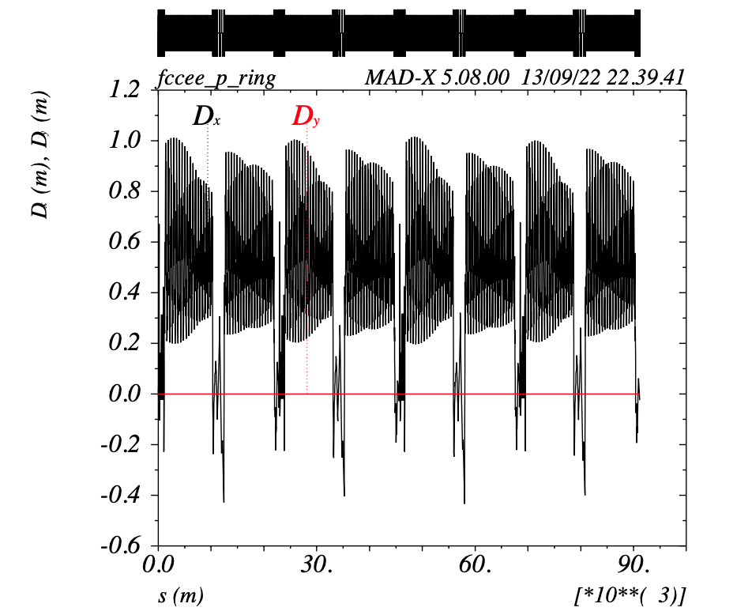
FODO Cell with combined function magnets
  In the first instance the lattice is stable (made to prove that), but is necessary to do matching.
  The Beta function increase.
  The tunes (Q1,Q2) decrease.
  The Chromaticity increase.
  The Dispersion function increase.
FCCee | Parameters (Only Dipoles)
Length | 91174.117 [m]
Q1 | 181.856
Q2 | 182.132
Betax_max | 3442.955
Betay_max | 18832.499
dQ1 | 116.530
dQ2 | 578.728
dxmax | 1.047

Slide 36
Summary
One of the main concerns is the effect of quadrupole error on beta functions as being studied.
  The maximum quadrupole error allowed in the dipoles by the machine to obtain 1% Beta-Beating is 1.6X10⁻⁴.
  For the same lattice with the same error applied, it is better to do a section by section matching instead of a matching applied to the entire ring.
In this presentation, the optimisation of first approximation layout of a combined-function periodic cell for the CERN FCC–ee lattice has been presented and discussed.

Slide 37
Summary
It is possible to use combined functions for the optics design of the FCC-ee and thus, by increasing the length occupied by dipoles, the magnetic field decreases in it and the associated adverse effects such as radiation, power, equilibrium, lower emittance.
It will be sought in later steps to achieve the appropriate parameters to have the initial conditions (as an ideal machine of the entire lattice) for combined functions.
Further studies will be performed in order to check if an Expert System could learn from these cases and constraints in order to evaluate the best way to obtain matching efficiently.

Slide 38


Slide 39
References
[1] FCC week 2022, “Accelerator overview”, Frank Zimmermann, Tor Raubenheimer. https://indico.cern.ch/event/1064327/timetable/
[2] https://acc-models.web.cern.ch/acc-models/fcc/fccee/V22/z/
[3] http://mad.web.cern.ch/mad/madx.old/madx_manual.pdf
[4] Design of beam optics for the future circular collider eþe− collider rings. K. Oide. PHYSICAL REVIEW ACCELERATORS AND BEAMS 19, 111005 (2016).
[5] Dynamic aperture of electron storage rings with nointerleaved sextupoles. K. Oide & H. Koiso. Physical Review E 1993.
[6] Haruyo Koiso, Akio Morita, Yukiyoshi Ohnishi, Katsunobu Oide, Kotaro Satoh, Lattice of the KEKB colliding rings, Progress of Theoretical and Experimental Physics, Volume 2013, Issue 3, March 2013, 03A009, https://doi.org/10.1093/ptep/pts086
[7] M. Koratzinos. 150th FCC-ee Optics Design Meeting & 21st FCCIS WP2.2 Meeting. https://indico.cern.ch/event/1118297/
[8] https://www.bnl.gov/magnets/hts-magnet-program.php

Slide 40
References
[A] HIGH-FIELD COMBINED-FUNCTION MAGNETS FOR A 1.5×1.5 TeV MUON COLLIDER STORAGE RING* V.V. Kashikhin.
[B] Considerations on combined-function optics for high-energy storage rings and colliders. M. Giovannozzi, EPJ Techniques and Instrumentation (2022) 9:5 https://doi.org/10.1140/epjti/s40485-022-00081-2.
[C] https://hibtc.github.io/cpymad/getting-started.html#redirecting-output
[D] https://hibtc.github.io/cpymad/getting-started.html#table
[E] https://indico.cern.ch/event/847209/contributions/3558973/attachments/1932901/3201996/AccPhys_Lect7_MomEff.pdf
[F] https://cds.cern.ch/record/398300/files/p191.pdf (natural chromaticity)

Slide 41
Backup

Slide 42
Strategy
Look for the super-FODOs in the ARCs.
Install markets at points of interest (start, end arcs and IP).
Since there are 2 and 4 FODOs left over, they are sought to be towards the Intermediate Straight Section (ISS) so that the complete super-FODOs are closer to the Interaction Point (IP).
Add errors in the ARCs in b1 and match.
Do the matching with each section of the IR, in only 25% of the ring, ensuring that the Quads close to the ARCs are occupied and that they are the least amount of elements to match.
Application of errors to all the ARCs with the +- sign according to the ARC in question because there is a change of tunnel in the RF and in the IP.
By twiss these Chromas are obtained: dQ1=-0.945, dQ2=-2.796
When making the Beta-Beating and Chroma graphs, it is noted that in the IR 2,4,6,8 there are peaks, which correspond to the QUADs QH2, QI4, QI6, QI8.

Slide 43
Matching Methods
LMDIF: Fast Gradient Minimisation.
The LMDIF command minimises the sum of squares of the constraint functions using their numerical derivatives.
MIGRAD: Gradient Minimisation.
The MIGRAD command minimises the penalty function using the numerical derivatives of the sum of squares.
SIMPLEX: Simplex Minimisation.
The SIMPLEX command minimises the penalty function by the simplex method.
JACOBIAN: Newton Minimisation.
The JACOBIAN command minimises the penalty function calculating the Jacobian and solving the linear problem. A QR or LQ decomposition is performed when the system is over or under-determined.

Slide 44
SaveBeta with symmetry in the ARCs
Point of interest | TOTAL ARC | Using super-FODO
ARC_1_START | betx: 173.234408 alfx: 2.403465 mux: 5.006802 bety: 31.414086 alfy: -0.478409 muy: 5.184548 dx: 0.574197 dpx: -0.008480 | betx: 173.234408 alfx : 2.403465 mux: 5.006802 bety: 31.414086 alfy: -0.478409 muy: 5.184548 dx: 0.574197 dpx: -0.008480
ARC_1_END | betx: 173.234780 alfx : 2.403477 mux: 26.756810 bety: 31.414156 alfy : -0.478415 muy: 26.934557 dx : 0.598699 dpx : -0.008044 | betx: 173.234895 alfx: 2.403474 mux: 26.256810 bety: 31.414061 alfy: -0.478410 muy: 26.434556 dx : 0.574197 dpx: -0.008480

Slide 45
IR1_R
Penalty | 2.296x10⁻²⁴ | 1.898x10⁻²⁵ | 6.503x10⁻²³ | 8.324x10⁻⁸
vary | K1QFG2 K1QG1 K1QG2 K1QG3 K1QG4 K1QG5 K1QG6 K1QG7 K1QG8 K1QG9 | K1QG1 K1QG2 K1QG3 K1QG4 K1QG5 K1QG6 K1QG7 K1QG8 K1QG9 | K1QG2 K1QG3 K1QG4 K1QG5 K1QG6 K1QG7 K1QG8 K1QG9 | K1QG3 K1QG4 K1QG5 K1QG6 K1QG7 K1QG8 K1QG9

Slide 46
IR_2_L
Penalty | 3.325 x10⁻²² | 1.454 x10⁻²² | 2.672 x10⁻²² | 1.639 x10⁻²³ | 3.605 x10⁻²² | 8.733 x10⁻²² | 3.459 x10⁻⁰²
vary | K1QH8 K1QH7 K1QH6 K1QH5 K1QH4 K1QH3 K1QH2 K1QU8 K1QU7 K1QU6 K1QU5 K1QU4 K1QU3 K1QU2 K1QU1 | K1QH8 K1QH7 K1QH6 K1QH5 K1QH4 K1QH3 K1QH2 K1QU8 K1QU7 K1QU6 K1QU5 K1QU4 K1QU3 K1QU2 | K1QH8 K1QH7 K1QH6 K1QH5 K1QH4 K1QH3 K1QH2 K1QU8 K1QU7 K1QU6 K1QU5 K1QU4 K1QU3 | K1QH8 K1QH7 K1QH6 K1QH5 K1QH4 K1QH3 K1QH2 K1QU8 K1QU7 K1QU6 K1QU5 K1QU4 | K1QH8 K1QH7 K1QH6 K1QH5 K1QH4 K1QH3 K1QH2 K1QU8 K1QU7 K1QU6 K1QU5 | K1QH8 K1QH7 K1QH6 K1QH5 K1QH4 K1QH3 K1QH2 K1QU8 K1QU7 K1QU6 | K1QH8 K1QH7 K1QH6 K1QH5 K1QH4 K1QH3 K1QH2 K1QU8 K1QU7

Slide 47
IR3_L
Penalty | 1.450 x10⁻²² | 2.032 x10⁻²² | 5.814 x10⁻²⁴ | 3.460 x10⁻⁰²
vary | K1QL4 K1QL3 K1QL2 K1QL1 K1QB6 K1QB5 K1QB4 K1QB3 K1QB2 K1QB1 K1QY2L | K1QL4 K1QL3 K1QL2 K1QL1 K1QB6 K1QB5 K1QB4 K1QB3 K1QB2 K1QB1 | K1QL4 K1QL3 K1QL2 K1QL1 K1QB6 K1QB5 K1QB4 K1QB3 K1QB2 | K1QL4 K1QL3 K1QL2 K1QL1 K1QB6 K1QB5 K1QB4 K1QB3

Slide 48
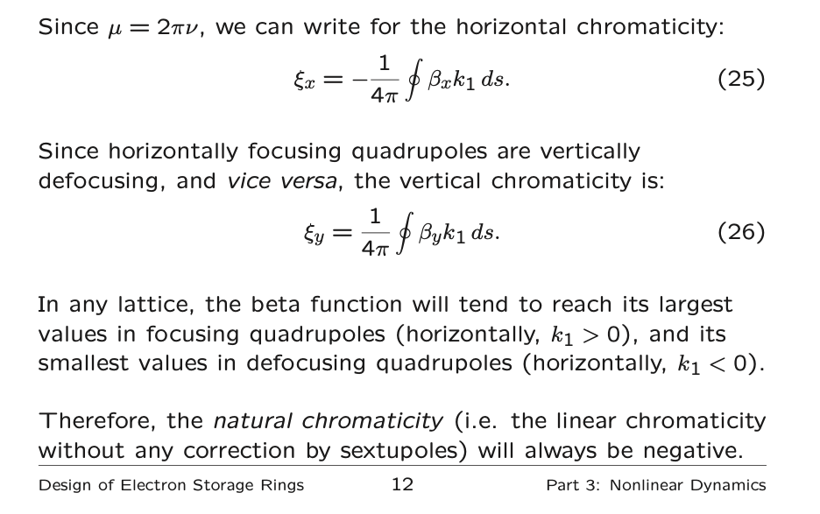
Why dQ1, dQ2 are negatives:

Slide 49
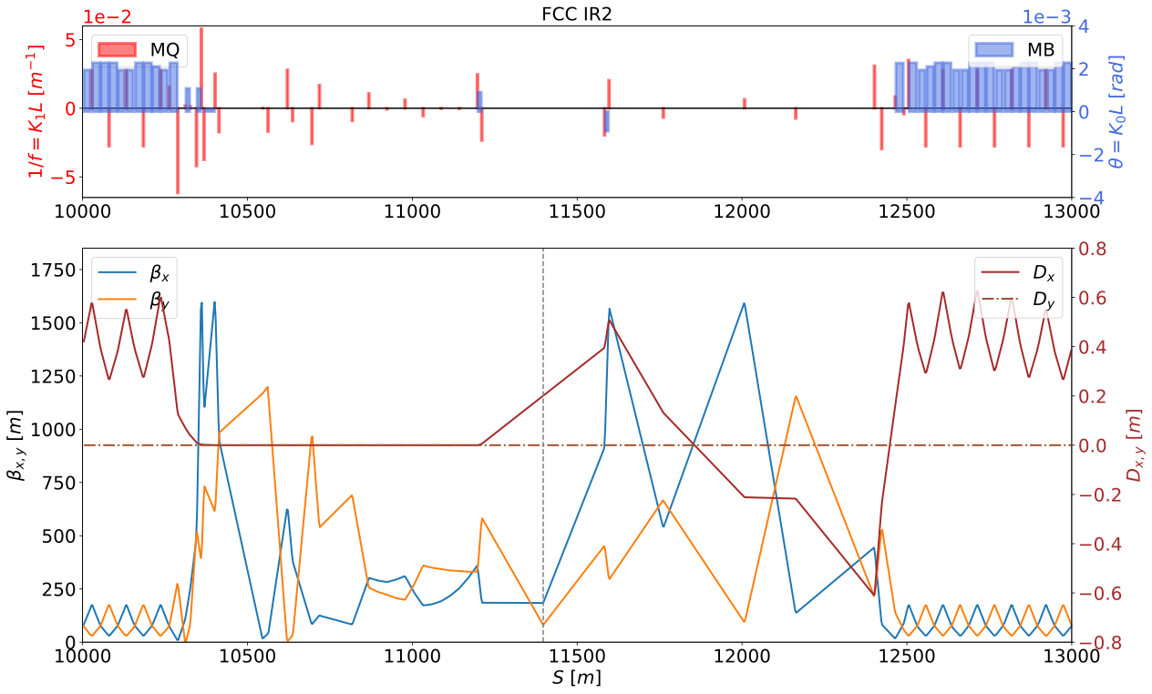
IR_2 with Ideal Machine

Slide 50
IR_2 with b2 error and Matching

