Slide 1
Electron Cloud
Sabato Luca, Mether Lotta
EPFL-LPAP FCC-ee Software Framework Meeting
11th May 2022

Slide 2
Outline
Background
Project Goals
EPFL-LPAP FCC-ee Software Framework Meeting 11/05/2022

Slide 3
Outline
Background
Project Goals
EPFL-LPAP FCC-ee Software Framework Meeting 11/05/2022

Slide 4
Background
In the framework of long term coherent stability and diffusion studies for the Future Circular Collider
In particular, electron cloud effect can be a persistent limitation for high intensity beams in circular colliders (as the LHC experience has shown)
Surface treatments, by means of beam induced scrubbing, can suppress the electron cloud build-up, reducing the Secondary Electron Yield (SEY)
Even if beam induced multipacting can be efficiently suppressed, residual electron cloud generation due to the photoemission resulting from synchrotron radiation may still be significant for beam dynamics
EPFL-LPAP FCC-ee Software Framework Meeting 11/05/2022

Slide 5
Outline
Background
Project Goals
EPFL-LPAP FCC-ee Software Framework Meeting 11/05/2022

Slide 6
Project Goals
Improve the model of the electron cloud formation based on the current state of knowledge (from both lab and the LHC experience)
Validate the existing numerical tools for electron cloud build-up based on the LHC RUN3 data set
Development code and benchmark of PyECLOUD for Xsuite in the software framework for FCC
By using the results of the model, propose modifications for the design of the vacuum chambers of the FCC in terms of shape, material, coating or surface treatment
Contribute to the development of a framework for comprehensive beam dynamics simulations on the combined effect of persisting electron cloud, beam-beam and impedance aiming at the prediction of stability limits and beam lifetime evolution during collisions
EPFL-LPAP FCC-ee Software Framework Meeting 11/05/2022

Slide 7
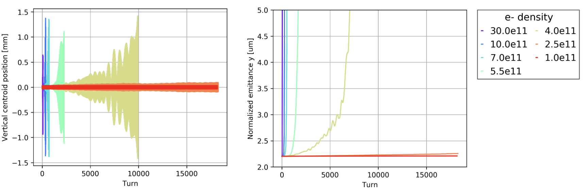
Project Goals
Comparison between the analytical central electron density threshold for single bunch instability and the simulation results
Analytical equation
[] K. Ohmi et al., “Study of Electron Cloud Instabilities in FCC-hh”, Proc. of IPAC2015
Single-bunch stability simulations in dipoles
Courtesy of L. Mether

Slide 8
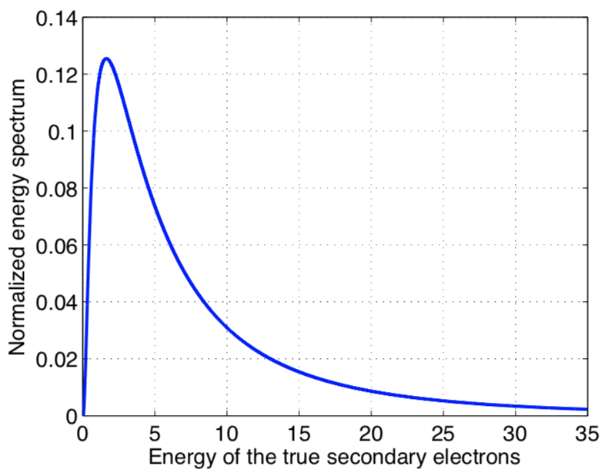

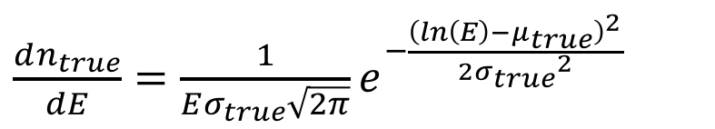
Project Goals
Improvement of the energy spectrum model of the emitted electrons, using lab measurements
$\frac{dn_{true}}{dE}=\frac{1}{Eσ_{true}\sqrt{2π}}e^{−\frac{{\left(ln\left(E\right)−μ_{true}\right)}^{2}}{2{σ_{true}}^{2}}}$
LHC beam chambers:
  $σ_{true}$ = 1.0828
  $μ_{true}$ = 1.6636
[] B. Henrist et al., “Secondary Electron Emission Data for the Simulation of Electron Cloud”, cds 2002.
EPFL-LPAP FCC-ee Software Framework Meeting 11/05/2022

Slide 9
Thank you for your attention
EPFL-LPAP FCC-ee Software Framework Meeting 11/05/2022

