Slide 1
Code effort for FCC-ee: lattice, imperfections, radiation
R. De Maria, A. Faus-Golf, F. Schmidt, G. Simon
CERN, Paris-Saclay

Slide 2
Proposed approach
Invest on MAD-X code to create a solid platform for FCC-ee
  MAD-X already used for FCC-ee studies, has synergies with many other projects.
Radiation effects in MAD-X used in many FCC-ee studies:
  Few calculations have shown inconsistent results related to thin multipole elements and solenoid
  Some usability issues have been identified related to tapering in the last version
Stabilize radiation calculations in MAD-X
  Review and document radiation related physics applied to MAD-X
  Compare calculations on FCC-ee or other test lattices using different methods such as direct tracking, map formalism, radiation integral formalism
  Fix issues in the code
  Coordinate with optics studies for defining priorities such as interaction region modelling and vertical emittance studies

Slide 3
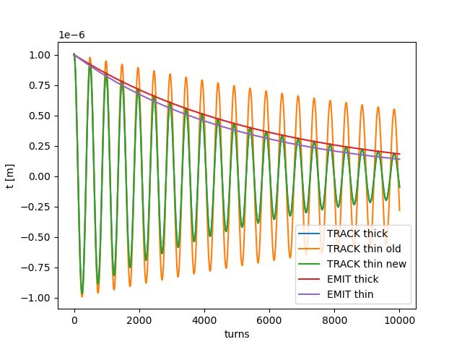

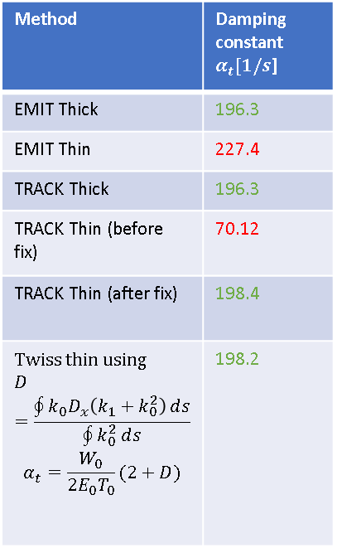
Recent results and next steps
Identified and corrected bug in TRACK for thin multipole resulting in incorrect damping times
Collected other issues that are under investigations:
  tapering introduces optics beating
  equilibrium emittance not correct for tilted solenoid
  twiss energy loss does not take the gamma of the closed orbit correctly into account
  issue with radiation of multipoles in track and emit
  adding ktap on additional elements
  synchrotron radiation integrals zero with zero length elements
Deterministic damping
Method | Damping constant $α_{t}[1/s$]
EMIT Thick | 196.3
EMIT Thin | 227.4
TRACK Thick | 196.3
TRACK Thin (before fix) | 70.12
TRACK Thin (after fix) | 198.4
Twiss thin using $$D=\frac{\oint{k_{0}D_{x}\left(k_{1}+k_{0}^{2}\right)}ⅆs}{\oint{k_{0}^{2}}ⅆs}$$ $$α_{t}=\frac{W_{0}}{2E_{0}T_{0}}(2+D)$$ | 198.2
$$t[turns]=t_{0}e^{−α_{t}{ T}_{0} turns}$$

