Slide 1
Progress on MAD-X validation
G. Simon, R. De Maria

Slide 2
Master Plan
PhD to be driven by FCC project needs and focused on code development and improvements.
Goal: find quality specifications for the FCC interaction region magnets with focus on improving software tools
Steps:
Validate multipole and solenoid physics in MAD-X [on going]
Obtain a realistic field map (e.g. from Koratzinos 26/11/2021)
Expand and slice in multipoles+solenoids (checks field residuals to validate the model)
Perform tracking for dynamic aperture, momentum acceptance, equilibrium emittance
Check dependencies from individual multipoles to identify most relevant multipole components
Find acceptable ranges from each multipoles

Slide 3
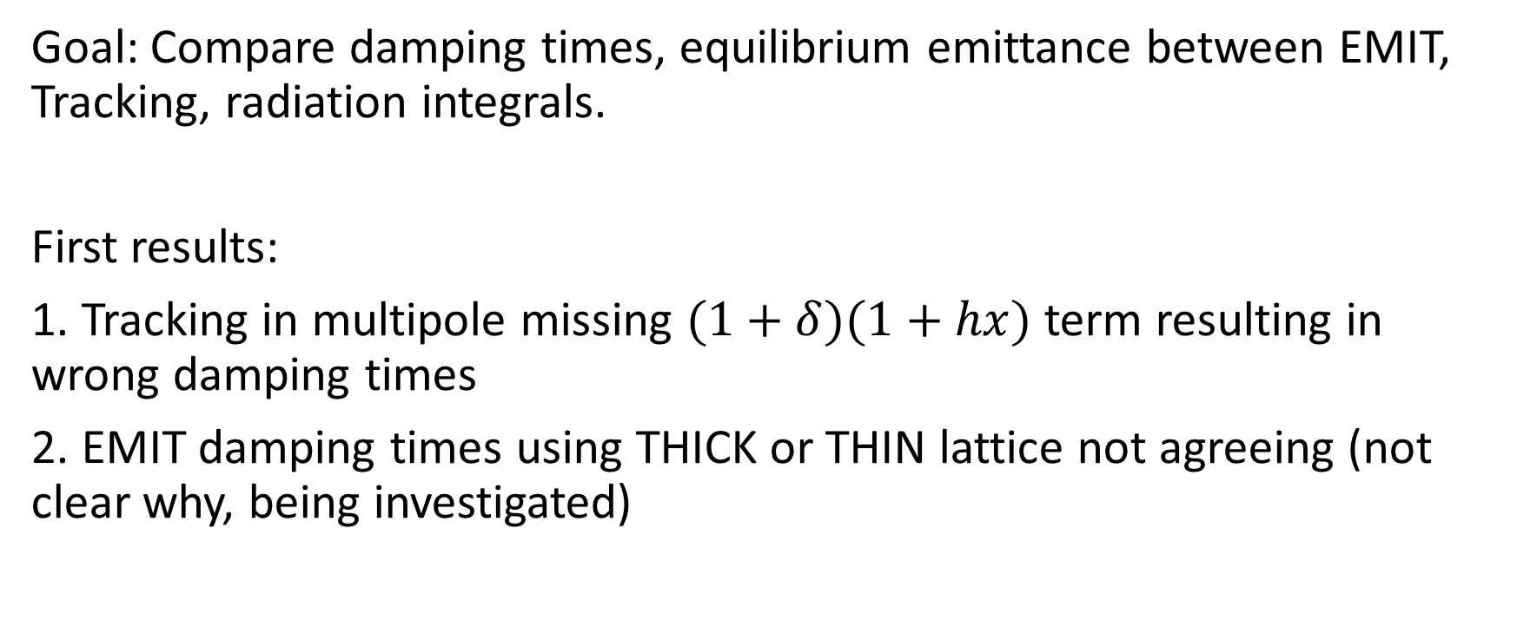
Validate multipole and solenoid physics in MAD-X
Goal: Compare damping times, equilibrium emittance between EMIT, Tracking, radiation integrals.
First results:
1. Tracking in multipole missing $(1+δ)(1+hx)$ term resulting in wrong damping times
2. EMIT damping times using THICK or THIN lattice not agreeing (not clear why, being investigated)

Slide 4
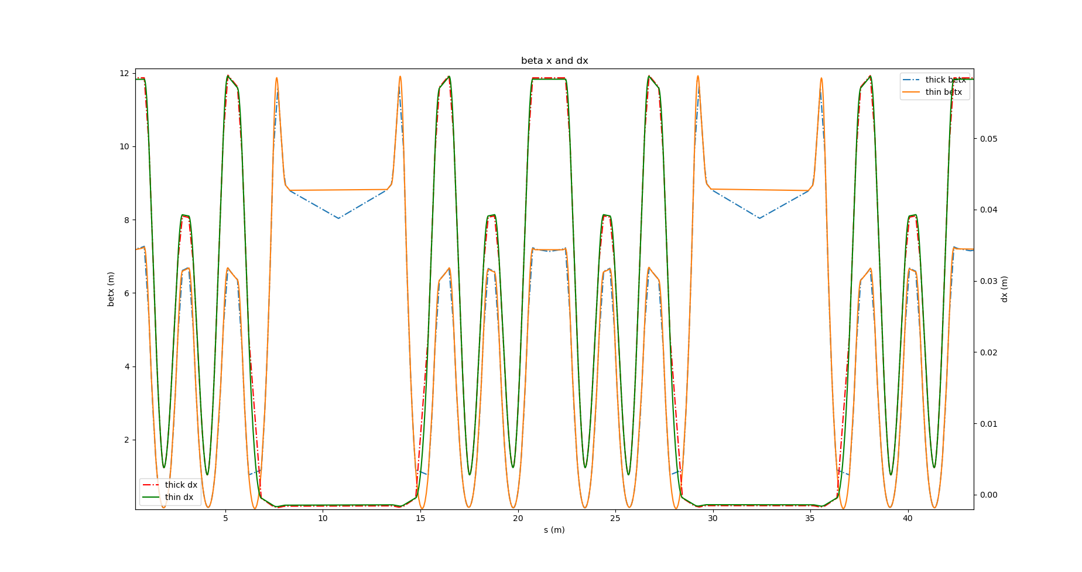
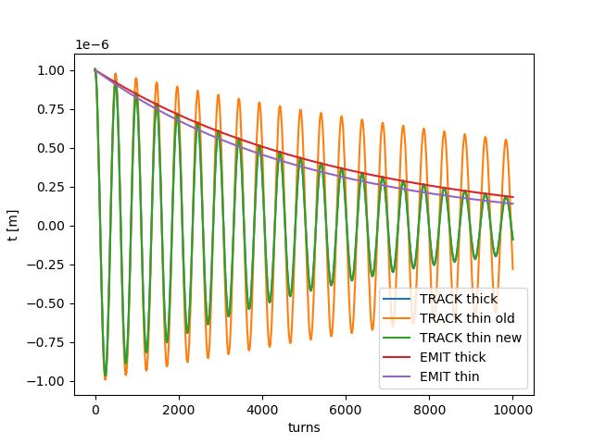
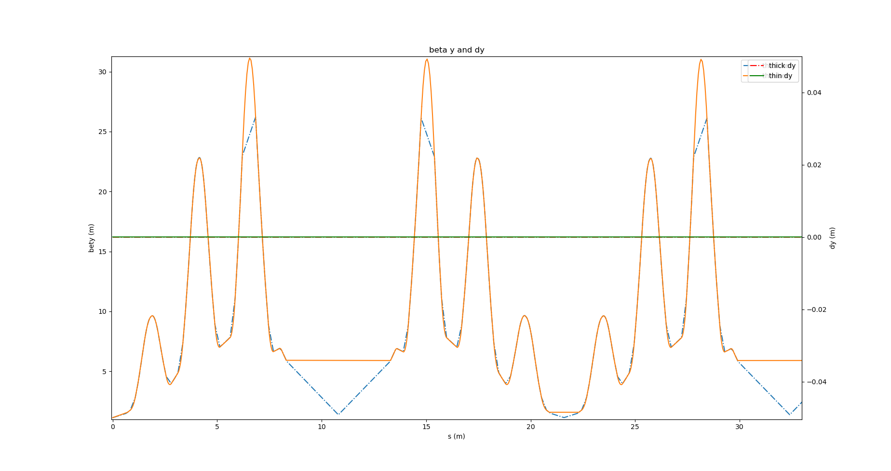
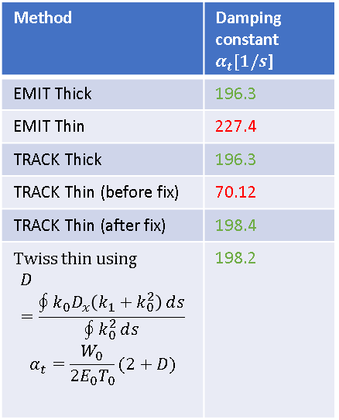

Damping times of Electra lattice
Taking Electra lattice as an example of small lattice with few cavities
Method | Damping constant $α_{t}[1/s$]
EMIT Thick | 196.3
EMIT Thin | 227.4
TRACK Thick | 196.3
TRACK Thin (before fix) | 70.12
TRACK Thin (after fix) | 198.4
Twiss thin using $$D=\frac{\oint{k_{0}D_{x}\left(k_{1}+k_{0}^{2}\right)}ⅆs}{\oint{k_{0}^{2}}ⅆs}$$ $$α_{t}=\frac{W_{0}}{2E_{0}T_{0}}(2+D)$$ | 198.2
$$t[turns]=t_{0}e^{−α_{t}{ T}_{0} turns}$$
NB. EMIT thick and thin gives the same T₀ and W₀

Slide 5
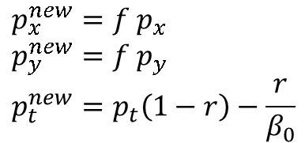
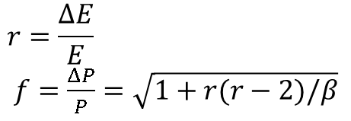
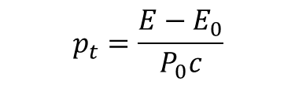



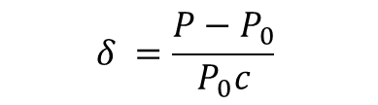
Multipole maps
General equation for average energy loss
$$−\frac{dE}{dt}=\frac{2}{3}\frac{r_{e}}{m_{0}c}\frac{dP^{μ}}{dτ}\frac{dP_{μ}}{dτ}$$
$$r_{e}=\frac{e^{2}}{m_{0}c^{2}}$$
with
With $\frac{dP_{μ}}{d_{τ}}=\frac{e}{m_{0}c}(0,P×B)$ we get$−\frac{dE}{dt}=\frac{2}{3}\frac{{e^{2}r}_{e}P^{2}}{{\left(mc\right)}^{3}}B^{2}$
Integrating on the integration length $l(1+hx )$with the integrated multipole kick $Δp=\sqrt{Δp_{x}^{2}+Δp_{y}^{2}}$ we get:
$$−ΔE=\frac{2}{3}\frac{{e^{2}r}_{e}P^{2}P_{0}^{2}}{{\left(m_{0}c\right)}^{3}}{\left(\frac{Δp}{l}\right)}^{2}\frac{l\left(1+hx\right)}{βc}=\frac{2}{3}\frac{{e^{2}r}_{e}E P_{0}^{3}\left(1+δ\right)}{c{\left(m_{0}c\right)}^{3}}{\left(\frac{Δp}{l}\right)}^{2}l\left(1+hx\right)$$
$$δ =\frac{P−P_{0}}{P_{0}c}$$
$$p_{t}=\frac{E−E_{0}}{P_{0}c}$$
$$p_{x}=\frac{P_{x}}{P_{0}} p_{x}=\frac{P_{y}}{P_{0}}$$
with
$$r=\frac{ΔE}{E}$$
$f=\frac{ΔP}{P}=\sqrt{1+r(r−2)/β}$
$$p_{x}^{new}=f p_{x}$$
$$p_{y}^{new}=f p_{y}$$
$$p_{t}^{new}=p_{t}\left(1−r\right)−\frac{r}{β_{0}}$$
Assuming
then

Slide 6
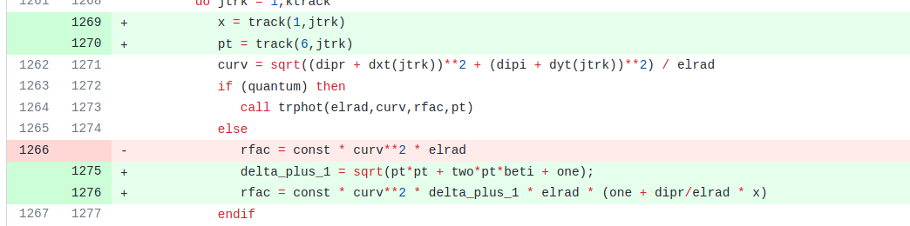
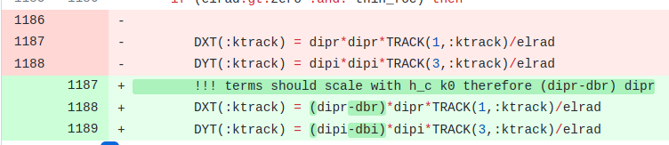

Fixes in track
https://github.com/MethodicalAcceleratorDesign/MAD-X/pull/1079
Missing $\left(1+δ\right)\left(1+hx\right)$ dependence
Not directly related to radiation damping but still need fix when k0l different from angle

Slide 7
Next steps
Fix multipoles in EMIT
Test random fluctuations with multipoles and equilibrium emittances
Test tapering with multipoles (waiting for Ghislain to push implementations)
Test solenoid
Collect field map and implement sequence with slicing

