Slide 1

Design of the 590 MeV Proton Beamline for the Proposed TATTOOS Production Target at PSI
LPAP Activity Meeting
Marco Hartmann
10th June, 2022

Slide 2
Table of contents
Outline of the TATTOOS initiative
Applied Radionuclide sciences
Proton beamline
PhD Timeline

Slide 3
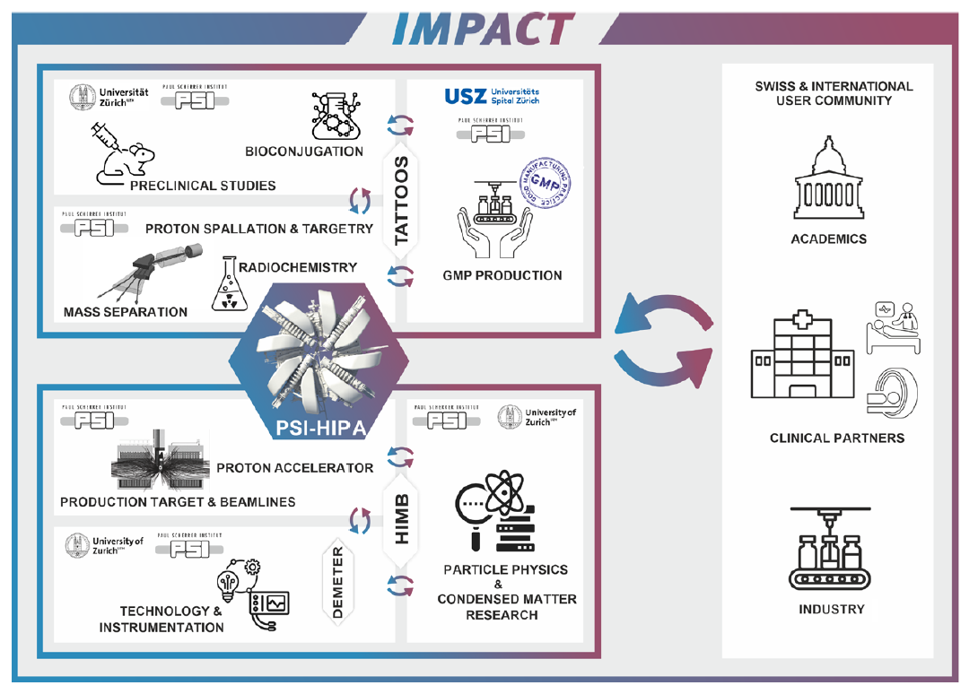
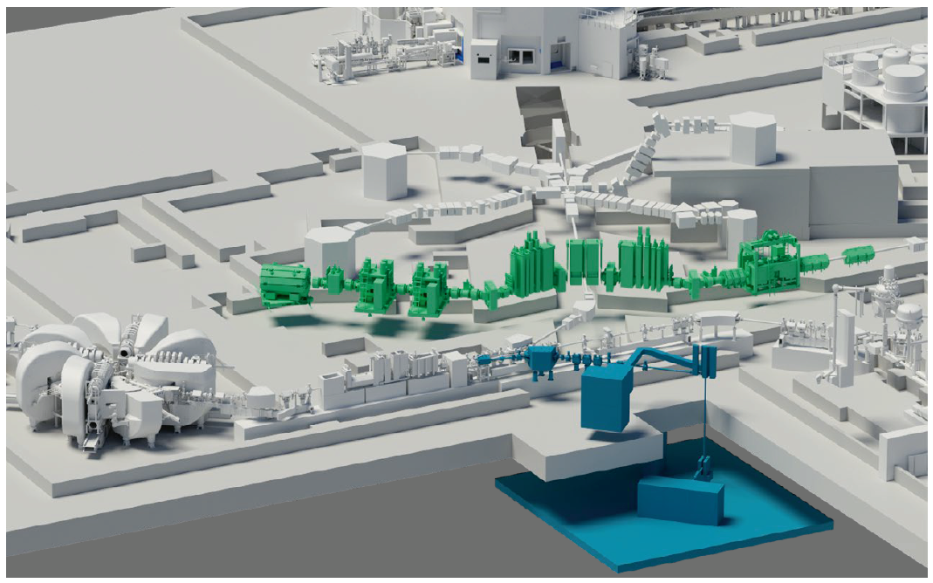
Outline of the TATTOOS initiative
Overview of IMPACT initiative (TATTOOS and HIMB) [1]
High Intensity Proton Accelerator (HIPA) at PSI - 590 MeV CW proton beam, currents up to 2.4 mA.
IMPACT (Isotope and Muon Production with Advanced Cyclotron and Target Technologies) - proposed initiative for HIPA.
Joint proposal by University of Zürich (UZH) and PSI.
IMPACT = TATTOOS + HIMB.
TATTOOS (Targeted Alpha Tumour Therapy and Other Oncological Solutions) – production of terbium radionuclides for therapeutic and diagnostic purposes.
TATTOOS beamline intensity - 100 μA → Requires continuous splitting via electrostatic splitter.
SAMIRA (Strategic Agenda for Medical Ionising Radiation Applications), EU action plan for radionuclide supply.

Slide 4
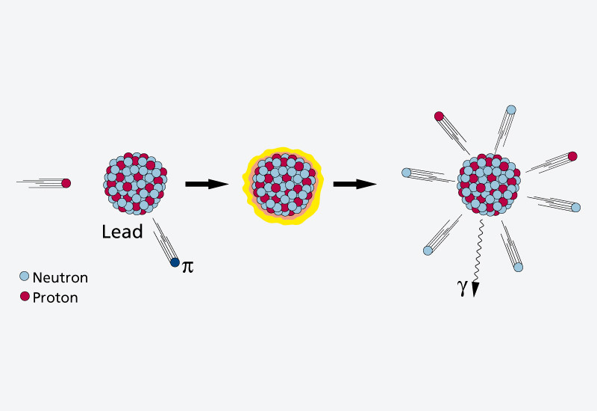
Applied radionuclide sciences – Spallation reactions
Goal : Production and delivery of radionuclides for pharmaceutical use.
For cyclotrons with proton energies of 18-70 MeV – only proton rich radionuclides produced.
Spallation reactions lead to radionuclide lighter than the target material.
Target containing high Z is irradiated by a high energy (600 MeV – 1GeV), low intensity proton beam → Spallation reactions → Plethora of elements produced.
Spallation reactions for SINQ target (lead) [2]

Slide 5
Spallation reaction in TATTOOS
CAD overview of TATTOOS facility [1]
For TATTOOS, Tantalum (Ta) target → Large lanthanide (e.g. Terbium) production rates.
Extraction system :
Selection of designated radionuclides
Diffusion out of the heated target + high potential difference
Ionisation by Laser-Resonance Ionisation (RILIS)
Mass purification via mass separator (collection of radionuclides of specific mass)
50 x higher beam intensity than ISOLDE → Pure radionuclides of unprecedented activities.
Simplified CAD Ta target (courtesy of S.Jollet)

Slide 6
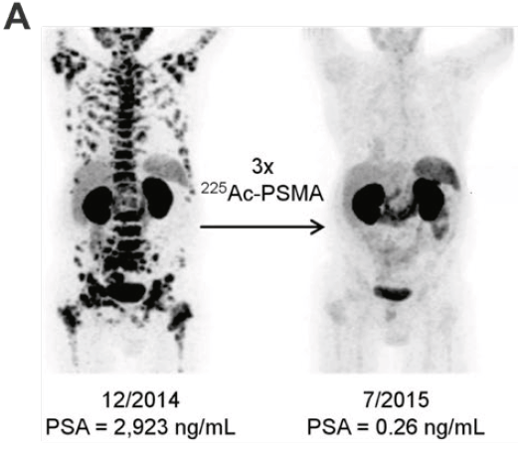
Applied radionuclide sciences – Terbium radionuclides
Terbium (Tb) - one of the initial main production goals of TATTOOS.
3 main isotopes:
¹⁵⁵Tb emits γ-radiation suitable for SPECT-
¹⁵²Tb decays, emission of β⁺⁻particles useful for PET.
¹⁴⁹Tb, “flagship” nuclide for this project - promising properties for α-radionuclide therapy.
Targeted alpha-particle therapy (TAT) - Alpha decay effective at killing of tumours.
Successful TAT in a patient suffering from disseminated prostate cancer (pre and post therapy) [3]
Tb radionuclides produced from spallation with Ta target [4]

Slide 7
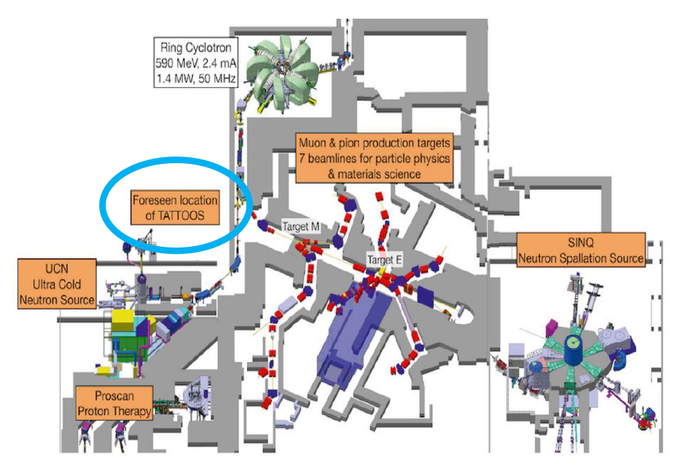
Overview of the HIPA facility
Proton beam is extracted from the Ring Cyclotron.
Two spallation sources:
Swiss Spallation Neutron Source (SINQ)
Ultra Cold Neutron source (UCN).
Fast kicker magnet (rise time < 1ms) diverts full intensity beam towards UCN via macro-pulsed kicks.
Beam splitter downstream of kicker magnet, peels off small portion of beam, sends it to UCN target.
HIPA facility and foreseen TATTOOS location [1]

Slide 8
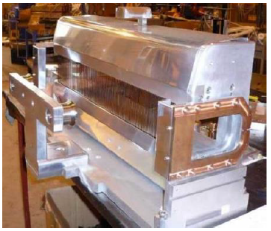
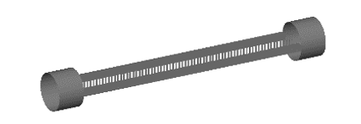
Beam splitter
Peels off high powered beam.
Series of 179 electrically grounded tungsten alloy strips.
2 cathodes creating two electric fields on every side of strips.
Protons pulled away from strips for each beam.
Detailed electric field map with ANSYS and implemented in BDSIM.
Innovative beamline element
Viability of the splitter - Splitter can withstand power deposition (~20 W deposited on first strip).
Splitter in an experimental hall
Splitter geometry implemented in BDSIM

Slide 9
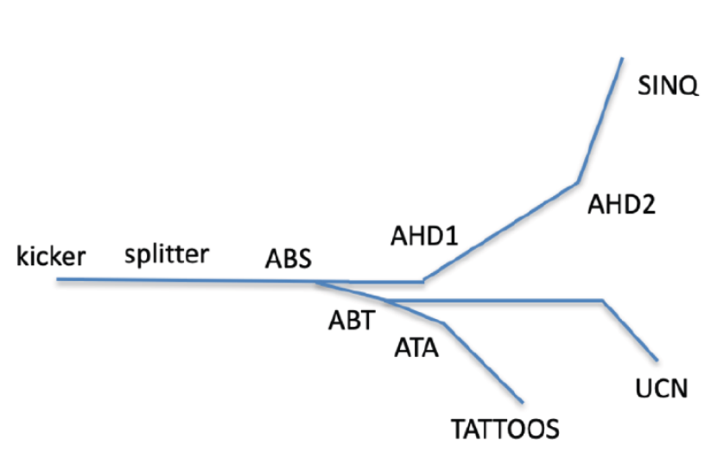
Alternating beam operation
Split off part of main beam needed for TATTOOS via beam splitter.
Use existing ABS septum magnet to divert peeled beam to UCN line.
Steer the peeled beam out of UCN and towards TATTOOS via a new bending magnet (ABT).
Advantage : Splitter and septum magnet already integrated.
Critical point : UCN and TATTOOS cannot operate simultaneously
Solution: Run TATTOOS between 2 UCN pulse (one UCN pulse ~ 8 seconds, time between 2 pulses ~300 s)
TATTOOS alternating beam operation [1]

Slide 10


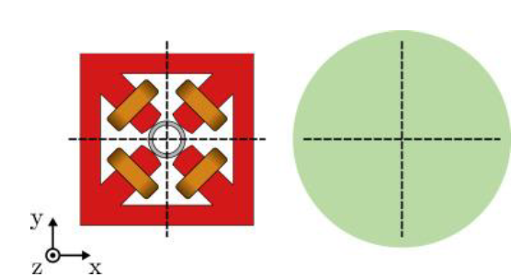

Beam Delivery Simulation (BDSIM)
Need to perform tracking simulations in EM fields + accurately predict interaction processes with TATTOOS components.
Beam Delivery Simulation (BDSIM) [5], a Geant4 based tool that can create a computational model of an accelerator and delivers optimal and complete simulation from the beam splitter to the TATTOOS target.

Slide 11
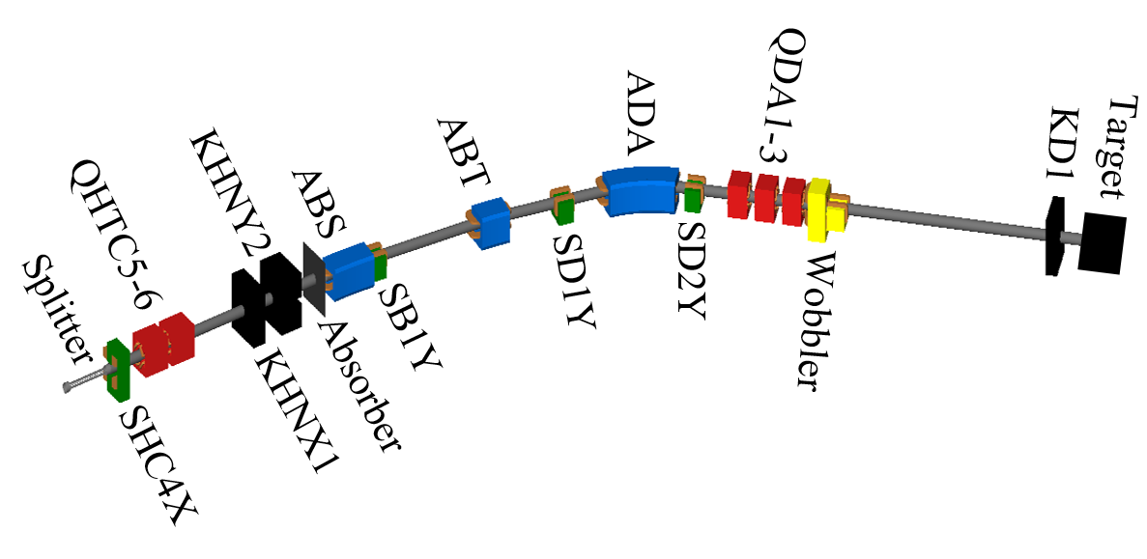
TATTOOS Beamline Description
Component | Use for TATTOOS
ABS | Dipole magnet. Diverts peeled beam to the UCN beamline (6.5° bend).
ABT | Dipole magnet. Diverts peeled beam UCN line into TATTOOS (6.5° bend).
ADA | Dipole magnet. Bends beam by further 32°.
QDA1-3 | Quadrupole triplet shapes beam on target.
SB1Y, SD1Y , SD2Y | Steer the beam in vertical plane.
“Wobbler” | Two fast dipole magnets driven by AC current. Flattens beam footprint to achieve uniform target temperature (frequency ~ 30 Hz).
KHNX1, KHNY2 | Jaw collimators acting in x and y planes
KD1 | Collimator to protect target
Complete TATTOOS beamline in BDSIM
* Detailed component specifications in Backup slides

Slide 12
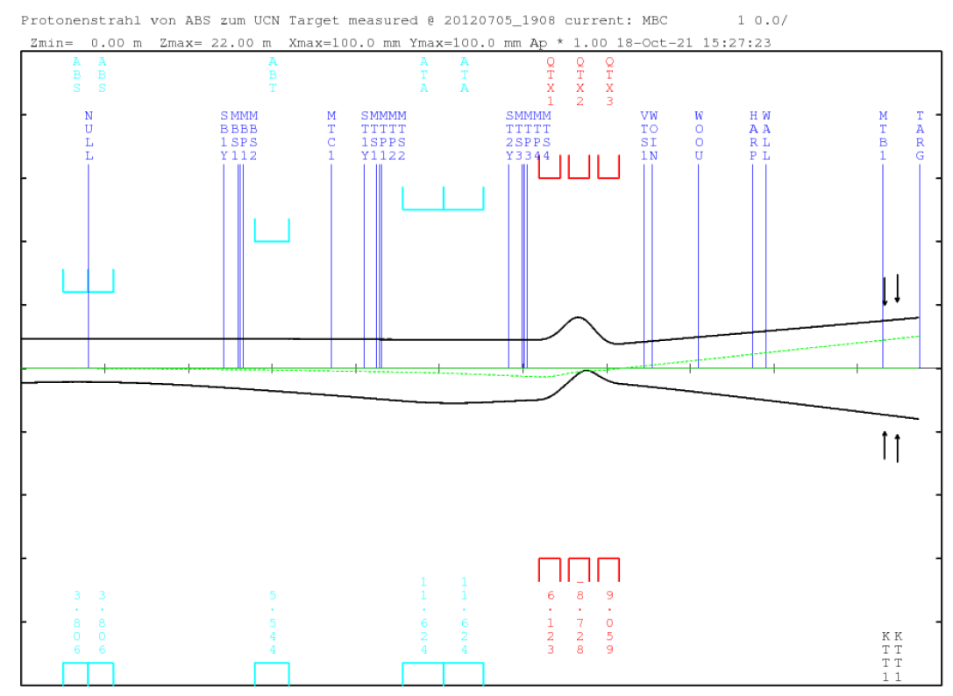
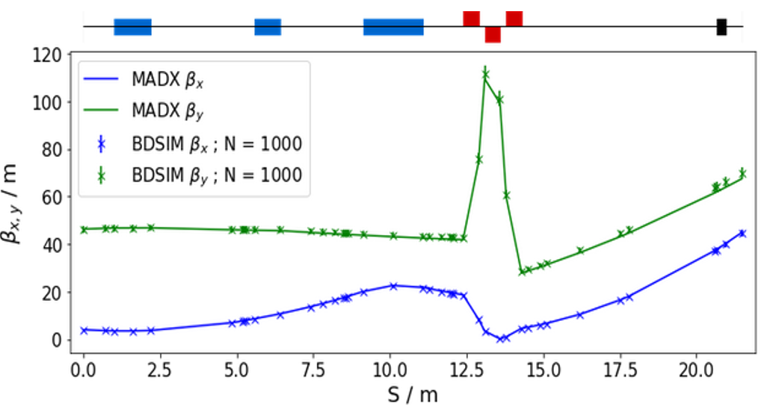
Beamline Optics validation
Beamline and beam optics (two-sigma envelope) as simulated in TRANSPORT [1]
Beamline lattice designed with TRANSPORT code.
Beam optics from BDSIM benchmarked with MAD-X.
Proton tracking excludes the splitter.
Total TATTOOS length from the starting to target – 21.479 m.
Excellent agreement between BDSIM and MAD-X.
Benchmarking between BDSIM and MADX- beta function validation

Slide 13
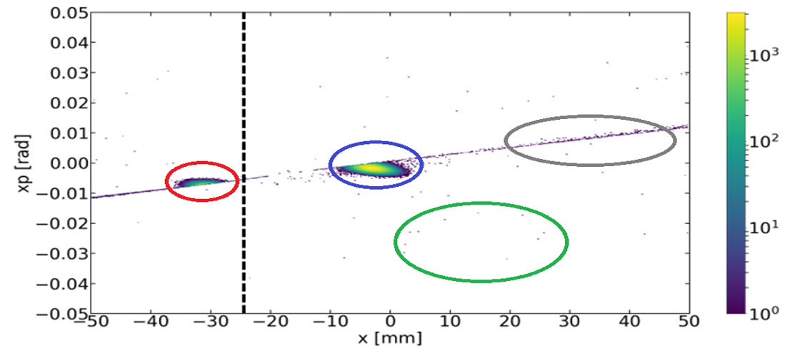
Input file and Horizontal Beam Profile
Initial beam – Gaussian distribution.
Protons tracked from splitter to target
→ input file used to record phase space coordinates after the splitter.
CPU time is saved as the splitter field map is not loaded for each simulation run.
In BDSIM - wide range of physics processes included.
Clear distinction between main and split beams.
Various scattering processes visible.
Horizontal phase space at, approximately m from the splitter

Slide 14
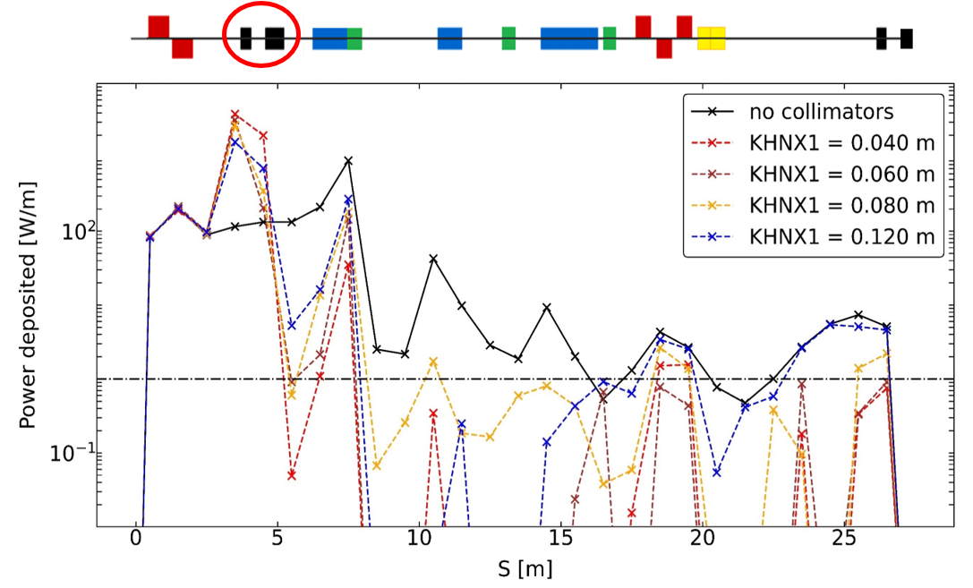
Influence of collimator aperture size on power deposited
Influence of two collimators KHNX1 and KHNY2 is studied.
Aim: infer the aperture sizes for minimising the energy losses.
Power deposited is highest at collimators (red circle).
Lower power deposited when collimators present.
In general, power deposited with collimators < 1 W/m.
Power deposition along beamline
1 W/m

Slide 15
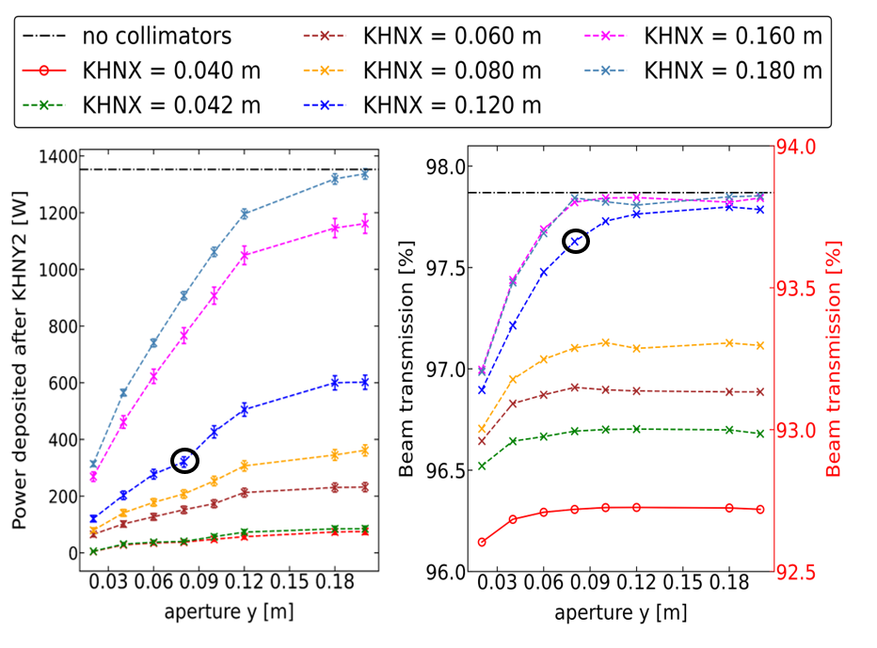
Power deposition and Transmission studies
Power deposition after KHNY2 as a function of KHNY2 aperture size
Transmission of split beam studied.
Initial number of taken from split beam distribution before collimators.
Transmission studies: only primary protons tracked.
Power deposition studies – also secondary particles.
Larger aperture size → approximates no collimator case.
KHNX1 = 0.040 m → transmission is decreased.
Optimal collimator aperture:
KHNX1 = 0.120 m, KHNY2 = 0.080 m.

Slide 16
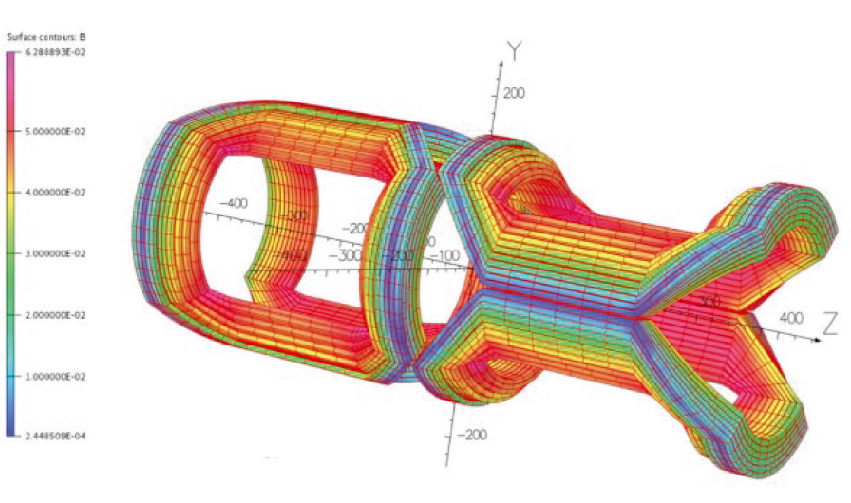
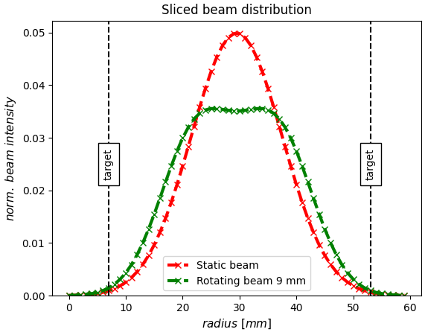
Wobbling of beam at target
Model of the two fast dipole magnets constituting the wobbler (one for each direction) [1]
“Wobbler”- flattens beam footprint.
Cylindrical tantalum target.
Beam current density in the centre of target reduced with wobbled beam.
Acceptable temperature range (2400-2900)°C.
Risk of melting (Ta melting temp. 3017°C).
Different ongoing proposals.
Static vs wobbled beam at target

Slide 17
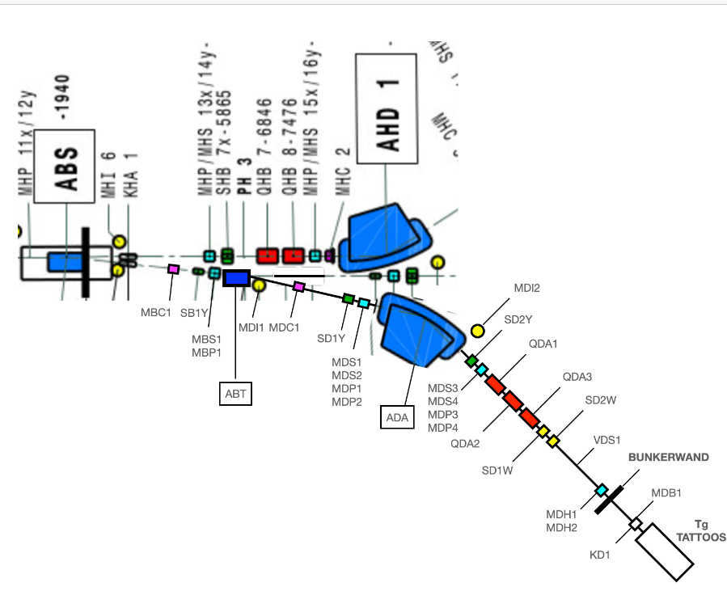
Diagnostic elements for TATTOOS beamline
Diagnostic element | Use for TATTOOS
2 Beam current monitors | Absolute measurement used to calibrate relative monitor. Provides more stability over time
2 Beam loss monitors | Detect beam losses in the sub-nA level. Coupled to machine protection
4 Beam position monitors (BPMs) | Provide the means to steer the beam through the beamline (resolution at 100 μA is ~0.2 mm)
4 Beam profile monitors | Measure and verify the optics (placed in same vacuum chamber as BPMs)
Harp for each plane before target chamber | Measures both beam profile and position in a continuous manner
Diagnostic elements along TATTOOS beamline (courtesy of J.Snuverink)

Slide 18
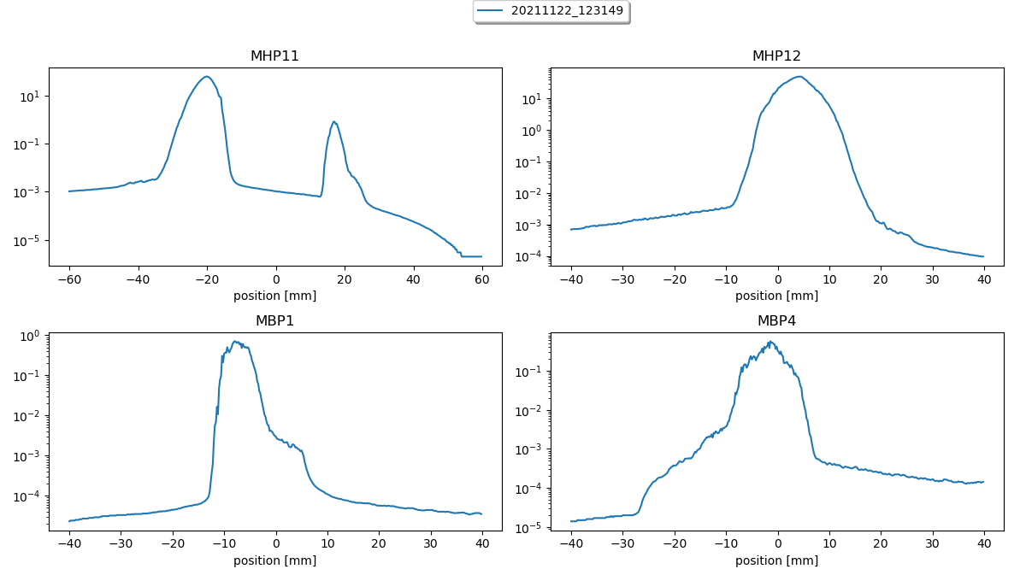
Profile measurements
Example profile measurements with beam splitter, beam current 10 μA
Measured beam profiles with splitter implemented.
Split beam current of 10 μA.
Full beam current : 1797 μA ~ 0.5% split.
Comparisons between simulations and measurements ongoing.

Slide 19


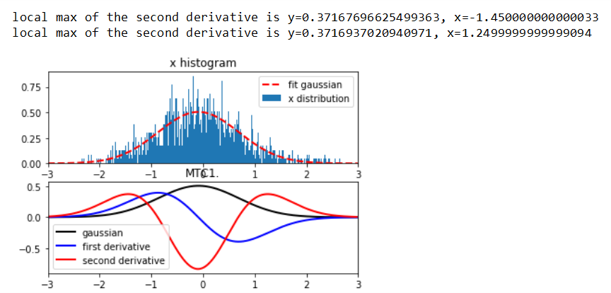
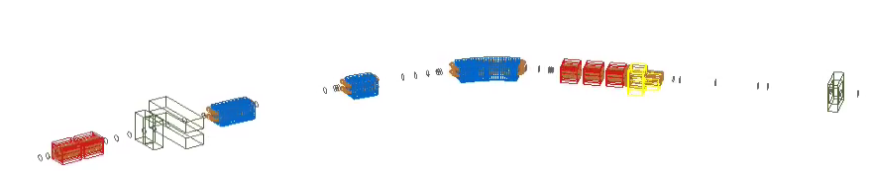
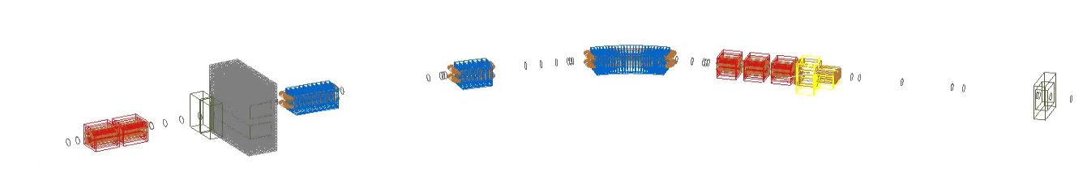
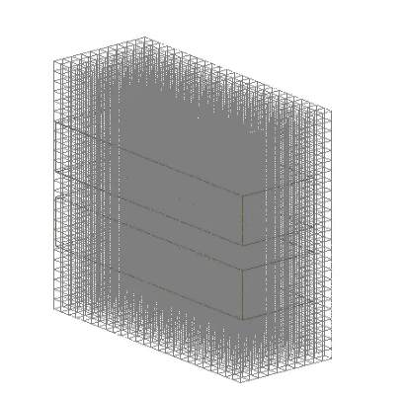
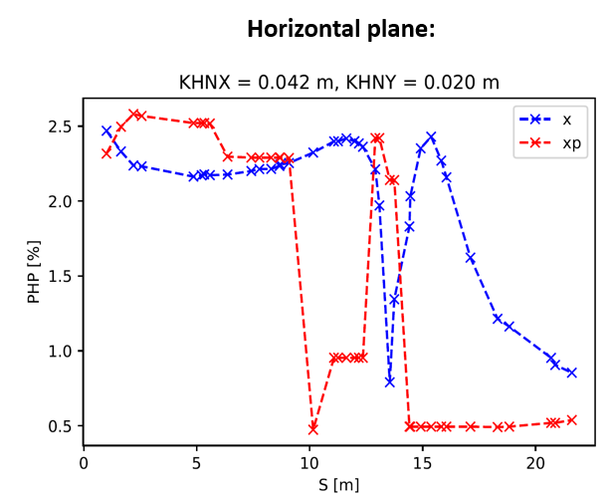
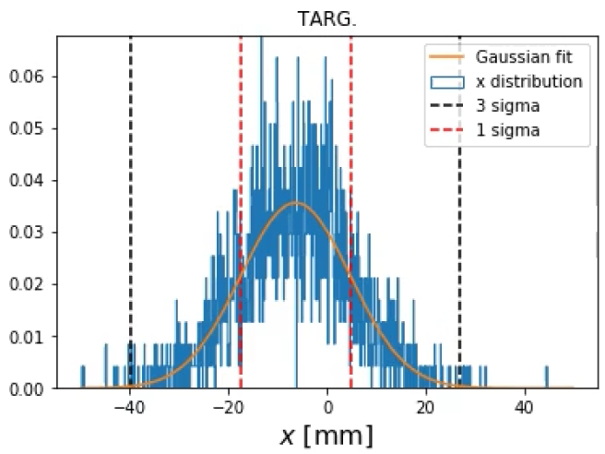

Next steps
Quantification of Beam halo using several methods
Energy deposition per volume in BDSIM
1 sigma
…and other aspects, e.g. :
Implementation of wobbler in BDSIM code and realistic magnet geometry
Comparisons of measurement and simulation data
Beam distribution at target optimisation
Effect of misalignments on power deposition
Realistic input distributions
Losses at splitter

Slide 20
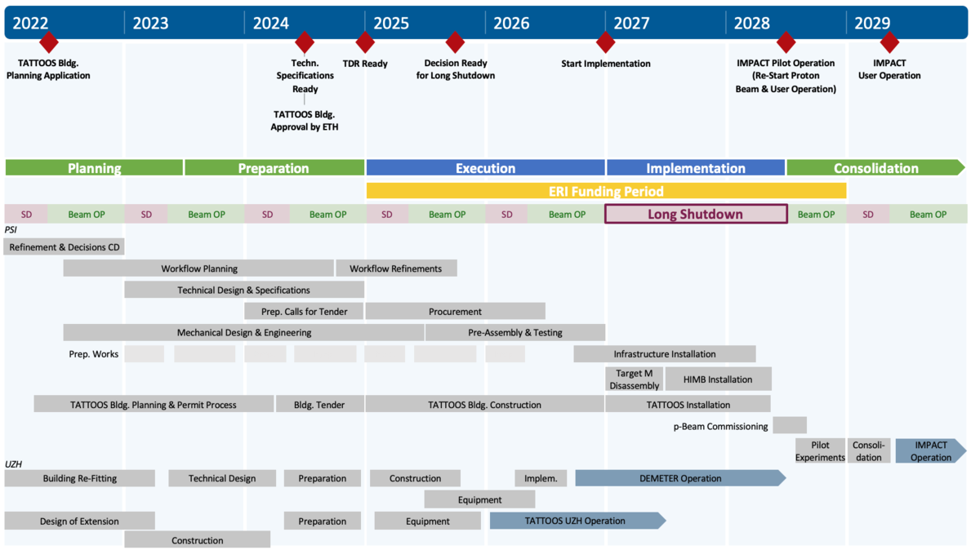
IMPACT Timeline
Key dates [1]:
Realisation of the project : 2025-2028.
Long shutdown of the HIPA - 16 months starting in January 2027.
Normal IMPACT user operation starting in May 2029.

Slide 21
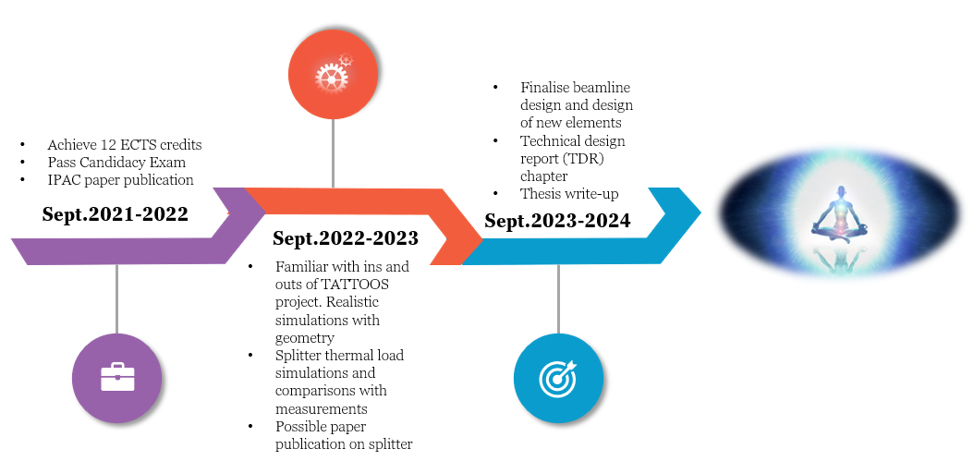
PhD Timeline

Slide 22
References
[1] R. Eichler et al., “IMPACT conceptual design report”, Paul Scherrer Institute, Villigen PSI, Switzerland, PSI Rep. No.22-01, Jan. 2022.
[2] B. Blau et al., “The Swiss Spallation Neutron Source SINQ at the Paul Scherrer Institute”, Neutron News, vol. 20, Aug. 2009.
[3] R.P.Baum et al., “¹⁷⁷Lu-Labeled Prostate-Specific Membrane Antigen Radioligand Therapy of Metastatic Castration-Resistant Prostate Cancer: Safety and Efficacy”, Journal of Nuclear Medicine 57 (7), Jul. 2016.
[4] C.Müller et al., Eur J Nucl Med Mol Imaging. 46(9), Aug. 2019.
[5] BDSIM Manual (2019), http://pp.rhul.ac.uk/bdsim/manual

Slide 23
Thank you!

Slide 24
Backup

Slide 25
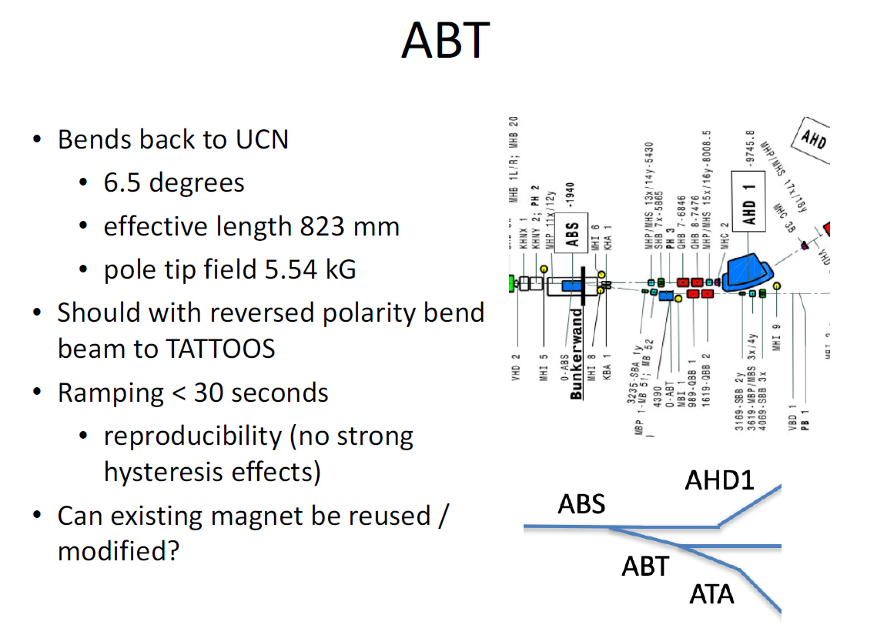

Slide 26
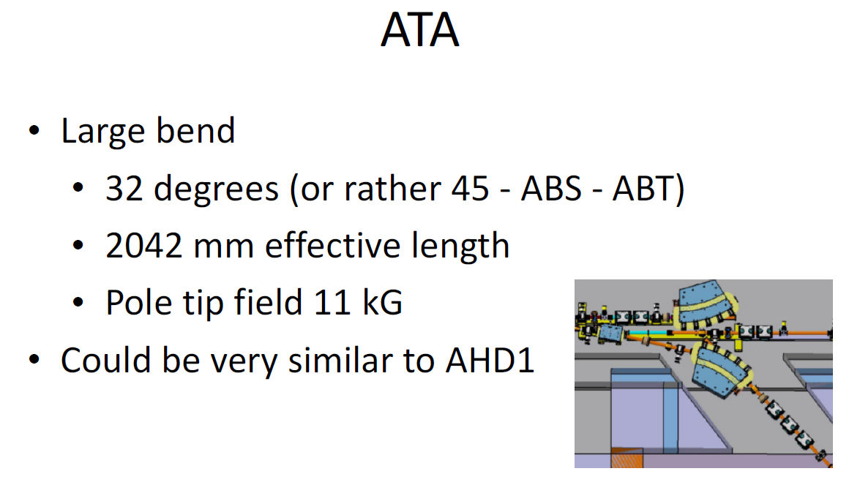

Slide 27
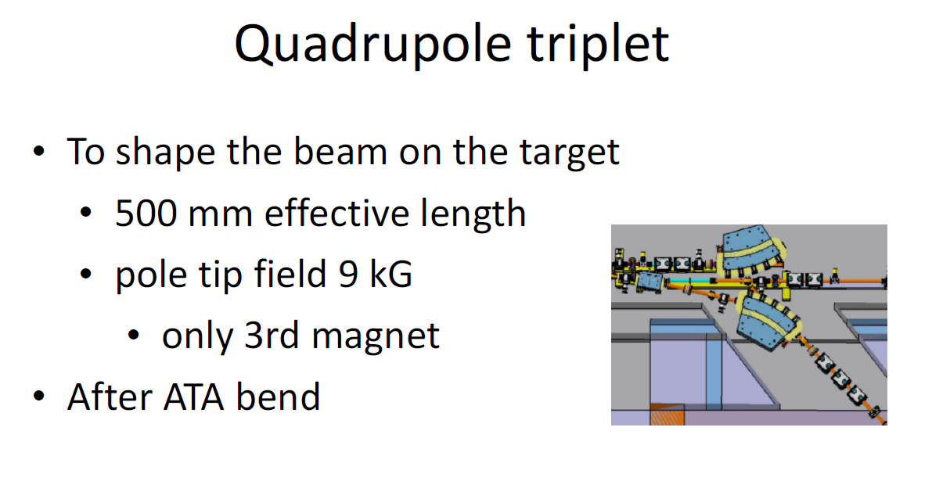

Slide 28
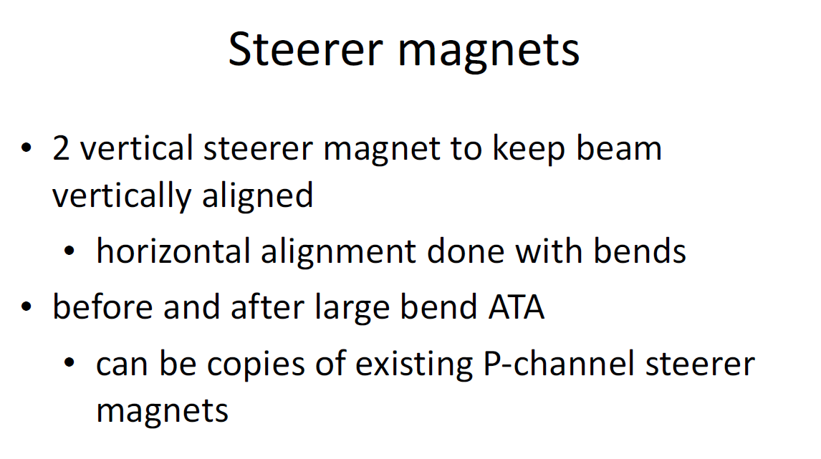

Slide 29
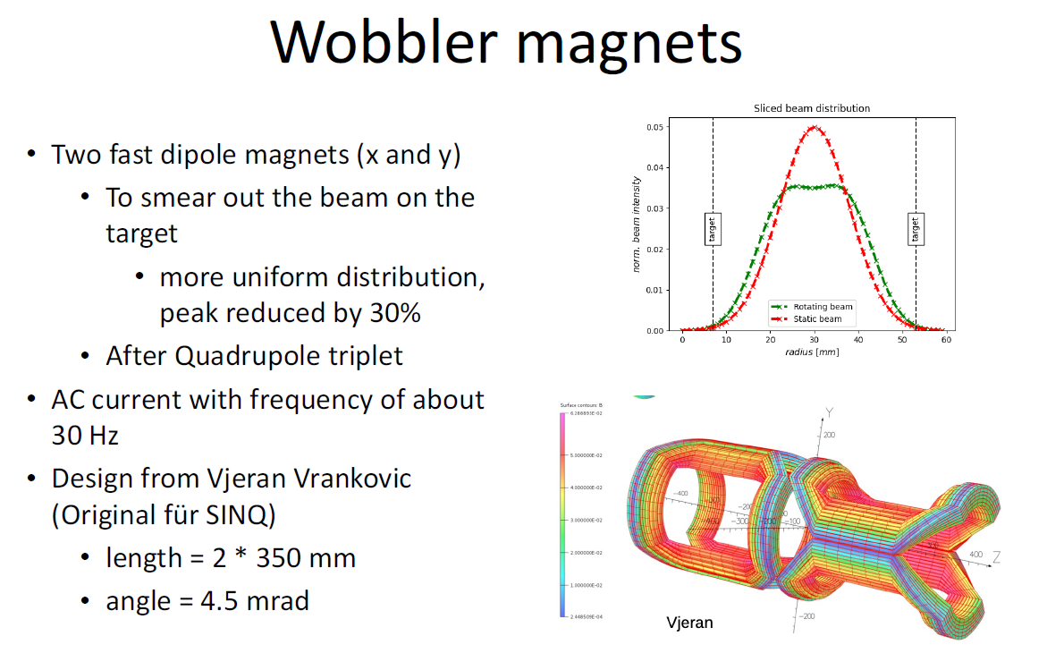

Slide 30
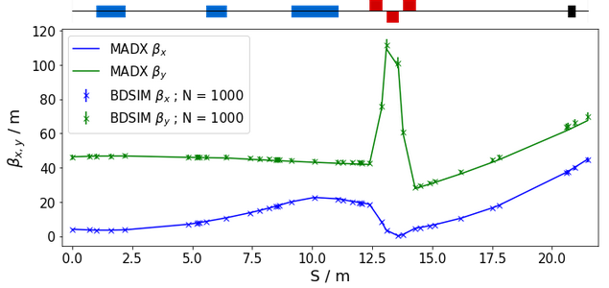
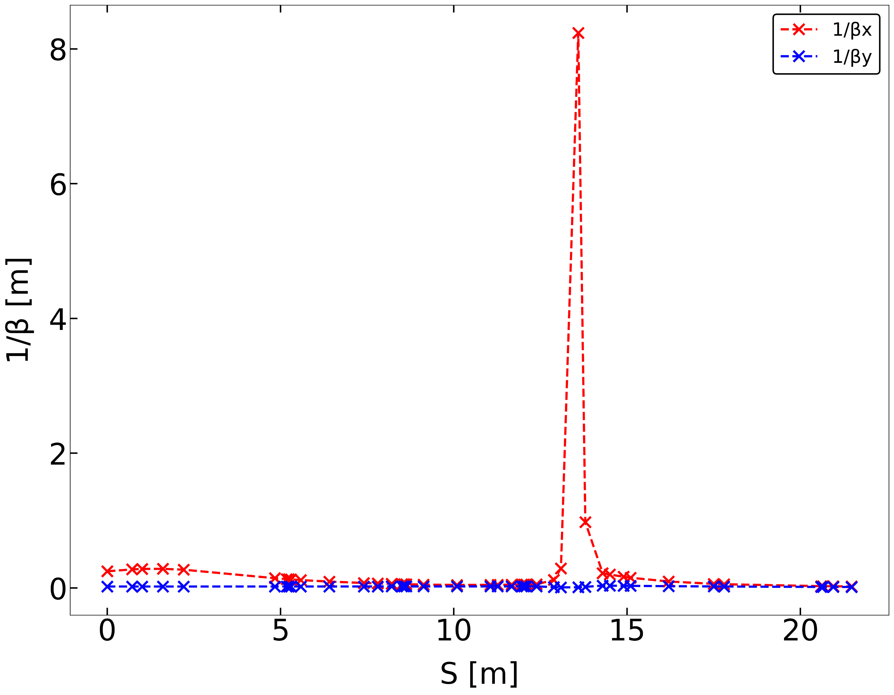
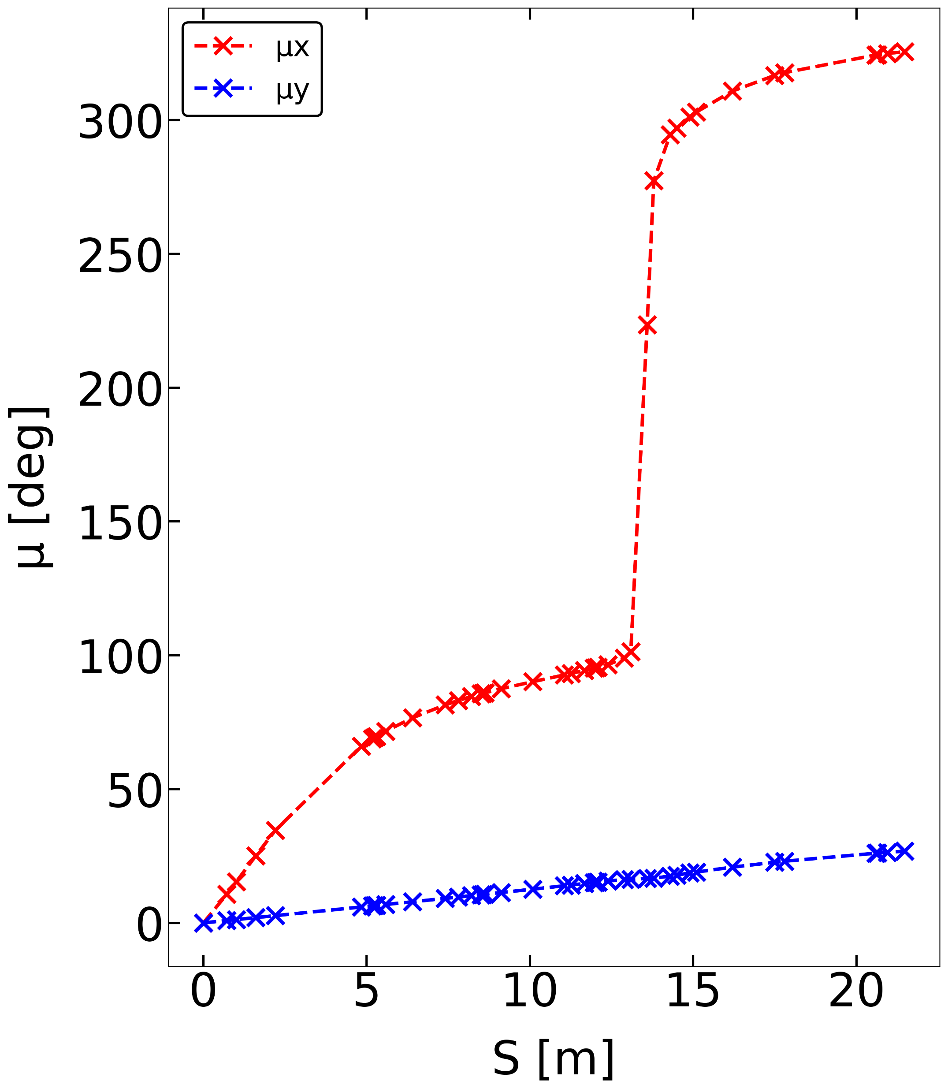
TATTOOS line - phase advance

Slide 31
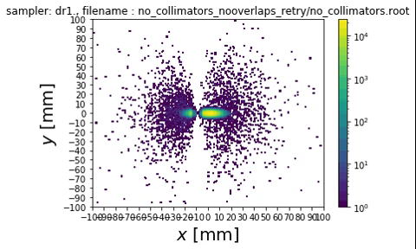
X-Y evolution, N = 1mil., no KHNX1 and KHNY2 collimators

Slide 32
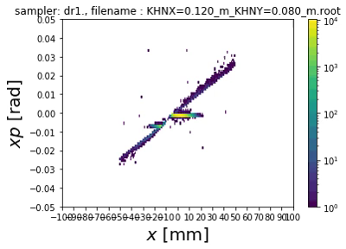
X-XP evolution, N = 1mil., KHNX = 0.120 m, KHNY = 0.080 m

