Slide 1
PhD progress report
Innovative Compact Beam Separator for FLASH Electron Therapy Facilities
Vera Korchevnyuk
February 11th, 2022

Slide 2
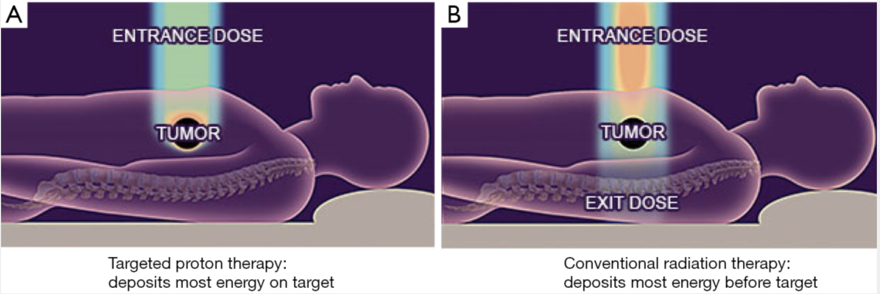
Cancer treatment with radiation therapy
A
B
Source: https://tcr.amegroups.com/article/view/5803
Photons (X-rays) and electrons: compact and relatively cheap facilities, but the treatment damages the surrounding healthy tissues;
Heavy particles (protons, ions): more precise energy delivery, but the facilities are large and expensive.
Source: Courtesy of D. Tommasini

Slide 3
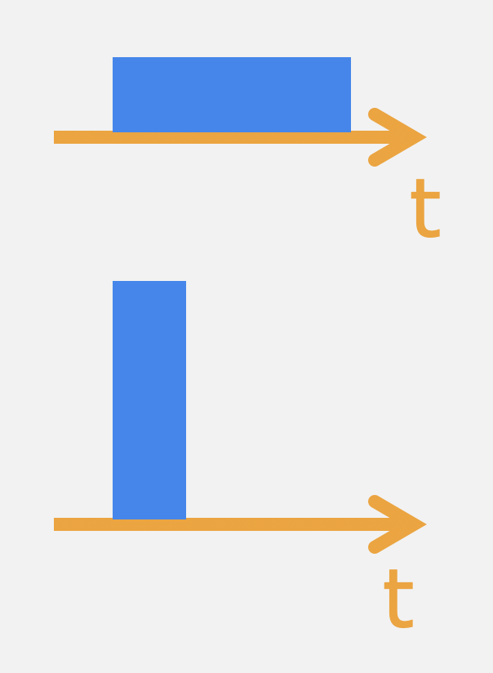
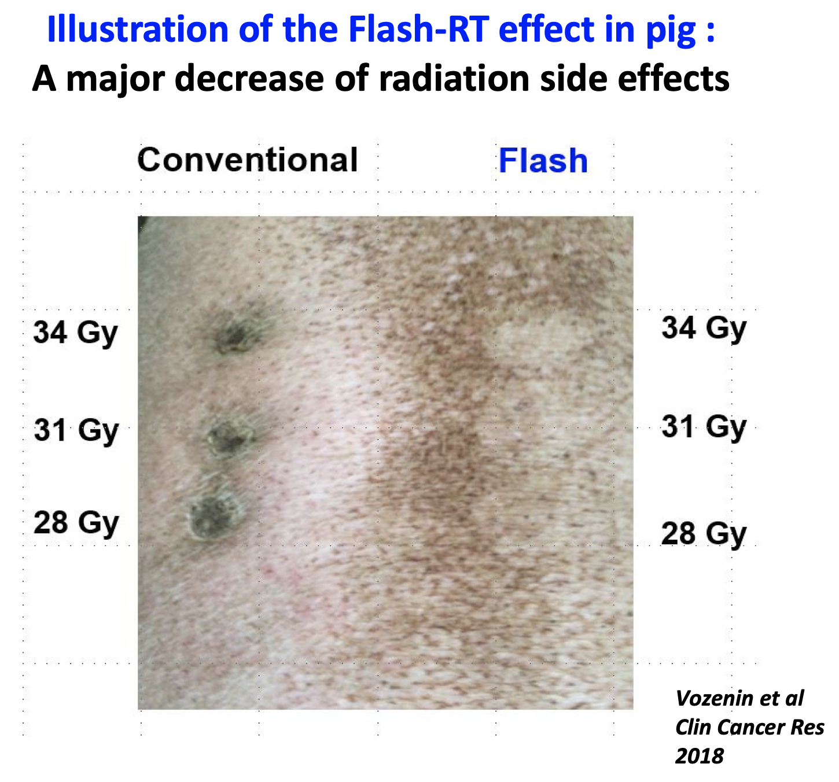
FLASH radiation therapy
Consists in delivering the full treatment dose in a very small time window – FLASH effect;
This effect spares the healthy tissues, while still affecting the tumour cells.
Conv. therapy:
FLASH therapy:
Treatment time < 0.5 s
FLASH with Electrons
High energy beams allow to target deep-seated tumours;
High current allows to treat large tumours (higher beam current is easier to achieve with electrons).

Slide 4
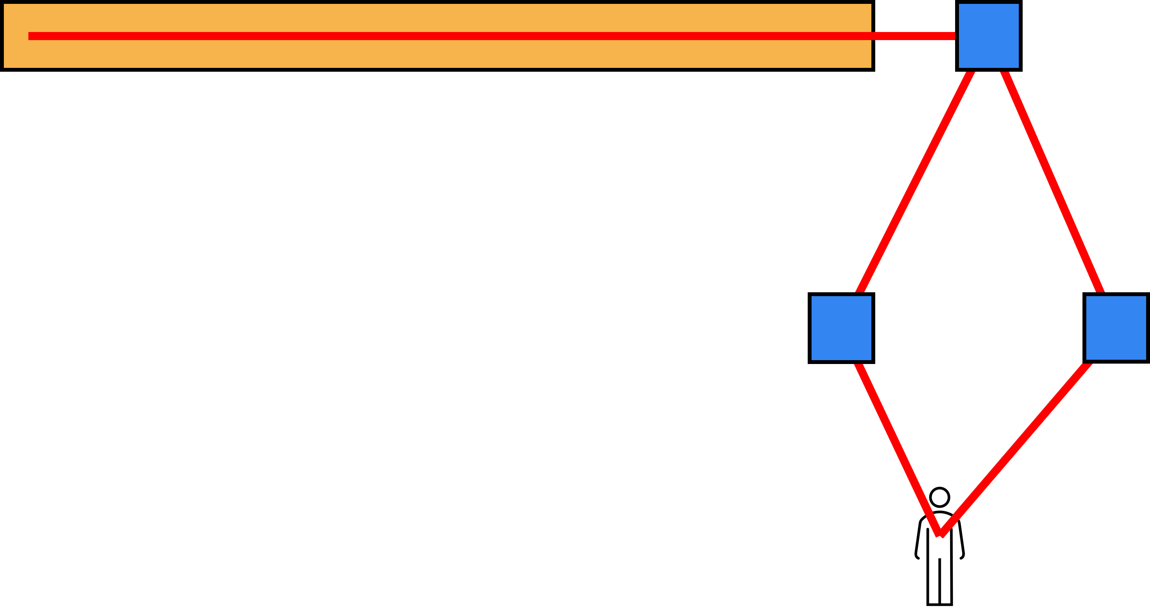
The DEFT (Deep Electron FLASH Therapy) facility
We irradiate a patient from different directions with high energy electron beams coming from a linac (CLIC-based technology).
At the exit of the linac, the beam is split into different beamlines by a separator.
electron beam
Beam separator
photoinjector and linac
patient

Slide 5
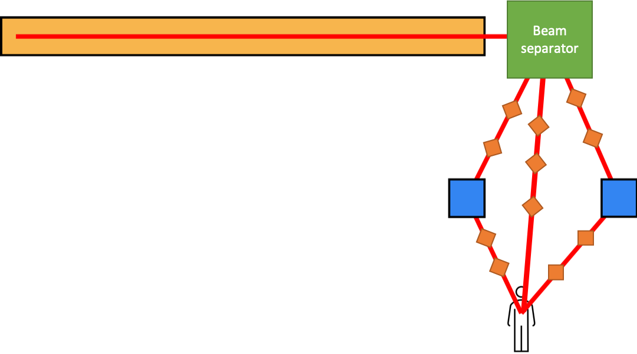
Functions of the separator
As compact as possible
The device shall separate the beams delivered by the linac into distinct directions, preserving the beam characteristics (profile, size and transmission);
We aim to maximize the separation of the beams to position the first elements of the transfer line as close as possible to the separator, to make the whole facility compact.
The challenge is to combine the functions of multiple transfer lines together with a splitter into a single magnetic element.

Slide 6
Options for Beam Separator
Steady-state spectrometer. This configuration needs to receive beams with different energies.
Fast-pulsed magnet (kicker). This configuration can operate with one energy.
The beam separation (position and angle) produced by the “separator” defines the distance at which the first element of the beamline can be placed.

Slide 7
Steady-state spectrometer or kickers?
We decided to focus on the steady-state spectrometer.
Fast-pulsed magnets require a complex and very expensive hardware (powering, timing system, controls).
The complexity of the steady-state spectrometer resides only in its design, which needs a creative approach.
We will then look for a solution for a spectrometer…

Slide 8
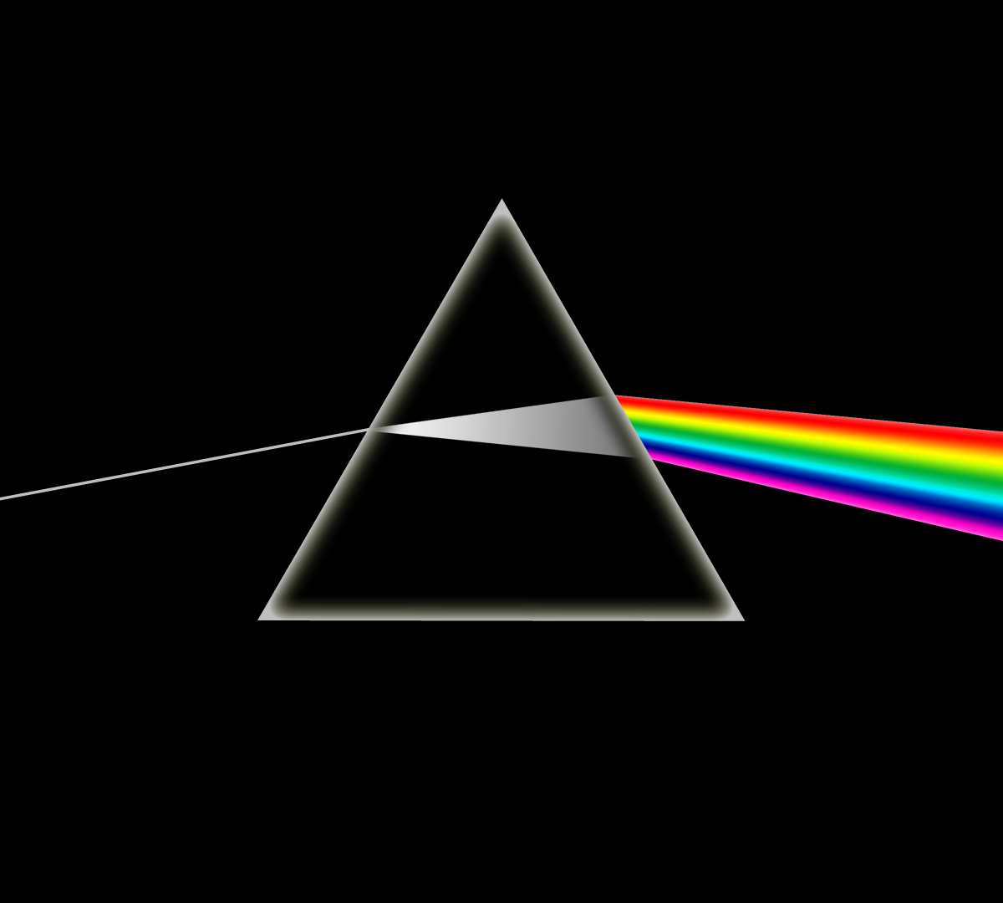
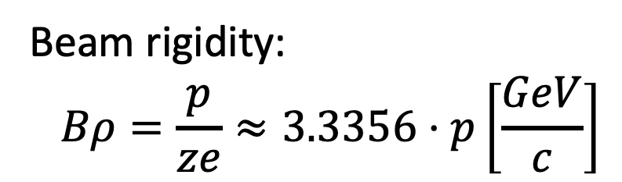
Spectrometer
Spectrometer
R1
R2
R3
Beam rigidity:
$$Bρ=\frac{p}{ze}≈3.3356⋅p\left[\frac{GeV}{c}\right]$$
We aim at maximizing the separation (distance and angle).

Slide 9
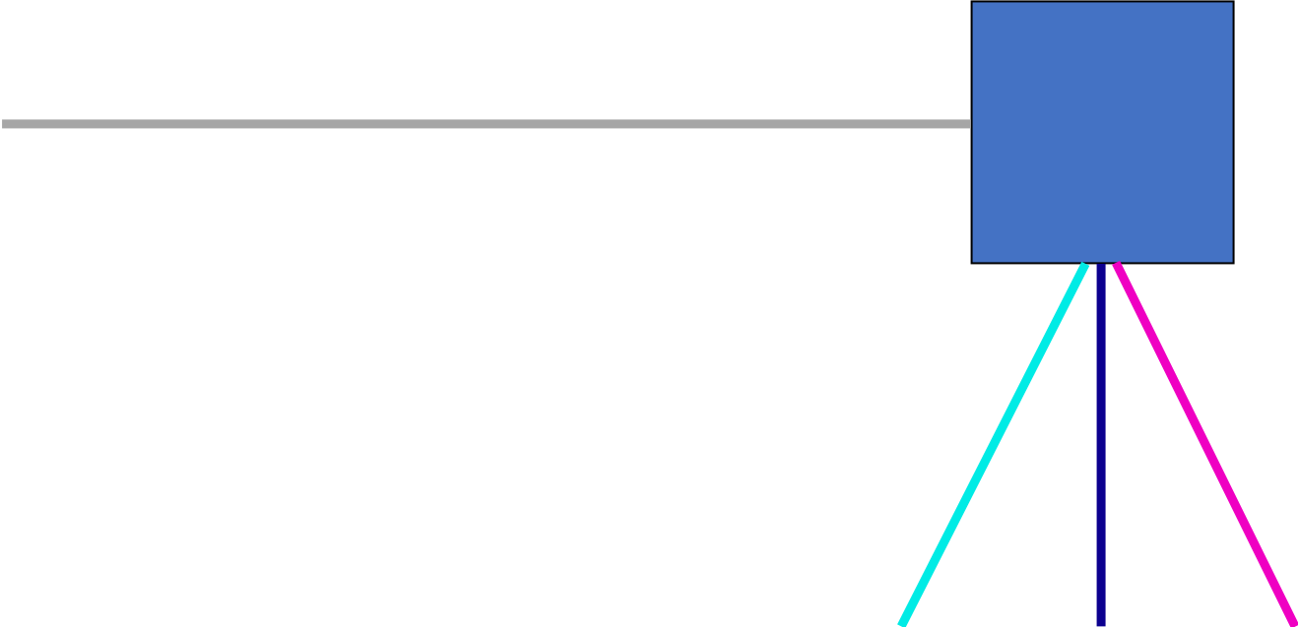
Effect of the spectrometer
A spectrometer separates particles with different energies, which is good between beams, but not desired within the beam (momentum spread).
We want to play with two contradictory effects:
  increase the separation between the beams;
  limit the beam growth.
The width of the beamline elements downstream grows with the size of the beam.
Notes:
Maximize orange, minimize the green
One of the challenges is to decouple the two effects.
(impact on the focusing characteristic of the field).

Slide 10
Ideas to increase beam separation
I will explore different magnetic configurations.
For example, in case of a combined function magnet;
Configuration amplifies the beam separation with respect to the one provided by a dipole field spectrometer, thanks to a defocusing effect;
We can place our lattice elements closer to the separator, which translates in a more compact facility;
However, this configuration also induces an additional beam growth.

Slide 11
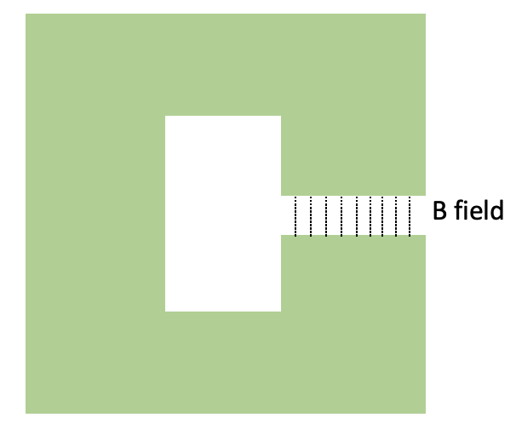

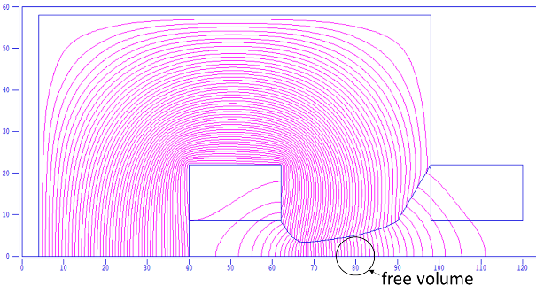
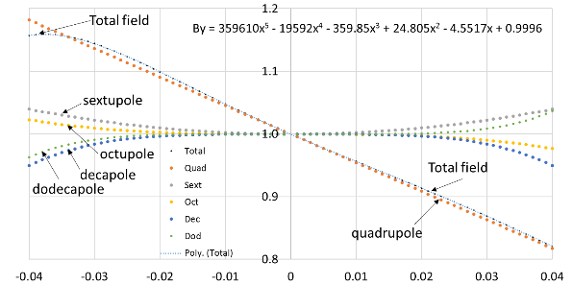
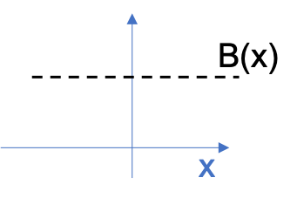
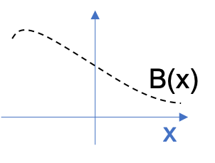
Pure dipole vs. combined function
Pure dipole
Combined function
Example:
2D model of the PS Main Unit, CERN
Source:
Magnets in Particle Accelerators, D. Tommasini
E

Slide 12
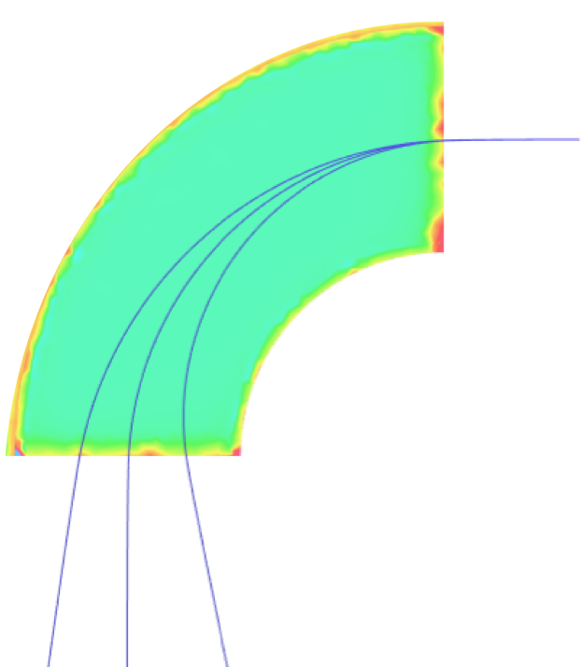
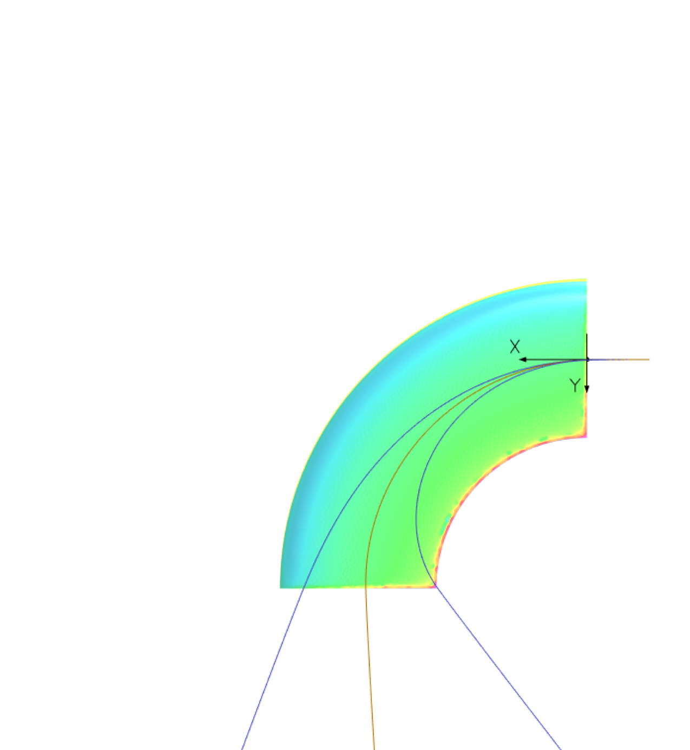
Pure dipole vs. combined function magnet
Pure dipole
Combined function
d
d
⍺
⍺

Slide 13
Ideas to limit the beam size increase
I will investigate different concepts:
Varying the pole profile along the longitudinal trajectories;
Local focusing at the magnet edge;
Introduce magnetic inserts (permanent magnets, trimming elements).

Slide 14
Plan of activities
Characterize the correlation between magnet parameters, beam size and profile, transmission efficiency, and impact on the footprint of the facility;
Develop optimizing functions to achieve an ideal compromise between the above parameters;
Convert the optimized solution into a magnet design;
Develop a strategy in collaboration with beam dynamics to validate the identified solution.

