Slide 1
Xsuite code
R. De Maria and G. Iadarola
With contributions from
A. Abramov, X. Buffat, P. Hermes, S. Kostoglou, A. Latina,
A. Oeftiger, M. Schwinzerl, G. Sterbini
https://xsuite.readthedocs.io
FCC-ee Software Framework meeting - 30 September 2021

Slide 2
Outline
Introduction to Xsuite
Motivation
Requirements
Design choices
Architecture
Development status
Documentation and developer's resources
Usage examples
Single-particle tracking
Import an existing lattice
Collective elements
PyHEADTAIL interface
Checks and first applications
A look under the hood (optional)
Multiplatform programming with Xobjects
Summary

Slide 3
Outline
Introduction to Xsuite
Motivation
Requirements
Design choices
Architecture
Development status
Documentation and developer's resources
Usage examples
Single-particle tracking
Import an existing lattice
Collective elements
PyHEADTAIL interface
Checks and first applications
A look under the hood (optional)
Multiplatform programming with Xobjects
Summary

Slide 4
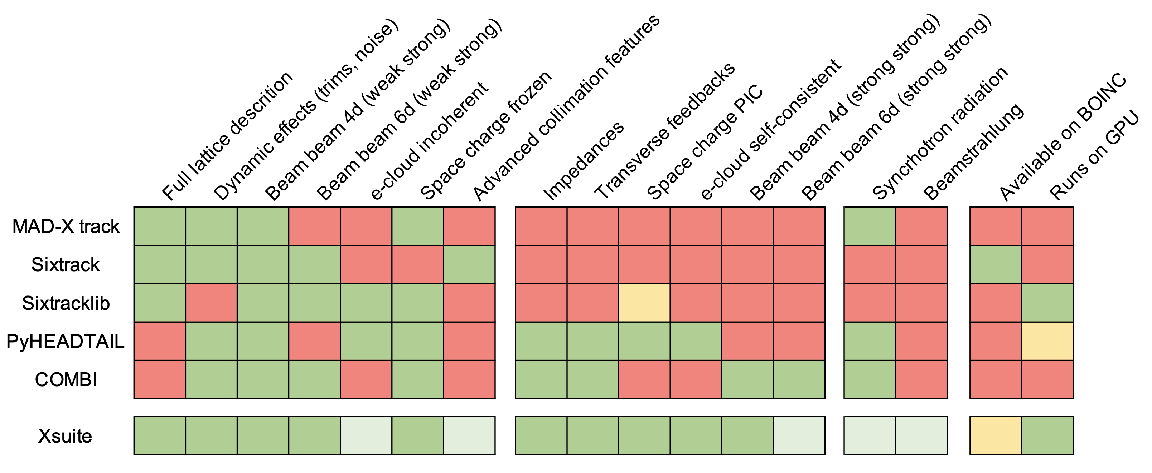
CERN-developed multiparticle codes
Available
Not available
Experimental
We currently have at least five CERN-developed multiparticle codes that are used in production studies for CERN synchrotrons (+ need to use PyORBIT-PTC for Particle-In-Cell space charge studies)
This has multiple drawbacks:
Simulation capabilities are limited (e.g. full-lattice + impedance is not possible)
Expensive to maintain and further develop (duplicated efforts)
Long and very specific learning curve for new-comers (know-how is not transferrable)
4

Slide 5
CERN-developed multiparticle codes
Available
Not available
Experimental
Adapting one of the existing codes to fulfil all the needs would be very difficult
opted to start a new design (Xsuite) considering all requirements
5

Slide 6

Xsuite: requirements
The following main requirements were identified :
Sustainability: development/maintainance compatible with ABP's available manpower and knowhow
Favor mainstream technologies (e.g. python) to:
profit from existing knowhow in ABP
have a short learning curve for newcomers
"guarantee" sufficient long life of the code
Code simple and slim: introduction of new features should be “student friendly”
Code should easy and flexible to use (scriptable)
It should be easy to interface with many existing physics tools:
MAD-X via cpymad, PyHEADTAIL, pymask, COMBI/PyPLINE, FCC-EPFL framework
Speed matters
Performance should stay in line with Sixtrack on CPU and with Sixtracklib on GPU
Need to run on CPUs and GPUs from different vendors
6

Slide 7

Xsuite foundations
We did not start from scratch, instead we could learn and inherit features from the following existing tools:
sixtraklib-pysixtrack
Clean, tested and documented implementation of machine elements (basically reused without changes, physics from SixTrack)
Particle description with redundant energy variables for better precision and speed (from sixtrack experience)
Experience with multiplatform code (CPU/GPU)
Tools for importing machine model from MAD-X or sixtrack input
PyHEADTAIL
Driving a multiparticle simulation through Python
Usage of vectorization through numpy to speed up parts of the simulation directly in Python
PyPIC
2D and 3D FFT Particle In Cell with integrated Green functions
Experience with CPU and GPU
Don't reinvent the wheel…
7

Slide 8
Outline
Introduction to Xsuite
Motivation
Requirements
Design choices
Architecture
Development status
Documentation and developer's resources
Usage examples
Single-particle tracking
Import an existing lattice
Collective elements
PyHEADTAIL interface
Checks and first applications
A look under the hood (optional)
Multiplatform programming with Xobjects
Summary

Slide 9


Xsuite – Python packages
Design choice #1:
The code is provided in the form of a set of Python packages (Xline, Xtrack, Xpart, …)
This has several advantages:
Profit of ABP know-how and experience with python (OMC tools, pytimber, PyHEADTAIL, PyECLOUD, harpy, lumi modeling and followup tools, …)
Newcomers typically have been already exposed to Python + learning-curve is common many tools used in ABP and at CERN for simulation, data analysis, operation…
Python can be used as glue among Xsuite modules and with several CERN and general-purpose Python packages (plotting, fft, optimization, data storage, ML, …)
Python is easy to extend with C, C++ and FORTRAN code for performance-critical parts
9

Slide 10






Xsuite – Support of GPUs
Support of Graphics Processing Units (GPUs) is a necessary requirement
applications like incoherent effects studies of space-charge or e-cloud are feasible only with GPUs
Market situation is somewhat complicated
there is no accepted standard for GPU programming
Different vendors have different languages, frameworks, etc.
Picture not expected to change on the short term
Design choice #2: same code should work on multiple platforms
Usable on conventional CPUs (including multithreading support) and on GPUs from major vendors (NVIDIA, AMD, Intel)
It is ready to be extended to new standards that are likely to come in the near future
Leveraged on available open-source packages for compiling/launching CPU and GPU code through Python
10

Slide 11
Outline
Introduction to Xsuite
Motivation
Requirements
Design choices
Architecture
Development status
Documentation and developer's resources
Usage examples
Single-particle tracking
Import an existing lattice
Collective elements
PyHEADTAIL interface
Checks and first applications
A look under the hood (optional)
Multiplatform programming with Xobjects
Summary

Slide 12
Xsuite – architecture
Xsuite is made of five python modules:
One low-level module (xobjects) managing memory and code compilation at runtime on CPUs and GPUs
Four physics modules which interact with the underlying computing platforms (CPU or GPU) through Xobjects
Xline
import and manipulation of machine sequences
Xpart
generation of particles distributions
Physics modules
Xtrack
single particle
tracking engine
Xfields
computation of EM fields from particle ensembles
Xobjects
interface to different computing plaforms
(CPUs and GPUs of different vendors)
12

Slide 13
Outline
Introduction to Xsuite
Motivation
Requirements
Design choices
Architecture
Development status
Documentation and developer's resources
Usage examples
Single-particle tracking
Import an existing lattice
Collective elements
PyHEADTAIL interface
Checks and first applications
A look under the hood (optional)
Multiplatform programming with Xobjects
Summary

Slide 14
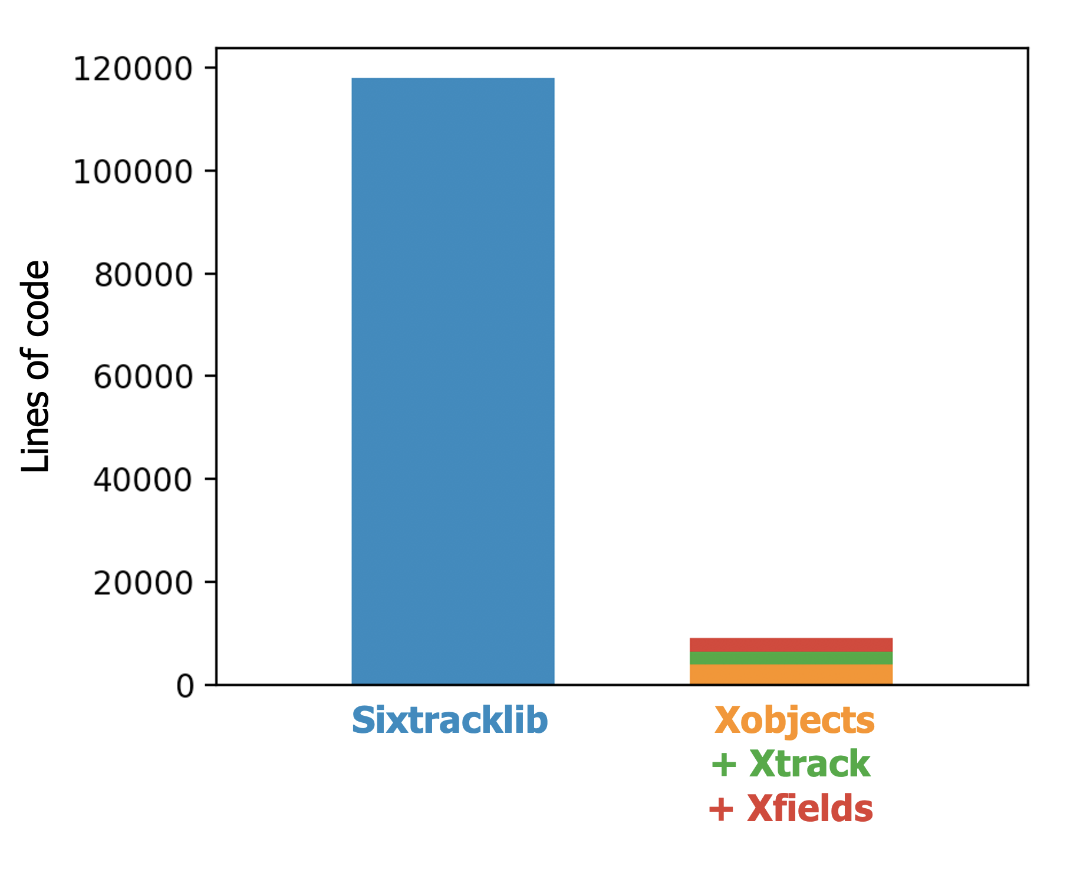
Xsuite: code complexity
Xsuite leverages Python's flexibility (introspection) and massive code autogeneration to minimize code complexity
Code is compact and readable (significant step forward w.r.t. Sixtracklib, where we had achieved multiplatform compatibility using pre-compiler macros)
A developer who knows the basics of Python and C can easily contribute code (e.g. introduce new beam elements)
Fundamental to guarantee future development and maintenance with available manpower!
14

Slide 15
Xsuite development status
Several colleagues could already contribute to the development (many thanks!)
Demonstrated short learning curve for developers
Greatly helped to achieve a quick progress of the project (Xsuite is now being used for first production studies)
⁽¹⁾
⁽¹⁾
⁽²⁾
⁽¹⁾
^{(3,4,5)}
⁽⁶⁾
⁽⁶⁾
⁽⁶⁾
^{(1,7)}
^{(1,7)}
⁽⁸⁾
⁽⁷⁾
⁽⁹⁾
⁽¹⁾ Uses optimized implementation of Faddeeva function providing x10 speedup on GPU (M.Schwinzerl)
⁽²⁾ To be ported from Sixrtacklib (straightforward)
⁽³⁾ Electron lens implemented (P. Hermes)
⁽⁴⁾ Geant4 interface working (A. Abramov)
⁽⁵⁾ Porting K2 scattering and Fluka coupling
is under development (F. Van Der Veken, P. Hermes)
⁽⁶⁾ Through PyHEADTAIL interface (X. Buffat)
Only CPU for now
⁽⁷⁾ Under development (P. Kicsiny, X. Buffat)
⁽⁸⁾ Under development (A. Latina)
⁽⁹⁾ Under study
15

Slide 16
Outline
Introduction to Xsuite
Motivation
Requirements
Design choices
Architecture
Development status
Documentation and developer's resources
Usage examples
Single-particle tracking
Import an existing lattice
Collective elements
PyHEADTAIL interface
Checks and first applications
A look under the hood (optional)
Multiplatform programming with Xobjects
Summary

Slide 17
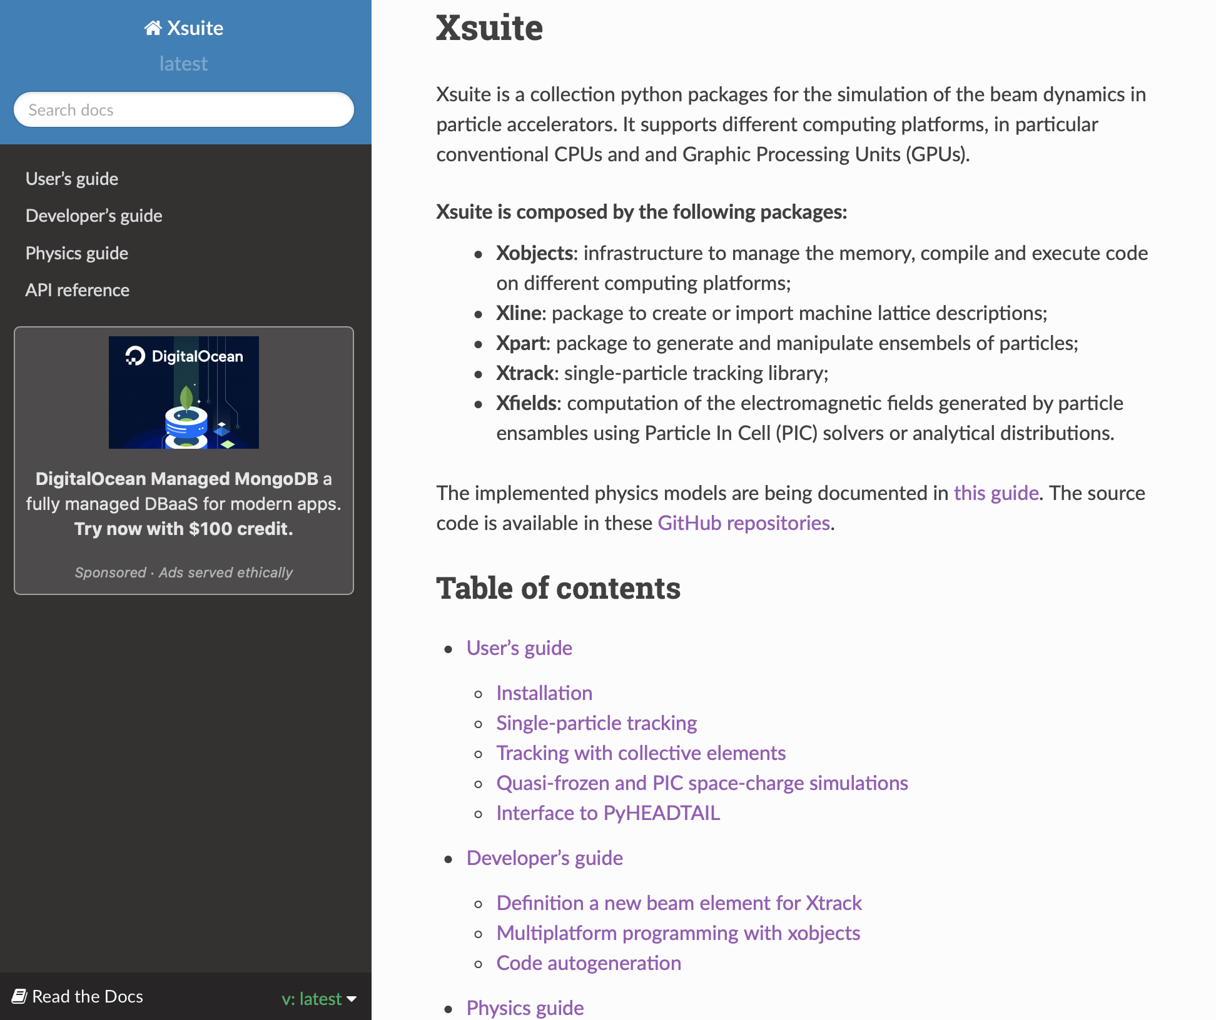
User's guide
As the code aims to serve a large user community, we need to provide sufficient documentation for users to be able to install Xsuite and perform first simulation
Using "ReadTheDocs" platform (widely adopted in the Python community)
Docs available at https://xsuite.readthedocs.io are already quite reach
Documentation integrated by sets of examples available in the repository
So far experience was very positive: users with some python experience were able to get started with little or no tutoring
17

Slide 18
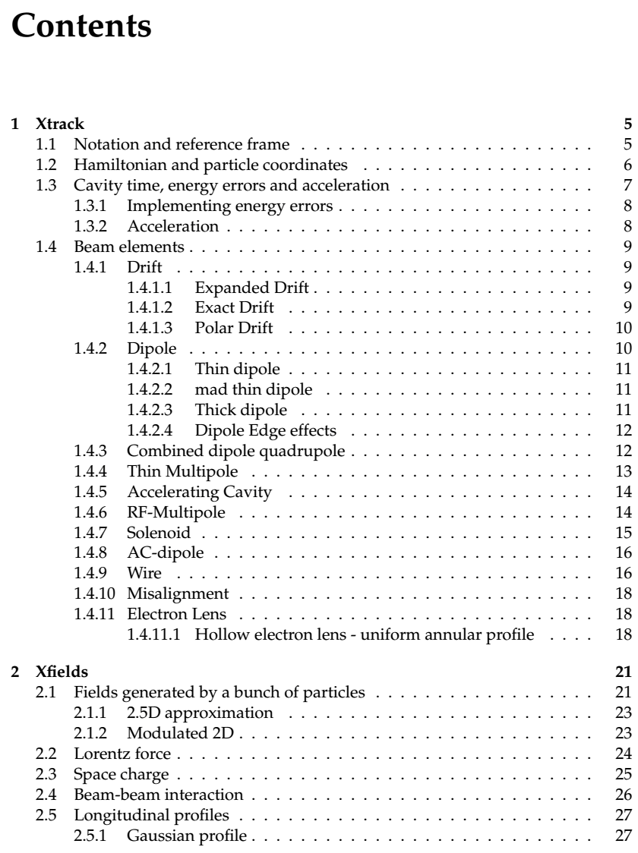
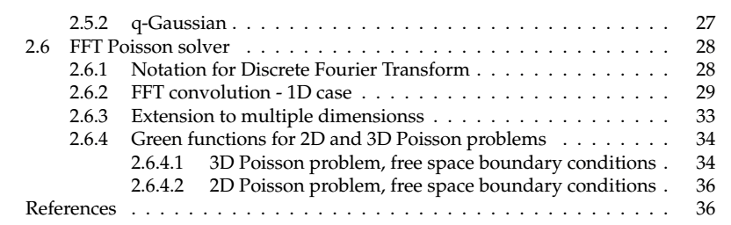
Physics guide
Effort was made to document the physics models implemented in the code
Include mathematical derivation when not available elsewhere
Using as much as possible the same notation used in the implementation
Docs for single-particle elements largely inherited from Sixtracklib manual
18

Slide 19
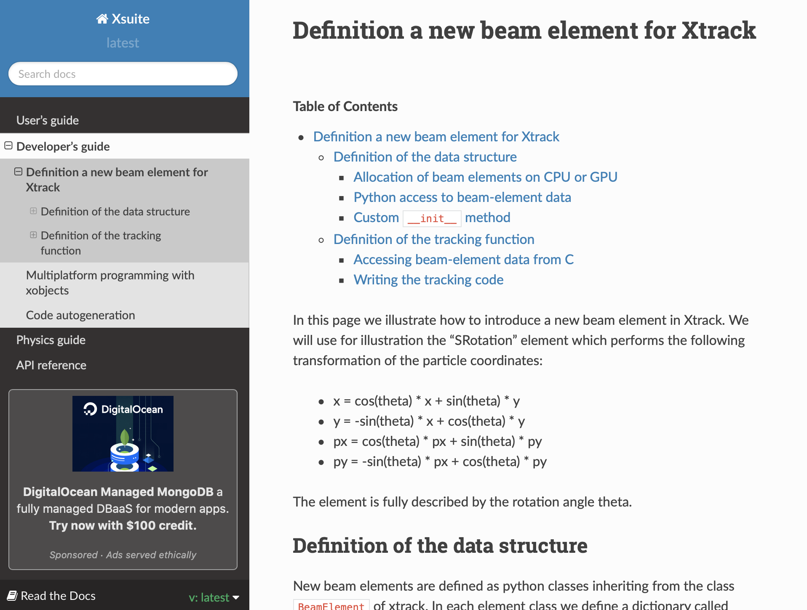
Developer's guide
Xsuite is intended as an open-source community project:
User community is encouraged to contribute improvements and new features
Documentation includes developer's guide with section explaining how to introduce a new beam element in Xsuite
Aiming at keeping learning curve for new developers as short as possible
→ First experiences were very positive
19

Slide 20
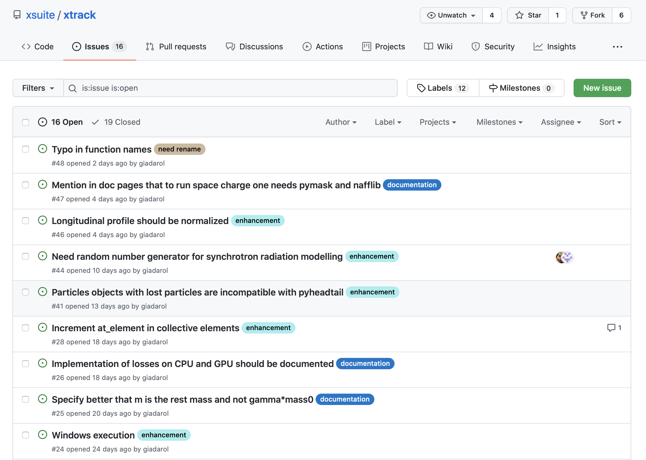
Development tools
Xsuite is tracked and versioned on GitHub (standards solution)
Source code is openly available at https://github.com/xsuite
Platforms profides tools to compare and merge versions while keeping track of changes
GitHub Issues are used to track bugs, ideas for improvements, feature requests
20

Slide 21
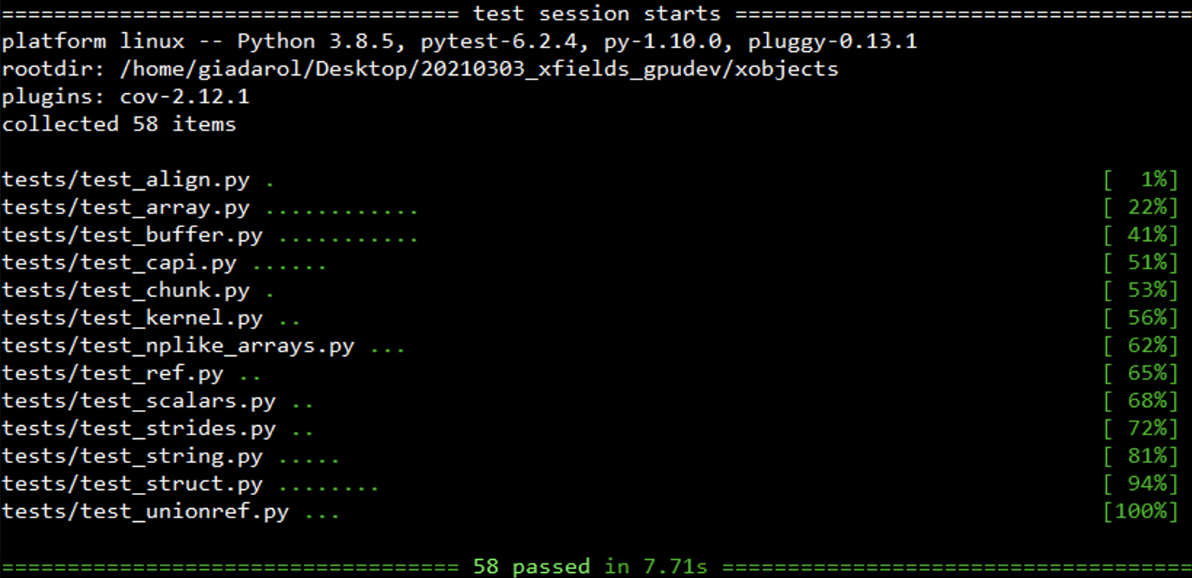
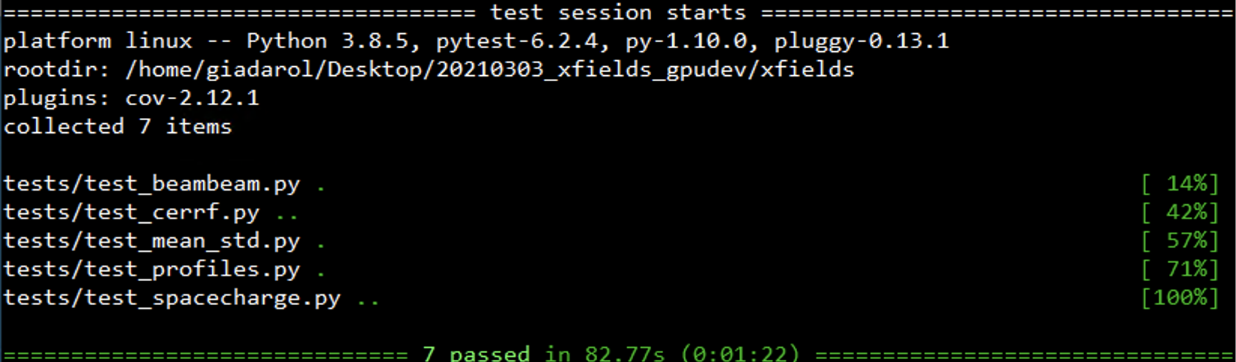
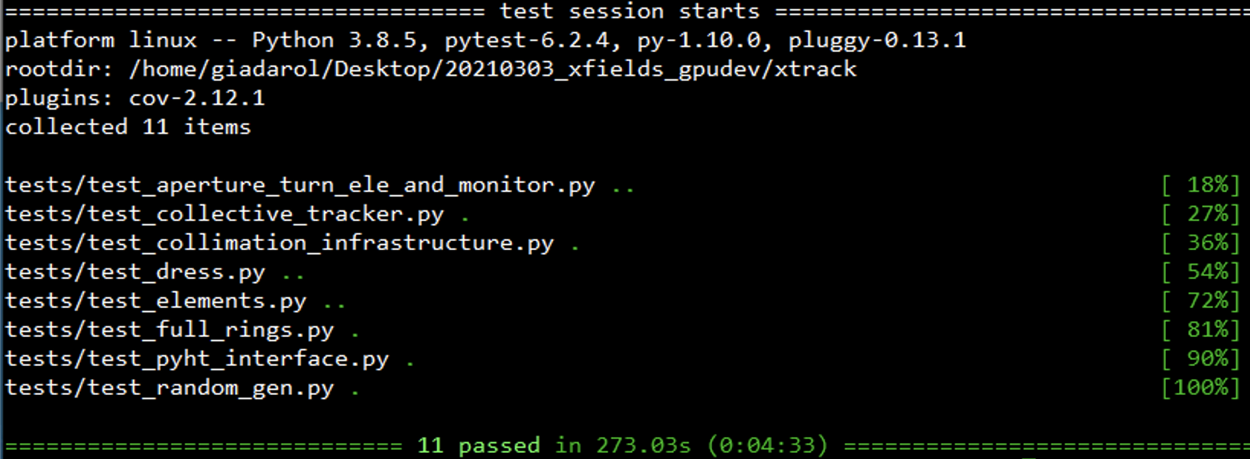
Test suite
To verify that new modifications don’t affect the functionality and correctness of existing features, test suites are implemented for all modules
Notably they include check of tracking results for LHC, HL-LHC and SPS
Before releasing new versions of the code, the tests are run on different computing platforms (CPU and GPU)
21

Slide 22
Outline
Introduction to Xsuite
Motivation
Requirements
Design choices
Architecture
Development status
Documentation and developer's resources
Usage examples
Single-particle tracking
Import an existing lattice
Collective elements
PyHEADTAIL interface
Checks and first applications
A look under the hood (optional)
Multiplatform programming with Xobjects
Summary

Slide 23
A basic example: single-particle tracking
Simulations are configured and launched with a Python script (or Jupyter notebook)
import xobjects as xo
import xline as xl
import xtrack as xt
## Generate a simple sequence
sequence = xl.Line(
elements=[xl.Drift(length=1.), xl.Multipole(knl=[0, 1.], ksl=[0,0]),
xl.Drift(length=1.), xl.Multipole(knl=[0, -1.], ksl=[0,0])],
element_names=['drift_0', 'quad_0', 'drift_1', 'quad_1'])
## Choose a context
context = xo.ContextCpu() # For CPU
## Transfer lattice on context and compile tracking code
tracker = xt.Tracker(_context=context, sequence=sequence)
## Build particle object on context
n_part = 200
import numpy as np
particles = xt.Particles(_context=context, p0c=6500e9,
x=np.random.uniform(-1e-3, 1e-3, n_part),
zeta=np.random.uniform(-1e-2, 1e-2, n_part),
delta=np.random.uniform(-1e-4, 1e-4, n_part))
## Track (saving turn-by-turn data)
tracker.track(particles, num_turns=100, turn_by_turn_monitor=True)
## The particle is changed in place and turn-by-turn data is available at:
tracker.record_last_track.x, tracker.record_last_track.px # etc...
We import the Xsuite modules that we need
23

Slide 24
A basic example: single-particle tracking
Simulations are configured and launched with a Python script (or Jupyter notebook)
import xobjects as xo
import xline as xl
import xtrack as xt
## Generate a simple sequence
sequence = xl.Line(
elements=[xl.Drift(length=1.), xl.Multipole(knl=[0, 1.], ksl=[0,0]),
xl.Drift(length=1.), xl.Multipole(knl=[0, -1.], ksl=[0,0])],
element_names=['drift_0', 'quad_0', 'drift_1', 'quad_1'])
## Choose a context
context = xo.ContextCpu() # For CPU
## Transfer lattice on context and compile tracking code
tracker = xt.Tracker(_context=context, sequence=sequence)
## Build particle object on context
n_part = 200
import numpy as np
particles = xt.Particles(_context=context, p0c=6500e9,
x=np.random.uniform(-1e-3, 1e-3, n_part),
zeta=np.random.uniform(-1e-2, 1e-2, n_part),
delta=np.random.uniform(-1e-4, 1e-4, n_part))
## Track (saving turn-by-turn data)
tracker.track(particles, num_turns=100, turn_by_turn_monitor=True)
## The particle is changed in place and turn-by-turn data is available at:
tracker.record_last_track.x, tracker.record_last_track.px # etc...
We use Xline to create a simple sequence (a FODO)
24

Slide 25
A basic example: single-particle tracking
Simulations are configured and launched with a Python script (or Jupyter notebook)
import xobjects as xo
import xline as xl
import xtrack as xt
## Generate a simple sequence
sequence = xl.Line(
elements=[xl.Drift(length=1.), xl.Multipole(knl=[0, 1.], ksl=[0,0]),
xl.Drift(length=1.), xl.Multipole(knl=[0, -1.], ksl=[0,0])],
element_names=['drift_0', 'quad_0', 'drift_1', 'quad_1'])
## Choose a context
context = xo.ContextCpu() # For CPU
## Transfer lattice on context and compile tracking code
tracker = xt.Tracker(_context=context, sequence=sequence)
## Build particle object on context
n_part = 200
import numpy as np
particles = xt.Particles(_context=context, p0c=6500e9,
x=np.random.uniform(-1e-3, 1e-3, n_part),
zeta=np.random.uniform(-1e-2, 1e-2, n_part),
delta=np.random.uniform(-1e-4, 1e-4, n_part))
## Track (saving turn-by-turn data)
tracker.track(particles, num_turns=100, turn_by_turn_monitor=True)
## The particle is changed in place and turn-by-turn data is available at:
tracker.record_last_track.x, tracker.record_last_track.px # etc...
We choose the computing platform on which we want to run (CPU or GPU)
25

Slide 26
A basic example: single-particle tracking
Simulations are configured and launched with a Python script (or Jupyter notebook)
import xobjects as xo
import xline as xl
import xtrack as xt
## Generate a simple sequence
sequence = xl.Line(
elements=[xl.Drift(length=1.), xl.Multipole(knl=[0, 1.], ksl=[0,0]),
xl.Drift(length=1.), xl.Multipole(knl=[0, -1.], ksl=[0,0])],
element_names=['drift_0', 'quad_0', 'drift_1', 'quad_1'])
## Choose a context
context = xo.ContextCpu() # For CPU
## Transfer lattice on context and compile tracking code
tracker = xt.Tracker(_context=context, sequence=sequence)
## Build particle object on context
n_part = 200
import numpy as np
particles = xt.Particles(_context=context, p0c=6500e9,
x=np.random.uniform(-1e-3, 1e-3, n_part),
zeta=np.random.uniform(-1e-2, 1e-2, n_part),
delta=np.random.uniform(-1e-4, 1e-4, n_part))
## Track (saving turn-by-turn data)
tracker.track(particles, num_turns=100, turn_by_turn_monitor=True)
## The particle is changed in place and turn-by-turn data is available at:
tracker.record_last_track.x, tracker.record_last_track.px # etc...
We build a tracker object, which can track particles in our beam line on the chosen computing platform
26

Slide 27
A basic example: single-particle tracking
Simulations are configured and launched with a Python script (or Jupyter notebook)
import xobjects as xo
import xline as xl
import xtrack as xt
## Generate a simple sequence
sequence = xl.Line(
elements=[xl.Drift(length=1.), xl.Multipole(knl=[0, 1.], ksl=[0,0]),
xl.Drift(length=1.), xl.Multipole(knl=[0, -1.], ksl=[0,0])],
element_names=['drift_0', 'quad_0', 'drift_1', 'quad_1'])
## Choose a context
context = xo.ContextCpu() # For CPU
## Transfer lattice on context and compile tracking code
tracker = xt.Tracker(_context=context, sequence=sequence)
## Build particle object on context
n_part = 200
import numpy as np
particles = xt.Particles(_context=context, p0c=6500e9,
x=np.random.uniform(-1e-3, 1e-3, n_part),
zeta=np.random.uniform(-1e-2, 1e-2, n_part),
delta=np.random.uniform(-1e-4, 1e-4, n_part))
## Track (saving turn-by-turn data)
tracker.track(particles, num_turns=100, turn_by_turn_monitor=True)
## The particle is changed in place and turn-by-turn data is available at:
tracker.record_last_track.x, tracker.record_last_track.px # etc...
We generate a set of particles (in this case using a standard python random generator)
27

Slide 28
A basic example: single-particle tracking
Simulations are configured and launched with a Python script (or Jupyter notebook)
import xobjects as xo
import xline as xl
import xtrack as xt
## Generate a simple sequence
sequence = xl.Line(
elements=[xl.Drift(length=1.), xl.Multipole(knl=[0, 1.], ksl=[0,0]),
xl.Drift(length=1.), xl.Multipole(knl=[0, -1.], ksl=[0,0])],
element_names=['drift_0', 'quad_0', 'drift_1', 'quad_1'])
## Choose a context
context = xo.ContextCpu() # For CPU
## Transfer lattice on context and compile tracking code
tracker = xt.Tracker(_context=context, sequence=sequence)
## Build particle object on context
n_part = 200
import numpy as np
particles = xt.Particles(_context=context, p0c=6500e9,
x=np.random.uniform(-1e-3, 1e-3, n_part),
zeta=np.random.uniform(-1e-2, 1e-2, n_part),
delta=np.random.uniform(-1e-4, 1e-4, n_part))
## Track (saving turn-by-turn data)
tracker.track(particles, num_turns=100, turn_by_turn_monitor=True)
## The particle is changed in place and turn-by-turn data is available at:
tracker.record_last_track.x, tracker.record_last_track.px # etc...
We launch the tracking
(particles are updated as tracking progresses)
28

Slide 29
A basic example: single-particle tracking
Simulations are configured and launched with a Python script (or Jupyter notebook)
import xobjects as xo
import xline as xl
import xtrack as xt
## Generate a simple sequence
sequence = xl.Line(
elements=[xl.Drift(length=1.), xl.Multipole(knl=[0, 1.], ksl=[0,0]),
xl.Drift(length=1.), xl.Multipole(knl=[0, -1.], ksl=[0,0])],
element_names=['drift_0', 'quad_0', 'drift_1', 'quad_1'])
## Choose a context
context = xo.ContextCpu() # For CPU
## Transfer lattice on context and compile tracking code
tracker = xt.Tracker(_context=context, sequence=sequence)
## Build particle object on context
n_part = 200
import numpy as np
particles = xt.Particles(_context=context, p0c=6500e9,
x=np.random.uniform(-1e-3, 1e-3, n_part),
zeta=np.random.uniform(-1e-2, 1e-2, n_part),
delta=np.random.uniform(-1e-4, 1e-4, n_part))
## Track (saving turn-by-turn data)
tracker.track(particles, num_turns=100, turn_by_turn_monitor=True)
## The particle is changed in place and turn-by-turn data is available at:
tracker.record_last_track.x, tracker.record_last_track.px # etc...
Access to the recorded particles coordinates

Slide 30
A basic example: single-particle tracking
Simulations are configured and launched with a Python script (or Jupyter notebook)
import xobjects as xo
import xline as xl
import xtrack as xt
## Generate a simple sequence
sequence = xl.Line(
elements=[xl.Drift(length=1.), xl.Multipole(knl=[0, 1.], ksl=[0,0]),
xl.Drift(length=1.), xl.Multipole(knl=[0, -1.], ksl=[0,0])],
element_names=['drift_0', 'quad_0', 'drift_1', 'quad_1'])
## Choose a context
context = xo.ContextCpu() # For CPU
## Transfer lattice on context and compile tracking code
tracker = xt.Tracker(_context=context, sequence=sequence)
## Build particle object on context
n_part = 200
import numpy as np
particles = xt.Particles(_context=context, p0c=6500e9,
x=np.random.uniform(-1e-3, 1e-3, n_part),
zeta=np.random.uniform(-1e-2, 1e-2, n_part),
delta=np.random.uniform(-1e-4, 1e-4, n_part))
## Track (saving turn-by-turn data)
tracker.track(particles, num_turns=100, turn_by_turn_monitor=True)
## The particle is changed in place and turn-by-turn data is available at:
tracker.record_last_track.x, tracker.record_last_track.px # etc...
To run on GPU all we need to do is to change the context
30

Slide 31
A basic example: single-particle tracking
Simulations are configured and launched with a Python script (or Jupyter notebook)
import xobjects as xo
import xline as xl
import xtrack as xt
## Generate a simple sequence
sequence = xl.Line(
elements=[xl.Drift(length=1.), xl.Multipole(knl=[0, 1.], ksl=[0,0]),
xl.Drift(length=1.), xl.Multipole(knl=[0, -1.], ksl=[0,0])],
element_names=['drift_0', 'quad_0', 'drift_1', 'quad_1'])
## Choose a context
context = xo.ContextCupy() # For NVIDIA GPUs
## Transfer lattice on context and compile tracking code
tracker = xt.Tracker(_context=context, sequence=sequence)
## Build particle object on context
n_part = 200
import numpy as np
particles = xt.Particles(_context=context, p0c=6500e9,
x=np.random.uniform(-1e-3, 1e-3, n_part),
zeta=np.random.uniform(-1e-2, 1e-2, n_part),
delta=np.random.uniform(-1e-4, 1e-4, n_part))
## Track (saving turn-by-turn data)
tracker.track(particles, num_turns=100, turn_by_turn_monitor=True)
## The particle is changed in place and turn-by-turn data is available at:
tracker.record_last_track.x, tracker.record_last_track.px # etc...
To run on GPU all we need to do is to change the context
31

Slide 32
A basic example: single-particle tracking
Simulations are configured and launched with a Python script (or Jupyter notebook)
import xobjects as xo
import xline as xl
import xtrack as xt
## Generate a simple sequence
sequence = xl.Line(
elements=[xl.Drift(length=1.), xl.Multipole(knl=[0, 1.], ksl=[0,0]),
xl.Drift(length=1.), xl.Multipole(knl=[0, -1.], ksl=[0,0])],
element_names=['drift_0', 'quad_0', 'drift_1', 'quad_1'])
## Choose a context
context = xo.ContextPyopencl() # For AMD GPUs and other hardware
## Transfer lattice on context and compile tracking code
tracker = xt.Tracker(_context=context, sequence=sequence)
## Build particle object on context
n_part = 200
import numpy as np
particles = xt.Particles(_context=context, p0c=6500e9,
x=np.random.uniform(-1e-3, 1e-3, n_part),
zeta=np.random.uniform(-1e-2, 1e-2, n_part),
delta=np.random.uniform(-1e-4, 1e-4, n_part))
## Track (saving turn-by-turn data)
tracker.track(particles, num_turns=100, turn_by_turn_monitor=True)
## The particle is changed in place and turn-by-turn data is available at:
tracker.record_last_track.x, tracker.record_last_track.px # etc...
To run on GPU all we need to do is to change the context
32

Slide 33
Outline
Introduction to Xsuite
Motivation
Requirements
Design choices
Architecture
Development status
Documentation and developer's resources
Usage examples
Single-particle tracking
Import an existing lattice
Collective elements
PyHEADTAIL interface
Checks and first applications
A look under the hood (optional)
Multiplatform programming with Xobjects
Summary

Slide 34
Interface: a basic example
import numpy as np
import xobjects as xo
import xline as xl
import xtrack as xt
## Generate a simple sequence
sequence = xl.Line(
elements=[xl.Drift(length=1.), xl.Multipole(knl=[0, 1.], ksl=[0,0]),
xl.Drift(length=1.), xl.Multipole(knl=[0, -1.], ksl=[0,0])],
element_names=['drift_0', 'quad_0', 'drift_1', 'quad_1'])
## Choose a context
context = xo.ContextCpu() # For CPU
## Transfer lattice on context and compile tracking code
tracker = xt.Tracker(_context=context, sequence=sequence)
## Build particle object on context
n_part = 200
particles = xt.Particles(_context=context, p0c=6500e9,
x=np.random.uniform(-1e-3, 1e-3, n_part),
zeta=np.random.uniform(-1e-2, 1e-2, n_part),
delta=np.random.uniform(-1e-4, 1e-4, n_part))
## Track (saving turn-by-turn data)
tracker.track(particles, num_turns=100, turn_by_turn_monitor=True)
## The particle is changed in place and turn-by-turn data is available at:
tracker.record_last_track.x, tracker.record_last_track.px # etc...
Creating the sequence "by hand" becomes impractical for realistic lattices
34

Slide 35
Get sequence from MAD-X
import numpy as np
import xobjects as xo
import xline as xl
import xtrack as xt
## Generate machine model with MAD-X script
from cpymad.madx import Madx
mad = Madx()
mad.call("lhc.madx")
line = xl.Line.from_madx_sequence(mad.sequence['lhcb1'])
## Choose a context
context = xo.ContextCpu() # For CPU
## Transfer lattice on context and compile tracking code
tracker = xt.Tracker(_context=context, sequence=sequence)
## Build particle object on context
n_part = 200
particles = xt.Particles(_context=context, p0c=6500e9,
x=np.random.uniform(-1e-3, 1e-3, n_part),
zeta=np.random.uniform(-1e-2, 1e-2, n_part),
delta=np.random.uniform(-1e-4, 1e-4, n_part))
## Track (saving turn-by-turn data)
tracker.track(particles, num_turns=100, turn_by_turn_monitor=True)
## The particle is changed in place and turn-by-turn data is available at:
tracker.record_last_track.x, tracker.record_last_track.px # etc...
Xline provides tools to import the machine sequence from MAD-X (via cpymad)
35

Slide 36
Get sequence from sixtrack input
import numpy as np
import xobjects as xo
import xline as xl
import xtrack as xt
## Import machine model from sixtrack input
import sixtracktools as st
sequence = xl.Line.from_sixinput(st.sixinput('./sixtrackfiles'))
## Choose a context
context = xo.ContextCpu() # For CPU
## Transfer lattice on context and compile tracking code
tracker = xt.Tracker(_context=context, sequence=sequence)
## Build particle object on context
n_part = 200
particles = xt.Particles(_context=context, p0c=6500e9,
x=np.random.uniform(-1e-3, 1e-3, n_part),
zeta=np.random.uniform(-1e-2, 1e-2, n_part),
delta=np.random.uniform(-1e-4, 1e-4, n_part))
## Track (saving turn-by-turn data)
tracker.track(particles, num_turns=100, turn_by_turn_monitor=True)
## The particle is changed in place and turn-by-turn data is available at:
tracker.record_last_track.x, tracker.record_last_track.px # etc...
Xline provides tools to import the machine sequence from a set of sixtrack input files (fort.*)
36

Slide 37
Load sequence from file
import numpy as np
import xobjects as xo
import xline as xl
import xtrack as xt
## Load sequence from json file
## (e.g. LHC sequence generated by pymask)
sequence = xl.Line.from_json("lhc_b1_with_bb.json")
## Choose a context
context = xo.ContextCpu() # For CPU
## Transfer lattice on context and compile tracking code
tracker = xt.Tracker(_context=context, sequence=sequence)
## Build particle object on context
n_part = 200
particles = xt.Particles(_context=context, p0c=6500e9,
x=np.random.uniform(-1e-3, 1e-3, n_part),
zeta=np.random.uniform(-1e-2, 1e-2, n_part),
delta=np.random.uniform(-1e-4, 1e-4, n_part))
## Track (saving turn-by-turn data)
tracker.track(particles, num_turns=100, turn_by_turn_monitor=True)
## The particle is changed in place and turn-by-turn data is available at:
tracker.record_last_track.x, tracker.record_last_track.px # etc...
Xline sequence can be imported from JSON files (as saved by pymask)
37

Slide 38
Outline
Introduction to Xsuite
Motivation
Requirements
Design choices
Architecture
Development status
Documentation and developer's resources
Usage examples
Single-particle tracking
Import an existing lattice
Collective elements
PyHEADTAIL interface
Checks and first applications
A look under the hood (optional)
Multiplatform programming with Xobjects
Summary

Slide 39
Collective beam elements
Xsuite can handle collective elements, i.e. elements for which the action on a particle depends on the coordinates of other particles
it means that the tracking of different particles cannot happen asynchronously
No special action is required by the user. Collective elements are handled automatically by the the Xtrack tracker
# [Imports, contexts, particles as for single-particle simulations]
## Build a collective element (e.g. space-charge interaction)
import xfields as xf
spcharge = xf.SpaceCharge3D(_context=context, update_on_track=True,
x_range=(-5e-3, 5e-3), y_range=(-4e-3, 4e-3), z_range=(-4e-3, 4e-3),
length=1, nx=256, ny=256, nz=100, solver='FFTSolver2p5D')
## Build a simple sequence including the space-charge element
sequence = xl.Line(
elements = [xl.Multipole(knl=[0, 1.]), xl.Drift(length=1.),
spcharge,
xl.Multipole(knl=[0, -1.]), xl.Drift(length=1.)]
element_names = ['qf1', 'drift1', 'spcharge' 'qd1', 'drift2', '])
## Transfer lattice on context and compile tracking code
## as for single particle simulations
tracker = xt.Tracker(_context=context, sequence=sequence)
A PIC space-charge element is a collective element
39

Slide 40
Collective beam elements
Xsuite can handle collective elements, i.e. elements for which the action on a particle depends on the coordinates of other particles
it means that the tracking of different particles cannot happen asynchronously
No special action is required by the user. Collective elements are handled automatically by the the Xtrack tracker
# [Imports, contexts, particles as for single-particle simulations]
## Build a collective element (e.g. space-charge interaction)
import xfields as xf
spcharge = xf.SpaceCharge3D(_context=context, update_on_track=True,
x_range=(-5e-3, 5e-3), y_range=(-4e-3, 4e-3), z_range=(-4e-3, 4e-3),
length=1, nx=256, ny=256, nz=100, solver='FFTSolver2p5D')
## Build a simple sequence including the space-charge element
sequence = xl.Line(
elements = [xl.Multipole(knl=[0, 1.]), xl.Drift(length=1.),
spcharge,
xl.Multipole(knl=[0, -1.]), xl.Drift(length=1.)]
element_names = ['qf1', 'drift1', 'spcharge' 'qd1', 'drift2', '])
## Transfer lattice on context and compile tracking code
## as for single particle simulations
tracker = xt.Tracker(_context=context, sequence=sequence)
It can be included in a Xline sequence together with single-particle elements
40

Slide 41
Collective beam elements
Xsuite can handle collective elements, i.e. elements for which the action on a particle depends on the coordinates of other particles
it means that the tracking of different particles cannot happen asynchronously
No special action is required by the user. Collective elements are handled automatically by the the Xtrack tracker
# [Imports, contexts, particles as for single-particle simulations]
## Build a collective element (e.g. space-charge interaction)
import xfields as xf
spcharge = xf.SpaceCharge3D(_context=context, update_on_track=True,
x_range=(-5e-3, 5e-3), y_range=(-4e-3, 4e-3), z_range=(-4e-3, 4e-3),
length=1, nx=256, ny=256, nz=100, solver='FFTSolver2p5D')
## Build a simple sequence including the space-charge element
sequence = xl.Line(
elements = [xl.Multipole(knl=[0, 1.]), xl.Drift(length=1.),
spcharge,
xl.Multipole(knl=[0, -1.]), xl.Drift(length=1.)]
element_names = ['qf1', 'drift1', 'spcharge' 'qd1', 'drift2', '])
## Transfer lattice on context and compile tracking code
## as for single particle simulations
tracker = xt.Tracker(_context=context, sequence=sequence)
The tracker can be built as seen for single-particle simulations
The tracker takes care of cutting the sequence at the collective elements
Tracking between the collective elements is performed asynchronously (better performance)
Simulation of collective interactions is performed synchronously
41

Slide 42
Outline
Introduction to Xsuite
Motivation
Requirements
Design choices
Architecture
Development status
Documentation and developer's resources
Usage examples
Single-particle tracking
Import an existing lattice
Collective elements
PyHEADTAIL interface
Checks and first applications
A look under the hood (optional)
Multiplatform programming with Xobjects
Summary

Slide 43
Interface to PyHEADTAIL
X. Buffat
PyHEADTAIL can be used to intruduce collective beam elements (impedances, dampers, e-cloud) in Xsuite simulation
PyHEADTAIL elements can be used as valid Xtrack collective elements
For this purpose one needs to enable the "PyHEADTAIL-compatiblity mode" in Xtrack
Only CPU supported for now (GPU support would require modifications in PyHEADTAIL)
import xtrack as xt
xt.enable_pyheadtail_interface()
## Create a PyHEADTAIL element
from PyHEADTAIL.feedback.transverse_damper import TransverseDamper
damper = TransverseDamper(dampingrate_x=10., dampingrate_y=15.)
## Build a simple sequence including the space-charge element
sequence = xl.Line(
elements = [xl.Multipole(knl=[0, 1.]), xl.Drift(length=1.),
damper,
xl.Multipole(knl=[0, -1.]), xl.Drift(length=1.)]
element_names = ['qf1', 'drift1', damper', 'qd1', 'drift2'])
## Transfer lattice on context and compile tracking code
## as for single particle simulations
tracker = xt.Tracker(_context=context, sequence=sequence)
43

Slide 44
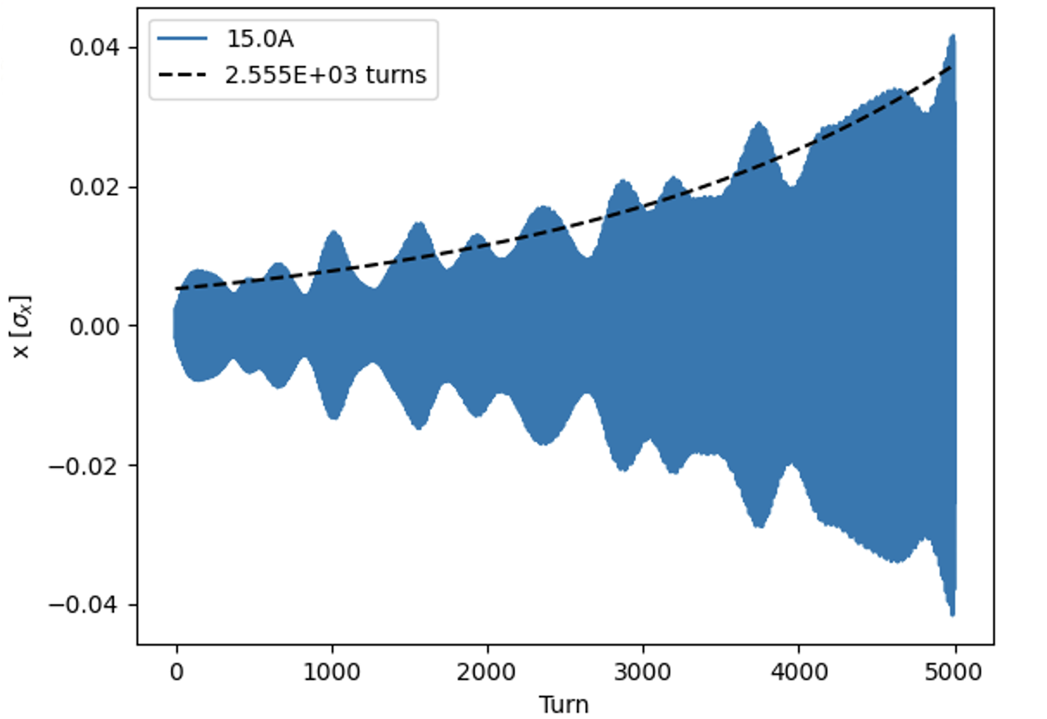
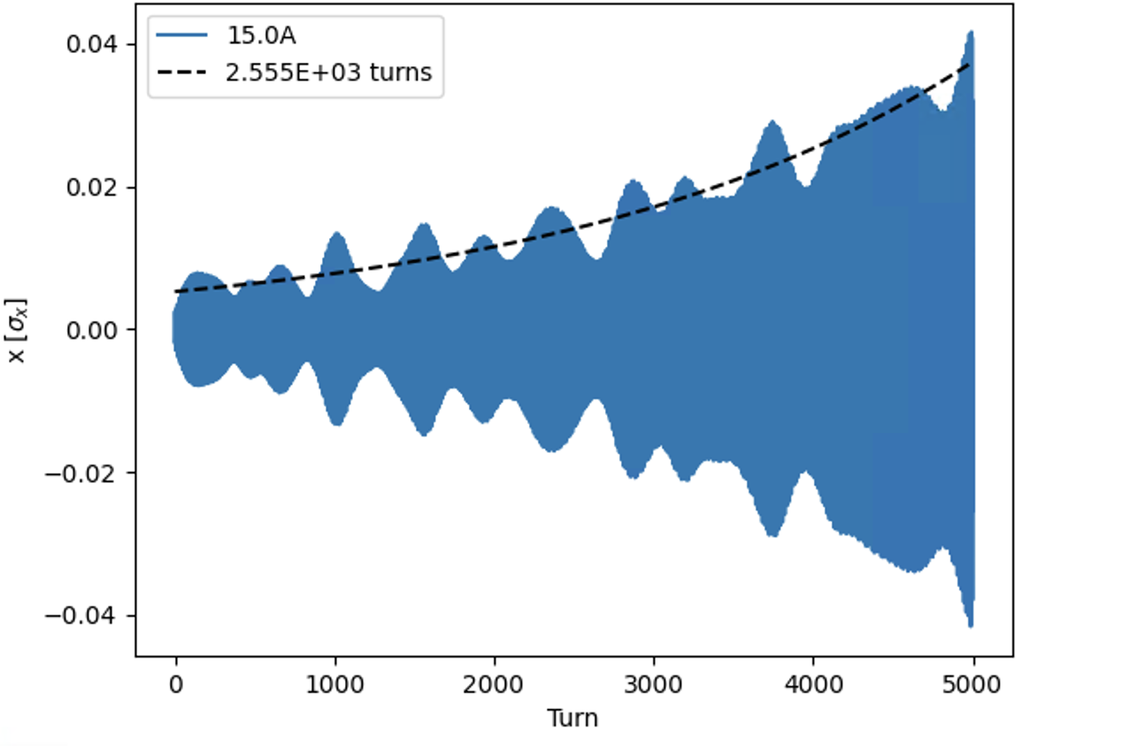
Interface to PyHEADTAIL
X. Buffat
PyHEADTAIL can be used to intruduce collective beam elements (impedances, dampers, e-cloud) in Xsuite simulation
For this purpose one needs to enable the "PyHEADTAIL-compatiblity mode" in Xtrack
PyHEADTAIL elements can be used as valid Xtrack collective elements
Only on CPU context supported for now (GPU support would require modifications in PyHEADTAIL)
Comparison
Tracking, impedance and damper
in PyHEADTAIL
Tracking Xsuite
impedance and in PyHEADTAIL
import xtrack as xt
xt.enable_pyheadtail_interface()
## Create a PyHEADTAIL element
from PyHEADTAIL.feedback.transverse_damper import TransverseDamper
damper = TransverseDamper(dampingrate_x=10., dampingrate_y=15.)
## Build a simple sequence including the space-charge element
sequence = xl.Line(
elements = [xl.Multipole(knl=[0, 1.]), xl.Drift(length=1.),
damper,
xl.Multipole(knl=[0, -1.]), xl.Drift(length=1.)]
element_names = ['qf1', 'drift1', 'spcharge' 'qd1', 'drift2', '])
## Transfer lattice on context and compile tracking code
## as for single particle simulations
tracker = xt.Tracker(_context=context, sequence=sequence)
44

Slide 45
Outline
Introduction to Xsuite
Motivation
Requirements
Design choices
Architecture
Development status
Documentation and developer's resources
Usage examples
Single-particle tracking
Import an existing lattice
Collective elements
PyHEADTAIL interface
Checks and first applications
A look under the hood (optional)
Multiplatform programming with Xobjects
Summary

Slide 46
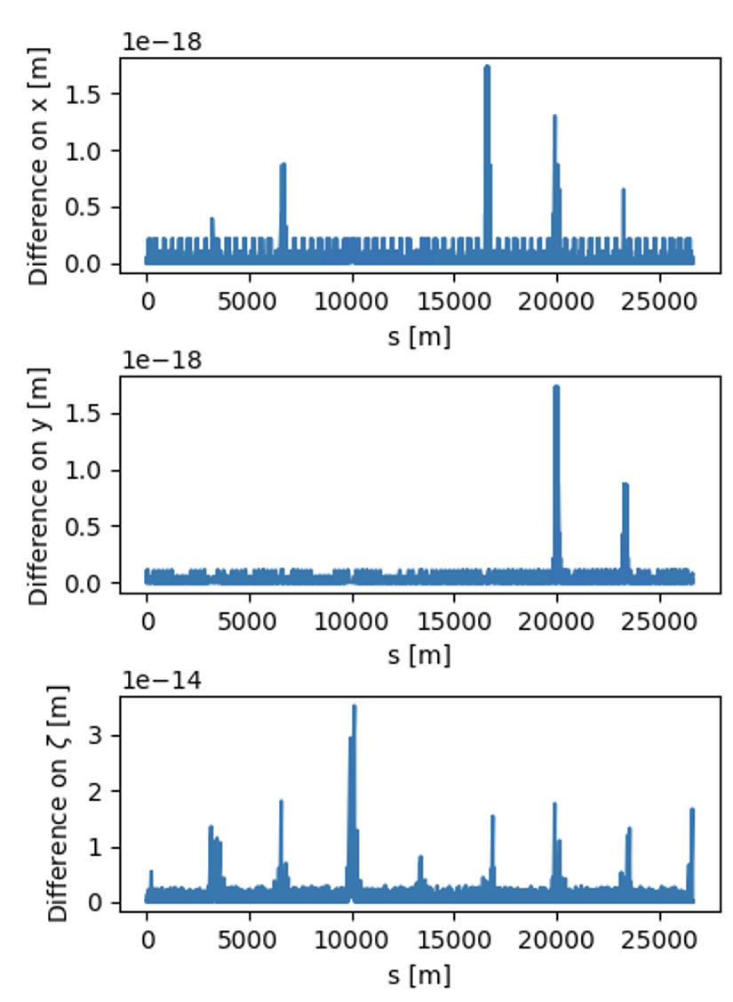
Single-particle tracking – benchmarks and performance
Single-particle tracking has been successfully benchmarked against SixTrack
→ Checks performed for protons and ions
Computation time very similar to Sixtrack on CPU and to sixtracklib on GPU
Platform | Computing time
CPU | 190 (μs/part./turn)
GPU (Titan V, cupy) | 0.80 (μs/part./turn)
GPU (Titan V, pyopencl) | 0.85 (μs/part./turn)
(*) tests made on ABP GPU server
46

Slide 47
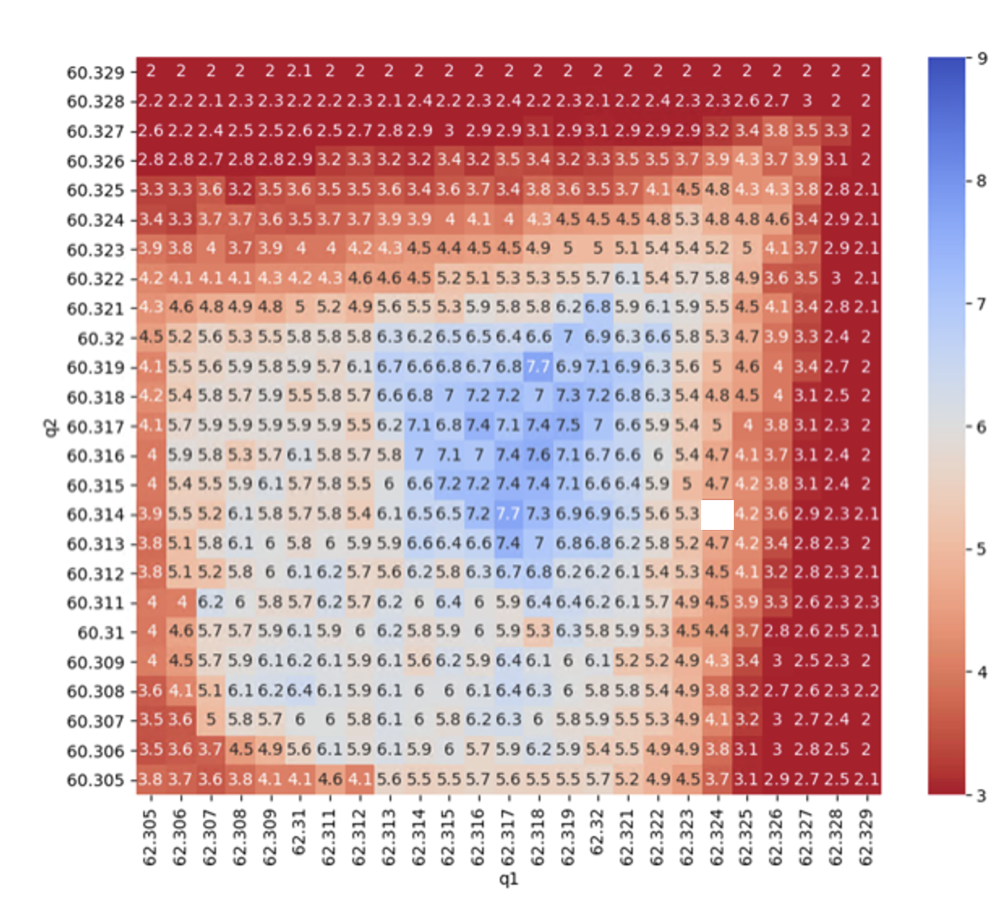
HL-LHC Dynamic Aperture scan
G. Sterbini, K. Paraschou, S. Kostoglou
Example of integration with other Pythonic tools in a complex workflow
Pymask used to prepare the machine configurations
Generation of matched particle distribution using python module from pysixtrack
Job management using a new Python package (TreeMaker)
Tracking performed with Xsuite (parquet files used for data storage)
Dynamic Aperture computation in Python using Pandas
Parameters of pilot study
Full HL-LHC lattice (20k elements)
Weak strong Beam-beam
N. tune configurations = 625
N. tracked particles/conf. = 1780
N. turns = 10⁶
N. jobs = ~10'000
Comp. time ~48h on INFN- CNAF cluster
47

Slide 48
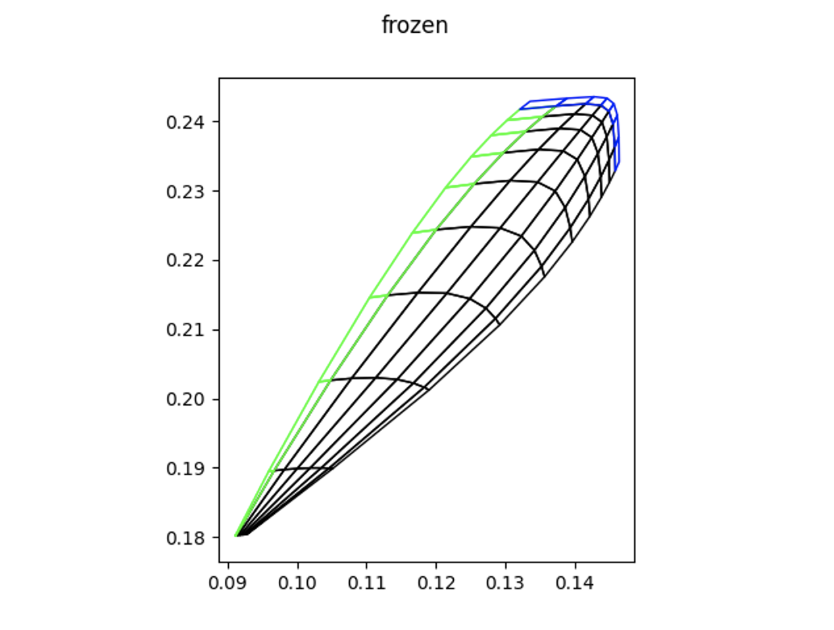
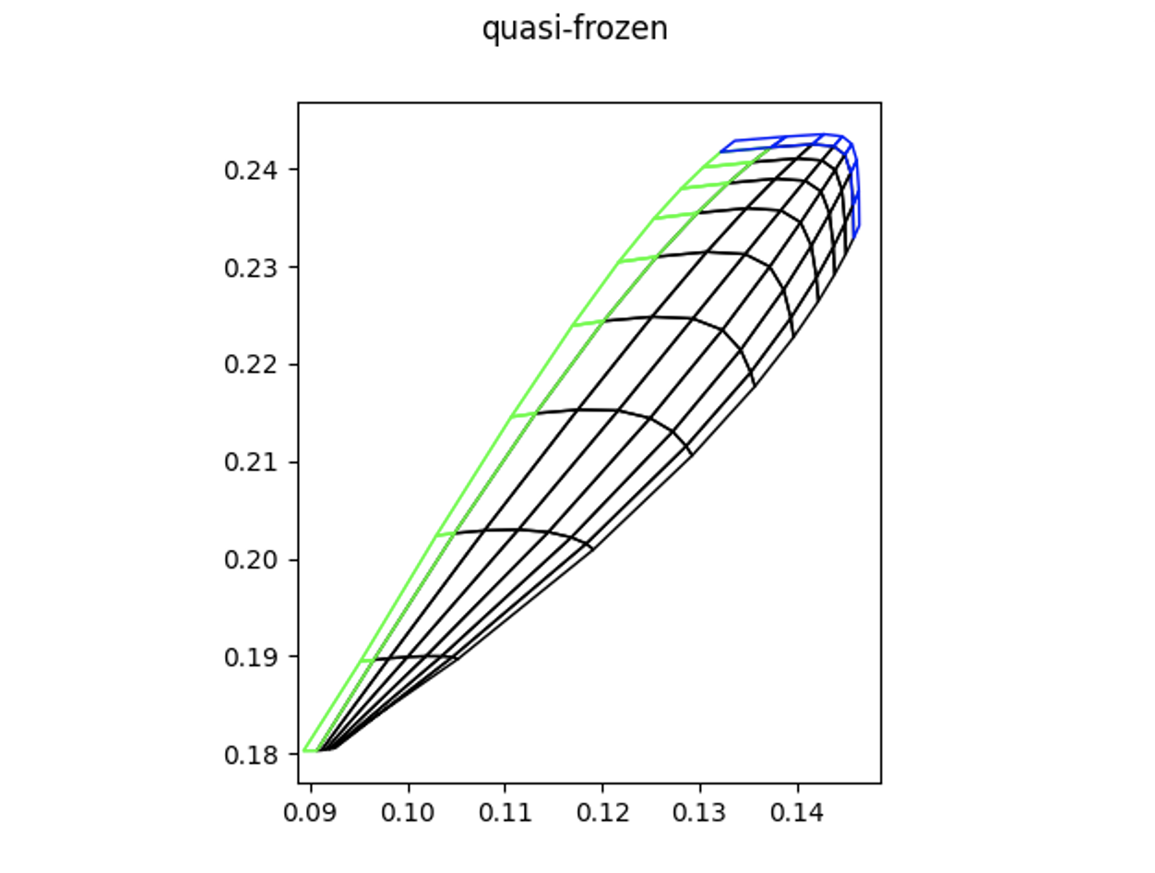
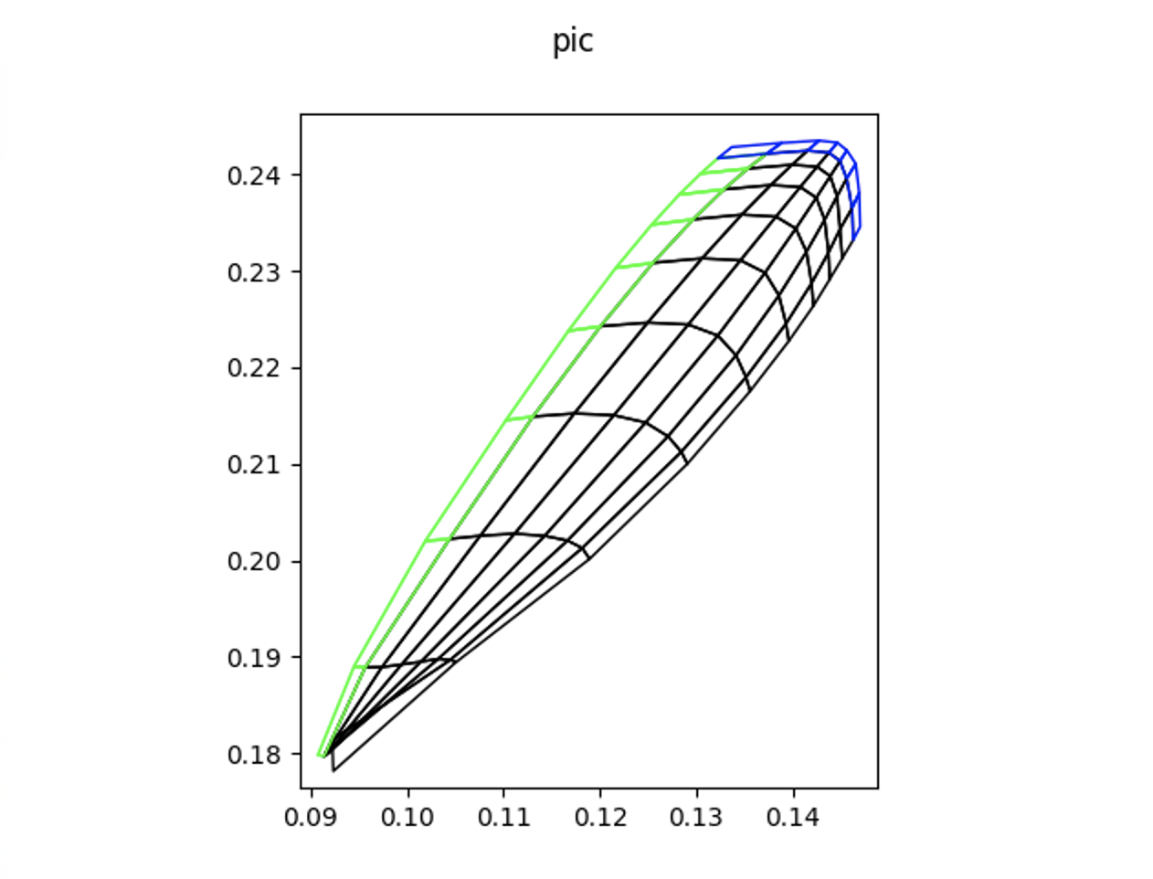
Space-charge – benchmarks and performance
Xsuite allows different kinds of space-charge simulations (frozen, quasi-frozen, Particle In Cell - switching from one to the other is straightforward)
Tested in the realistic case of the full SPS lattice with 540 space-charge interactions
Example of application where the usage of GPUs is practically mandatory
10⁶ particles
32 turns
Comp. time:
CPU 24 h
GPU 9 min
Vertical tune
Horizontal tune
Horizontal tune
Horizontal tune

Slide 49
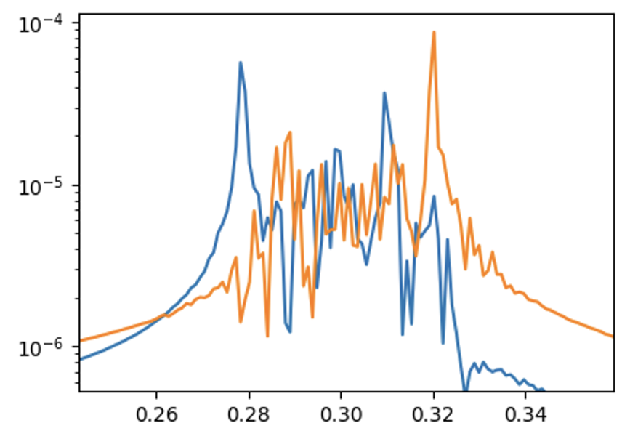
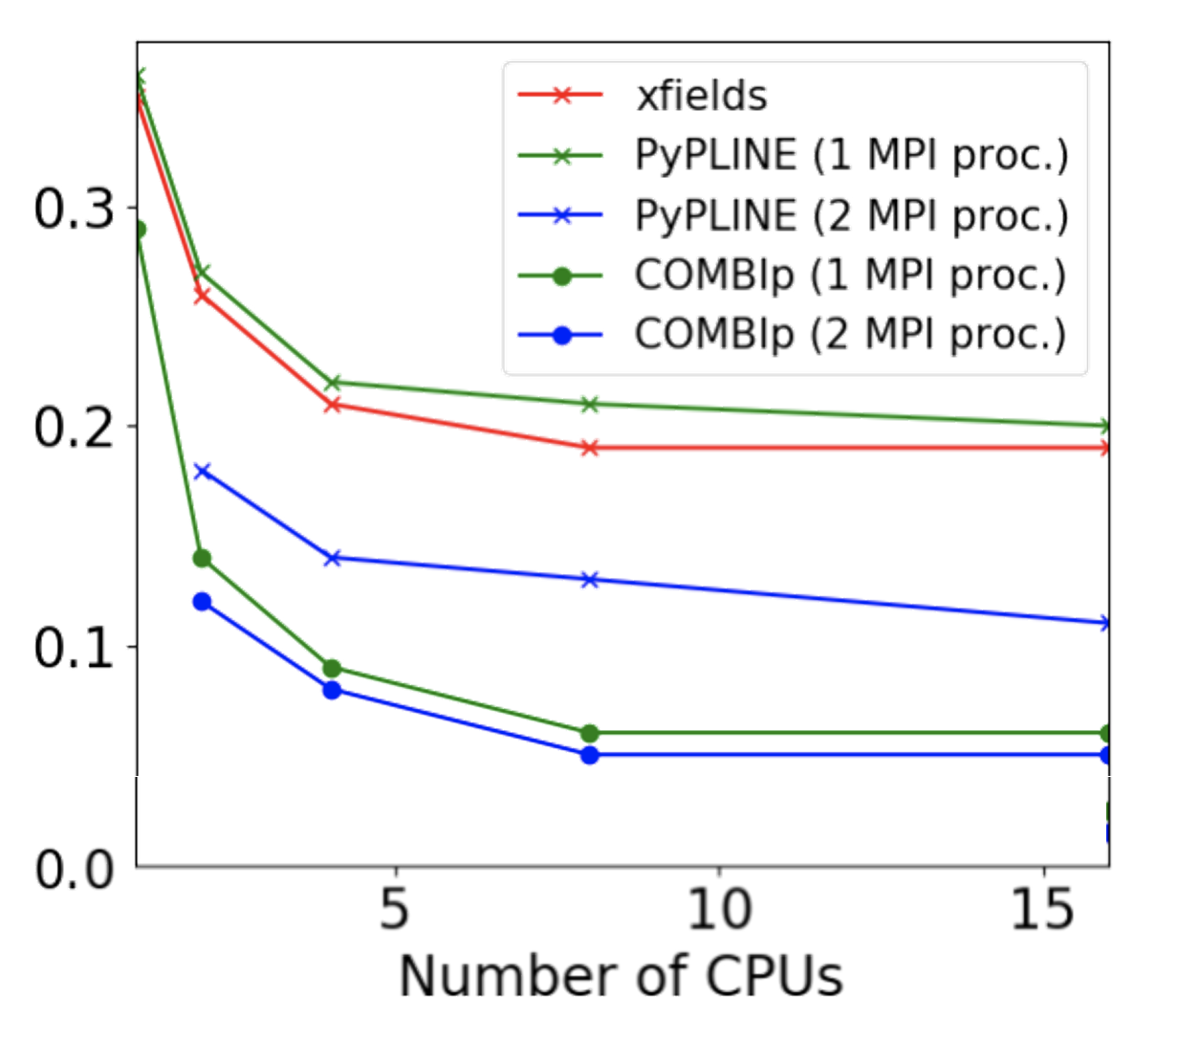
Strong-strong beam beam
X. Buffat
Xsuite used to simulate strong-strong beam beam effects
Additional package (PyPLINE) is under development to provides multi-node parallelization and simulate many bunches
→ Provides two-level parallelization in combination with Xsuite multithreading
Being tested on CERN HPC cluster
Performance from first tests already acceptable
Some tuning needed to gain the last factor 2
Coherent beam spectrum (2 bunches)
Horizontal
Vertical
Transverse spectrum
Tune

Slide 50
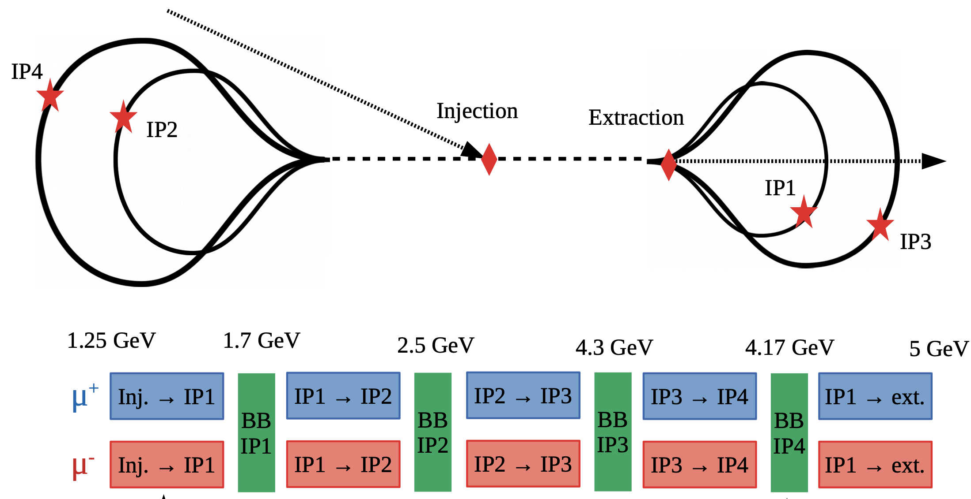
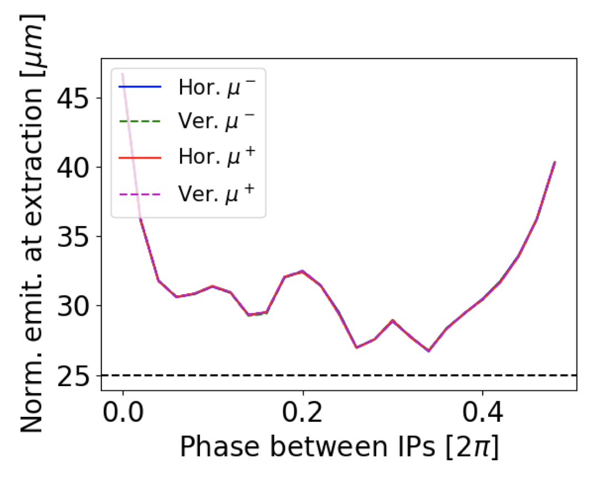
Recirculating linac for muon collider
X. Buffat
Xsuite used for first studies on emittance degradation due to beam-beam effects

Slide 51
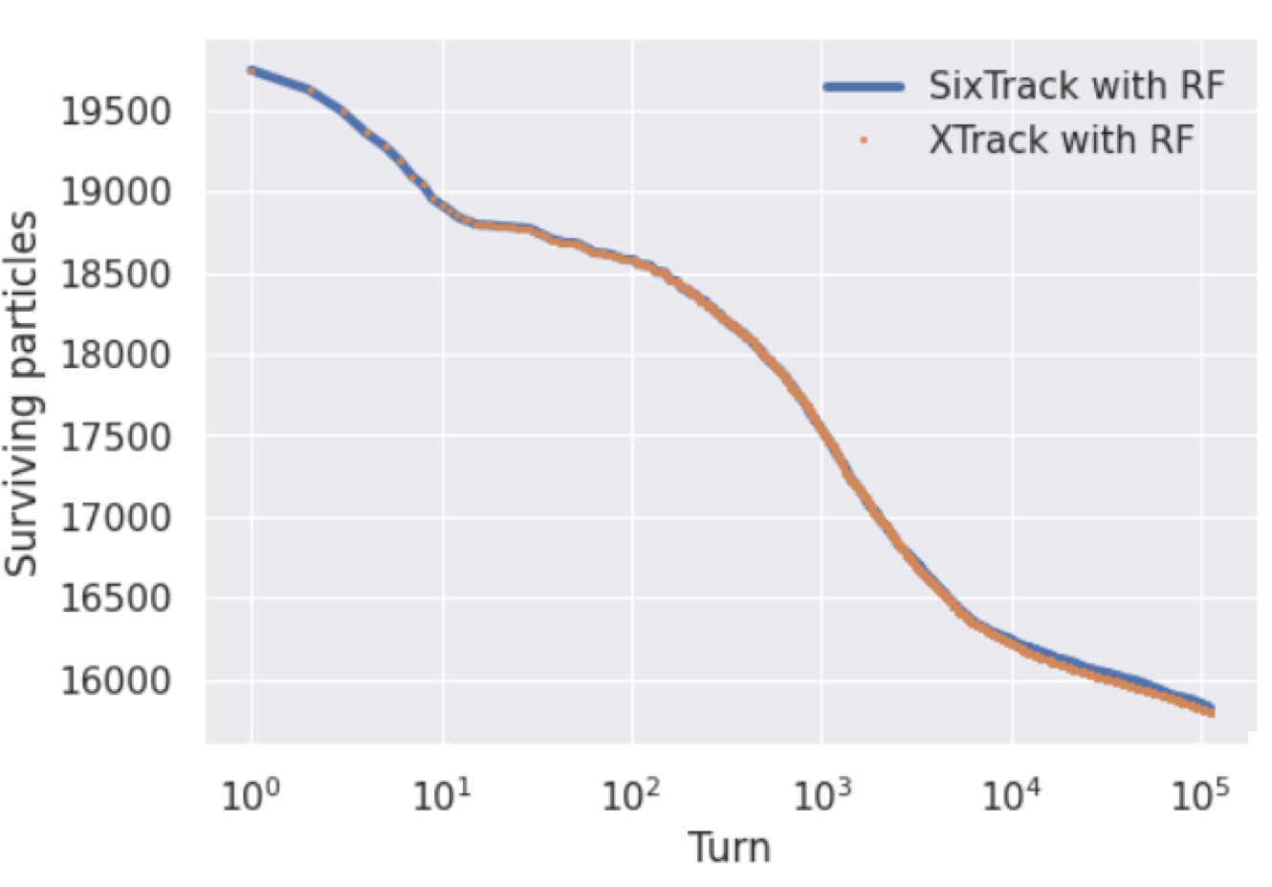
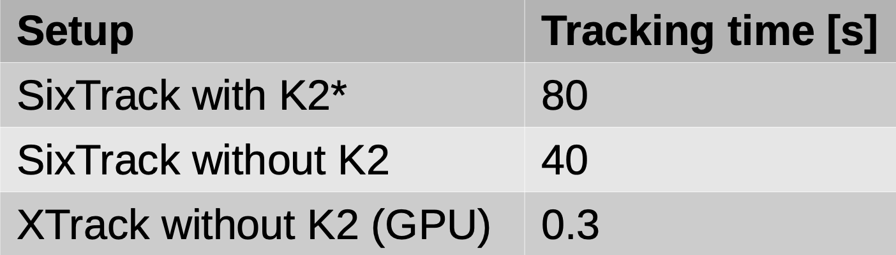
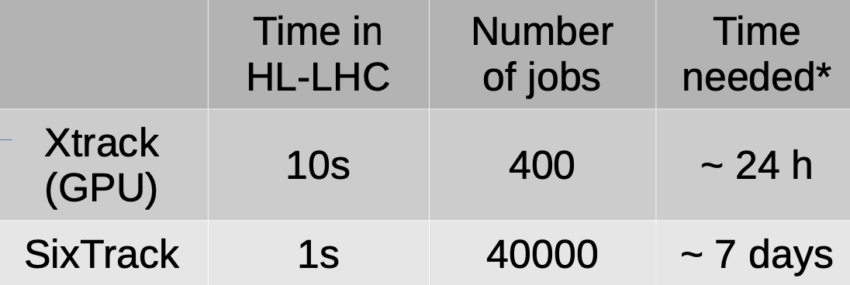
Hollow electron lens studies
P. Hermes
Xsuite is being used to study halo depletion with hollow electron lenses for HL-LHC
Implemented hollow e-lens in Xtrack
Benchmarked against Sixtrack
Performed first realistic studies (parametric scans)
→ Showed significant advantage of using GPUs
Test run (10 turns)
Realistic study (parametric scan)
Simulated
time interval
* CPUs and GPUs in HTCondor
More details at https://indico.cern.ch/event/1068125/contributions/4491551

Slide 52
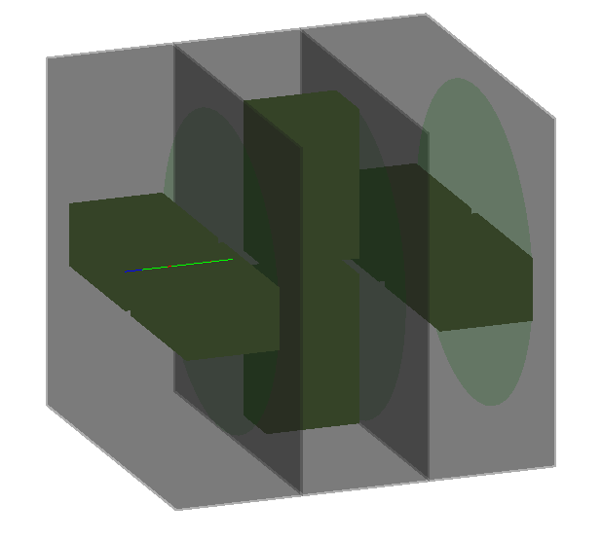
Xsuite-Geant4 simulations
A. Abramov
C++
Python
Using a C++ framework based on BDSIM (L. Nevay):
Geant4 radiation transport model with collimators in individual cells
Particles exchanged between the tracking code and the Geant4 model
Similar mechanism to the SixTrack-FLUKA coupling
Dedicated C++ - Python interface implemented (collimasim)
The first integration with Xtrack is available:
Supports collimator definition, beamline integration, and particle transfer
Tests ongoing
Geant4
ROOT
BDSIM
collimasim
xtrack
CLHEP
collimators
particle interacting
plane for back-transfer
(green disk)
isolated cells

Slide 53
Outline
Introduction to Xsuite
Motivation
Requirements
Design choices
Architecture
Development status
Documentation and developer's resources
Usage examples
Single-particle tracking
Import an existing lattice
Collective elements
PyHEADTAIL interface
Checks and first applications
A look under the hood (optional)
Multiplatform programming with Xobjects
Summary

Slide 54
Xobjects
Xobjects provides a link betweent the Xsuite physics packages and the computing hardware
Manages memory on CPU and GPU
Allocation in memory of data objects giving full read/write access to Python
Arrays on CPU and GPU memory are visble in python as numpy-like arrays, using numpy itself on CPU and its counterparts, i.e. cupy and PyOPENCL on GPU
Provides autogeneration of functions (C-API) to access and manipulate in C the data objects allocated from Python
Specializes C code for the different computing platforms
Compiles code on the chosen platform at run time and makes the compiled code efficiently accessible through Python
Xline
import and manipulation of machine sequences
Xpart
generation of particles distributions
Physics modules
Xtrack
single particle
tracking engine
Xfields
computation of EM fields from particle ensembles
Xobjects
interface to different computing plaforms
- CPUs and GPUs of different vendors

Slide 55
Xobjects – data manipulation in python
The main features of Xobjects can be illustrated with a simple example (Xsuite physics packages are largely based on the features illustrated here)
A Xobjects Class can be defined as follows:
import xobjects as xo
class DataStructure(xo.Struct):
a = xo.Float64[:] # Array
b = xo.Float64[:] # Array
c = xo.Float64[:] # Array
s = xo.Float64 # Scalar
An instance of our class can be instantiated on CPU or GPU by passing the appropriate context
# ctx = xo.ContextCpu()
ctx = xo.ContextCupy() # for NVIDIA GPUs
obj = DataStructure(_context=ctx,
a=[1,2,3], b=[4,5,6],
c=[0,0,0], s=0)
Independently on the context, the object is accessible in read/write directly from Python. For example:
print(obj.a[2]) # gives: 3
obj.a[2] = 10
print(obj.a[2]) # gives: 10
55

Slide 56
Xobjects – data access from C
# From before
class DataStructure(xo.Struct):
a = xo.Float64[:]
b = xo.Float64[:]
c = xo.Float64[:]
s = xo.Float64
# ctx = xo.ContextCpu() # CPU
ctx = xo.ContextCupy() # GPU
obj = DataStructure(_context=ctx,
a=[1,2,3], b=[4,5,6],
c=[0,0,0], s=0)
The definition of a Xobject class in Python, automatically triggers the generation of a set of functions (C-API) that can be used in C code to access the data.
They can be inspected by:
print(DataStructure._gen_c_decl(conf={}))
which gives (without the comments):
// ...
// Get the length of the array DataStructure.a
int64_t DataStructure_len_a(DataStructure obj);
// Get a pointer to the array DataStructure.a
ArrNFloat64 DataStructure_getp_a(DataStructure obj);
// Get an element of the array DataStructure.a
double DataStructure_get_a(const DataStructure obj, int64_t i0);
// Set an element of the array DataStructure.a
void DataStructure_set_a(DataStructure obj, int64_t i0, double value);
// get a pointer to an element of the array DataStructure.a
double DataStructure_getp1_a(const DataStructure obj, int64_t i0);
// ... similarly for b, c and s
56

Slide 57
Xobjects – writing cross-platform C code
A C function that can be parallelized when running on GPU is called "Kernel".
# From before
class DataStructure(xo.Struct):
a = xo.Float64[:]
b = xo.Float64[:]
c = xo.Float64[:]
s = xo.Float64
# ctx = xo.ContextCpu() # CPU
ctx = xo.ContextCupy() # GPU
obj = DataStructure(_context=ctx,
a=[1,2,3], b=[4,5,6],
c=[0,0,0], s=0)
Example: C function that computes obj.c = obj.a * obj.b
src = '''
/*gpukern*/
void myprod(DataStructure ob, int nelem){
for (int ii=0; ii<nelem; ii++){ //vectorize_over ii nelem
double a_ii = DataStructure_get_a(ob, ii);
double b_ii = DataStructure_get_b(ob, ii);
double c_ii = a_ii * b_ii;
DataStructure_set_c(ob, ii, c_ii);
}//end_vectorize
}
'''
57

Slide 58
Xobjects – writing cross-platform C code
A C function that can be parallelized when running on GPU is called "Kernel".
# From before
class DataStructure(xo.Struct):
a = xo.Float64[:]
b = xo.Float64[:]
c = xo.Float64[:]
s = xo.Float64
# ctx = xo.ContextCpu() # CPU
ctx = xo.ContextCupy() # GPU
obj = DataStructure(_context=ctx,
a=[1,2,3], b=[4,5,6],
c=[0,0,0], s=0)
Example: C function that computes obj.c = obj.a * obj.b
src = '''
/*gpukern*/
void myprod(DataStructure ob, int nelem){
for (int ii=0; ii<nelem; ii++){ //vectorize_over ii nelem
double a_ii = DataStructure_get_a(ob, ii);
double b_ii = DataStructure_get_b(ob, ii);
double c_ii = a_ii * b_ii;
DataStructure_set_c(ob, ii, c_ii);
}//end_vectorize
}
'''
(Comments in red are Xobjects annotation, defining how to parallelize the code on GPU)
The Xobjects context compiles the function from python:
ctx.add_kernels(
sources=[src],
kernels={'myprod': xo.Kernel(
args = [xo.Arg(DataStructure, name='ob'),
xo.Arg(xo.Int32, name='nelem')],
n_threads='nelem')
} )
The kernel can be easily called from Python and is executed on CPU or GPU based on the context:
# obj.a contains [3., 4., 5.] , obj.b contains [4., 5., 6.]
ctx.kernels.myprod(ob=obj, nelem=len(obj.a))
# obj.c contains [12., 20., 30.]
58

Slide 59
Xobjects – code specialization
Before compiling, Xobjects specializes the code for the chosen computing platform.
Specialization and compilation of the C code are done at runtime through Python, right before starting the simulation→ gives a lot of flexibility
Code written by the user
/*gpukern*/ void myprod(DataStructure ob, int nelem){
for (int ii=0; ii<nelem; ii++){ //vectorize_over ii nelem
double a_ii = DataStructure_get_a(ob, ii);
double b_ii = DataStructure_get_b(ob, ii);
double c_ii = a_ii * b_ii;
DataStructure_set_c(ob, ii, c_ii);
}//end_vectorize
}
Code specialized for CPU
Code specialized for GPU (OpenCL)
void myprod(DataStructure ob, int nelem){
for (int ii=0; ii<nelem; ii++){ //autovectorized
double a_ii = DataStructure_get_a(ob, ii);
double b_ii = DataStructure_get_b(ob, ii);
double c_ii = a_ii * b_ii;
DataStructure_set_c(ob, ii, c_ii);
}//end autovectorized
}
__kernel void myprod(DataStructure ob, int nelem){
int ii; //autovectorized
ii=get_global_id(0); //autovectorized
double a_ii = DataStructure_get_a(ob, ii);
double b_ii = DataStructure_get_b(ob, ii);
double c_ii = a_ii * b_ii;
DataStructure_set_c(ob, ii, c_ii);
//end autovectorized
}

Slide 60
Xobjects – code specialization
Before compiling, Xobjects specializes the code for the chosen computing platform.
Specialization and compilation of the C code are done at runtime through Python, right before starting the simulation→ gives a lot of flexibility
Code written by the user
/*gpukern*/ void myprod(DataStructure ob, int nelem){
for (int ii=0; ii<nelem; ii++){ //vectorize_over ii nelem
double a_ii = DataStructure_get_a(ob, ii);
double b_ii = DataStructure_get_b(ob, ii);
double c_ii = a_ii * b_ii;
DataStructure_set_c(ob, ii, c_ii);
}//end_vectorize
}
Code specialized for CPU
Code specialized for GPU (Cuda)
void myprod(DataStructure ob, int nelem){
for (int ii=0; ii<nelem; ii++){ //autovectorized
double a_ii = DataStructure_get_a(ob, ii);
double b_ii = DataStructure_get_b(ob, ii);
double c_ii = a_ii * b_ii;
DataStructure_set_c(ob, ii, c_ii);
}//end autovectorized
}
__global__ void myprod(DataStructure ob, int nelem){
int ii; //autovectorized
ii=blockDim.x * blockIdx.x + threadIdx.x; //au
if (ii<nelem){
double a_ii = DataStructure_get_a(ob, ii);
double b_ii = DataStructure_get_b(ob, ii);
double c_ii = a_ii * b_ii;
DataStructure_set_c(ob, ii, c_ii);
}//end autovectorized
}

Slide 61
Outline
Introduction to Xsuite
Motivation
Requirements
Design choices
Architecture
Development status
Documentation and developer's resources
Usage examples
Single-particle tracking
Import an existing lattice
Collective elements
PyHEADTAIL interface
Checks and first applications
A look under the hood (optional)
Multiplatform programming with Xobjects
Summary

Slide 62
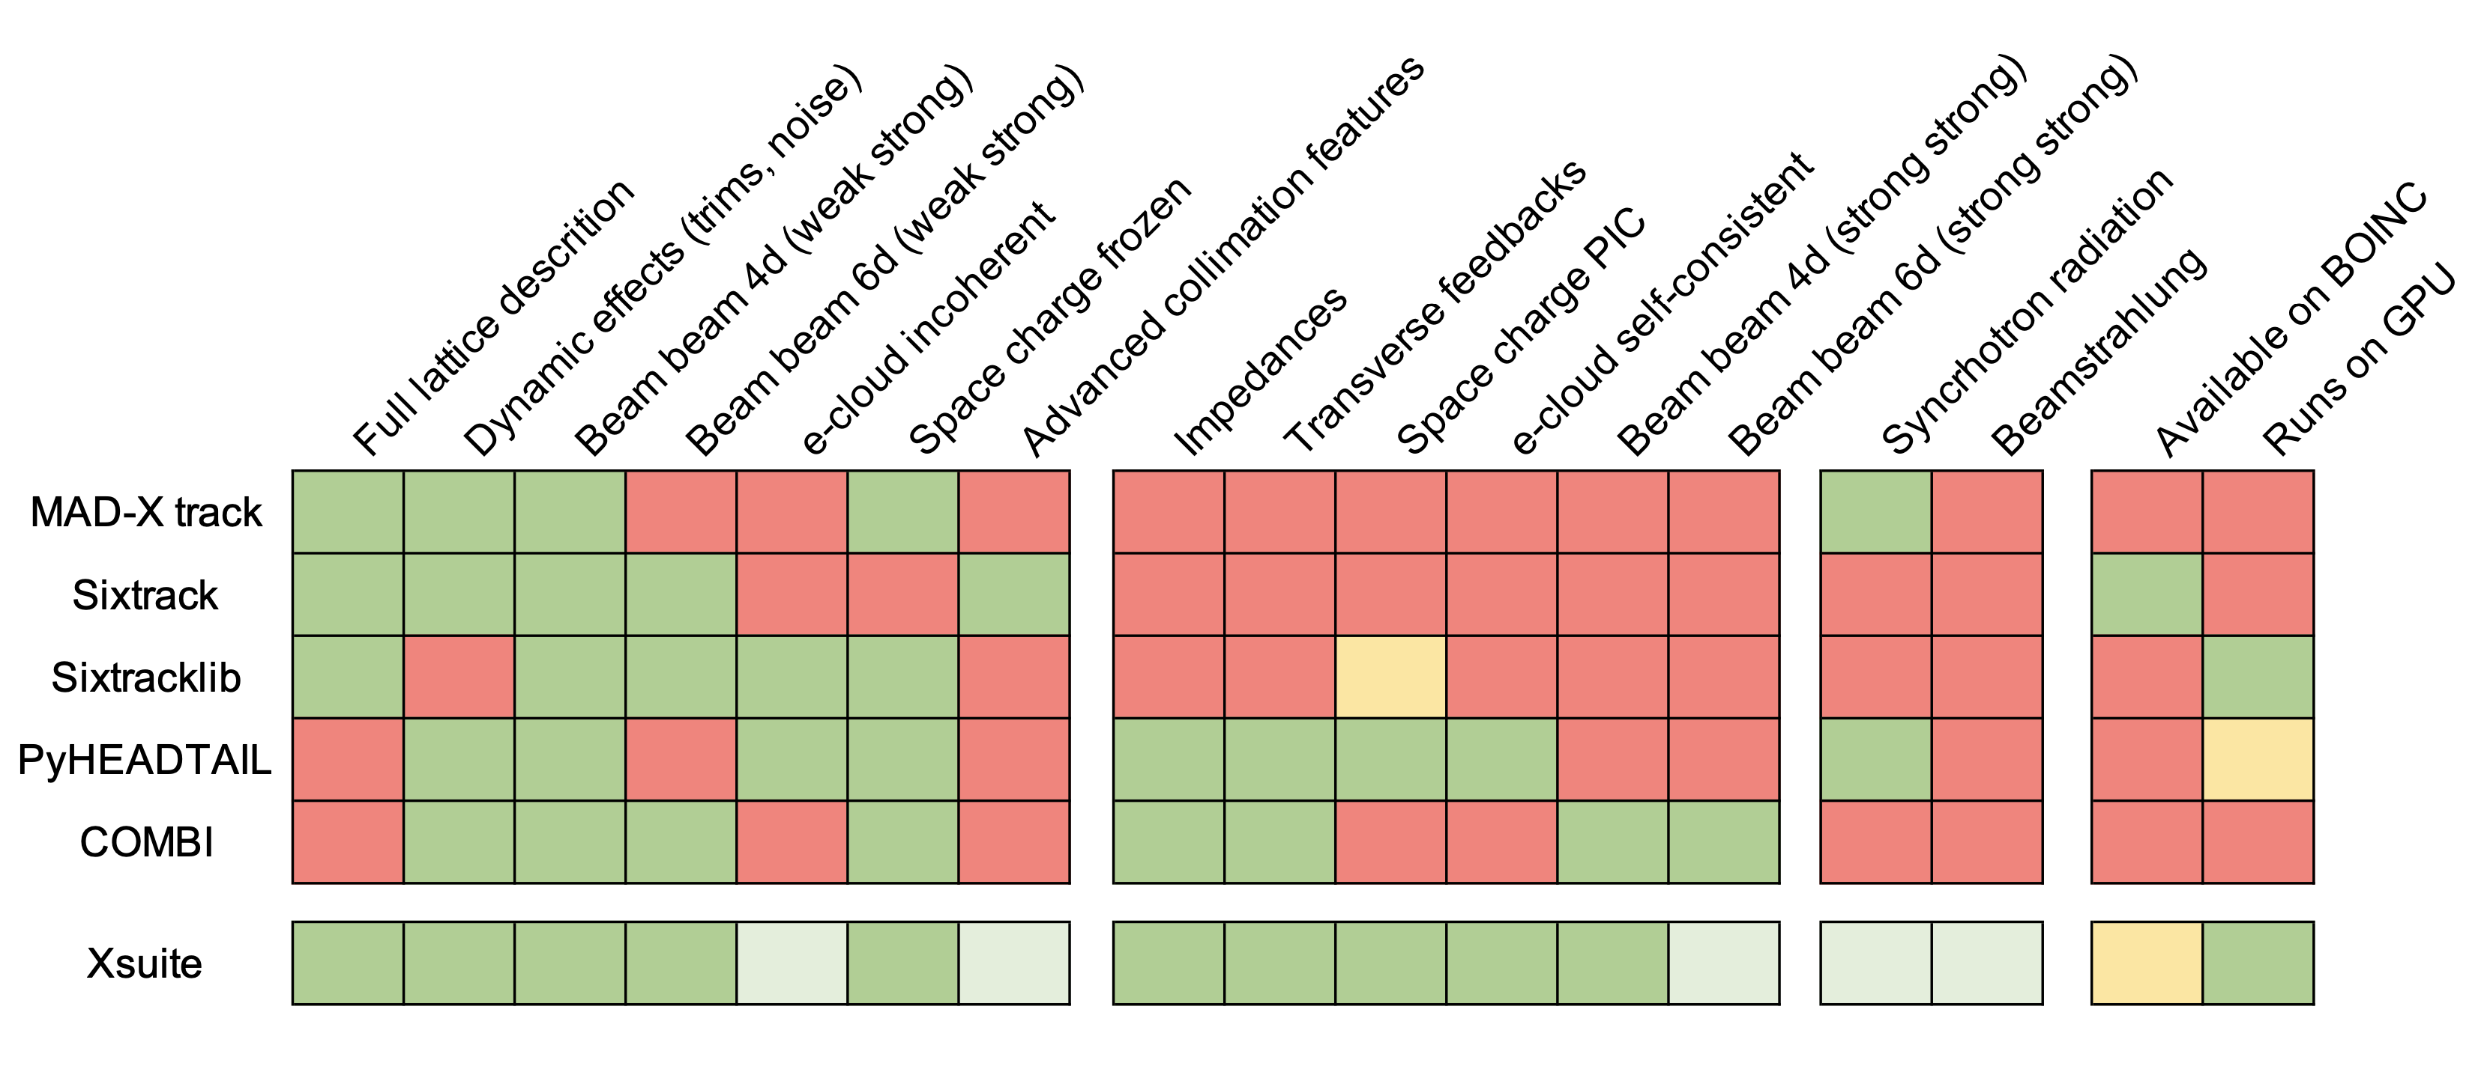
Summary
Available
Under development
Under study
Xsuite development experience so far:
Shows feasibility of integrated modular code covering the application of our interest
Demonstrates a convenient approach to handle multiple computing platform while keeping compact and readable physics code
You are very welcome to give it a try and provide your feedback
You are even more welcome to contribute to the development of new features

Slide 63
Thanks for your attention!

Slide 64
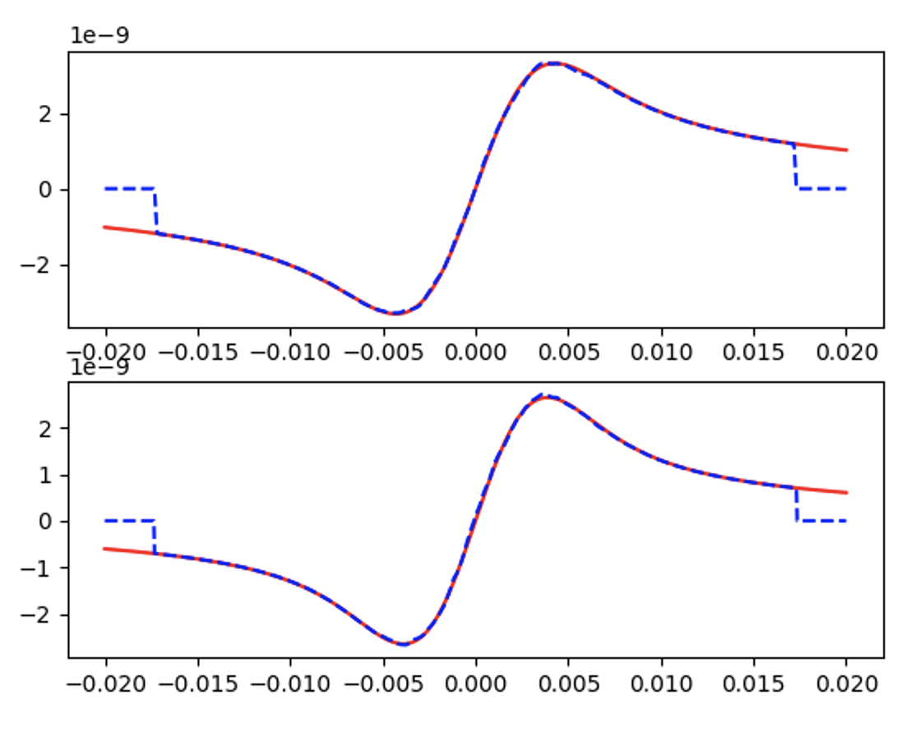
Space-charge – benchmarks and performance
Different methods crosschecked against each other
Particular care in optimizing performance on GPU
Space-charge check
Xfields PIC
Bassetti Erskine formula
Platform | Computing time
CPU | 5.5 s
GPU (Titan V, cupy) | 20 ms
GPU (Titan V, via pyopencl) | 38 ms
(*) tests made on ABP GPU server for typical SPS space-charge interaction (PIC)

