Slide 1

Modeling of Crab Waist and Monochromatization Schemes in Weak-Strong Beam-Beam Codes
D. Shatilov (BINP)
EPFL-LPAP FCC-ee Software Framework Meeting
08 July 2021

Slide 2
Outline
Beam-beam interaction in a weak-strong model
  Longitudinal slicing of the “strong” bunch
  Scheme of beam-beam interaction
Monochromatization
Crab Waist
Quasi-strong-strong model
  Coherent beam-beam instability
D. Shatilov EPFL-LPAP FCC-ee Software Framework meeting, 08 July 2021 2

Slide 3
Longitudinal Slicing
like “makethin” in MAD
One of the good and simple slicing algorithms:
N_{s} – number of slices.
Number of slices required: , where is the length of interaction area.
D. Shatilov EPFL-LPAP FCC-ee Software Framework meeting, 08 July 2021 3

Slide 4
Scheme of Beam-Beam Interaction
Particle interacts with a slice of the opposite bunch. This is not a slice-to-slice interaction!
Particle arrives to the IP.
Azimuth of collision with the first slice is calculated based on the particle 6D coordinates and the slice z-coordinate.
Particle is tracked to that azimuth through a drift space. In most cases, this will be in the opposite direction.
We need the slice parameters (transverse sizes, their derivatives, possible x-y tilt) at that azimuth. They can be obtained through the matrix of 2nd order momenta (envelope, or Σ matrix). We need Σ matrix at the IP, then it can be found at any azimuth. We assume that the particle distribution in slices is Gaussian.
Transverse kicks are calculated by Bassetti-Erskine formulae, the energy change – by formulae given in Part. Accel. 40, 205 (1993). Luminosity of particle-slice collision is calculated trough the local slice’s density at the point where the particle crosses the slice. Local curvature of the trajectory determines the parameters for beamstrahlung, which is a random process.
The azimuth of collision with the next slice is calculated and particle is tracked there through a drift space. The slice parameters at that azimuth also are calculated, so we can apply a 6D symplectic beam-beam kick (+ beamstrahlung).
After collision with the last slice, the particle is tracked back to the IP through a drift space. In most cases, this will be in the opposite direction.
D. Shatilov EPFL-LPAP FCC-ee Software Framework meeting, 08 July 2021 4

Slide 5
Monochromatization
Particle interacts with the electro-magnetic field of the opposite bunch. The energy distribution of particles in the strong bunch does not matter!
Dispersion at the IP affects the Σ matrix. You don't need to use any special tweaks for tracking with monochromatization!
We always assume that the particles survive after colliding with the opposite bunch. This means that luminosity events are not considered in tracking! Although the luminosity value can be calculated in tracking.
The effect of monochromatization can be estimated analytically. In principle, it can be also accounted in tracking, but there is no particular need for it.
D. Shatilov EPFL-LPAP FCC-ee Software Framework meeting, 08 July 2021 5

Slide 6
Crab Waist
The main effect of crab waist comes from the sextupoles acting on the particles of the weak bunch (test particles). You just need to place the sextupoles in the right places.
Crabbed strong bunch has a non-Gaussian distribution, so the Bassetti-Erskine formulae are not applicable to it. We need a special “grid” (or “mesh”) at the IP to calculate the 6D beam-beam interaction with such a distribution. See e.g. in ICFA Beam Dyn. Newslett. 52, p. 42-55 (2010).
Crabbed strong bunch gives a small positive effect on the luminosity and the nonlinear beam dynamics. But in most simulations, the strong bunch is not crabbed.
D. Shatilov EPFL-LPAP FCC-ee Software Framework meeting, 08 July 2021 6

Slide 7
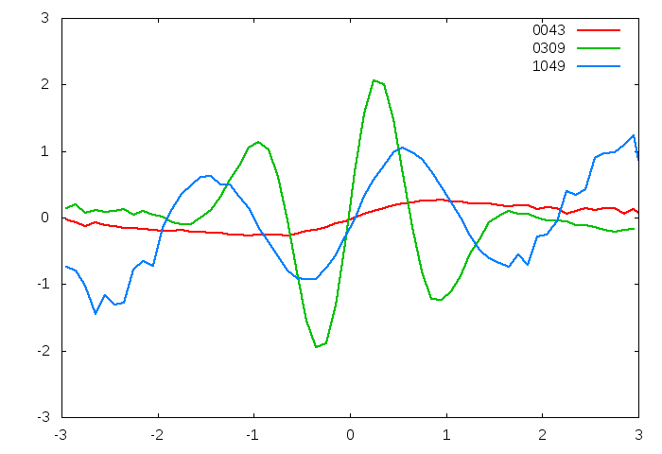
Quasi-Strong-Strong Model
Weak and strong bunches are swapped, so we periodically update the parameters to find a self-consistent solution. An example: coherent beam-beam instability (discovered by K.Ohmi in strong-strong simulations).
Slices of the opposite bunch are shifted horizontally, to represent the bunch shape.
Two colliding bunches are tracked simultaneously in parallel, and their shapes (transverse emittances and shifts of slices) are updated every turn.
As usual, particles collide with slices – for both bunches.
Since the horizontal disruption parameter is small, the bunch shape does not change during collision. This allows the weak-strong model (which is much faster!) to be used for modeling.
If we consider a stable situation without instabilities, the swap of weak and strong bunches can be done after many (not one) turns.
Bunch shape in the horizontal plane at some turns
x / σ_{x}
z / σ_{z}
D. Shatilov EPFL-LPAP FCC-ee Software Framework meeting, 08 July 2021 7

