Slide 1
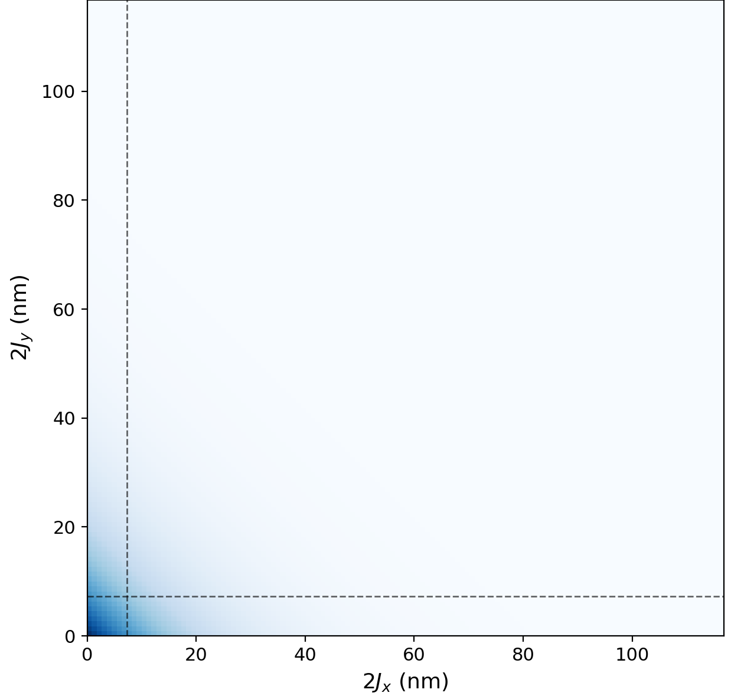


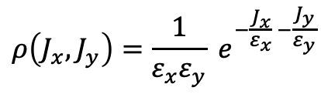
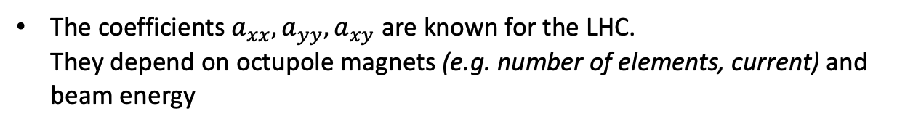


Introduction
Gaussian beam and octupole magnets
Gaussian distribution
$J_{x}, J_{y}$ are the particle actions (amplitudes)
$$ρ\left(J_{x}, J_{y}\right)=\frac{1}{ε_{x}ε_{y}} e^{−\frac{J_{x}}{ε_{x}} −\frac{J_{y}}{ε_{y}}}$$
Here I use round beam, i.e. $ε_{x}=ε_{y}$
Octupole magnets
Detuning with amplitude
$$ΔQ_{x}=a_{xx} 2J_{x}+a_{xy} 2J_{y}$$
$$ΔQ_{y}=a_{xy} 2J_{x}+a_{yy} 2J_{y}$$
The coefficients $a_{xx}, a_{yy}, a_{xy}$ are known for the LHC.
They depend on octupole magnets (e.g. number of elements, current) and beam energy

Slide 2
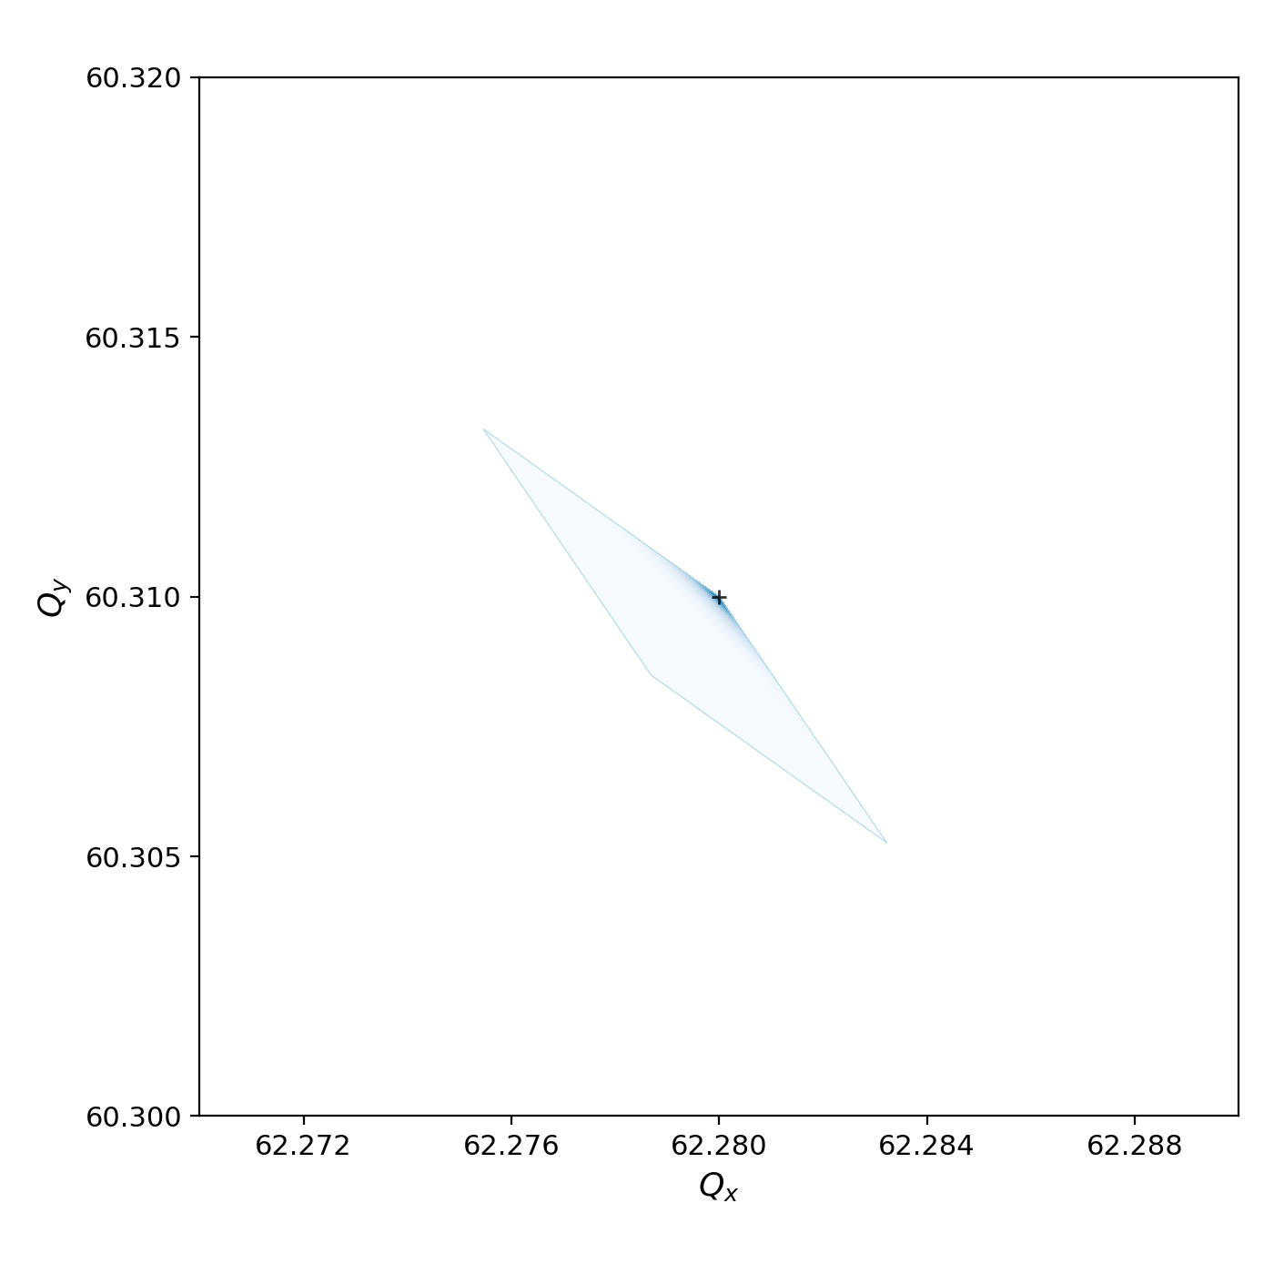
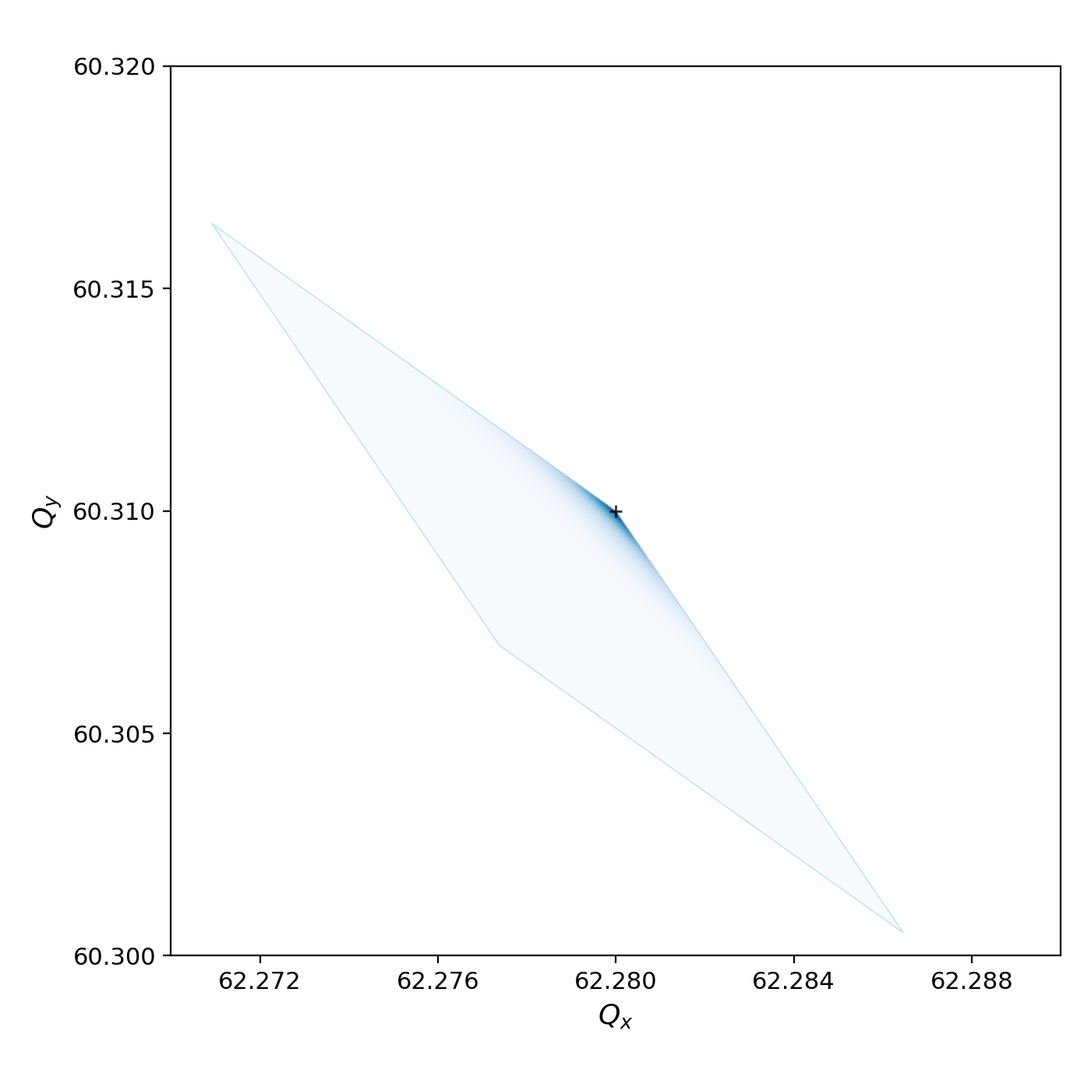
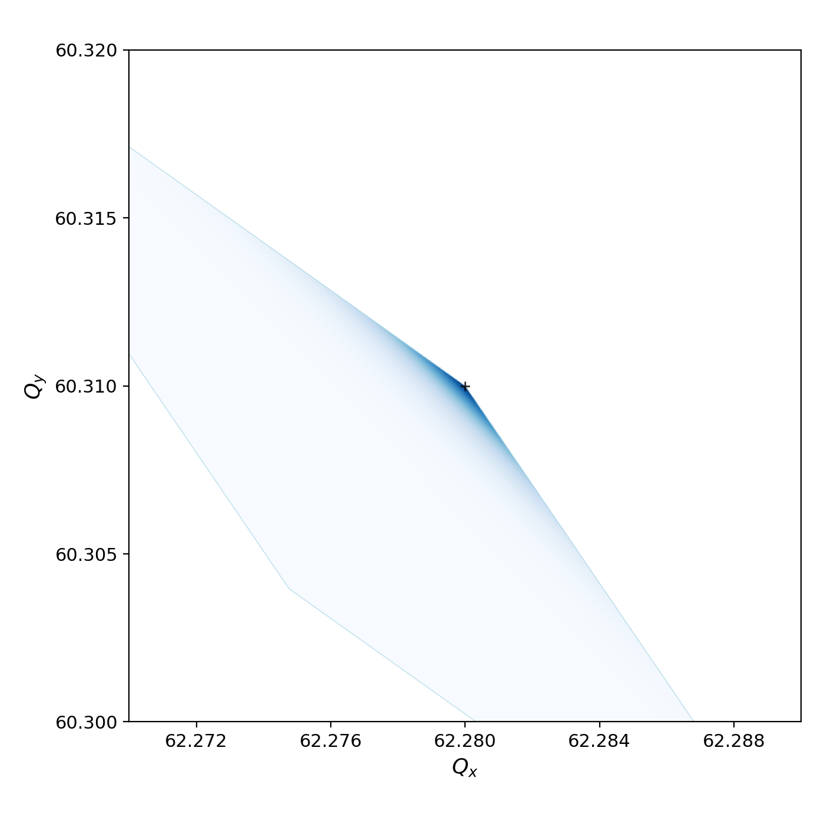



Introduction
Tune footprint from octupoles
$$I_{oct}=−10 A$$
$$I_{oct}=−20 A$$
$$I_{oct}=−40 A$$
Increase in absolute current increases tune footprint
Shape depends on coefficients and beam emittances

Slide 3
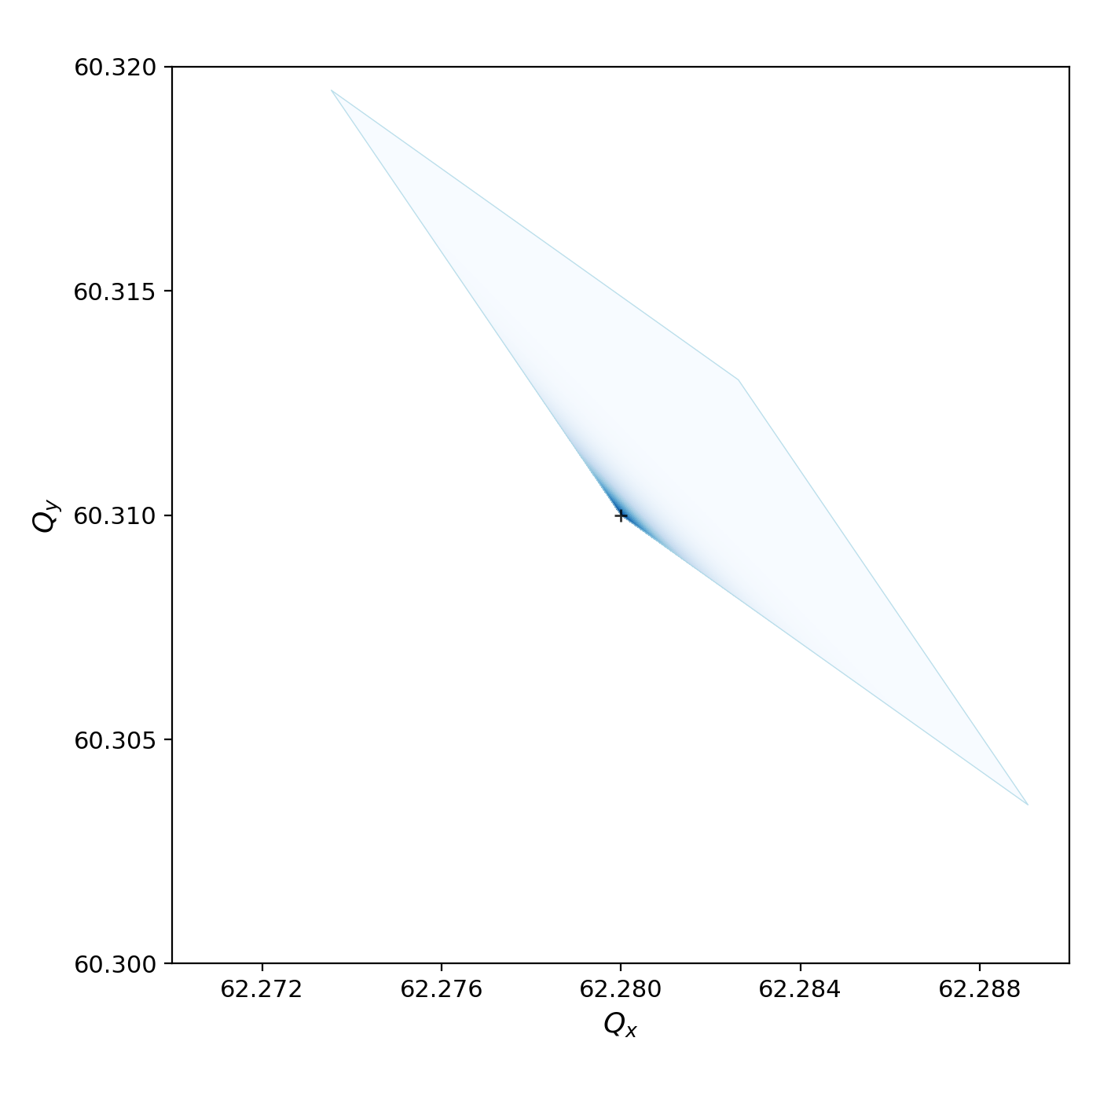


Introduction
Tune footprint from octupoles
$$I_{oct}=−20 A$$
$$I_{oct}=20 A$$
Change in octupole polarity flips tune distribution

Slide 4
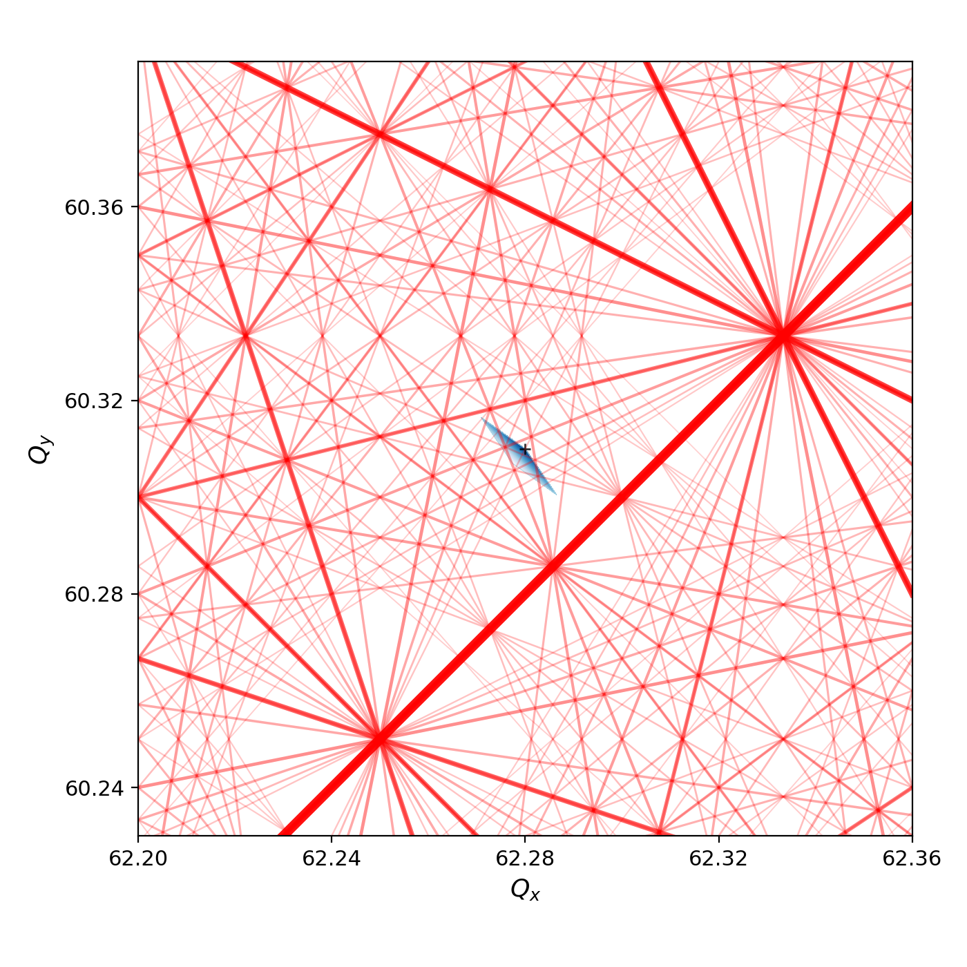
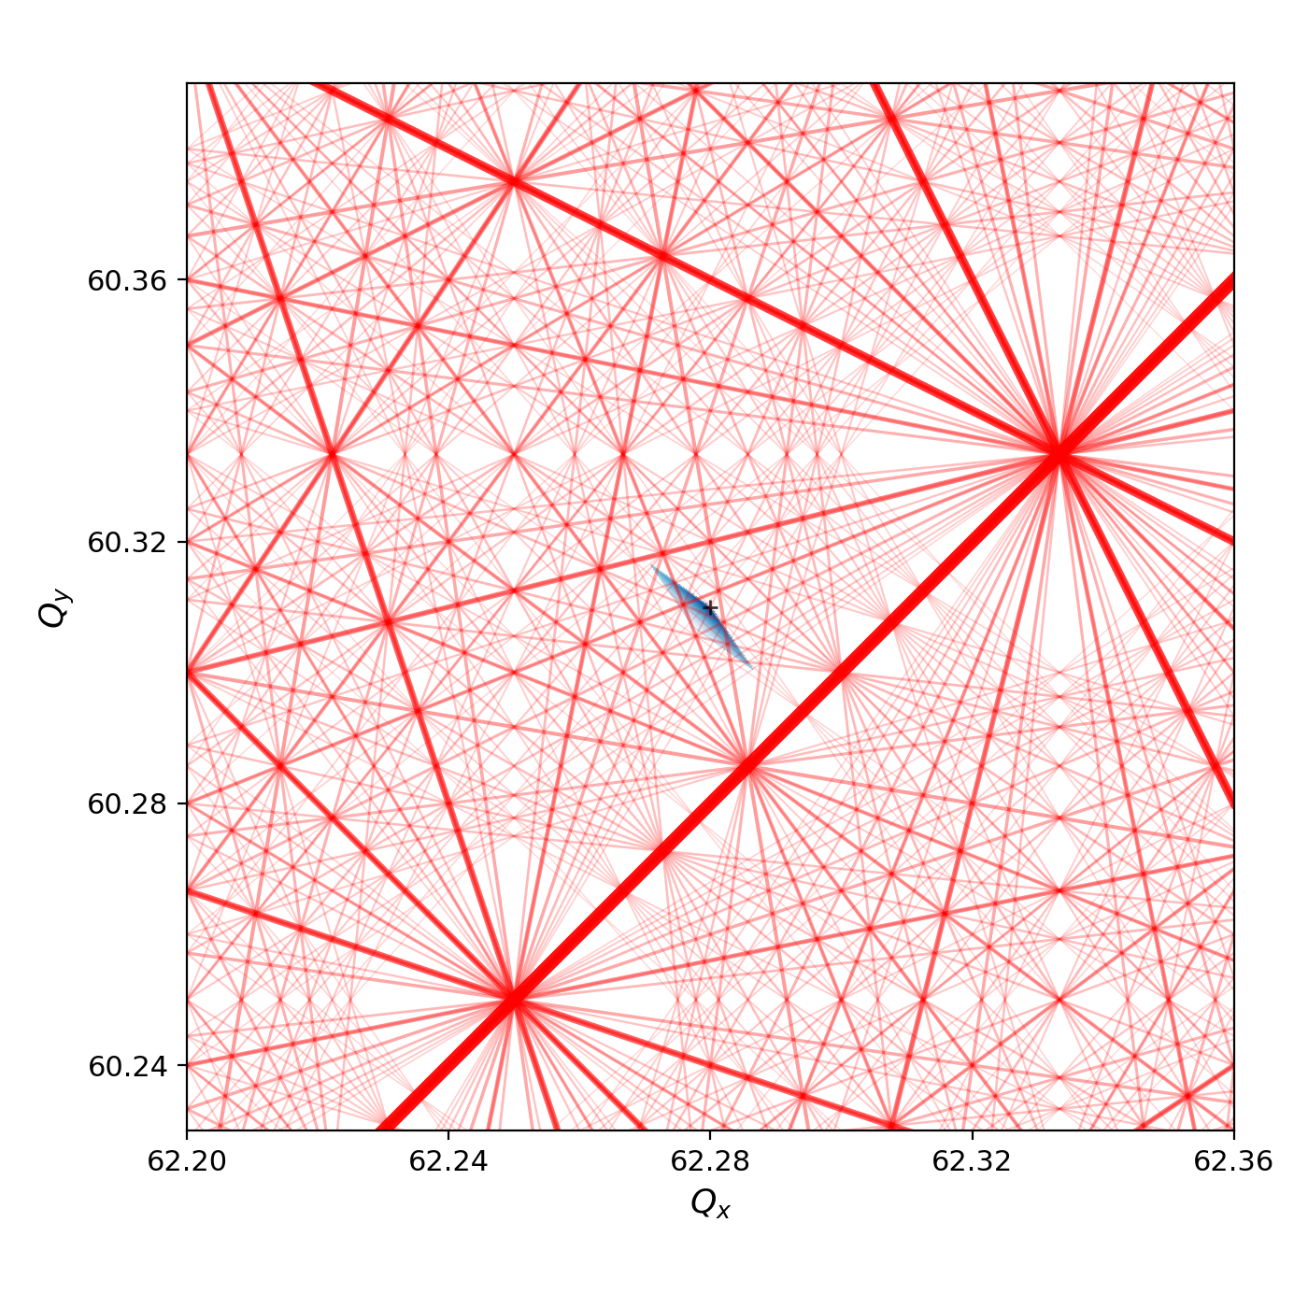
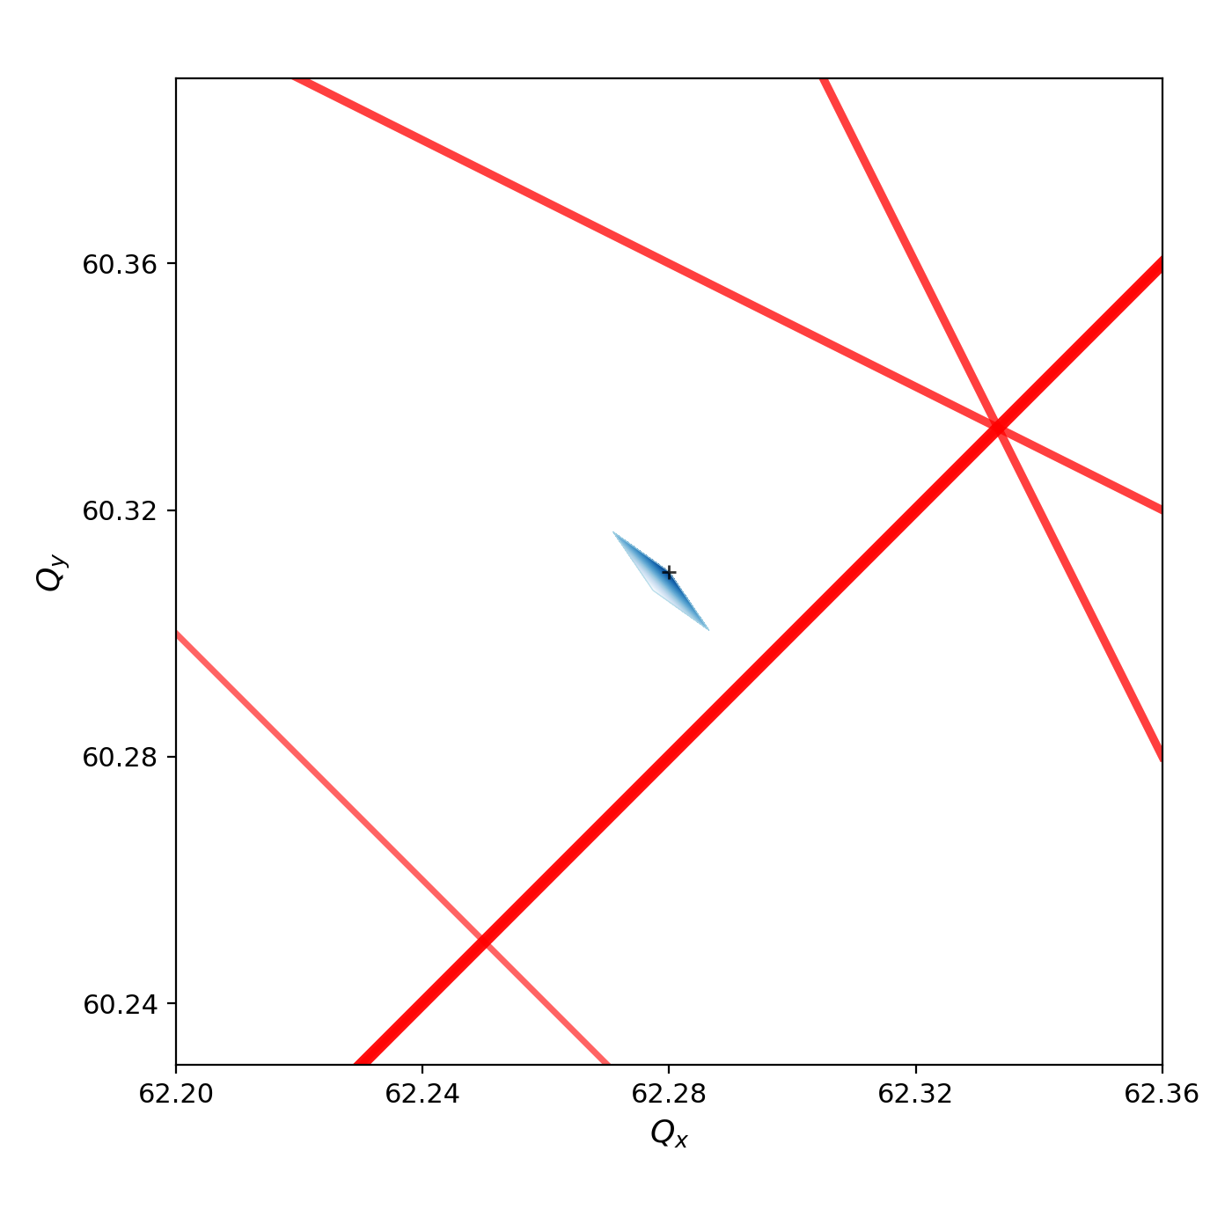
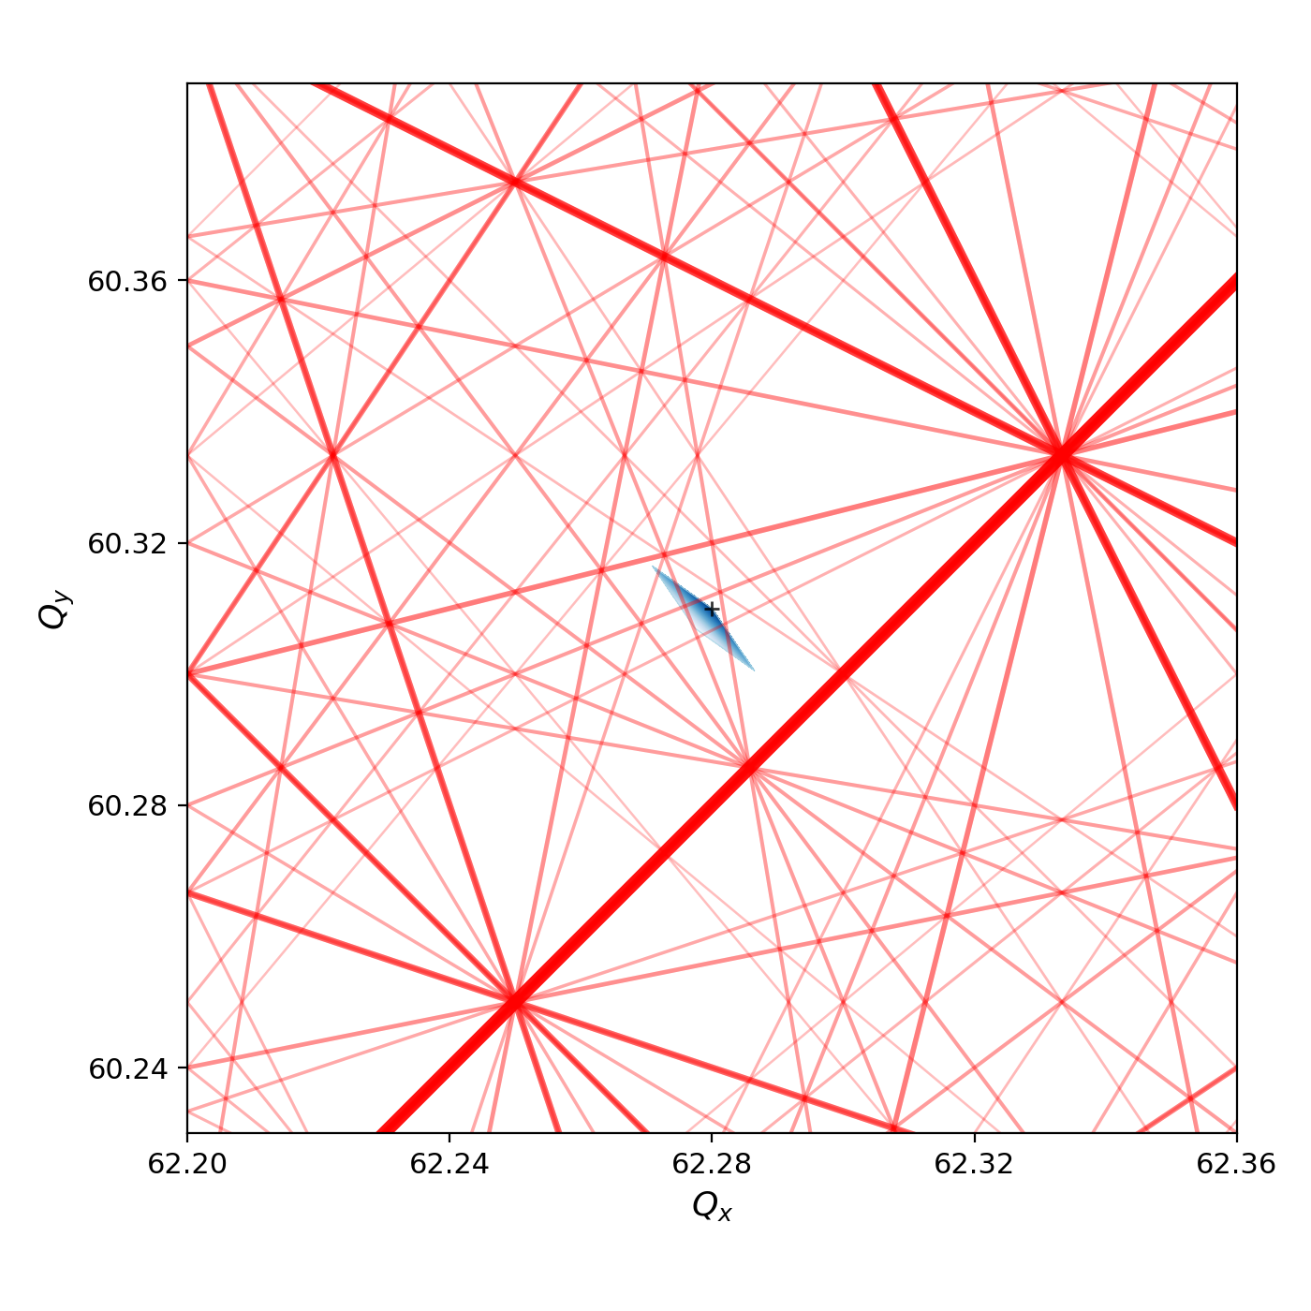
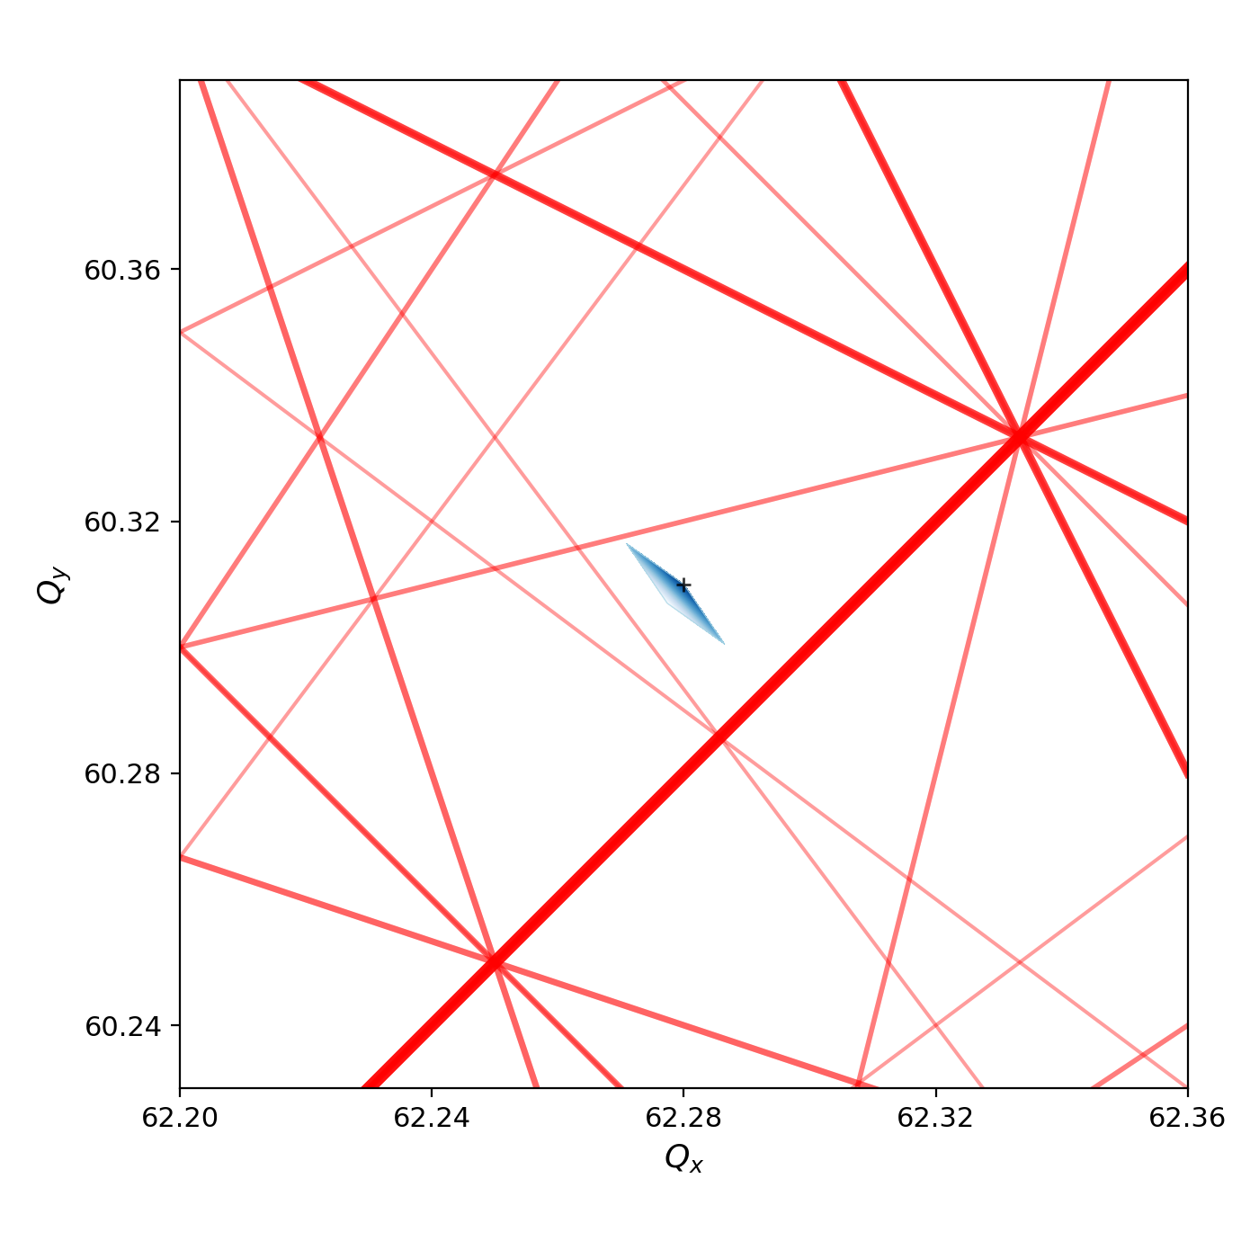
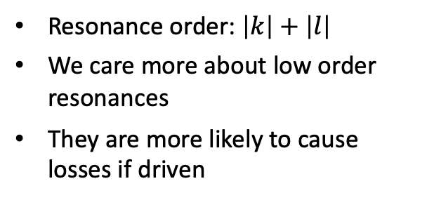

Introduction
Resonance condition and diagrams
Up to order 16
Up to order 4
Up to order 20
Up to order 12
Up to order 8
Resonance condition
$k Q_{x}+l Q_{y}=m, k, l, m∈ℤ$
Resonance order: $\left|k\right|+\left|l\right|$
We care more about low order resonances
They are more likely to cause losses if driven

Slide 5
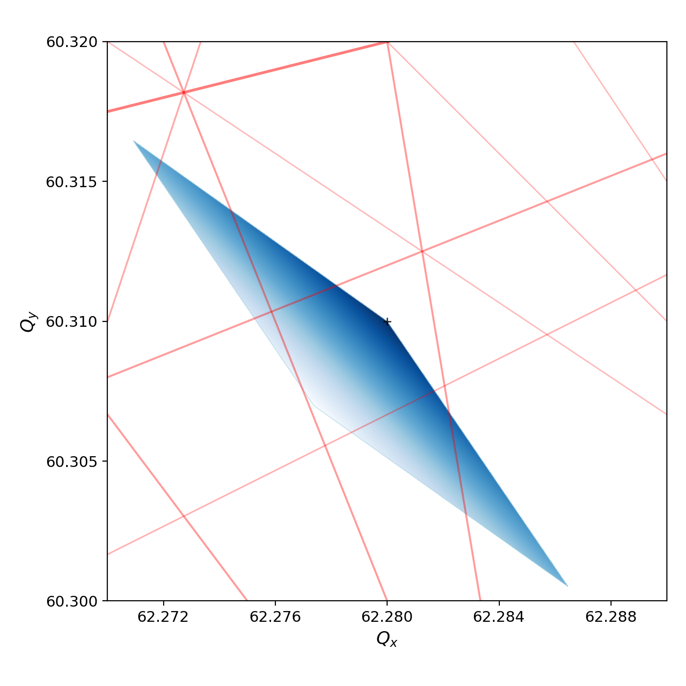
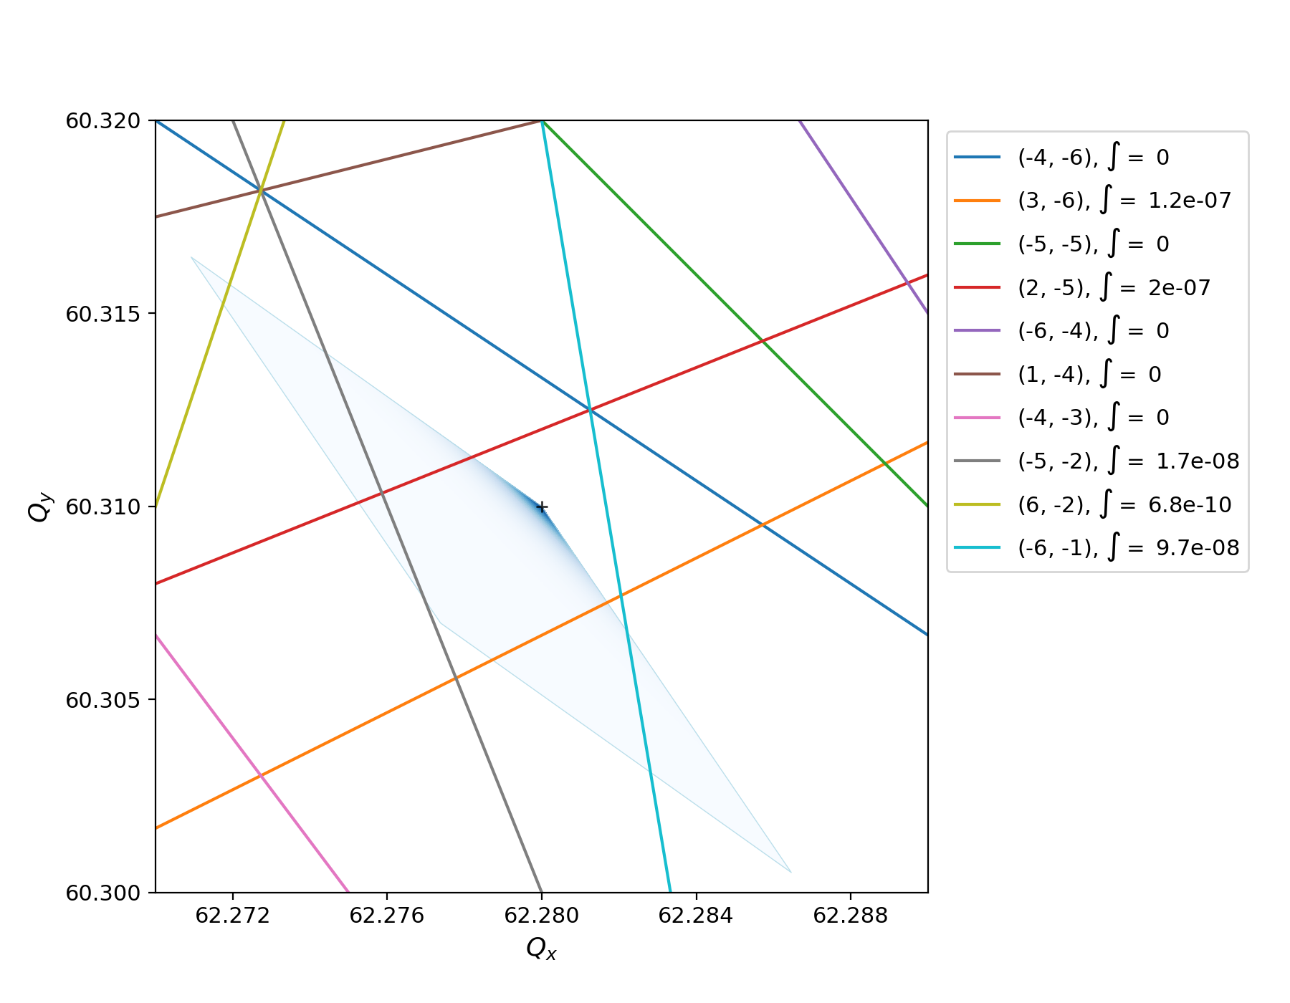
Some results
Integration
E.g. up to order 12
Perform line integrals of tune distribution of all resonances (up to given order)
Requires 2D interpolation of tune distribution (using scipy RBF)
No weights for importance of resonance yet

Slide 6
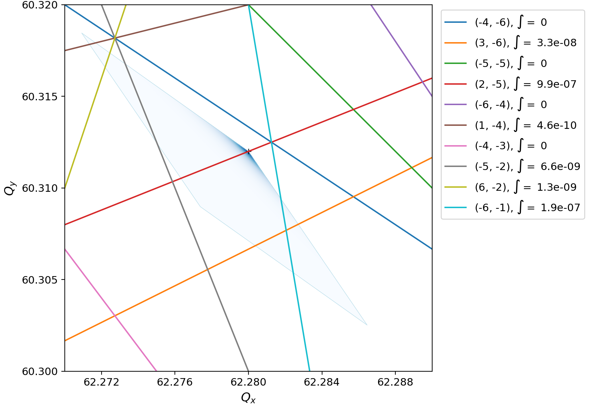
Some results
Integration: different working point (= main tune)
Change of main tunes (= working point)
Validation: qualitative for now …
Some resonance lines become more important (larger overlap), others less

Slide 7
Other thoughts
Unfortunately, it’s a bit more complicated …
  We do not have good knowledge of particle distribution
  (Gaussian is an OK assumption, but there is halo formation which is unknown)
  Footprint from octupoles in the LHC is quite insignificant compared to that e.g. from electron cloud
  Importance of each resonance line is not only defined by its order, but also by whether there are actual nonlinear fields in the machine that can drive the resonance (e.g. multipolar errors, nonlinear magnets, etc.)
  There are also chromatic effects that add to the footprint
Overall, not sure how useful it can be for the model, but maybe it’s worth a try?

Slide 8
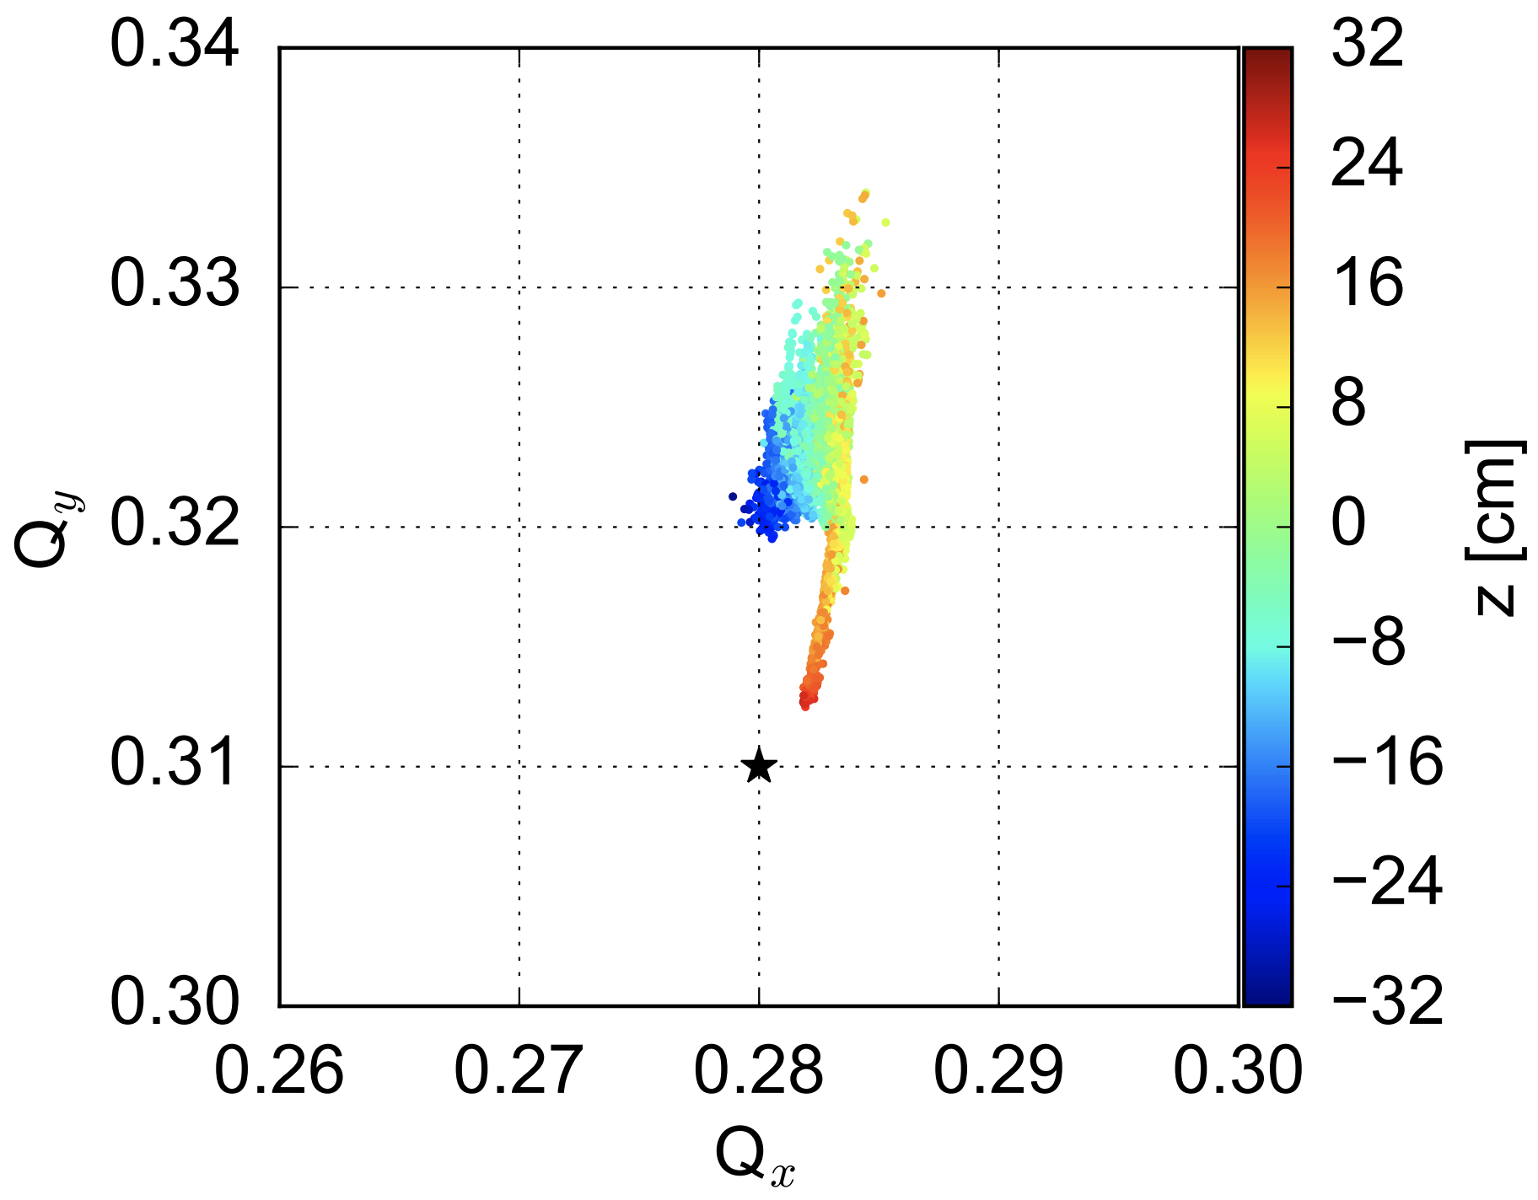
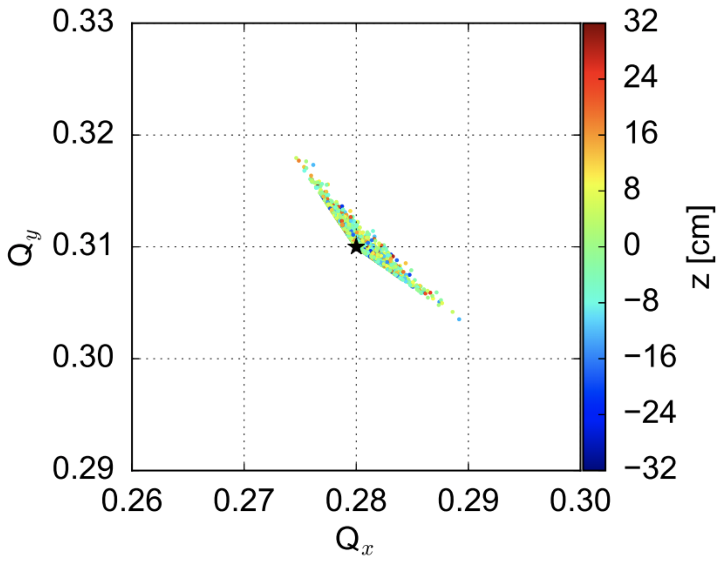

Other thoughts
Electron cloud tune footprint
LHC injection energy
Electron cloud in the dipoles
Octupole footprint at $I_{oct}=26 A$
Taken from: A. Romano, “Electron cloud formation in CERN particle accelerators and its impact on the beam dynamics”, PhD Thesis, 2018.

Slide 9
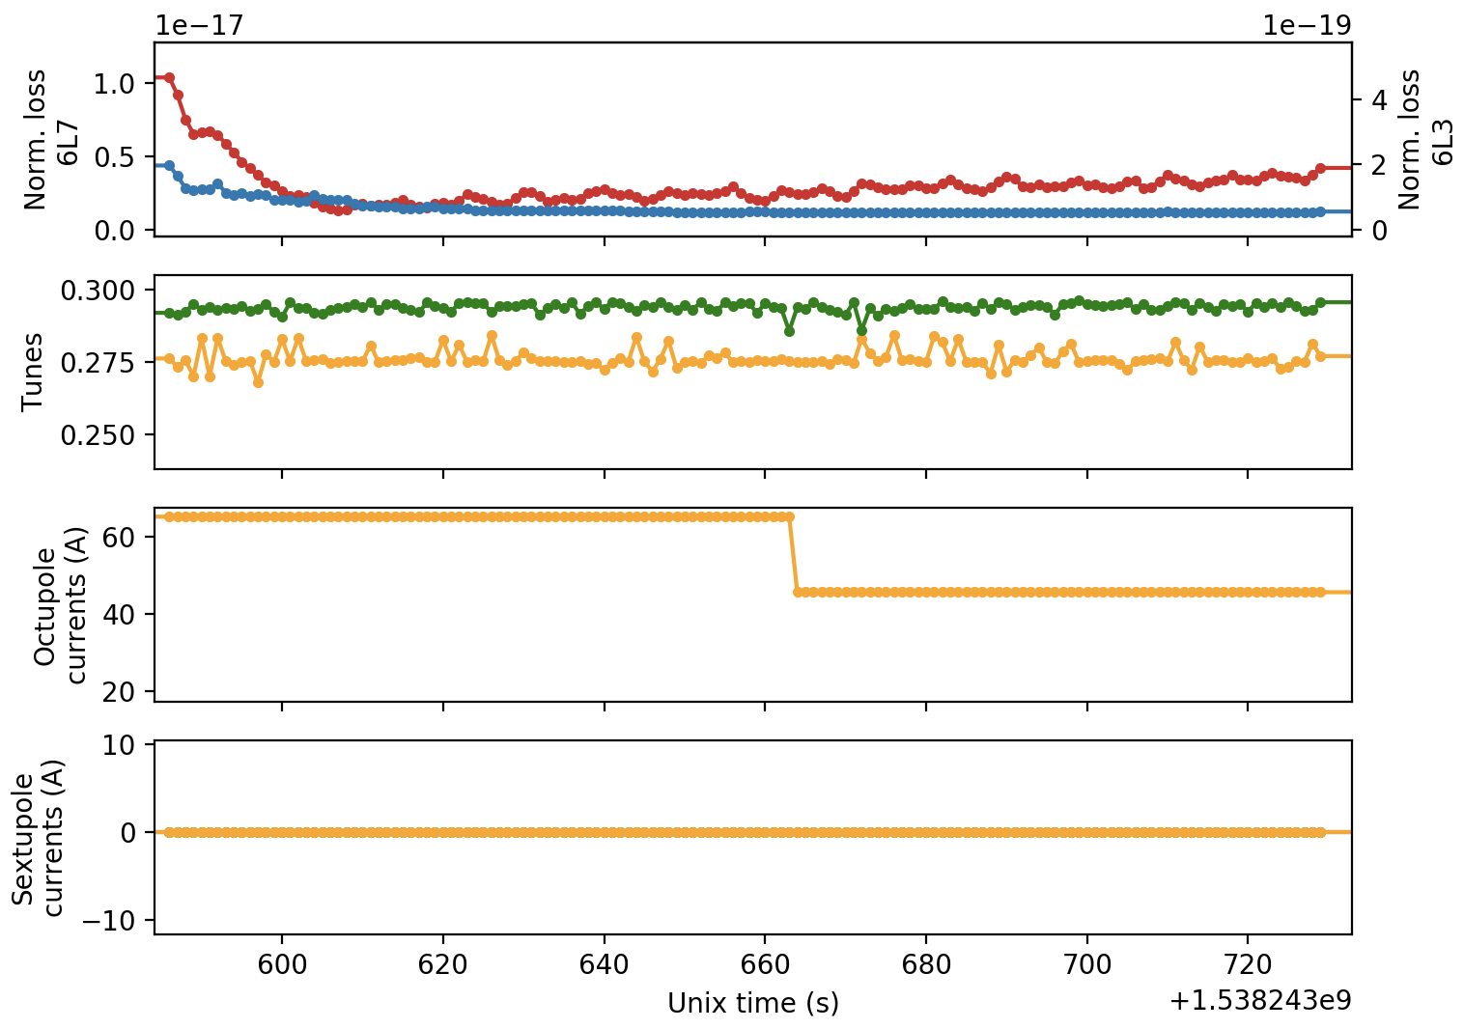
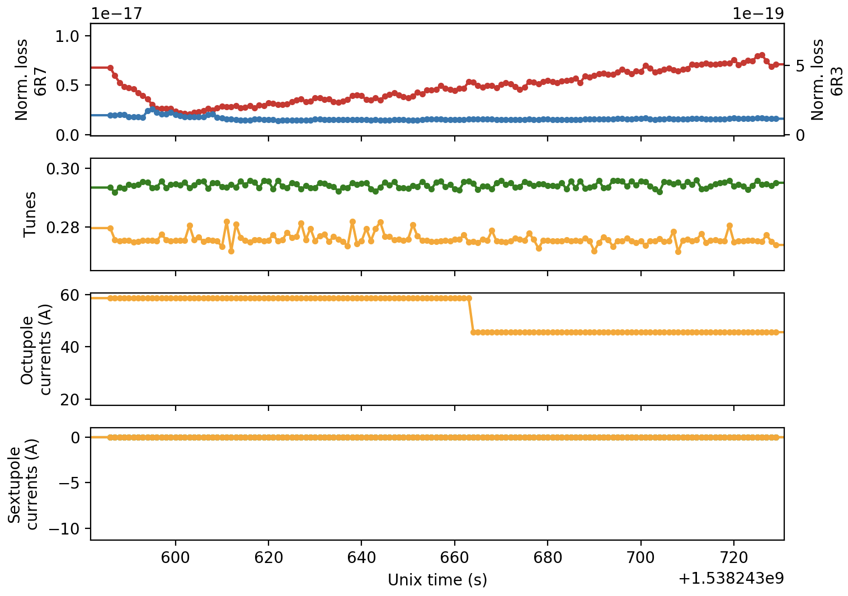
Outlier fill
Fill 7236
Beam 1
Beam 2

