Slide 1


Status of SixTrack loss rate simulations
M. Schenk for the EPFL team
EPFL & CERN, Switzerland
Acknowledgements
R. Bruce, R. De Maria, M. Giovannozzi, A. Mereghetti, D. Mirarchi, T. Persson, S. Redaelli
04. May 2020

Slide 2
Objectives and overview
Complement LHC beam loss model based on experimental data with SixTrack simulations
What we would like to learn
  Loss rate dependency and sensitivity to machine knobs:
  How do chromaticity, octupoles, tunes, etc. affect long-term (~10⁶ turns) particle loss?
  How are losses distributed with respect to H / V?
Type of studies
  Similar to dynamic aperture (DA) studies
  Instead of 1 m amplitude threshold:
  use H, V, S primary collimators near IR7 (w/o. scattering)
  Results likely of qualitative nature
Framework
  PySixDesk & SixTrack
  Using HTCondor for now
  Move to BOINC soon

Slide 3
Contents
Aperture model
Particle initialization
Post-processing / analysis
Some test results for discussion
Questions & feedback

Slide 4
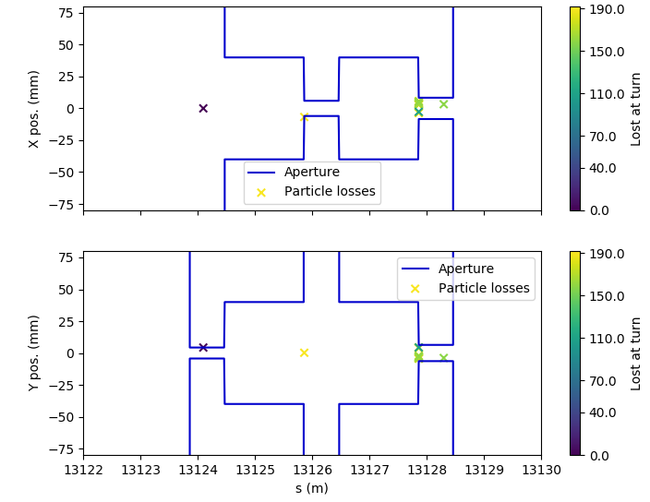
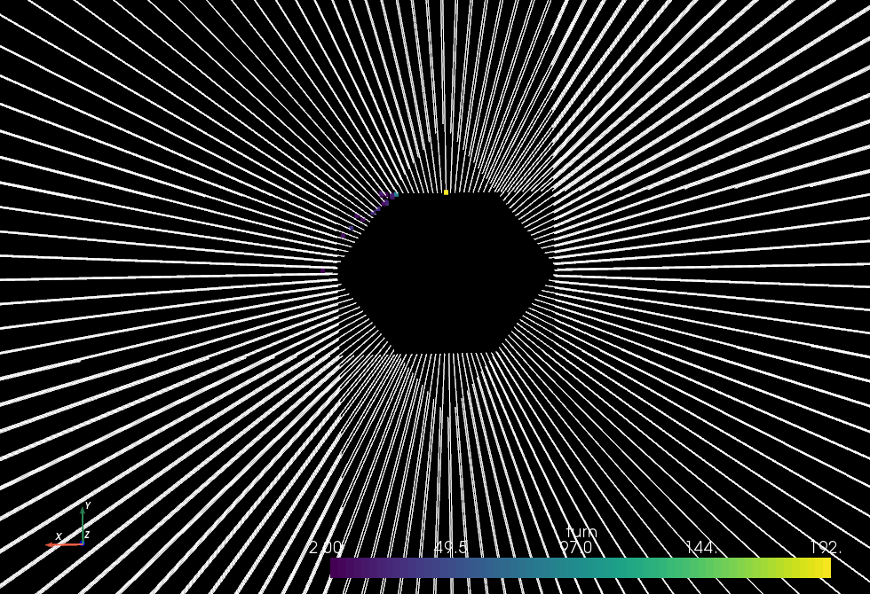
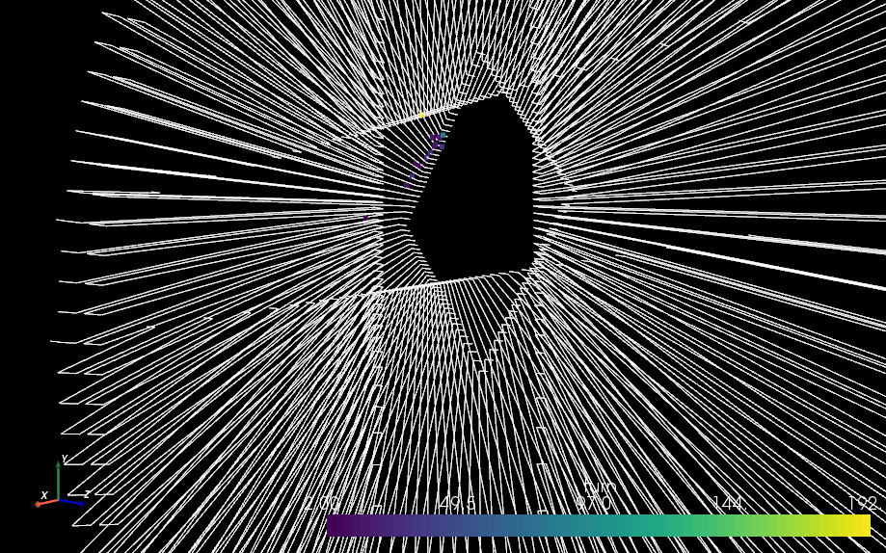
Aperture model
Primary collimators only
Discussion with collimation and SixTrack experts (21.02.20)
  Consider black absorber model: expect losses only on primaries (TCP) since no scattering
  Full aperture model not required for our purposes
Created very simple model consisting only of TCPs near IR7 (betatron cleaning)
A. Mereghetti: calculate collimator gaps from N. Fuster-Martinez, Evian 2019
(Tab. 1: TCP IR7 at injection: 5.7σ for ε_{norm} = 3.5 μm rad)
Half gaps set in our model depend on beta functions at elements
Loic’s 3D aperture / loss visualizer ☺

Slide 5
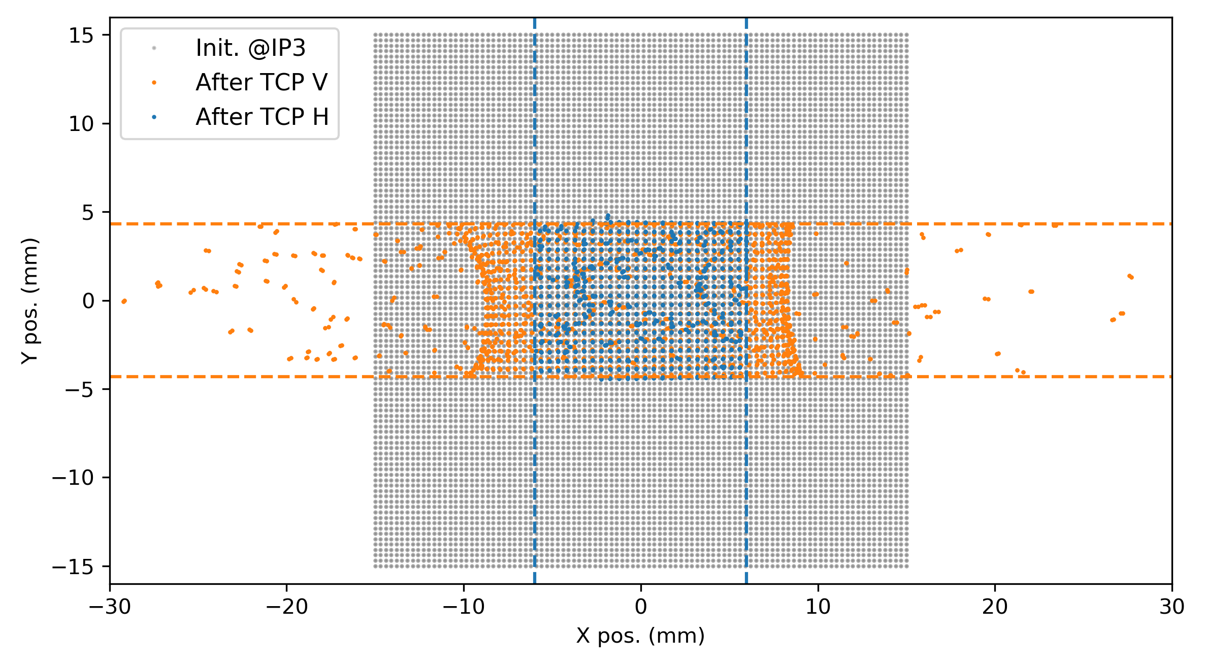
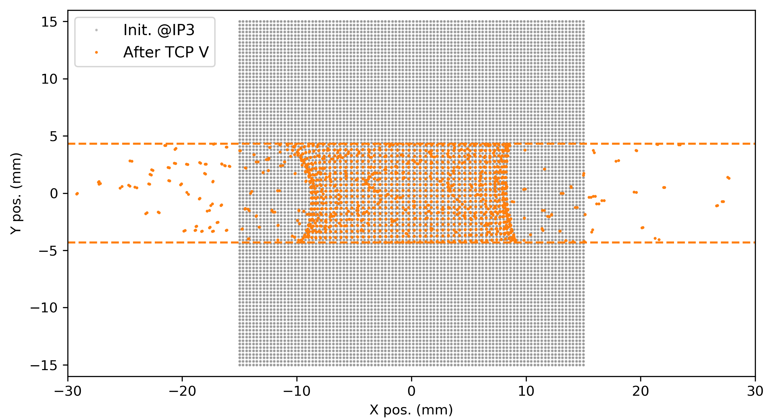
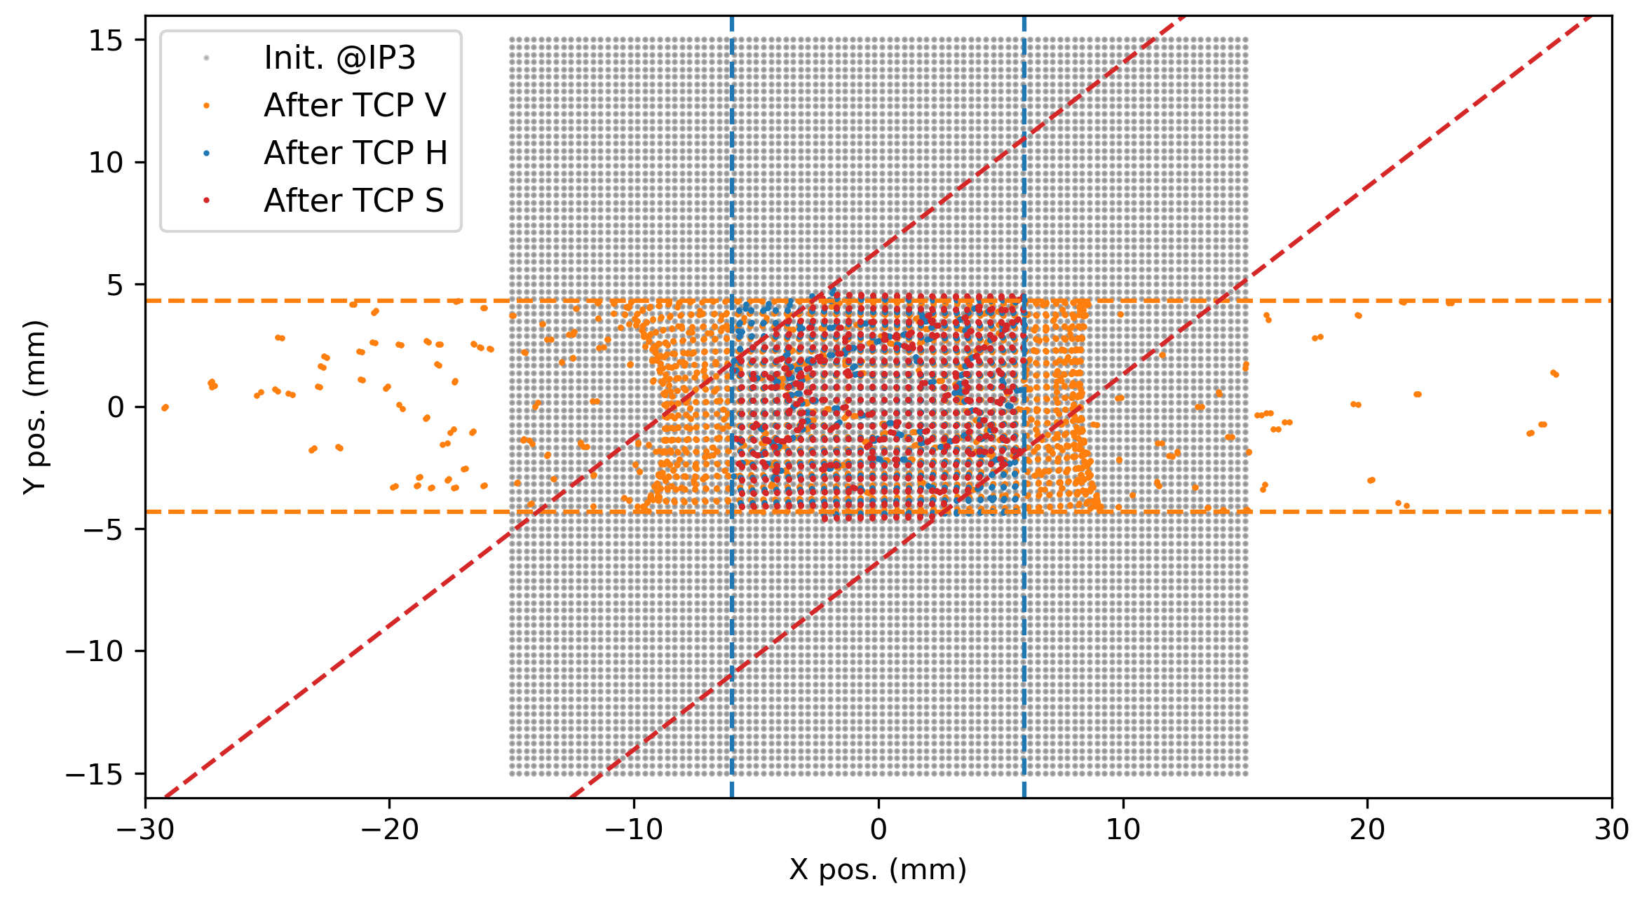
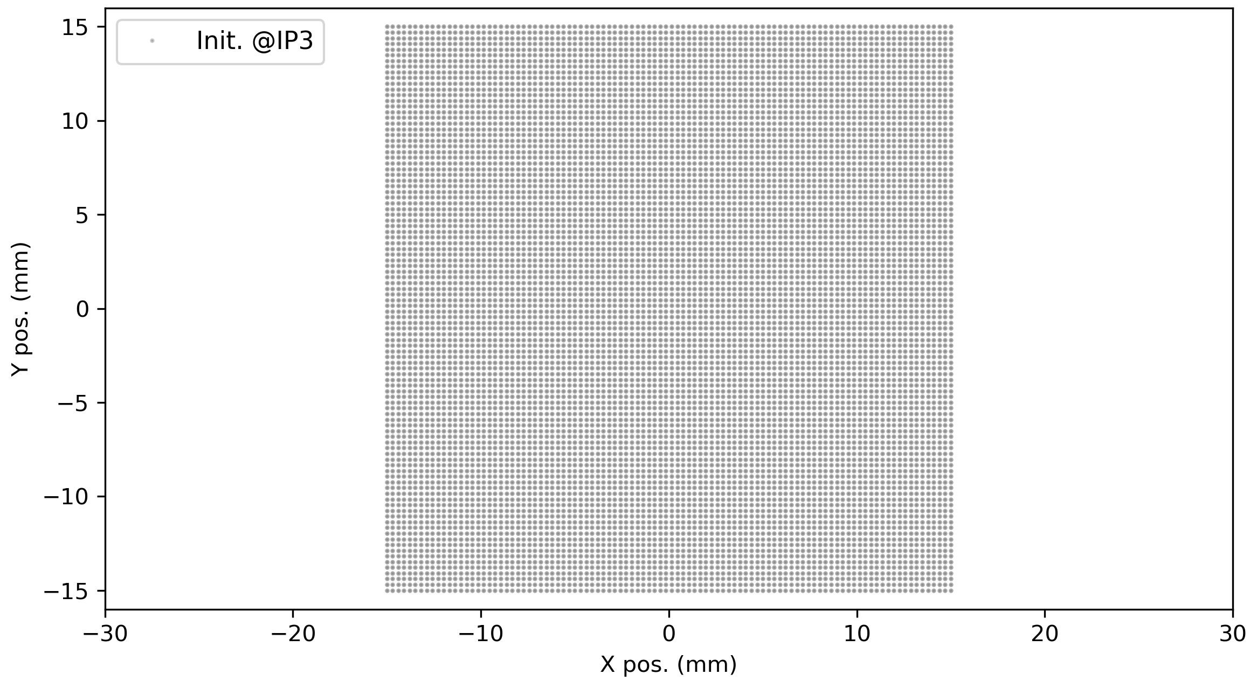
Aperture model
Validation
Track square beam through machine to verify gaps and skew collimator angles
TCP H
half gap: 5.973 mm
angle: 0°
TCP S
half gap: 5.057 mm
angle: 127.5°
TCP V
half gap: 4.308 mm
angle: 90°
Gaps correctly applied and tilt angle correctly propagated to SixTrack

Slide 6
Contents
Aperture model
Particle initialization
Post-processing / analysis
Some test results for discussion
Questions & feedback

Slide 7
Particle initialization
SixTrack DIST block
Work with DA-style initial conditions and weights,
i.e. uniform polar or rectangular grid in (J_{x}, J_{y}) space
(Actual Gaussian distributions would require tracking too many “irrelevant” core particles)
So far
  (Py)SixDesk runs SixTrack one-turn jobs first to obtain Twiss parameters for
  given lattice and machine parameters
  Cannot initialize matched distribution otherwise
With DIST block
  DISTlib takes care of the matching, no need for one-turn jobs for our studies
  Simplifies particle initialization and job management

Slide 8
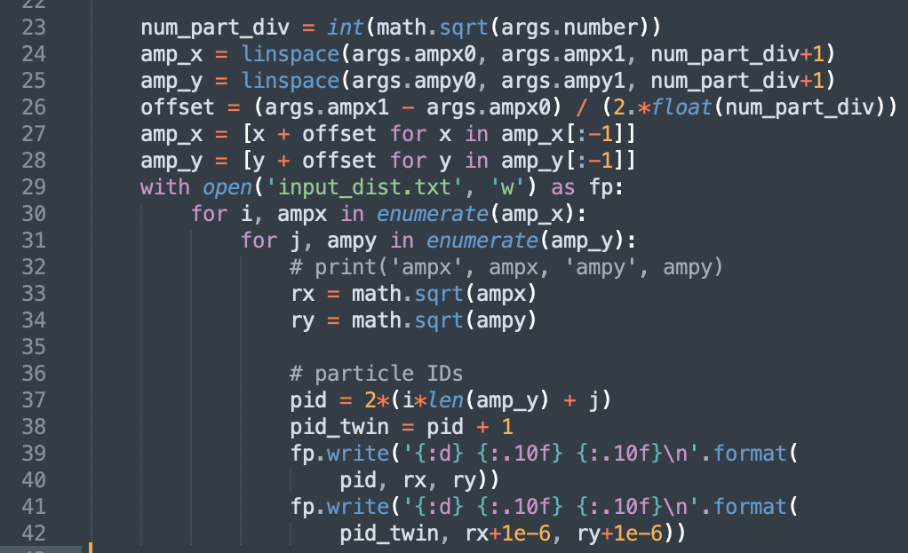
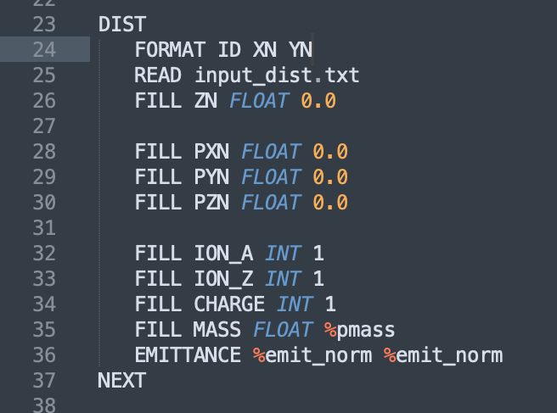
Particle initialization
SixTrack DIST block
Included in PySixDesk, but in a “hacky manner”
Node runs init_dist.py: generates distribution on rectangular grid for given amplitudes
(twin particle also initialized – “close” to original one)
DIST block in fort.3: read distribution from file
All momenta initialized to 0 here for now
OK for transverse planes: fast phase mixing similarly to DA studies
Longitudinal coordinate also set to 0 (OK ?)

Slide 9
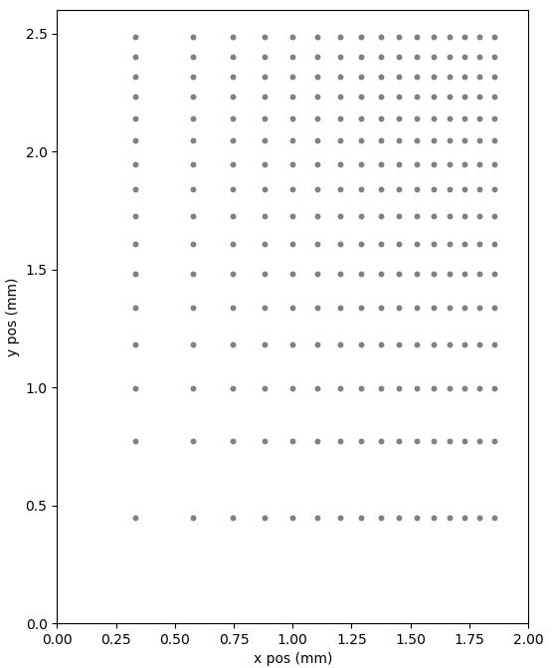
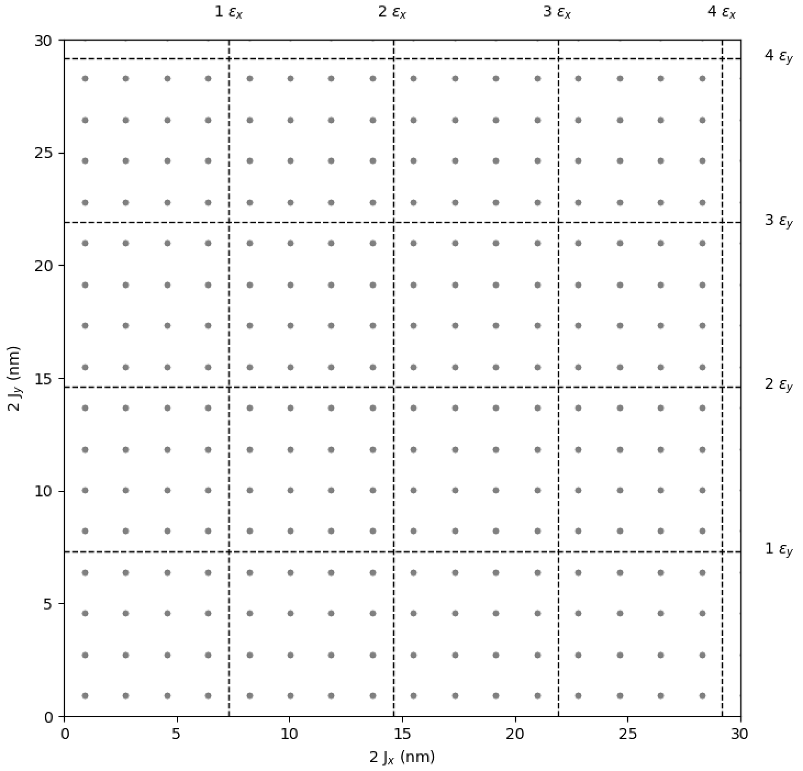

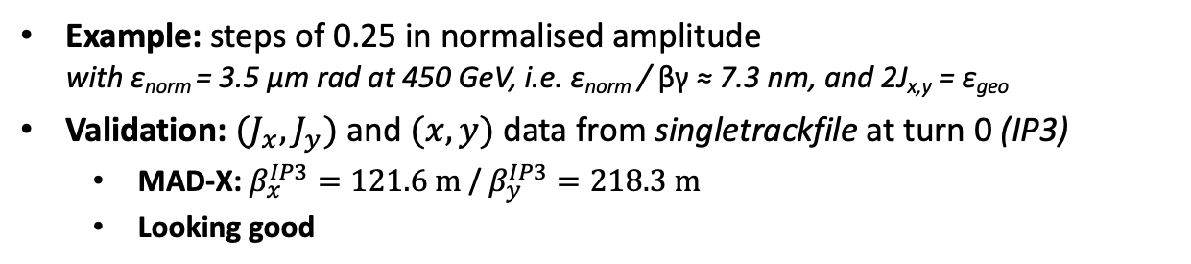


Particle initialization
SixTrack DIST block
Example: steps of 0.25 in normalised amplitude
with ε_{norm} = 3.5 µm rad at 450 GeV, i.e. ε_{norm} / βγ ≈ 7.3 nm, and 2J_{x,y} = ε_{geo}
Validation: ${(J}_{x}, J_{y})$ and $(x, y)$ data from singletrackfile at turn 0 (IP3)
  MAD-X: $β_{x}^{IP3}=121.6 m$ / $β_{y}^{IP3}=218.3 m$
  Looking good
$$\sqrt{2J_{x,y}β_{x,y}^{IP3}}$$
0.45 mm
$$\frac{ε_{geo}}{8}$$
$$\frac{ε_{geo}}{8}$$
Action space
0.33 mm
Coord. space

Slide 10
Contents
Aperture model
Particle initialization
Post-processing / analysis
Some test results for discussion
Questions & feedback

Slide 11
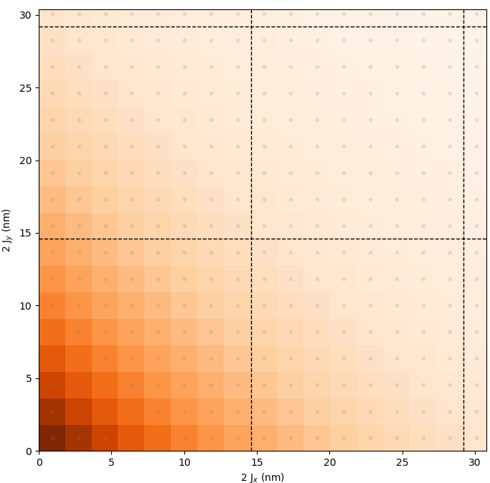
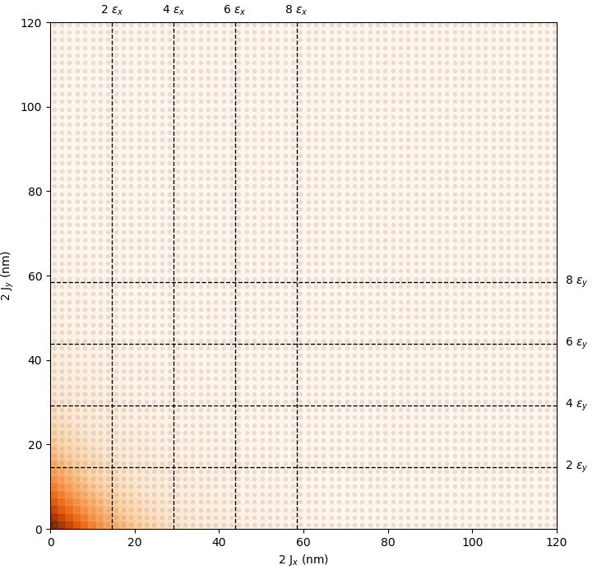
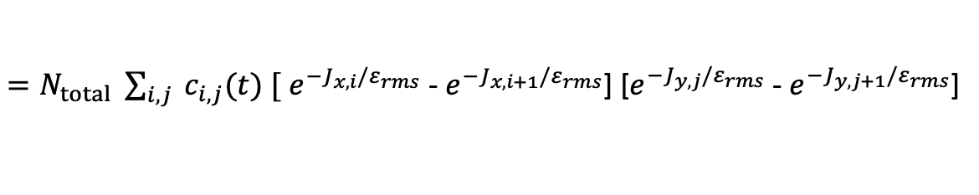
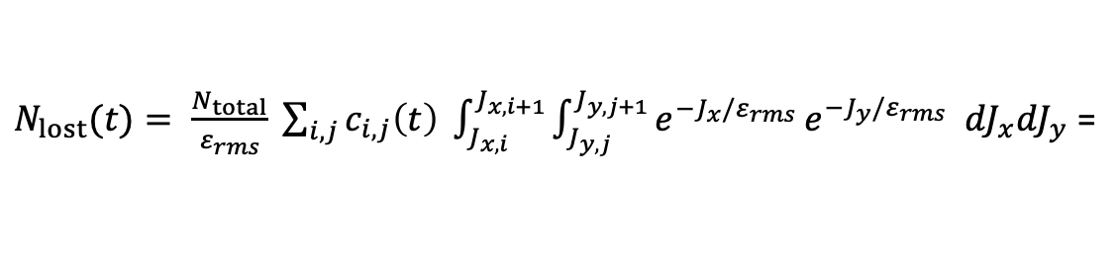
Post-processing: loss calculation
Gaussian weights
(J_{x}, J_{y}) space divided into square cells, s.t. every cell contains 1 particle (pair)
= 1 initial condition
c_{i,j} (t) : flag particle in cell (i, j) dead (= 1) or alive (= 0) after t turns
Calculate weights w_{i,j} in action space for beam distribution we would like to mimic
Weights are illustrated by orange color
Example: round Gaussian beam
$N_{lost}(t)= \frac{N_{total}}{ε_{rms}} \sum_{i, j}{c_{i,j}\left(t\right) \int_{J_{x,i}}^{J_{x,i+1}}{\int_{J_{y,j}}^{J_{y,j+1}}{e^{−J_{x}/ε_{rms}}}e^{−J_{y}/ε_{rms}} {dJ}_{x}{dJ}_{y}}}$ =
$=N_{total} \sum_{i, j}{{ c}_{i,j}(t) [}$ $e^{−J_{x,i}/ε_{rms}}$ - $e^{−J_{x,i+1}/ε_{rms}}$] [$e^{−J_{y,j}/ε_{rms}}$ - $e^{−J_{y,j+1}/ε_{rms}}$]
= w_{i,j}

Slide 12
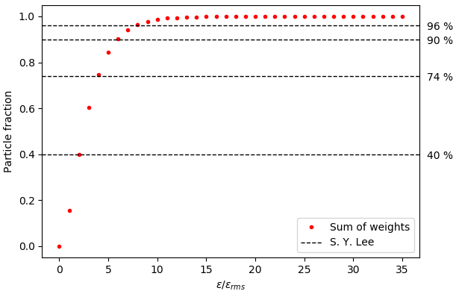
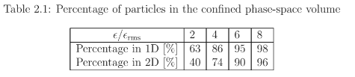
Post-processing: loss calculation
Gaussian weights: validation
Validation: compare calculated Gaussian weights to literature
All in good agreement
S. Y. Lee, Accelerator Physics, 4th edition, pg. 59

Slide 13
Contents
Aperture model
Particle initialization
Post-processing / analysis
Some test results for discussion
Questions & feedback

Slide 14
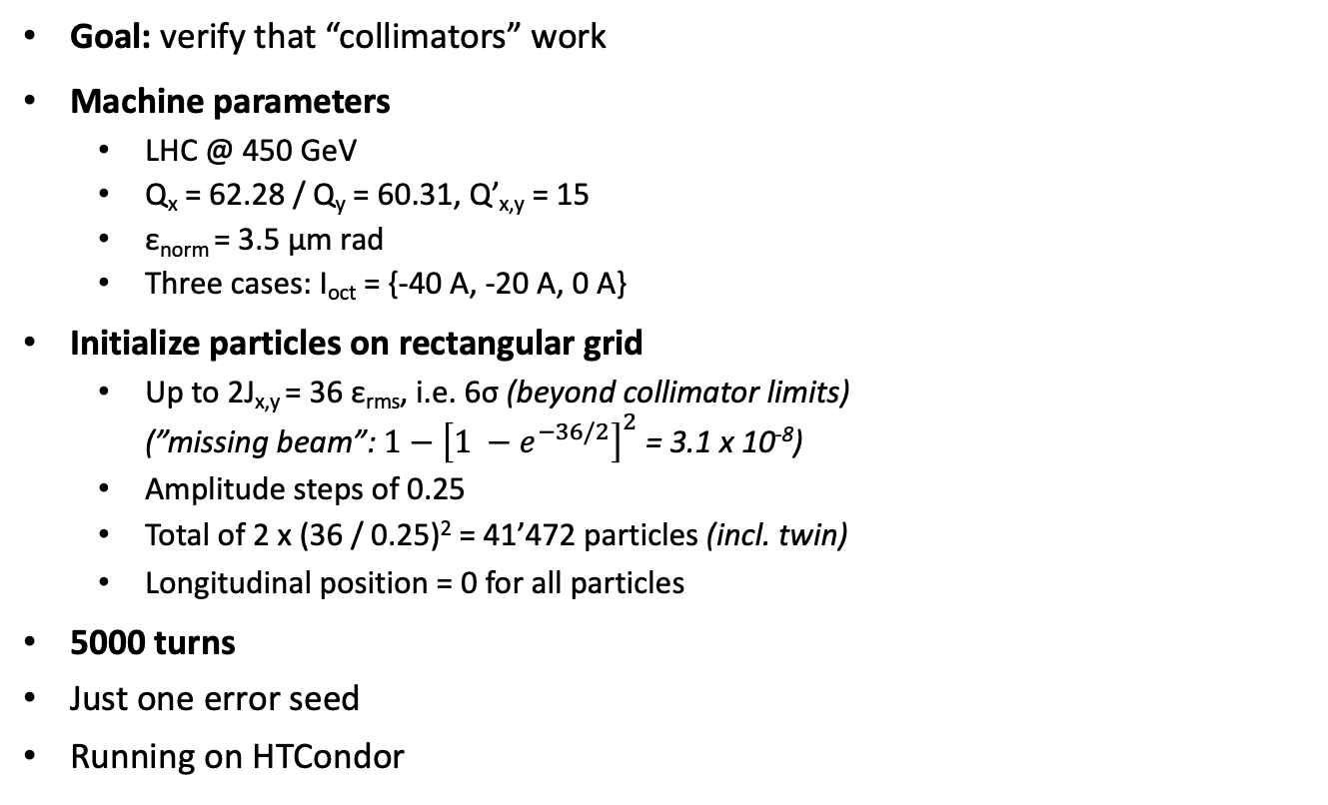
Some test results
Short runs (5000 turns): setup
Goal: verify that “collimators” work
Machine parameters
  LHC @ 450 GeV
  Q_{x} = 62.28 / Q_{y} = 60.31, Q’_{x,y} = 15
  ε_{norm} = 3.5 µm rad
  Three cases: I_{oct} = {-40 A, -20 A, 0 A}
Initialize particles on rectangular grid
  Up to 2J_{x,y} = 36 ε_{rms}, i.e. 6σ (beyond collimator limits)
  (”missing beam”: $1−{\left[1 −e^{−36/2}\right]}^{2}$ = 3.1 x 10⁻⁸)
  Amplitude steps of 0.25
  Total of 2 x (36 / 0.25)² = 41’472 particles (incl. twin)
  Longitudinal position = 0 for all particles
5000 turns
Just one error seed
Running on HTCondor

Slide 15
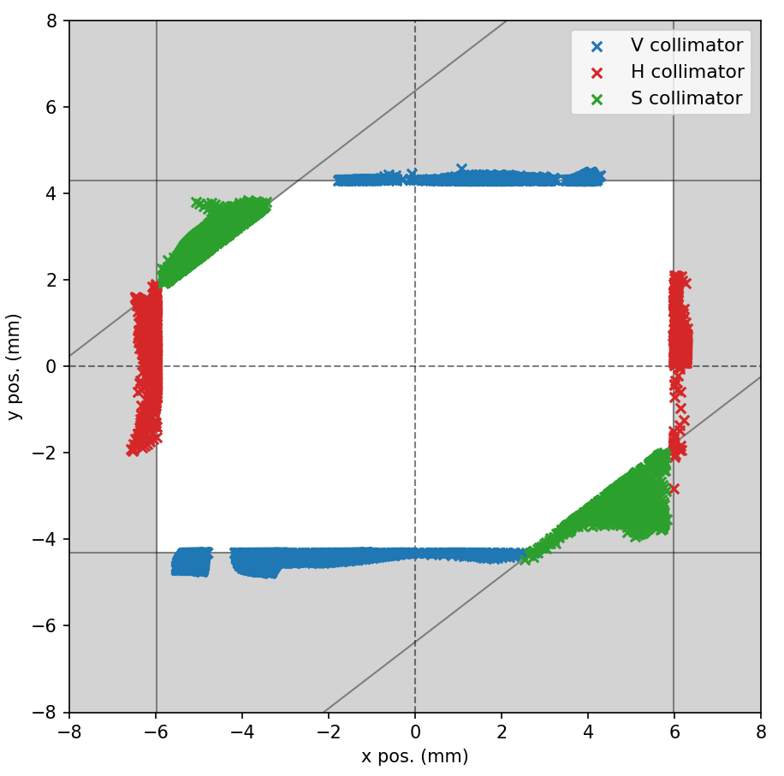
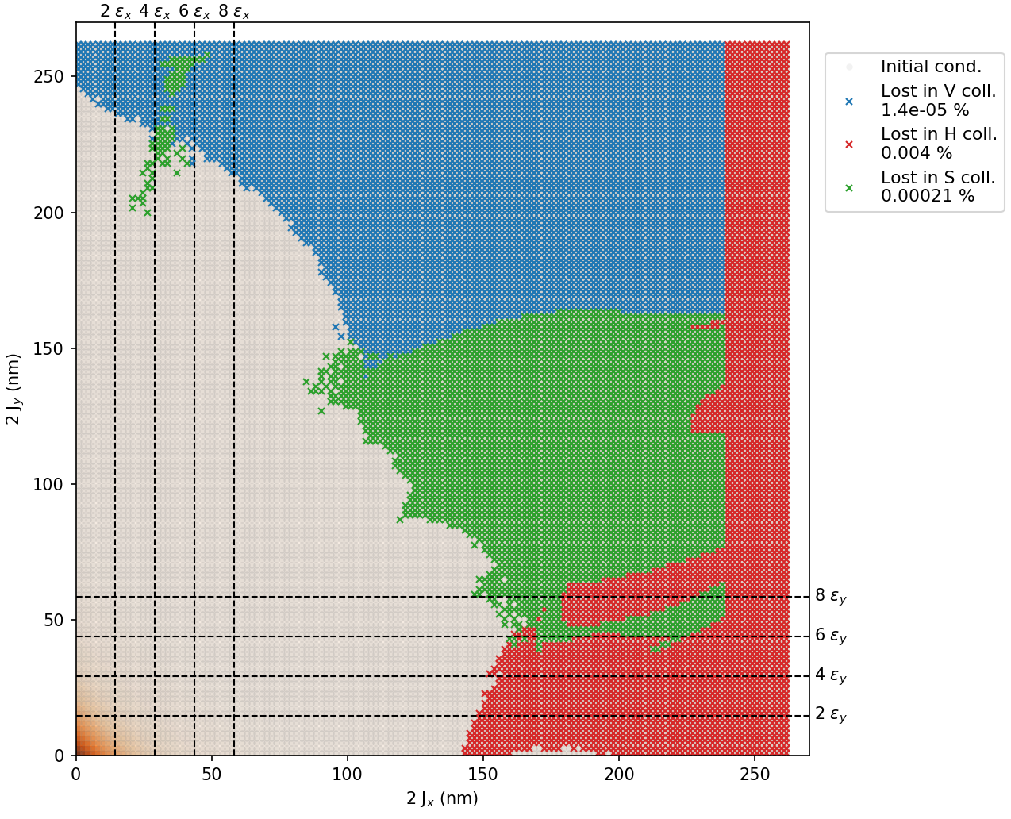
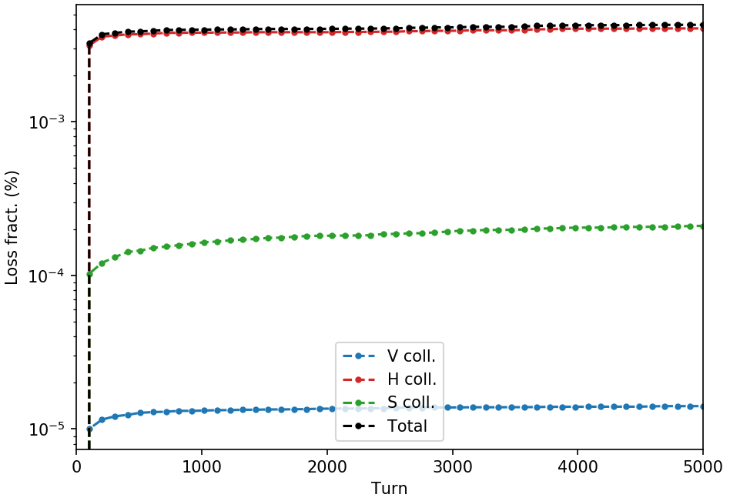


Some test results
Example 1: I_{oct} = -40 A
$$\frac{H_{hg}^{2}}{β_{x}^{coll}}$$
$$\frac{V_{hg}^{2}}{β_{y}^{coll}}$$
Losses on collimators within first few hundred turns
(discussed with Daniele)

Slide 16
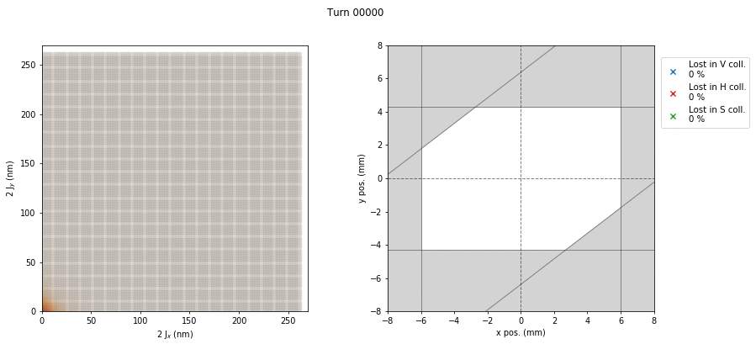


Some test results
Example 1: I_{oct} = -40 A
$$\frac{H_{hg}^{2}}{βx}$$
$$\frac{V_{hg}^{2}}{βy}$$
Losses on collimators within first few hundred turns
(discussed with Daniele)

Slide 17
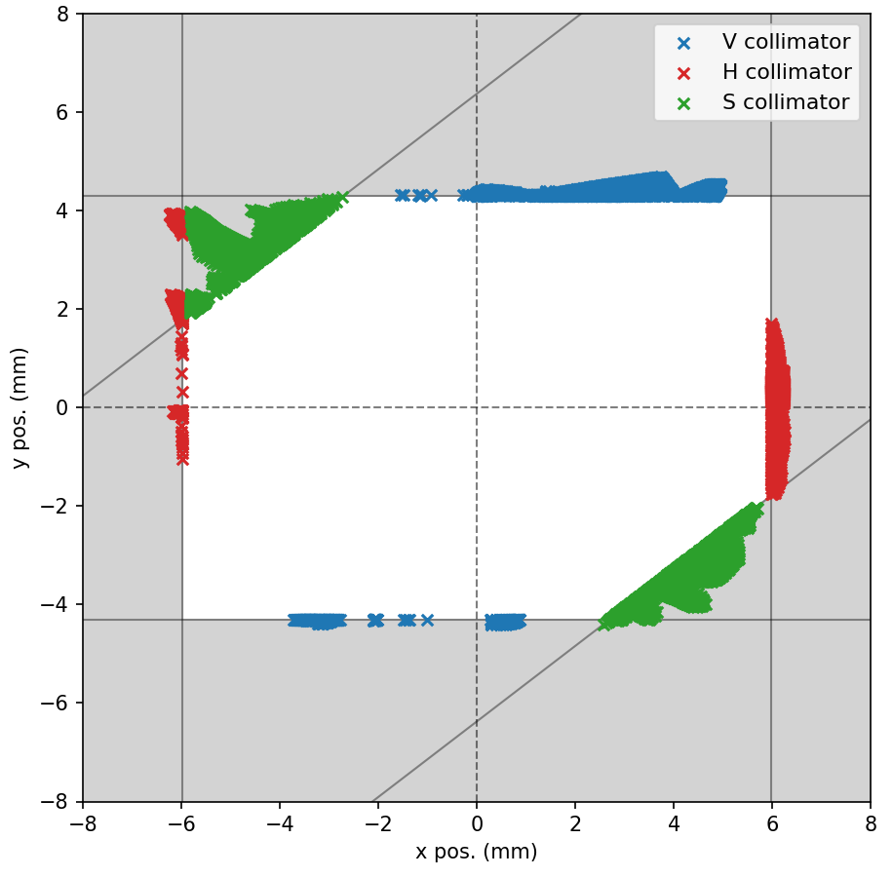
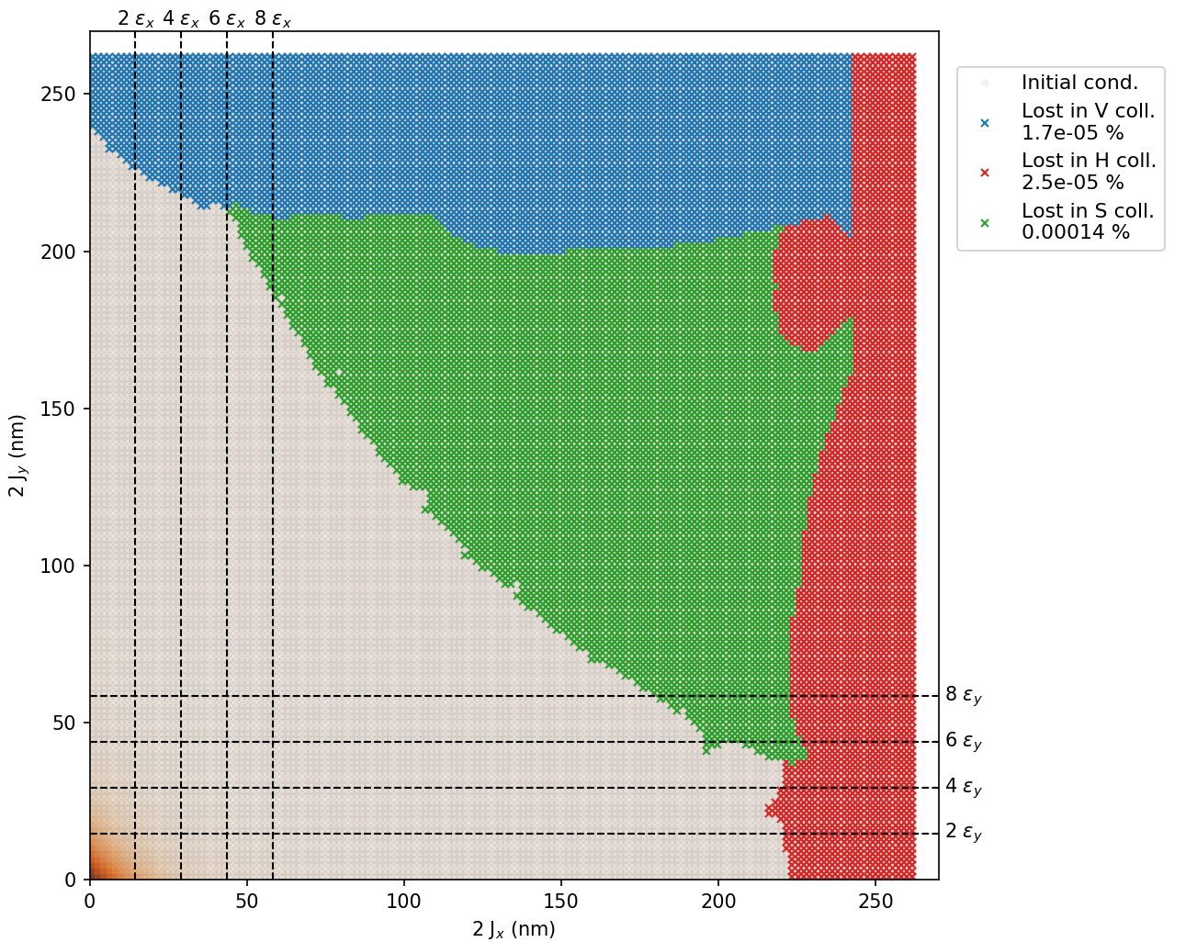
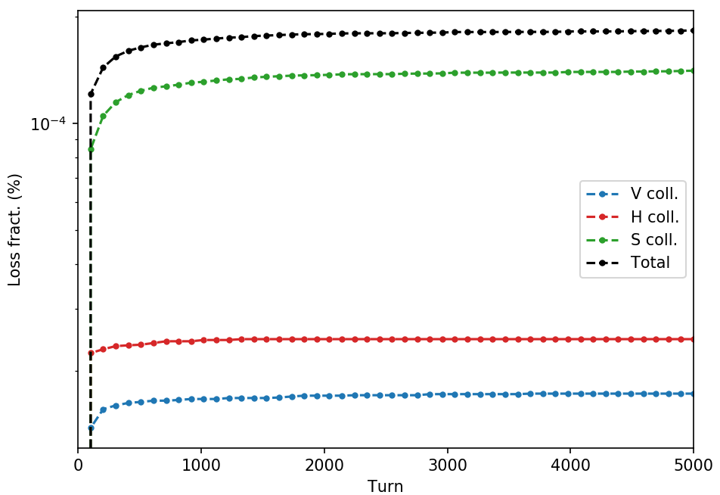
Some test results
Example 2: I_{oct} = -20 A

Slide 18
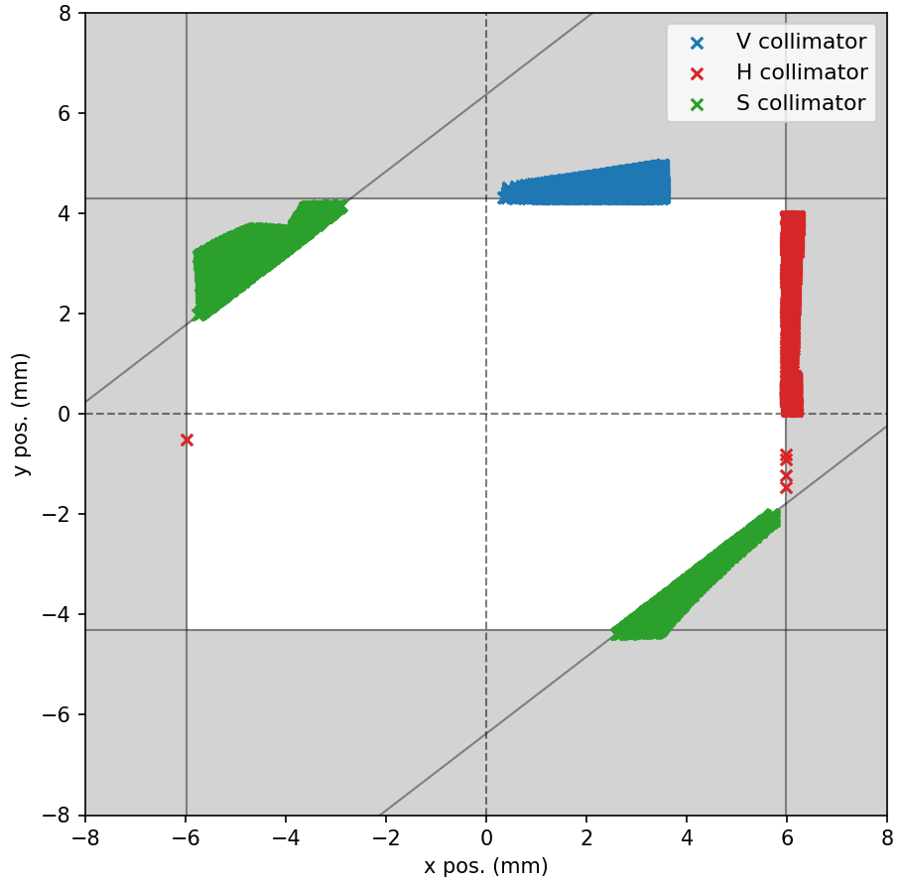
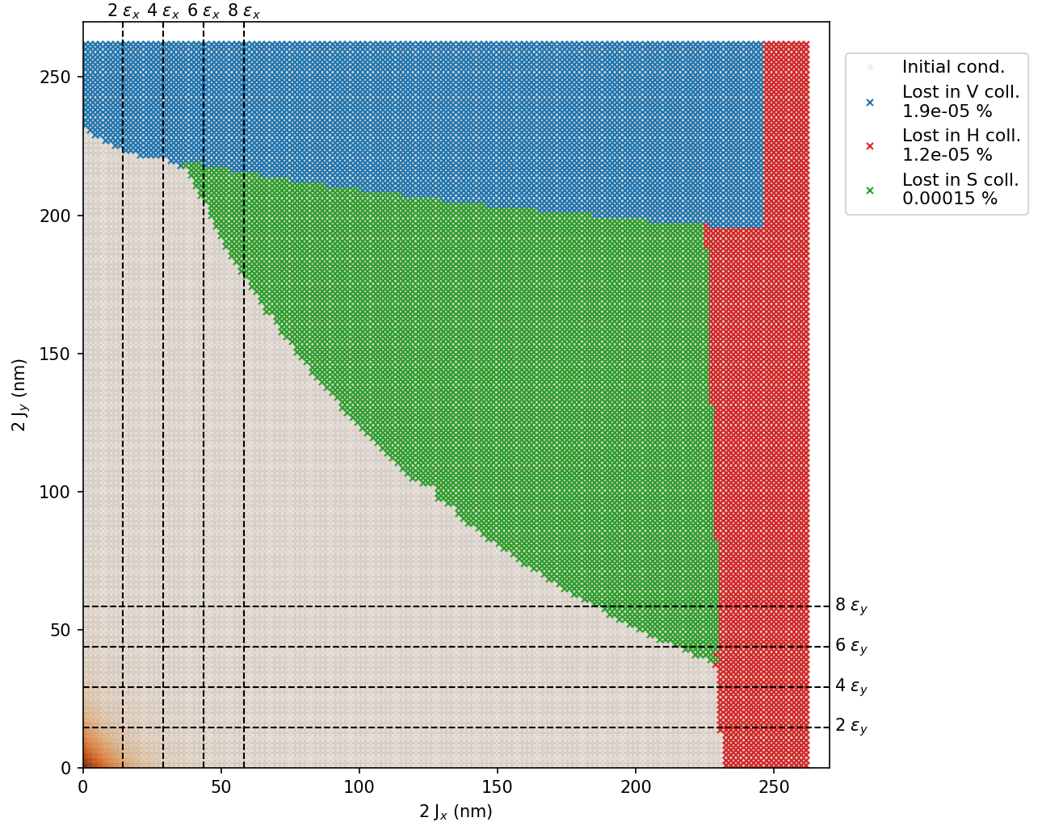
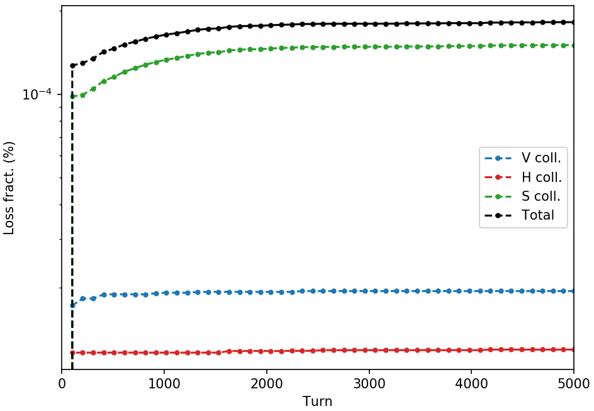
Some test results
Example 3: I_{oct} = 0 A

Slide 19
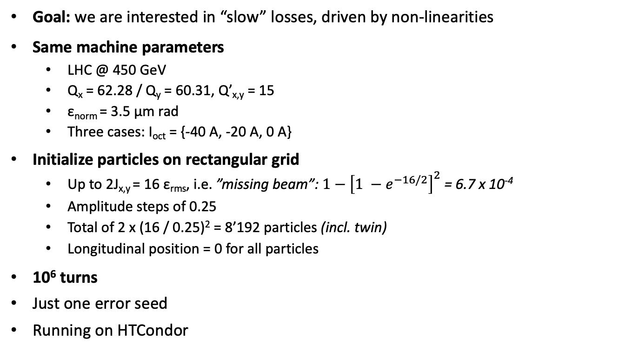
Some test results
Long runs (10⁶ turns)
Goal: we are interested in “slow” losses, driven by non-linearities
Same machine parameters
  LHC @ 450 GeV
  Q_{x} = 62.28 / Q_{y} = 60.31, Q’_{x,y} = 15
  ε_{norm} = 3.5 µm rad
  Three cases: I_{oct} = {-40 A, -20 A, 0 A}
Initialize particles on rectangular grid
  Up to 2J_{x,y} = 16 ε_{rms}, i.e. ”missing beam”: $1−{\left[1 −e^{−16/2}\right]}^{2}$ = 6.7 x 10⁻⁴
  Amplitude steps of 0.25
  Total of 2 x (16 / 0.25)² = 8’192 particles (incl. twin)
  Longitudinal position = 0 for all particles
10⁶ turns
Just one error seed
Running on HTCondor

Slide 20
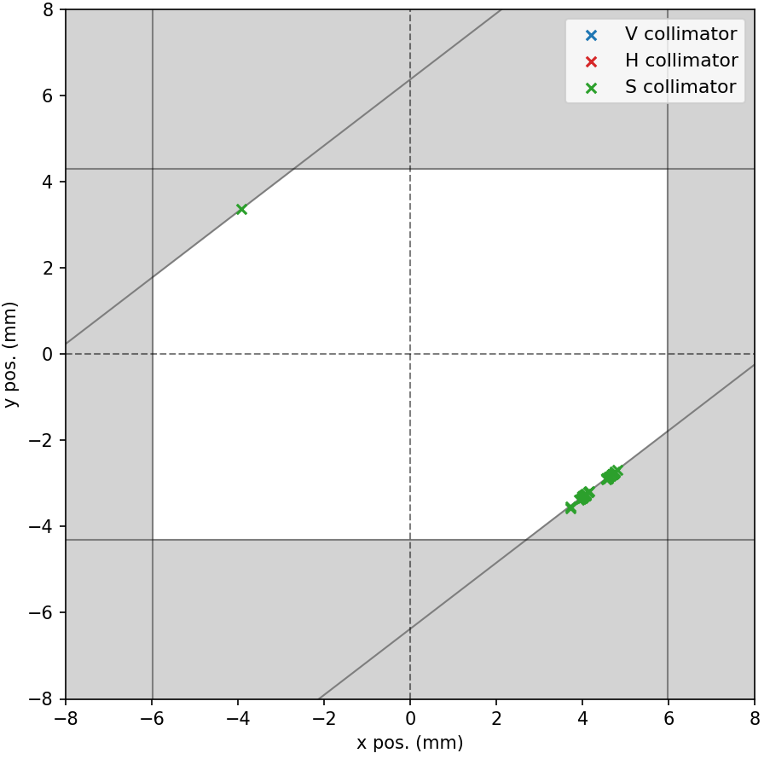
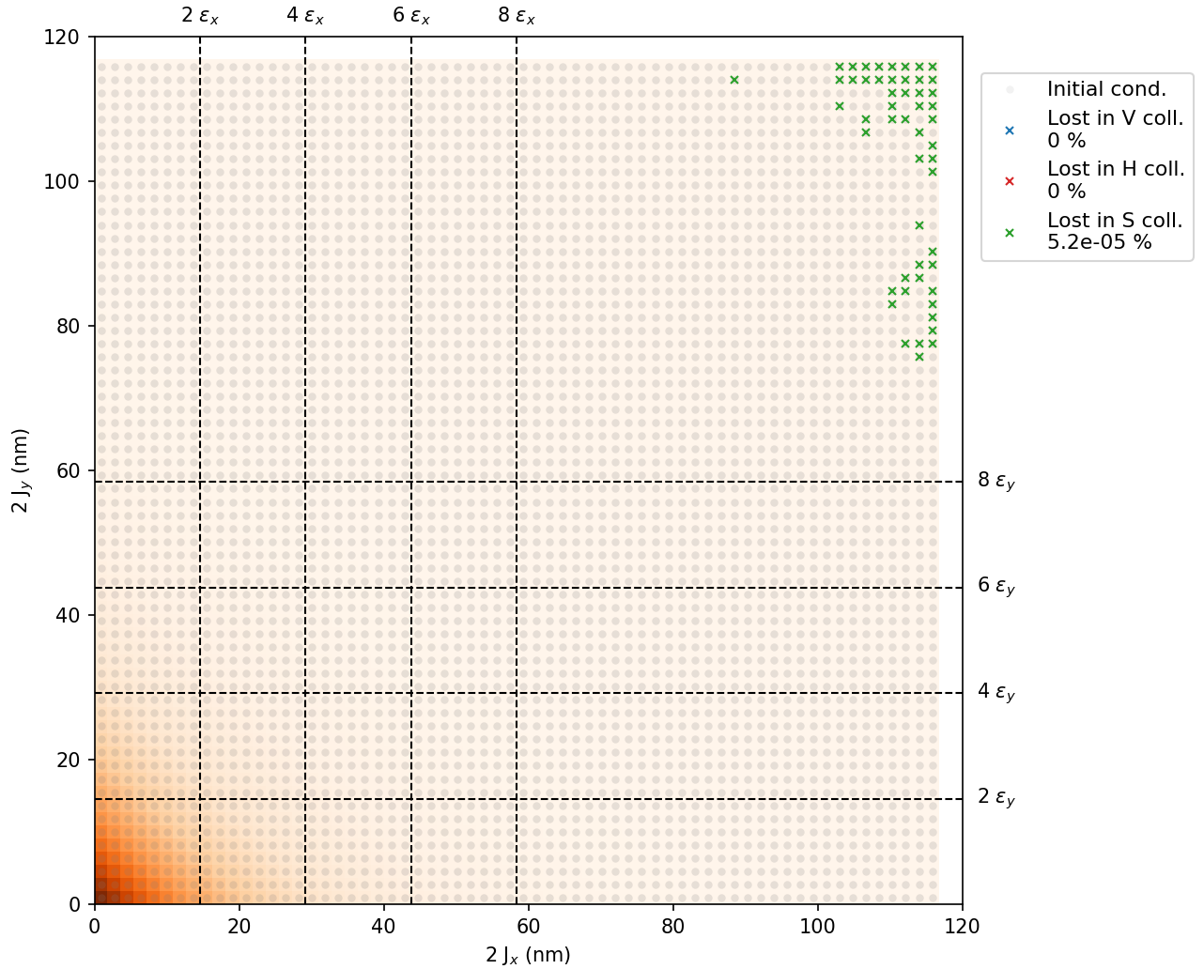
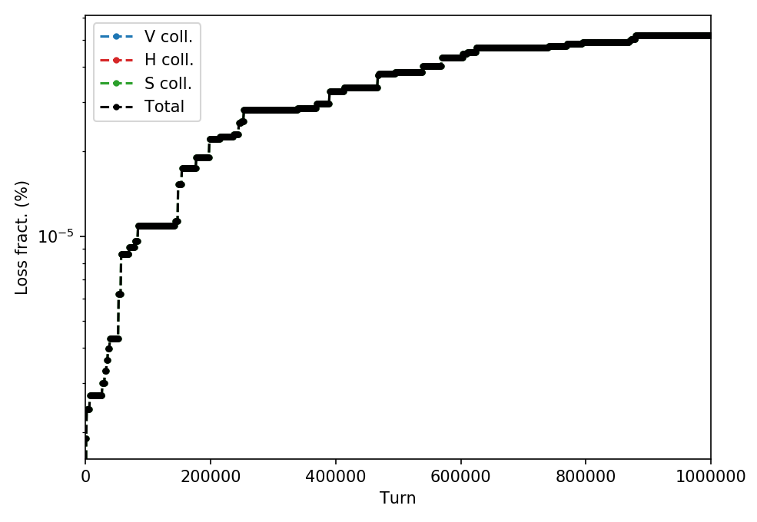
Some more test results
Example 1: I_{oct} = -40 A
Do observe losses until up to 10⁶ turns
Encouraging, but I_{oct} = -40 A for 3.5 µm rad beam at injection energy is very high
Why is everything lost on skew collimator? Expected?

Slide 21
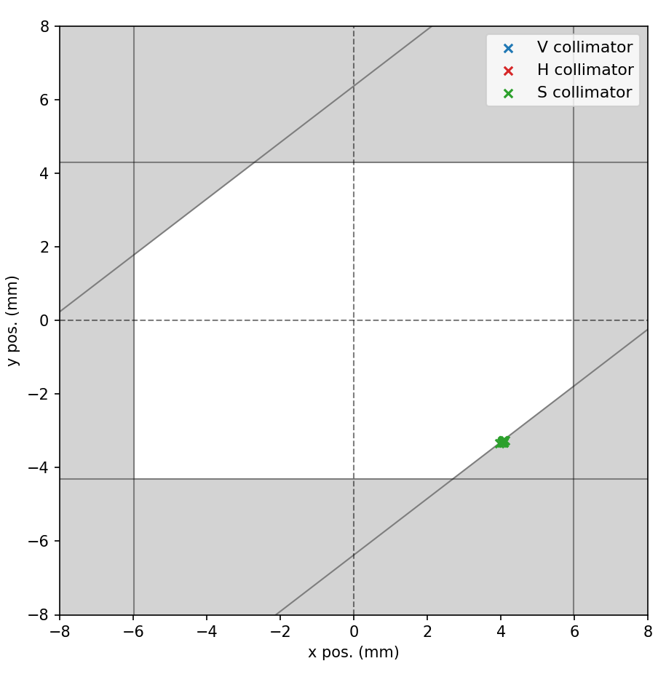
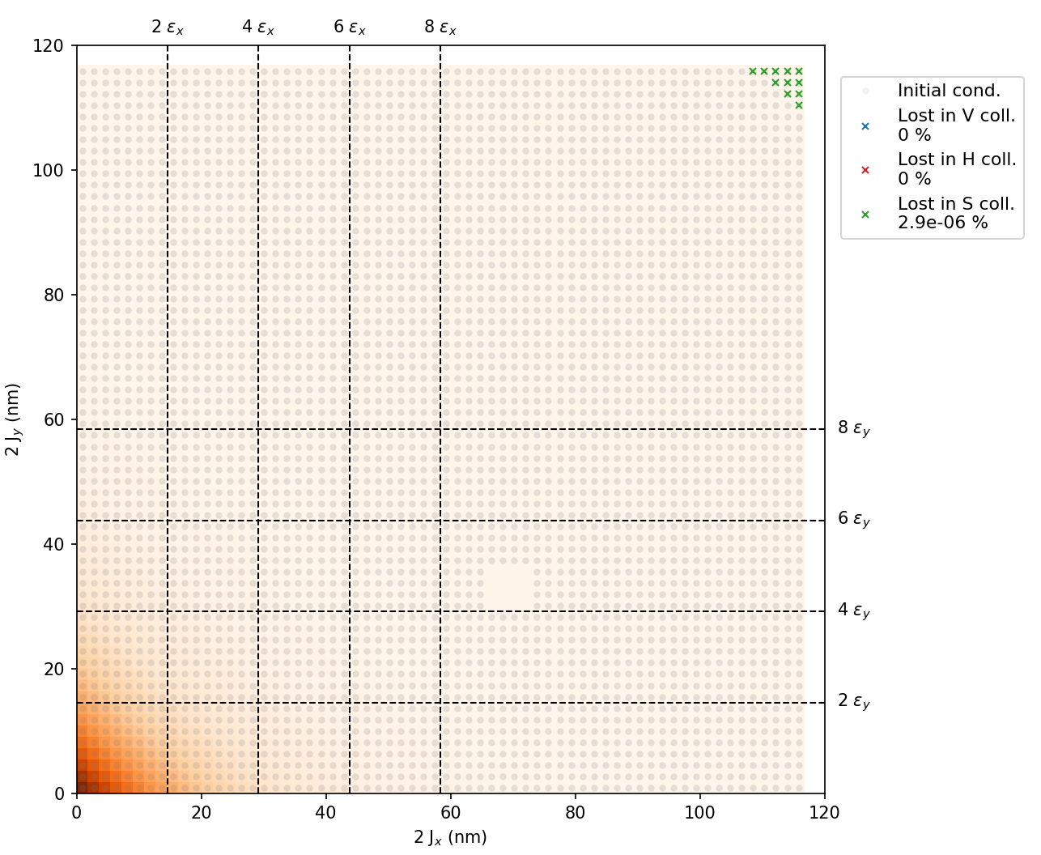
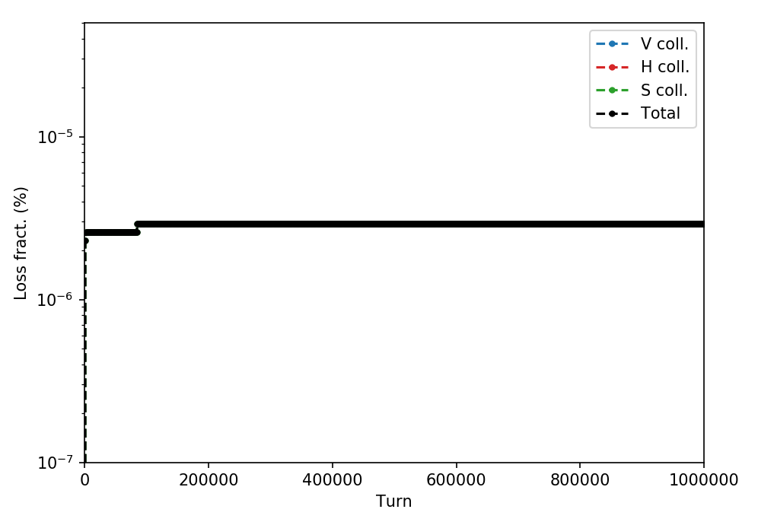
Some more test results
Example 2: I_{oct} = -20 A
Losses are reduced – that’s OK
Main loss in beginning – not much else happening till end
”Sensitivity issue”? More turns required?
Again everything lost on skew collimator

Slide 22

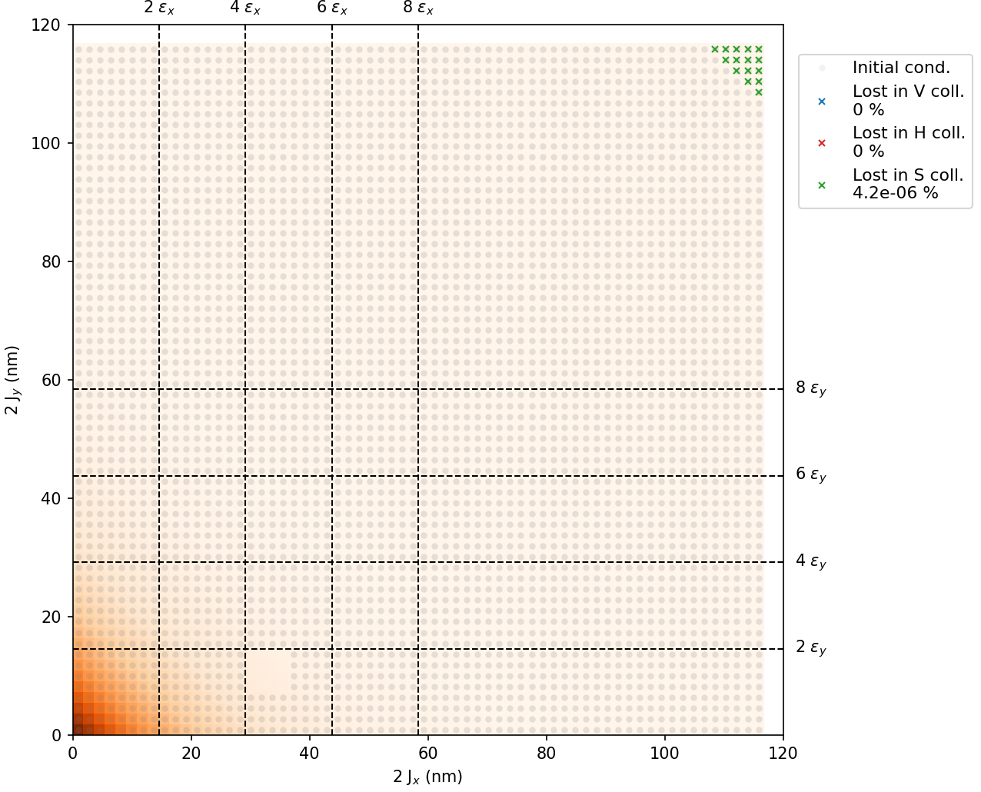
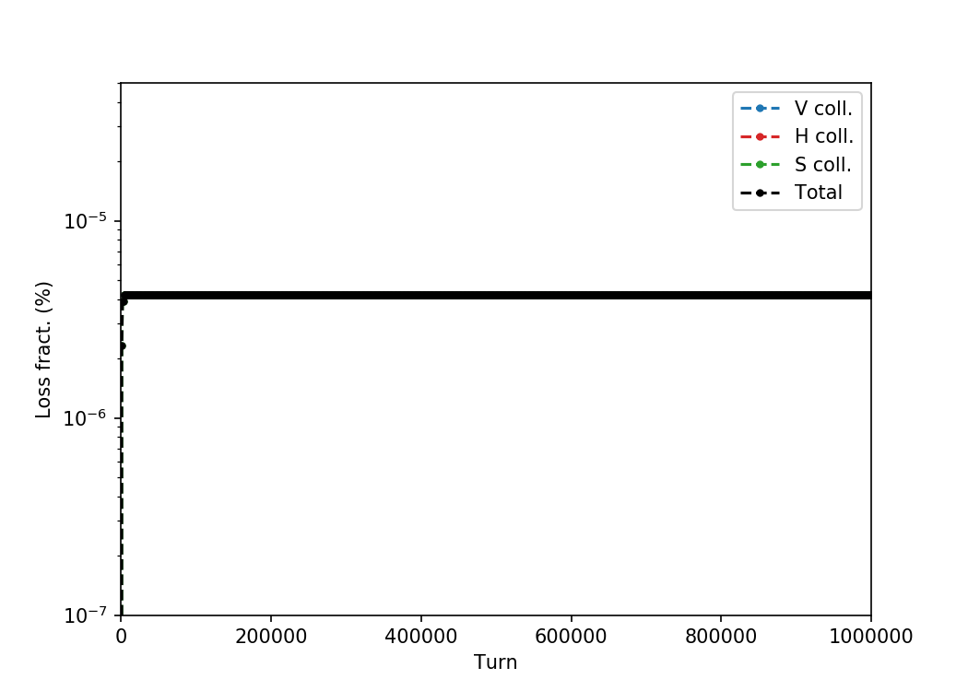
Some more test results
Example 3: I_{oct} = 0 A
Slightly higher loss rate (unexpectedly),
but all lost in first few thousand turns
Again everything on skew collimator

Slide 23
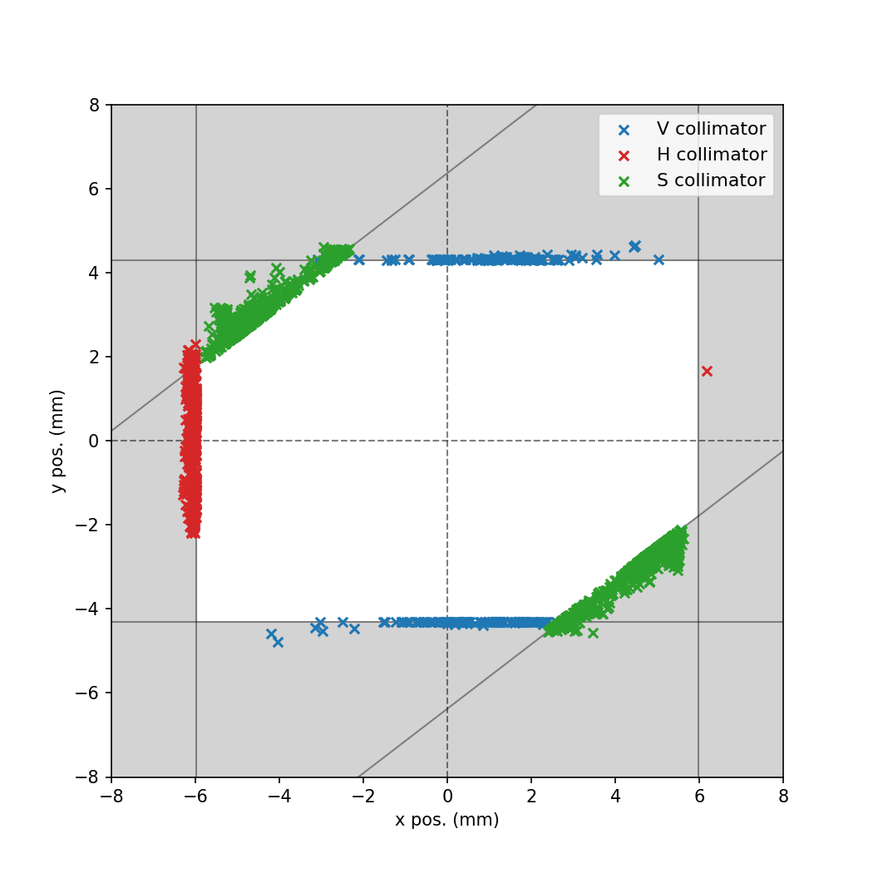
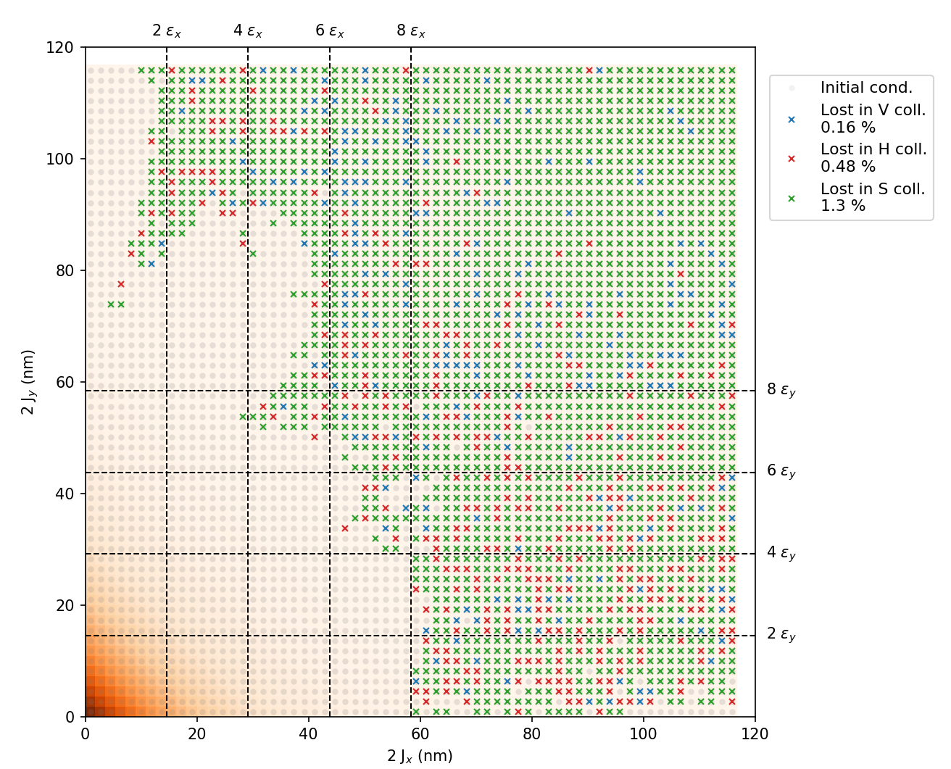
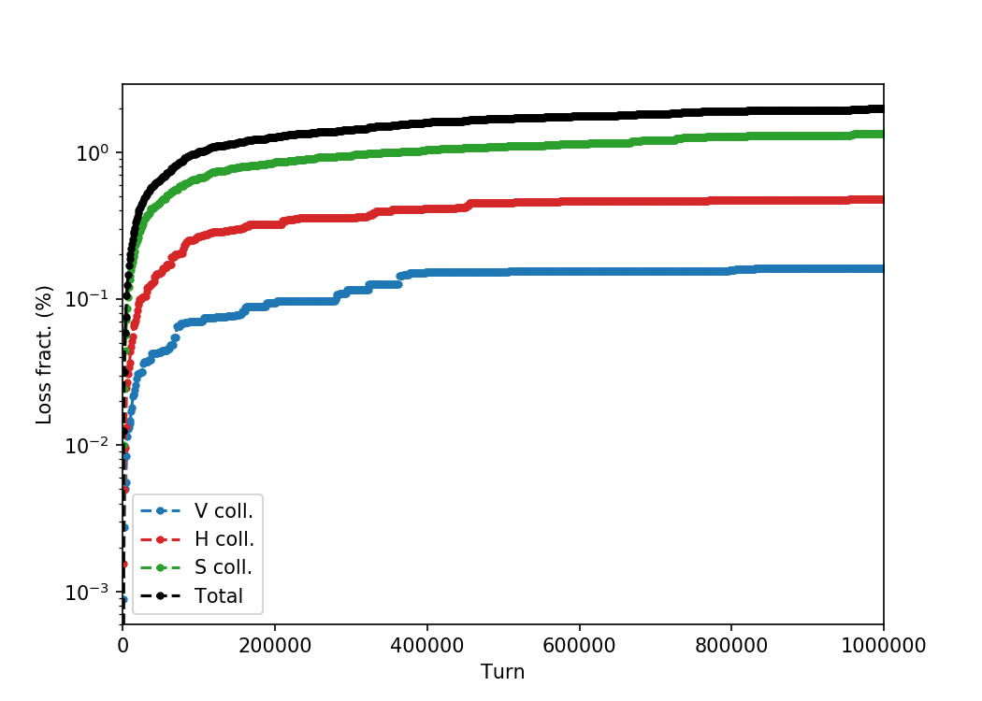
Some more test results
Example 4: I_{oct} = -100 A …
Very unrealistic scenario …
Just to see what happens

Slide 24
Contents
Aperture model
Particle initialization
Post-processing / analysis
Some test results for discussion
Questions & feedback

Slide 25
Questions & feedback
Generally: are we on the right track? Better approaches / suggestions?
First tests show that it may be challenging to reach sensitivity for actual (close-to) operational machine parameters
However, some things still left for testing
  Longitudinal coordinate z = 0?
  Only looked at I_{oct}. What about tunes, Q’, other error seeds, etc.?
  Yet more turns, larger phase space area?
  Consider twin particle
  Other ideas?
Grid and beam distribution
  Rectangular or polar?
  Grid density: our loss is upper estimate since we assume whole area is lost if our cell-particle is lost. Should be good estimate if cells are small enough
  Mimic beam distribution with weights: way to go?
  Gaussian beam? (especially important at high amplitudes where we see losses)
Using Python script to generate initial distribution on each computing node: would that work with BOINC?
Papers / references on the subject?

