Slide 1
Description of Coherent Beam Instabilities in the presence of Space-charge Forces using the Circulant Matrix Model (CMM)
Cathrine Høgh
Supervisor: Xavier Buffat
LPAP group meeting
24. April 2020

Slide 2
Table of contents
Background
Numerical Method
Method of convergence
  Gaussian
  Airbag
Future work

Slide 3
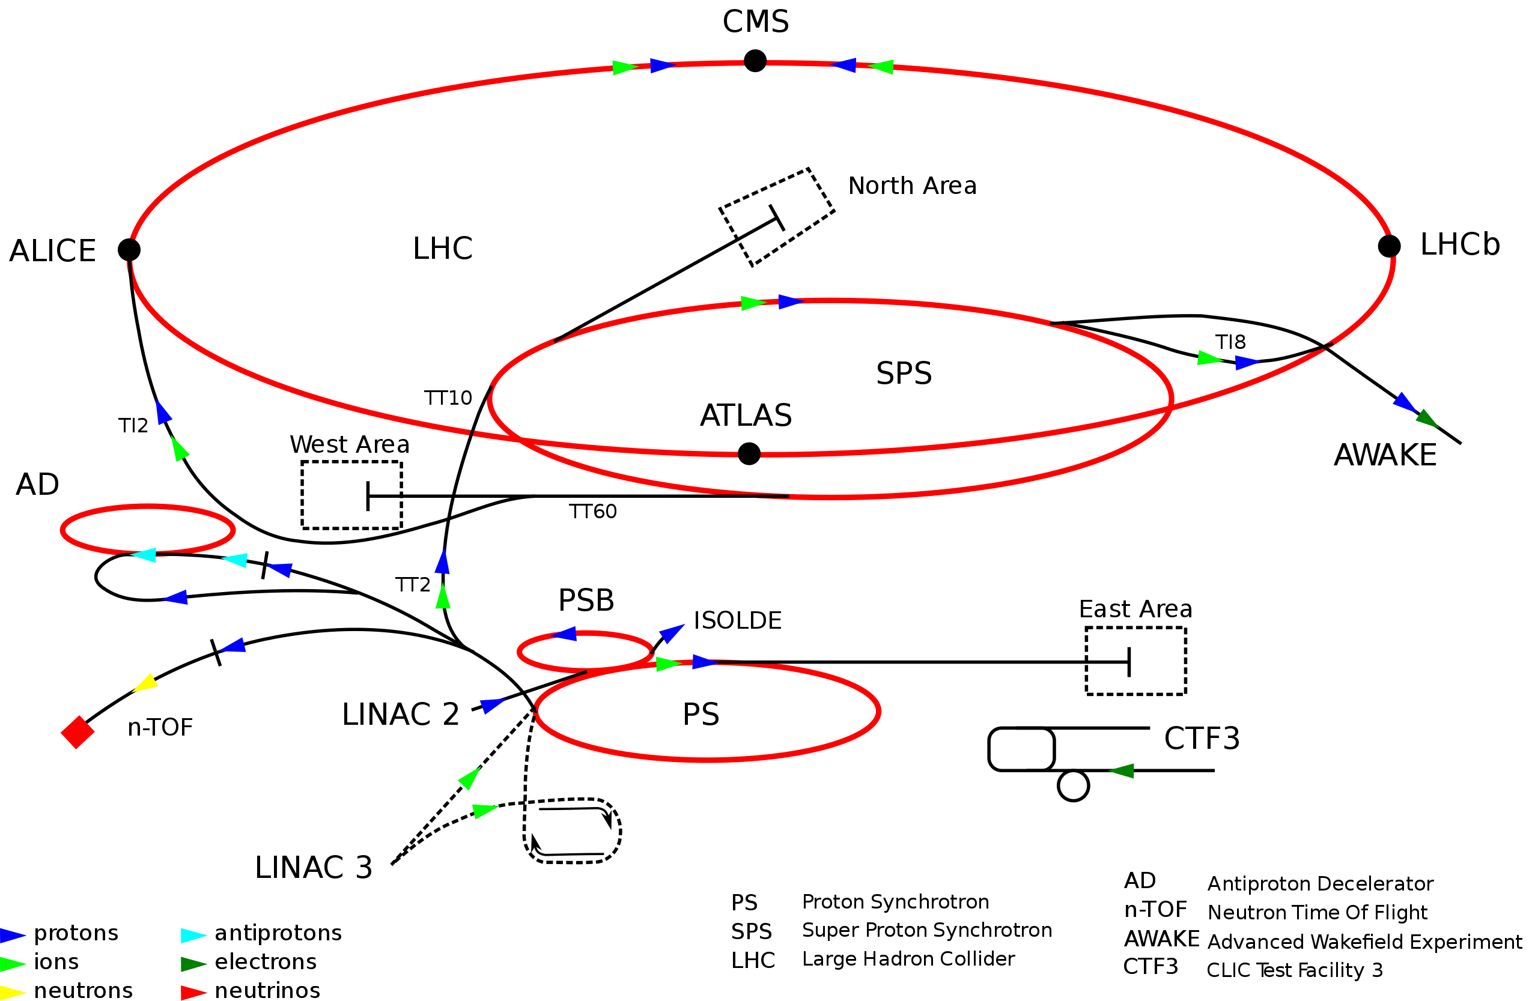
Background
Model for synchrotrons
Synchrotrons have many collective effects that cause instabilities such as space charge forces
Space charge forces result from direct electromagnetic interactions of the particles within a charged particle beam and significantly limit the performance of all low energy and high brightness hadron accelerators
Instabilities cause beam blow up and can lead to beam losses
Synchrotrons at CERN
(https://en.wikipedia.org/wiki/Proton_Synchrotron)

Slide 4
Background: code
BimBim calculates one turn matrix using CMM
CMM contains:
  Transport of beam through the lattice
  Wake fields (generated by the the interaction of the beam with its surroundings and cause head tail instabilities)
AIM: Extend BimBim to include Space Charge forces, obtain and diagonalize the one turn matrix then calculate the tune and growth rate of the beam instabilities
Notes:
Head tail instabilities are characterised by a self-amplification of any small perturbation
Will be using one bunch one beam that can then be scaled up

Slide 5
Outline of Project
Motivation:
To improve the understanding of beam instabilities in space-charge dominated machines by extending analytical results obtained with an airbag distribution to a more realistic distribution using a semi analytical approach.
Main Project Steps:
Add the effect of space charge to BimBim
Find converged parameters for space charge action
Compare Gaussian and Airbag beam distribution tune shifts
Analyse beam instability due to space charge and wake fields

Slide 6
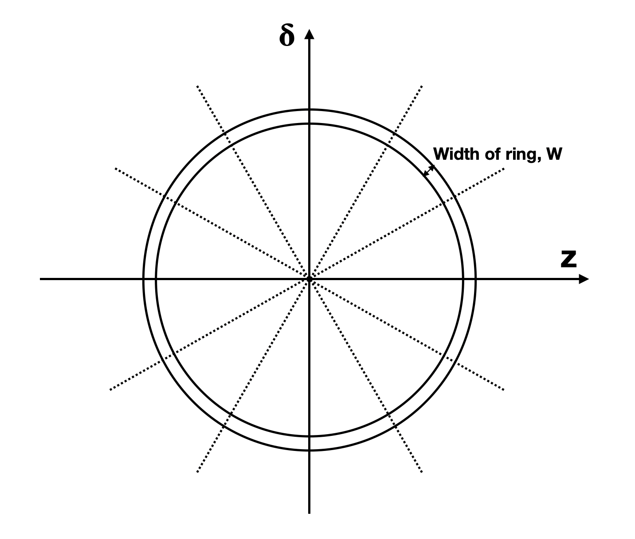
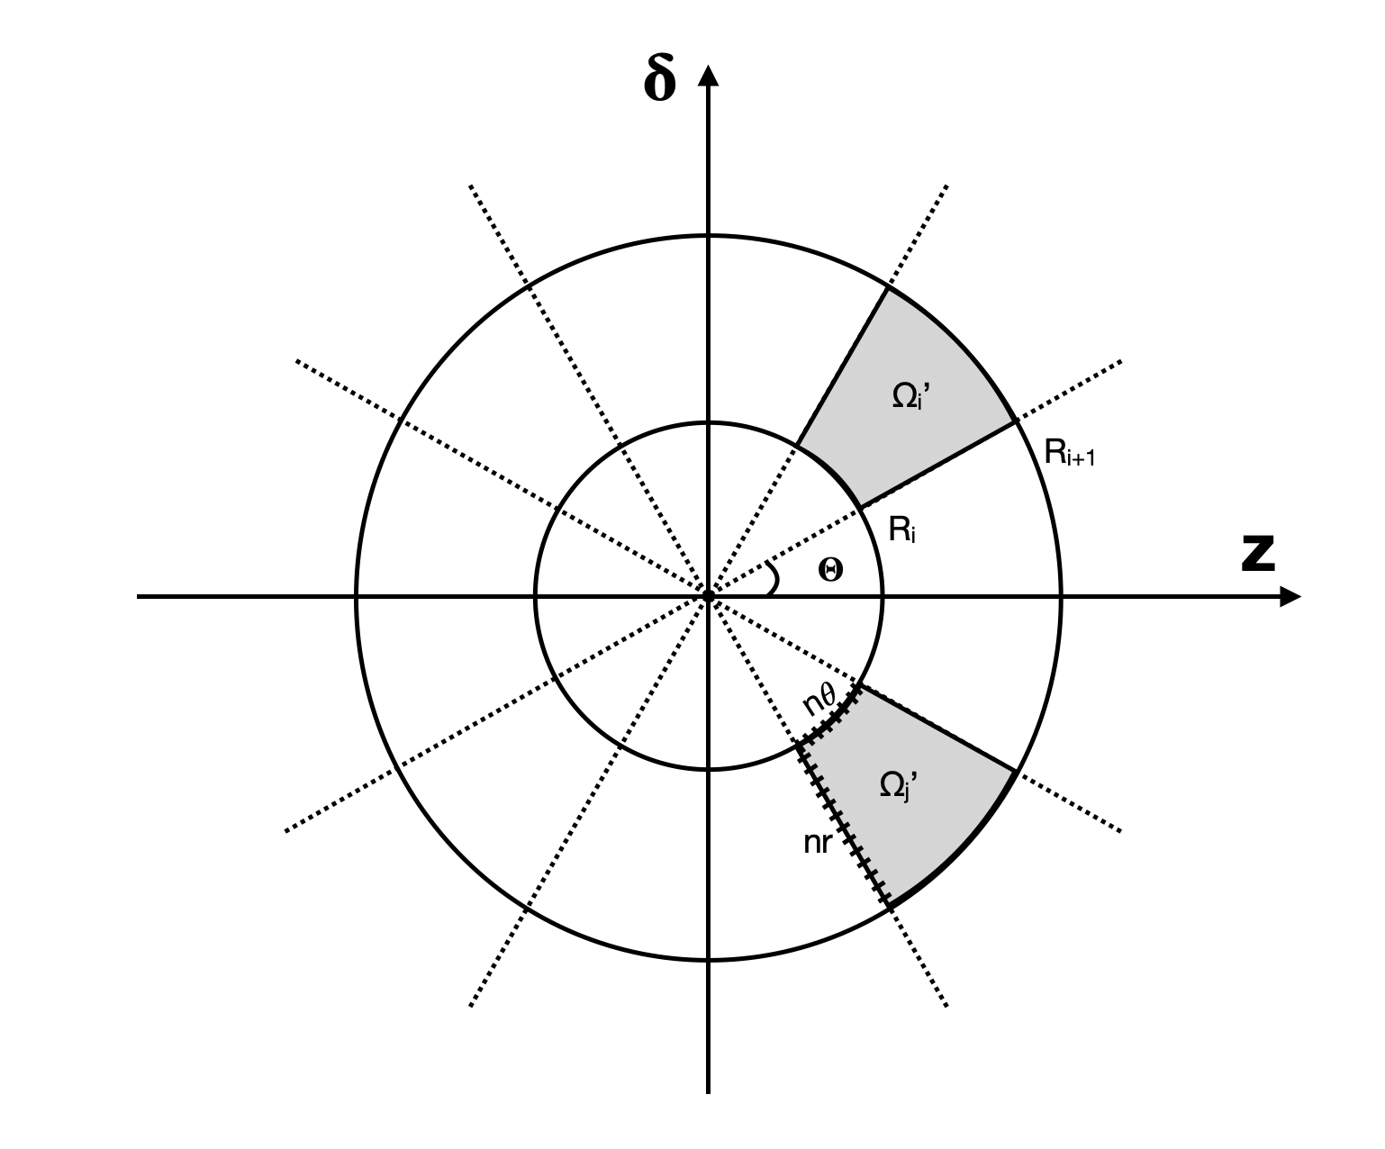
Airbag Distribution Gaussian Distribution
Model has infinitely thin ring, but to address numerically we give it a finite width with distribution:
Ring and slice system to create cells in beam with overall distribution:
Notes:
Sig_z = bunch length. Unrealistic model

Slide 7
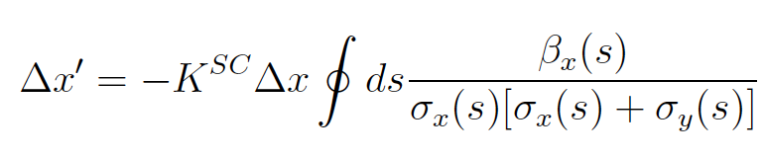
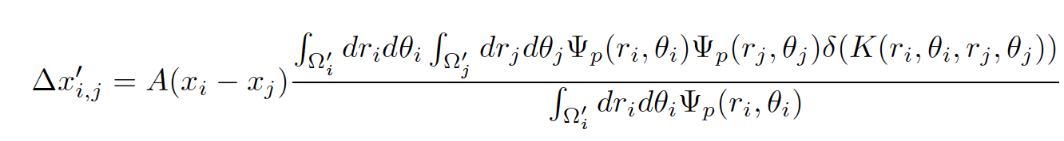
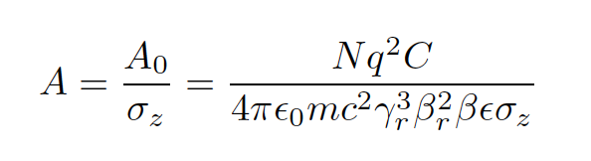

Numerical Method
Need to input the linearised kicks of the beamlets on each other in one turn matrix
General formula for kick of space charge force (1)
Take smooth approximation so that the optical β function is constant over the ring and linearise
Get kick of cell j on i (2)
(1)
Cell i
Cell j
(2)
Notes:
CMM already contains the Hill’s equation of motion so just need to add the kick due to SC
Had to change to polar coordinates, and introduced delta function for the line density

Slide 8
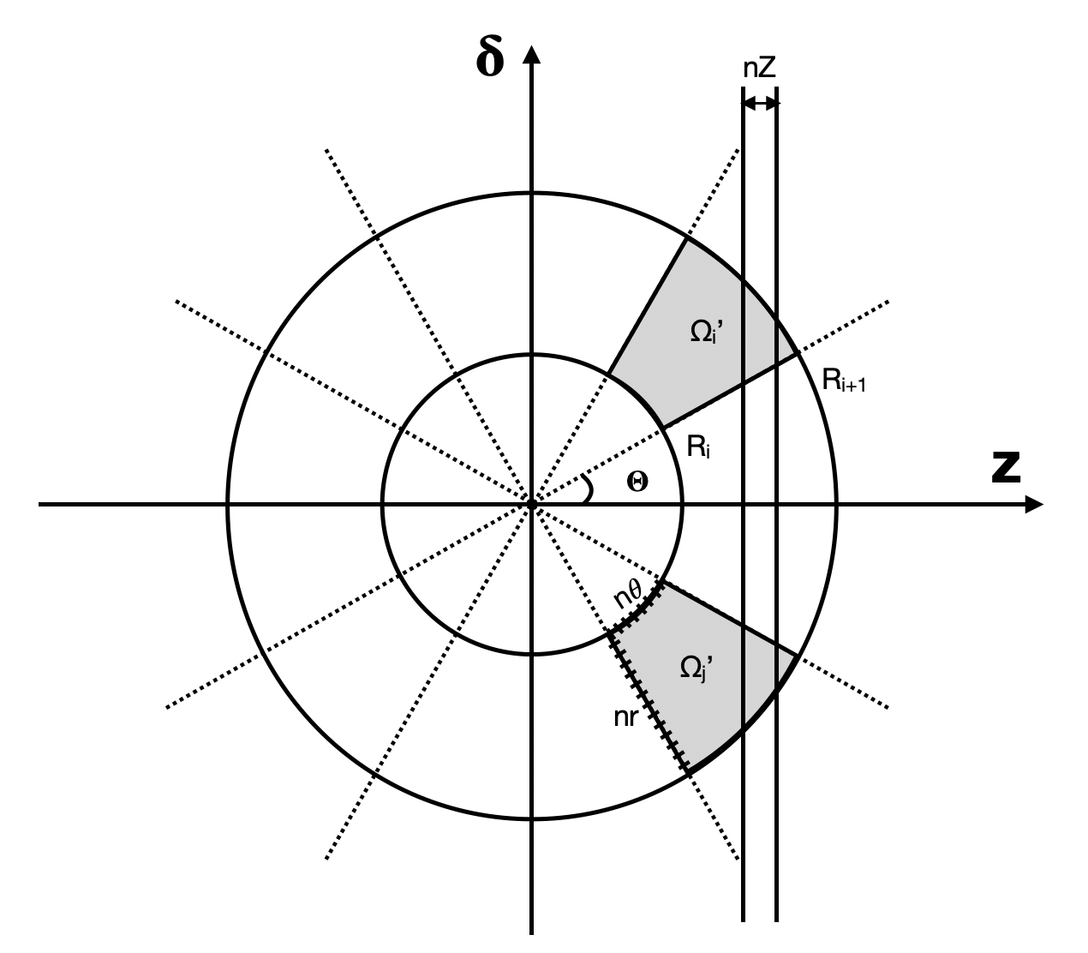
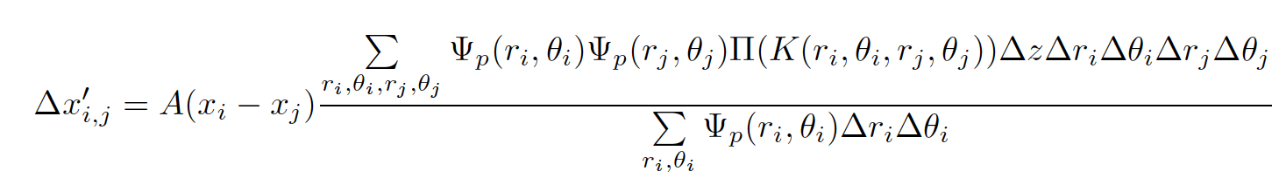
Numerical Method: Discretisation
Discretise integrals into summations for numerical computation
  Delta function becomes a step function with finite width Δz (Δz=1/nZ)
  Integration over phase space becomes dependent on step size, parameterized by nTheta and nR.
  We assume size of steps in theta and r are same for i and j
Δz

Slide 9
Method of Convergence
For given configuration of rings and slices, space charge is a function of nTheta, nR, nZ
Find convergence of nTheta and nR for given nZ
  Take maximum value of interaction matrix and plot against nR and nTheta respectively
  Converged values determined visually
  Values checked by doubling and seeing if max matrix value varies by < 1%
Find converged nZ
  Plot nZ against max matrix value for converged nR and nTheta
  Converged nZ found by plotting the percentage change when doubled to be < 1%

Slide 10
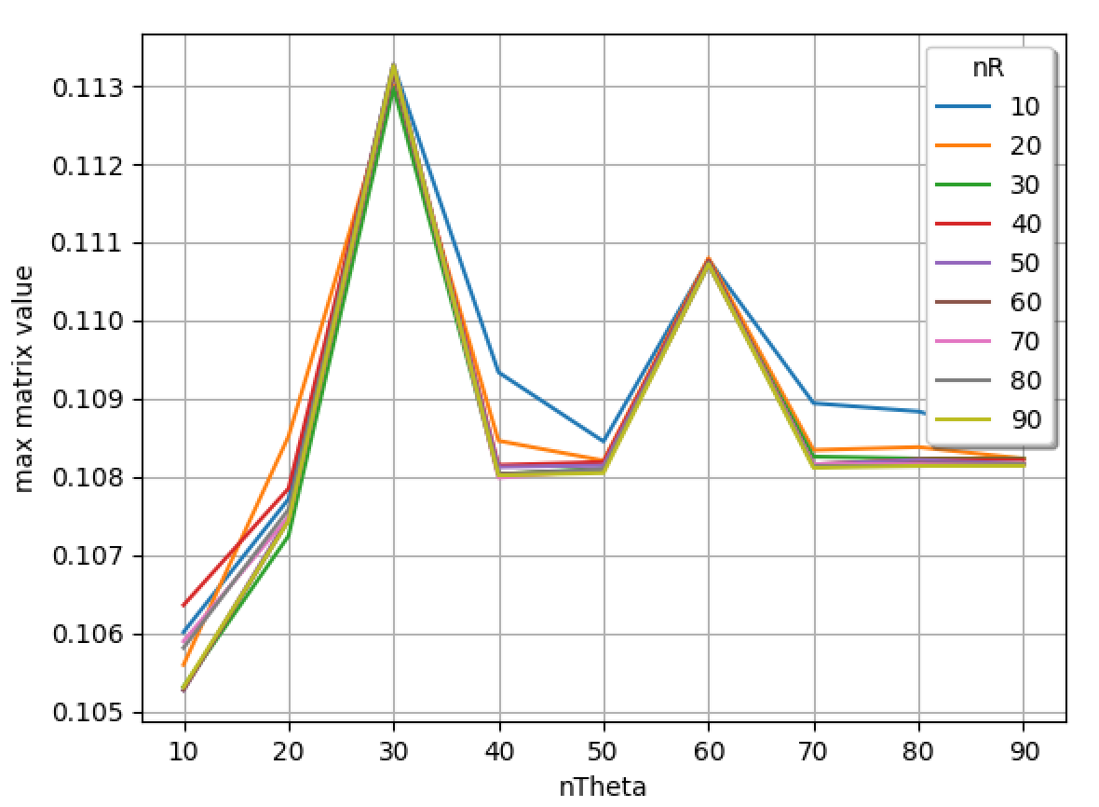
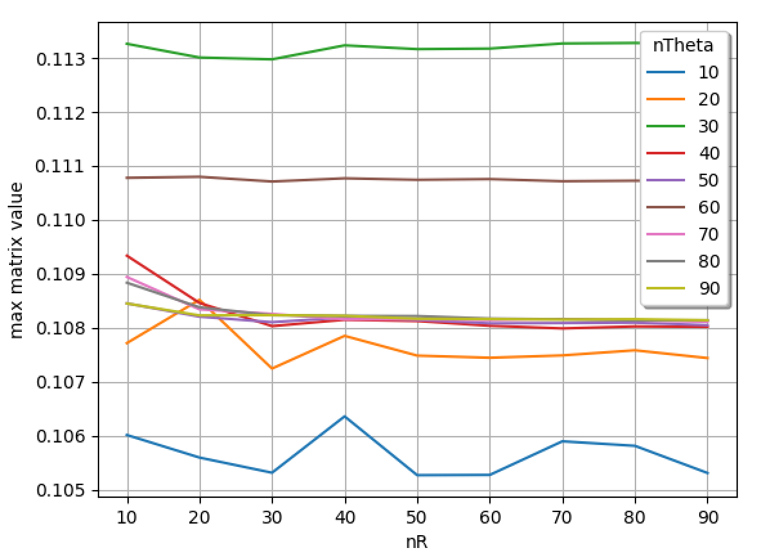
1) Convergence graphs for 20 Slices 1 ring with a Gaussian distribution
nTheta taken as 80, nR as 50
Check: Doubled parameters have 0.57% change in matrix value
Left: Graph of nTheta vs maximum matrix value for nZ=10
Right: Graph of nR vs maximum matrix value for nZ=10

Slide 11
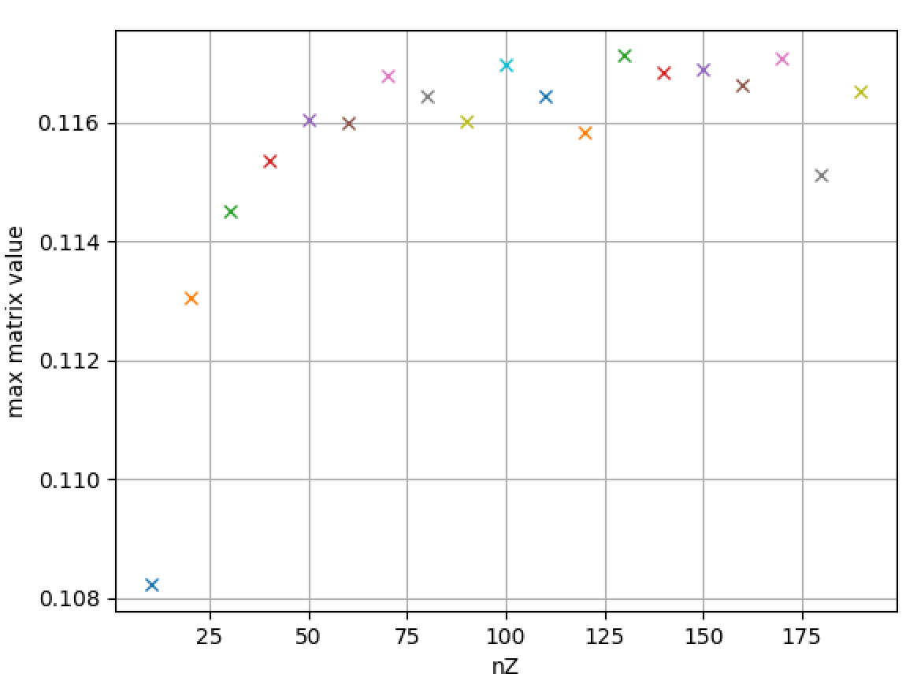
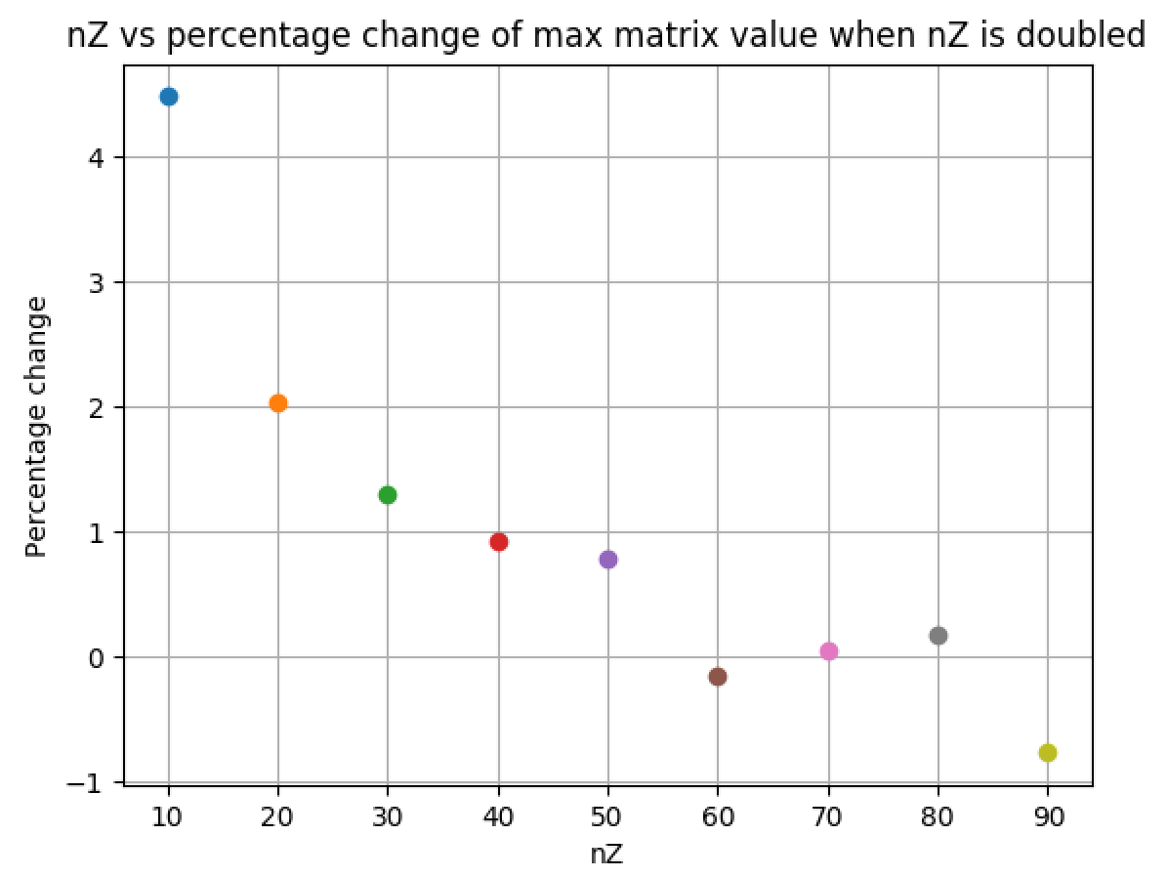
2) Convergence graphs for 20 Slices 1 ring with a Gaussian distribution
Left: Graph of nZ vs maximum matrix value
Right: Graph of percentage change when nZ is doubled
When nZ=50, matrix value < 1%

Slide 12
Method of Convergence (Airbag)
For airbag distribution need to find convergence of parameters nZ, nTheta, nR and the width of the ring, W
Find convergence of nTheta, nR and nZ for each W
  We tested widths of 0.1, 0.01, 0.001, 0.0001
Plot tune shifts to compare shape produced by different widths
  To calculate tune shifts:
    diagonalize one turn matrix to calculate eigenvalues
    Use formula to calculate tune: Q = e^{λi/2π}
    Take real part of eigenvalues
  When shape of plots don’t change with decreased width, W is converged

Slide 13
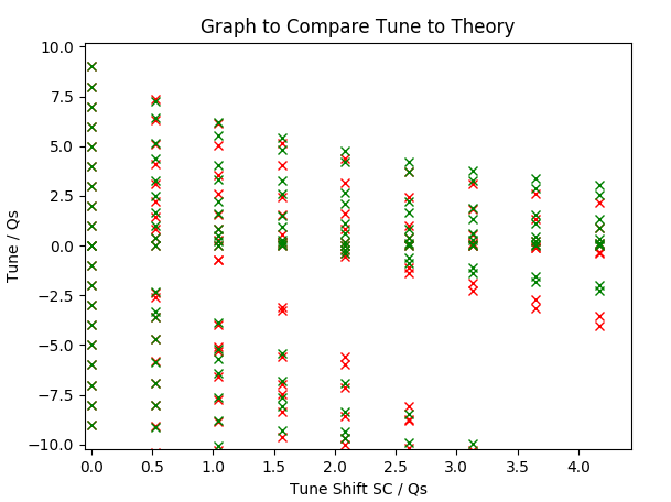
Plot of the coherent tunes for increasing space charge strength
Eg. For W=0.1 and W=0.01
20 Slices

Slide 14
Future work on project
Finish work on convergence
  different configurations of rings and slices for Gaussian distribution
  More widths for Airbag
Check simulated tune shifts for Airbag model matches theory
Compare Gaussian distribution to Airbag
Beam instability: analyse for increasing space charge strength

Slide 15
References
X. Buffat, “Transverse beams stability studies at the Large Hadron Collider,” [PhD thesis] Faculty of Basic Sciences, EPFL, 2015.
A. Oeftiger, “Space Charge Effects and Advanced Modelling for CERN Low Energy Machines,” [PhD thesis] Faculty of Basic Sciences, EPFL, 2016.
E. Gottlob, “Implementation of Space Charge Forces in BimBim,” [Master's thesis] Faculty of Basic Sciences, EPFL, 2018.

