Slide 1


Preparing for SixTrack loss rate simulations
M. Schenk for EPFL team
EPFL & CERN, Switzerland
Acknowledgements
R. Bruce, R. De Maria, M. Giovannozzi, A. Mereghetti, D. Mirarchi, T. Persson, S. Redaelli
EPFL Activity Meetings 20. March 2020

Slide 2
Objectives and steps
Complement LHC beam loss model based on experimental data with SixTrack* simulations
Realize simulations of
  loss rates or H/V loss distributions (qualitative)
  parameter dependency and sensitivity (machine knobs)
Requires aperture model of machine
Prepare machinery for large parameter scans and long term tracking
  Use BOINC† platform
  Profit from recent improvements of
    SixTrack particle initialization (DIST block)
    SixTrack job management (PySixDesk)
    MAD-X mask file handling (see link)
1
2
3
  ^{(*)} Sixtrack is a single particle 6D symplectic tracking code optimized for long term tracking
  ^{(ꝉ)} BOINC is an open-source software platform for computing using volunteered resources

Slide 3
Objectives and steps
Complement LHC beam loss model based on experimental data with SixTrack* simulations
Realize simulations of
  loss rates or H/V loss distributions (qualitative)
  parameter dependency and sensitivity (machine knobs)
Requires aperture model of machine
Prepare machinery for large parameter scans and long term tracking
  Use BOINC† platform
  Profit from recent improvements of
    SixTrack particle initialization (DIST block)
    SixTrack job management (PySixDesk)
    MAD-X mask file handling (see link)
1
2
3
  ^{(*)} Sixtrack is a single particle 6D symplectic tracking code optimized for long term tracking
  ^{(ꝉ)} BOINC is an open-source software platform for computing using volunteered resources

Slide 4
Aperture model
Overview of models for LHC
MAD-X offers functionality to directly export aperture model for SixTrack
  Not in production state yet, but go-to model in future to simplify workflow
“Manually-adjusted” reference model made by CERN collimation team
First thought: go with model A for our studies (simpler workflow)
After exploring that path
  Still some work required
  Will show some of the studies/observations briefly for completeness
There is a simpler, more appropriate solution for us

Slide 5
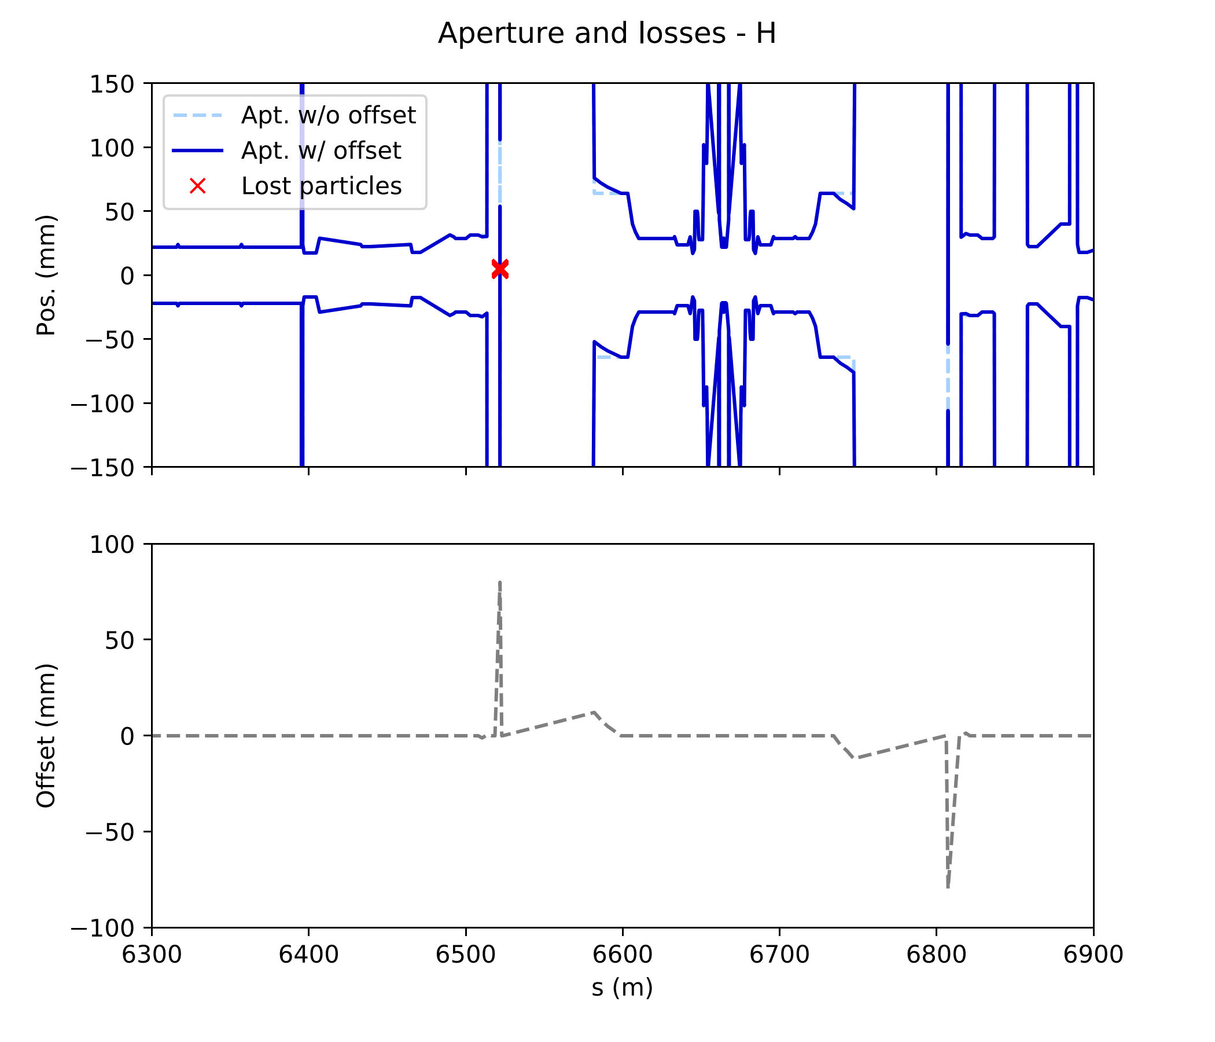
MAD-X exported model (A)
Elements with incorrect parameters: e.g. TANs (neutral beam absorbers)
Inconsistency with offsets for TANs (mech_sep = 0):
all particles crash there
R. De Maria: Advice to remove TANs and put Y chamber markers in place instead
Markers from (old) layout database
IP5

Slide 6
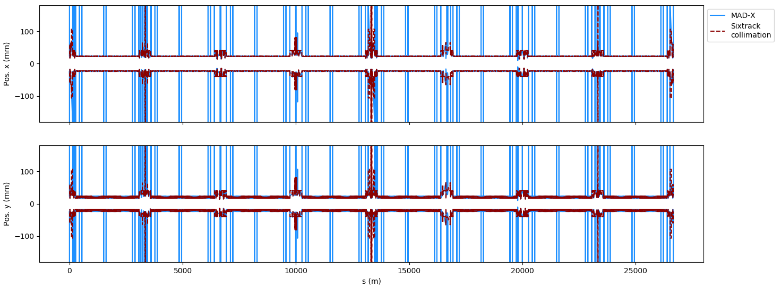
MAD-X exported model (A)
Comparison with reference model (B)
Using PySixDesk, mount reference aperture model (B) onto my MAD-X optics output for SixTrack (fort.2)
Makes direct comparison with MAD-X exported model (A) possible
IP1
IP5

Slide 7
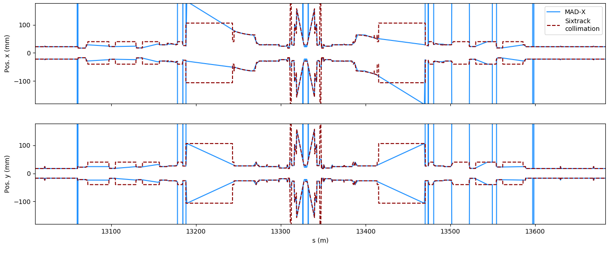
MAD-X exported model (A)
Comparison with reference model (B)
Models reasonably close
Some observations that may (or not) need fixing
  MAD-X linearly interpolates between aperture markers
  MAD-X produces aperture ‘spikes’ (= very large aperture): no concern
  Element offsets/corrections not always the same between the models
Still some work required
IP5
MAD-X using lin. interpolation

Slide 8
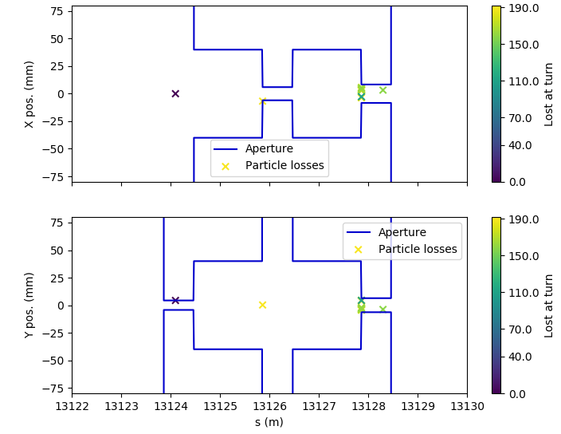
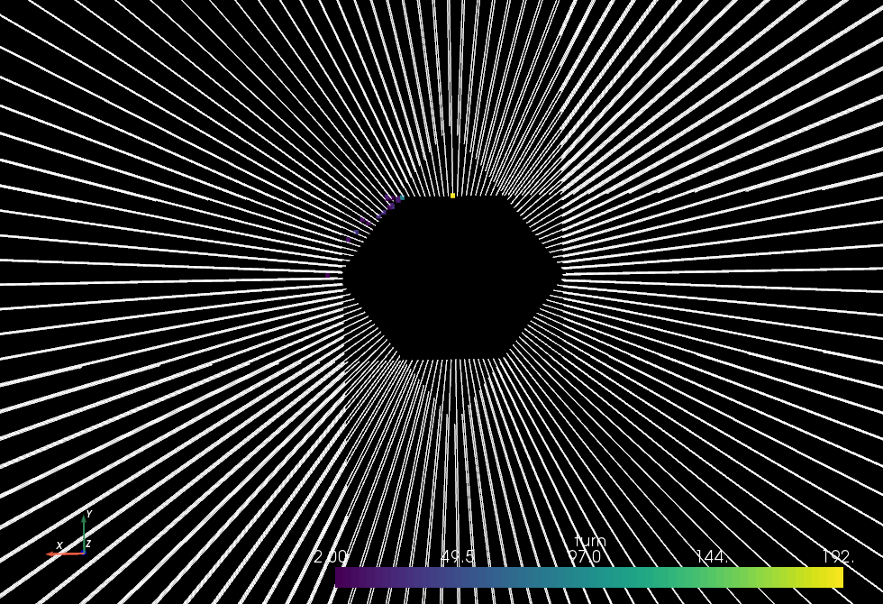
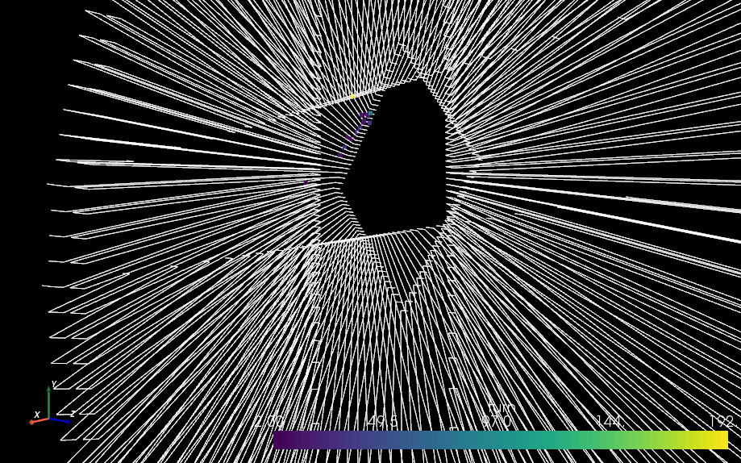
Simple aperture model
Primary collimators only
Discussion with collimation and SixTrack experts (21.02.20)
  Consider black absorber model: expect losses only on primaries (TCP) since no scattering
  Full aperture model not required for our purposes
Created very simple model consisting only of TCPs near IR7 (betatron cleaning)
A. Mereghetti: calculate collimator gaps from N. Fuster-Martinez, Evian 2019
(Tab. 1: TCP IR7 at injection: 5.7σ for ε_{N} = 3.5 μm rad)
Half gaps set in our model depend on beta functions at elements
Loic’s 3D aperture / loss visualizer ☺

Slide 9
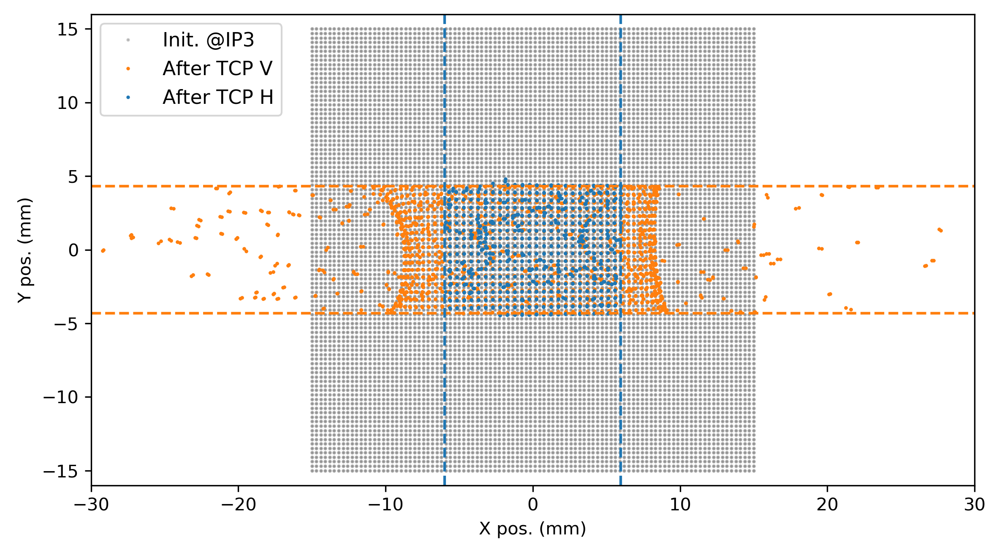
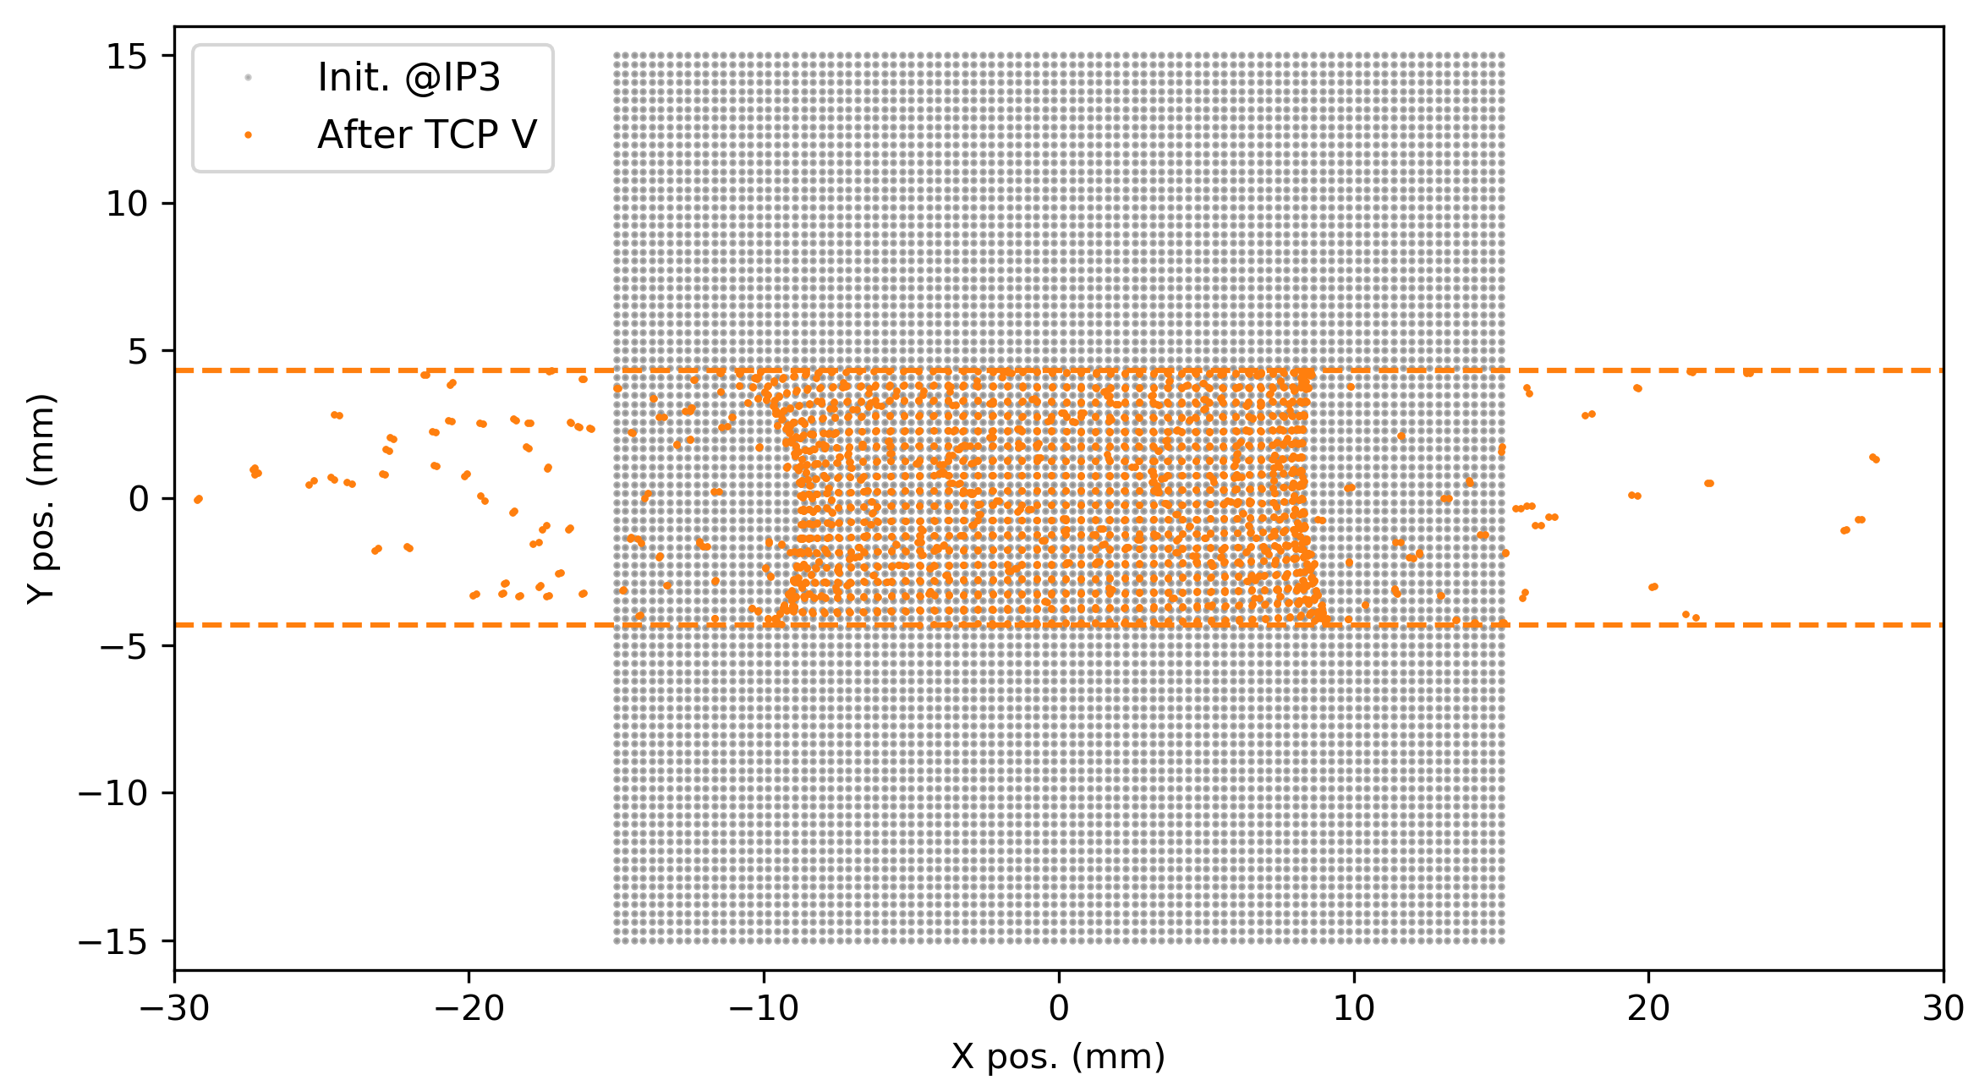
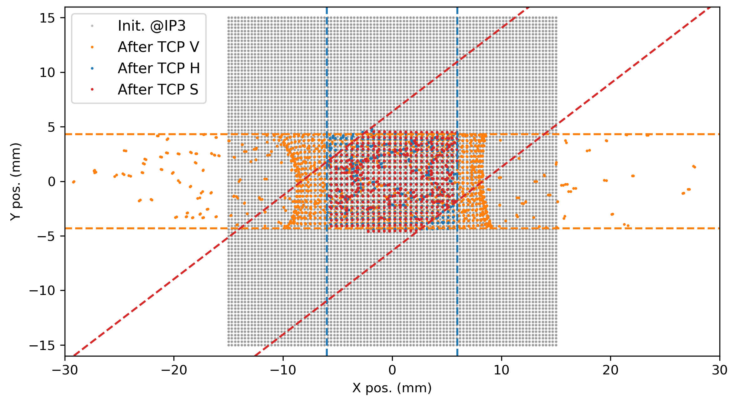
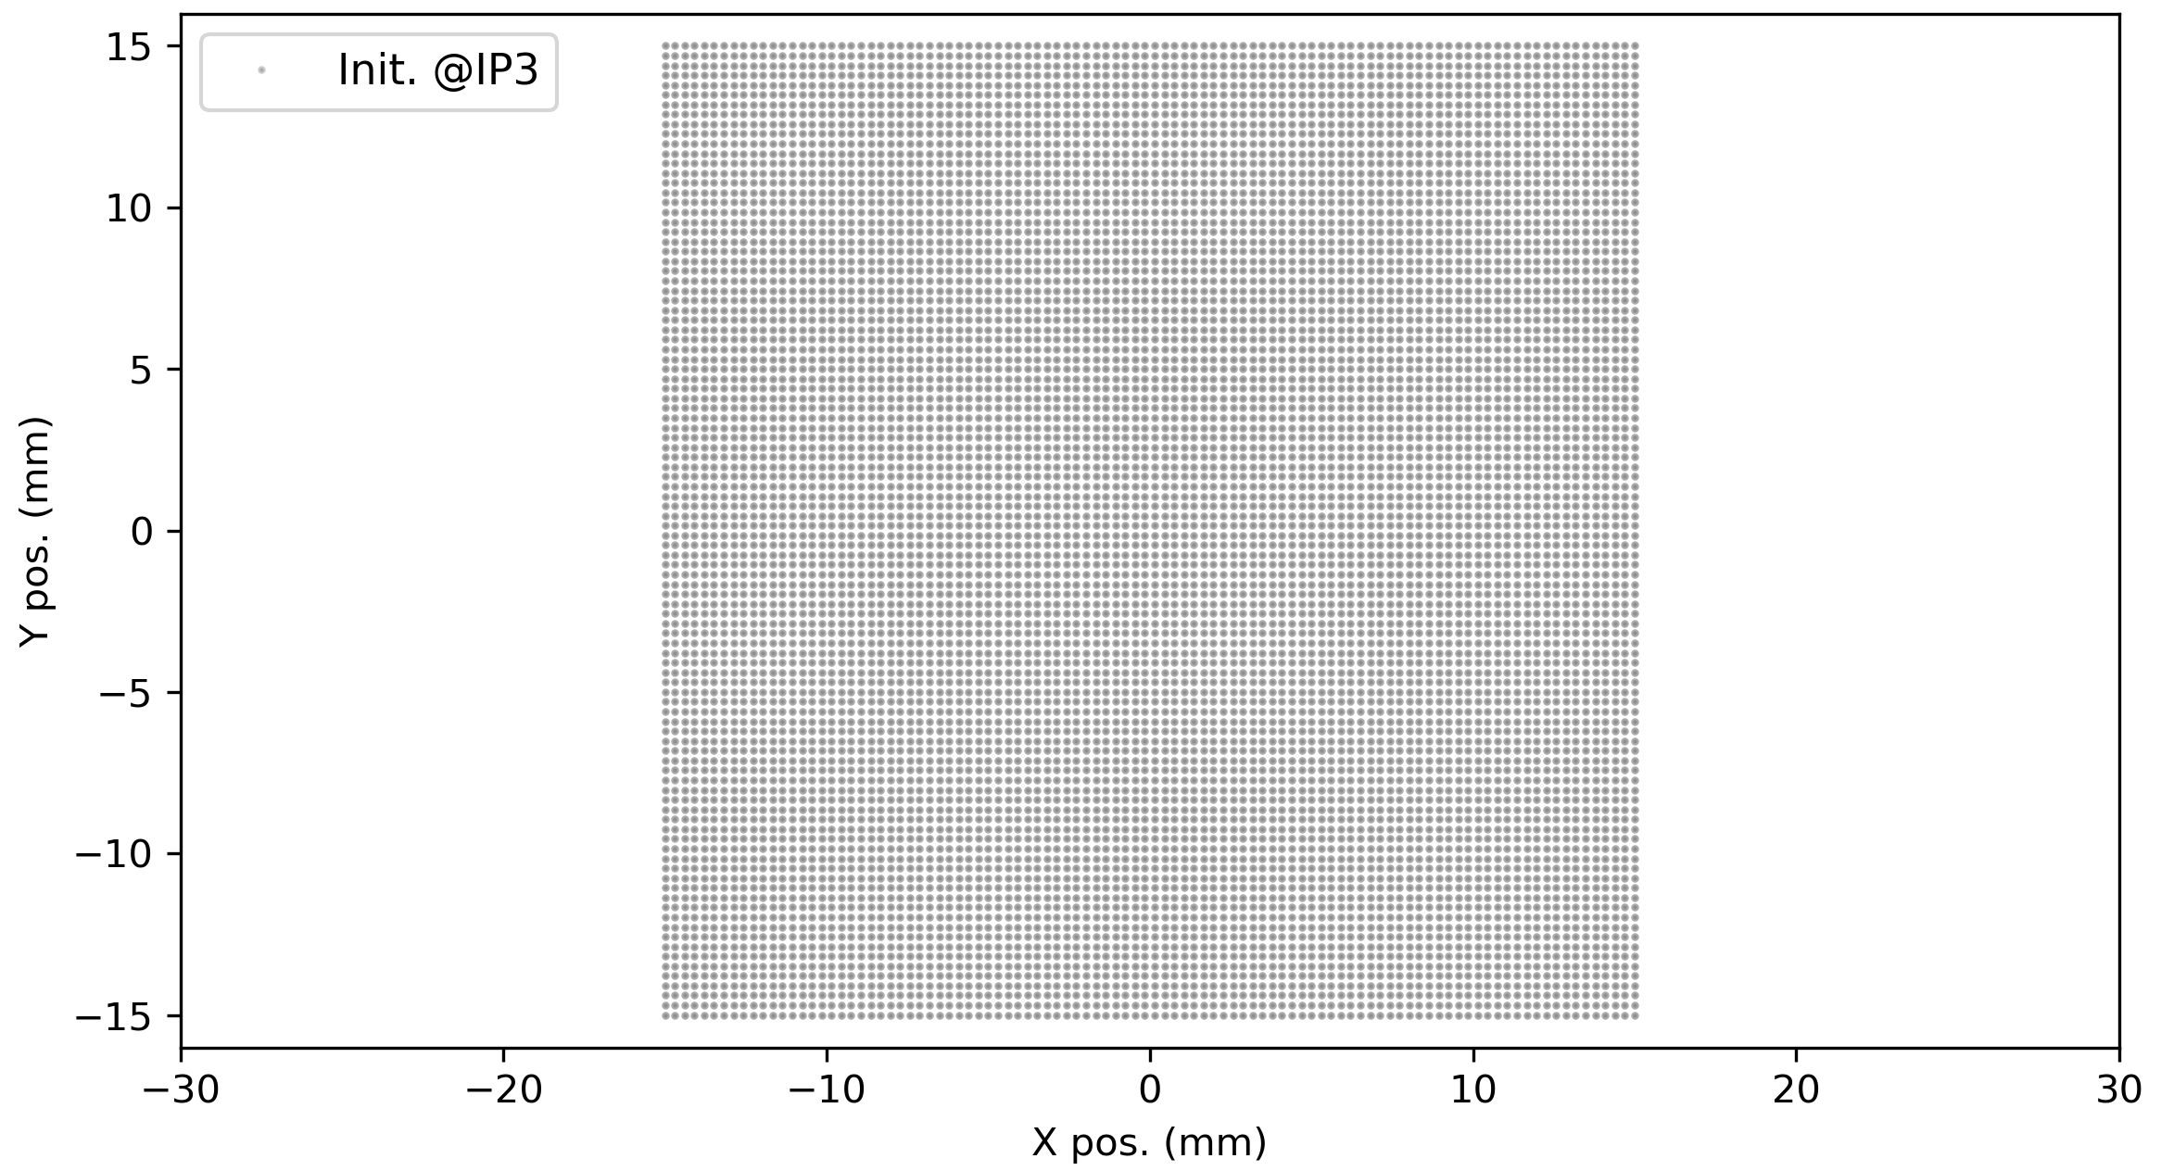
Simple aperture model
Primary collimators only: validation
Track square beam through machine to verify gaps and skew collimator angles
TCP H
half gap: 5.973 mm
angle: 0°
TCP S
half gap: 5.057 mm
angle: 127.5°
TCP V
half gap: 4.308 mm
angle: 90°
Gaps correctly applied and tilt angle correctly propagated to SixTrack
(thanks to T. Persson)

Slide 10
Objectives and steps
Complement LHC beam loss model based on experimental data with SixTrack* simulations
Realize simulations of
  loss rates or H/V loss distributions (qualitative)
  parameter dependency and sensitivity (machine knobs)
Requires aperture model of machine
Prepare machinery for large parameter scans and long term tracking
  Use BOINC† platform
  Profit from recent improvements of
    SixTrack particle initialization (DIST block)
    SixTrack job management (PySixDesk)
    MAD-X mask file handling (see link)
1
2
3
  ^{(*)} Sixtrack is a single particle 6D symplectic tracking code optimized for long term tracking
  ^{(ꝉ)} BOINC is an open-source software platform for computing using volunteered resources

Slide 11
Particle initialization
SixTrack DIST block
We will work with DA-style initial conditions and weights, i.e. polar grid in J_{x}, J_{y}
(Gaussian distributions would require tracking far too many particles)
So far
  (Py)SixDesk runs SixTrack one-turn jobs first to obtain Twiss parameters for
  given lattice
  Cannot initialize matched distribution otherwise
With DIST block
  DISTlib takes care of the matching, no need for one-turn jobs for our studies
  Simplifies particle initialization and job management
  Currently figuring out how to use it correctly: example to follow

Slide 12
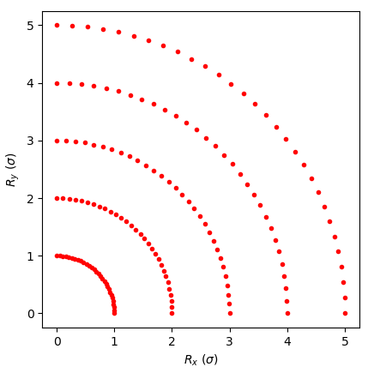
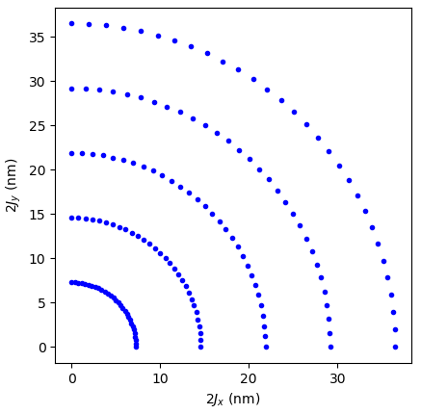
Particle initialization
SixTrack DIST block
Calculate particle actions J_{x,y} from singletrack file at turn 0
(using T-matrix)
Initialized amplitudes in units of σ
What’s been done here
  Initialize polar grid of amplitudes R_{x} = r cos θ / R_{y} = r sin θ (units of σ)
  Compute DIST block-style normalized coordinates XN, YN by applying sqrt(R_{x,y})
  Provide normalized emittances in DIST block => DISTlib will compute coordinates based on XN, YN, given emittances and beta functions at initialization element
  Run SixTrack and evaluate singletrack file output to verify
1σ amplitude particles correspond to specified geometric beam emittances => good!
(here: ε_{x,y} = 3.5 um rad / (βγ) ≈ 7.3 nm, and 2J_{x,y} = ε_{x,y})
To be included in PySixDesk

Slide 13
Objectives and steps
Complement LHC beam loss model based on experimental data with SixTrack* simulations
Realize simulations of
  loss rates or H/V loss distributions (qualitative)
  parameter dependency and sensitivity (machine knobs)
Requires aperture model of machine
Prepare machinery for large parameter scans and long term tracking
  Use BOINC† platform
  Profit from recent improvements of
    SixTrack particle initialization (DIST block)
    SixTrack job management (PySixDesk)
    MAD-X mask file handling (see link)
1
2
3
  ^{(*)} Sixtrack is a single particle 6D symplectic tracking code optimized for long term tracking
  ^{(ꝉ)} BOINC is an open-source software platform for computing using volunteered resources

Slide 14
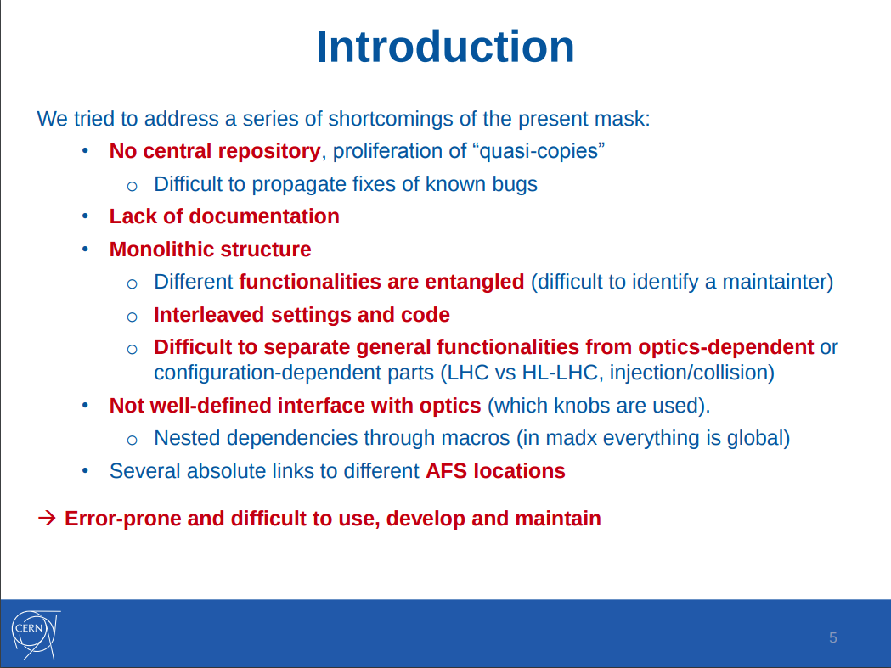
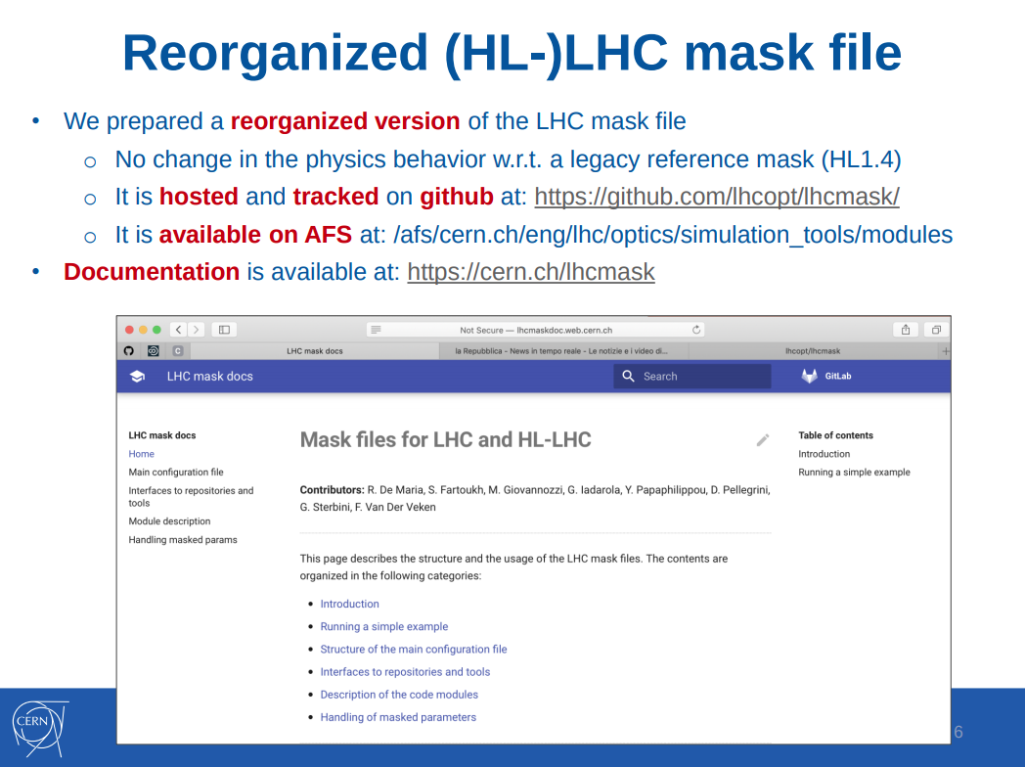
New MAD-X mask file handling
Really useful!!
    R. De Maria et al., Reorganization of
    (HL-)LHC mask, Beam-beam and
    Luminosity Studies, 28.02.20

Slide 15
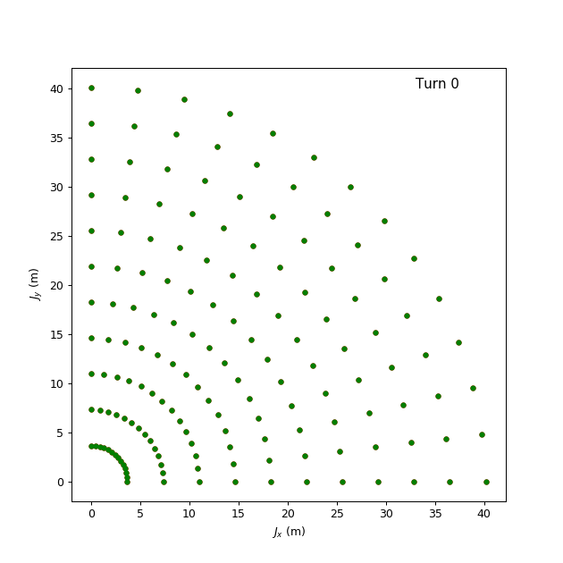
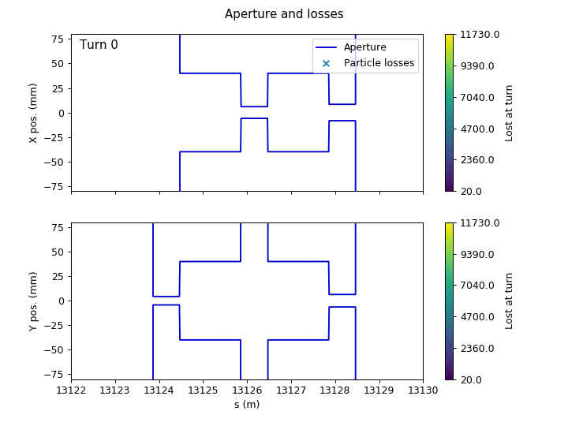
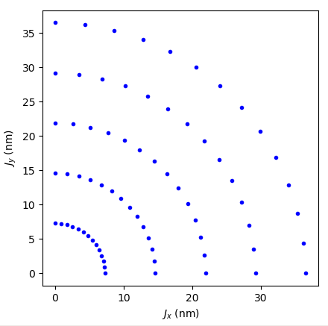
Putting it all together
An example
For testing purposes: unrealistic setup to trigger losses fast
HL-LHC, inj. energy, I_{oct} = 500 A, Q’ = 30 …
ε_{n x,y} = 3.5 um rad
15’000 turns
TCP V
TCP H
TCP S
5σ

Slide 16
Summary and outlook
Summary
  Main pieces of the puzzle are ready to be put together
  First tests with PySixDesk already ran successfully on HTCondor, both the MAD-X and SixTrack jobs, including long term tracking (500’000 turns)
Outlook
  Some implementations still to be done in PySixDesk (e.g. using DIST block), but should be ready soon
  Further testing planned (e.g. running on BOINC)
  Off-topic: conference proceedings for MCBI Zermatt ‘19 due by next Friday …

