Slide 1


MAD-X aperture for SixTrack
M. Schenk for EPFL team
EPFL & CERN, Switzerland
Acknowledgements
R. Bruce, R. De Maria, A. Mereghetti, D. Mirarchi, T. Persson
Discussion on loss maps and SixTrack 21. February 2020

Slide 2
Overview
Background
Support LHC beam loss model from data (rates, H/V) with SixTrack simulations
  Parameter sensitivity and dependency studies
  To be run on BOINC using PySixDesk
Requires at least simple aperture model
  Collimators are black absorbers for now
  Use LHC aperture model created by MAD-X as input to SixTrack
  (go to in the future)
Contents
Some aperture tests and comparisons with SixTrack-Collimation
Outlook

Slide 3
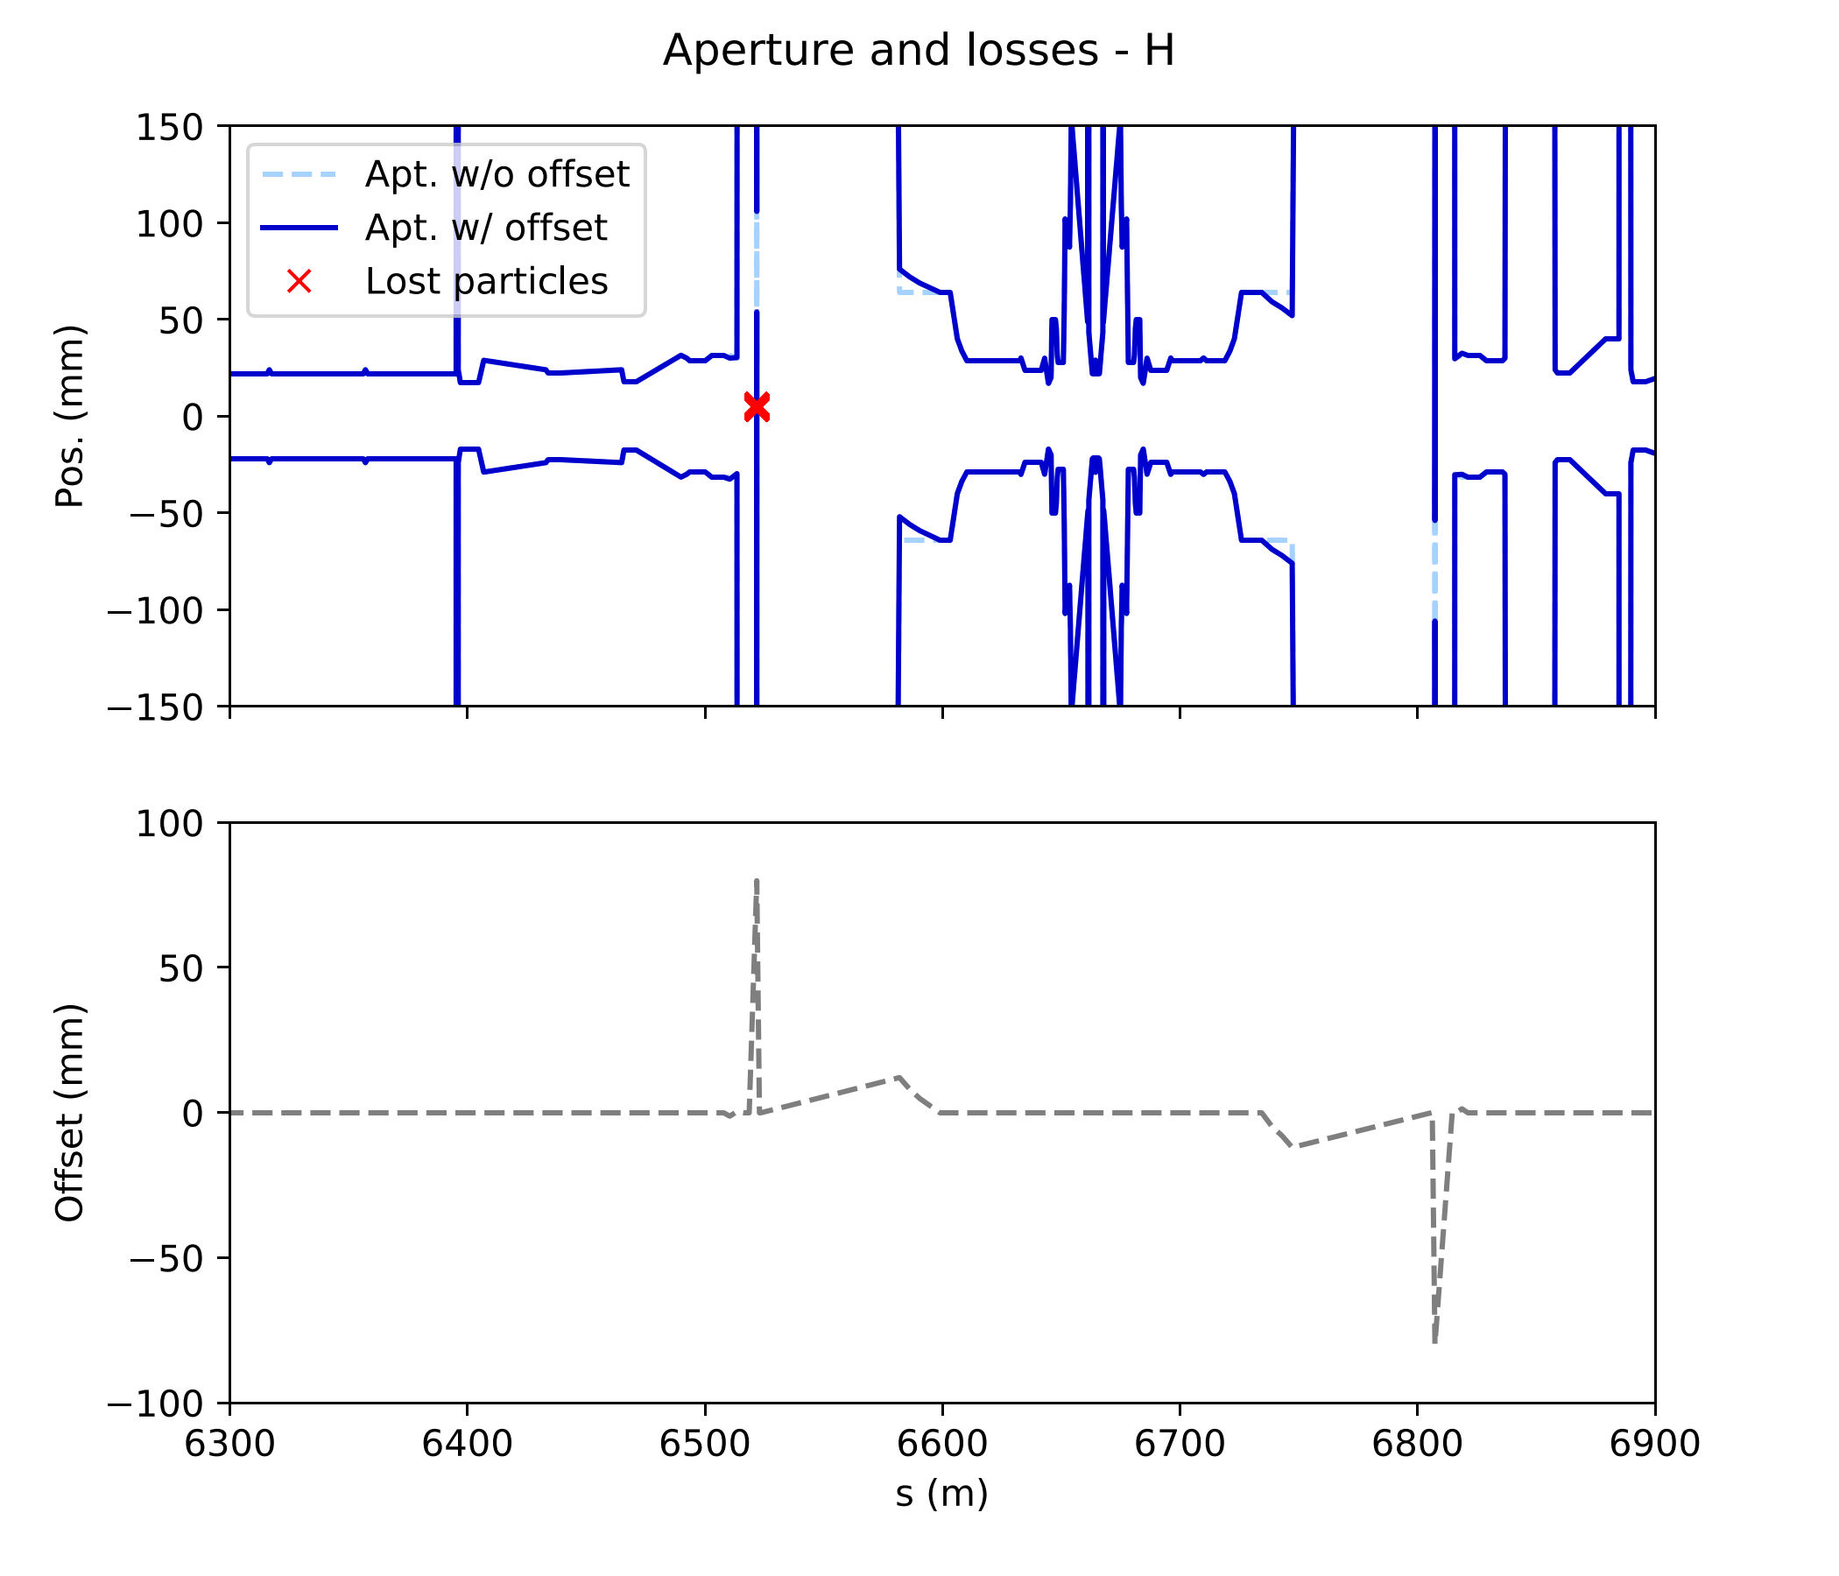
TANs (neutral beam absorbers)
Inconsistency with offsets for TANs (mech_sep = 0):
all particles crash there
Advice to remove TANs and put Y chamber markers in place instead
(thanks Riccardo)
Markers from (old) layout database
IP5

Slide 4
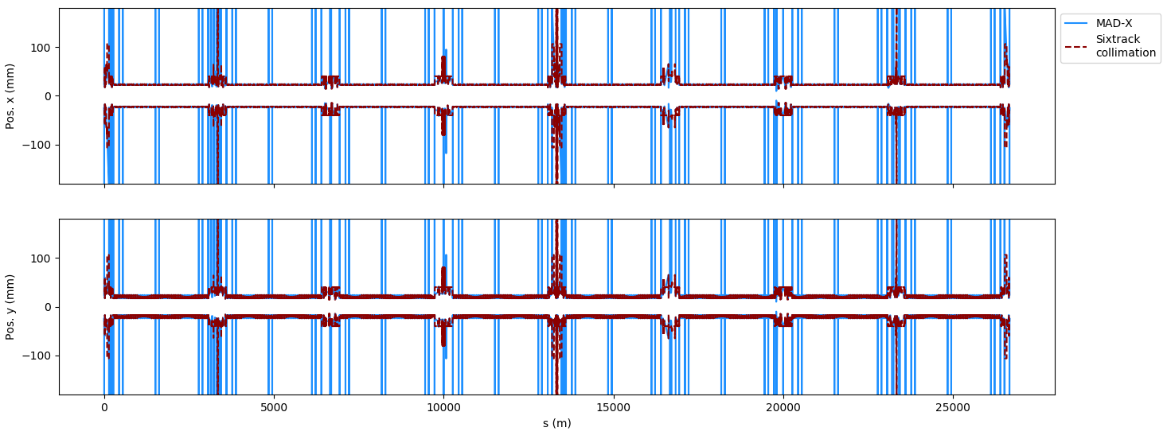
Comparison with SixTrack-Collimation aperture
Using PySixDesk, mounted collimation aperture (allaper.b1) onto MAD-X optics output for SixTrack (fort.2)
Makes direct comparison with MAD-X aperture possible
Thank you to Alessio for pointing out issue concerning IP1 vs. IP3 reference …
IP1
IP5

Slide 5
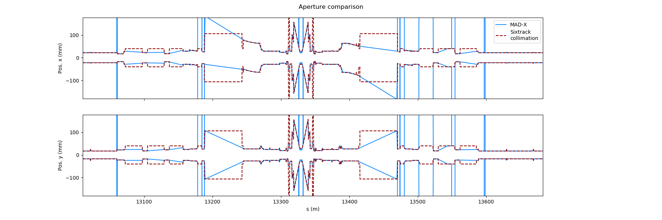
Comparison with SixTrack-Collimation aperture
Models reasonably close
Some observations that may (or not) need fixing
  MAD-X linearly interpolates between aperture markers
  MAD-X produces aperture ‘spikes’ (= very large aperture): no concern
IP5
MAD-X using lin. interpolation

Slide 6
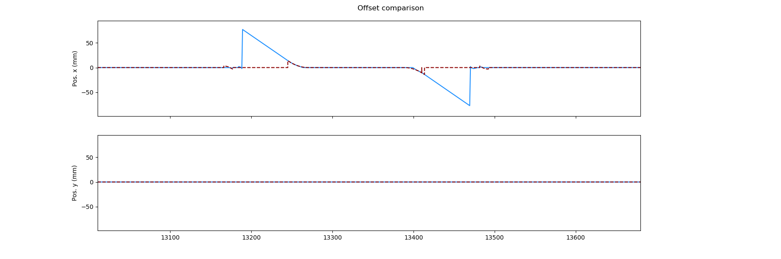
Comparison with SixTrack-Collimation aperture
Models reasonably close
Some observations that may (or not) need fixing
  MAD-X linearly interpolates between aperture markers
  MAD-X produces aperture ‘spikes’ (= very large aperture): no concern
  Offsets not always the same between the models
Happy to help if needed
IP5

Slide 7
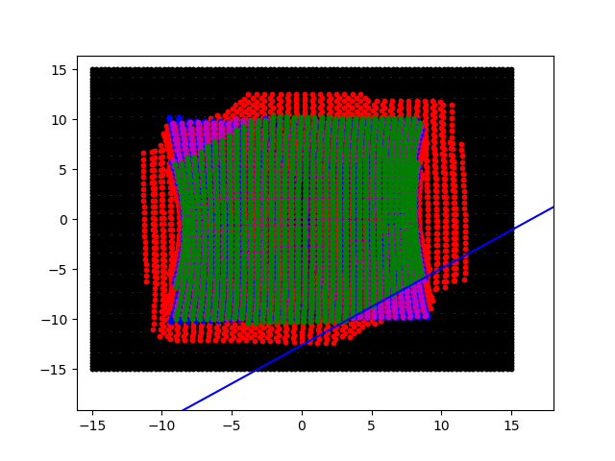
Pseudo collimator test
Loic installed TCPs as ‘pseudo collimators’ (H, V, S)
Track square beam through machine to verify skew collimator angle
Aper_tilt correctly propagated to fc.3.aper file – thanks Tobias
15
initial (IP3)
before pseudo coll.
after coll. H
after coll. V
after coll. S
10
5
y (mm)
0
127.5°
-5
-10
-15
-15
-10
-5
0
5
10
15
x (mm)

Slide 8
Outlook
Getting ready with PySixDesk
  First tests ran successfully on HTCondor, both MAD-X and SixTrack jobs
  Implementation of DIST block in PySixDesk for both DA studies and other initial conditions (Loic, ongoing)
  Test on BOINC
May use MAD-X or SixTrack-Collimation aperture
  For now loss rates at primaries are of interest to us:
  both models likely to provide solid results

