Slide 1


LHC surrogate model
DA concepts and modeling approaches
L. Coyle, G. Obozinski, A. Pentina, T. Pieloni, M. Schenk
EPFL & SDSC, Switzerland
Acknowledgements
R. de Maria, M. Giovannozzi, X. Lu, E.H. Maclean, A. Mereghetti, M. Titze,
F. Van der Veken

Slide 2
Objectives
  Discuss questions on / understanding of dynamic aperture (DA) concepts to identify best modeling approach(es)
  Decide what to go for
    Model that infers scaling law parameters (DA vs. turns N) from beam / machine input
      + allows extrapolation to N >> N_{max,sim}, good for comparison with long-term loss evolution in machine
      - depends on (i) scaling law model, and (ii) model to get from D(N) to loss

Slide 3
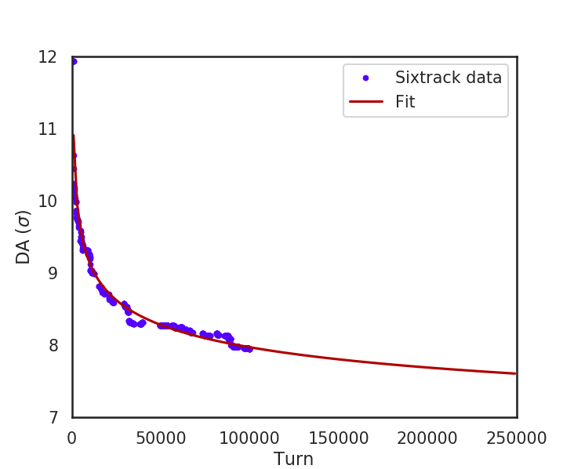
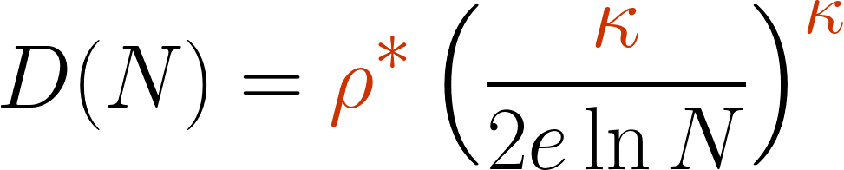
Original idea: Model A
Infer scaling law parameters for DA vs. turns
Extrapolate DA with D(N) and apply loss model for comparison with experiments (several available)
Input
Scan params:I_{oct}
Q’_{x,y}
Q_{x,y}
seed
…
Surrogate model
Output
D(N) fit params
(here: ρ*, κ)
Sixtrack
DB files
Relative loss ΔI/I₀
DA vs. turns from raw data (average over angles)
Fit D(N) using scaling law
Fit params. depend on the fit model chosen for D(N) extrapolation
E.g. model-2b
(M. Giovannozzi, “Some considerations on
Nekhoroshev theorem”, March 2019)

Slide 4
Objectives
  Discuss questions on / understanding of dynamic aperture (DA) concepts to identify best modeling approach(es)
  Decide what to go for
    Model that infers scaling law parameters (DA vs. turns N) from beam / machine input
      + allows extrapolation to N >> N_{max,sim}, good for comparison with long-term loss evolution in machine
      - depends on (i) scaling law model, and (ii) model to get from D(N) to loss
    Model for short-term losses, up to ~10⁶ turns, based on Sixtrack simulations with mechanical machine aperture
      + direct, hence reliable for short-term loss, can get loss distribution around machine (“loss map”) for comparison with experimental data
      - extrapolation beyond 10⁶ ?
      o What would it look like (input / output) ?
    Combination of models A & B
    from mech. aperture data => D(N) => extrapolate beyond 10⁶ if needed
    Other ideas for model at “lower level”
    (e.g. discrete Markov process: transition probability matrix in phase space)
  What data do we need to save (e.g. phase space at fixed intervals)?

Slide 5
Open questions
from discussion with SDSC, 23.07.19
Discussed DA / accelerator terminology, workflow “Sixtrack to losses”, available data
Does proposed surrogate model (A) make sense from data science point-of-view?
Main questions / comments
ML perspective: better to go directly from start to end => here a model that maps machine/beam input parameters directly to loss
But, to compare with long-term loss measurements: need ΔI/I₀(N) at N >> N_{max,sim}
We do not have extrapolation law for losses (?)
Resolved through D(N) scaling laws: if model predicts D(N) we have a way to also extrapolate loss beyond N_{max,sim}
Are there other possibilities to get to losses more directly?
Definition of DA
  How is DA obtained from Sixtrack runs?
  Using min. DA per angle (resp. max. init. ampl. of stable motion) => robustness?
  Could we also use other statistics, e.g. quantiles?
Scaling laws / fits
  Scaling laws applicable in presence of magnetic errors?
  Variance on D(N) points? Error propagation to fit parameters?
  Is least squares fit the right method?
  Would it make sense to fit scaling law to D(N, θ), i.e. for each angle individually, not to “lose” the angular information for the model?

Slide 6
Open questions
from discussion with SDSC, 23.07.19
Discussed DA / accelerator terminology, workflow “Sixtrack to losses”, available data
Does proposed surrogate model (A) make sense from data science point-of-view?
Main questions / comments
ML perspective: better to go directly from start to end => here a model that maps machine/beam input parameters directly to loss
But, to compare with long-term loss measurements: need ΔI/I₀(N) at N >> N_{max,sim}
We do not have extrapolation law for losses (?)
Resolved through D(N) scaling laws: if model predicts D(N) we have a way to also extrapolate loss beyond N_{max,sim}
Are there other possibilities to get to losses more directly?
Definition of DA
  How is DA obtained from Sixtrack runs?
  Using min. DA per angle (resp. max. init. ampl. of stable motion) => robustness?
  Could we also use other statistics, e.g. quantiles?
Scaling laws / fits
  Scaling laws applicable in presence of magnetic errors?
  Variance on D(N) points? Error propagation to fit parameters?
  Is least squares fit the right method?
  Would it make sense to fit scaling law to D(N, θ), i.e. for each angle individually, not to “lose” the angular information for the model?

Slide 7
Open questions
from discussion with SDSC, 23.07.19
Other
  Lower-level model (phase space evolution)
  Markov idea: use Sixtrack turn-by-turn (or fixed interval) tracking data to infer a transition probability matrix in phase space
    Calculate a time propagator T_{N} (= transition probability matrix, sparse) for phase space density ρ(x, p, t) using tracking simulation data (fixed number of turns N), for discretized phase space (x, p)
    Evolution of particle density in phase space can then be computed at times equal to integer multiples of N through successive application of the propagator to an initial distribution:
    ρ(x, p, t=k∙N) ≈ (T_{N})^{k} ρ(x, p, t=0)
    This was done for an electron storage ring and beam-beam effects at DESY in 1993:
    Good agreement found with conventional tracking for 1 dof, i.e. 2D phase space, with large speed up
    For 2 dof limited by storage / resolution (phase space discretization)
    See A. Pauluhn, Stochastic beam dynamics in storage rings, PhD thesis, 1993

Slide 8
Open questions
from discussion with SDSC, 23.07.19
Discussed DA / accelerator terminology, workflow “Sixtrack to losses”, available data
Does proposed surrogate model (A) make sense from data science point-of-view?
Main questions / comments
ML perspective: better to go directly from start to end => here a model that maps machine/beam input parameters directly to loss
But, to compare with long-term loss measurements: need ΔI/I₀(N) at N >> N_{max,sim}
We do not have extrapolation law for losses (?)
Resolved through D(N) scaling laws: if model predicts D(N) we have a way to also extrapolate loss beyond N_{max,sim}
Are there other possibilities to get to losses more directly?
Definition of DA
  How is DA obtained from Sixtrack runs?
  Using min. DA per angle (resp. max. init. ampl. of stable motion) => robustness?
  Could we also use other statistics, e.g. quantiles?
Scaling laws / fits
  Scaling laws applicable in presence of magnetic errors?
  Variance on D(N) points? Error propagation to fit parameters?
  Is least squares fit the right method?
  Would it make sense to fit scaling law to D(N, θ), i.e. for each angle individually, not to “lose” the angular information for the model?

Slide 9
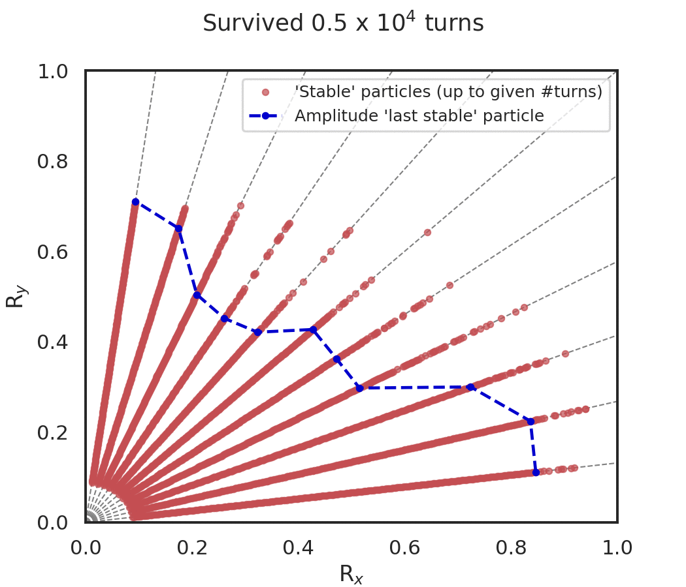
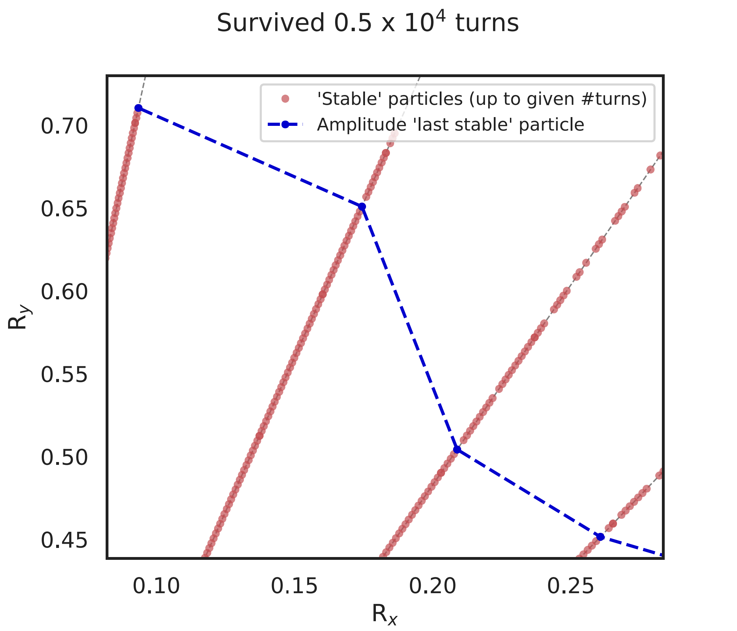
Definition of DA
How DA vs. turns is obtained from Sixtrack runs
R_{x}, R_{y} are related to particle oscillation amplitudes in H and V, respectively
How we get to D(N)
  Particles are initialized on polar grid for selection of amplitudes and angles θ
  (ideally n_{angles} > 30, see backup)
  D(N, θ) is given by highest initial amplitude such that all particles with lower initial amplitude are still part of the beam up to turn N
  (we always refer back to initial conditions: in reality, at turn N, particles may have moved to other amplitudes)
  Highest initial amplitude particle with stable motion is defined as shown on right: even if ‘gap’ given by just 1 lost particle, we consider everything at higher amplitudes unstable / outside of DA

Slide 10
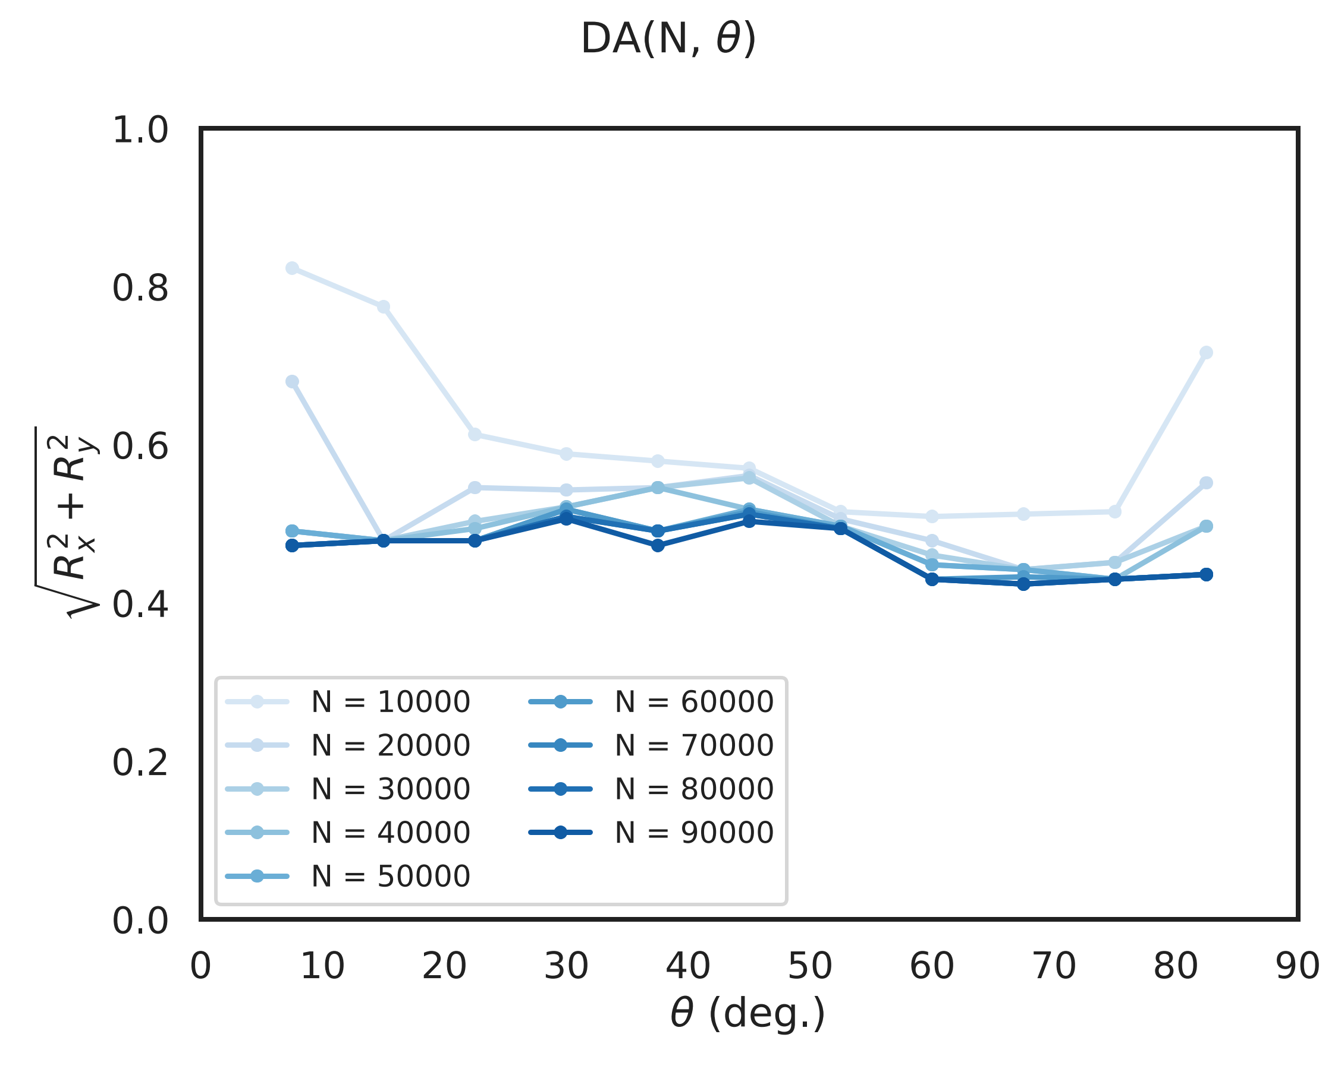
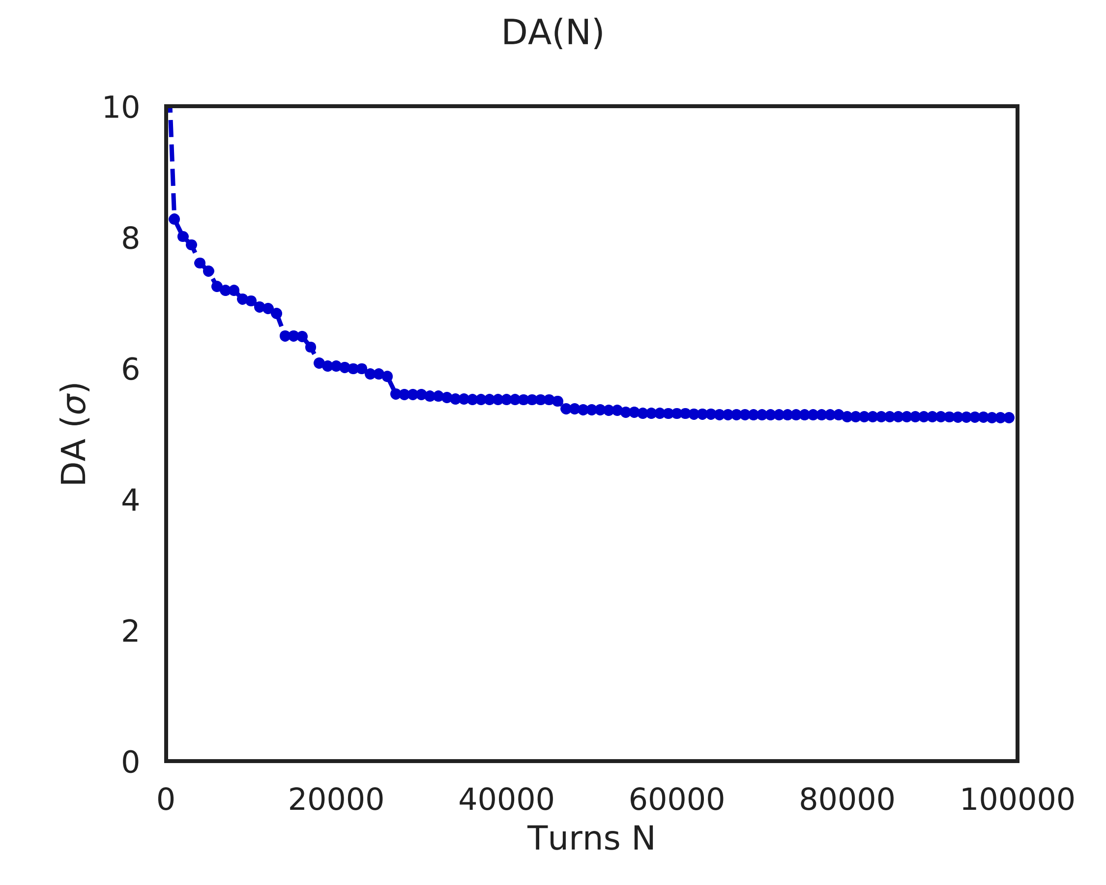
Definition of DA
How DA vs. turns is obtained from Sixtrack runs
  Once we have D(N, θ), numerically integrate over angle (open boundaries, Simpson rule) to obtain average (initial) amplitude up to which stable motion occurs up to turn N
  By doing that for various numbers of turns, we get final result D(N) that we can then fit with scaling laws to extrapolate

Slide 11
Definition of DA
Why always with respect to initial conditions?
Why are survival plots and D(N, θ) shown wrt. initial conditions?
Can we obtain the actual time-evolution of particle distribution in amplitude space?
This could potentially be useful for Markovian model for example
(note that A. Pauluhn, Stochastic beam dynamics in storage rings, PhD thesis, 1993 is using (x, p) rather than action-angle variables)
Short answer: definition of DA
DA describes which initial conditions remain stable up to a certain number of turns
From discussion with E. Maclean: difficult to define / measure the amplitude of a particle in presence of nonlinearities => why?

Slide 12
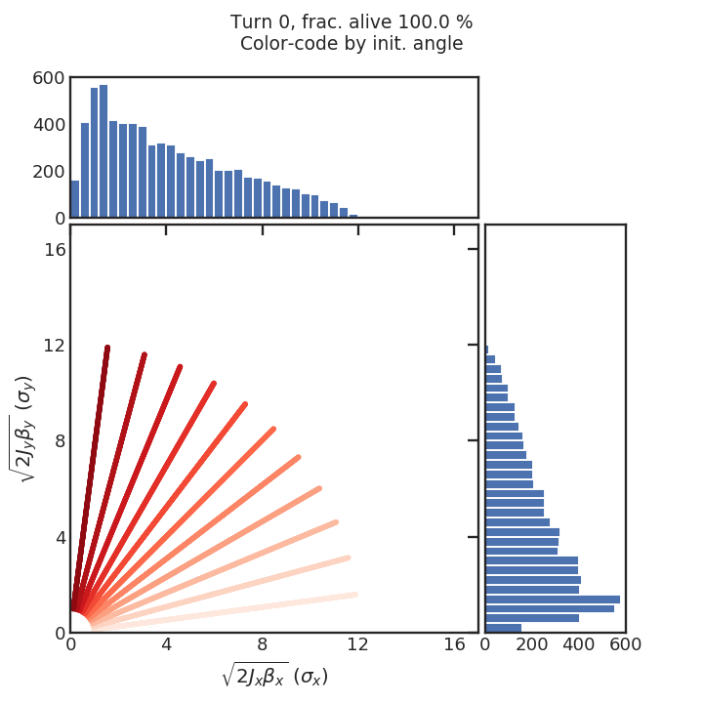
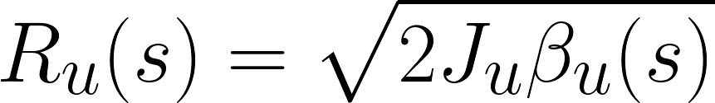
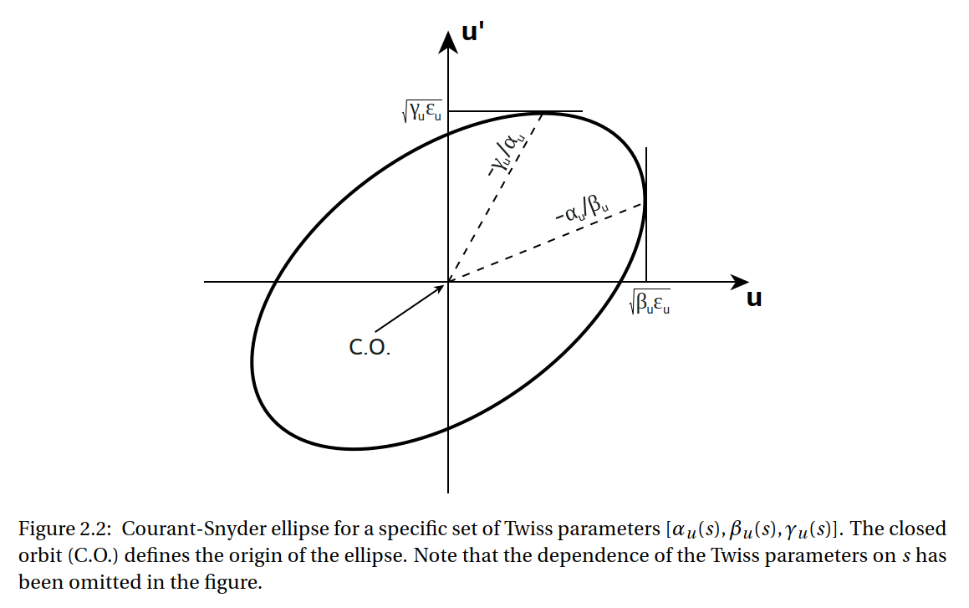
Definition of DA
Why always with respect to initial conditions?
Initialization of particle distribution is done on polar grid in amplitude space (R_{x}, R_{y}) at specific location s in the ring, with
with u in {x, y}
Horizontal, vertical amplitude pairs can be more naturally described in polar coordinates (R, θ)
Note that we “ignore” two phases ψ_{x,y} [angles in (x, x’),
(y, y’) resp.] to reduce dimensionality from 4D -> 2D
ψ_{x,y} are chosen such that particles are initialized along major axis of the ellipse in (u, u’) spaces (an arbitrary choice?)
Studies have shown that DA depends mostly on (J_{x}, J_{y}) and that phases ψ_{x,y} can be neglected: reason is a fast phase mixing that occurs on a much faster time-scale than diffusion processes of particles in (R_{x}, R_{y}) space
We assume upon initialization that all the particles will move on ellipses: this is not usually the case for nonlinear systems (unfortunately, we do not have a better assumption than that before we start tracking)
R
θ

Slide 13
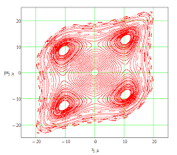
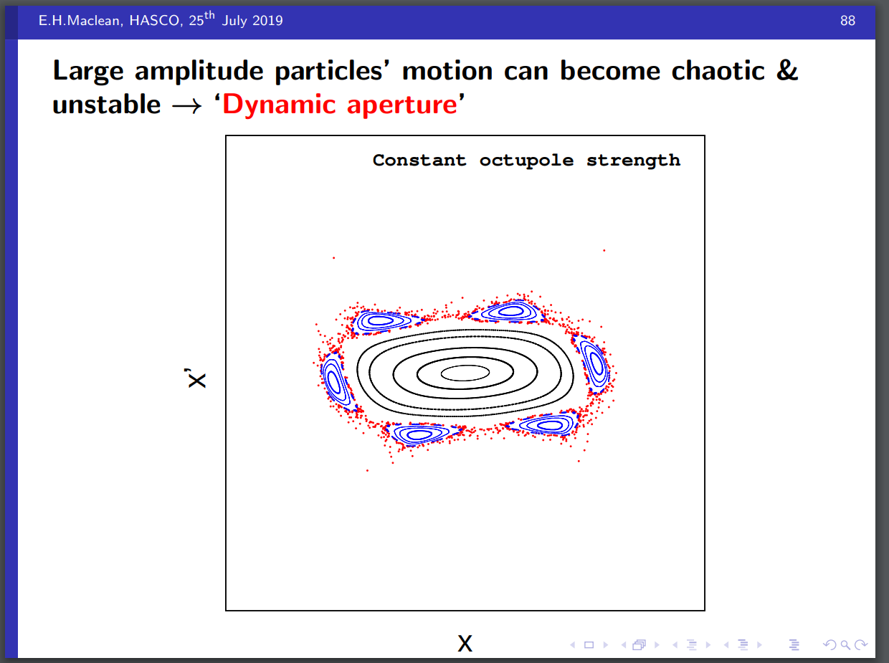
Definition of DA
Why always with respect to initial conditions?
In Sixtrack: first define initial polar grid of amplitude pairs in action-angle coordinate system, and then compute particles’ initial coordinates (x, x’, y, y’) to start tracking process
Coordinate transform is done using Twiss parameters at location s of particle initialization
This conversion of coordinates implicitly assumes particles moving on ellipses
=> very likely not the case due to nonlinear fields (affect mainly large-amplitude particles)
  In the core, where the fields are almost perfectly linear, trajectories do resemble ellipses
  Outside of core region, at larger amplitudes, this is no longer the case. Islands can form due to resonances. The motion in this chaotic regime is irregular and typically unstable
In presence of nonlinearities, defining amplitude is difficult
For Markov model idea: would we need to stick to coordinate space (x, x’, y, y’) rather than action-angle variables?
Courtesy E.H. Maclean

Slide 14
Definition of DA
Robustness
Definition of D(N, θ)
“Rigorously speaking, the dynamic aperture is the innermost radius of the region in the phase space, where the motion is stable. Trajectories with initial conditions in this domain remain confined forever.” (https://cds.cern.ch/record/267125/files/sl-94-024.pdf, chapter 2)
Related question: Why is it enough to have just one particle flagged as lost to set DA? Is this robust?
Particle is considered lost as soon as it exceeds certain amplitude
(default: 1 m) in coordinate space (x, y)
DA = phase space amplitude boundary that separates stable core region (low amplitudes, linear fields) from chaotic regime (high amplitudes, nonlinear fields)
If for one specific angle and turn number only one particle at certain initial condition is lost, but other particles have yet survived at larger amplitudes, this would be only a temporary state (always true?)
  Island formation: these particles are not considered part of stable beam
  Given large enough number of turns, island particles will diffuse to larger amplitudes and separation from stable core will become clearer
  Particles are close to stable regime => often take long time to get lost
Taking max. initial condition that is still stable as DA boundary is following the actual definition of DA and robust in that sense
Courtesy E.H. Maclean

Slide 15
Open questions
from discussion with SDSC, 23.07.19
Discussed DA / accelerator terminology, workflow “Sixtrack to losses”, available data
Does proposed surrogate model (A) make sense from data science point-of-view?
Main questions / comments
ML perspective: better to go directly from start to end => here a model that maps machine/beam input parameters directly to loss
But, to compare with long-term loss measurements: need ΔI/I₀(N) at N >> N_{max,sim}
We do not have extrapolation law for losses (?)
Resolved through D(N) scaling laws: if model predicts D(N) we have a way to also extrapolate loss beyond N_{max,sim}
Are there other possibilities to get to losses more directly?
Definition of DA
  How is DA obtained from Sixtrack runs?
  Using min. DA per angle (resp. max. init. ampl. of stable motion) => robustness?
  Could we also use other statistics, e.g. quantiles?
Scaling laws / fits
  Scaling laws applicable in presence of magnetic errors?
  Variance on D(N) points? Error propagation to fit parameters?
  Is least squares fit the right method?
  Would it make sense to fit scaling law to D(N, θ), i.e. for each angle individually, not to “lose” the angular information?

Slide 16
Conclusion
What modeling approach is most promising in your opinion?
Important for now is to save all Sixtrack output we may need to evaluate the different models
Best way to proceed
  2018 injection: systematic real machine scans (MD) available to compare to
  Track for 10⁵ .. 10⁶ turns
  Use mechanical aperture to determine losses (instead of 1 m threshold): should still be able to infer long-term DA vs. turns from this data
  Save also phase space at regular time intervals & locations of lost particles
  Angular and amplitude resolution can be improved extended with additional runs later

Slide 17
Backup

Slide 18
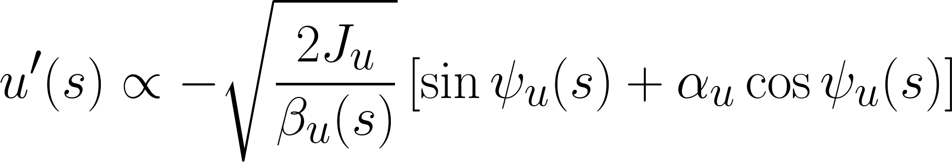
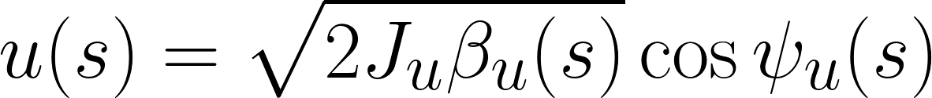
Short introduction to single-particle dynamics
Action-angle coordinates
Particle accelerator 6D phase space is given by (x, x’, y, y’, z, δ), where (x, x’) / (y, y’) are the horizontal / vertical coordinates and conjugate momenta; (z, δ) describe the longitudinal phase space (not considered here for now).
This is the coordinate system that Sixtrack uses to do the tracking, i.e. to compute the ‘kicks’ received by every particle as they pass through magnets.
For many analytical calculations, the transverse particle motion can be described more conveniently in so-called action-angle coordinates (J_{x},ψ_{x}), (J_{y}, ψ_{y})
The relationship between (x, x’, y, y’) and the 4D action-angle coordinates is given by
with u in {x, y}.
α_{x,y} and β_{x,y} are the ‘optics functions’ of the machine (aka. “Twiss” parameters)
The action J_{u} is an invariant of the motion, i.e. independent of the longitudinal position s along the accelerator, and hence time, as long as the fields in the accelerator system are fully linear.
In this case, particle motion describes an ellipse in phase space, called the Courant-Snyder ellipse, and 2π J_{u} corresponds to the area of the ellipse in (u, u’) phase space.
Sometimes ε_{u} = 2J_{u} is referred to as the single-particle emittance.

Slide 19
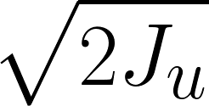
Short introduction to single-particle dynamics
Courant-Snyder ellipse
At a specific location s in the accelerator, with only linear fields, given that we wait long enough (many turns), and if the particle’s oscillation frequency (betatron tune) is an irrational number, its motion will densely trace out the Courant-Snyder ellipse.
In a perfectly linear machine, all particles are hence moving on ellipses of different sizes according to their action (assuming we always observe the particles at the same specific location s in the accelerator).
There also exists a coordinate transform (Floquet transform) to normalized coordinates that maps the ellipse onto a circle of radius .
If we also include the s dimension, the particles move on tori, since their amplitude varies along the accelerator ring (on top of the betatron oscillation itself) as described by the Twiss parameters
(= machine optics).
If the tune is a rational number, a particle would only ‘sample’ specific points along the ellipse over time (for example if the tune is 0.25, four points would be sampled along the ellipse only).
There is a danger of resonances in that case, once nonlinear fields are present in the machine that can drive them.

Slide 20
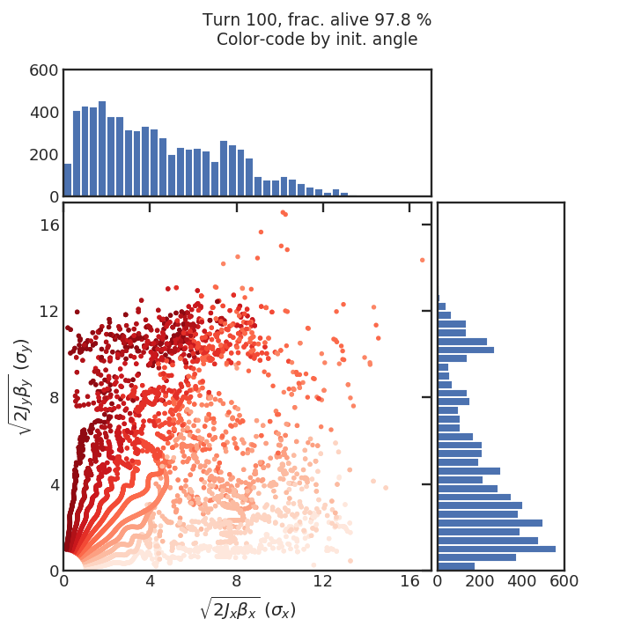
Short introduction to single-particle dynamics
The issue with defining the correct amplitude II
Sixtrack turn-by-turn tracking data is output in (x, x’, y, y’) coordinates. Transforming back to action-angle coordinates (or 2D amplitude space), for example to display the survival plots of particles using the amplitudes at turn N (and not those set for initial conditions), is not obvious since our original assumption of elliptical trajectories is not generally correct (back-transform simply using the optics functions is wrong).
An example is shown below where the back-transform from (x, x’, y, y’) was done incorrectly using the original optics functions
LHS: initial conditions at turn 0. RHS: particle ‘amplitudes’ after 100 turns, computed based on the assumption of elliptical trajectories. The reason why it looks like many particles have already experienced a large change in their amplitudes is simply because the back-transform was done incorrectly (these are the particles where the assumption of elliptical trajectory is wrong. Their amplitudes have not changed, but they are just not moving on ellipses), and not because of diffusion, or chaotic motion (time-scale is too short for that to be the reason).
Particles at small amplitudes are more likely to experience only linear fields and hence the assumption there is ‘more correct’, the ‘incorrect’ back-transform hence still gives reasonable results.

Slide 21
Definition of DA
When a particle is considered lost
A particle is considered lost as soon as it exceeds certain amplitude in coordinate space (x, y)
  Typically threshold at 1 m
  Studies done with different thresholds show that short-term DA (10³ .. 10⁴ turns) can depend quite strongly on threshold
  Long-term DA on the other hand is not affected much by threshold given that tracking is done for ‘large enough’ number of turns

Slide 22
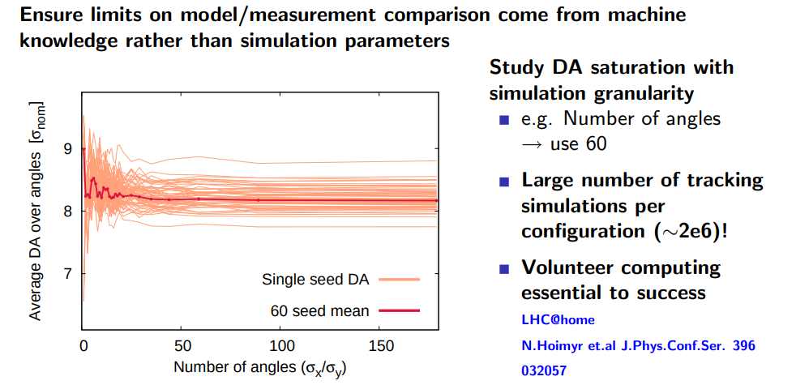
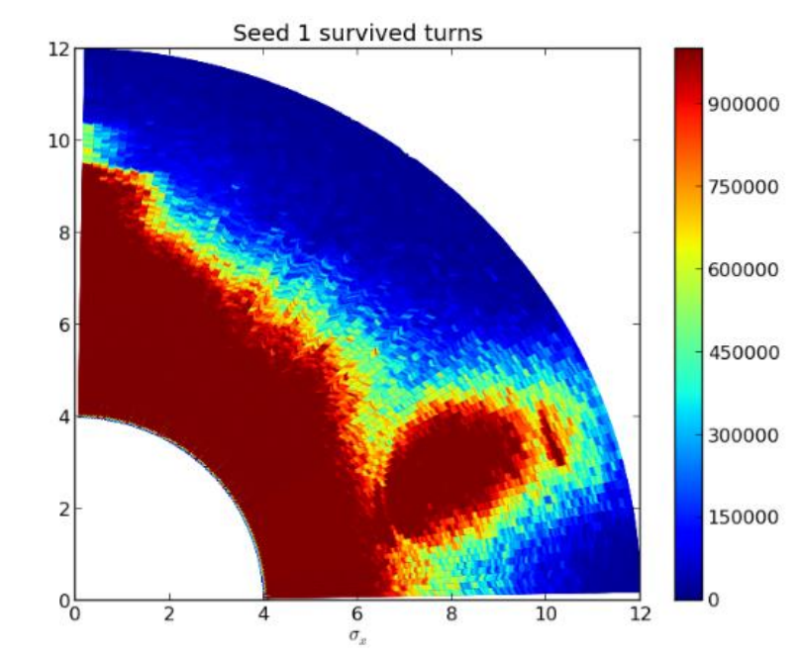
Additional remarks
Why no particles initialized at angles 0° and 90°?
By convention / habit. If n_angles large enough there is no significant effect as demonstrated by convergence studies.
Should typically use about 30 angles for convergence (for specific LHC measurement comparisons typically use 60 angles)
Lower plot shows example survival plot with higher angular resolution. Impact of missing data at angles 0° and 90° becomes small.
Particles are tracked completely independently: there is no interaction between them
However, if particles are part of same island, they may behave similarly since they are all governed by similar dynamics, see also previous slides)
Reference: https://cds.cern.ch/record/267125/files/sl-94-024.pdf, (mainly chapter 2), contains additional useful information.
Courtesy E.H. Maclean
Courtesy R. de Maria

