Slide 1


SPS ongoing studies: towards reinforcement learning for electrostatic septum alignment
M. Schenk^{ꝉ}, M. Fraser*, B. Goddard*,
S. Hirlaender^{*Ꝉ}, V. Kain*, T. Pieloni^{ꝉ}
*CERN & ^{ꝉ}EPFL, Switzerland
^{Ꝉ}also at University of Malta
PACMAN Project Meeting: SPS ongoing studies 21. June 2019

Slide 2
Overview
Introduction
  SPS slow-extraction scheme
  Electrostatic septum: an optimisation problem
Motivation: reinforcement learning
Data-driven model
  Overview
  Results: training and validation
Final remarks

Slide 3
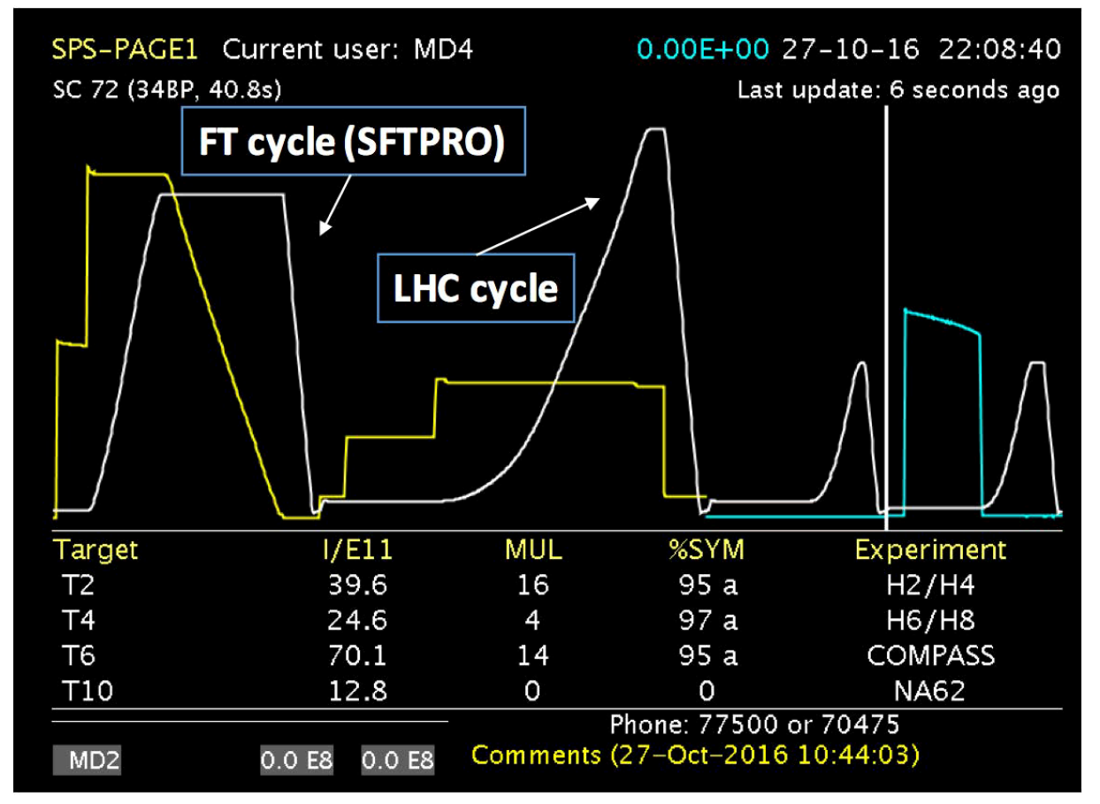
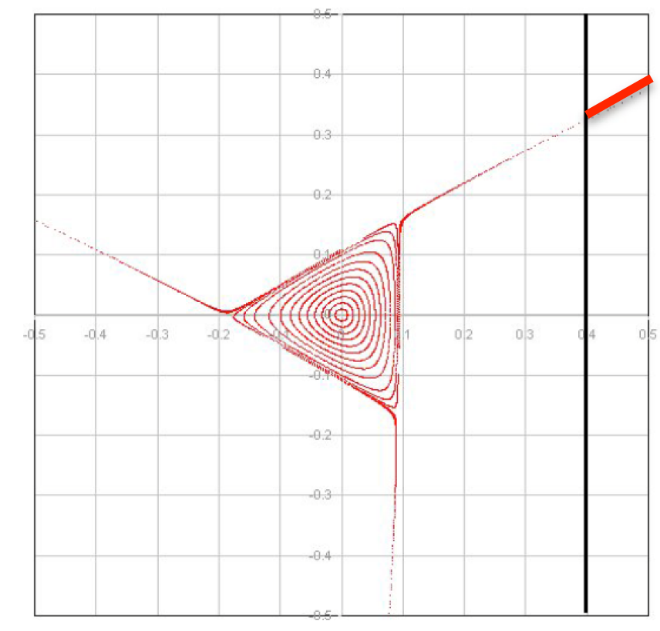
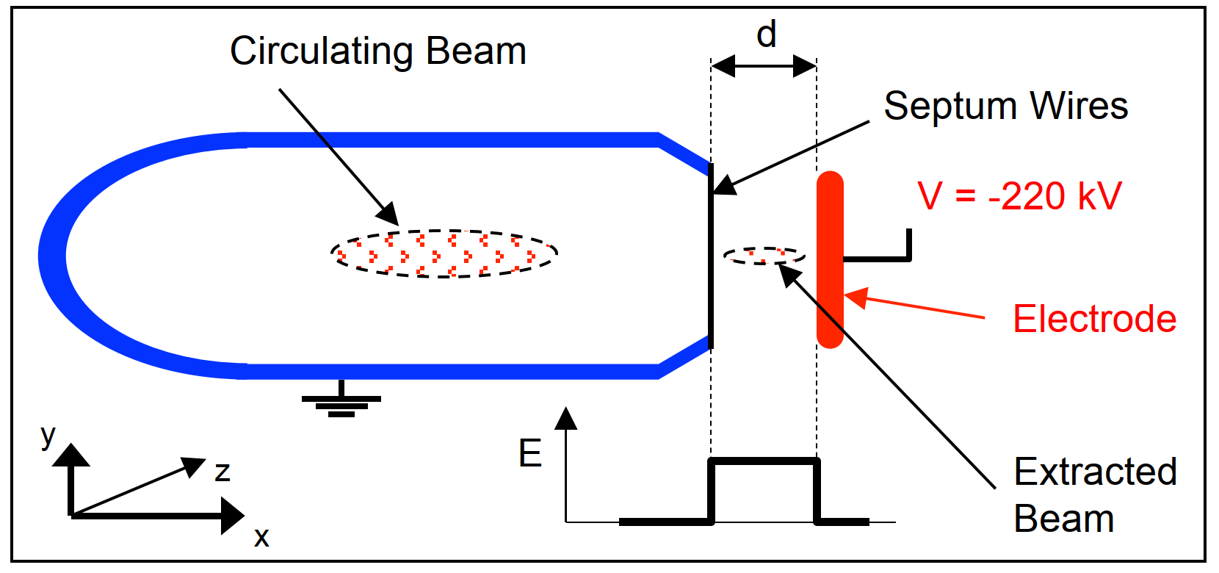
Introduction
SPS slow-extraction scheme
Super Proton Synchrotron (SPS) delivers protons
to Fixed Target experiments (FT)
FT request constant particle flux for several
seconds (= spill)
Solution: multi-turn resonant extraction scheme
  Excite third-order resonance
  Extract beamlets by means of electrostatic septum (ZS)
Challenge: inherently a lossy process
Optimisation problem: align ZS anode wires to reduce particle losses
Slow extraction
Extracted beam
Losses on wires
field-free region
x’
Septum wires
x
M. Fraser (TE-ABT)
B. Goddard (TE-ABT)

Slide 4
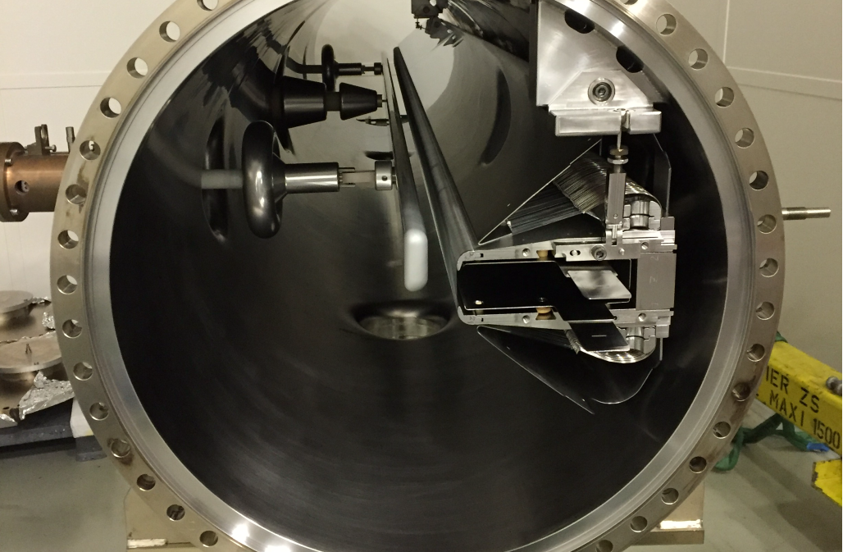
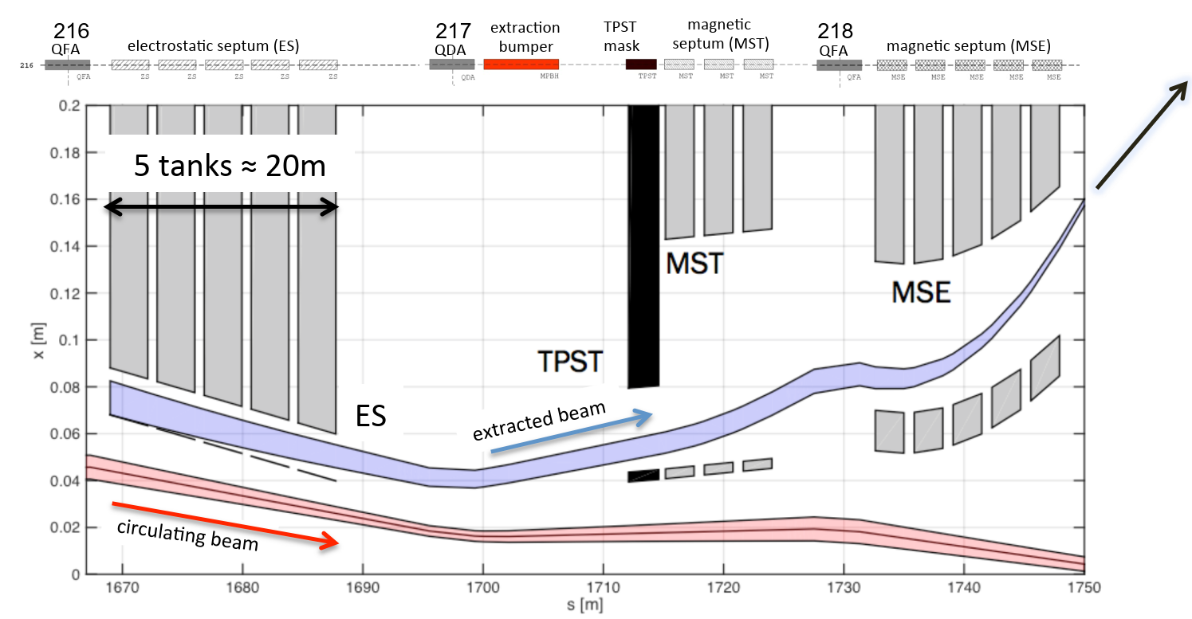
Introduction
SPS ZS
SPS ZS composed of 5 tanks
System with 12 degrees of freedom (dof)
  10 dof: adjustable positions for anode wires up- and downstream for every tank
  2 dof: girder positions up- and downstream
Loss monitoring: > 20 beam loss monitors (BLMs)
Entangled dynamics: modeling and optimisation of system not straightforward
Anode
wires
Cathode
extracted beam
Circulating beam
M. Fraser (TE-ABT)
to FT experiments
M. Fraser (TE-ABT)

Slide 5
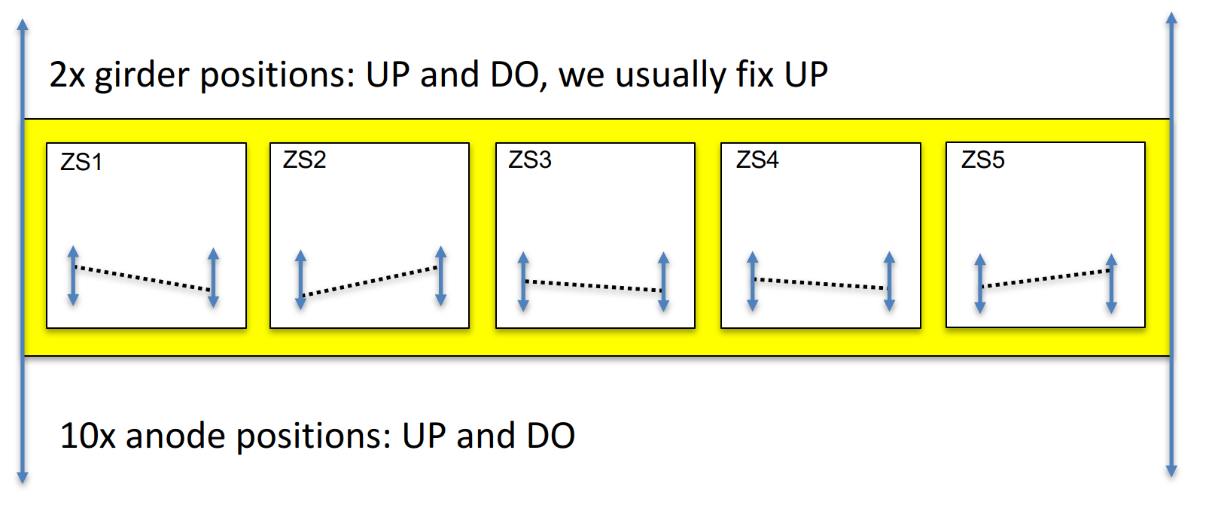
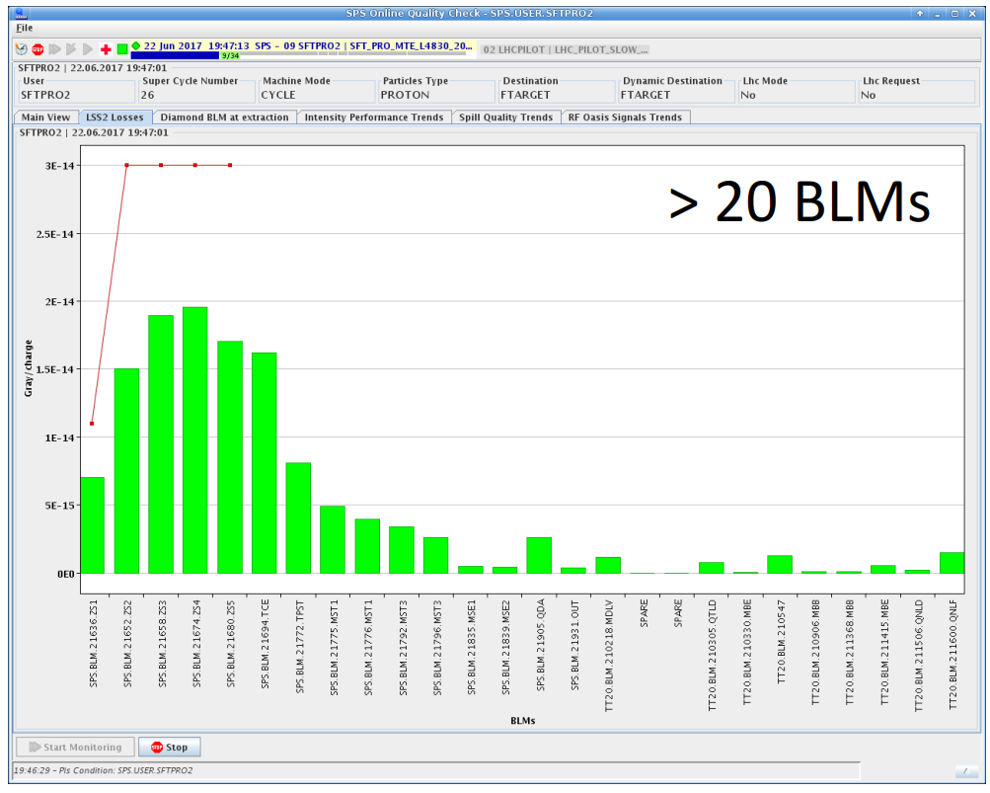
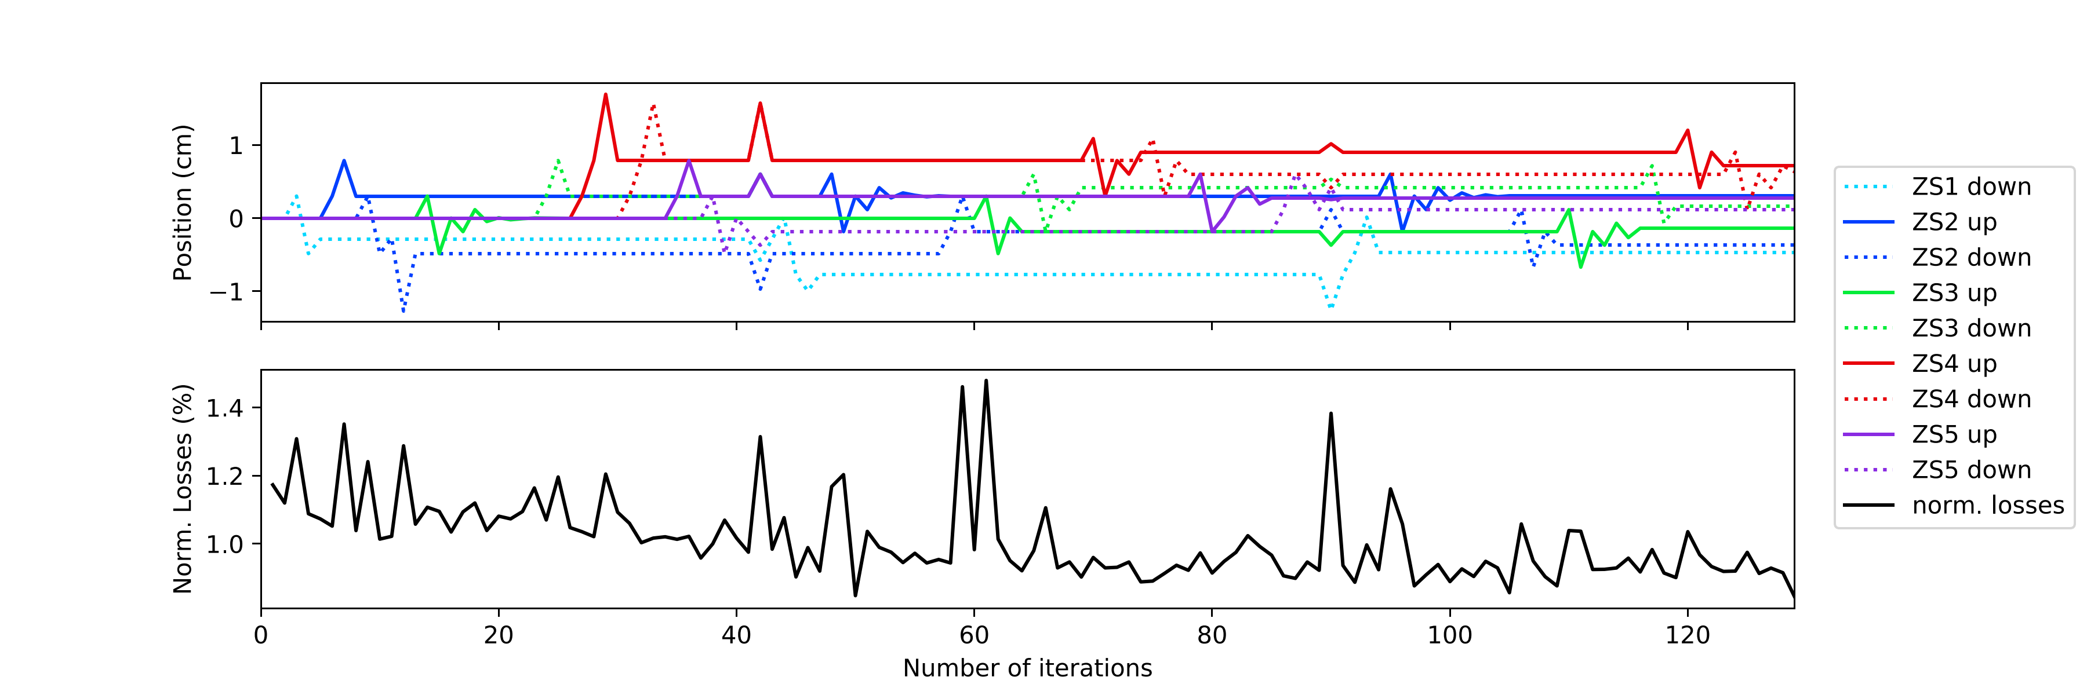
Introduction
SPS ZS alignment procedures
Controls (features)
Output (observables)
Norm. beam loss (Gy/charge)
x
s
M. Fraser (TE-ABT)
BLMs near ZS
Until 2018:
  Manual anode-by-anode optimisation
  Time-consuming (≈ 8 h) and tedious
Test in Nov. 2018:
  Automatic alignment: proof-of-principle
  with modified Powell optimiser
  Does first line search along every direction,
  then simultaneous parameter adjustment
  Big impact: time for full adjustment reduced
  to 40’ with same improvement on total loss
1
Anode pos. (cm)
0
-1
1.4
1.2
Norm. loss (%)
1.0
0
20
40
60
80
100
120
Iterations
S. Hirlaender, V. Kain (BE-OP) & TE-ABT

Slide 6
Motivation
Reinforcement learning
Reinforcement learning
Can we do even better?
  Powell optimiser has no memory:
  ZS alignment from scratch every time
  Reinforcement learning (RL)
    Agent interacts with environment and
    learns dynamics of the system
    State not restricted to action space
    Agent strategy / knowledge typically
    represented by neural network (Deep RL)
    => once trained, agent finds optimum in a few steps
action
agent
Environment
(e.g. accelerator)
state (observation)
reward

Slide 7
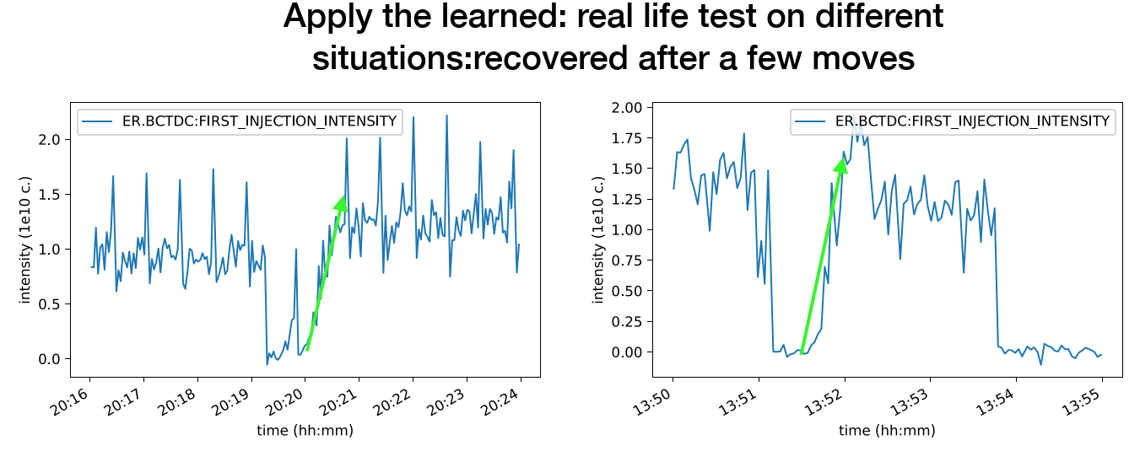
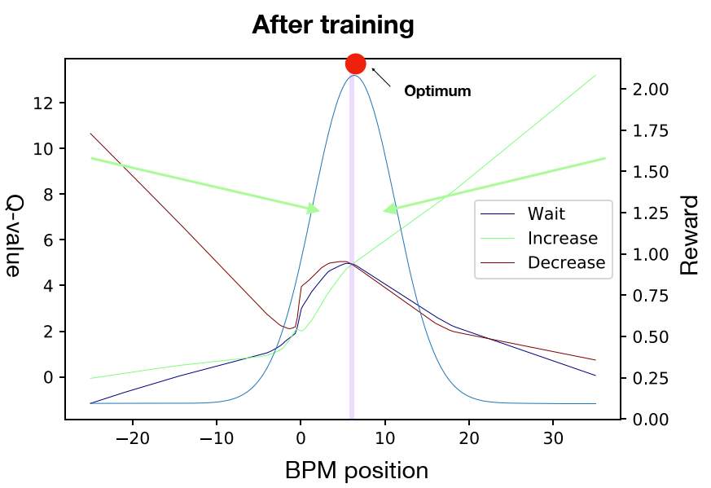
Motivation
Reinforcement learning
RL defines state-of-the-art performance in robotics, playing games
(e.g. Atari, AlphaGo), … and artificial intelligence problems in general
Applied to particle accelerator domain
  Proof-of-principle at CERN Low Energy Ion Ring (LEIR)
  1 control parameter: optimise injected intensity by tuning dipole magnet strength
  Solved as discrete control problem
  Model-free RL agent successfully learned the dynamics of the system
Implemented and studied many continuous control algorithms using OpenAI gym environment templates (S. Hirlaender, V. Kain)
Experience shows: sample efficiency is of major importance for our problems
S. Hirlaender, V. Kain, M. Schenk

Slide 8
Motivation
Reinforcement learning
Reinforcement learning
Can we do even better?
  Powell optimiser has no memory:
  ZS alignment from scratch every time
  Reinforcement learning (RL)
    Agent interacts with environment and
    learns dynamics of the system
    State not restricted to action space
    Agent strategy / knowledge typically
    represented by neural network (Deep RL)
    => once trained, agent finds optimum in a few steps
Reinforcement learning (RL)
  Sample efficiency is key as machine time is expensive
  Idea: pre-train RL agent offline for ‘warm start’ in the accelerator
Offline training requires a model F(x) of the system
  Tracking simulation, data-
  driven model, …
  Fast, cheap evaluation needed:
  Pre-training may require few
  thousand iterations
action
agent
Environment
(e.g. accelerator)
data-driven model
state (observation)
reward
Features
Observables
F(x)
Beam loss (Gy/charge)
BLMs

Slide 9
Data-driven model
Overview
Features
Observables
F(x)
Beam loss (Gy/charge)
BLMs
Start with simple model
9 features: All anode positions (except ZS1 UP), no girder positions
5 observables: BLMs ZS1, ZS2, .., ZS5
Neural network: feed-forward, dense, 1 hidden layer, 7 / 15 nodes, leaky ReLU activation
Adam optimizer
Missing features: girders, orbit, cathode voltage, ...
Training and test sets from existing data
  Training on data from Powell scan (01.11.18, 467 samples)
  => Predict manual scan 27.03.19 (test set)
  => Fake scans for all anode positions
  Training on data from Powell scan and manual scan (27.03.19, 1308 samples)
  => Predict manual scan 30.03.19 (test set)
  => Perform anode scans as above

Slide 10
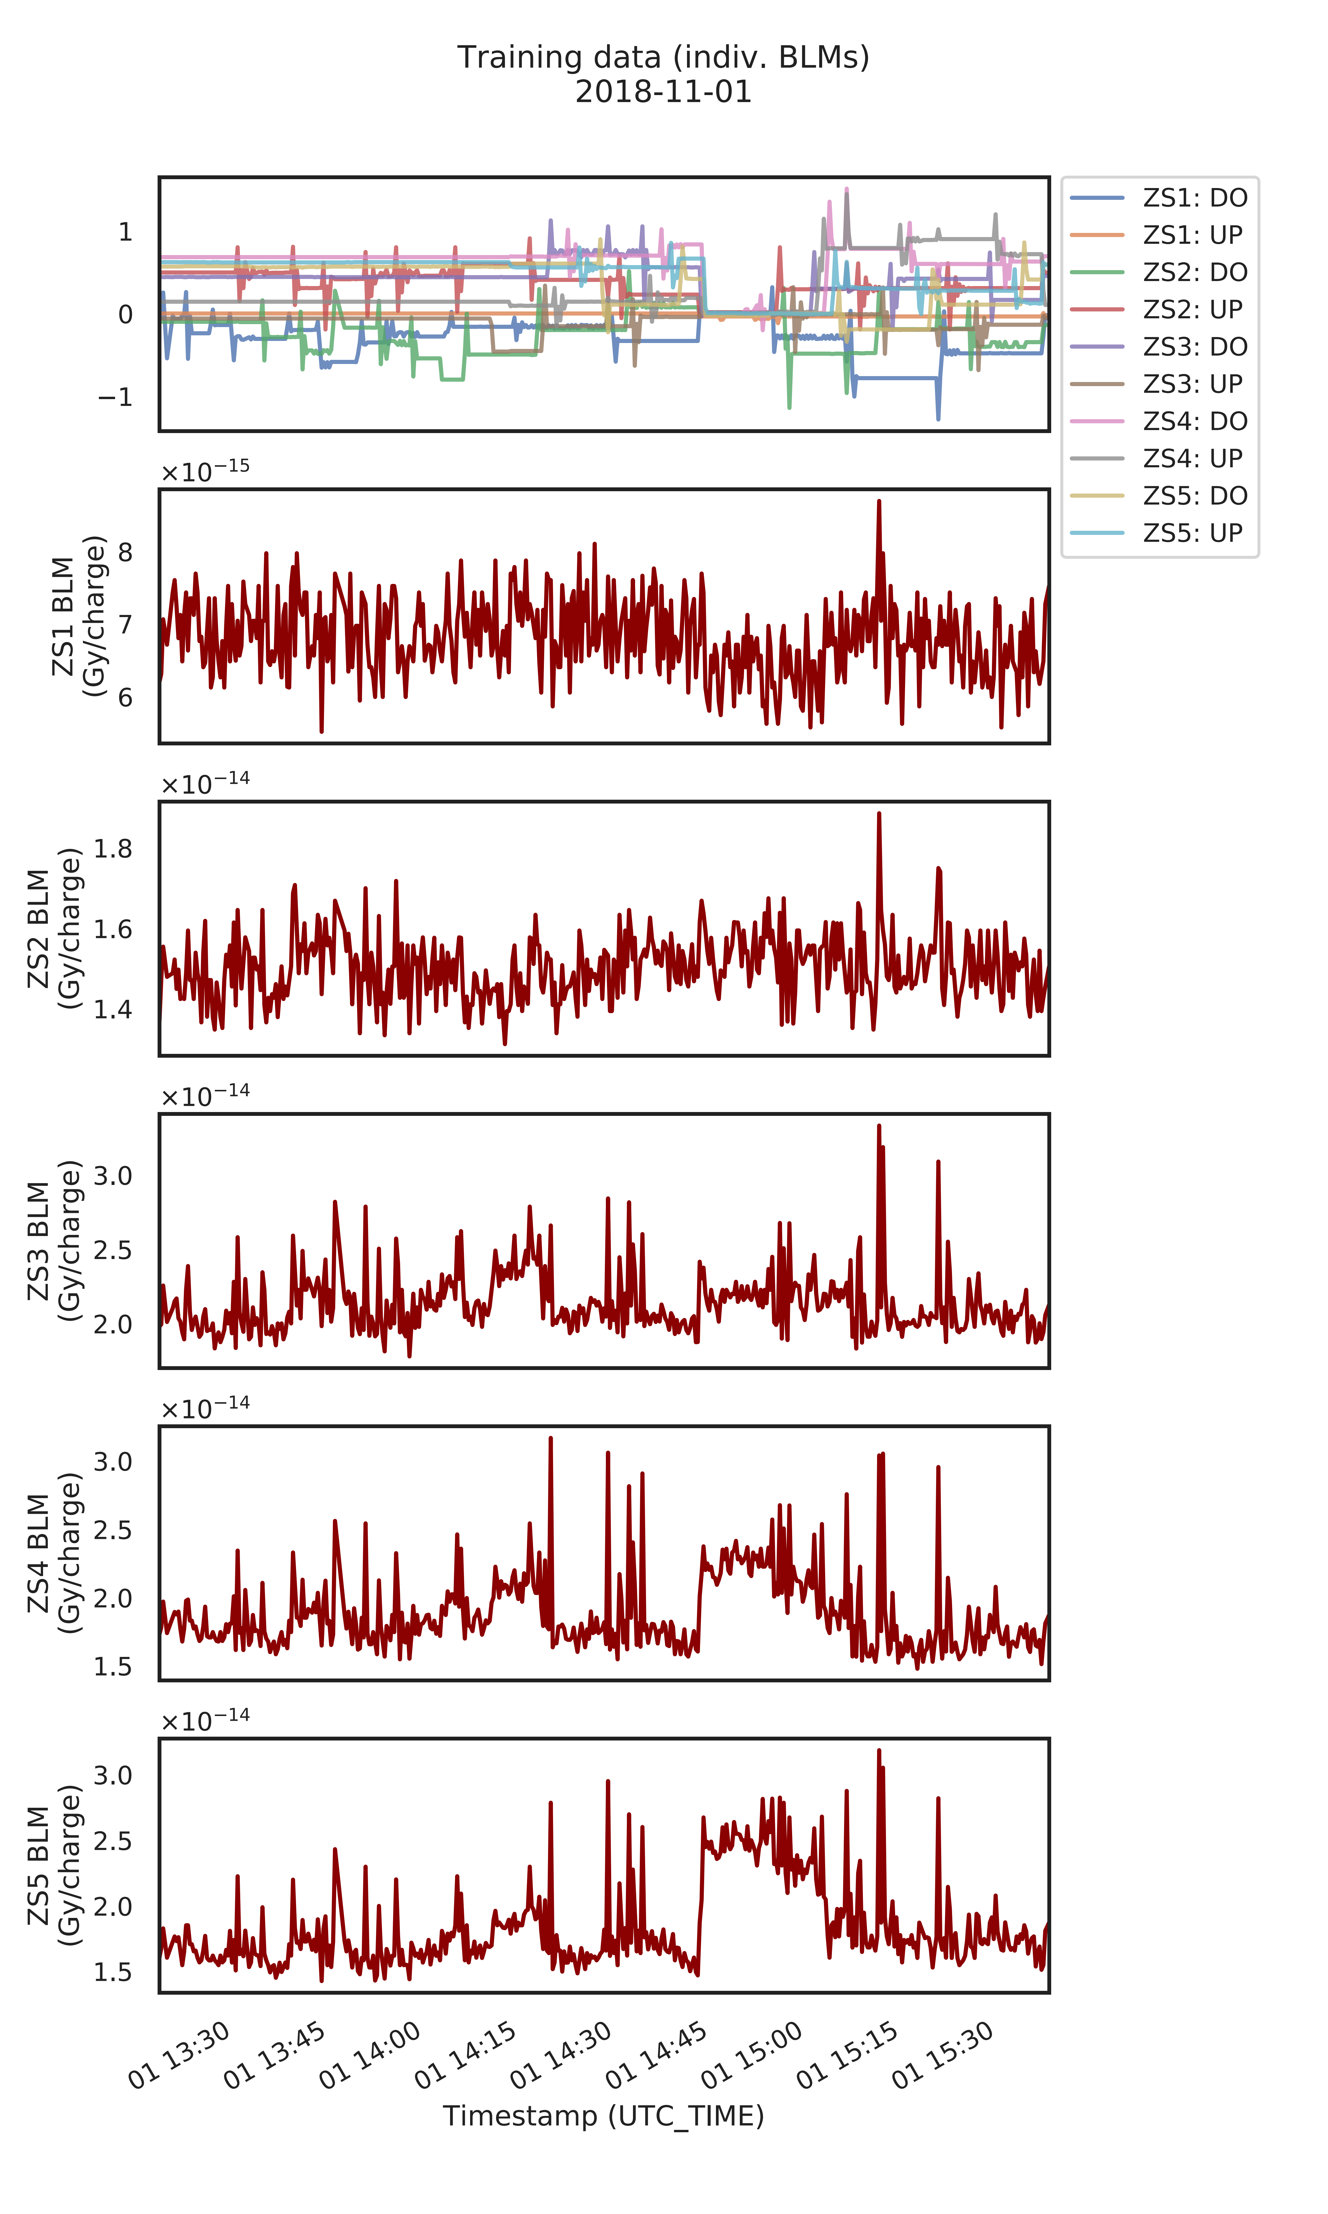

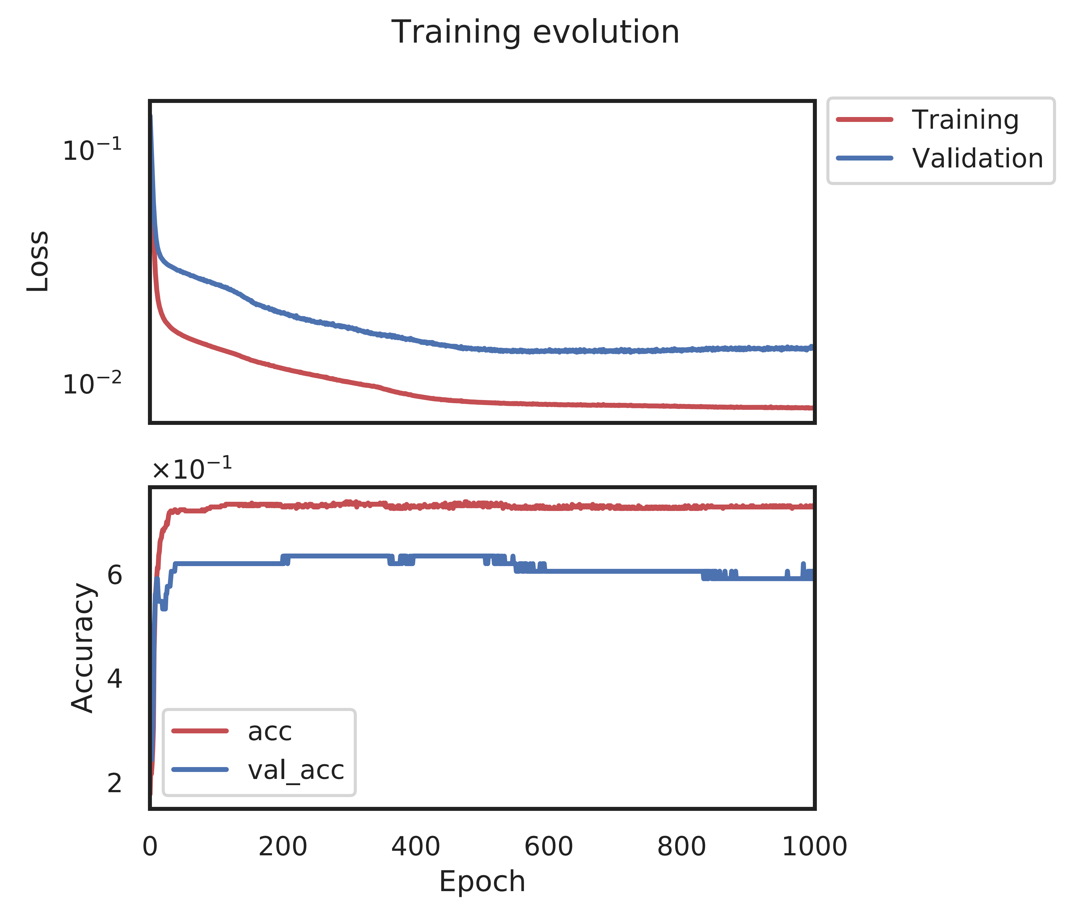
Data-driven model
Case I: Training data and evolution (7-node neural network)
Overfitting

Slide 11
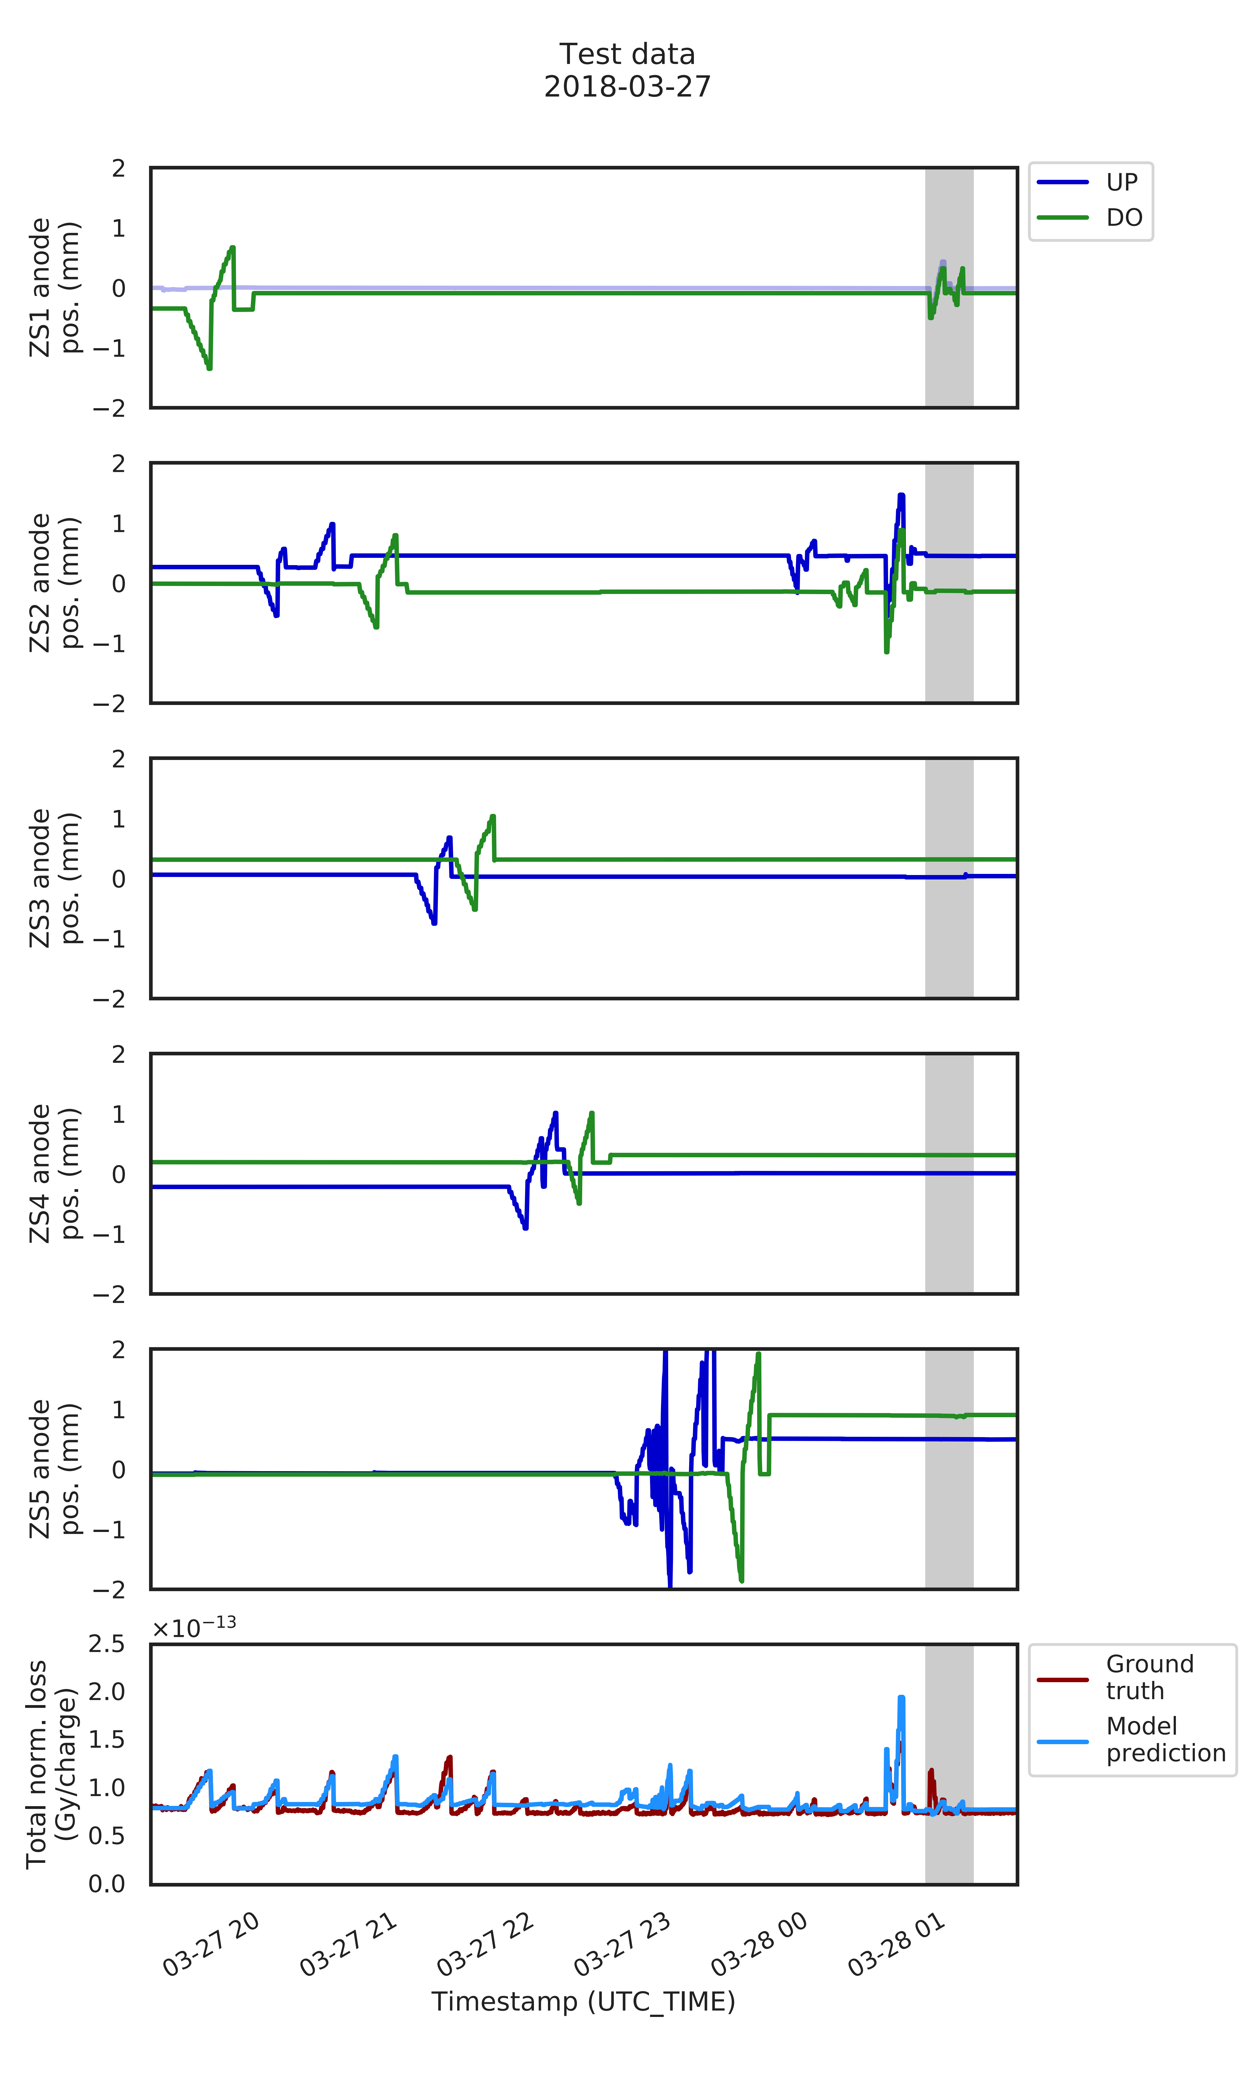
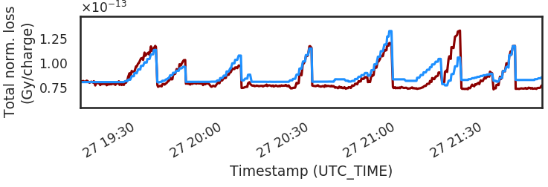
Data-driven model
Case I: Test set predictions (total loss)
Good quantitative agreement, given simplicity of model and low number of samples
Training and test set separated by 7 months
Offset in ‘baseline’ & some peaks only qualitative agreement
  Missing feature (girder, orbit)?
  See individual loss on BLM ZS5 (backup)
Another source of discrepancy is range in
anode positions
  Training set: ≈ ± 0.5 - 1 mm
  Test set: up to ≈ ± 2 mm
Zoomed view of total loss

Slide 12
Data-driven model
Validation: orthogonal anode scans
Scan individual anode positions and predict total loss
Case I: Trained on Powell data (7-node NN)
Case II: Trained on Powell and manual scan data (15-node NN)
Loss response is convex – as expected
Small impact on total loss from ZS4 and ZS5 – as observed in the machine
‘Piecewise linear’ functions due to simplicity of network
Case II: A second ZS NN model with 15 nodes trained on Powell and manual scan data performs even better on a test set (backup)
Good news: both models predict similar loss response

Slide 13
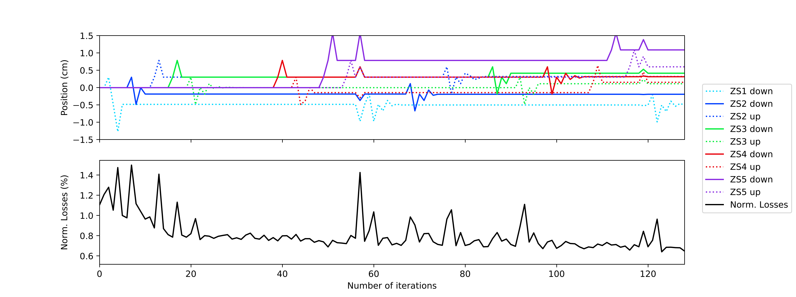
Data-driven model
Validation: Powell optimisation on SPS machine and trained model
Measurement
Model

Slide 14
Data-driven model
Validation: Powell optimisation on SPS machine and trained model
Measurement
Measurement and model show similar evolution
Model behaves well
Powell algorithm probes feature space better, not just along orthogonal directions
Similar test with COBYLA (Constrained Optimisation BY Linear Approximation) algorithm: converges even faster than Powell (see backup)
Model

Slide 15
Final remarks
Even with little training data: ZS model performs well and passes validation tests
It is yet incomplete and hence improved further: adding more features / observables
Trained ZS model is now embedded in OpenAI gym environment and used for RL benchmarks
Excellent testbed for multidimensional RL optimisation problems to study various algorithms for continuous control
Sample efficiency is a key player (for accelerator domain)
Data-driven or surrogate models can be game changers

Slide 16
Backup

Slide 17
Other ongoing and upcoming projects
Gather knowledge and expertise in machine learning, reinforcement learning, and advanced numerical optimisers
  Bayesian optimisation
  Reinforcement learning with NAF, Gaussian processes, and other algorithms
  Explore for best sample efficiency, robustness, etc.
  Use self-made OpenAI gym environments (target steering model, ZS model)
Electron cooling in LEIR
  Build surrogate model based on simulation code
  Analysis of Schottky spectra: convolutional neural networks, autoencoders?
  Provide operational tool
SPS slow extraction
  Model for hysteresis of main magnets in SPS
  Reinforcement learning for spill optimisation?
Optimisation of transition crossing in the SPS
LINAC4 and AWAKE: beam matching

Slide 18
Data-driven model
Case I: Test set predictions (total loss)
Good quantitative agreement, given simplicity of model and low number of samples
Training and test set separated by 7 months
Offset in ‘baseline’ & some peaks only qualitative agreement
  Missing feature (girder, orbit)?
  See individual loss on BLM ZS5 (backup)
Another source of discrepancy is range in
anode positions
  Training set: ≈ ± 0.5 - 1 mm
  Test set: up to ≈ ± 2 mm
Moving in range [-2, 2] mm
Not trained for that (extrapolation)
But: ZS5 no big impact on total loss,
hence prediction still OK
Peak not predicted
Moving ZS1 UP
Not trained for that

Slide 19
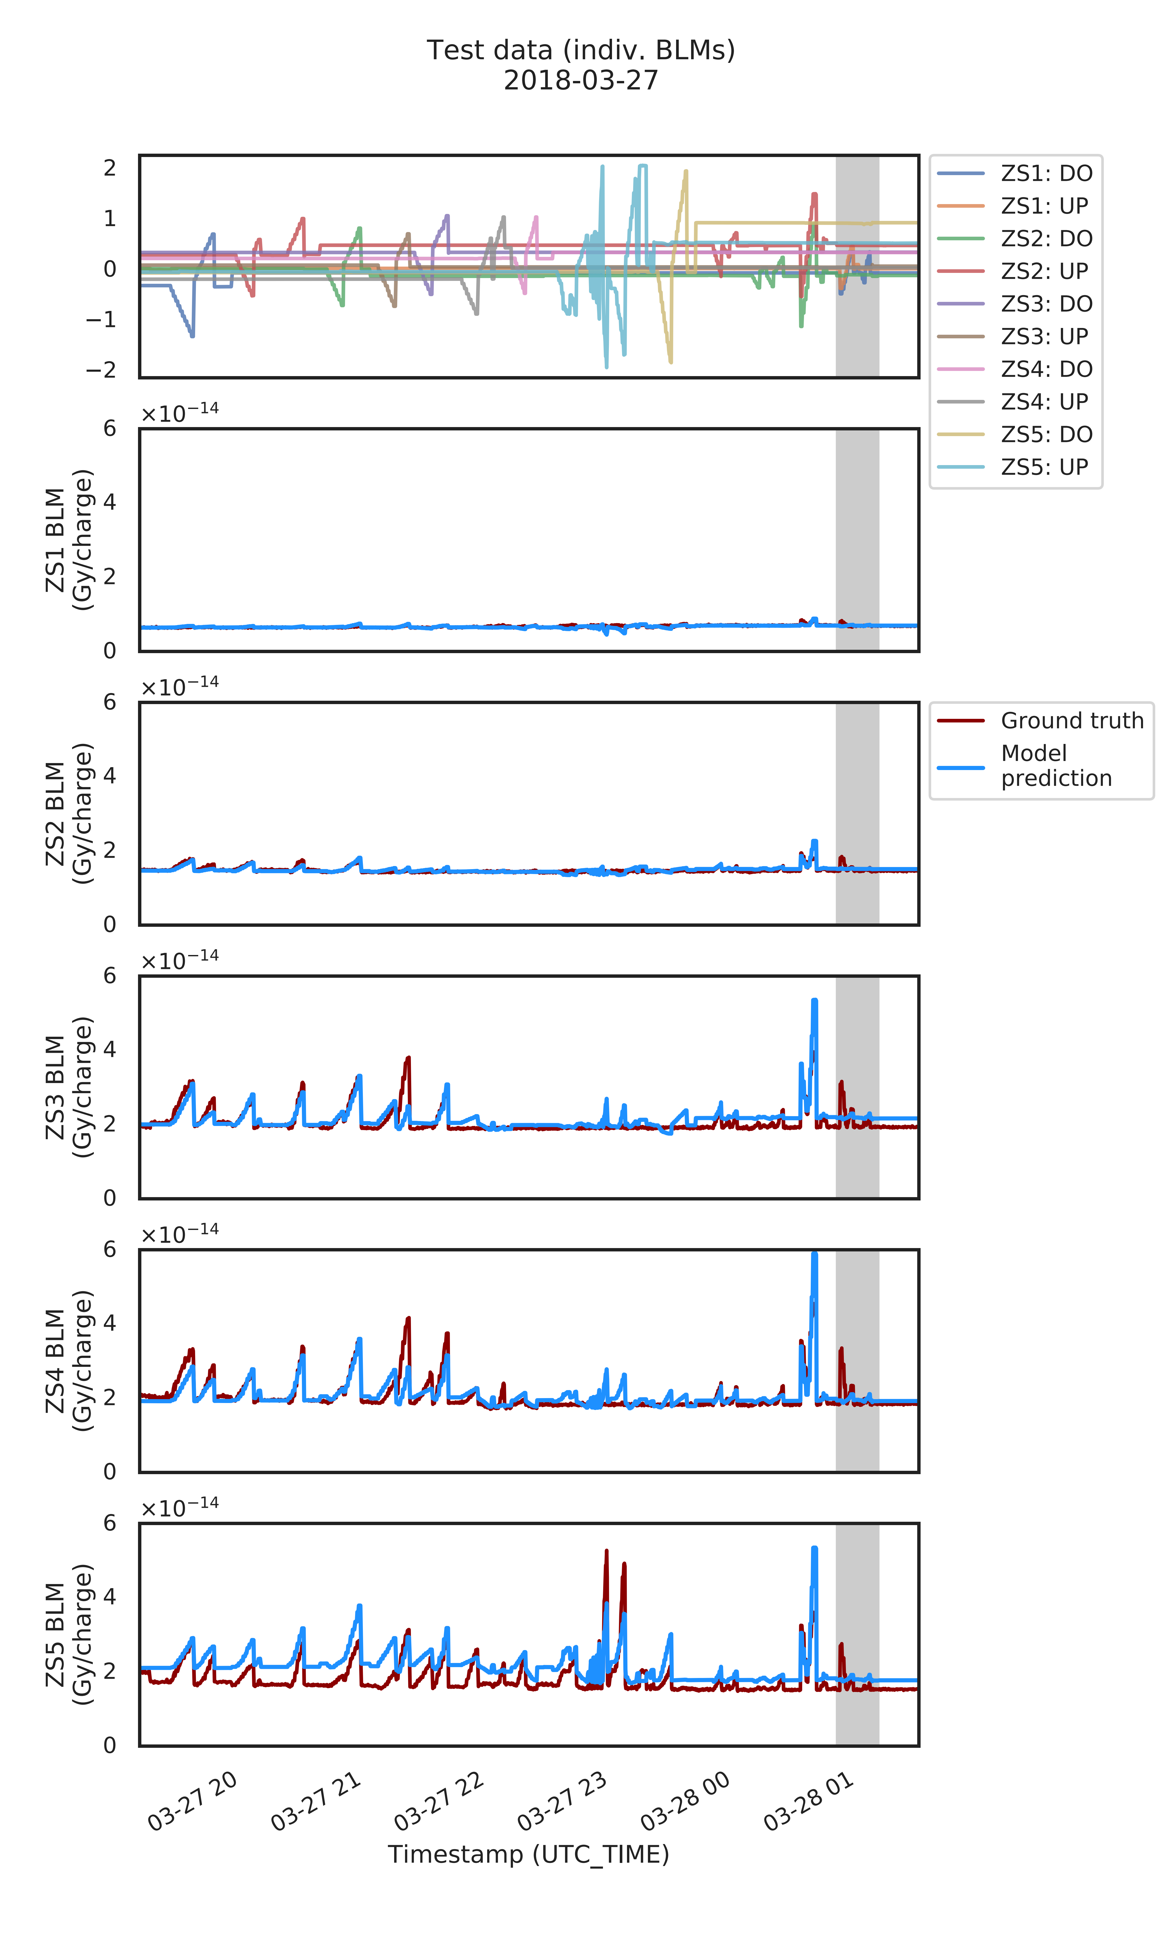
Data-driven model
Case I: Test set predictions (individual BLMs)
Overfitting artefacts?
Offsets on BLM ZS5
Possibly due to changed settings
on features that are not included
in the model (orbit, girder, cathode voltage, etc.)

Slide 20
Data-driven model
Case I: Tests with ‘fake’ anode scans
Orthogonal scans reasonable: convex shapes
No strong impact on total loss from ZS4 and ZS5, as observed in the machine
Piecewise linear functions due to simplicity of network

Slide 21
Data-driven model
Overview
Features
Observables
F(x)
Beam loss (Gy/charge)
BLMs
Start with simple model
9 features: All anode positions (except ZS1 UP), no girder positions
5 observables: BLMs ZS1, ZS2, .., ZS5
Neural network: feed-forward, dense, 1 hidden layer, 7 – 15 nodes, leaky ReLU activation
Adam optimizer
Missing features: girders, orbit, cathode voltage, ...
Training and test sets from existing data
  Training on data from Powell scan (01.11.18, 467 samples)
  => Predict manual scan 27.03.19 (test set)
  => Perform ‘fake’ scans for all anode positions
  Training on data from Powell scan and manual scan (27.03.19, 1308 samples)
  => Predict manual scan 30.03.19 (test set)
  => Perform ‘fake’ anode scans as above

Slide 22
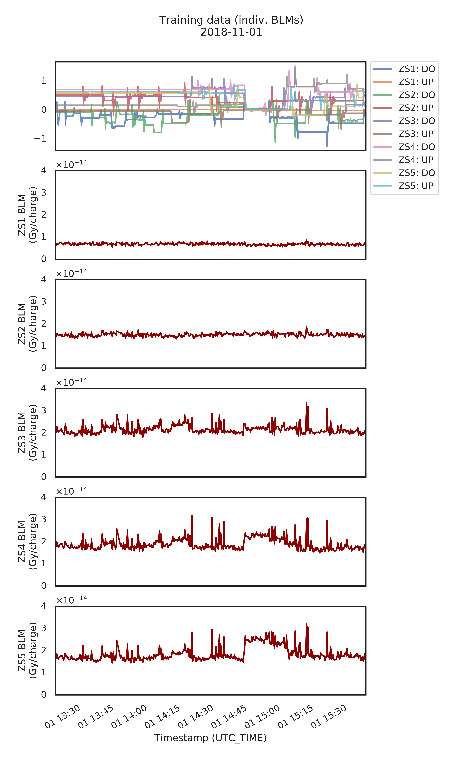
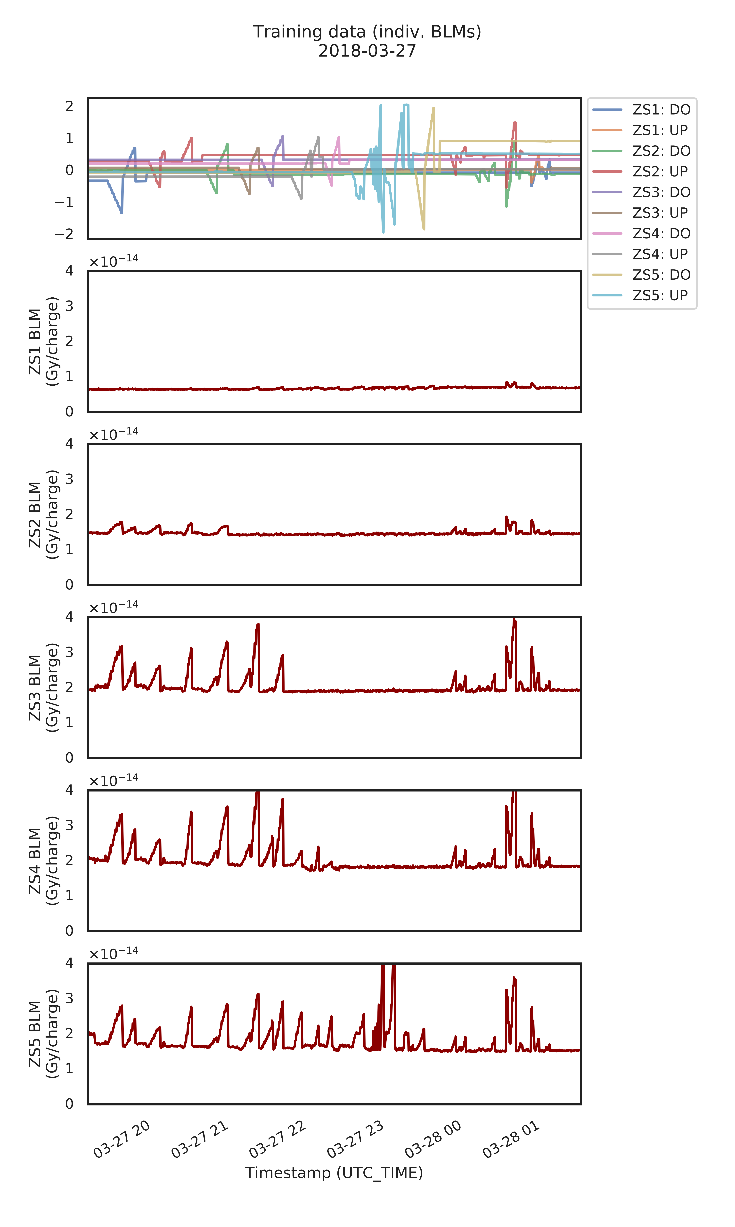
Data-driven model
Case II: Training data (15-node neural network)

Slide 23
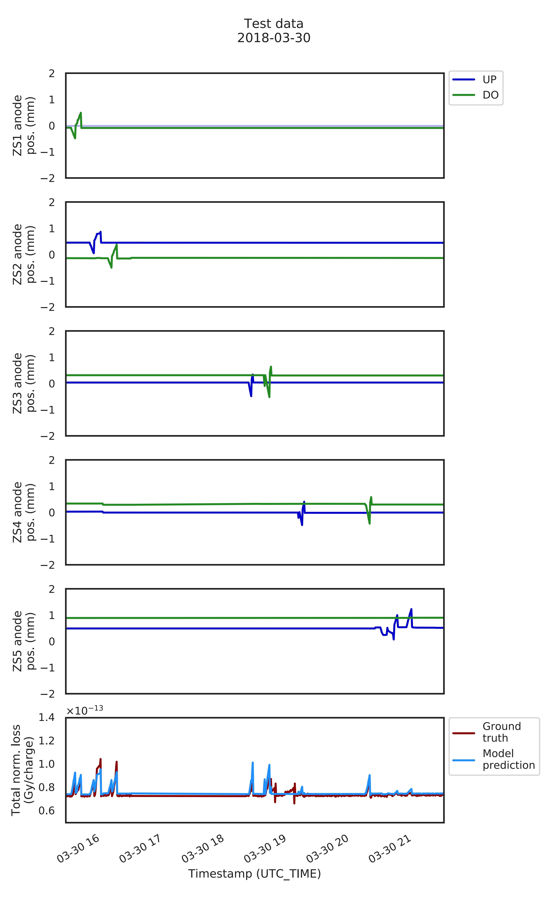
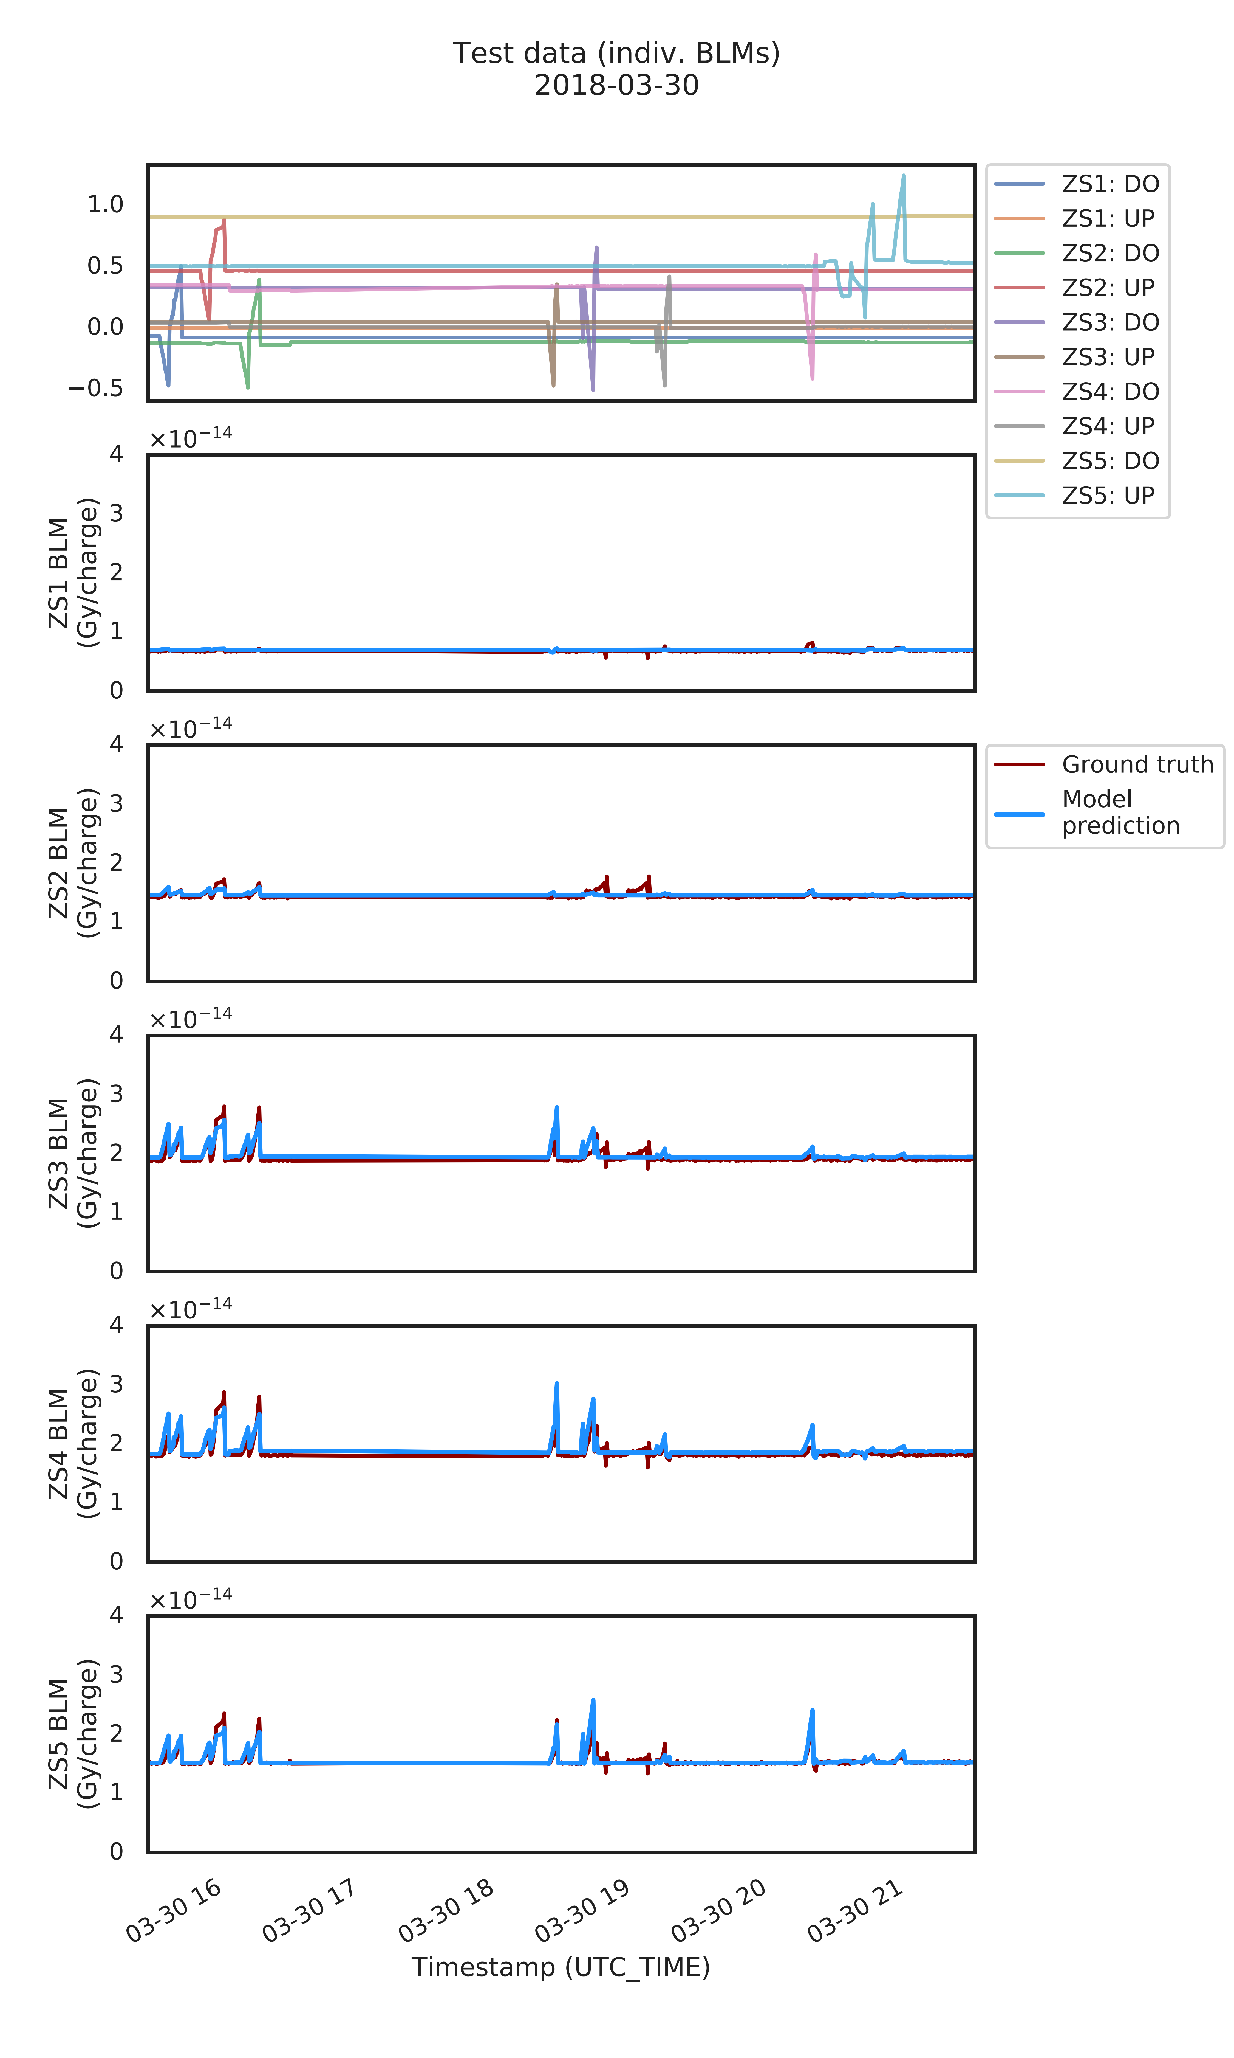
Data-driven model
Case II: Test set predictions (on ‘independent’ data set)
Other scans / settings
(miniscans)

Slide 24
Data-driven model
Case II: Test set predictions (on ‘independent’ data set)
Less surprising that performance of the model is good
It ‘has seen the test set’ already (sets not independent …)
Even when overfitting would likely still perform well on test set
Difficult to find solid, independent test from available data in that case
Other scans / settings
(miniscans)

Slide 25
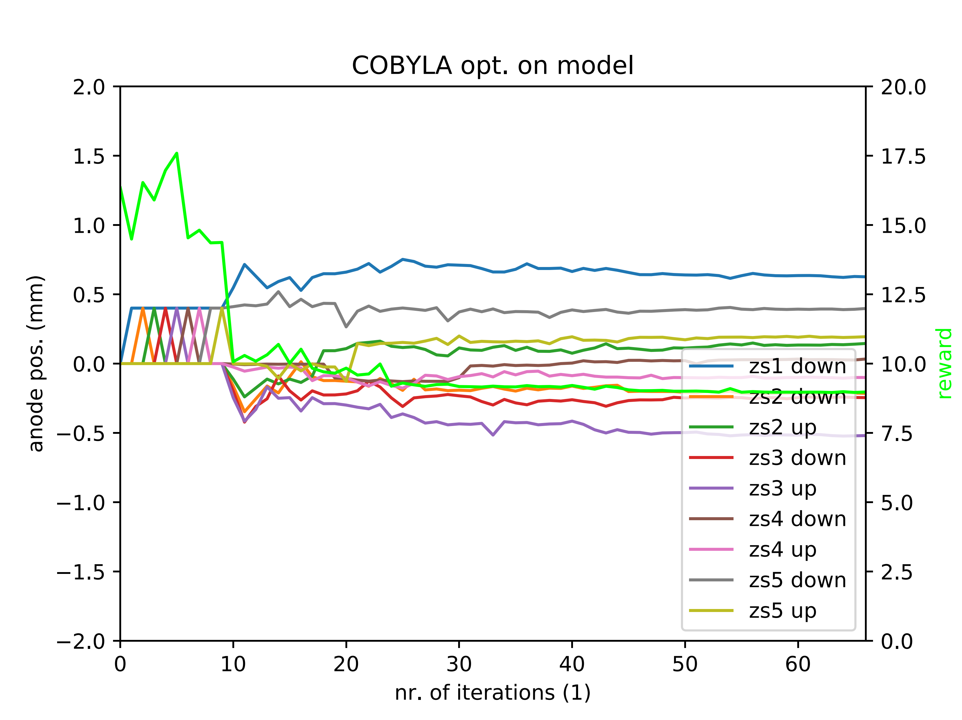
Data-driven model
Validation: COBYLA performance on trained model (7-node NN)
COBYLA with constraints on anode positions to ± 2 mm:
Optimisation on NN model to check if it produces sensible output
Not clear yet how NN model behaves outside ‘trained range’ …
COBYLA or Powell algorithms probe feature space better, not just along orthogonal directions
Reward = total loss x 10¹⁴
Optimum expected at
8 x 10⁻¹⁴ Gy/charge
(from data and NN model)
Even faster convergence than Powell – looks promising

