Slide 1


Investigation of beam-beam effects on the absolute luminosity measurements at the Large Hadron Collider experiments
Rongrong Cai
Supervisor: Dr. T. Pieloni

Slide 2
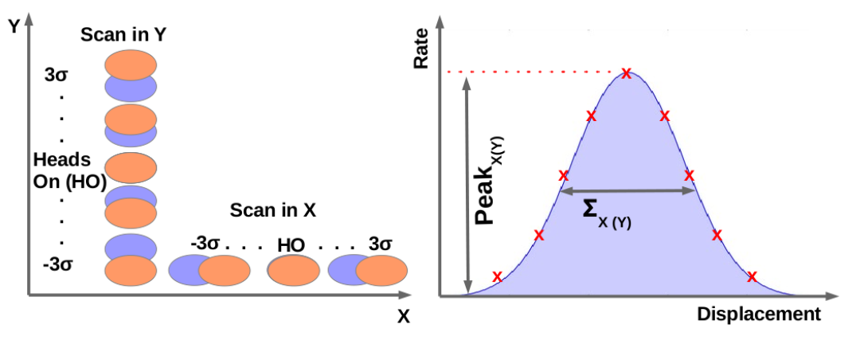
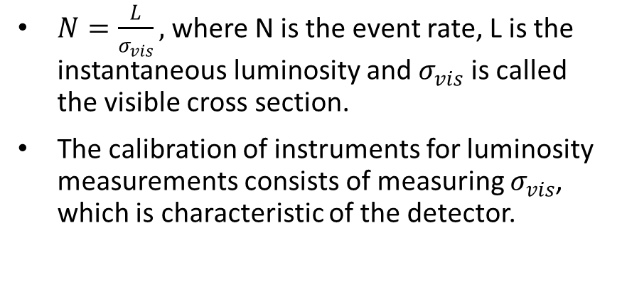
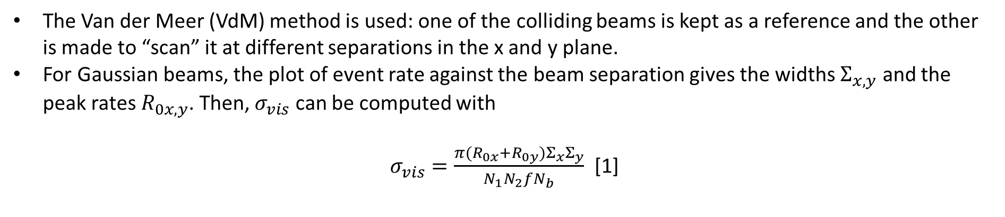
Absolute luminosity from machine parameters
$N=\frac{L}{σ_{vis}},$where N is the event rate, L is the instantaneous luminosity and $σ_{vis}$ is called the visible cross section.
The calibration of instruments for luminosity measurements consists of measuring $σ_{vis}$, which is characteristic of the detector.
[2]
The Van der Meer (VdM) method is used: one of the colliding beams is kept as a reference and the other is made to “scan” it at different separations in the x and y plane.
For Gaussian beams, the plot of event rate against the beam separation gives the widths $Σ_{x,y}$ and the peak rates $R_{0x,y}$. Then, $σ_{vis}$ can be computed with
$σ_{vis}=\frac{π(R_{0x}+R_{0y})Σ_{x}Σ_{y}}{N_{1}N_{2}fN_{b}}$ [1]

Slide 3
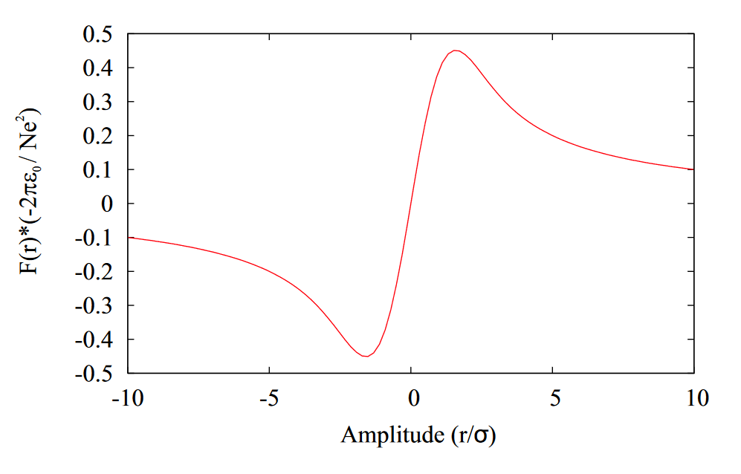
Beam-beam force
Bunches at different separations experience a different force

Slide 4
Beam-beam Effect
Caused by:
Electromagnetic interactions between colliding beams
Types:
Head-on/Short-range
Long-range
Some of the effects:
Orbit effect
Change in betatron frequencies (tune shift)
Dynamic beta
...

Slide 5
Motivations
Beam-beam interactions play an important role in collisions in modifying some key optical parameters.
The knowledge of this will be useful for various applications including absolute luminosity determination.
Current model uses analytical predictions. However, these may not be enough, especially in case of train of bunches.
Their implications should be estimated at a first approximation to check the necessity of further detailed investigations.

Slide 6
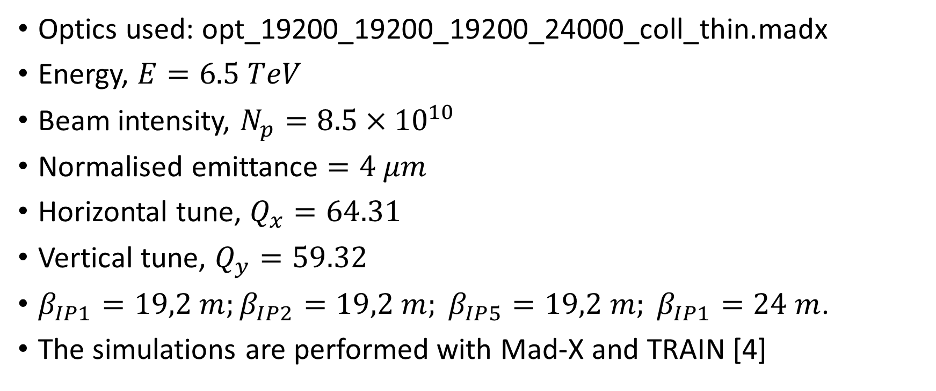
Simulation parameters
Optics used: opt_19200_19200_19200_24000_coll_thin.madx
Energy, $E=6.5 TeV$
Beam intensity, $N_{p}=8.5×{10}^{10}$
Normalised emittance $=4 μm$
Horizontal tune, $Q_{x}=64.31$
Vertical tune, $Q_{y}=59.32$
$β_{IP1}=19,2 m;β_{IP2}=19,2 m; β_{IP5}=19,2 m; β_{IP1}=24 m$.
The simulations are performed with Mad-X and TRAIN [4]

Slide 7

Analysed parameters
Orbit effect: $x_{BB}−x_{noBB}$
Tune shift: $Q_{BB}−Q_{noBB}$
Relative luminosity: $L/L_{0}$
Luminosity ratio: $\frac{L_{noBB}−L_{BB}}{L_{noBB}}$

Slide 8
Collision configurations
Bunch distribution:
Single bunch
Bunch trains
Collision schemes:
Different IP activations
Parallel plane separation: at all non-scanning IPs
Crossing plane separation: at IP1 and IP5
Scanning (interaction point) IP: IP5

Slide 9
Single bunch collision

Slide 10
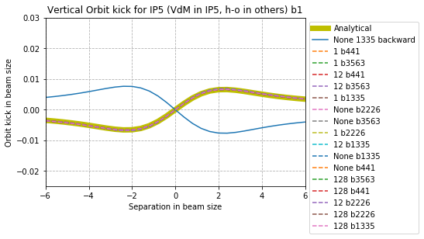
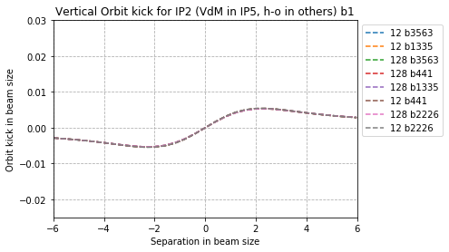
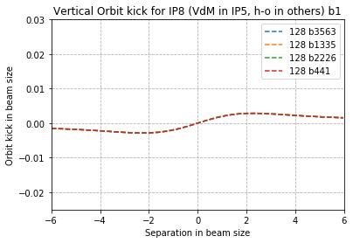
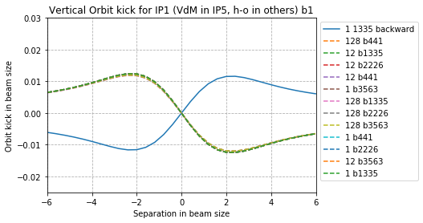
Different IP activations – Orbit effect
Vertical Orbit effect at IP5 b1
Vertical Orbit effect at IP2 b1
Orbit effect in beam size
Orbit effect in beam size
Analytical description is a good approximation.
The orbit effect curve of all bunches behave in the same way as they are coupled via head-on collision.
Scan in IP5 propagates orbit effect to the other IPs following the phase advance.
In the horizontal plane no orbit effect is visible as expected.
Vertical Orbit effect at IP8 b1
Orbit effect in beam size
Vertical Orbit effect at IP1 b1
Orbit effect in beam size

Slide 11
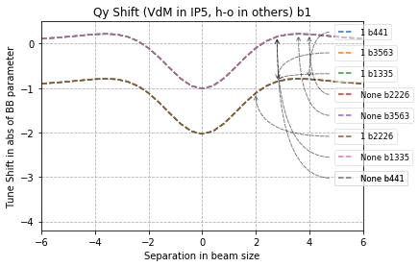
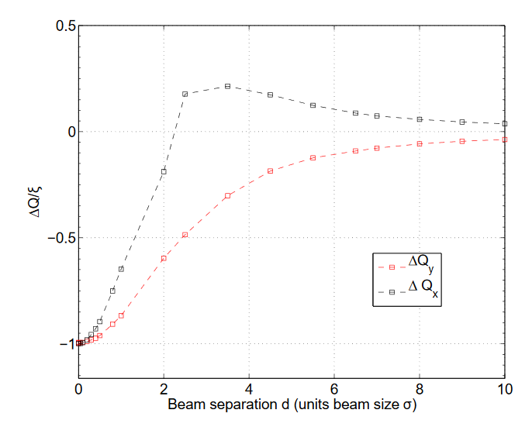
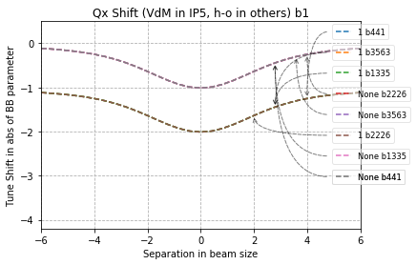
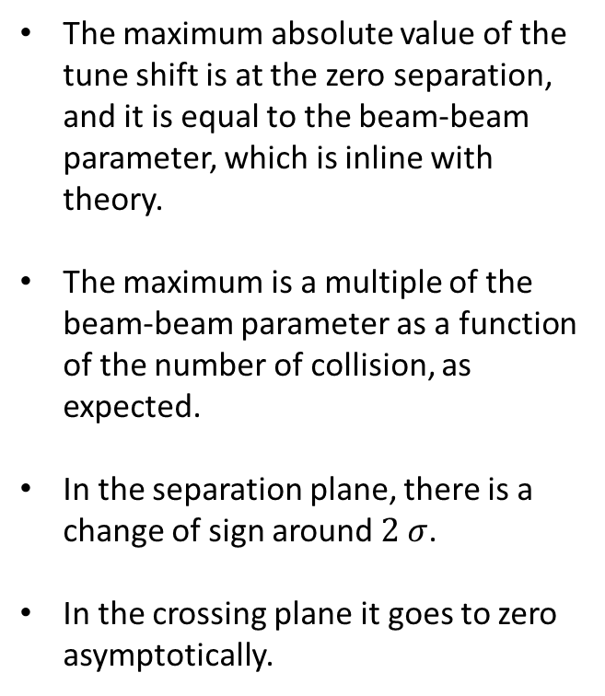
Different IP activations – Tune shift
The maximum absolute value of the tune shift is at the zero separation, and it is equal to the beam-beam parameter, which is inline with theory.
The maximum is a multiple of the beam-beam parameter as a function of the number of collision, as expected.
In the separation plane, there is a change of sign around $2 σ$.
In the crossing plane it goes to zero asymptotically.
IP5
IP1, IP5
[5]

Slide 12
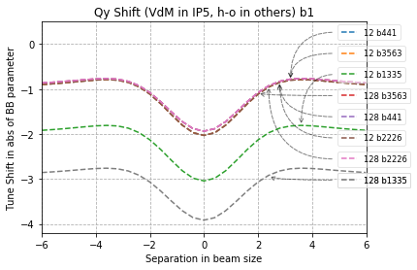
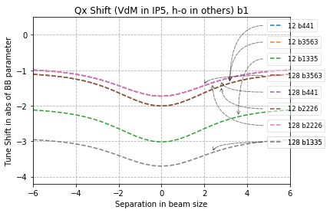
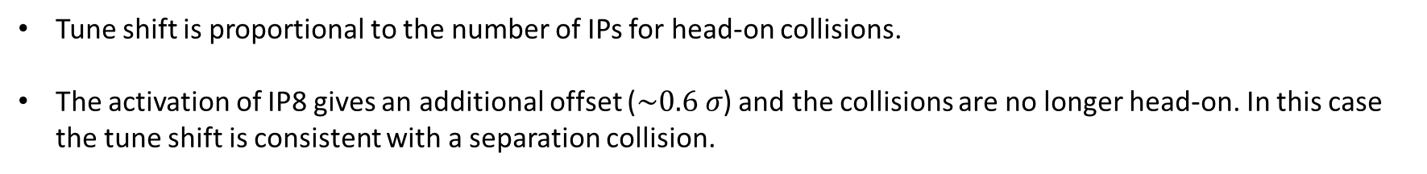
Different IP activations – Tune shift
Tune shift is proportional to the number of IPs for head-on collisions.
The activation of IP8 gives an additional offset ($\sim 0.6 σ$) and the collisions are no longer head-on. In this case the tune shift is consistent with a separation collision.

Slide 13
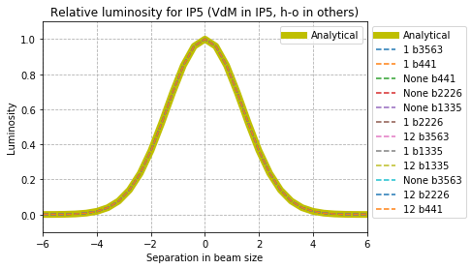
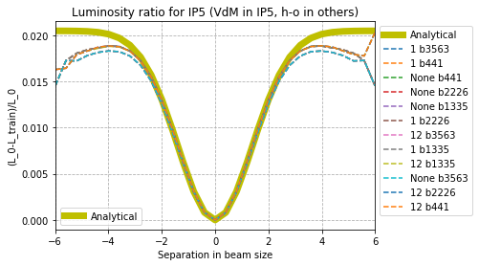
Different IP activation – Relative luminosity and luminosity ratio
Relative luminosity
Analytical solution can approximate well the relative luminosity at the scanning IP, IP5.
Effect of beam-beam effect can be taken into account using the closed-orbit coordinates.
There is a deviation for the large separations, further investigation needed.

Slide 14
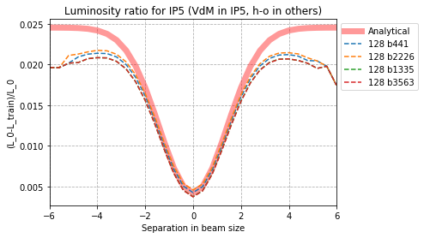
IP8 with offset – Relative luminosity and luminosity ratio
The scan in IP5 propagates at IP8 where a beam-beam kick takes place and further propagates to IP5 → resulting in a further change in the luminosity at zero separation.
Results deviate from the analytical expectations due to an extra orbit effect from IP8.
Effects on large separations still present.

Slide 15
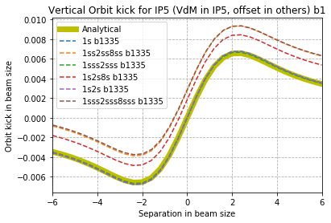


IPs with offset in separation plane – Orbit effect
The parallel plane separations results in a shift of the orbit effect curve, which depends on the separation on the other IPs
Vertical Orbit effect at IP5 b1
$2 σ$, $3 σ$
Orbit effect in beam size
$$1 σ$$

Slide 16
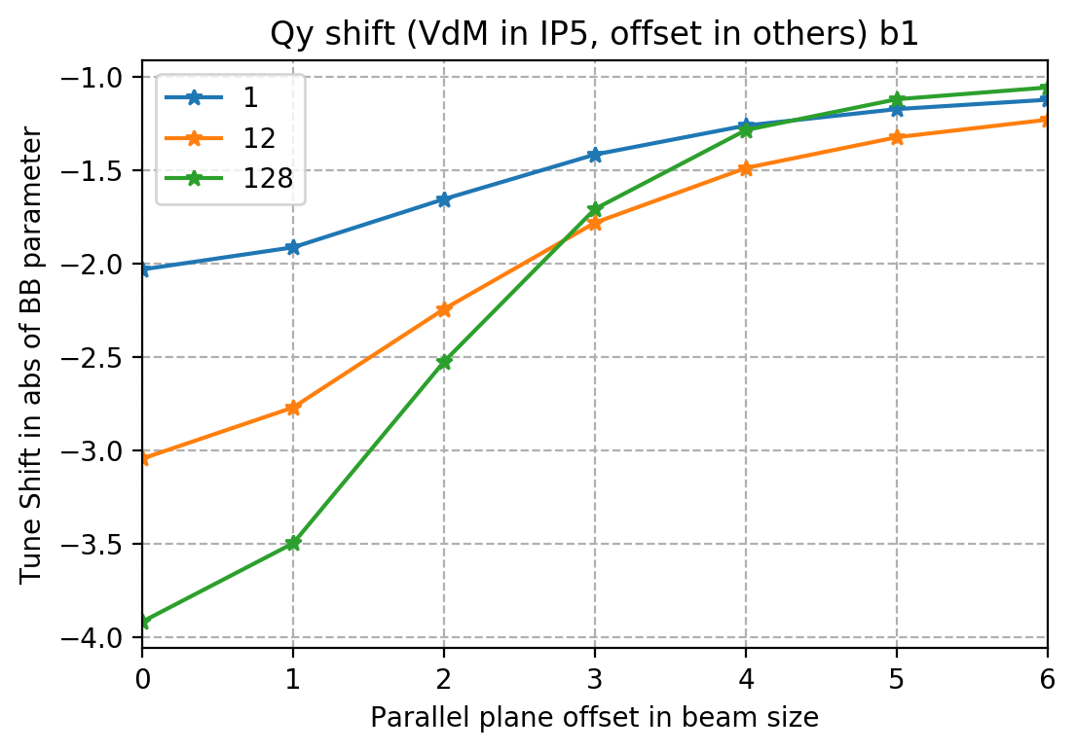
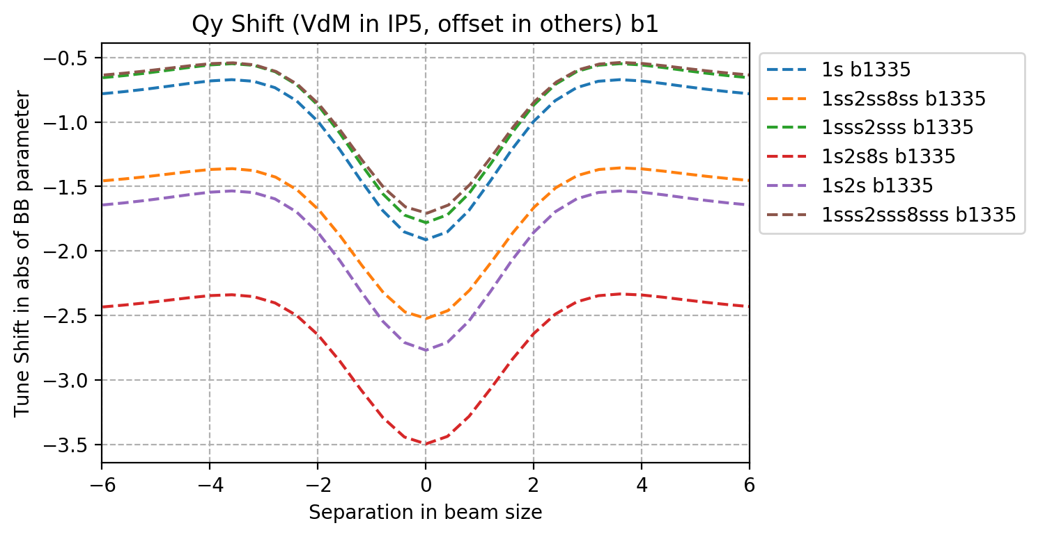
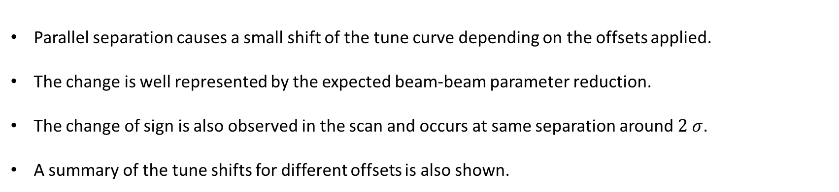
IPs with offset in separation plane – Tune shift in scan plane
Parallel separation causes a small shift of the tune curve depending on the offsets applied.
The change is well represented by the expected beam-beam parameter reduction.
The change of sign is also observed in the scan and occurs at same separation around $2 σ$.
A summary of the tune shifts for different offsets is also shown.

Slide 17
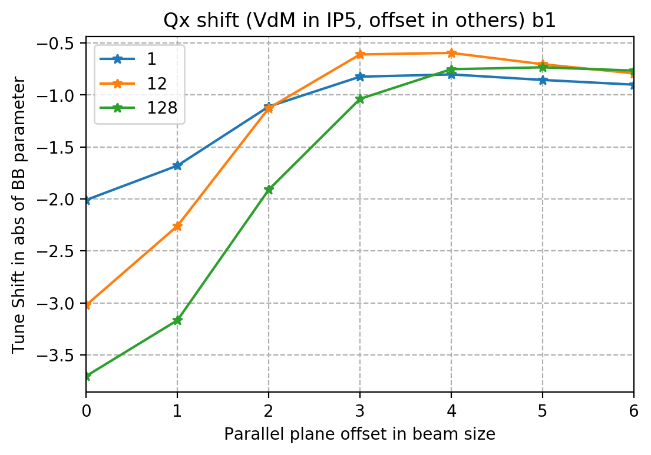
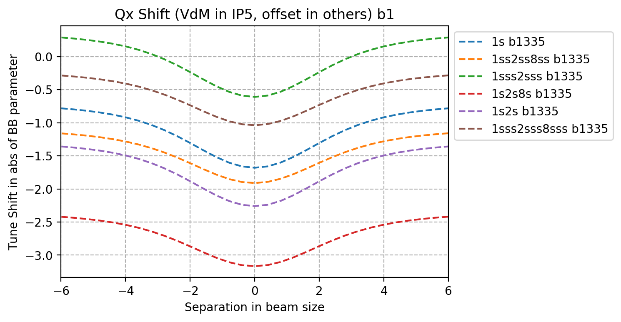
IPs with offset in separation plane – Tune shift in crossing plane
A small shift of the tune shift curve is also present in the horizontal plane.
A summary plot in given for the zero separation.

Slide 18
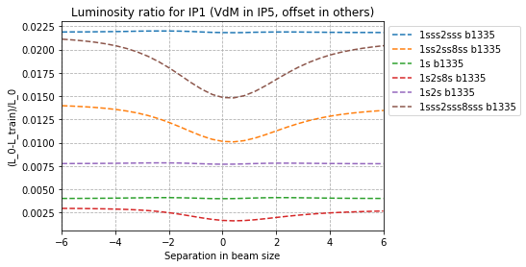
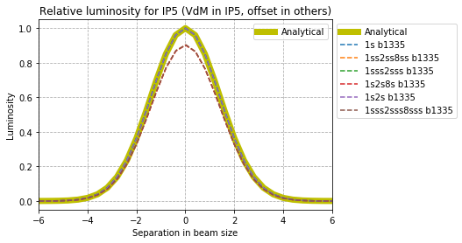
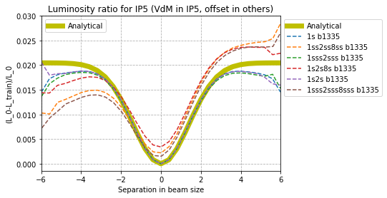



Parallel plane separation – Relative luminosity and luminosity ratio
$$0.7 \%$$
Relative luminosity
$$0.5 \%$$
$$0.3 \%$$
The impact of a VdM scan from IP5 on IP1 changes depending on the offsets applied.
A maximum effect of 0.5% has been found for this study.
An unexpected effect at larger separations occurs and needs further investigations.

Slide 19
Single Train collision
Trains of 33 bunches

Slide 20
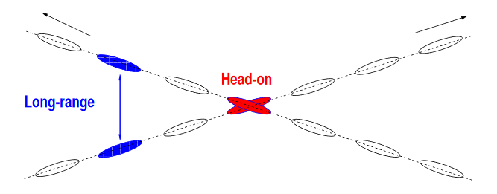
Long-range beam-beam effects
With bunches organised in trains, also the non-head-on bunches feel beam-beam effects.
[6]

Slide 21
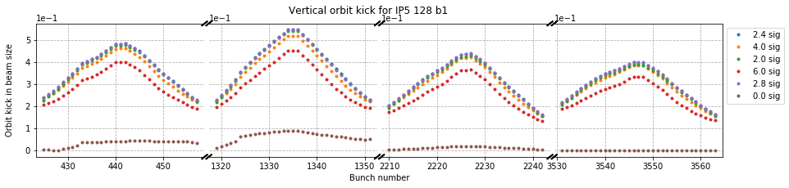
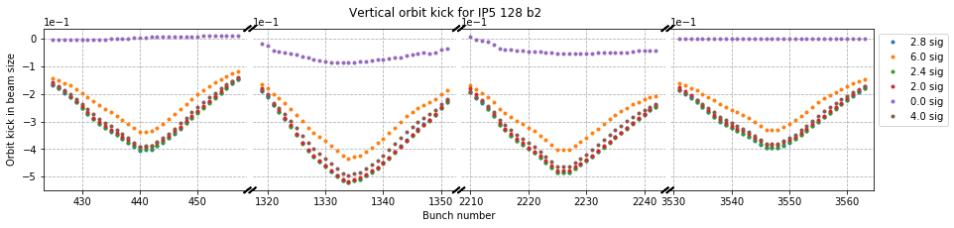
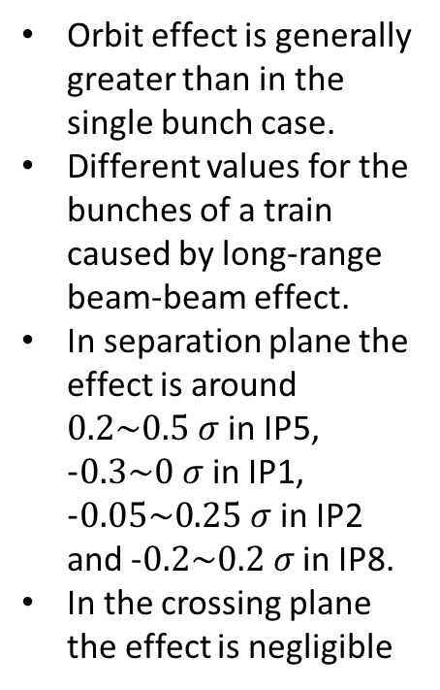
Different IP activations – Orbit effect
Orbit effect in beam size
Vertical Orbit effect at IP5 128 b1
Orbit effect is generally greater than in the single bunch case.
Different values for the bunches of a train caused by long-range beam-beam effect.
In separation plane the effect is around $0.2\sim 0.5 σ$ in IP5, $−0.3\sim 0 σ$ in IP1, $−0.05\sim 0.25 σ$ in IP2 and -$0.2\sim 0.2 σ$ in IP8.
In the crossing plane the effect is negligible
Orbit effect in beam size
Vertical Orbit effect at IP5 128 b2

Slide 22
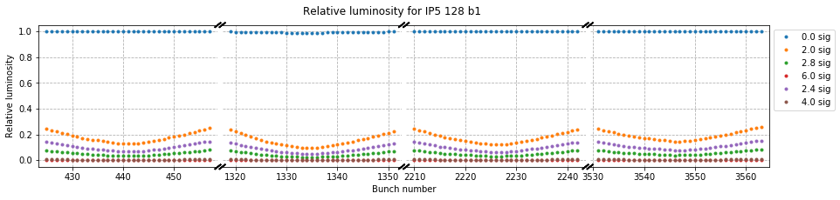
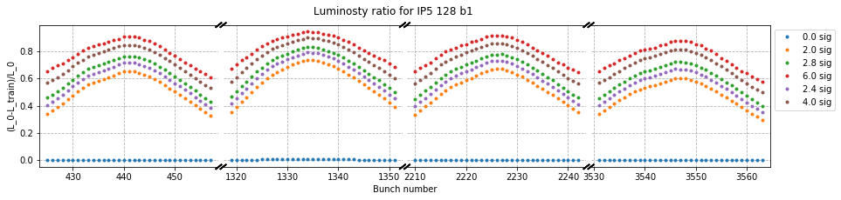
Different IP activation – Relative luminosity and luminosity ratio
Rapid decrease in luminosity after the zero separation as expected.
The reduction in luminosity is consistent with the sum of the separation with the beam-beam orbit effects
The bunch by bunch deviations are around 20%

Slide 23
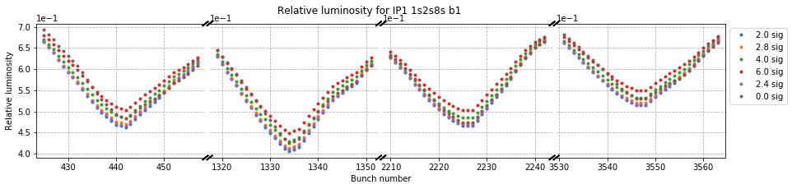
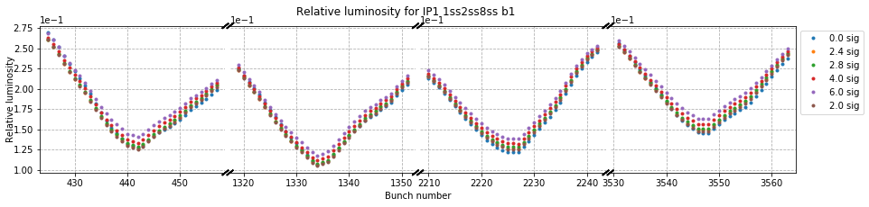
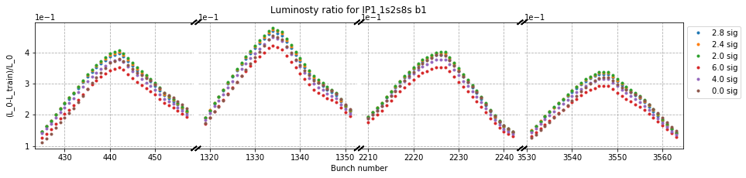
Parallel plane separation – Relative luminosity and luminosity ratio
Decrease of relative luminosity for simple collision IPs with a similar pattern of that of a relative luminosity curve with respect to beam separation.
The difference between head and tail bunches goes up to 0.5%

Slide 24
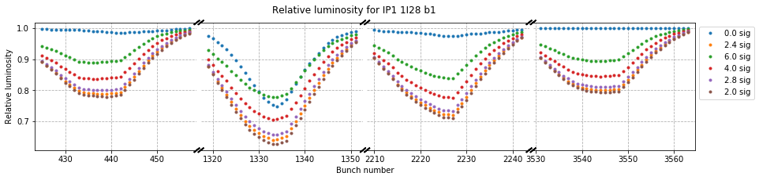
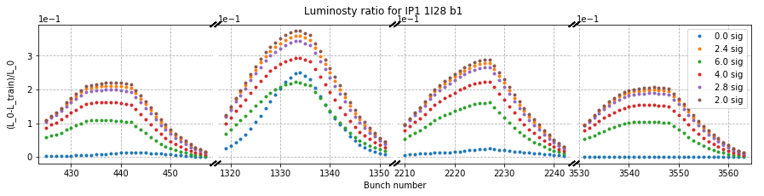
Crossing plane separation – Relative luminosity and luminosity ratio
Bigger effect on relative luminosity for small separations.
Luminosity spread of the order of 0.5 % around initial value.

Slide 25
Conclusions
A model to quantify the impact of beam-beam effects to the luminosity VdM scans has been carried out using the MAD-X and TRAIN model for the LHC.
The beam-beam impact to the orbits, betatron tunes and luminosity has been studied for the single bunch scan case for a typical VdM scan and results have been compared to analytical estimates where possible.
  Results from numerical model agree with the analytical estimates.
  Multiple IP configurations have been explored showing the impact of the other IPs to the luminosity measurements.
  The impact of beam-beam orbit effects to the luminosity calculations are of the order of 2-3 % in agreement with the single bunch model used for VdM calibrations.
  Deviations from the analytical predictions have been observed at large separations and further investigations is needed.
Different configurations of offsets at other IPs have been explored and small impact has been seen (0.5% maximum deviation).
The study has been extended to understand the effects of long-range beam-beam and the impact on luminosity has been quantified: a bunch by bunch spread of around 20% should be expected starting from the head-on value.
The study has been extended also to larger beam-beam parameters like in operational conditions.
Results and studies will be summarized in a note.

Slide 26
Reference
[1] Peter Tsrunchev, Luminosity measurements at CMS. Sep 2018. URL: https://cds.cern.ch/record/2647770, Presented 11 Sep 20
[2] Olena Karacheban. Luminosity measurement at CMS. 2017. URL: http://cds.cern.ch/record/2294183, Presented 05 Jan 20
[3] S. White, Determination of the absolute luminosity at the LHC. Theses, Université Paris Sud - Paris XI, October 2010. URL: https://tel.archives-ouvertes.fr/tel-005373
[4] Ariadna Ribes Metidieri and Xavier Buffat. TRAIN Reference Manual. PhD thesis, Geneva. URL: https://twiki.cern.ch/twiki/pub/ABPComputing/TrainWikiPage/TRAIN_reference_manual.pdf
[5] Tatiana Pieloni, Werner Herr, Aurelio Bay, and Leonid Rivkin. A study of beam-beam effects in hadron colliders with a large number of bunches. PhD thesis, 2008. URL: http://cds.cern.ch/record/1259906, Presented on 4 Dec 20
[6] W. Herr and T. Pieloni. Beam-Beam Effects. (arXiv:1601.05235. arXiv:1601.05235):431–459. 29 p, Jan 2016. URL: https://cds.cern.ch/record/1982430, 29 pages, contribution to the CAS - CERN Accelerator School: Advanced Accelerator Physics Course, Trondheim, Norway, 18-29 Aug 2013.

