Slide 1


SPS ongoing studies: towards reinforcement learning for electrostatic septum alignment
M. Schenk^{ꝉ}, M. Fraser*, B. Goddard*,
S. Hirlaender^{*Ꝉ}, V. Kain*, T. Pieloni^{ꝉ}
*CERN & ^{ꝉ}EPFL, Switzerland
^{Ꝉ}also at University of Malta
EPFL Activities Meeting 05. July 2019

Slide 2
Overview
Introduction
  SPS slow-extraction scheme
  Electrostatic septum: an optimisation problem
Motivation: reinforcement learning
Data-driven model
  Overview
  Results: training and validation
Final remarks

Slide 3
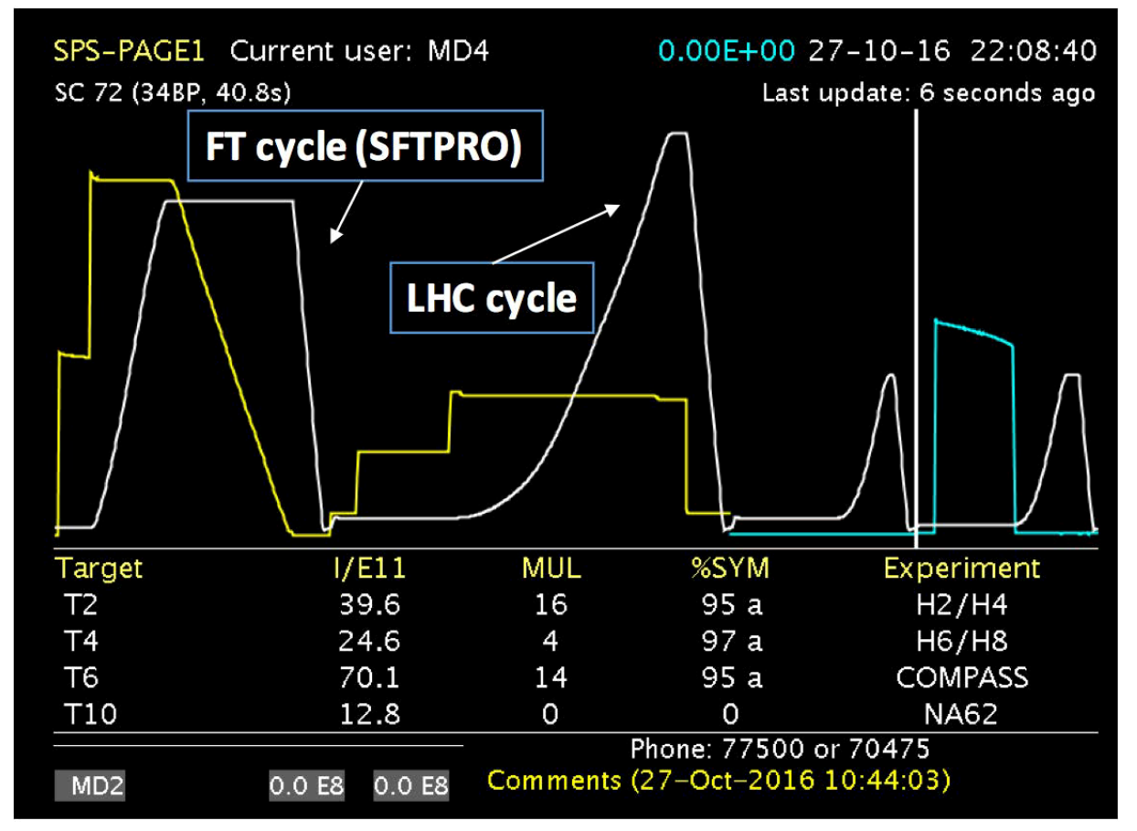
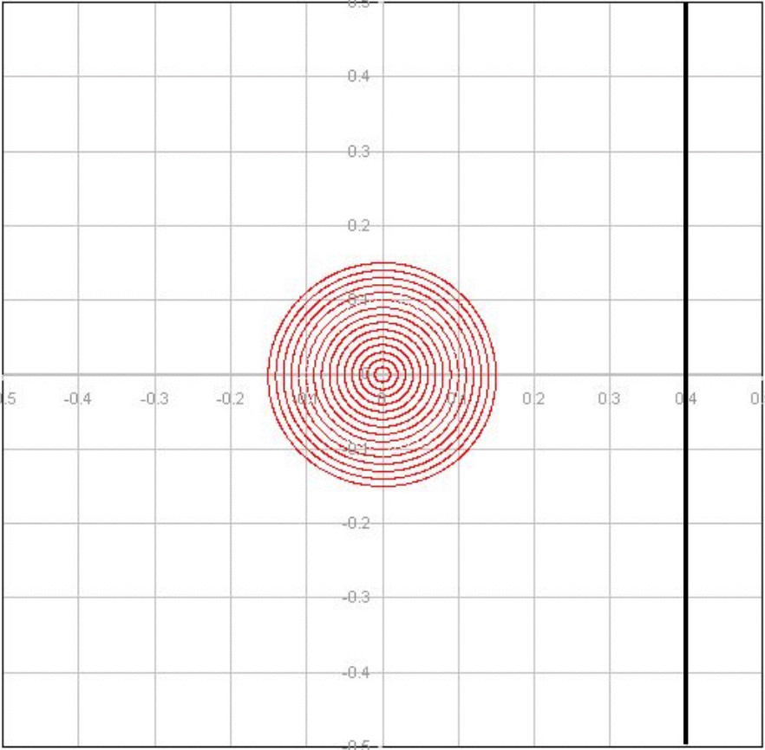
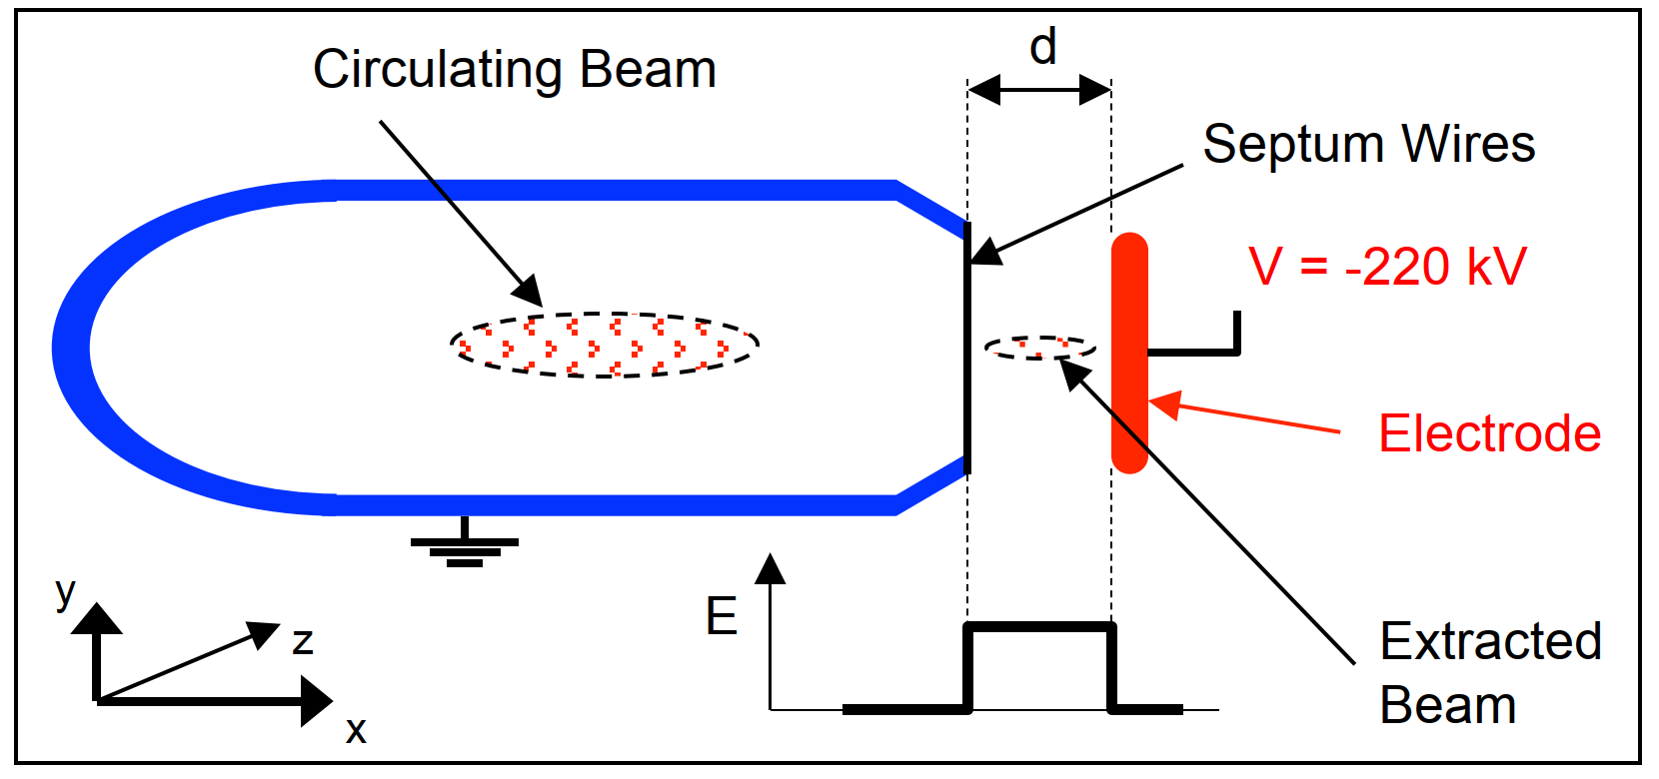
Introduction
SPS slow-extraction scheme
Slow extraction
SPS delivers protons to Fixed Target experiments (FT)
FT request constant particle flux for several seconds (= spill)
Solution: multi-turn resonant extraction scheme
  Excite third-order resonance
  Extract beamlets by means of electrostatic septum (ZS)
Challenge: inherently a lossy process
Optimisation problem: align ZS anode wires to reduce particle losses
Why important: need to reduce losses / activation (SLA Working Group), particularly in view of Physics Beyond Collider projects (BDF: SHiP)
B. Goddard (TE-ABT)
Extracted beam
Losses on wires
field-free region
x’
Septum wires
M. Fraser (TE-ABT)
x

Slide 4
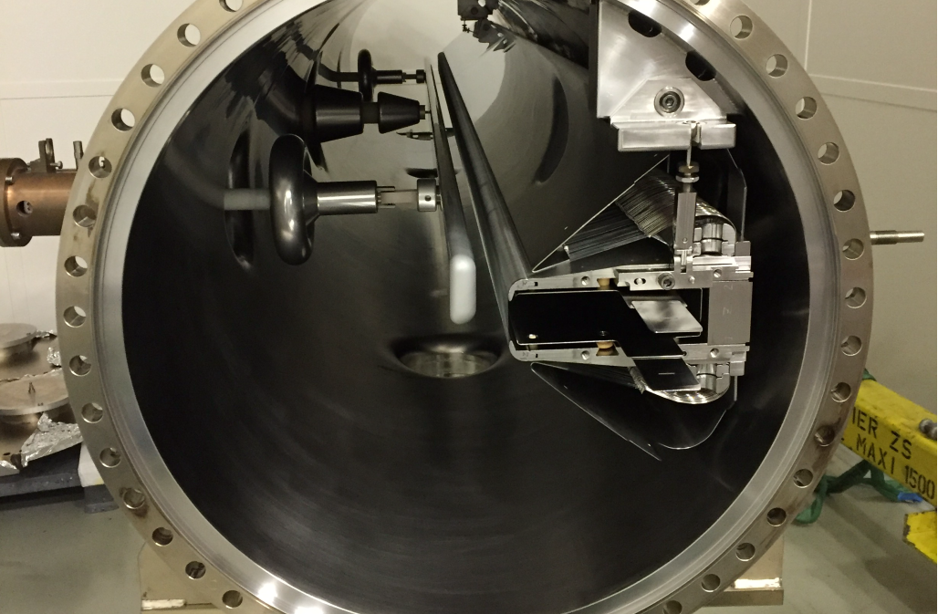
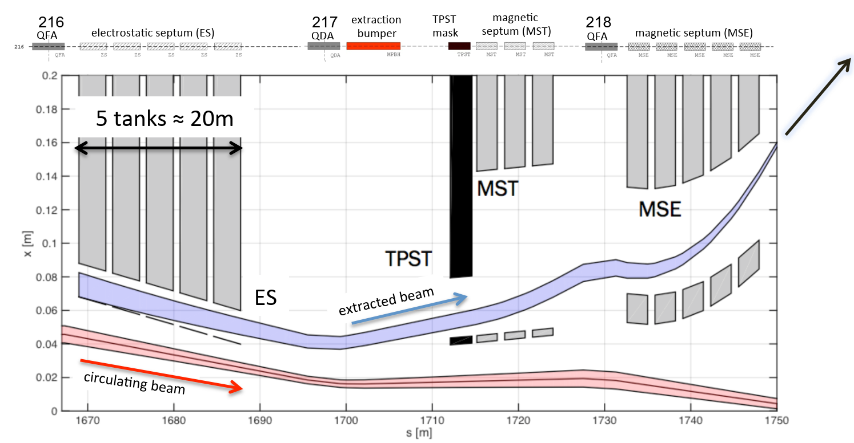
Introduction
The SPS ZS
SPS ZS composed of 5 tanks
System with 12 degrees of freedom (dof)
  10 dof: adjustable anode wire positions up- and downstream for every tank
  2 dof: girder positions up- and downstream
Loss monitoring: > 20 beam loss monitors (BLMs)
Entangled dynamics & ‘many’ parameters:
modeling and optimisation not straightforward
anode
wires
cathode
circulating beam
extracted beam
M. Fraser (TE-ABT)
to FT experiments
M. Fraser (TE-ABT)

Slide 5
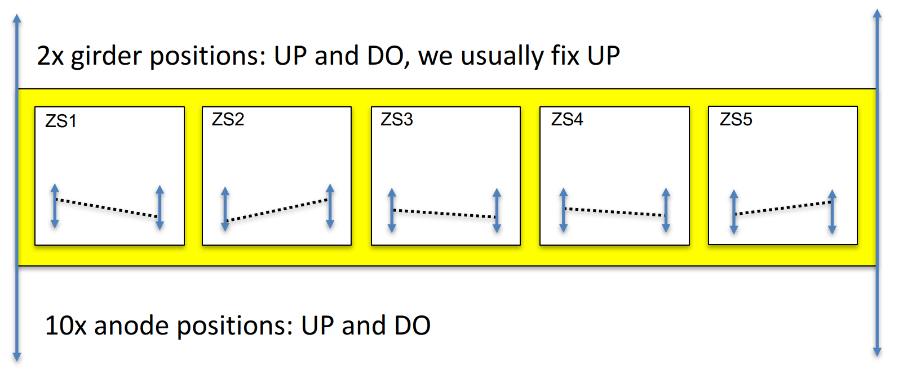
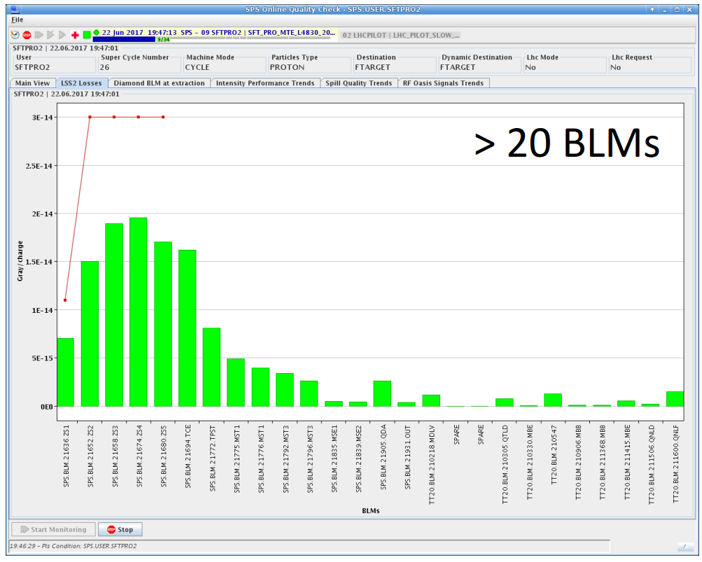
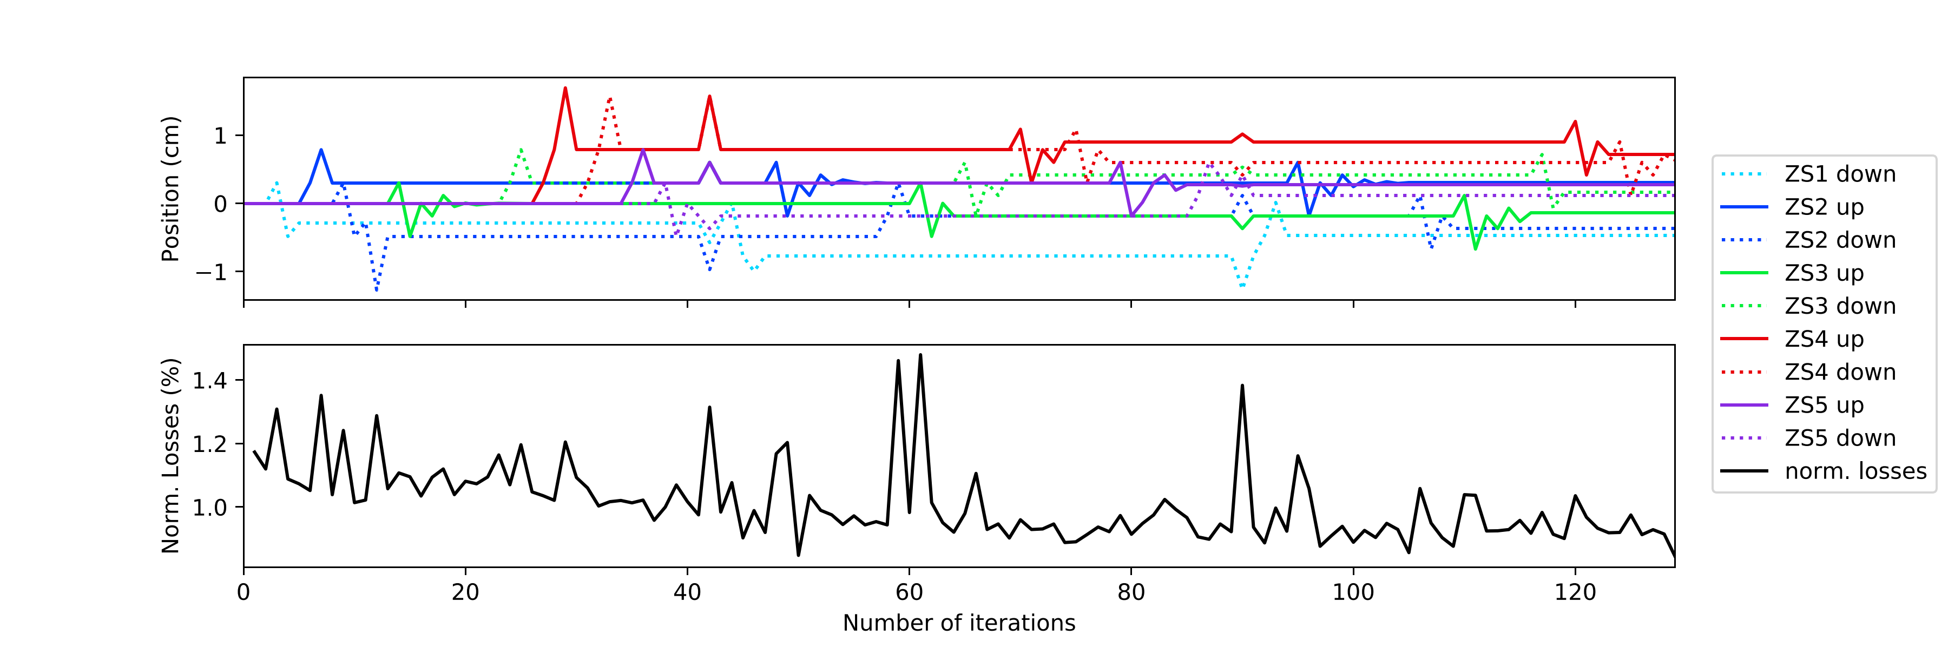
Introduction
SPS ZS alignment procedures
Controls (features)
Output (observables)
Norm. beam loss (Gy/charge)
x
s
M. Fraser (TE-ABT)
BLMs near ZS
Until 2018:
  Manual, anode-by-anode optimisation
  Time-consuming (≈ 8 h) and tedious
  Required several times per year
Test in Nov. 2018:
  Automatic alignment: proof-of-principle with modified numerical optimiser (Powell’s method)
  Does first line search along every direction, then simultaneous parameter adjustment
  Big impact: time for full adjustment reduced to 40’
  with same improvement on total loss
1
Anode pos. (cm)
0
-1
1.4
1.2
Norm. loss (%)
1.0
0
20
40
60
80
100
120
Iterations
S. Hirlaender, V. Kain (BE-OP) & TE-ABT

Slide 6
Motivation
Reinforcement learning
Can we do even better?
  Numerical optimiser has no memory: alignment from scratch every time
  Reinforcement learning (RL)
    Agent interacts with environment and learns dynamics
    of the system
    State not restricted to action space
    Agent strategy / knowledge typically represented by
    neural network (Deep RL)
    => once trained, agent remembers and finds optimum in a few steps
Reinforcement learning
action
agent
Environment
(e.g. accelerator)
state (observation)
reward

Slide 7
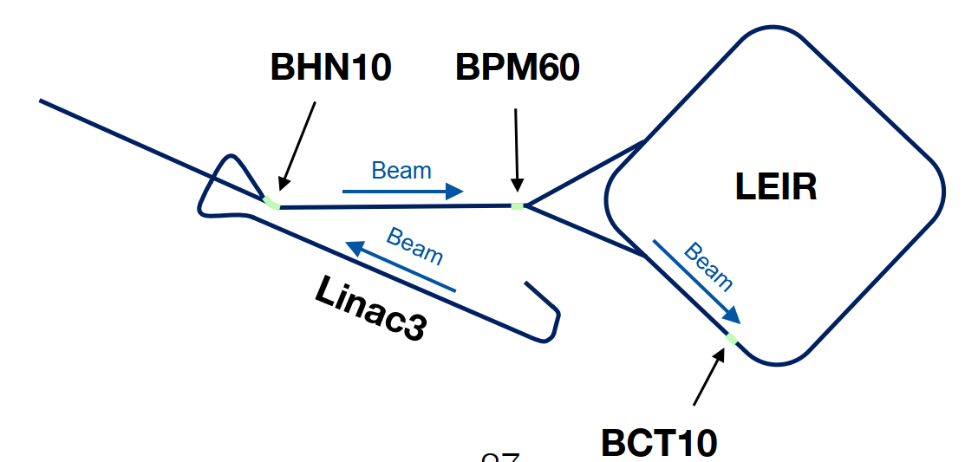
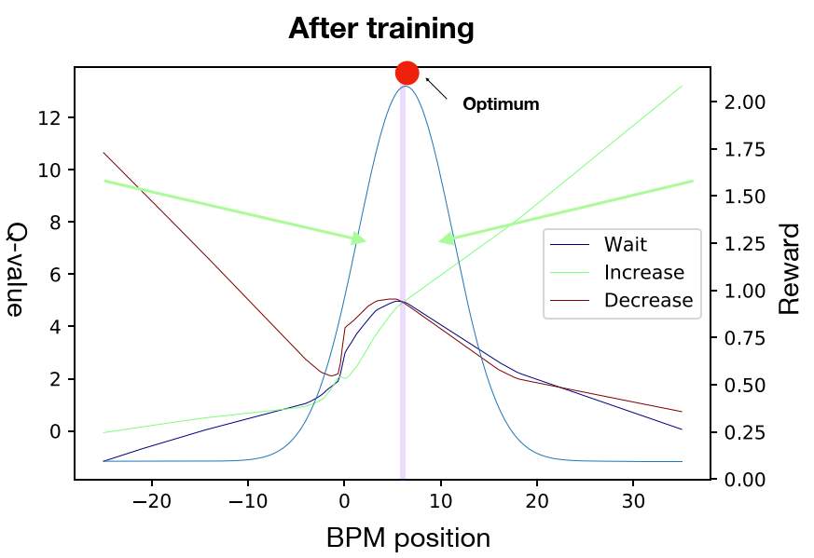
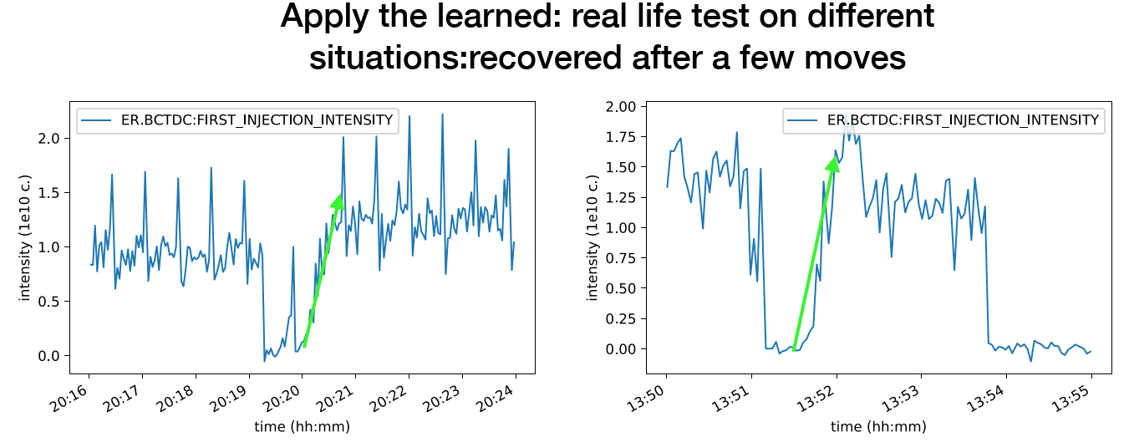
Motivation
Reinforcement learning
RL defines state-of-the-art performance in robotics, playing games (e.g. Atari, AlphaGo), … and artificial intelligence problems in general
Applied to particle accelerator domain
  Proof-of-principle at CERN Low Energy Ion Ring (LEIR)
  1 control parameter: optimise injected intensity by tuning
  dipole magnet strength (BHN10)
  Solved as discrete control problem
  Model-free RL agent successfully learned the dynamics
  of the system
Implemented and tried out various continuous control algorithms using OpenAI gym environment templates
Experience shows: sample efficiency is of major importance for our problems
action
state
reward
S. Hirlaender, V. Kain, M. Schenk

Slide 8
Motivation
Reinforcement learning
Can we do even better?
  Numerical optimiser has no memory: alignment from scratch every time
  Reinforcement learning (RL)
    Agent interacts with environment and learns dynamics
    of the system
    State not restricted to action space
    Agent strategy / knowledge typically represented by
    neural network (Deep RL)
    => once trained, agent remembers and finds optimum in a few steps
Reinforcement learning
  Sample efficiency is key as machine time is expensive
  Idea: Pre-train agent offline for ‘warm start’ in accelerator
Offline training requires a model F(x) of the system
  Tracking simulation, data-driven model, …
  Fast, cheap evaluation needed:
  Pre-training may require a few thousand iterations
Reinforcement learning
action
agent
Environment
(e.g. accelerator)
data-driven model
state (observation)
reward
Features
Observables
F(x)
Beam loss (Gy/charge)
BLMs

Slide 9
ZS data-driven model
Overview
Start with simple model
9 features
All anode positions (except ZS1 UP), no girders
5 observables
BLMs ZS1, ZS2, .., ZS5
Neural network
Feed-forward, dense, 1 hidden layer, 7 - 15 nodes, leaky ReLU activation
Adam optimizer
Missing features: girders, orbit, cathode voltage, ...
Training and test sets from existing data
  Training on data from Powell scan
  01.11.18, 467 samples
  => Predict manual scan 27.03.19 (independent test set, 7 months)
  => Fake scans for all anode positions
  Training on data from Powell scan and manual scan
  27.03.19, 1308 samples
  => Predict manual scan 30.03.19 (test set)
  => Perform anode scans as above
Features
F(x)
Observables
Beam loss (Gy/charge)
BLMs

Slide 10
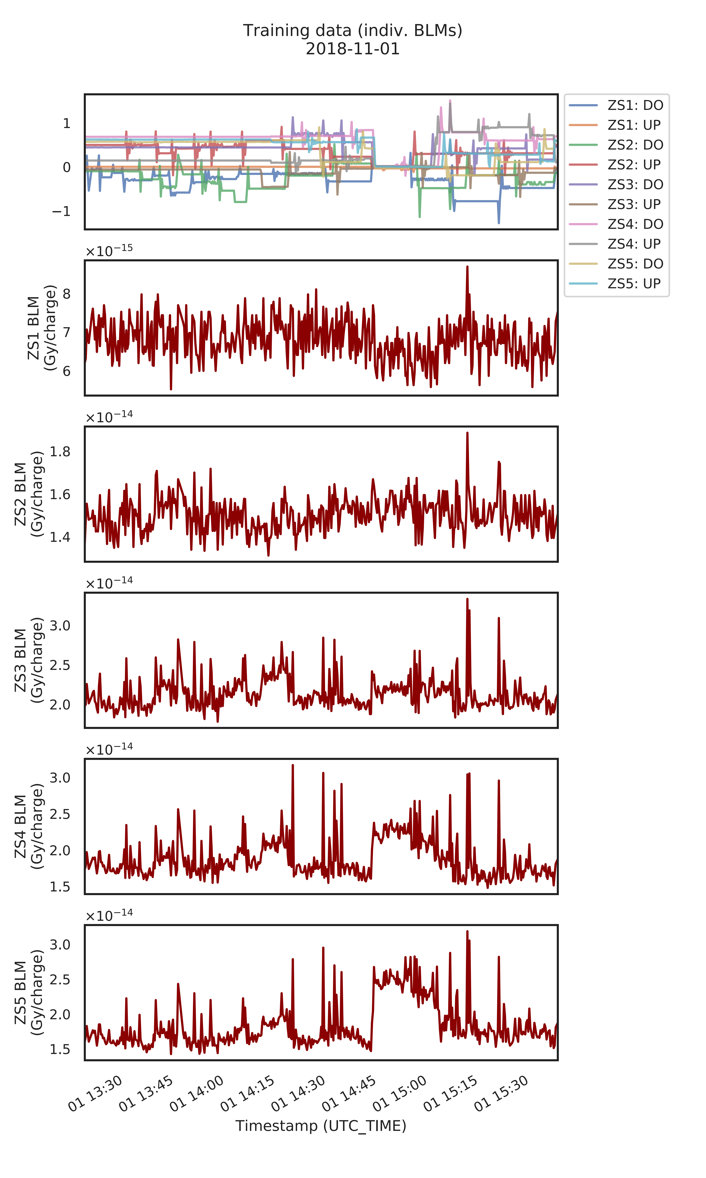

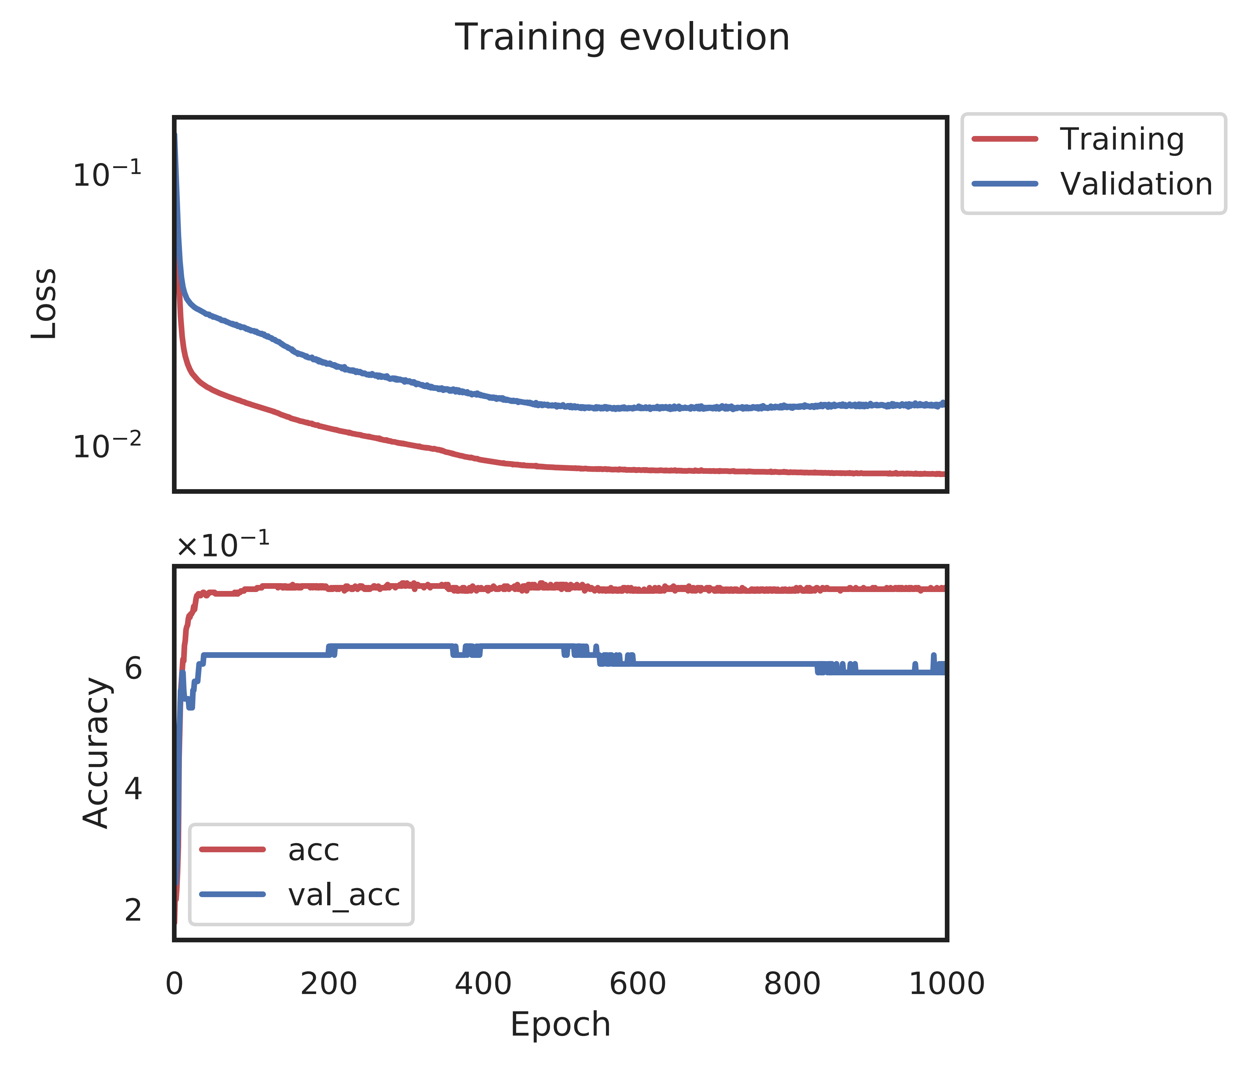
ZS data-driven model
Case I: Training data and evolution (7-node neural network)
Features
Overfitting?
Accuracy relatively low due to small number of samples
Observables

Slide 11
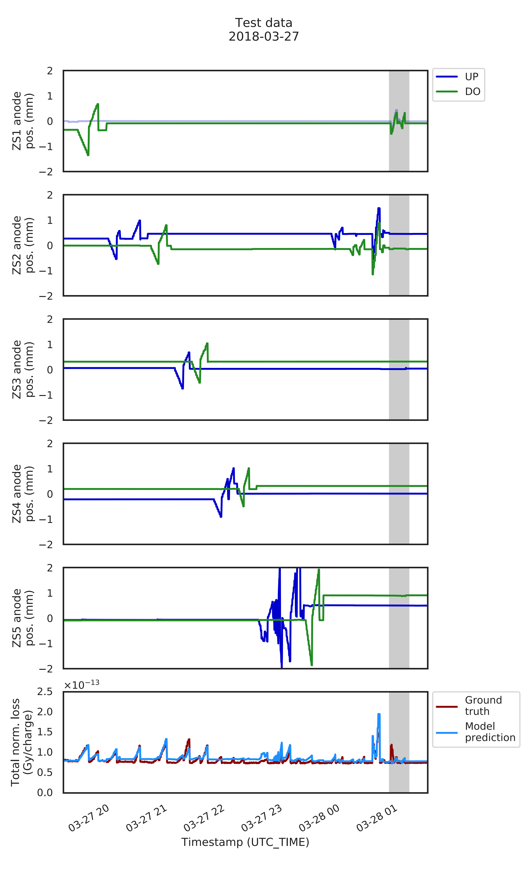
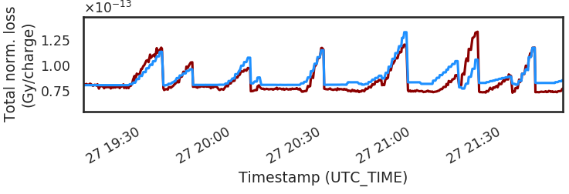
ZS data-driven model
Case I: Test set predictions (total loss)
Good quantitative agreement, given simplicity of model and low number of samples
Training and test set separated by 7 months
Offset in ‘baseline’ & some peaks only qualitative agreement
  Missing feature (girder, orbit)?
  See individual loss on BLM ZS5 (backup)
Another source of discrepancy is range in anode positions
  Training set: ≈ ± 0.5 - 1 mm
  Test set: up to ≈ ± 2 mm
Zoomed view of total loss

Slide 12
ZS data-driven model
Case I: Test set predictions (total loss)
Good quantitative agreement, given simplicity of model and low number of samples
Training and test set separated by 7 months
Offset in ‘baseline’ & some peaks only qualitative agreement
  Missing feature (girder, orbit)?
  See individual loss on BLM ZS5 (backup)
Another source of discrepancy is range in anode positions
  Training set: ≈ ± 0.5 - 1 mm
  Test set: up to ≈ ± 2 mm
Moving in range [-2, 2] mm
Not trained for that (extrapolation)
But: ZS5 no big impact on total loss, hence prediction still OK
Peak not predicted
Moving ZS1 UP
Not trained for that

Slide 13
ZS data-driven model
Validation: orthogonal anode scans
Scan individual anode positions and predict total loss
Case I: Trained on Powell data (7-node NN)
Case II: Trained on Powell and manual scan data (15-node NN)
Loss response is convex – as expected
Small impact on total loss from ZS4 and ZS5 – as observed in the machine
‘Piecewise linear’ functions due to simplicity of network
Case II: A second ZS NN model with 15 nodes trained on Powell and manual scan data performs even better on a test set (backup)
Good news: both models predict similar loss response

Slide 14
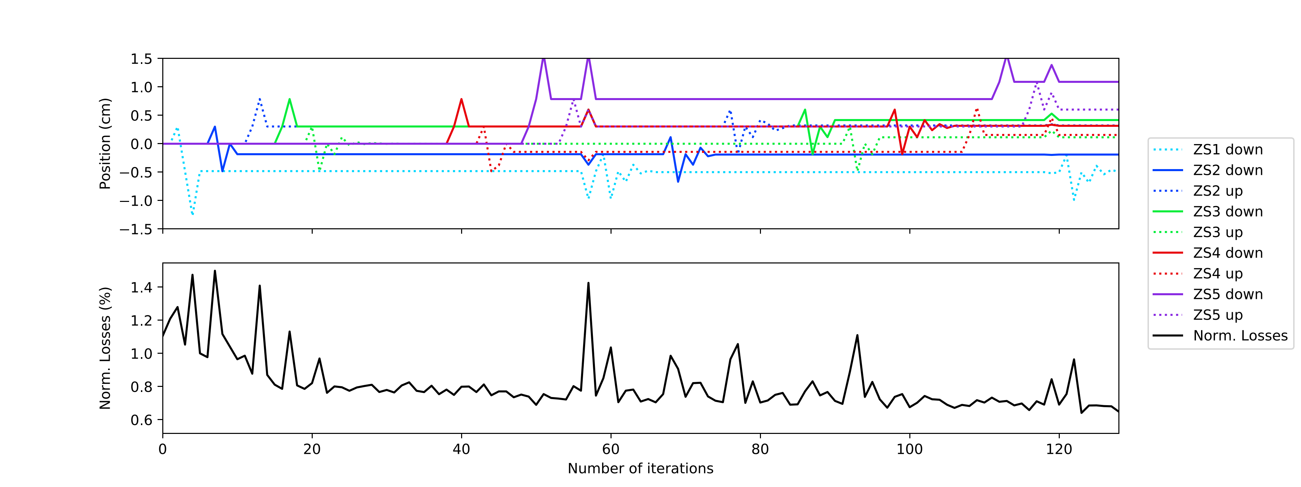
ZS data-driven model
Validation: Powell optimisation on SPS machine and trained model
Measurement
Model

Slide 15
ZS data-driven model
Validation: Powell optimisation on SPS machine and trained model
Measurement
Measurement and model show similar evolution
Model behaves well
Powell algorithm probes feature space better, not just along orthogonal directions
Similar test with COBYLA (Constrained Optimisation BY Linear Approximation) algorithm: converges even faster than Powell (see backup)
Model

Slide 16
Final remarks
Even with little training data: ZS model performs well and passes validation tests
It is not yet complete and hence improved further: adding more features / observables
Trained ZS model is now embedded in OpenAI gym environment and used for RL benchmarks
Excellent testbed for multidimensional RL optimisation problems to study various algorithms for continuous control
Sample efficiency is key (for accelerator domain)
Data-driven or surrogate models can be game changers

Slide 17
Backup

Slide 18
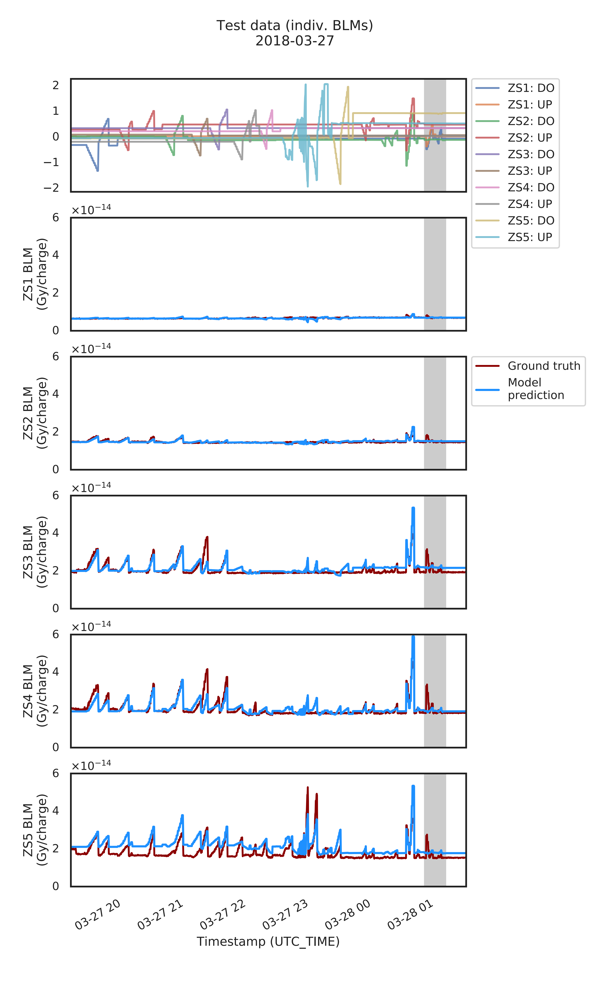
ZS data-driven model
Case I: Test set predictions (individual BLMs)
Overfitting artefacts?
Offsets on BLM ZS5
Possibly due to changed settings
on features that are not included
in the model (orbit, girder, cathode voltage, etc.)

Slide 19
ZS data-driven model
Case I: Tests with ‘fake’ anode scans
Orthogonal scans reasonable: convex shapes
No strong impact on total loss from ZS4 and ZS5, as observed in the machine
Piecewise linear functions due to simplicity of network

Slide 20
ZS data-driven model
Overview
Start with simple model
9 features
All anode positions (except ZS1 UP), no girders
5 observables
BLMs ZS1, ZS2, .., ZS5
Neural network
Feed-forward, dense, 1 hidden layer, 7 - 15 nodes, leaky ReLU activation
Adam optimizer
Missing features: girders, orbit, cathode voltage, ...
Training and test sets from existing data
  Training on data from Powell scan
  01.11.18, 467 samples
  => Predict manual scan 27.03.19 (independent test set, 7 months)
  => Fake scans for all anode positions
  Training on data from Powell scan and manual scan
  27.03.19, 1308 samples
  => Predict manual scan 30.03.19 (test set)
  => Perform anode scans as above
Features
F(x)
Observables
Beam loss (Gy/charge)
BLMs

Slide 21
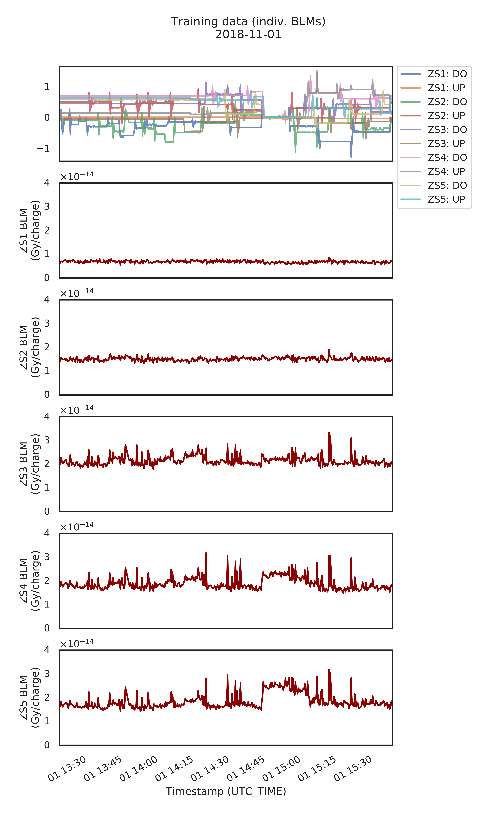
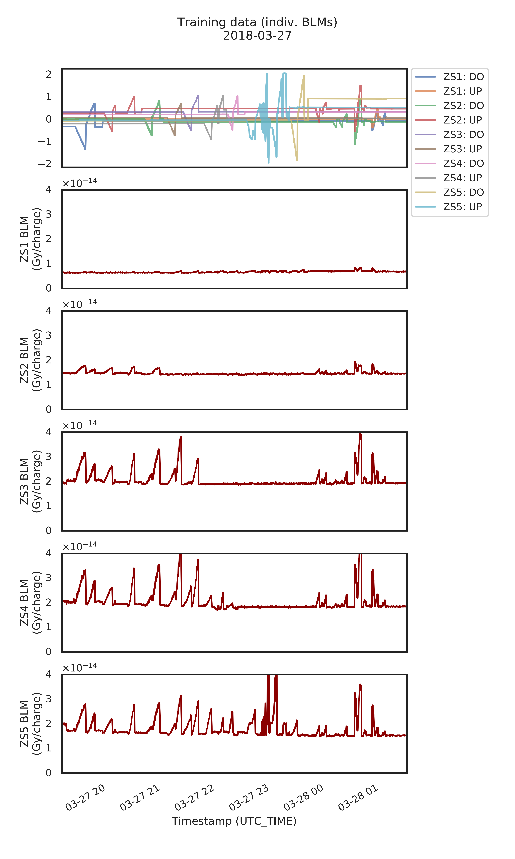
ZS data-driven model
Case II: Training data (15-node neural network)

Slide 22
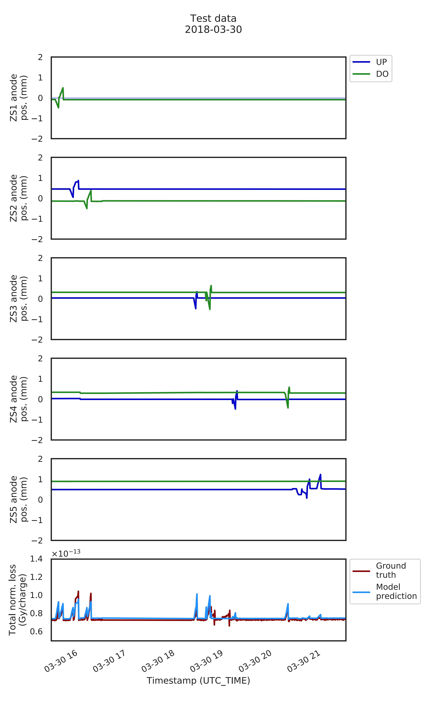
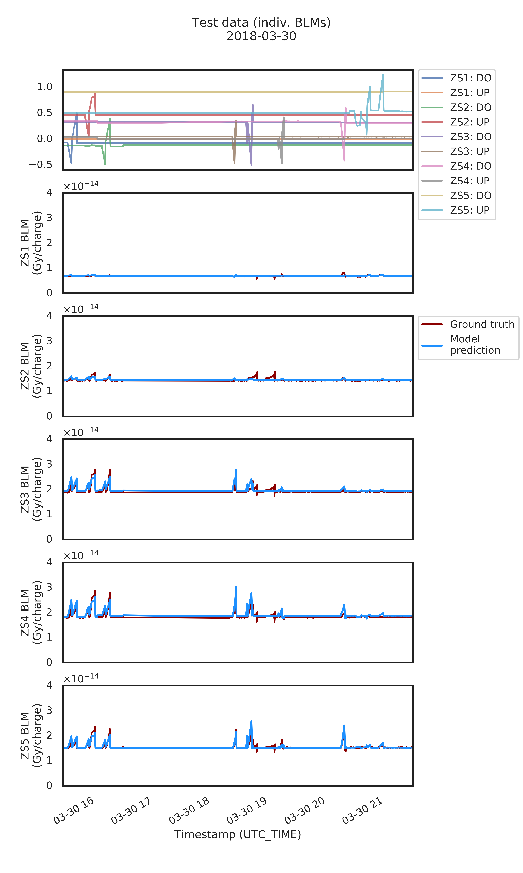
ZS data-driven model
Case II: Test set predictions (on ‘independent’ data set)
Other scans / settings
(miniscans)

Slide 23
ZS data-driven model
Case II: Test set predictions (on ‘independent’ data set)
Less surprising that performance of the model is good
It ‘has seen the test set’ already (sets not independent …)
Even when overfitting would likely still perform well on test set
Difficult to find solid, independent test from available data in that case
Other scans / settings
(miniscans)

Slide 24
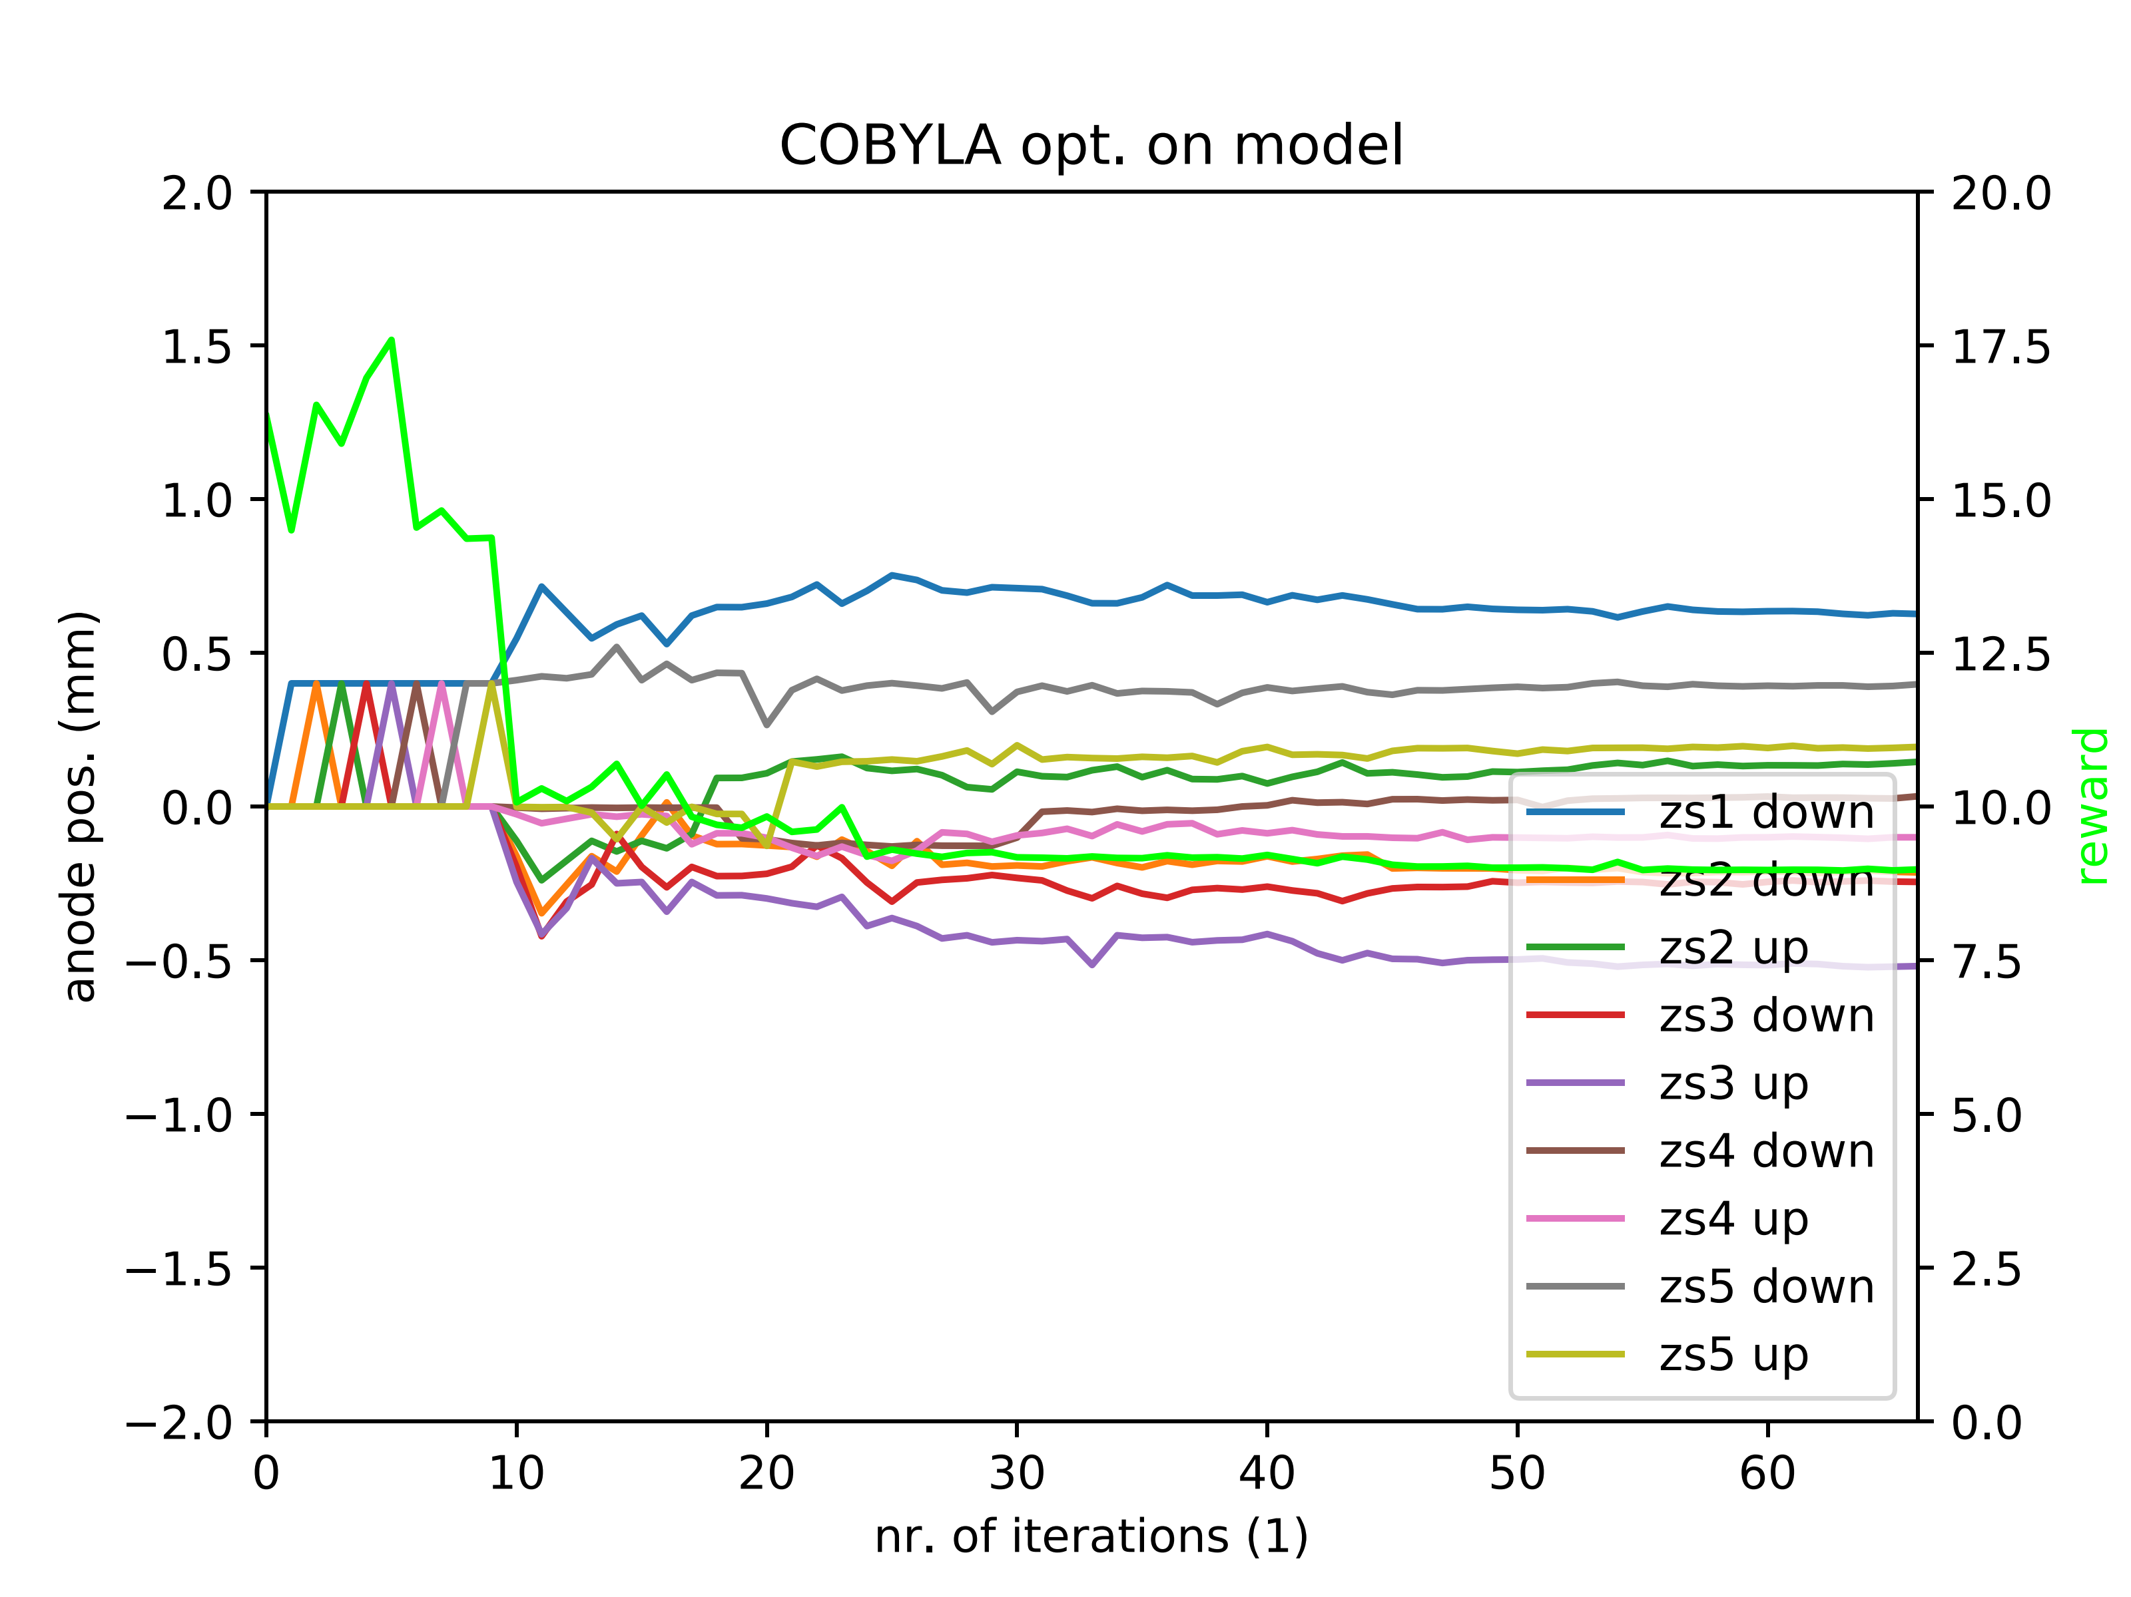
ZS data-driven model
Validation: COBYLA performance on trained model (7-node NN)
COBYLA with constraints on anode positions to ± 2 mm:
Optimisation on NN model to check if it produces sensible output
Not clear yet how NN model behaves outside ‘trained range’ …
COBYLA or Powell algorithms probe feature space better, not just along orthogonal directions
Reward = total loss x 10¹⁴
Optimum expected at
8 x 10⁻¹⁴ Gy/charge
(from data and NN model)
Even faster convergence than Powell – looks promising

