Slide 1

Beam Intersection Factor
and
Neutron Induced Reaction Analysis
Presented by: Xinheng AI
Supervisors: Vasilis Vlachoudis , Francisco Ogallar Ruiz , Massimo Barbagallo

Slide 2
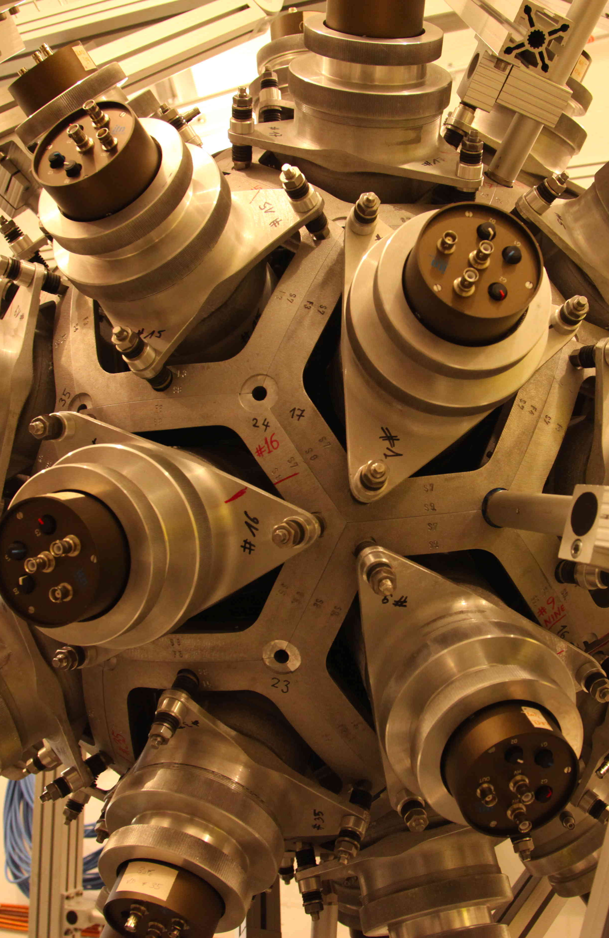
CERN n_TOF
n_TOF EAR1
Neutron Time of Flight Technology

Slide 3
Motivation
Nucleosynthesis in stars
Material
structure
Nuclear waste management

Slide 4
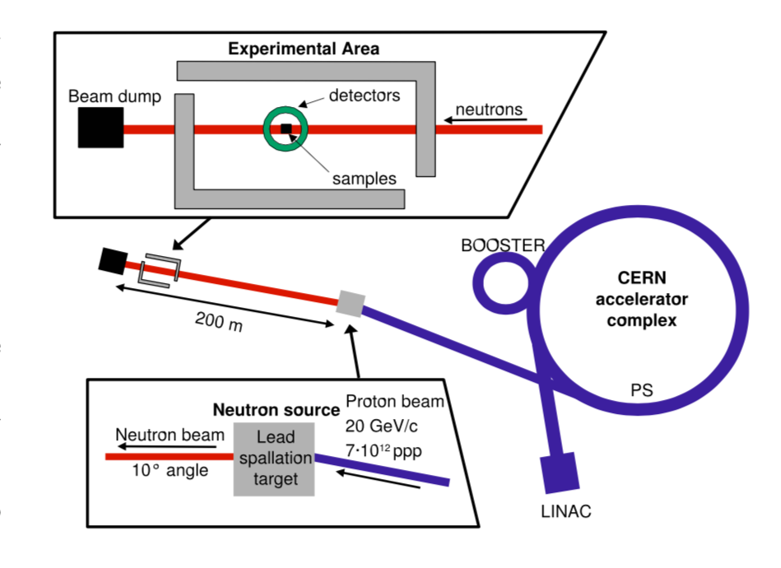
Proton beams(～300neutrons/proton):
Dedicated:～7∙10^12/pulse Parasitic: ～2.5∙10^12/pulse
n_TOF set-up
10° hitting angle from top view
to remove partial charged particles and gamma rays along the flight path

Slide 5
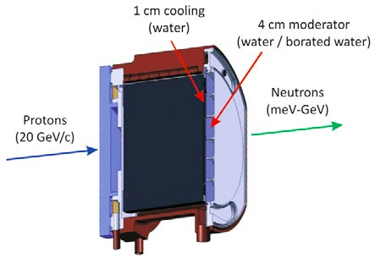

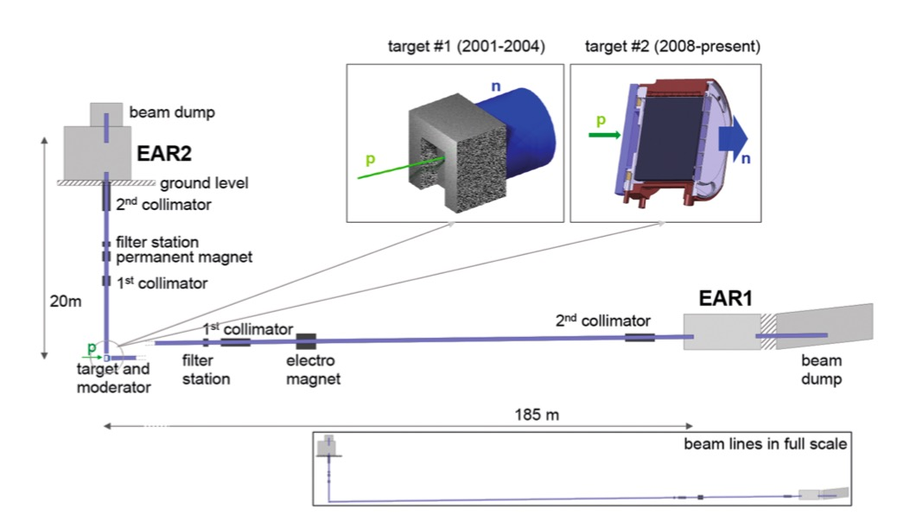
Target
EAR1(H2O+1.28%H3BO3):
• Better energy resolution
EAR2(H2O):
• Higher neutron flux (25 times than EAR1)
• Exclusion of gravity effect possible

Slide 6
FLUKA: For high-E of proton-target spallation
MCNP: For low density sample when resonance structure of studied materials is crucial
Neutrons which arrive at the experimental area are within a very small solid angle 10^-8Sr.
Full calculation is cumbersome and meaningless.
Simulation
Transport code is developed for this issue!

Slide 7
Transport code
Proton beam → Lead target → Scoring plane → experimental area or detector
Spallation process is done by FLUKA
Neutrons are scored at the experimental area
Useless neutrons are eliminated according to assumptions

Slide 8
Assumptions
1.Within a small cut angle, neutrons are emitted isotropically.
It holds within 5° and in practice 1° for EAR1 and 2° for EAR2 are used.
2.Project each neutron to the experimental area first.
Discarding neutron outside L × tanθcut + 0.4m(0.4m radius of vacuum tube after lead target).
3. Neutrons hitting either a tube or collimator are eliminated
Scoring surface is selected at experimental area with 1mm step of scoring grid.

Slide 9
Neutron energy spectrum
Water/borated water :
Hydrogen moderation
Thermal neutron killer
Background radiation reduction
Thiner/Thicker target:
Thiner:Fast neutron, lower fluence
Thicker: Wider energy range, higher fluence

Slide 10
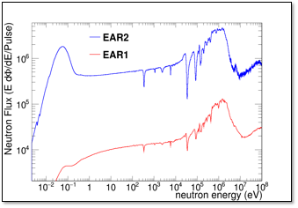
Neutron Fluence
The number of neutrons per incident proton pulse , which arrives at experimental
area.

Slide 11
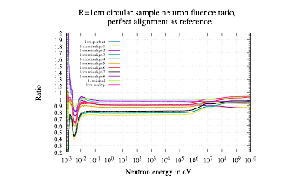
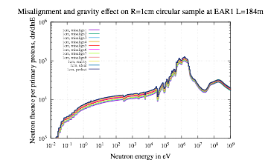
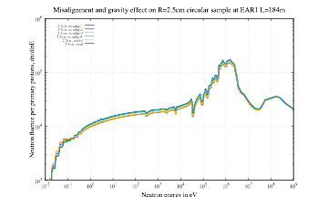
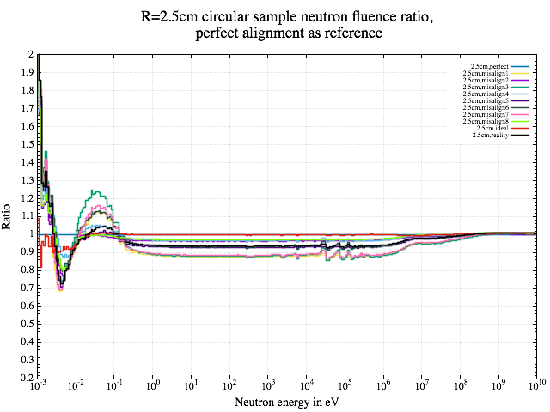
Neutron Fluence

Slide 12
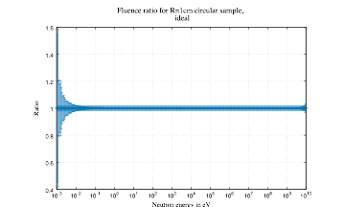
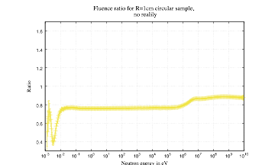
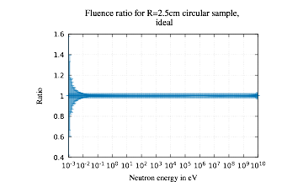
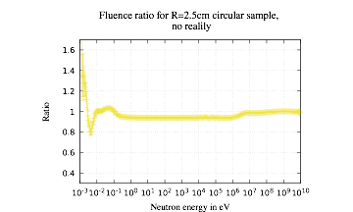
Neutron Fluence ration uncertainty

Slide 13
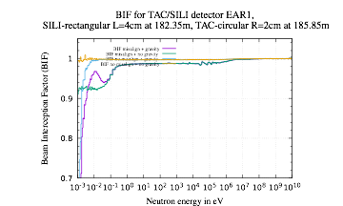
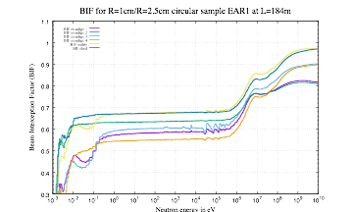
BIF
Beam Intersection Factor:
BIF is the flux seen by sample or detector over full flux along arriving at experimental area
Low-E, sensitive to gravity effect
High-E, forward peaked instead of isotropic distribution.

Slide 14
Data analysis —workflow
Gamma flash is used as reference
In the same time, lots of productions of charge particles, decay gamma from pion+ and kion+
LINAC → Booster → PS → sending dedicated and parasitic protons.
Proton will travel a distance in the target before induce a gamma ray, simulation available.
N_TOF : receive protons and triggers on.
First gamma flash should be treated extremely carefully by gamma flash locating.
Detection:
Peaks of gamma rays are distinguishable
Gamma locating:
Gamma-flash locating correctly is extremely important, by setting proper parameter

Slide 15
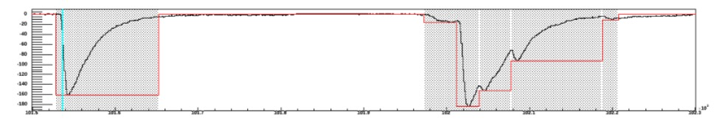
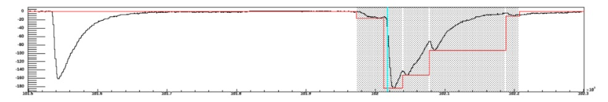
Gamma flash locating
Minimal expected width:Find out the real start of gamma flash from false ones
Window:Pluses are protected from elimination after finding out the real gamma flash, the length of time after gamma flash
severe elimination conditions: Customized thresholding
Base line is and should be redefined around the gamma flash
30% of amplitude height of the gamma flash is used as the starting point.
Later by extracting these useful pulses , we generated the spectrum of gamma counts in a manner of time
of flight, which means energy of neutron
Before thresholding
After thresholding

Slide 16
Fluence check
In order to double check the coming neutron fluence, some XS-well-known samples are used.
SILI detector uses Li-6 as checking materials, by looking at the peak of fission peak.Peak counts are corresponding to coming flux since the cross section is well-known
Additionally we can put an unknown
sample in front of the well-known sample
along the coming flux for correction
w/o unknown ———— one spectrum from well-known
w/ unknown ———— another spectra from well-known
Comparing in a smart way, we can know some properties of unknown materials
But this method is just for correction while main information is from gamma peaks vs time of flight

Slide 17
Au-197 capture yield analysis
Capture yield :The probability that a capture reaction occurs in the sample
Flowchart
Proton → Lead target → Neutrons → Au-197 activation → TAC and D6C6 detectors → DAQ → calibration.
Calibration is done by:
Cs-137, 662keV
Y-88, 898 and 1836KeV
Pu/C, 6131keV from O-16
All data comes from different sizes of sample
to avoid systematic error
Counts measured with and without the sample
Detection efficiency can be simulated and calibrated.
Neutron flux can be determined such as Li-6 fluence check method
BIF can be simulated

Slide 18
Other effects
Pileup and dead time :
Pileup problems are affecting only the low-energy part of
the energy deposited in each crystal
150 keV for the individual crystals
Two capture events within the coincidence window
Owing to the constraints on total deposited energy,
the combination of two (or more) capture reactions leads to
the loss of one or both events, depending on
whether the resulting falls within the adopted pulse height window
Decreasing the time window
Background:
in-beam γ rays,
ambient background
α radioactivity of Ra from scintillator
Solutions:
In-beam gamma can be obtained from Pb sample
Measurement with beam-on and beam-off
Empty-sample is used to estimate gamma leaking from collimators

Slide 19
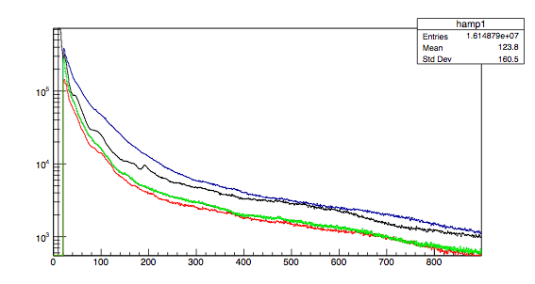
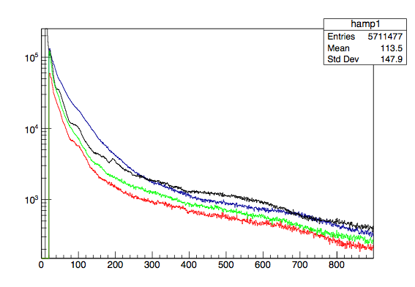
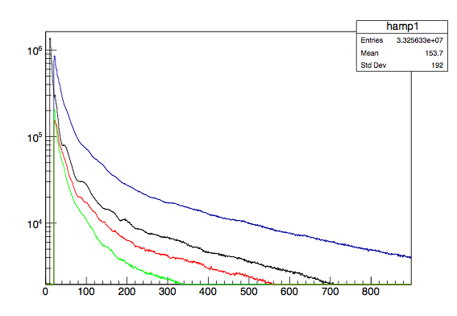
Au-197 amplitude by C6D6
Test Au-197
Empty sample
After normalization
Four C6D6 detectors were used
Detector 1
Detector 2
Detector 3
Detector 4

Slide 20
Au-197 spectrum by TAC
A delicate part of the data analysis consists of the choice
of the optimal thresholds for the deposited energy in TAC
to maximize the capture-to-background ratio.
Spectrum is normalized to 4.9eV
which is the most famous peak for Au-197

Slide 21
Reference
C. Guerrer et al,Performance of the neutron time-of-flight facility n TOF at CERN, Eur. Phys. J. A (2013) 49: 27
The n TOF Collaboration, Nuclear data activities at the n TOF facility at CERN, Eur. Phys. J. Plus (2016) 131: 371
M. Barbagall, High-accuracy determination of the neutron flux at n TOF, Eur. Phys. J. A (2013) 49: 156
Vasilis Vlachoudis and Marta Sabte Gilarte , Yield calculation using resampling method for including the n TOF resolution function
M. Sabte-Gilarte, High-accuracy determination of the neutron flux in the new experimental area n TOF-EAR2 at CERN, Eur. Phys. J. A (2017) 53: 210
J. Cole and R. Cherkaoui-Tadili, Proton-induced spallation reactions between 300 MeV and 20 GeV, PHYSICAL REVIEW C VOLUME 36, NUMBER 4 OCTOBER 1987
C. Weiß et al, The new vertical neutron beam line at the CERN n_TOF facility design and outlook on the performance, Nuclear Instruments and Methods in Physics Research A799(2015)90–98
Massimo Barbagallo, MEASUREMENT OF THE NEUTRON FLUX AND OF THE CAPTURE CROSS SECTION OF U-236 AT N_TOF, ESAME FINALE 2013
C. Massimi, 197Au (n,γ ) cross section in the resonance region, PHYSICAL REVIEW C 81, 044616 (2010)
Wikipedia Au-197 spectrum
Disneyland Mickey Mouse

Slide 22
End
Thanks for your attention!

