Slide 1


Update HE-LHC Beam-Beam studies
C. Tambasco, T. Pieloni, J. Barranco

Slide 2
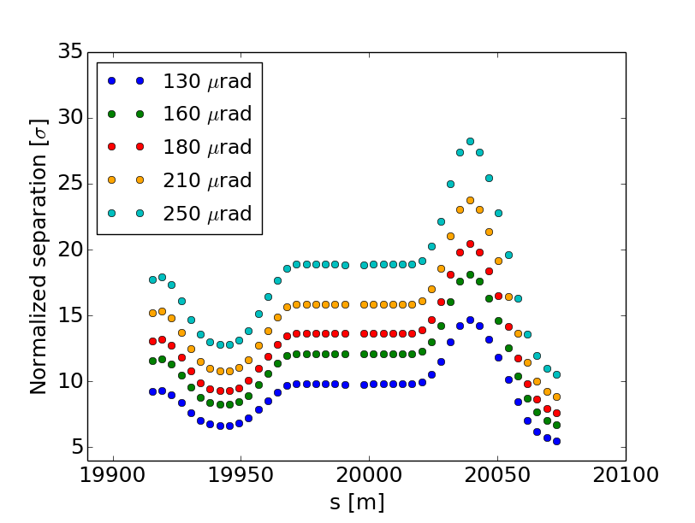
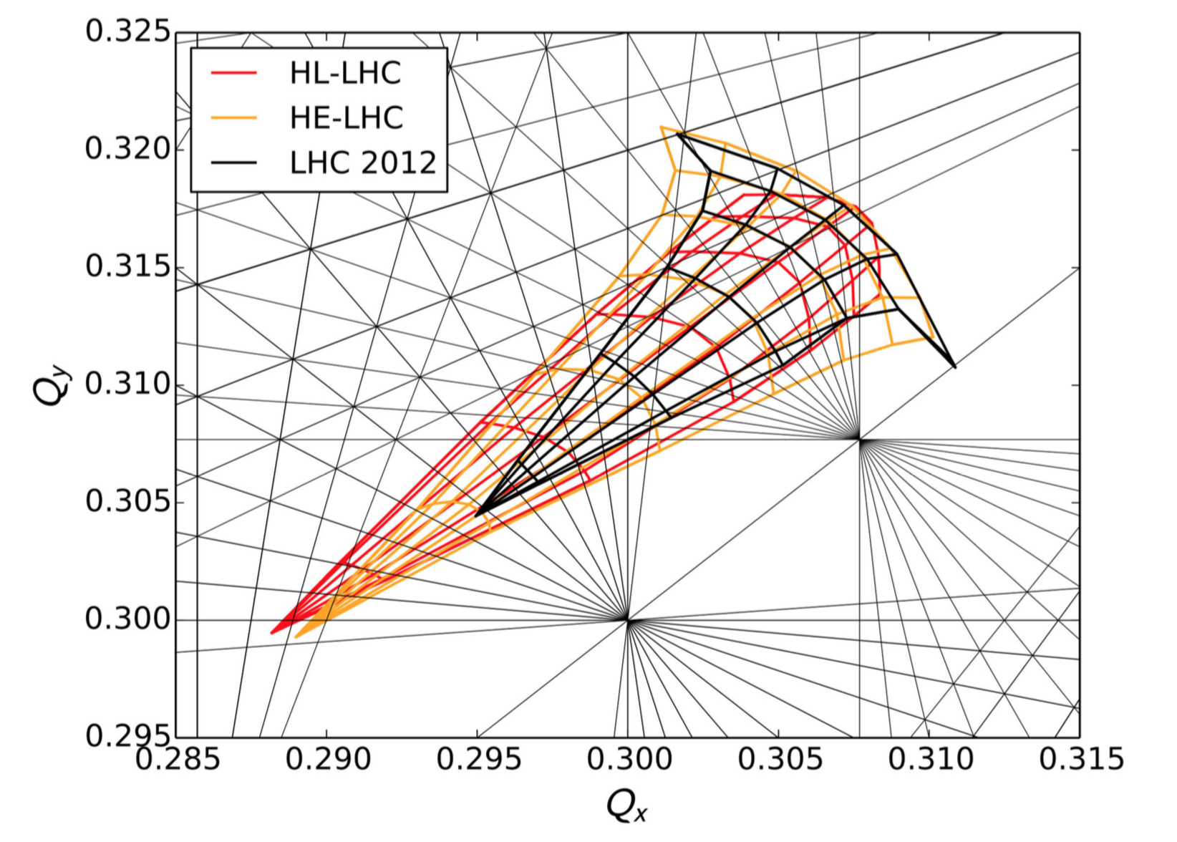
Long range interactions in the HE-LHC: summary
from the December review and FCC week
Half crossing angle
LHC 2012
HL-LHC (TDR)
HE-LHC (360 μrad)
1) X-angle =260 μrad not feasible, several long-range encounters close to 5 σ separation! DA BAD!
2) X-angle > 420 μrad best guess scaling from LHC and HL-LHC →but it is at the limit of the aperture
3) Assuming radiation damping and possibilities to find mitigation techniques (beta* leveling) a 360 μrad has been accepted but still it is extremely challenging.
Mitigation techniques with small impact on performances as for HL-LHC :
4) Option is to increase β* and reduce during physics fill as in HL.
β* = 40 cm
16 σ separations for a x-angle = 370 μrad

Slide 3
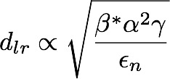
First Dynamic Aperture studies
Beta* =0.25 cm
2/4
3
1
At full intensity beam-beam separation has to be 16 σ
Option 1 (130 μrad) and 3 (180 μrad) too low DA
Option 2 is at the limit of aperture
Option 4: increase the β* and reduce the crossing angle

Slide 4
First Dynamic Aperture studies
Beta* =0.25 cm
2/4
3
β *= 45 cm
165 μrad (half)
Sep = 16.8 σ
1
Option 1 (130 μrad) and 3 (180 μrad) too low DA
Option 2 is at the limit of aperture
Option 4: increase the β* and reduce the crossing angle

Slide 5
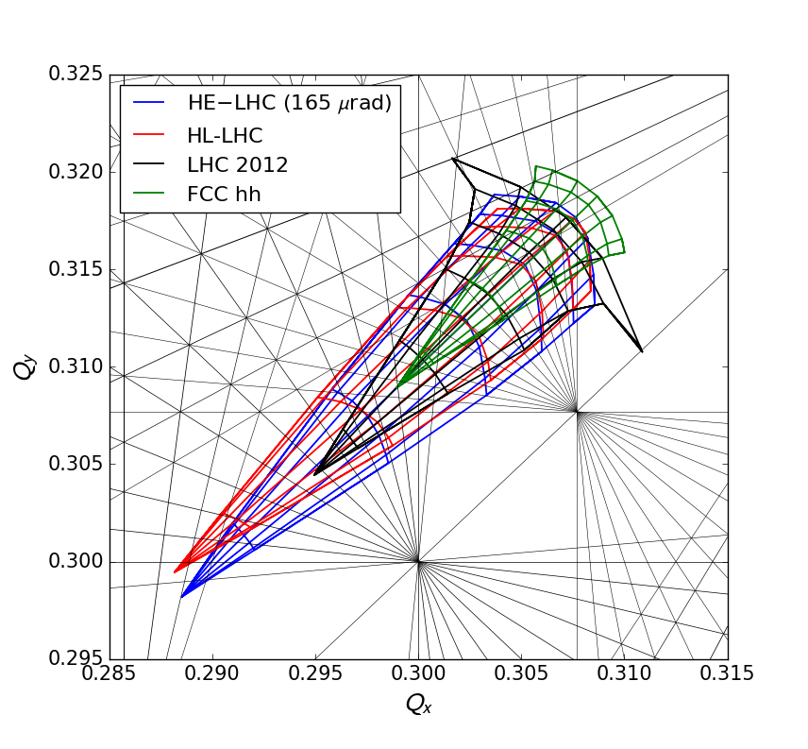
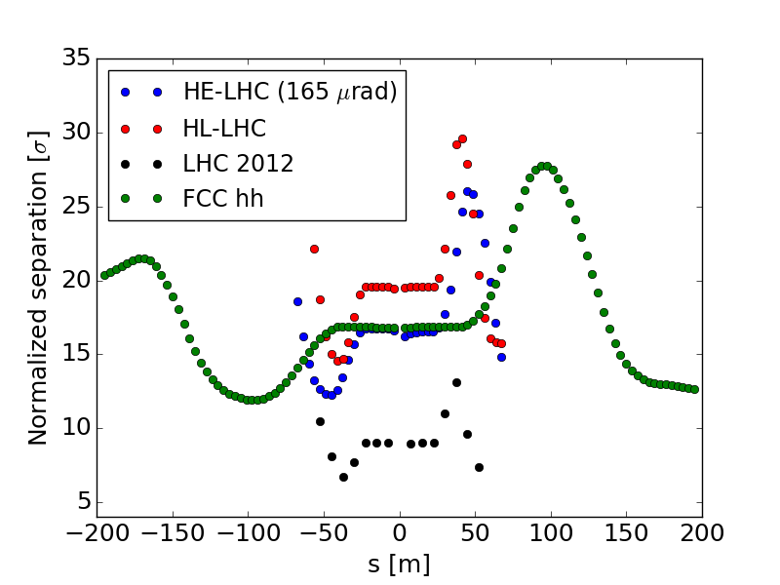
Comparing different machines
An angle of 330 μrad with β *= 45 cm corresponds to a sep = 16.8 σ: it guarantees DA > 6 σ
Limit of aperture satisfied
Reduction of β * during the fill is possible
DA studies with multipolar errors and high chromaticity to be performed

Slide 6
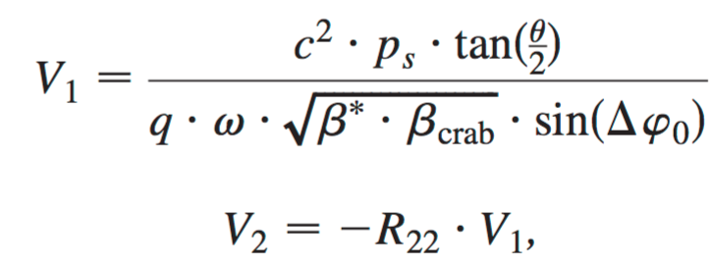
Crab Cavity Voltage
The crab cavity voltage (6.3 MV) was designed for a bb_{LR} separation of 10 σ corresponding to the initial angle of 260 μrad (excluded at the HE-LHC review)
HL-LHC (12.5 σ) 590 μrad β*=15 cm | HE-LHC (10 σ) 260 μrad β*=25 cm | HE-LHC (13.5 σ) 360 μrad β*=25 cm | HE-LHC (17 σ) 330 μrad β*=45 cm
10 MV | 6.3 MV | 8.7 MV | 8 MV
Crab voltage required is 8 MV → voltage increase from 6.3 MV to 8 MV or uncompensated angle of 70 μrad with 6.3 MV.

Slide 7
Back-up

