Slide 1
Analytical Computation of Wake Functions using the Residue Theorem
Adam Rahemtulla

Slide 2
Background/
Motivation

Slide 3
Particle accelerators are very important in modern physics
Natural to be interested in making ‘better’ accelerators
  i.e higher energy beams, greater collision rate
Important to understand limiting effects on the performance of accelerators

Slide 4
Limits on the performance may arise from beam instabilities, in particular those caused by electromagnetic interaction between beam and walls around it
  The ‘wall impedance’ is a quantity describing this interaction
  For large machines like LHC, or the proposed FCC, these wall impedance effects can be detrimental
  Important to investigate how this affects beam stability

Slide 5
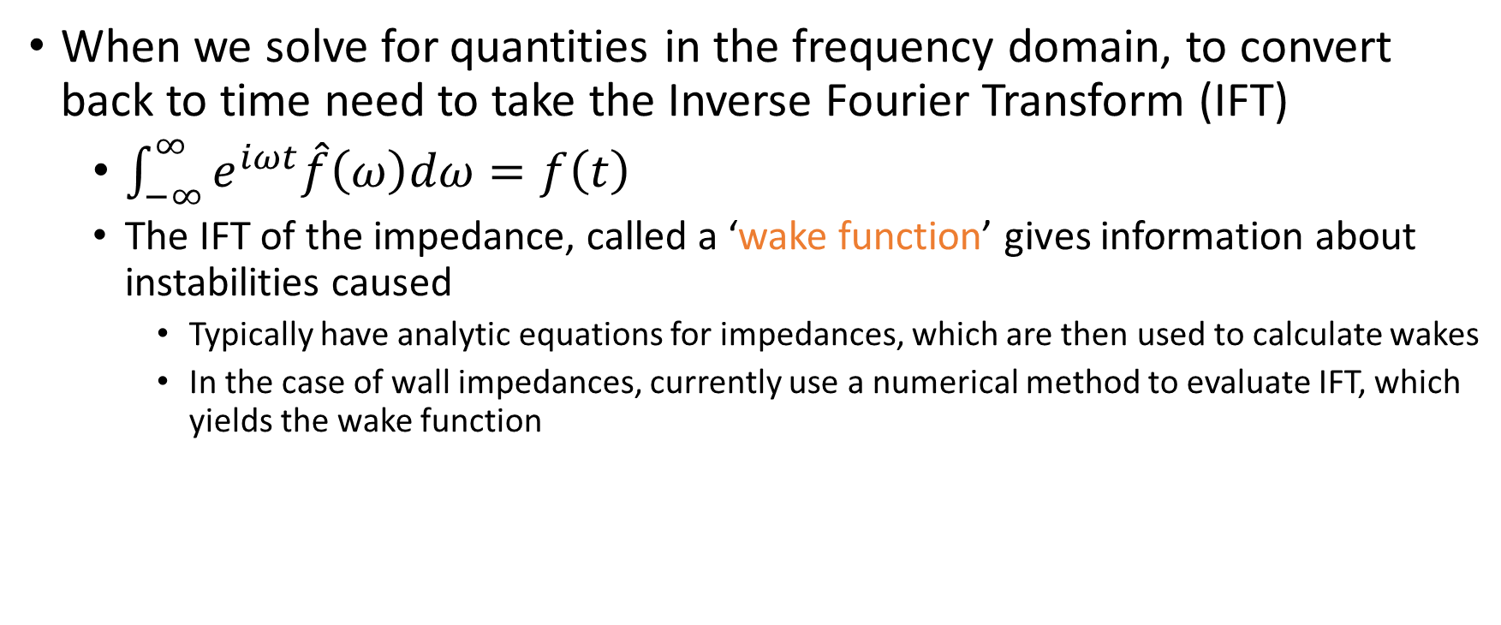
Impedances and Wake Function
When we solve for quantities in the frequency domain, to convert back to time need to take the Inverse Fourier Transform (IFT)
  $\int_{−∞}^{∞}{e^{iωt}\hat{f}\left(ω\right)dω}=f\left(t\right)$
  The IFT of the impedance, called a ‘wake function’ gives information about instabilities caused
    Typically have analytic equations for impedances, which are then used to calculate wakes
    In the case of wall impedances, currently use a numerical method to evaluate IFT, which yields the wake function

Slide 6
What we want to do
Want to design an approach using the analytical equations for wall impedances to determine wake functions analytically
  Using Residue Theorem
  Would provide a faster method of computing wake functions, and hopefully yield more accurate results
In future want to apply results FCC

Slide 7
Method/Theory

Slide 8
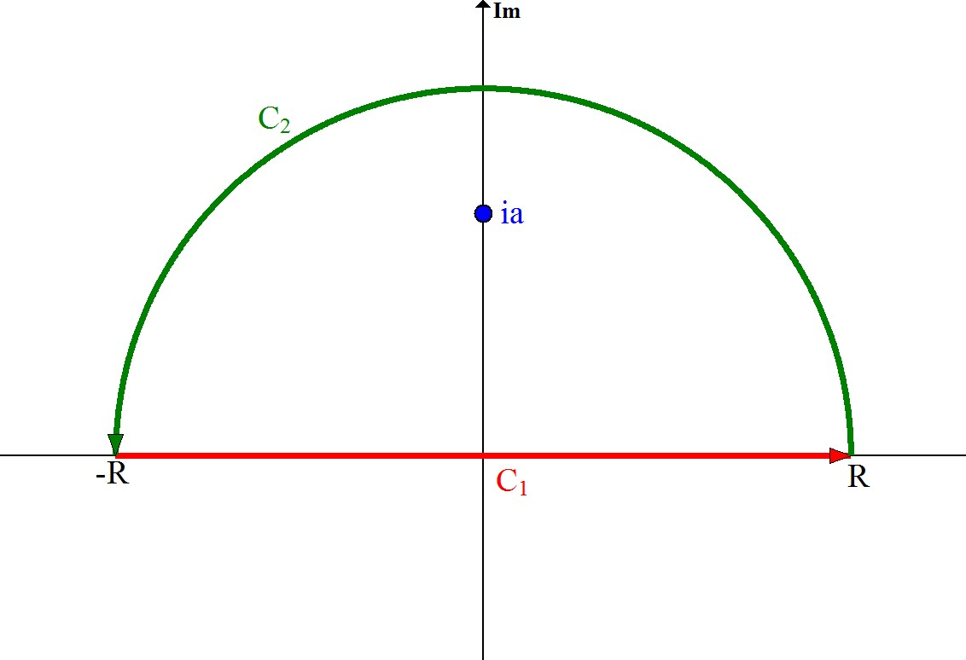
Residue Theorem
A theorem in complex analysis which gives a convenient method of computing line integrals
  An IFT can be considered as a line integral over the real axis
  Specifically tells us how to compute line integrals over closed contours

Slide 9
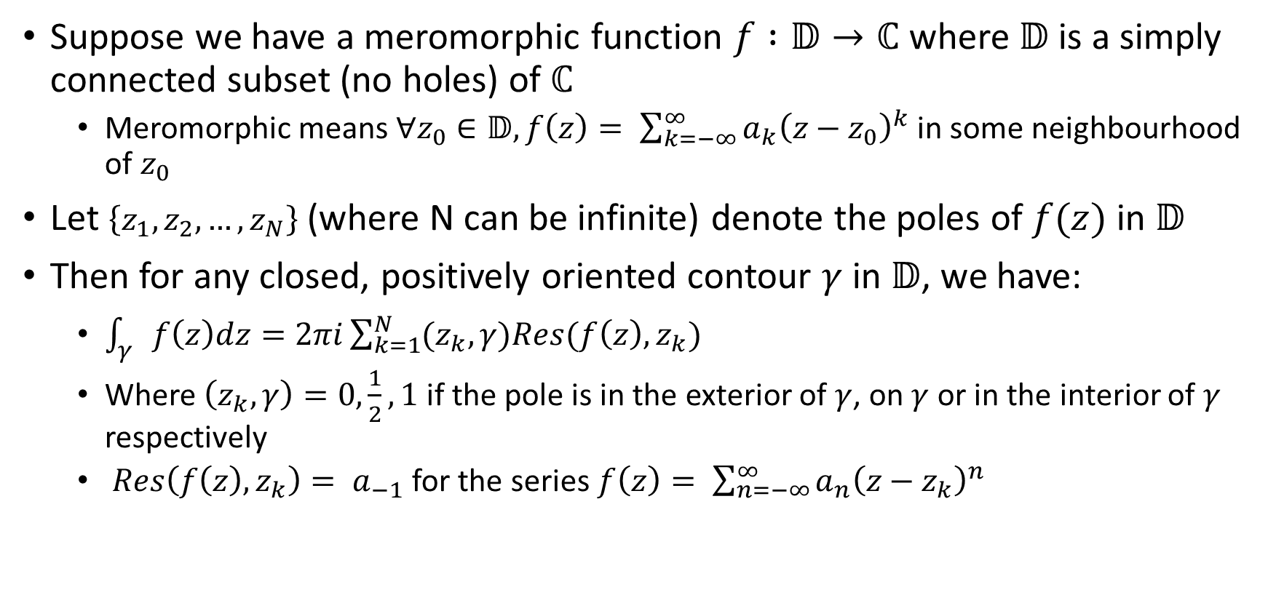
Residue Theorem, cont.
Suppose we have a meromorphic function $f :𝔻→ℂ$ where $𝔻$ is a simply connected subset (no holes) of $ℂ$
  Meromorphic means $∀z_{0}∈𝔻, f\left(z\right)= \sum_{k=−∞}^{∞}{a_{k}{\left(z−z_{0}\right)}^{k}}$ in some neighbourhood of $z_{0}$
Let $\left\{z_{1},z_{2},…,z_{N}\right\}$ (where N can be infinite) denote the poles of $f(z)$ in $𝔻$
Then for any closed, positively oriented contour $γ$ in $𝔻$, we have:
  $\int_{γ}{f\left(z\right)dz=2πi\sum_{k=1}^{N}{(z_{k},γ)Res(f\left(z\right), z_{k})}}$
  Where $\left(z_{k},γ\right)=0, \frac{1}{2}, 1$ if the pole is in the exterior of $γ$, on $γ$ or in the interior of $γ$ respectively
  $Res\left(f\left(z\right),z_{k}\right)= a_{−1}$ for the series $f\left(z\right)= \sum_{n=−∞}^{∞}{a_{n}{\left(z−z_{k}\right)}^{n}}$

Slide 10
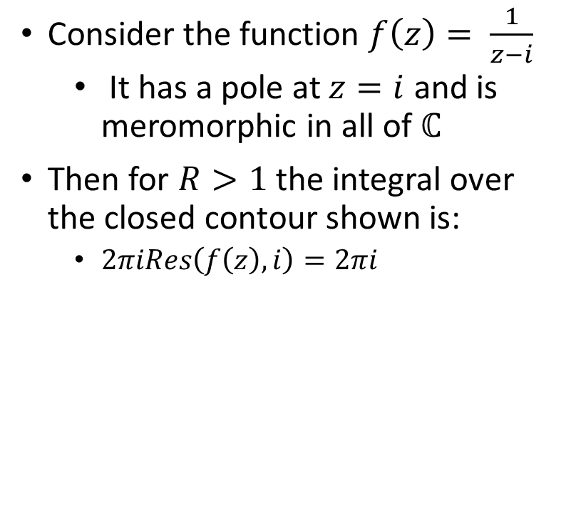
Residue Theorem, example
Consider the function $f\left(z\right)= \frac{1}{z−i}$
  It has a pole at $z=i$ and is meromorphic in all of $ℂ$
Then for $R>1$ the integral over the closed contour shown is:
  $2πiRes\left(f\left(z\right), i\right)=2πi$

Slide 11
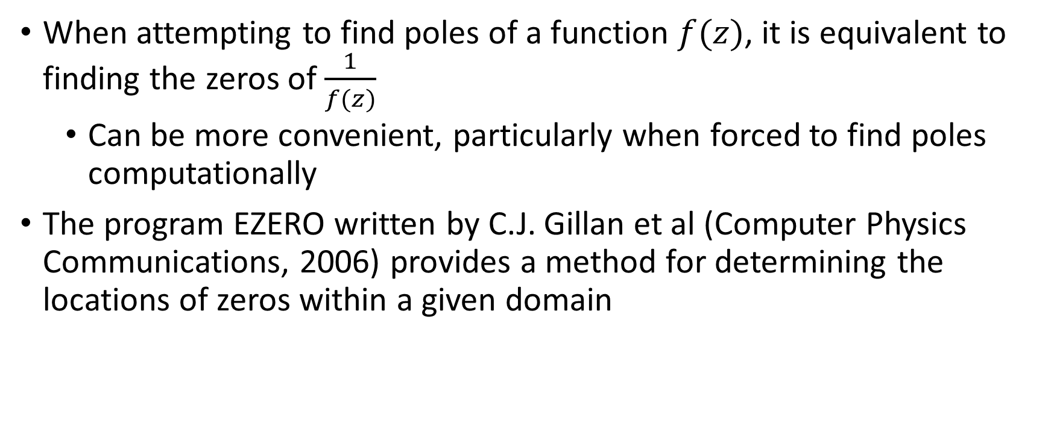
EZERO
When attempting to find poles of a function $f(z)$, it is equivalent to finding the zeros of $\frac{1}{f(z)}$
  Can be more convenient, particularly when forced to find poles computationally
The program EZERO written by C.J. Gillan et al (Computer Physics Communications, 2006) provides a method for determining the locations of zeros within a given domain

Slide 12
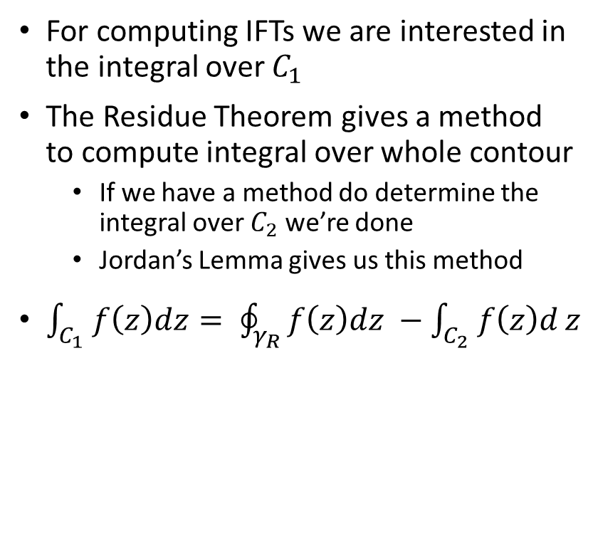
Jordan’s Lemma
For computing IFTs we are interested in the integral over $C_{1}$
The Residue Theorem gives a method to compute integral over whole contour
  If we have a method do determine the integral over $C_{2}$ we’re done
  Jordan’s Lemma gives us this method
$\int_{C_{1}}{f\left(z\right)dz= \oint_{γ_{R}}{f\left(z\right)dz −\int_{C_{2}}{f\left(z\right)d}z} }$

Slide 13
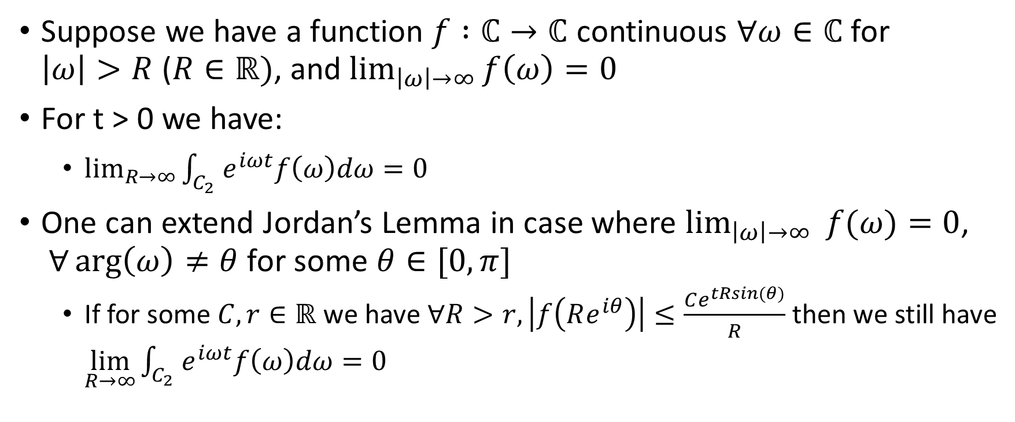
Jordan’s Lemma cont.
Suppose we have a function $f :ℂ→ℂ$ continuous $∀ω∈ℂ$ for $\left|ω\right|>R$ ($R∈ℝ)$, and $\lim_{\left|ω\right|→∞}{f\left(ω\right)=0}$
For t > 0 we have:
  $\lim_{R→∞}{\int_{C_{2}}{e^{iωt}f\left(ω\right)dω=0}}$
One can extend Jordan’s Lemma in case where $\lim_{\left|ω\right|→∞}{f(ω)}{=0}$, $∀\arg\left(ω\right)≠θ$ for some $θ∈[0,π]$
  If for some $C,r∈ℝ$ we have $∀R>r, \left|f\left(Re^{iθ}\right)\right|≤\frac{Ce^{tRsin(θ)}}{R}$ then we still have $\lim_{R→∞}{\int_{C_{2}}{e^{iωt}f\left(ω\right)dω=0}}$

Slide 14
Results

Slide 15
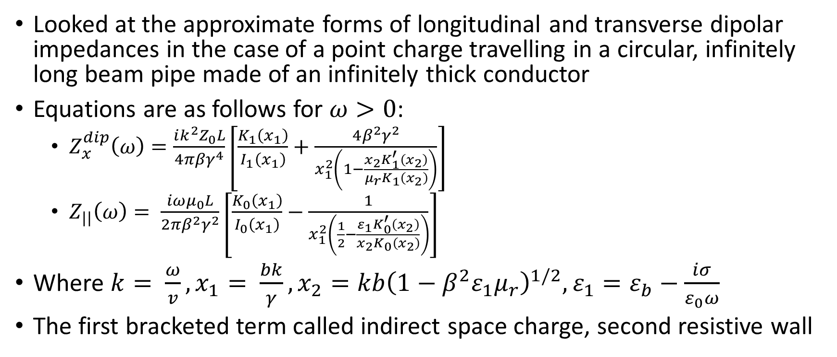
IFTs to Compute
Looked at the approximate forms of longitudinal and transverse dipolar impedances in the case of a point charge travelling in a circular, infinitely long beam pipe made of an infinitely thick conductor
Equations are as follows for $ω>0$:
  $Z_{x}^{dip}\left(ω\right)=\frac{i{k^{2}Z}_{0}L}{4πβγ^{4}}\left[\frac{K_{1}\left(x_{1}\right)}{I_{1}\left(x_{1}\right)}+\frac{4β^{2}γ^{2}}{x_{1}^{2}\left(1−\frac{x_{2}K_{1}^{′}\left(x_{2}\right)}{μ_{r}K_{1}\left(x_{2}\right)}\right)}\right]$
  $Z_{||}\left(ω\right)= \frac{iωμ_{0}L}{2πβ^{2}γ^{2}}\left[\frac{K_{0}\left(x_{1}\right)}{I_{0}\left(x_{1}\right)}−\frac{1}{x_{1}^{2}\left(\frac{1}{2}−\frac{ε_{1}K_{0}^{′}\left(x_{2}\right)}{x_{2}K_{0}\left(x_{2}\right)}\right)}\right]$
Where $k= \frac{ω}{v}, x_{1}= \frac{bk}{γ}, x_{2}=kb{\left(1−β^{2}ε_{1}μ_{r}\right)}^{1/2}, ε_{1}=ε_{b}−\frac{iσ}{ε_{0}ω}$
The first bracketed term called indirect space charge, second resistive wall

Slide 16
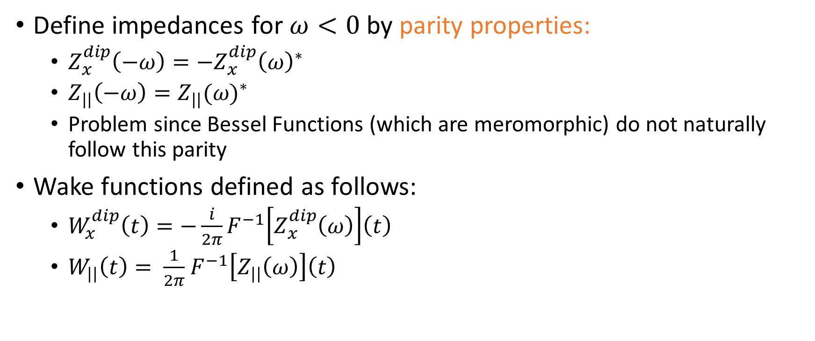
Problem with Impedances
Define impedances for $ω<0$ by parity properties:
  $Z_{x}^{dip}\left(−ω\right)=−{Z_{x}^{dip}\left(ω\right)}^{∗}$
  $Z_{||}\left(−ω\right)={Z_{||}(ω)}^{∗}$
  Problem since Bessel Functions (which are meromorphic) do not naturally follow this parity
Wake functions defined as follows:
  $W_{x}^{dip}\left(t\right)=−\frac{i}{2π}F^{−1}\left[Z_{x}^{dip}\left(ω\right)\right]\left(t\right)$
  $W_{||}\left(t\right)= \frac{1}{2π}$ $F^{−1}\left[Z_{||}\left(ω\right)\right]\left(t\right)$

Slide 17
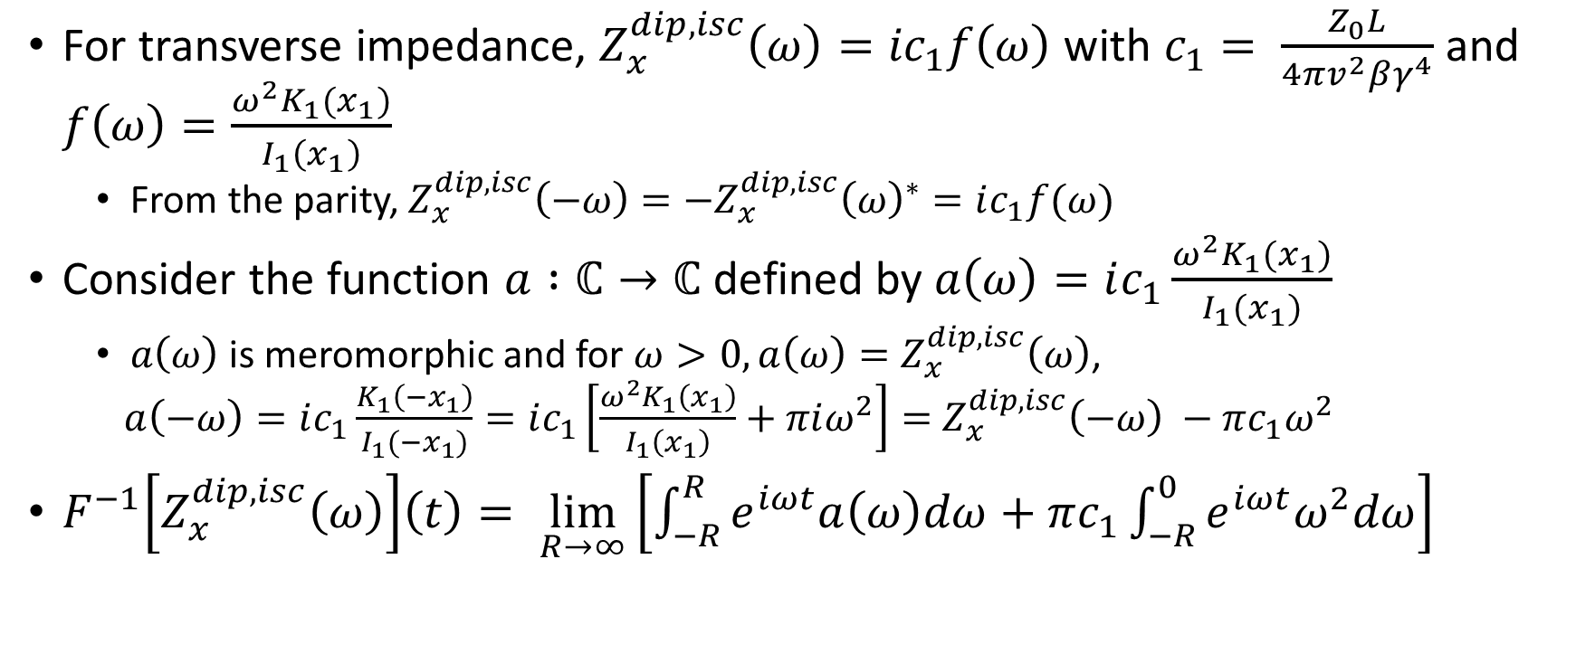
Indirect Space Charge
For transverse impedance, $Z_{x}^{dip, isc}\left(ω\right)={ic}_{1}f\left(ω\right)$ with $c_{1}= \frac{Z_{0}L}{4πv^{2}βγ^{4}}$ and $f\left(ω\right)=\frac{ω^{2}K_{1}(x_{1})}{I_{1}\left(x_{1}\right)}$
  From the parity, $Z_{x}^{dip, isc}\left(−ω\right)={−Z}_{x}^{dip, isc}{\left(ω\right)}^{∗}=ic_{1}f(ω)$
Consider the function $a :ℂ→ℂ$ defined by $a\left(ω\right)=ic_{1}\frac{ω^{2}K_{1}(x_{1})}{I_{1}(x_{1})}$
  $a\left(ω\right)$ is meromorphic and for $ω>0, a\left(ω\right)=Z_{x}^{dip, isc}\left(ω\right)$,
  $a\left(−ω\right)=ic_{1}\frac{K_{1}\left(−x_{1}\right)}{I_{1}(−x_{1})}=ic_{1}\left[\frac{{ω^{2}K}_{1}\left(x_{1}\right)}{I_{1}\left(x_{1}\right)}+πiω^{2}\right]=$ $Z_{x}^{dip, isc}\left(−ω\right) −πc_{1}ω^{2}$
$F^{−1}\left[Z_{x}^{dip, isc}\left(ω\right)\right]\left(t\right)= \lim_{R→∞}\left[\int_{−R}^{R}{e^{iωt}a\left(ω\right)dω+πc_{1}\int_{−R}^{0}{e^{iωt}ω^{2}dω}}\right]$

Slide 18
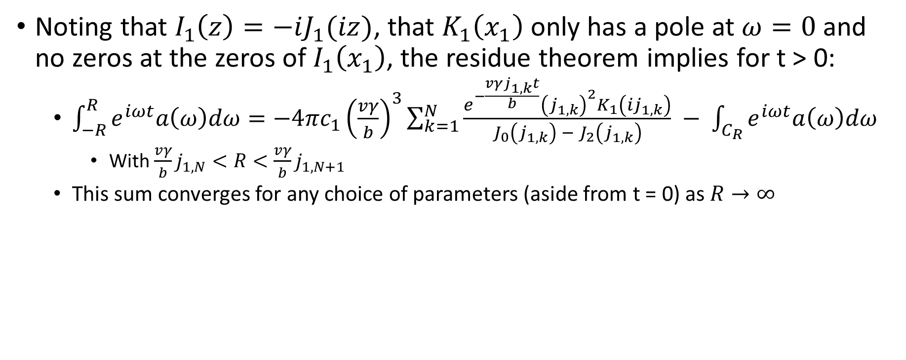
Indirect Space Charge, cont.
Noting that $I_{1}\left(z\right)=−iJ_{1}(iz)$, that $K_{1}\left(x_{1}\right)$ only has a pole at $ω=0$ and no zeros at the zeros of $I_{1}\left(x_{1}\right)$, the residue theorem implies for t > 0:
  $\int_{−R}^{R}{e^{iωt}a\left(ω\right)dω}=−4πc_{1}{\left(\frac{vγ}{b}\right)}^{3}\sum_{k=1}^{N}{\frac{e^{−\frac{vγj_{1,k}t}{b}}{\left(j_{1,k}\right)}^{2}K_{1}\left({ij}_{1,k}\right)}{J_{0}\left(j_{1,k}\right) − J_{2}\left(j_{1,k}\right)}} − \int_{C_{R}}{e^{iωt}a\left(ω\right)dω}$
    With $\frac{vγ}{b}j_{1,N}<R<\frac{vγ}{b}j_{1,N+1}$
  This sum converges for any choice of parameters (aside from t = 0) as $R→∞$

Slide 19
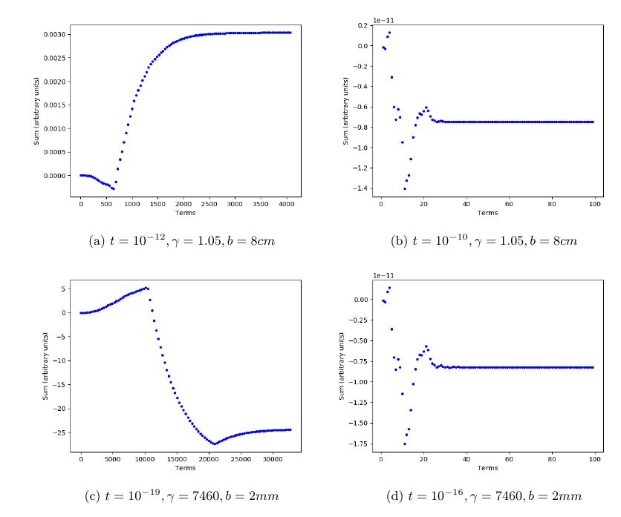

Slide 20
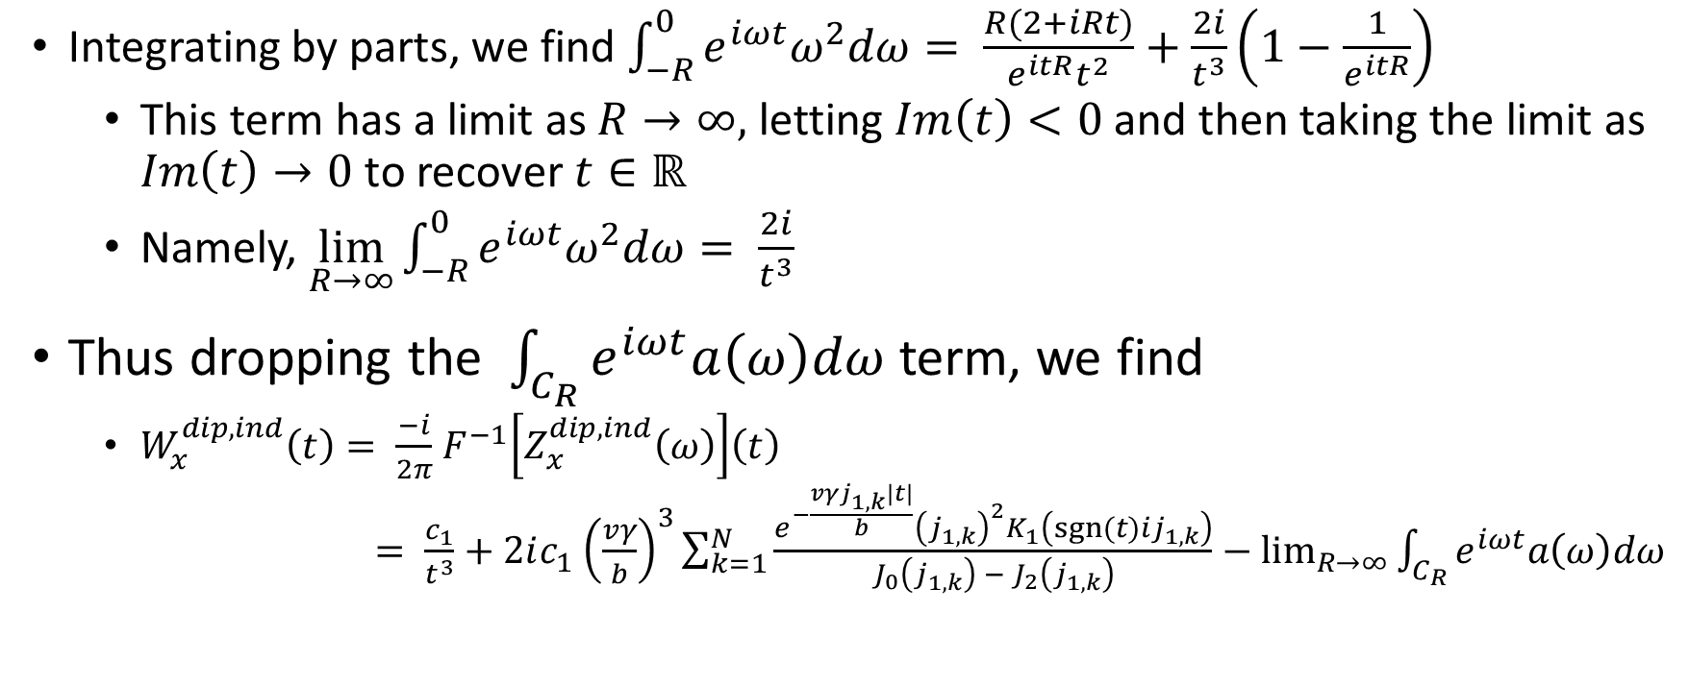
Indirect Space Charge, cont.
Integrating by parts, we find $\int_{−R}^{0}{e^{iωt}ω^{2}dω}= \frac{R(2+iRt)}{e^{itR}t^{2}}+\frac{2i}{t^{3}}\left(1−\frac{1}{e^{itR}}\right)$
  This term has a limit as $R→∞,$ letting $Im\left(t\right)<0$ and then taking the limit as $Im\left(t\right)→0$ to recover $t∈ℝ$
  Namely, $\lim_{R→∞}{\int_{−R}^{0}{e^{iωt}ω^{2}dω}= \frac{2i}{t^{3}}}$
Thus dropping the $\int_{C_{R}}{e^{iωt}a\left(ω\right)dω}$ term, we find
  $W_{x}^{dip,ind}\left(t\right)= \frac{−i}{2π}$ $F^{−1}\left[Z_{x}^{dip, ind}\left(ω\right)\right]\left(t\right)$
  $= \frac{c_{1}}{t^{3}}+2ic_{1}$ ${\left(\frac{vγ}{b}\right)}^{3}\sum_{k=1}^{N}{\frac{e^{−\frac{vγj_{1,k}|t|}{b}}{\left(j_{1,k}\right)}^{2}K_{1}\left({sgn⁡(t)ij}_{1,k}\right)}{J_{0}\left(j_{1,k}\right) − J_{2}\left(j_{1,k}\right)}−\lim_{R→∞}{\int_{C_{R}}{e^{iωt}a\left(ω\right)dω}}}$

Slide 21
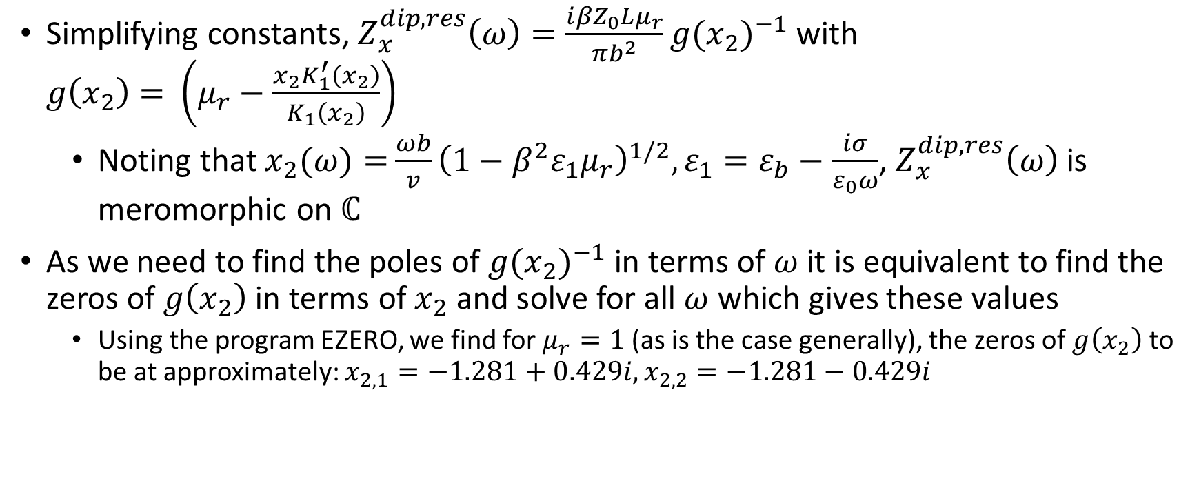
Resistive Wall
Simplifying constants, $Z_{x}^{dip,res}\left(ω\right)=\frac{i{βZ}_{0}Lμ_{r}}{πb^{2}}{g(x_{2})}^{−1}$with $g\left(x_{2}\right)=$ $\left(μ_{r}−\frac{x_{2}K_{1}^{′}\left(x_{2}\right)}{K_{1}\left(x_{2}\right)}\right)$
  Noting that $x_{2}(ω)=$ $\frac{ωb}{v}{\left(1−β^{2}ε_{1}μ_{r}\right)}^{1/2}, ε_{1}=ε_{b}−\frac{iσ}{ε_{0}ω}$, $Z_{x}^{dip,res}\left(ω\right)$ is meromorphic on $ℂ$
As we need to find the poles of ${g(x_{2})}^{−1}$ in terms of $ω$ it is equivalent to find the zeros of $g\left(x_{2}\right)$ in terms of $x_{2}$ and solve for all $ω$ which gives these values
  Using the program EZERO, we find for $μ_{r}=1$ (as is the case generally), the zeros of $g\left(x_{2}\right)$ to be at approximately: $x_{2,1}=−1.281+0.429i, x_{2,2}=−1.281−0.429i$

Slide 22
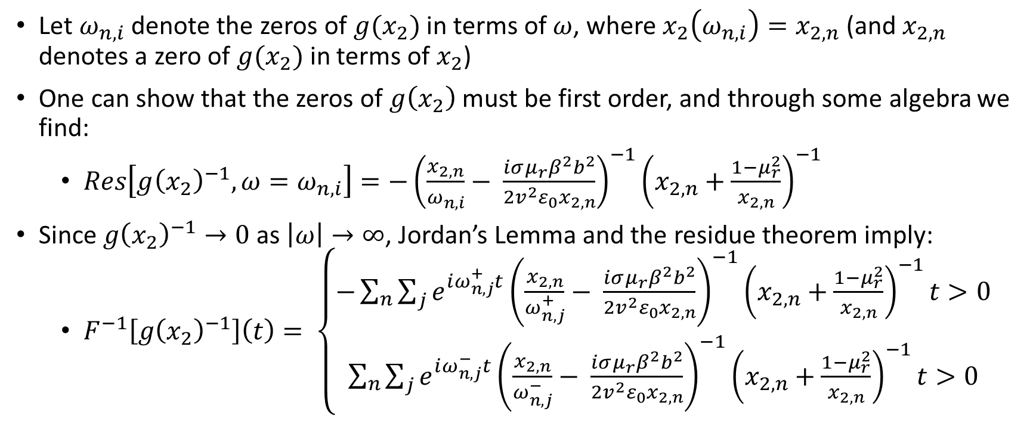
Resistive Wall, cont.
Let $ω_{n,i}$ denote the zeros of $g(x_{2})$ in terms of $ω$, where $x_{2}\left(ω_{n,i}\right)=x_{2,n}$ (and $x_{2,n}$ denotes a zero of $g(x_{2})$ in terms of $x_{2}$)
One can show that the zeros of $g\left(x_{2}\right)$ must be first order, and through some algebra we find:
  $Res\left[g{\left(x_{2}\right)}^{−1}, ω=ω_{n,i}\right]=−{\left(\frac{x_{2,n}}{ω_{n,i}}− \frac{iσμ_{r}β^{2}b^{2}}{2v^{2}ε_{0}x_{2,n}}\right)}^{−1}{\left(x_{2,n}+\frac{1−μ_{r}^{2}}{x_{2,n}}\right)}^{−1}$
Since $g{\left(x_{2}\right)}^{−1}→0$as $\left|ω\right|→∞$, Jordan’s Lemma and the residue theorem imply:
  $F^{−1}\left[g{\left(x_{2}\right)}^{−1}\right]\left(t\right)= \left\{\begin{aligned}−\sum_{n}{\sum_{j}{e^{iω_{n,j}^{+}t}{\left(\frac{x_{2,n}}{ω_{n,j}^{+}}− \frac{iσμ_{r}β^{2}b^{2}}{2v^{2}ε_{0}x_{2,n}}\right)}^{−1}{\left(x_{2,n}+\frac{1−μ_{r}^{2}}{x_{2,n}}\right)}^{−1}t>0}} \\ \sum_{n}{\sum_{j}{e^{iω_{n,j}^{−}t}{\left(\frac{x_{2,n}}{ω_{n,j}^{−}}− \frac{iσμ_{r}β^{2}b^{2}}{2v^{2}ε_{0}x_{2,n}}\right)}^{−1}{\left(x_{2,n}+\frac{1−μ_{r}^{2}}{x_{2,n}}\right)}^{−1}t>0}}\end{aligned}\right.$

Slide 23

Resistive Wall, cont.
$W_{x}^{dip, res}\left(t\right)=\frac{{βZ}_{0}Lμ_{r}}{2π^{2}b^{2}}\left\{\begin{aligned}−\sum_{n}{\sum_{j}{e^{iω_{n,j}^{+}t}{\left(\frac{x_{2,n}}{ω_{n,j}^{+}}− \frac{iσμ_{r}β^{2}b^{2}}{2v^{2}ε_{0}x_{2,n}}\right)}^{−1}{\left(x_{2,n}+\frac{1−μ_{r}^{2}}{x_{2,n}}\right)}^{−1}t>0}} \\ \sum_{n}{\sum_{j}{e^{iω_{n,j}^{−}t}{\left(\frac{x_{2,n}}{ω_{n,j}^{−}}− \frac{iσμ_{r}β^{2}b^{2}}{2v^{2}ε_{0}x_{2,n}}\right)}^{−1}{\left(x_{2,n}+\frac{1−μ_{r}^{2}}{x_{2,n}}\right)}^{−1}t>0}}\end{aligned}\right.$

Slide 24
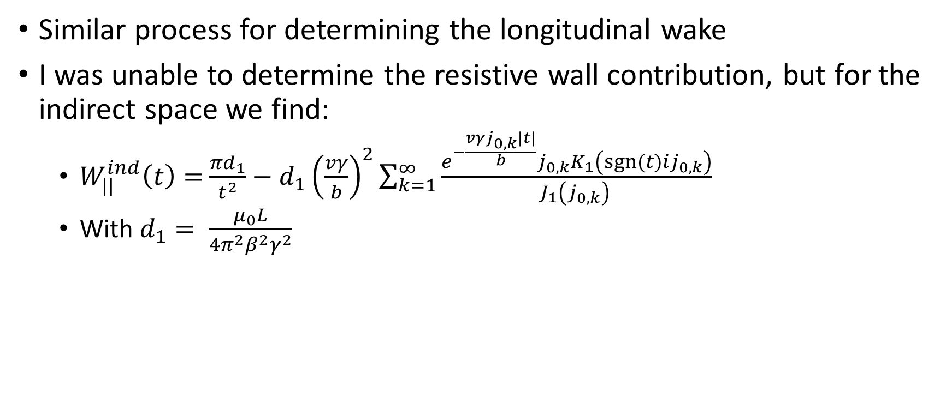
Longitudinal Wake
Similar process for determining the longitudinal wake
I was unable to determine the resistive wall contribution, but for the indirect space we find:
  $W_{||}^{ind}\left(t\right)=$ $\frac{{πd}_{1}}{t^{2}}−d_{1}{\left(\frac{vγ}{b}\right)}^{2}\sum_{k=1}^{∞}{\frac{e^{−\frac{vγj_{0,k}|t|}{b}}j_{0,k}K_{1}\left({sgn⁡(t)ij}_{0,k}\right)}{J_{1}\left(j_{0,k}\right) }}$
  With $d_{1}= \frac{μ_{0}L}{4π^{2}β^{2}γ^{2}}$

Slide 25
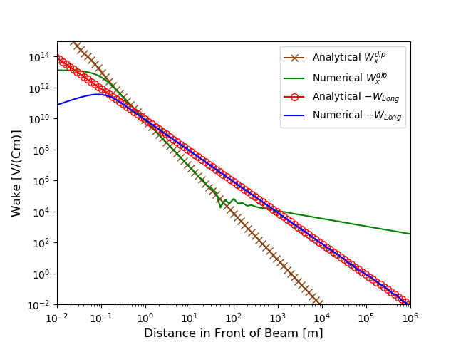
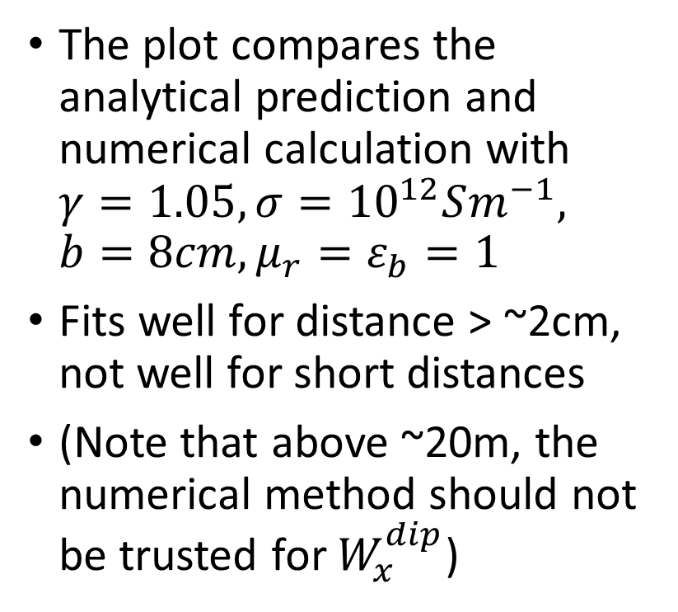
Indirect Space Charge Comparison
The plot compares the analytical prediction and numerical calculation with $γ=1.05, σ={10}^{12}Sm^{−1}, b=8cm, μ_{r}=ε_{b}=1$
Fits well for distance > ~2cm, not well for short distances
(Note that above ~20m, the numerical method should not be trusted for $W_{x}^{dip}$)

Slide 26
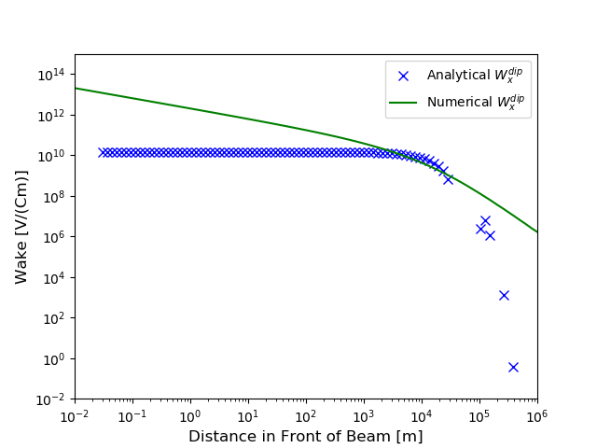

Resistive Wall Comparison
The plot compares the analytical prediction and numerical calculation with $γ={10}^{7}, σ={10}^{6}Sm^{−1}, b=8mm, μ_{r}=ε_{b}=1$
Doesn’t fit very well generally

Slide 27
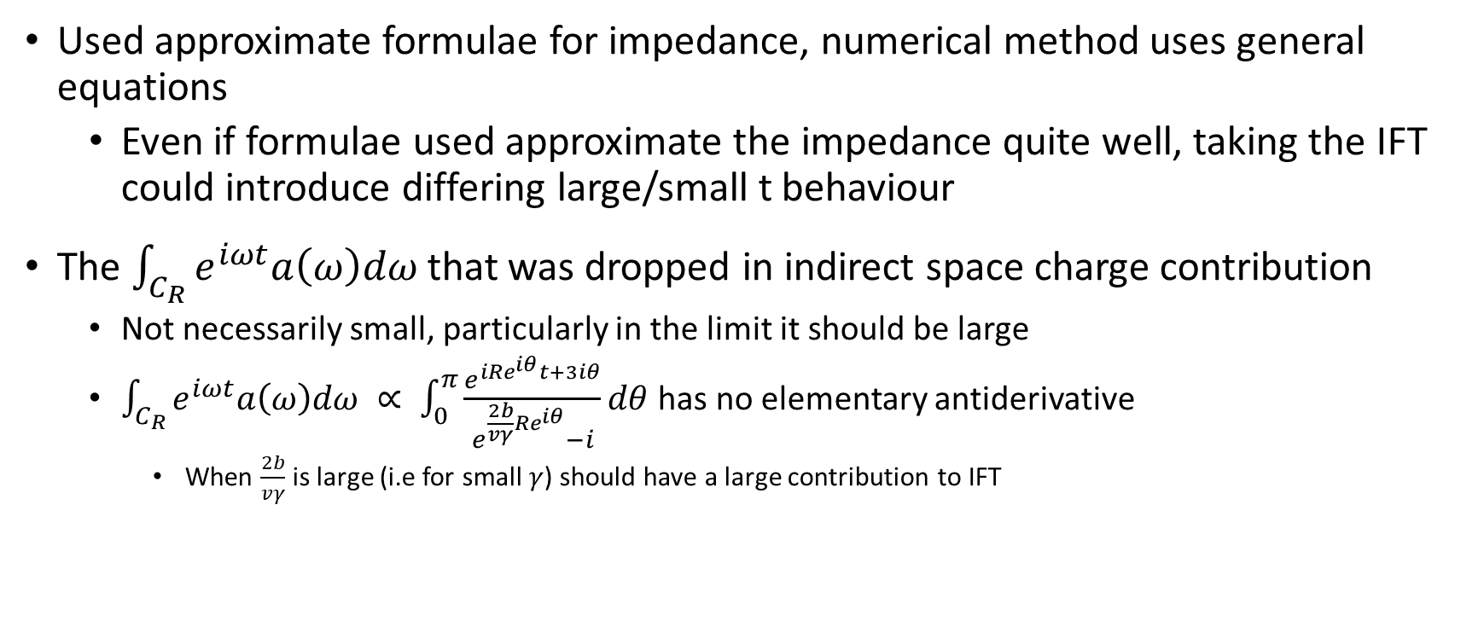
Reasons for Discrepancy
Used approximate formulae for impedance, numerical method uses general equations
  Even if formulae used approximate the impedance quite well, taking the IFT could introduce differing large/small t behaviour
The $\int_{C_{R}}{e^{iωt}a\left(ω\right)dω}$ that was dropped in indirect space charge contribution
  Not necessarily small, particularly in the limit it should be large
  $\int_{C_{R}}{e^{iωt}a\left(ω\right)dω ∝ \int_{0}^{π}{\frac{e^{iRe^{iθ}t+3iθ}}{e^{\frac{2b}{vγ}Re^{iθ}}−i}dθ} }$has no elementary antiderivative
    When $\frac{2b}{vγ}$is large (i.e for small $γ$) should have a large contribution to IFT

Slide 28
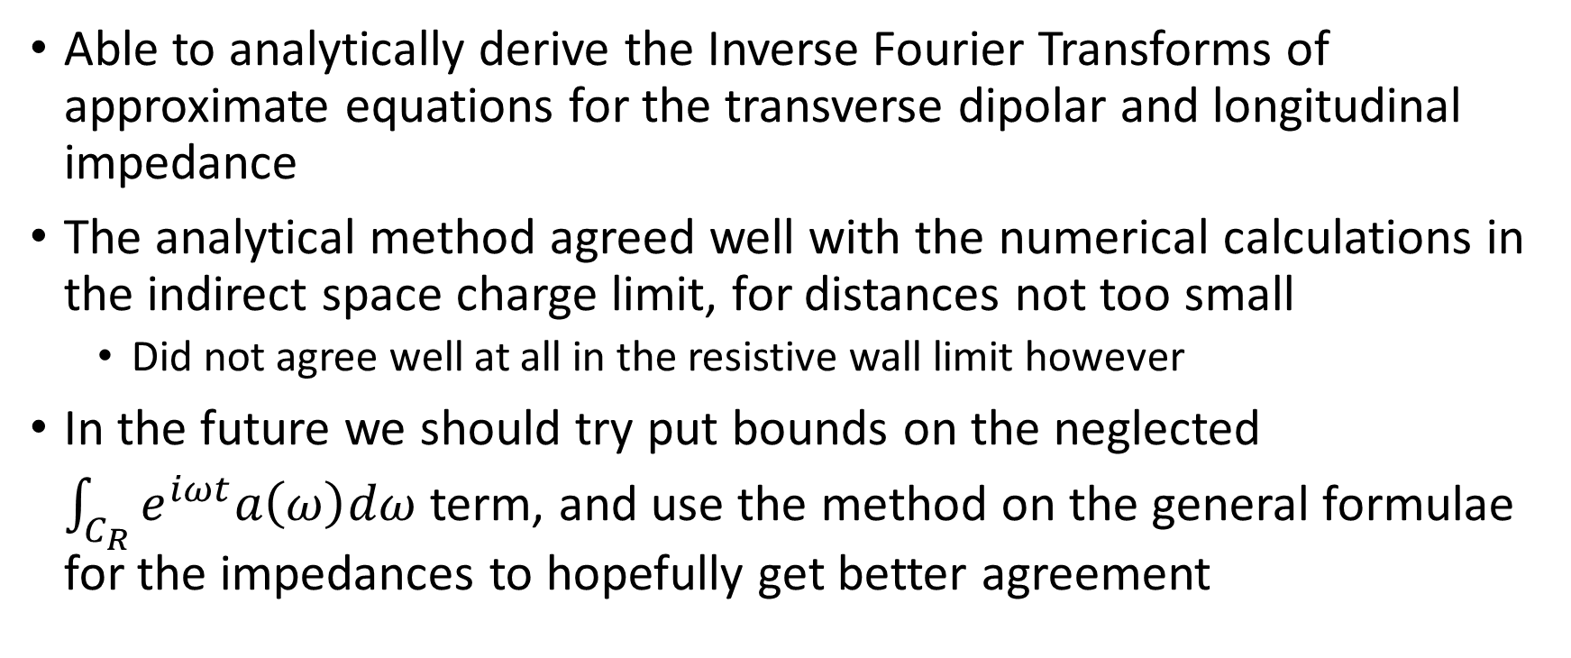
Conclusions
Able to analytically derive the Inverse Fourier Transforms of approximate equations for the transverse dipolar and longitudinal impedance
The analytical method agreed well with the numerical calculations in the indirect space charge limit, for distances not too small
  Did not agree well at all in the resistive wall limit however
In the future we should try put bounds on the neglected $\int_{C_{R}}{e^{iωt}a\left(ω\right)dω}$ term, and use the method on the general formulae for the impedances to hopefully get better agreement

