Slide 1


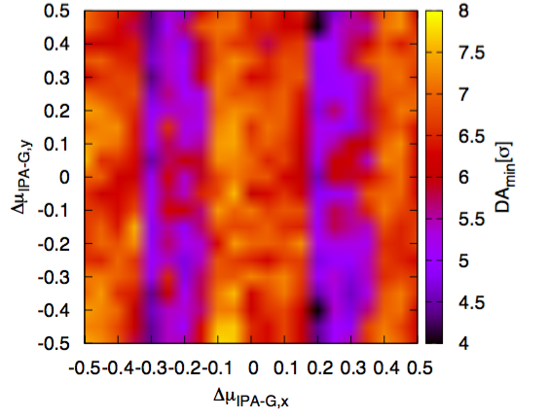
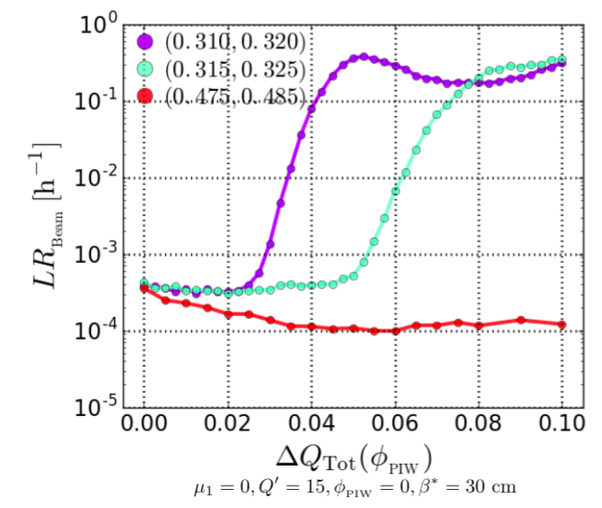
Future Circular Collider Studies
FCC-hh and HE-LHC
Studies summarized in CDR
IPAC 2017 TUPVA026
IPAC2018 MOPMF069
Phase optimization of Beam-beam compensation with octupole magnets
 | FCC-hh Baseline-Ultimate | FCC-hh Ultimate
Luminosity[10³⁴cm⁻²s⁻¹] | 5 | 20-30
Bunch distance | 25 (5) [ns]
Bunch charge | 1 (0.2) 10¹¹ protons
Norm. emitt. | 2.2 (0.44) [μm]
ξ_{bb} per IP | 0.01 (0.02) | 0.03
IP beta-function | 1.1 [m] | 0.3 [m]
IP beam size [μm] | 6.8 (3) | 3.5 (1.6)
RMS bunch length | 8 [cm]
Lattice design with global compensation of beam-beam long-range effects with multipole magnets in place
Head-on limit studies fundamental due to strong radiation damping
Coherent stability and interplay with impedance
CERN-THESIS-2017-279 (2017)

Slide 2
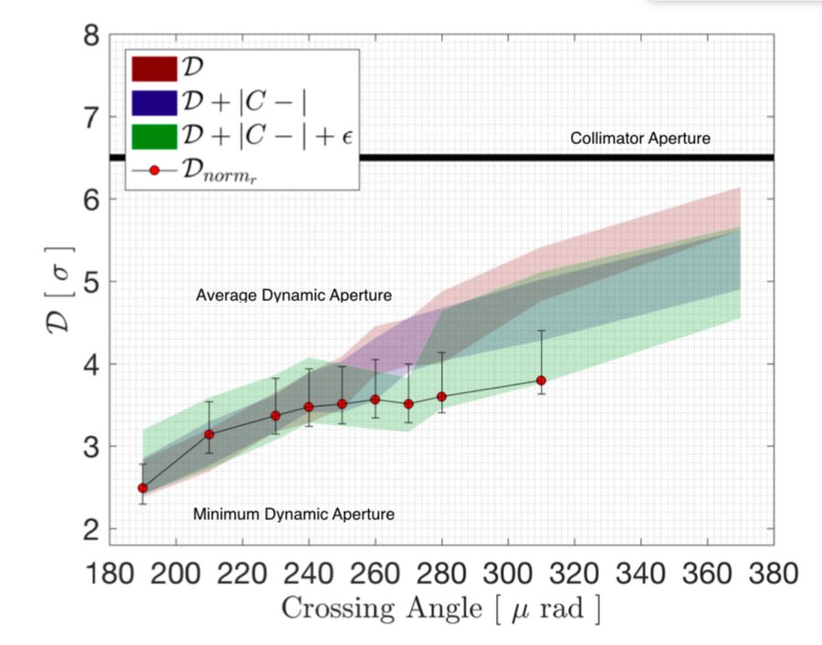
Beam-Beam Effects: FCC challenges
LHC benchmark of dynamic aperture and losses very positive for beam-beam effects but we have learned some lessons:
Much larger number of tracked particles needed in phase space to describe full beam-beam dynamics of LHC
Multipolar errors in model with beam-beam
Number of tracked turns has to be increased to compare to observations 10⁶ turns only
LHC case for 1 configuration:
LXBATCH (300-1000 CPUs) → 8.3-2.5 days
LHC@HOME (4000 CPUs) → 0.63 days
LHC Experiments data 2016 versus simulations
IPAC THPAB056
FCC-hh and HE-LHC factor 3&5 complexity :
LXBATCH (300-1000 CPUs) → 41-22.5 days
LHC@HOME (4000 CPUs) → 3.15 days
Designing for the future with lesson learned from LHC is today impossible!
Projects on going to apply machine learning techniques to predict long term dynamic aperture!

Slide 3
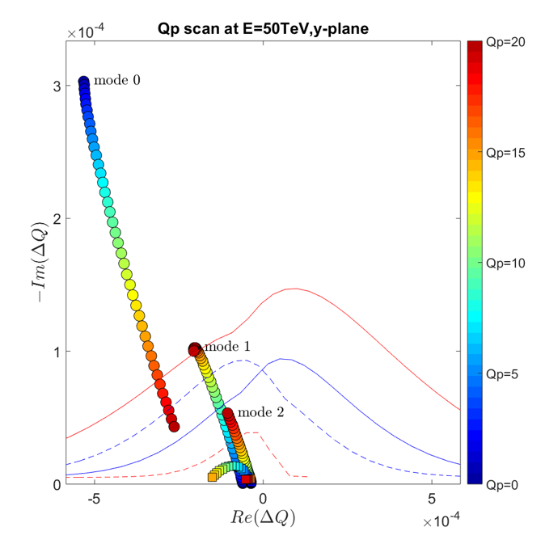
Beam stability and beam-beam
FCC-hh configuration (HE-LHC similar strategy)
β* at injection 4.6 m
Ramp and Squeeze to 2-1.2 m
Collide and squeeze at reduced angle
Flat top (LOF > 0)
Flat top (LOF < 0)
EOS (LOF > 0)
EOS (LOF < 0)
Octupoles at their maximum strength
Continuous benchmark to LHC data to understand instability thresholds and Landau damping in presence of diffusive mechanism
IPAC 2018 THPAF074
Stability is provided by Landau octupoles at flat top (DA > 18 σ)
Most unstable coupled bunch modes with ADT gain of 460 turns are stable at EOS (30 cm) with LOF < 0 ➔ DA optimized up to 8 σ with global compensation scheme
Increasing the ADT gain gives additional margins
EPFL PHD Thesis 7867 (2017)

