Slide 1
EPFL-LPAP TP IV
Oscar Holguin

Slide 2
Objectives
1
Describe the evolution of beam parameters (Intensity and Luminosity evolution) of the LHC and FCC colliders during a physics fill [[4] Xavier Buffat and Daniel Schulte. Evolution of the Beam Parameters during LuminosityProduction in the Future Circular Hadron Collider. (CERN-ACC-2016-262):TUPMW008. 4p, 2016.]
Implement the losses due to dynamic aperture in the presence of beam beam effects as measured and simulated in the LHC [15]
[15] Matthew Crouch, Robert Appleby, Javier Barranco Garc ́ıa, Xavier Buffat, Massimo Giovan-
nozzi, Ewen Maclean, Bruno Muratori, Tatiana Pieloni, and Claudia Tambasco. Dynamic
Aperture Studies of the Long-Range Beam-Beam Interaction at the LHC. (CERN-ACC-2017-
182):THPAB056. 4 p, 2017
2

Slide 3
Objectives
Describe the impact of the physics mechanisms contributing to the beam parameters evolutions (intensity and emittances, Radiaion damping, IBS).
For the LHC case a direct comparison to 2012 physics data is shown to benchmark the model against crossing angles changes at the Interaction Points.
Perform calculations for the Future Circular Collider design study.
3
4
1
5

Slide 4

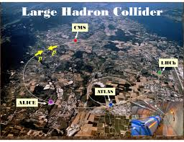
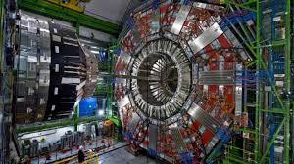
LHC
The world’s current largest and most powerful hadron collider, having a 27 km circumference and reaching a center of mass energy of up to 13 TeV and a Luminosity of around 10E34 given by the equation:

Slide 5
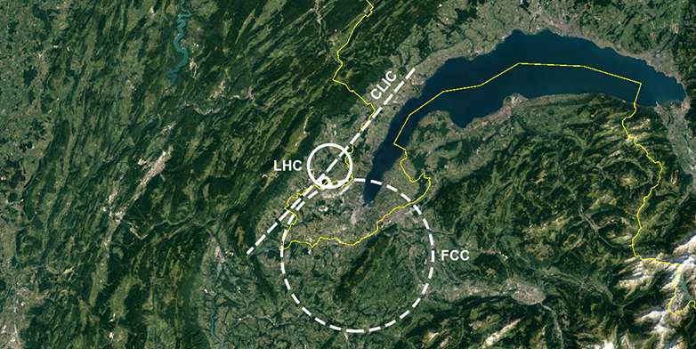

FCC
The Future Circular Collider (FCC) design study aims at explaining the possibility to extend the current particle physics research beyond the LHC.
It will help to study rare physics phenomena in a new energy range.
Its expected to reach higher luminosity and higher energies (100TeV center of mass energy and 3E34 cm-2 s^-1).

Slide 6
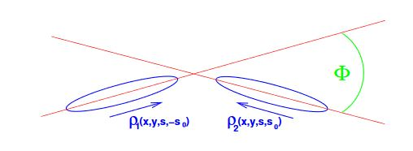
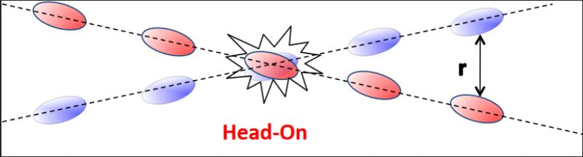

In LHC the crossing angle between the beams at the interaction point is necessary because of the beam beam interaction. These are electromagnetic interactions between the beams when sharing a common pipe
Head on or long range
Can lead to particle losses or beam instabilities
Notes:
to avoid multiple collisions at the left and right of the interaction point.
Because of this reduced overlap of the two bunches, Luminosity reduced by a geometrical reduction factor S.
The σs represents the bunch length, and σx the transverse beam size in the plane of crossing

Slide 7
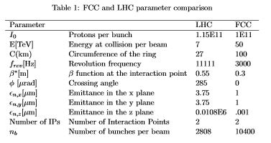
FCC vs LHC
Notes:
0 xing angle because special devices called crab cavities, which compensate for the crossing angle at the interaction point.
they can tilt the proton bunches in each beam, maximizing their overlap at the collision point. Because of this, every proton in the bunch is forced to pass through the opposite bunch increasing the probability of collision. After being tilted, the motion of the proton bunches appears to be sideways – just like a crab

Slide 8

Results
LHC burnoff
In collision particles are lost due to the production of new physics events, these loses are defined as burnoff losses and are proportional to the pp cross section, the luminosity and the number of interaction points.
The implementation was done with the following equations that describe this phenomena.

Slide 9
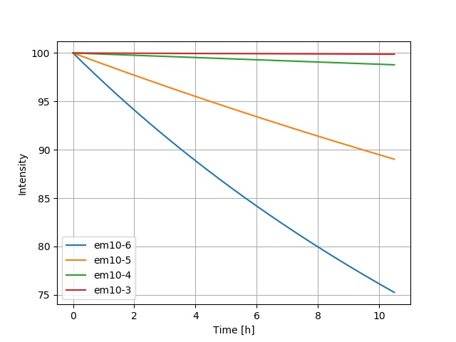
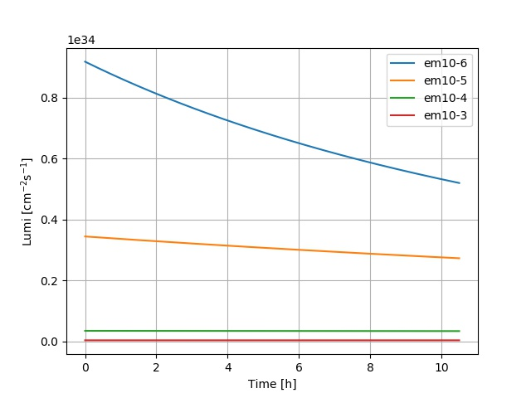
Results
LHC burnoff (constant emittances)
Notes:
Smaller emittance bigger burnoff (as seen in formulas)
Since emittance=Area particles occupy then more prob to collide if its smaller

Slide 10

Dynamic Aperture
DA is the region in phase space where stable motion occurs.
Particles out od the DA show chaotic motion and one eventually lose them with time.
[7]M. Giovanozzi proposes a model that relates DA and losses that depends on 3 parameters (Dinf,b and k) as shown on the equations below
As described in [8] M Giovannozzi et al.
And already applied in [10]

Slide 11
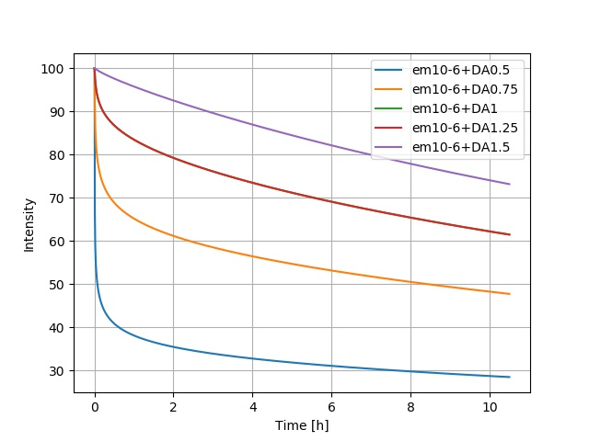
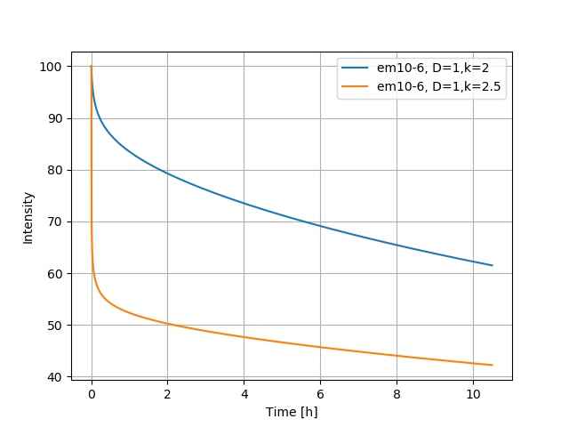
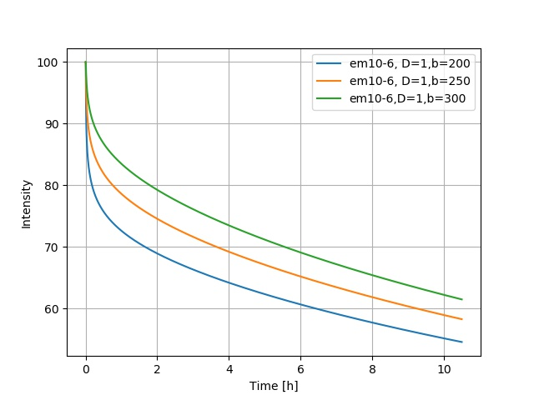
Results
LHC Dynamic Aperture
Different D∞, different b and different k
Notes:
The nonlinearities of the beam dynamics give rise to the dynamic aperture
protons encounter themselves with several types of imperfections that can interfere with their motion eventually driving particles to larger and larger amplitudes until the case where they can be lost in the collider

Slide 12
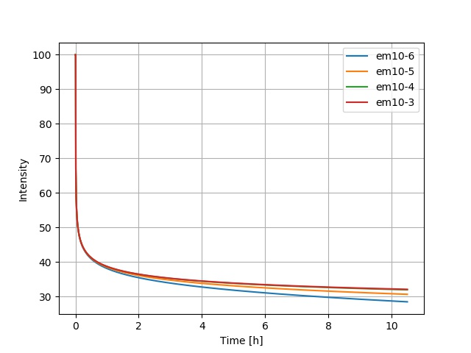
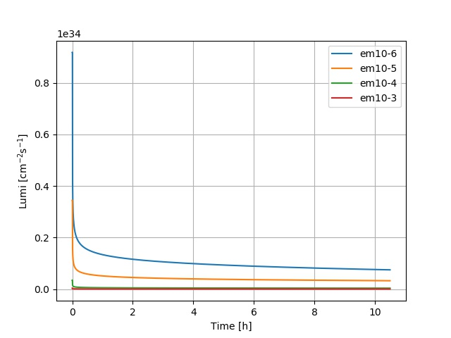
Results
LHC DA different emittances
Differences shown are mainly due to burnoff since DA losses are independent of emittances
Notes:
the emittances specifically on dyanmic aperture losses is not expected to have a relevant impact

Slide 13
IBS
Intra Beam Scattering
IBS refers to multiple small angle scattering between charged particles within the same bunch. IBS causes a growth of the beam emittances
A large change in momentum can lead to particle loss (because the energy deviation of particles is greater acceptance of ring)
Smaller emittance=bigger IBS growing because particles are closer to one another and have more probability to scatter

Slide 14
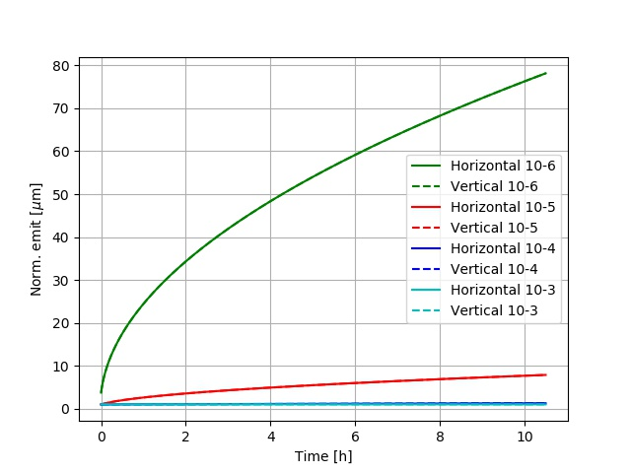
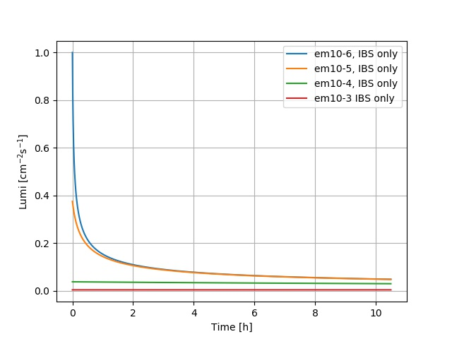
Results
LHC
Intra-Beam Scattering

Slide 15
Synchrotron Radiation
Radiation emitted when charged particles are accelerated in a curved path or orbit
Produced at the bending magnets where the charged beam is bent, thus accelerated

Slide 16
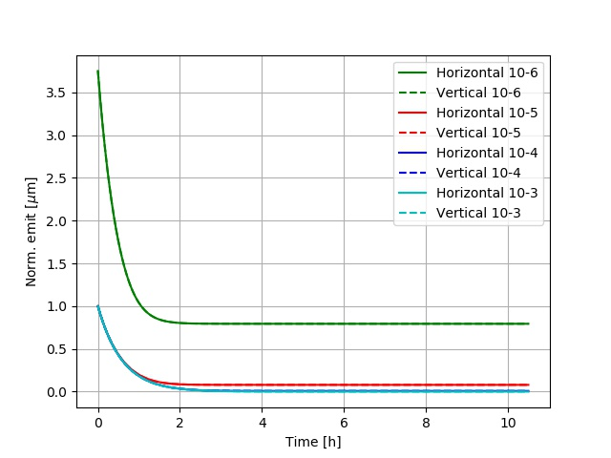
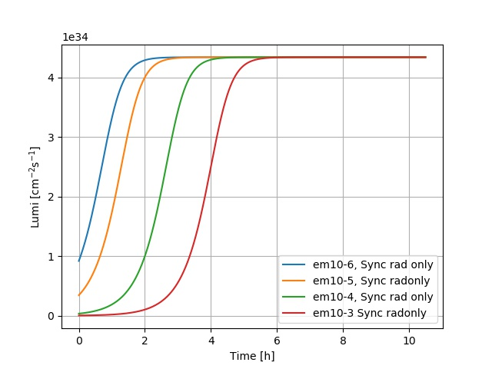
Results LHC
Synchrotron Radiation

Slide 17
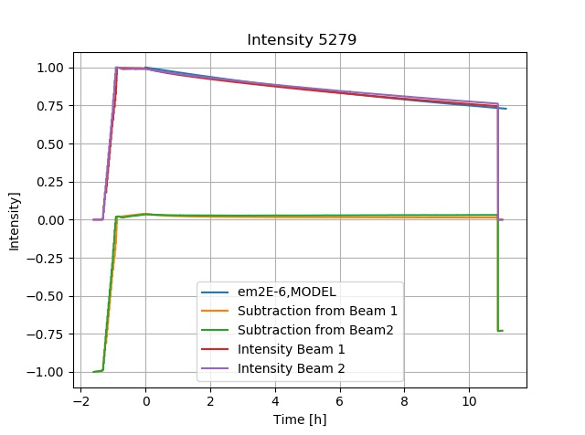
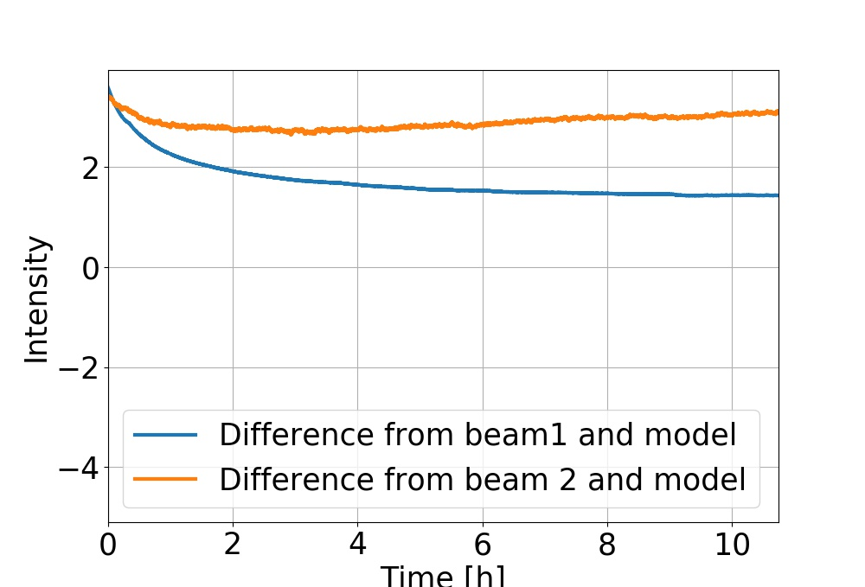
Results
LHC model vs LHC data 5279
Difference in percentage
Notes:
4 physics fills 2 before and 2 after changing crossing angle

Slide 18
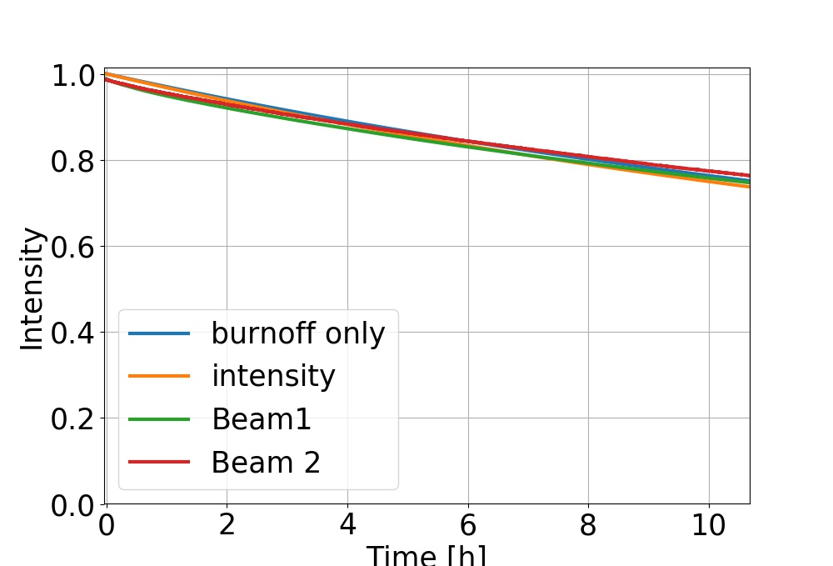
Results
LHC model vs LHC data 5279
This plot shows the relative intensity considering both burnoff and Dynamic aperture effects.
The parameters used for the dynamic aperture were taken from a dedicated experiment [15]Matthew Crouch, Robert Appleby, Javier Barranco Garc ́ıa, Xavier Buffat, Massimo Giovan-
nozzi, Ewen Maclean, Bruno Muratori, Tatiana Pieloni, and Claudia Tambasco. Dynamic
Aperture Studies of the Long-Range Beam-Beam Interaction at the LHC. (CERN-ACC-2017-
182):THPAB056. 4 p, 2017
This parameters, were: b=-0.0895,b1=-1.2,k=-1, and Dinfty=7.7849

Slide 19
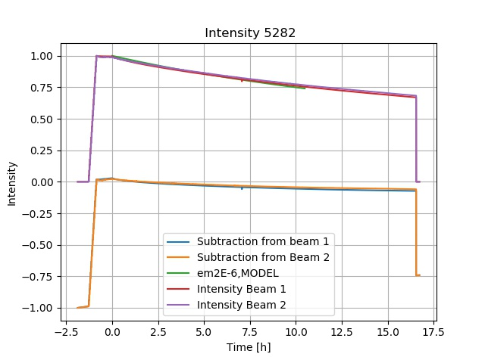
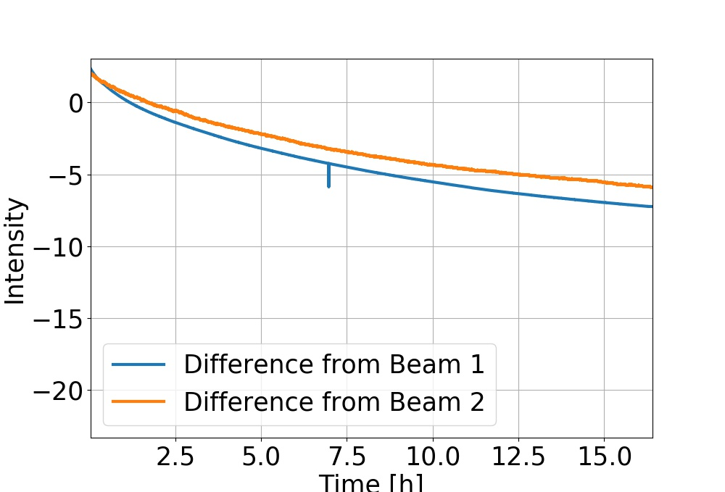
Results
LHC model vs LHC data 5282

Slide 20
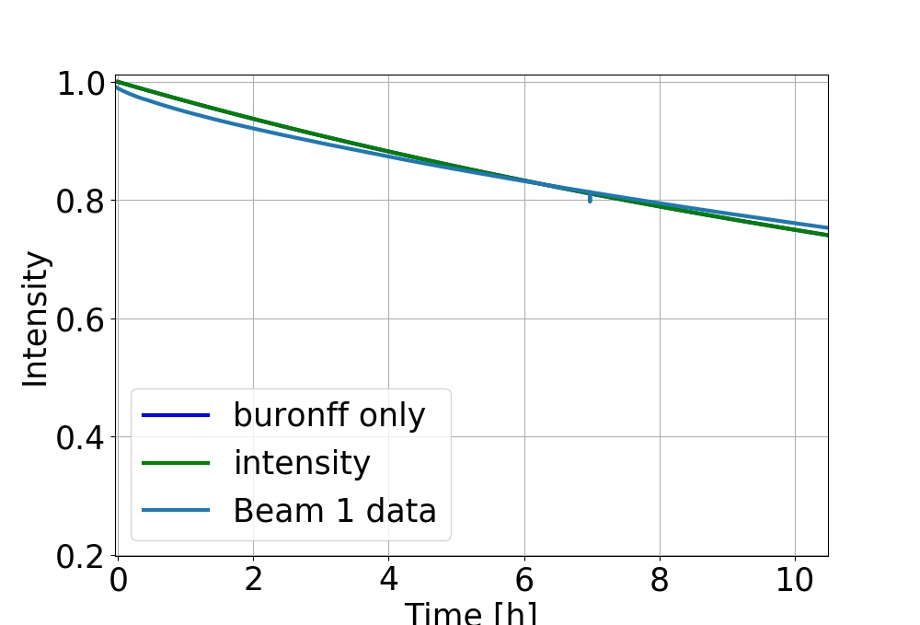
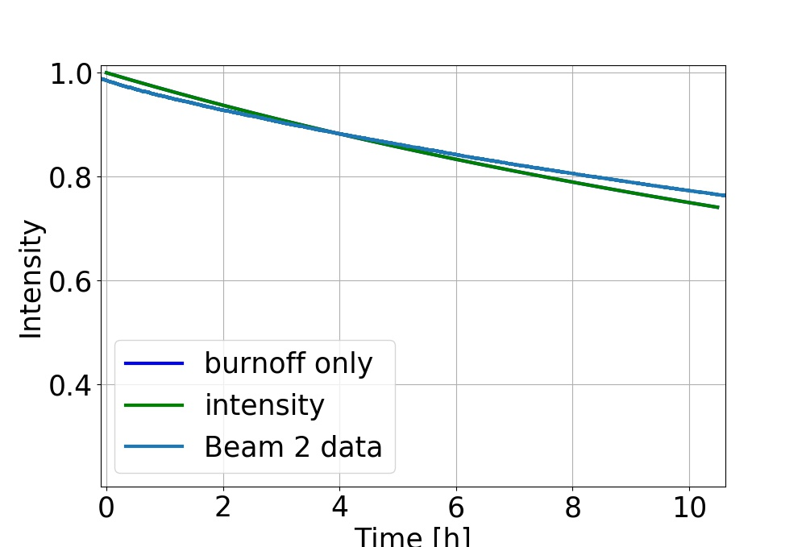
LHC vs Timber data 5282
The dynamic aperture effect with the given parameters (b=-0.0827,b1=-1.2,k=-1,Dinfty=7.2838)
The dynamic aperture effect with the given parameters (b=-0.0920,b1=-1.1 ,k=-1,Dinf=7.3448)

Slide 21
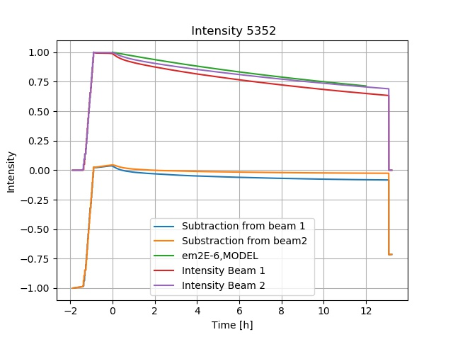
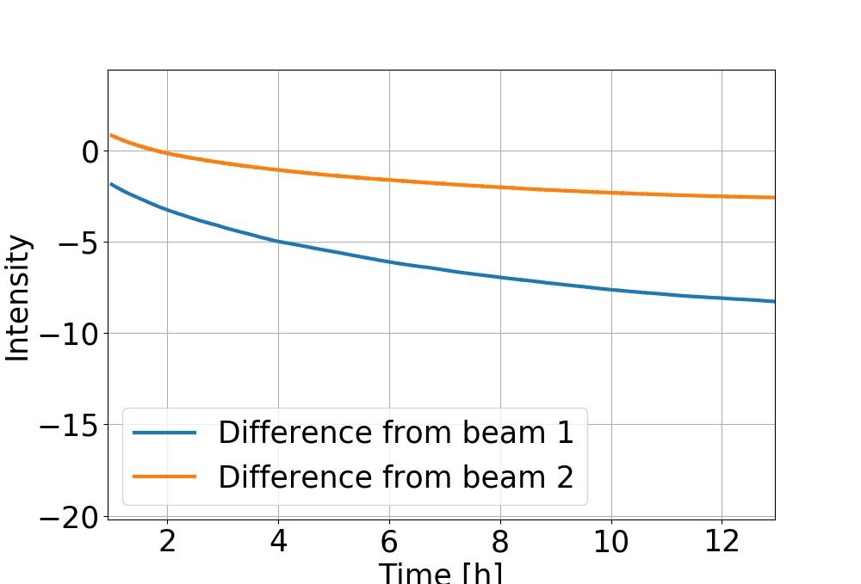
Results
LHC vs Timber data 5352

Slide 22
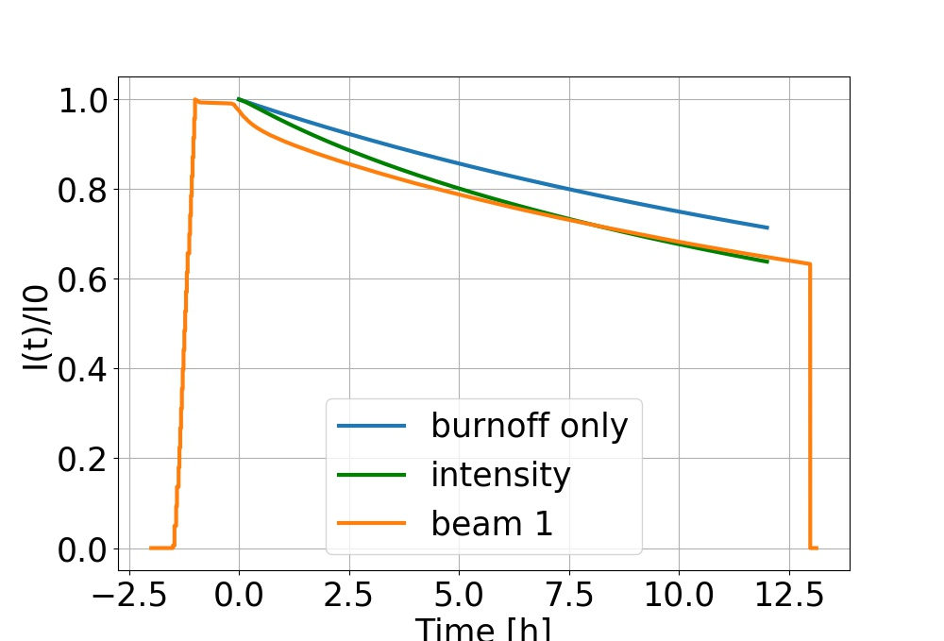
Results
LHC vs Timber data 5352 DA fitting
The dynamic aperture parameters are obtained through a fitting and were the following: b=1.22044e+06,b1=0,k=2.32945,Dinfty=.00184696.

Slide 23
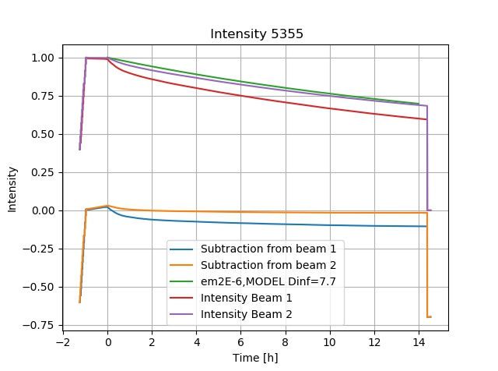
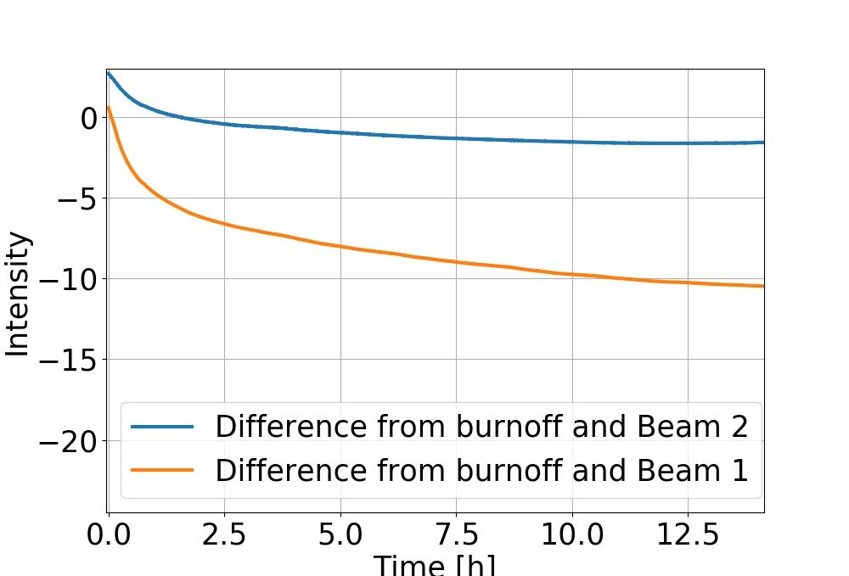
Results
LHC vs Timber data 5355

Slide 24
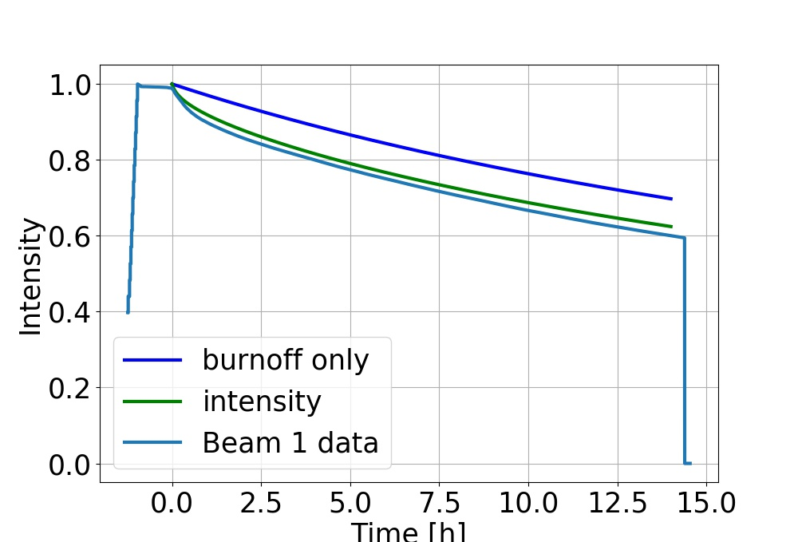
Results
LHC vs Timber data 5355
The dynamic aperture parameters are obtained through a fitting and were the following: b=24472.1,b1=0,k=1.15793,D_infty=.00271263

Slide 25
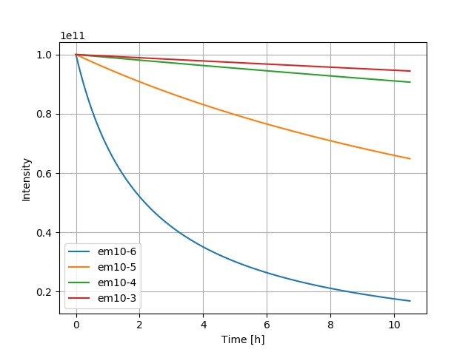
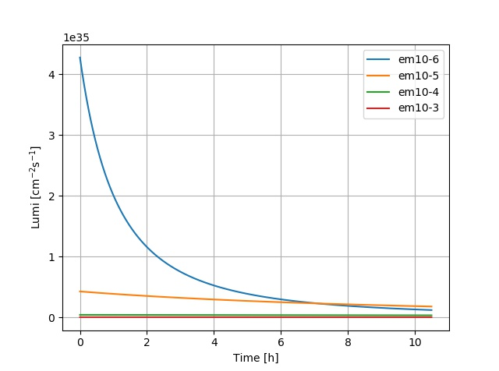
Results FCC
Burnoff only
Notes:
Same, behavior LHC but a Little different

Slide 26
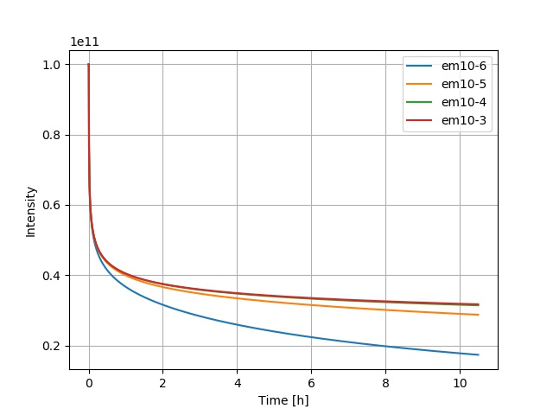
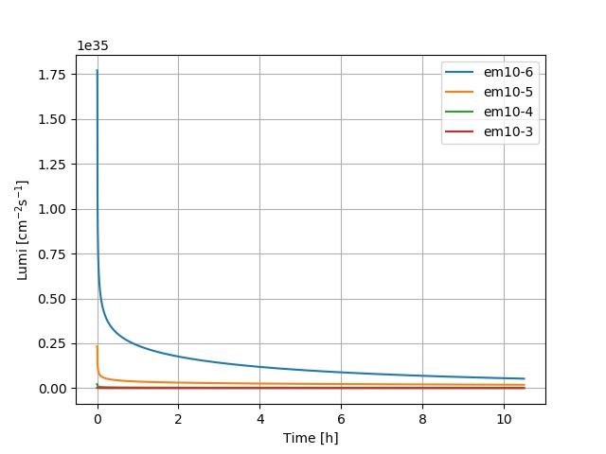
Results
FCC Dynamic Aperture
Notes:
Expected behaviour

Slide 27
Conclusion
In this project an attempt was made on performing a model that accurately simulates high energy particle collider's performance, like LHC or FCC.
The main results executed by the model were in a graphic way revealing information about the luminosity, intensity and emittance evolution over time. The evolution of intensity mainly due to losses as a consequence of dynamic aperture and proton burnoff effects, which happens because of proton proton collisions, was modeled for the FCC and LHC
The changes in emittances were only simulated in the LHC model and were due to intra-beam scattering (IBS) radiation damping.

Slide 28
Conclusion
In the second part of the project, the model was compared to LHC measured data of four physics fills,5279,5282,5352 and 5355. In that section, the model with only burnoff effects was very close to the intensities of both beams of the measured data for the first two physics fills;having differences of even less than 5%.
The dynamic aperture losses gave no significant losses in these cases. On the other hand, for the physics fills 5352 and 5355 the model with burnoff was not enough to match the measured data, it was clear dynamic aperture losses were needed.
The dynamic aperture losses were then introduced with a specific combination of parameters obtained through fitting. Nevertheless, the fitting was not perfect and didn't yielded the best results, so the model didn't describe these last fills that accurately.
In all cases, the extra losses needed to match the measured data are not considered in the model and could be a further task to match the simulation with the measured data more accurately

Slide 29
References
The Large Hadron Collider. Jan 2014.
[2] Michael Benedikt and Frank Zimmermann. Future Circular Colliders.
PoS LeptonPhoton2015(CERN-ACC-2015-0165):052. mult. p, Aug 2015. please take note that
this paper is different form the document FCC-DRAFT-ACC-2015-031.
[3] Oliver Sim Br ̈uning, Paul Collier, P Lebrun, Stephen Myers, Ranko Ostojic, John Poole, and
Paul Proudlock. LHC Design Report. 2004.
[4] Xavier Buffat and Daniel Schulte. Evolution of the Beam Parameters during Luminosity
Production in the Future Circular Hadron Collider. (CERN-ACC-2016-262):TUPMW008. 4
p, 2016.
[5] by Iva Raynova and Iva Raynova. Crab cavities: colliding protons head-on. Dec 2017.
[6] Lyndon Evans and Philip Bryant. LHC Machine.
JINST
, 3:S08001, 2008.

Slide 30
[8] M. Giovannozzi. Proposed scaling law for intensity evolution in hadron storage rings based on
dynamic aperture variation with time.
Phys. Rev. ST Accel. Beams
, 15:024001, Feb 2012.
[9] Werner Herr and Bruno Muratori. Concept of luminosity.
[10] Louise Marc. Travail pratique 4. page 3–30, Jan 2018.
[11] Tom Mertens, John Jowett, and Miguel Sousa Da Costa. Intrabeam scattering in the LHC,
2011. Presented 17 Jun 2011.
[12] Tatiana Pieloni, Danilo Banfi, and Javier Barranco Garcia. Dynamic Aperture Studies for
HL-LHC with beam-beam effects. May 2017.
[13] Karlheinz Schindl. The injector chain for the LHC. (CERN-OPEN-99-052):6 p, Jan 1999.
[14] R P Walker. Radiation damping; rev. version. 1994.
[15] Matthew Crouch, Robert Appleby, Javier Barranco Garc ́ıa, Xavier Buffat, Massimo Giovan-
nozzi, Ewen Maclean, Bruno Muratori, Tatiana Pieloni, and Claudia Tambasco. Dynamic
Aperture Studies of the Long-Range Beam-Beam Interaction at the LHC. (CERN-ACC-2017-
182):THPAB056. 4 p, 2017

