Slide 1
Simulations Studies of Electron Lens Impact on Beam Parameters for Future Circular Colliders
Diego Machain EPFL LPAP
Supervisors:
Claudia Tambasco
Tatiana Pieloni
June 27, 2018

Slide 2
Content
Introduction
  Electron lens distributions
  Electron lens kicks
Model for simulations
  Poisson solver and COMBI: COherent Multi Bunch Interaction
Simulation results
  Tune spread
  Displacement noise
  Displacement noise for a cylindric hollow electron lens
  Cylindric hollow collimation
  Tracked distributions
  Tracked distributions with weight function
  Particles kicked outside 6 sigma
Conclusions

Slide 3
What is an e-lens?
An electron lens is characterized as a low energy electron beam which can interact with hadron beams.
There are varied applications of e-lens such as compensation of beam-beam effects, provide Landau damping and collimation for halo particles. [5]
The impacts on the incident beam depend on the distribution of the electron lens.
Notes:
In this work we focused on Landau damping mechanism and collimation. These effects are possible because different distributions used in a electron lens

Slide 4


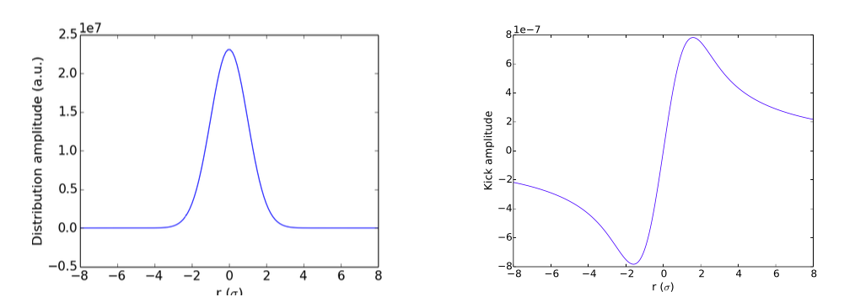

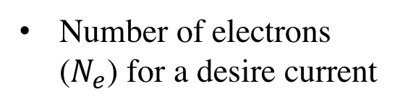
Electron lens distributions
Gaussian Distribution
Where
Kicks depend on amplitude
Slope of amplitude kick is related with maximum tune shift of 0-amplitude particle
Detuning with amplitude, suppressor of collective stabilities
Number of electrons ($N_{e}$) for a desire current
Gaussian distribution
Kicks produced by distribution
Notes:
There are multiple distributions that can be used, but one that is important is the gaussian distribution. The kicks produced by this distribution, these kicks depend on amplitude. And also, the

Slide 5
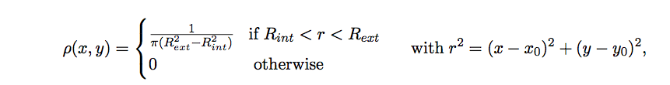
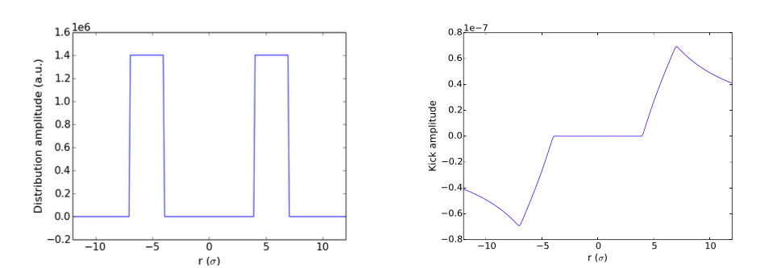
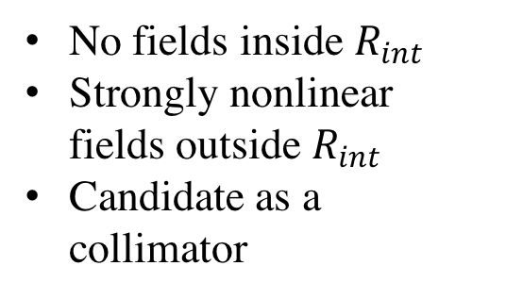
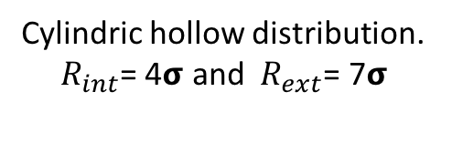
Cylindric Hollow Distribution
No fields inside $R_{int}$
Strongly nonlinear fields outside $R_{int}$
Candidate as a collimator
Cylindric hollow distribution. $R_{int}$= 4𝞂 and $R_{ext}\text{= }\text{7}\text{σ}$
Kicks produced by distribution

Slide 6
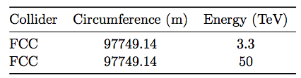
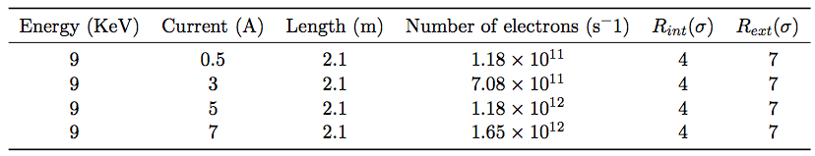
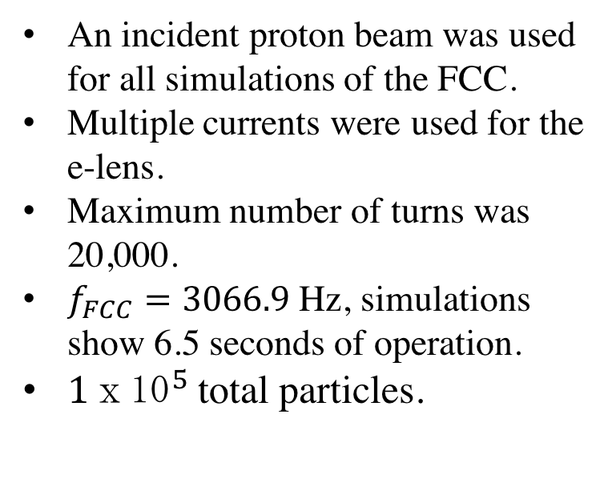
Model for simulations
An incident proton beam was used for all simulations of the FCC.
Multiple currents were used for the e-lens.
Maximum number of turns was 20,000.
$f_{FCC}=3066.9$ Hz, simulations show 6.5 seconds of operation.
${1ⅹ10}^{5}$total particles.
Table: Proton beam specifications
Table: e-lens specifications

Slide 7
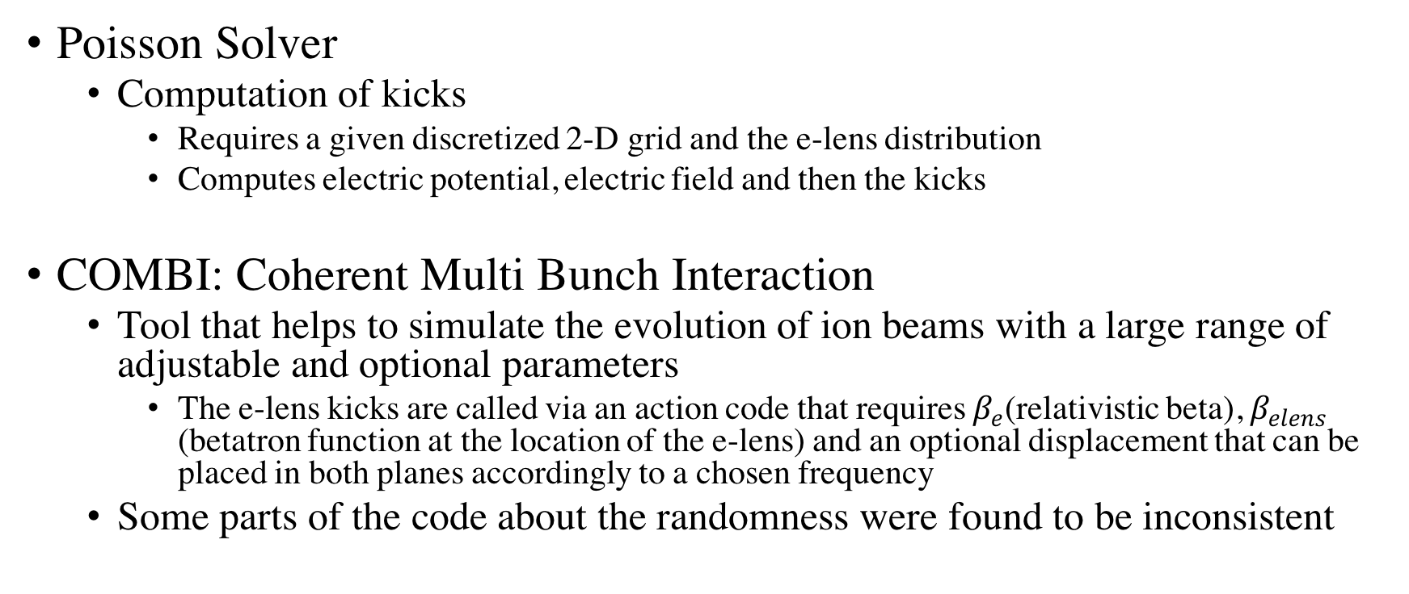
Computational tools
Poisson Solver
  Computation of kicks
    Requires a given discretized 2-D grid and the e-lens distribution
    Computes electric potential, electric field and then the kicks
COMBI: Coherent Multi Bunch Interaction
  Tool that helps to simulate the evolution of ion beams with a large range of adjustable and optional parameters
    The e-lens kicks are called via an action code that requires $β_{e}$(relativistic beta), $β_{elens}$ (betatron function at the location of the e-lens) and an optional displacement that can be placed in both planes accordingly to a chosen frequency
  Some parts of the code about the randomness were found to be inconsistent

Slide 8

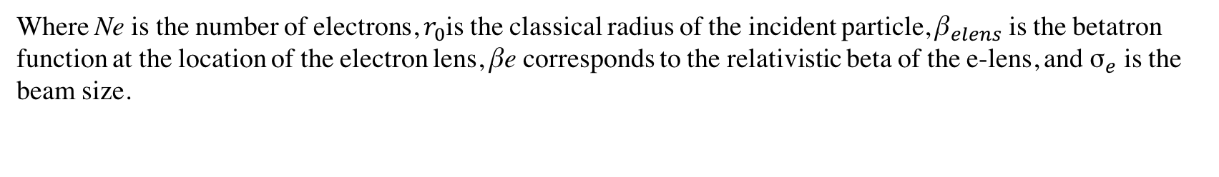
Simulation results
A Gaussian distribution can help to suppress collective instabilities by Landau damping.
Results visualized in a so-called tune footprint diagram.
In COMBI the oscillations frequencies are obtained for particles from 0σ to 6σ.
The maximum tune shift given by a Gaussian electron beam distribution can be calculated analytically for the 0-amplitude amplitude particle as:
Footprint diagram
[6]
Where Ne is the number of electrons, $r_{0}$is the classical radius of the incident particle, ${\text{β}}_{elens}$ is the betatron function at the location of the electron lens, βe corresponds to the relativistic beta of the e-lens, and ${\text{σ}}_{e}$ is the beam size.

Slide 9
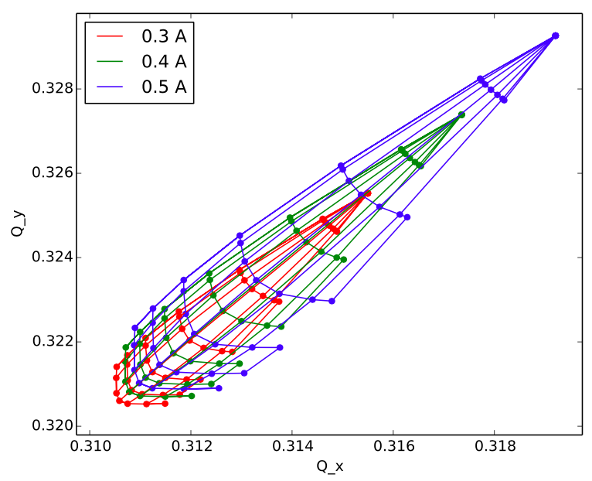



Tune Spread
Initial tunes
Analytical maximum tune spread in x plane for different currents:
Current (A)
0.3 | 0.005505
0.4 | 0.007340
0.5 | 0.009175
As the current gets higher the maximum tune spread also increases
Simulations are closed to analytical results
Footprints for Gaussian distributions and multiple currents.

Slide 10
Displacement Noise
A misalignment of the electron lens will introduce undesirable noise in the incident proton beam.
  Leads to an emittance increase with consequent reduction of the luminosity reach of the collider.
Some simulations with random displacements in the x-plane and/or y-plane were carried out, and the results on the emittance increase per hour are analyzed.
The Current used for the simulations was 1 A.

Slide 11
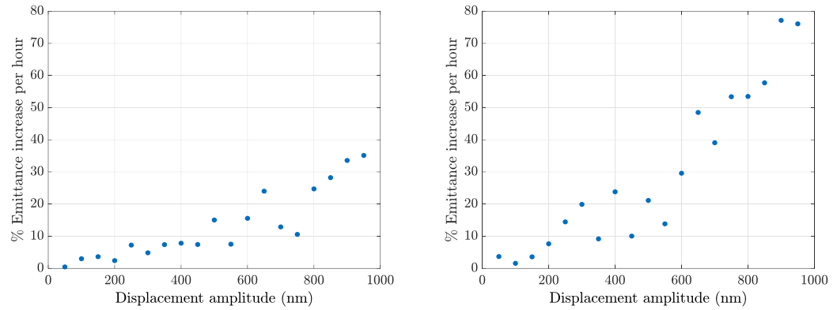
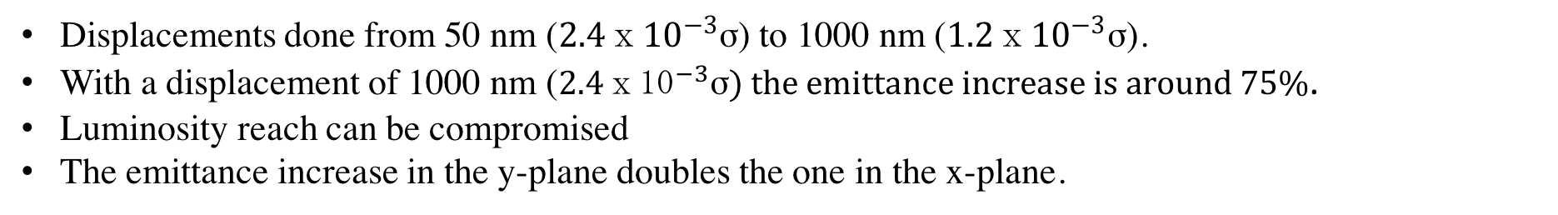
Gaussian e-lens Noise
Displacements done from 50 nm (${2.4ⅹ10}^{−3}$σ) to 1000 nm (${1.2ⅹ10}^{−3}$σ).
With a displacement of 1000 nm (${2.4ⅹ10}^{−3}\text{σ}) the emittance increase is around 75\%$.
Luminosity reach can be compromised
The emittance increase in the y-plane doubles the one in the x-plane.
x-plane
y-plane
Amplitude emittance growth for random displacements with $Q_{x}=0.31$ and $Q_{y}=0.32.$

Slide 12
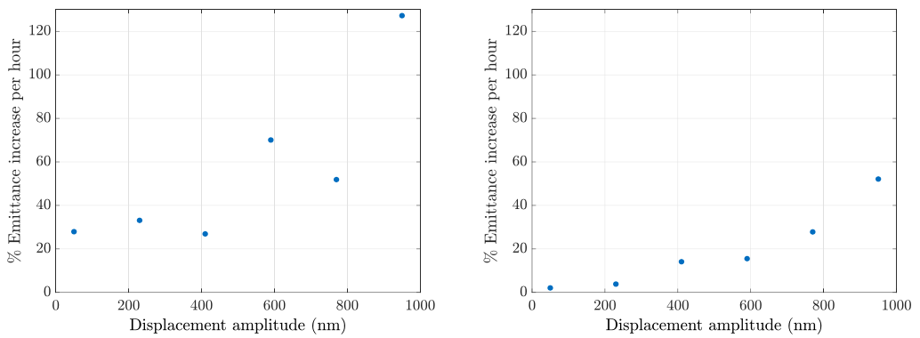
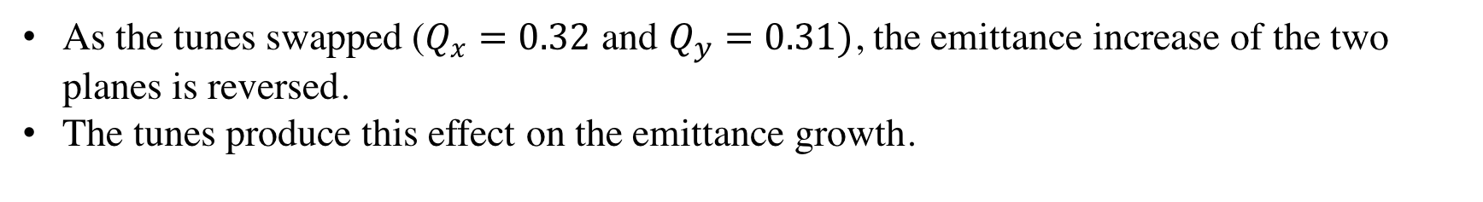
Gaussian e-lens Noise
As the tunes swapped ($Q_{x}=0.32$ and $Q_{y}=0.31)$, the emittance increase of the two planes is reversed.
The tunes produce this effect on the emittance growth.
x-plane
y-plane
Amplitude emittance growth for random displacements with $Q_{x}=0.32$ and $Q_{y}=0.31.$

Slide 13
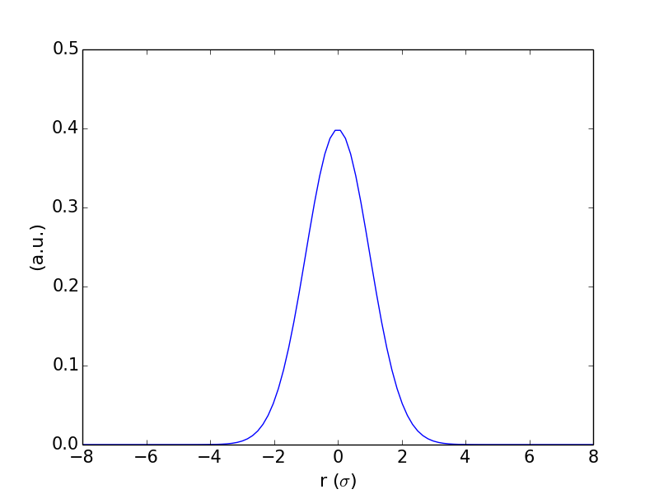
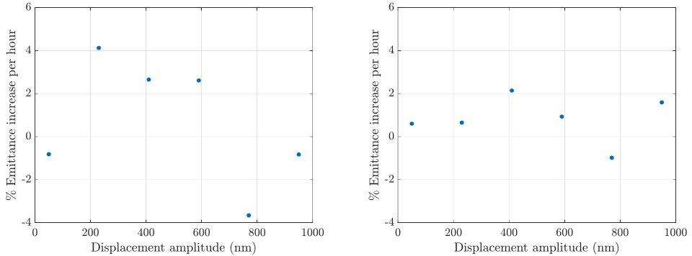
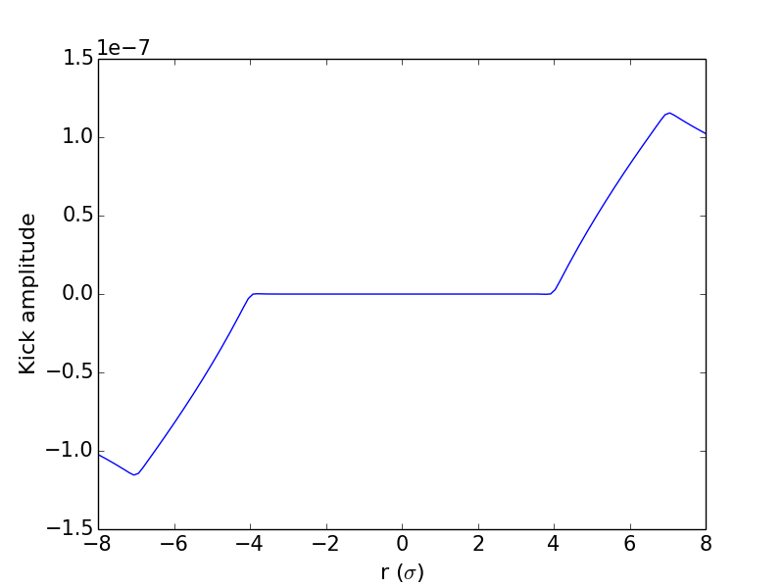
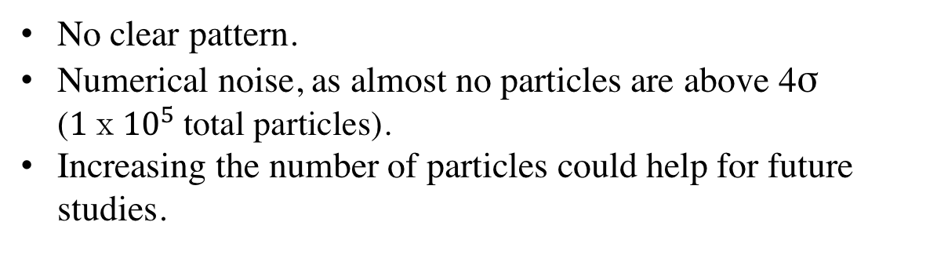
Cylindric Hollow Noise
No clear pattern.
Numerical noise, as almost no particles are above 4σ (${1ⅹ10}^{5}$total particles).
Increasing the number of particles could help for future studies.
Proton distribution
x-plane
y-plane
Kicks produced
Amplitude emittance growth for random displacements with $Q_{x}=0.32$ and $Q_{y}=0.31.$

Slide 14
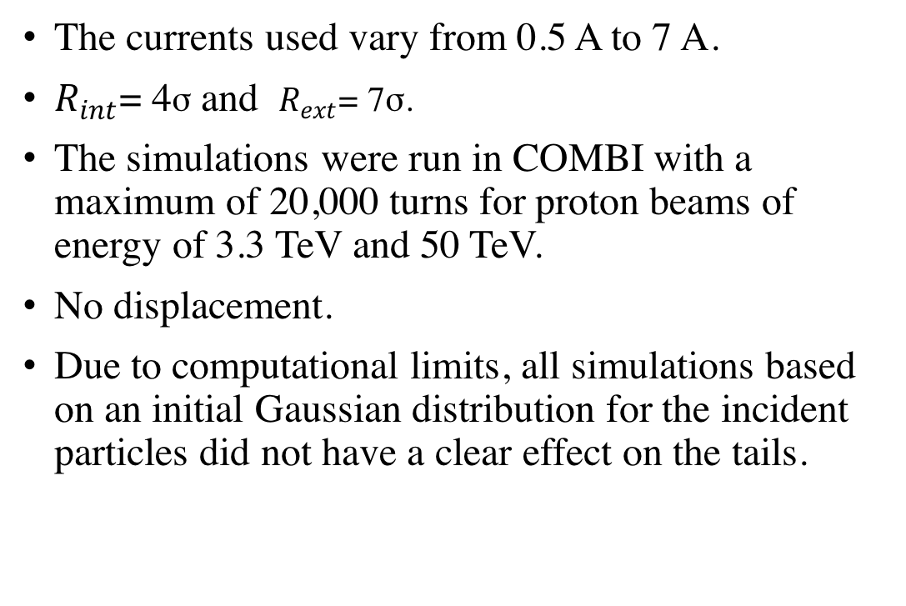
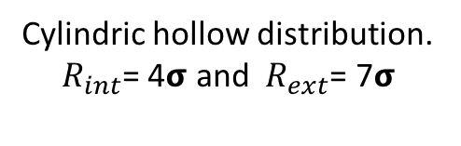
Cylindric Hollow Collimation
The currents used vary from 0.5 A to 7 A.
$R_{int}$= 4σ and $R_{ext}\text{= }\text{7}\text{σ}\text{.}$
The simulations were run in COMBI with a maximum of 20,000 turns for proton beams of energy of 3.3 TeV and 50 TeV.
No displacement.
Due to computational limits, all simulations based on an initial Gaussian distribution for the incident particles did not have a clear effect on the tails.
Cylindric hollow distribution. $R_{int}$= 4𝞂 and $R_{ext}\text{= }\text{7}\text{σ}$
Notes:
The e-lens for these simulations was perfectly aligned without any displacement.

Slide 15
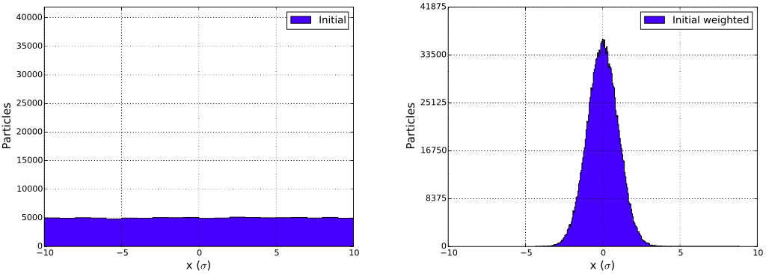
Weight Function
In order to better visualize the impact above 4σ particles, an initial uniform distribution defined from −10σ to 10σ was used.
A weight Gaussian function was then used
Initial flat distribution
Weighted function

Slide 16
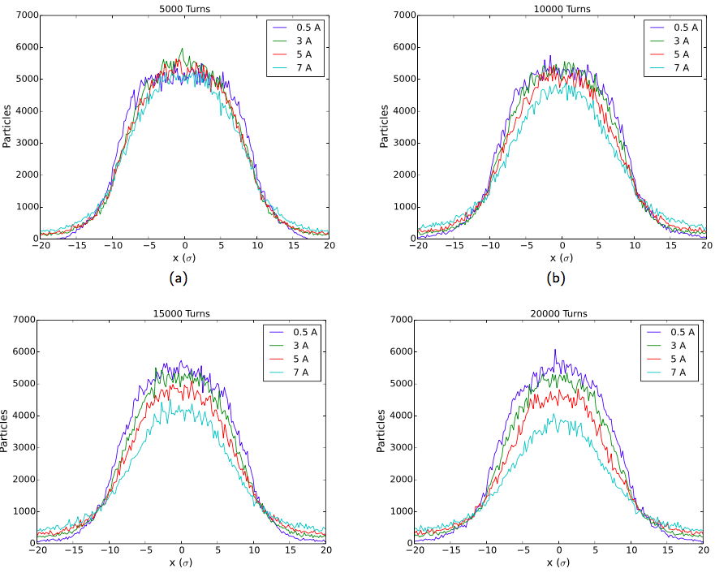
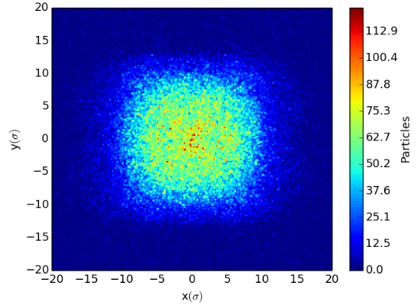
Tracked Distributions without Weight Function
Simulations for 3.3 TeV proton beam
Tails are populated
E-lens with high currents seems to affect the core
Distribution of the x-plane for multiple currents and turns

Slide 17
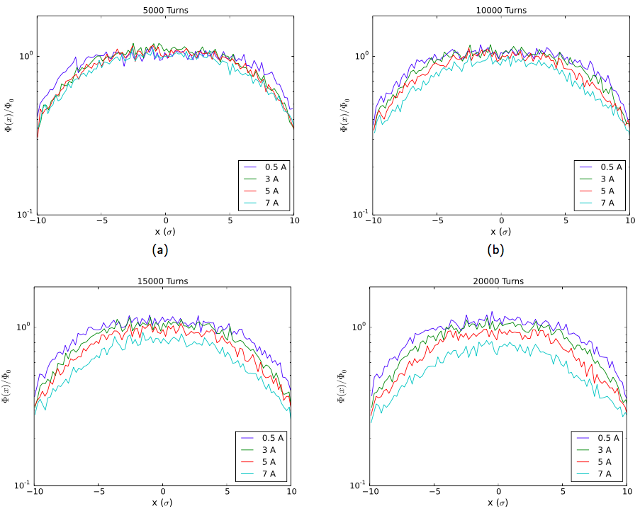



Tracked Distributions with Weight Function
Initial weighted distribution labeled as .
Tracked distribution .
The comparison is done as a ratio in the form .
Drop of particles begin at 4σ.
High current e-lens kick out particles easily.
Distribution profile in x-plane for 3.3 TeV incident beam

Slide 18
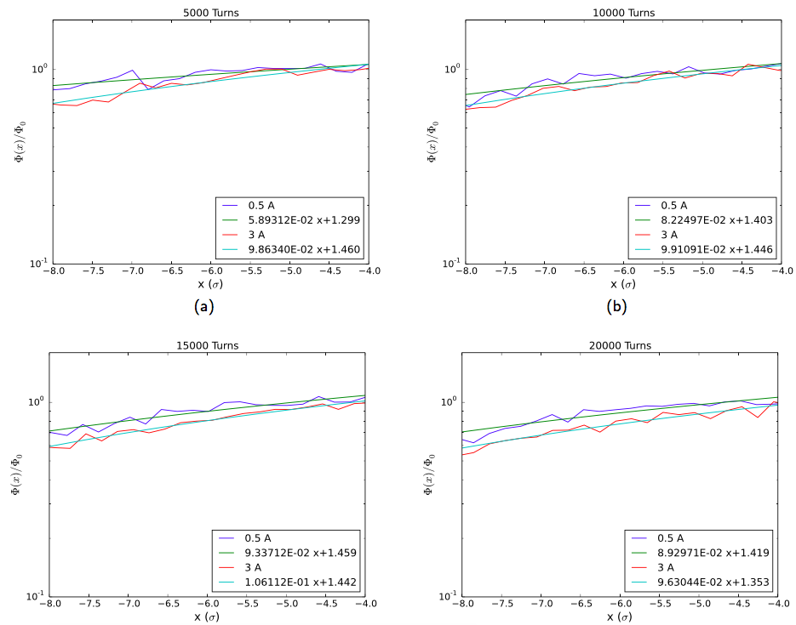
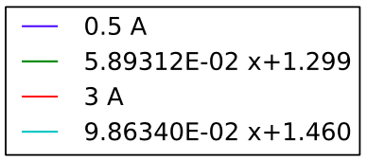
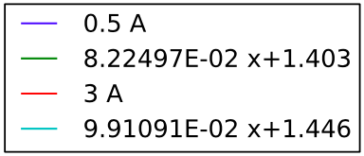
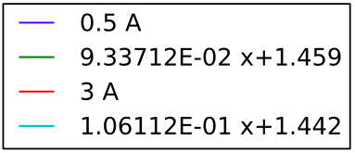
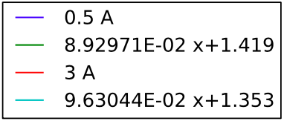
Linear Fit
Linear fit applied to profile distributions from -8σ to -4σ.
Slopes give an approximation of the diffusion rate per sigma.
Slopes of 3 A case is higher than the 0.5 A.
The diffusion rate increases with a higher current.
Linear fits of x-plane for particle distribution of 0.5 A and 3 A with 3.3 TeV

Slide 19
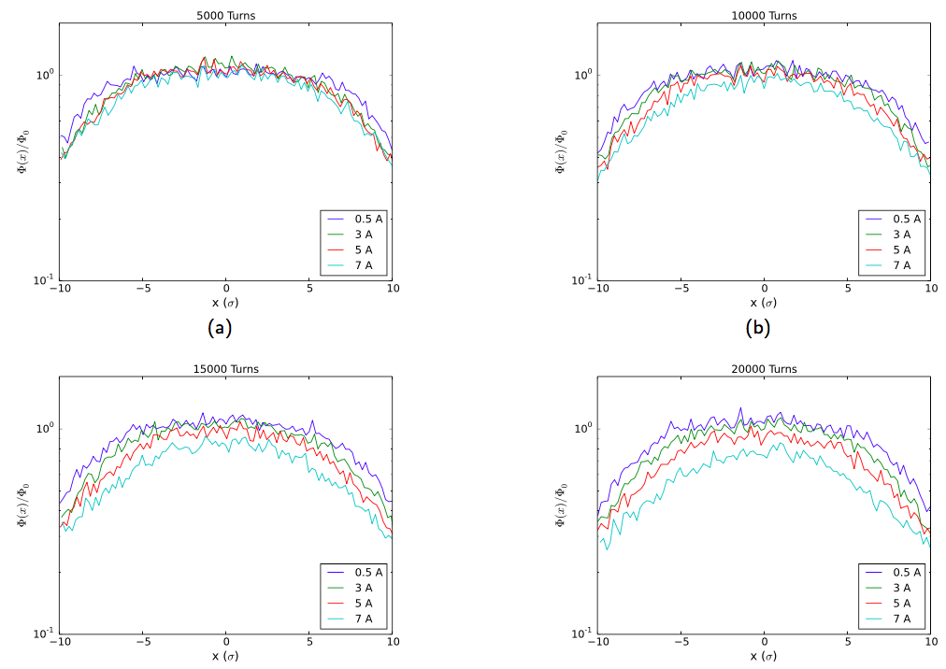
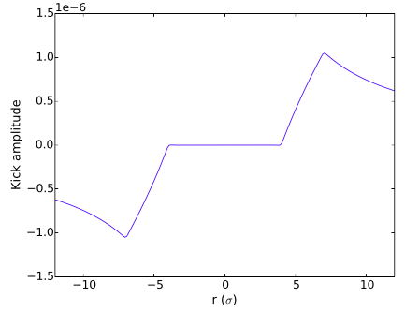
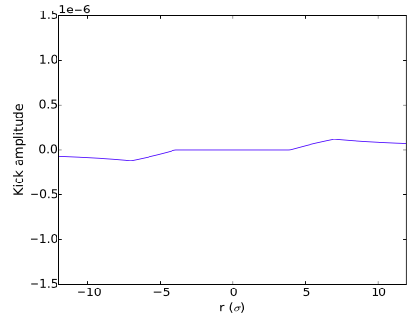
Tracked Distributions with Weight Function
50 TeV proton beam.
Lower amplitude kicks. However, in this model there is no difference in particle distribution between 3.3 TeV and 50 TeV.
Core is still affected.
3.3 TeV kicks
50 TeV kicks
Distribution profile in the x-plane for 50 TeV incident beam

Slide 20
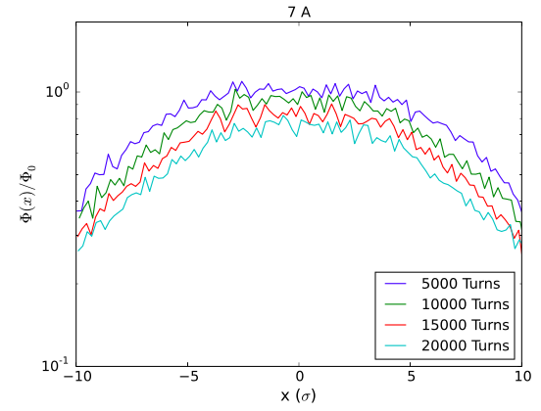
High current e-lens
An e-lens with a high current as 7 A, starts to affect the core of the distribution.
This could be a result of an emittance blow-up.
Evolution of the x-plane distribution for a 7 A e-lens

Slide 21
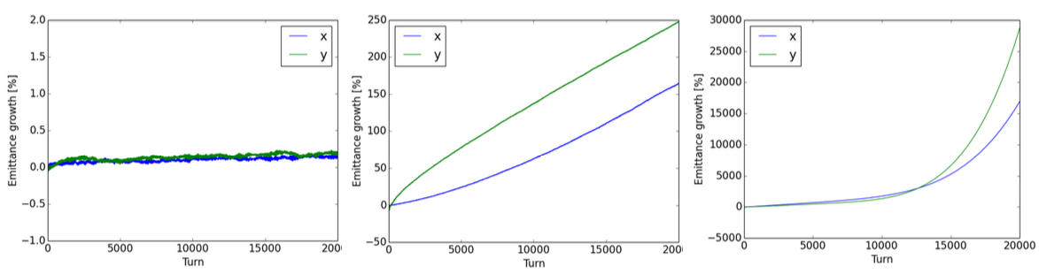
Emittance increase
There is an emittance increase of 0.25% for a 0.5A e-elens (inside working range).
Almost 250% of emittance increase in the 3 A e-lens.
Emittance increase grows exponentially around 11,000 turns for 7 A case.
The emittance growth in the case of 3 A and 7 A is not optimum for the collider performance.
0.5 A
3 A
5 A

Slide 22
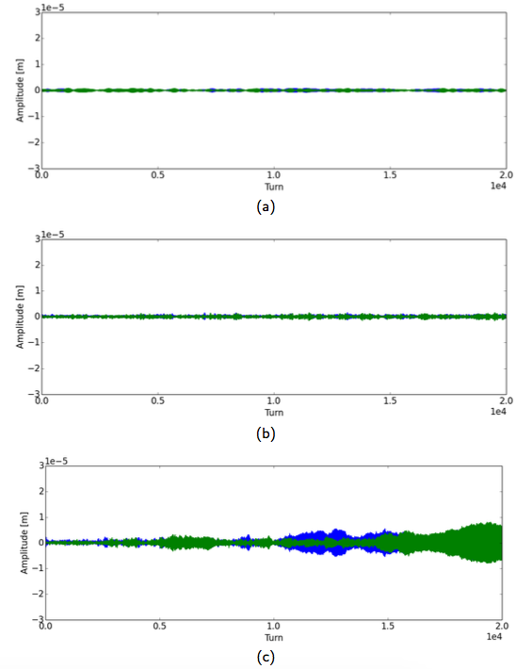
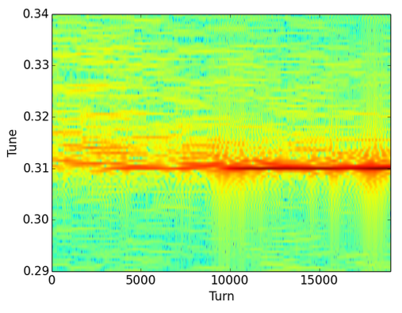
Frequency Spectrum and Oscillation Amplitudes
Oscillation amplitude increase abruptly around 11,000 turns for 7 A e-lens.
Dark red spot on frequency spectrum also around 11,000 turns.
Signs of instabilities with a consequent exponential growth of emittance
The core of the beam distribution is affected as previously seen
Instabilities
Frequency spectrum after the application of cylindric hollow e-lens of 7 A.
Oscillation amplitudes for a) 0.5 A, b) 3 A and c) 7 A.The x-plane corresponds to the blue part and y-plane to the green.

Slide 23
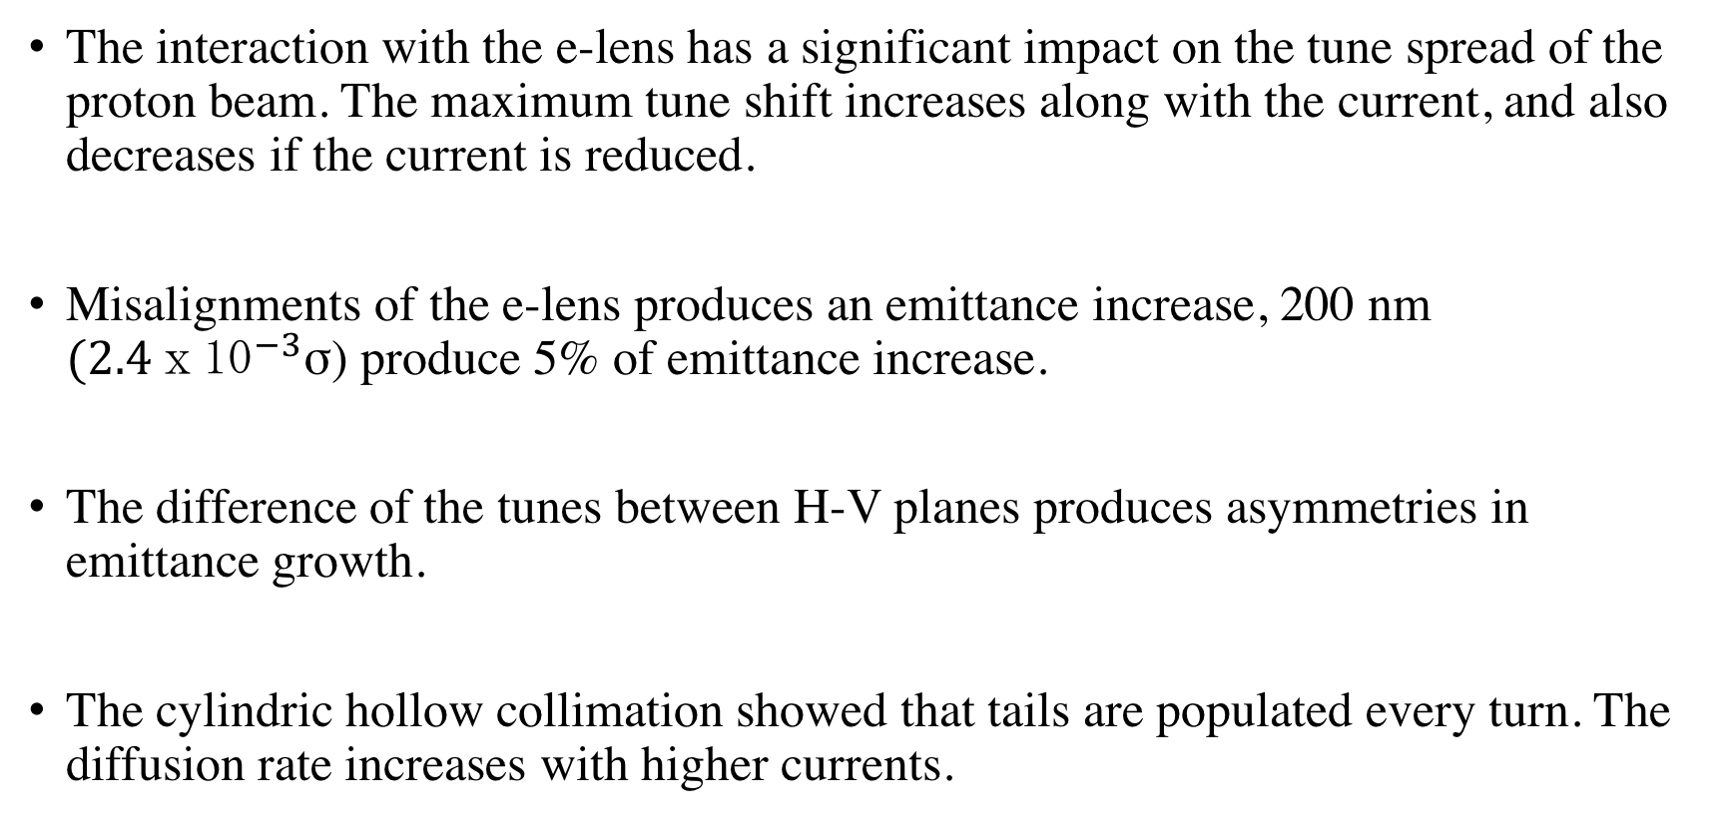
Conclusions
The interaction with the e-lens has a significant impact on the tune spread of the proton beam. The maximum tune shift increases along with the current, and also decreases if the current is reduced.
Misalignments of the e-lens produces an emittance increase, 200 nm ${(2.4ⅹ10}^{−3}$σ) produce 5% of emittance increase.
The difference of the tunes between H-V planes produces asymmetries in emittance growth.
The cylindric hollow collimation showed that tails are populated every turn. The diffusion rate increases with higher currents.

Slide 24
Conclusions
High turns (7 A, 5 A and3 A) have consequences on emittance growth and create instabilities, so the core is also affected.
The presented studies can be extended by including a longitudinal tilt in order to analyze the impacts on beam parameters.
Convergence studies could also improve the understanding of the noise introduce by the e-lens.

Slide 25
References
[1] V.Shiltsev, et.al. LHC Particle Collimation with Hollow Electron Beams. FERMILAB-CONF- 08-184 (2008).
[2] G. Stancari, et.al. Development of Hollow Electron Beams for Proton and Ion Collimation. FERMILAB-CONF-10-182-AD-APC (2012).
[3] H. Rafique, et.al. High Luminosity LHC Hollow Electron Lens Collimation Using Merlin. Proc. ICAP2015 (2015).
[4] Fischer, W., et.al. Compensation of head-on beam-beam induced resonance driving terms and tune spread in the Relativistic Heavy Ion Collider. Physical Review Accelerators and Beams, 20, 091001 (2017).
[5] V. Shiltsev, et.al. Landau Damping of Beam Instabilities by Electron Lenses. Physical Review Letters, PRL 119, 134802 (2017).
[6] Tambasco, C., Pieloni, T., Buffat, X. and Banfi, D. e-lens and BTF in COMBI. (2014).
[7] T. Kramer., et.al. Considerations for the Bea Dump System of a 100 TeV Centre-of-Mass FCC HH Collider. Proc. IPAC2015 (2015).

Slide 26
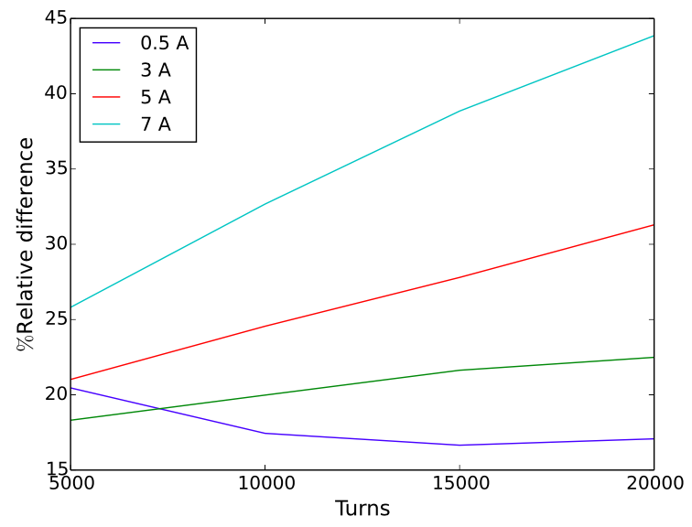
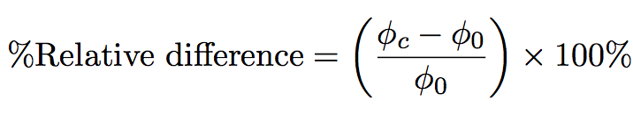


Particles Kicked Outside 6σ
Most collimation systems start working from 6σ.
Comparison between particles kicked out from 6σ.
The increase rate of relative difference depends on current.
0. 5 A case stays almost constant.
Where represents the particles outside 6σ for a tracked particles.
And is the number of particles outside 6σ for the initial distribution.
Relative difference of amount of particles form 6σ until last particle

