Slide 1



Beam-Beam Studies for FCC-HH
Work supported by the Swiss State Secretariat for Education, Research and Innovation SERI
J. Barranco, X. Buffat, M. Crouch, S. V. Furuseth,
P. Goncalves, T. Pieloni, C. Tambasco
Acknowledgements: R. Tomas, L. Medina, D. Schulte, L. Rivkin, A. Seryi, EIR team, M. Roman, B. Dalena, M. Hofer, M. Giovannozzi, E. Metral, F. Zimmermann, J. Wenninger, G. Arduini, A. Chance, R. DeMaria and W. Herr

Slide 2
Contents
Dynamic aperture studies for Round optics
Low Luminosity Experiments
Alternative solutions: flat optics
Compensation techniques
Head-on studies
Summary and outlook

Slide 3
Collider parameters
 | FCC-hh Baseline | FCC-hh Ultimate
Luminosity L [10³⁴cm⁻²s⁻¹] | 5 | 20-30
Background events/bx | 170 (34) | <1020 (204)
Bunch distance Δt [ns] | 25 (5)
Bunch charge N [10¹¹] | 1 (0.2)
Fract. of ring filled η_{fill} [%] | 80
Norm. emitt. [μm] | 2.2(0.44)
Max ξ for 2 IPs | 0.01 (0.02) | 0.03
IP beta-function β [m] | 1.1 | 0.3
IP beam size σ [μm] | 6.8 (3) | 3.5 (1.6)
RMS bunch length σ_{z} [cm] | 8
Crossing angle [σ’] | 12 | Crab. Cav.
Turn-around time [h] | 5 | 4
From D. Schulte
IPA and IPG main high luminosity experiments:
Goal → maximum luminosity with good lifetimes → maximum integrated luminosity
IPL and IPB low luminosity Ips:
Goal → in shadow on main IPs where possible → will define luminosity operation

Slide 4
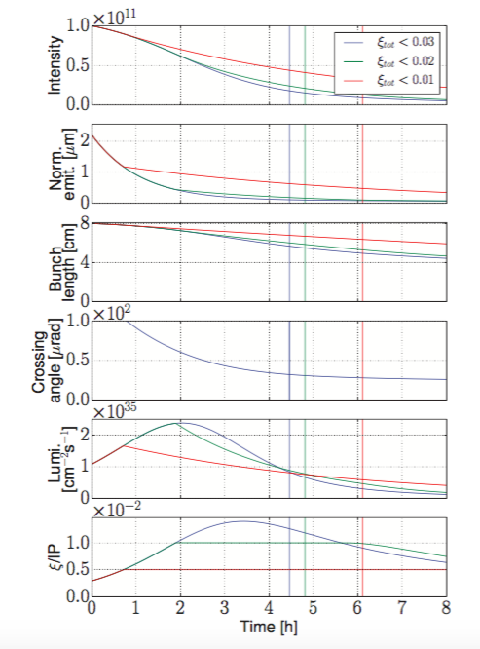
Beam-Beam Effects
Due to strong radiation damping we have quite some different regimes from beam-beam point of view:
LHC/HL-LHC beam-beam dynamics ξ_{bb} = 0.06→0.01
  LHC experience and long-range effects
Head-on driven dynamics with beam-beam parameter ξ_{bb} = 0.01→ 0.02 plus 2 low luminosity IPs
  LHC experience with HL-LHC MDs
Mixed status, radiation damping and possible operational scenarios
Need new developments in models
3
2
1
X. Buffat & D. Schulte

Slide 5
Beam-Beam Effects
Due to strong radiation damping we have quite some different regimes from beam-beam point of view:
LHC/HL-LHC beam-beam dynamics ξ_{bb} = 0.06→0.01
  LHC experience and long-range effects
Head-on driven dynamics with beam-beam parameter ξ_{bb} = 0.01→ 0.02 plus 2 low luminosity IPs
  LHC experience with HL-LHC MDs
Mixed status, radiation damping and possible operational scenarios
Need new developments in models
3
2
1
All cases with 25 ns bunch spacing
X. Buffat & D. Schulte

Slide 6
Ultimate case Round Optics: IPA and IPG
FCC New Lattice L* 40 m
Dynamic Aperture should be larger than 6.0 σ with all non linearities in the presence of beam-beam at different stages of the operational cycle
Q’ = 2 units
TCP Collimators aperture 7.2 σ
Q’ = 20 units
For FCC-hh case TCPs at 7.2 σ
M. Fiascari et al. @IPAC2016
Crossing angle of 200 μrad at IPA and IPG proposed
→ Still to be added some margins for:
→ Landau Octupoles
→ Magnets imperfections
→ Tunability and low luminosity experiments

Slide 7
Crossing Schemes: HV versus HH and VV
LHC DATA 2016
B. Salvachua et al.
@IPAC2017 TUPVA025
HH Crossing is equivalent to HV in terms of DA for nominal bunches
VV not acceptable at the (0.31-0.32) working point due to strong impact of 3rd order resonance effect → Mirrored tune will solve the problem
Moving on the mirrored tunes inverts the situation where then HH pushes particles on the 3rd order resonance
Alternative crossing schemes are possible to support energy deposition constrains (I. Besana and Cerruti)

Slide 8
PACMAN Bunches
For all crossing schemes the major impact of long-range effects are on the nominal bunches
PACMAN bunches always show a better dynamic aperture, DA is defined by nominal bunches
Orbit effects still to be addressed for conclude on PACMAN
Should allow for flexible tuning

Slide 9
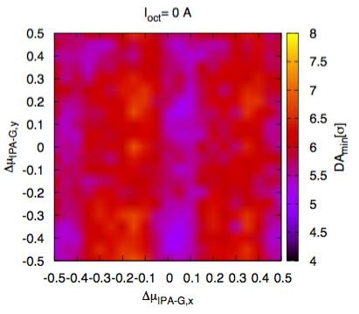
Optimization of optics based on dynamic aperture
Optimum phase advance for optics is not the best for beam-beam and octupole compensation
Beam-Beam Effects
Beam-Beam Effects + Octupoles
Make use of Octupole magnets to compensate long-range beam-beam→ further optimization of phase advance with beam-beam and octupoles compensation needed
Allow for a dynamic change over the operational cycle of the collider of the lattice phase advance to have maximum Dynamic Aperture and maintain compensation

Slide 10
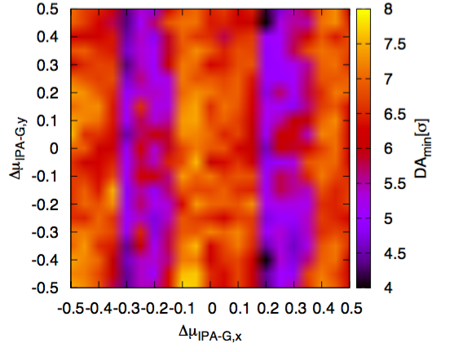
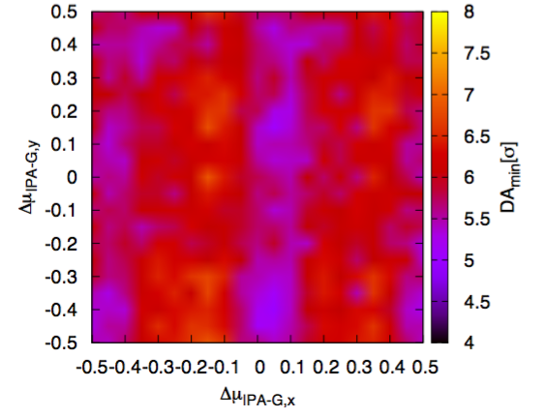
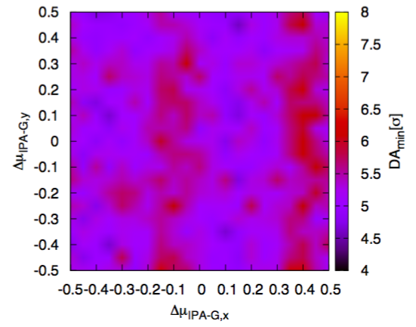
Landau Octupoles and beam-beam compensation
- Landau Octupoles
Beam-Beam Effects
+ Landau Octupoles
We choose to have negative octupole polarity (compensates the long-range beam-beam effects):
→ provides larger stability for single beam (see C. Tambasco talk)
→allows for larger DA with optimized phase advance thanks to compensation
(CERN-ACC-NOTE-2017-036)
Different Phase advances at different stages of the operational cycle to have maximum Dynamic Aperture and maintain compensation

Slide 11
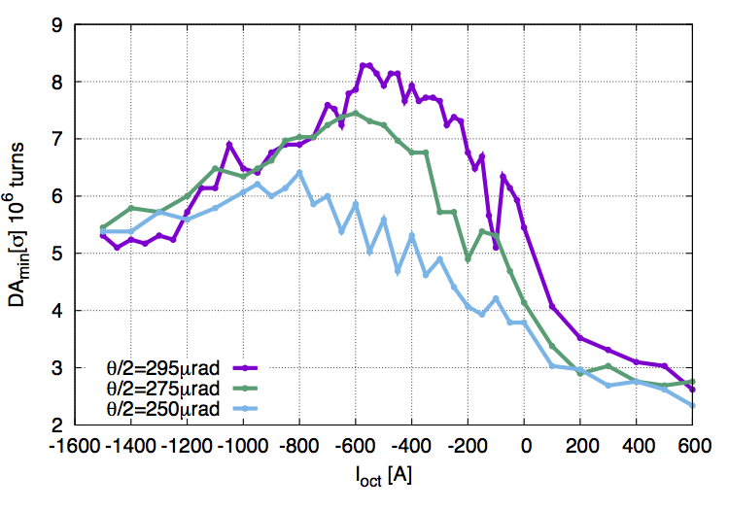
Global compensation with Octupoles
1
2
2
3
1
3
4
4
HL-LHC study case
CERN-ACC-NOTE-2017-0035
Octupole magnets are used/needed to provide tune spread for Landau damping.
They have very negative effect on DA if not used with care.
If installed at right location they could help compensating long-range effects!
FCC should allow for these option with some tunability of the lattice measurements

Slide 12
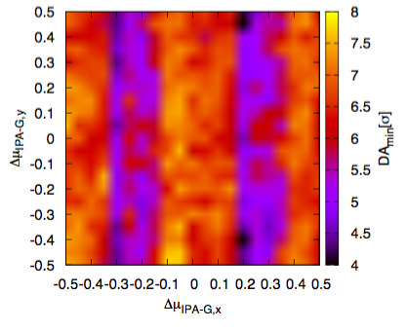
Optimization of optics based on dynamic aperture
Optimum phase advance for optics is not the best for beam-beam and octupole compensation→ need optimized phase advance where DA is smallest (with BB)
Beam-Beam Effects
Beam-Beam Effects + Octupoles
Make use of Octupole magnets to compensate long-range beam-beam→ further optimization of phase advance with beam-beam and octupoles compensation
Allow for a dynamic change over the operational cycle of the collider of the lattice phase advance to have maximum Dynamic Aperture and maintain compensation

Slide 13
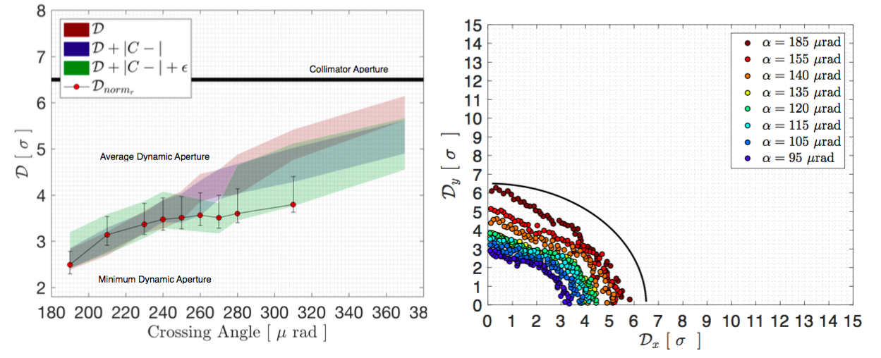
Dynamic Aperture benchmark to LHC
@IPAC 2017 THPAB056
Long-range behave like scrapers (losses well defined by DA) no emittance blow-up
Dynamic Aperture in the LHC well correlated to the particle losses
Further studies on particle distributions and implementation into models
Dynamic Aperture in the LHC well correlated to the particle losses

Slide 14
Low Luminosity Experiments: IPL and IPP
The long-range effects of IPL and B will impact bunches differently (no passive compensation)
To have them not perturbing the high luminosity experiments should have angles > 80 μrad
Long-range: to keep effects weak larger angles needed →larger than 80 μrad
Head-on apply separation leveling of luminosity = limit on integrated luminosity per year of run!

Slide 15
IPL and IPP
Tune shifts during separation leveling and lumi constrains

Slide 16
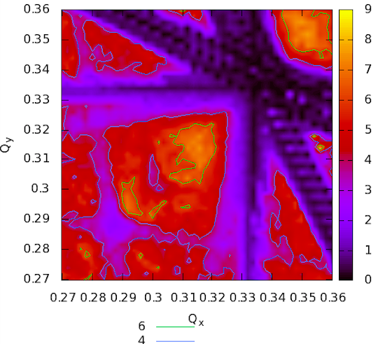
Dynamic Aperture dependency on tune
Define robust baseline scenario with Dynamic Aperture above 6 σ with all non-linearities (magnets errors, Landau octupoles, high chromaticity and beam-beam effects) and some margins for parameter fluctuations (10%)
Tune optimization to find optimum and large area in tune diagram
→ host low luminosity experiments contributions (tune shifts in the order of few 10⁻³)

Slide 17
Alternative solutions: Flat optics versus round
Flat optics is the natural back up solution in case crab cavities do not work,
Beam-Beam long-range and head-on behave differently:
Due to trains and braked passive compensation → tune shifts (for H-V crossing schemes)
Head-on beam-beam creates larger detuning with amplitude
Flat optics introduces several unwanted effects

Slide 18
Flat versus round optics: beam-beam effects
Study case beta ratio of 4 and H-V crossing scheme:
- Flat optics will need 43% more separation respect to round
Correcting for the tune shift reduces the needs but still need 26% larger separations
Larger aspects ratios of betas make things worse!

Slide 19
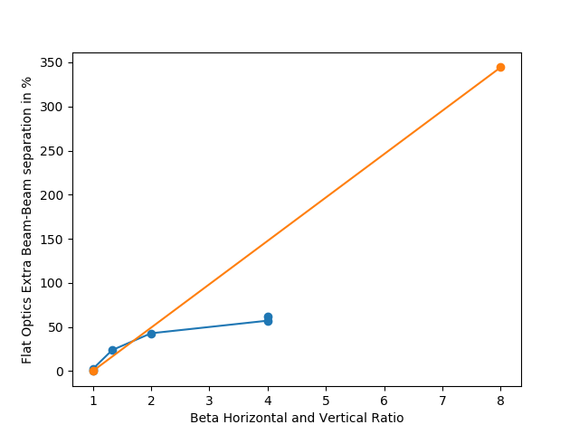
PACMAN effects Flat versus Round
Extra beam-beam separation needed in percentage respect to round
For H-V crossing (blue line) and H-H crossing (yellow line)
Target of 6 sigma DA
To be discussed!Flat option proposed NOT OK.

Slide 20
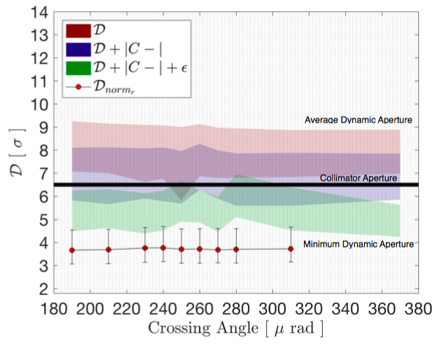
Head-on Limit: Losses and Emittance growth
Head-on beam-beam can result in losses and emittance growth. FCC pushed to beam-beam tune shifts of 0.02-0.03 total.
From LHC experience head-on alone can explain losses in the presence of multipolar errors from magnets!

Slide 21
Head-on Limit: Losses and Emittance growth
Model developed for FCC-hh of loss rates with 6D beam-beam and simplified lattice!
First comparisons to LHC losses data during dedicated experiment
Total Beam-Beam parameter of 0.02
GPU accelerated 6D simulations (CABIN) compared to measured losses in the LHC.
Clear impact of Piwinski angle to loss mechanism
Good qualitative agreements
Work on going on quantitative estimates (magnets errors)
DATA
Poster by S. Vik Furuseth
Strong Head-on Beam-Beam Interactions

Slide 22
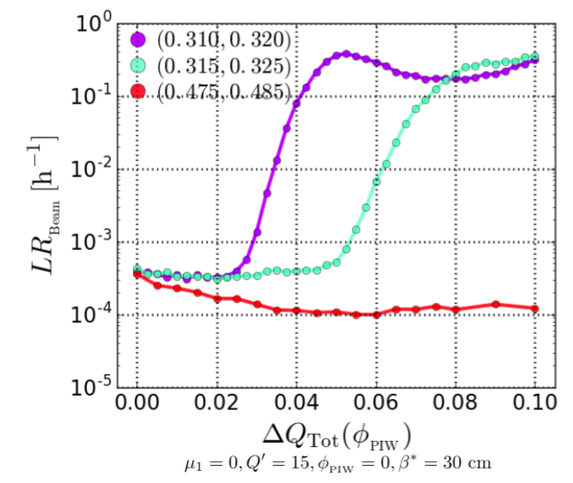
Head-on Limit: Losses and Emittance growth
Working point optimization could increase the beam-beam maximum tune shift (0.046)
Further optimization with dynamic aperture cross check in the presence of long-range beam-beam are foreseen
Poster by S. Vik Furuseth
Strong Head-on Beam-Beam Interactions
Further studies needed to explore flat option and real limit with long-range beam-beam effects

Slide 23
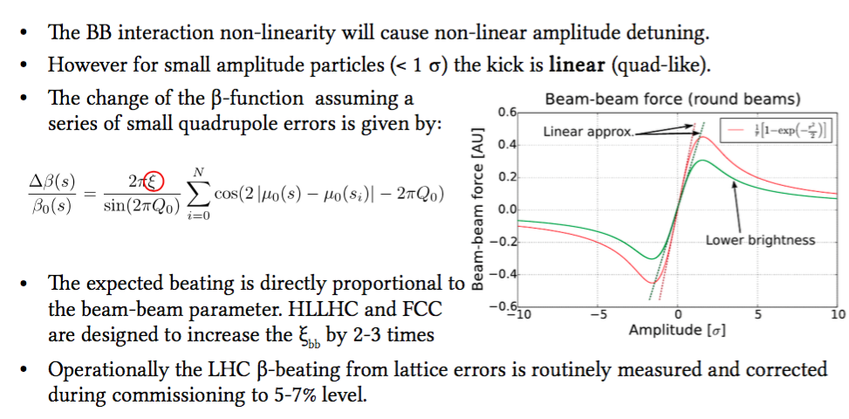
Head-on Beam-beam β-beating
Head-on interaction at two IPs will result in a very important beating of roughly 30%
An important unexpected contribution from IP5 (s=6665 m) is present on the vertical measured β-beating plot.
For a 2 σ oscillation amplitude, a reduction of the β-beating of roughly 30% is expected leading to a maximum β-beating of about 8-6%.
A 20% smaller normalized emittance ε_{n} provides a smaller β-beating as expected that is more consistent with measurements.

Slide 24
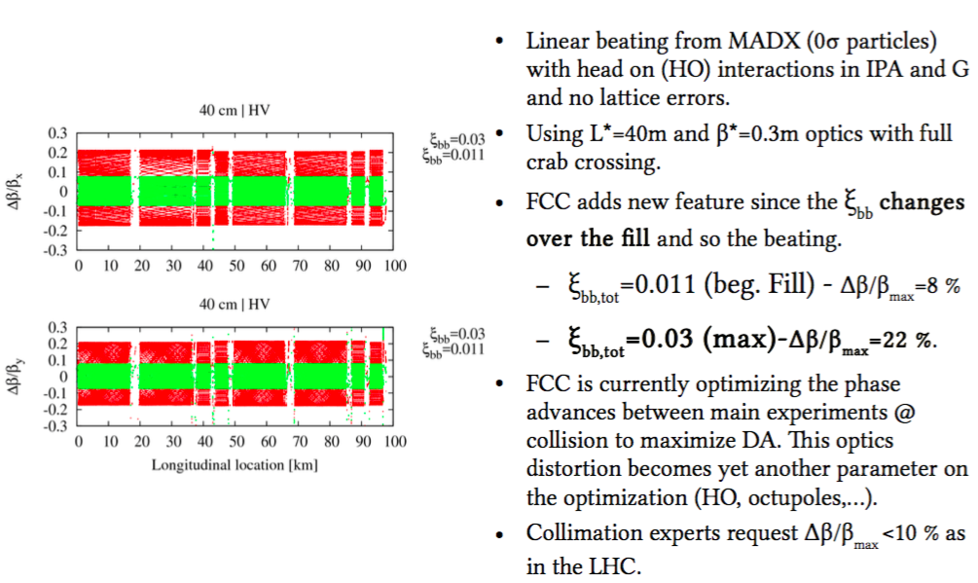
Head-on Beam-beam β-beating
An important unexpected contribution from IP5 (s=6665 m) is present on the vertical measured β-beating plot.
For a 2 σ oscillation amplitude, a reduction of the β-beating of roughly 30% is expected leading to a maximum β-beating of about 8-6%.
A 20% smaller normalized emittance ε_{n} provides a smaller β-beating as expected that is more consistent with measurements.

Slide 25
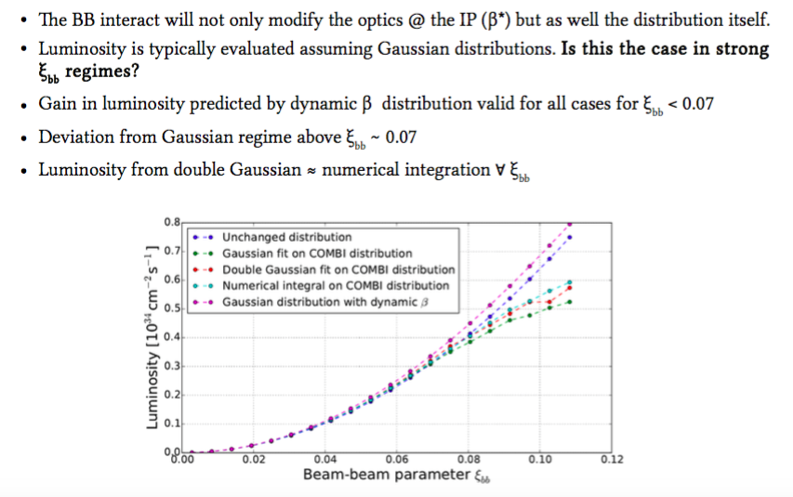
Head-on Beam-beam β-beating impact on Luminosity
Impact on Luminosity marginal for FCC beam-beam parameters
An important unexpected contribution from IP5 (s=6665 m) is present on the vertical measured β-beating plot.
For a 2 σ oscillation amplitude, a reduction of the β-beating of roughly 30% is expected leading to a maximum β-beating of about 8-6%.
A 20% smaller normalized emittance ε_{n} provides a smaller β-beating as expected that is more consistent with measurements.

Slide 26
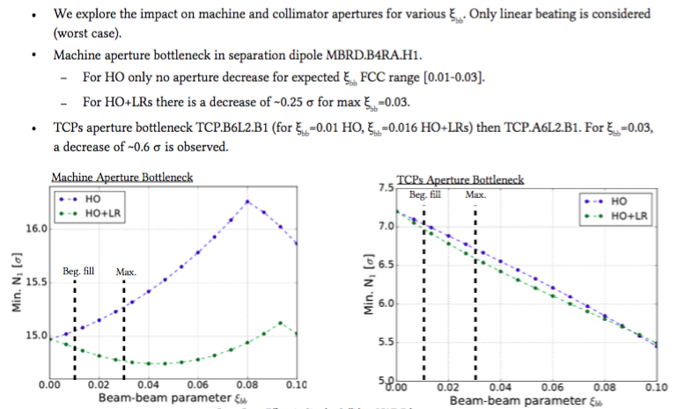
Head-on Beam-beam β-beating impact on aperture
Impact on Luminosity marginal for FCC beam-beam parameters
An important unexpected contribution from IP5 (s=6665 m) is present on the vertical measured β-beating plot.
For a 2 σ oscillation amplitude, a reduction of the β-beating of roughly 30% is expected leading to a maximum β-beating of about 8-6%.
A 20% smaller normalized emittance ε_{n} provides a smaller β-beating as expected that is more consistent with measurements.

Slide 27
Summary
…...

Slide 28
Thank you!

Slide 29
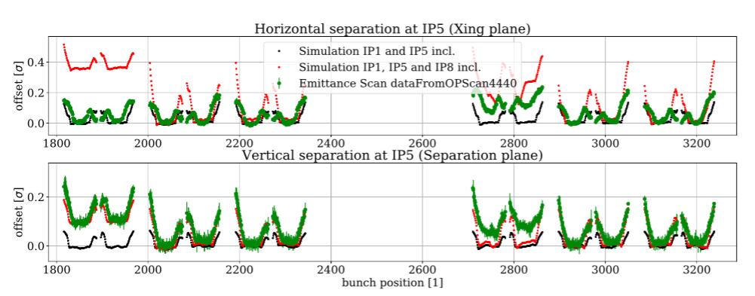
Orbit Effects
@IPAC2017 THPAB042

Slide 30
What have we learned from LHC and DA?
LHC DATA
Head-on colliding bunch and nominal have similar losses at larger angles
For separation below 8.3 σ long-range effects take over
@IPAC 2017 THPAB056

Slide 31
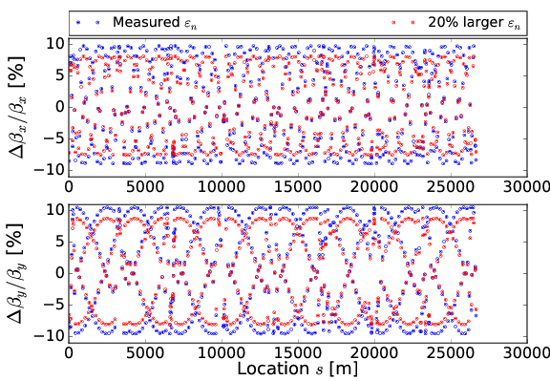
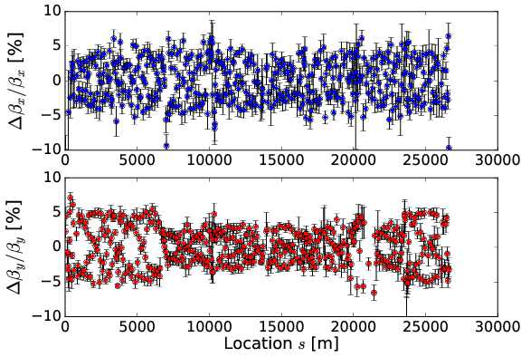
Head-on Beam-beam β-beating
First measurements in LHC and tests
@IPAC2017
WEOAB2, TUPVA030
Measurements consistent with expectation
First attempt to correct, results under evaluations
An important unexpected contribution from IP5 (s=6665 m) is present on the vertical measured β-beating plot.
For a 2 σ oscillation amplitude, a reduction of the β-beating of roughly 30% is expected leading to a maximum β-beating of about 8-6%.
A 20% smaller normalized emittance ε_{n} provides a smaller β-beating as expected that is more consistent with measurements.

