Slide 1


HE-LHC electron cloud
L. Mether
I. Bellafont, G. Guillermo, G. Iadarola, R. Kersevan, K. Ohmi,
G. Rumolo, F. Zimmermann
Work supported by the Swiss State Secretariat for Education, Research and Innovation SERI

Slide 2
Outline
Introduction
Overview of previous results
New results
Summary of current results
Conclusions

Slide 3
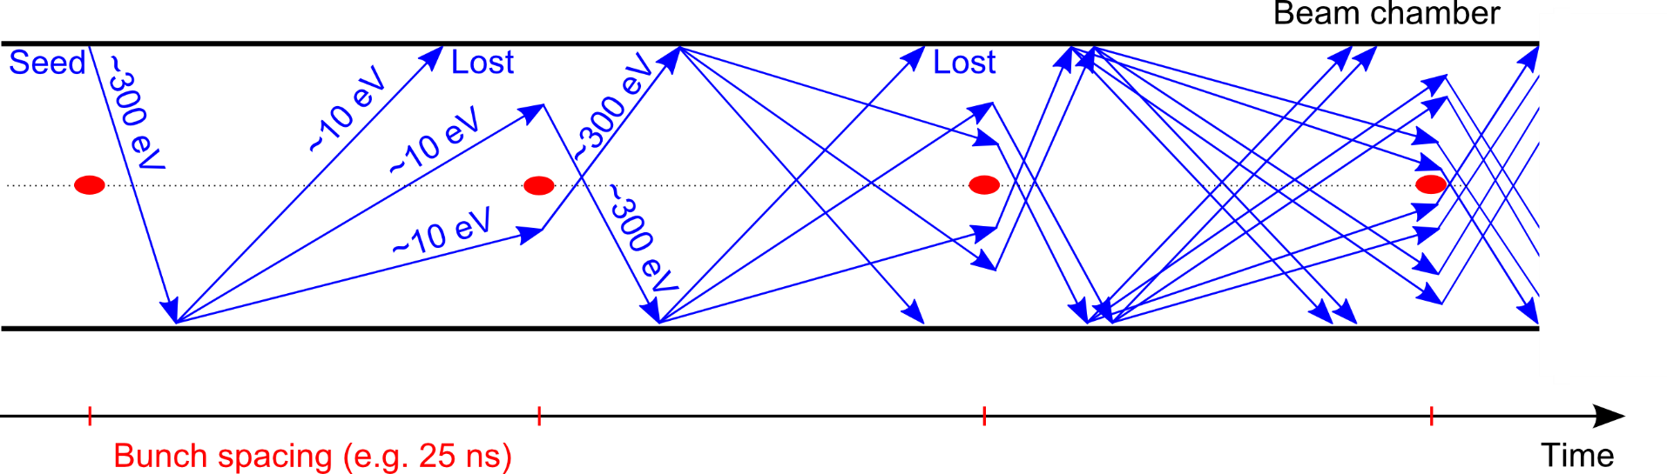
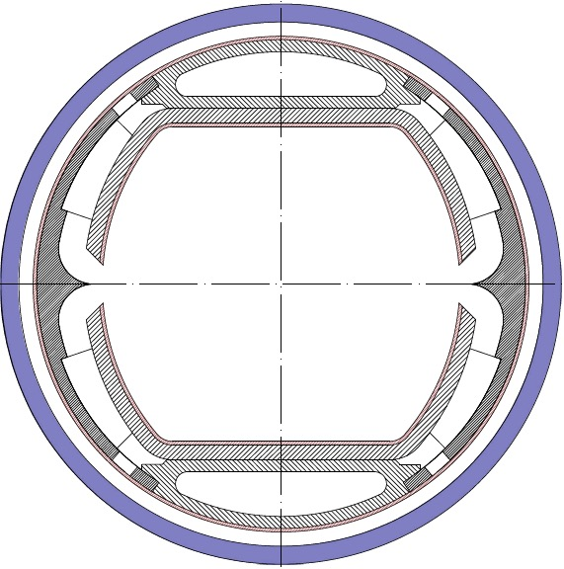
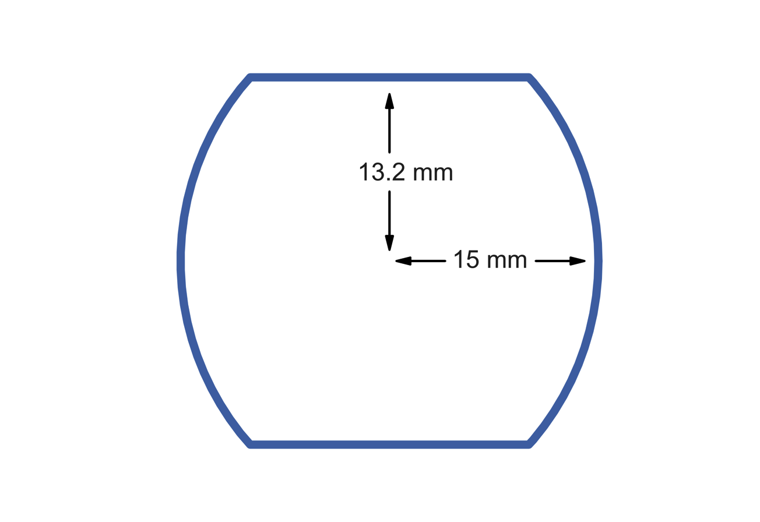
Introduction
Main concerns of electron cloud
Heat load and vacuum degradation due to electron flux on chamber wall
Transverse instabilities due to interaction between beam and electron cloud
Emittance growth, tune shift and spread, beam losses
Simulation studies
Electron cloud build-up for 25 ns, 12.5 ns and 5 ns beam:
Main chamber of beam screen (2015 version), Cu surface
Arc dipoles and quadrupoles
Simple photoelectron model based on ray tracing results
Beam screen geometry
Injection energy
Field free regions
Photoelectrons distribution from ray tracing

Slide 4
Overview of previous studies
Simulation studies of e-cloud effects for different bunch spacing options
Electron cloud build-up for 25 ns, 12.5 ns and 5 ns beam:
Main chamber of beam screen (2015 version), Cu surface
Arc dipoles, quadrupoles
Machine parameters
 | Injection | Flat top
Energy | 1.3 TeV | 13.5 TeV
Arc elements
 | Dipole | Quad
Field | 16 T | 216 T/m
Main chamber of FCC beam screen
(2015 version), with Cu surface
Beam parameters
Bunch spacing [ns] | 25 | 12.5 | 5
Bunch intensity [p⁺] | 2.2 x 10¹¹ | 1.1 x 10¹¹ | 4.4 x 10¹⁰
Norm. emittance [m] | 2.5e-6 | 1.25e-6 | 0.5e-6
Bunch length [m] | 0.0755
Bunch train pattern | (72b + 9e)*4 | (144b + 18e)*4 | (360b + 45e)*4

Slide 5
Electron cloud build-up
The multipacting thresholds, i.e. secondary emission yield (SEY) limits for electron cloud build-up, have been identified with build-up simulations
  Multipacting thresholds from build-up simulation
  (defined as highest SEY without build-up)
 | 5 ns | 12.5 ns | 25 ns | 5 ns | 12.5 ns | 25 ns
 | Injection 1.3 TeV |  |  | Flat top 13.5 TeV
Dipole | 1.0 | 1.2 | 1.55 | 1.0 | 1.15 | 1.45
Quadrupole | 1.10 | 1.05 | 1.40 | 1.05 | 1.10 | 1.45
The 5 ns beam has very low thresholds, and would need a coating with an SEY no larger than 1.0 to be a viable beam option (also very high heat loads and central electron densities, see next slides)
The 25 ns beam has relatively high thresholds and should be able to operate similarly to the LHC and the HL-LHC
The thresholds for the 12.5 ns beam are on the limit of what can be achieved without low-SEY coatings

Slide 6
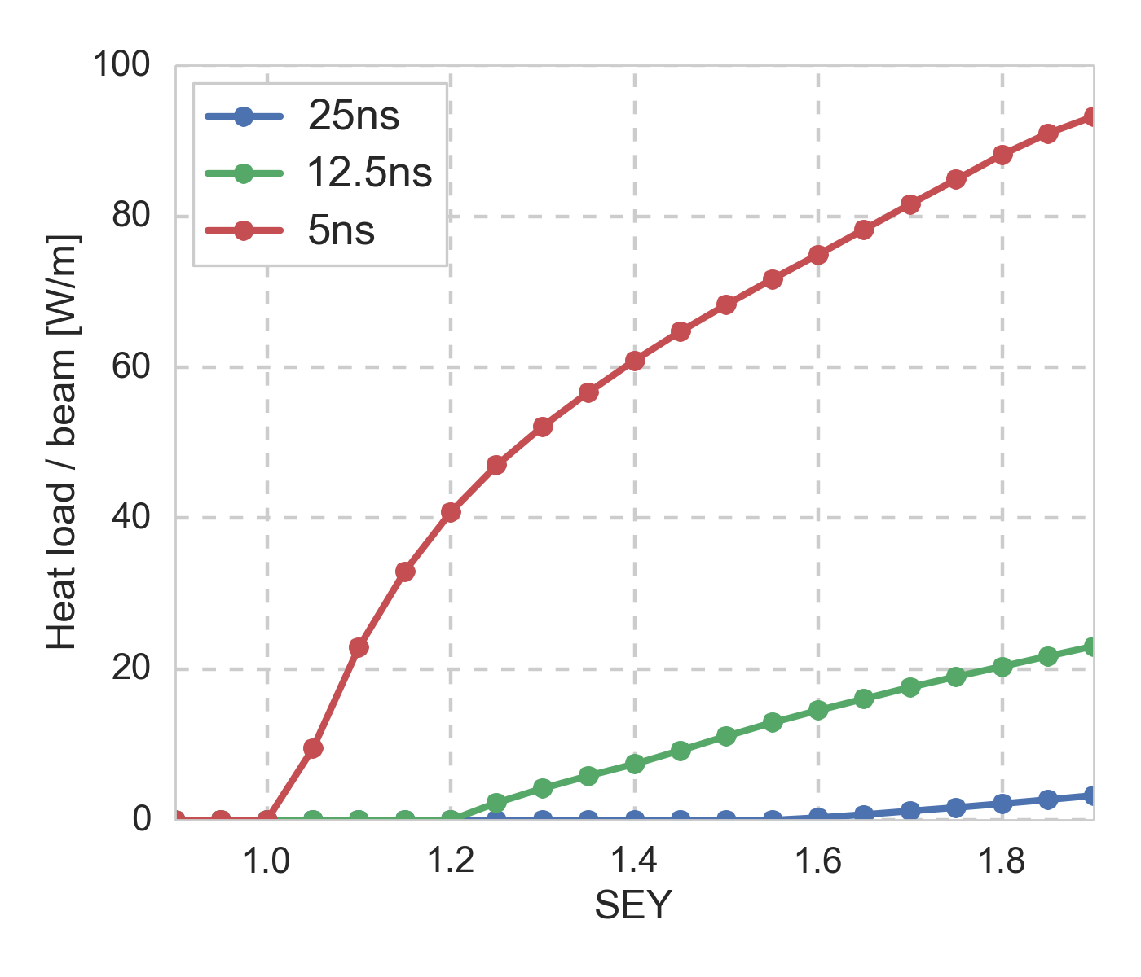
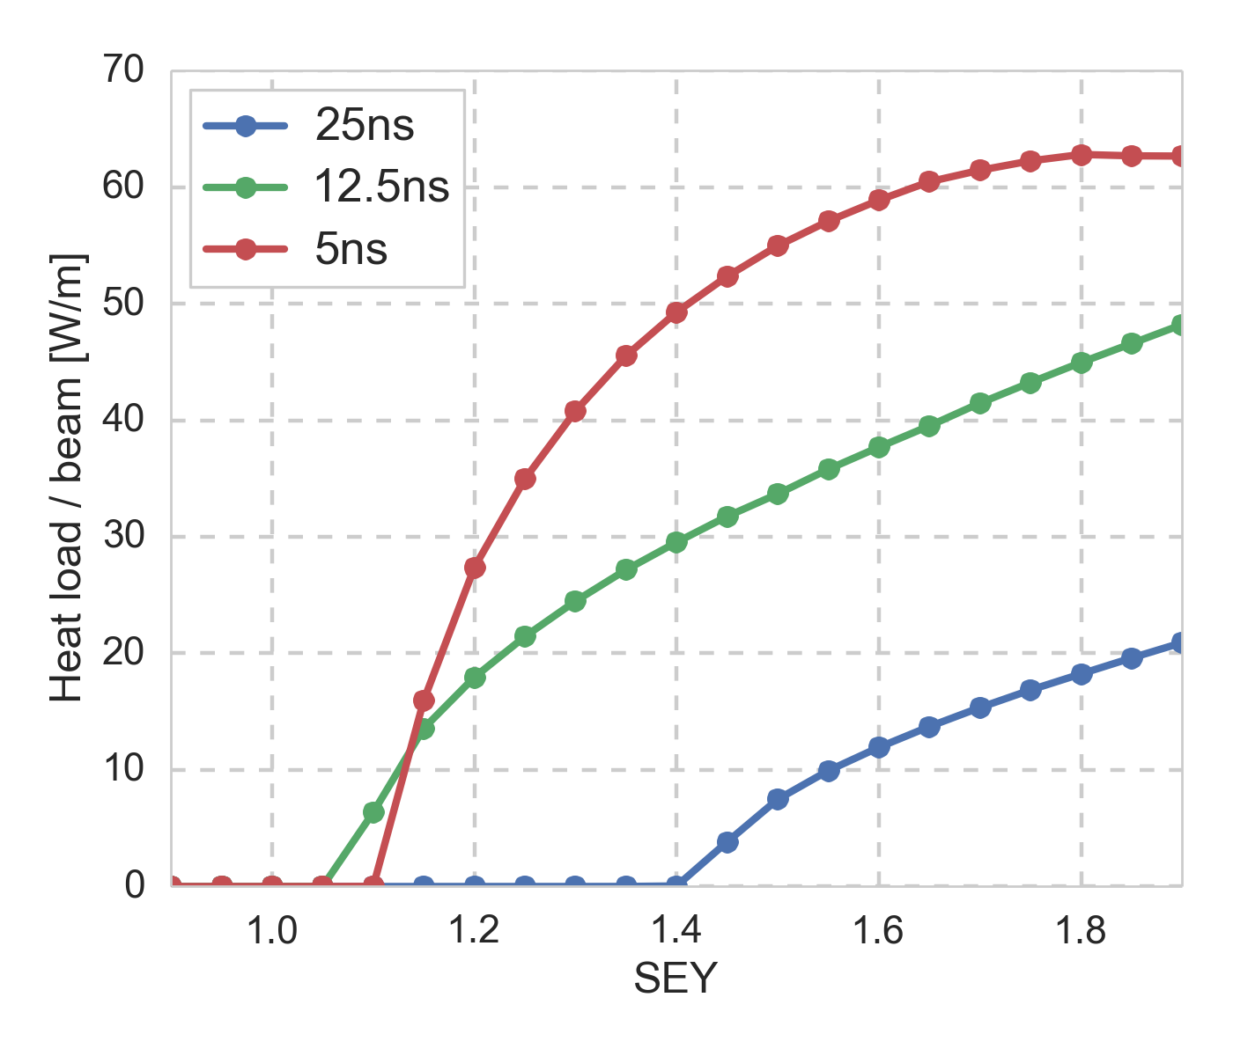
Heat load
The heat load must be within the cooling capacity of the cryogenic system
  The available cooling capacity is till to be defined
  For comparison, the load from synchrotron radiation is 4.6 W/m/beam
Dipole 1.3 TeV
Quadrupole 1.3 TeV
The heat load for the 5 ns beam is too high above SEY = 1.0
The heat load from the 12.5 ns beam should be manageable below SEY values around 1.3
The 25 ns beam has a relatively small heat load for SEY values below 1.4

Slide 7
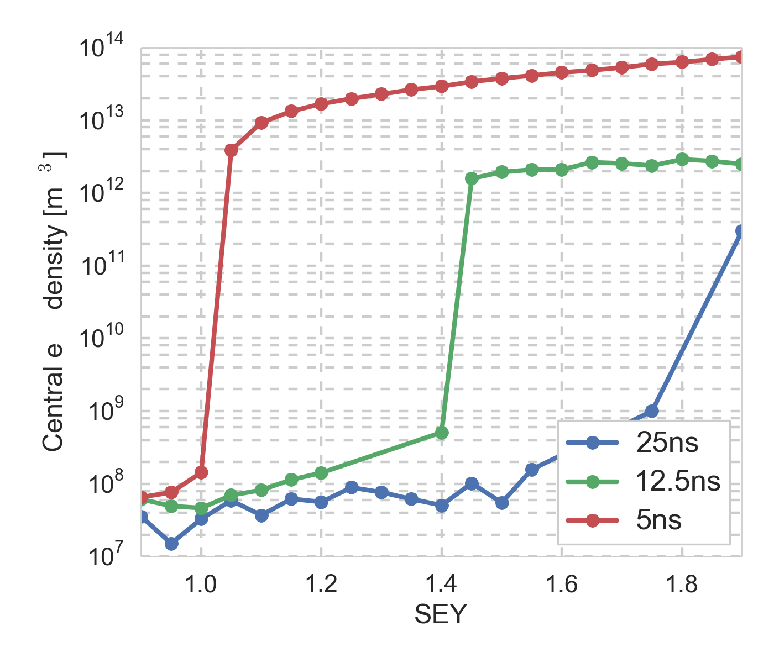
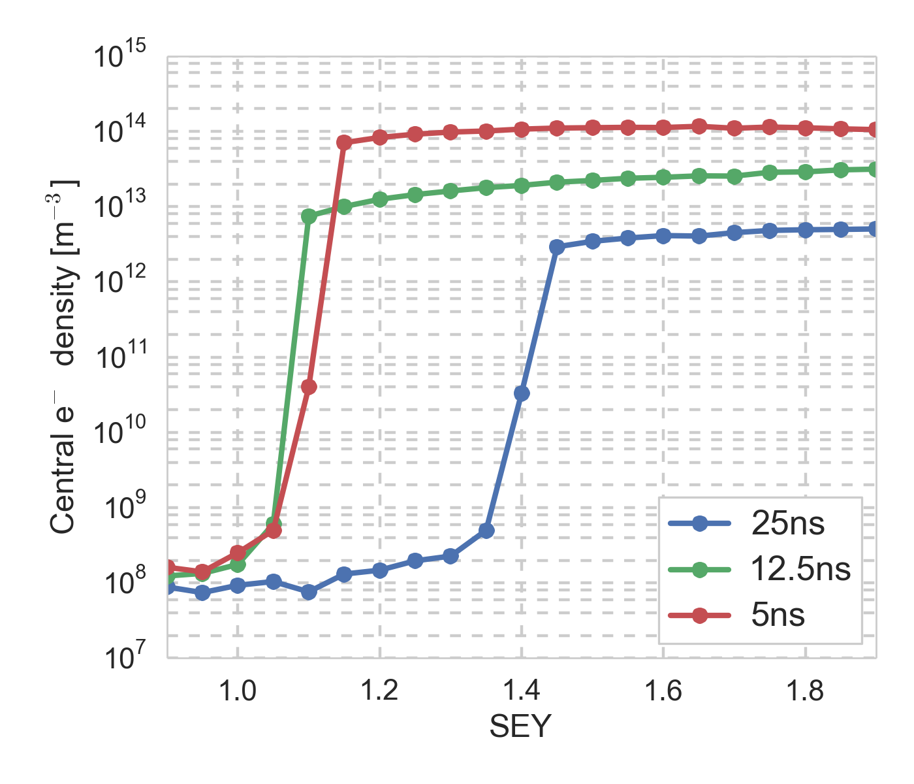
Single bunch instability
K. Ohmi
Analytical estimate of threshold electron density for instability
 | 450 GeV | 13.5 TeV
Analytic | 1.4 x 10¹¹ | 8.1 x 10¹¹
Simulation | 3 x 10¹¹ | 6 x 10¹²
with ,
25 ns beam not at risk of instability
12.5 ns beam at risk for SEY > 1.4
5 ns beam unstable for SEY > 1.0
To be scaled to fraction of length: ~10%
25 ns beam around threshold for SEY = 1.45
12.5 and 5 ns unstable already at low SEY
Dipole 1.3 TeV
Quadrupole 1.3 TeV

Slide 8
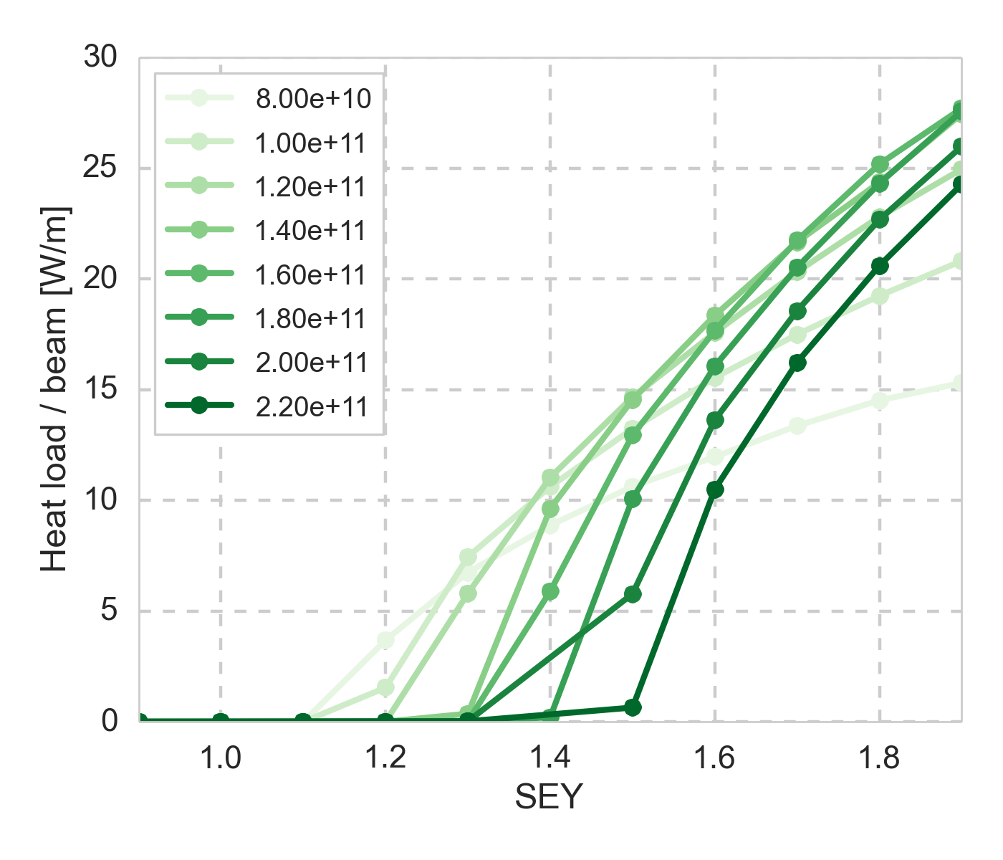
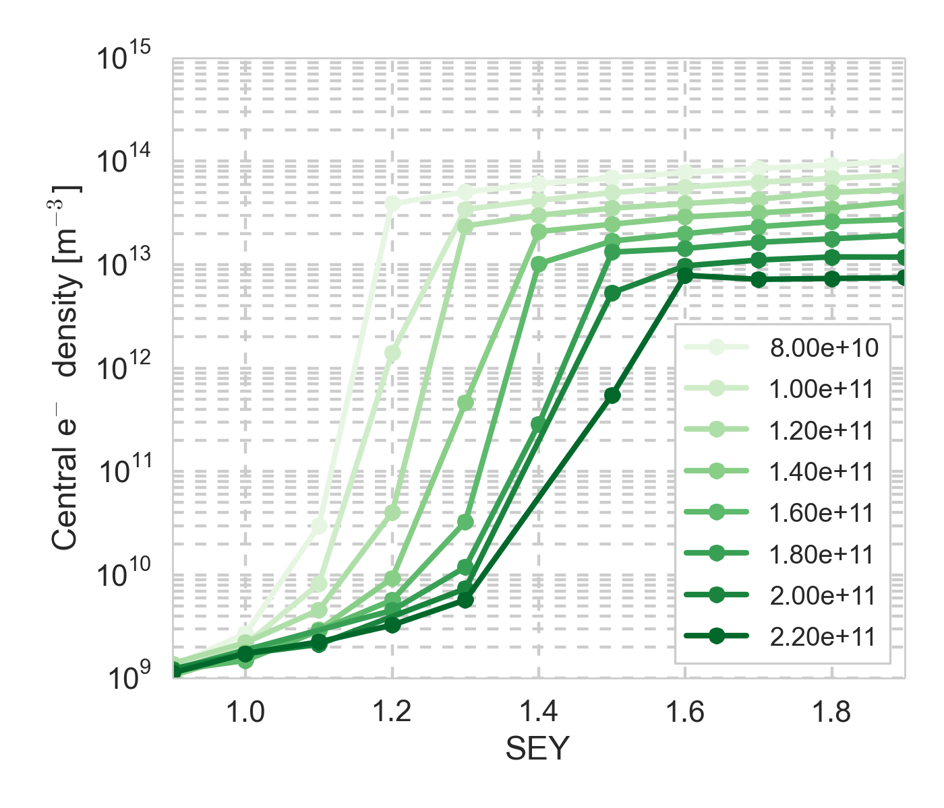
Evolution during fills
E-cloud effects don’t scale linearly with intensity
Some effects may get worse with the intensity burn-off during fills
Scan decreasing intensity and emittance in uniform steps shows effect for the 12.5 and 25 ns beams, in particular in the quadrupoles (also dipoles for 12.5 ns)
The multipacting threshold significantly decreases with decreasing intensity
For lower intensities, the 25 ns beam approaches the instability threshold
Quadrupole 13.5 TeV, 25 ns
Quadrupole 13.5 TeV, 25 ns

Slide 9
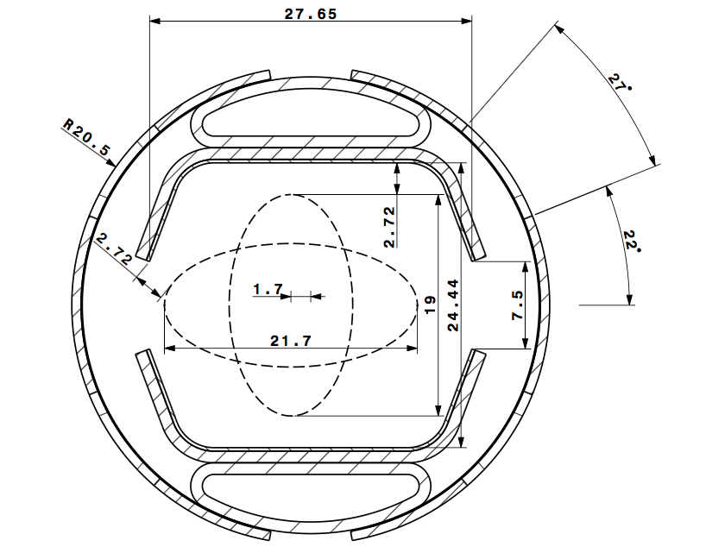
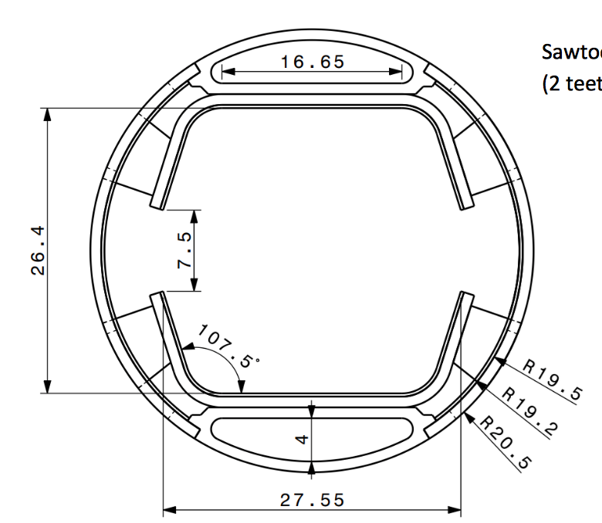
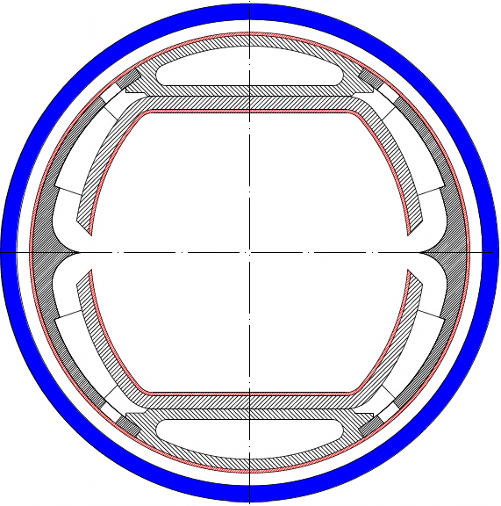
Effect of beam screen design
Evolution of beam screen design:
  2015 → 2017: straight edges, much larger slit, same vertical aperture
    Impact expected mainly in the drifts, due to the spatial restriction of the e-cloud in magnetic fields
  2017 → 2018 proposal: smaller vertical aperture (by 2 mm)
2015
2017
2018
2015
2017

Slide 10
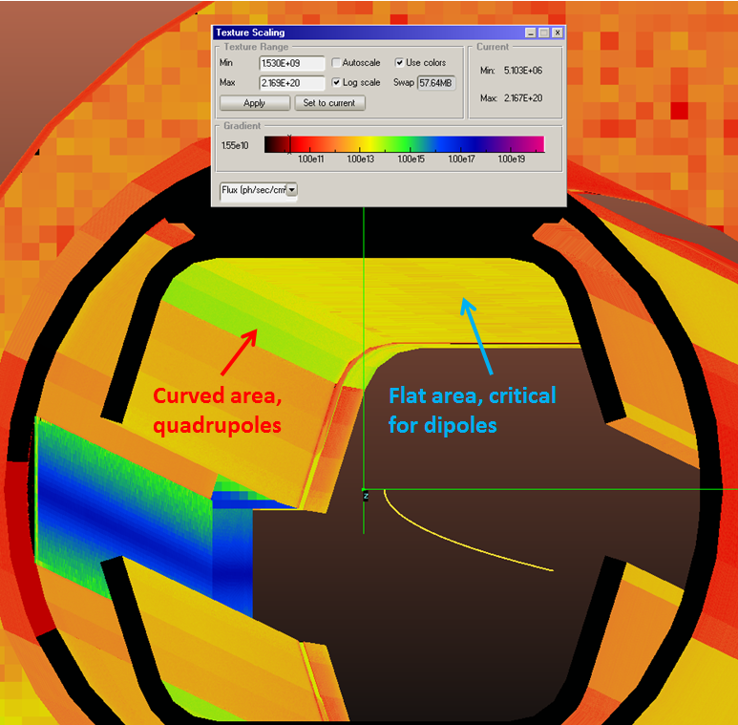
Photoelectrons
Previous studies with photoelectrons showed that they could raise the central density above the instability threshold even below the multipacting threshold, especially for the 12.5 and 5 ns beams
Constraints on the photoelectron flux were estimated and considered by the beam screen design team, which found the 2017 model with saw-tooth compatible
Photoelectron distributions based on ray-tracing
studies implemented in the build-up simulations to
confirm compatibility for a conservative estimate and
LASE surface (including effect of photoelectrons
at the saw-tooth surface)
  The new module with photoemission per chamber segment
  was used and shown to work, after a small bug-fix inverting
  the sign of the surface normal
Simulations are still on-going…
I. Bellafont

Slide 11
Effect of beam screen design
Equivalent simulations set up with the full geometry of the 2017 and 2018 chambers
Simulations in progress…
2015
2017
2018

Slide 12
Injection energy scan

