Slide 1


Electron cloud
L. Mether
I. Bellafont, G. Iadarola, R. Kersevan, K. Ohmi, G. Rumolo
Work supported by the Swiss State Secretariat for Education, Research and Innovation SERI

Slide 2
Outline
Introduction
Overview of previous results
New results
Summary of current results
Conclusions

Slide 3
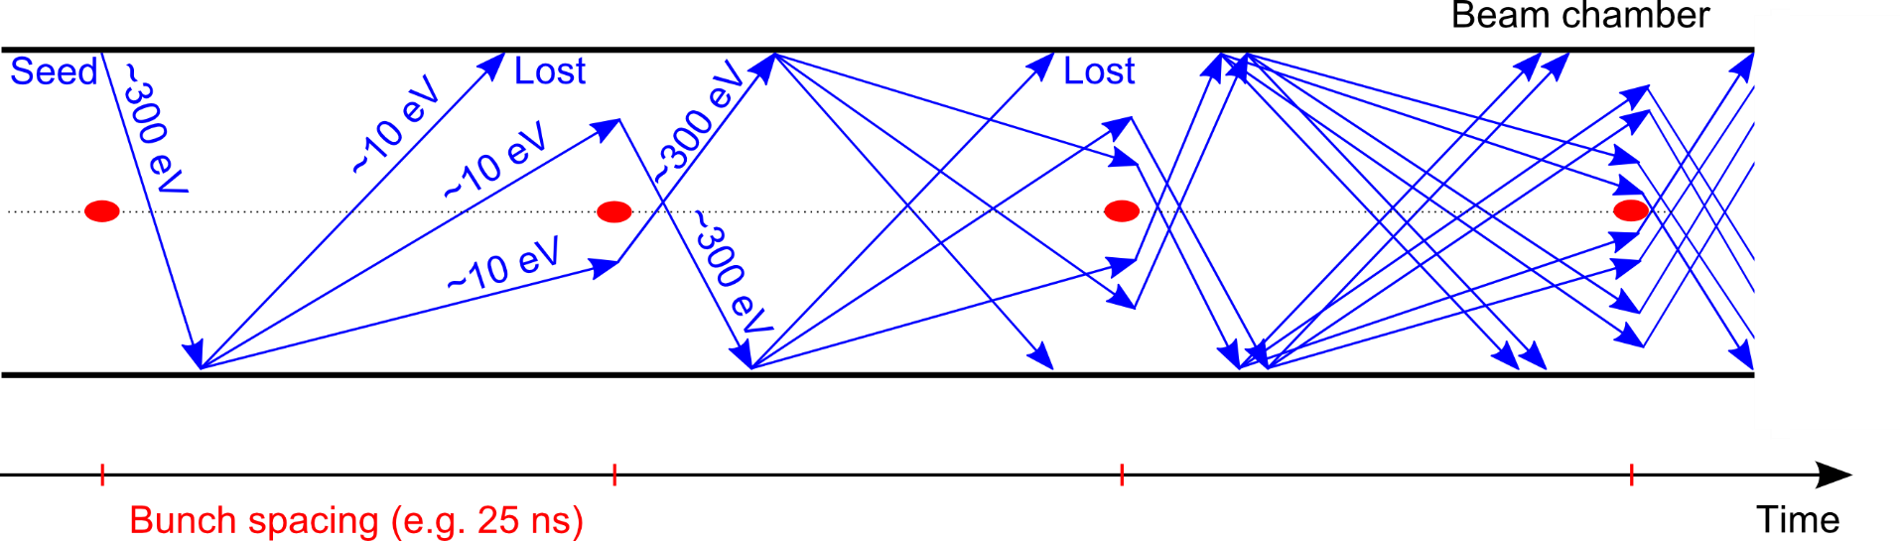
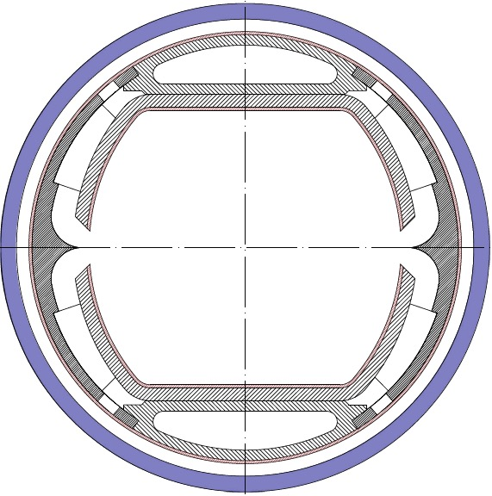
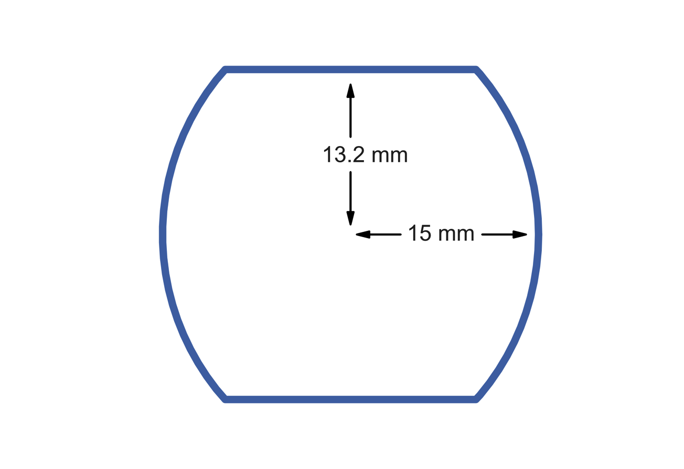
Introduction
Main concerns of electron cloud
Heat load and vacuum degradation due to electron flux on chamber wall
Transverse instabilities due to interaction between beam and electron cloud
Emittance growth, tune shift and spread, beam losses
Simulation studies
Electron cloud build-up for 25 ns, 12.5 ns and 5 ns beam:
Main chamber of beam screen (2015 version), Cu surface
Arc dipoles, quadrupoles, drifts
Effect of photoelectrons
Instability simulation studies
Beam screen geometry
Bunch train pattern and other updated parameters
Photoelectrons according to distribution from ray tracing

Slide 4
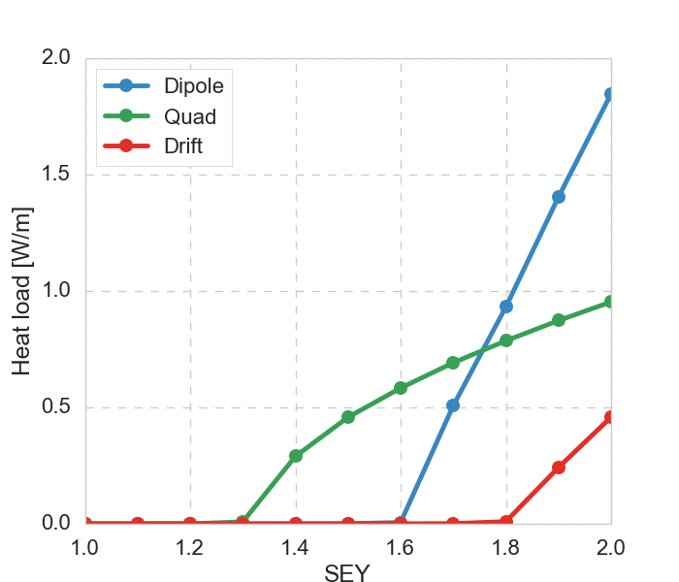
Electron cloud build-up
The multipacting thresholds, i.e. secondary emission yield (SEY) limits for electron cloud build-up, have been identified with build-up simulations
For 25 ns the thresholds are high enough that an
amorphous carbon coating can be used to suppress build-up
For alternative bunch spacings, especially 12.5 ns,
a lower SEY may be needed for full suppression
Heat loads are moderate compared to the synchrotron
radiation ~30 W/m
25 ns, 50 TeV
  Multipacting thresholds from build-up simulation
  (defined as highest SEY without build-up)
 | 25 ns |  | 12.5 ns |  | 5 ns
E [TeV] | 3.3 | 50 | 3.3 | 50 | 3.3 | 50
Dipole | 1.6 | 1.6 | 1.2 | 1.2 | 1.5 | 1.4
Quadrupole | 1.2 | 1.3 | 1.0 | 1.1 | 1.1 | 1.1
Drift | 1.8 | 1.8 | 1.2 | 1.2 | 1.5 | 1.4
Heat load scaled to device length in half-cell

Slide 5
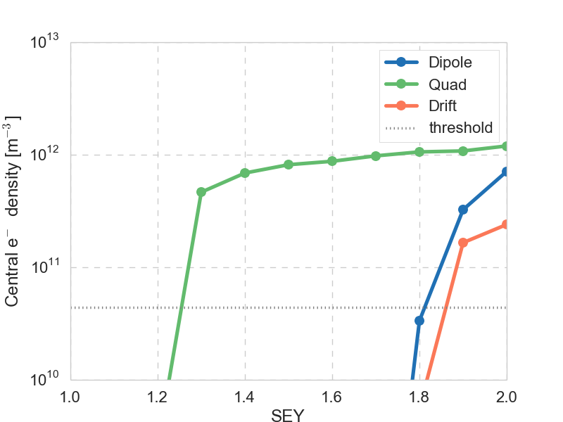
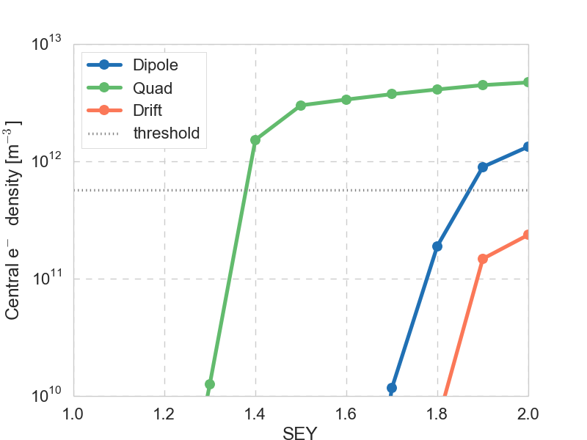
Single bunch instability
Analytical estimate of threshold electron density for instability
3.3 TeV | 50 TeV
6 x 10¹⁰ m⁻³ | 3.6 x 10¹¹ m⁻³
with ,
Instability threshold from simulations agree to factor 2-3 with analytical estimate
Above the multipacting threshold, central electron densities are above the instability threshold in almost all cases
→ need to keep SEY below multipacting threshold for stability
Central electron densities scaled to device length in half-cell
25 ns, 3.3 TeV
25 ns, 50 TeV

Slide 6
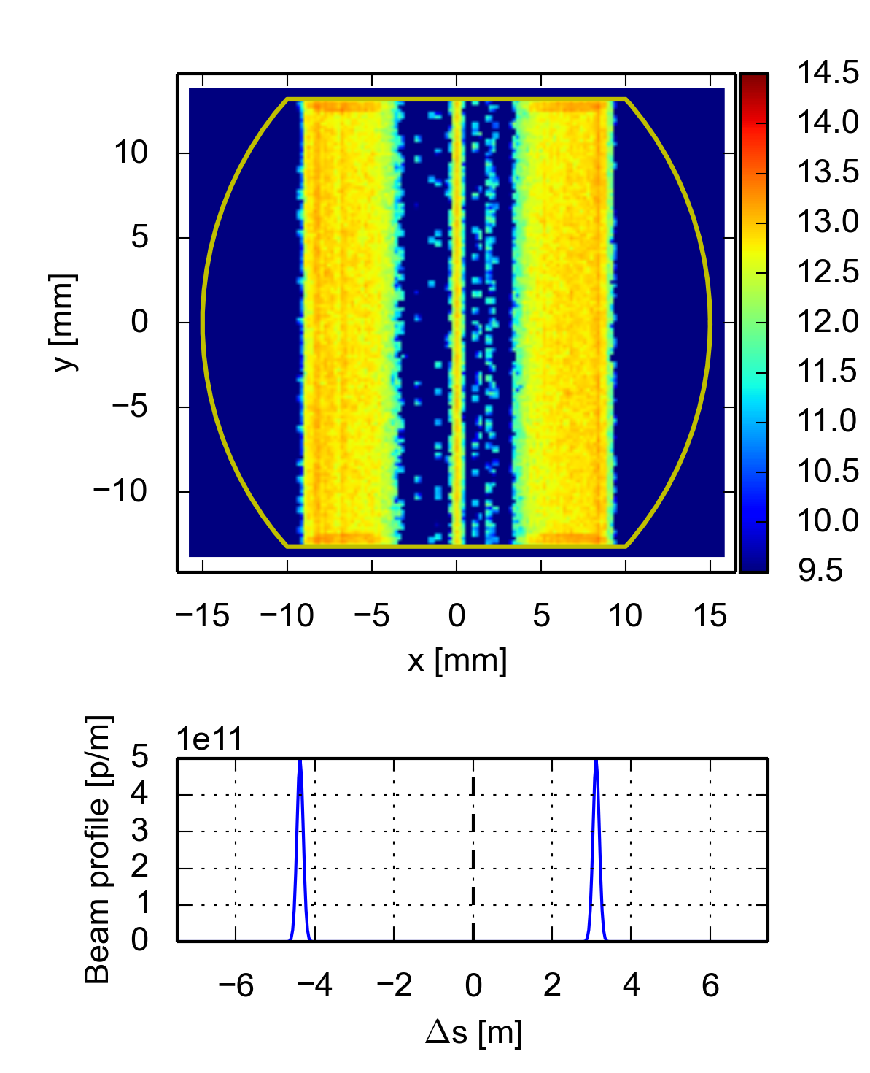
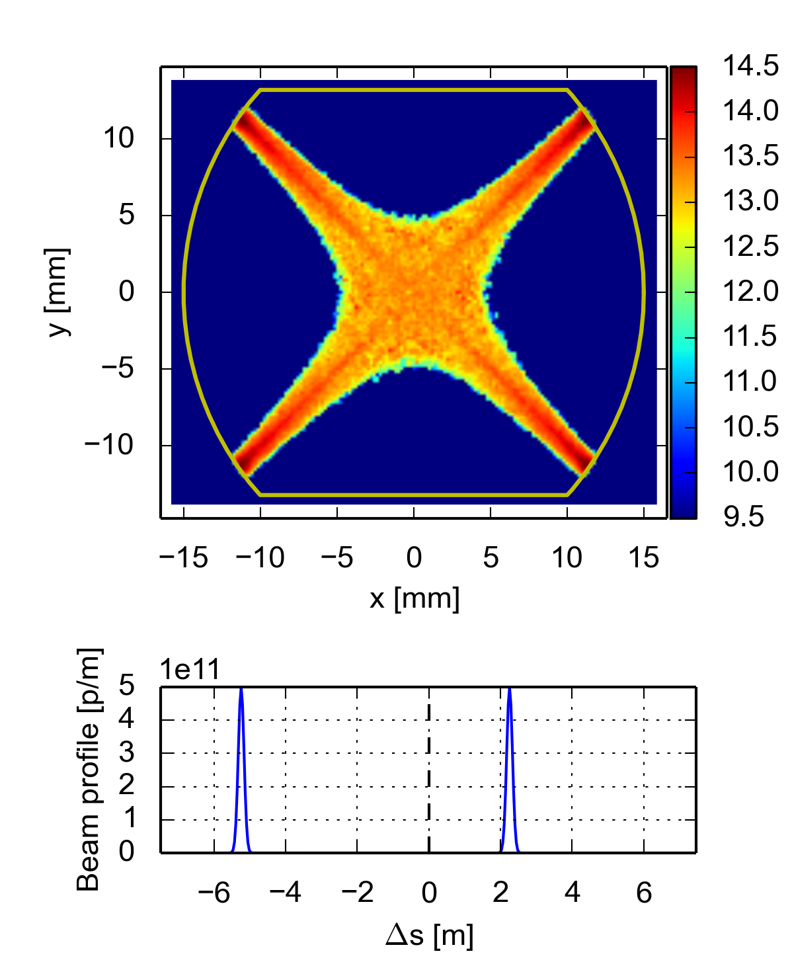
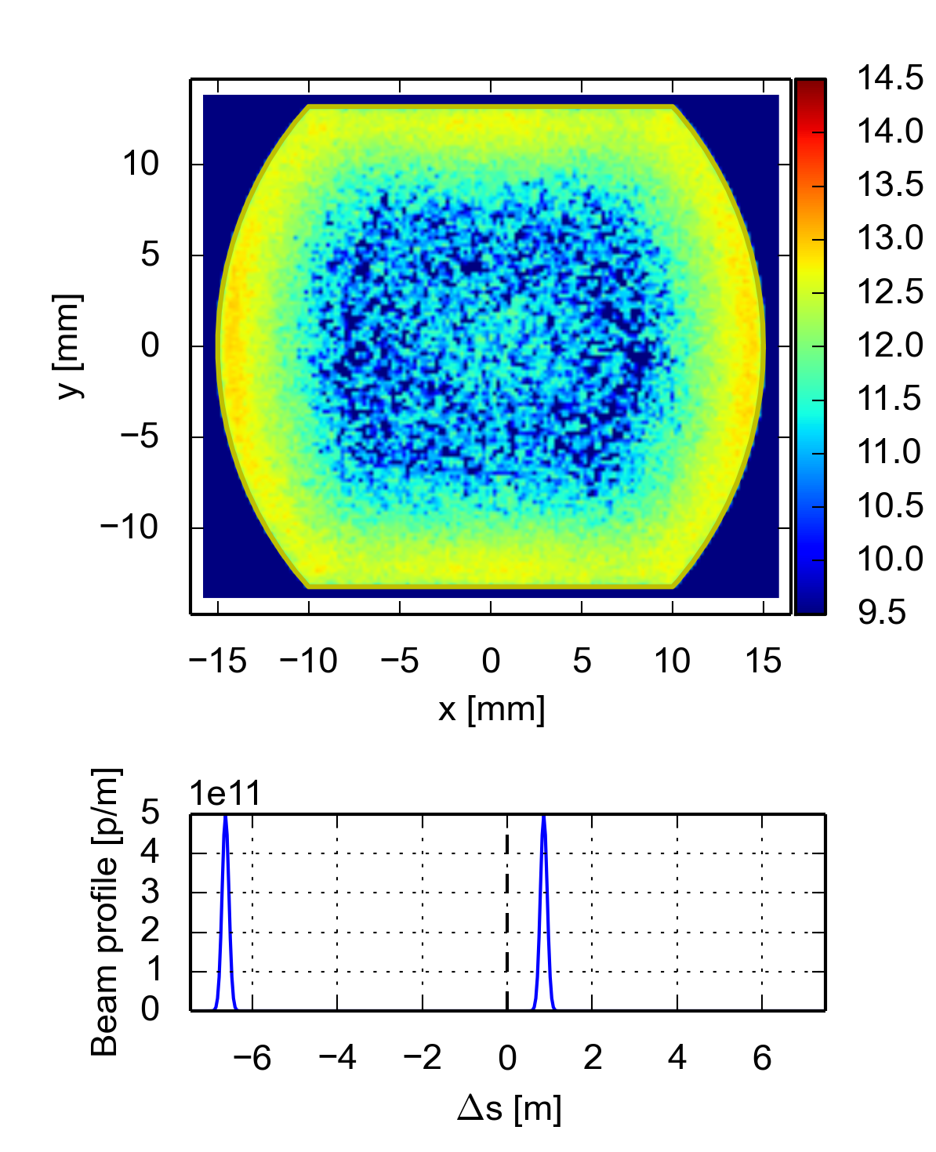
Cloud distribution
The cloud distributions have been identified to determine where beam screen coating is required
In dipoles the coating should cover the full top and bottom of the chamber
In quadrupoles coating is required at 45° to the horizontal plane
In drifts, multipacting can occur on all sides, with hot spots on along the horizontal and vertical axes.
  However the threshold is high: 1.8, so no dedicated coating may be necessary
  The effect of the slits not considered here
Dipole
Quadrupole
Drift

Slide 7
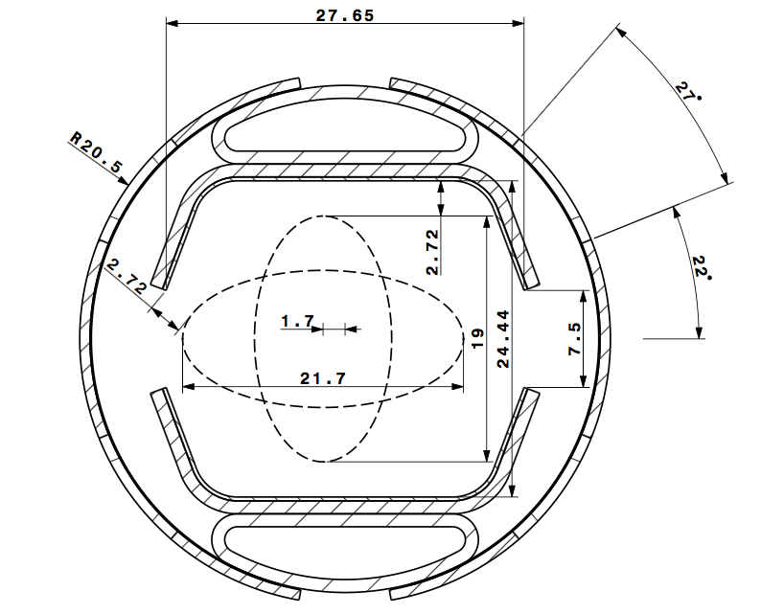
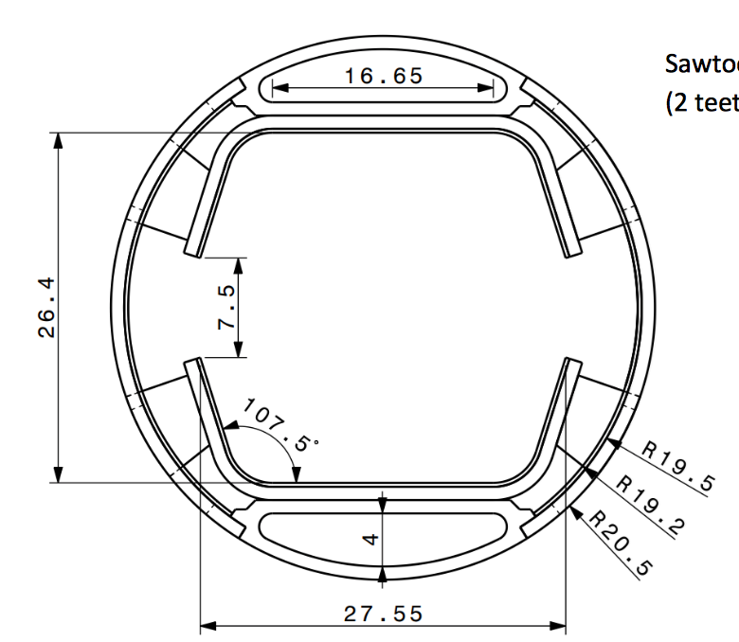
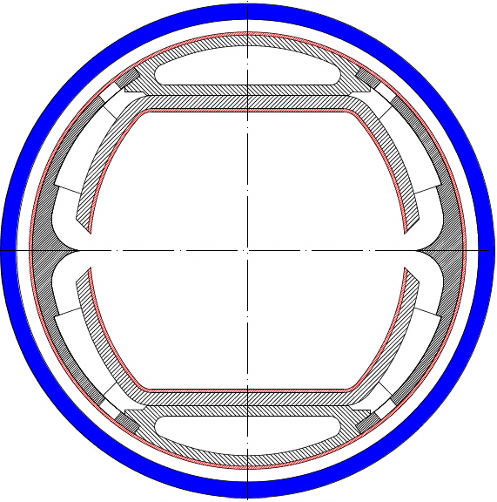
Effect of beam screen design
Evolution of beam screen design:
  2015 → 2017: straight edges, much larger slit, same vertical aperture
    Impact expected mainly in the drifts, due to the spatial restriction of the e-cloud in magnetic fields
  2017 → 2018 proposal: smaller vertical aperture (by 2 mm)
2015
2017
2018
2015
2017

Slide 8
Effect of beam screen design
Equivalent simulations set up with the full geometry of the 2017 and 2018 chambers
2015
2017
2018

Slide 9
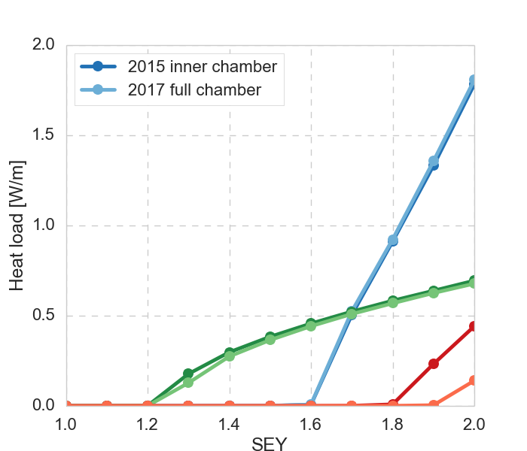
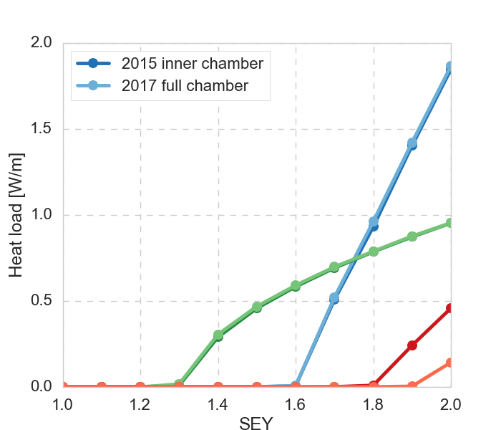
Effect of beam screen design
Equivalent simulations set up with the full geometry of the 2017 and 2018 chambers
The 2017 geometry pushes the threshold in the drift higher, no other significant effect
25 ns, 3.3 TeV
25 ns, 50 TeV

Slide 10
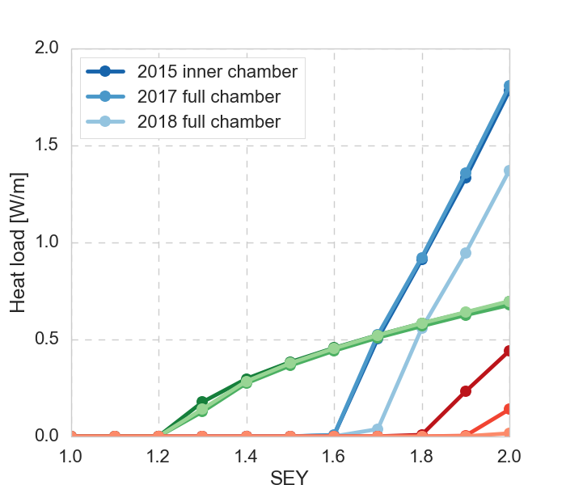
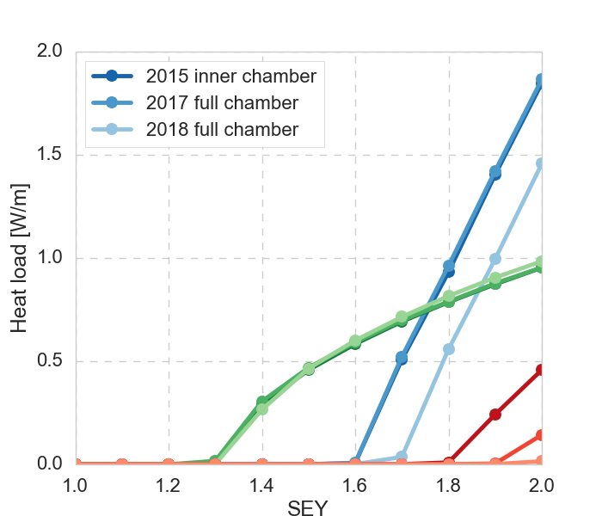
Effect of beam screen design
Equivalent simulations set up with the full geometry of the 2017 and 2018 chambers
The 2017 geometry pushes the threshold in the drift higher, no other significant effect
The 2018 proposed geometry increases the drift threshold further, and is slightly better in the dipole as well
25 ns, 3.3 TeV
25 ns, 50 TeV

Slide 11
Effect of beam screen design
Equivalent simulations set up with the full geometry of the 2017 and 2018 chambers
The 2017 geometry pushes the threshold in the drift higher, no other significant effect
The 2018 proposed geometry increases the drift threshold further, and is slightly better in the dipole as well
No sign of tendency for build-up in the ante-chamber, except in drifts
25 ns, 3.3 TeV
25 ns, 50 TeV

Slide 12
Updated bunch pattern
Previous simulations have been done for a bunch train pattern of 50 bunches + 12 empty slots (25 ns),
a more realistic train pattern based on injection considerations is 80 bunches + 17 empty slots

Slide 13
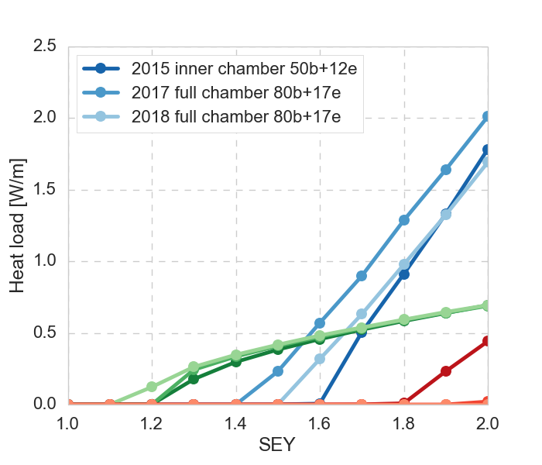
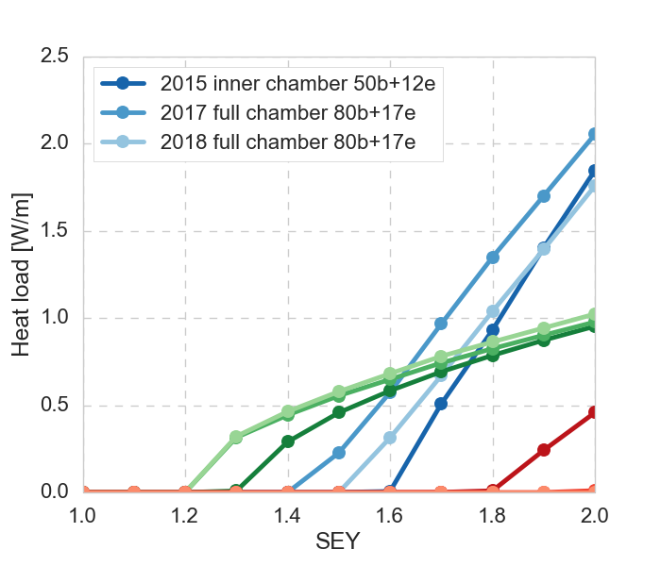
Updated bunch pattern
Previous simulations have been done for a bunch train pattern of 50 bunches + 12 empty slots (25 ns),
a more realistic train pattern based on injection considerations is 80 bunches + 17 empty slots
With the new bunch pattern the thresholds in the dipole and quadrupole are lowered
25 ns, 3.3 TeV
25 ns, 50 TeV

Slide 14
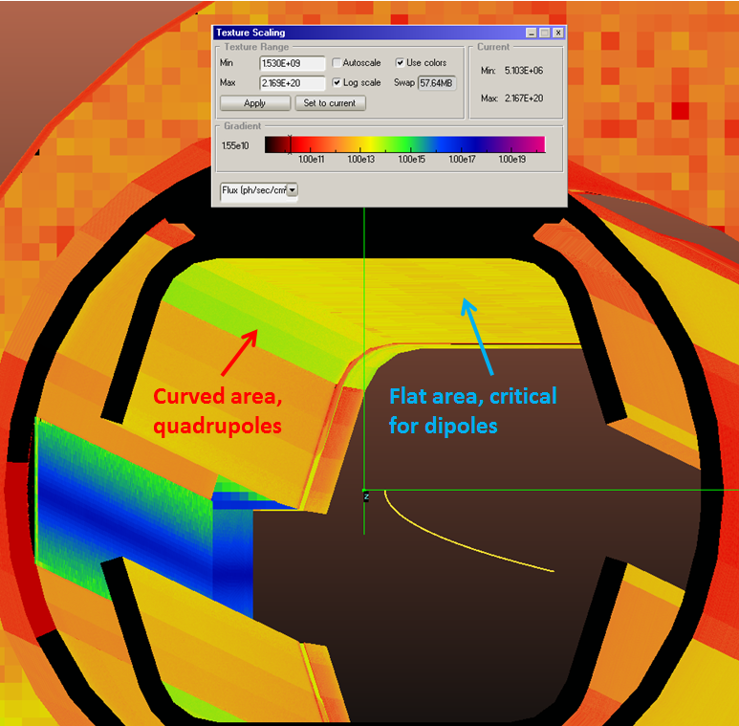
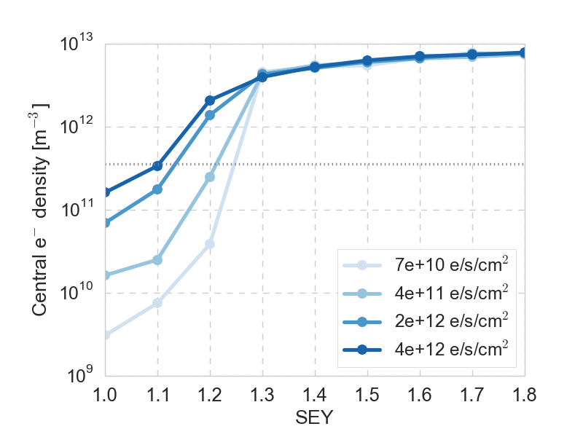
Photoelectrons
Previous studies with photoelectrons showed that they could raise the central density above the instability threshold even below the multipacting threshold, especially for the 12.5 and 5 ns beams
Constraints on the photoelectron flux were estimated and considered by the beam screen design team, which found the 2017 model with saw-tooth compatible
I. Bellafont
12.5 ns, 50 TeV
Dipole

Slide 15
Photoelectrons
Previous studies with photoelectrons showed that they could raise the central density above the instability threshold even below the multipacting threshold, especially for the 12.5 and 5 ns beams
Constraints on the photoelectron flux were estimated and considered by the beam screen design team, which found the 2017 model with saw-tooth compatible
Photoelectron distributions based on ray-tracing
studies implemented in the build-up simulations to
confirm compatibility for a conservative estimate and
LASE surface (including effect of photoelectrons
at the saw-tooth surface)
  The new module with photoemission per chamber segment
  was used and shown to work, after a small bug-fix inverting
  the sign of the surface normal
Simulations are still on-going…
I. Bellafont

Slide 16
Summary & conclusions
Multipacting thresholds with new chamber, filling pattern etc.
An amorphous carbon coating should still be sufficient to suppress build-up for the 25 ns beam
  Coating in dipoles and quadrupoles, should not be necessary in drifts
For the alternative beams, the situation is somewhat tighter than before
  SEY ~1 needed for full suppression,
  Coating may be necessary also in field free regions
  Multipacting thresholds from build-up simulation with 2017/2018 chamber
  (defined as highest SEY without build-up)
 | 25 ns |  | 12.5 ns |  | 5 ns
E [TeV] | 3.3 | 50 | 3.3 | 50 | 3.3 | 50
Dipole | 1.4/1.5 | 1.4/1.5 | 1.1 | 1.1 | 1.5 | 1.5
Quadrupole | 1.2/1.1 | 1.2 | 1.0 | 1.0 | 1.1 | 1.0
Drift | 2.0 | 2.0 | 1.3 | 1.3 | 1.6 | 1.6

