Slide 1
SAHA-S Equation of State
Present state and recent results
V.A.Baturin*, A.V.Oreshina, S.V.Ayukov, V.K.Gryaznov
Sternberg Astronomical Institute, Lomonosov Moscow State University

Slide 2
SAHA-S EOS (20 years story)
Authors:
V.K.Gryaznov, Institute of Problems of Chemical Physics RAS, Chernogolovka, Russia;
I.L.Iosilievskiy, Moscow Institute of Physics and Technology, Dolgoprudnyi, Russia;
A.N.Starostin, Troitsk Institute for Innovation and Fusion Research, Troitsk, Russia;
V.E.Fortov, Institute of Problems of Chemical Physics RAS, Chernogolovka, Russia;
References:
V.K.Gryaznov et al., J. Phys. A: Math. Gen. 39 (2006) p. 4459
S.V.Ayukov et al., JETP Letters, Vol. 80, No. 3, (2004) p. 141
V.K.Gryaznov et al. in «Equation-of-State and Phase-Transition Issues in Models of Ordinary Astrophysical Matter», Eds. V.Celebonovic, W.Dappen, D.Gough, AIP Conference Proceedings v. 731, (2004) p.147, and several papers ibid.
Availability of basic tables:
Basic tables of SAHA-S EOS are available via http://crydee.sai.msu.ru/SAHA-S_EOS

Slide 3
Thermodynamics of solar plasma SAHA-S
A⁺
e
A⁺
Equilibrium composition between
145 species:
{e, H, H⁺, ..., He, He+, He⁺²,
C, C+, …, N, N+,…, O, O+, …, Ne, Ne+, …},
Elements (H He C N O Ne Si Fe Mg S) and all ions and selected molecules
A⁺⁺
A ↔ A⁺ + e
A
Ze
r_{c}
A⁺⁺
 Coulomb interaction:
Debye approximation
in Grand canonical ensemble
 Partition functions:
Modification of Planck-Larkin partition
function (A.Starostin, 2002-2004 [1])

Slide 4
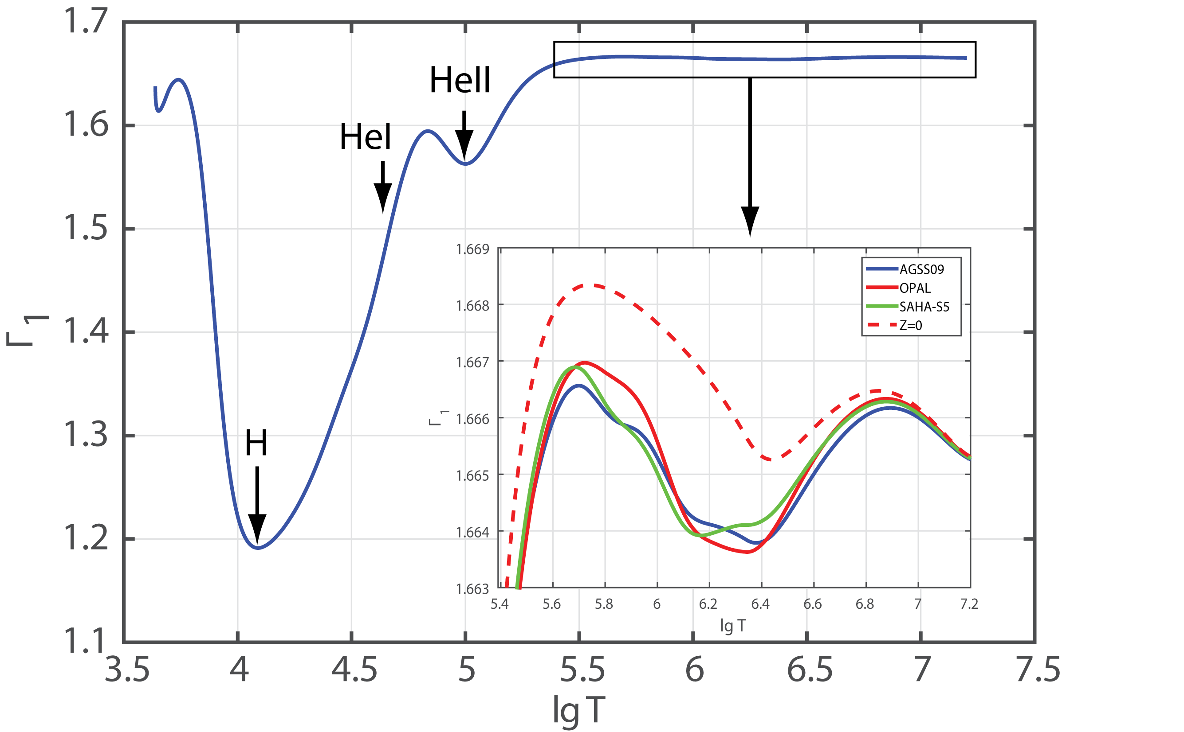
Г₁ profile in solar interior

Slide 5
Effect of excited states of atom modelled with the partition function.
Planck-Larkin
Starostin-Roerich

Slide 6
Methodical remarks
(1) Using the PL-partition function in physical picture has a specific context and appeared in the term, which proportional to the product of activities of proton and electron. And in a general case, it is not possible to compare directly this term to one in chemical picture. As result, using PL and the other type of partition functions as effective statistical weights in chemical picture is not well justified.
(2) There are two limits where physical and chemical picture may be equivalently compared. First one is plasma without the Coulomb interaction between free classical charges. The second limit is the fully ionized plasma. Both cases look not very appropriate for a real system, but they may be found at solar conditions in some approximation.
(3) Strictly speaking, the partition function was obtained for hydrogen only. There are reasons to extend this result to hydrogen-like ion. But even for helium atom, theoretical basis for usage of such function is rather weak.

Slide 7
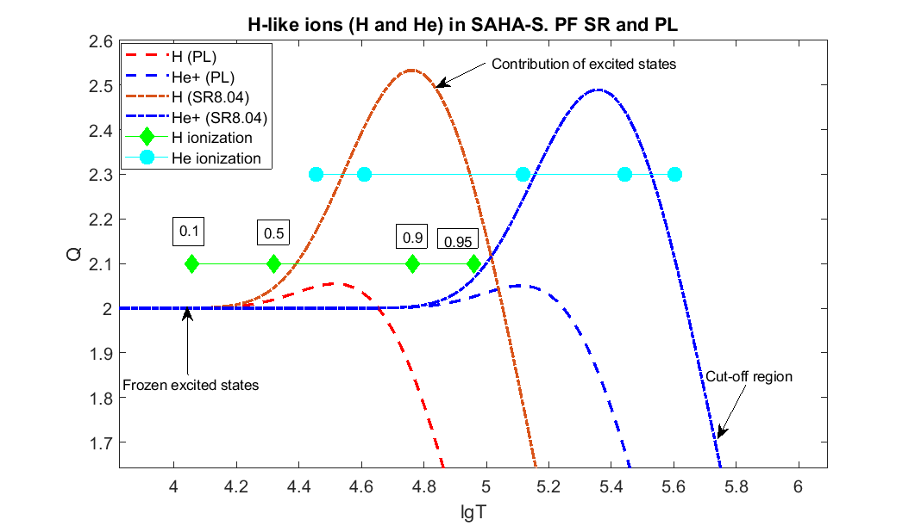

Slide 8
Current conclusions.
- SR-function is always larger than PL-function. In the region where lgT=5, the SR predicts 20% excess of the statistical weight due to the contribution of excited states in compare to the case of ground state only.
- Ionization equilibrium in SR case is shifted towards neutrals and the same degree of ionization is moved to higher temperature.
- The SR-partition function model applies to all composite particles. On the figure the Q-profile for He+ are shown. Our general suggestion is that the partition function should be the same for hydrogen-like ions.

Slide 9
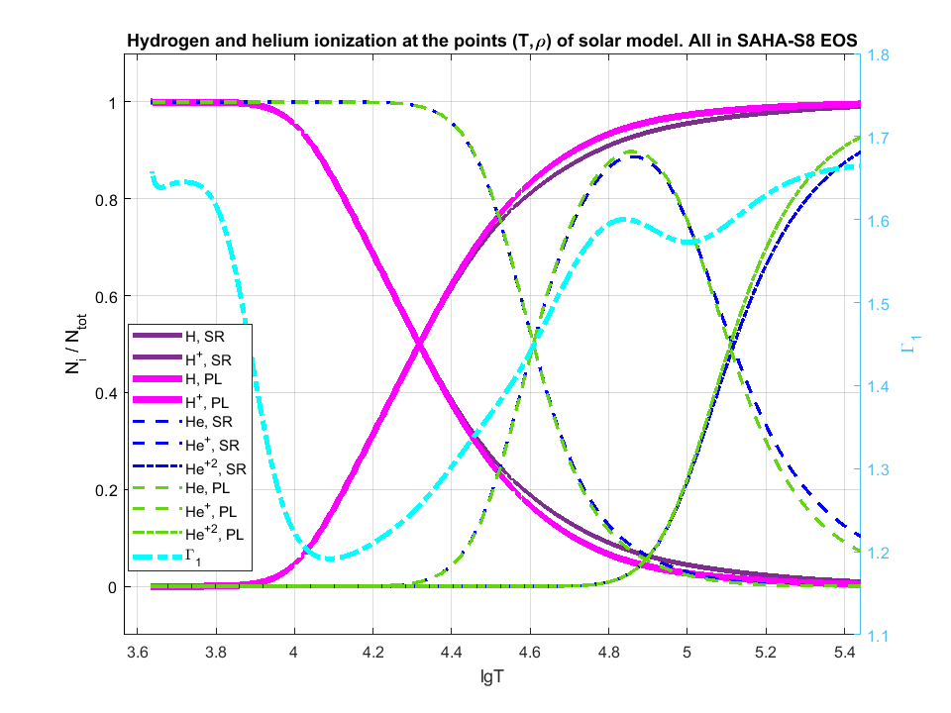

Slide 10
Current conclusions.
- Ionization is shifted towards higher temperature in SR-case in comparison with PL-case. It is a systematic effect with the same sign at all temperatures.
- This ionization shift is most prominent when ionization degree exceeds 1/2.
- The region of the most correction to hydrogen ionization matches to the helium ionization hump.

Slide 11
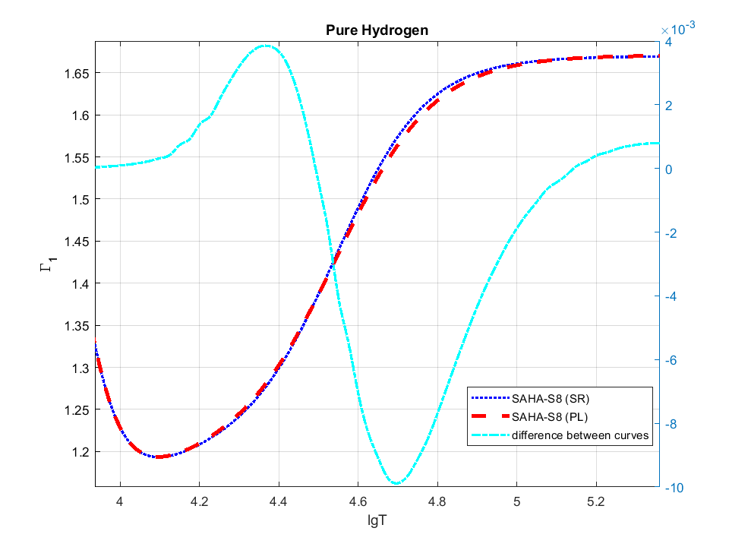

Slide 12
Current conclusions.
- Г1- profile for pure hydrogen in the PL-case appears to be shifted toward higher temperature at the lgT=5.0
- Amplitude of the difference is as large as 1e-2.
- The same effect of Г1-disturbance appears for all H-like ionizations.

Slide 13
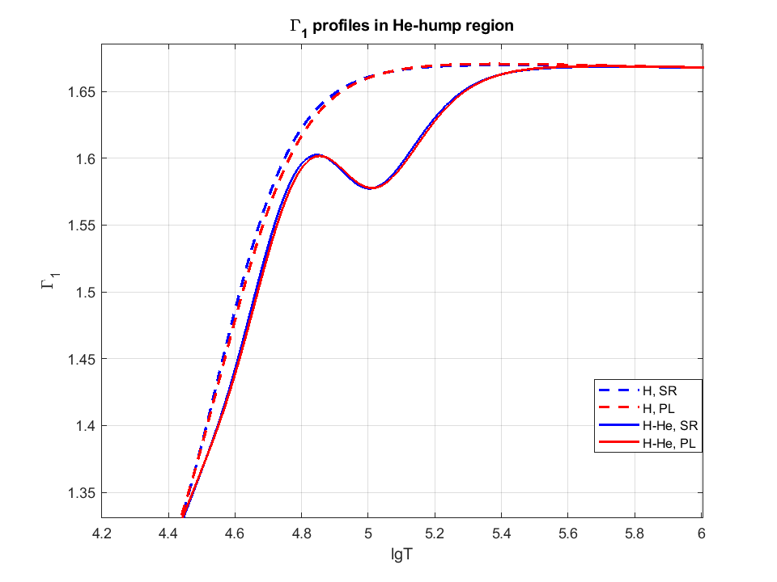

Slide 14
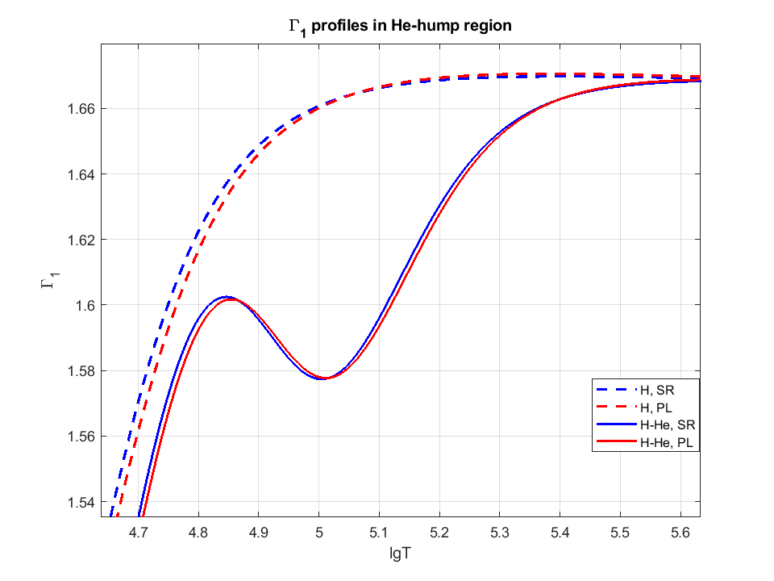

Slide 15
Conclusions.
- The positions of the helium hump in the models with different partition functions demonstrate the remarkable shift towards higher temperature in the PL-case. The shape of the He-hump is similar in both cases.
- It does not mean that helium ionization takes place lately in PL-case. Instead, the ionization degree curves show an inverse shift. The shift is explained by the similar effective shift of the pure hydrogen Г1-profile.
- The Г1-disturbance due to excited states contributions can hardly be ignored in the helioseismic inversion. The shift of such amplitude may lead to change of helium content measurement by 5%!
- Combinatorial interference of H-He effect gives us a chance to study the role of excited states in the solar plasma.

Slide 16
II. Coulomb correction in SAHA-S in comparison with classic DH-correction.

Slide 17
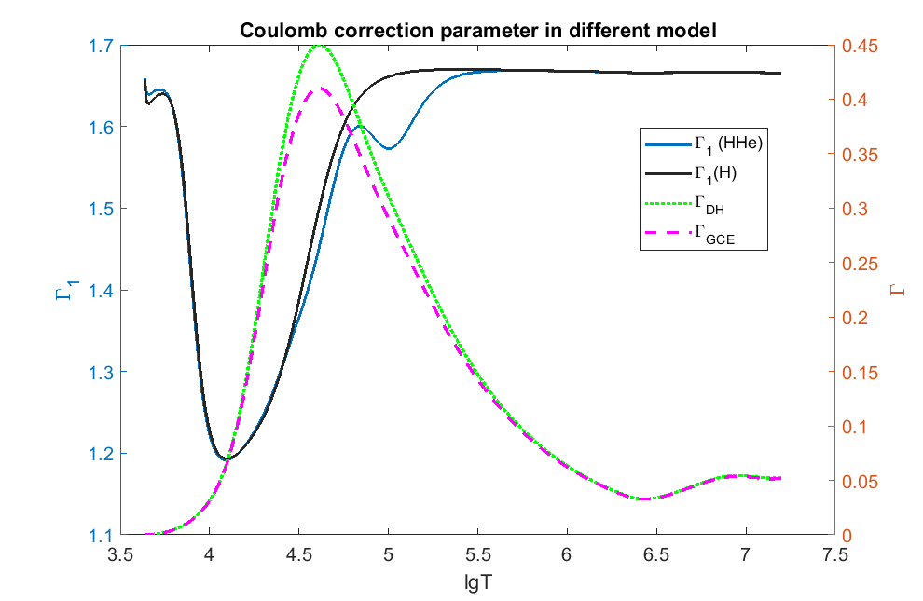

Slide 18
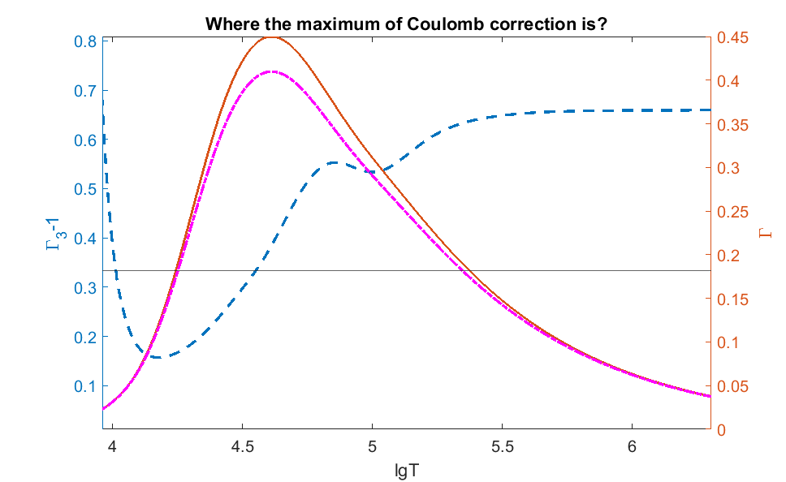

Slide 19
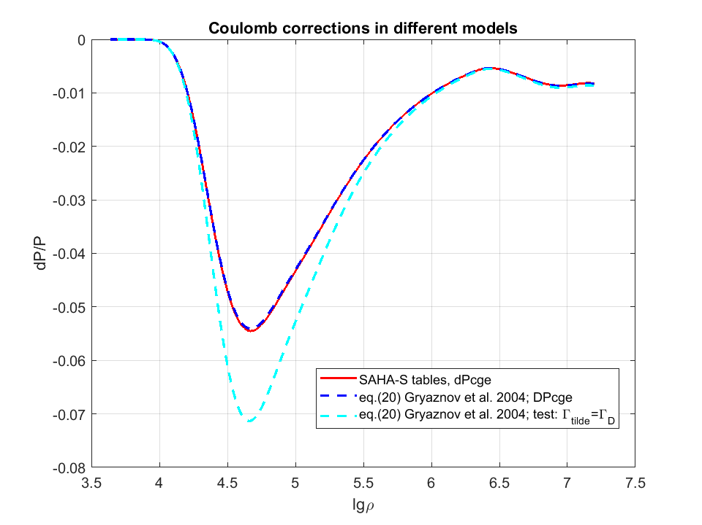

Slide 20
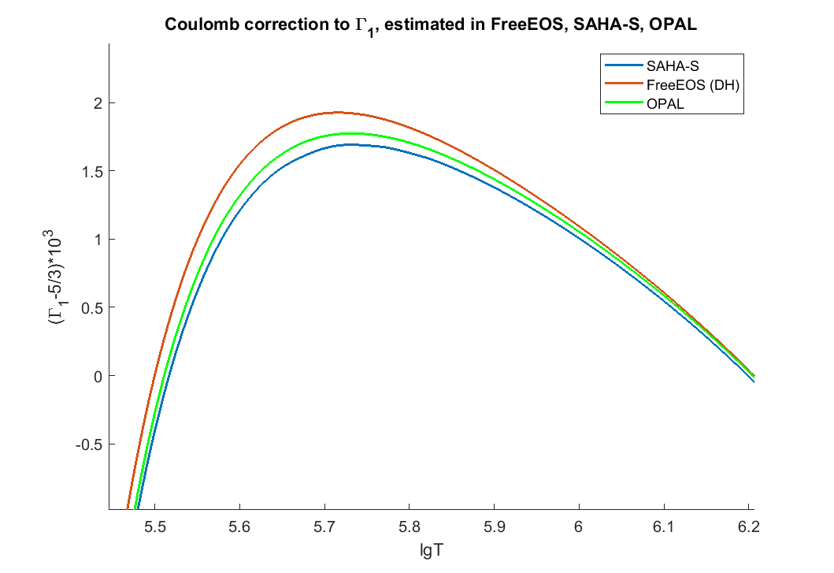

Slide 21
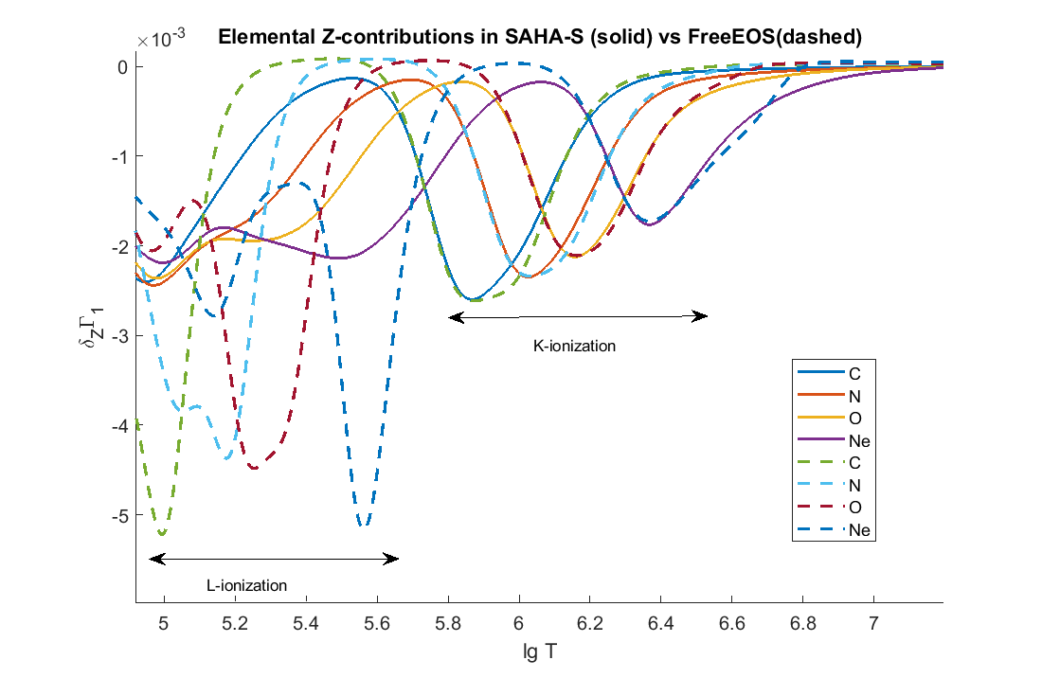

Slide 22
General conclusions:
A. Effect of excited states could disturb Г1 in pure hydrogen by 1e-2. It has magnified effect on position of He-hump.
B. Coulomb correction in GCE model decrease Г1 by 3e-4 in comparison with classic DH correction. This decrease brings it close to OPAL calculation with 1e-4 accuracy. All estimations are made at maximum of Г1.
C. Accuracy of theoretical Г1 in the deep adiabatic part is better than 5e-5.

Slide 23
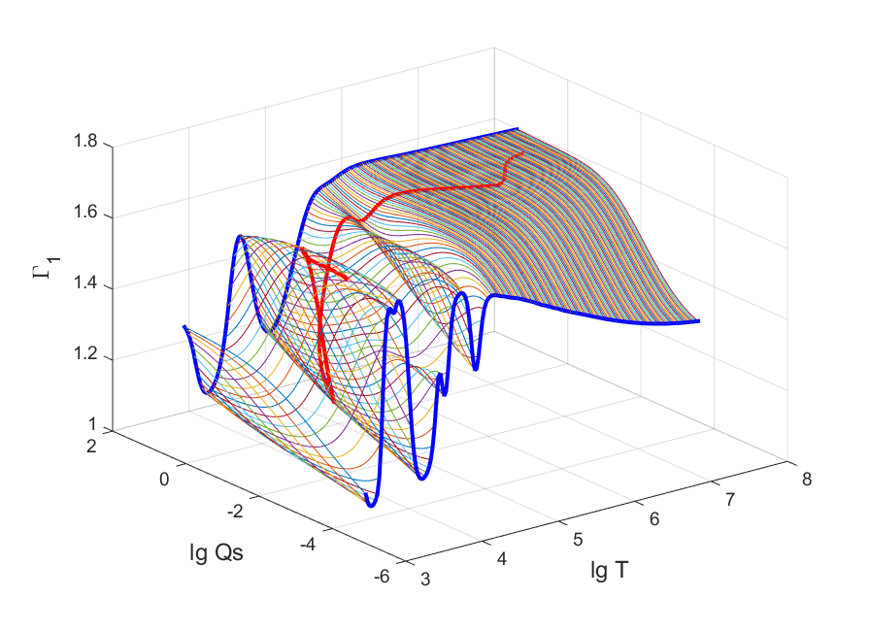
Thank you for your attention!!!
Object for meditation and contemplation

