Slide 1
Importance of the Sun for the other stars
Georges Meynet
Geneva Observatory, University of Geneva
Credit: NASA and the Night Sky Network

Slide 2
Importance of the Sun for the other stars
For testing stellar physics
Magnetic breaking
Stellar dynamo
Physics of convection
The chemical modes
Physics of opacity
Physics of rotation
Physics of neutrinos
Physics of tides
Spectroscopic Diagnoses
……..
For setting the zero point of the metallicity scale
For exploring new frontiers
habitability (space weather,…)
Fontiers in physics
A solar type star with a black hole
Lorenzo-Oliveira et al. 2018; 2019
Charbonneau and Sokolov 2023
Scardigli et al. 2021; Zhang et al. 2022
Tucci Maia et al. 2015; Carlos et al. 2019; Boesgard et al. 2022
Buldgen and Eggenberger 2022
Eggenberger et al. 2022
Gann et al. 2021
Terquem 2021
Gouttebroze and Leibacher 1980; Dupree 2021
Przybilla et al. 2015;
Lichtenberger et al. 2015; Botelho et al. 2019; Forbes et al. 2021:
Salmon et al. 2021; Murphy et al. 2022
El Badry et al. 2023;

Slide 3
TO TEST STELLAR PHYSICS
THE CHEMICAL MODES
Lithium and beryllium are fragile
destroyed at temperatures of about
2.5 10⁶ K and 3.5 10⁶ K, respectively (through α and proton captures).

Slide 4
77 solar twins + the Sun (6707.75 A Li I line)
Strong correlation between
Li-depletion and age
Sun has the lowest Li abundance
In comparison with solar twins at
Similar age
Most Li depleted stars have fewer
refractory elements
SUN
Carlos et al. MNRAS 2019
Notes:
fewerThis work aims to examine in detail the depletion of lithium in solar twins to better constrain
stellar evolution models and investigate its possible connection with exoplanets.
1) Strong correlation between Li depletion and stellar age.
2) In addition, for the first time we
show that the Sun has the lowest Li abundance in comparison with solar twins at similar age
(4.6°æ0.5 Gyr).
3) We compare the lithium content with the condensation temperature slope for a
subsample of the best solar twins and determine that the most lithium-depleted stars also have
fewer refractory elements.
We speculate whether the low lithium content in the Sun might be
related to the particular configuration of our Solar system.
We measured high-precision lithium abundances (median error of
0.036 dex) for a sample of 77 solar twins with high resolution and
high signal-to-noise spectra from the HARPS spectrograph.
We confirm previous results showing the strong connection
between lithium depletion and stellar ages and also identified a
steeper Li depletion with stellar age for young solar twins (Age
2.0 Gyr).
Three of the four outliers in this work can be explained when
considering the respective masses of their convective envelopes.
It seems that there is no significant difference in lithium depletion
between known planet host stars and stars with no planets detected,
when we analyse the lithium depletion and stellar age correlation.
The same behaviour is found for visual and spectral binaries in
comparison with single field stars.
We found that the Sun can be considered a lithium-poor star in
comparison with other solar twins at similar age (by a factor of
∼2σ). Also, our data suggest that stars with the lowest Li abundances
are accompanied by a lower level of refractory elements.
This could be explained by the presence of rocky planets and the
unique architecture of the Solar system.

Slide 5
stars within ±0.02 of 1M_{sun}.
Tucci-Maia et al. 2015
Boesgard et al. 2022

Slide 6
TO TEST STELLAR PHYSICS
ACTIVITY AND MAGNETIC BRAKING

Slide 7
SUN
SUN
Lorenzo-Oliveira et al. 2019
Lorenzo-Oliveira et al. 2018

Slide 8
TO PROBE STELLAR PHYSICS
FROM SOLAR SPECTROSCOPY
TO MASSIVE STAR SPECTROSCOPY

Slide 9
Evolution of the V to R peak og Mg II K line
Betelgeuse
Sun
R
V
Gouttebroze and Leibacher 1980
Dupree 2021

Slide 10
VLT images
Credit: ESO/M. Montargès et al.
Notes:
Two images of Betelgeuse captured by the Very Large Telescope. Left shows the view in January 2019 and right shows the view in December 2019, revealing the star’s change in brightness over time. Credit: Credit: ESO/M. Montargès et al.
These images, taken with the SPHERE instrument on ESO's Very Large Telescope, show the surface of the red supergiant star Betelgeuse during its unprecedented dimming, which happened in late 2019 and early 2020. The image on the left, taken in January 2019, shows the star at its normal brightness, while the remaining images, from December 2019, January 2020, and March 2020, were all taken when the star's brightness had noticeably dropped, especially in its southern region. The brightness returned to normal in April 2020.
In late 2019, Betelgeuse dimmed by a large amount in brightness, having fallen to a low of about one-third of its normal brightness from early 2019 to early 2020. In April 2020, however, Betelgeuse returned to its normal range of brightnesses, with the culprit being a large “burp” of dust having been emitted by the star.

Slide 11
2015-2023 from AAVSO
Notes:
This graph shows the apparent brightness of Betelgeuse from 2015-2023, with data from the American Association for Variable Star Observers (AAVSO). The large dimming event from 2019-2020 stands out on the graph, but the recent brightening is very surprising.
Rami Maddow/Twitter

Slide 12
THE SOLAR METALLICITY AS A REFERENCE
[Fe/H]=log (n(Fe)/n(H))* - log (n(Fe)/n(H))_{SUN}
[-6.2 ; +0.6]
[0.000 000 009 ; 0.056]
If Z_{SUN}=0.014

Slide 13
the lowest ever detected abundance of iron in a star (see also Keller’s star)
SMSS J160540.18−144323.1,
[Fe/H] = −6.2 +- 0.2
Nordlander et al. 2019

Slide 14
The most metal poor globular clusters
a stellar stream, C-19, metallicity is less than 0.05% of the solar metallicity
[F e / H ]=−3.38 ±0.06
Martin et al. 2022

Slide 15
The galactic centre
Do et al. 2018

Slide 16
THE SOLAR METALLICITY COMPARED TO YOUNG
NEARBY MASSIVE STARS
SHOULD BE EQUAL OR SMALLER
IF NOT IMPACT ON SOLAR BIRTH

Slide 17
ApJ 2008
X=0.715, Y=0.271, and Z=0.014
Notes:
A representative sample of unevolved early B-type stars in nearby OB associations and the field is analyzed
to unprecedented precision using NLTE techniques. The resulting chemical composition is found to be more
metal-rich and much more homogeneous than indicated by previous work. A rms scatter of ∼10% in abundances
is found for the six stars (and confirmed by six evolved stars), the same as reported for ISM gas-phase abundances.
A cosmic abundance standard for the present-day solar neighborhood is proposed, implying mass fractions for
hydrogen, helium, and metals of X p 0.715, Y p 0.271, and Z p 0.014. Good agreement with solar photospheric
abundances as reported from recent 3D radiative-hydrodynamical simulations of the solar atmosphere is obtained.
As a first application we use the cosmic abundance standard as a proxy for the determination of the local ISM
dust-phase composition, putting tight observational constraints on dust models.
Comparison of chemical abundance studies (NLTE) of B stars in the solar neighborhood. Red bars, present work; solid line and thick solid line (for
the same stars as in our work), Kilian (1992, 1994); dotted line, Cunha & Lambert (1994), Cunha et al. (2006) for Ne; short-dashed line, Gies & Lambert (1992)
excluding bright giants and SGs; long-dashed line, Daflon et al. (1999, 2001a, 2001b, 2003); dot-dashed line, Morel & Butler (2008); triple-dot-dashed line,
Lyubimkov et al. (2004, 2005). Bin width is j/2 of the individual studies. Iron abundances in LTE in all previous work. HR 5285 is Si-peculiar and therefore
excluded from the silicon mean abundance. Solar abundances (,): GS98 and AGS05 (lower values). The panel for C is reproduced from NP08 for completeness.
See the text for details. [See the electronic edition of the Journal for a color version of this figure.]

Slide 18
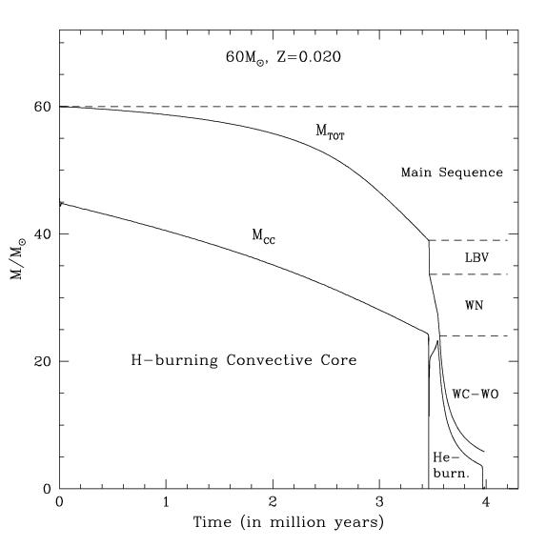

Change of
Surface
abundances
Evolution of the total mass
Change of surface
abundances
At the surface
the mass fraction
of H < ~0.4
(initial ~0.70)
WN stars
At the surface
He-burning products
WC-WO stars
Notes:
Successes test nuclear pathways
Ne22

Slide 19
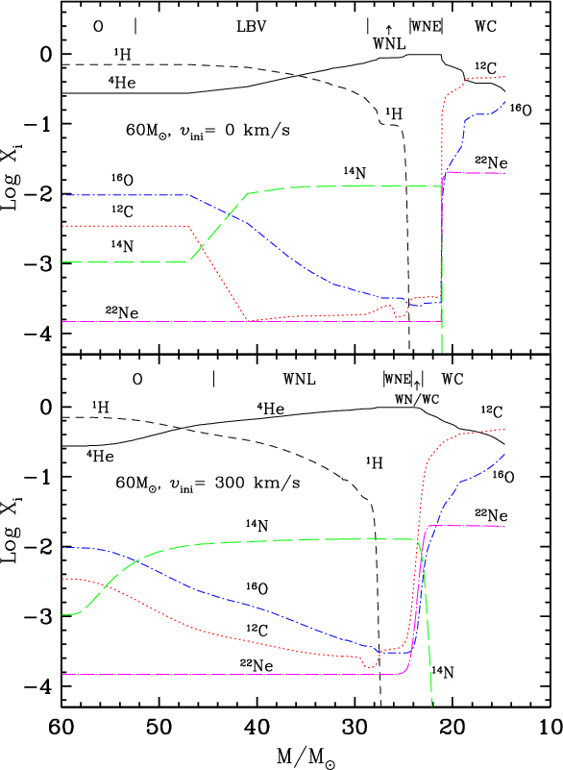
INITIAL CNO FROM WC OBSERVATIONS
TESTS OF THE NUCLEAR REACTIONS

Slide 20
WC→ ²²Ne~¹⁴N~C+N+O
TESTS OF THE NUCLEAR REACTIONS

Slide 21
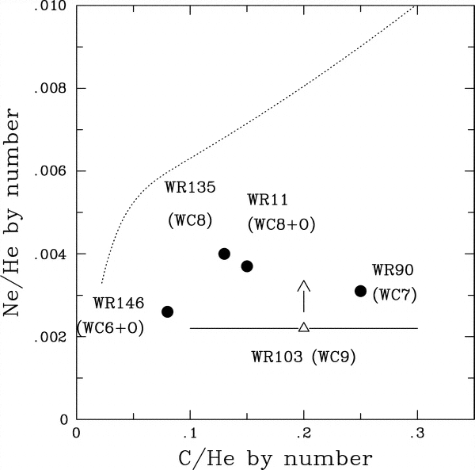
Neon too high!
Z=0.020
Ne constant
Ne/He increases
Because
He decreases
Crowther et al. 2006

Slide 22
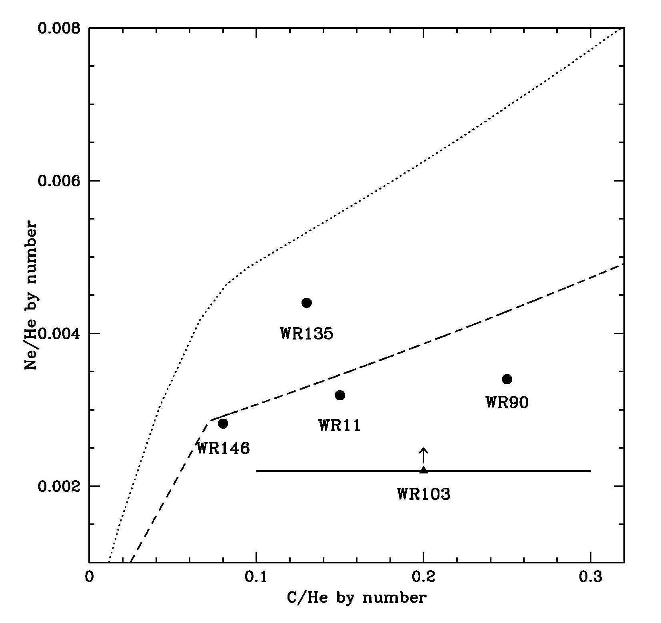
Z=0.020
Crowther et al. 2006
Z=0.014
CNO~0.080
Z=0.020
CNO~0.015
Massive stars in
Solar vicinity→
Z~ Asplund et al (2005)
Notes:
Interestingly observations of Ne22 at the surface of WC stars supports this fact.
Indeed Ne22 comes from the transformation, at the beginning of the core He-burning phase of nitrogen 14.
Nitrogen 14 which was produced by the transformation of C and O in the core H-burning during the MS phase.
Thus the abundance of Ne22 is a measure of the initial CNO content. You have here a plot from Paul Crowther
Showing the Ne over He as a function of carbon over helium. The line here corresponds to
The evolution of these two ratios at the surface of a WC star. Note that the slope here is due
To the decrease of helium abundance with time not to the increase of Ne22. The abundance of this isotope remains
Constant.
We see that the line is well above the observed point.
Now when models are computed with the new solar abundances of Asplund et al, the agreement is better
Simply because less CNO elements implies les Ne22.
Thus this tends to confirm that the new solar abundances by Asplund does appear much more
Consistant with the abundances in massive stars of the solar vicinity.

Slide 23
WHEN DOES THE ABSOLUTE METALLICITY MATTER?
e.g. FOR STELLAR NUCLEOSYNTHESIS
(secondary production channel)
¹³C, ¹⁴N, ¹⁹F, ²²Ne, ²⁶Al, s-process, …

Slide 24
Martinet et al. 2022

Slide 25
THE SUN TO EXPLORE NEW FRONTIERS
HABITABILITY

Slide 26
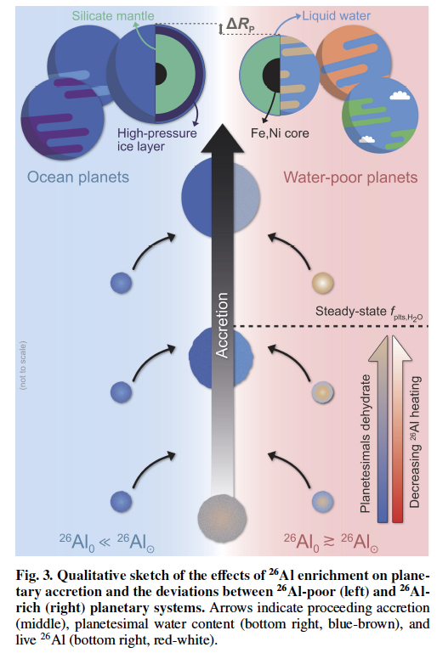
Lichtenberger et al. 2015

Slide 27
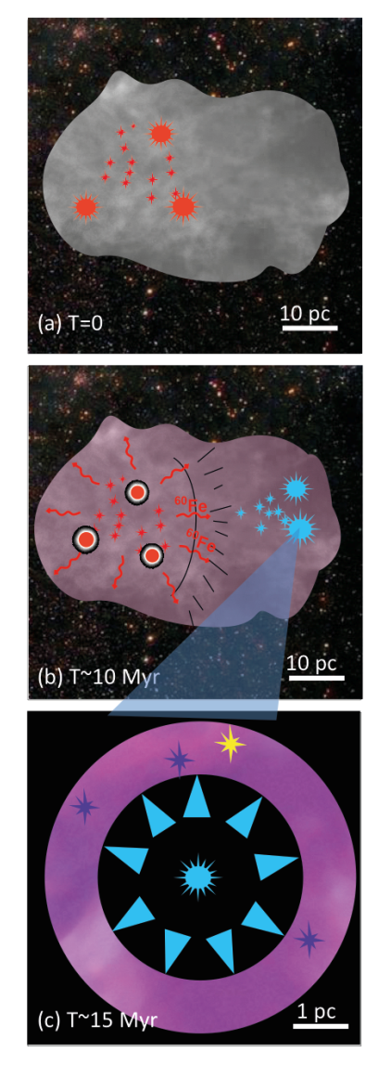
  Generation 1: t=0
  ~5000 stars
  Generation 2: form after 5-20My Gen 1
  composition ISM+2% ejecta generation 1
  ~1000 stars (at least 1 >30M_{sol} but < 5)
  Generation 3: form after 0.65-6.2 My Gen 2
  in 1000 M_{sol} shell
  (30% SFE, 0.5M_{sol})→ 600 *
The Sun
Formation of the Sun in a relatively small cluster is in
agreement with dynamical requirements, i.e. stability of planetary
orbits, existence of the Kuiper belt object Sedna, and formation
of the Oort cloud (Adams 2010; Brasser et al. 2012).
Gounelle and Meynet 2012

Slide 28
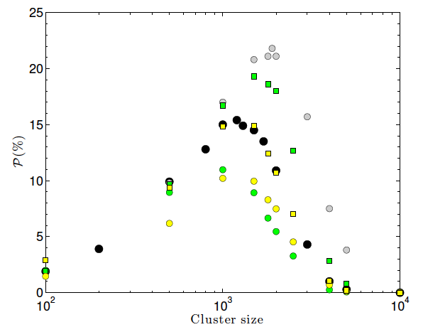
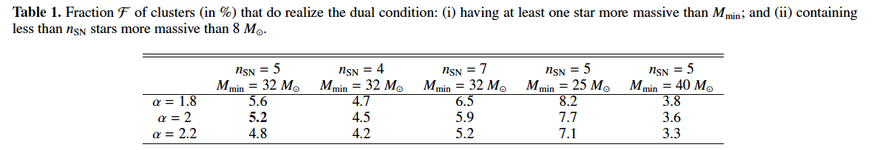
Gounelle 2015

Slide 29
Nature Astronomy 2021
Notes:
Anomalies among the daughter nuclei of the extinct short-lived
radionuclides in calcium–aluminium-rich inclusions indicate
that the Solar System must have been born near a source of
the short-lived radionuclides so that they could be incorporated
before they decayed away1. γ-rays from one such living
short-lived radionuclide, 26Al, are detected in only a few nearby
star-forming regions.
Here we employ multiwavelength observations
to demonstrate that one such region, Ophiuchus, containing
many prestellar cores that may serve as analogues for
the emerging Solar System2, is inundated with 26Al from the
neighbouring Upper Scorpius association3, and so may provide
concrete guidance for how short-lived radionuclide enrichment
proceeded in the Solar System, complementary to the meteoritics.
We demonstrate via Bayesian forward modelling drawing
on a wide range of observational and theoretical results that
this 26Al probably (1) arises from supernova explosions, (2)
arises from multiple stars, (3) has enriched the gas before the
formation of the cores and (4) gives rise to a broad distribution
of core enrichment spanning about two orders of magnitude.
This means that if the spread in calcium–aluminium-rich
inclusion ages is small, as it is in the Solar System, protoplanetary
disks must suffer a global heating event.
Origin of 26Al in Upper Sco. Here we show the share of probability
that the living 26Al observed in Upper Sco originates predominantly
from supernovae, WR stars or a mixture of both, conditional on the
average age of the association. The opacity shows the marginal posterior
probability of a given age. The x axis refers to the time lapsed between
the epoch of star formation and the current time. While we find that the
supernova-dominated case is the most probable overall, a WR-dominated
case is still possible, particularly if the association is modestly younger than
that (tobs − tSF ≃ 10 Myr) currently suggested by observations.

Slide 30
MNRAS 2019
53 thin disc solar twins → mantle energy budget of terrestrial planets
Notes:
We have investigated the thorium (Th) abundance in a sample of 53 thin disc solar twins
covering a wide range of ages. These data provide constrains on the mantle energy budget
of terrestrial planets that can be formed over the evolution of the Galaxy’s thin disc. We
have estimated Th abundances with an average precision of 0.025 dex (in both [Th/H] and
[Th/Fe]) through comprehensive spectral synthesis of a Th II line present at 4019.1290 Å,
using very high resolution (R = 115 000) high quality HARPS spectra obtained at the ESO
La Silla Observatory. We have confirmed that there is a large energy budget from Th decay
for maintaining mantle convection inside potential rocky planets around solar twins, from
the Galactic thin disc formation until now, because the pristine [Th/H]ZAMS is super-solar on
average under a uniform dispersion of 0.056 dex (varying from+0.037 up to+0.138 dex based
on linear fits against isochrone stellar age). Comparing to neodymium (Nd) and europium (Eu),
two others neutron-capture elements, the stellar pristine abundance of Th follows Eu along
the Galactic thin disc evolution, but it does not follow Nd, probably because neodymium has
a significant contribution from the s-process (about 60 per cent).
[Th/X]ZAMS as a function of the isochrone stellar age (where X: H, Fe, Nd, Eu, and Si): a statistically robust linear fit is shown in each plot (blue
solid line). The fitting equation with coefficients and their errors inside parenthesis are also displayed. The fits correspond to 53 thin disc solar twins only (black
filled circles). Specifically for the plots [Th/Fe]ZAMS–age and [Th/Eu]ZAMS–age, an additional fit is also shown (red solid line) by excluding one borderline
3σ outlier (HIP 101905, a 1.2 Gyr old star relatively poor in Th), but the results do not change significantly. Data of excluded stars are plotted together for
illustration purposes only (red empty triangles: four α-rich old stars, and magenta empty square: the chemically anomalous in s-elements HIP 64150). Sun’s
data are also plotted as reference (green solar standard symbol), although are consistent with the fits.

Slide 31
THE SUN TO EXPLORE NEW FRONTIERS
PARTICLE PHYSICS

Slide 32
Phys. Rev. D. 2010
Similar idea →Rato et al. MNRAS 2021 (asteroseismology of sub giant)

Slide 33
THE SUN TO EXPLORE NEW FRONTIERS
THE FINE STRUCTURE CONSTANT

Slide 34
Science 2022
Ekström et al. A&A 2010
Notes:
The fine structure constant a sets the strength of the electromagnetic force. The Standard Model of
particle physics provides no explanation for its value, which could potentially vary. The wavelengths of
stellar absorption lines depend on a but are subject to systematic effects owing to astrophysical
processes in stellar atmospheres. We measured precise line wavelengths from observations of 17 stars,
selected to have almost identical atmospheric properties to those of the Sun (solar twins), which
reduces those systematic effects. We found that a varies by ~<50 parts per billion within 50 parsecs from
Earth. Combining the results from all 17 stars provides an empirical local reference for stellar
measurements of a, with an ensemble precision of 12 parts per billion.
Fine-structure constant measurements.
The relative deviation of the fine-structure
constant Da/a is shown for each star in our
sample. These values are averages of all 17 line
pairs for each star. The inner large error bars
indicate the 1s statistical uncertainties, dominated
by the number of observations available of
each star, whereas the outer small error bars
combine the statistical and systematic uncertainties
in quadrature. The weighted mean of the
sample hDa=ai
w is indicated with the dotted
cyan line; the blue shaded region indicates the
combined 1s statistical and systematic uncertainties.
c2v
. 1:1 is the reduced c2 (per degree
of freedom) of the individual measurements
around the weighted mean.

Slide 35
THE SUN TO EXPLORE NEW FRONTIERS
BLACK HOLE

Slide 36
MNRAS 2023
Mass of the luminous component: 0.93 M_{sol} (log g =4.5, Log T_{eff}=5850 K, [Fe/H]=-0.2)
Mass of the unseen companion: 9.62 +-0.18 M_{sol}
Orbital period : 185.6 days, e=0.45, dynamics→ born in the MW with nearly no natal kick
Nearest BH, its discovery → populations of dormant BHs

Slide 37
CONCLUSIONS
-The Sun as a benchmark to test physical processes
the zero point of the metallicity scale
a window on new frontiers
Is the Sun and the solar system common in the Galaxy
In the past, the observation of the Sun and its modelling have made remarkable breatthroughs in physics on topics as discovery of hélium, nuclear reactions, neutrino physics, helioseismology…
What will come next?

Slide 38
The sun, with all those planets revolving around it and dependent on it,
can still ripen a bunch of grapes as if it had nothing else in the universe to do.
Galileo Galilei

Slide 40
Notes:
a detector able to study, in real time, solar neutrinos
from few tens of keV of energy by measuring separately the fluxes produced by
the various nuclear fusion reactions that take place in the Sun.
The activity for Borexino started in 1990
only in 2007 we started the data taking
With these premises, Borexino was able to identify the fusion reactions of the pp
chain emitting neutrinos via the separate measurement of their fluxes.
Borexino was able to study the CNO cycle undertaking the analysis of
the solar neutrinos produced by this cycle.
Borexino provided the
direct experimental proof of the CNO cycle existence.

Slide 41
Martinet et al. 2022

Slide 42
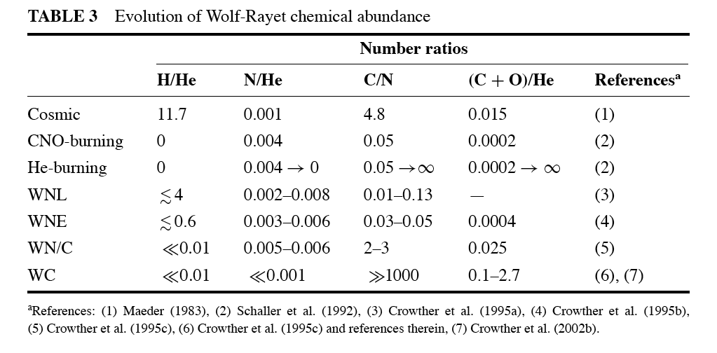
CNO in massive stars: N produced at the expense of O and C
He burning: C and O is created. N destroyed.

Slide 43
