Slide 1

How to gender Physics
Tomas Brage
Professor and Director of Education in Physics
Lund university, Sweden

Slide 2
How to discover Gender in Physics
Tomas Brage
Professor and Director of Education in Physics
Lund university, Sweden

Slide 3
Physics and Gender?
Physics is considered to be objective – not affected by the sex or gender or … of the people involved (researcher, teacher, student …)
… but ….
Physics class-rooms, labs, history are extremely affected by sex or gender – almost always dominated by men
… seems like a contradiction …

Slide 4


Basic model – Levels of Change
Londa Schiebinger, Stanford University
Numbers
Culture
Gender awareness
Subject
Gender perspective

Slide 5
Level 1: Numbers

Slide 6
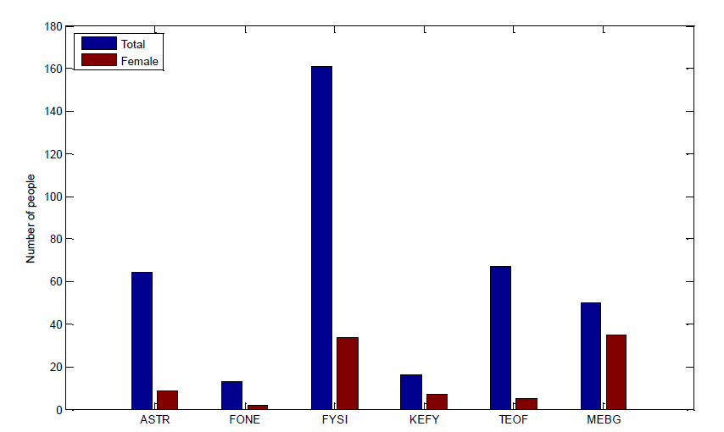
Numbers – Horisontal segregation of Physics in Lund
Astronomy
Accelerator
Physics
Theor Physics
Meteorology
Chem/Physics

Slide 7
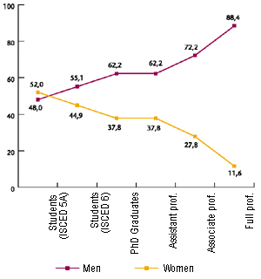
Numbers -
Chemistry
The scissors diagram
%
Physics
Vertical segregation
%

Slide 8
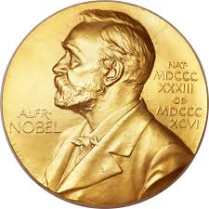
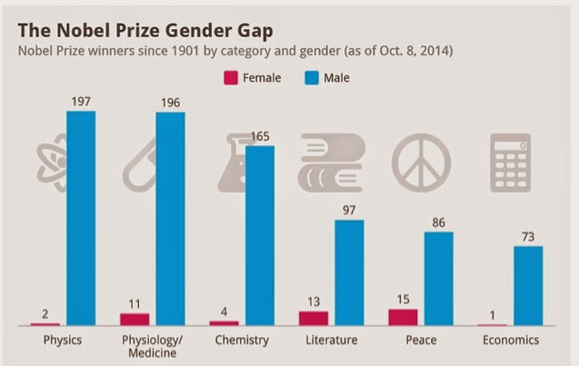
Vertical Segregation – even higher
Courtesy www.statista.com

Slide 9
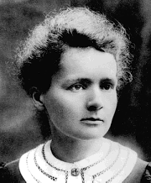
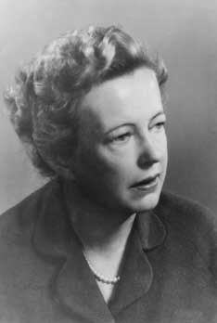
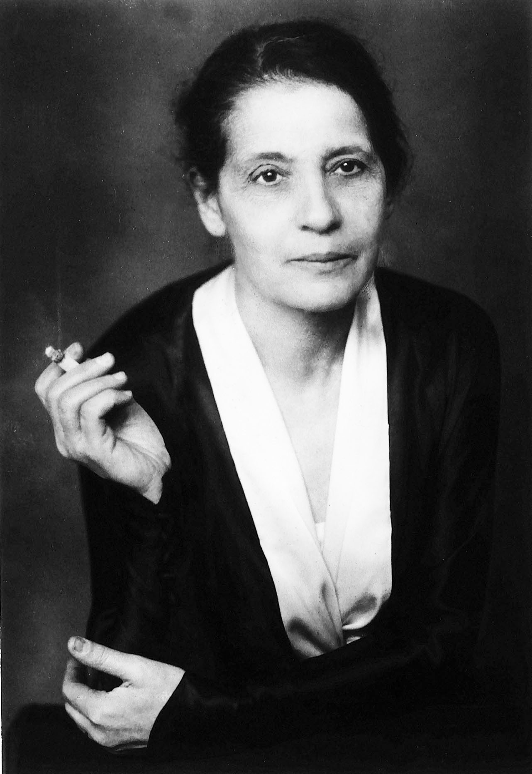
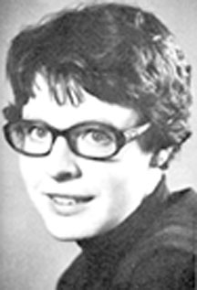
.. No women in Physics?
Marie Curie 1903 (och 1911)
Maria Goeppert-Mayer 1963
Lise Meitner
(not 1944!!)
Jocelyn Bell
(not 1974!!)

Slide 10
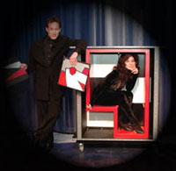
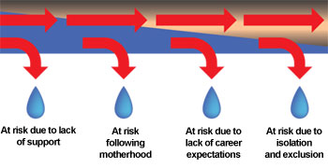
Numbers – vertical segregation
From the leaky pipeline …
…. to the vanishing box
Etzkowitz and Ranga 2011 Gender Dynamics in Science and Technology ..., Brussels Economic Review
7

Slide 11
Level 2: ”Culture”

Slide 12

The culture of Physics
Antropology – a classic:
SharonTraweek – Beamtimes and Lifetimes
  A culture without culture
  what is male, defines excellence
And since then work in
Pedagogics – with shortcuts for learning
History of Science – false in textbooks
Sociology – it is the culture within Physics
Psychology – Implicit bias and stereotypes
Core values – bias ruins meritocracy

Slide 13
Today
One simple investigation
One brilliant research

Slide 14

Culture – visual presentations in textbooks
Calculus based, introductory books
Benson, University Physics
  Traditional book

Slide 15
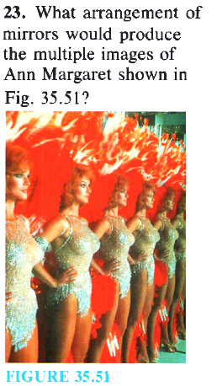
Culture – visual presentations
Benson

Slide 16
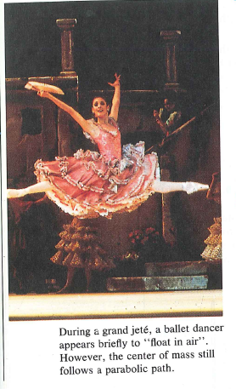
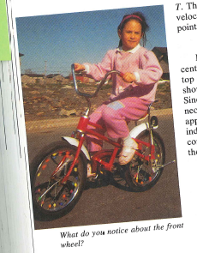
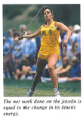
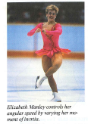
Culture – visual presentations
Pictures of women
Benson

Slide 17
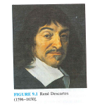
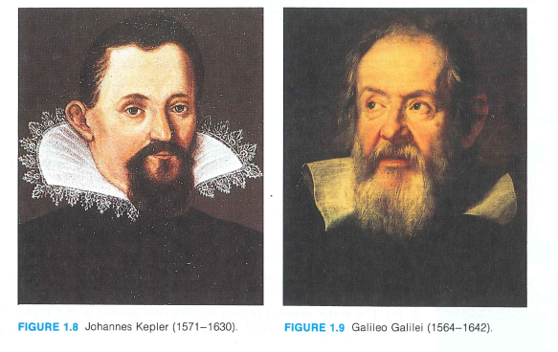
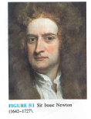
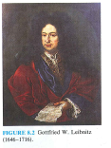
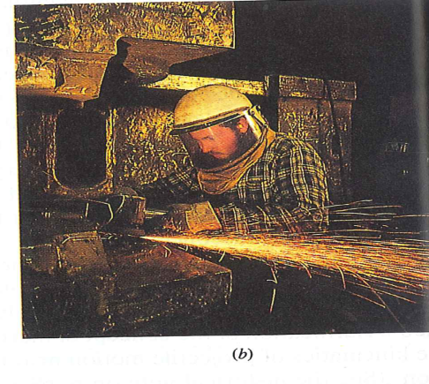

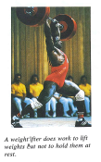
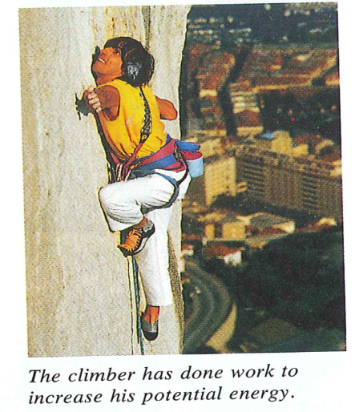
Culture – visual presentations
Pictures of men

Slide 18

Culture - Sociology:
Hasse and Trentemoller: UPGEM-project (2008)
What is the percentage of women among Physics professors?
Denmark, Estonia, Finland, Italy, Poland
Which has the largest percentage?
Which has the smallest percentage?

Slide 19
Culture - Sociology:
Hasse and Trentemoller: UPGEM-project (2008)
What is the percentage of women among Physics professors?
Denmark, Estonia, Finland, Italy, Poland
Denmark – 3%
Estonia – 11%
Finland – 12%
Poland – 14%
Italy – 23%

Slide 20
Is it Physics in culture?
Using ”Culture Contrasts” to understand:
Is it Physics in Culture – outside Physics?
The Classically schooled Physicist
Family culture
  Parenthood contra motherhood
  Child care contra nannies
  Nuclear contra extended family
  Strong border between family and work?
  What about flexibility?
Religion
Denmark – 3%
Estonia – 11%
Finland – 12%
Poland – 14% Italy – 23%

Slide 21
... Or is it Physics as culture?
Three cultures ”discovered”:
Hercules-culture – the fighter’s culture
Care taker-culture – the social culture
Working bee-culture – the industrious culture
Denmark – 3%
Estonia – 11%
Finland – 12%
Poland – 14% Italy – 23%

Slide 22
Hercules:
Oh yes, there is a lot of competition. This whole process is extremely competitive. The case that the department needs to make to the university is that I am not only good enough for the job, but I am the best person in the world for this job.
Care-taker:
There’s always a team behind a genius. (...) Good teamwork always brings the best results, but of course, not everyone is lucky enough to find a good group to work with. Sometimes when there are very competitive people, it is difficult to form a group..
Working bee:
But in this respect, for us not to show ourselves too much and do no crazy things, we had to sit quiet and pretend we were not there

Slide 23
Investigation of five countries:
Denmark, Finland, Estonia, Poland and Italy
What culture defines Physics departments in the different countries?
Denmark – 3% - Hercules
Estonia – 11% - Working bee
Poland – 14% - Working bee
Italy – 23% - Care-taker
Finland –12% - not a clear culture
Remember: It is the perception of the culture, but
..... is it really the culture of Physics?
..... and what do they say to their students?

Slide 24
So – what can we do?
Education, information, infiltration
Gender mainstreaming through e.g. gender integrated leadership education
Bias observers
Not only affirm women, but also confine men – but do get involved
Counterspaces (see Maria Ong et al.)
Awards/Certification for best practices (e.g. Athena Swan or Gender certification)
Notes:
24

Slide 25
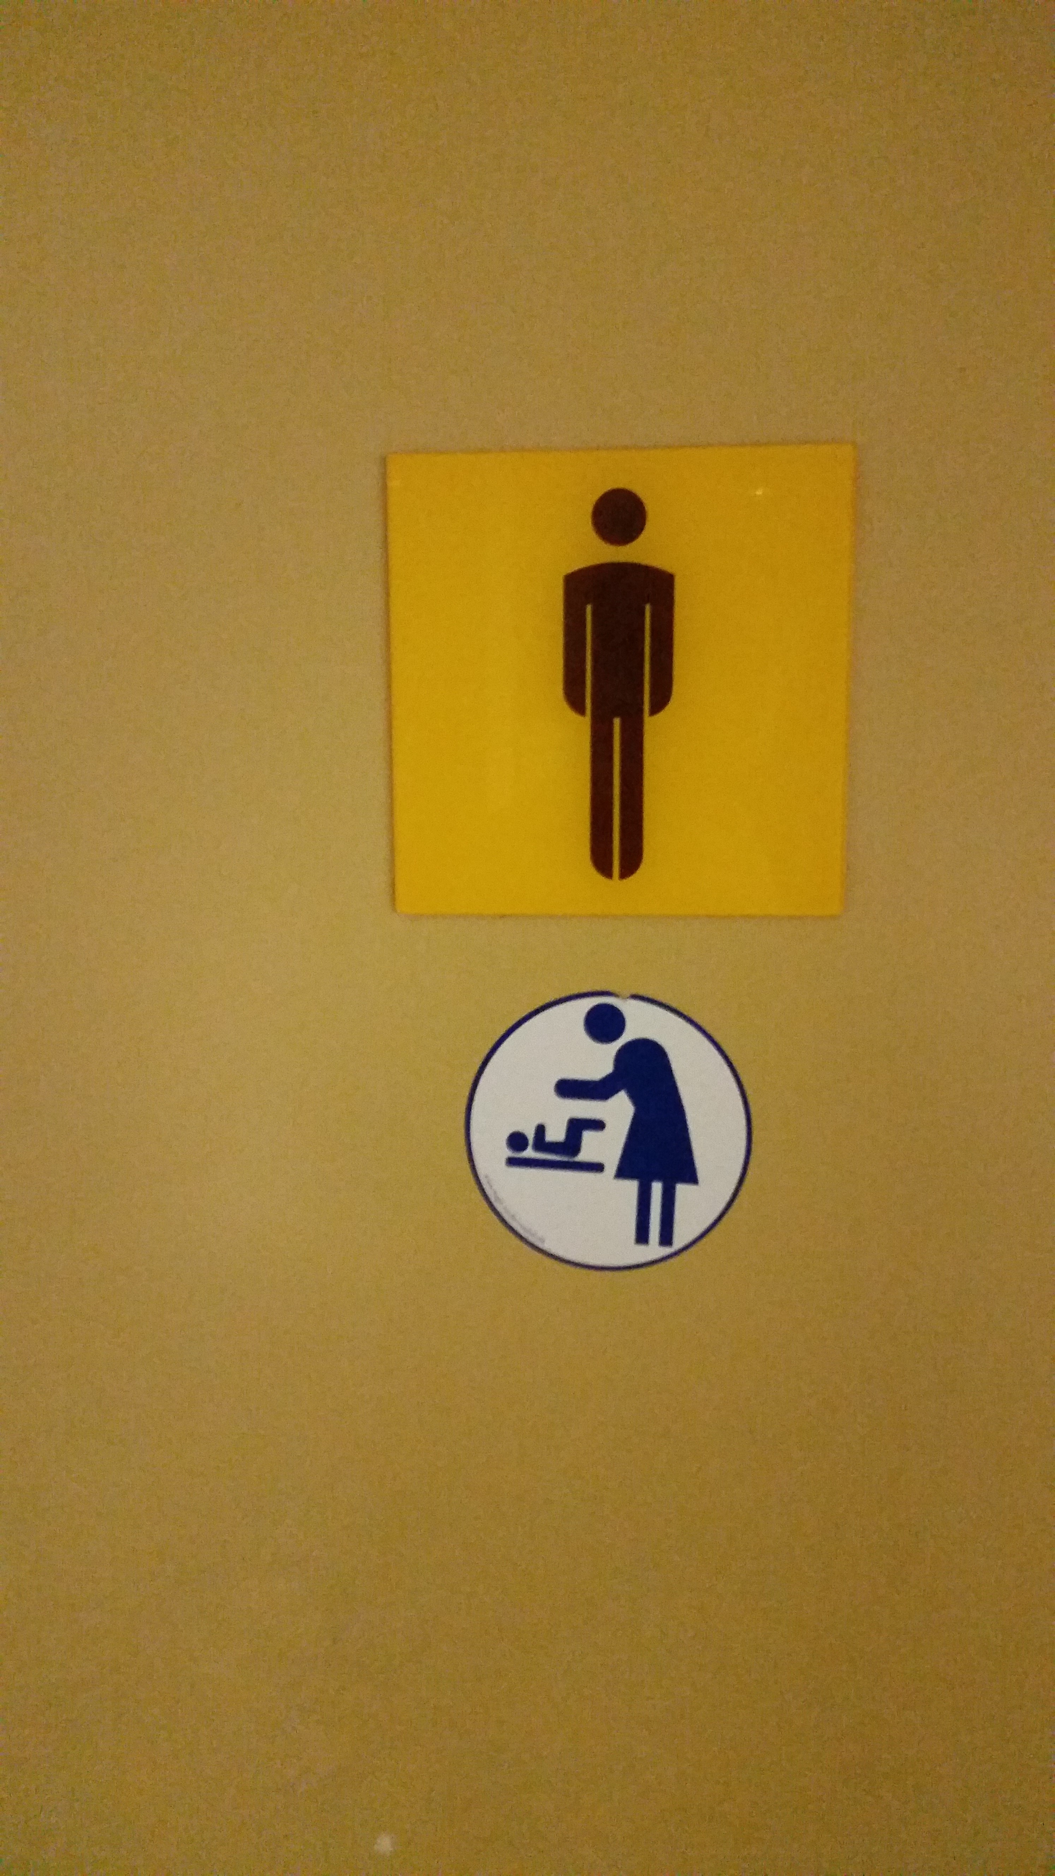
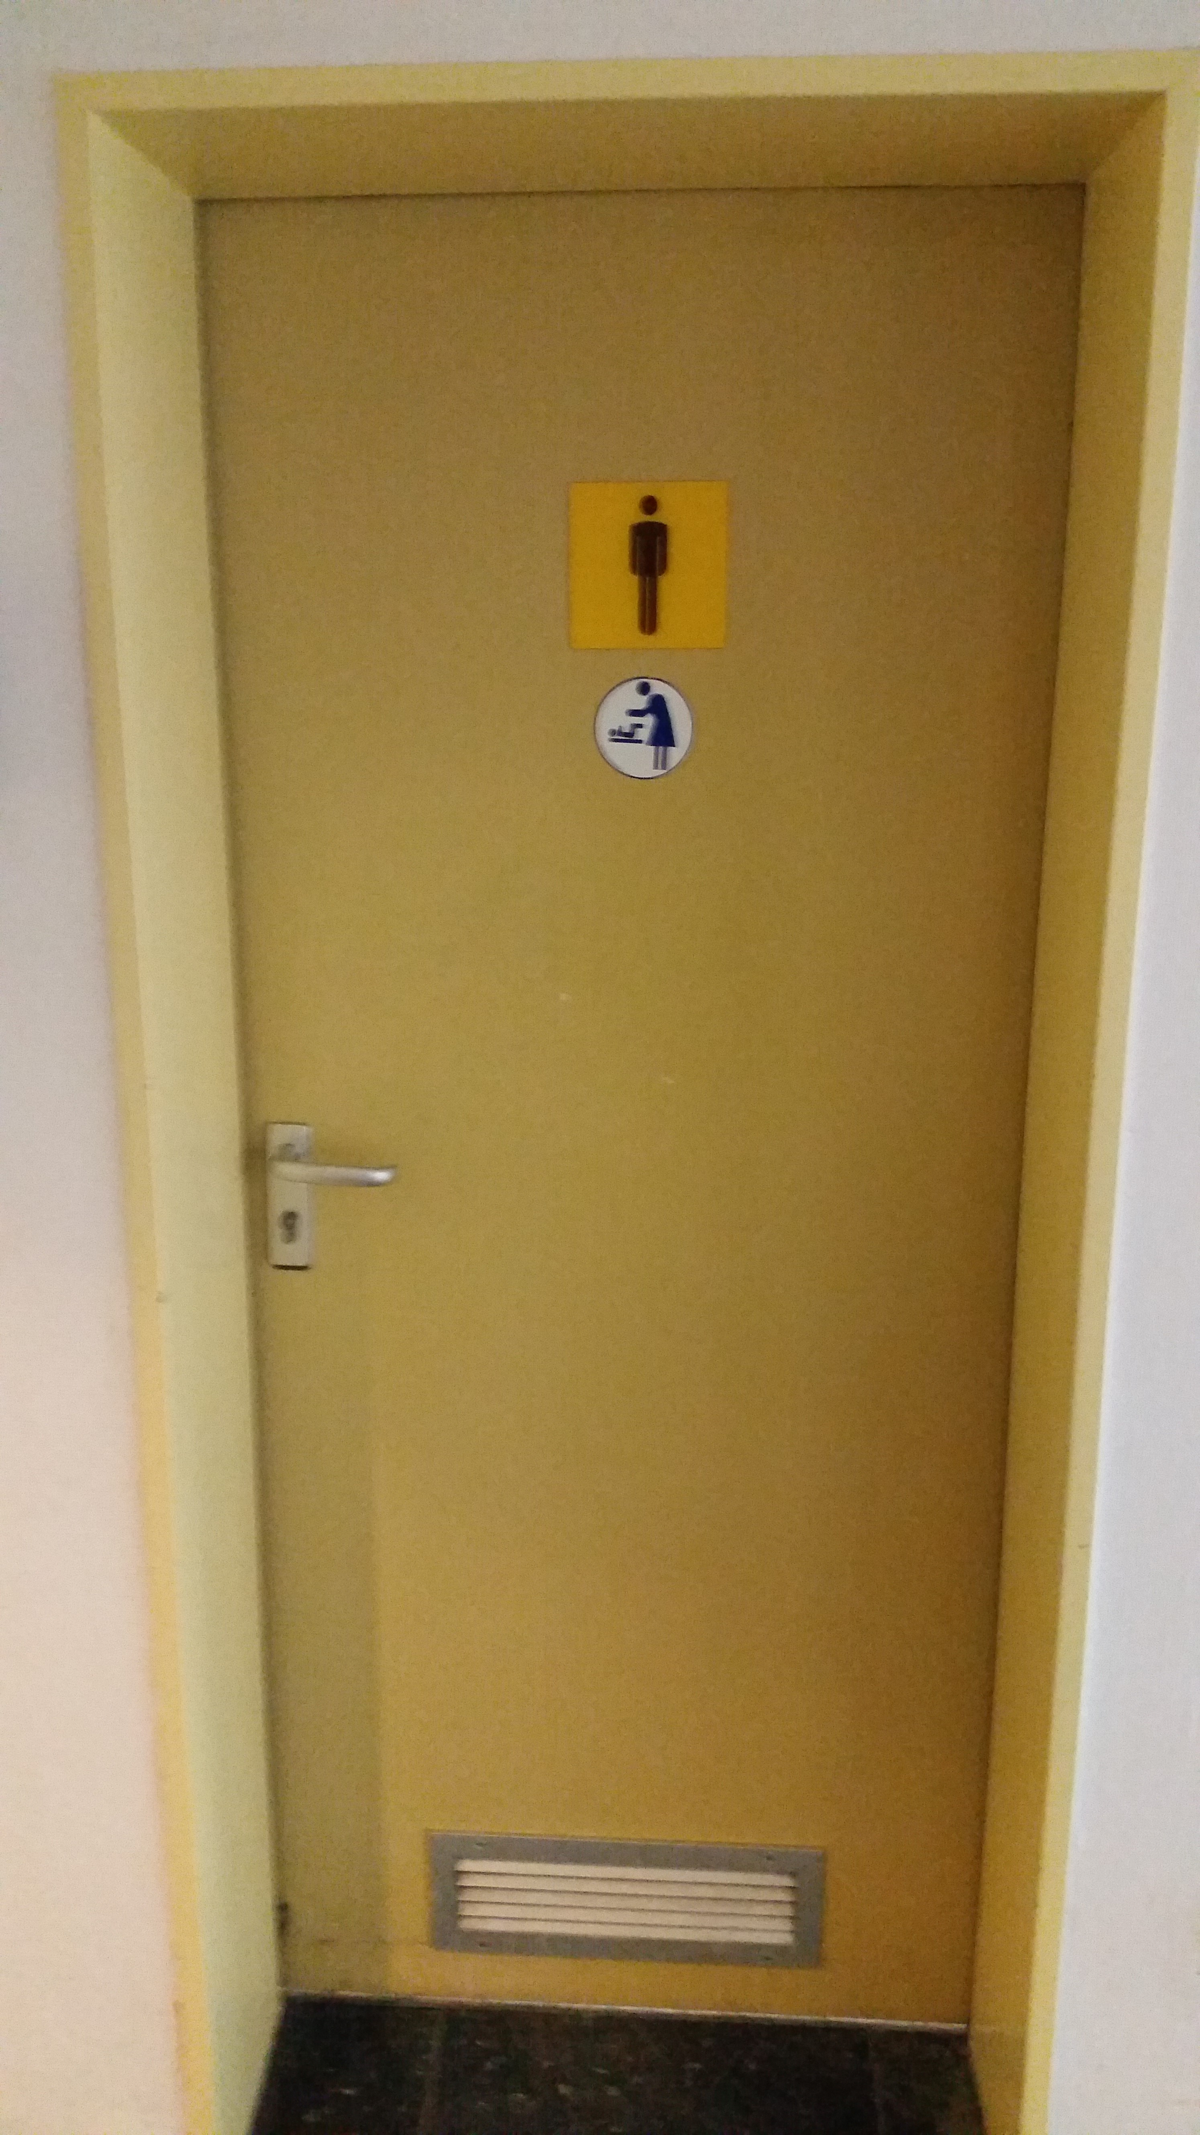
It is not easy...

Slide 26
Thank you for your attention!

Slide 27
References
Banaji et al, Project implicit, https://implicit.harvard.edu
Barad 2007, Meeting the universe halfway, Duke university press
Brage and Lövkrona 2016, Core values work in academia – with experiences from lund univeristy, Lund University
Conell 2014, Gender, Springer Fachmedien, Wiesbaden
Hasse and Trentemöller 2008, Break the Pattern!, UPGEM-project report, Tartu University Press
MacNell et al 2014, What’s in a Name: Exposing Gender Bias in Student Ratings of Teaching, Innov High Educ, Springer Verlag.
Nielsen 2015, Nature 525 427
Rosser 1995, Teaching the Majority, Teacher’s college press
Rosser 2012, Breaking into the Lab, New York University Press
Schiebinger (ed) 2008, Gendered Innovations in Science and Engieering, Stanford University Press
Schiebinger et al: https://genderedinnovations.stanford.edu/
Notes:
27

