Slide 1
Geneva, gip day, 26th of January 2017
„Ananlysis of actions“ in the Swiss equal opportunity programme
Prof. Dr. Doris Wastl Walter, VR for Quality Management, University of Berne
President Programme Equal Opportunity / Gender Studies, P-4

Slide 2
Rector‘s Conference and Equal opportunity 1
„Projektgebundene Beiträge“ (PgB) 2013-2016 (N=10 unis), 13,7 mio:
  Programme P-4, Equal opportunity /Gender Studies
  State secretariat for Education, Research & Innovation, SERI, UAS, 10 mio/4-yrs
    Programme Equal opportunity at the universities of applied sciences
  PgB 2017-2020, 12 mio
    Programme P-7, equal opportunity and development of HEI
      funding for Gender Action Plans GEP (N=27!)
      funding for inter-institutional cooperations (call in spring 2017)
      funding for administration & national activities/studies (GS swu)
      Possible collaborations with other PgB programmes 17-20:
      „Fachkräftemangel“ health and promotion of STEM-education
      Doctoral Programmes & 3. cyle (unis & UAS)

Slide 3

Rector‘s Conference and Equal opportunity 2, international collaboration:
Euraxess FP7,
  Euraxess Rights, Charter and Code, http://ec.europa.eu/euraxess/index.cfm/rights/index
  The Human Resources Strategy for Researchers (HRS4R) of the EC
  ERA-NET Gender-Net FP7, www.gender-net.eu (ended in october 2016)
    WP2: Gender Equality (GE) in Research and HEI through structural change:
      D2.6 Analysis Report on “Plans and initiatives in selected research institutions aiming to stimulate gender equality and
      enact structural change” (O. Vinogradova, ICWS, Uni BE)
      Both Swiss equal opportunity programmes participated
      Lead WBF, SERI, Y. Jänchen

Slide 4
Structural change in research institutions, D 2.6
5 Thematic areas based on essential elements of structural change:
  Decision-making structures and procedures at regional and national levels
  Anchoring gender equality issues at leadership level
  Recruitment, retention and advancement of women researchers (Agora Project of izfg: Deconstruct Gender Stereotypes associated with certain professions by creating a game for teenagers)
  Improving work environment, work-life balance and dual careers
  Facilitating in-/outgoing researcher mobility for women researchers

Slide 5
Key findings from mapping and analysis D 2.6
Factors that contributed most to structural change
  Top-leadership support on gender equality issues at an institutional level, including approval of GEP at the top level
  Visibility of women researchers and their active involvement as agents of change
  Cooperation between different structural units, especially between top leadership officers and the gender equality delegates at an institutional level
  Collection, analysis, strategic use and dissemination of gender-monitoring data
  Gender-balanced commissions at all levels (including boards)
  Systematic awareness raising and capacity-building concerning gender stereotypes
  Integration of gender-equality aspects into the leadership programme for the management, training courses for academic and non-academic staff

Slide 6
Underlying reasons for low numbers in STEM in Switzerland
  Gender-stereotypes (STEM is not for females, East vs. North-West, India)
  Rush hour of life & Dual career topic at post doc level
  Need for justification of specific STEM choice (profession is not feminine)
  Pressure of group (inclusion or exclusion)
  Male “culture” in the STEM domains
  “Bildungsausländerinnen” increase our female numbers in STEM fields

Slide 7
Domains of action in the Swiss equal opportunity program P-4
  Anchoring equal opportunity/gender equality at the institution
  Raising the percentage of female professors and women in leading positions
  Gender-sensitive measures in the promotion of junior academics
  Support for students, technical and academic staff with care obligations
  Reducing horizontal segregation among new students and decreasing vertical segregation in disciplines where one gender is underrepresented, STEM, Vet.
  Measures in HR and organisational development
  Others and new activities (communication, stereotypes, etc.)

Slide 8
Examples from the University of Berne,
Faculty action plans
1. Institutional establishment and definition of gender equality
  Structures of equality within faculties/department, centres and the administration
  Action plan and equality controlling within the faculties/departments and centres
  Measure: during the next revision of the faculty/department regulations, the head of the department will check, whether the principles of gender equality as demanded by the university GEP are granted.
  Indicator: Gender equality is anchored in the faculty/department regulations

Slide 9
Faculty action plans ff
2. Gender equality in the recruitment procedures
  Collaboration of representatives of the equal opportunity department AfG with equal opportunities faculty delegates in the recruiting/nomination commissions
  Improvement of the management of the nomination processes and the respective monitoring, head hunting
  Measure: the nomination commission informs all candidates about the programmes of the AfG supporting career and family (DCC, job sharing etc.)
  Responsible: President

Slide 10
Faculty action plans ff
3. Promotion of early career researchers (focus post Doc)
  Targeted courses and coaching
  Field-specific Mentoring offers
  Measure: to rise the proportion of women in the upper middle staff, faculty mentoring and 120% solution support measures are continued
  Responsible: faculty staff
      Indicator: the proportion of female academic upper middle staff has to reach 50% by 2018

Slide 11
Faculty action plans ff
4. Horizontal segregation, studies, STEM/(Vet)Med
  Challenging of Gender-stereotypical choices of studies and domains
  “Schnuppertage” and National future day
  Use of Social Media
  Measure: the faculty participates at the future day of the university with a special programme for boys/girls of 5th to 6th grade primary school
  Responsible: all stakeholders, communication
  Indicator: increase of proportion of female/male students
  impact of measure proved by evaluation of action plan?

Slide 12
Faculty action plans ff
5. Reconciliation of studies, academic career, profession and care obligations
  Promotion of flexible work time modules and child care offers
  Family friendly University
  Measure: the faculty supports the consequent implementation of family friendly meeting schedules and working hours
  Responsible: faculty/department leaders
  Indicator: increase of faculty members of both sexes in leading positions which reconcile care and career

Slide 13
Conclusions
Needed:
  Declared will for institutional change by people in power
  Shared ownership at all levels of governance
  People in charge of faculty work (resources)
  Role models (Katrin Altweg, University of Berne, Ursula Keller ETHZ))
  Networking and empowerment for specific STEM domains
  Motivation campagnes (Movie on the live of Marie Curie, Poster),
  Prizes and recognition for leaders (Scientific merit system)
  Adaption of curricula of STEM studies (e.g. IT & design course, FHNW)
  Specific scholarships for female early career in STEM (Kevin Heng)
  Transfer of measures of other gender action plans: toolkit UZH: http://www.gleichstellung.uzh.ch/de/politik/aktionsplan2013/toolkit.html
  EIGE tool: http://eige.europa.eu/gender-mainstreaming/tools-methods/GEAR
  Facts & figures and monitoring, endurance!

Slide 14
Be an agent of change!
www.swissuniversities.ch

Slide 15
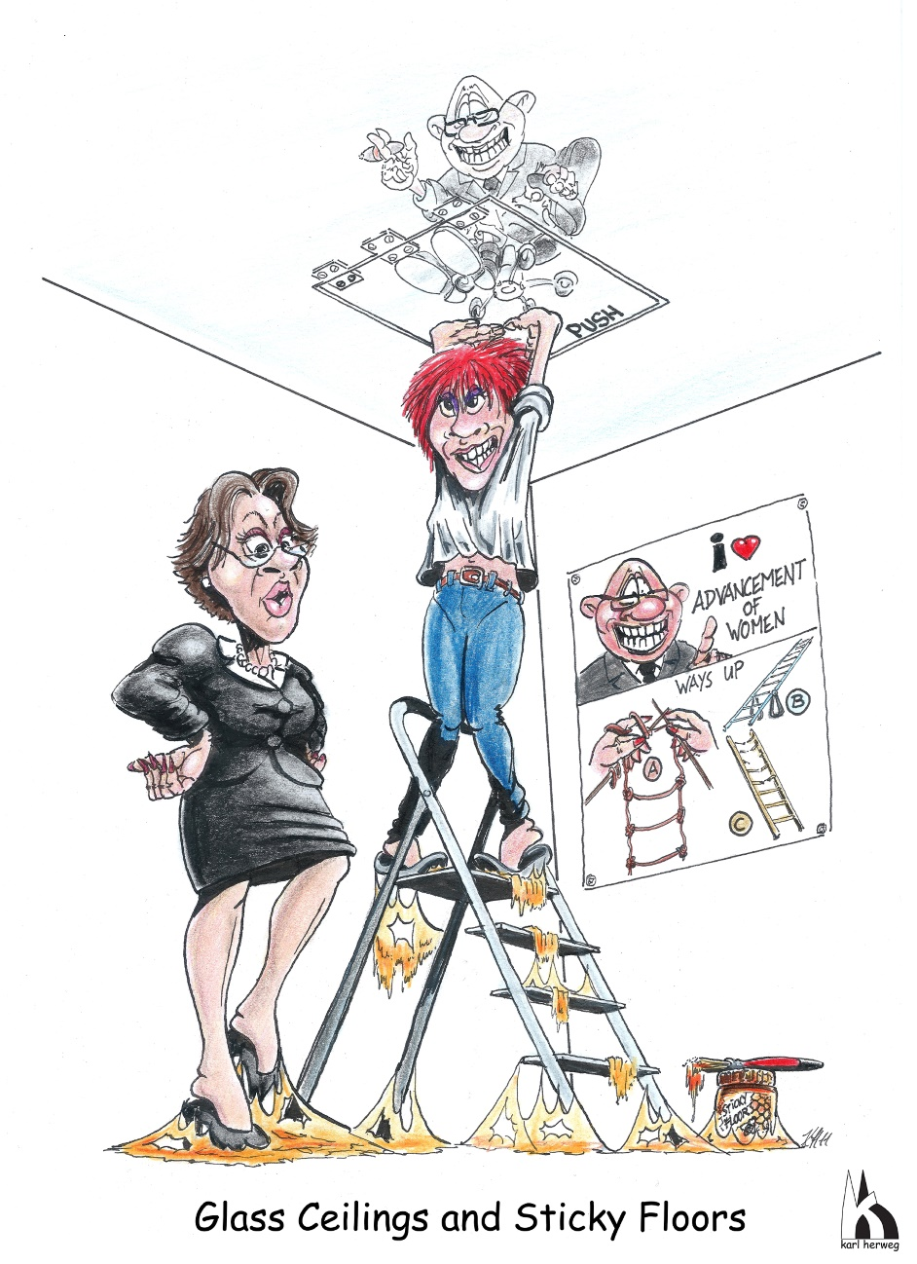
Thank you!
Contact
Prof. Dr. Doris Wastl Walter
Vice-Rectrice University of Berne
Dr. Gabriela Obexer-Ruff
swissuniversities, domain R&D
doris.wastl-walter@giub.unibe.ch
doris.wastl@rectorat.unibe.ch
T +41 31 631 80 16
gabriela.obexer@swissuniversities.ch
T +41 31 335 07 55
www.swissuniversities.ch

