Slide 1
GENERA
Geneva 26.01.2017
Brigitte Mantilleri
Director
Equal Opportunities Office
University of Geneva

Slide 2



Slide 3
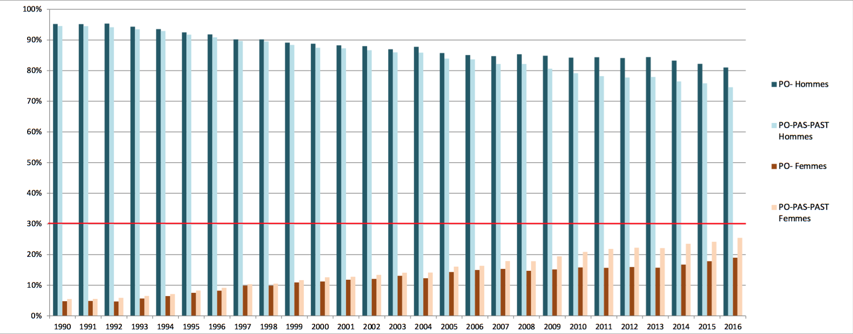

Slide 4


Slide 5
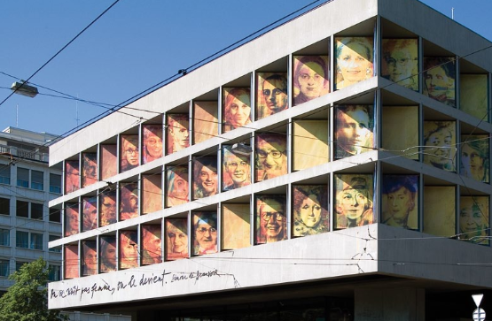
Faces à faces exhibition commemorating the 450th anniversary of the institution in 2009. Time to discover, or rediscover, important female scientists.

Slide 6



Slide 7


Slide 8


Slide 9


Information campaigns on stereotypes, gender bias, conferences, workshops and high level discussions.

Slide 10
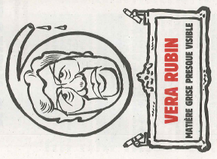
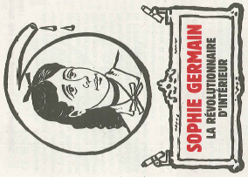
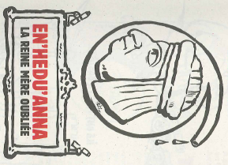
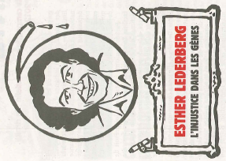
Charlie Hebdo brings out of the cupboard forgotten female scientists

Slide 11


Slide 12
Two studies
Vahan Garibian on Equal salary
Klea Faniko on Academic career at UNIGE

Slide 13



Slide 14
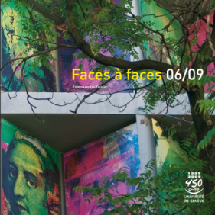

Slide 15
Henriette Saloz-Joudra
Vitebsk 1855 – Geneva 1928, Faculty of medecine
Micheline Stefanowska
Grodno 1855 – Cracovie 1942, Faculty of science
Léonore Gourfein-Welt
Sadagora 1859 – Geneva 1944, Faculty of medecine
Vera Bogdanowski
St Petersburg 1867 – Izevsk 1896, Faculty of science
Maria Fischmann di Vestea
Odessa 1868 –Pisa 1931, Faculty of medecine and science
Marguerite Champendal
Geneva 1870 – 1928 , Faculty of medecine
Elisabeth Chahnazarian
Chouchi 1873- Geneva 1949, Faculty of medecine

Slide 16
Nina Daïnow-Dicker
Levintzi 1876 – Geneva 1970 , Faculty of medecine
Lina Stern
Libau 1878- Moscou 1968 Faculty of science and of medecine
Vera Chatzman-Weizmann
Rostov sur le Don 1879 Rehovot 1966, Fauclty of medecine
Catherine Chamié
Odessa 1888 – Paris 1950, Faculty of science and working with Marie Curie
Kitty Ponse
Sumatra 1897 – Geneva 1982 Faculty of science
Gabrielle Perret-Gentil
Geneva 1910 -1999 , Faculty of medecine
Edith Alice Müller
Madrid 1918 1995, Faculty of science
Grete Gujer-Kellenberger
Zurich 1919 - 2013 Faculty of science

Slide 17

Last but not least, Let’sfill the Wikipedia Gender Gap. We organise conferences and workshops: to teach the contribution techniques and to publish articles on wellknown Swiss women. Next step: female scientists.

Slide 18
Thank you very much!!!

