Slide 1
Jets and outflows in ultraluminous X-ray sources
Roberto Soria
ICRAR-Curtin University (Perth)
Manfred Pakull, Christian Motch, Fabien Grise’ (Strasbourg)
James Miller-Jones, Tom Russell, Ryan Urquhart (ICRAR-Curtin)

Slide 2
Content
Introduction: radiative and kinetic power of BHs
Observational evidence of jets and winds in ULXs
Measuring BH power from optical/radio bubbles
Optically thin and optically thick winds

Slide 3
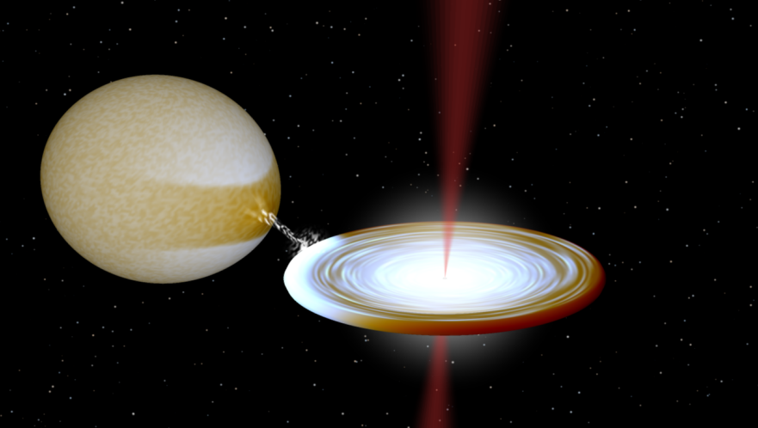
Ultraluminous X-ray sources (ULXs)
= high-luminosity end of X-ray binary population
L_{x} > 1E39 erg/s

Slide 4
Total power of a BH
Radiation (directly observable in some bands)
Kinetic energy (jets & winds; not directly observable)
Radiation
(X-ray) photo-ionized nebulae
Winds
shock-ionized nebulae
Jets
shock-ionized nebulae
(possibly) hot spots
synchrotron emission (mostly radio)
1. Select powerful non-nuclear BHs in nearby galaxies
2. Search for evidence of ionized gas around them
3. Use the bubbles as calorimeters for the BH power

Slide 5
Kinetic power measured from:
(Flat-spectrum) core radio emission
2. Direct kinematic study of bubble expansion velocity
3. Fluxes and flux ratios of diagnostic optical/IR lines
4. Synchrotron radio emission from the lobes & hot spots
Very difficult to detect in ULXs
L(Hβ) ~ (3/1000) P_{jet}
L([FeII]1.64) ~ 0.2-0.4 L(Hβ) ~ (1/1000) P_{jet}

Slide 6
Kinetic power measured from:
(Flat-spectrum) core radio emission
Very difficult to detect in ULXs

Slide 7
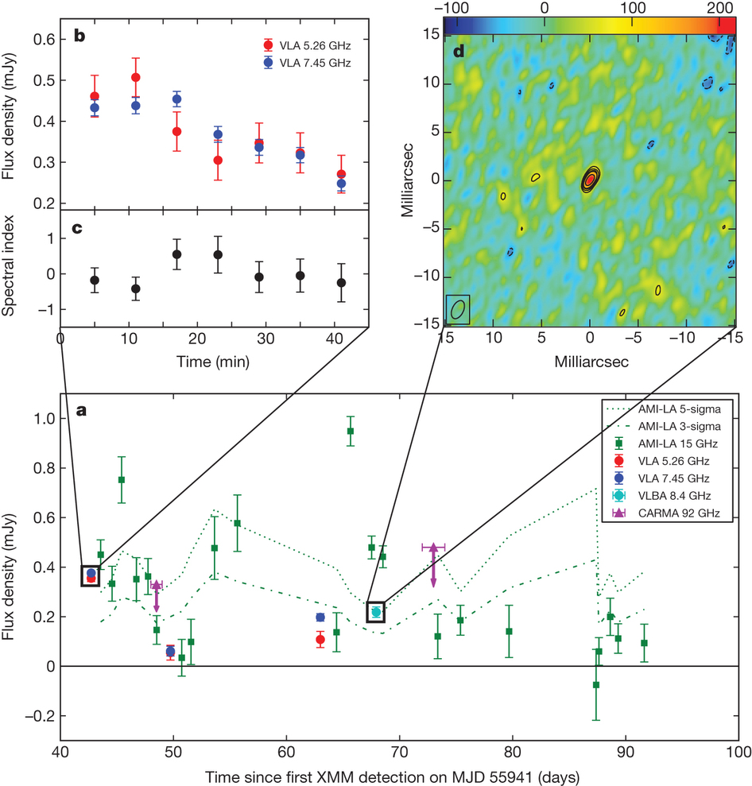
M31
ULX transient
L_{X} ~ 1E39 erg/s
Radio flaring
like in GBHs
(Middleton et al 2013)

Slide 8
Kinetic power measured from:
(Flat-spectrum) core radio emission
2. Direct kinematic study of bubble expansion velocity
3. Fluxes and flux ratios of diagnostic optical/IR lines
4. Synchrotron radio emission from the lobes & hot spots
Very difficult to detect in ULXs
L(Hβ) ~ (3/1000) P_{jet}
L([FeII]1.64) ~ 0.2-0.4 L(Hβ) ~ (1/1000) P_{jet}

Slide 9
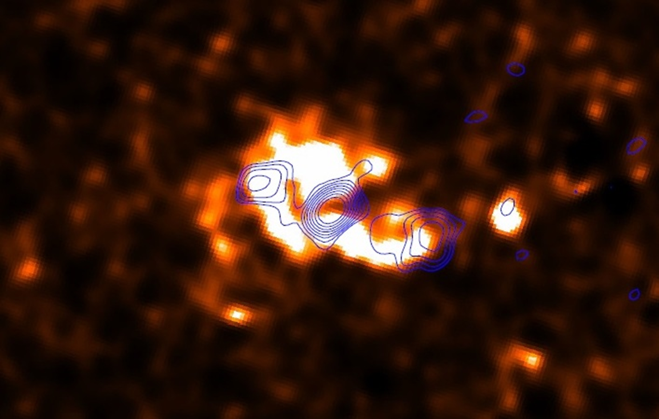
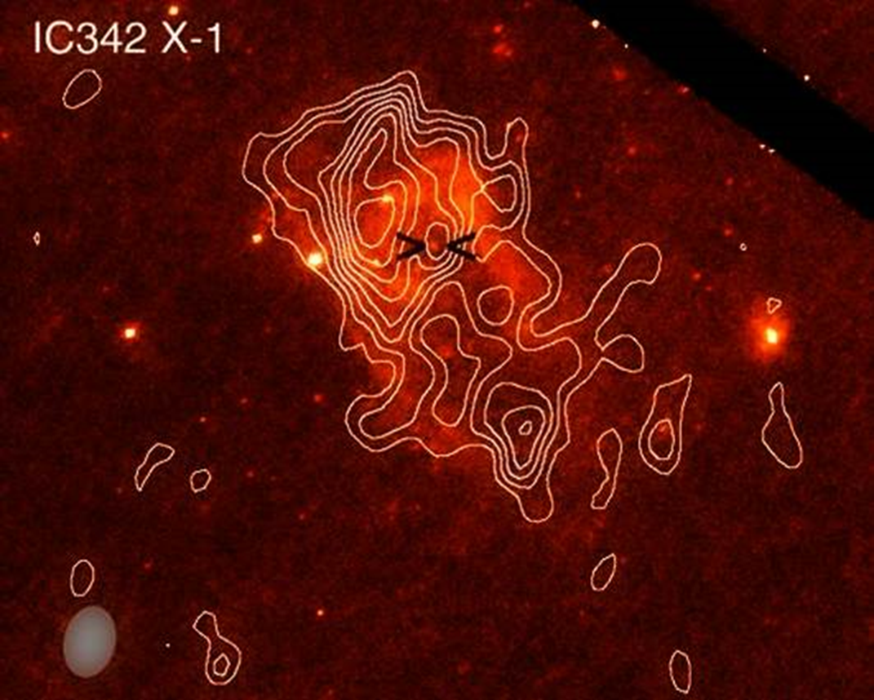
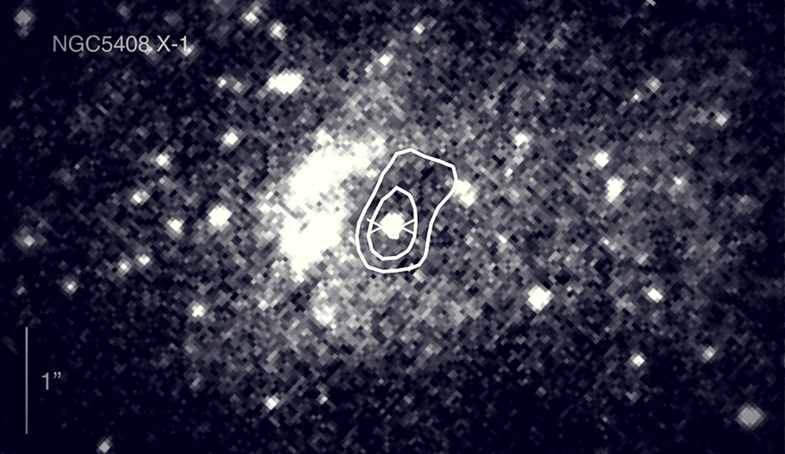
Holmberg II X-1
(Cseh et al 2014)
(Cseh et al 2012)
NGC5408 X-1
Indirect evidence of jets
from optically-thin
synchrotron emission
P_{jet} ~ a few 10³⁹ erg/s
inferred from the radio emission
(Grise’ et al. 2012, Soria et al 2006, Kaaret et al 2003)

Slide 10
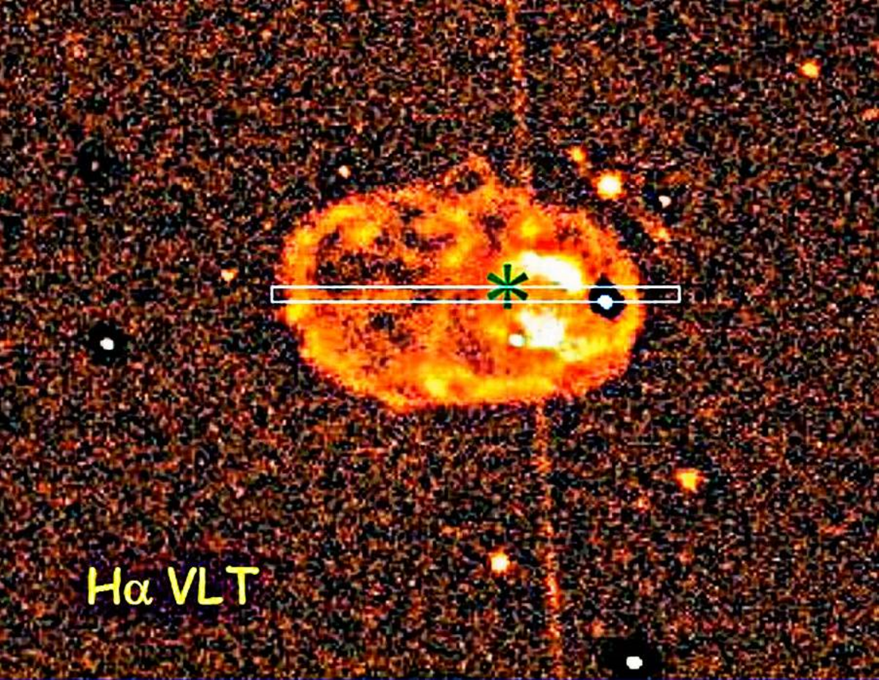
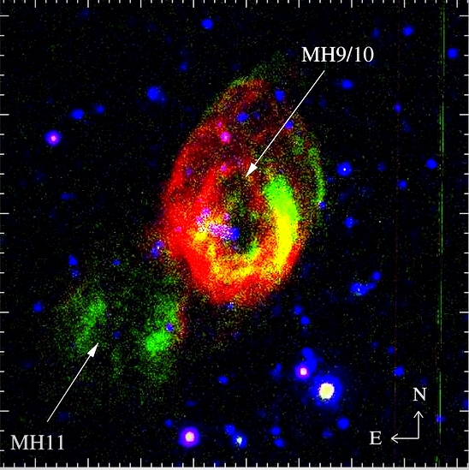
NGC1313 X-2
(Grise’ et al 2008)
Large shock-ionized
ULX bubbles
without radio emission
Winds but no jet?
Holmberg IX X-1
(Grise’ et al 2011)
Hα
size ~ 200 x 300 pc
P_{wind} ~ a few 10³⁹ erg/s
inferred from the optical bubble
size ~ 300 x 470 pc

Slide 11
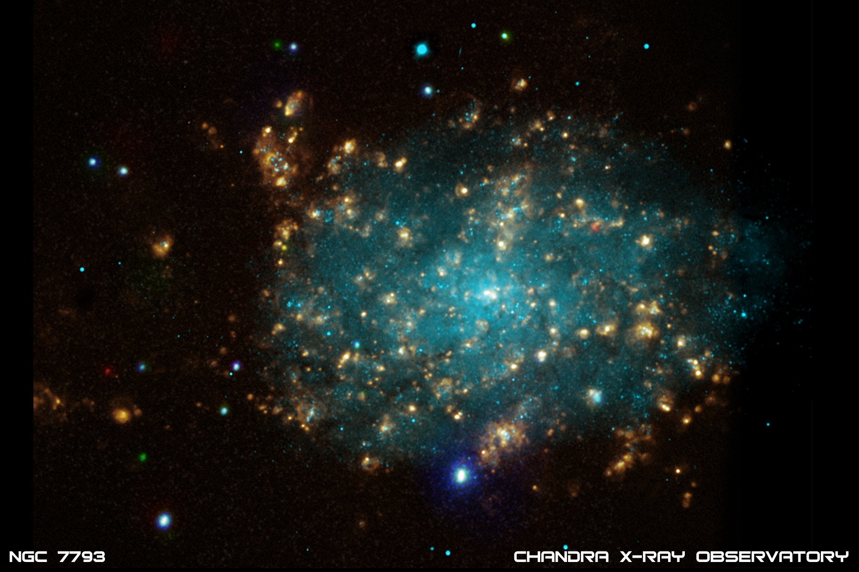
S26 microquasar in NGC7793
Pakull, Soria & Motch (2010, Nature)
Soria et al (2010, MNRAS)

Slide 12
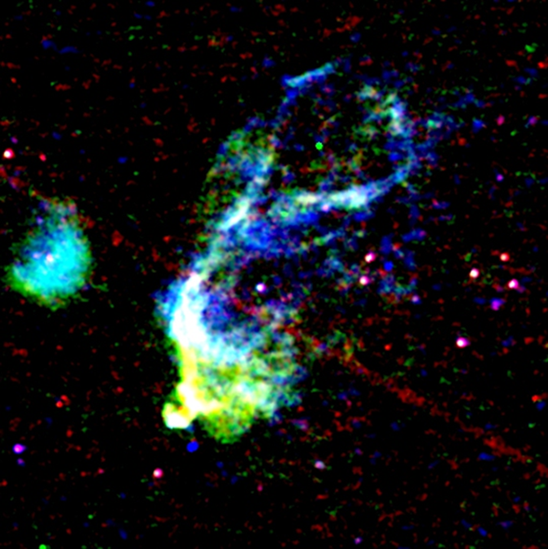
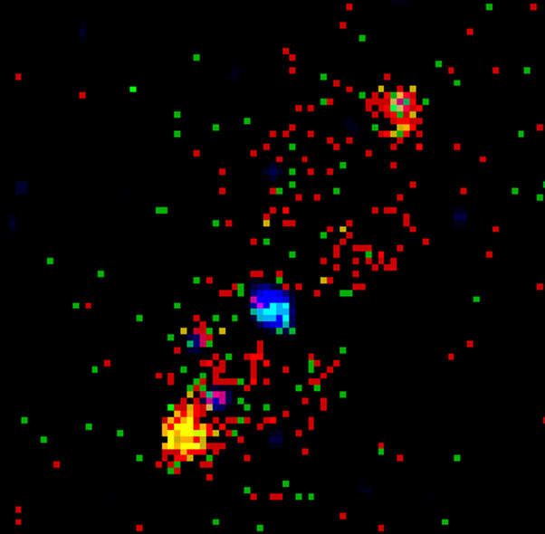
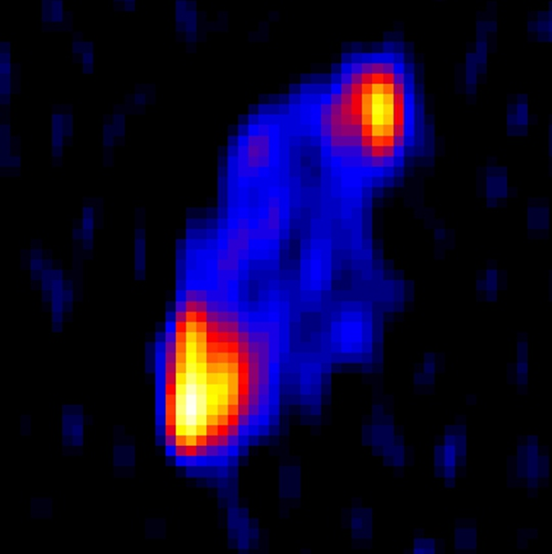
S26 microquasar in NGC7793
Pakull, Soria & Motch (2010, Nature)
Soria et al (2010, MNRAS)
HST
diameter ~ 270 pc
Chandra
Jet-inflated bubble with hot spots
P_{jet} ~ 1E40 erg/s > L_{X}
ATCA 5.5 GHz

Slide 13
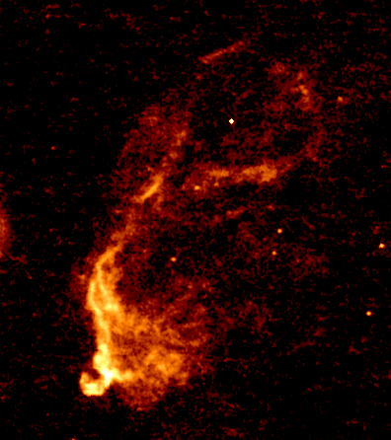
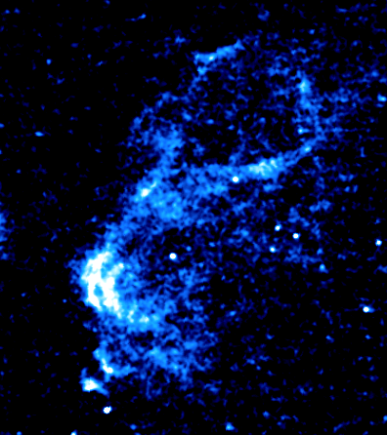
S26 microquasar in NGC7793
P_{jet} ~ 1E40 erg/s > L_{X}
Age ~ 300,000 yrs, v ~ 270 km/s
Hα
[O III] 5007

Slide 14
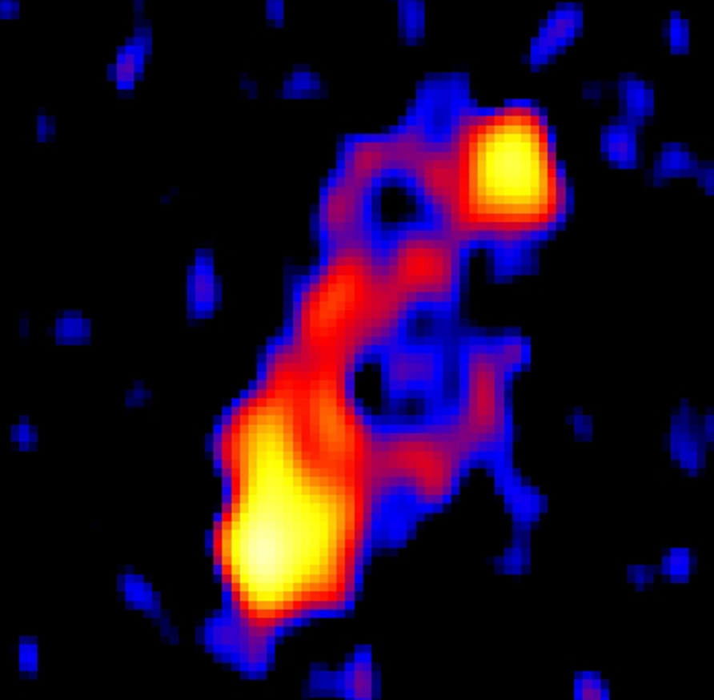
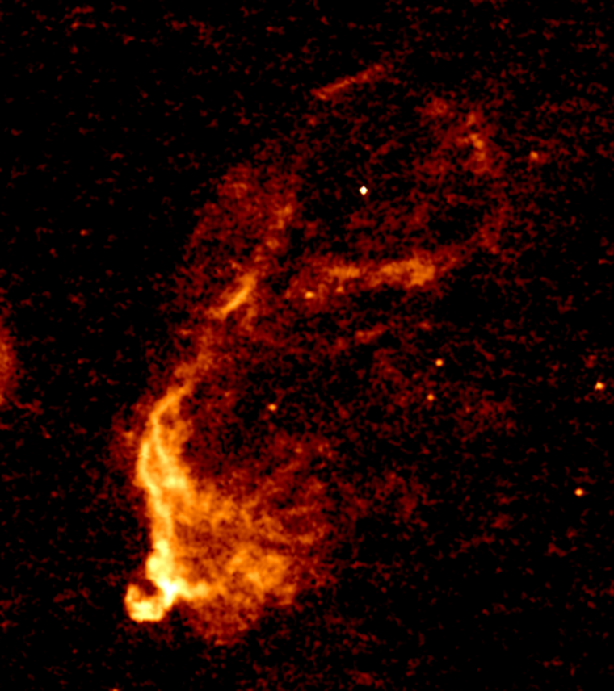
S26 microquasar in NGC7793
P_{jet} ~ 1E40 erg/s > L_{X}
Age ~ 300,000 yrs, v ~ 270 km/s
[O III] 5007
Hα
9 GHz

Slide 15
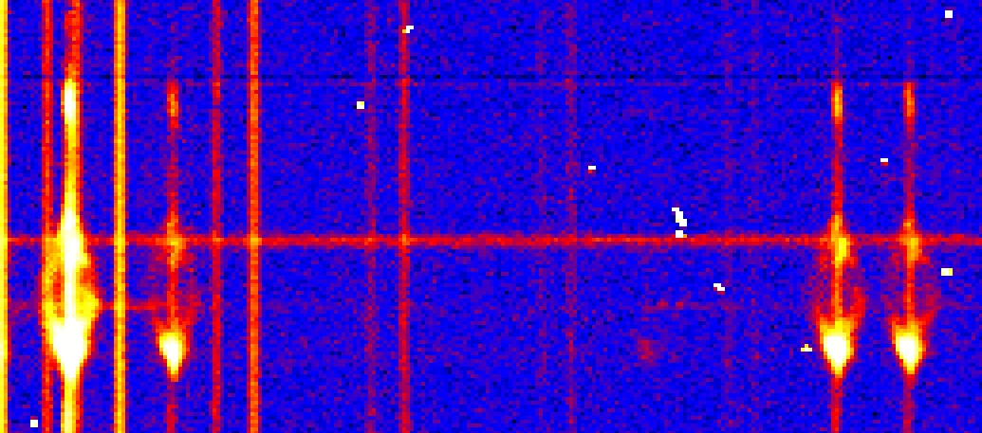
S26 microquasar in NGC7793
wavelength
space
Hα
[NII]
[SII]
[SII]
VLT/FORS2 spectra: slit oriented along the major axis
(Pakull, Motch, Soria & Grise’, in prep)

Slide 16
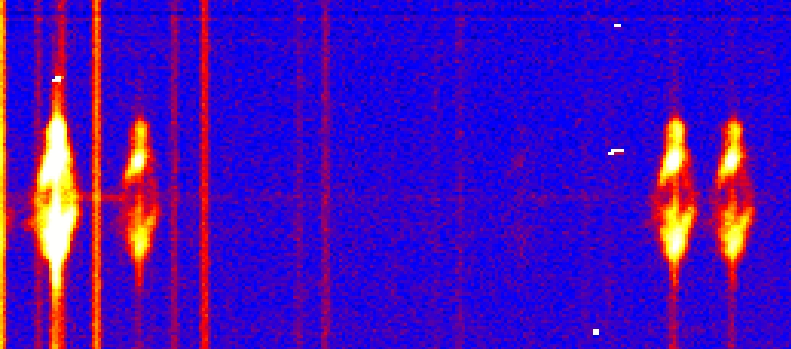
S26 microquasar in NGC7793
wavelength
space
Hα
[NII]
[SII]
[SII]
VLT/FORS2 spectra: slit oriented along the minor axis
(Pakull, Motch, Soria & Grise’, in prep)

Slide 17
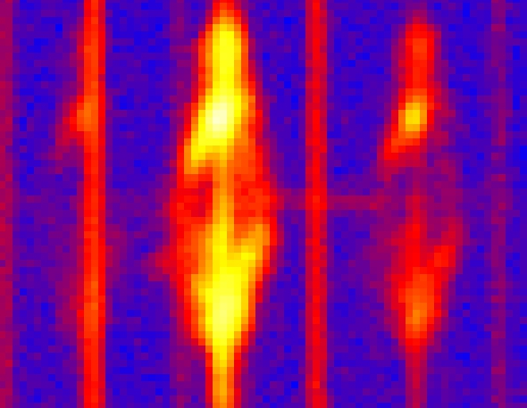
S26 microquasar in NGC7793
wavelength
space
550 km/s
[NII]
Hα
[NII]
VLT/FORS2 long-sit spectra
(Pakull, Motch, Soria & Grise’, in prep)

Slide 18
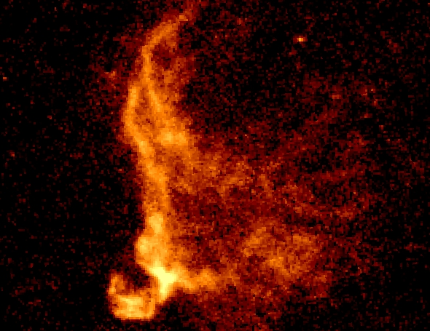
HST close-up view
of the southern lobe
Hα filter
BH
Radio hot spot
X-ray hot spot
P_{jet} ~ 1E40 erg/s

Slide 19
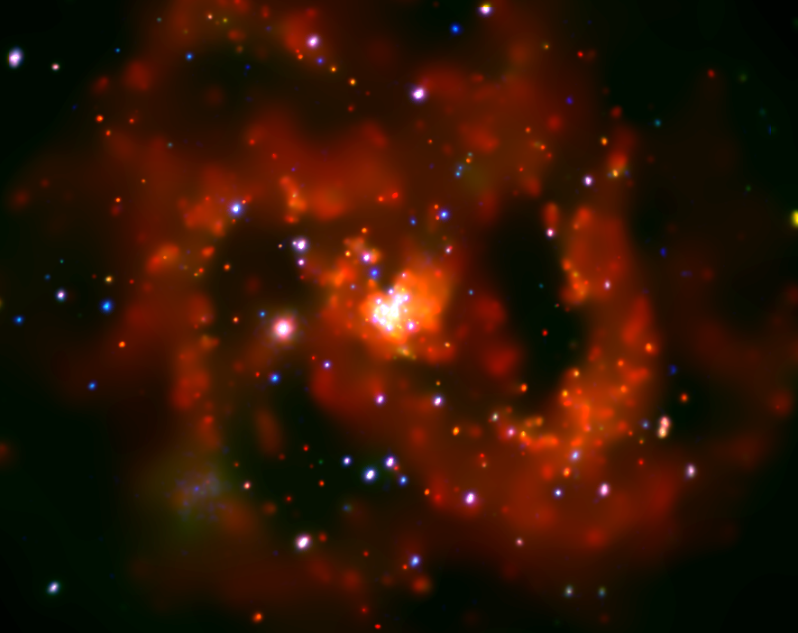
M83 (X-ray image)

Slide 20
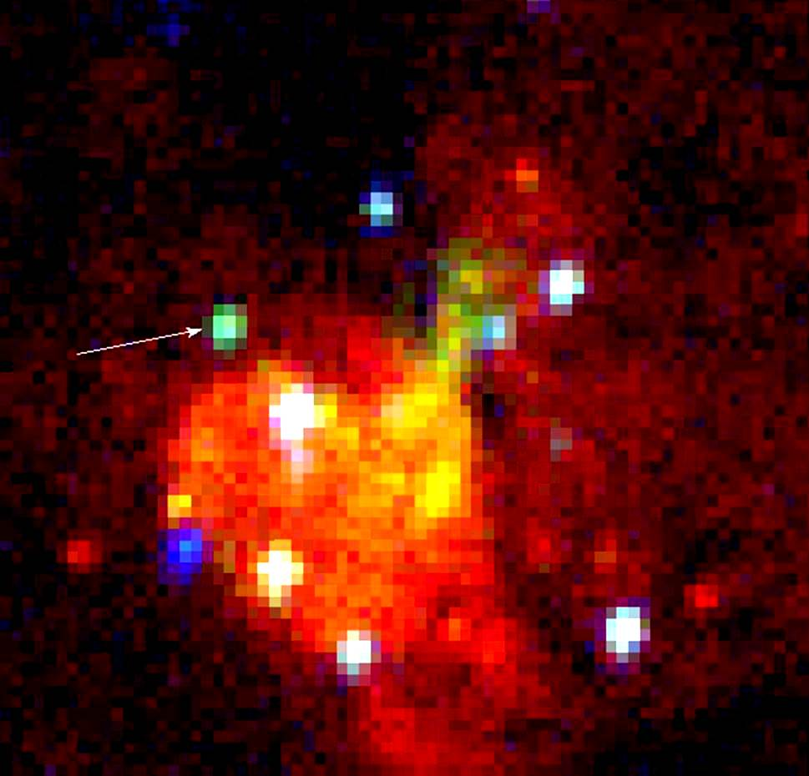
M83 MQ1

Slide 21
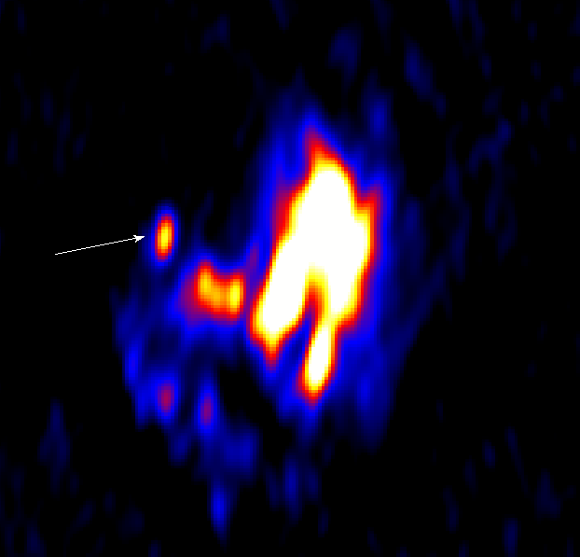
M83 MQ1
F(5.5 GHz) = 1.6 mJy

Slide 22
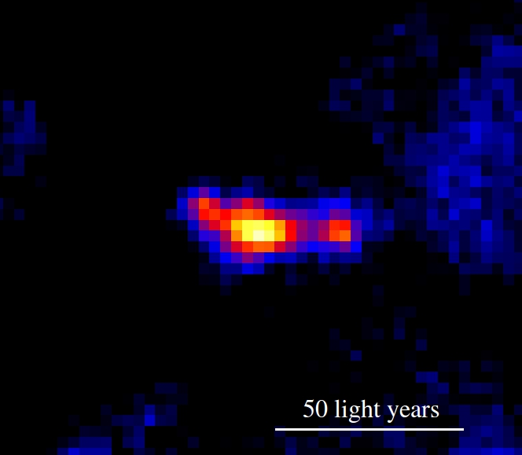
M83 MQ1
Shock-ionized hot spots (= powerful jet)
+ photo-ionized core
Hubble image
Hα + [S II]
P_{jet} ~ 1E40 erg/s
L_{X} ~ 1E38 erg/s
L_{5GHz} ~ 1E35 erg/s
(Soria et al 2014, Science)
HST/STIS spectrum
approved for 2016

Slide 23
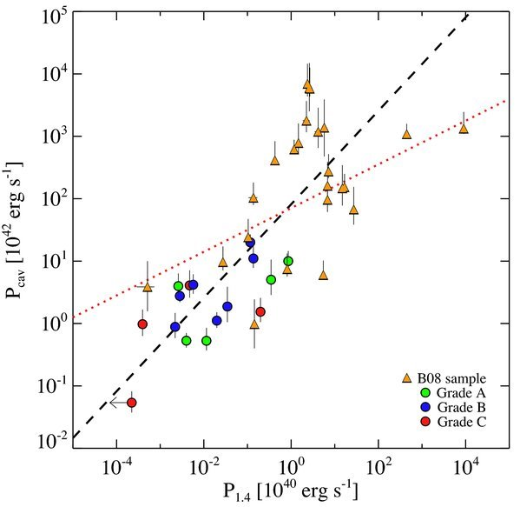
K=1
S26
in NGC7793
MQ1
in M83
Radio lobe luminosity vs jet power
for a sample of AGN and radio galaxies (Cavagnolo et al 2010)
Power in relativistic electrons ~ (1/100)—(1/1000) of the total jet power

Slide 24
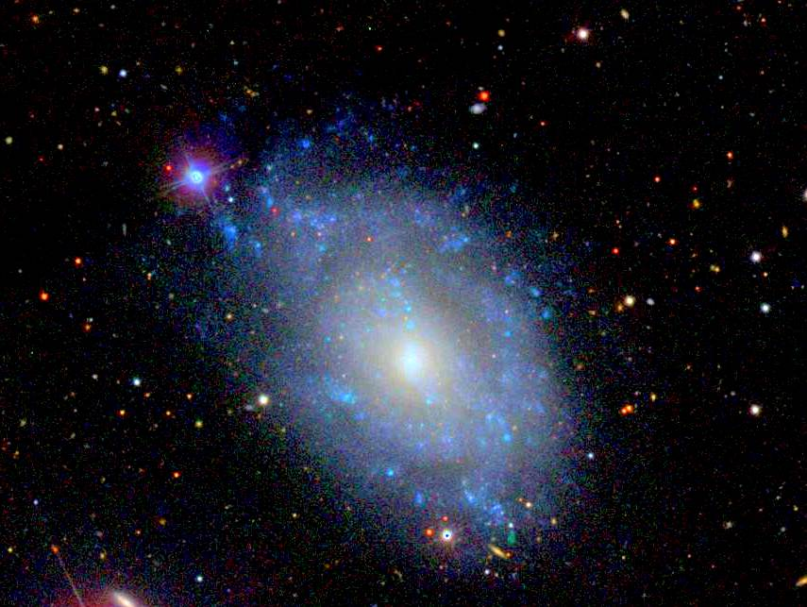
NGC 5585 X-1

Slide 25
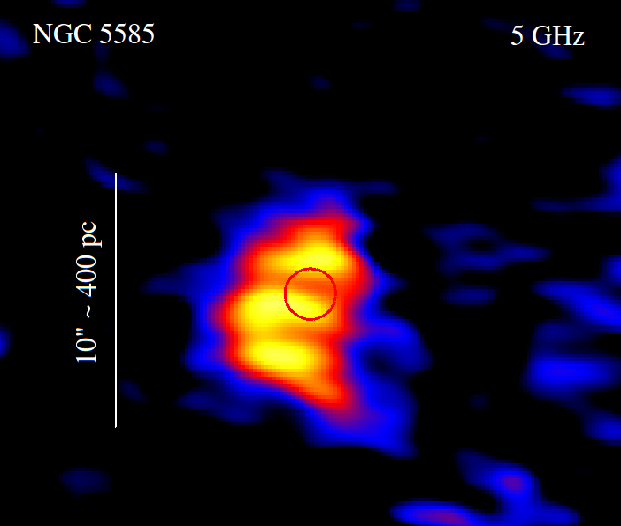
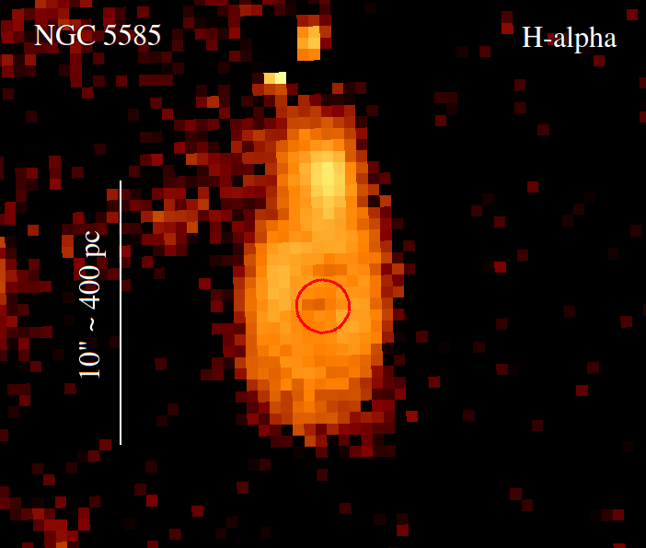
Hα + [ N II ]
Chandra 0.3-7 keV
Hα + [ N II ]
NGC 5585 X-1
P_{jet} ~ L_{X} ~ 4E39 erg/s
Slim-disk ULX
+ shock-ionized bubble
(Soria, Pakull, et al., 2016, in prep.)

Slide 26
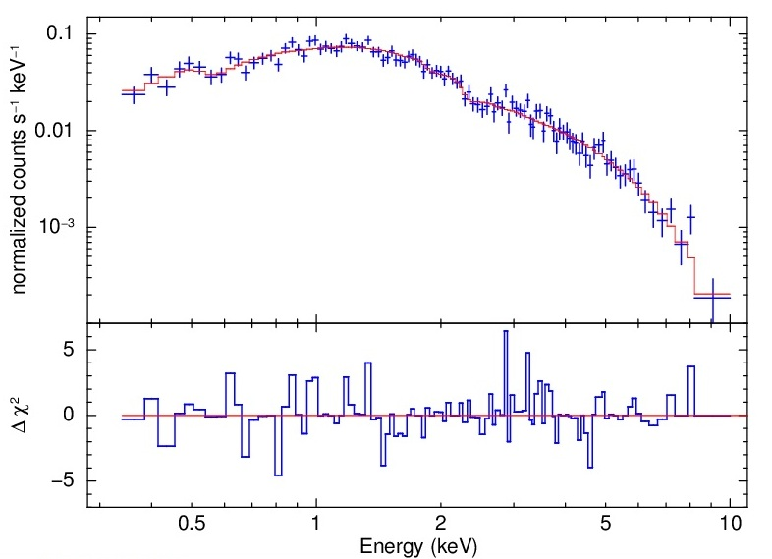
NGC 5585 X-1
P_{jet} ~ L_{X} ~ 4E39 erg/s
Slim-disk ULX
+ shock-ionized bubble
(Soria, Pakull, et al., 2016, in prep.)

Slide 27
NGC 300 - S9

Slide 28
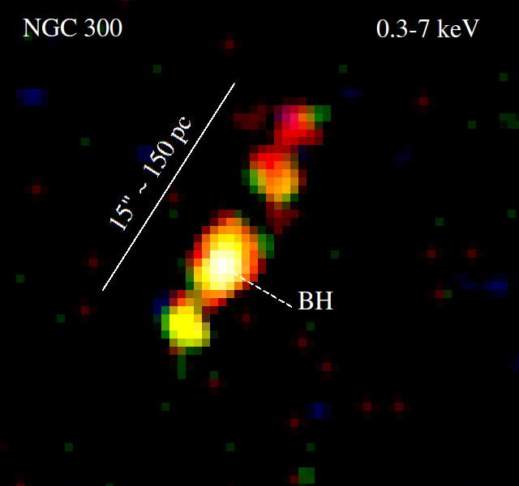
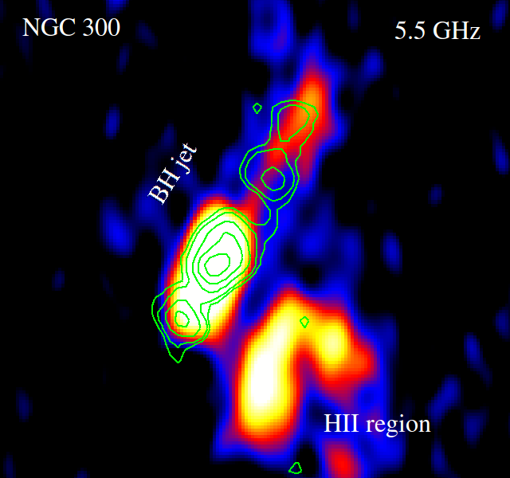
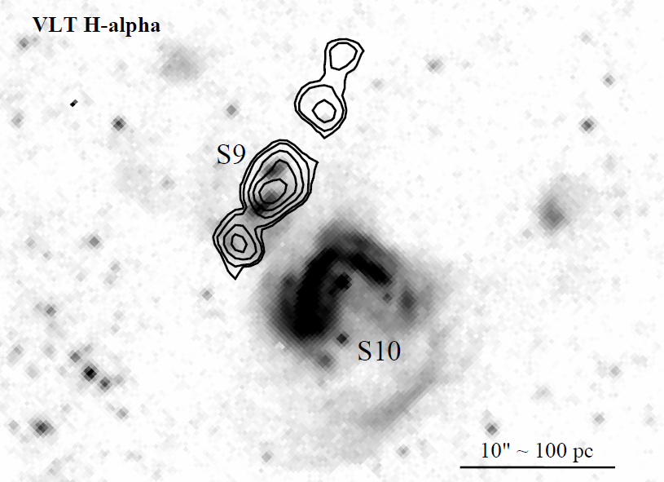
NGC 300 - S9
Jet with multiple
X-ray knots
ATCA
X-ray, Hα and radio detection
X-ray, Hα
and radio detection
(Soria, Urquhart & Pakull 2016)

Slide 29
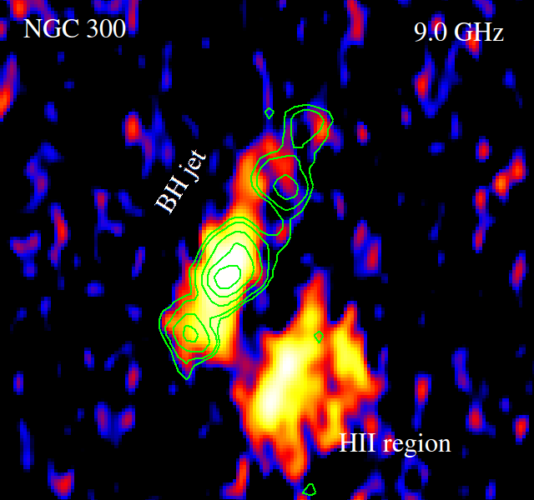
NGC 300 - S9
Jet with multiple
X-ray knots
ATCA
X-ray, Hα
and radio detection
(Soria, Urquhart & Pakull 2016)

Slide 30
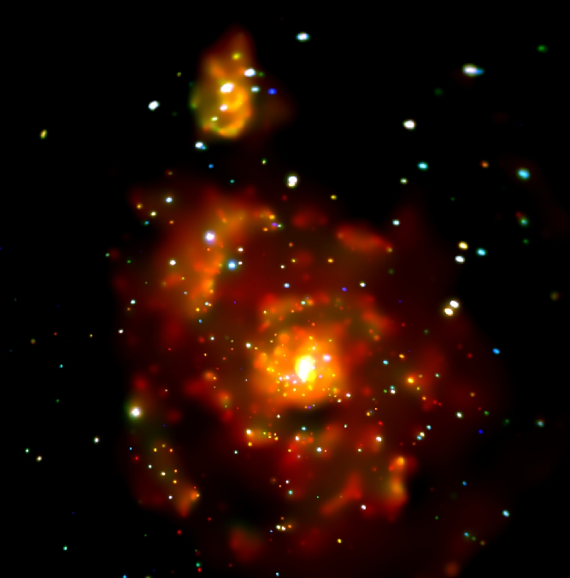
M51

Slide 31
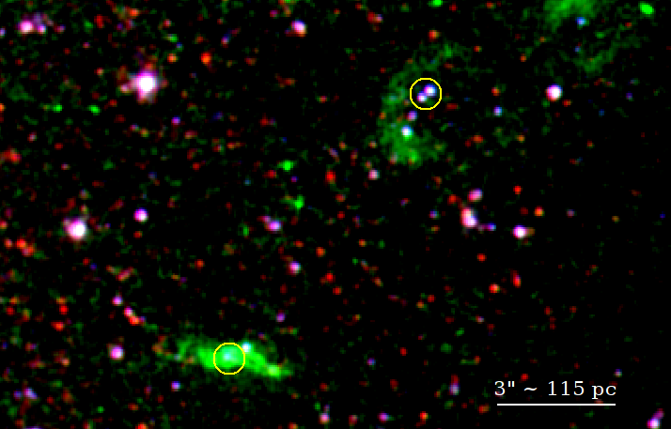
ULX2
ULX1
M51
Two ULXs with L_{X} ~ 1E39 associated with Hα emission
(Soria, Urquhart, et al in prep)

Slide 32
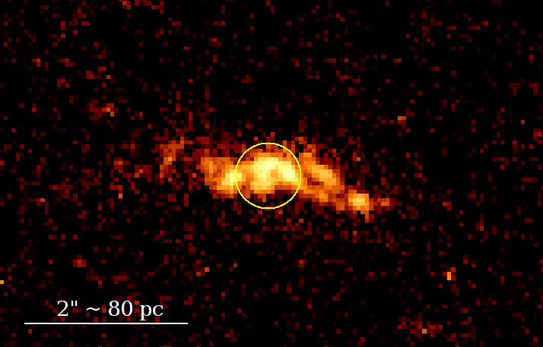
HST ACS
F658N filter = Hα
ULX1
M51
ULX1: evidence of an extended jet

Slide 33
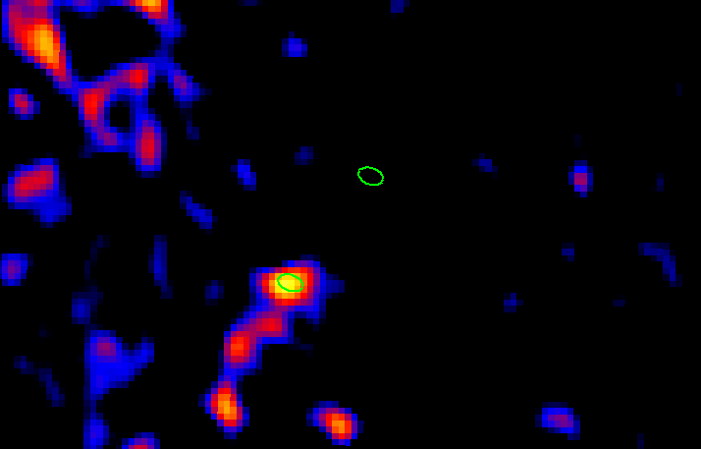
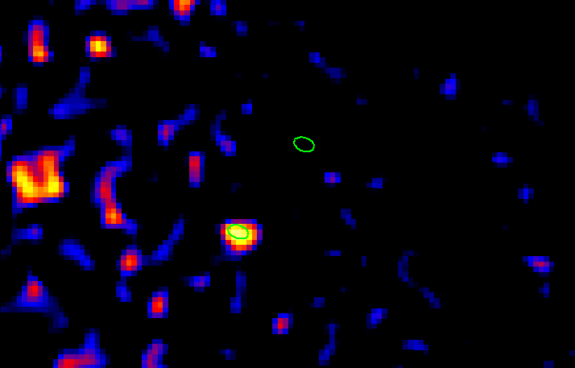
VLA 20 cm
M51
ULX2
ULX1
VLA 6 cm
ULX1 is indeed
a strong radio source
ULX2
ULX1
(Soria, Urquhart, et al in prep)

Slide 34
Summary of ULX bubble studies
We use BH bubbles as calorimeters for L_{X}, P_{mech}
We found evidence of powerful BH winds and jets
at super-critical accretion rates, P_{mech} > 1E39 erg/s
We use L_{radio}/L_{bol} of a bubble to constrain ε_{e}/ε_{p}
= {energy in electrons} / {energy in ions}
Next challenge: find compact radio cores (S_{9GHz} ~ μJy)
Local-Universe test of feedback & reionization models

Slide 35
Other evidence of outflows in ULXs
Information on outflows from X-ray spectra?

Slide 36
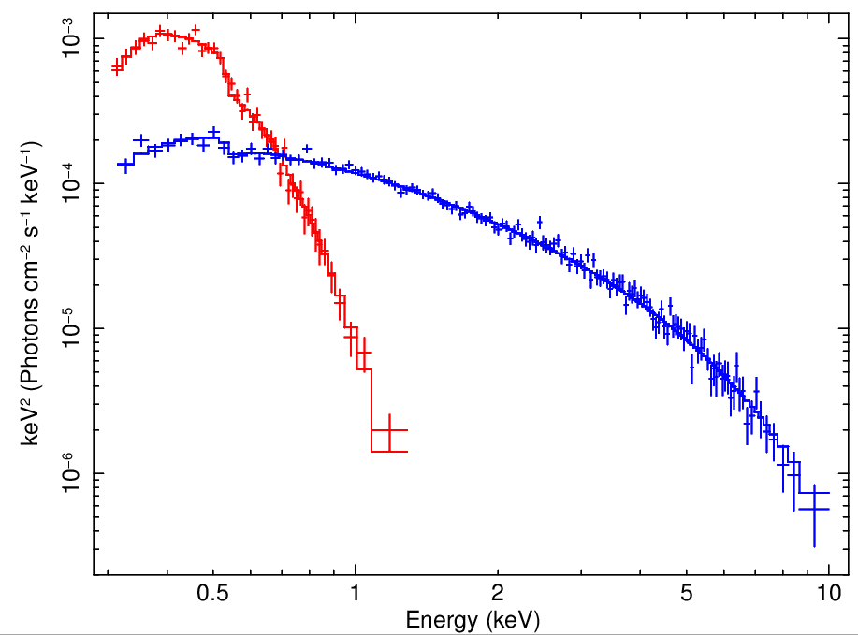
Two types of super-Eddington sources
ULS
ULX
M81 ULS
M83 ULX

Slide 37
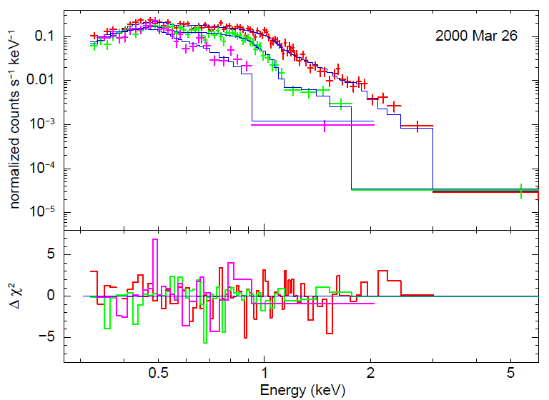
M101 ULS
But some ULSs (occasionally) develop a hard tail
(Soria & Kong 2015, MNRAS in press)

Slide 38
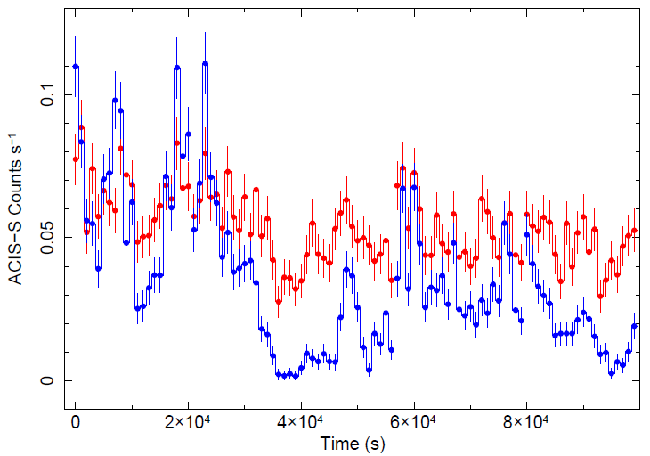
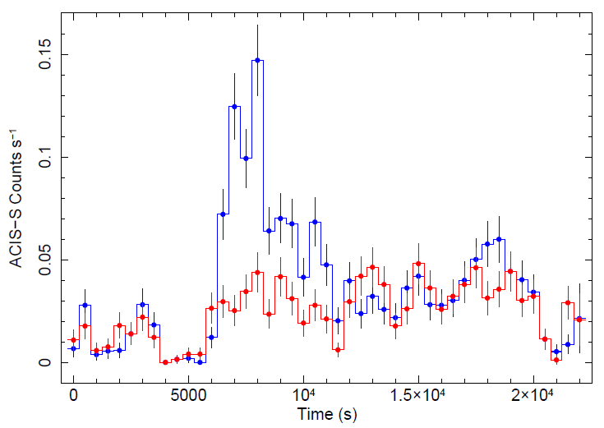
Flaring of the M101 ULS
(Urquhart & Soria 2015,
MNRAS, in press)
ULS are strongly variables
on short timescales

Slide 39
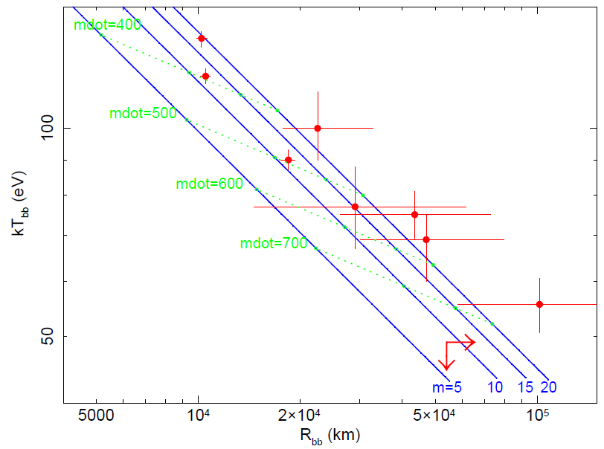
(Soria & Kong 2015, MNRAS)
M101 ULS
Temperature ~ (Radius)^{-1/2}

Slide 40
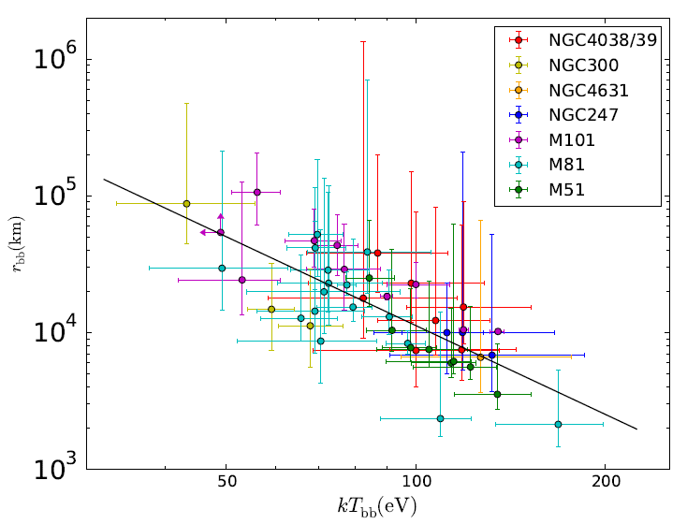
ULSs
(Urquhart & Soria 2015, MNRAS)

Slide 41
Super-Eddington BH
with optically thin wind
X-ray photons
scattered by the wind
Super-Eddington BH
with optically thick wind
X-ray photons
thermalized by the wind

Slide 42
Baryonic jet found in M81 ULS by Liu et al (2015, Nature)
from Doppler-shifted Balmer emission lines

Slide 43
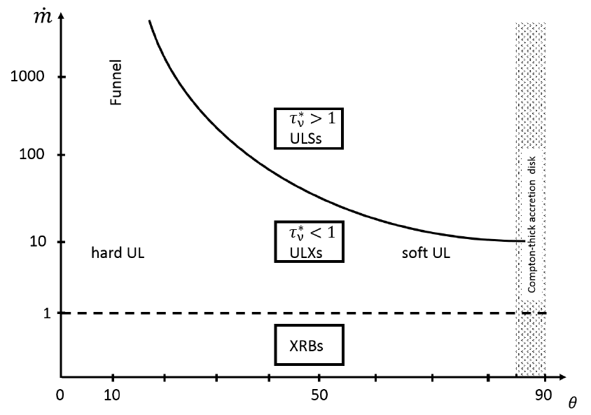
Ultraluminous
UV sources
(Urquhart & Soria 2015)

Slide 44
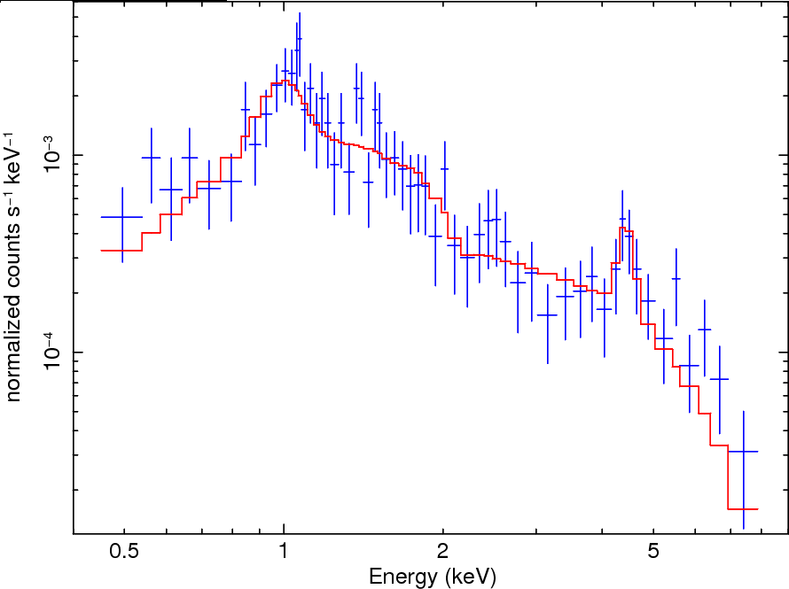
Evidence of relativistic baryonic jets
in a super-Eddington ULX
Emission line at E = 4.4 keV
Redshifted 6.7-keV Fe line? (v~c, i=70º)
P13 in NGC7793
(130 ks on XMM-Newton waiting for trigger )

Slide 45
Conclusions
Super-critical accretion produces strong outflows,
sometimes also jets
Outflows observed in radio, optical, X-ray bands
Optical/radio bubbles = calorimeters for kinetic power
P_{mech} >~ a few E39 erg/s ~ L_{X}
Wind effective τ < 1: Ultraluminous X-ray sources
Wind effective τ > 1: Ultraluminous supersoft sources

