Slide 1

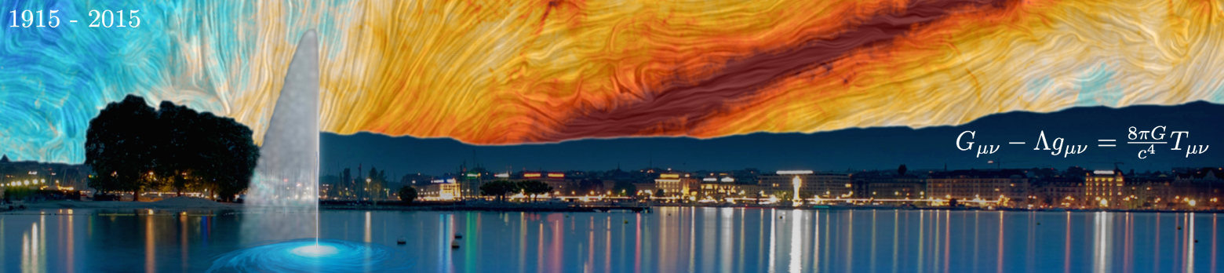
Relativistic tidal disruption events: what do we learn from their rate distribution?
Imma Donnarumma
INAF-IAPS
Italy
28th Texas Symposium, Geneva 2015

Slide 2
Outline
What is a tidal disruption event (TDE)?
High potential for delivering physical information
“jetted TDE” observations
Observations vs jet production efficiency
Radio and X-ray synergy to discover new jetted TDEs
Future Perspectives

Slide 3

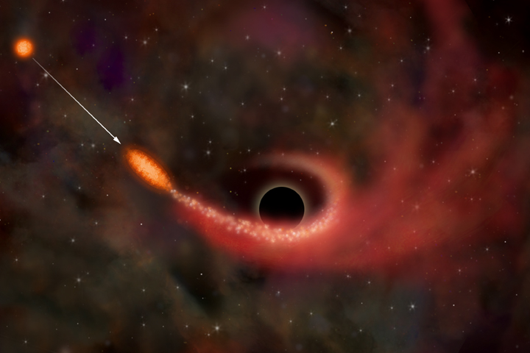
Tidal disruption events
When a star orbits close to a massive black hole and its periastron distance reaches
R~ R∗(M_{BH} / m∗)^{1/3}, it will be disrupted and cause what is commonly referred to as a tidal disruption flare.
MASS FALLS BACK AT A RATE:
Rees 88
Phinney 89

Slide 4
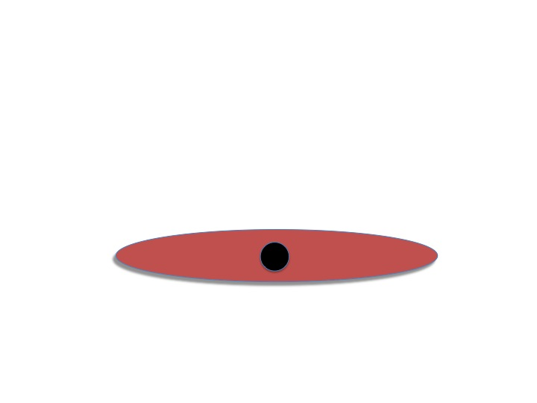
A TRANSIENT DISC,
ACCRETING AT THE FALLBACK RATE
IF SUB-EDDINGTON ONLY THERMAL
EMISSION IS FROM DISC

Slide 5
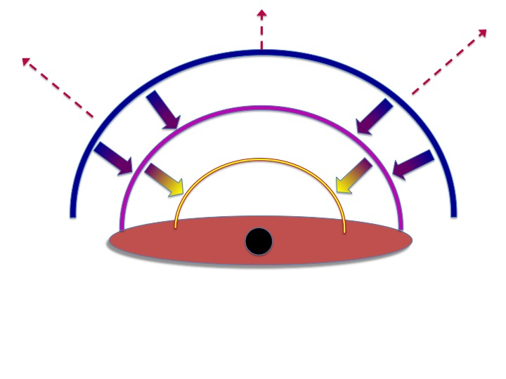
Super Eddington mass loss
Rossi & BEGELMAN ‘08
STRUBBE & QUATAERT ‘09
LODATO & Rossi ‘10
THE PEAK IS FIRST IN optical AND THEN IT MOVES TO higher FREQUENCIES

Slide 6
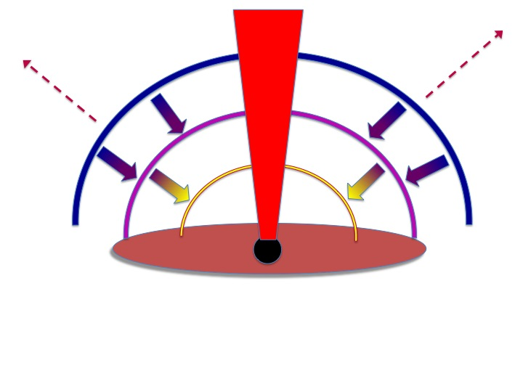
...and the jet
WHAT WE SEE DEPENDS ON THE VIEWING ANGLE

Slide 7
OBSERVATION OF TDE IS IMPORTANT
Studying disc accretion in different regimes on month timescale
Super Eddington accretion not well understood
constrain jet/disc connection
discover quiescent supermassive black holes (SMBH) and measure their mass
constrain SMBH mass function

Slide 8
Jetted TDE: 3 SWIFT Events
Sw J1644+57 (z=0.35; Burrows et al. 2011), Sw J2058+05 (z=1.18; Cenko et al. 2011), Sw J1112.2-8238 (z=0.89; Brown et al. 2015)
exploded in quiescent galaxies.
Sw J1644 and Sw J2058 have position within 150 pc and 400 pc of their galactic center, respectively (Levan et al. 2011, Pasham et al. 2015)
Persistent (months), variable and bright X-rays lightcurve (L ~ 10⁴⁷ erg/s after 2 weeks)
bright radio counterparts (e.g. Zauderer et al. 2011, Cenko et al. 2011)

Slide 9
Three jetted TDEs discovered in hard X-rays, inferring a very low rate:
can we deliver information about jet production efficiency from the BAT rate?

Slide 10
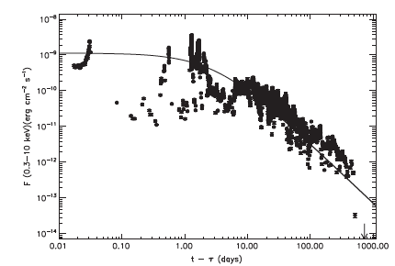
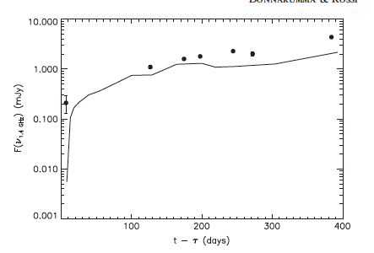


How can we derive the rate of jetted TDEs?
Donnarumma & Rossi 2015
Using Sw J1644 as a prototype to make predictions in X-rays and radio energy bands
0.3-10 keV
1.4 GHz
MDL

Slide 11
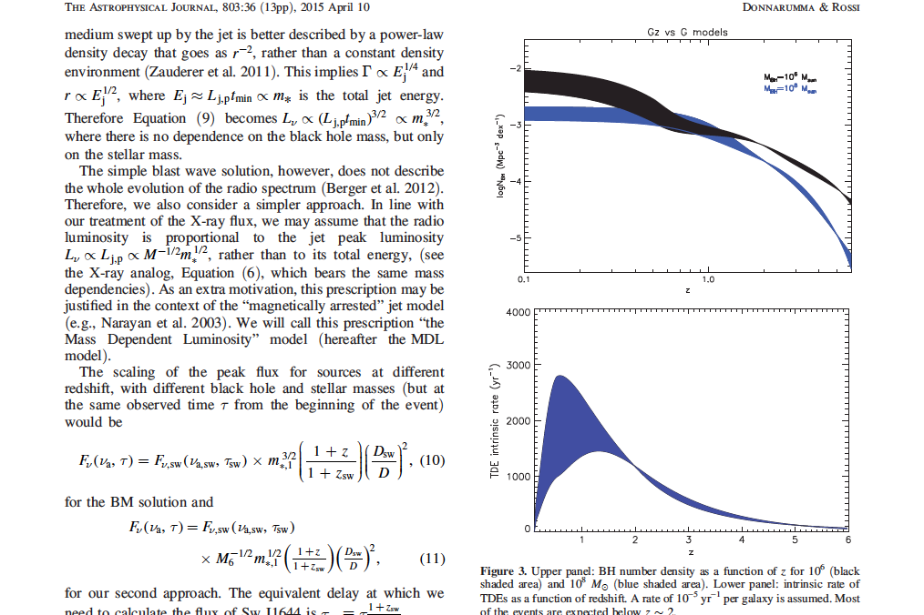
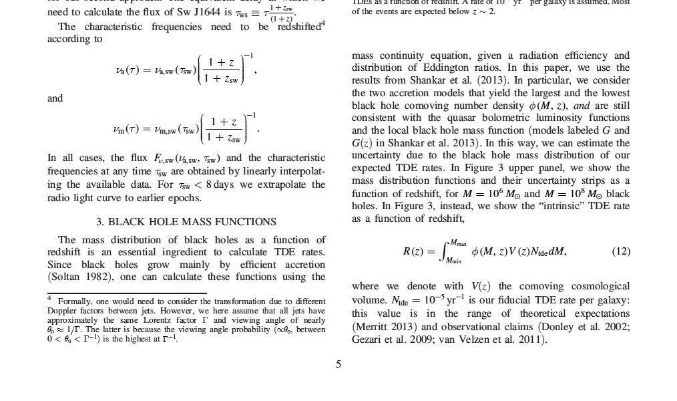
The intrinsic rate R(z) and the beaming reduction
Shankar et al. 2013 mass function (G and Gz models adopted)
Intrinsic rate
N_{TDE}~ 10⁻⁵ per yr per galaxy
M = [10⁶ ⁻ 10⁸ Msun ]
From intrinsic to jetted TDE rate: rescaling R(z) by a factor (2Γ)⁻²

Slide 12

Rate predictions: constraints from current observations
A Monte Carlo approach:
main ingredients, τ and m*
  τ - randomly extracted from a uniform distribution between 0 and 1 yr
  m* -extracted from a Kroupa IMF
τ = X-ray lag time
(the same applies to radio
light curve)
m* = star mass

Slide 13
Looking at the discovery potential for current and future missions
The Square Kilometre Array survey:
large sky coverage (~ 20,000 deg²) performed with multiple cadence (daily/weekly) at 1.4 GHz with a flux limit of 90 uJy
(Donnarumma et al. 2015, Fender et al. 2015, Donnarumma & Rossi 2015)
Current Hard X-ray survey
BAT
Future X-ray surveys:
eRosita, Einstein-Probe, LOFT-like Wide Field Monitor

Slide 14
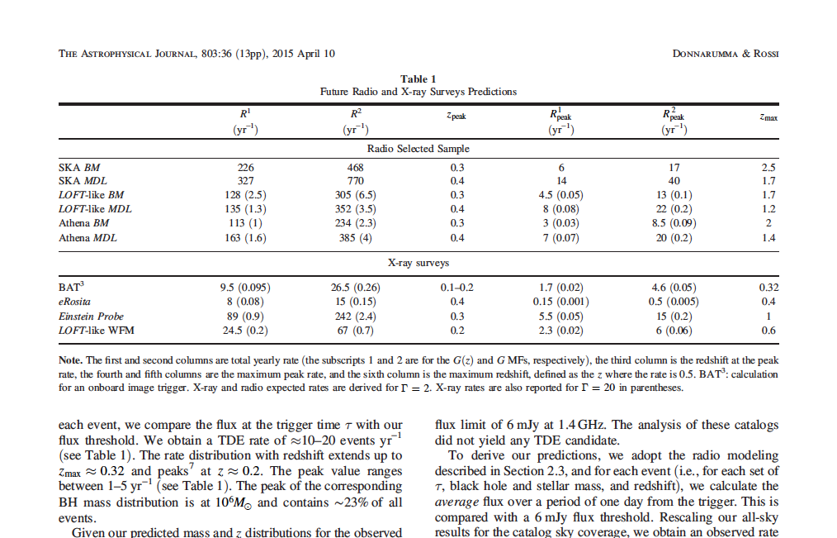
Radio and X-ray surveys predictions
Donnarumma & Rossi 2015
These rates assume a
a jet production efficiency of 100%

Slide 15
Main findings I
It is not possible to infer jet production efficiency from the BAT rate
this is due to the degeneracy between observing efficiency (sky coverage vs flux limit) and the value of the bulk Lorentz factor Γ
Note that even assuming a jet production efficiency of 100%, Γ in the range 10 – 20 can reconcile observations with predictions

Slide 16
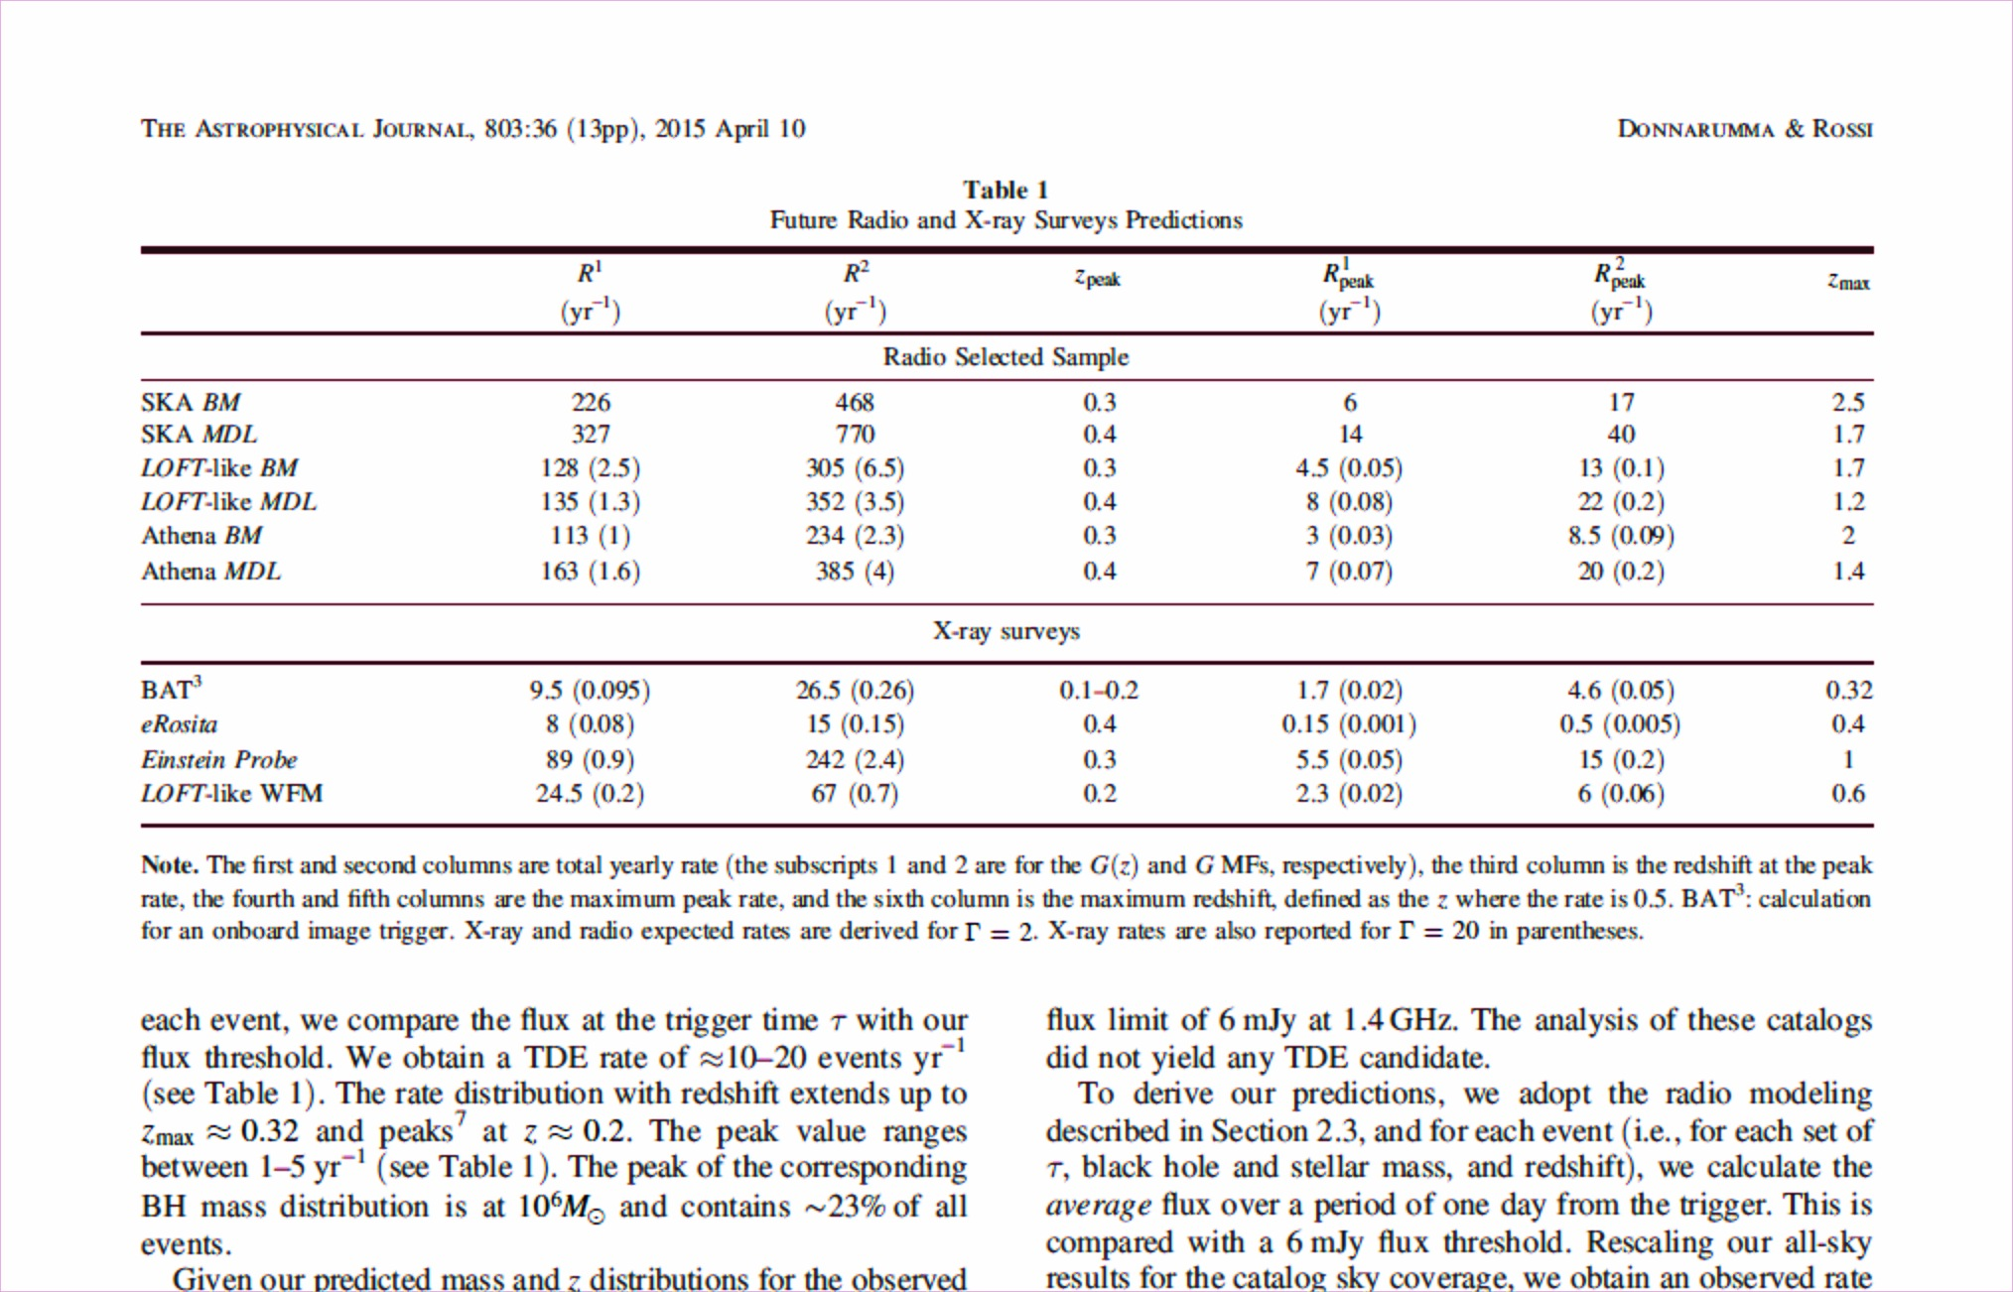
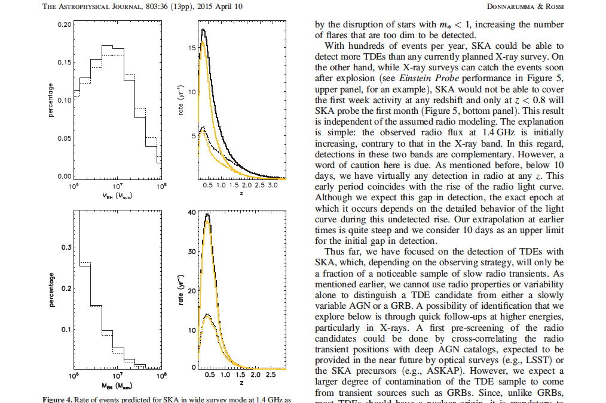
TDE rate predictions with SKA
BM model
MDL model
Donnarumma & Rossi 2015; Donnarumma et al. 2015, SKA Science paper

Slide 17
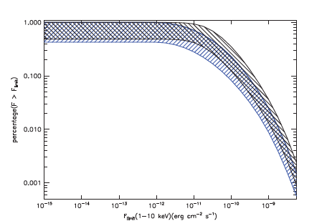
Predictions for future X-ray surveys
Higher discovery potential with follow-up observations
Complete X-ray radio-selected sample
(sky accessibility and repointing efficiency)
ATHENA mission will be able to follow-up “almost” all radio triggered TDEs
(it depends on the sky accessibility, ~50%)

Slide 18
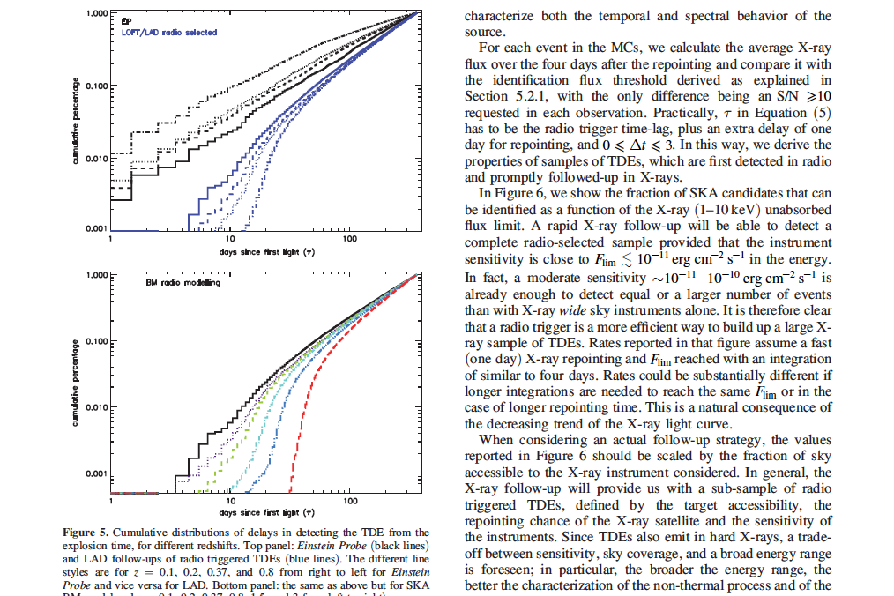
The trigger time: the complementary roles of radio and X-ray surveys

Slide 19
Main findings: II part
SKA will have a great discovery potential of relativistic TDEs in combination with a prompt follow-up at higher energies (mainly in X-rays, e.g. Athena, XIPE). Several hundreds of TDEs expected to be detected up to z ~ 2.5 (if a jet efficiency of 100% is assumed)
Future X-ray surveys will be complementary to the SKA detections, because of the chance to detect the TDE earlier than in radio, enabling the studyof the first phases of disc/jet formation

Slide 20
Conclusions
The rate of TDEs will strongly depend on the observing strategy (20000 deg² of the sky covered in daily/even weekly passes looks as an effective strategy)
A rapid quick look alert system needed for a fast repointing at higher energies
Great perspectives in the future thanks to the synergy among radio (SKA), optical (LSST) and possibly X-ray surveys
Jetted TDEs will provide a unique tool to detect quiescent SMBHs in the far Universe z ~2 -3, mainly in the low-mass tail of the SMBH mass function (L_{TDE} ∝ M_{BH}^{-1/2})

Slide 21
Future perspectives: new code for the rate distribution
Accounting for the spin distributions for different BH seed models (low vs high mass seeds)
TDE rate dependence on BH mass
SPIN dependence included in the calculation of the peak luminosity in TDEs
Work in progress with E. Rossi, A. Sesana, E. Barausse

