Slide 1


The Radio Evolution of the Galactic Center Magnetar
Joseph Gelfand (NYUAD / CCPP)
Scott Ransom (NRAO), Chryssa Kouveliotou (GWU),
Mallory S.E. Roberts (NYUAD), Hind Al Ali (NYUAD), Yoni Granot

Slide 2
Outline
What is a magnetar?
  Why care about a magnetar’s radio emission?
Galactic Center Magnetar SGR J1745‒29
  Located only a few parsecs from Sgr A*
New observations
  44 GHz pulsations: Predominantly bright single pulses
  Broadband continuum radio: Possible change in radio spectrum

Slide 3
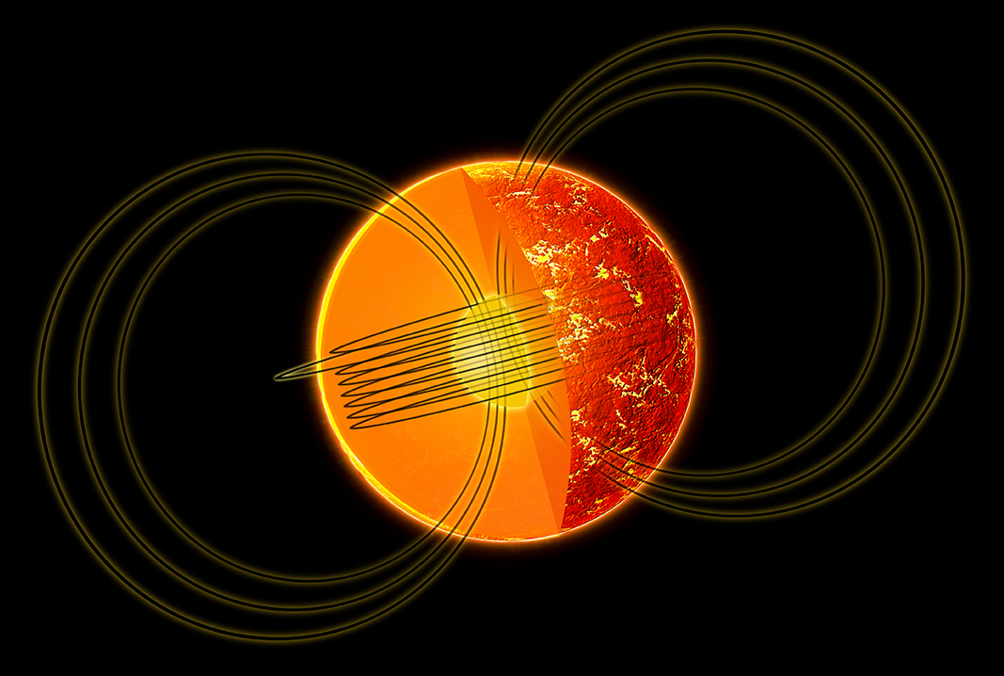
What is a magnetar?
Class of isolated neutron star
  ≥10¹⁴ G external magnetic fields
  Even stronger internal magnetic fields
  Emission powered by magnetic field decay
(Illustration: NASA/CXC/M.Weiss)

Slide 4
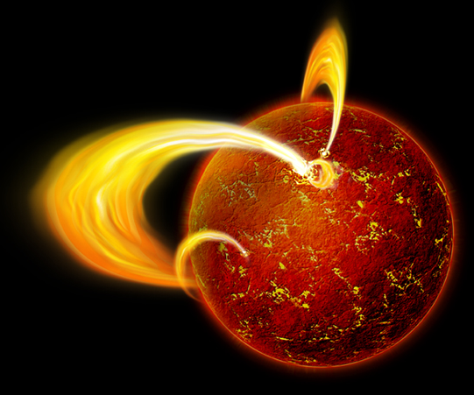
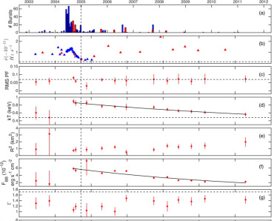
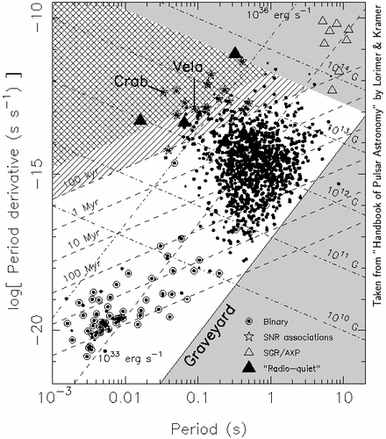
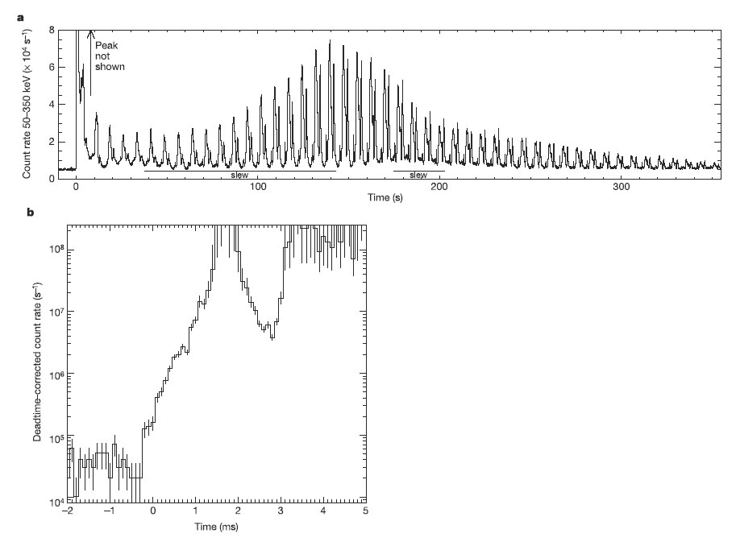
Why do we think “magnetars” exist?
Neutron stars with high Ṗ, P
  Dipole Surface B ≥ few×10¹³ G
Soft Gamma Repeaters (SGRs)
  Repeated bursts of hard X-rays
  Giant flares
Anomalous X-ray Pulsars
  Blackbody X-ray spectrum
  L_{x} ≥ Ė
(Palmer et al. 2005, Nature, 434, 1107)
(Younes et al. 2015, arXiv:1507.05985)

Slide 5
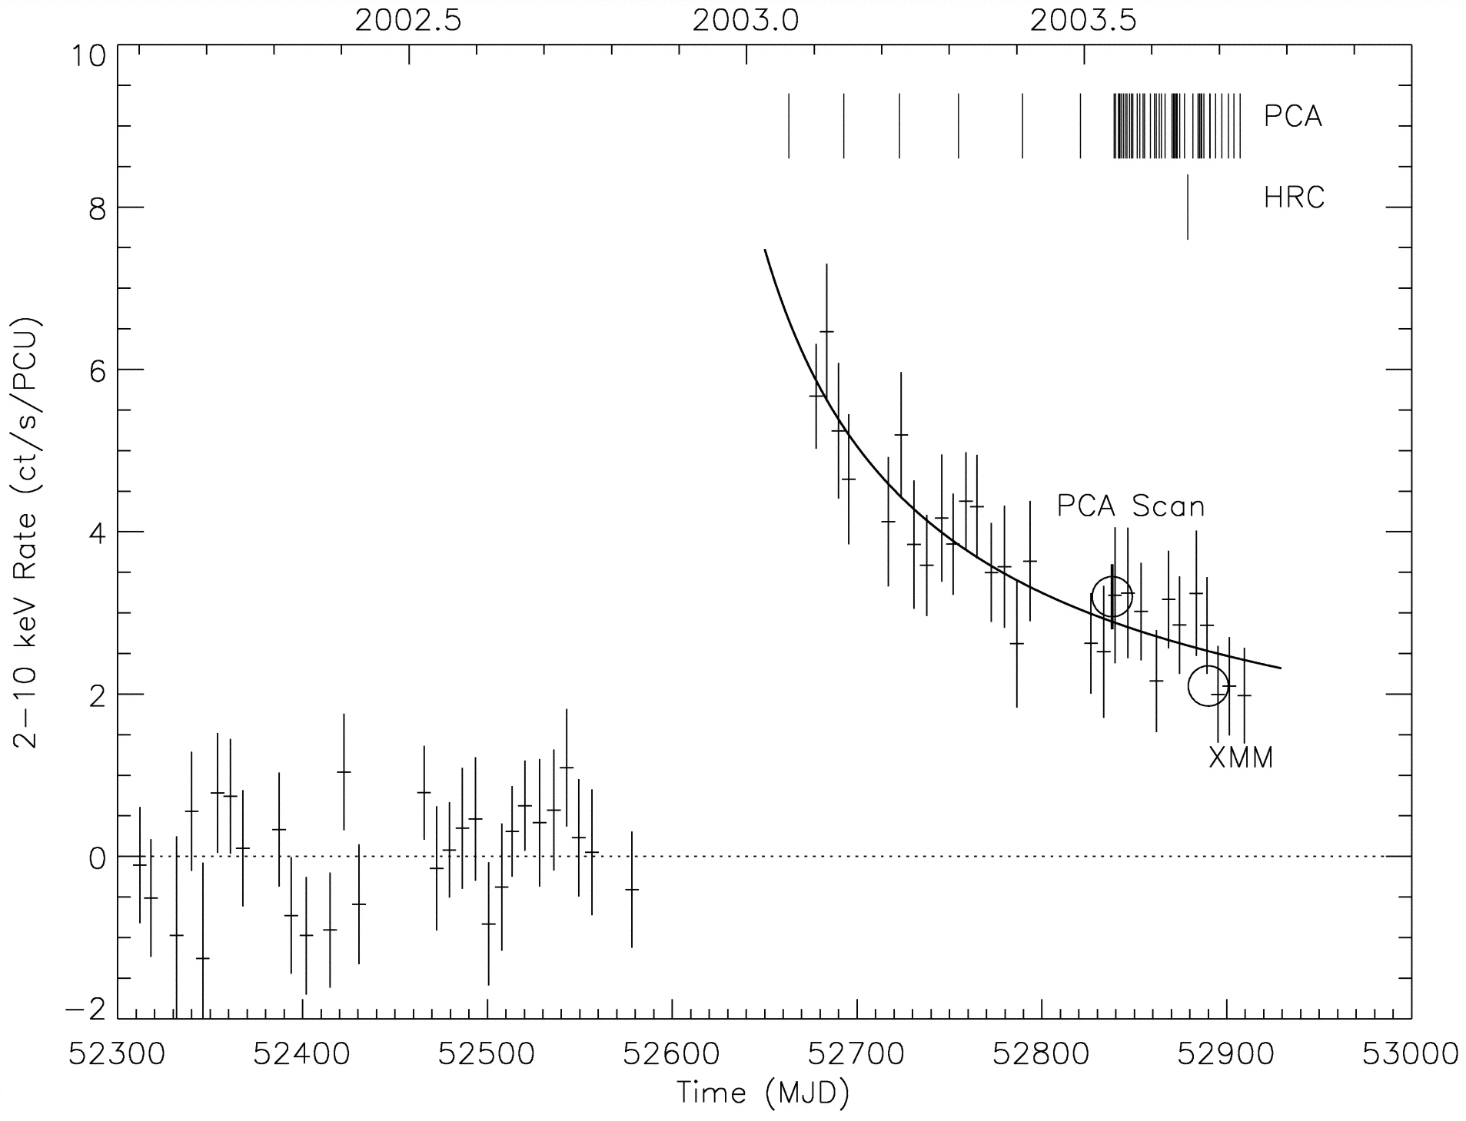
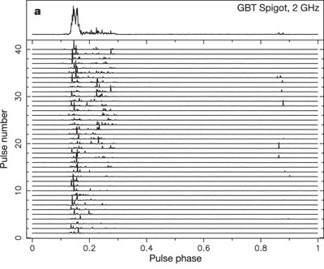
Magnetar “activation”
Rapid increase in X-ray luminosity
  ≥1000x quiescent luminosity
  Followed by slow exponential decay to new steady-state level
Magnetar often produces pulsed radio emisson
(Camilo et al. 2006, Nature, 442, 892)
(Ibrahim et al. 2004, ApJ, 609, L21)

Slide 6
Pulsed radio emission from a magnetar
Radio Pulsars
  Stable pulsar shape
  Constant flux density
  Steep radio spectrum
  Somewhat polarized
  Bright single pulses rare
Magnetars
  Variable pulse shape
  Variable flux density
  Flat or gigahertz radio spectrum
  ~100% linear polarization
  Bright single pulses common
Different emission mechanism?

Slide 7
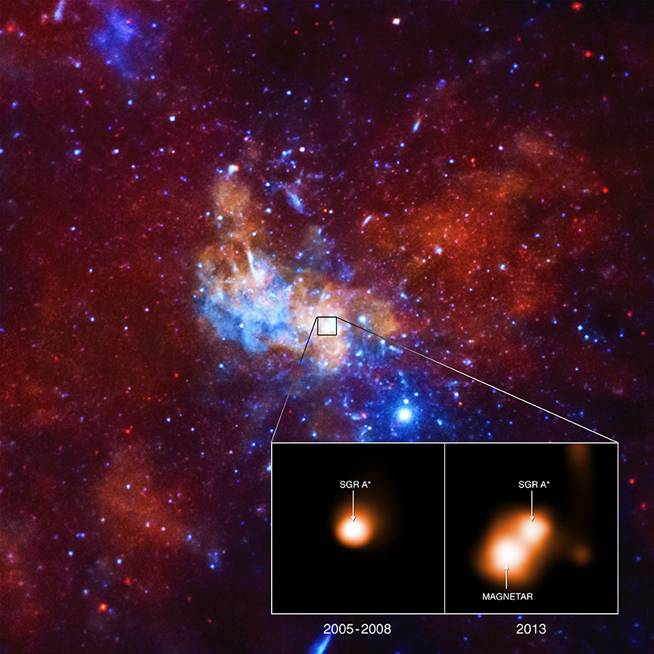
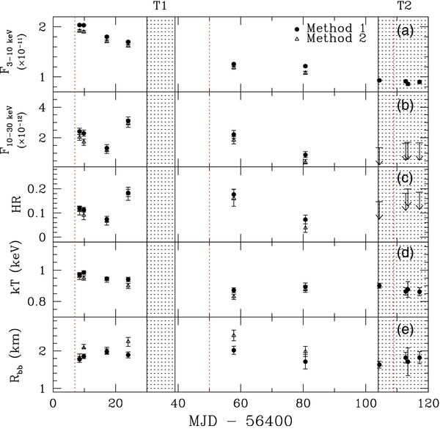
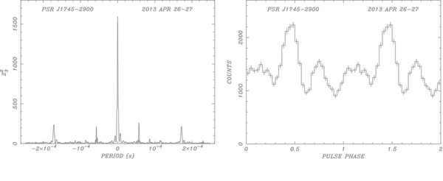
Galactic Center Magnetar SGR J1745-29
2013 Apr 24: Swift XRT detects increase in X-rays from GC region
  2013 Apr 26: NuSTAR detects 3.76 s pulsations
  Subsequent decrease in X-ray flux
(Mori et al. 2013, ApJ, 770, L23)
(Credit: NASA/CXC/INAF/F.Coti Zelati et al)
(Kaspi et al. 2014, ApJ, 786, 84)

Slide 8
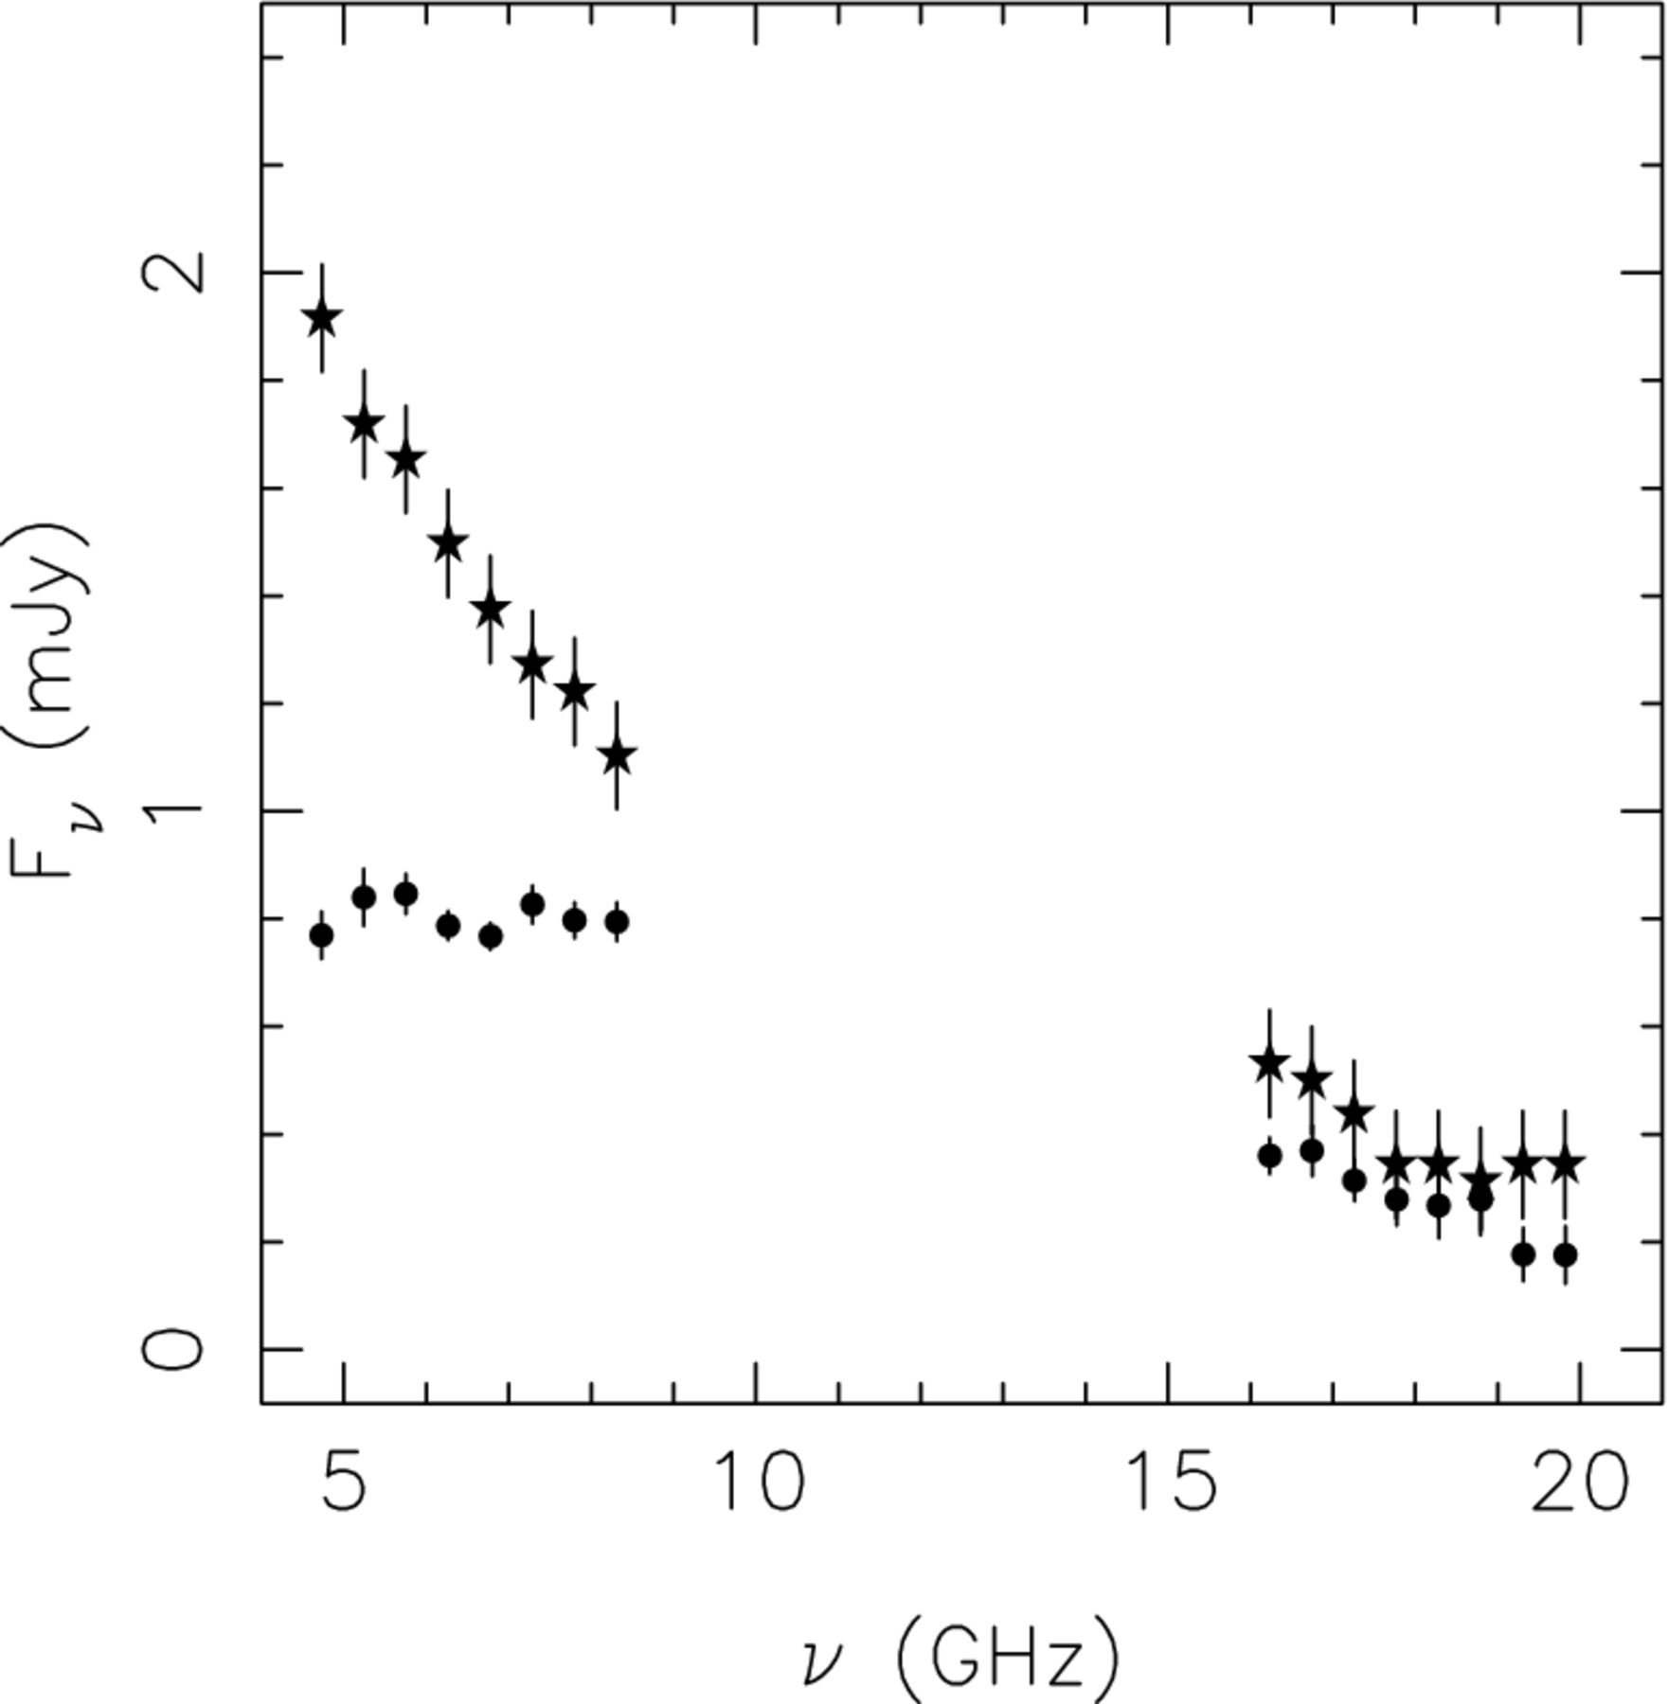
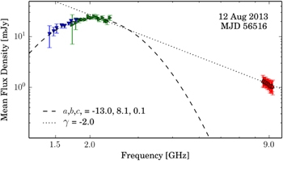
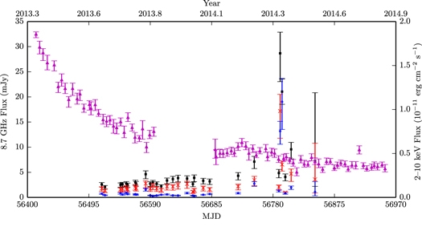
Early Radio Observations
Radio spectral variability
  Particularly ≤10 GHz
  Flattening of spectrum
Constant flux density
  Until 2014 Mar
2013 May 1
2013 May 31
(Pennucci et al. 2015, ApJ, 808, 81)
(Lynch et al. 2015, ApJ , 806, 266)
(Shannon and Johnston 2013, MNRAS, 435, L29)

Slide 9
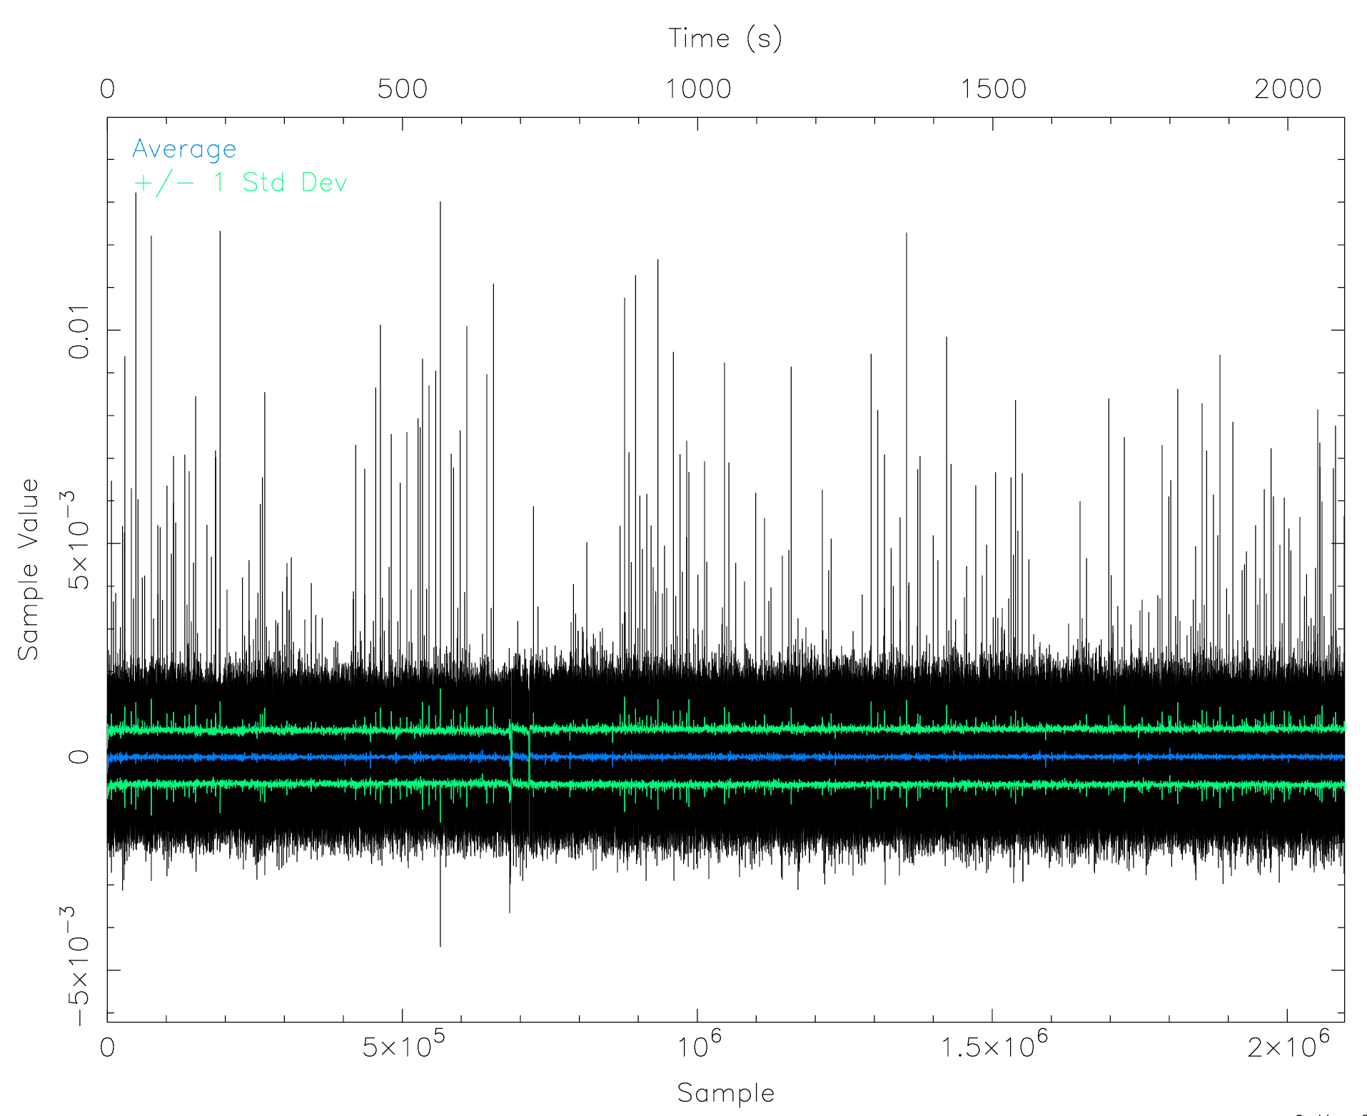
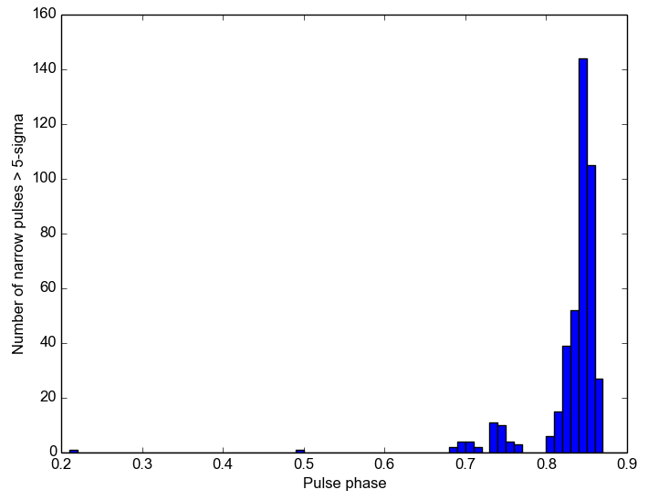
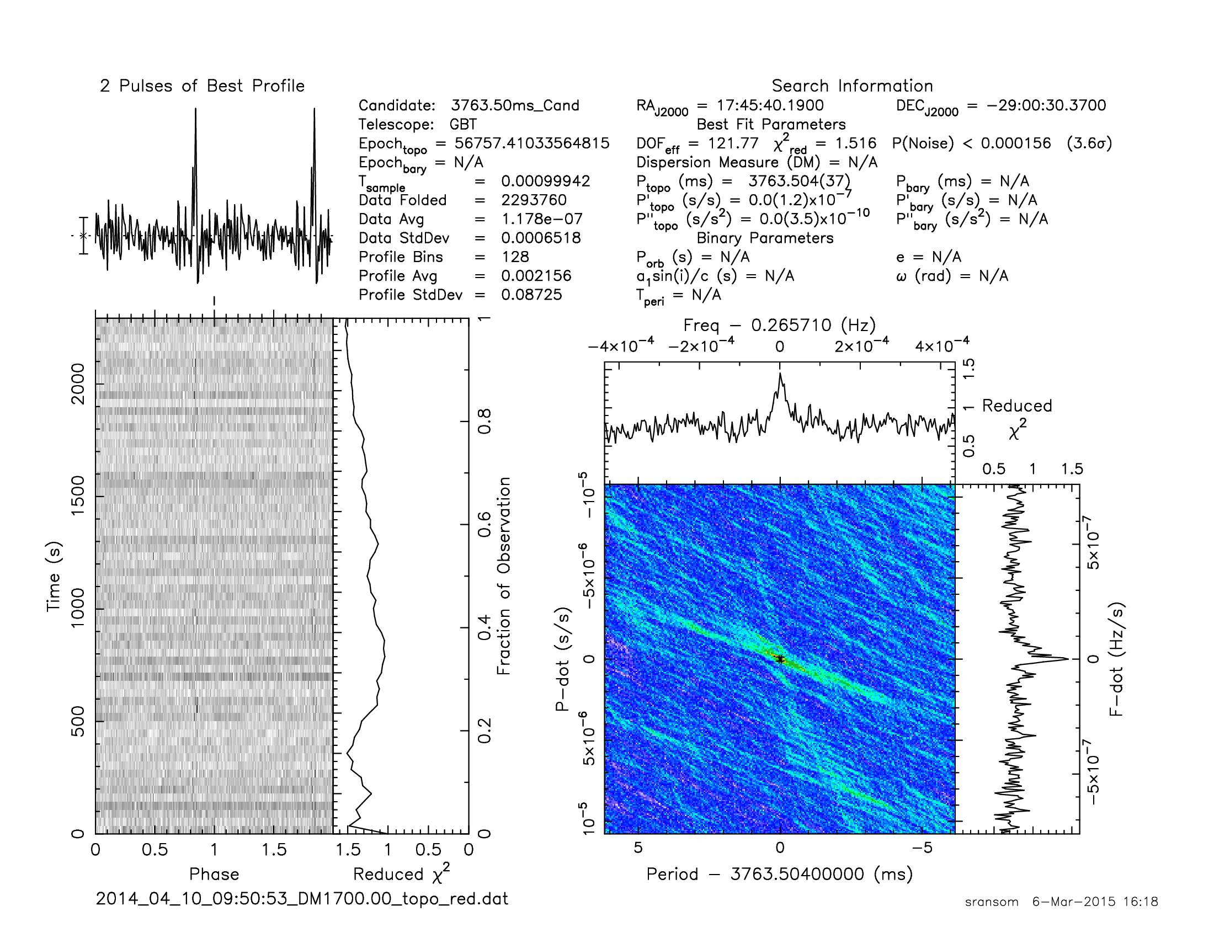
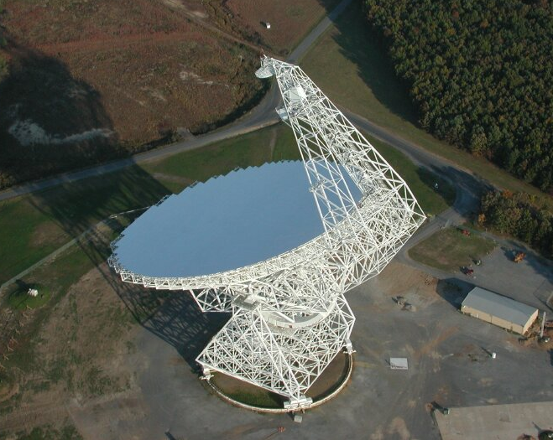
44 GHz GBT Observation
2014 April 10 (MJD 53105)
  35 minutes: GUPPI
  30 minutes: VEGAS
Clear detection
  Bright single pulses from ~70% of rotations
  Narrow phase distribution
(Gelfand et al., in prep.)

Slide 10
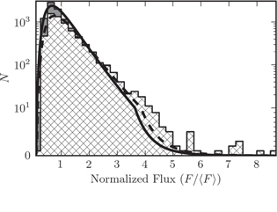
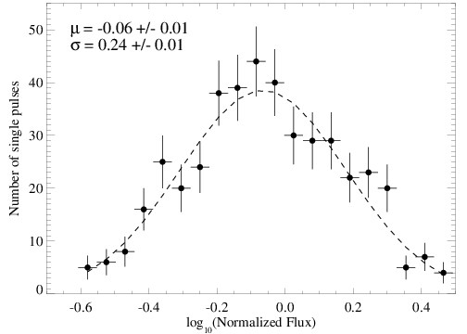
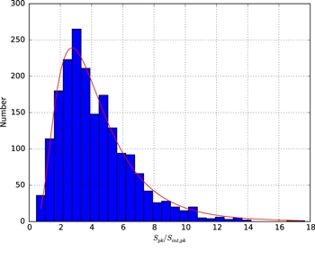
Flux distribution of single pulses
Log-normal distribution
  Similar distribution as 8.5 GHz
Possible explanations
  Same physical generating mechanism
  Constant across observations?
8.5 GHz
(Lynch et al. 2015, ApJ, 806, 266)
(Yan et al. 2015, ApJ, 814, 5)
(Gelfand et al., in prep.)

Slide 11
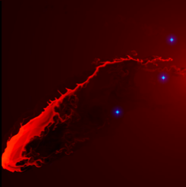
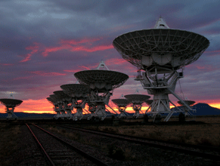
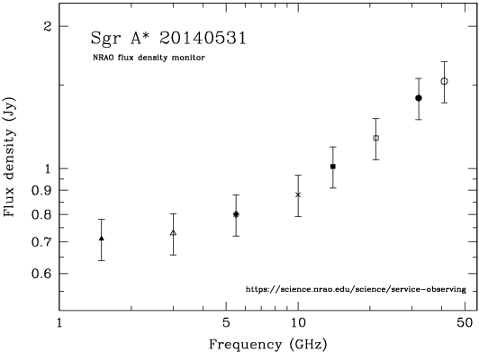
Broadband radio spectrum
JVLA Project Code TOBS0006
  In expectation of G2 encounter with Sgr A*
  1.5 – 41 GHz in 8 bands
  A configuration: 2014 Feb 15 – 2014 May 31

Slide 12
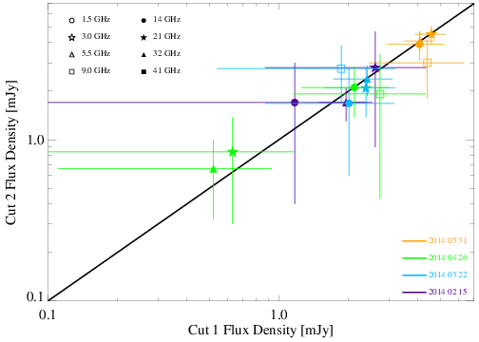
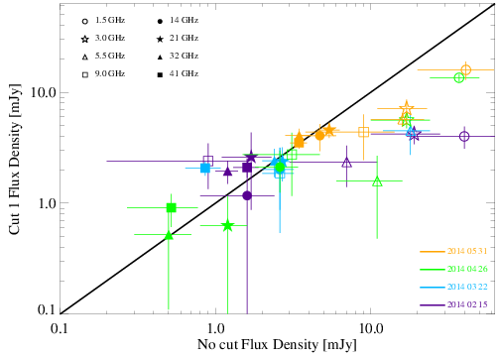
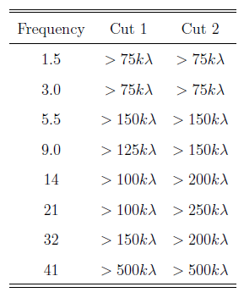
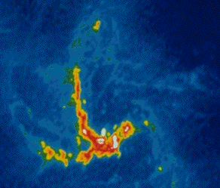
GC Magnetar Flux Density
Very crowded region
  Significantly contaminates magnetar flux
u,v filtering
  2013-10-26 B-configuration
  2014-05-31 A-configuration
  Removes diffuse emission
  Give consistent results
Magnetar
(Gelfand et al., in prep.)
(http://www.astro.ucla.edu/~ghezgroup/gc/journey/dynamicGas.shtml)

Slide 13
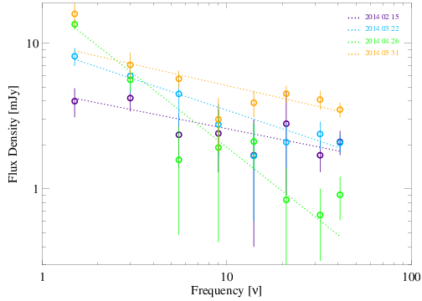
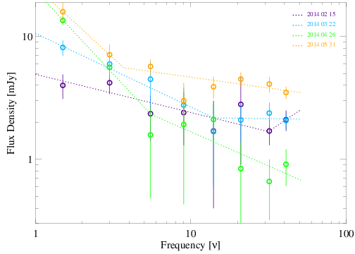
Continuum radio spectrum
Not Giga-hertz peaked
Power law
  Very good fit for first two epochs
Broken power law
  Works better for last two epochs
α = -1.16±0.41
α = -1.36 ± 0.05
ν_{b} = 3.7 ± 1.2 GHz
α = -0.42 ± 0.06
α = -0.18 ± 0.09
α = -0.25 ± 0.07
ν_{b} = 5.5 ± 0.3 GHz
α = -0.56 ± 0.09
(Pennucci et al. 2015, ApJ, 808, 81)
(Gelfand et al., in prep.)

Slide 14
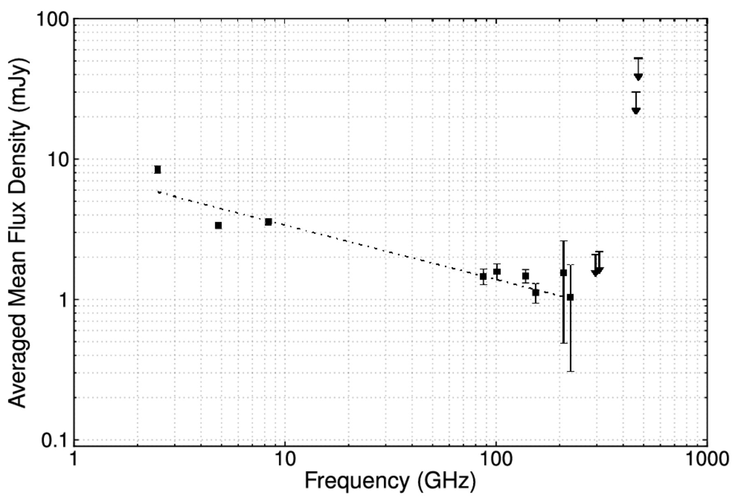
POSSIBLE interpretation
Flux increase at low frequencies
  New emission component?
  If so, likely has a steep spectrum
  (Re-) appearance of “normal” radio pulsar emission?
Possibly seen at later epochs
2014 July - August
(Torne et al. 2015, MNRAS, 451, L50)

Slide 15
Summary
44 GHz Pulsed Emission
  ~70% of rotations produce a bright radio pulses
  Log-Normal Flux distribution
  Same parameters as composite 8.5 GHz observations
1.4 – 44 GHz Radio Continuum Emission
  First two epochs single power-law
  Later two epochs broken power-law (?)
  Increase in low-frequency flux → “normal” pulsar emission mechanism?
Thank you!

